Slide 1
EAOR Training
January 28, 2021
Division of Air Resource Management

Slide 2
Electronic Annual Operating Report (EAOR)
Welcome to the EAOR Training.
You are encouraged to ask questions by typing in your questions on your screen. We will answer as many questions as we can after each section and at the end of the webinar.
PLEASE mute your phone if not asking a question.
PLEASE do not put this call on hold.
If you encounter problems with the audio or other technical problems during the webinar, please let us know via the questions message pane.
Notes:
The EAOR software is used to report annual Point source air emissions to the department, and today I will talk about some of the common data issues and process issues experienced using EAOR. NEXT

Slide 3
Electronic Annual Operating Report (EAOR)
Agenda
1:30 PM Opening Remarks
EAOR Website: Downloads and Links
1:45 PM EAOR Training: Easy Start Menu
EAOR Training: Static Data/Facility Form Sections A-D, and Attachments
2:00 PM EAOR Training: EU Form Sections A-D
EAOR Training: EU Form Section E, Reports, Data Submission, Title V Fee Invoice, and Electronic Signature
2:30 PM Questions
Notes:
The EAOR software is used to report annual Point source air emissions to the department, and today I will talk about some of the common data issues and process issues experienced using EAOR. NEXT

Slide 4
Questions/Assistance Contacts
Dianne Spingler, AOR Coordinator
Dianne.Spingler@floridadep.gov
850-717-9100
EAOR Helpdesk
eaor@dep.state.fl.us
DARM Switchboard: 850-717-9000
DARM.Helpdesk@dep.state.fl.us
E-signatures: registering for an air account/PIN, forgot PIN or password.
Other Assistance
Cindy Phillips, Senior Analyst
  Contact Cindy re: Emissions Calculator tool for SCCs.
  Cindy.Phillips@floridadep.gov
  850-717-9098
Kris Lanh, Engineer
  Contact Kris with general AOR questions.
  Kris.Lanh@floridadep.gov
  850-717-9094
Notes:
How to reach the AOR coordinator, Dianne, or PIN/password assistance, etc.
questions or comments?

Slide 5
Electronic Annual Operating Report (EAOR)
  Purpose of Annual Operating Reports
  EAOR Process
  Resources Available
Notes:
The EAOR software is used to report annual Point source air emissions to the department, and today I will talk about some of the common data issues and process issues experienced using EAOR. NEXT

Slide 6
Purpose
Applications
  Annual trend reports
  Emissions trading
  SIP
  Modeling activities
  Compliance demonstrations
  Emissions fees
  For the SIP program, the air emission inventory is a fundamental building block in developing an air quality control and maintenance strategy, and depends on a comprehensive, accurate and current inventory of actual emissions.
  Regulatory agencies rely on emission inventories as indicators of air quality changes, and produce assessments which help guide efforts to cut air pollution (and in identifying those air toxics which are of greatest concern in terms of contribution to population risk), and for setting permitting requirements.
Notes:
EPA’s Air Emissions Reporting Rule and our AOR rule requires us to compile and update emissions inventories. These inventories provide the foundation of many air quality decisions, and are critical to setting realistic regulations and attainment strategies, including:
Air quality assessment – National Air Quality & Emissions Trend Report, National Air Toxics Assessment (NATA), State Implementation Plan (SIP) development, (regional haze) planning, pollutant deposition studies, and analysis of issues of great public concern
Air permitting – air quality modeling permit review for setting permitting requirements (National Ambient Air Quality Standards analysis, (PSD) increment analysis) and verification of the “baseline actual-to-projected actual” applicability test for (NSR) new source review.
Compliance – verification of compliance with annual permit limits, such as limits on operation hours, process rates, or fuel usage, and indication of possible noncompliance with any permit limits on annual emissions.
Other uses of annual emissions inventory include– performance-based budgeting, public information, and strategic planning, (not only air, water agencies as well, need to know annual emissions for toxics like Mercury, when assessing water quality); and
For emissions fee programs. *Regulatory agencies rely on emission inventories as indicators of air quality changes, and produce assessments which help guide efforts to cut air pollution (i.e. identify those air toxics which are of greatest concern in terms of contribution to population risk), and for setting permitting requirements.

Slide 7
EAOR Process
Annual AOR Letter
EAOR Installation
Completing / Revising EAOR
Signing EAOR
Title V Fees (Major sources only)
Notes:
Some common issues might present themselves throughout these steps in the EAOR process:

Slide 8
Annual AOR Letter
AOR Letter sent in mid-December Includes:
Changes since the previous year
Pertinent due dates
EAOR website and contact.
Tip: Please be sure we have the current Primary RO or Owner/Authorized Rep e-mail address in our system (ARMS).
Notes:
An AOR Letter is emailed to all facilities flagged in our system which are expected to submit an AOR, including Active, Construction, and some Inactive status facilities. For Title V facilities, it is sent to the Primary RO, Facility Contact, and AOR Report Contact (listed for the previous AOR year). If the Primary RO changes during the year, it is important that you please send an RO Notification Change Form to the compliance office (this form can be found on the EAOR website), and ensure that the email listed is current.
Changes since the previous year – the letter notifies you of changes in software versions, rules, processes; and
Pertinent due dates – AOR must be submitted by April 1, fees postmarked or received by April 1; and
EAOR Website and contact information – the EAOR website is updated annually in early January, and is where you download current software from, access important information related to EAOR, including the date of the EAOR Training Webinar.
As I indicated, the AOR Letter is sent to facilities with a Construction Status (and Inactive facilities that have permanently shutdown during the reporting year). If your facility is TV and under construction (or has not yet started construction) and therefore did not operate during the year- you may still receive an AOR letter, however simply let me know of your status. TV facilities with a status of construction are listed on the TV Emissions Fee report as ‘under construction’ and therefore no fee is required, as they don’t meet the definition of a ‘facility’ if they are under construction.

Slide 9
EAOR Rule
There are no new AOR Rule changes for the 2020 AOR.
2020 is a HAP Reporting year.
(The last rule changes, shown below, were done in 2017:
  Removal of Requirements to report summer season daily process rates and emissions, including seasonal operational data (i.e. percent hrs operation by season, average and total summer season operation).
  “HAP Reporting Year” reporting changes for hazardous air pollutants (i.e. Individual HAPS & Total HAPS):
    Expanded the reporting requirements to include non-major sources of HAPs during a HAP reporting year.
    Revised the threshold for Total HAPS.
  Added thresholds for H₂S, PM10 - Pri, PM2.5 - Pri.
  Additional pollutants were added to accommodate new federal regulations.)
Notes:
The rule changes effective June 22, 2017 included the following:
Removal of Requirements to report summer season daily process rates and emissions, including seasonal operational data (i.e. percent hrs operation by season, average and total summer season operation). Summer Season Daily (SSD) fields were removed from DEP’s rule and from EAOR software in accordance with EPA’s Air Emissions Reporting Rule, which no longer requires the state to submit this data when reporting it’s annual emissions data to EPA (as of 2015), instead the SSD data may be acquired by EPA through other regulations in place.
“HAP Reporting Year” reporting of hazardous air pollutants (i.e. Individual HAPS & Total HAPS) now applies to both major and non-major sources of haps:
The reporting requirements were expanded to include non-major sources of HAPs during a HAP reporting year. (see page 10 of the ‘general instructions’ in the AOR form and instructions).
Revised the threshold for Total HAPS from 1000 lbs to 2500 lbs (see page 10 of the ‘general instructions’ in the AOR form and instructions).
Added thresholds for H₂S, PM10 - Pri, PM2.5 – Pri (with a reporting threshold of 5.0 tons/year for each of these pollutants).
New pollutants were added to Appendix A of the form to accommodate new federal regulations:
For example: CO2, CO2E, HFCS, CH4, N2O, PFCS, TH, HHH, H106E, HC, NMHC, THC, THCE, TVH, HC +NOX, NMHC +NOX, NMOC, TOC) were added. Note pollutant codes added which end in ‘E’ (such as CO2E, THCE) mean equivalent (i.e. ‘Carbon Dioxide Equivalent’, ‘Hydrocarbons, Total Equivalents’).
Also HAP Metals codes were added to accommodate reporting of the mass of the metal atoms only. For example, to report the emissions of lead, which occur either as elemental lead or as a chemical compound containing lead, as the mass of the lead atoms only, use pollutant code “PB” in EAOR. Or, to report the emissions of lead as a metal compound (for example, lead oxide or PbO), use the pollutant code “H110” in EAOR. For example, if the testing method reports the mass of the metal atoms, then using code PB and reporting only the mass of metal atoms is the preferred way for reporting emissions, per EPA.
Example: Elemental composition of PbO:
Symbol Element Atomic weight Atoms Mass percent
Pb Lead 207.2 1 92.8318 %
O Oxygen 15.9994 1 7.1682 %
Other HAP metals codes were added for reporting the mass of the metal atoms only (the code for the HAP metal compounds is shown below as well). Note that most codes for reporting the mass of the metal atoms only will have an “A” at the end of the code (however “PB” is an exception):
HAP Metals HAP Metal Compounds
H014A (Antimony) H014 (Antimony Compounds)
H015A (Arsenic) H015 (Arsenic Compounds)
H021A (Beryllium) H021 (Beryllium Compounds)
H027A (Cadmium) H027 (Cadmium Compounds)
H046A (Chromium) see note below H046 (Chromium Compounds)
H047A (Cobalt) H047 (Cobalt Compounds)
H054A (Cyanide) H054 (Cyanide Compounds)
Lead (PB) H110 (Lead Compounds)
H113A (Manganese) H113 (Manganese Compounds)
H114A (Mercury) H114 (Mercury Compounds)
H133A (Nickel) H133 (Nickel Compounds)
H162A (Selenium) H162 (Selenium Compounds)
Note: Chromium metal occurs primarily in two valence states in the environment:
Chromium III [H046III] or trivalent chromium
Chromium VI [H046VI] or hexavalent chromium
To report emissions of chromium, which occur either as elemental chromium or as a chemical compound containing chromium, as the mass of the trivalent chromium atoms only, use the pollutant code H046III.
To report emissions of chromium, which occur either as elemental chromium or as a chemical compound containing chromium, as the mass of the hexavalent chromium atoms only, use the pollutant code H046VI.

Slide 10
Report Pollutants Subject to an Emission Limiting Standard or Threshold
Report Pollutants Subject to Emission Limiting Standards:
  For any pollutant that is subject to a numerical emission-limiting standard, either by rule or permit condition, report the pollutant, for each SCC, even if quantities are small. Pollutants subject to emission limiting standards should be ‘marked’ in the EAOR and our partially-prefilled AOR form. This also includes any pollutant which is part of a facility-wide or multi-unit emissions cap.
*Marked: A ‘marked’ pollutant is one which has a numerical emissions limit or emissions cap in the permit and will have an * next to the pollutant in EAOR (for example *PM).
Notes:
Pollutants subject to an emissions-limiting standard or emissions cap are reported annually, even if the amount emitted is small.

Slide 11
Report Pollutants Subject to an Emission Limiting Standard or Threshold Continued
Report Pollutants Subject to Reporting Thresholds:
  For pollutants as listed in the AOR form that are emitted from the unit but not subject to any numerical emission limiting standards, report for each pollutant, for each SCC, only if the pollutant was emitted from the emissions unit during the reporting year in an amount, by SCC, equal to or greater than the appropriate pollutant-specific threshold listed in the AOR form. Pollutants need not be reported for any SCC for which the emissions were less than the appropriate threshold.
Notes:
Pollutants not subject to an emission limiting standard, however are subject to a threshold are reported annually, with the noted exception of every three years for individual hazardous air pollutants and Total HAPS (i.e. “HAP reporting years”).
For pollutants subject to a threshold, you must report the pollutant only if it was emitted for that SCC in an amount equal to or greater than the pollutant thresholds listed in the rule.
Important Notes about hazardous air pollutants not subject to an emission limiting standard, but are subject to a threshold:
-The Total HAPS threshold was changed and is now 2500 lbs;
-Note that 2017 is a “HAP reporting year”.
-Also, please note the reporting of Individual HAPS and Total HAPS now applies to both major and non-major sources of hazardous air pollutants during a “HAP reporting year”:
Pollutant Reporting Threshold by SCC
Ammonia (NH3) 5.0 tons/year
Carbon monoxide (CO) 5.0 tons/year
Condensable particulate matter (CPM) 5.0 tons/year
Hazardous Air Pollutant (H001 – H189) 1000 pounds/year
For each hazardous air pollutant not subject to an
emission-limiting standard, the reporting requirement
applies only for reporting year 2017 and every third year
thereafter (e.g., for reporting years 2020, 2023, etc.).
Hazardous Air Pollutants, Total (HAPS) 2500 pounds/year
For total hazardous air pollutants not subject to an
emission-limiting standard, the reporting requirement
applies only for reporting year 2017 and every third year
thereafter (e.g., for reporting years 2020, 2023, etc.).
Hydrogen sulfide (H2S) 1000 pounds/year
Lead (PB) 500 pounds/year
(Emissions of lead which occur either as elemental lead
or as a chemical compound containing lead, and reported
as the mass of the lead atoms only.)
Nitrogen oxides (NOX) 5.0 tons/year
Particulate Matter – PM10-Filterable (PM10) 5.0 tons/year
Particulate Matter – PM10-Primary (PM10-PRI) 5.0 tons/year
Particulate Matter – PM2.5-Filterable (PM2.5) 5.0 tons/year
Particulate Matter – PM2.5-Primary (PM2.5-PRI) 5.0 tons/year
Sulfur dioxide (SO2) 5.0 tons/year
Volatile organic compounds (VOC) 5.0 tons/year

Slide 12
EAOR Webpage for 2020 AOR include:
  Use the same version of EAOR software this year as we used last year (version 2018-1).
  Documents under ‘Assistance’ such as FAQs were updated for 2020 AOR.
  Items of general importance will be posted to the EAOR webpage (especially true between January – April).

Slide 13
EAOR Installation
EAOR Website
  EAOR software & installation instructions version 2018-1
  Installation errors & links to resolutions:
    Folder Permissions – read / write permissions
    Crystal Reports error
    EAOR program suddenly stops working
https://floridadep.gov/air/permitting-compliance/content/annual-operating-report
Tip: Check the EAOR website for installation error resolutions.
Notes:
The data verification changes in EAOR done in 2018 will require you to download a new version of EAOR for the 2018 AOR. Even if you are not ready to complete the EAOR, you can go ahead and download the software and determine if you have are having any problems with the installation, or if your file needs any corrections.
If you encounter installation issues, note that resolutions are available on the EAOR website. Also, please be sure to consult the “Installation Instructions” on the EAOR download page, and follow the installation steps.
Unfortunately, the new version of EAOR was not able to be upgraded for use with windows 10. Some functional issues were discovered during beta testing of windows 10 EAOR, and our IT are still working to resolve these issues. However, many facilities have successfully used windows 10 and submitted their EAOR with it.

Slide 14
Before Beginning EAOR Data Entry:
In EAOR, first check you have the correct version of EAOR (version 2018-1), do this by going to “Help” on the bar menu, then “About EAOR”.
After importing your facility data, please review your prefilled facility data in EAOR before completing the report.
  If there is an error in the prefilled data, for example, a pollutant has an emissions limit in the permit however is not ‘marked’ in EAOR (*), or an emissions unit is missing, then please call DARM before starting your EAOR data entry. This is to prevent you from possibly having to redo your entire EAOR data entry!
If you are adding (or invalidating) an SCC in EAOR, and there is any question regarding which SCC to use, then please first check with the permitting office, and cc DARM.
Remember the RICE – Emergency / Limited Use/Black Start Engines that have numerical emissions limits for any pollutant or meet the threshold are to be included in AORs as they have not been exempted from the AOR form instructions.
Notes:
Once the software is successfully installed, before beginning entering data in the report, review the file.

Slide 15
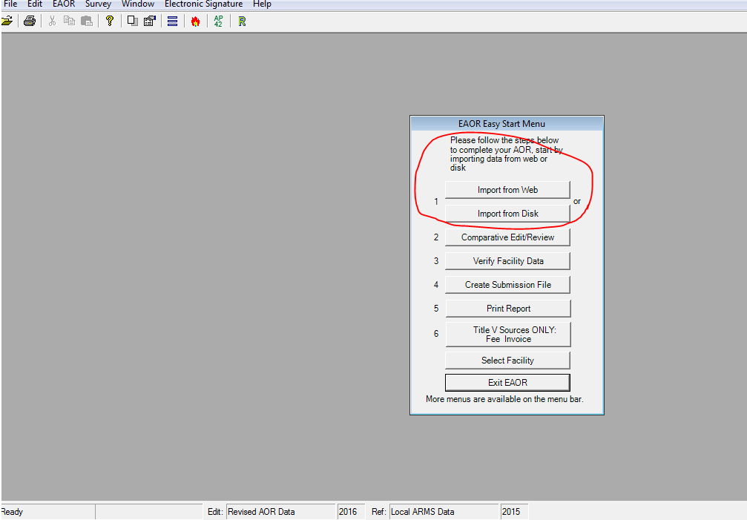
EAOR Easy Start Menu
Notes:
First - regarding importing your data file for completing the AOR for the current reporting year:
Only import your facility’s data file once! If you try to import twice it will give you a warning: “Re-importing your data will replace any data you have updated.” Unless this is desired, then Click ‘No’ you do not want EAOR to replace your data.
If you can’t find your file for the current reporting year, first make sure you have the proper version of EAOR software installed (to check the EAOR software version, go to HELP on the bar menu at the top of the screen, then click on About EAOR. The version number should match the software version number on the EAOR website.
If you have the right version, and still can’t find the file for the current reporting year, or you’re not able to import from the web for other reasons, then please be sure to send me an email or give me a call so I can send you your file.
**In no case, should you overwrite the data of the previous year’s AOR with the current reporting year’s data!

Slide 16
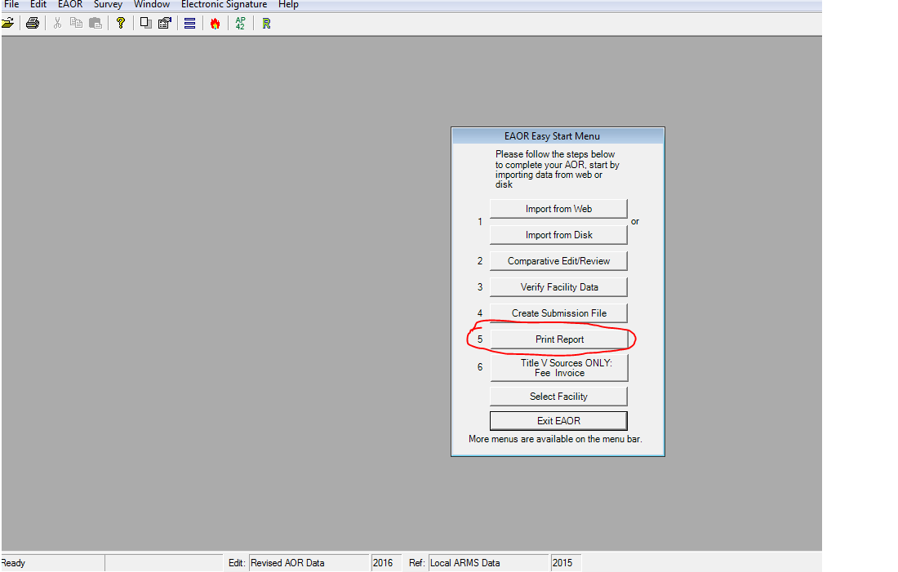
EAOR Easy Start Menu – Print Report
After importing your facility data, first review it, then begin editing:
Notes:
Second - after importing your data file, please review it prior to completing the report. You can go to Step 5 on the Easy Start Menu and select an Emissions Report by EU to ensure all the EUs and Pollutants are there, and that the pollutants are correctly ‘marked’. They should be marked when there is an emissions limit for the pollutant or it is included in an emissions cap in the permit. This review is important to do especially when your permit has recently changed. If the data are not correct in EAOR, for example a marked pollutant is missing, or facility activities have changed, and an emissions unit is not identified in EAOR, then please let me know so I can send you a corrected file.
Tip: Review data file in EAOR prior to completing the report. Let me know if you need a corrected file!

Slide 17
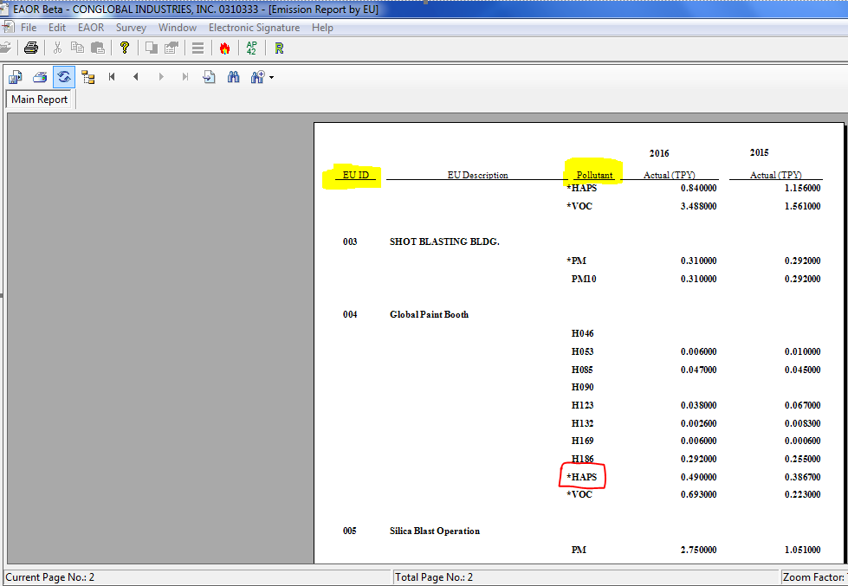
Review: Emissions Report by EU
Notes:
This is the EAOR Emissions Report by Emissions Unit, you can use this report to review the emissions units listed, pollutants, and ‘marked’ pollutants are correct. The list of emissions units should include all regulated or unregulated emissions units in an active or construction status (and include those EUs with an Inactive status if the unit permanently shut down during the reporting year), and the list should match the permit. The list of pollutants should include all reportable pollutants, per the AOR rule, those that have emissions limits, or emitted at or above the threshold. The pollutants with emissions limits including an emissions cap, should be marked with an asterisk. As you can see *HAPS is a marked pollutant in this example.

Slide 18
Completing EAOR: Facility Form
Facility Information:
Status (as of December 31st) – A, C, Inactive.
Facility Owner/Comp. & Site Name – Owner.
Facility History Information – Previous Owner /Company Name if changed during reporting year.
Owner/Contact Information:
Person who is authorized / responsible for signing this AOR:
Non-Title V: Owner/Authorized Representative or
Title V: Responsible Official
Notes:
Next, we’ll talk about a couple of fields in EAOR for facility information, the status and owner information:

Slide 19
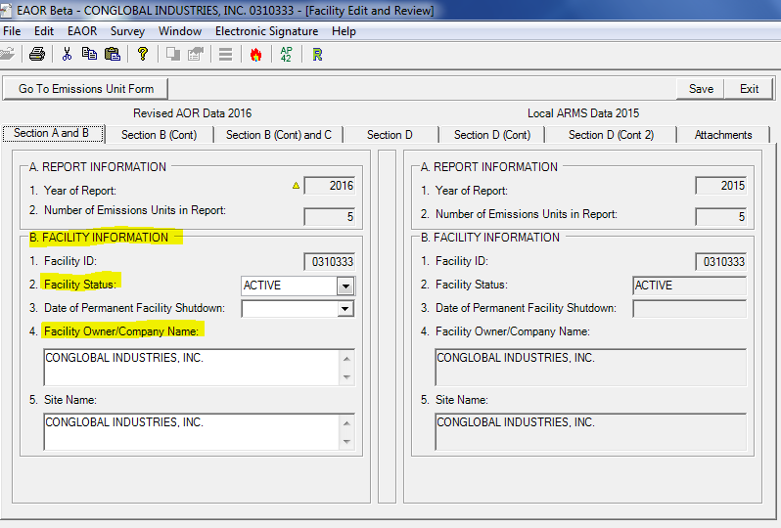
EAOR Facility Form– Status, Owner
Notes:
The facility status refers to the status as of December 31 of the reporting year. If this is not correct in EAOR, then please change it:
Active - One or more emissions units in operation, on standby status, temporarily shut down (including any shutdown while undergoing modification), or on long-term reserve shutdown. This code indicates an existing facility which has not been permanently shut down, though it may not be operating at the time of this report.
Construction - All emissions units in planning stage or undergoing initial construction, including reconstruction. This code indicates a proposed new facility, or an existing facility which has been or will be shut down in its entirety for reconstruction.
Inactive - All emissions units permanently shut down; permit(s) surrendered or expired. If shut down during the reporting year, then enter the shutdown date of all operations.
Fac Owner/Company Name & Site Name- This is populated with the owner/company name we have in our system as of the end of the current reporting year (i.e. as of Dec 31) and normally is not changed in EAOR, however if it is not correct in our system and doesn’t match your permit, then you may need to change it in EAOR, and this will also change it in our main system (called the ARMS system), so please only change it when needed and enter exactly what is on your current permit). Note: EAOR is not the mechanism for changing your permit, if your permit needs correcting or a transfer of ownership form needs to be sent in, then this should be done through proper permitting channels.
Your data changes in EAOR will display a yellow triangle (for example, the yellow triangle next to 2016 Year of Report).
Facility History - If the Facility Owner/Company Name changed during the reporting year, then please enter the previous Name in the section for Facility History Information.
Owner/Contact Information – this is the person who will be signing the AOR. If Title V and RO have changed, send an RO Notification form.

Slide 20
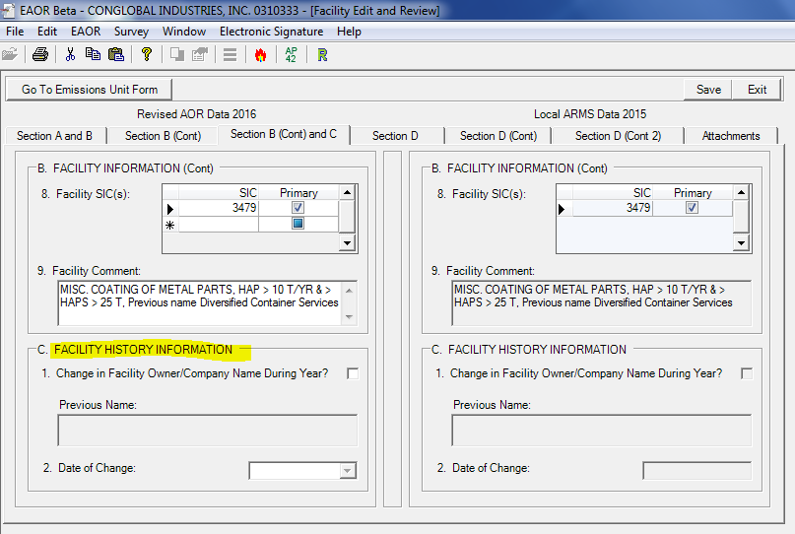
EAOR Facility Form - History
Notes:
Facility History - If the Facility Owner/Company Name changed during the reporting year, then please enter the previous Name in the section for Facility History Information.

Slide 21
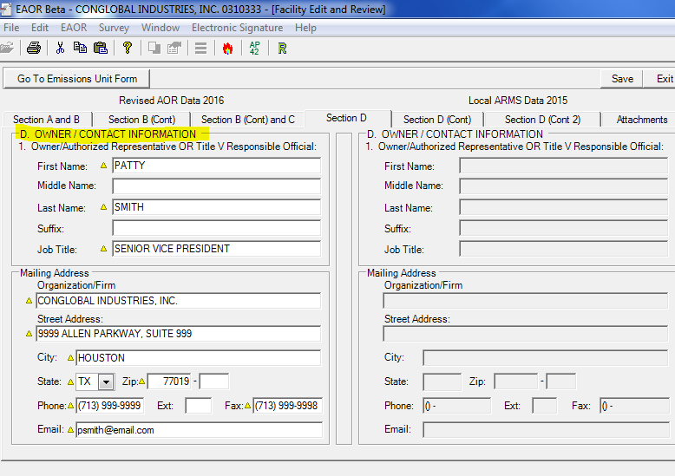
EAOR Facility Form: Owner Information
Notes:
Owner/Contact Information – In Section D, information of the person who will be signing this AOR is entered. Though information entered here is required, unfortunately it does not update our ARMS system, so if the Owner/ Contact information has changed at the facility, to change it in our ARMS system, please send an RO Notification Change form certifying the changes (if you’re a TV facility), or if you are a non-TV facility, let your compliance office listed in your permit, know that the information needs to be updated in our ARMS system.
For Non-Title V sources: Contact information for the Owner/Authorized Representative who is signing this AOR is required.
For Title V sources: Contact information for the Responsible Official who is signing this AOR is required (does not have to be the Primary RO).
While here on the Facility level screen in EAOR, please note the tab for Attachments:

Slide 22
EAOR Facility Form: Attachments
Make sure supporting information is attached in EAOR
  Helps communicate the whole picture to us and saves time otherwise spent on follow-up questions to the facility (especially important when Emissions Calculation worksheet or Emissions Comment field does not contain the calculation formula.)
Other Attachments
  Signature Pages may be attached in EAOR (i.e. AOR pages 1& 2).
  However, if e-signing, then it is not necessary to attach the signature pages in EAOR.

Slide 23
Completing EAOR Continued
Make sure the correct SCCs are reported in EAOR: If you are adding (or invalidating) an SCC in EAOR, and there is any question regarding which SCC to use, then please first check with the permitting office, and cc DARM.
Make sure the correct Emissions Method Codes used to calculate emissions are reported:
  Rule 62-210.370(2)(d)1.c., F.A.C., states “The owner or operator shall compute emissions by multiplying the appropriate emission factor by the appropriate input, output or gas volume value for the period over which the emissions are computed. The owner or operator shall not compute emissions by converting an emission factor to pounds per hour and then multiplying by hours of operation, unless the owner or operator demonstrates that such computation is the most accurate method available.”
    View Rule 62-210.370 for methods to be used when computing actual emissions.
Make sure to use the correct Emission Factor (EF) for the particular pollutant:
  For PM, PM₁₀, and PM_{2.5} emissions, EFs used were often for the wrong pollutant. For example, AP42/Webfire EF for PM was used to report PM10.
  Depending on the SCC and control equipment configuration, there may be emission factors for *primary PM, primary PM₁₀, primary PM_{2.5}, filterable PM, filterable PM₁₀, filterable PM_{2.5} and condensable PM (CPM).
Notes:
SCC – SCC emissions factors are developed from testing for specific processes, and the SCC used in EAOR should reflect the specific process or activity that emits the air pollutant, as much as possible. For example, if the permit changed because a specific fuel is no longer allowed to be burned, then the SCC for that fuel should not be available in EAOR. Also, when gap filling HAP emissions, EPA bases their process on the SCC code, so please make sure the right one is used for reporting your emissions. Note: EPA retires and adds SCCs, usually to result in a more detailed or accurate description of the activity. If these changes affect your facility sector, please consult with the department’s permit engineer regarding which SCC to use.
Emissions Method Codes – Please make sure the highest ranked applicable emissions method listed in the rule are used for computing actual emissions; in addition the methods used may change over time for example, when a more accurate method is required (e.g. from AP-42 to site-specific testing), therefore please remember to update EAOR accordingly, including calculation sheets and emissions comments when necessary.

Slide 24
Completing EAOR Continued
Make sure emission factors have the correct Units:
  For example, for an SCC for external combustion boilers burning oil, AP42/Webfire units for criteria pollutants are Lbs per 1000 Gallons Oil, and units for metals are Lbs per Million Btus Heat Input, however EAOR calculation worksheet ‘Emission Factor’ unit is Lbs per 1000 Gallons Distillate Oil.
  Provide the source of the emissions factor (EF) in EAOR.
    For example, if emissions were calculated using an EF based on site specific data such as stack tests, then list the test dates, and EF units; or if the EF was established in a permit, then reference which permit.
Double check your emissions calculation formula:
  A minor omission could result in either underreporting emissions (and subject to additional Title V fee / penalties); or over reporting emissions (and overpaying fees).
  EAOR calculates Title V fees based on actual emissions, review and correct discrepancies in formula’s, ensure the values used in the formula are correct:
    Units; convert from lbs to tons
    Emissions factor
    Consider control efficiency
    Process rate / Fuel usage
    Average heat content
    Total hours operated
CPM, PM2.5, and PM10 should typically be reported for combustion sources.
  If the information is available and the reporting threshold of 5 tons/year was exceeded (or is a marked pollutant), then report the emissions.
Notes:
Emissions Factors – note the EF units in EAOR on the Calculation Worksheet normally match the units for the criteria pollutant in AP42/Webfire. However, you may add an EF with a different unit in the Calculation Worksheet.
Regarding Emissions Calculations, these are required to be provided in EAOR (either using the EAOR “Calculation Worksheet” or they may be attached in EAOR). If calculations are only attached in EAOR, then a comment must be entered in the EAOR field “Emission Calculation”, such as “see attachment for…calculations…”. Calculations should clearly show soot blowing, startup / shutdown, control eff. / capture efficiency, and fugitive emissions as applicable. If emissions are determined by CEMS and these are included in total emissions reported, then note this in EAOR. In general, please Add notes explaining unusual activity! Notes can be added to the Calculation Worksheet or in the “Emission Comment” field for the pollutant and are very helpful.
Also, explanations or notes can be added for an emission unit, in the “Emissions Unit Comment field”.
***Tip: Attachments with emissions calculations are very helpful and ensure good data quality!

Slide 25
EAOR: Examples of Data Quality Issues
A change during the reporting year in the facility’s tracking/reporting methodology resulted in underreporting of emissions (i.e. from AP42- to CEMS);
Different emissions factors are used for reporting in different systems (TRI vs. AOR);
Overestimating previous years emissions;
Instances where the emissions factor or fuel usage/ process rate is off by an order of magnitude; or incorrect value was used in the formula in EAOR;
Duplication of process rate / fuel usage: The exact same process rate was reported for different fuels burned, for example diesel and natural gas;
Notes:
When QA’ing the emissions data for suspect values, typically what I find is that it relates to the emissions method or emissions factor used, sometimes causing emissions to be over estimated or underreported, (or appear to be incorrect and require follow-up). Some of the following scenarios, though infrequently encountered, may be typical:
A change during the reporting year in the facility’s tracking/reporting methodology resulted in underreporting of emissions: In this case, the facility went from using AP-42 emissions factor to using CEMS, however programming of the CEMS to switch to calculating the mass value was only available for part of the year, and emissions not picked up by CEMS for the other half of the year were inadvertently excluded (and subsequently had to be calculated based on the fuel consumed during this time using AP-42 emissions factors);
Different emissions factors are used for reporting in different systems (i.e. TRI vs. AOR comparison): AOR reporting schedule may precede TRI reporting, and in some cases, the more accurate emissions factors used for TRI, which considered specific controls, were not available until after the AOR reporting deadline (or were only utilized in TRI, and not EAOR) and consequently a comparison of emissions from the two systems showed a large disparity.
In this case, a significant decrease was observed in their NOx emissions in the current reporting year vs. previous year, which seemed out of proportion to their process rate increase in current year (i.e. Nox CEMs, and NOX had decreased by 30%, in spite of a slight increase in the tons of coal burned). After follow-up with the facility, it was determined default CEMS values required to be used in the previous year overestimated actual Nox emissions for that year. Tip: When possible, add a note in EAOR explaining why the Nox emissions were higher in the previous year, compared to the current year.
Instances where the emissions factor or fuel usage / process rate is off by an order of magnitude; or simply, not the right value was used in the formula in EAOR; or
The exact same process rate was reported for different fuels burned, for example diesel and natural gas.

Slide 26
EAOR: Examples of Data Quality Issues
Instances where materials or substances used in the previous year’s processes were discontinued prior to the current reporting year, however were inadvertently reported anyway;
Cases where emissions were normally calculated by applying a control efficiency, however were inadvertently reported without it;
Emissions value reported was in pounds, conversion to tons was excluded from the formula;
Cases where HAP VOCs are not included with the total VOC emissions; and
Formulas needing revision:
  workbook setup to capture data for the AOR, such as fuel usage, not working;
  Formula omits an important conversion factor (i.e. conversion of sulfur to SO2);
  Incorrectly uses a “percentage” (i.e. 10% ash) instead of a “number” (i.e. 0.1 ash fraction), resulting in emissions being over reported (for HAPS metals).
Notes:
6) Instances where materials or substances used in the previous year’s processes were discontinued prior to the current reporting year, however were inadvertently reported anyway;
Cases where emissions were normally calculated by applying a control efficiency, however were inadvertently reported without the control, resulting in over reporting of emissions;
Forgetting to convert emissions value from lbs to tons: reporting in pounds when the conversion to tons was excluded from the formula;
Cases where VOC HAPs are not included with the VOC emissions: If an individual hazardous air pollutant is also a VOC, then the individual hap is to be included with the total VOC emissions (in 2018 a verification error will show, if this scenario is found).
Cases where the workbook setup to capture data for the AOR such as fuel usage, needed the formulas to be revised; or the formula omits a conversion factor (i.e. for conversion of sulfur to SO2), underreporting emissions by half;
Spreadsheet incorrectly contains a “percentage” Format type (i.e. 10% ash) instead of a “number” Format type (i.e. 0.1 ash fraction), as a result HAPS metal emissions were over reported.
*Notes:
“Individual Hap” include H001 thru H189 (including H110, H014A, H015A, H021A, H027A, H046A, H047A, H054A, H113A, H114A, H133A, H162A, H106E), PB, and DF.
“Individual VOC Hap” is each “individual Hap” except for any “individual non-VOC Hap”.
“Individual non-VOC Hap” include PB, H014, H015, H016, H021, H027, H028, H038, H046, H047, H054, H105, H106, H107, H110, H113, H114, H119, H128, H131, H133, H147, H148, H161, H162, H167, and H014A, H015A, H021A, H027A, H046A, H047A, H054A, H113A, H114A, H133A, H162A, and H106E.

Slide 27
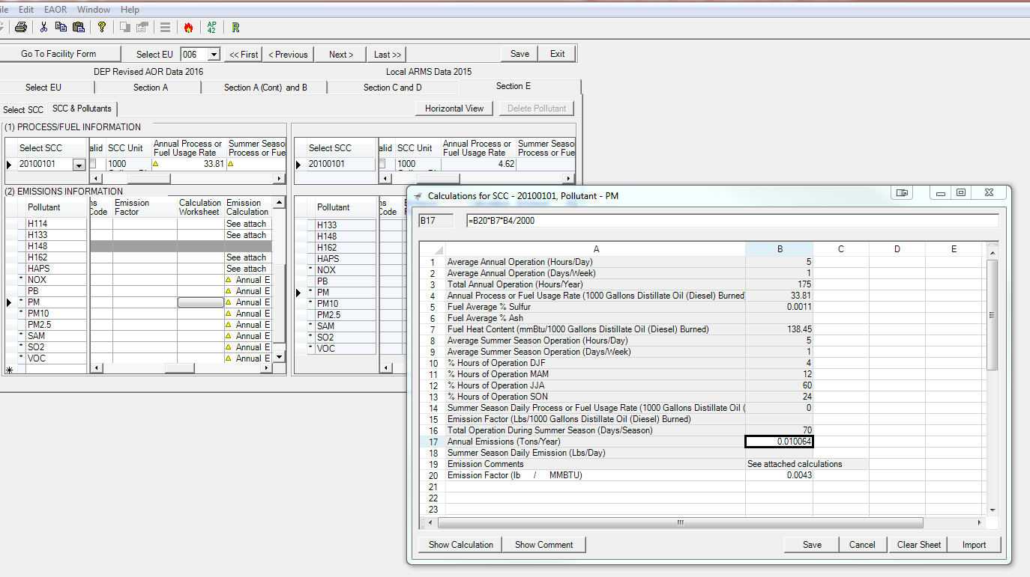
EAOR Calculation Worksheet
Notes:
Calculation Worksheet: (note this is an old capture which still shows SSD, summer season daily fields were removed and are greyed out as if 2017-1 EAOR version, since there is no requirement to report SSD).

Slide 28
Additional Data Review
DARM Performs Edit Checks & Compares to ARMS:
  Missing AOR Report
  Missing Process Rates
  Missing Annual Emissions
  Missing Cap Emissions
  Missing data for SCC (if burning Coal, Oil, Gas) – lists SCC if the sulfur content, or ash content, or heat content is missing.
Notes:
In addition to reviewing the data in EAOR, after EAOR data is uploaded to ARMS, we perform additional edit checks for missing data, or potential compliance issues:
The edit reports list Missing Data:
Missing AORs for emissions units – and we will follow-up with the facility if an AOR is expected but not found – the report includes inactive EUs that permanently shut down operations during the reporting year.
Emissions Units that reported as operating, however are missing annual Process Rate or Emissions.
Missing emissions for pollutants with an allowable emissions limit or emissions cap (usually this occurs when ARMS was updated after the fact, and poll was not ‘marked’ in EAOR, follow-up if allow applied in reporting year).

Slide 29
DARM Edit Checks Continued
Operating Schedule – if exceeds the permitted schedule.
Excess Process Rate – if reported annual process rate larger than the permit limit.
Excess Sulfur, Ash – if reported sulfur/ash content is larger than the permit limit.
Excess Heat Input
Excess Emissions – reported annual emission larger than the permit limit allowable: equivalent tons/year.
Exceeded Emissions Cap – reported annual emission larger than emissions cap (fac wide or multi-unit cap).
Notes:
Additional checks look for possible Exceedances:
Lists EUs with operating schedule which exceeds the permitted operating schedule (hrs/day, days/week/hrs/year)
Exceeded List EUs where the EAOR process rate, or sulfur, or ash content > the permit limit.
Looks for instances of excess heat input, [Max heat input (mmBtu/hour) x Hours/year] < [Annual process rate x Heat content],
or pollutants with reported emissions greater than the permit allowable emissions limit or emissions cap.

Slide 30
Revising an EAOR
If you are a Title V facility and revisions affect Title V fees, or are very involved, then resubmit a revised EAOR.
Make the revisions in EAOR, resubmit, and sign.
Do not re-import your data file from the web. This will overwrite and null out data values that you have already entered!
*** Contact me if you have questions or problems! ***
Notes:
If you need to make a correction, then you can revise the EAOR data, and resubmit it. Normally if revisions are complex, or alter the Title V fees, then it is best to revise the EAOR and resubmit it. In EAOR, you Select the *file you want to revise and go to Step 2, Comparative/Edit Review. Save your changes and Create Submission file. Do not ‘Import from Web’ again, this will overwrite the data you have already entered.
If this happens, then call and let me know; I should be able to send you your original file.
*If the file was not prepared on your computer, then whoever prepared it can ‘export’ the file as a .arm file and email it to you, then you can import it from disc to your computer’s EAOR. If the preparer and computer are gone, let me know.

Slide 31
Signing the AOR
For Non-Title V Sources – The Owner or Authorized Representative must sign.
For Title V Sources - The Title V source Responsible Official must sign. If there is more than one Responsible Official at the Title V source, then it is not necessary that this person be the Primary Responsible Official.
Whether the AOR is submitted electronically via the web or email, you may sign the AOR electronically or submit signature pages. The AOR is not complete until it is signed.
Please note: In order to sign electronically, you will need a user account and PIN. You do not need to download the EAOR software in order to sign the AOR.
  Information on how to sign electronically can be found on the EAOR website: http://www.dep.state.fl.us/air/emission/eaor/default.htm
  Click Here to Register a New Account - Note the ‘Help’ button on this screen.
  Download PIN Request Form (requires login)
If you forgot your PIN or registration password or need signing help:
DARM Application Support Desk
Email: DARM.HelpDesk@dep.state.fl.us
Phone: 850-717-9000 (Fax: 850-717-9001)
Notes:
If you are e-signing, allow time if you need to set up an air account an get a PIN number. PINs are assigned to the person, not the facility. You do Not need to download EAOR software in order to e-sign.
If you are registering for an account, notice there is a Help button, please note, you may need to first adjust the Compatibility View setting if you are using Internet Explorer 10, and instructions are found by clicking on the Help button. An account is used for both EPSAP and AOR.
Only one signature method is necessary, e-sign or attach signature pages in EAOR, or email them to us: TV go to EAOR@dep.state.fl.us (Tallahassee), Non-Title V go to the district/local compliance office.

Slide 32
EAOR Benefits
The completed report can be submitted by the Internet.
The report is partially filled with the data from the Department database. This ensures the report is completed according to each facility's permit.
The side-by-side view allows comparison of the current year data with the data from previous years.
Data changes are highlighted to ease the review of the data.
Help is available at one key stroke, including the definitions of each data field.
Formulas to calculate emissions can be set up in the program and be re-used in future AORs.
Edit checks are included to catch missing data.
Supporting electronic documents can be attached.
The data are reviewed and transferred into the Department database electronically, avoiding having to enter the new data and update the existing data manually.
Reports can be saved as .PDF files. With this feature, you can send the completed AOR to someone else to review, without that person having to install the EAOR program.
Automatically calculates Title V fees based on the AOR emissions reported.
The report can be signed electronically.
Notes:
There are many benefits to using EAOR from both perspectives, formulas can be established in EAOR for the pollutant, and each year, once the pertinent data is entered, such as process rate etc., you can reuse the formula, and recalculate the emissions by clicking on the Recalculate button, there is no need to go into each formula to recalculate the emissions.
In addition, edit checks called Data Verification are done in EAOR to catch missing data.

Slide 33
EAOR: Potential Improvements
Small screen size
  Requires use of a scroll bar
Data Verifications
Emissions Comments
Comparisons with permit limits /thresholds/EPSAP not available
Improving display of Emissions Comparison reports – graphed trend chart showing multiple years.
Including automated emissions calculator tools to determine which thresholds are exceeded and require reporting.
EAOR is not web based
  Limitations on operating systems
Notes:
Some common user issues and some excellent suggestions for improvements are:
Small screen size – even with screen resolution adjusted to optimize the display, fields are small and require the use of a scroll bar to see the whole screen, some times fields are missed.
Data Verifications – can be confusing and not clear how to fix the them - for example “Tot HAPS > sum of individual HAPS”. For this one we are enhancing this to make is easier to find the problem.
Emissions Comments – comments entered for the previous year are not carried over to the current year, must be copied an pasted. We will look into an option to allow them to be carried over automatically).
Comparisons with permit limits or regulatory classifications, i.e. if classified as ‘not a major source of HAPS’, but exceeded threshold of 10 TPY for single HAP or 25 TPY for combined HAPS;
Or comparisons with EPSAP for example to compare EAOR emissions with PTE (potential to emit) as reported in EPSAP would be helpful, but not available.
Improving emissions comparison reports in EAOR – for example displaying a graphed trend chart of emissions.
Including automated emissions calculators tools to determine which thresholds are exceeded and require reporting.
Develop a web based system, EAOR is not web based and must download software when a new version of EAOR is required, and as indicated requires windows 7 or XP operating system, if IT assistance is needed to download the software, this can delay completing the report.
Jump to Contacts slide (36), website Links are on 34 – 35.

Slide 34
EAOR Website: Links and Downloads
EAOR Website has information pertinent to EAOR:
https://floridadep.gov/air/permitting-compliance/content/annual-operating-report
The AOR and Title V Fee are due by April 1.
  Title V facilities must submit the AOR using EAOR software (or claim technical or financial hardship by submitting Division’s pre-filled form).
  Title V emissions fee checks must be postmarked no later than April 1.
  Electronic banking transfer submissions must be received by DEP by April 1.
  The Title V Emissions Fee website is here:
  https://floridadep.gov/air/permitting-compliance/content/title-v-fees
EAOR Software
  EAOR software allows you to submit your Annual Operating Report to Florida DEP.
  The latest version of EAOR is found on the EAOR website.
  EAOR software requires: Windows 7, 8, 10
  Non–Title V facilities may submit their AOR using a pre-filled hardcopy. Download a prefilled copy at this link (however Title V must use EAOR as mentioned above): https://floridadep.gov/air/permitting-compliance/content/annual-operating-report
Notes:
This slide shows links for EAOR Website, plus Title V Fee information, and EAOR Software links.

Slide 35
EAOR: DEP Web Resources
EAOR Website
https://floridadep.gov/air/permitting-compliance/content/annual-operating-report
Title V Annual Emissions Fee On-line Information
https://floridadep.gov/air/permitting-compliance/content/title-v-fees
AOR Form (including instructions)
https://floridadep.gov/air/permitting-compliance/content/air-division-forms
FDEP incoming FTP site:
ftp://ftp.dep.state.fl.us/pub/incoming
EAOR Helpdesk
eaor@dep.state.fl.us
Webpage: How to Find Air Documents Online
https://floridadep.gov/air/air-director/content/how-find-air-documents-online
(850-717-9000 DARM switchboard)
Notes:
This slide is a Summary of some DEP Web Resources:
Note for emails sent to the eaor@dep.state.fl.us the AOR contact in DARM (Dianne Spingler) will see these emails and respond to you! (Or, staff at the helpdesk will respond regarding PINs or user accounts, or forward your email for AOR assistance to other staff if Dianne is out of the office etc.)
New webpage: How to Find Air Documents Online – good for compliance and permitting documents, however only a couple years of AORs for previous years may be available. If you need an AOR for a previous year, send a request to eaor@dep.state.fl.us

Slide 36

EAOR: EPA Web Resources
EPA’s WEBFIRE (contains EPA’s
recommended emissions factors)
https://www.epa.gov/electronic-reporting-air-emissions/webfire
EPA’s Searchable SCC database
(contains a list of most
updated SCCs):
www.epa.gov/scc
Notes:
EPA Web Resources

Slide 37
EAOR Optional Assistance:
Emissions Calculators
The following emissions calculators are based on Webfire. They may be used to estimate emissions, however use is optional; also please note, per rule 62-210.370, the most accurate emissions method to compute emissions must be used when reporting emissions in EAOR.
What if I don’t know my CPM (condensable particulate matter) emissions?
CPM emissions must be reported if the emissions unit is subject to a numerical emission limit for CPM.
Otherwise, CPM should be reported if information is available to estimate emissions, and such emissions are equal to or greater than 5.0 tons per year per SCC. Do not add the pollutant CPM in EAOR if you do not have emissions data to report. A Calculator to estimate CPM emissions based on some available CPM emissions factor information from AP-42 is provided for you at this link: http://www.dep.state.fl.us/air/emission/eaor/CPM-reporting.htm
  Below is a link to the Annual Air Emissions Calculators (based on WebFIRE Emissions Factors) for some SCC. If you would like additional SCCs added, please email them to Cindy.Phillips@dep.state.fl.us
  Annual Air Emissions Calculators for some SCC
Notes:
Emissions calculator resources are available, however please Note, these are optional tools which may be used for estimating emissions, however, these ‘calculators’ are based on AP42 emissions factors and therefore must not replace a more accurate method of determining and reporting emissions if one is available and applies in your specific case.
However, in other cases, the calculator tool may be helpful in determining if the pollutant emissions have reached the threshold for reporting on the AOR.

Slide 38
Reporting PM, PM_{10,} and PM_{2.5}
When reporting PM, PM₁₀, and PM_{2.5} emissions make sure to use the correct emission factor for the pollutant.
  Depending on the SCC and control equipment configuration, there may be emission factors for primary PM, primary PM₁₀, primary PM_{2.5}, filterable PM, filterable PM₁₀, filterable PM_{2.5} and condensable PM (CPM).
  PM filterable >= PM₁₀ filterable >= PM_{2.5} filterable
  PM₁₀ primary >= PM_{2.5} primary >= CPM
  NOTE: ‘Primary PM’ is not reported. Rather, ‘PM’ determined by standard EPA Method 5 is filterable PM, which is reported.
  The emission factors listed as primary include both the filterable and condensable components. For example, primary PM_{2.5} is the total of PM_{2.5} filterable plus condensable PM (CPM), and primary PM₁₀ is the total of PM₁₀ filterable plus CPM.
  PM_{2.5} primary = PM_{2.5} filterable + CPM
  PM₁₀ primary = PM₁₀ filterable + CPM
  You should never add the emission factors for primary and filterable together, since primary already includes the filterable.
  If reported, report condensable PM₁₀ and condensable PM_{2.5} as CPM.
  PM₁₀ condensable = PM_{2.5} condensable = CPM
Notes:
Extra: This slide discusses relationship of Primary PM2.5 and Primary PM10 (which is made up of the filterable and condensable portions);
For example, PM2.5 Primary must equal PM2.5 filterable + CPM (or a data verification error will occur in EAOR).
And pollutant code “PM” (which is the filterable portion) must be greater than or equal to PM10 filterable value, and PM10 filterable value must be greater than or equal to PM2.5 filterable value.

