Slide 1

AirCom
Training Session
Compliance Assurance and Inspection Tool Module
Session 2
Presented by: DARM

Slide 2
Session Topics
Manage Violations
Resolution Activities
Reports (FAR, STR, MRR, VE22, and CEM)
Summarize the day and introduce Day 2 topics
  Questions

Slide 3


Manage Violations

Slide 4

Where to Start…..
From the AirCom Welcome Screen:
Select Air Compliance Menu
Select Manage Facility
Select Search Facility
Select Compliance Details Hyperlink for the Facility
Select Add Facility Activity button
Add Activity data (* required fields) and click the Save button
Select the Sources Tab
Click Add Source button
Select Sources
Click the Link button
Verify Compliance for each source

Slide 5
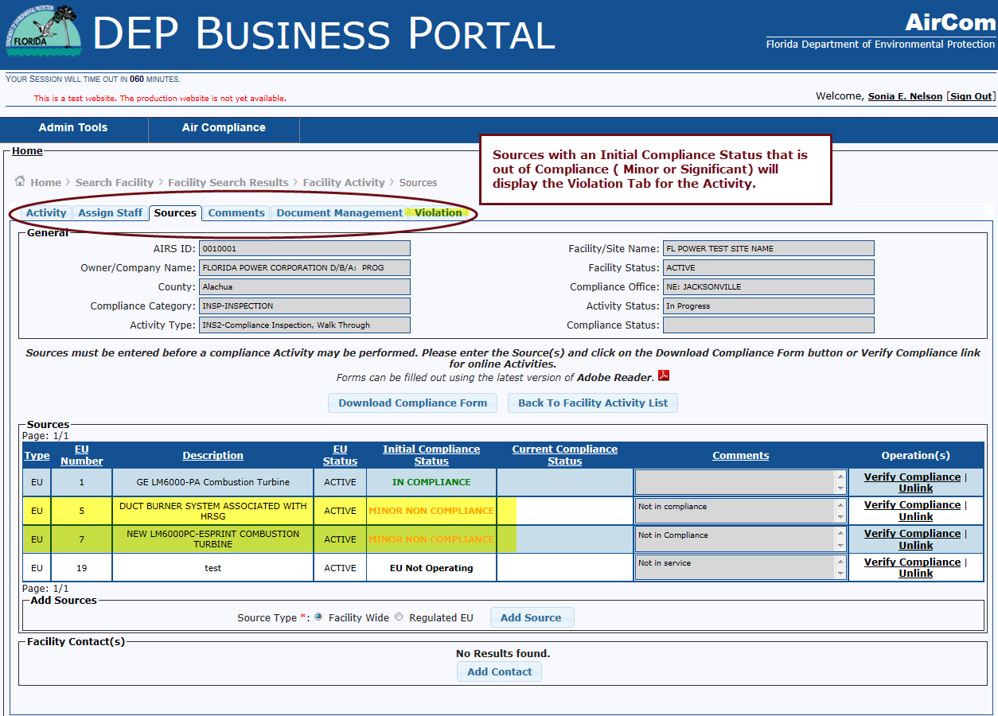
Some Sources are Out of Compliance

Slide 6
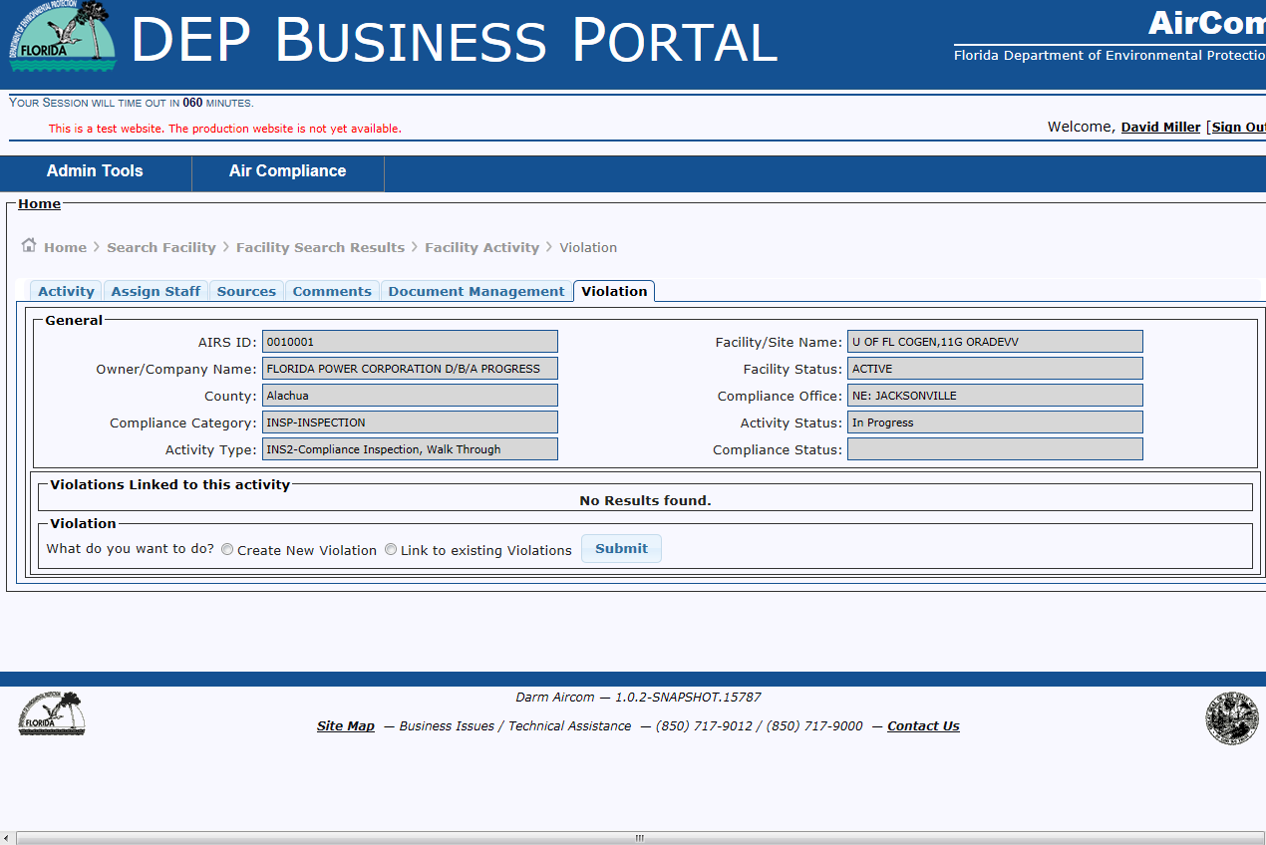
Violation Tab
To Create a violation, select Create New Violation and click Submit.

Slide 7
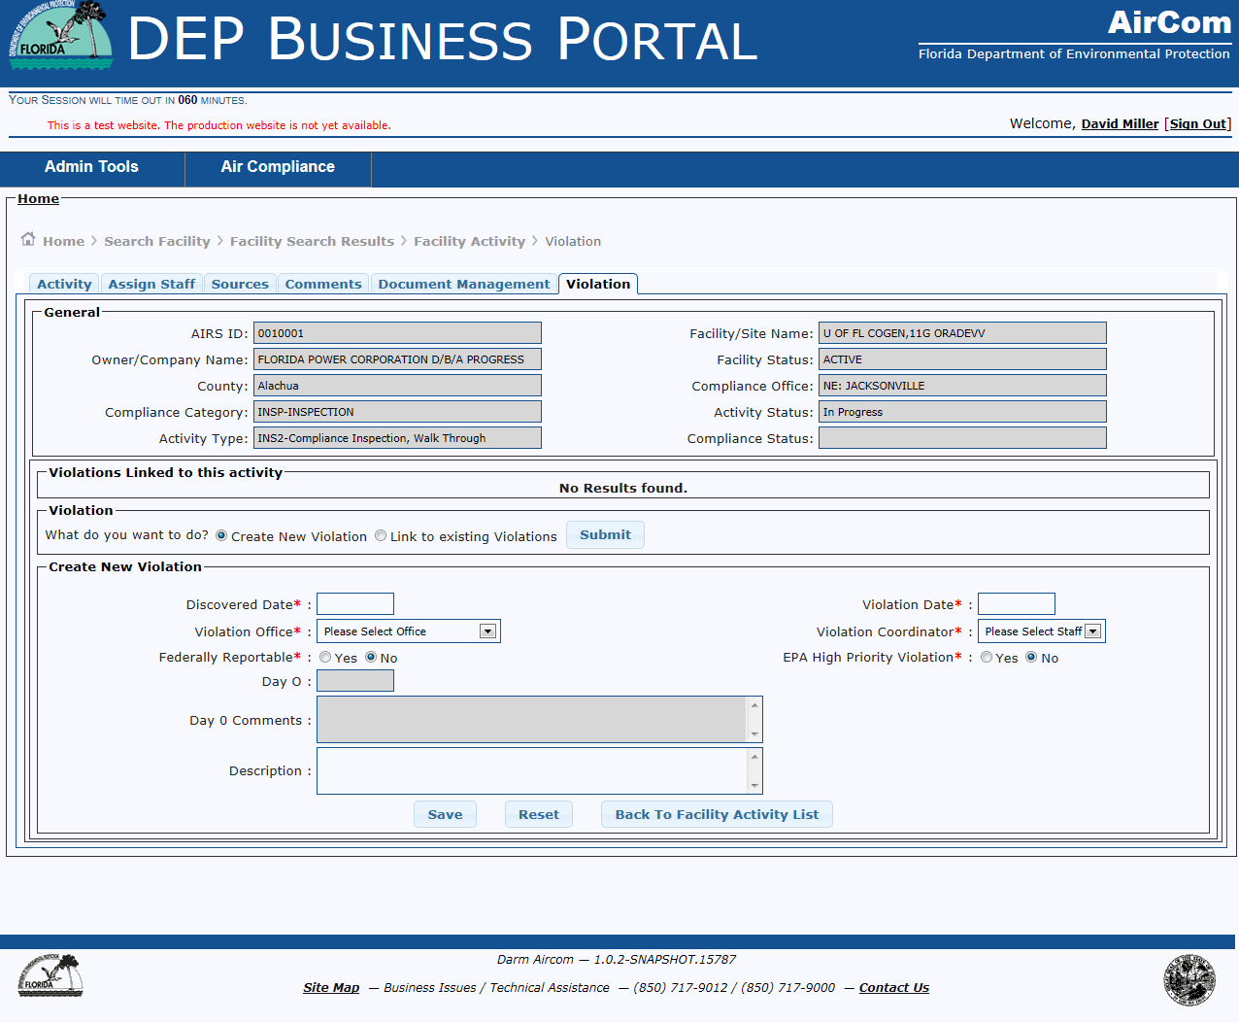
Create New Violation

Slide 8
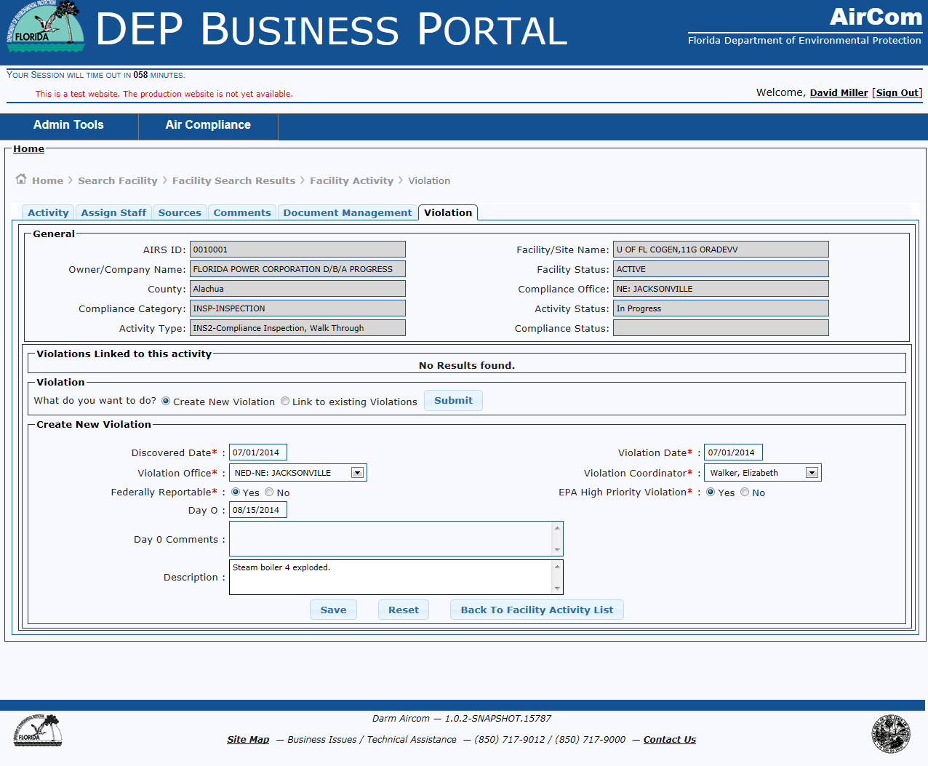
Create New Violation
Add Data to required (*) fields

Slide 9
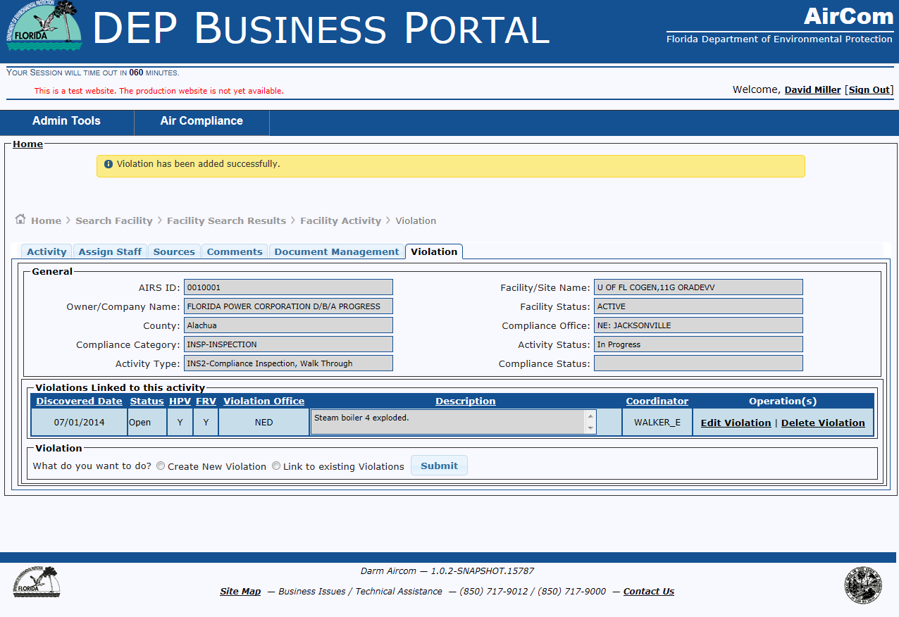
Successful Completion – Violation Created
Violation can be modified or deleted by using the associated hyperlinks

Slide 10
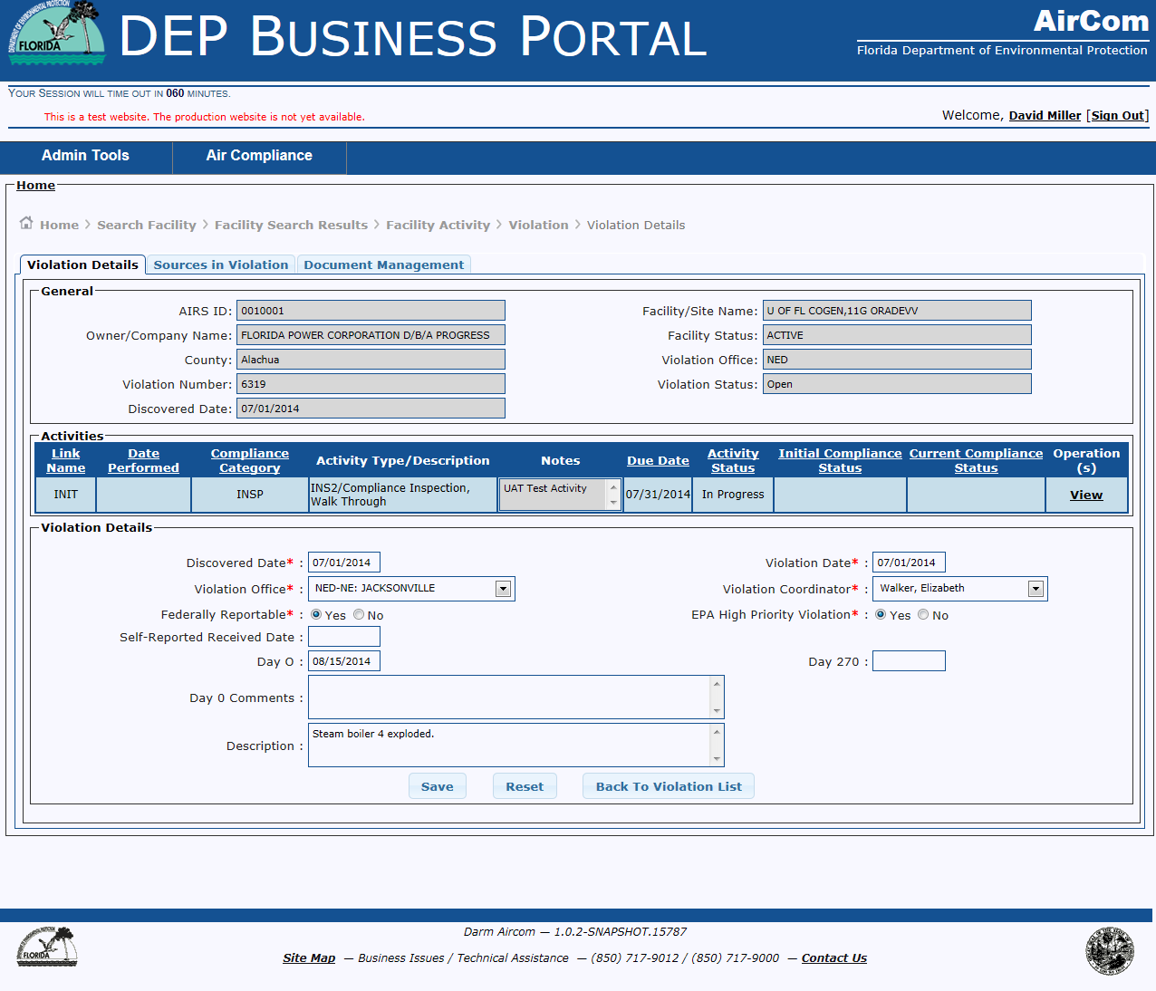
Edit Violation Hyperlink – Violation Details Tab

Slide 11
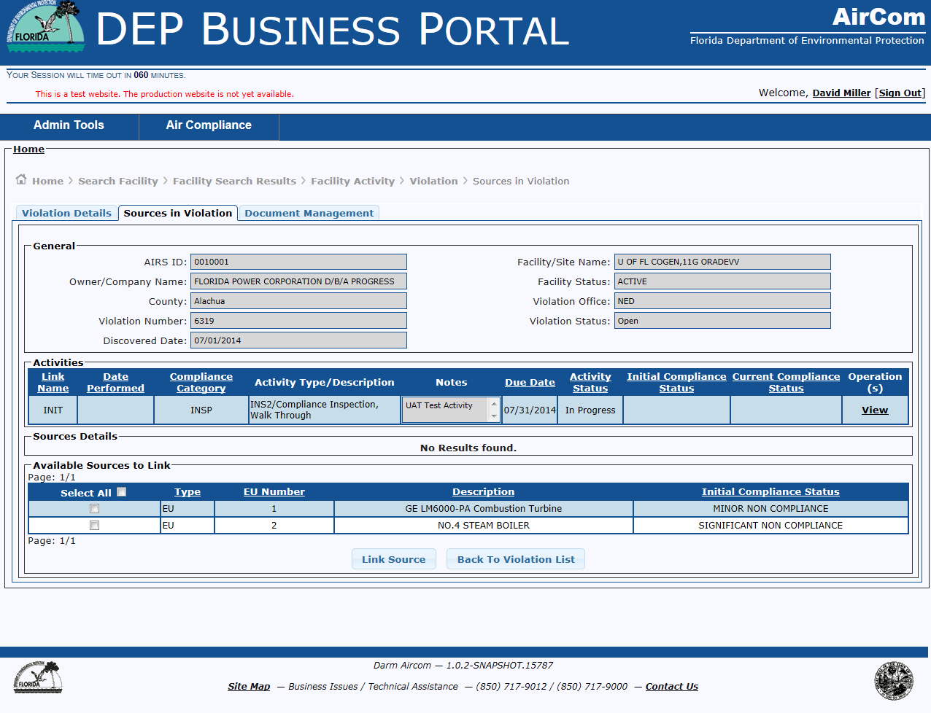
Edit Violation - Sources in Violation Tab

Slide 12

Linking Sources to Violation

Slide 13
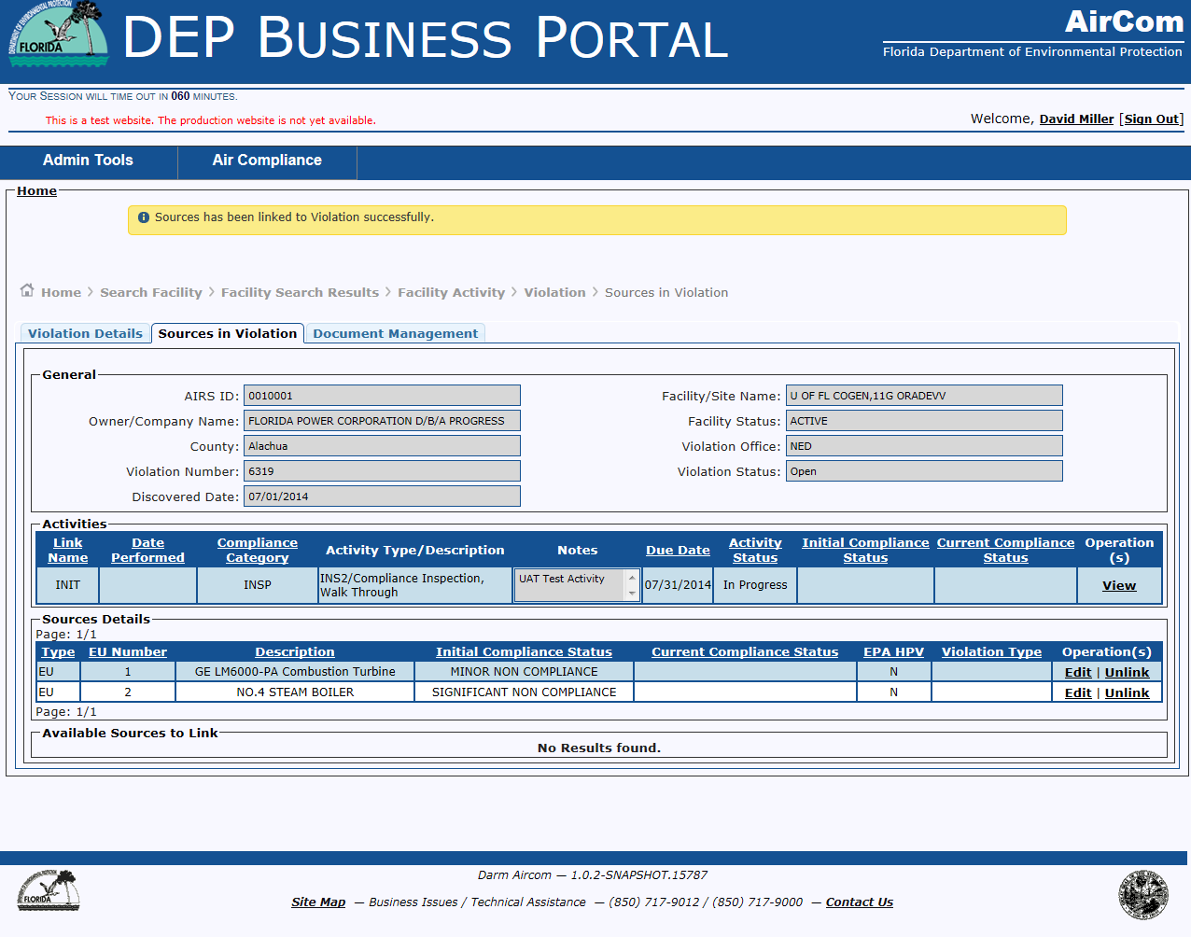
Successful Completion – Sources linked to Violation

Slide 14
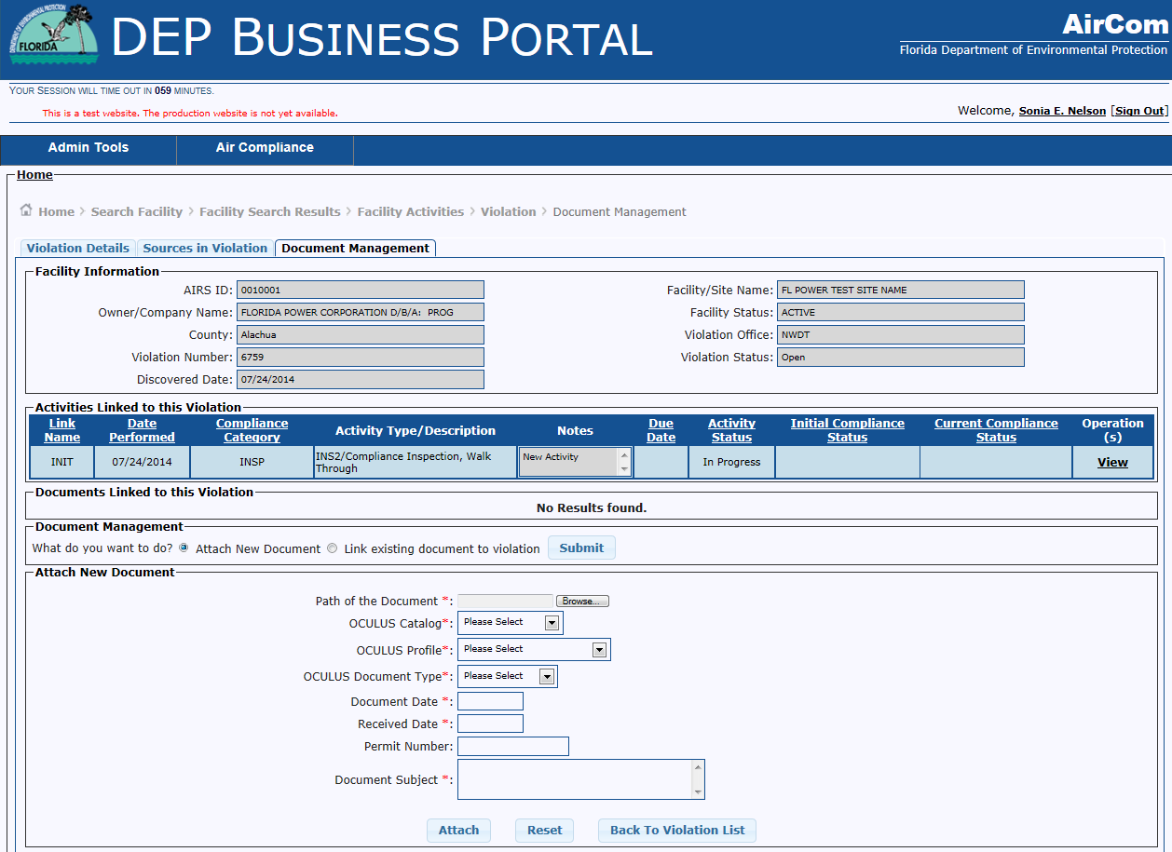
Edit Violation – Document Management Tab

Slide 15
Edit Violations – Attach New Document
Documentation not in the AirCom database can be attached to the violation. Documents will be stored in OCULUS.
Complete the document profile information and click attach to upload a document.

Slide 16
Edit Violations – Back to Violations List

Slide 17
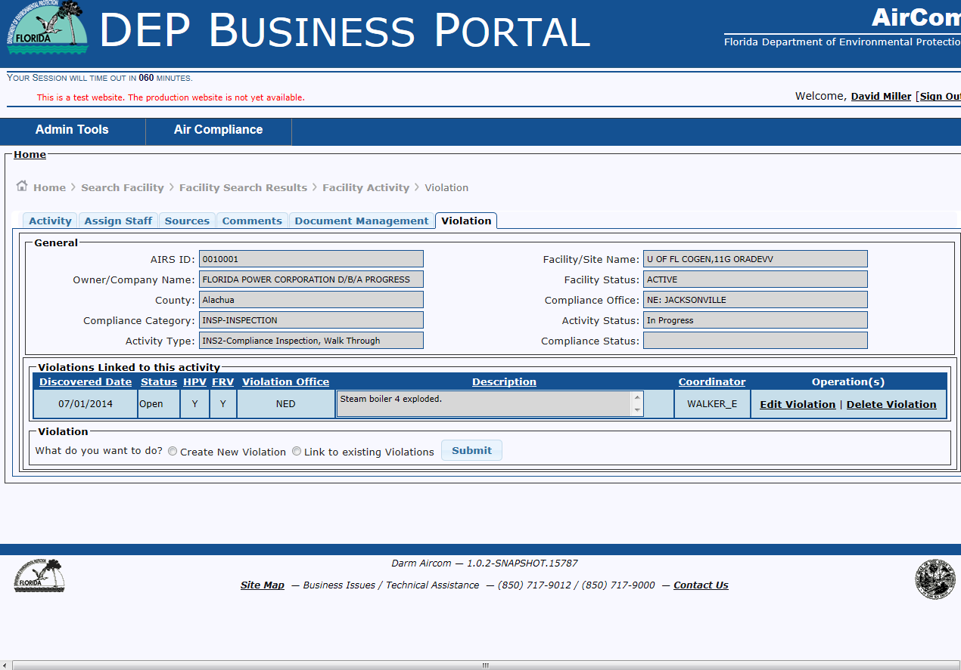
Violation Tab

Slide 18

RESV Activities

Slide 19

Where to Start…..
From the AirCom Welcome Screen:
Select Air Compliance Menu
Select Manage Facility
Select Search Facility
Select Compliance Details Hyperlink for the Facility
Select Add Facility Activity button
Add Activity data (* required fields) and click the Save button

Slide 20
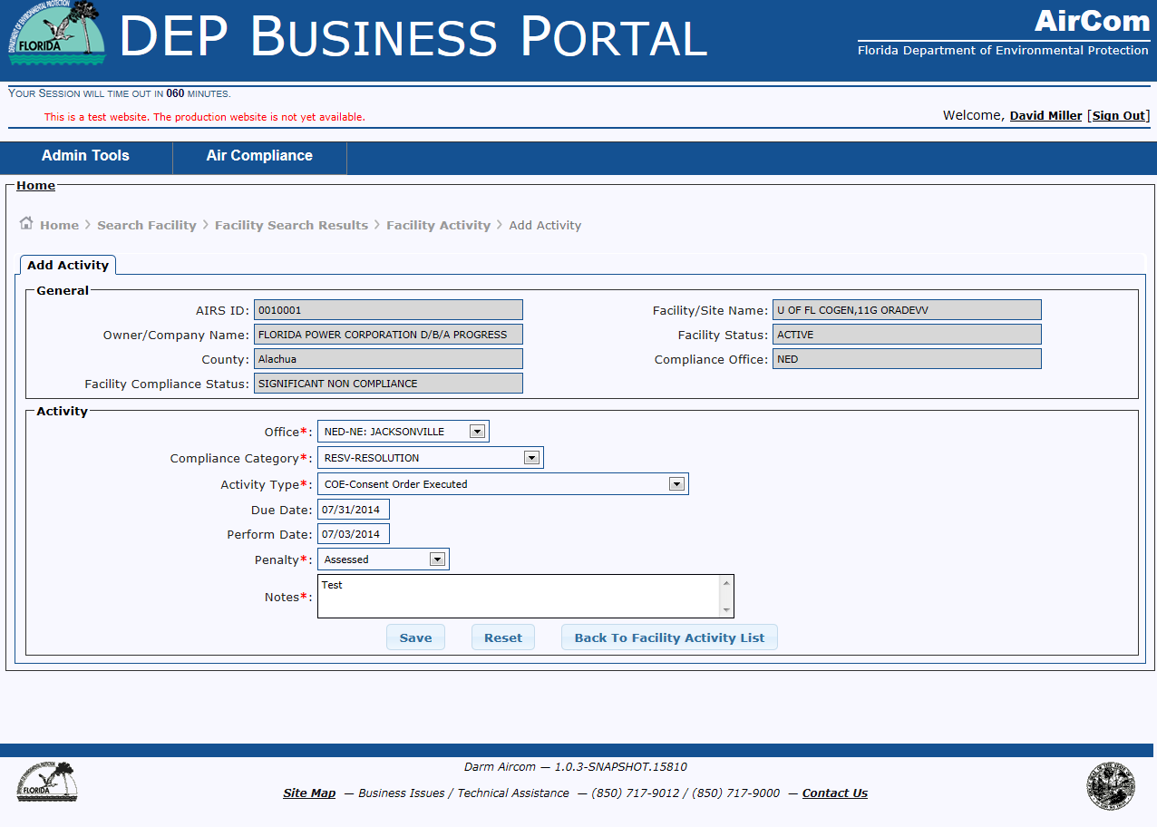
Create RESV Activity

Slide 21
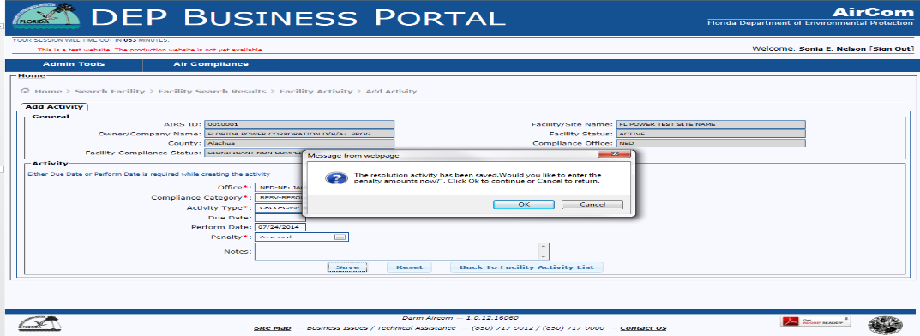
Create RESV Activity with Penalty
For the following Activity Types:
  CRCA
  CRCO
  CRCF
  CRMR
  COE
  FOI
  MCOE
  SCOE

Slide 22
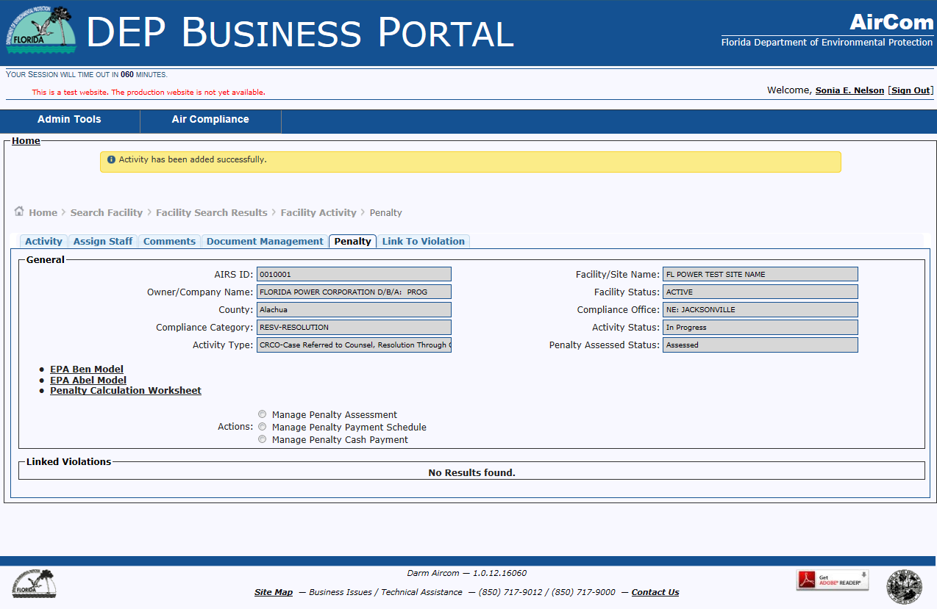
RESV Activity - Penalty Tab

Slide 23
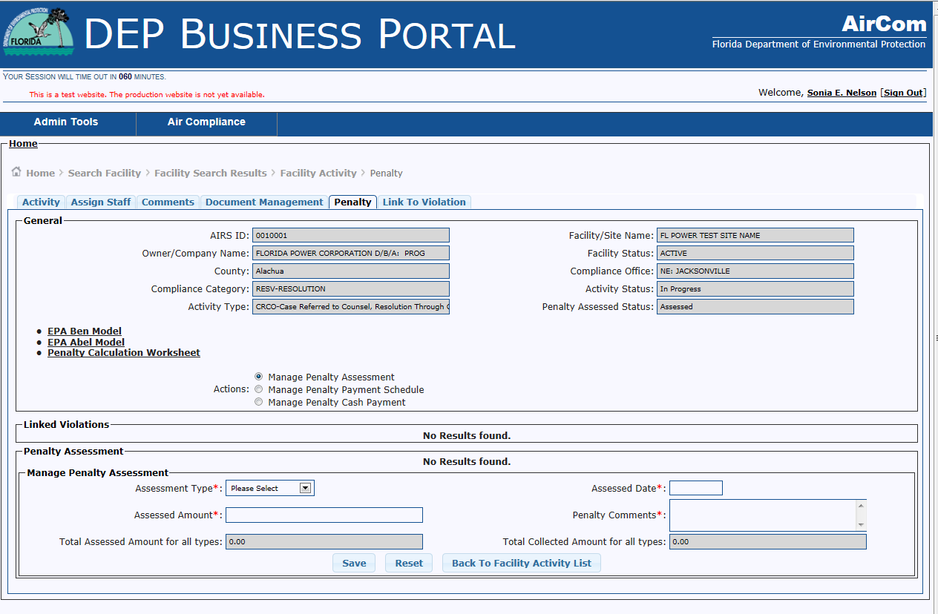
Penalty Tab – Manage Penalty Assessment

Slide 24
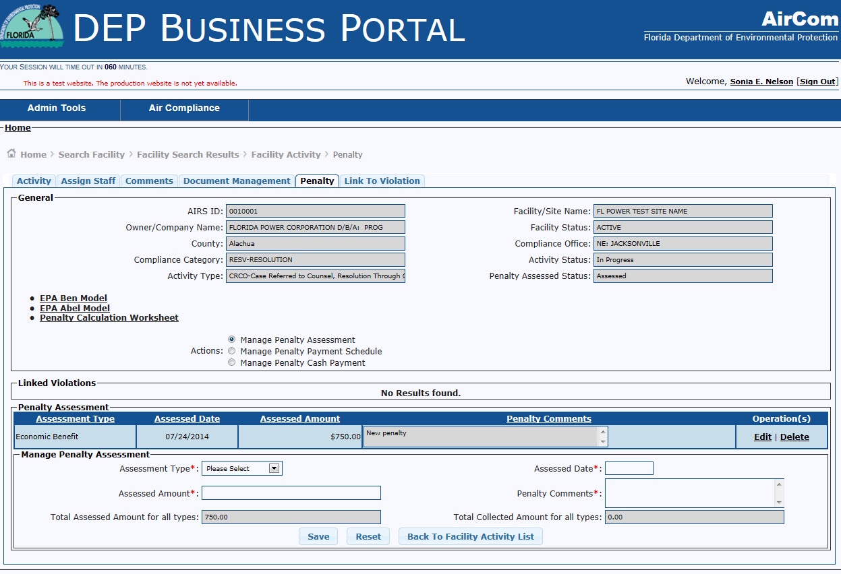
Penalty Tab – Manage Penalty Assessment Grid

Slide 25
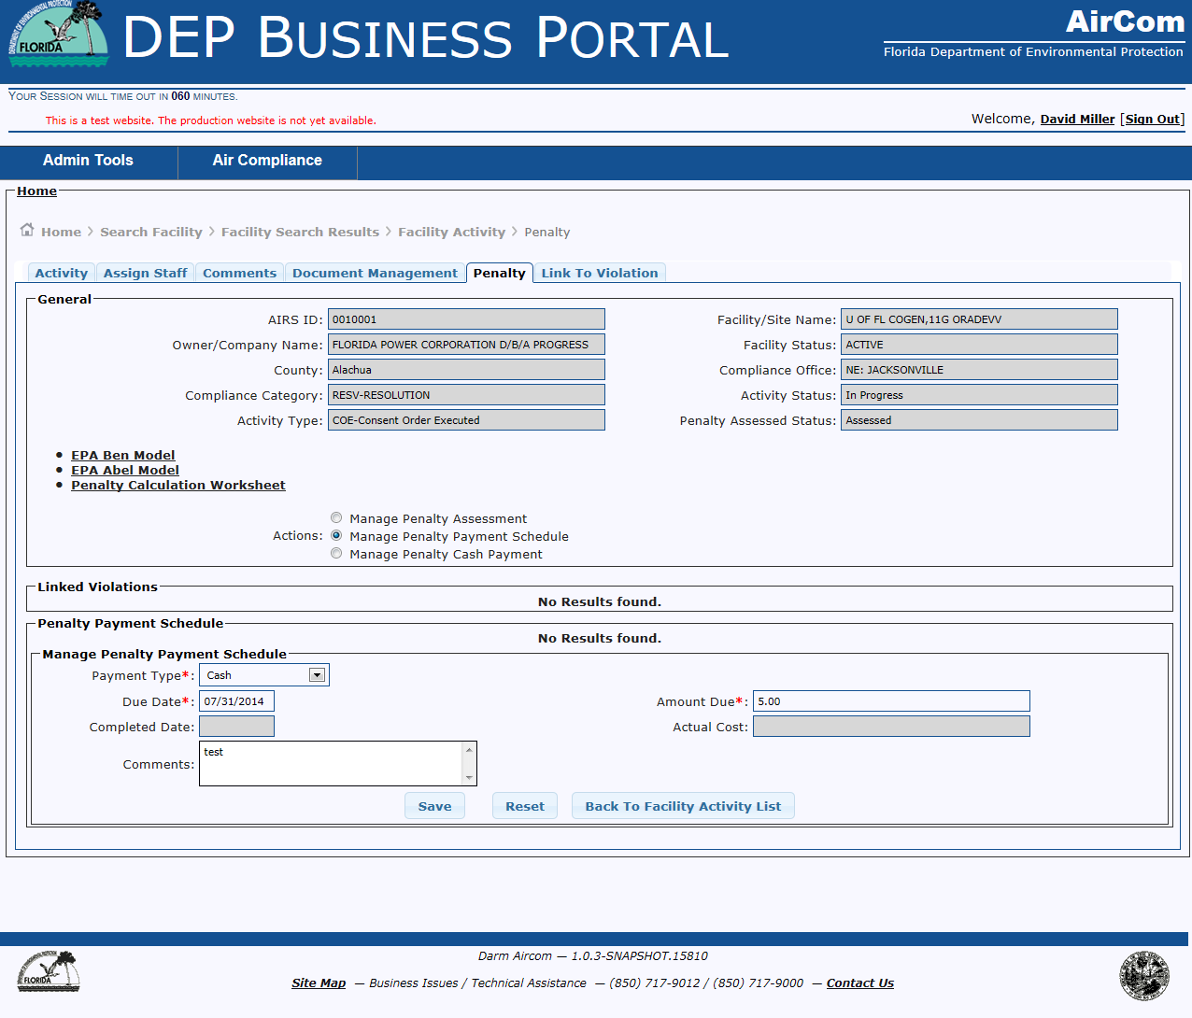
Penalty Tab – Manage Penalty Payment Schedule

Slide 26
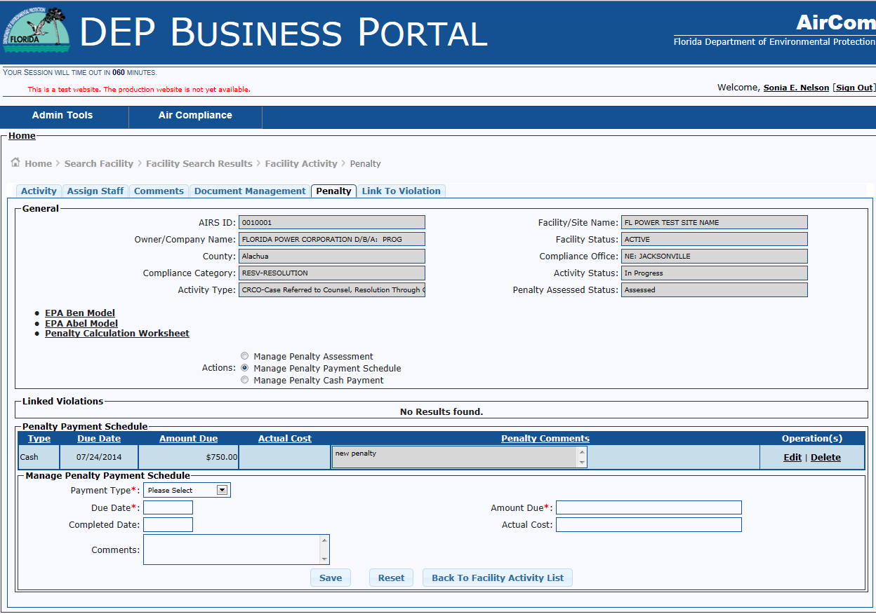
Penalty Tab – Manage Penalty Payment Schedule Grid

Slide 27
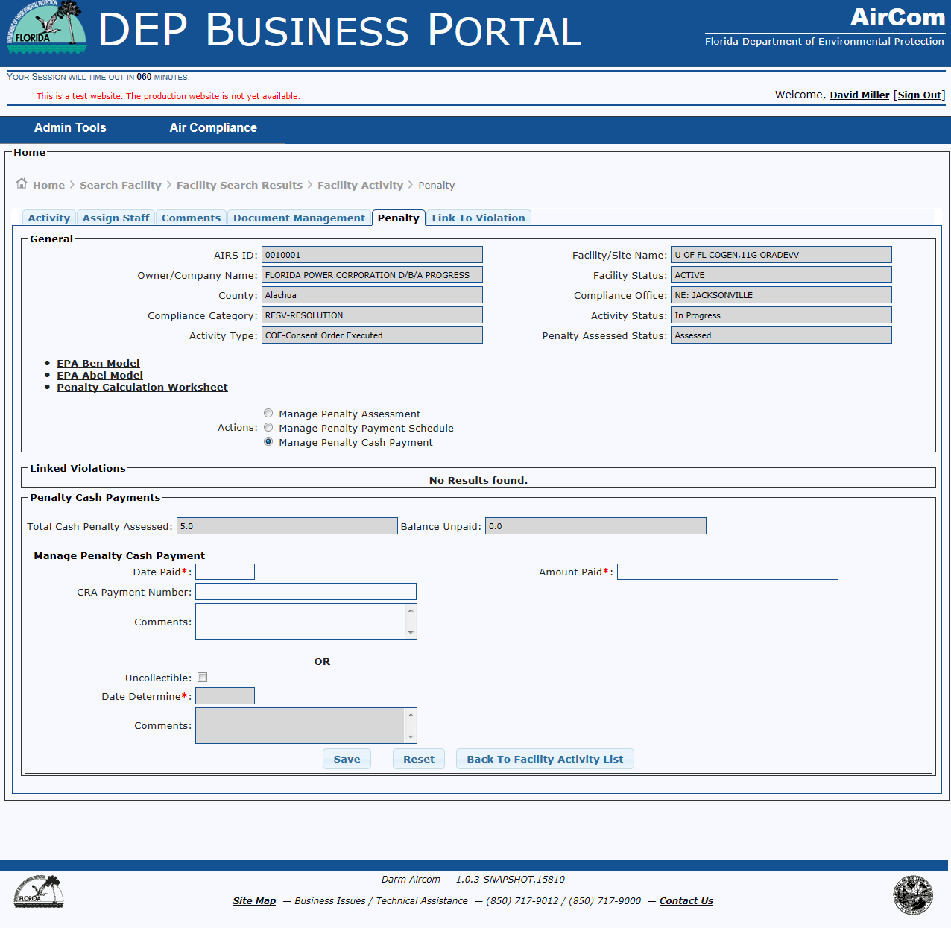
Penalty Tab – Manage Penalty Cash Payment

Slide 28
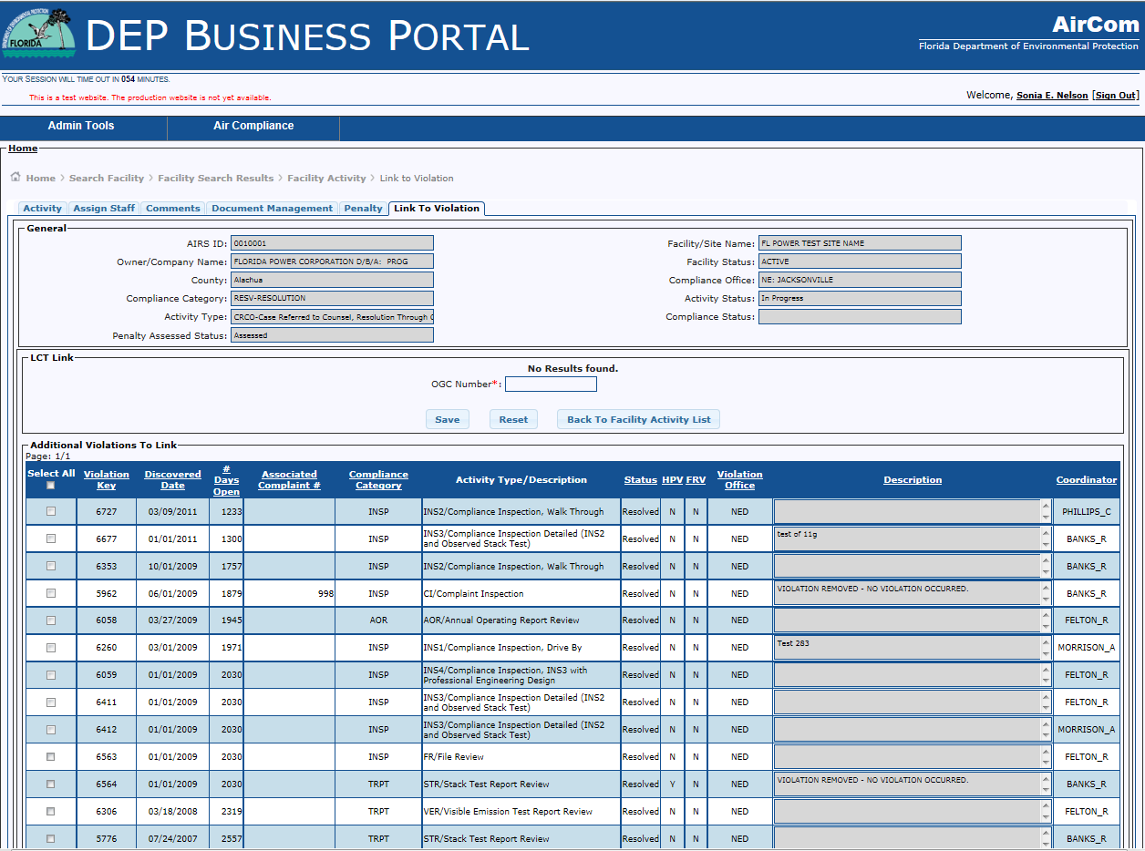
Link to Violation Tab
Select existing Violation for this RESV Activity by selecting the Violation from the Additional Violations to link grid.

Slide 29
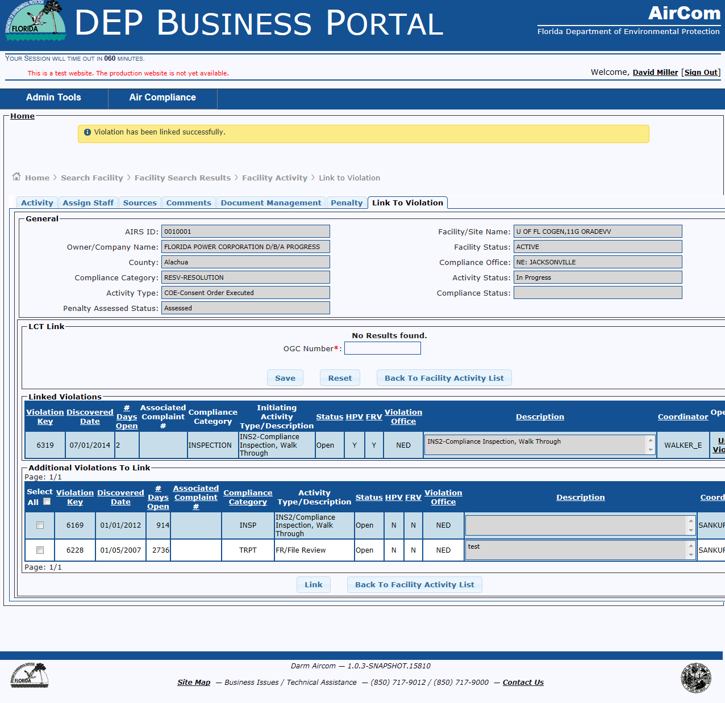
Link Violation to RESV Activity

Slide 30
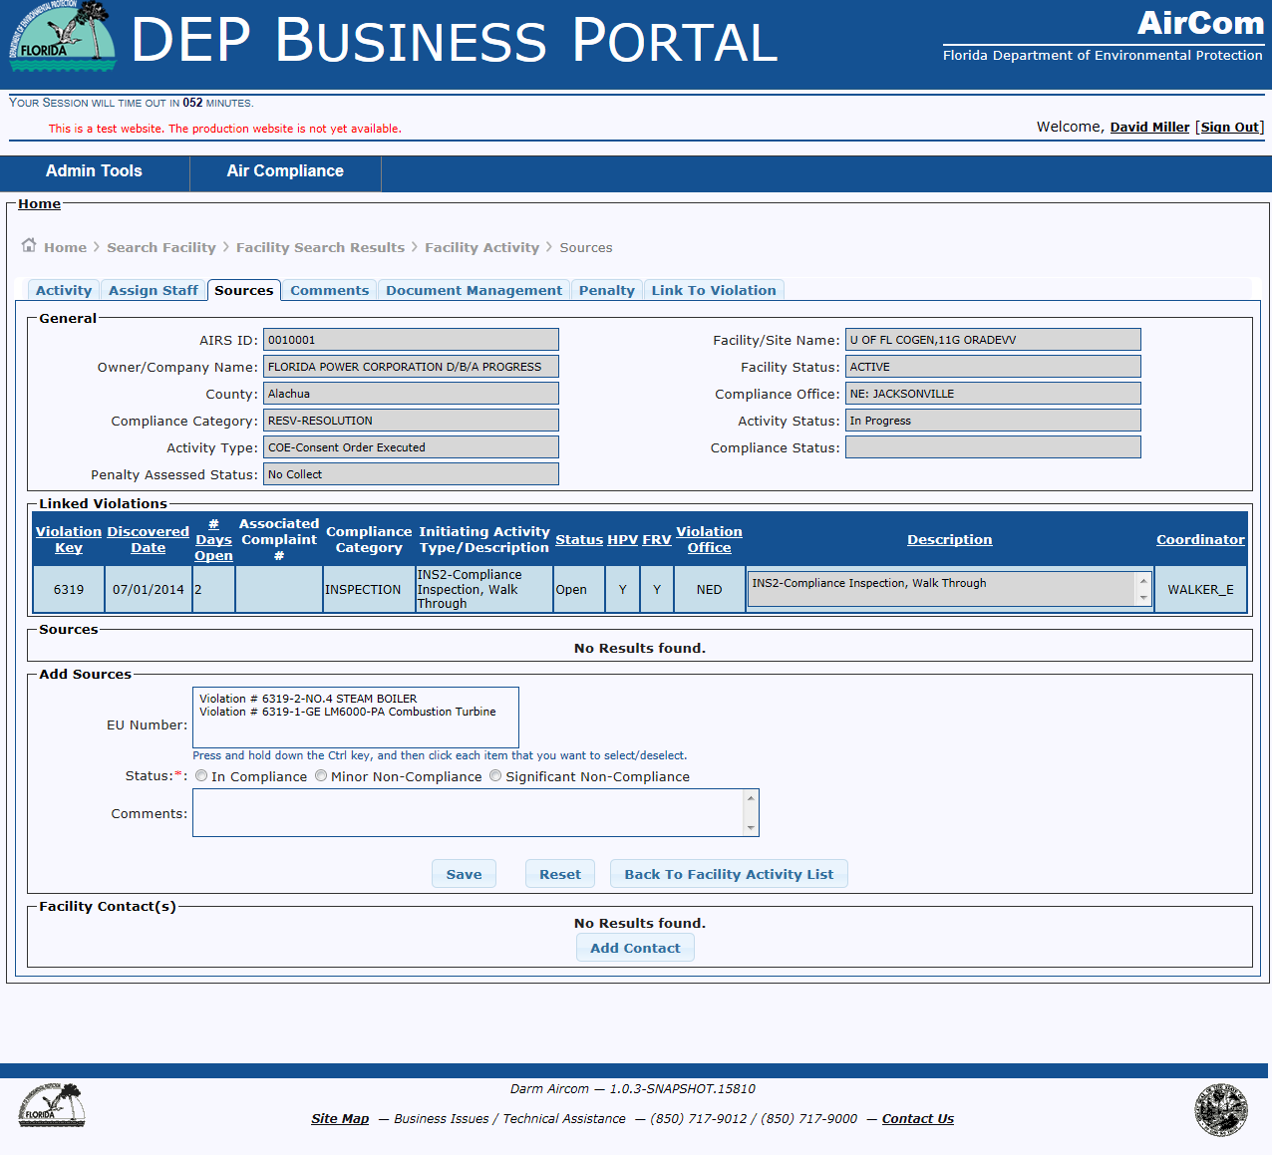
Sources Tab for linked violations

Slide 31
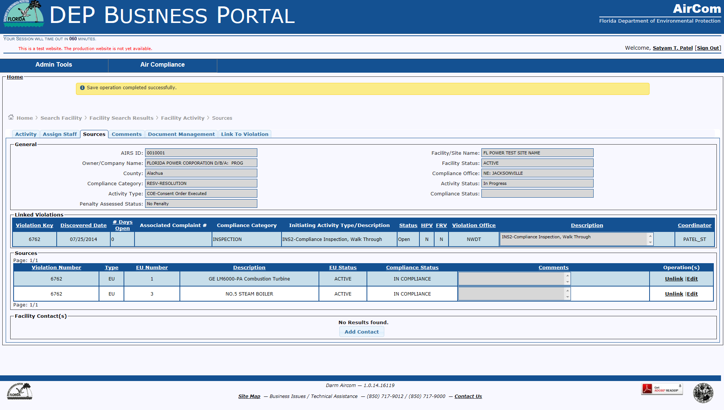
Sources Tab –sources (in compliance)

Slide 32
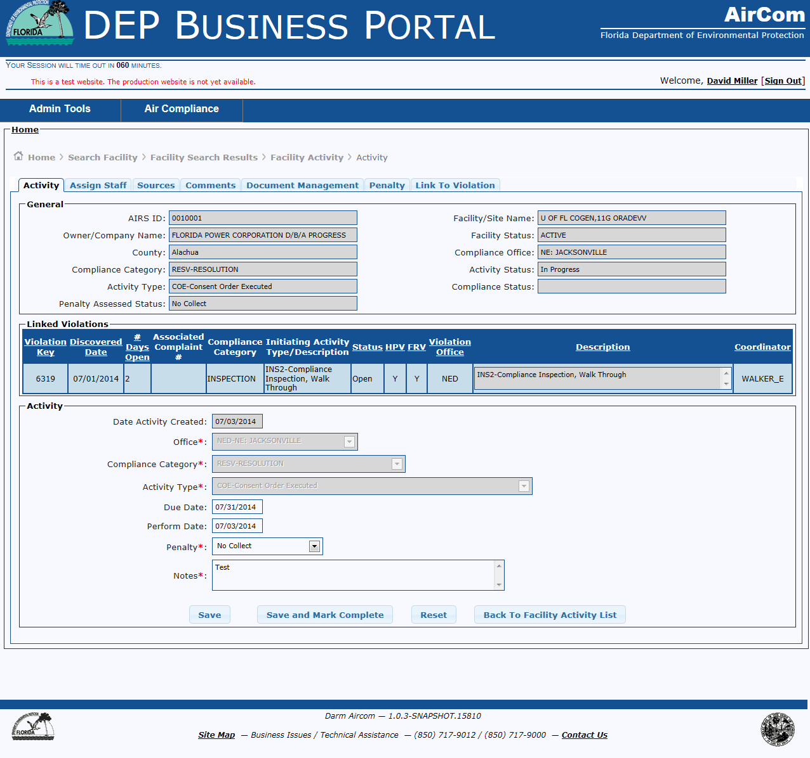
Resv Activity Tab – save and mark complete

Slide 33
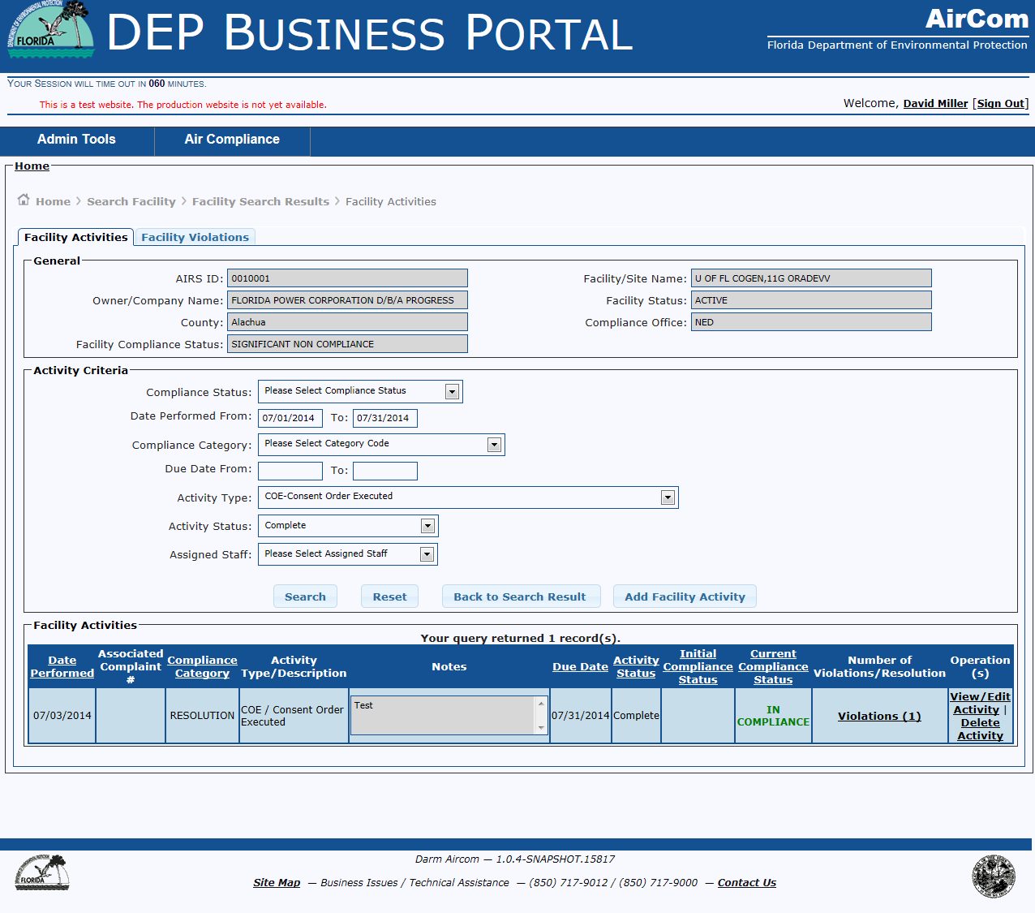
Facility Activities – Resolution Activity

Slide 34
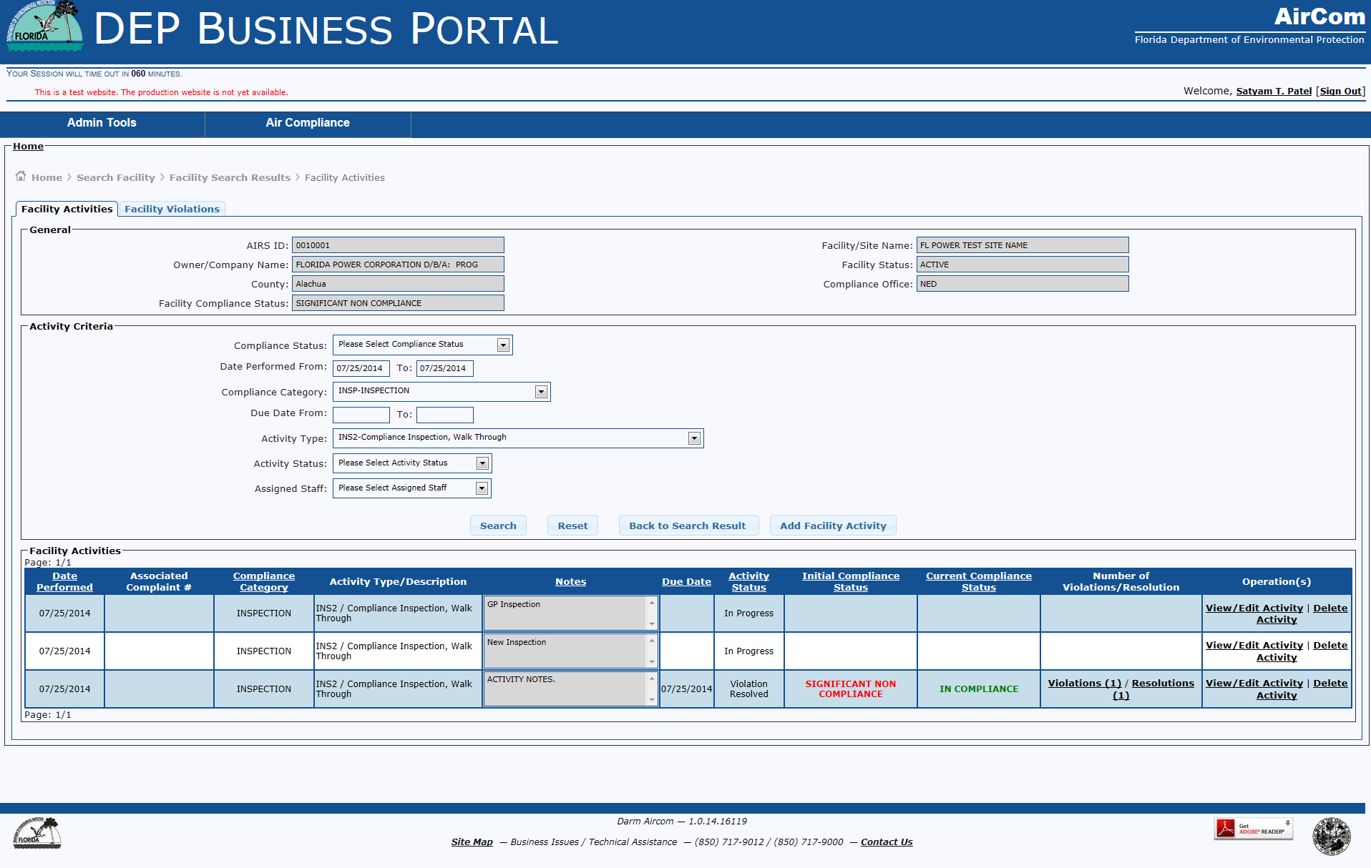
Facility Activities – Current Compliance Status

Slide 35

RESV / CCDL Activity

Slide 36
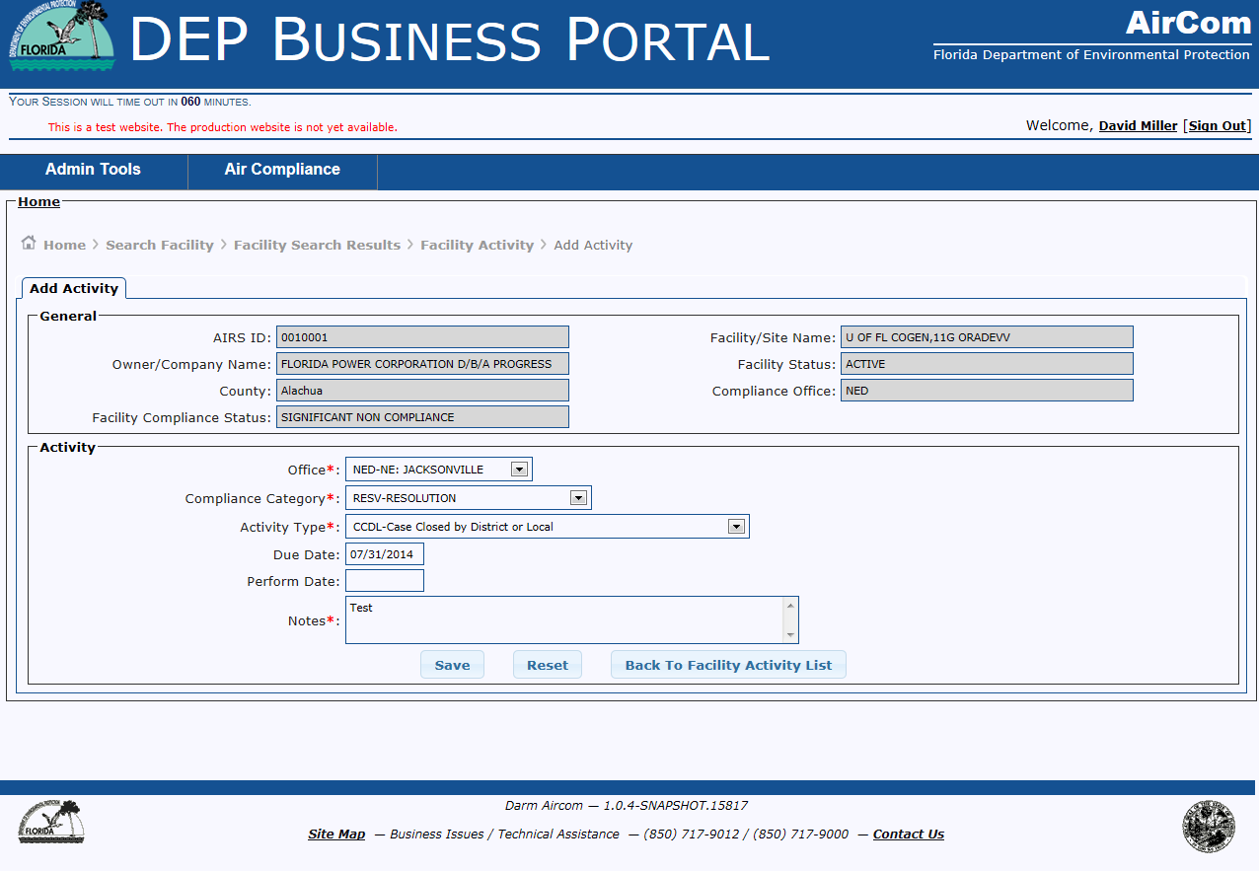
Add Activity – RESV - CCDL

Slide 37
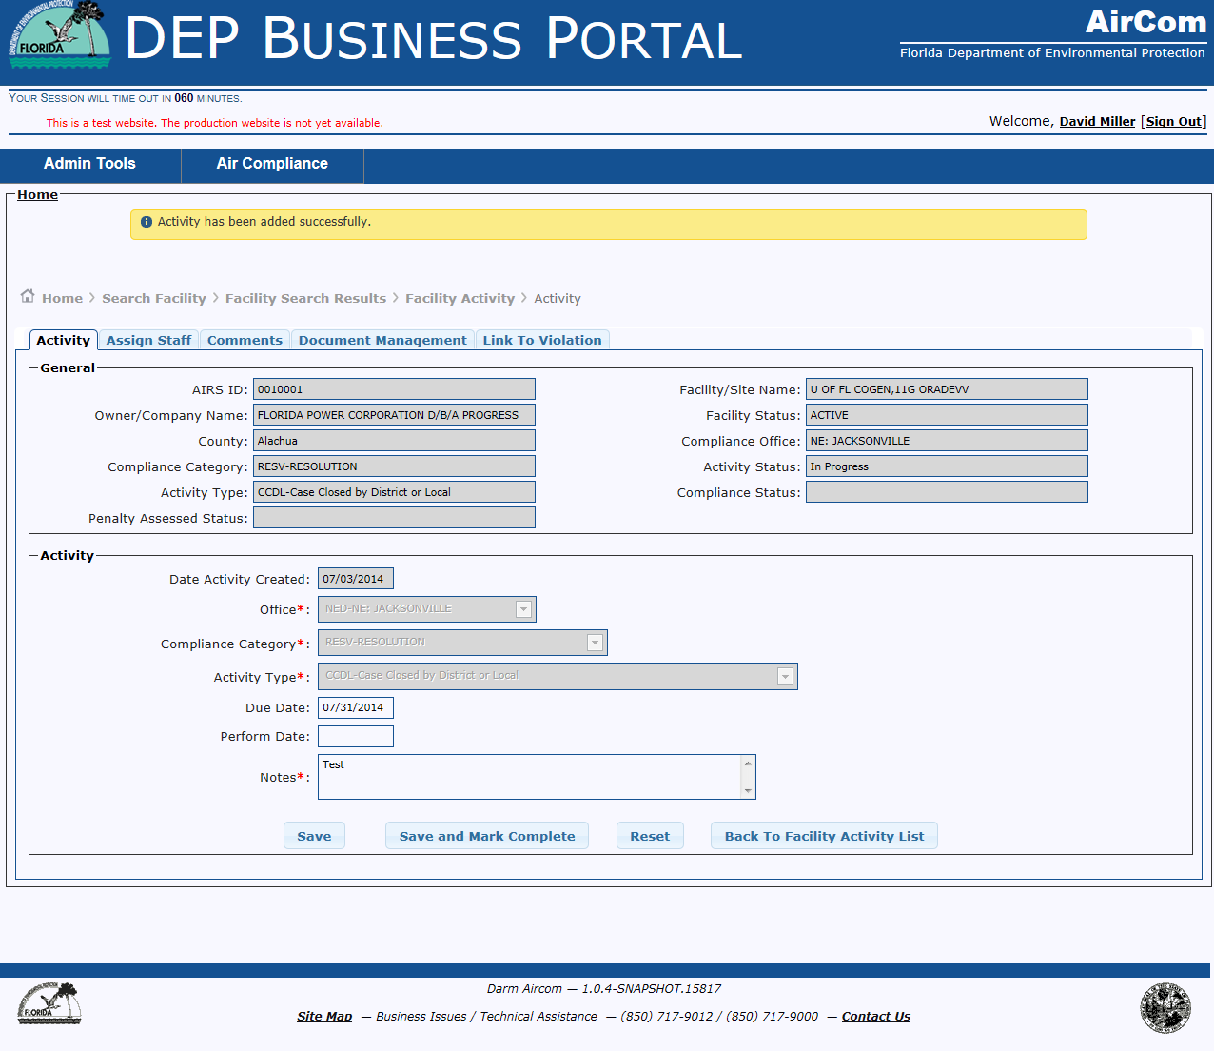
Successful Completion – Activity Added

Slide 38
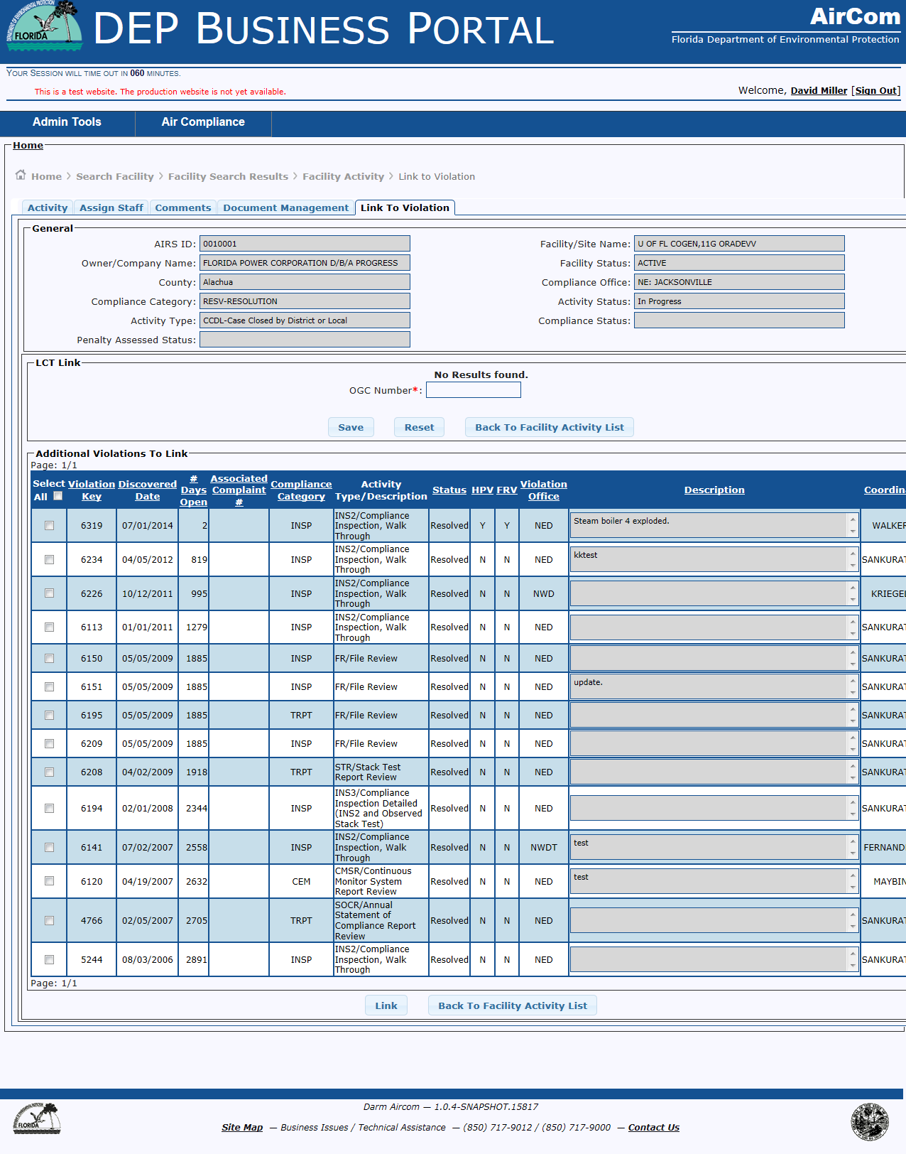
Linked to Violation Tab
Only one resolved violation can be linked. Select violation to link and click the link button

Slide 39
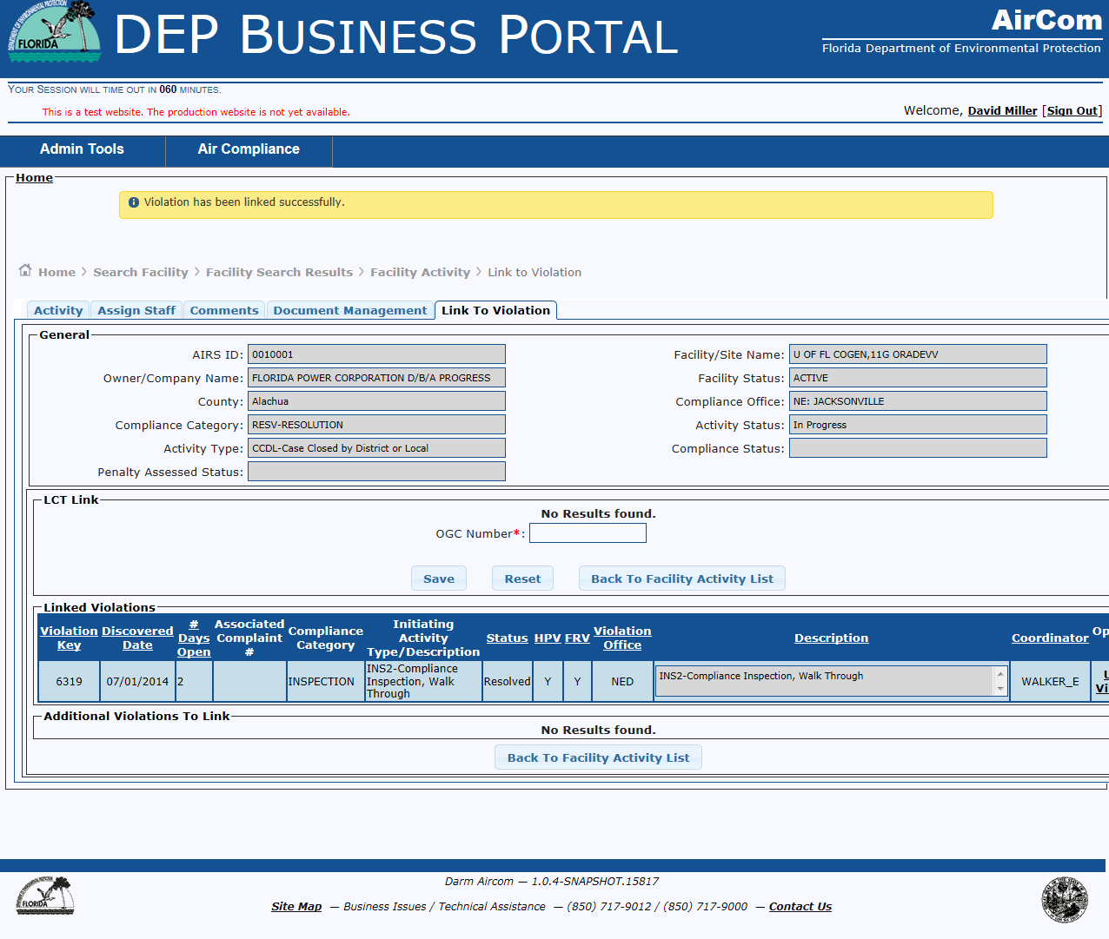
Successful Completion – Violation linked

Slide 40
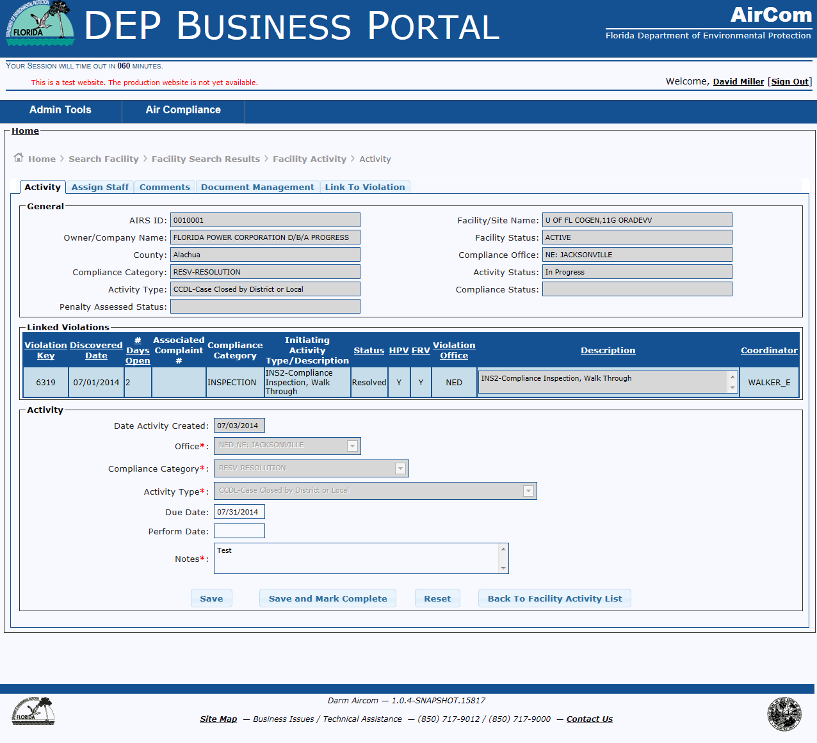
Edit Activity – CCDL – Save and Mark Complete

Slide 41
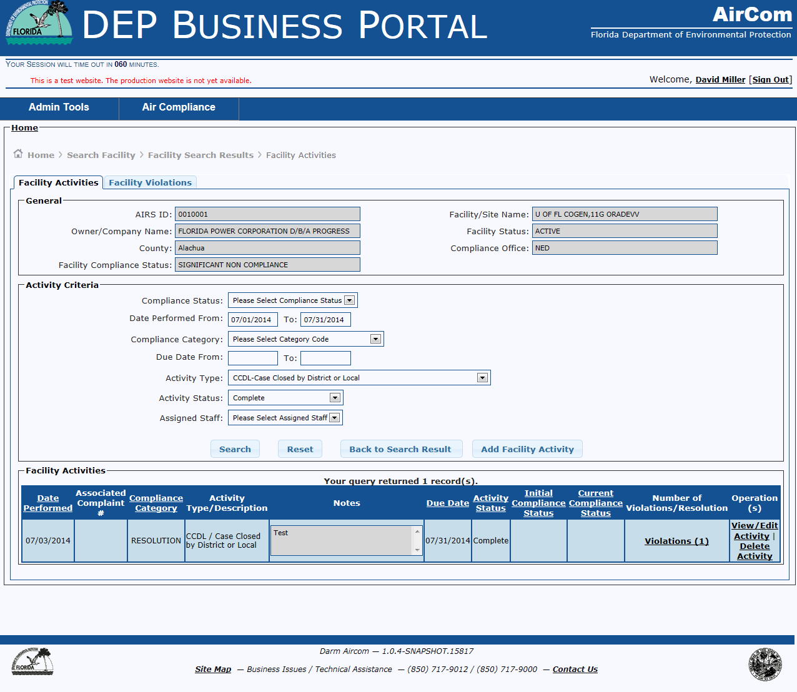
View/Edit Activity – Update Activity

Slide 42
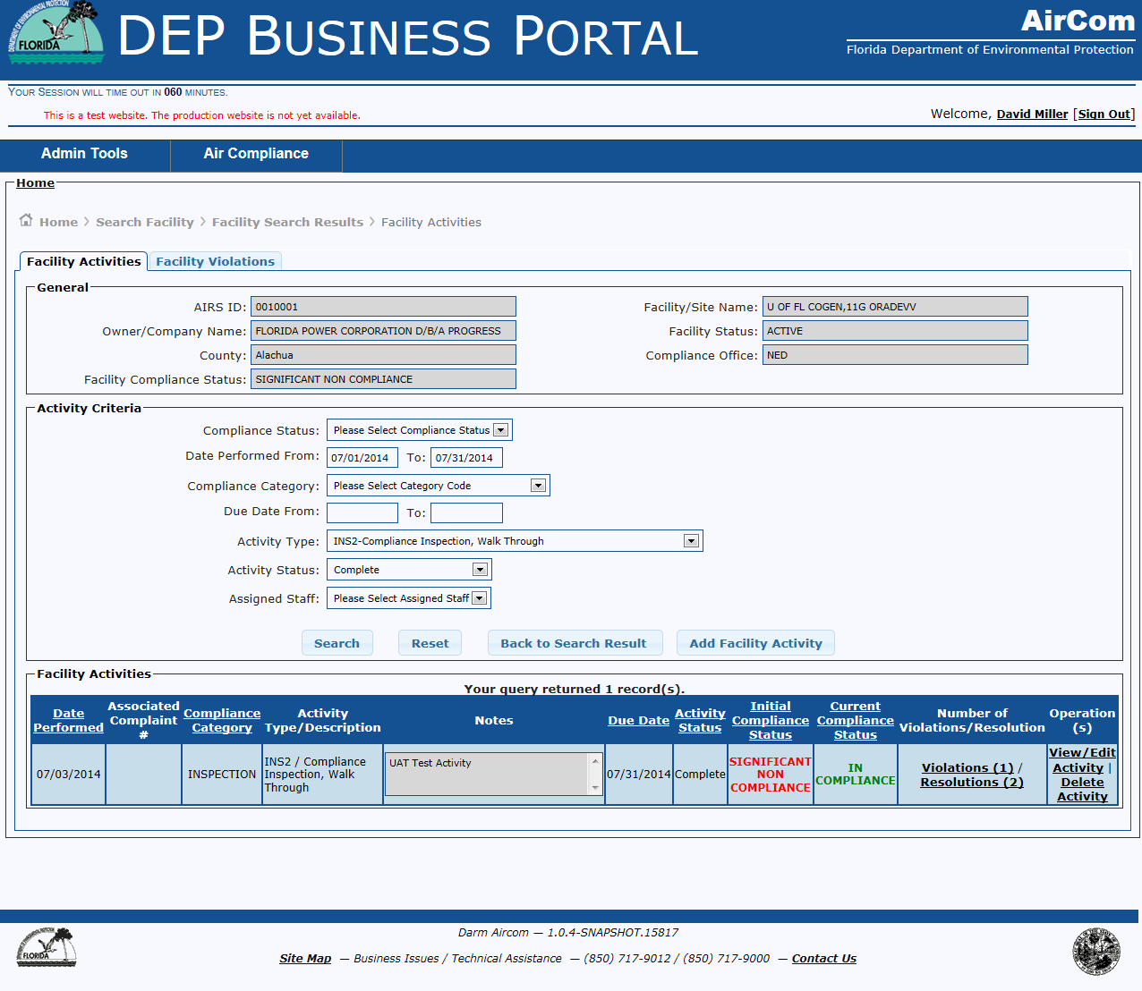
Initiating Activity – Marked Complete

Slide 43
Reports
Stack Test
Visible Emissions Method 22
Fuel Analysis
Miscellaneous Report
Continuous Emission Monitor

Slide 44
Stack Test Report

Slide 45
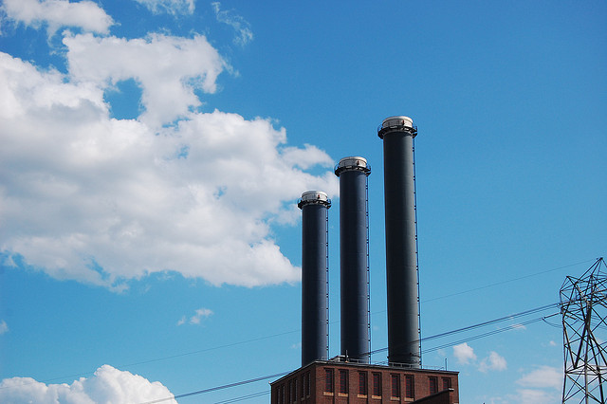
Where to Start…..
From the AirCom Welcome Screen:
Select Air Compliance Menu
Select Manage Facility
Select Search Facility
Select Compliance Details Hyperlink for the Facility
Select Add Facility Activity button
Add Activity data (* required fields) and click the Save button
Date Due or Date Performed must be completed
Compliance Category = TRPT – Test and Reports
Activity Type = STR – Stack Test Report Review
Click Save button
Select the Sources Tab
Add Regulated EU and click Verify Compliance button
Click on Stack Test Report Details tab

Slide 46
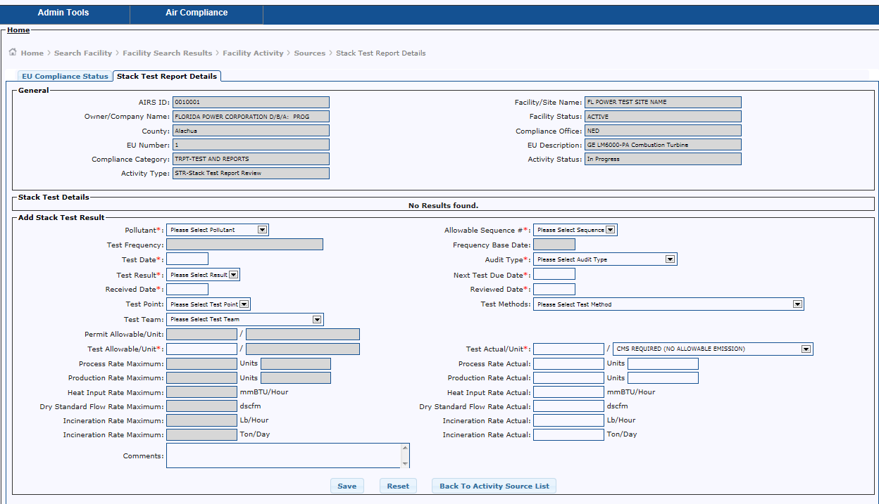
Stack Test Report Details Tab

Slide 47
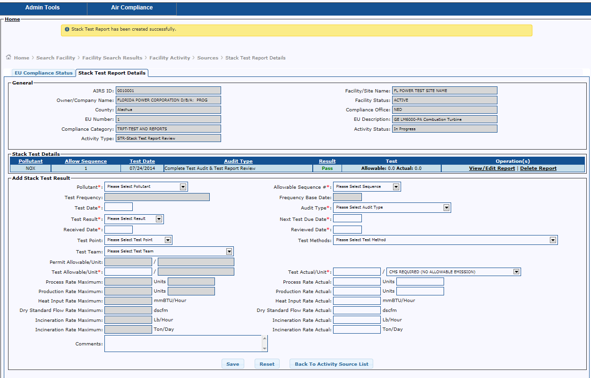
Successful addition – Str detail

Slide 48
Visible Emissions Method 22 Test Report

Slide 49
Where to Start…..
From the AirCom Welcome Screen:
Select Air Compliance Menu
Select Manage Facility
Select Search Facility
Select Compliance Details Hyperlink for the Facility
Select Add Facility Activity button
Add Activity data (* required fields) and click the Save button
Date Due or Date Performed must be completed
Compliance Category = TRPT – Test and Reports
Activity Type = VE22 – EPA Method 22 Report Review
Click Save button
Select the Sources Tab
Add Regulated EU and click Verify Compliance button
Click on Visible Emission Method 22 Test Report Details tab

Slide 50
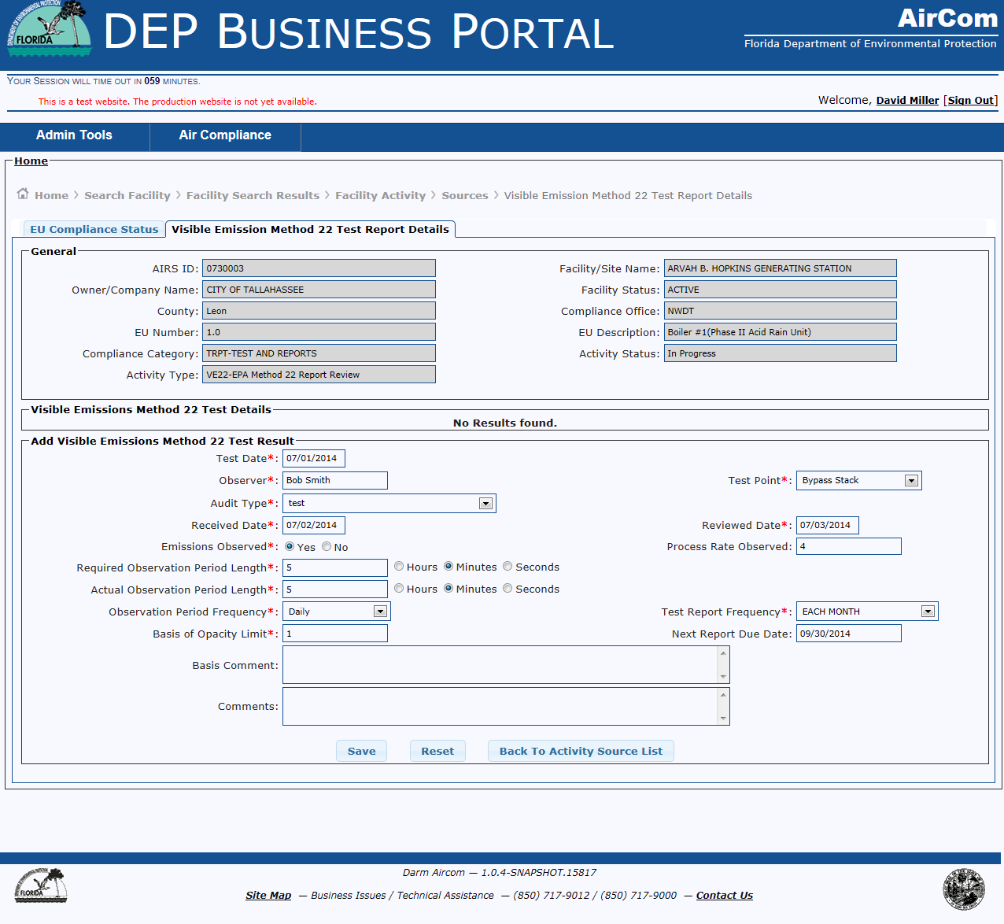
Visible emission method 22 test report details tab

Slide 51
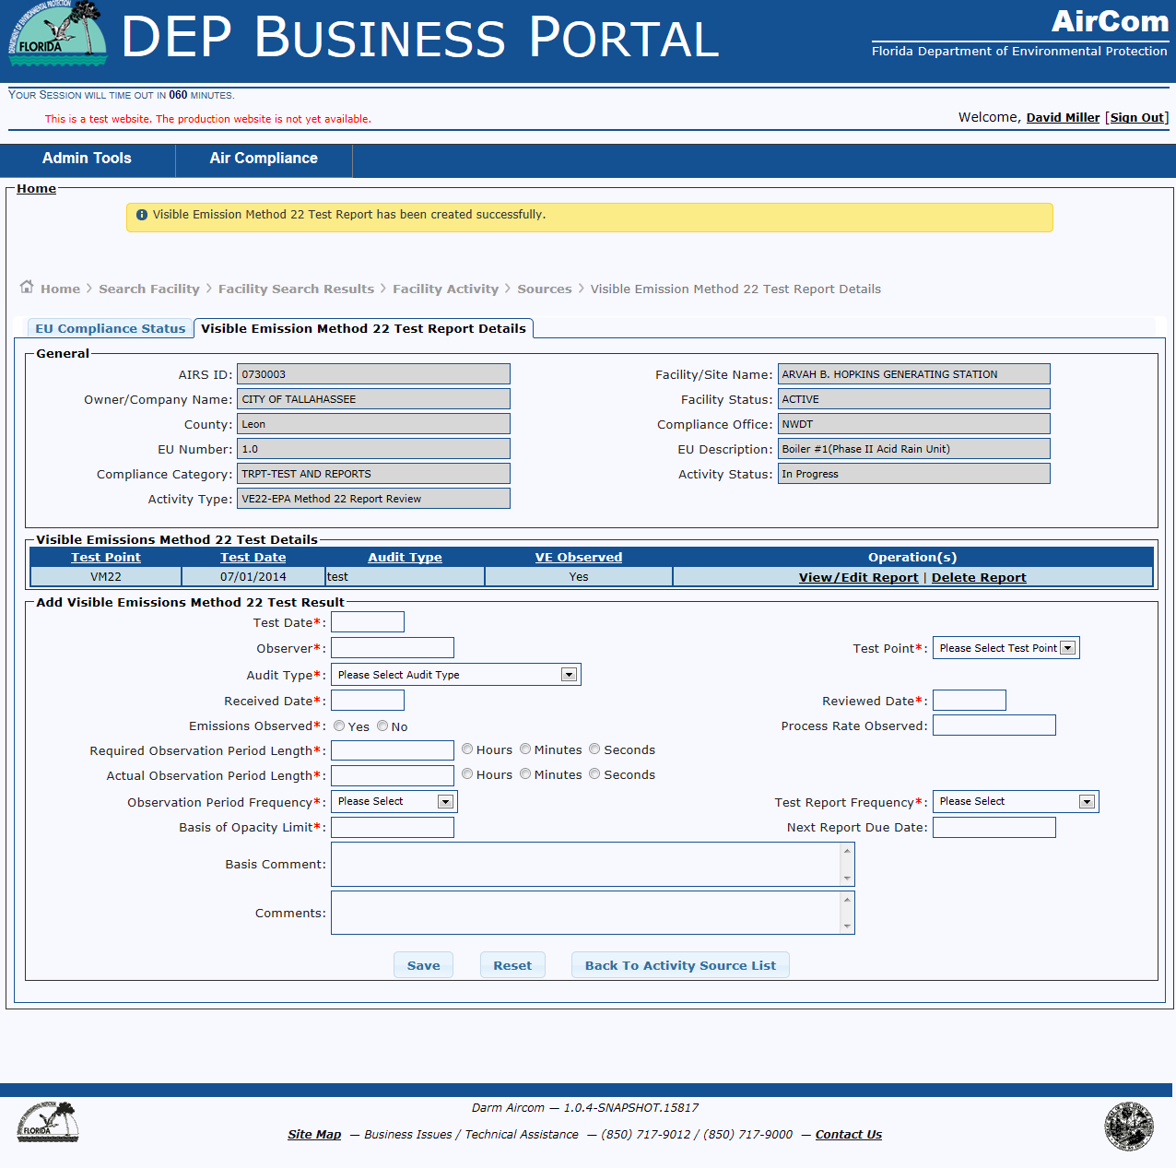
Successful addition – VM22 report details

Slide 52
Fuel Analysis Test Report

Slide 53
Where to Start…..
From the AirCom Welcome Screen:
Select Air Compliance Menu
Select Manage Facility
Select Search Facility
Select Compliance Details Hyperlink for the Facility
Select Add Facility Activity button
Add Activity data (* required fields) and click the Save button
Date Due or Date Performed must be completed
Compliance Category = TRPT – Test and Reports
Activity Type = FAR – Fuel Analysis Report
Click Save button
Select the Sources Tab
Add Regulated EU and click Verify Compliance button
Click on Fuel Analysis Test Report tab

Slide 54
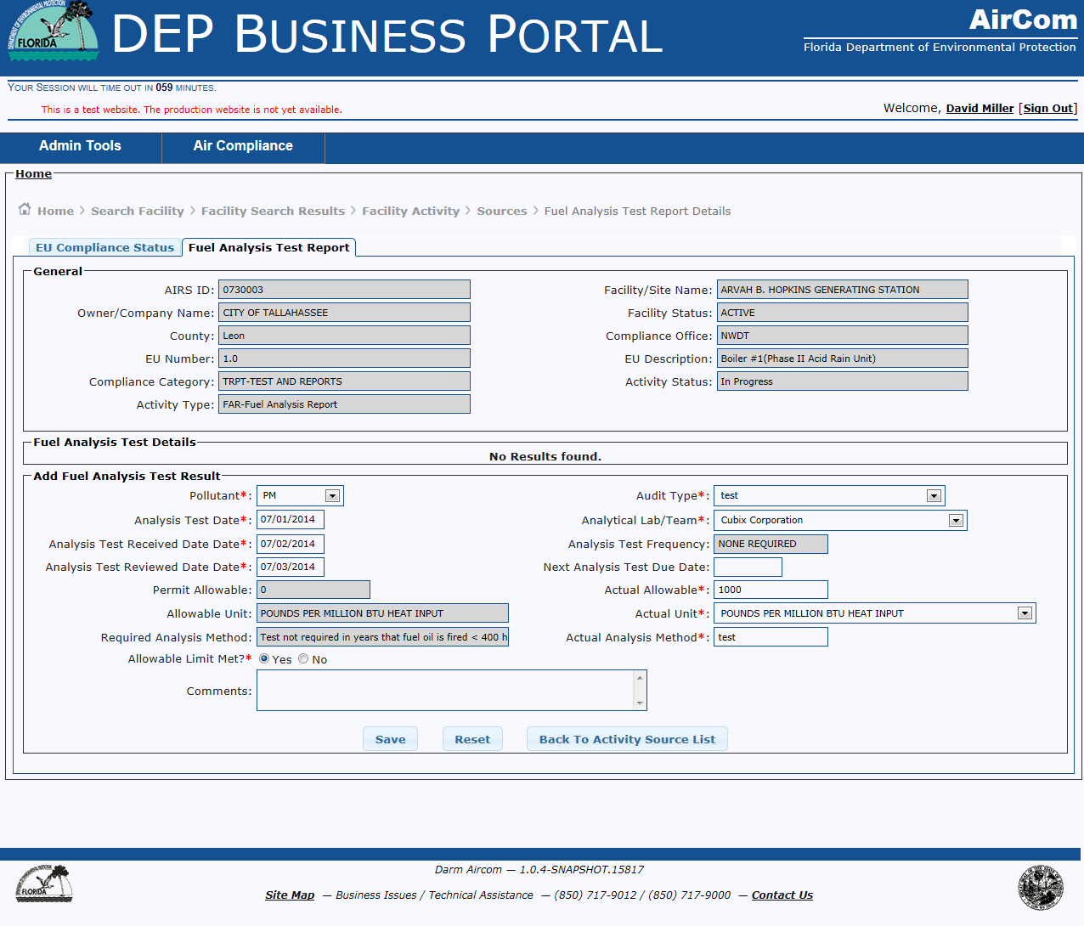
Fuel analysis test report tab

Slide 55
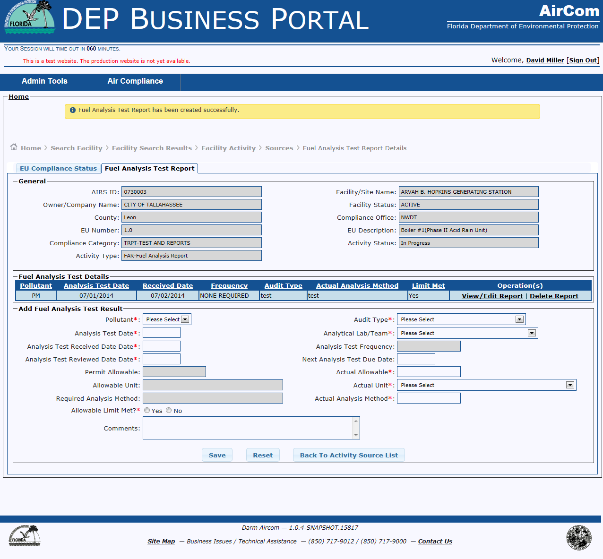
Successful addition – fuel analysis test report

Slide 56
Miscellaneous Report

Slide 57
Where to Start…..
From the AirCom Welcome Screen:
Select Air Compliance Menu
Select Manage Facility
Select Search Facility
Select Compliance Details Hyperlink for the Facility
Select Add Facility Activity button
Add Activity data (* required fields) and click the Save button
Date Due or Date Performed must be completed
Compliance Category = TRPT – Test and Reports
Activity Type = MRR – Miscellaneous Report Review
Click Save button
Select the Sources Tab
Add Regulated EU and click Verify Compliance button
Click on Report Review Details tab

Slide 58
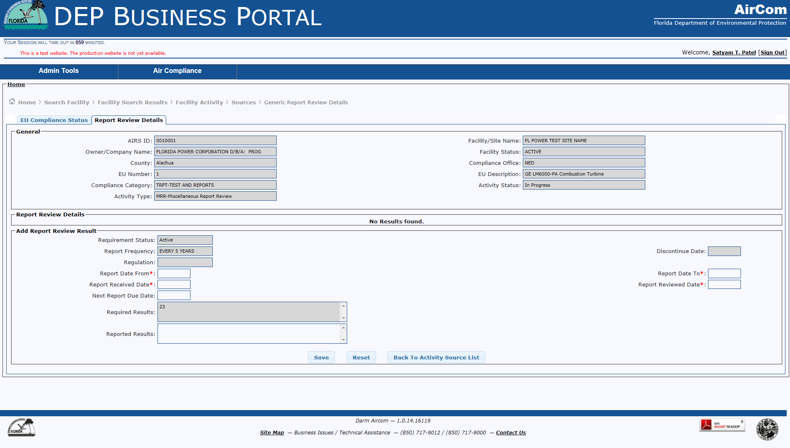
Report Review details tab

Slide 59
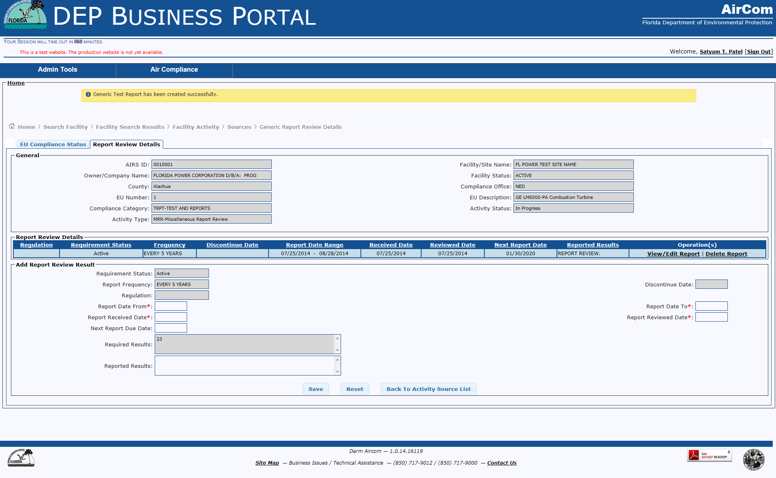
Successful addition – report review details tab

Slide 60
Continuous Emission Monitor Report

Slide 61
Where to Start…..
From the AirCom Welcome Screen:
Select Air Compliance Menu
Select Manage Facility
Select Search Facility
Select Compliance Details Hyperlink for the Facility
Select Add Facility Activity button
Add Activity data (* required fields) and click the Save button
Date Due or Date Performed must be completed
Compliance Category = CEM– Continuous Emission Monitor
Activity Type = CMSR – Continuous Monitor System Report Review
Click Save button
Select the Sources Tab
Add Regulated EU and click Verify Compliance button
Click on Continuous Monitor System Report Review tab

Slide 62
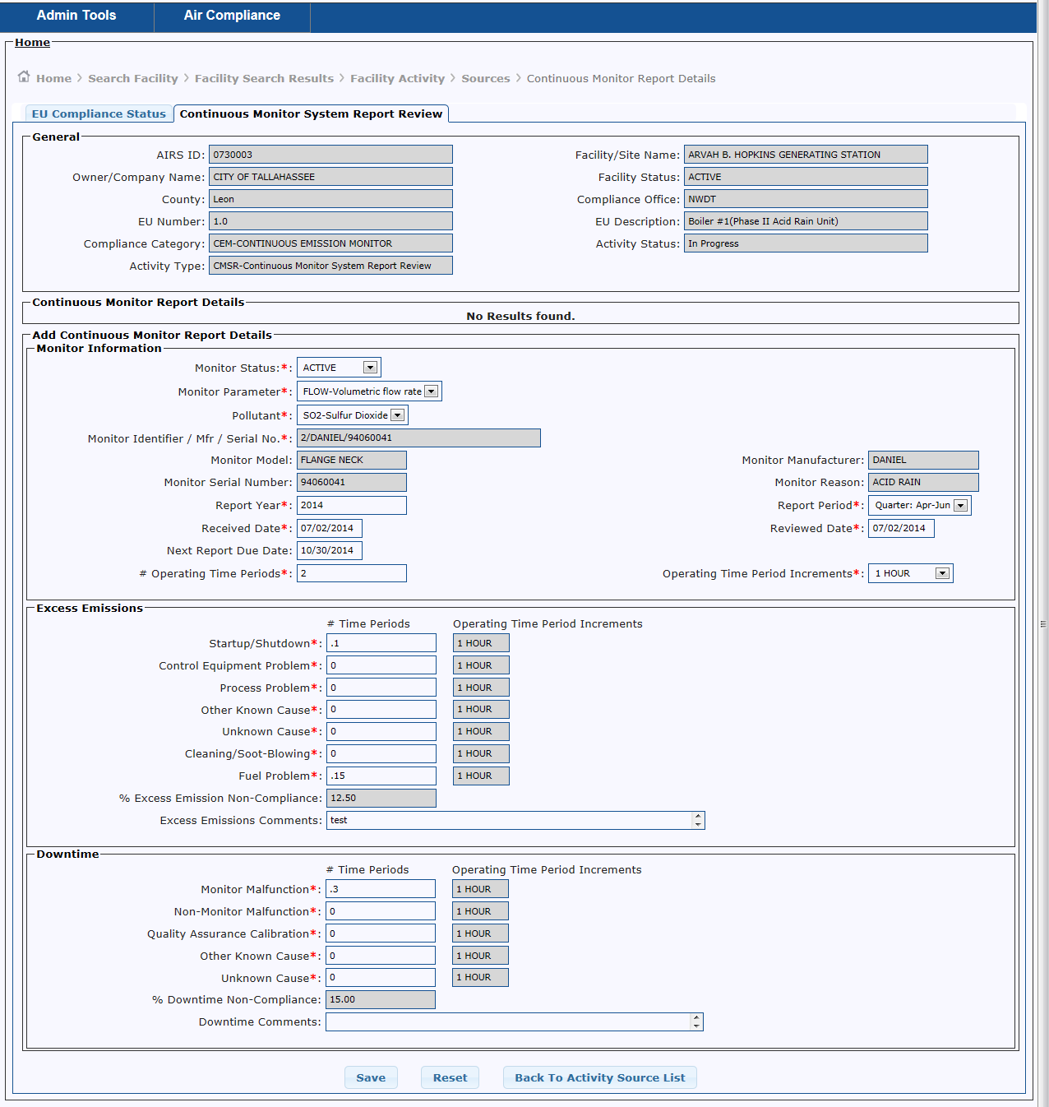
Continuous monitor system report review tab

Slide 63
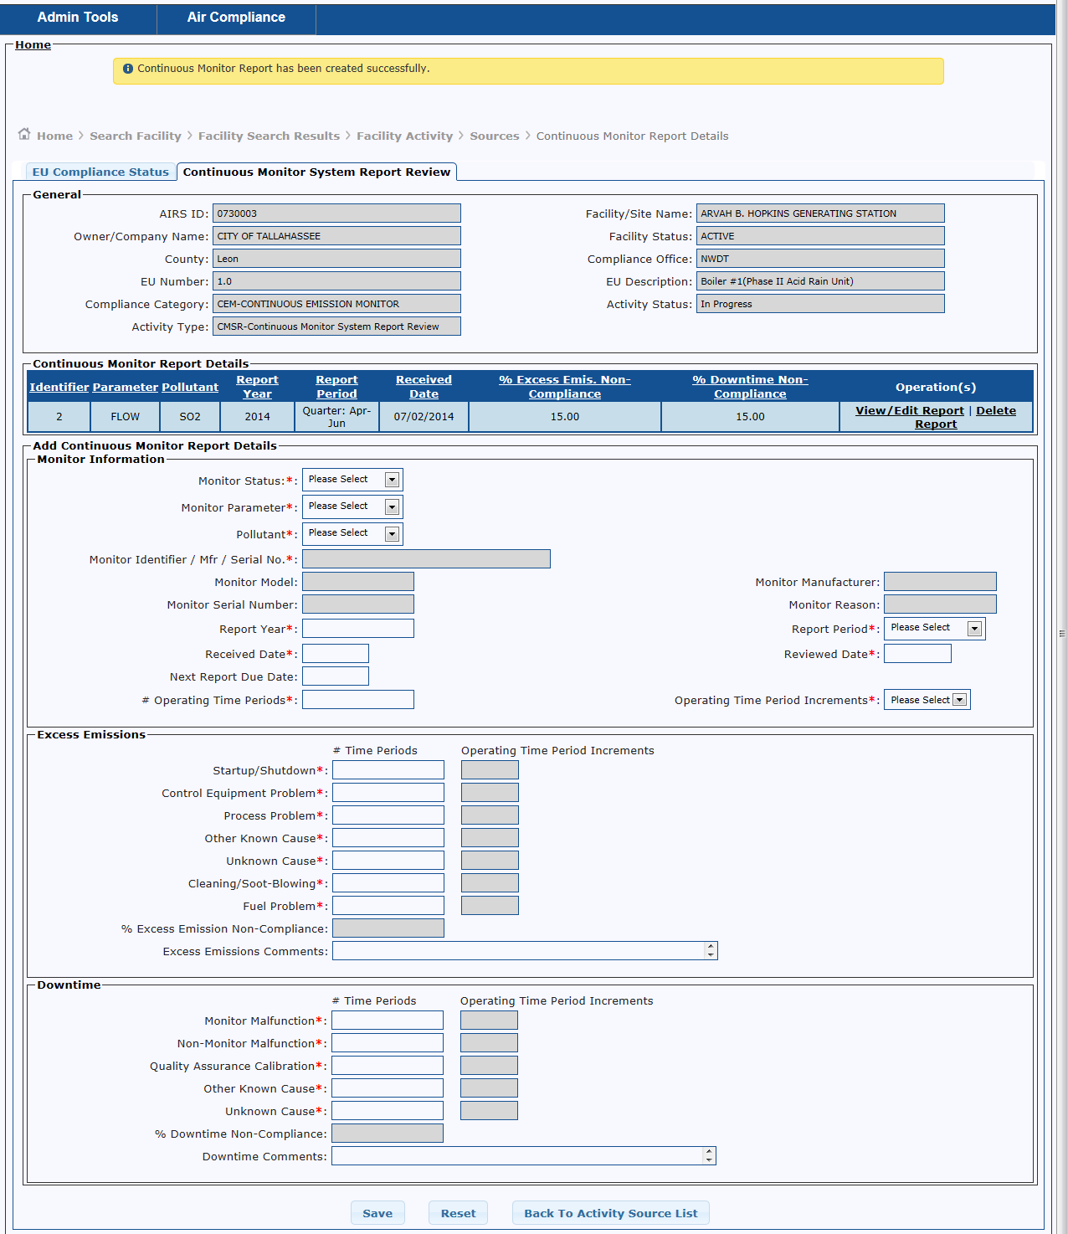
Successful addition – continuous monitor system report review

Slide 64
Next on the Agenda …
Manage Complaints
FCE Checklist
AirCom Production Timeline
Questions

Slide 65
Questions?

