Slide 1

AirCom
Training Session
Compliance Assurance and Inspection Tool Module
Session Date: August 2014
Presented by: Elizabeth Walker

Slide 2

Session Topics
Manage Complaints
FCE Checklist Activity
AirCom Production Schedule
Questions

Slide 3

Manage Complaints

Slide 4
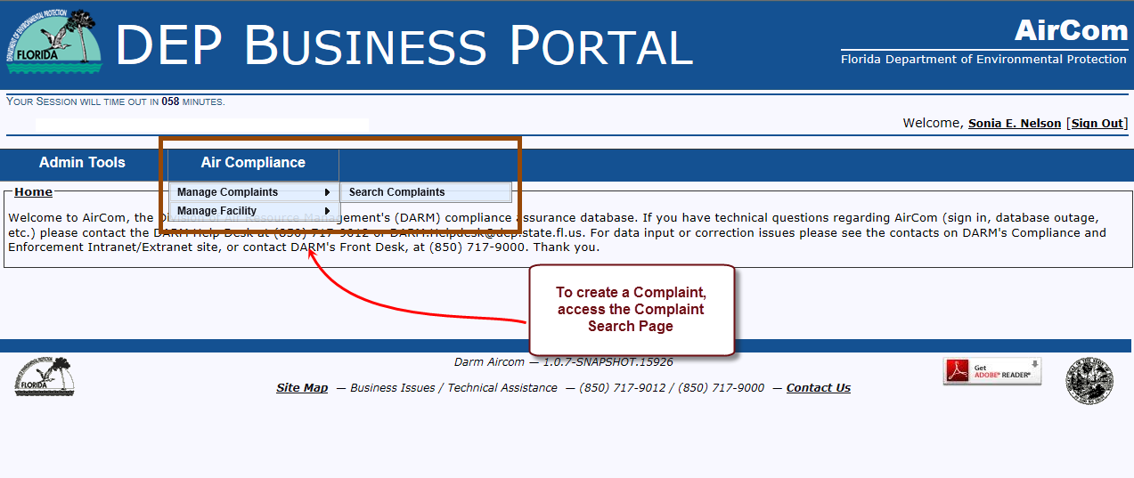
AirCom Welcome Page
Select Air Compliance Menu
Select Manage Complaint from the sub-menu
Select Search Complaint

Slide 5
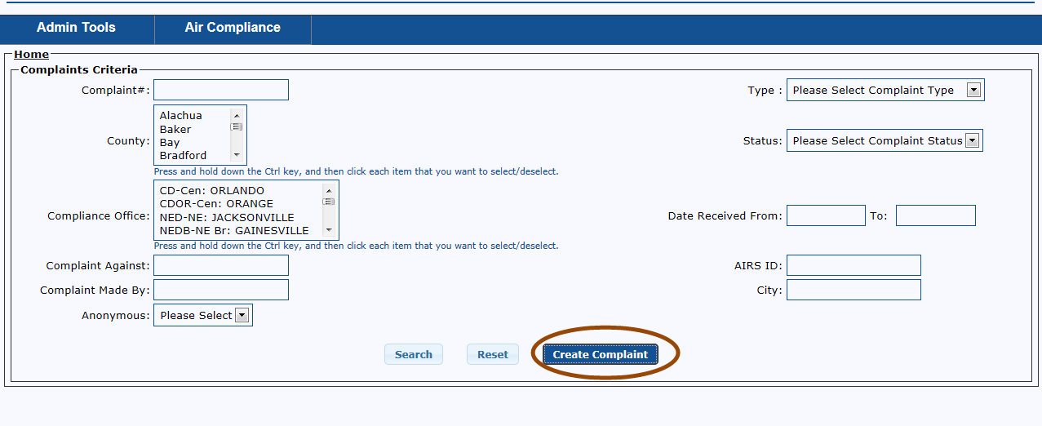
Create Complaint Button

Slide 6
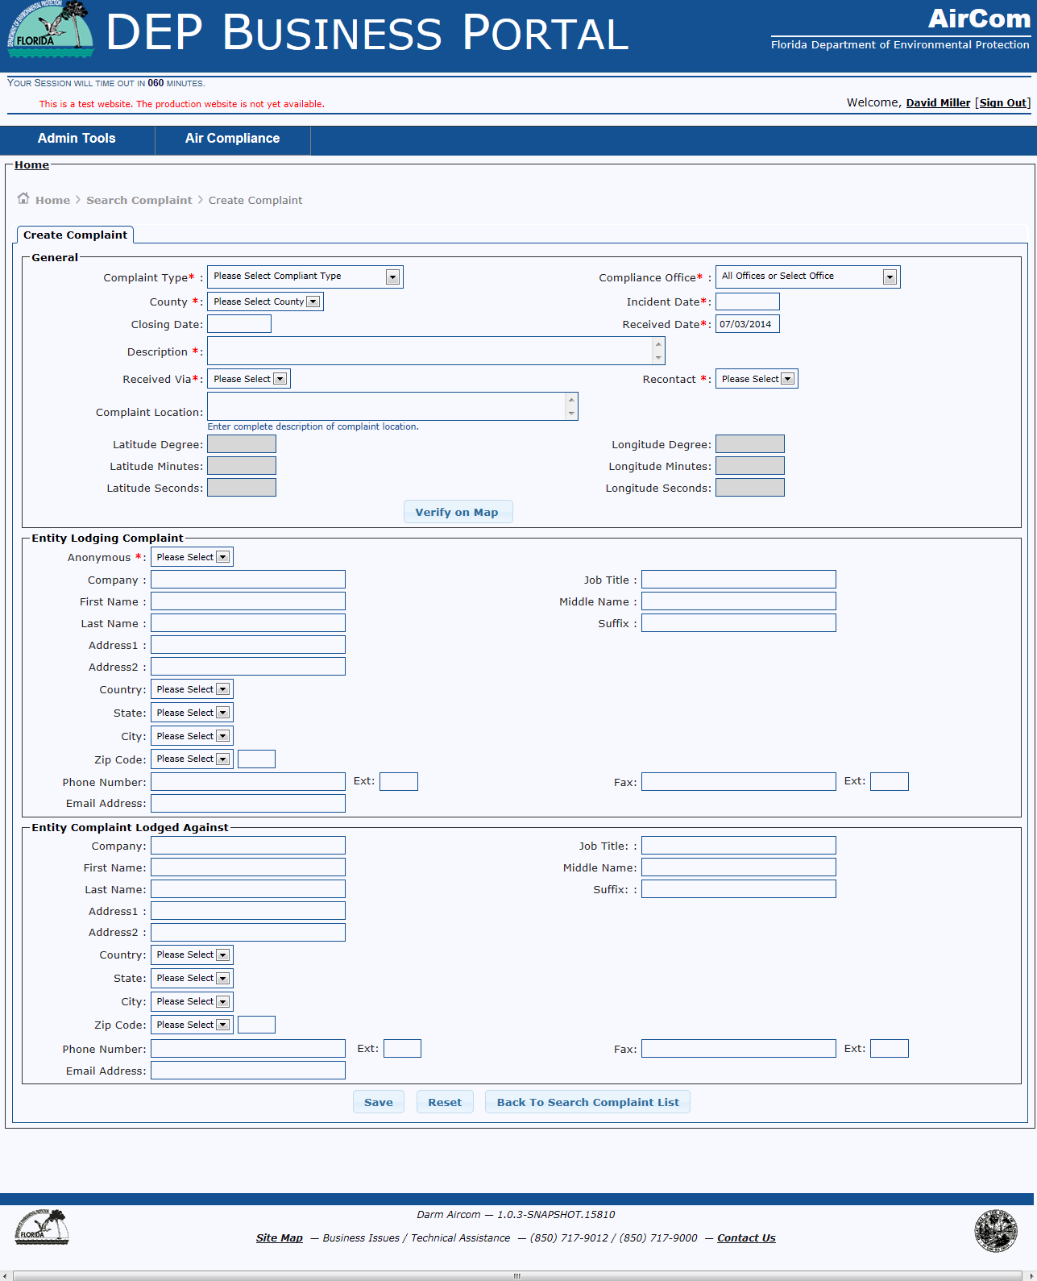
Create Complaint Page

Slide 7
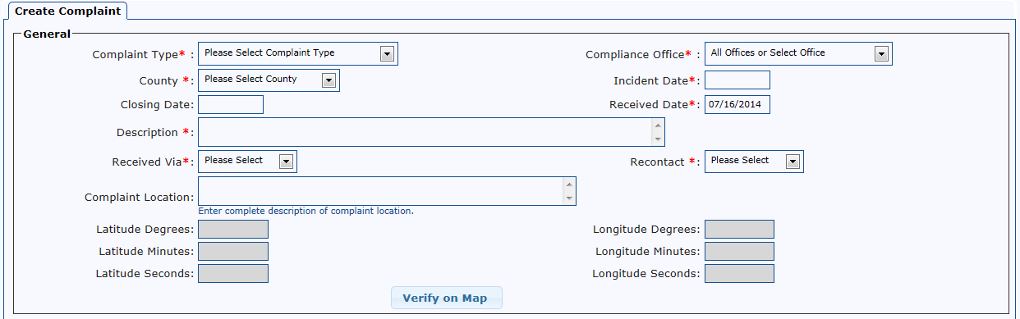
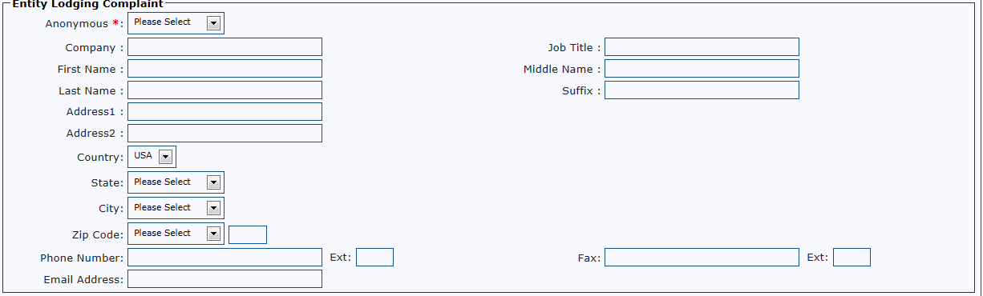

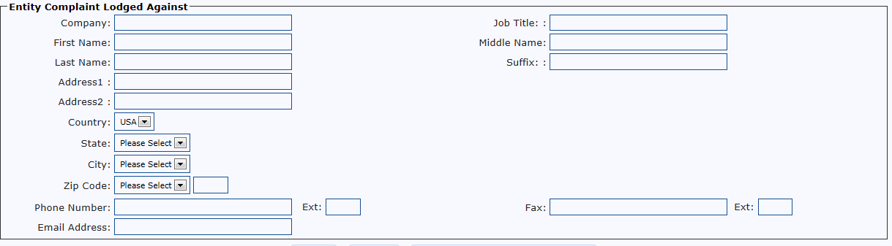
Create Complaint - Page Sections
General
Entity Lodging Complaint
Entity Complaint Lodged Against

Slide 8
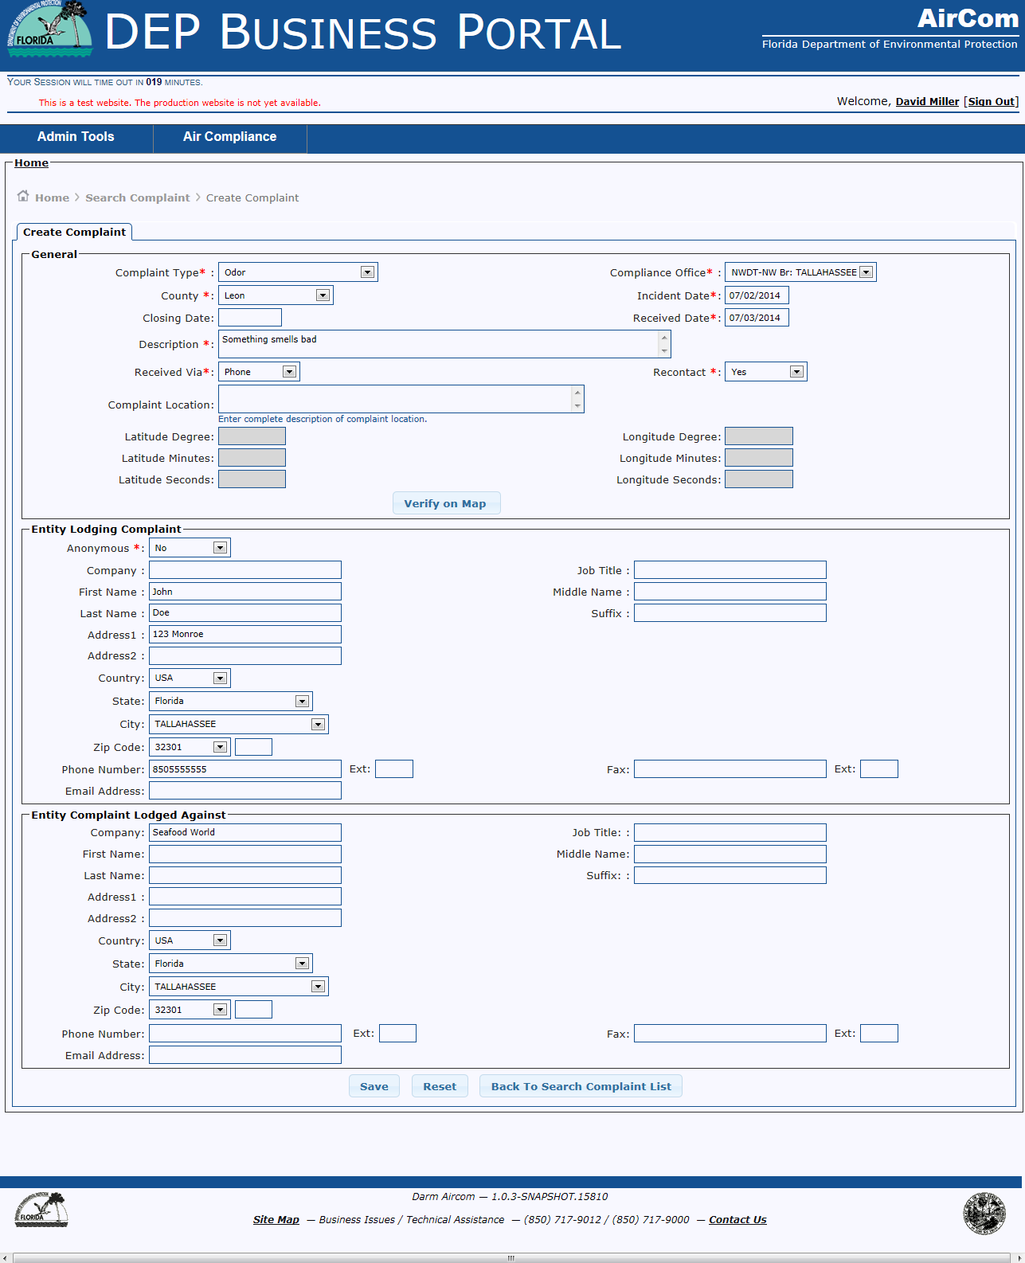
Create Complaint – Data Entry
Required Fields:
Complaint Type
Compliance Office
County
Received Date
Description
Received Via (Email, Fax, Letter, Other, Phone, Visit)
Recontact
Anonymous
Enter Required Data to Save complaint

Slide 9
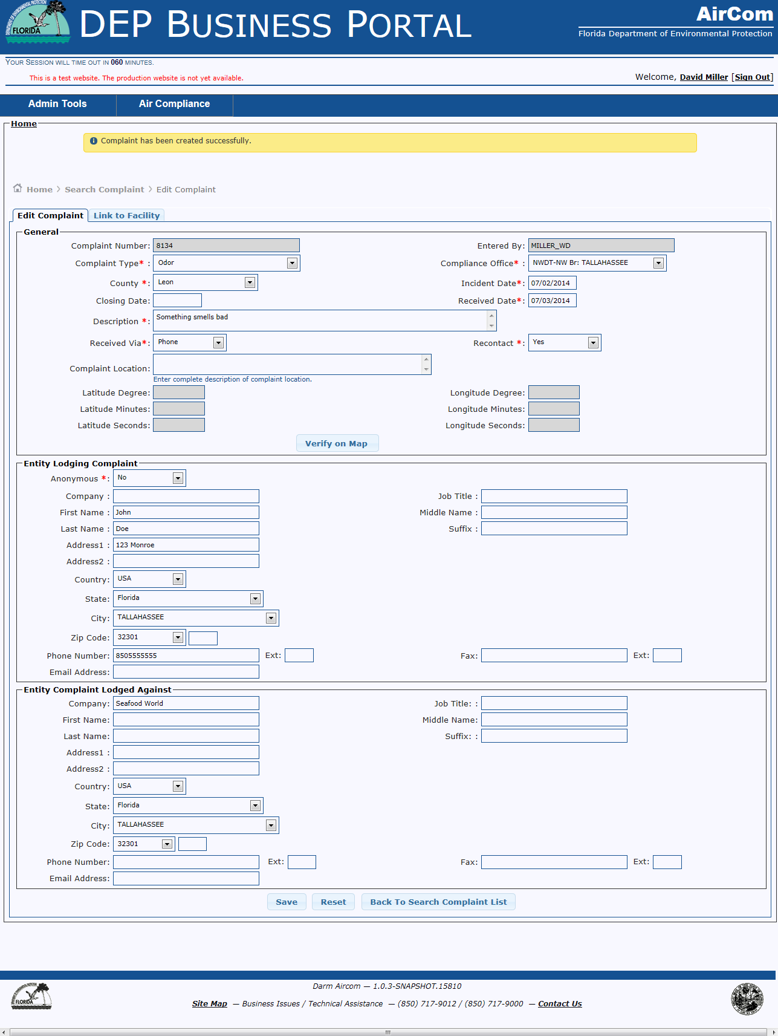
Complaint has been Created
To Link Complaint to a Facility, click the Link to Facility Tab.

Slide 10
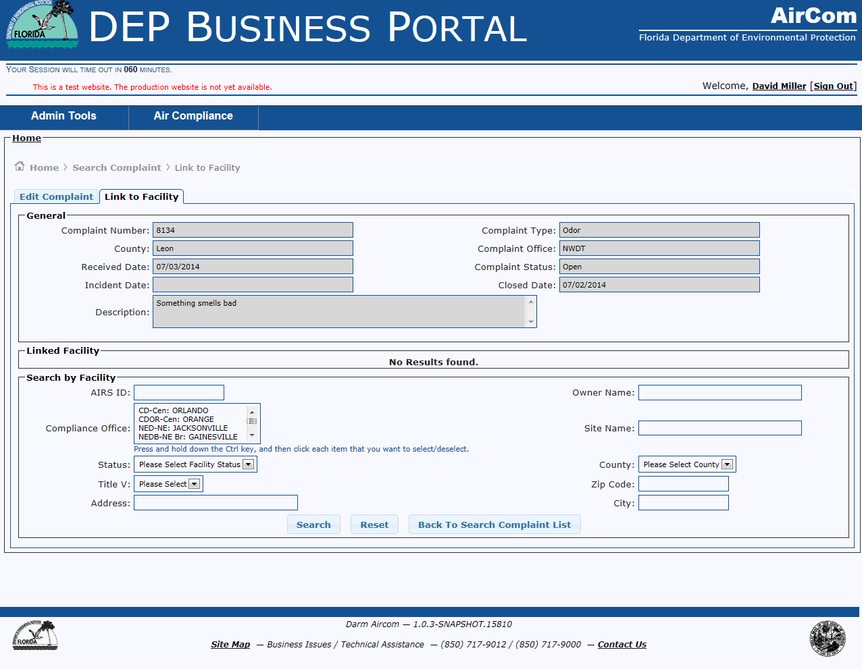
Link to Facility Tab
Use the Search by Facility section to locate the Facility the Complaint will link to.

Slide 11
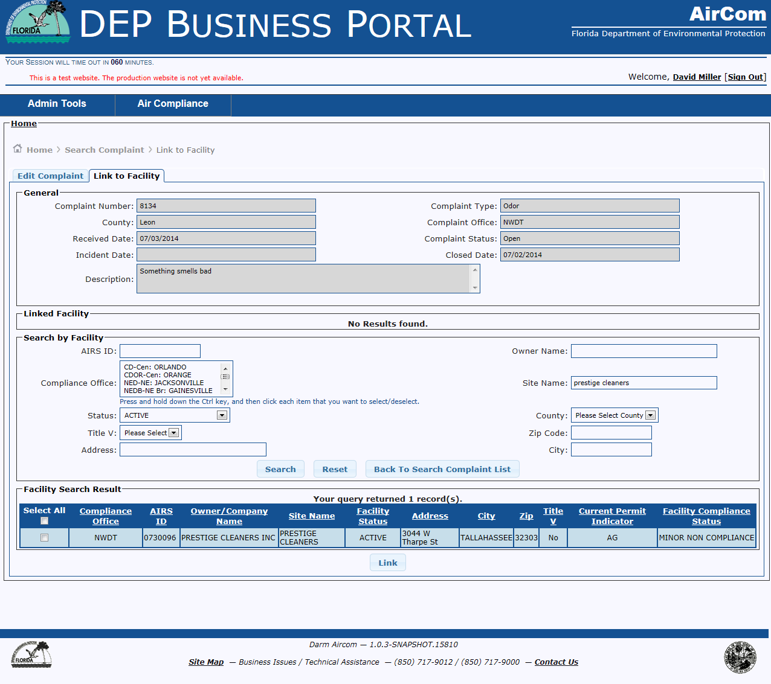
Facility Search Results Grid

Slide 12
Link Facility to Complaint
To link Complaint to Facility
Select the Facility
Click the link button

Slide 13
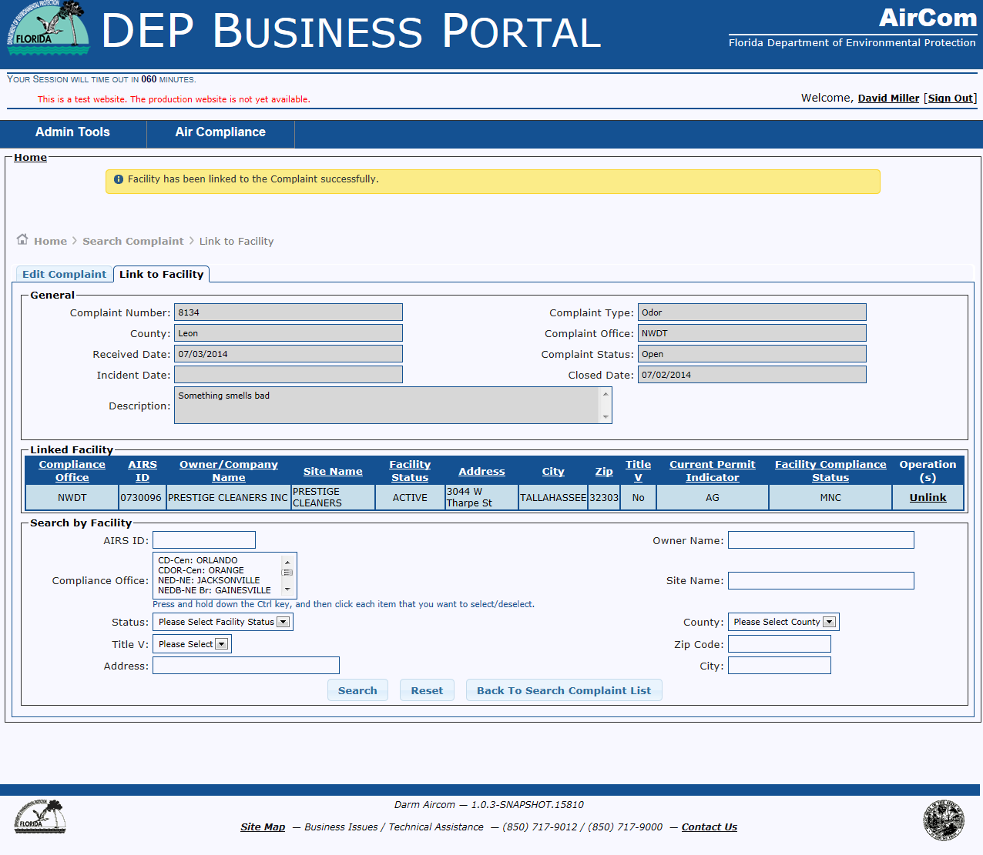
Successful Completion – Complaint is linked to Facility
To Add Complaint Activity, click the Back to Search Complaint List button

Slide 14
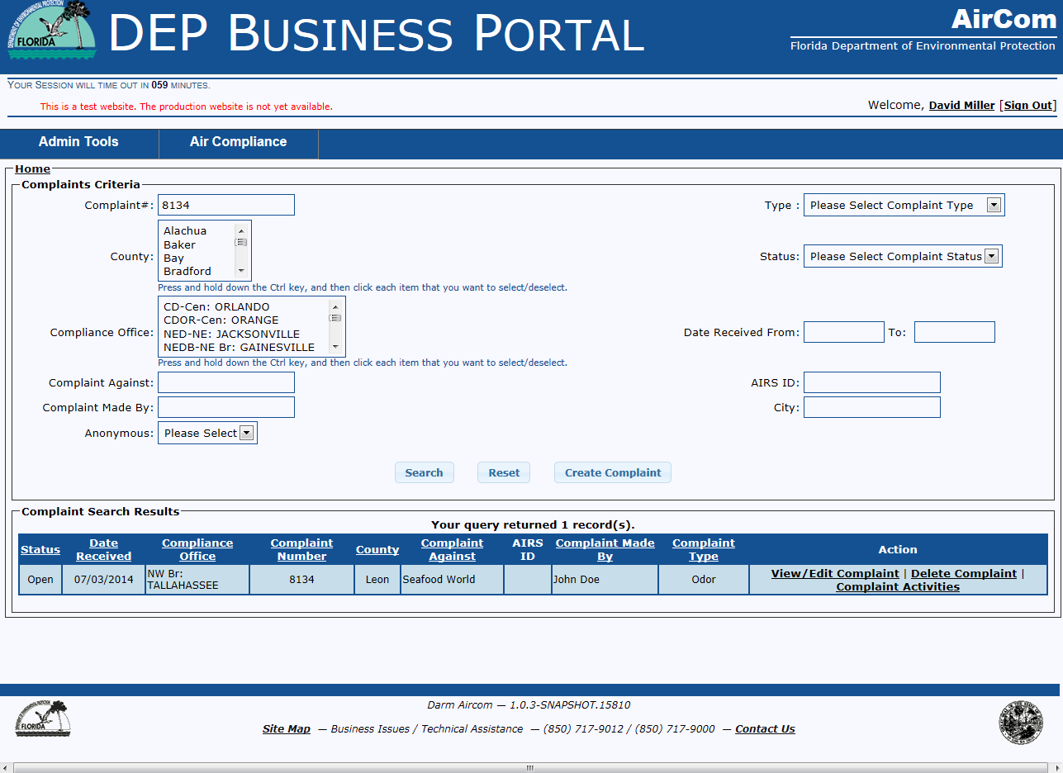
Complaint Activities hyperlink
Select Complaint Activities Hyperlink

Slide 15
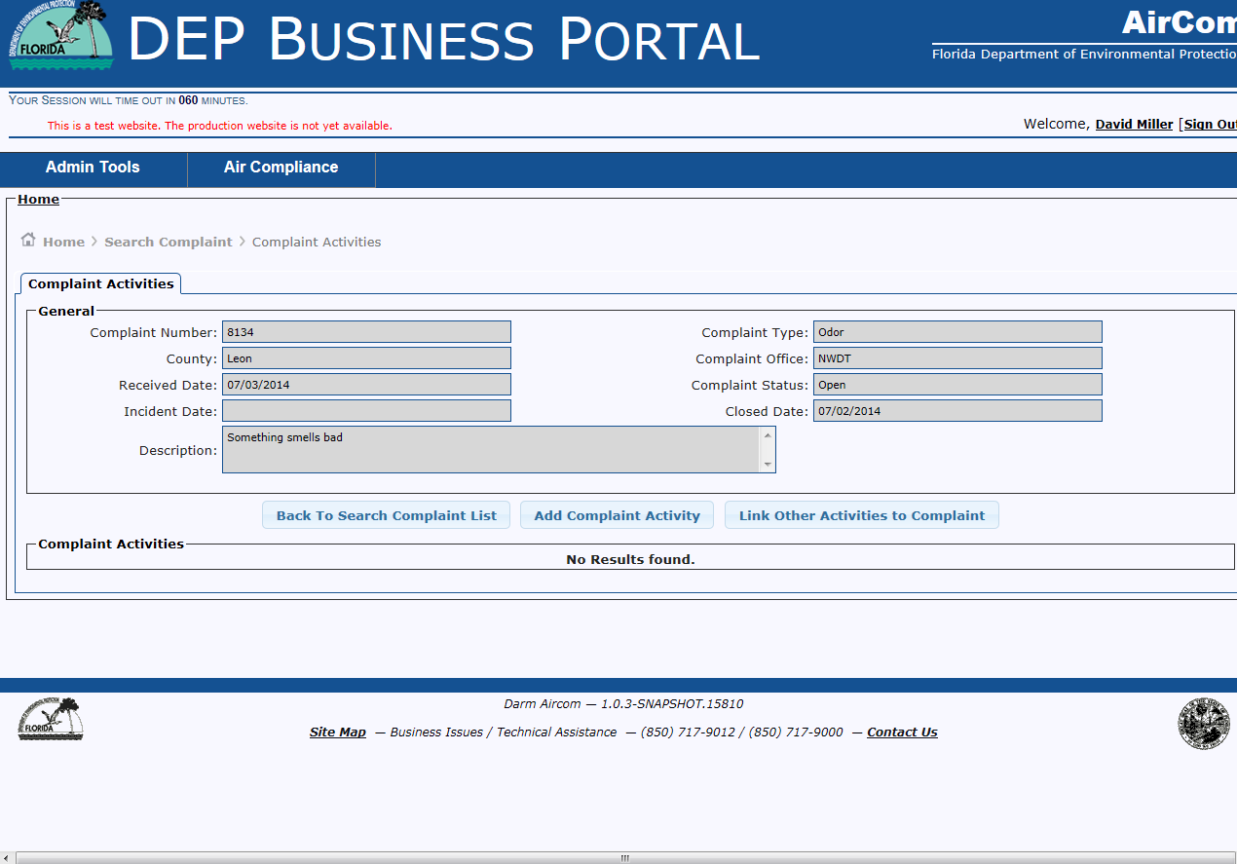
Complaint Activities
Click Add Complaint Activity button

Slide 16
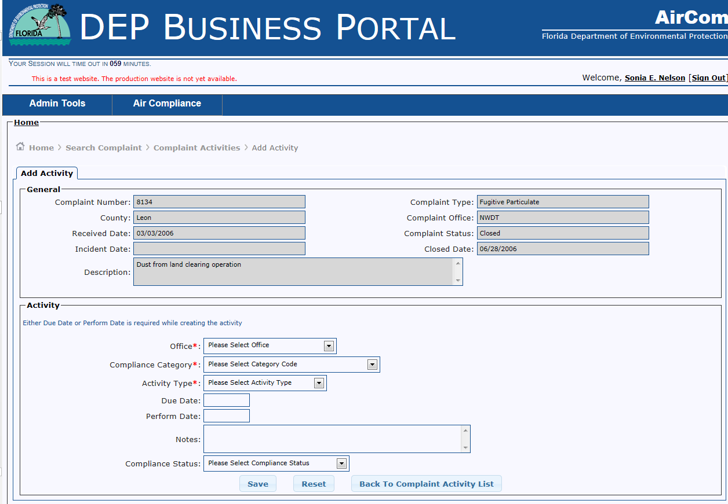
Add Complaint Activity
When Complaint is not linked to a Facility
Red * indicates the field must have data to save the activity

Slide 17
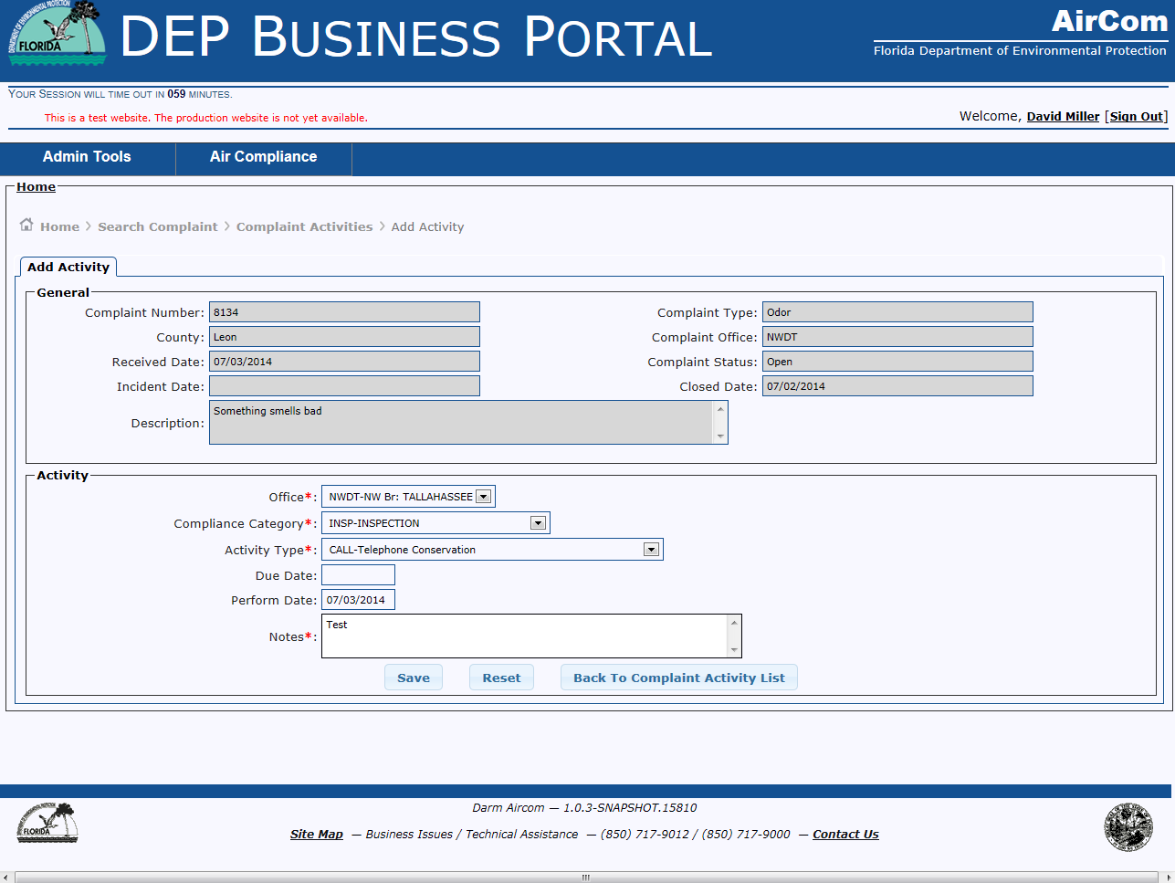
SAVE Complaint Activity

Slide 18
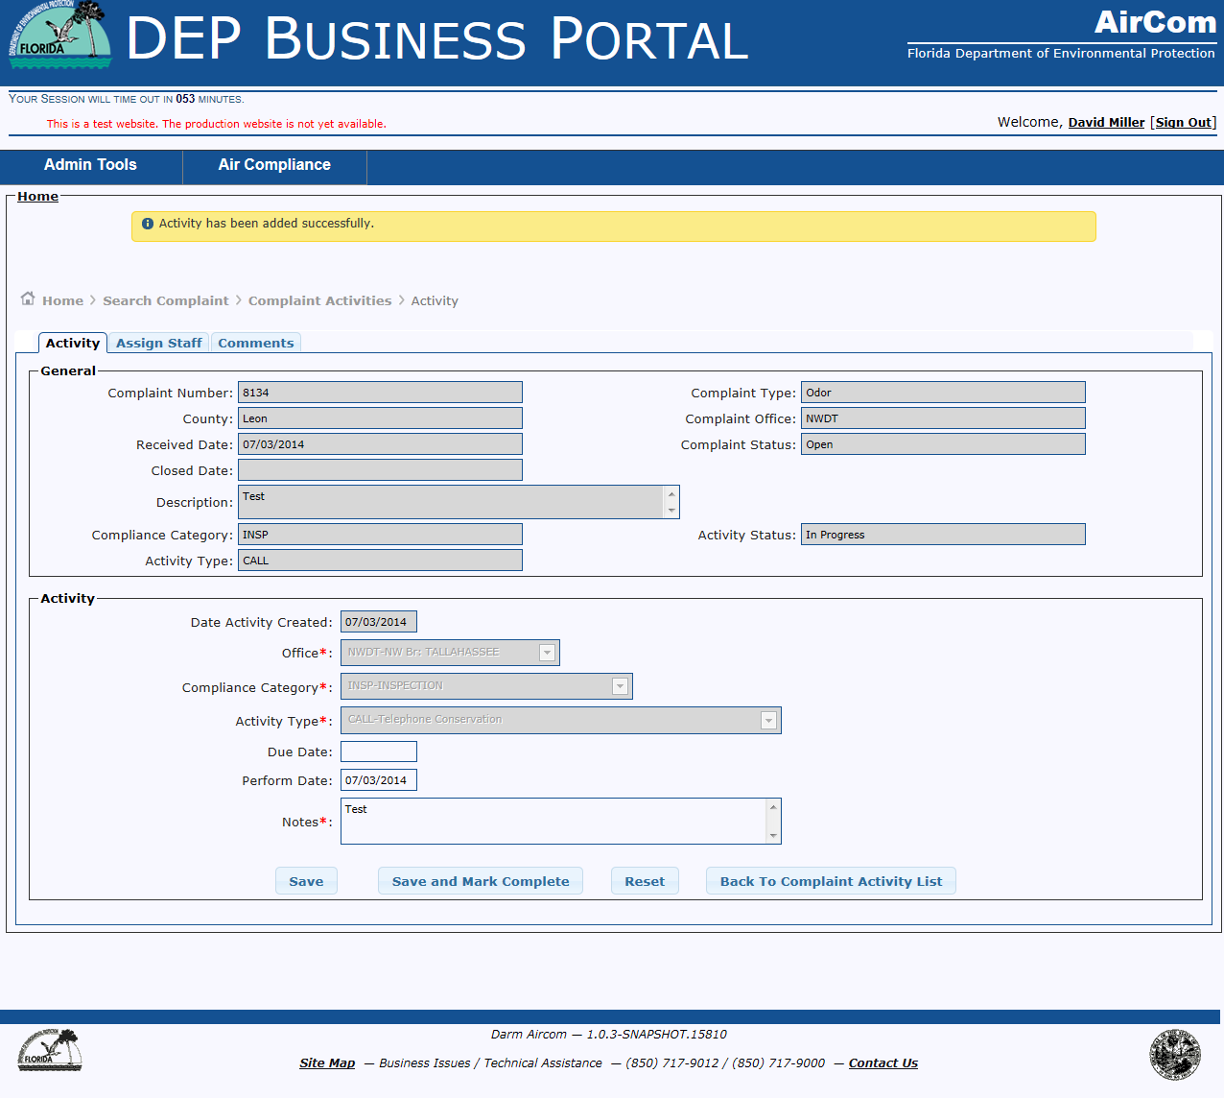
System Message – Successful Completion

Slide 19
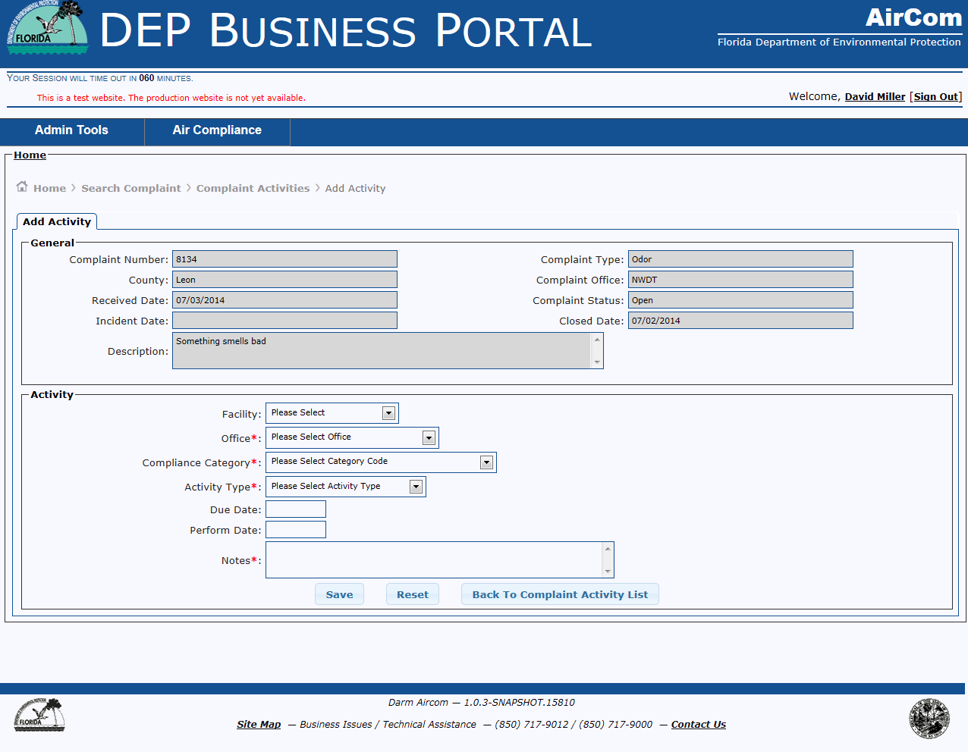
Add Complaint Activity
When Complaint is linked to a Facility
When a Complaint is linked to a facility, the Facility drop down will be present to link the activity to the Facility.

Slide 20
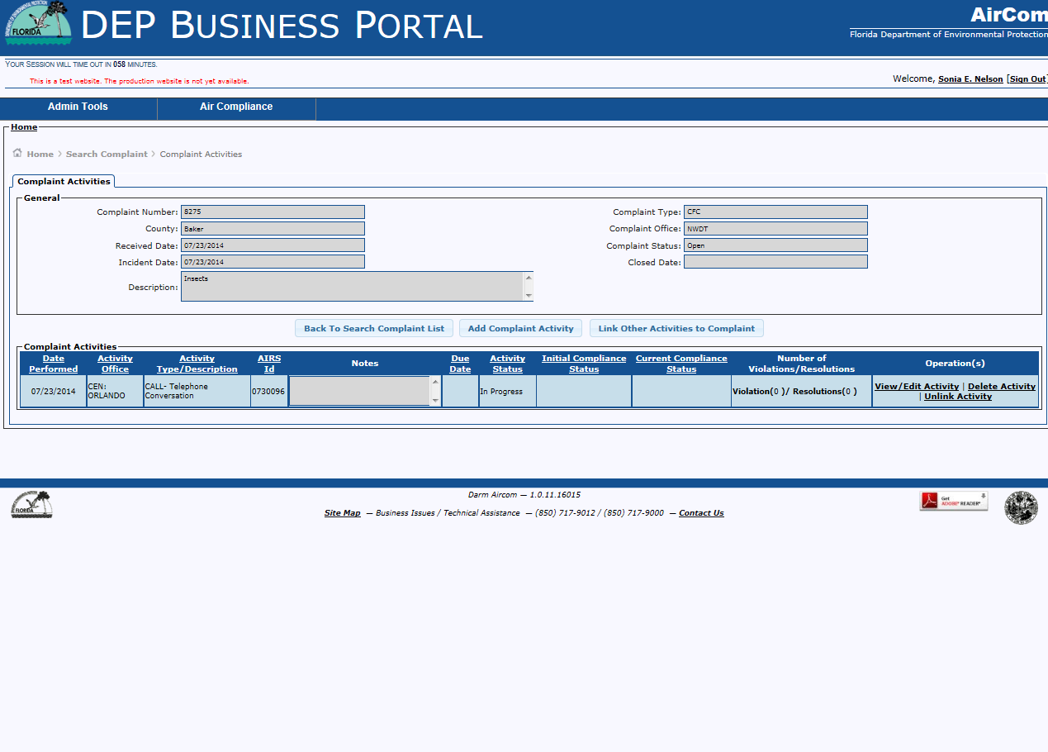
Complaint Activities Grid
Details Activity associated with a Complaint

Slide 21

FCE Checklist Activity

Slide 22
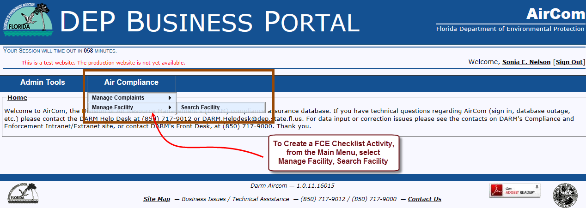
AirCom Welcome Page
1) Select Air Compliance Menu
2) Select Manage Facility
3) Select Search Facility

Slide 23
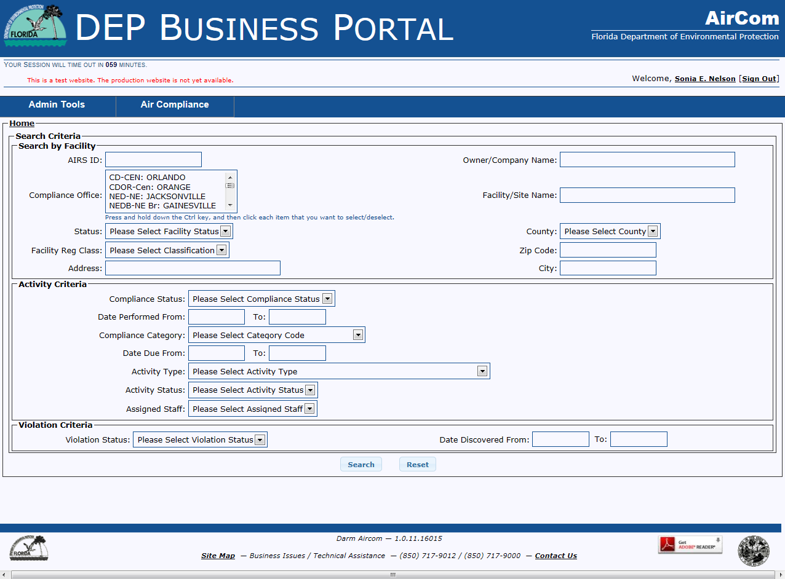
Facility Search Criteria Page
Search and select the Facility
If known use AIRS ID for the most direct search

Slide 24
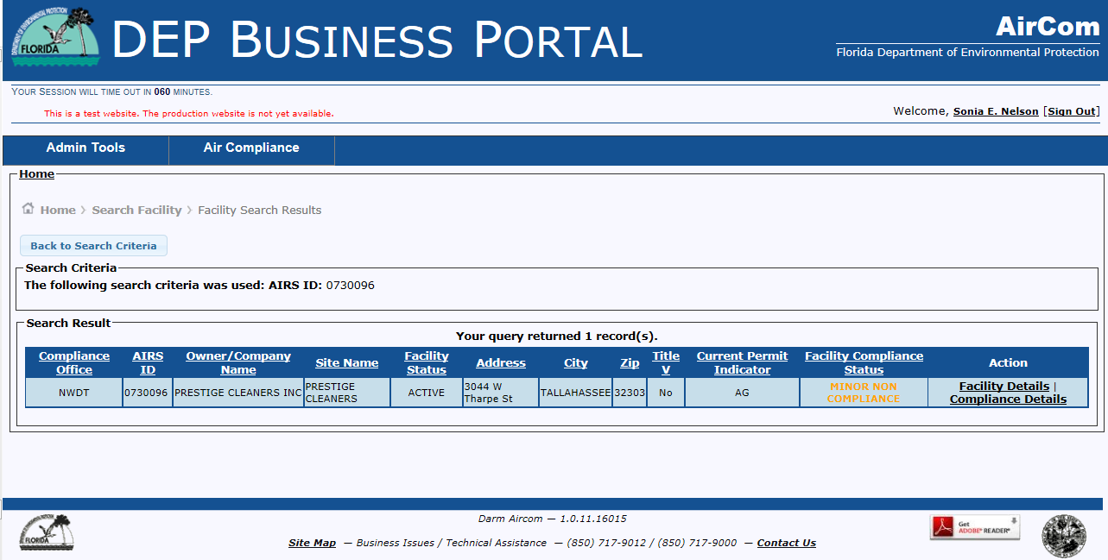
Facility Search Results Page
Select Compliance Details Hyperlink

Slide 25
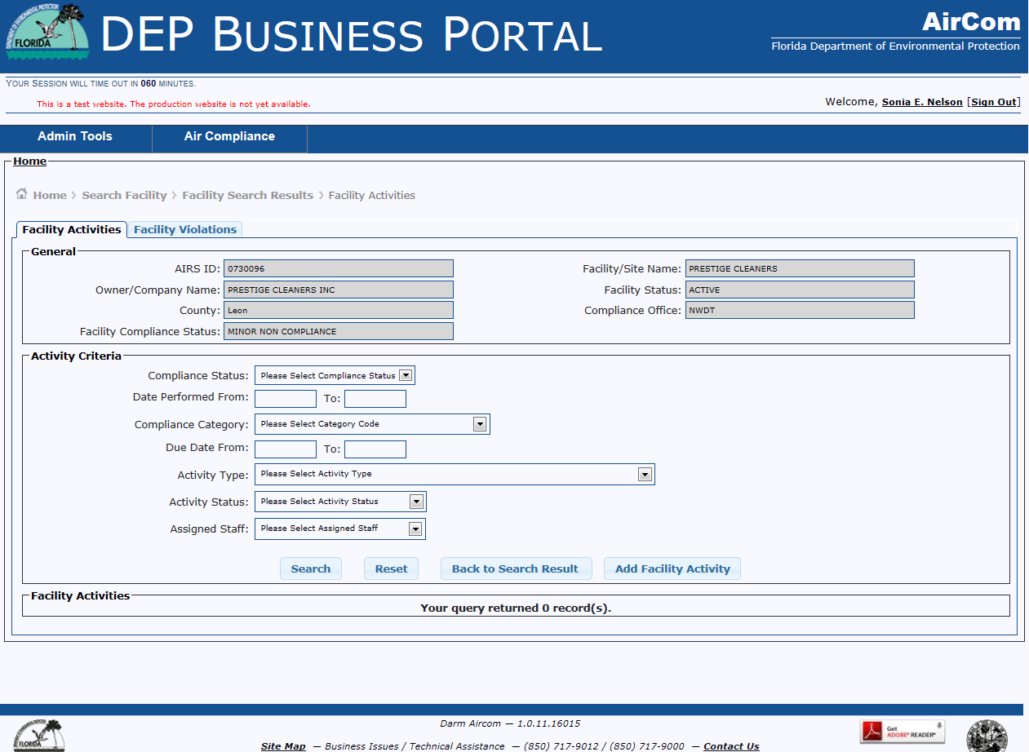
Facility Activities Tab
Click the Add Facility Activity button

Slide 26
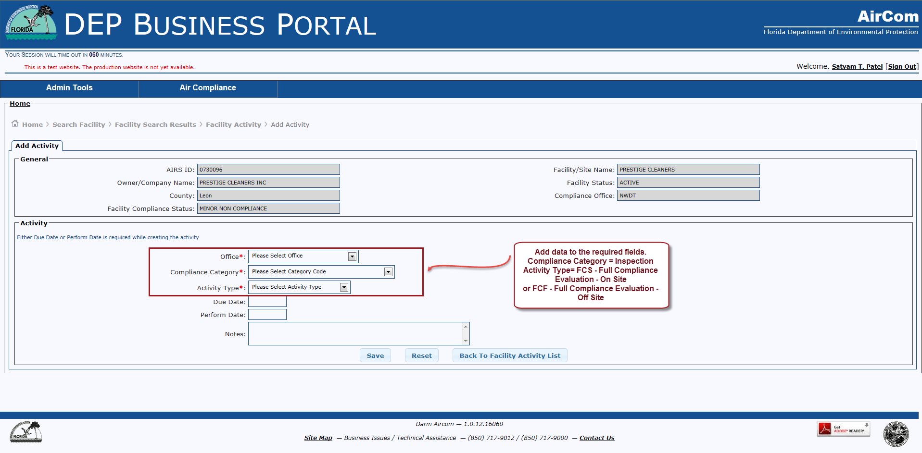
Add Activity Page
Click the Save button

Slide 27
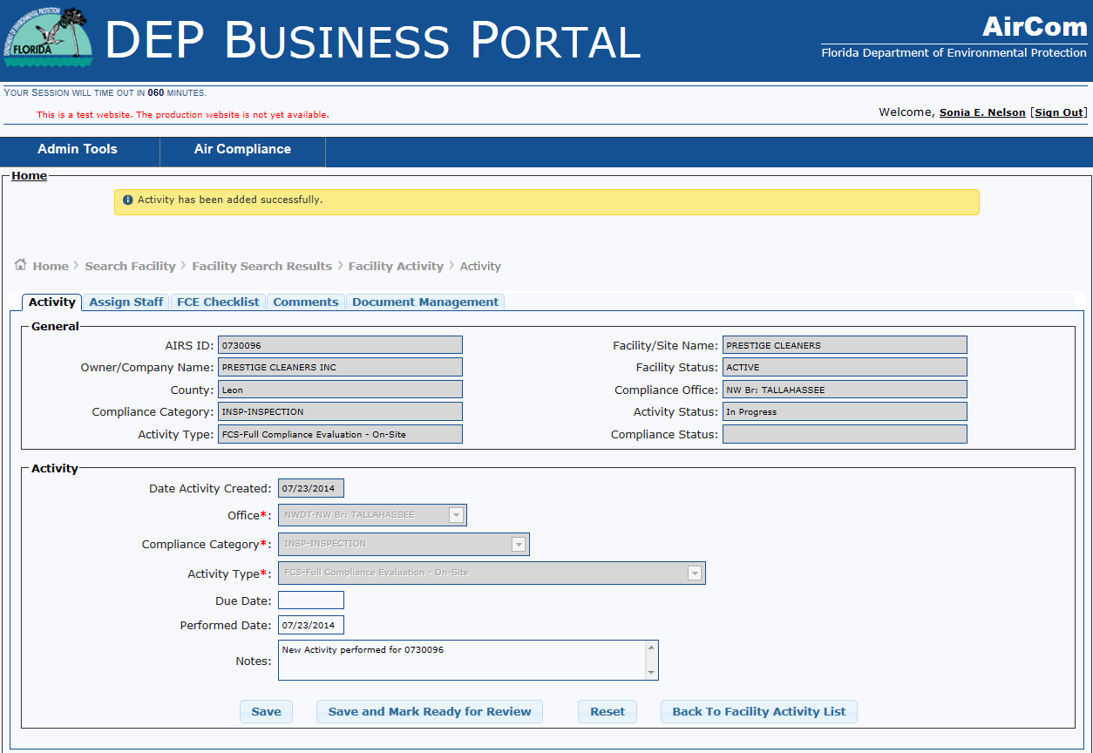
FCE Checklist Tab

Slide 28
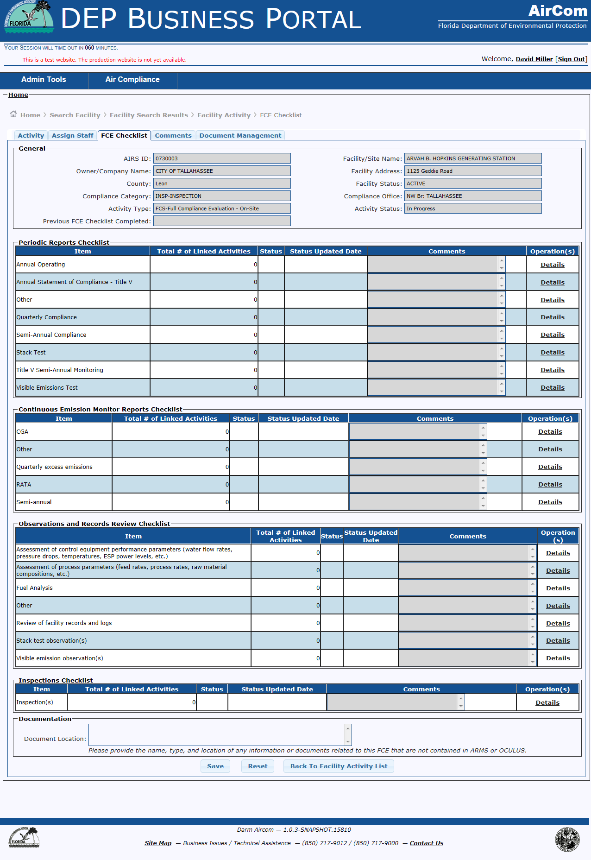
FCE Checklist Page
To attach a Activity to the Checklist, click on the Details Hyperlink for the activity.

Slide 29
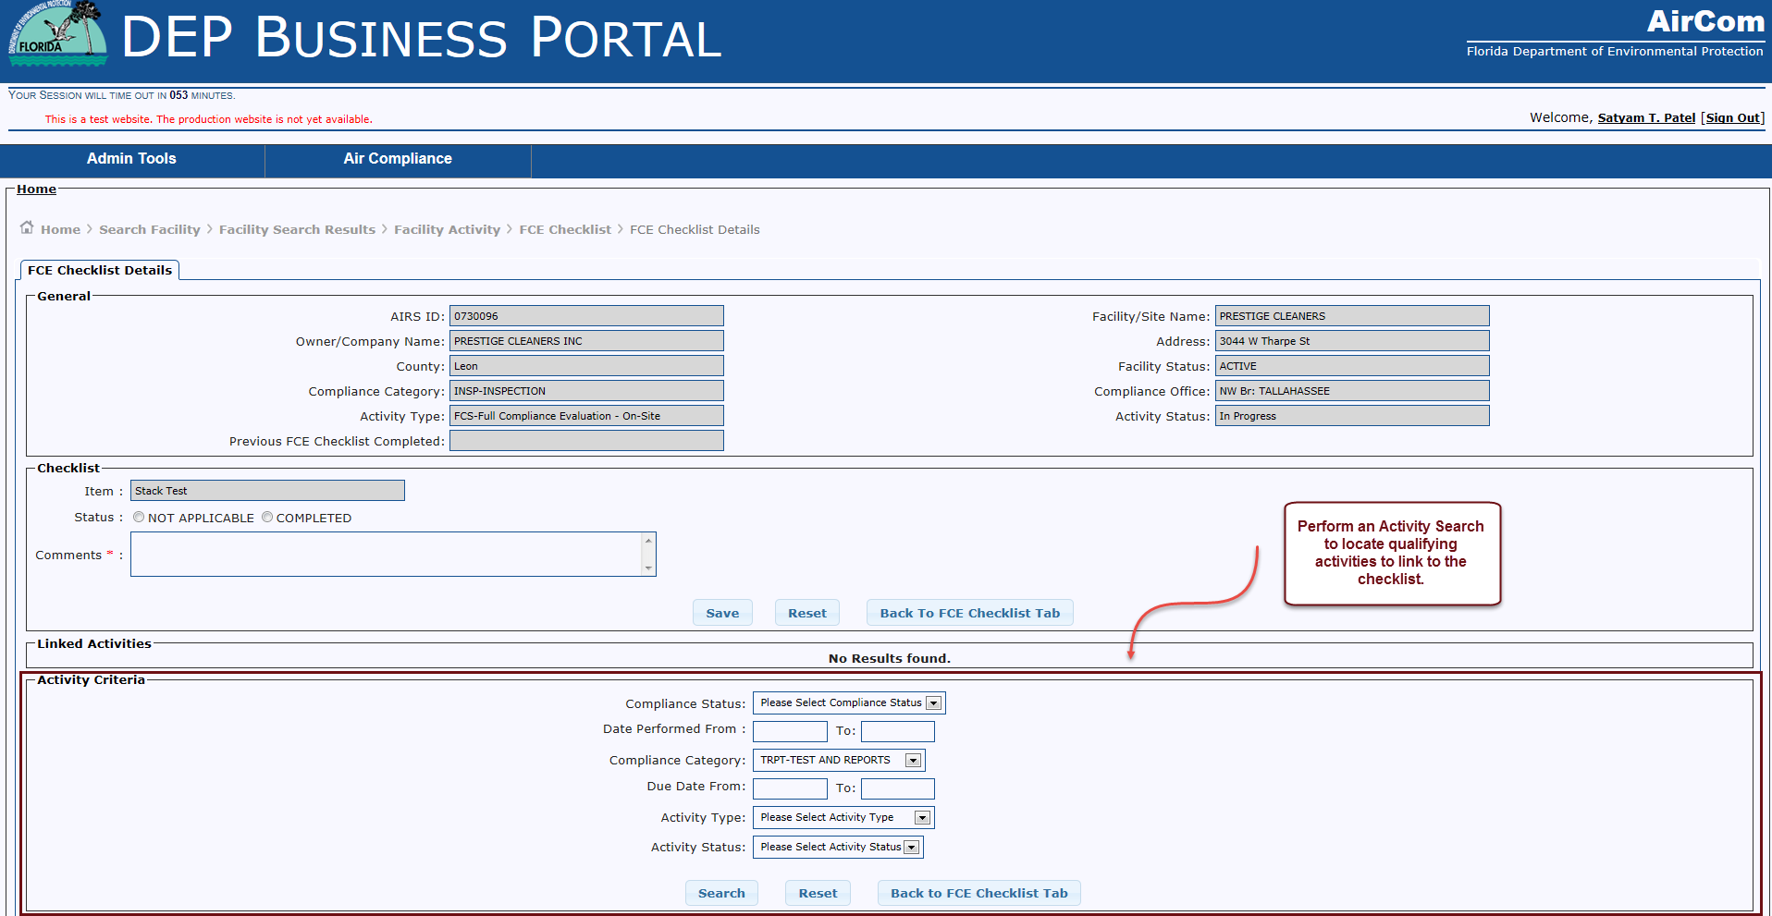
FCE Checklist Details Page

Slide 30
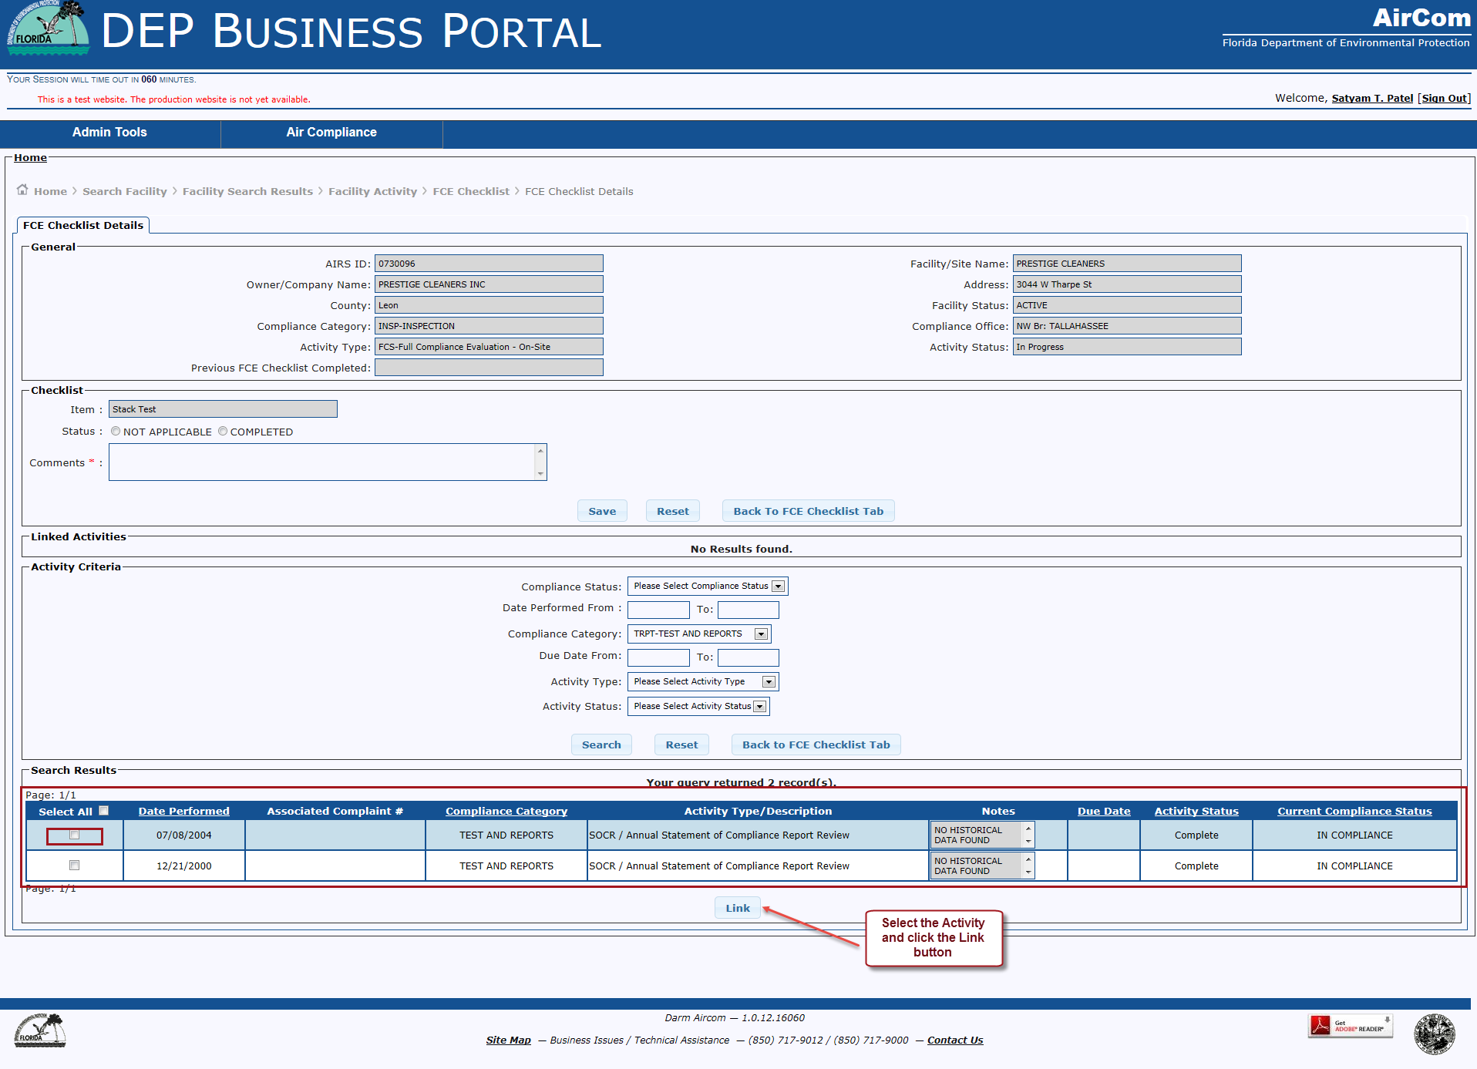
FCE Checklist Details Page – Search Results Grid
DATE RESTRICTION
Activity being linked must be within 18 months of the current date.

Slide 31
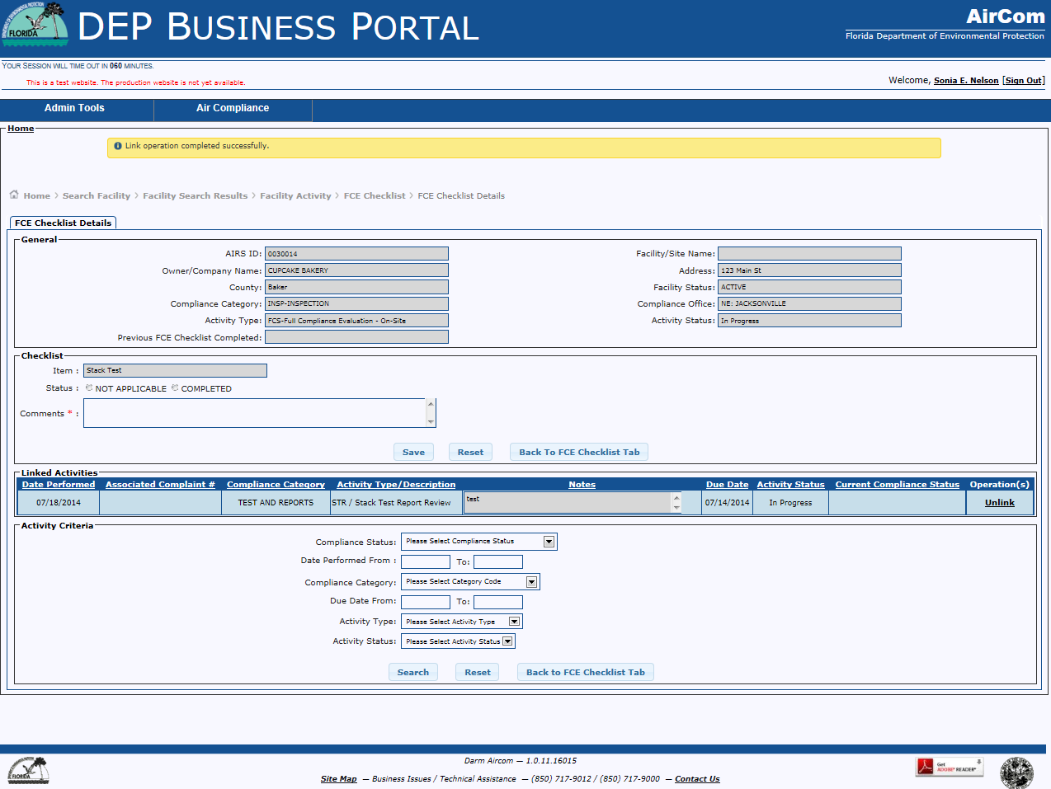
FCE Checklist Details Page – Linked Activities

Slide 32
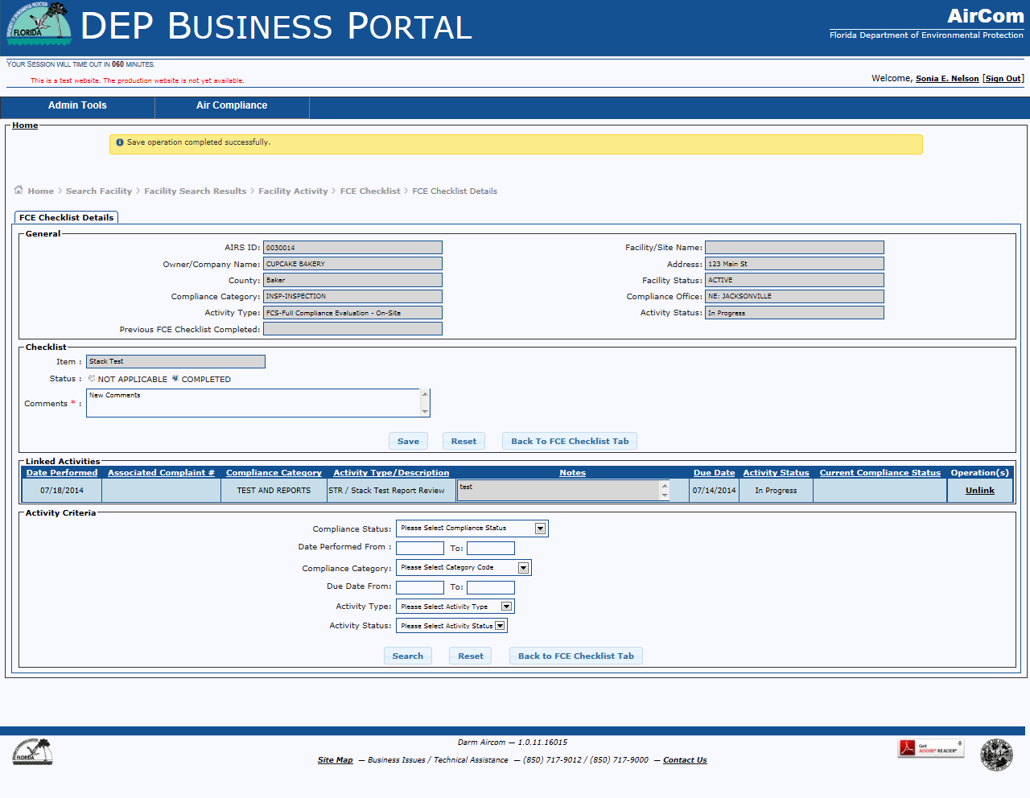
FCE Checklist Details Page – Checklist Status & Comments

Slide 33
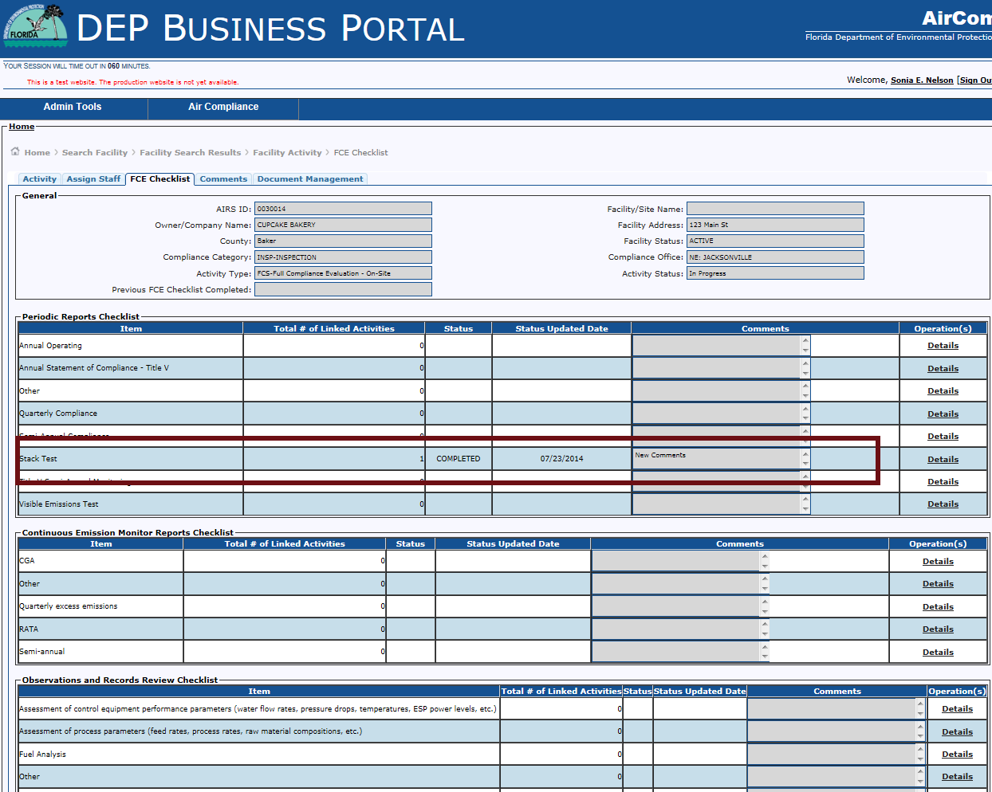
FCE Checklist Tab – Linked activity
Checklist Item
Complete each checklist item by updating status and linking an activities.

Slide 34
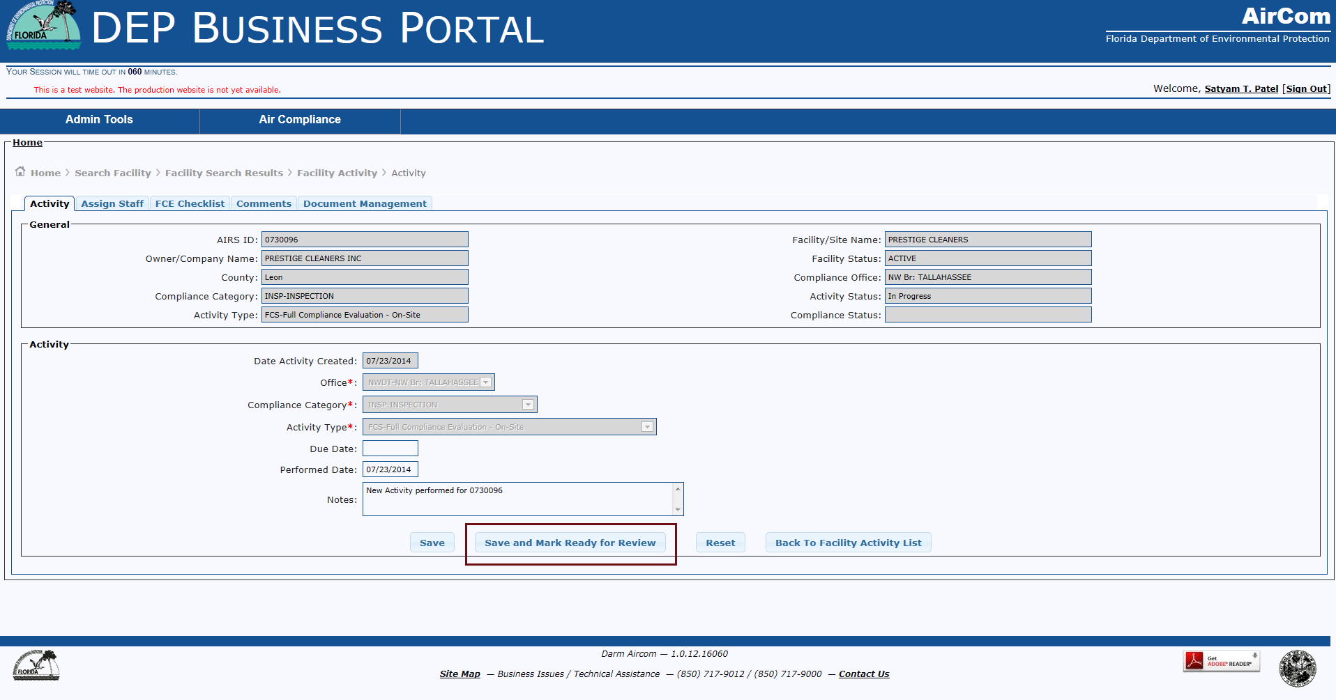
EDIT ACTIVTY Tab – READY FOR REVIEW

Slide 35
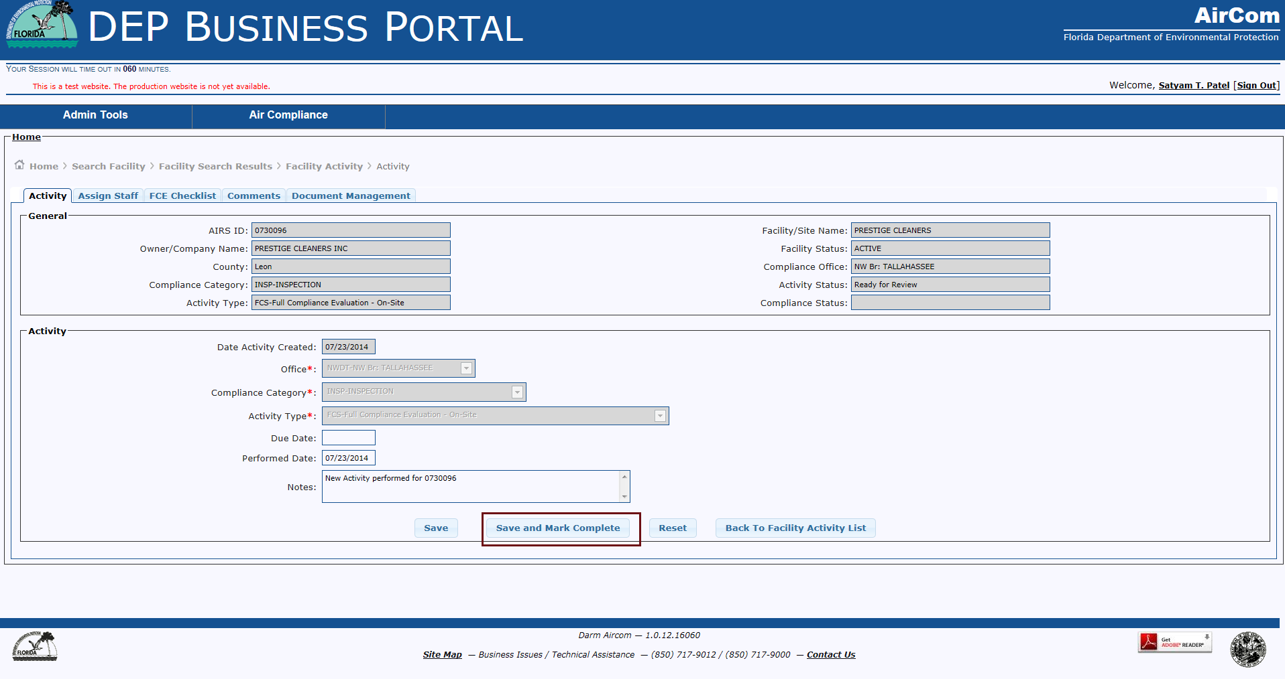
EDIT ACTIVTY Tab – save and mark complete

Slide 36
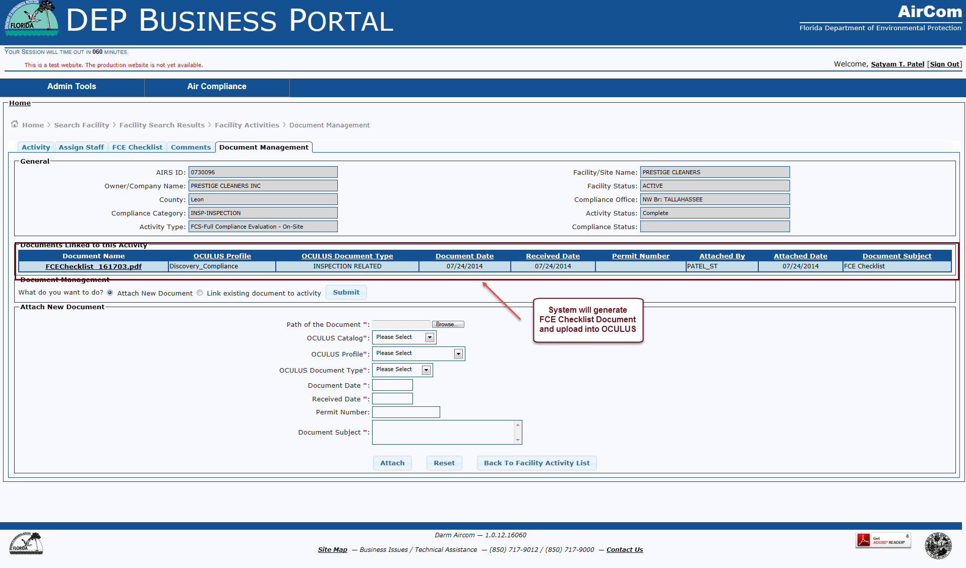
Document Management Tab

Slide 37

AirCom Production Schedule

Slide 38
AirCom Production Schedule
August 12-15 – AirCom Orientation sessions
August 16
  AirCom goes into production
  ARMS CA, EASIIR, and GPCI shutdown
  ACES and existing canned reports will no longer be pulling current data
January 2015 – Canned reports available

Slide 39
Questions?

