Slide 1

Florida Department of Environmental Protection
Northeast District
As part of our outreach to industries,
the Florida Department of Environmental Protection will be providing compliance assistance training/presentation featuring
AIR CURTAIN INCINERATORS
Land clearing professionals are invited to attend this free, one hour event.
Topics include: Compliance with federal and state air rules as well as the requirements for obtaining permits.
Thursday, March 15, 2012
10:30 a.m. - 11:30 a.m.
Department of Environmental Protection
Northeast District Office
7825 Baymeadows Way, Suite 200B
Jacksonville, Florida 32256
For more information, please contact: Ray Barata
(904) 256-1557
raymond.barata@dep.state.fl.us

Slide 2
Table of Contents
Introduction Page
Purpose ________________________ 1
II. Incinerators
What is an incinerator? _____________ 1
How do incinerators work?___________ 2
Rules and Regulations _____________ 6
Environmental Impact ______________ 7
What problems are common among
incinerators?_____________________ 8-19
III. Implement Plan of Action
Develop a Compliance Checklist.______1-3
Conduct operator training.___________ 4
Monitor and Measure Progress _______ 4
IV. Conclusion
Expected outcome ________________ 1

Slide 3
Section I
Introduction

Slide 4
Air Resource Management
Improving customer service through compliance assistance.
Reducing operational costs and increasing efficiency with performance objectives at a high priority.
Assisting regulated community to be in compliance by focusing on problem areas.

Slide 5
Purpose
Use compliance assistance as a
valuable resource.
Identify root causes and problem
areas for non-compliance.
Maintain a pro-active approach in
assisting facilities into compliance.

Slide 6
Section II
Air Curtain Incinerators

Slide 7
What is an Air Curtain Incinerator?
An air curtain incinerator is a type of air pollution control device used to control emissions from open burning.
Operates by projecting a high velocity curtain of air across an open chamber or open pit in which combustion occurs.

Slide 8
Not to be confused with conventional
combustion devices with enclosed
fireboxes and controlled air technology, (such as mass burn, modular, and fluidized bed combustors.)

Slide 9
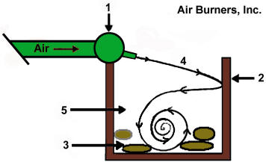
 | Air Curtain Burners do not burn anything. They control the results of something burning.
High velocity air is directed across and
downwards at an angle into the pit.
Air curtain on top and a rotational turbulence
within the pit itself.
Oxygen enriched environment within the
combustion zone.
Accelerates the combustion process by raising
the temperatures within the pit to approximately
1,832º F (approx. 1,000º C).

Slide 10
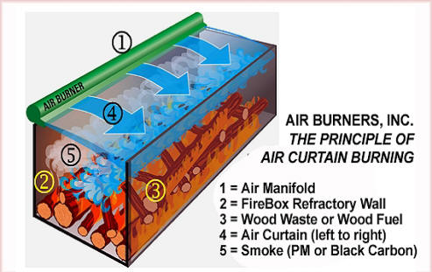
stall or slow down the smoke particles on
their way out of the Fire Box.
re-burn, further reducing their size to an
acceptable limit.
result is a very clean burn with opacities
well under 10% (as compared to open
burning which typically can run at 80% to
100% opacity

Slide 11
Types of ACI
Can be constructed above or below ground
With or without refractory walls and floor

Slide 12
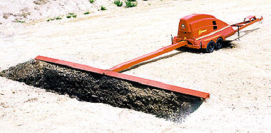
Burn Materials Protruding
Properly Constructed Trench Type ACI

Slide 13
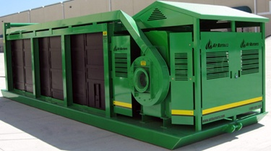
Above ground Air Curtain Incinerator
Self contained, completely assembled unit
Some models are refractory lined
Designed for the high temperature burning
of forest slash, land clearing debris, green
waste, storm debris and other untreated wood

Slide 14
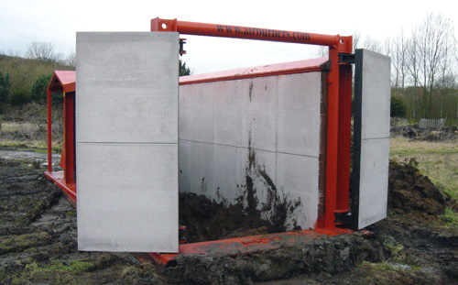
Door for ash removal

Slide 15
What materials are allowed to burn?
  100 percent wood waste
  100 percent clean lumber
  100 percent mixture of only wood
  waste, clean lumber, and/or yard
  waste.

Slide 16
Rules and Regulations
62-296.401 F.A.C - Emissions Standard
62-297.310 F.A.C.- Emissions Monitoring
40 CFR 60 Subpart AAAA
40 CFR 60 Subpart BBBB
40 CFR 60 Subpart CCCC
40 CFR 60 Subpart EEEE

Slide 17
Emission limitations
The opacity limitation is 10 percent
(6-minute average), except during
startup.
Opacity limitation is 35 percent (6-minute
average) during the startup period that is
within the first 30 minutes of operation.

Slide 18
  Environmental Impact

Slide 19
Why Air Curtain Incinerators?
  An environmentally friendly
  alternative to open burning.
  Relies on airflow to enhance the fire
  and reduce the emissions.
  Can be used in closer proximity to
  existing structures.

Slide 20
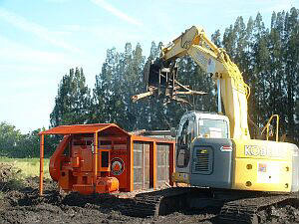
Air Quality
Open burning averages 60% to 80%
opacity (smoke plume);
ACI average 10% or less opacity.
Land Clearing Site

Slide 21
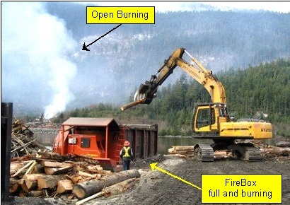

Slide 22
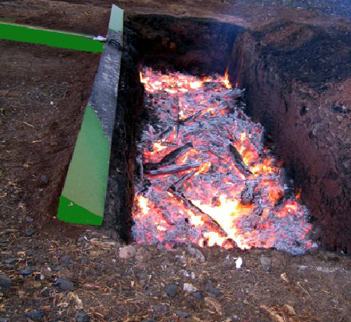
Burn Materials Protruding
Trench Type ACI - in Operation

Slide 23
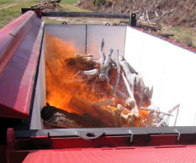
Above Ground ACI – In Full Operation

Slide 24
Incinerator Inspections
OTHER INCINERATION | 27-Jul-06 | 28-Aug-07 | 27-Feb-08 | 24-Nov-09 | 31-Aug-10 | 18-May-11
OTHER INCINERATION | 7-Apr-06 | 28-Aug-07 | 9-Sep-08 | 13-Jan-09 | 22-Oct-10 | 15-Nov-11
OTHER INCINERATION | 20-Mar-06 | 8-Nov-07 | 20-Oct-08 | 20-Nov-09 | 2-Aug-10 | 29-Jul-11
OTHER INCINERATION |  | 19-Oct-07 | 17-Oct-08 | 14-Dec-09 | 8-Jul-10 | 18-Jul-11
OTHER INCINERATION |  | 8-Feb-07 | 25-Jan-08 | 24-Feb-09 | 9-Sep-10 | 11-Mar-11
OTHER INCINERATION | 6-Jul-06 | 12-Mar-07 | 7-Aug-08 | 16-Jul-09 | 30-Jun-10 | 29-Aug-11
OTHER INCINERATION | 13-Jul-06 | 10-Dec-07 | 29-Oct-08 | 9-Jun-09 | 20-Sep-10 | 29-Apr-11
OTHER INCINERATION | 10-Jan-06 | 31-Jul-07 | 1-Oct-08 | 12-Jan-09 | 10-Sep-10 | 29-Apr-11
OTHER INCINERATION |  |  |  | 3-Sep-09 | 15-Apr-10 | 8-Sep-11
OTHER INCINERATION |  |  | 14-Oct-08 | 20-Oct-09 | 14-Oct-10 | 19-Aug-11
OTHER INCINERATION |  |  | 10-Dec-08 | 13-Oct-09 | 22-Oct-10 | 26-Oct-11
OTHER INCINERATION |  |  |  |  | 30-Nov-10 | 20-Dec-11
OTHER INCINERATION |  |  |  |  | 28-May-10 | 11-May-11
PATHOLOGICAL INCINERATOR | 8-Nov-06 | 6-Jul-07 | 26-Sep-08 | 12-Mar-09 | 16-Mar-10 | 16-Sep-11
PATHOLOGICAL INCINERATOR | 3-Nov-06 | 19-Jul-07 | 26-Sep-08 |  | 25-Jun-10 | 31-Aug-11
PATHOLOGICAL INCINERATOR | 17-Nov-06 | 3-Jul-07 | 26-Sep-08 | 12-Mar-09 | 24-Aug-10 | 8-Apr-11
HOSPITALS/HEALTH CARE | 10-Jan-06 | 20-Jun-07 | 3-Dec-08 | 24-Sep-09 | 19-Oct-10 | 28-Sep-11
HOSPITALS/HEALTH CARE | 16-Feb-06 | 30-Nov-07 |  | 30-Dec-09 | 14-Oct-10 | 22-Sep-11
19 Noncompliance Inspections
  15 Minor, 4 Significant

Slide 25
Incinerator Violations
Overcharged | 6
Open burning | 6
Missing Test/Records | 5
High opacity | 4
Minimum temperature | 4
Pit dimensions | 2
Missing Personnel | 2
Ash not removed | 2
Other | 3

Slide 26
ACI Regulations
Federal (http://ecfr.gpoaccess.gov/)
  40 CFR 60 (NSPS)
    CCCC, DDDD
    IIII, JJJJ
  40 CFR 63 (NESHAP)
    ZZZZ
State (http://www.dep.state.fl.us/air/rules/current.htm)
  62-296.401(7)
  62-210.300(3)(a)35

Slide 27
Permit Forms & Fees
Non Title V permit applications forms
  http://www.dep.state.fl.us/air/rules/forms/application.htm
Construction
  Less than 5 tons/yr -- $250
  5 to 25 tons/yr -- $1000
  25 to 50 tons/yr -- $2000
  50 to 100 tons/yr -- $4500
  More than 100 tons/yr -- $5000
Operating
  $1000

Slide 28
Testing Requirements
Visible Emissions (VE) test
  Prior to initial operation permit application
  Within 30 days of moving to new trench
  Annually thereafter

Slide 29
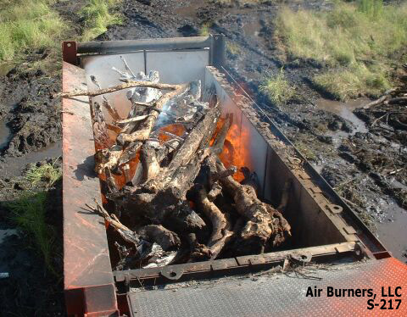
Burn Materials Protruding
Burn Materials Protruding

Slide 30
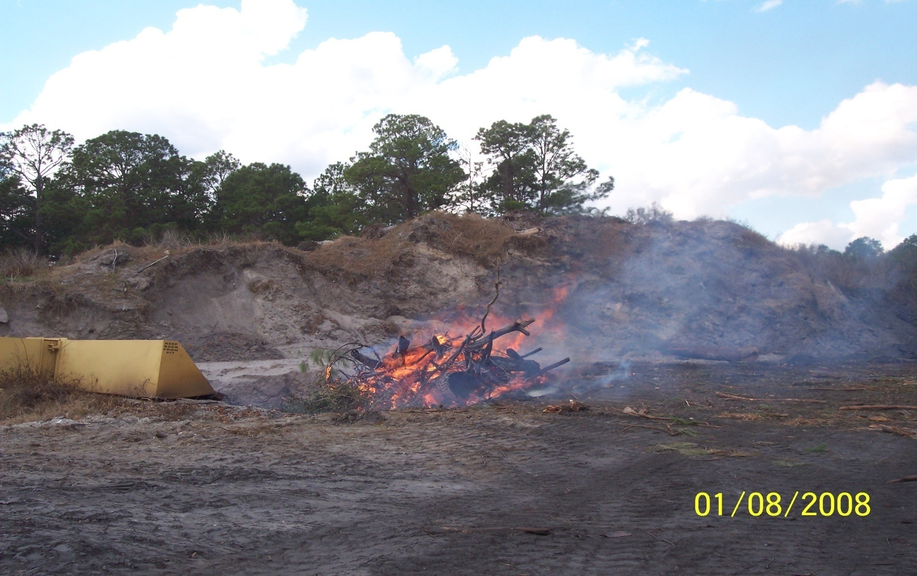
Overcharging

Slide 31
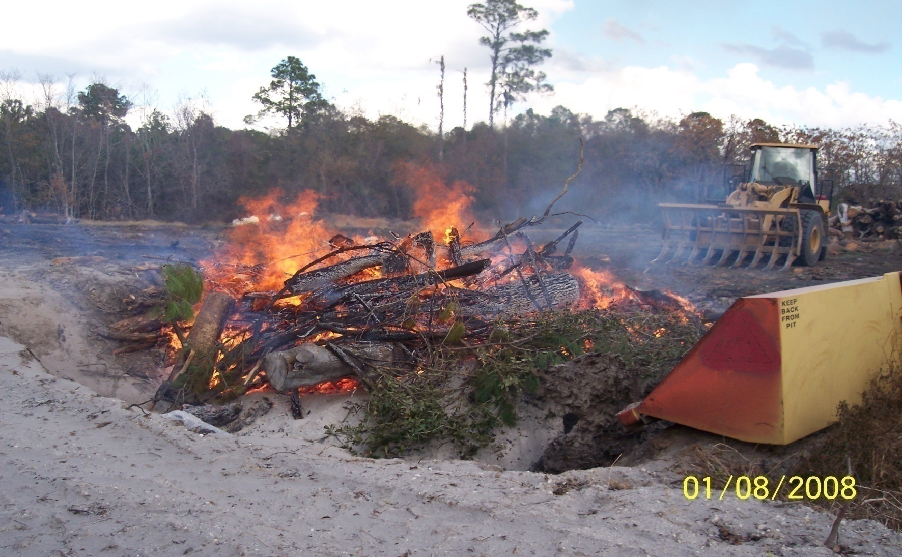
Overcharging

Slide 32
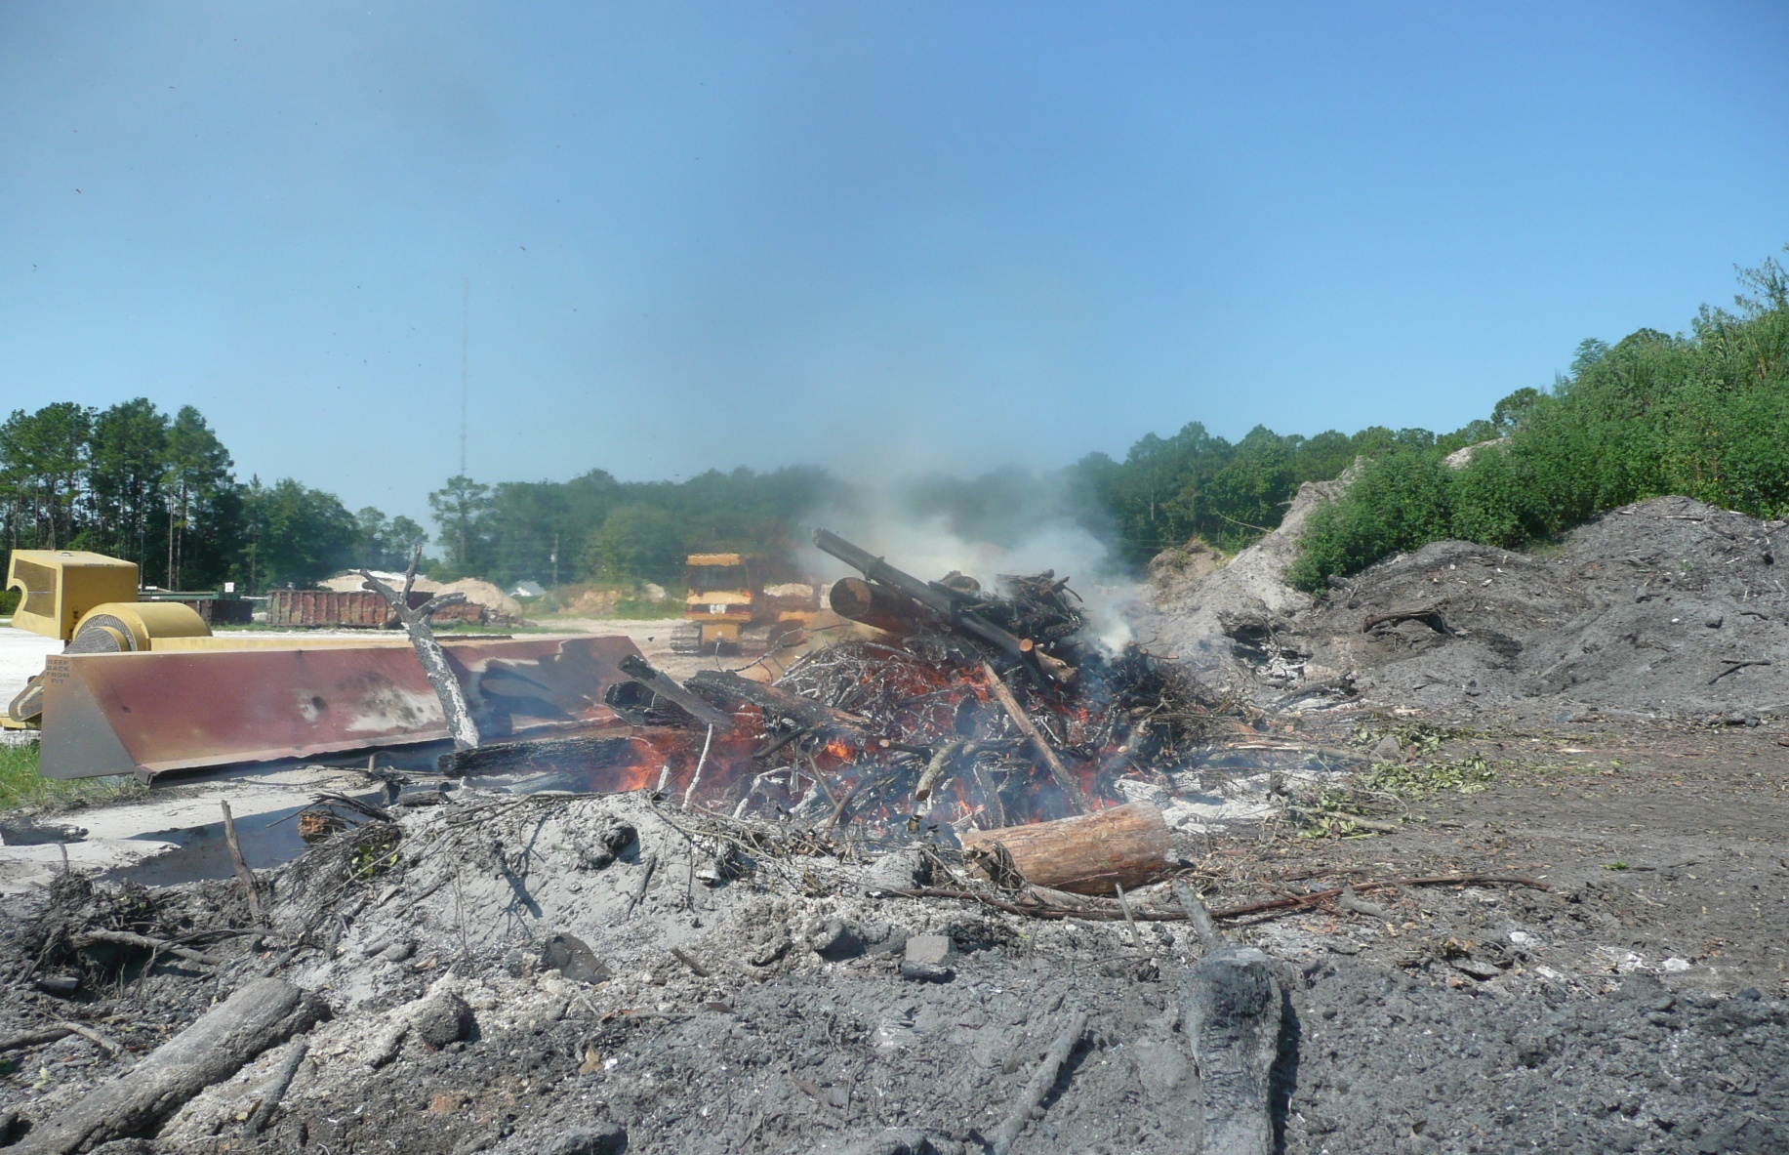
Overcharging

Slide 33
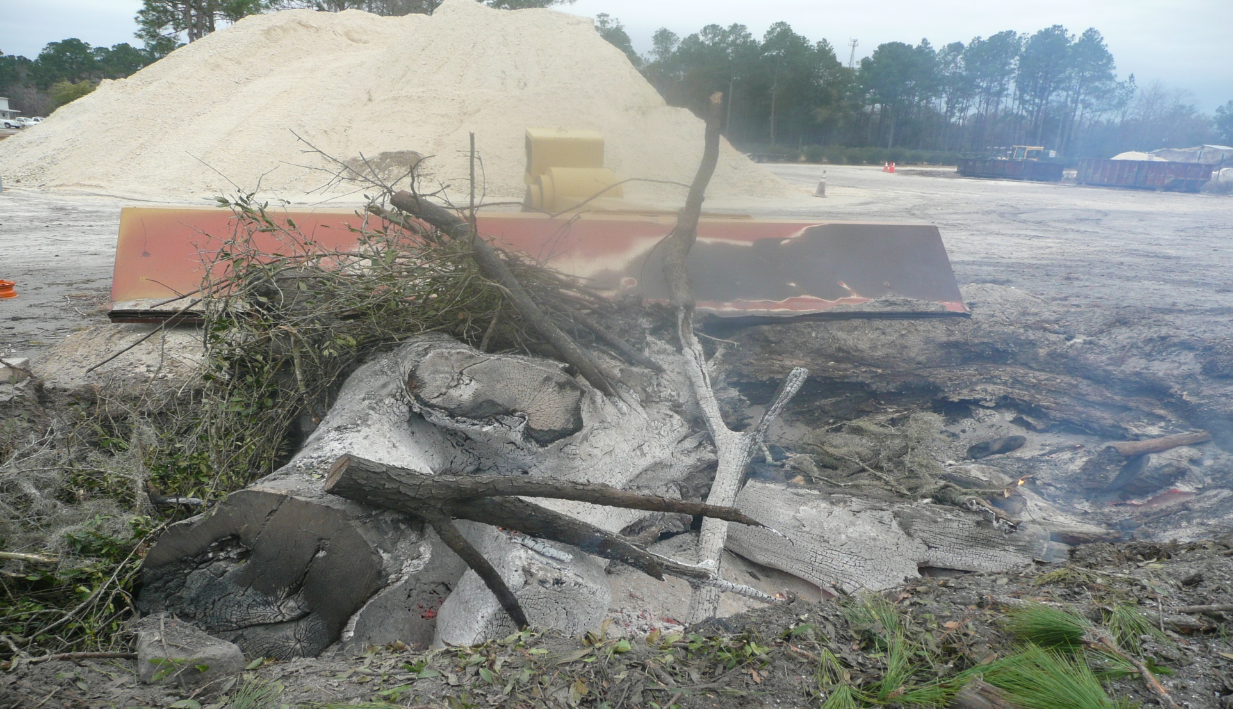
Trench Overload

Slide 34
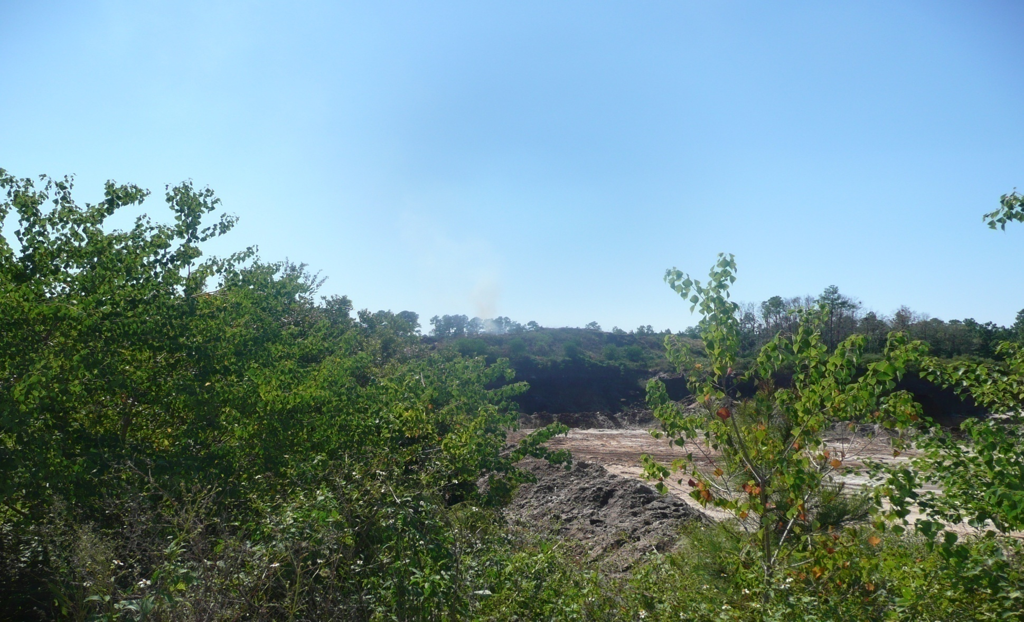
ACI

Slide 35
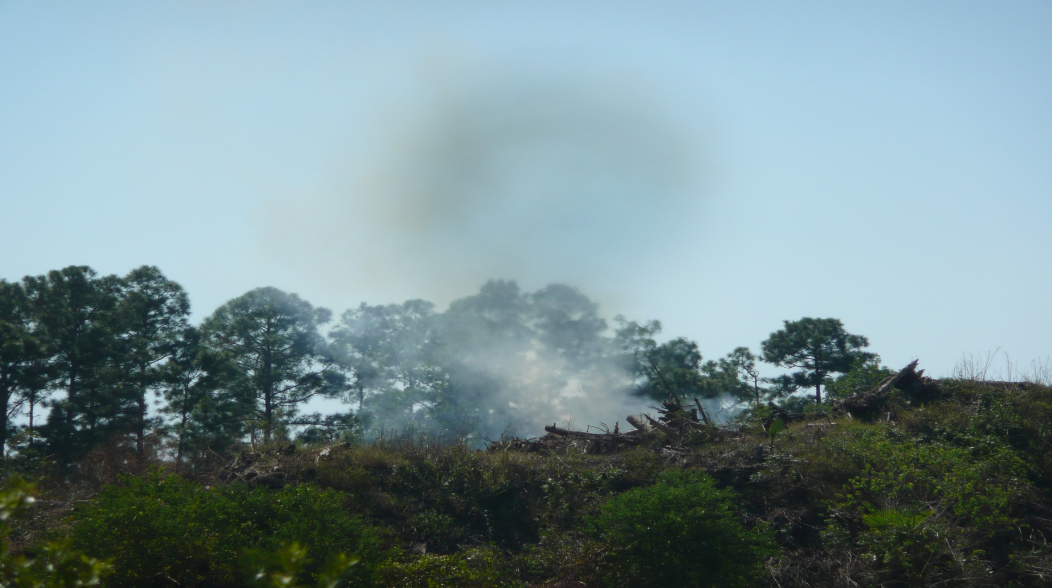
Visible Emission

Slide 36
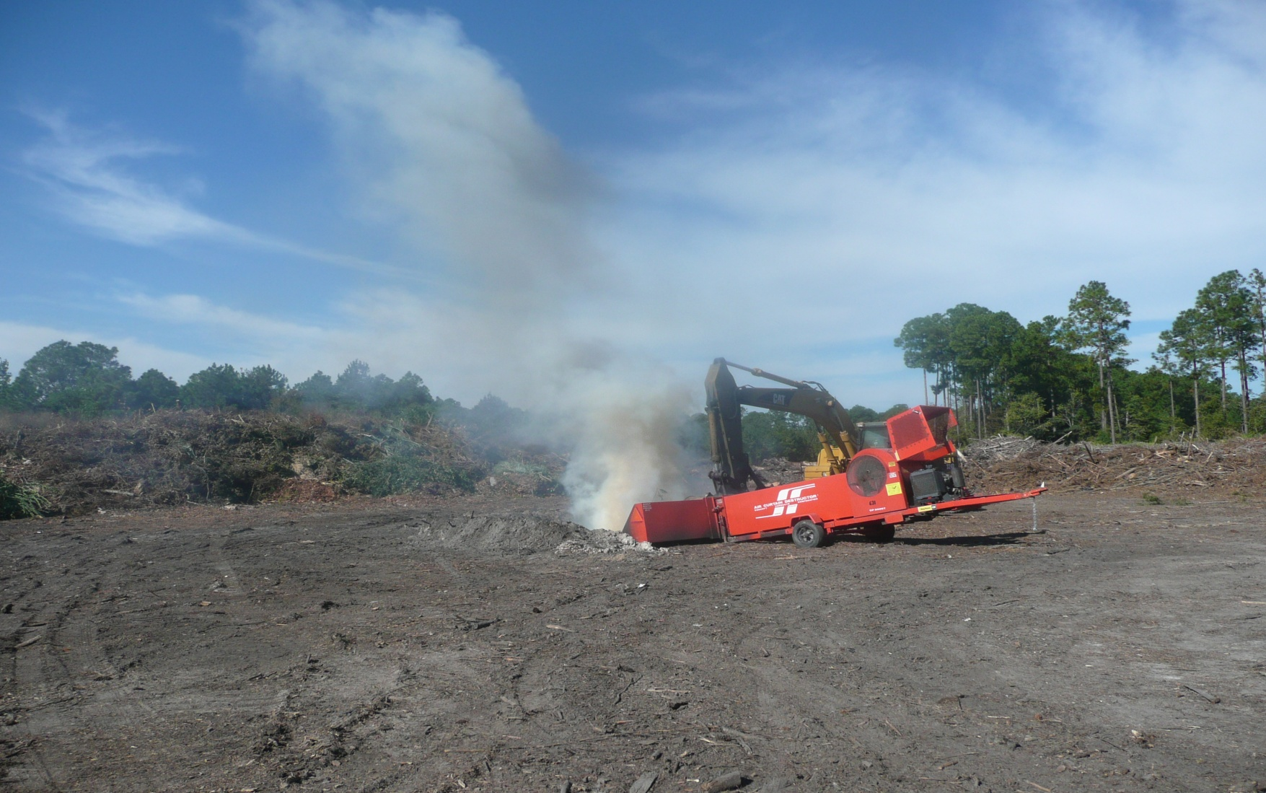
Only during start-up

Slide 37
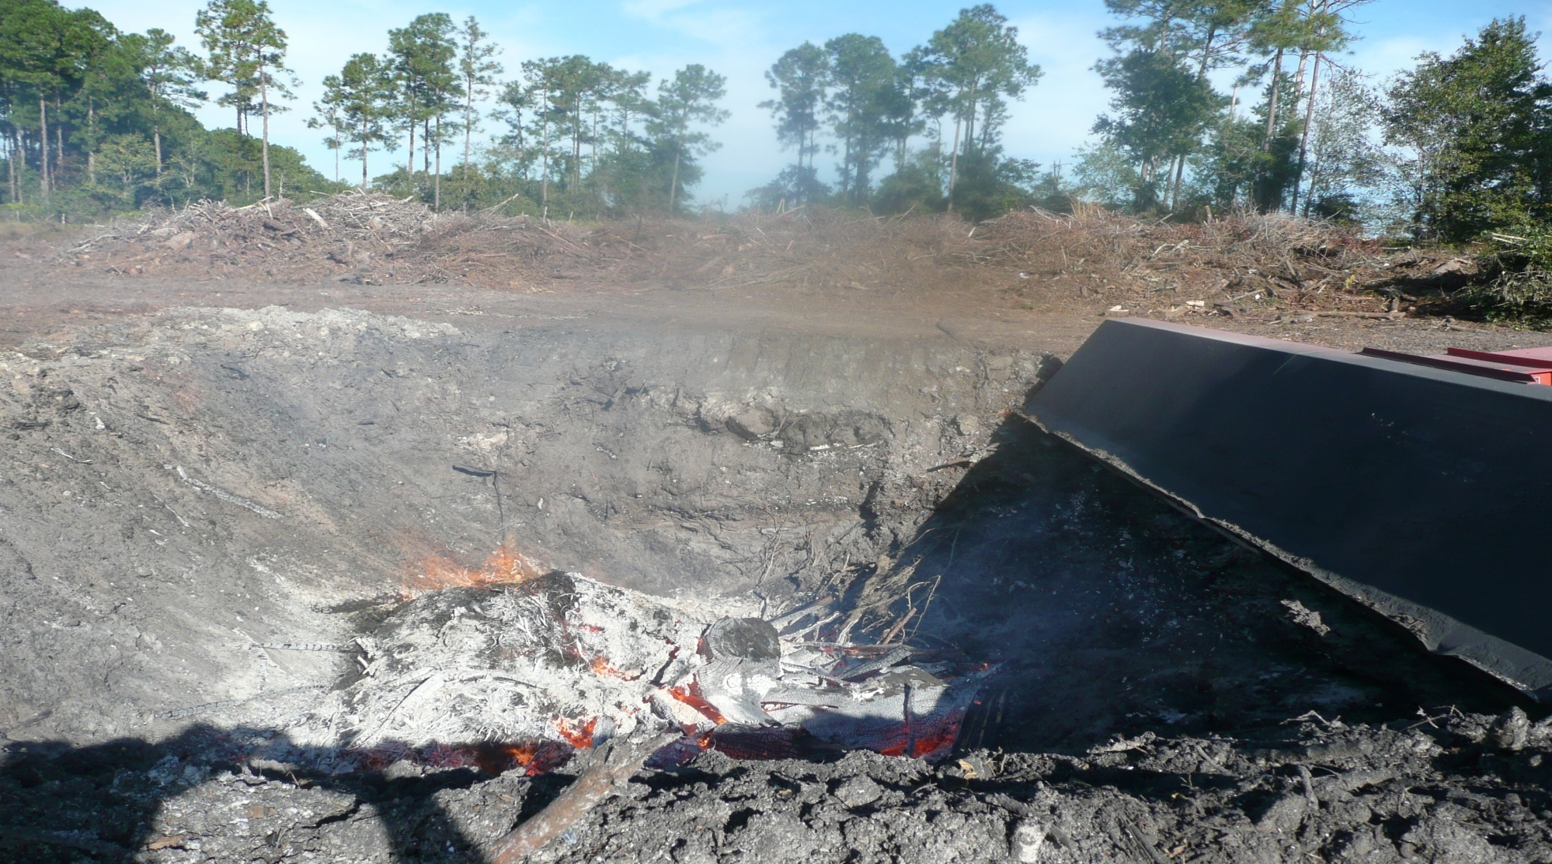
Improperly constructed trench

Slide 38
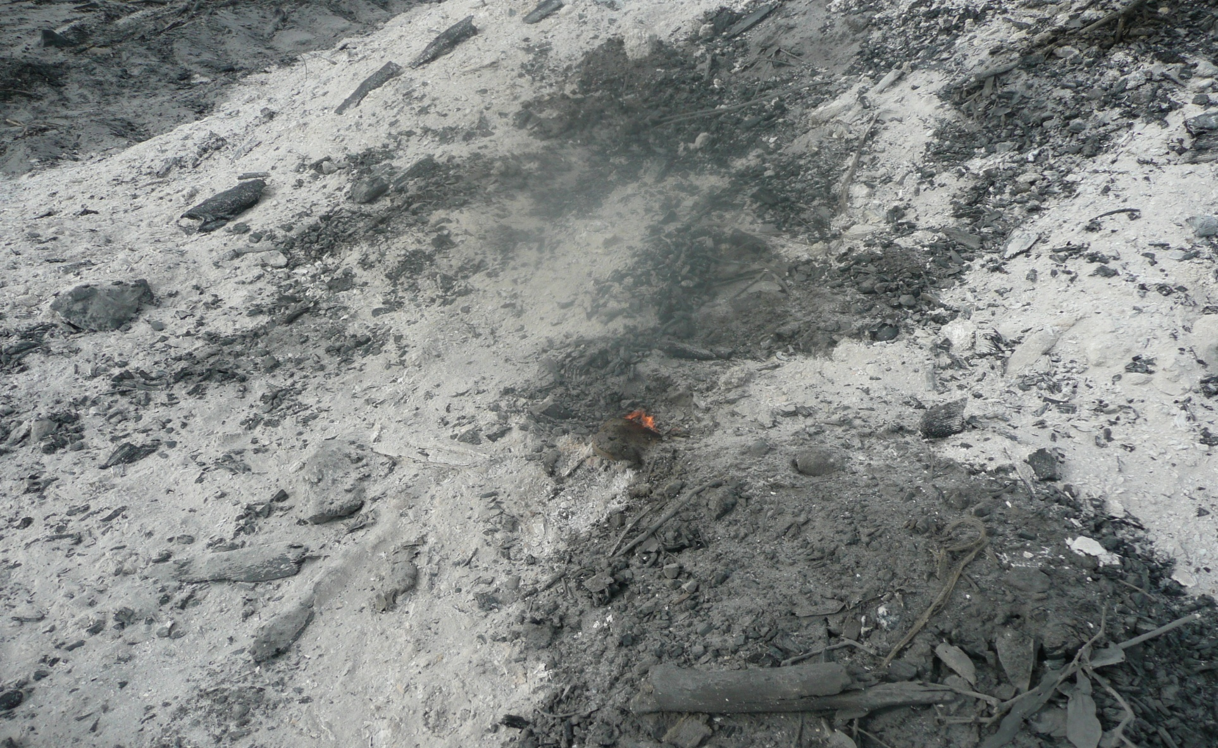
Re-flash
Ash Mount

Slide 39
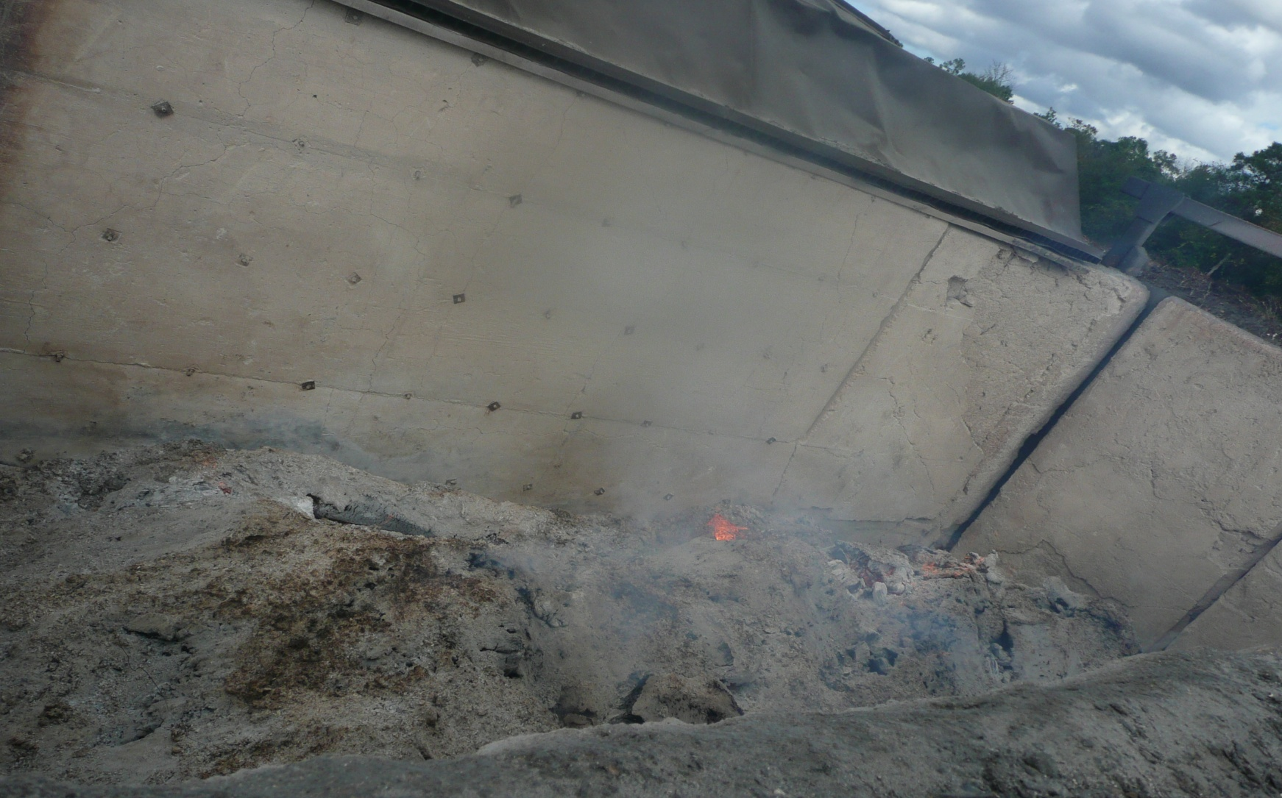
Ash Buildup

Slide 40
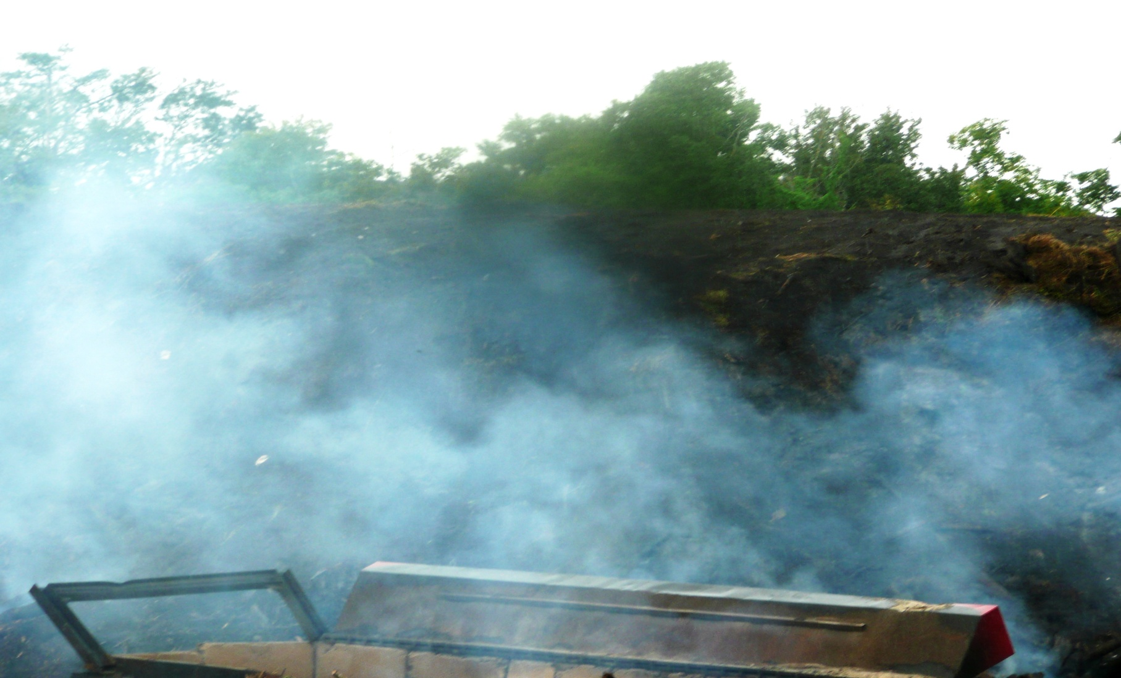

Slide 41
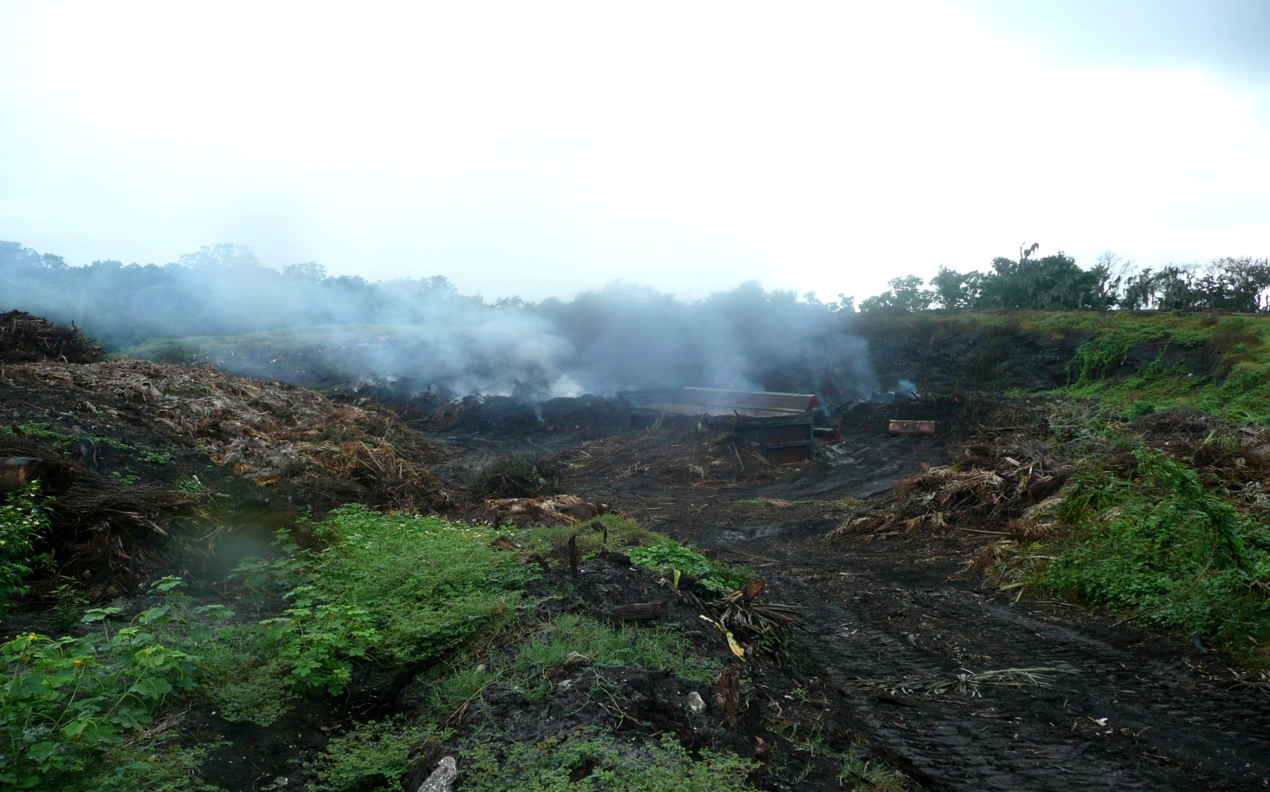
Fire had jumped off the fire box

Slide 42
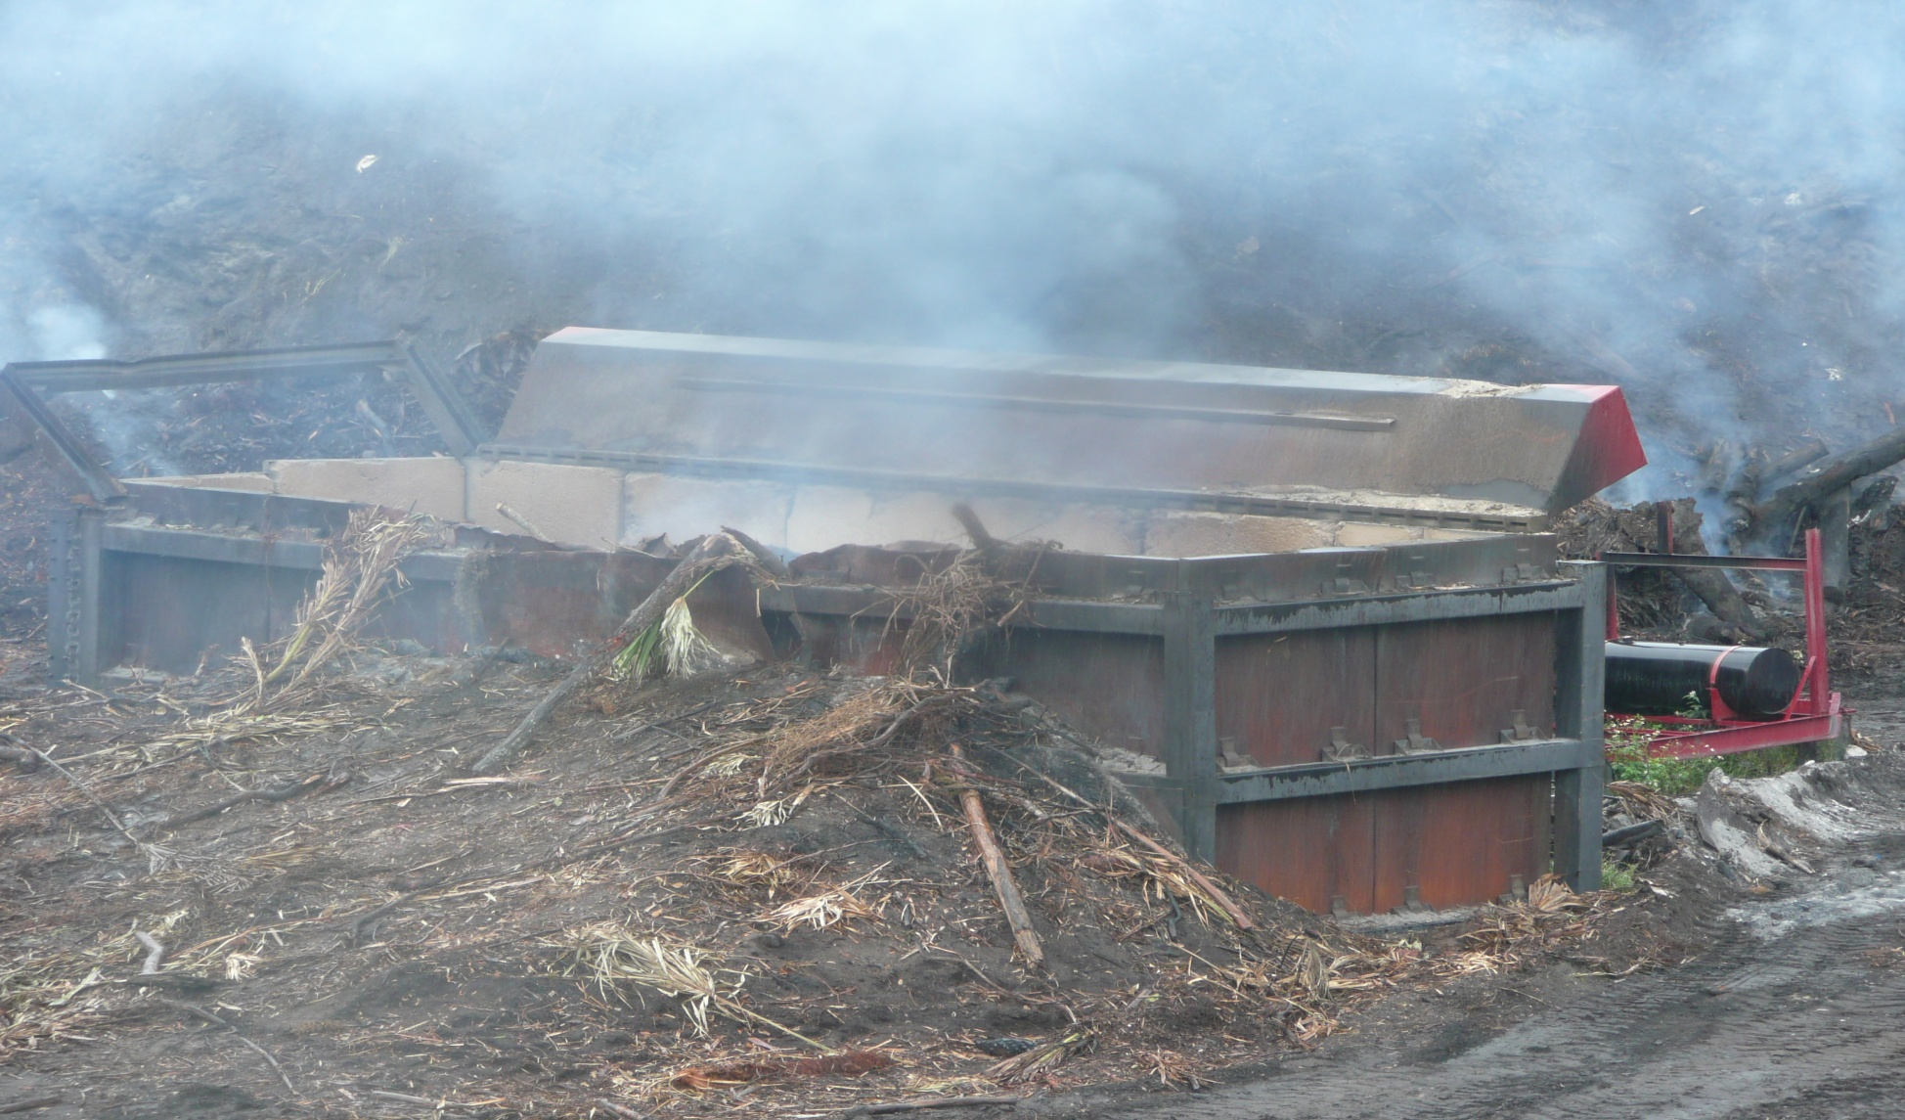
Fuel tank next to firebox

Slide 43
SECTION III
Implement Plan of Actions

Slide 44
Compliance Assistance Checklist
General Operating Requirements:
Does the owner/operator have an Air Operation
permit DEP to operate the ACI? □YES □NO
2. ACI started after sunrise and ended no later than
one hour after sunset? □YES □NO
3. Is the ACI attended to at all times while materials
are being burned? □YES □NO

Slide 45
Compliance Assistance Checklist
General Operating Requirements: (Con’t)
4. Does the ACI meet the setback requirement of at
least 50 feet from any wetlands, brush, combustible
structures or paved public roadway? □YES □NO
5. Is there an operation and maintenance manual
available to operators at all times? □YES □NO
6. Does burn pit meet dimensions specified in the
permit? □YES □NO

Slide 46
Compliance Assistance Checklist
General Operating Requirements: (Con’t)
7. Does the ACI only burn vegetative material and
untreated wood (excluding sawdust)? □YES □NO
Is the ash residue maintained at less than 1/3 the
pit depth? □YES □NO
Is compliance test for opacity conducted
annually? □YES □NO

Slide 47
Compliance Assistance Checklist
Recordkeeping Requirements:
Maintains daily log of operation? □YES □NO
If YES, does it show ;
Beginning and ending charging times? □YES □NO
Daily total of material burned (in tons)? □YES □NO
Total hours of operation? □YES □NO
12-months rolling operating hours? □YES □NO
12-months rolling materials burned (in tons)?
□YES □NO
Notes:
During the pres

Slide 48
Compliance Assistance Checklist
Recordkeeping Requirements:
2. Results of annual opacity tests kept on-site?
□YES □NO
3. All records of maintenance performed?
□YES □NO
Are records kept for at least 5 years?
□YES □NO
Notes:
During the pres

Slide 49
Conduct Operator Training:
  Individually onsite
  Regionalize by group
  Just in time training
Notes:
During the pres

Slide 50
Monitor & Measure Progress:
  Conduct customer feedback
  Increase face to face contact
  Highlight improvements
Notes:
During the pres

Slide 51
Section IV
Conclusion

Slide 52
What do we hope to achieve?
Knowledgeable operators
Increased rate of compliance
Reduction in number of violations
Fewer citizen complaints

Slide 53
Questions ?

Slide 54
Air Resource Management
TEAM MEMBERS
  RAY BARATA
  BRENT STEELE
  SCOTT JOHNSTON
  MARC LOVALLO

