Slide 1
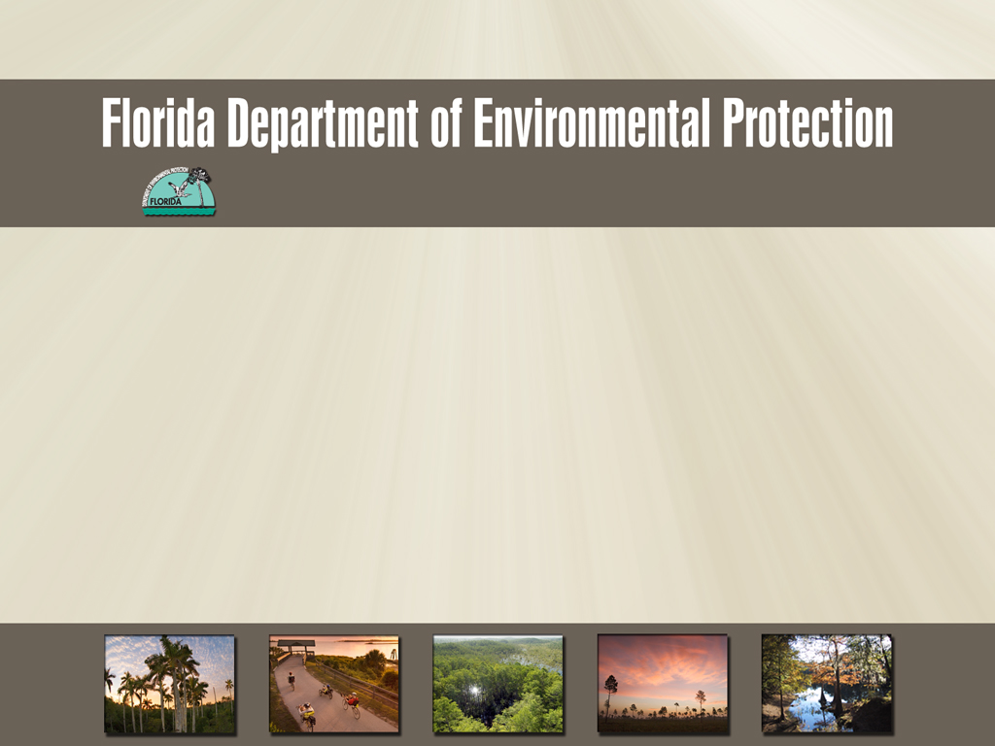
Southeast District
Asbestos Compliance Assistance
August 2013

Slide 2
Purpose
The Florida Department of Environmental Protection regulates asbestos containing materials and requires;
      Notification of all renovations removing regulated materials, and;
  Notification of all demolitions regardless of the presence of asbestos, and;
  Proper disposal
This presentation will cover FDEP requirements for asbestos removal and disposal and information on how to stay in compliance.

Slide 3
Scope and Objectives
To introduce the new online system to generate notifications.
Improve customer service with the industry.
Address multi-program topics (Air and Solid Waste)
To use compliance assistance to focus on the common areas of noncompliance.

Slide 4
Quick Review
Why is asbestos an Environmental concern?
Asbestos fibers are small and light, they can stay in the air for a long time and can be inhaled.
The fibers can easily penetrate body tissues once inhaled and may be deposited and retained in the airways and lung tissue.
Each exposure increases the likelihood of developing an asbestos-related disease
Notes:
Asbestos related diseases may not appear until years after exposure. Some diseases are Asbestosis: scarring of lung tissue due to asbestos fibers. It is usually caused by occupational exposure. Lung cancer: Smoking in combination with occupational exposure increase the risk of lung cancer. Mesothelioma: A rare cancer that occurs in the thin membrane lining of the lungs, chest, abdomen, and (rarely) heart that is directly caused by Asbestos exposure.

Slide 5
Asbestos Regulation
The U.S. Environmental Protection Agency (EPA) and the Occupational Safety and Health Administration (OSHA) are responsible for regulating environmental exposure and protecting workers from asbestos.
OSHA is responsible for the health and safety of workers who may be exposed to asbestos in the work place.
EPA is responsible for developing and enforcing regulations necessary to protect the general public from exposure to airborne contaminants that are known to be hazardous to human health.
Notes:
The EPA's Worker Protection extends the OSHA standards to state and local employees who perform asbestos work and who are not covered by by a state OSHA plan.

Slide 6
Asbestos Regulation
The Asbestos Hazard Emergency Response Act (AHERA) and its regulations require public school districts and non-profit schools including charter schools and schools affiliated with religious institutions to:
Notify the Local Education Agency
Inspect their schools for asbestos-containing building materials
Prepare management plans and to take action to prevent or reduce asbestos hazards
If removal of asbestos during renovation is warranted, or school buildings will be demolished, public school districts and non-profit schools must also comply with the NESHAP requirements as well.
AHERA rule below:
http://www.gpo.gov/fdsys/pkg/USCODE-2011-title15/pdf/USCODE-2011-title15-chap53-subchapII.pdf

Slide 7
Asbestos Regulation
Remember:
A threshold amount of regulated material is
  260 linear feet (80 linear meters), or
  160 square feet (15 square meters), or
  at least 35 cubic feet (1 cubic meter)
  of Regulated Asbestos Containing Materials (RACM).
Friable materials (RACM):
  contain more than 1% asbestos (as determined by Polarized Light Microscopy) that,
  when dry, may be crumbled, pulverized, or reduced to powder by hand pressure.

Slide 8
Rules
40 CFR61 Subpart M
  E.P.A asbestos NESHAP ‐The National Emission Standard for Hazardous Air Pollutants for asbestos
62‐204.800 Florida Administrative Code (F.A.C.)
  Adopts the NESHAP in whole
62‐257 F.A.C.
  Establishes fees based on materials
  Standardized form
  http://www.dep.state.fl.us/Air/emission/asbestos.htm FDEP website
469 FS
  Department of Business and Professional Regulation, asbestos abatement
Notes:
State of Florida has adopted the NESHAP in whole. On this slide there are links to all rules and also a link to our FDEP website which will take you to the notification form, rules, and contacts. You can also pay fees online.

Slide 9
Common Areas of Noncompliance
Demolition/renovation without notification or conducting asbestos survey
Late or incomplete notifications
Improper wetting and visual emissions
Uncertified supervisor or untrained workers
Improper disposal methods
Notes:
In this presentation, we will discuss the main areas of noncompliance and ways to stay in compliance with the NESHAPS. We will provide information and links to resources.

Slide 10
Notifications
The NESHAP requires that all threshold renovations and all demolitions need to follow the 10 day rule:
  Notifications need to be received 10 business days (including holidays that fall on a weekday) prior to the start of work.
  Except for an emergency which can notify the next day
  The Department uses the 10 days to review the notification and to schedule an inspection if necessary.
A courtesy notification is for projects where notification is not required by law.
  For example, a renovation that contains no asbestos.
  This is good for high visible projects that could have public inquiries or complaints.
Notes:
Not notifying, late or not revised notification is the most common violation. A courtesy could also be a renovation below the threshold amount of asbestos being removed. For a renovation, the start date is the day that the removal of asbestos-containing material, or any other asbestos-handling activities, including precleaning, construction of containment, or other activities that could disturb the asbestos, will begin

Slide 11
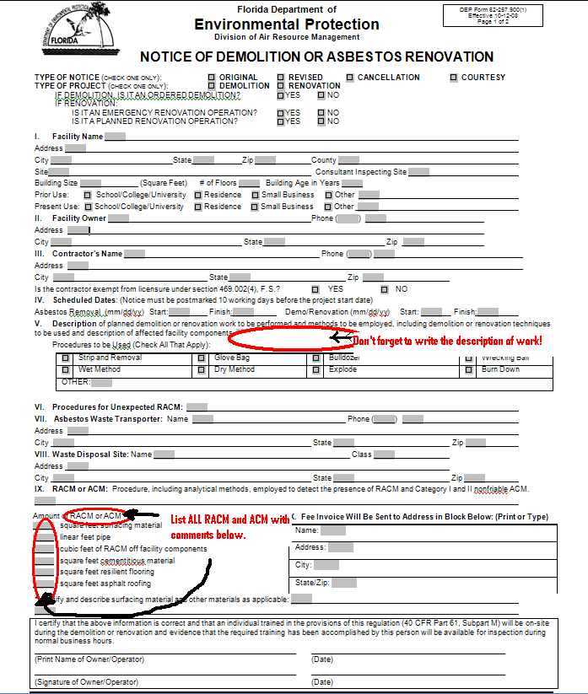
FDEP Notification
Fill out as much information as possible.
Located on our website
http://www.dep.state.fl.us/Air/emission/asbestos.htm
Notes:
This is the hard copy of the notification form. The link to it is on this page. Don’t forget to write a description of the work being done as well as checking off the procedures used. More than one procedure can be checked off if you are using different ones.
Dry method has to have prior approval from Tallahassee/EPA region 4
If asbestos removal and renovation/demolition dates are different, you can put both sets on one notification. Remember your 10 day starts when asbestos work starts, which includes any precleaning or construction of containment.
We also have started an online submittal process that I would like to discuss.

Slide 12
Online Notification Submittal
Go to: http://www.fldepportal.com/go/submit-registration/
Register with DEP; you will need to provide an email address.
From there, you will fill out a notification step by step
After you fill in the information, a notification will be generated and sent to the proper NESHAPS coordinator.
It will also generate any invoices for fees.
Notes:
We have just started a new online submittal process. This makes it easier to submit notifications to the correct NESHAPS contact person and get them in to start the 10 day clock quicker.

Slide 13
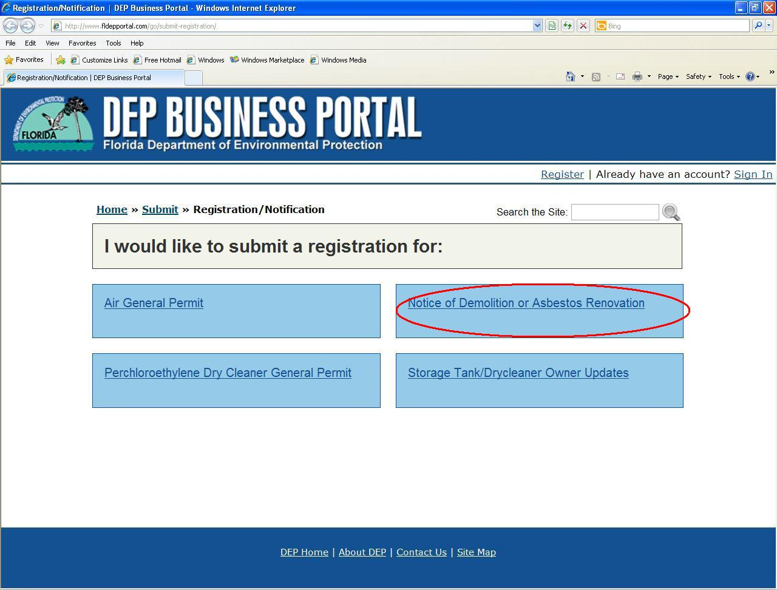
Online Submittal
Notes:
On the DEP Business portal website, there is now a section where you can submit an asbestos notification.

Slide 14
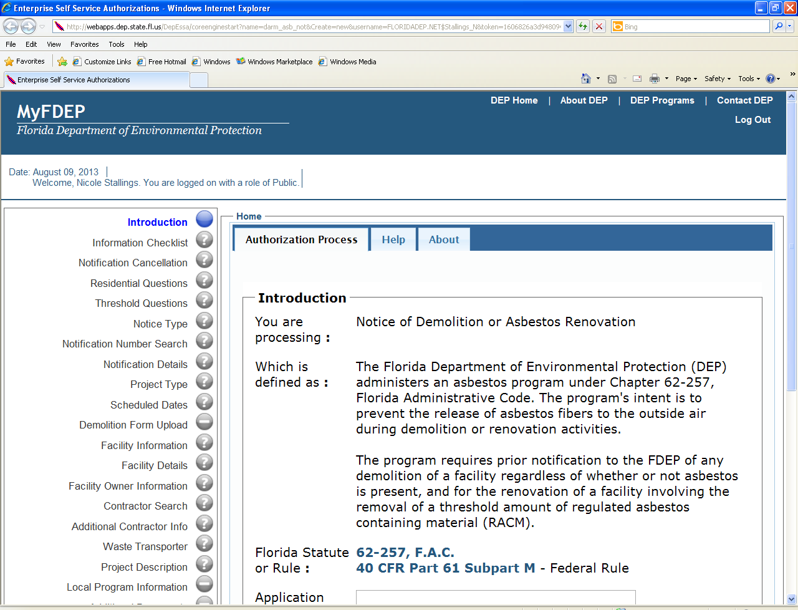
Online Submittal
Notes:
You can see on the left pane the steps to complete in the notification. You can stop in the middle and save it to complete at a later date. You can use the “Help” and “About” tabs to get more information on the screen you are on or who to contact if you run into problems.

Slide 15
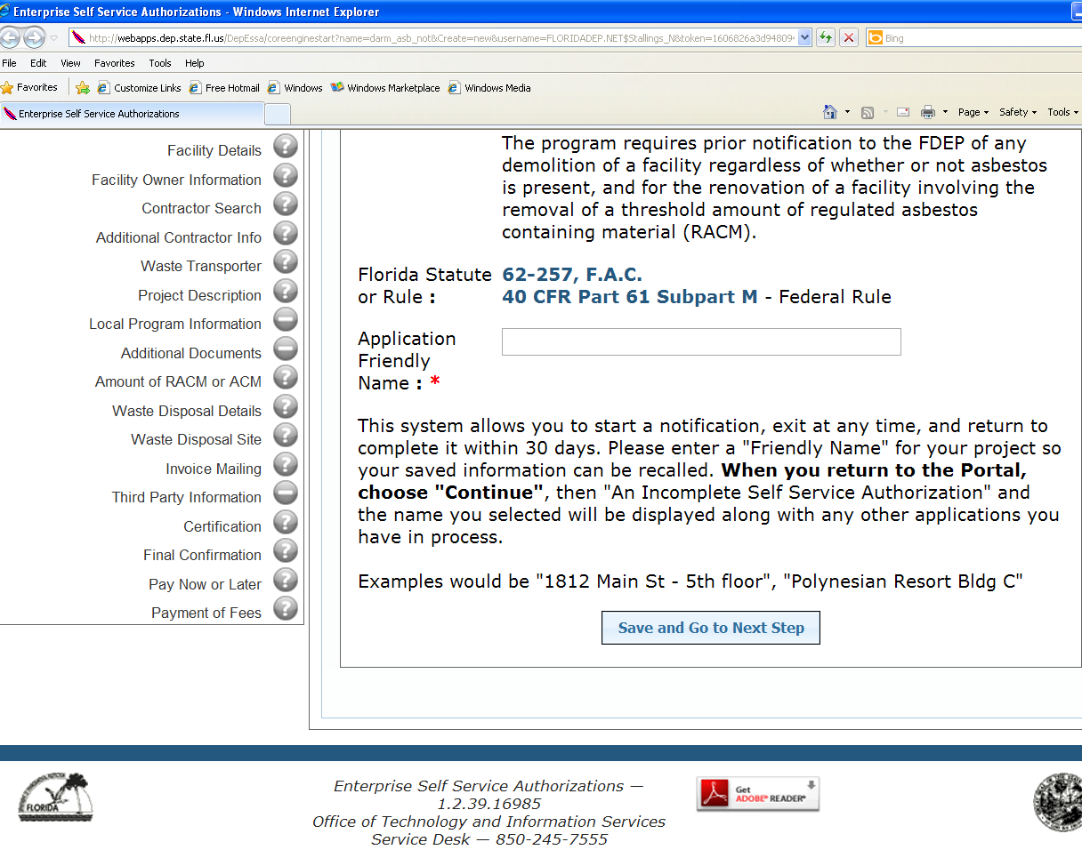
Online Submittal
Notes:
You can see at the bottom where you have the option to pay the fees online at the time of the submittal or later.

Slide 16
Adequately Wet
Adequately wet asbestos-containing waste material as follows:
Mix control device asbestos waste to form a slurry; adequately wet other asbestos-containing waste material
Discharge no visible emissions to the outside air from collection, mixing, wetting, and handling operations.
Seal all asbestos-containing waste material in leak-tight containers while wet or, put materials that will not fit into containers without additional breaking into leak-tight wrapping.
Label the containers or wrapped materials with warning labels specified by OSHA under 29 CFR 1910.1001(j)(4) or 1926.1101(k)(8). The labels shall be printed in letters of sufficient size and contrast so as to be readily visible and legible.
For asbestos-containing waste material to be transported off the facility site, label containers or wrapped materials with the name of the waste generator and the location at which the waste was generated.
Notes:
Not adequately wetting and causing visible emissions is another area of noncompliance. These suggestions for keeping down emissions comes straight from the NESHAPS asbestos rule.

Slide 17
Adequately Wetting and
Visual Emissions
To "adequately wet" ACM means to sufficiently mix or penetrate the material with liquid to prevent the release of particulates. If visible emissions are observed coming from ACM, then the material has not been adequately wetted.
Discharge no visible emissions to the outside air during the collection, processing (including incineration), packaging, or transporting of any asbestos-containing waste material generated by a source
Dry friable asbestos insulation on the ground violates the "adequately wet" requirement, and can be considered evidence of a visible emission.
Notes:
However, the absence of visible emissions is not evidence of being adequately wet.

Slide 18
Asbestos Emission Control
Remove all RACM from a facility being demolished or renovated before any activity begins that would disturb the material.
Adequately wet all RACM exposed during cutting or disjoining operations and carefully lower each unit or section to the floor not damaging or disturbing the RACM.
When RACM is stripped from a facility component while it remains in place in the facility, adequately wet the RACM during the stripping operation.
Notes:
This is taken directly from the NESHAPs rule.

Slide 19
Other Emission Control Methods
A local exhaust ventilation and collection system designed and operated to capture the particulate asbestos material produced by the stripping and removal of the asbestos materials. It must exhibit no visible emissions to the outside air
A glove-bag system designed and operated to contain the particulate asbestos material produced by the stripping of the asbestos materials.
Leak-tight wrapping to contain all RACM prior to dismantlement
Notes:
Dry removal requires written approval.

Slide 20
Remember:
For dry removal-
The owner or operator has to obtain prior written approval from the Administrator based on a written application that wetting to comply with the rules would unavoidably damage equipment or present a safety hazard.
A copy of the Administrator's written approval shall be kept at the worksite and made available for inspection.
Notes:
If you are not using a wet method, you need to have approval beforehand. You will also need to use the other emission control methods. Check with the NESHAPS coordinator for any exemptions to wet methods.

Slide 21
Waste Shipment Records
Maintain waste shipment records by including the following information:
The name, address, and telephone number of the waste generator.
The name and address of the local, State, or EPA Regional office NESHAP administrator.
The approximate quantity in cubic meters (cubic yards).
The name and telephone number of the disposal site operator.
The name and physical site location of the disposal site.
The date transported.
The name, address, and telephone number of the transporter(s).
A certification that the contents of this consignment are fully and accurately described by proper shipping name and are classified, packed, marked, and labeled, and are in all respects in proper condition for transport.

Slide 22
Training
The Asbestos NESHAP requires at least one trained supervisor, employed by the owner and/or operator to be present at any site where RACM is stripped, removed, or otherwise disturbed at any facility which is being demolished or renovated and is regulated by NESHAP.
Evidence of the training must be posted and made available for inspection at the demolition or renovation site.
Every 2 years the trained individual is required to receive refresher training. Information about the training and refresher courses is available from the Florida Department of Business and Professional Regulation at:
http://www.myfloridalicense.com/dbpr/pro/asbest/index.html.
Notes:
Training includes, at a minimum: applicability, notification, material identification, control procedures, waste disposal, reporting and record keeping, asbestos hazards and worker protection.

Slide 23
Solid Waste Disposal Options
Asbestos can be disposed of in a Class I or Class III landfill – the locations statewide are here: http://appprod.dep.state.fl.us/www_wacs/Reports/SW_Facility_Count.asp.
There are 43 active Class I and 36 Class III landfills

Slide 24
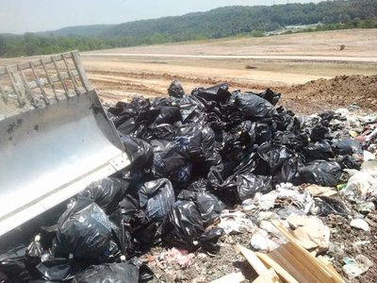
Asbestos
Asbestos-containing waste materials may be accepted for disposal at a permitted Class I or III landfill. Each active waste disposal site that receives asbestos-containing waste material from a source covered under the National Emission Standards for Asbestos must meet requirements of 40 CFR Part 61.154,

Slide 25
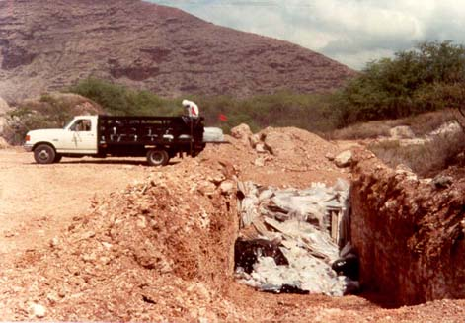
Class III Landfills
receive only yard trash, c&d debris, waste tires, asbestos, furniture other than appliances, or other materials approved by FDEP which are not expected to produce leachate which poses a threat to public health or the environment.

Slide 26
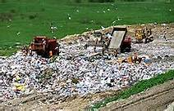
Class I Landfills
Receive generally, non-hazardous household, commercial, industrial, and agricultural wastes

Slide 27
Requirements for Accepting Asbestos Waste
The waste generator shall make arrangements with the landfill operator before disposal of regulated asbestos-containing waste materials, and inform the operator of the quantity of the waste and the scheduled date the shipment will arrive at the landfill.

Slide 28
Requirements for Accepting Asbestos Waste
The landfill operator shall direct the waste transporter to the designated disposal location. The disposal location shall be recorded in accordance with 40 CFR Part 61.154, and a record of the asbestos location shall be maintained.

Slide 29
Landfills That Take Asbestos
Medley Landfill
Palm Beach County Solid Waste Authority
South Dade Landfill
North Dade Landfill
Broward County Southwest Regional (Formerly BIC)
St. Lucie Balings and Recycling
Okeechobee Landfill
Indian River County Landfill

Slide 30
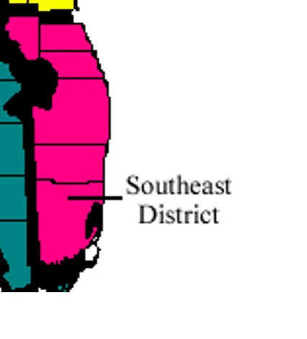
NESHAPS contacts in SE Florida
FDEP State Contact: Justin Green
Justin.B.Green@dep.state.fl.us
Indian River, St. Lucie, Martin, & Okeechobee Counties: Patricia Tampas, FDEP Southeast District
( patricia.tampas@dep.state.fl.us)
Palm Beach County: Alejandro Ortega, Palm Beach County Health Department
(Alejandro_Ortega@doh.state.fl.us)
Broward County: Walt Richards, Pollution Prevention, Remediation and Air Quality Division
(wrichards@broward.org)
Miami-Dade County: Ray Gordon, Division of Environmental Resources Management
(gordor@miamidade.gov )
***** If the project is county owned, the notification goes to the FDEP NESHAPS coordinator for the district the county is located.*****
Notes:
One of the most confusing parts of notifying is who to send the notification to… we take electronic notifications as well as fax and mail. For faxes it is a good idea to call to make sure the fax went through. We highly suggest using the new online submittal for your notifications.
The FDEP notification does not replace any county permits necessary for demolition/renovation work; be sure to check with each county to see what requirements they have.

Slide 31

Any Questions?????

