Slide 1


Florida Department of Environmental Protection
Concrete Batch Plant
Outreach Project
Air Resource Management
Northeast District Office

Slide 2

Project Team
Yasmin Enriquez
Scott Johnston
Marc Lovallo
Lary Perkins
(904) 256-1700

Slide 3
Concrete Batch Plant (CBP) General Permit (GP) Requirements

Slide 4
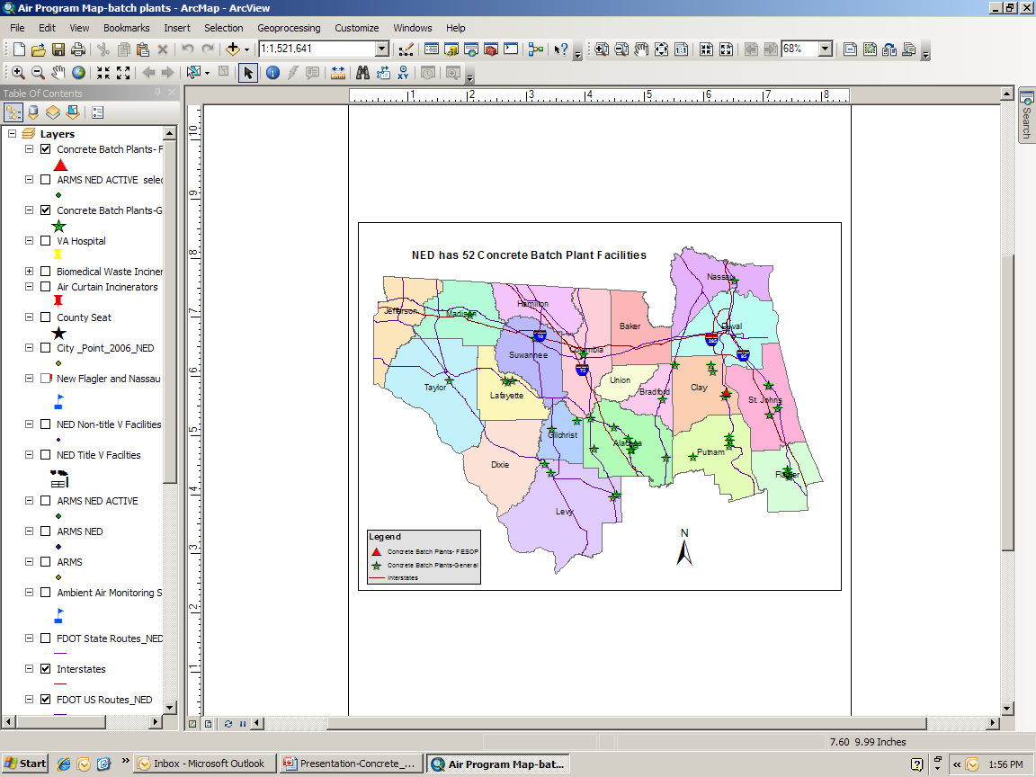

Slide 5
Definition of a CBP
Rule 62-296.414, F.A.C.
Concrete Batching Plants. The following requirements apply to new and existing emissions units producing concrete and concrete products by batching or mixing cement and other materials. This rule also applies to facilities processing cement and other materials for the purposes of producing concrete, and to equipment used to mix cement and soil for onsite soil augmentation or stabilization.

Slide 6
Concrete Batch Plant (CBP)
The use of an AG permit serves two purposes:
Provides notice to the Department that the facility is in operation and
Prescribes the requirements under which the facility is allowed to operate
(Rule 62-210.310(5)(b), F.A.C.)

Slide 7
  Air General Permit Eligibility Requirements
Must not emit 10 TPY or more of any listed Hazardous Air Pollutants (HAPs)
Or- 25 TPY or more of any combination of HAPs
OR- 100 TPY or more of any regulated air pollutant

Slide 8
Eligible Facilities That Collocate
[Rule 62-210.310(5)(b)4, F.A.C.]
A facility using the Concrete Batching Plant AG permit may collocate with other facilities:
That have separate concrete batching air general permits
With facilities using the Nonmetallic Mineral Processing Plant “crushers” AG permit, even if under the control of different persons.

Slide 9
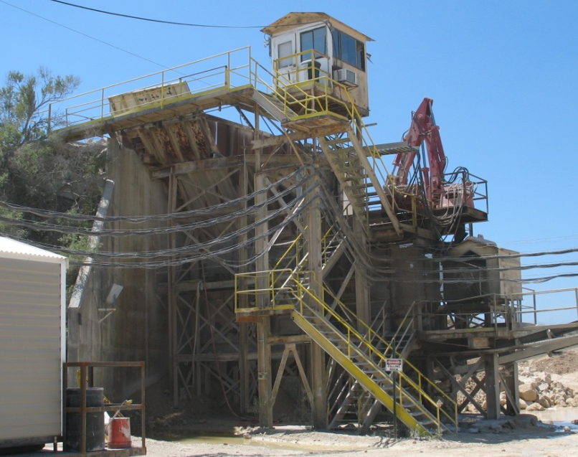
Collocate Requirements
[Rule 62-210.310(5)(b)4.a., F.A.C.]
The facility must meet the following conditions:
The collocation site must not contain any emission units and pollutant-emitting activities other than concrete batching plants and nonmetallic processing plants using the general permit, and nonmetallic mineral processing plants or other emissions units and pollutant-emitting activities exempted from permitting.

Slide 10
Collocate Requirements
[Rule 62-210.310(5)(b)5, F.A.C.]
Under the authority of an air general permit:
A relocatable CBP may perform a non-routine task
        making concrete for a construction project, at a facility with authorization by individual air construction or non-Title V Air Operating Permit, without revision to the facility’s air permit.
Any such CBP shall remain at the individually permitted facility for no more than:
        (6) months from the day it relocates to such facility.
The owner or operator of such concrete batching plant shall keep records to indicate how long the plant has been at the permitted facility.

Slide 11
General Conditions
[Rule 62-210.310(3), F.A.C.]
The duration of the Concrete Batching Plant AG permit is five (5) years. The owner /operator or authorized representative must submit the proper registration form and processing fee of $100.00 at least thirty (30) days prior to the expiration of the facility’s existing AG permit

Slide 12
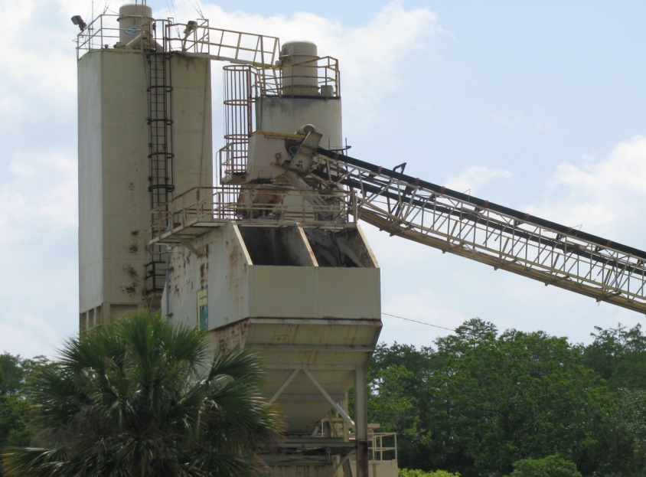
General Conditions
[Rule 62-210.310(3), F.A.C.]
If, for any reason, the owner or operator of any facility or emissions unit operating under an AG permit does not comply with or will be unable to comply with any condition or limitation of the permit, the owner or operator shall immediately provide the Department with:

Slide 13
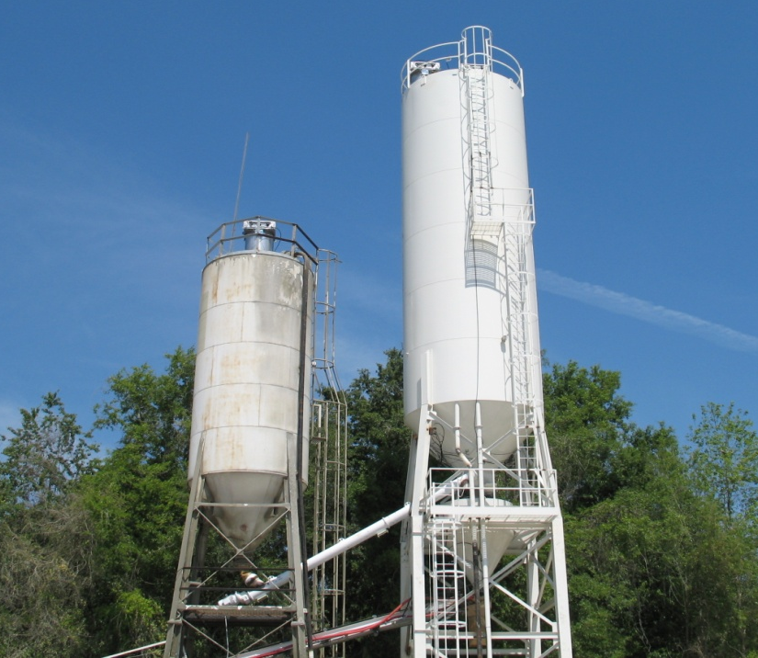
General Conditions
[Rule 62-210.310(3), F.A.C.]
A description of and cause of noncompliance; and,
The period of noncompliance, including dates and times; or, if not corrected, the anticipated time the noncompliance is expected to continue, and steps being taken to reduce, eliminate, and prevent recurrence of the noncompliance.

Slide 14
General Conditions
[Rule 62-210.310(3)n, F.A.C.]
Use of the AG permit does not eliminate or relieve the necessity for the owner/operator or authorized representative to obtain any other federal, state, or local permits that may be required.

Slide 15
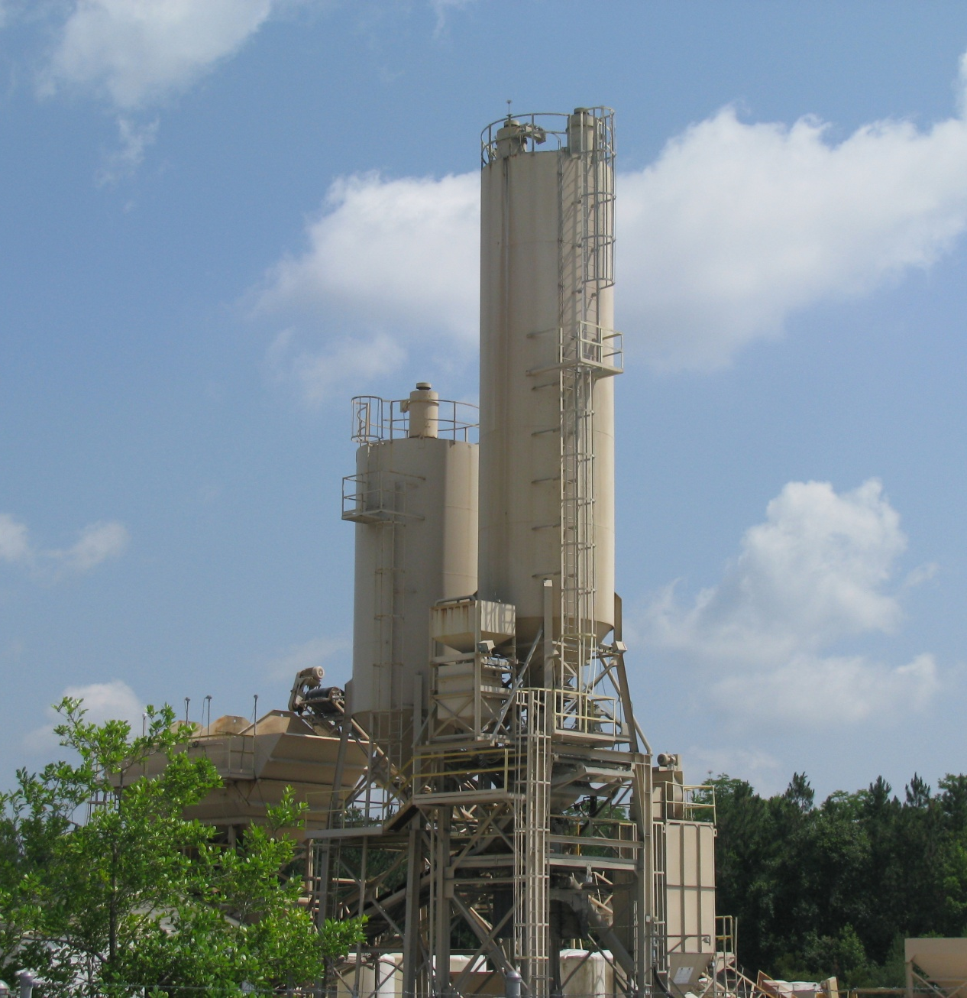
Control Technology

Slide 16
Control Technology requirements Rule 62-296.414(1),F.A.C.
1. Stack Emissions-Emissions from silos,
weigh hoppers (batchers), and other enclosed storage and conveying equipment shall be controlled to the extent necessary to limit visible emissions to 5 percent opacity.

Slide 17
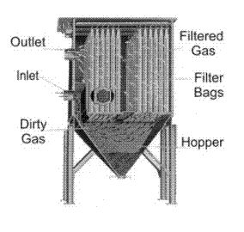
Control Technology Baghouse

Slide 18
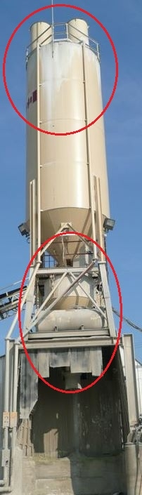
Baghouse Maintenance
Regularly scheduled preventative maintenance is important on a baghouse/dust collector.
An improperly running baghouse can be a production chokepoint, a hazard or an environmental problem.
Fixing minor problems before they become bigger ones are key to a successful operation.

Slide 19
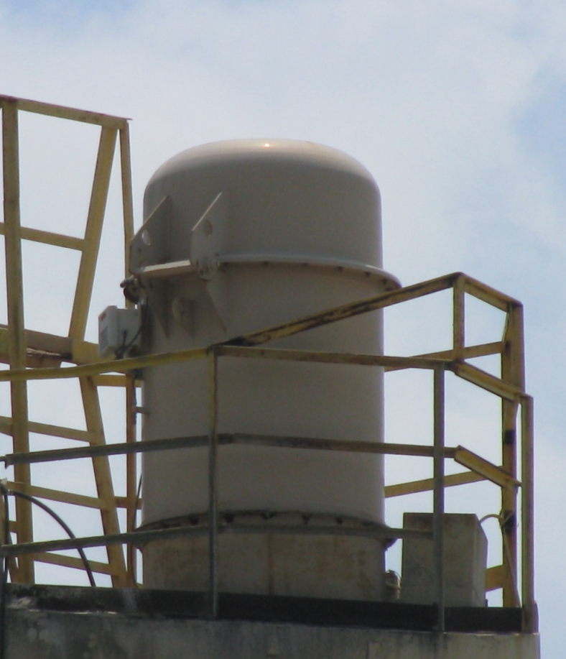
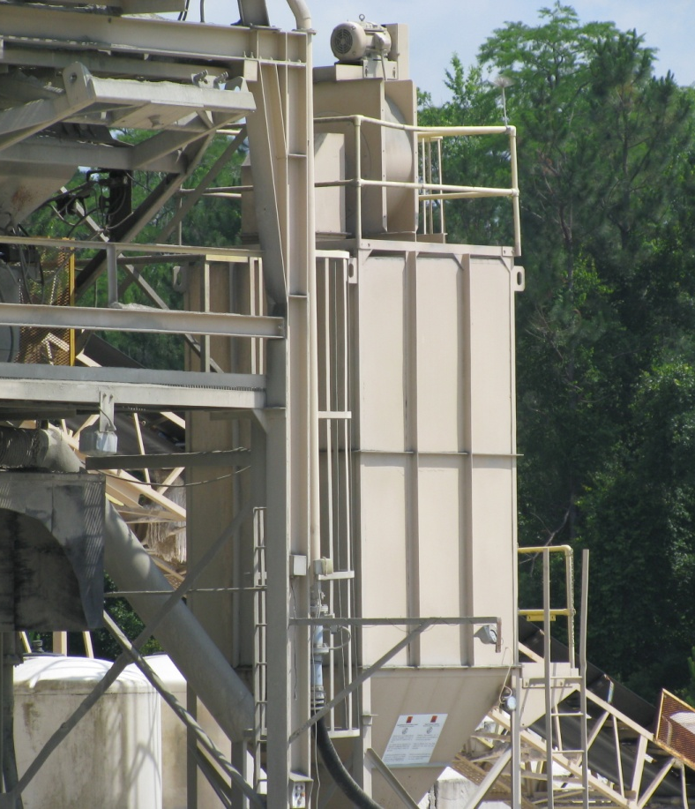
Control Technology
Cartridge Filter
Central Dust Collector

Slide 20
Control Technology requirements Rule 62-296.414(2),F.A.C.
Unconfined Emissions-The owner or operator shall take reasonable precautions
to control unconfined emissions from
hoppers, storage and conveying equipment, conveyor drop points, truck loading and unloading, roads, parking areas, stock piles and yards by doing the following:

Slide 21
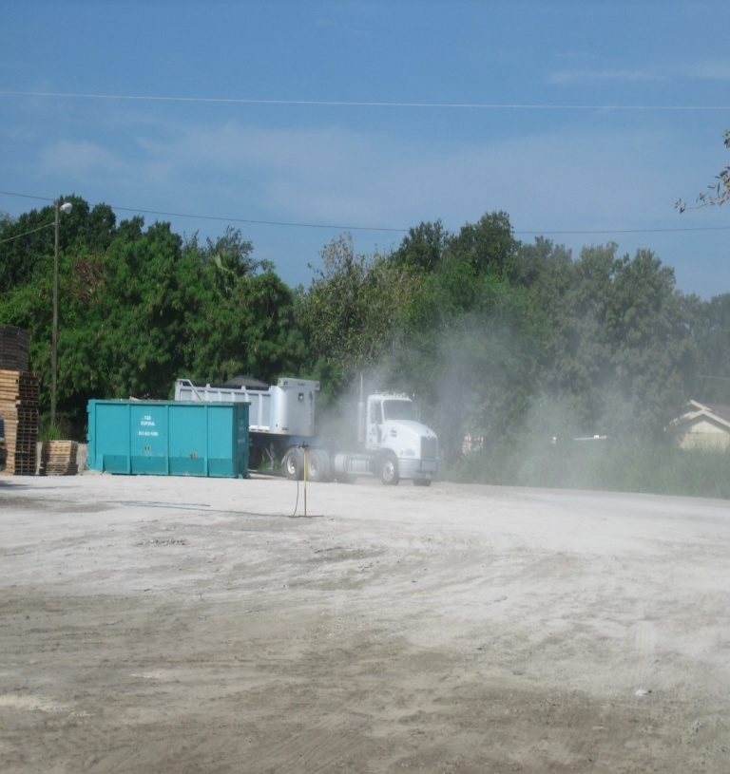
Control Technology –Unconfined Emissions
Rule 62-296.414(2),F.A.C.
a) Management of roads, parking areas,
stock piles, and yards, which shall include one or more of the following:

Slide 22
Control Technology-Unconfined Emissions
Rule 62-296.414(2),F.A.C.
  1. Paving and maintenance of roads, parking areas, and yards.
  2. Application of water or environmentally safe dust-suppressant chemicals when necessary to control emissions.
  3. Removal of particulate matter from roads and other paved areas under control of the owner or operator to mitigate reentrainment, from building or work areas to reduce airborne particulate matter from stock piles.
  4. Reduction of stock pile height or installation of wind breaks to mitigate wind entrainment of particulate matter from stock piles.

Slide 23
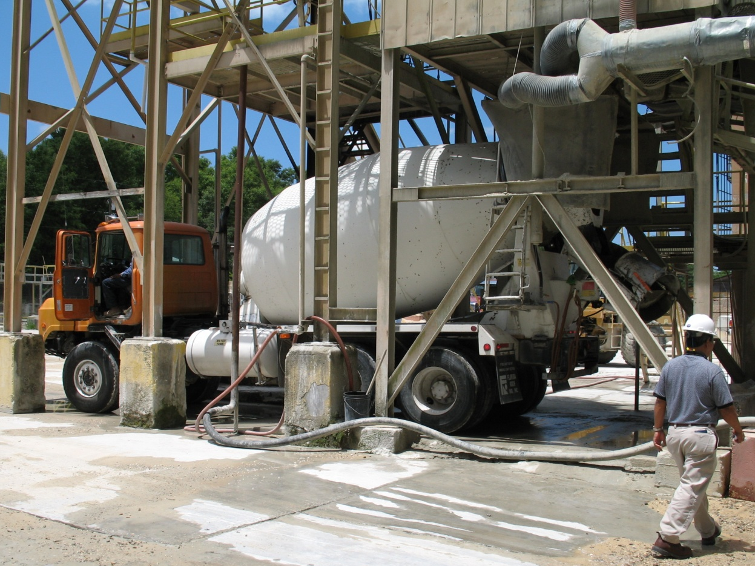
Control Technology-Unconfined Emissions
Rule 62-296.414(2),F.A.C.
b) Use of spray bar, chute, or partial enclosure to mitigate emissions at the drop point to the truck.

Slide 24
Visible Emission Test Methods and Procedures Rule 62-296.414(3), F.A.C.
All emissions tests performed pursuant to the requirements of this subsection shall comply with the following requirements.
The reference test method for visible emissions is EPA Method 9, 40 CFR 60 Appendix A
Test procedures that shall be followed are specified in Rule 62-297.310, F.A.C. and shall be reported to the Department. (15 day prior notice, list EU’s/within 45 days submitted)

Slide 25
Test Methods and Procedures
Rule 62-296.414(3), F.A.C.
    c) Visible emissions test of silo dust collector exhaust points shall be conducted:
    while loading the silo at a rate that represents the normal silo loading rate. The minimum loading rate shall be 25 tons per hour unless such a rate is unachievable in practice.
    If emissions from the weigh hopper (batcher) operation are also controlled by the silo dust collector, the batching operation shall be in operation during batching rate and duration.
    Each test report shall state the actual silo loading rate during emissions testing and, if applicable, whether or not batching occurred during emissions testing.

Slide 26
Test Methods and Procedures Rule 62-296.414(4), F.A.C.
The owner or operator of any concrete batching plant using the AG permit shall have a performance test conducted for visible emissions for each dust collector exhaust point no later than 30 days after commencing operation and once every calendar year thereafter.

Slide 27
Violations that resulted in non compliance, 2006-2011
15 total violations
4 SNC, 11 MNC
5 Excess emissions violations
3 Failed to perform VE test
3 Operating unpermitted machinery
2 Changed control device without notification
1 Fugitive dust emissions
1 Operating in excess of permitted rate

Slide 28
☑Reporting & Record-Keeping Relocation Requirements Rule 62-210.310(5)(b)3.b., F.A.C.
The owner or operator of equipment used to mix cement and soil for augmentation or stabilization proposing to change location shall notify the appropriate Department of Environmental Protection district office or local air pollution control program by phone, e-mail, fax, or written communication at least one business day prior to changing location and transmit a Facility Relocation Notification Form (DEP Form No. 62-210.900(6)) to the Department no later than five business day following relocation.

Slide 29
☑Reporting & Record-Keeping Relocation Requirements Rule 62-210.310(5)(b)3.b., F.A.C.
Any other relocatable concrete batching plant proposing to change location shall transmit a Facility Relocation Notification Form (DEP Form No. 62-210.900(6), F.A.C.) to the appropriate Department of Environmental Protection district or local air pollution control program office at least five (5) business days prior to relocation. The form and a statewide list of fax numbers are provided at the web link below for your convenience.
http://www.floridadep.org/air/rules/forms/relocation.htm

Slide 30
Temporary Facility/Emissions Unit Shutdown and Startup Guidance
Due to the current economic climate, there seem to be many permitted facilities that have temporarily shut down one or all of their emissions units. The purpose of this guidance is to review what is currently recommended in these situations.

Slide 31
Temporary Facility/Emissions Unit Shutdown and Startup Guidance
Compliance Testing
It is recommended that you not require a shutdown emissions unit to start-up in order to perform a compliance test by its due date, even if other parts of the facility are in operation. Please use care and reasonable judgment in evaluating the situation. For instance, even if there is activity at a concrete block plant but the cement silo itself is too full to accept a load of cement, the facility cannot be reasonably expected to test the filling of the silo for visible emissions until business improves and requires that a load of cement be delivered.

Slide 32
Any Questions, Comments?
Dickson E. Dibble , Div. of Air Resource Management
Air General Permit Program
(850) 717-9071
Dickson.Dibble@dep.state.fl.us

Slide 33
Compliance Checklist For
Concrete Batching Plants

Slide 34
General Requirements:
1. Has the owner/operator of the facility previously
submitted a DEP General Permit registration? □YES □NO
2. Does the facility keep records to show that it does not have the potential to emit:
a) 10 tons per year of or more of any hazardous air pollutant? □YES □NO
b) 25 tons per year or more of any combination of hazardous air
pollutants? □YES □NO
c) 100 tons per year or more of any other regulated air pollutant
□YES □NO
3. Did the facility provide written notification within 30 days of any administrative change to the facility or with a physical relocation of the facility or any of its emission units? □YES □NO

Slide 35
General Requirements:
4. Is the total combined annual facility wide fuel usage of less
than or equal to:
a) 275,000 gallons of diesel fuel? □YES □NO
b) 23,000 gallons of gasoline? □YES □NO
c) 44 million standard cubic feet of natural gas? □YES □NO
d) 1.3 million gallons of propane? □YES □NO
e) Or an equivalent prorated amount if multiple fuels are used? □YES □NO
5. Has the owner/operator maintained, available for inspection, records of monthly fuel consumption for each consecutive 12 month period for the past 5 years? □YES □NO

Slide 36
Emissions
1. Emissions from silos, weigh hoppers (batchers) and other enclosed storage and conveying equipment controlled to limit visible emissions to 5% opacity? □YES □NO
2. Management of roads, parking areas, stock piles and yards include one or more of the following?:
a) paving and maintenance of roads, parking areas and yards? □YES □NO
b) application of water or environmentally safe dust-suppressant chemicals to control emissions? □YES □NO
c) removal of particulate matter from roads and other paved areas near building and work areas? □YES □NO
d) installation of wind breaks or reduction of stockpile height? □YES □NO
3. Use of spray bar, chute or partial enclosure to mitigate emissions at the drop point to truck □YES □NO

Slide 37
Testing
1. Was a visible emissions test performed using EPA Method 9 in the last calendar year? □YES □NO
2. During testing of the silo dust collector exhaust points, was the loading of the silo conducted at a rate that is representative of the normal silo loading rate? □YES □NO
3. Was the minimum loading rate of 25 tons/hour achievable? □YES □NO
4. During testing of the weigh hopper (batcher) was the batching at a rate that is representative of the normal batching rate and duration? □YES □NO
5. VE test results filed with the DEP no later than 45 days after the test? □YES □NO

Slide 38
Credits:
The Northeast District would like to thank the the Southwest District Office. Several of the slides and some formatting were borrowed from their Online 2010 Workshop Guidance presentation.

