Slide 1
Compliance Assistance
Human and Animal Crematories

Slide 2
History
Burning corpses practiced since prehistoric times
Used in majority of funerals in Sweden during the Iron and Viking Ages.
In Western Roman Empire, cremation was standard until the 1st Century A.D. and was often associated with Military Honors

Slide 3
Cremation almost disappeared by the 5th Century A.D. during the spread of Christianity, except in unusual cases such as epidemics or war
Modern cremation began in the late 19th Century by Professor Brunetti.
The first modern crematory in the United States was established in Pennsylvania in 1876.
Today, cremation is practiced in at least 31 countries throughout the world.

Slide 4
Modern Crematories
Cremators are usually made of high-grade steel plate and lined inside with heavy refractory tile or brick.
Most cremators have a variety of automatic controls and use gas for heating the cremator.
1990 Clean Air Act classified crematories as medical waste incinerators and later as other solid waste incinerators.

Slide 5
Original 1990 regulation proposed for crematories was not based on any actual test data.
In 1999, costly and aggressive testing project with EPA and Cremation Association of North America takes place.
EPA decides not to regulate human or animal crematories.

Slide 6
Pollutants
Caused by combustion, incomplete combustion and the volatilization of metals in the body.
Particulate, carbon monoxide, nitrogen oxides, carbon dioxide, VOCs, hydrogen chloride, heavy metals and dioxins.

Slide 7
Secondary Chamber
Pollution control system for crematories.
Emissions of pollutants are controlled by controlling the temperature and residence time.
Volatilized carbon created in the combustion process is converted to carbon dioxide.
At least 1 second gas residence time required.

Slide 8
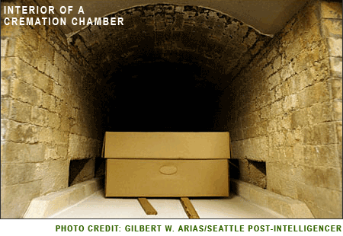
Primary Chamber

Slide 9
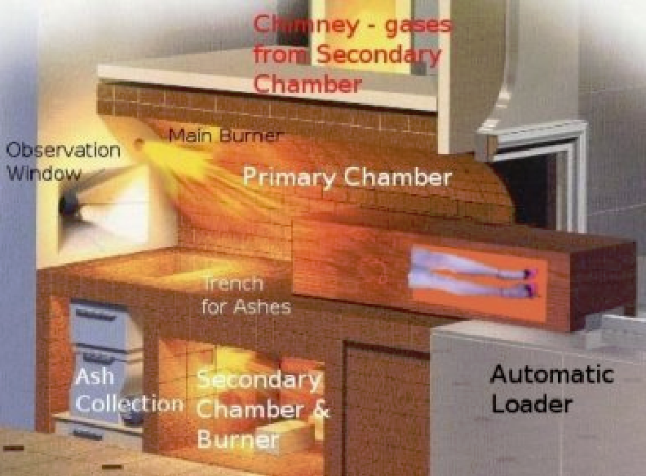
Crematory image

Slide 10
Prohibited Material
Human crematory units shall not incinerate other materials including biomedical waste.
Animal crematory units shall not cremate dead animals which were used for medical or commercial experimentation. No other material, including biomedical waste shall be incinerated.

Slide 11
Operational Requirements
Prior to August 30, 1989
Must maintain 1400 degrees F in the secondary chamber combustion zone.
Cremation in the primary chamber shall not begin unless the secondary chamber temperature is equal to or greater than 1400 degrees F.

Slide 12
Operational Requirements
After August 30, 1989
Secondary chamber must have sufficient volume to provide at least 1.0 seconds gas residence time at 1800 degrees F. Design calculations to confirm this must be submitted to the Department with the AG permit application

Slide 13
The actual operating temperature in the secondary chamber shall be no less than 1600 degrees F throughout the combustion process.
Cremation in the primary chamber shall not begin unless the secondary chamber combustion zone is equal to, or greater than 1600 degrees F.

Slide 14
Air General Permit
Eligibility Requirements
Must not emit 10 TPY or more of any listed HAP
Or – 25 TPY or more of any combination of HAPs
Or – 100 TPY or more of any regulated air pollutant

Slide 15
AG Permit Requirements
PM – not to exceed 0.080 grains per dry standard cubic feet of flue gas corrected to 7% oxygen
CO – not to exceed 100 PPM by volume, dry basis, corrected to 7% oxygen on an hourly basis
VE – limit to 5% opacity for up to 6 min. average with an exception for VE not to exceed 15% for 6 min. in any one hour period

Slide 16
Cremate only human or fetal remains with appropriate containers. Remains may be clothed.
Animal crematories shall cremate only animal remains and, if applicable, bedding associated with the animals and appropriate container.
Cremation containers shall have no more than 0.5%, by weight, chlorinated plastic – demonstrated by manufacturer’s certification. Certifying documents must be kept on file for at least 2 years

Slide 17
AG Permit valid only for the specific activity indicated
Facility must not emit objectionable odors.
  Objectionable odor is an odor present in the outdoor atmosphere which by itself or by combination with other odors, is or may be harmful or injurious to human health or welfare, which unreasonably interferes with the comfortable use and enjoyment of life or property, or which create a nuisance

Slide 18
Initial Compliance Testing
Conduct VE no later than 30 days after operation begins.
VE – every calendar year thereafter
CO & PM performance tests only required if the Department has good reason to require a Special Compliance test pursuant to 62-297.310 (5)(c), F.A.C.

Slide 19
Test Methods
VE – Method 9
CO – Method 10
O2 – Method 3
PM – Method 5 with minimum sample of 30dscf
Crematory shall be operated at the manufacturer’s recommended capacity. Human Cremator must be at a capacity of one adult sized cadaver

Slide 20
Florida Rules for Crematories
Chapter 403, Florida Statues
Chapter 62-4, Florida Administrative Code
Chapter 62-210, Florida Administrative Code
Chapter 62-296, Florida Administrative Code
Chapter 62-297, Florida Administrative Code

Slide 21
Common Crematory Violations
Overdue/Missing Test | 7
Missing Records | 3
Excess Emissions | 3
Equipment Malfunction | 2
Minimum Temperature | 2
Odor | 1

Slide 22
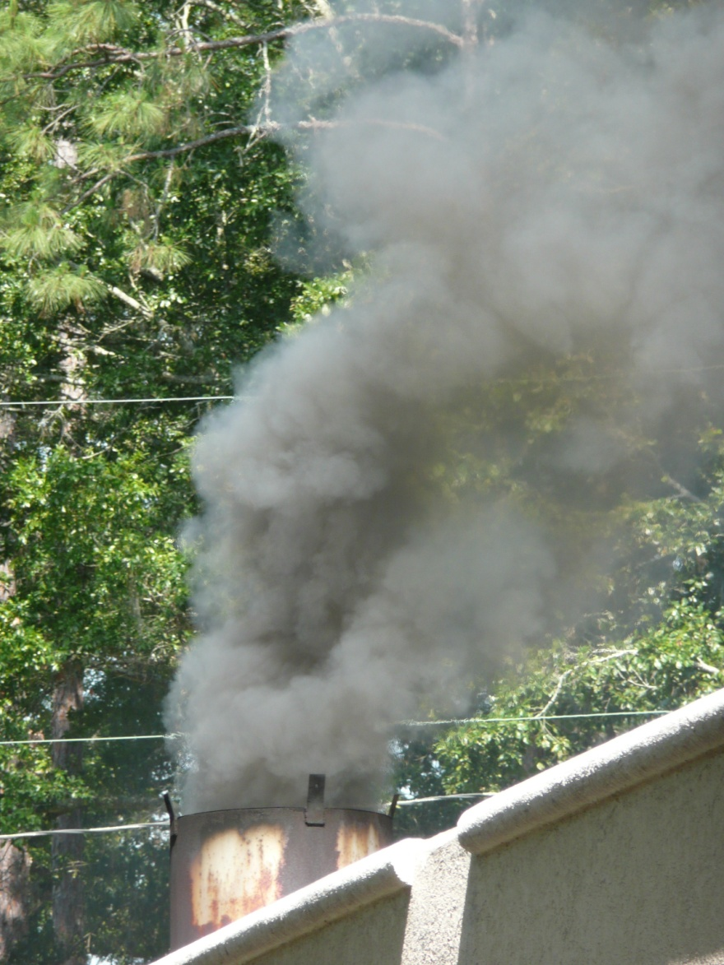
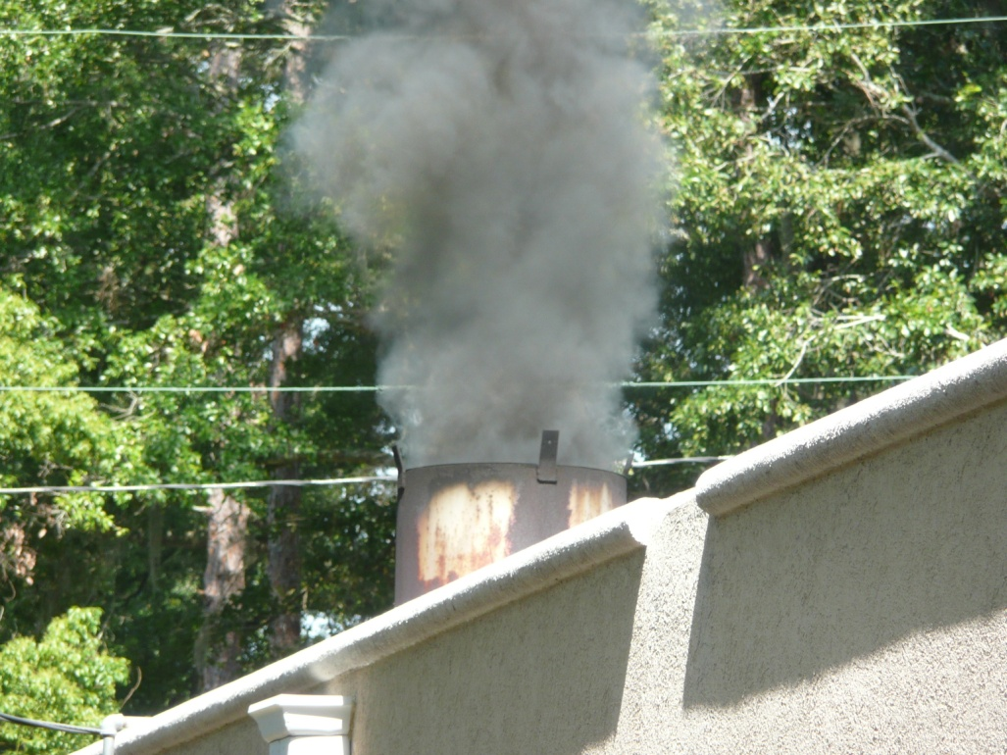
Excess Opacity

Slide 23
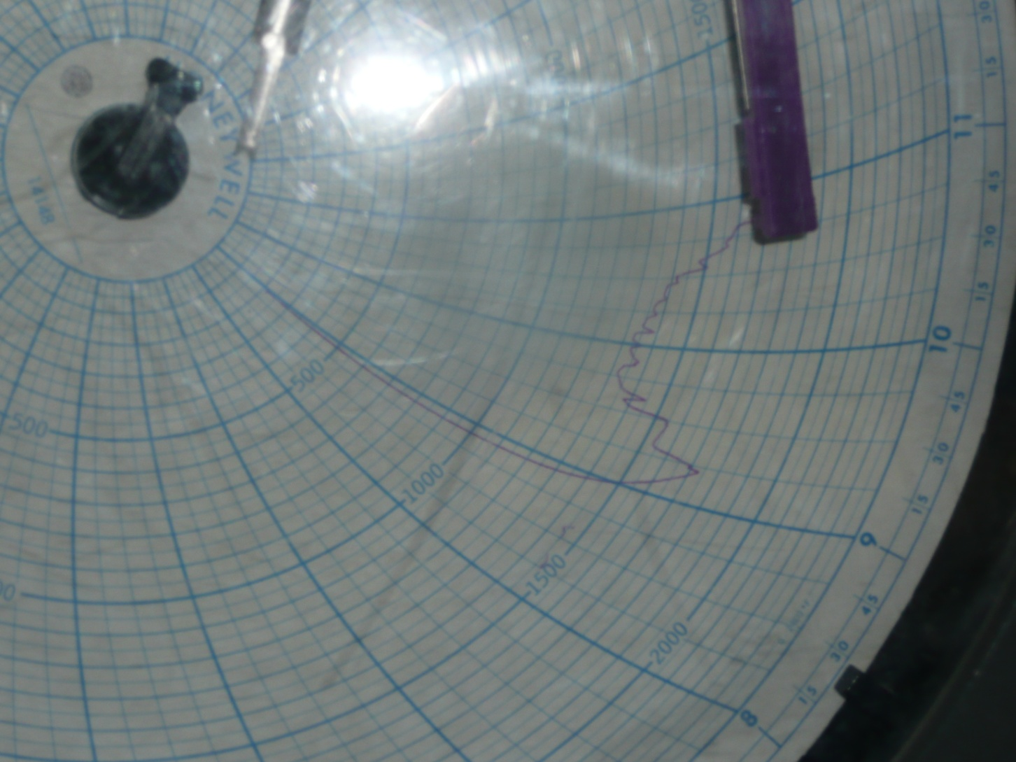
Temperature Chart – Out of Compliance

Slide 24
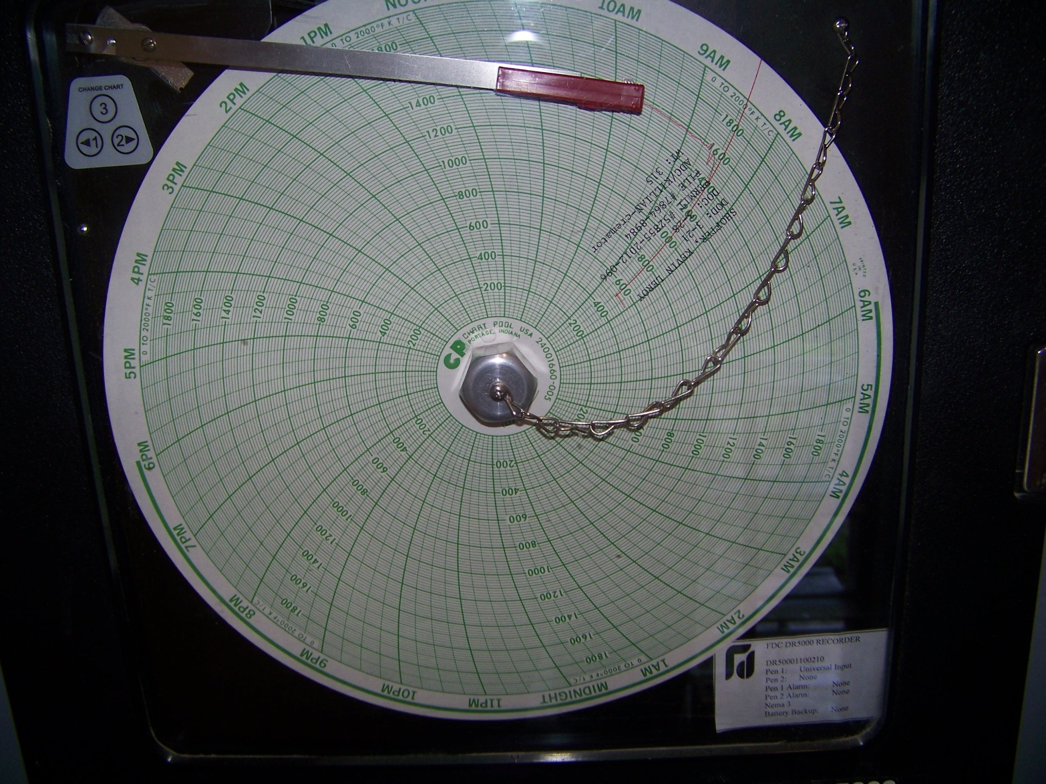
Temperature Chart- In Compliance

Slide 25
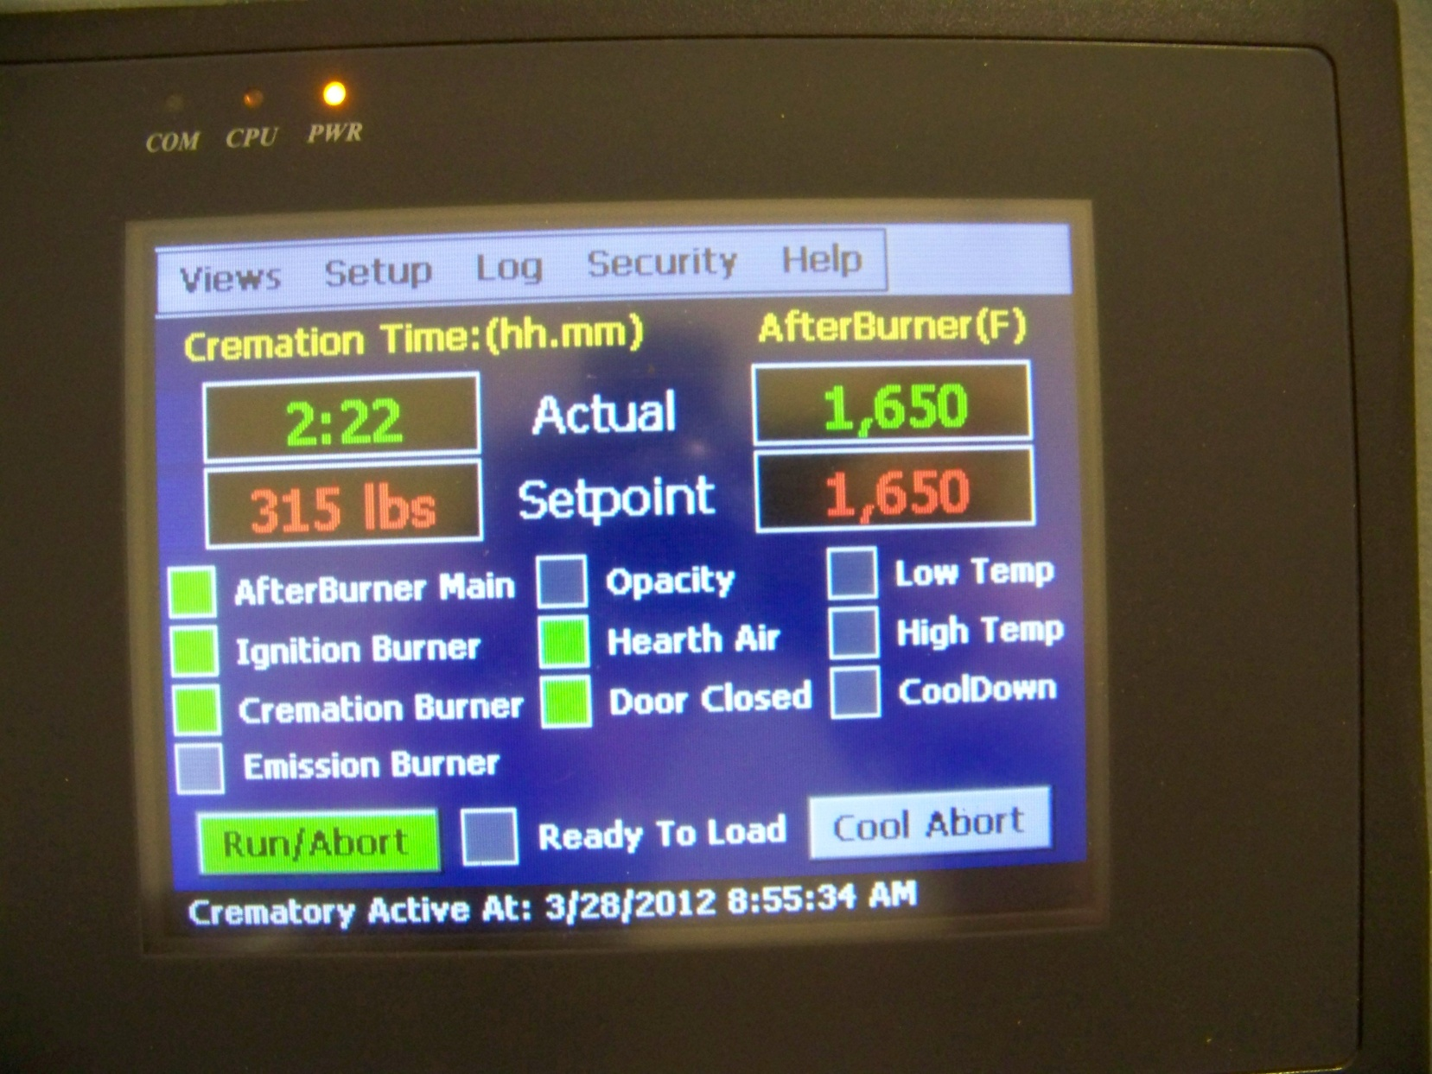
Control Panel

Slide 26
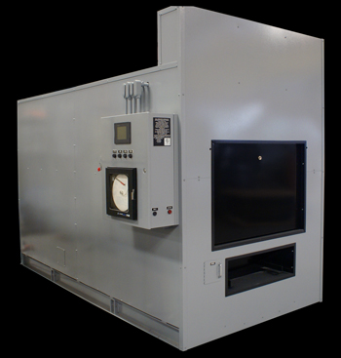
Crematory

Slide 27
Crematory Air Regulation Guidelines Poster

Slide 28
Compliance Checklist For
Human and Animal Crematories

Slide 29
General Operating Requirements:
Has the owner/operator of the facility previously
submitted a DEP General Permit registration? □YES □NO
2. Only human or fetal remains with appropriate
containers or clothing incinerated in unit? □YES □NO
3. For animal crematories, only animal remains (other than animals
that were used for medical or commercial experimentation)
and if applicable, the associated bedding and/or
containers incinerated in unit? □YES □NO

Slide 30
4. Do cremation containers contain no more than
0.5% by weight chlorinated plastics? □YES □NO
5. If yes, is the certifying documentation from the manufacturer kept on file for at least 2 years? □YES □NO
6. Operating temperature of secondary chamber
combustion zone no less than 1600 °F before and throughout the cremation process in the primary chamber? □YES □NO

Slide 31
7. If the crematory unit was installed after 2/1/07, is it equipped with a pollutant monitoring system that automatically restricts combustion in the primary chamber whenever any opacity exceeds 15% opacity? □YES □NO
8. Is there a written startup, shutdown and malfunction plan onsite? □YES □NO

Slide 32
Monitoring and Recordkeeping
Are the following records kept on file, available for inspection, for at least the past two years?
1. All temperature measurements □YES □NO
2. All CEMS or monitoring device measurements and calibration checks? □YES □NO
3. Preventive and corrective maintenance performed on system/devices? □YES □NO
4. Temperature charts with operator name, indication of when cremation in primary chamber began, date, time and temperature markings? □YES □NO
Notes:
During the pres

Slide 33
Visible Emissions Testing
A visible emissions test conducted every
calendar year cremating an adult sized cadaver? □YES □NO
2. For animal crematories, was the test conducted with the unit operating at a capacity that is representative of normal operations? □YES □NO
3. Results of VE test resulted in opacity of 5% or less or not exceeding 15% opacity in the highest 6-minute average? □YES □NO
4. The Department notified at least 15 days in
advance of the test? □YES □NO

Slide 34
