Slide 1
Air General Permit Non-Metallic Mineral Processing Plants

Slide 2
Commonly known as Crushers
A crusher is a machine designed to reduce large rocks into smaller rocks, gravel, or rock dust.
Reduce size or change form of materials so they may be recycled, disposed of or further processed.

Slide 3
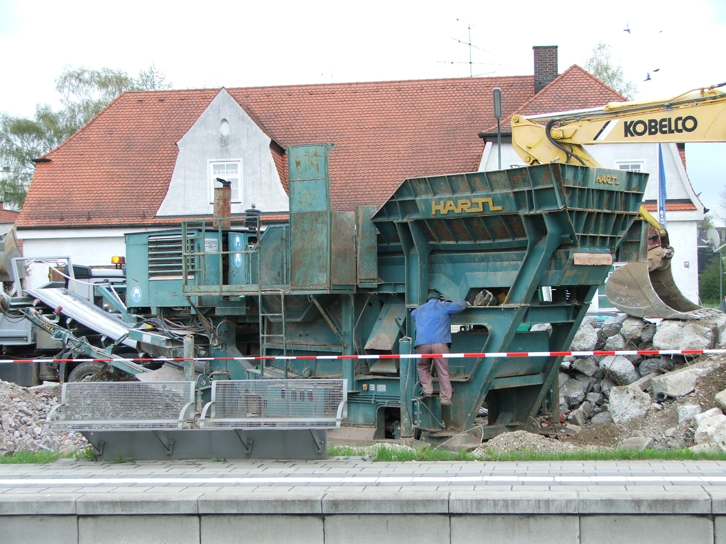
Mobile Crusher

Slide 4
NMMP Rule: 62-210.310(5)(e) F.A.C.
Air General Permit for Facilities Comprising Nonmetallic Mineral Processing Plants
Specific Conditions
  Fuel consumption limits
  Controlling unconfined particulate matter
  Controlling yard dust
  General visible emission requirement
  Subpart OOO requirements
    Title 40, Code of Federal Regulations (CFR), Part 60, Subpart OOO; 60.670-676
  Initial performance tests
  Annual performance tests
  Relocation requirements
Conditions for collocation
Non-routine use at non-Title V facilities

Slide 5
Fuel Consumption Limits

Slide 6
    Total fuel consumption shall not exceed:
      23,000 gallons per year of gasoline
      275,000 gallons per year of diesel
      1.3 million gallons per year of propane
      44 million standard cubic feet per year of natural gas
      Equivalent amount if multiple fuels used.

Slide 7
Controlling Unconfined Particulate Matter

Slide 8
Unconfined emissions from plants processing dry material shall be controlled by a wet suppression system with spray bars located wherever unconfined emissions occur.
Exception: located at mines or quarries and processing only material from onsite natural deposits.

Slide 9
    Unconfined emissions generated by vehicular traffic or wind shall be controlled by applying water (by water trucks equipped with spray bars) or effective dust suppressants on a regular basis to all stockpiles, roadways and work yards where the nonmetallic mineral processing plant is located.

Slide 10
General Visible Emissions Requirement
    Visible emissions from any emission point not subject to Subpart OOO shall be less than 20% opacity.

Slide 11
40 CFR 60 Subpart OOO Requirements
Nonmetallic mineral means any of the following minerals or any mixture of which the majority is any of the following minerals:
Crushed and Broken Stone, including Limestone, Dolomite, Granite, Traprock, Sandstone, Quartz, Quartzite, Marl, Marble, Slate, Shale, Oil Shale, and Shell.
Sand and Gravel.
Clay including Kaolin, Fireclay, Bentonite, Fuller's Earth, Ball Clay, and Common Clay.
Rock Salt.
Gypsum (natural or synthetic).
Sodium Compounds, including Sodium Carbonate, Sodium Chloride, and Sodium Sulfate.
Pumice.
Gilsonite.
Talc and Pyrophyllite.
Boron, including Borax, Kernite, and Colemanite.
Barite.
Fluorospar.
Feldspar.
Diatomite.
Perlite.
Vermiculite.
Mica.
Kyanite, including Andalusite, Sillimanite, Topaz, and Dumortierite.

Slide 12
40 CFR 60 Subpart OOO Requirements
The Subpart is applicable to the following affected facilities*:
Crusher
Grinding Mill
Screening Operation
Bucket Elevator
Belt Conveyor
Bagging Operation
Storage Bin
Enclosed Truck or Railcar Loading Station
*In the context of 40 CFR 60 Subpart OOO, “affected facilities” refers to facility components.

Slide 13
40 CFR 60 Subpart OOO Requirements
The Subpart is applicable to the following affected facilities*:
Crushers and grinding mills, and subsequent affected facilities up to, but not including, the first storage silo or bin at hot mix asphalt facilities that reduce the size of nonmetallic minerals embedded in recycled asphalt pavement.
i.e. RAP Crusher Systems
*In the context of 40 CFR 60 Subpart OOO, “affected facilities” refers to facility components.

Slide 14
40 CFR 60 Subpart OOO Requirements
An affected facility that commences construction, modification, or reconstruction after August 31, 1983, is subject to the requirements of this Subpart.

Slide 15
40 CFR 60 Subpart OOO Requirements
The Subpart Does Not apply to:
All facilities located in underground mines
Plants without crushers or grinding mills above ground

Slide 16
40 CFR 60 Subpart OOO Requirements
The Subpart Does Not apply to:
Fixed sand and gravel plants and crushed stone plants with capacities of 25 tons per hour or less;
Portable sand and gravel plants and crushed stone plants with capacities of 150 tons per hour or less;
Capacity means the cumulative rated capacity of all initial crushers that are part of the plant.
Initial crusher means any crusher into which nonmetallic minerals can be fed without prior crushing in the plant

Slide 17
When it comes to capacity…
Capacity means the cumulative rated capacity of all initial crushers that are part of the plant.
Initial crusher means any crusher into which nonmetallic minerals can be fed without prior crushing in the plant
The design capacity of the crusher is used to determine applicability of NSPS subpart OOO, rather than the intended throughput capacity an owner or operator proposes to utilize.

Slide 18
40 CFR 60 Subpart OOO Requirements
The Subpart Does Not apply to:
Common clay plants and pumice plants with capacities of 10 tons per hour or less
Capacity means the cumulative rated capacity of all initial crushers that are part of the plant.
Initial crusher means any crusher into which nonmetallic minerals can be fed without prior crushing in the plant

Slide 19

Scope
There are additional standards and requirements of 40 CFR 60 Subpart OOO not discussed within this presentation.
The scope is limited to affected facilities that are generally a part of a portable NMMPP operation.

Slide 20

40 CFR 60 Subpart OOO Requirements
Construction, Modification, Reconstruction after August 31, 1983, but prior to April 22, 2008
April 22, 2008
Construction, Modification, Reconstruction on or after April 22, 2008

Slide 21
After August 31, 1983, but prior to
April 22,2008
Fugitive Emissions (where a capture system is not used) shall not exceed
10 percent opacity
Grinding mills, screening operations, bucket elevators, transfer points on belt conveyors, bagging operations, storage bins, enclosed truck or railcar loading stations or from any other affected facility (as defined by the Subpart)
15 percent opacity
Crushers
* and for fugitive emissions escaping capture systems.

Slide 22
On or After April 22,2008
Fugitive Emissions (where a capture system is not used) shall not exceed
7 percent opacity
Grinding mills, screening operations, bucket elevators, transfer points on belt conveyors, bagging operations, storage bins, enclosed truck or railcar loading stations or from any other affected facility (as defined by the Subpart)
12 percent opacity
Crushers
* and for fugitive emissions escaping capture systems.

Slide 23
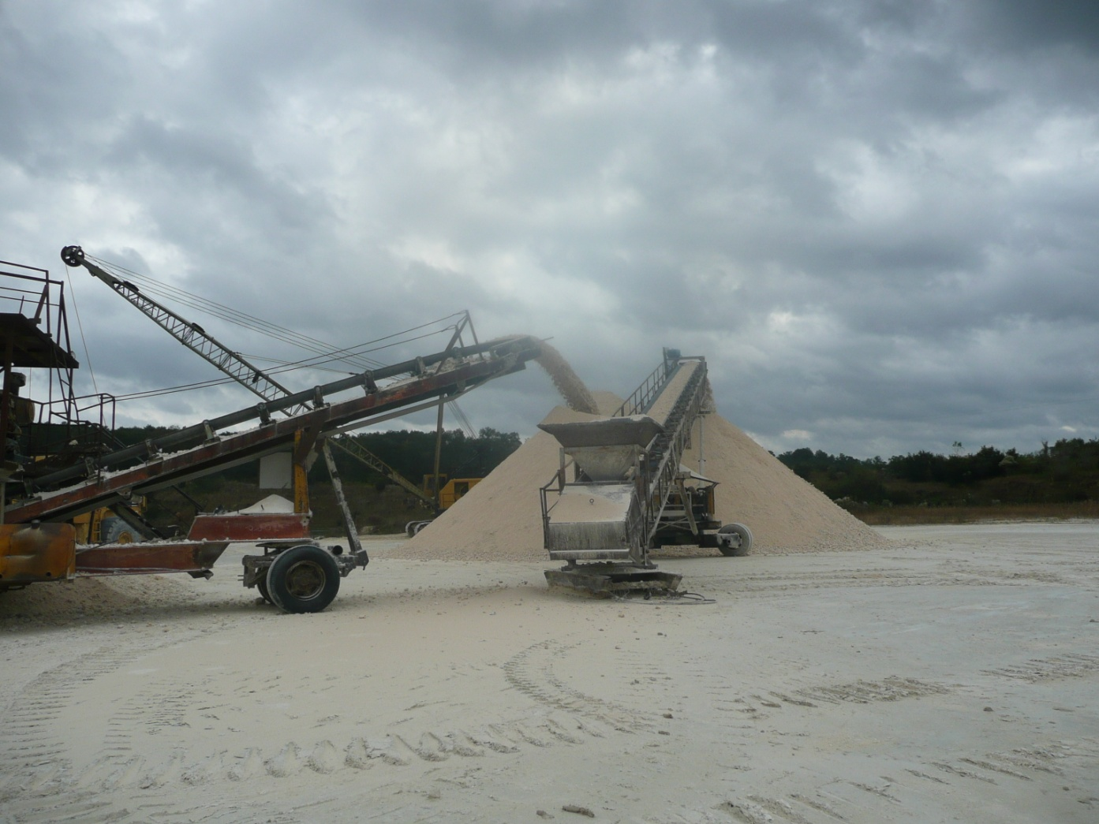
Transfer Point
Transfer point means a point in a conveying operation where the nonmetallic mineral is transferred to or from a belt conveyor except where the nonmetallic mineral is being transferred to a stockpile.

Slide 24
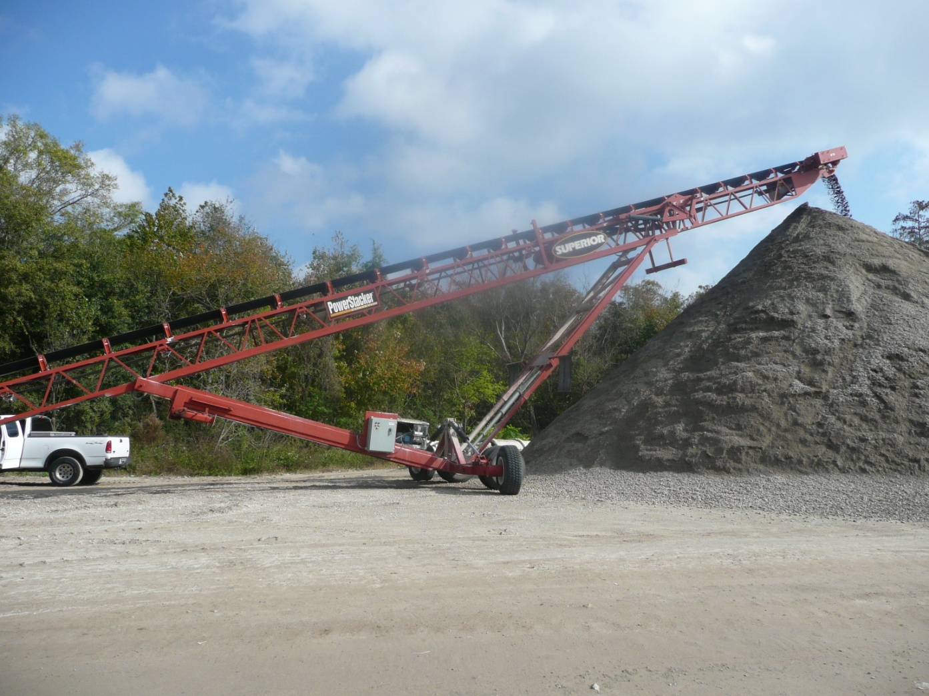
Transfer Point
Transfer point means a point in a conveying operation where the nonmetallic mineral is transferred to or from a belt conveyor except where the nonmetallic mineral is being transferred to a stockpile.

Slide 25
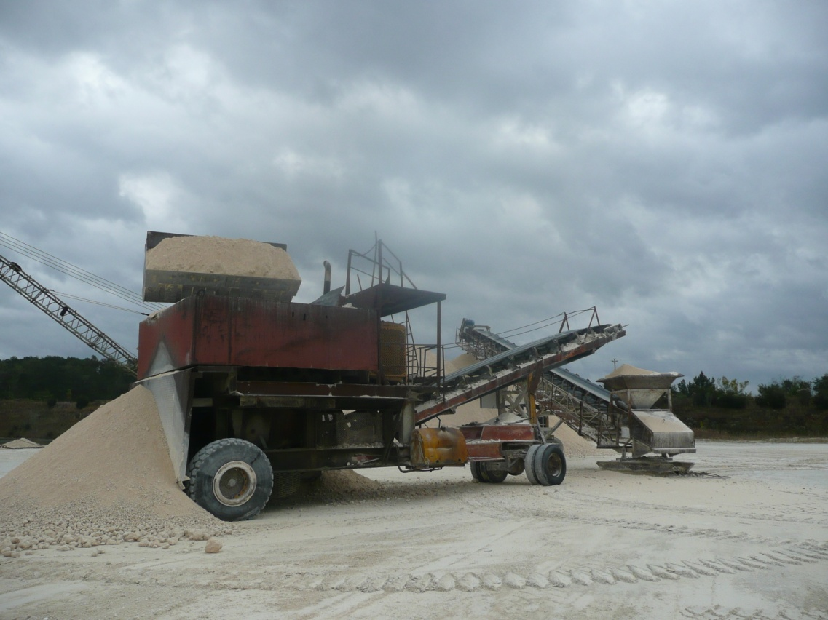
Exception to fugitive emissions standards
Truck Dumping of nonmetallic minerals into any screening operation, feed hopper, or crusher is exempt from these requirements.
Truck dumping means the unloading of nonmetallic minerals from movable vehicles designed to transport nonmetallic minerals from one location to another. Movable vehicles include but are not limited to: Trucks, front end loaders, skip hoists, and railcars.
* Therefore, the emissions from this activity must be separated from emissions originating directly from the affected facility.

Slide 26
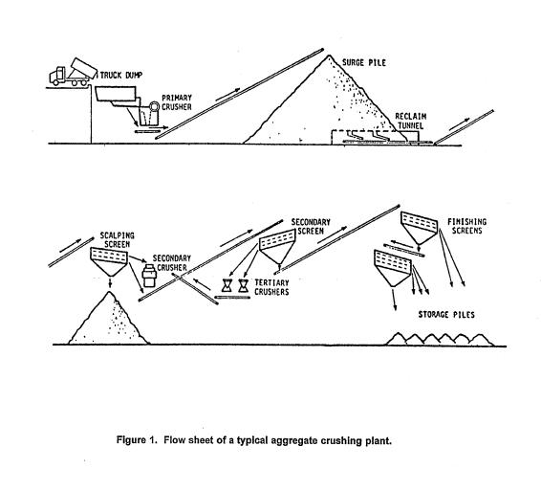
Conveyor transfer
Point (underbelt to stacker): 10%
Truck dumping: <20% standard, no testing
Conveyor to stock pile: <20% standard, no testing
Crusher (in & out), 15% standard
Screening: 10%
EPA Regulatory and Inspection Manual for Nonmetallic Minerals Processing Plants (305-B-97-008)

Slide 27
Initial Performance Tests
As it applies to NMMPs operating under the Air General Permit in Rule 62-210.310(5)(e), F.A.C.
Nonmetallic mineral processing plants subject to 40 CFR Part 60, 40 CFR 60 Subpart OOO shall conduct initial performance tests for particulate matter and visible emissions in accordance with all requirements of 40 CFR 60 Subpart OOO and Subpart A.

Slide 28
Initial Performance Tests
      Within 60 days after achieving the maximum production rate at which the affected facility will be operated, but not later than 180 days after initial startup of such facility, the owner or operator shall conduct performance test(s) and furnish the Administrator a written report of the results of such performance test(s).

Slide 29
Annual Performance Test
As it applies to NMMPs operating under the Air General Permit in Rule 62-210.310(5)(e), F.A.C.
For facilities subject to 40 CFR 60 Subpart OOO, performance tests for visible emissions shall be conducted annually.
VE tests in accordance with the test methods and procedures set forth at 40 CFR 60 Subpart OOO.
  Annual is once within each calendar year (January 1- December 31)
    Guidance Document No. DARM-OGG-18
    http://www.dep.state.fl.us/air/rules/guidance/ogg18.pdf

Slide 30
Test Method and Procedures
Visible Emissions
EPA Method 9 and the procedures in §60.11 shall be used to determine opacity with the following additions:
(i) The minimum distance between the observer and the emission source shall be 4.57 meters (15 feet).
(ii) The observer shall, when possible, select a position that minimizes interference from other fugitive emission sources ( e.g., road dust). The required observer position relative to the sun (Method 9 of Appendix A–4 of this part, Section 2.1) must be followed.

Slide 31
Test Method and Procedures
Visible Emissions
(iii) For affected facilities using wet dust suppression for particulate matter control, a visible mist is sometimes generated by the spray. The water mist must not be confused with particulate matter emissions and is not to be considered a visible emission. When a water mist of this nature is present, the observation of emissions is to be made at a point in the plume where the mist is no longer visible.

Slide 32
Test Method and Procedures
Visible Emissions- Test Duration
The duration of the Method 9 (40 CFR part 60, Appendix A–4) observations must be 30 minutes (five 6-minute averages).
Compliance with the applicable fugitive emission limits must be based on the average of the five 6-minute averages.

Slide 33
Test Method and Procedures
Visible Emissions - Alternative Methods
If emissions from two or more facilities continuously interfere so that the opacity of fugitive emissions from an individual affected facility cannot be read, either of the following procedures may be used:
Use for the combined emission stream the highest fugitive opacity standard applicable to any of the individual affected facilities contributing to the emissions stream.
(2) Separate the emissions so that the opacity of emissions from each affected facility can be read

Slide 34
Test Method and Procedures
Visible Emissions - Alternative Methods
A single visible emission observer may conduct visible emission observations for up to three fugitive emission points within a 15-second interval if the following conditions are met:
(1) No more than three emission points may be read concurrently.
(2) All three emission points must be within a 70 degree viewing sector or angle in front of the observer such that the proper sun position can be maintained for all three points.
(3) If an opacity reading for any one of the three emission points equals or exceeds the applicable standard, then the observer must stop taking readings for the other two points and continue reading just that single point.

Slide 35
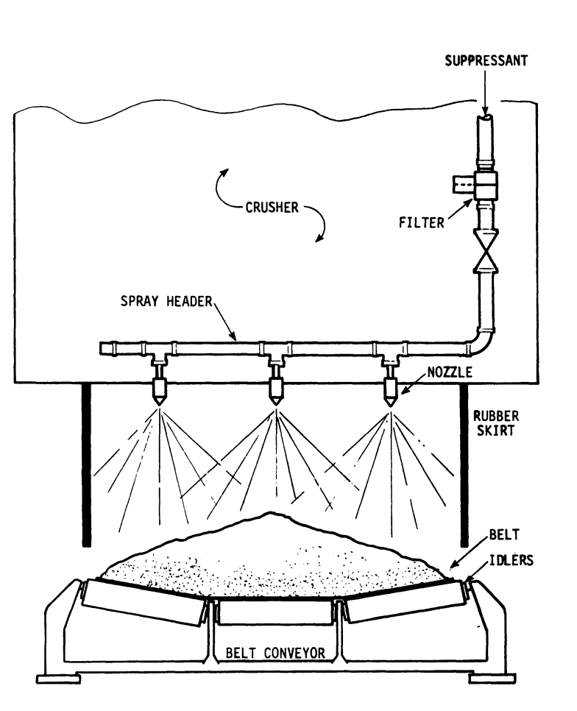
Monitoring Requirements
For those affected facilities construction, modified, reconstructed on or after April 22, 2008
Wet suppression systems
Owner or operator must perform monthly periodic inspections to check that water is flowing to discharge spray nozzles.
Water Suppression system
Figure from EPA Regulatory and Inspection Manual for Nonmetallic Minerals Processing Plants
(305-B-97-008)

Slide 36
Monitoring Requirements
For those affected facilities construction, modified, reconstructed on or after April 22, 2008
Wet suppression Systems
If during the Inspection of water spray nozzles, the operator finds water not flowing properly
The owner or operator must initiate corrective action within 24 hours and complete corrective action as expediently as practical.
The owner or operator must record each inspection of the water spray nozzles, including the date of each inspection and any corrective actions taken, in the logbook required under §60.676(b).

Slide 37
Monitoring Requirements
For those affected facilities construction, modified, reconstructed on or after April 22, 2008
Wet suppression Systems
If an affected facility that routinely uses wet suppression water sprays ceases operation of the water sprays or is using a control mechanism to reduce fugitive emissions other than water sprays during the monthly inspection (for example, water from recent rainfall), the logbook entry required under §60.676(b) must specify the control mechanism being used instead of the water sprays.

Slide 38
Recordkeeping and Reporting Requirements
For those affected facilities construction, modified, reconstructed on or after April 22, 2008
Owners or operators of affected facilities must record each periodic inspection required wet suppression systems including dates and any corrective actions taken, in a logbook (in written or electronic format).
The owner or operator must keep the logbook onsite and make hard or electronic copies (whichever is requested) of the logbook available to the Administrator upon request.

Slide 39
Recordkeeping and Reporting Requirements
For those affected facilities construction, modified, reconstructed on or after April 22, 2008
A notification of the actual date of initial startup of each affected facility shall be submitted to the Administrator.
For a combination of affected facilities in a production line that begin actual initial startup on the same day, a single notification of startup may be submitted by the owner or operator to the Administrator. The notification shall be postmarked within 15 days after such date and shall include a description of each affected facility, equipment manufacturer, and serial number of the equipment, if available.
For portable aggregate processing plants, the notification of the actual date of initial startup shall include both the home office and the current address or location of the portable plant.

Slide 40
Summary
As it applies to NMMPs operating under the Air General Permit in Rule 62-210.310(5)(e), F.A.C
 | The owner or operator must meet the following fugitive emissions limit for grinding mills, screening operations, bucket elevators, transfer points on belt conveyors, bagging operations, storage bins, enclosed truck or railcar loading stations or from any other affected facility (as defined in §§ 60.670 and 60.671) | The owner or operator must meet the following fugitive emissions limit for crushers at which a capture system is not used | The owner or operator must demonstrate compliance with these limits by conducting | Regulation/Rule
Emission points not subject to 40 CFR 60 Subpart OOO | 20 percent opacity | 20 percent opacity | No test required | Rule 62-210.310(5)(e)d., F.A.C.
Affected facilities (as defined in §§ 60.670 and 60.671) that commenced construction, modification, or reconstruction after August 31, 1983 but before April 22, 2008. | 10 percent opacity | 15 percent opacity | An initial performance test according to § 60.11 of this part and 60.675 of this subpart. | Rule 62-210.310(5)(e)e., F.A.C. 40 CFR 60 Subpart OOO, 60.675(c)
 |  |  | Annual performance test for visible emissions. Test methods and procedures pursuant to 40 CFR 60 Subpart OOO | Rule 62-210.310(5)(e)e., F.A.C.
 |  |  | Notifications of visible emissions tests and test results in accordance with the provisions of Rule 62-297.310, F.A.C. | Rule 62-210.310(5)(e)e., F.A.C.

Slide 41
Summary
As it applies to NMMPs operating under the Air General Permit in Rule 62-210.310(5)(e), F.A.C
 | The owner or operator must meet the following fugitive emissions limit for grinding mills, screening operations, bucket elevators, transfer points on belt conveyors, bagging operations, storage bins, enclosed truck or railcar loading stations or from any other affected facility (as defined in §§ 60.670 and 60.671) | The owner or operator must meet the following fugitive emissions limit for crushers at which a capture system is not used | The owner or operator must demonstrate compliance with these limits by conducting | Regulation/Rule
Affected facilities (as defined in §§ 60.670 and 60.671) that commence construction, modification, or reconstruction on or after April 22, 2008. | 7 percent opacity | 12 percent opacity | An initial performance test according to § 60.11 of this part and §60.675 of this subpart; and | Rule 62-210.310(5)(e)e., F.A.C. 40 CFR 60 Subpart OOO, 60.675(c)
 |  |  | Annual performance test for visible emissions. Test methods and procedures pursuant to 40 CFR 60 Subpart OOO | Rule 62-210.310(5)(e)e., F.A.C.
 |  |  | Notifications of visible emissions tests and test results in accordance with the provisions of Rule 62-297.310, F.A.C. | Rule 62-210.310(5)(e)e., F.A.C.
 |  |  | Periodic inspections of water sprays Water not flowing properly initiate corrective action within 24 hours and complete corrective action as expediently as practical. | 40 CFR 60 Subpart OOO, 60.674(b)

Slide 42
Summary
As it applies to NMMPs operating under the Air General Permit in Rule 62-210.310(5)(e), F.A.C
 | The owner or operator must meet the following fugitive emissions limit for grinding mills, screening operations, bucket elevators, transfer points on belt conveyors, bagging operations, storage bins, enclosed truck or railcar loading stations or from any other affected facility (as defined in §§ 60.670 and 60.671) | The owner or operator must meet the following fugitive emissions limit for crushers at which a capture system is not used | The owner or operator must demonstrate compliance with these limits by conducting | Regulation/Rule
Affected facilities (as defined in §§ 60.670 and 60.671) that commence construction, modification, or reconstruction on or after April 22, 2008. | 7 percent opacity | 12 percent opacity | Record each inspection of the water spray nozzles, including any corrective actions taken, in the logbook If an affected facility that routinely uses wet suppression water sprays ceases operation of the water sprays or is using a control mechanism other than water sprays during the monthly inspection (for example, water from recent rainfall), the logbook entry must specify the control mechanism being used instead of the water sprays. | 40 CFR 60 Subpart OOO, 60.674(b) 40 CFR 60 Subpart OOO, 60.674(b)(2)

Slide 43
Relocation Requirements
Relocation requires notification to the Department by telephone, e-mail, fax, or written communication at least one business day prior to moving and transmit by e-mail, fax, post or courier, a Facility Relocation Notification Form no later than five business days following relocation.

Slide 44
Collocation Requirements
Site-wide fuel usage limitations apply to the collocation site.
Recordkeeping requirements:
The owners or operators of all collocated concrete batching plants and NMMP plants shall maintain records to account for site-wide fuel consumption for each calendar month and each consecutive twelve months. The owners or operators shall retain these records, available for Department inspection, for at least five years.

Slide 45
Non-routine Operation at Non-Title V Facilities
Non-routine use at facilities with air construction or air operation permits is allowed as long as the following conditions are met:
  The NMMP plant must not be located at a single site for more than six months in any consecutive 12 months
  Records must be kept that indicate how long the NMMP plant has been at the permitted facility
  No NMMP plant using an air general permit shall perform a routine task at a permitted facility unless the NMMP plant operation is authorized by the permitted facility’s AC or AO permit. RAP crushing at an asphalt plant is considered a routine task.

Slide 47
Questions? Comments? Insights?
Advice?
Missouri Department of Natural Resources Guide to 40 CFR Subpart OOO: http://www.dnr.mo.gov/pubs/pub2387.pdf
E-CFR Page for Subpart OOO: http://ecfr.gpoaccess.gov/cgi/t/text/text-idx?c=ecfr&rgn=div6&view=text&node=40:12.0.1.1.1.11&idno=40
State Rule: http://www.dep.state.fl.us/air/rules/fac/62-210.pdf

