Slide 1
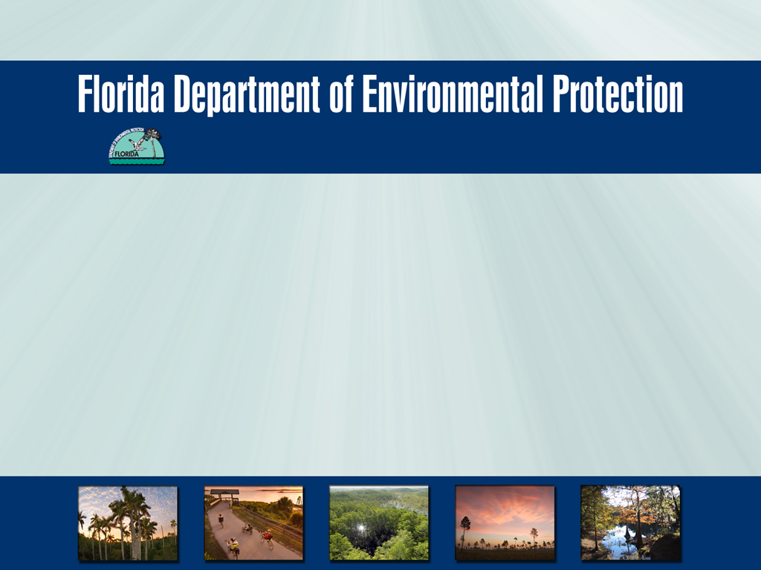
Southeast District Office
Dry Cleaning Facility
Compliance Assistance Outreach
2013

Slide 2
Purpose
The Florida DEP regulates dry cleaning facilities that use Perchloroethylene (Perc) and other non aqueous solvents. These solvents are effective at cleaning and are used by many professional dry cleaners, but are also considered toxic chemicals with both environmental and human health concerns. This presentation will discuss how to stay in compliance across air and waste programs.
Notes:
This includes spotting chemicals.

Slide 3
Scope and Objectives
Use Compliance Assistance to focus on common areas of noncompliance.
Increase the number of electronic Air permit registrations using the FDEP business portal.
Address multi-program topics (Air, Hazardous Waste, Waste Cleanup)
Improve customer service with the industry.

Slide 4
Dry Cleaner Air Rules
Rule 62-213.300 F.A.C
Rule 62-210.310 (5) (f) F.A.C
40 C.F.R Part 63 Subpart M

Slide 5
Air General Permit
All dry cleaning facilities that use perc must operate under an Air General Permit.
The responsible official must complete the registration form 30 days prior to beginning operations or 30 days prior to fifth anniversary for renewal.
The duration of the general permit is 5 years and the registration fee is $100.00 (this is separate from the annual State Registration fee).
The general permit is not transferable. Prior to sale, change of ownership or permanent shutdown of the facility, the responsible official should notify the Department.
Register for air general permit online at: http://www.dep.state.fl.us/air/emission/agpers.htm
For more information, visit our Small Business Environmental Assistance Program page at http://www.dep.state.fl.us/air/emission/sbeap/sbeap.htm
Or call (850) 717-9106 for more help.

Slide 6
Common Air Violations
Missing/Incomplete records
Operating without a permit
Missing equipment (leak detectors)

Slide 7
Recordkeeping Requirements
Dry Cleaners have to keep the following records on-site for a minimum of 5 years:
  Purchase receipts for perc and monthly consumption logs (including a 12- month rolling total of perc use).
  All leak detection and repair reports.
  The date and monitoring results on control equipment, such as the Carbon Adsorber, or temperature readings on the Refrigerated Condenser.
  A startup, shutdown and malfunction plan as well as an on-site copy of the operating manuals for each dry-cleaning system and emission control device used at the facility.

Slide 8
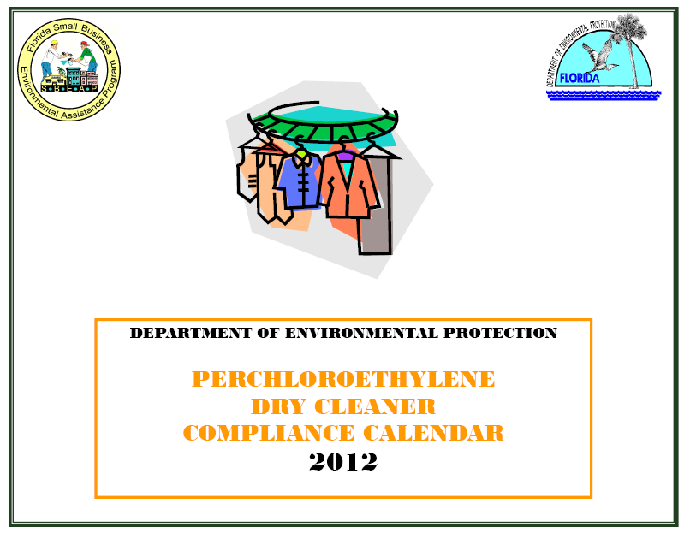
FDEP Air compliance calendar
Almost all dry cleaners use the FDEP Compliance calendar.
Follow instructions in calendar to get perc 12-month rolling totals.
Also record leak detection results in calendar.

Slide 9
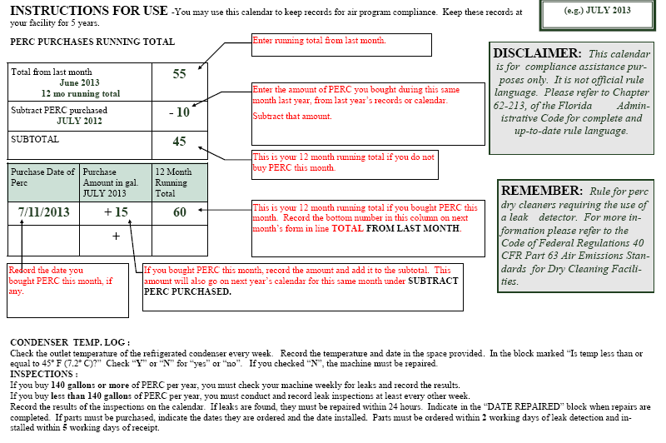

Slide 10
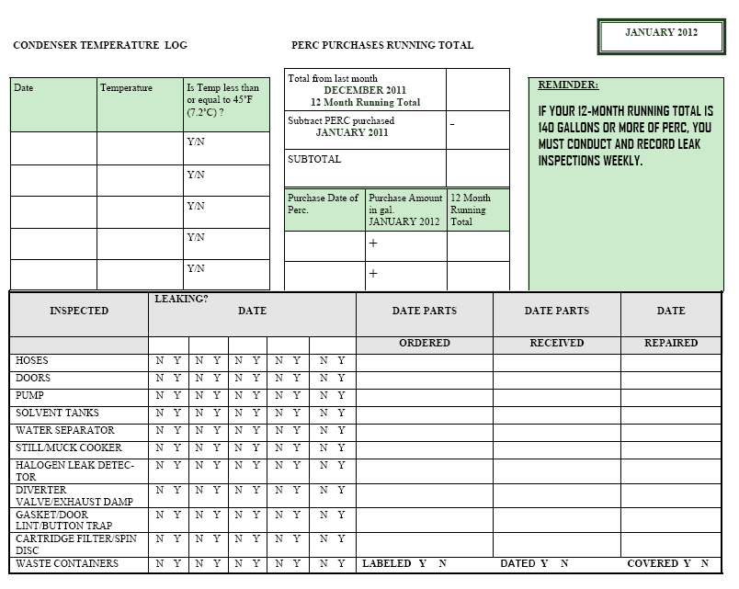
Notes:
If you are an Small Quantity Generator, you need to do weekly inspections of your containers. I would suggest to keep track of that in this log; makes it easier- not required.

Slide 11
Recordkeeping
All recordkeeping documents such as perc purchase receipts, waste manifests, Air calendar and maintenance reports should be filed neatly at the facility and be available for inspection at all times.

Slide 12
Leak Detection Requirements
The following should be inspected for leaks:
Hoses, pipe connections, valves
Doors
Pumps
Gaskets
Solvent Tanks
Still/Muck Cooker
Water Separator
Button Trap
Waste Containers
Filter Housings
If the facility buys 140 gallons or more of perc per year(large area source), leak checks are required every week. Less than 140 gallons (small area source) leak checks are required every other week.

Slide 13
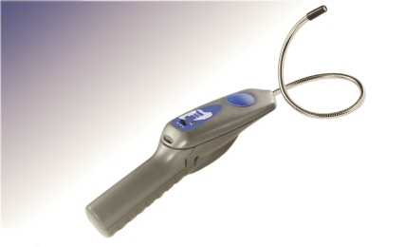
Leak Detector
A halogenated hydrocarbon detector should be used during leak detection.
The detector should be capable of detecting PCE vapor concentrations of 25 parts per million.
All leaks should be repaired within 24 hours, unless parts need to be ordered. Repair parts should be installed within 5 days of receipt.

Slide 14
General Conditions
Perc and perc wastes should be stored in tightly sealed and impervious containers.
All cartridge filters should be drained in their housing or other sealed container for a minimum of 24 hours prior to disposal.
Machine doors should be closed and secured except during loading and unloading.
Machine and surrounding area should be kept clean.

Slide 15

Dry Cleaning Facility
Hazardous Waste

Slide 16
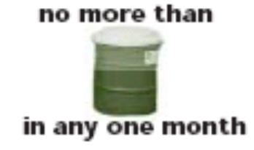
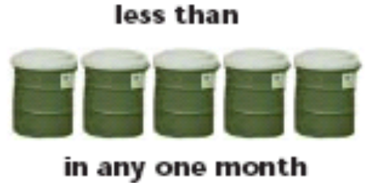
Facility Generator Status
Conditionally Exempt SQG (CESQG)
  Generates less than 100 kg/mo
  May not accumulate more than 1,000 kg
Small Quantity Generator (SQG)
  Generates 100 kg/m to 1000 kg/mo
  May not accumulate more than 6,000 kg

Slide 17
CESQG Requirements
Never generate >100kg/mo (~1/2 drum)
Never accumulate >1,000kg on-site (~ 5 drums)
Ensure Proper Disposal & Keep Records per Ch. 62-730, F. A. C. (receipts for disposal)
Be advised, if a CESQG does not follow the reduced management standards in 40 CFR 261.5, they are subject full regulation under 40 CFR 262
Notes:
If you are considered a conditionally exempt small quantity generator, but you cannot produce receipts for proper disposal you are automatically considered a small quantity generator. 62-730 is our State rule and the 40 CFR are the federal rules. The State can be more stringent that the Federal rules.

Slide 18
Small Quantity Generator Requirements
Obtain EPA identification number
Ensure delivery to permitted TSDF
Must use manifest
Ship drum within 180 days of first drop
Never accumulate >6000kg on-site (~30 drums)
Training (not documented)
Emergency Planning – see handout
Posting information near phones – see handout
Weekly Container Inspection Logs –see handout
60 day exception reports
Notes:
Example of a more stringent state rule is the weekly container inspection logs, the Federal rule says you have to do them and the State of Florida has required elements that must be included.

Slide 19
Listed or Characteristic
Hazardous Waste
Listed - F001 & F002
  No analysis needed
  Hazardous based on the process it is generated from
  Qualitative
Characteristic – D001 to D043
  Ignitable, Corrosive, Reactive, Toxic (TCLP Analysis)
  Analysis required
  Hazardous based on concentration of constituent
  Quantitative
Notes:
Petroleum solvents would be characteristic for ignitability (flash point equal to or less than 140 F)

Slide 20
Perchloroethylene – D039
TCLP limit for Perchloroethylene is 0.7 mg/L
mg/L = to 1 part per million (about 1 teaspoon of perc in 1,000 gallons of water)
Only need 0.7 parts per million of perc for it to be a hazardous waste and can be found in: separator water and mop water
Perc is also a F001 & F002 List Waste - used for its’ solvent properties (F001) and still bottoms (muck) from recovery of spent halogenated solvents (F002) , listed for ignitability and toxicity

Slide 21
10 Most Common HW Violations
Labeling
Open containers
Contaminated rags improperly disposed of
Maintaining records on site
Mop Water*
Modified contingency plan (SQGs)
Universal waste – fluorescent bulbs
Weekly container inspection logs
Training
Registration displayed
*Even if not Hazardous, should only go to POTW with permission or disposed as Industrial Wastewater.
Notes:
Remember, besides the Air General Permit registration fee every 5 years, there is an annual registration fee of $100.00 that is paid to the DCSCP. Once the fee is paid, the dry cleaning facility will receive registration by mail. This document should be displayed on the machine or any place product perc is stored.

Slide 22
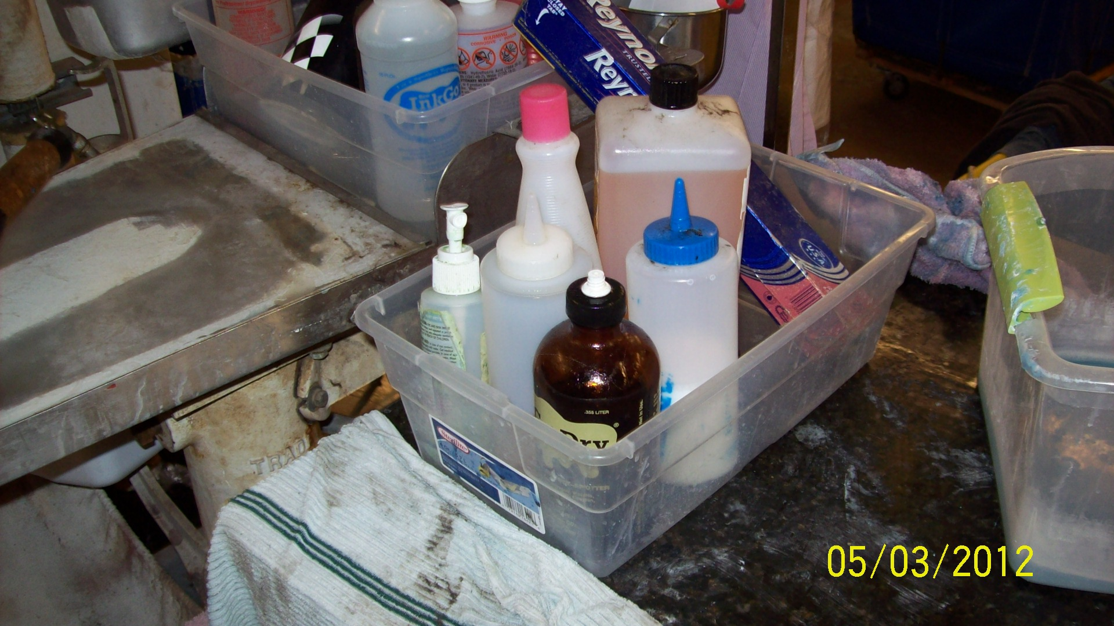
Secondary Containment (Good)

Slide 23
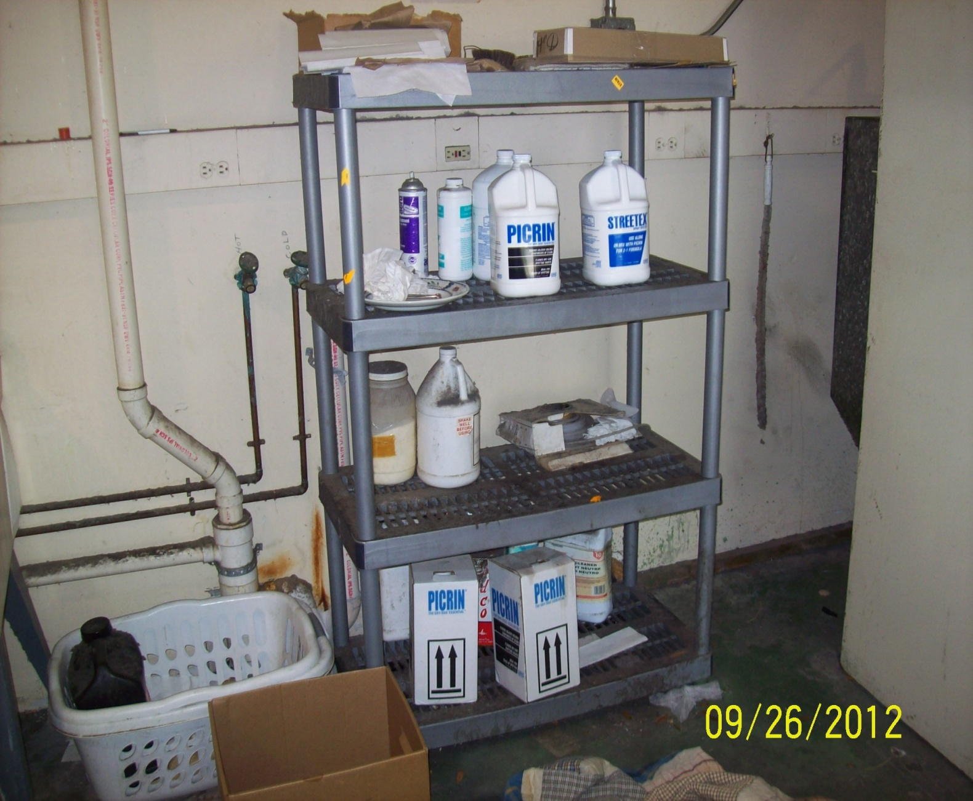
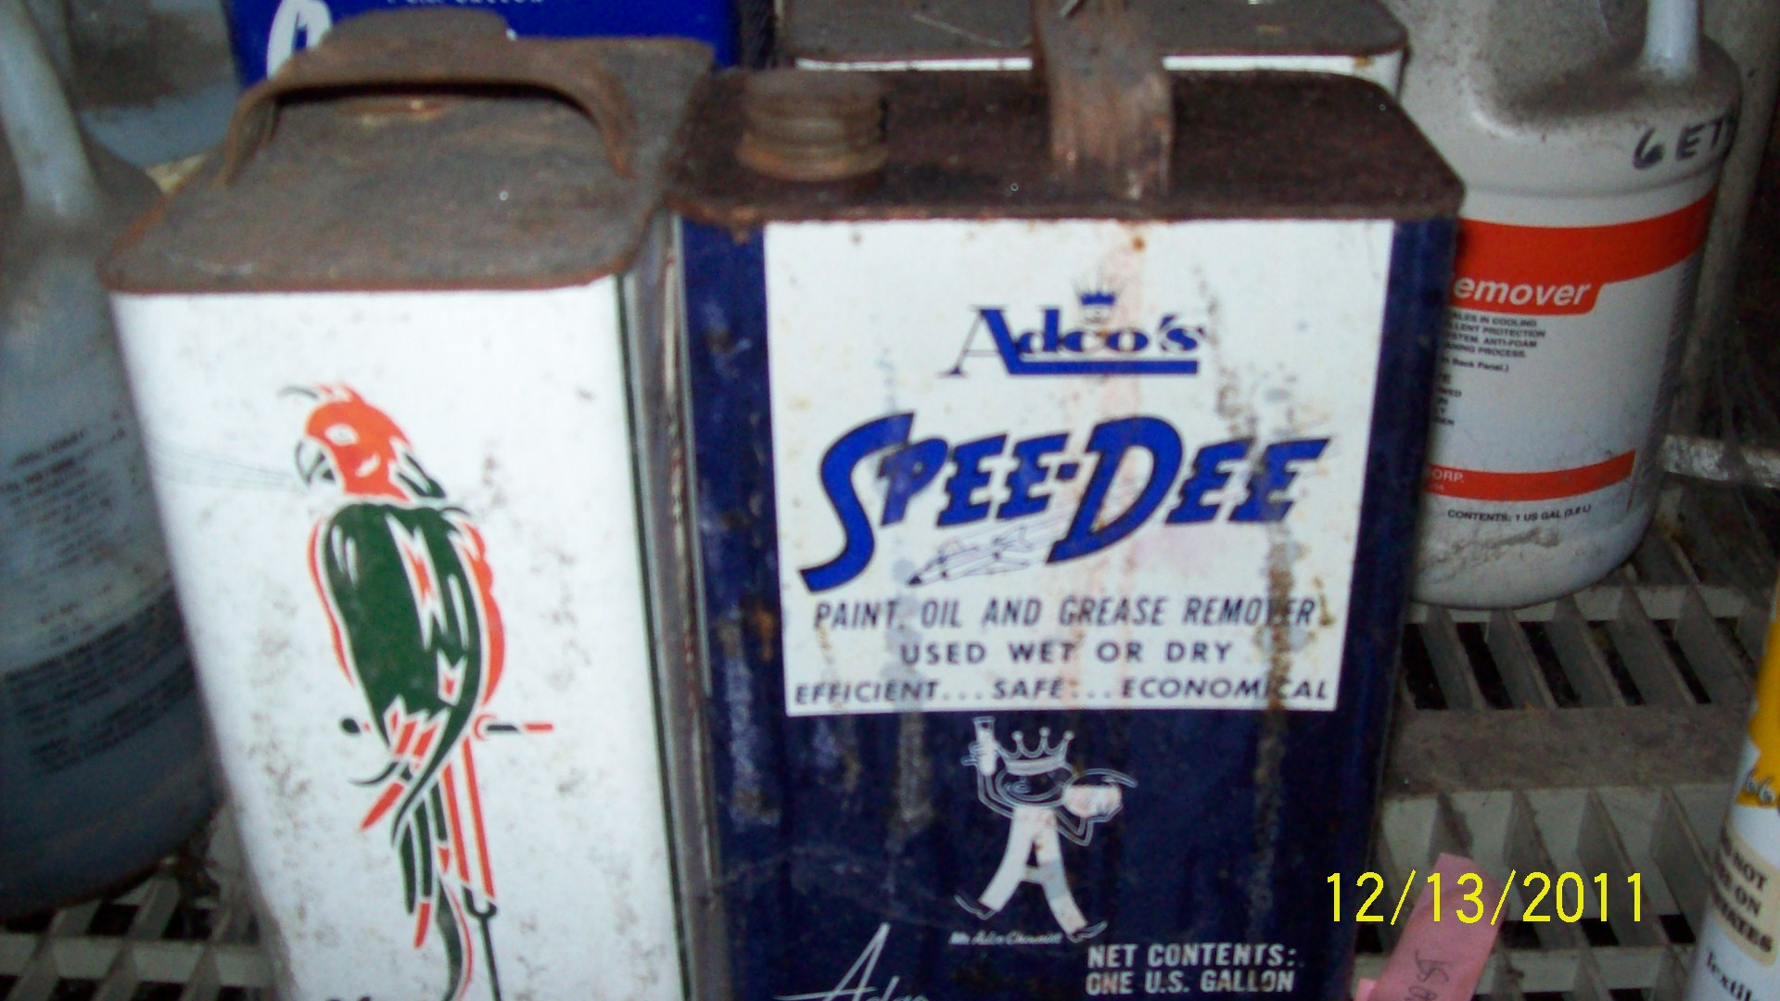
Spotting Chemicals: No
Secondary Containment (Bad)
376.3078(9)(a), F.S.
Notes:
Spotting chemicals still require secondary containment.

Slide 24
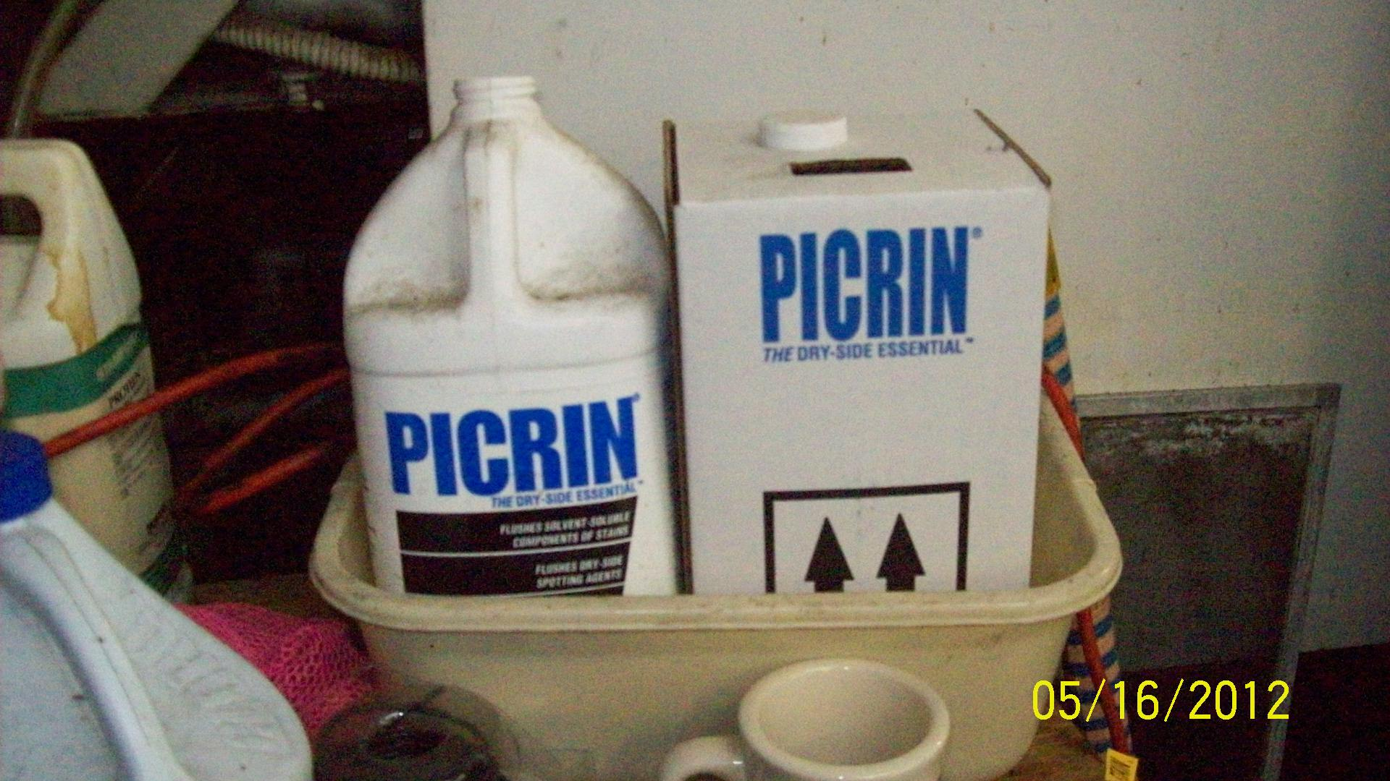
Secondary Containment (Good)

Slide 25
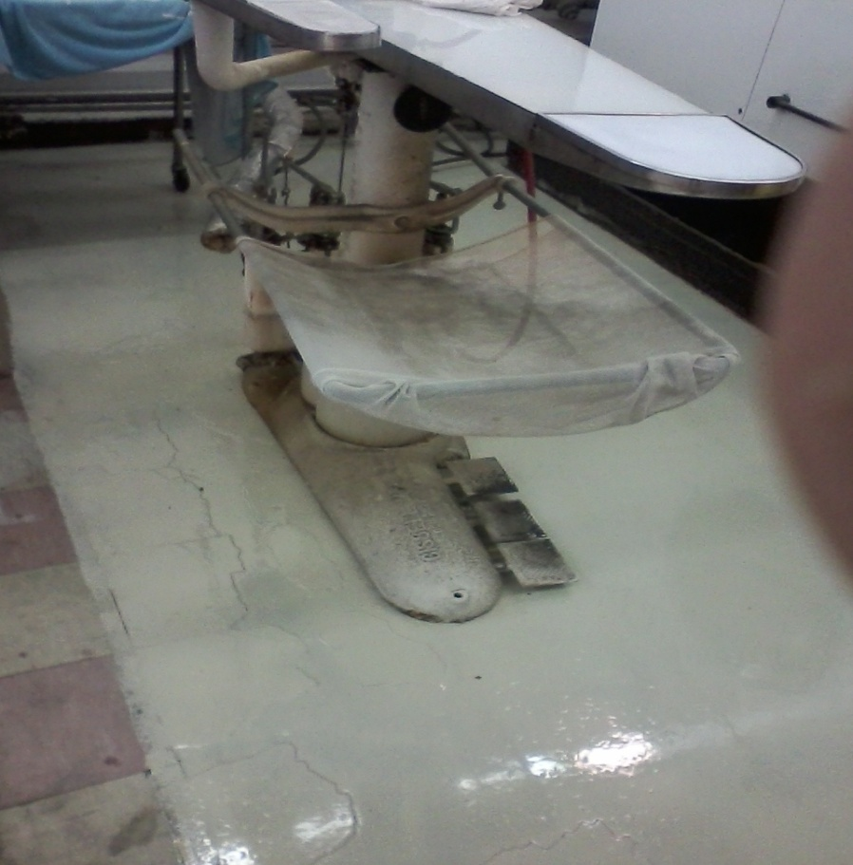
Sealant Around the
Spotting Board (Good)
376.3078(9)(a), FS
Impervious sealant around all sides of the
spotting board.

Slide 26
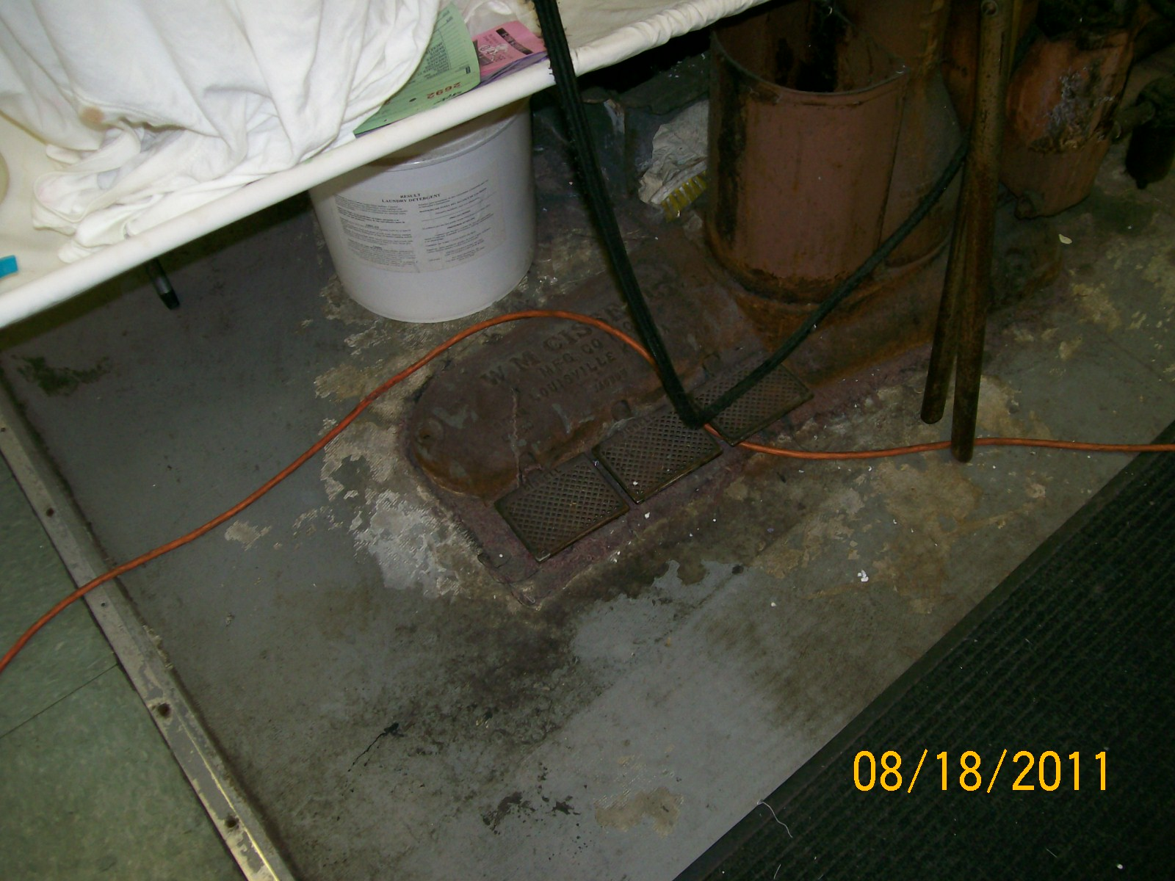
Sealant Worn (Bad),
376.3078(9)(a), FS
Notes:
376.3078(9)( a), FS

Slide 27
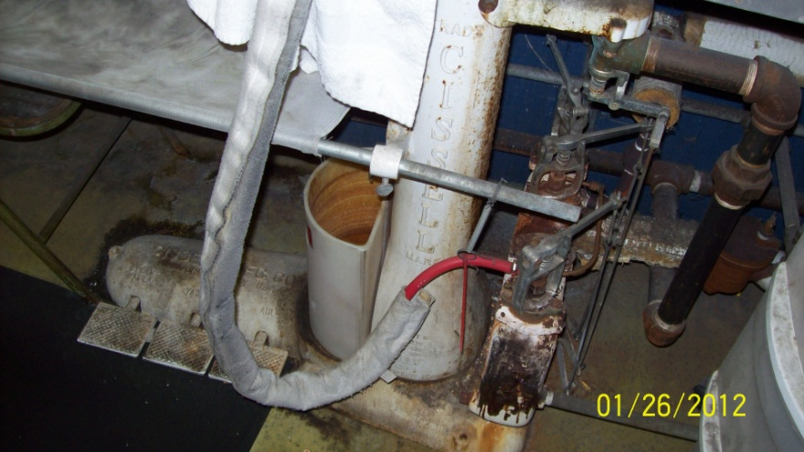
Vacuum Press Return Water
Possibly a hazardous waste when spotting chemicals that contain chlorinated solvents are used at the spotting board.
Notes:
You might want to do a representative sample for waste determination to see if it is hazardous. Then manage according to the results.

Slide 28
Hazardous Waste Streams Generated:
Spent cartridge filters that the solvent passes through
Waste perc sludge from the distillation tank
Perc-contaminated lint from the drying process
Perc-contaminated separator water from the condensation of the solvent

Slide 29
Filtration
Cartridge Filters
  Removed from the machine
  Filters are hazardous
  Contain activated carbon, paper,
Spin-Disk or Roto-Disk
  Not removed from the machine
  Generate less waste
After the filters have been drained in the machine, the filters should be removed from the machine and placed into a container that is closed and sealed, and located within secondary containment.
Notes:
Solvent is purified during the dry cleaning process by two methods, filtration and distillation. These processes extract soils, grease, fats, dyes, and other non-volatile residues from the solvent so that they will not be re-deposited onto the garments.
There are two general types of filtration systems in use in dry cleaning today; cartridge filters and roto-disc or spin-disc filters.
Most cartridge filters consist of an outer perforated metal shell for lint trapping. The core of the filter contains activated carbon to retain dissolved dyes by adsorption.
Adsorptive cartridge filters (also known as jumbo split or jumbo full-sized cartridge filters) contain activated carbon and activated clay or only activated clay in the filter core. Activated clay adsorbs non-volatile residues from the solvent. Activated clay can remove water, alcohol, acids, ketones, aromatic compounds, parrafins, and natural esters.
Spin disk- use gravity to separate impurities as solvent flows through for solvent recovery. The impurities are spun off and are fed by gravity into the distallation unit for solvent recovery. Some spin-disk filtration systems utilize a filter powder (diaomite) which is deposited on the outside of the disks to aid in the filtration process. Spin-disk filtration systems are becoming more common largely because they generate less waste (there are no cartridges to be disposed).

Slide 30
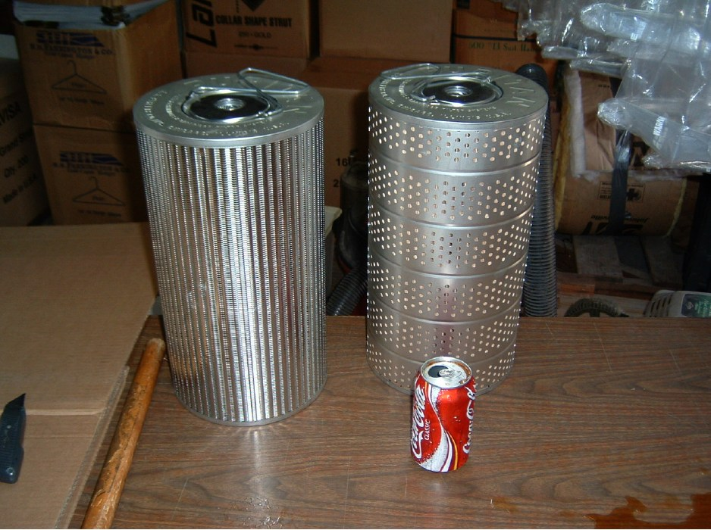
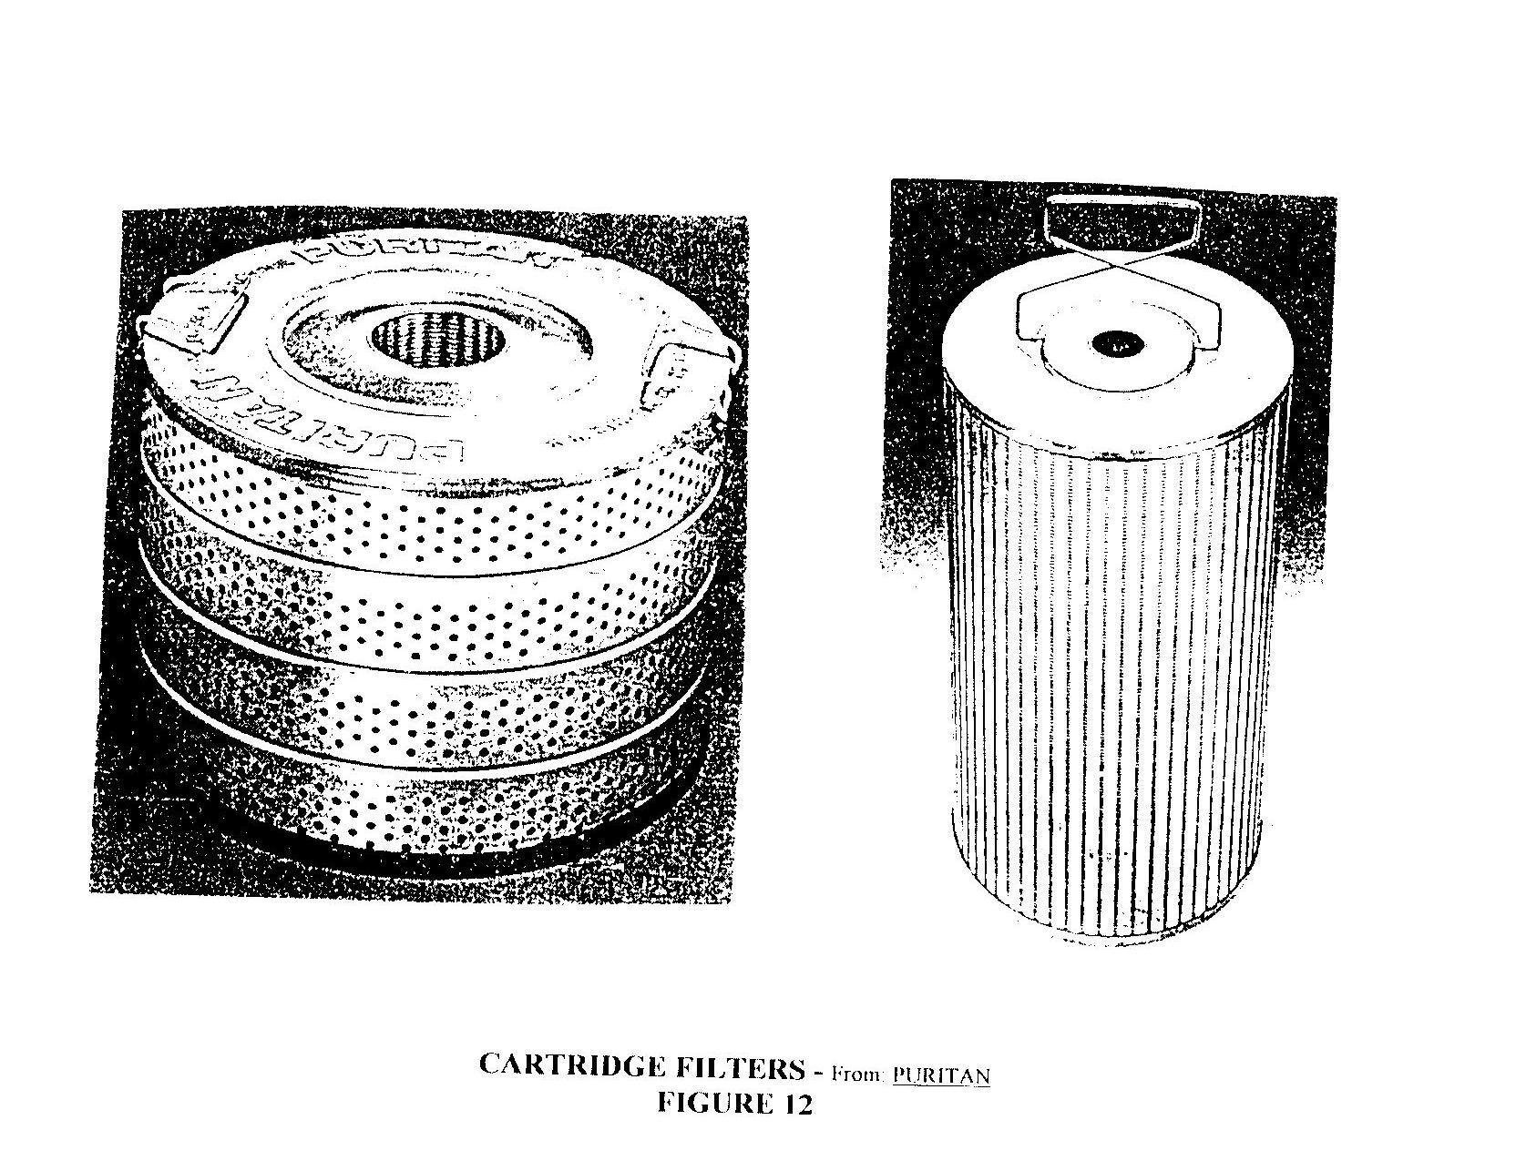
Examples – Cartridge Filters
Notes:
Filters used in petroleum dry cleaning would not be considered hazardous if it was properly drained as it would lose its characteristic of ignitability.
If using perc or spotting solvents with perc in it, the filters would be considered hazardous.

Slide 31
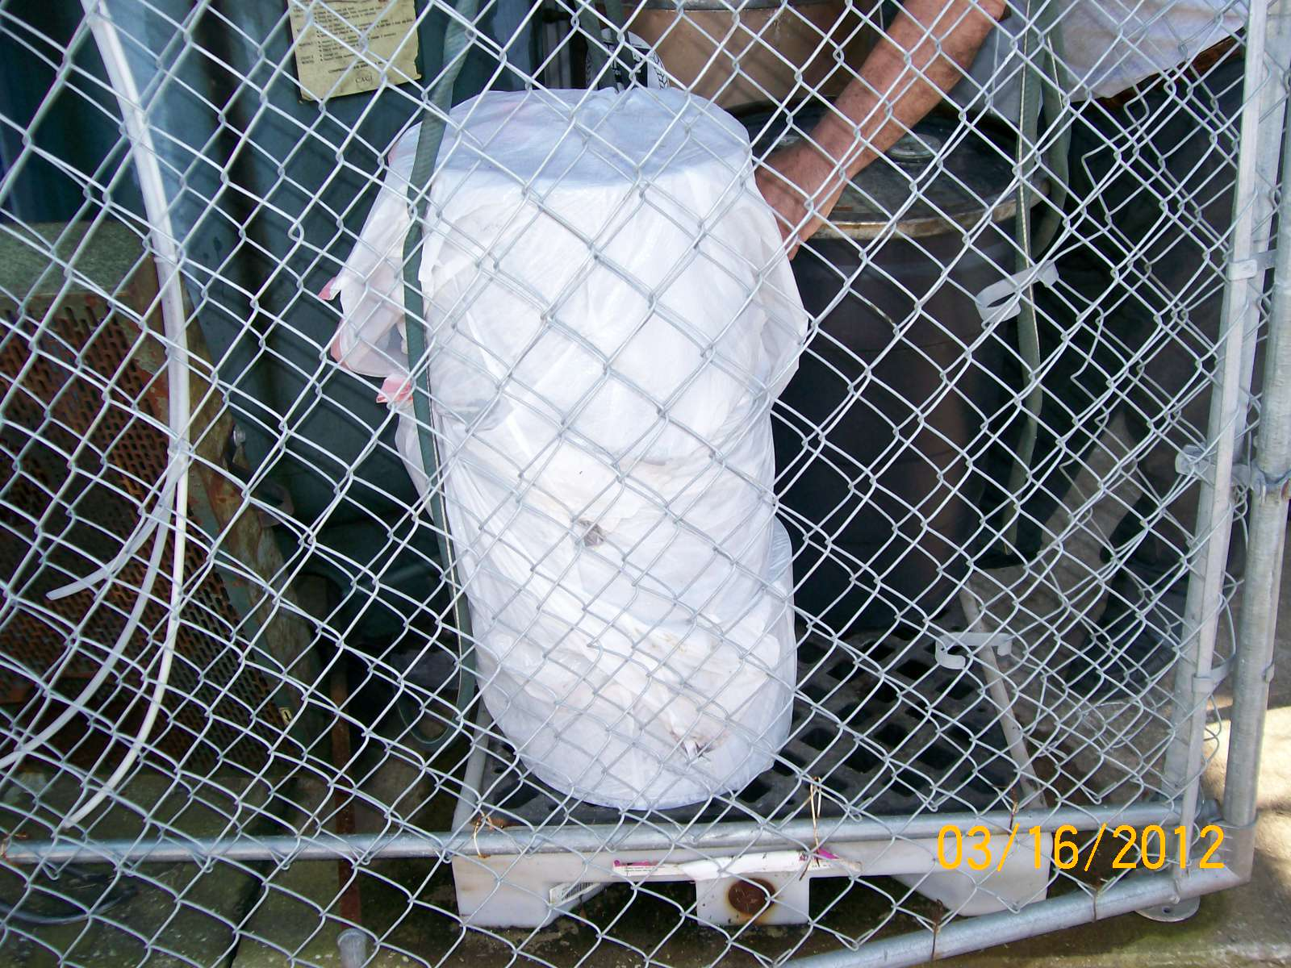
Bad 40 CFR 261.5(g)(3)

Slide 32
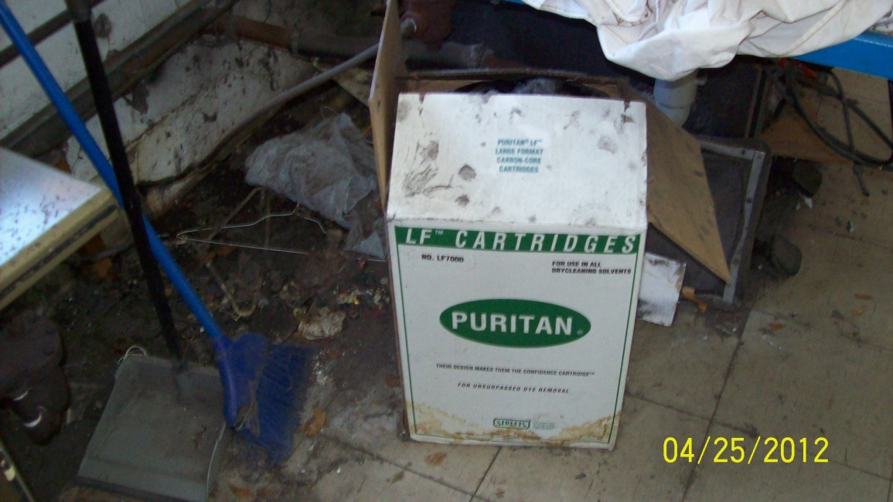
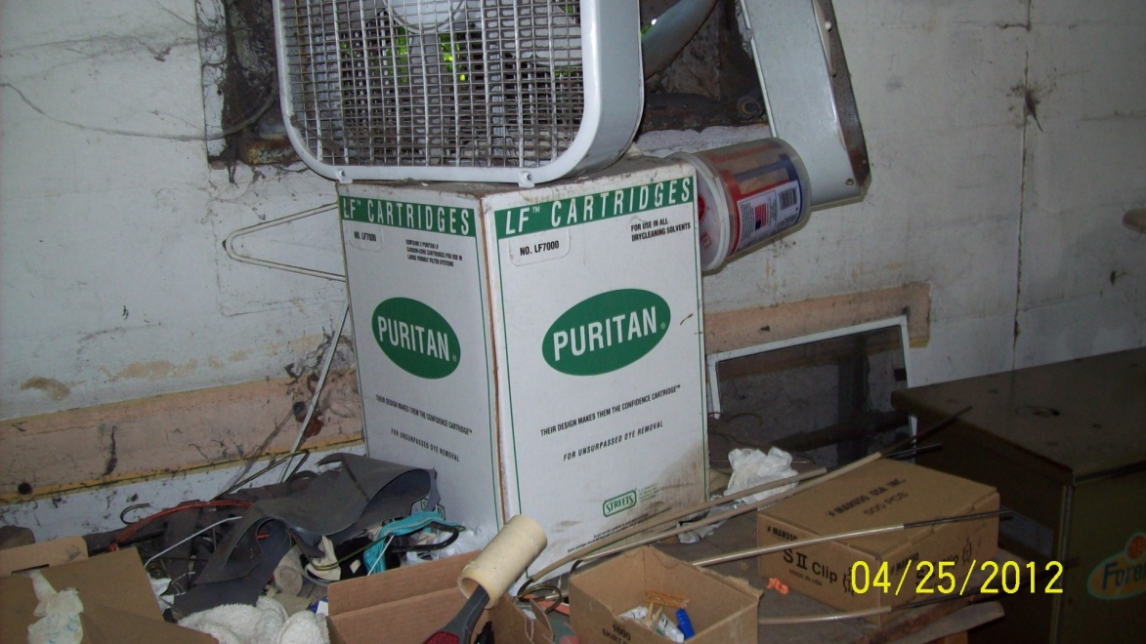
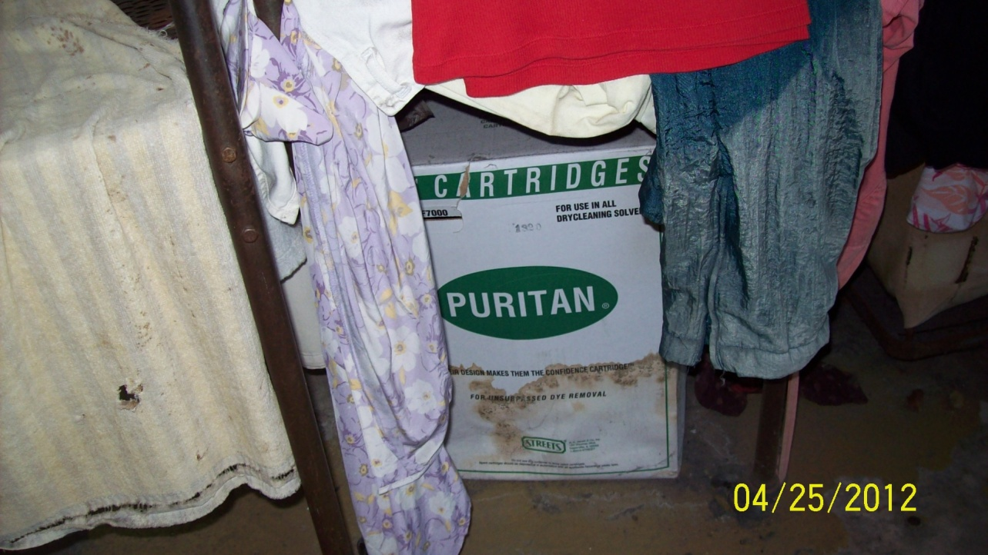
Bad 40 CFR 261.5(g)(3),
376.3078(9)(a), FS

Slide 33
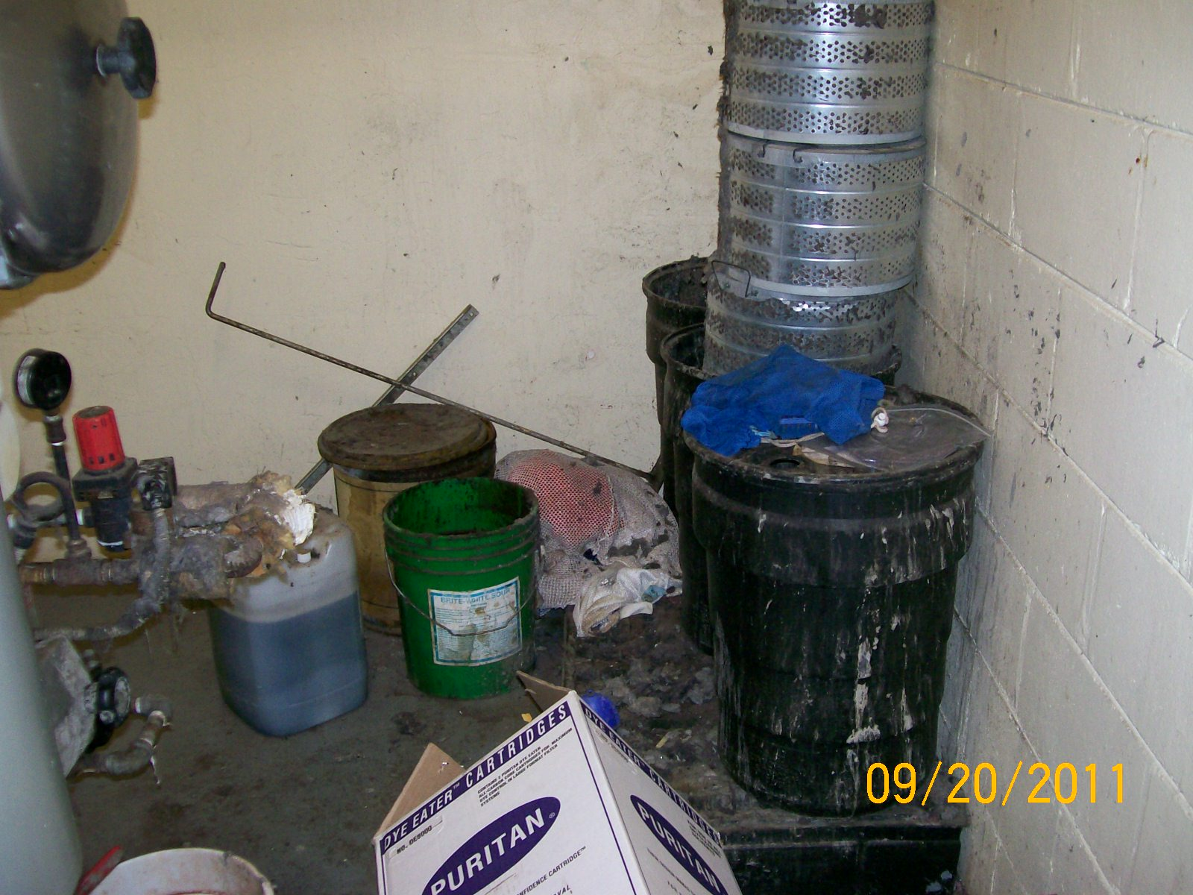
Very Bad 40 CFR 261.5(g)(3), 376.3078(9)(a) FS

Slide 34
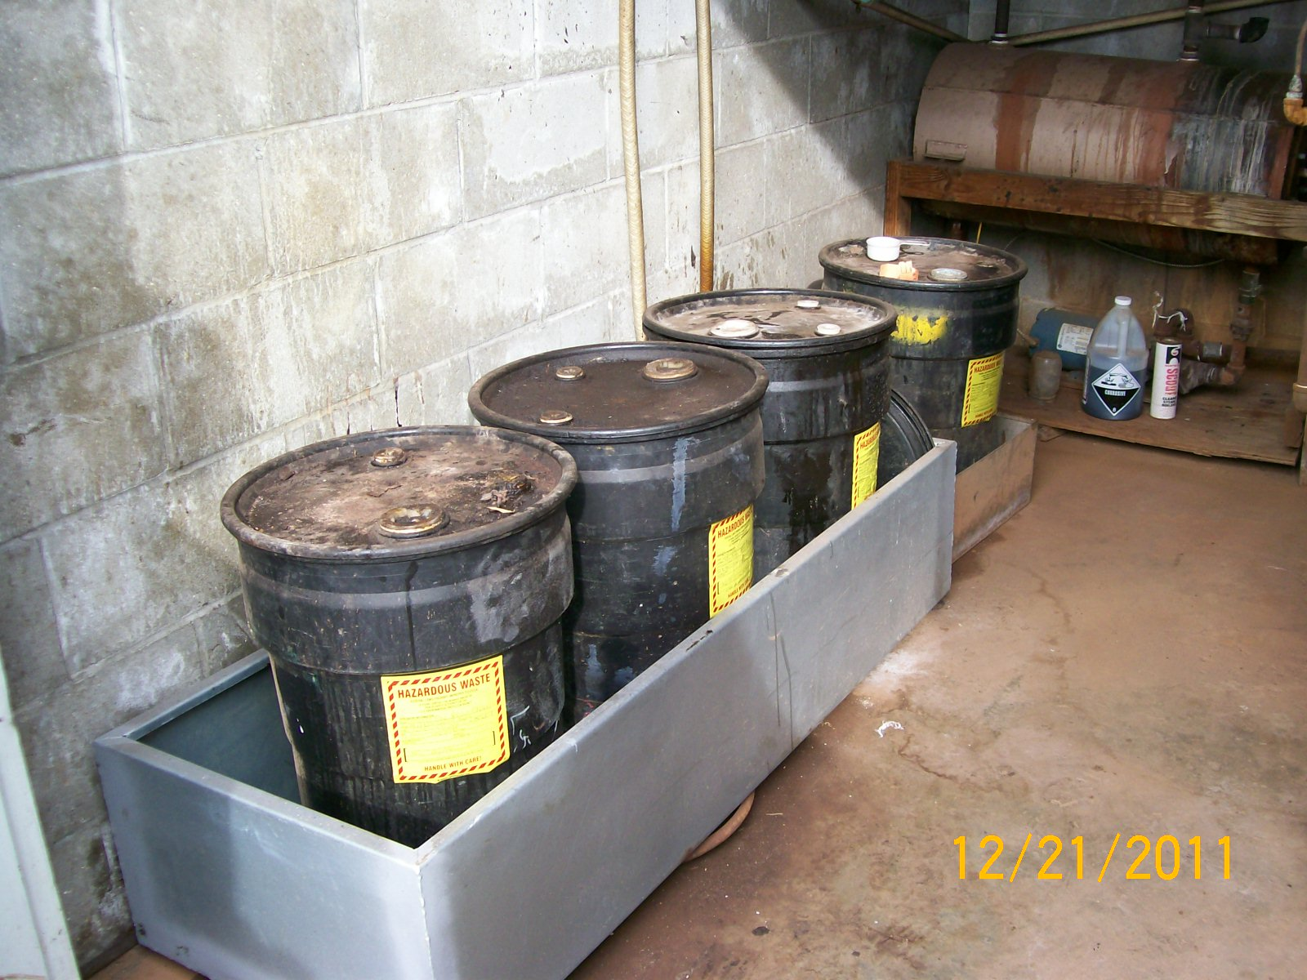
Good
Drums are closed and sealed, and within secondary containment.
Notes:
Secondary containment is required for the machine, treatment system if you have one, and any containers of hazardous waste. It is also strongly suggested that you use a chemical resistant epoxy paint around the machine and the spotting board. (approx. 2 feet) This ensures less chance of perc permeating the floor. Note that the containers are label. This is always a good idea. This is required for an SQG but not for CESQG.

Slide 35
Distillation
Dirty solvent is “cooked”
In machines that “cook”, some solvent is recovered and returned to the process.
Vapors routed to condenser
Generates F002 hazardous waste perc “sludge”
Should be managed in a closed and sealed container, and located within secondary containment.
Notes:
Distillation is the most effective method to remove solvent-soluble soils and dyes from dry cleaning solvent. The distillation unit can be a separate piece of equipment, but in most new dry cleaning machines, the distillation unit is contained in the machine. In the distillation process, dirty solvent is routed to a distillation unit (still) where it is heated until it boils. Pure PCE boils at 250° Fahrenheit but the presence of water and other impurities effectively lowers the boiling point of the mixture. The solvent and water (and any other substance whose boiling point is less than the solvent) are vaporized in the still. The vapors are routed to a condenser where they are cooled and condense into liquid. The residues left behind in the still are known as still bottoms. These residues can contain up to seventy-five percent solvent, by weight. Some drycleaners recover additional solvent from the still bottoms by steam sweeping, a process in which steam is added to the still bottoms and the resulting mixture is distilled.
Drycleaning operations that use powder filtrate material generate what is known as muck, a mixture of powder filtrate material and dirty solvent. Some drycleaners recover solvent from muck in a distillation unit known as a muck cooker. The waste product generated by a muck cooker is known as cooked powder residue.
In general, since most of the compounds contained in petroleum dry cleaning solvent have high boiling points (over 300° F), distillation of petroleum solvent is performed under a partial vacuum. Because of this added complexity, many petroleum dry cleaning operations do not perform distillation but instead utilize adsorptive cartridge filters to purify dirty solvent.

Slide 36
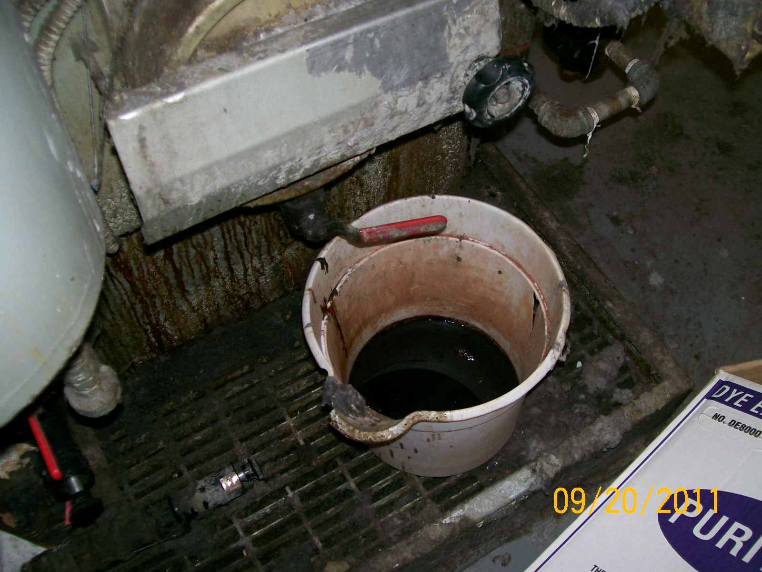
Bad, 40 CFR 261.5(g)(3)

Slide 37
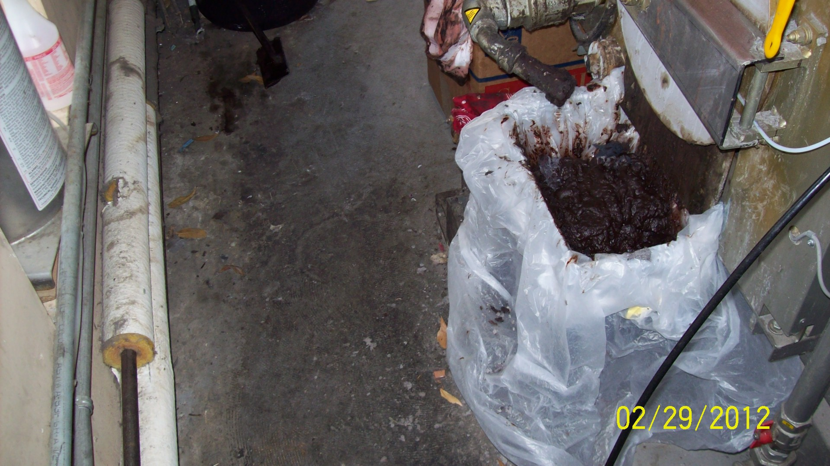
Bad, 40 CFR 261.5(g)(3) &
376.3078(9)(a), FS
Notes:
40 CFR 261.5(g)(3)

Slide 38
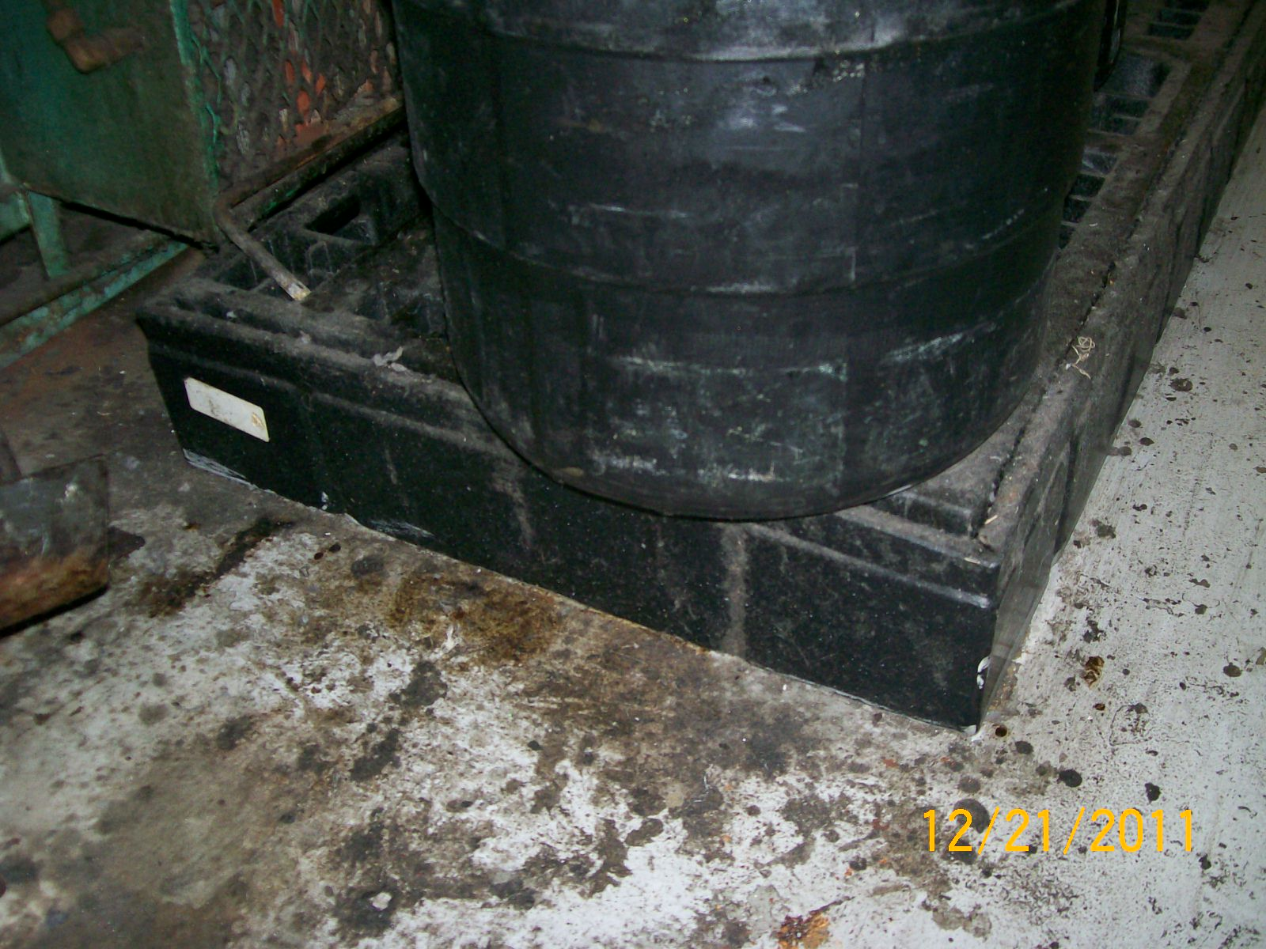
Sludge Drum (Bad) 376.3078(9)(a), FS
The drum is not fully on the pallet.
There is no sealant around the pallet.
(suggested)

Slide 39
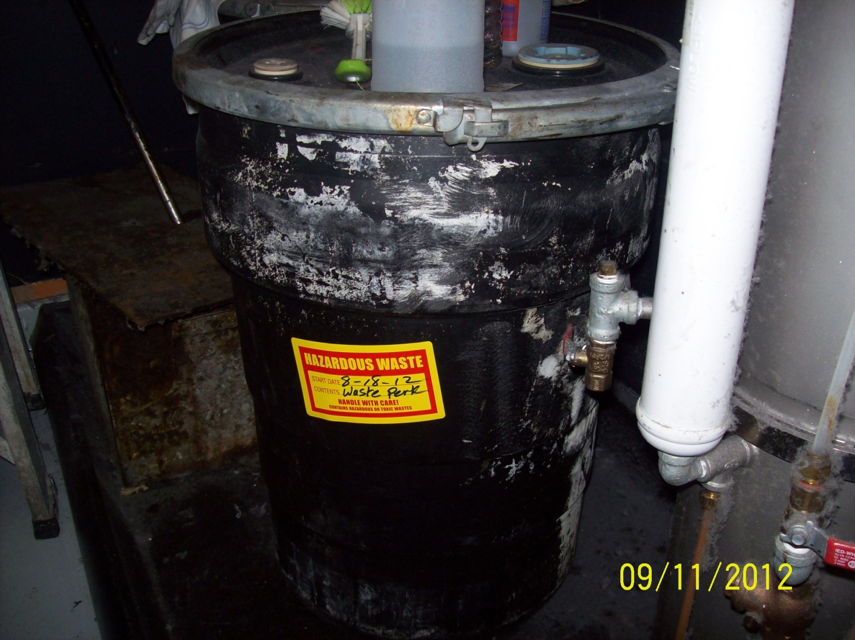
Good

Slide 40
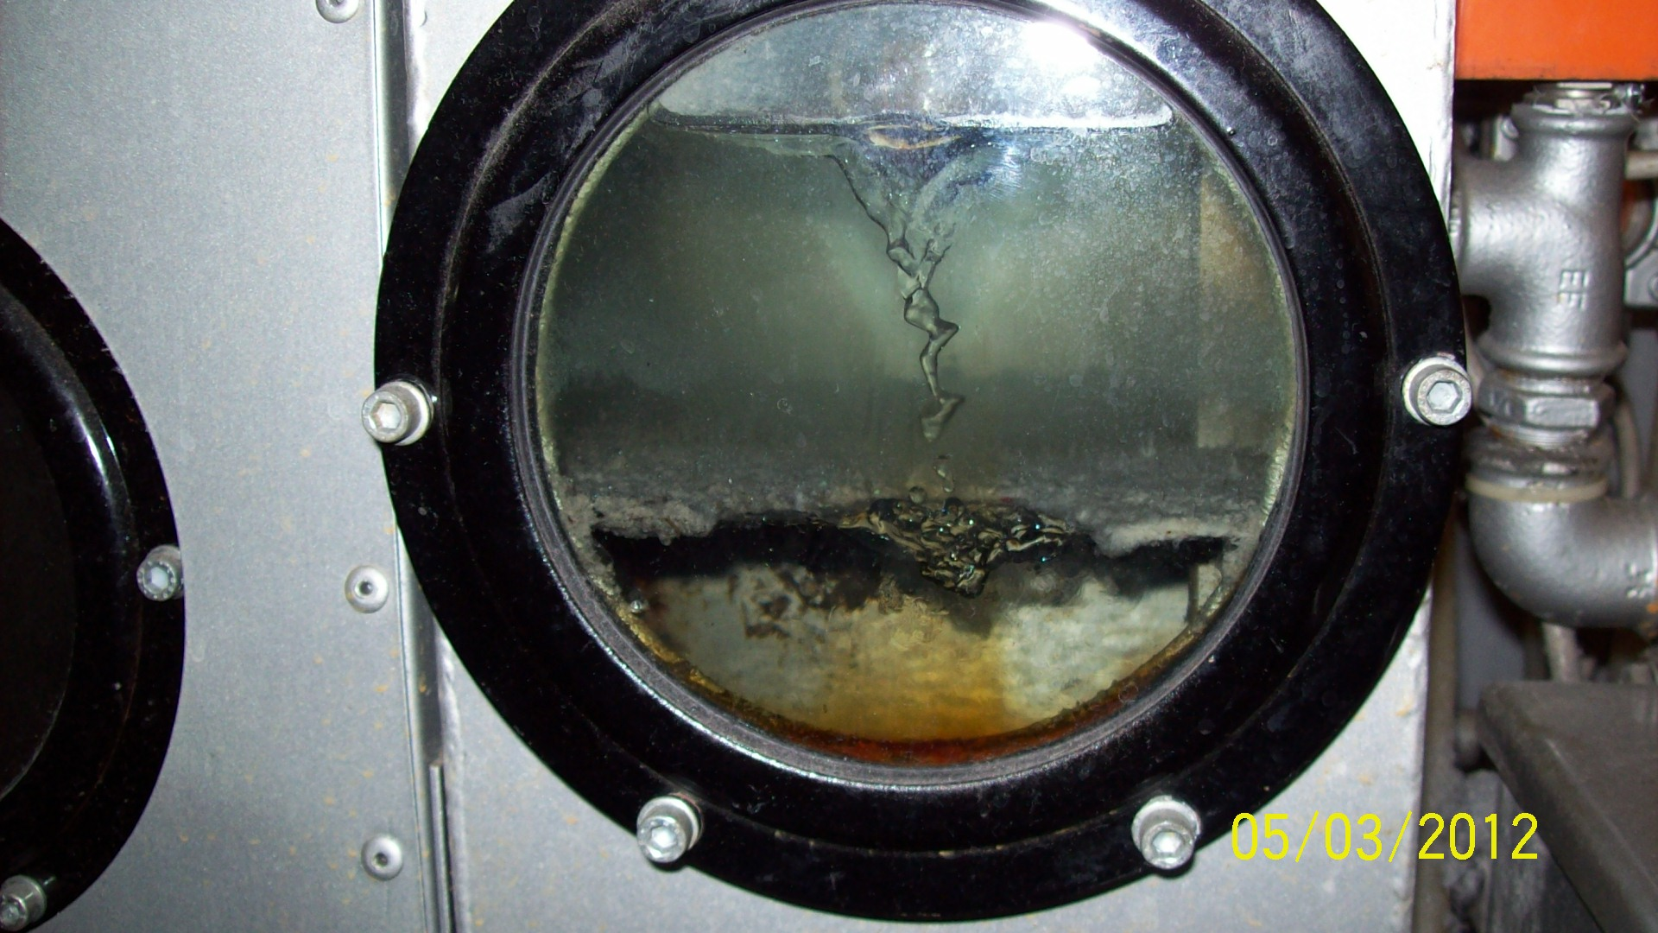
Separator Water
Separator water should be stored in closed and sealed containers, and located within secondary containment.
Separator water can either be treated on-site or managed as
D039 hazardous
waste.
Notes:
Perc is more dense than water (will sink)
Petroleum is less dense than water (will float)
Where it comes from:
Distillation unit via condenser
From dryer from warm solvent vapors
From dryer via carbon adsorption during cooling

Slide 41
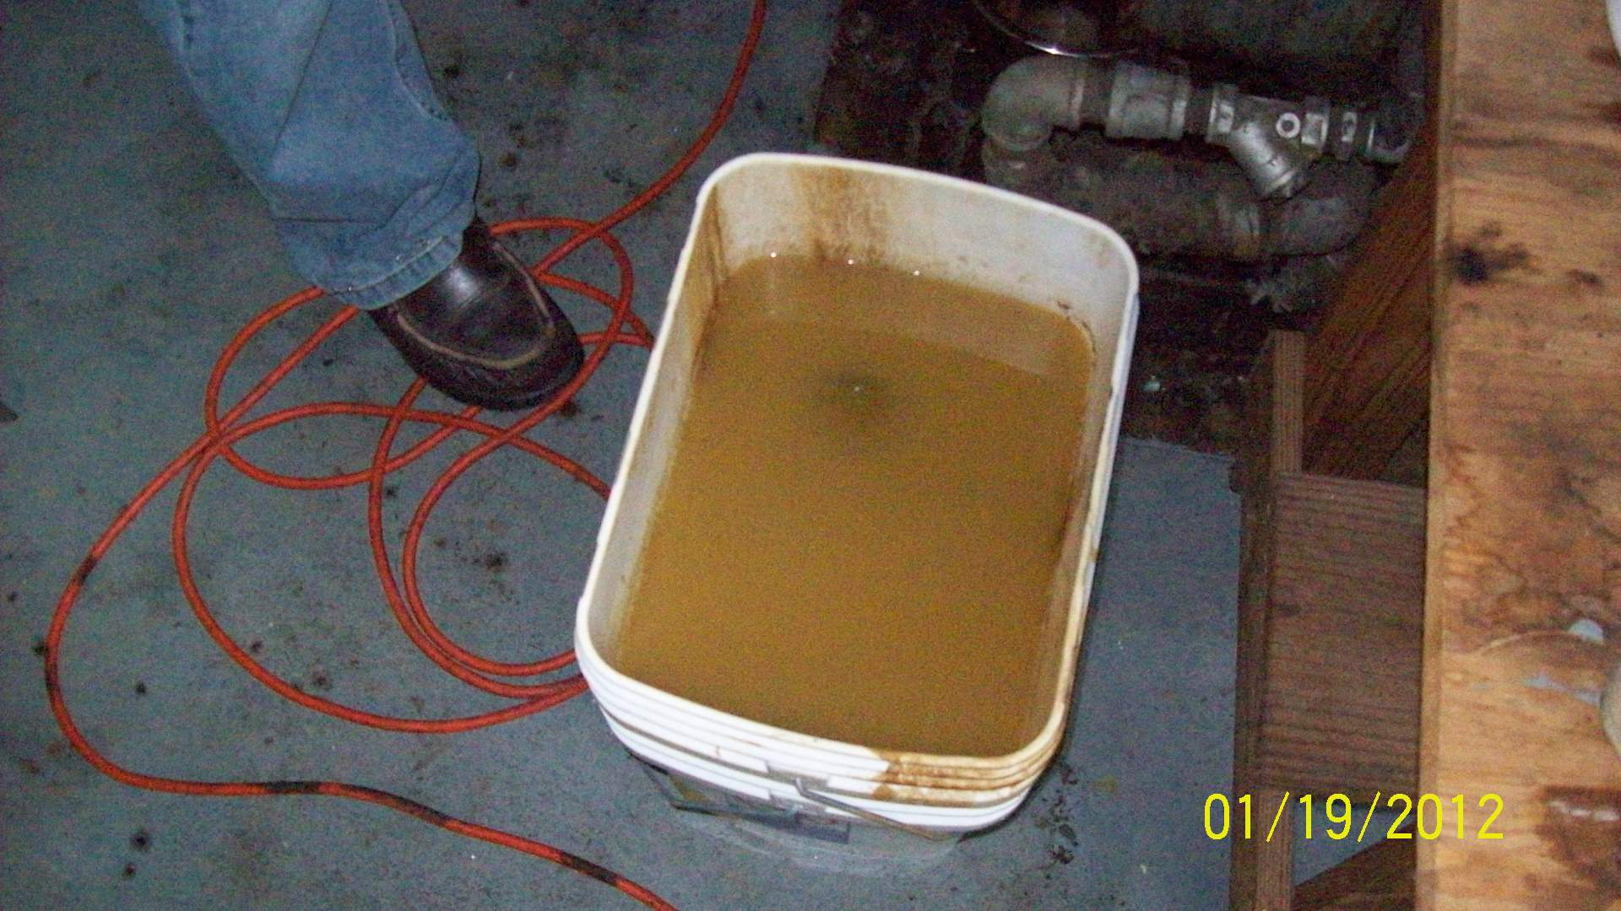
Bad, 40 CFR 261.5(g)(3)
376.3078(9)(a), FS
Notes:
40 CFR 261.5(g)(3)

Slide 42
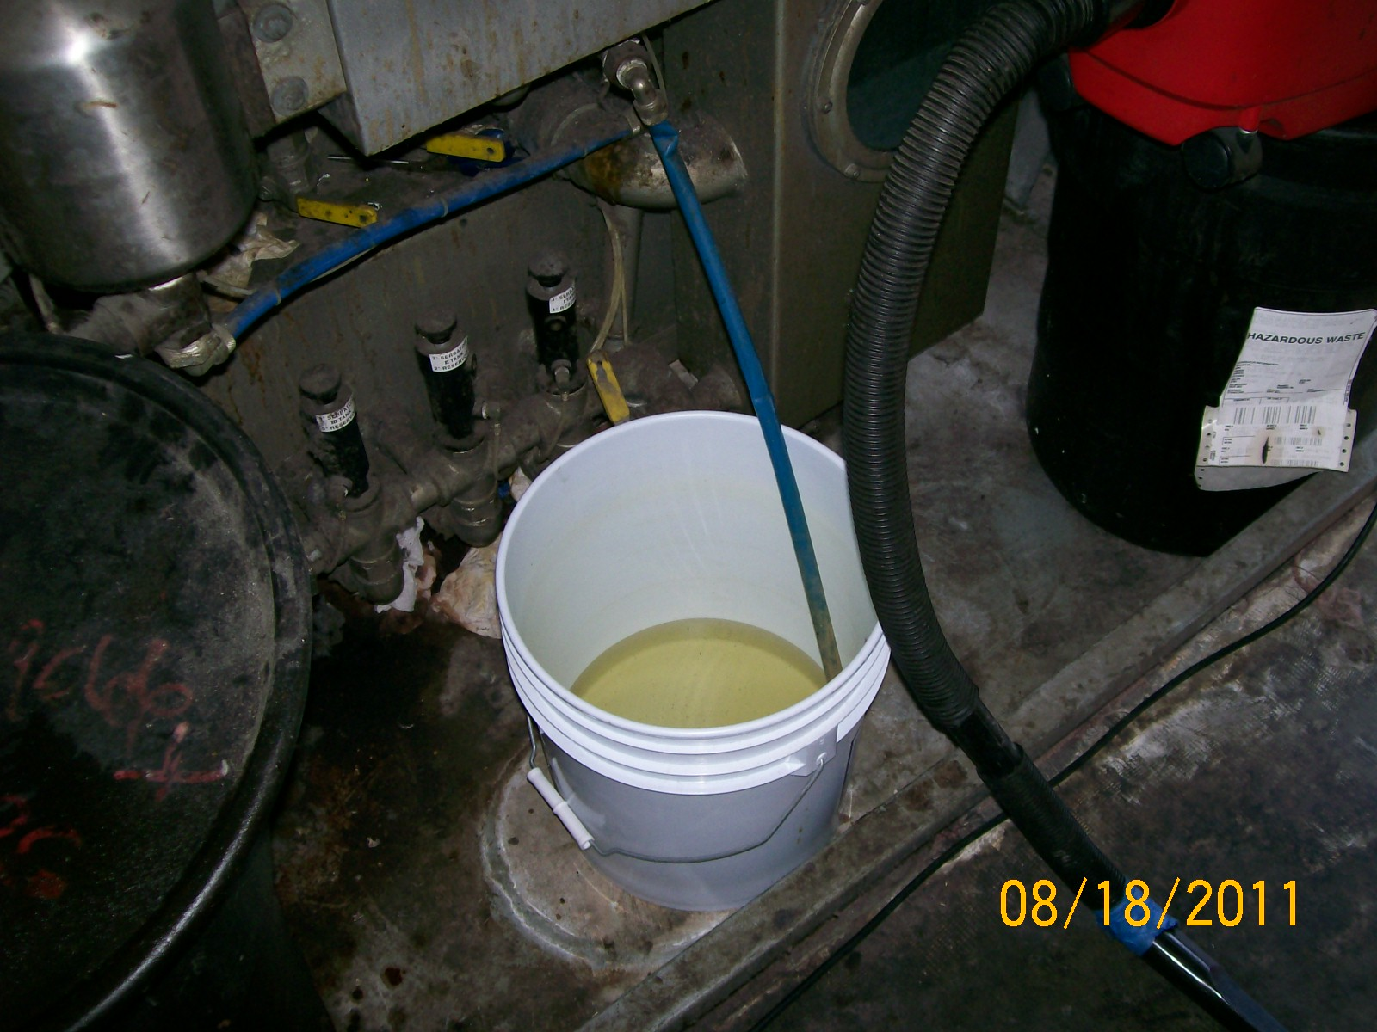
Bad, 40 CFR 261.5(g)(3)
376.3078(9)(a), FS
Notes:
40 CFR 261.5(g)(3)

Slide 43
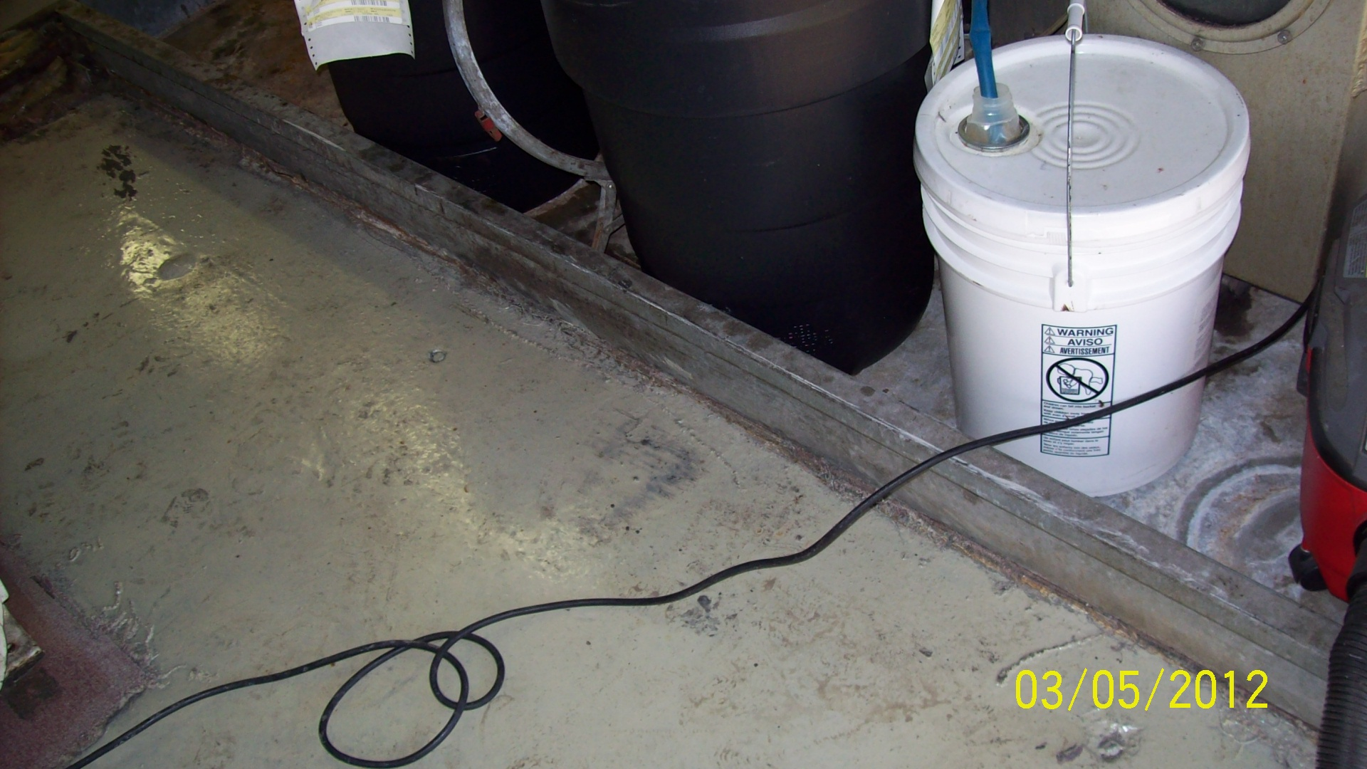
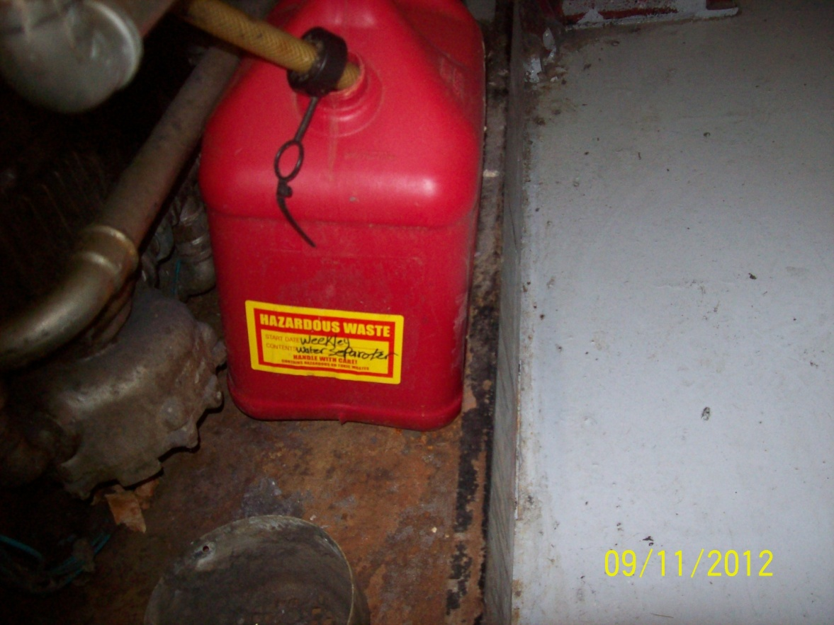
Good

Slide 44
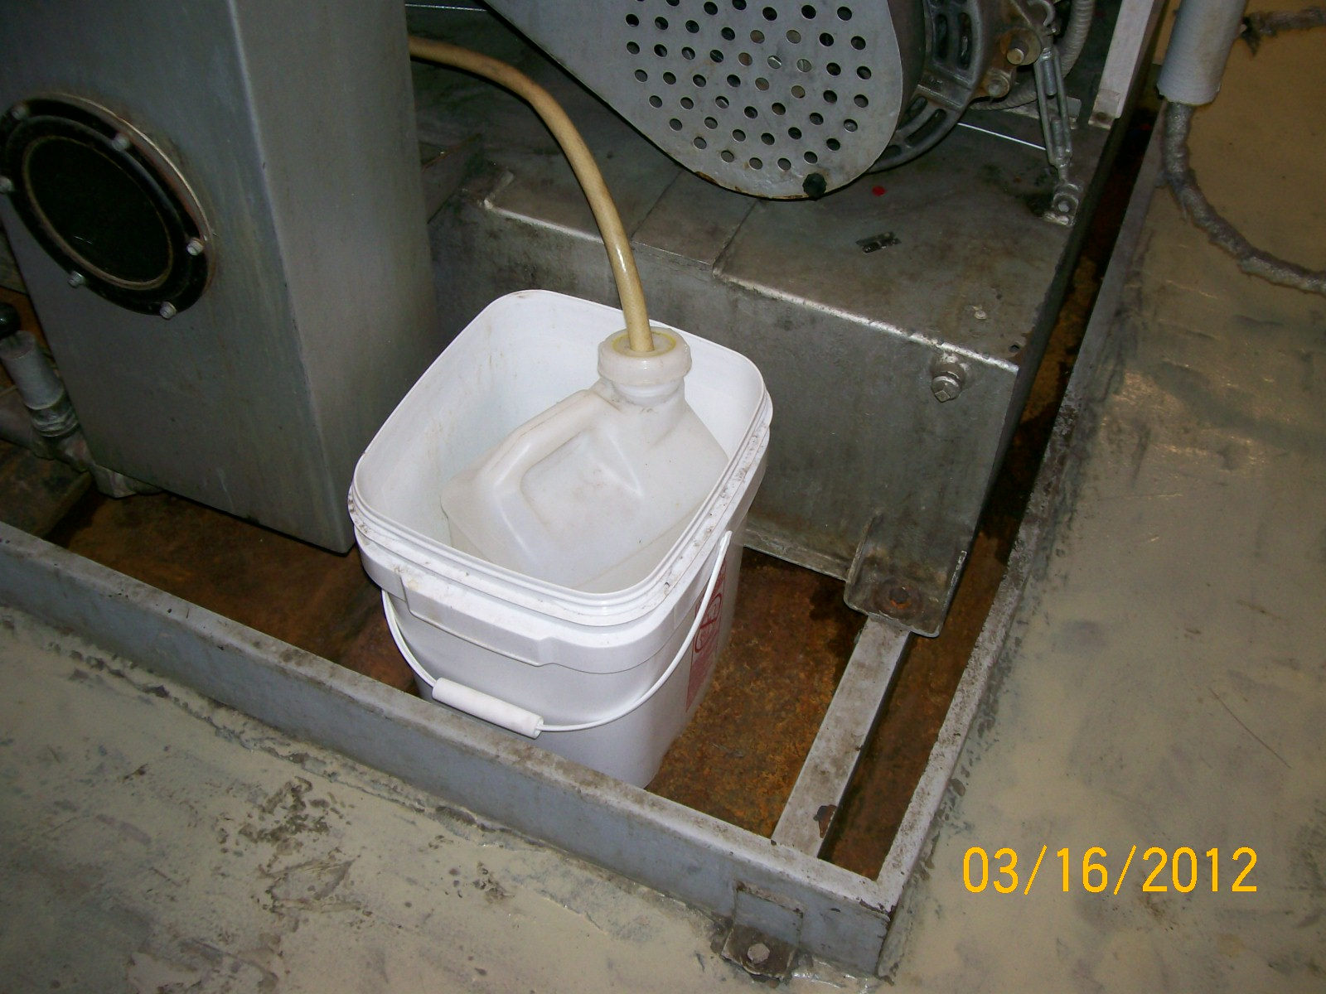
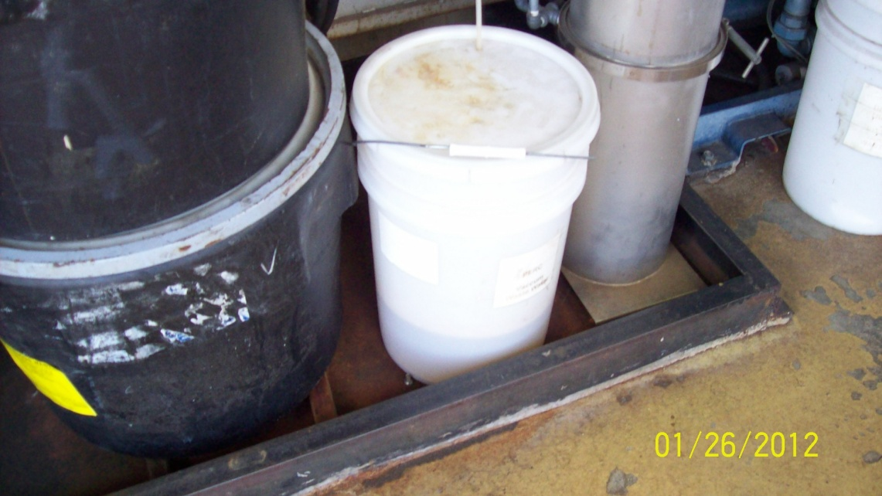
Good
Notes:
Tight fit of hose to the cap. No space.

Slide 45
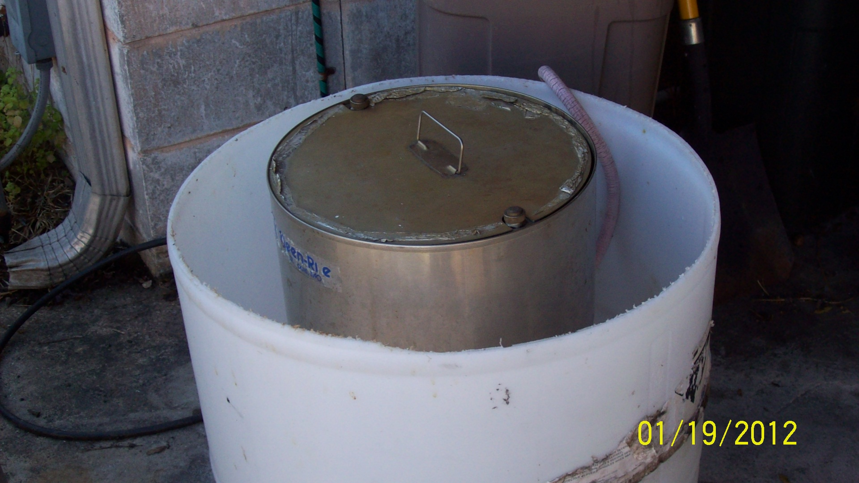
Treatment
Dispose of as D039 hazardous waste
Treat in on-site mister
  Activated Carbon
  Polymer filters
Notes:
Some drycleaners dispose of separator water through a hazardous waste disposal firm, but others have on-site capacity to treat the separator water and reclaim some of the solvent. In on-site reclamation, the water is treated, often with either granular activated carbon or polymer filters, to remove most of the dissolved solvent before evaporating or misting (atomizing) the treated wastewater to the atmosphere or discharging it to the sanitary sewer. Some operators evaporate the water without treatment or dispose of untreated water directly to the sanitary sewer, though both of these disposal methods are illegal in many parts of the country.

Slide 46
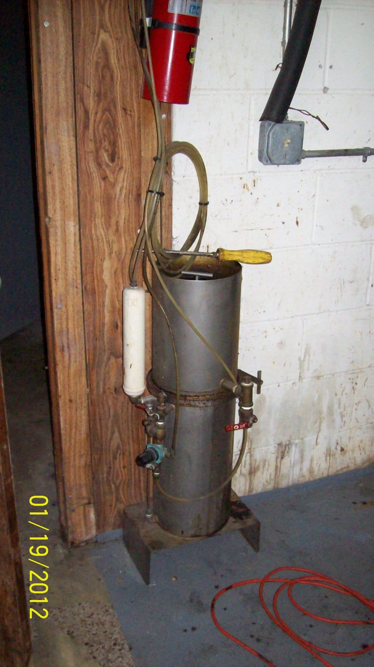
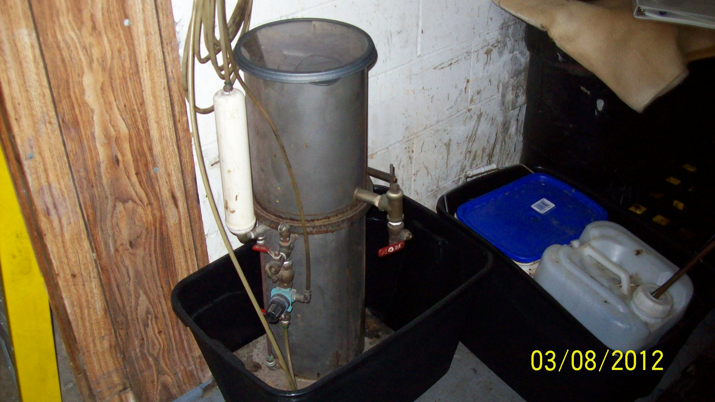
Mister
Bad, 376.3078(9)(a), FS
Good
Notes:
376.3078(9)(a), FS

Slide 47
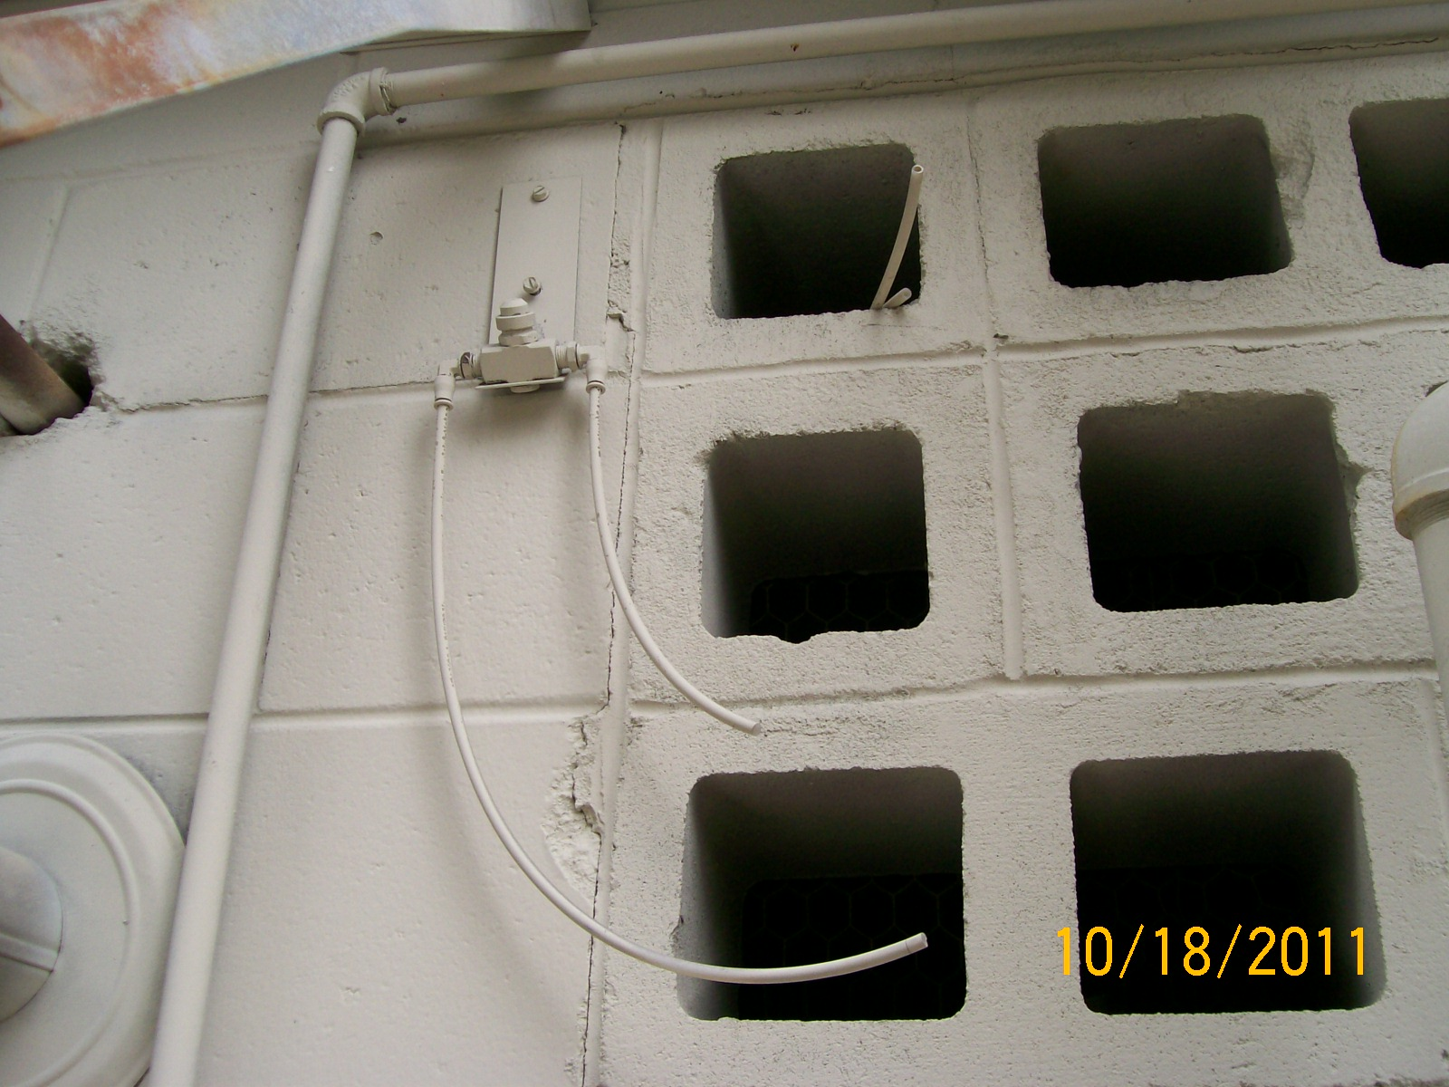
Disconnected Mister, Bad
Notes:
This mister is disconnected.

Slide 48
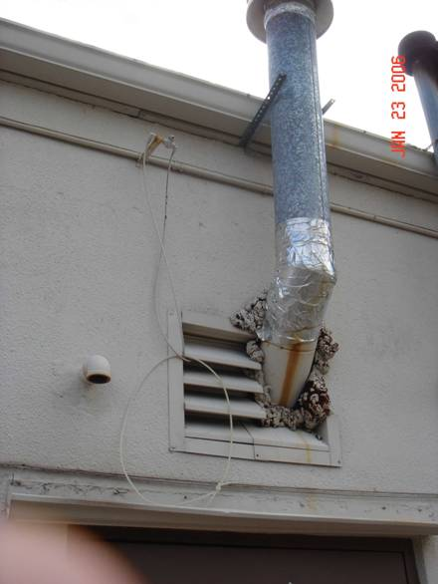
Good, Aerosolizing
Notes:
Properly working mister

Slide 49
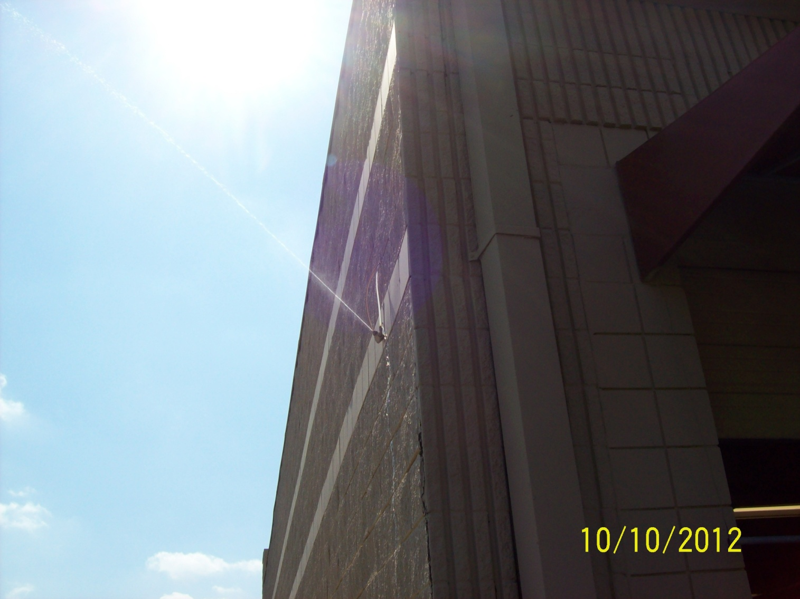
Bad, Direct discharge of separator water 40 CFR 261.5(g)(3)

Slide 50
Lint
F002 Perc-contaminated lint from the dry cleaning machine
Sources: Air filters, Button trap, Vacuum
Should be managed in closed and sealed containers, and located within secondary containment.
Typically stored in perc sludge drum or filter drum.
Notes:
Lint, constantly accumulates at a dry cleaning facility. Lint is a hazardous waste and must be handled as such. Above right, a clean lint bag is being installed into a machine lint filter, seen at right. Lint is flammable and can therefore cause fire to spread rapidly. Just like lint from your dryer at home, it can escape the machine and settle onto everything in the facility, thus it is critical to remove excess lint buildup from exposed surfaces, including the ceiling and machine parts, at regular intervals.

Slide 51
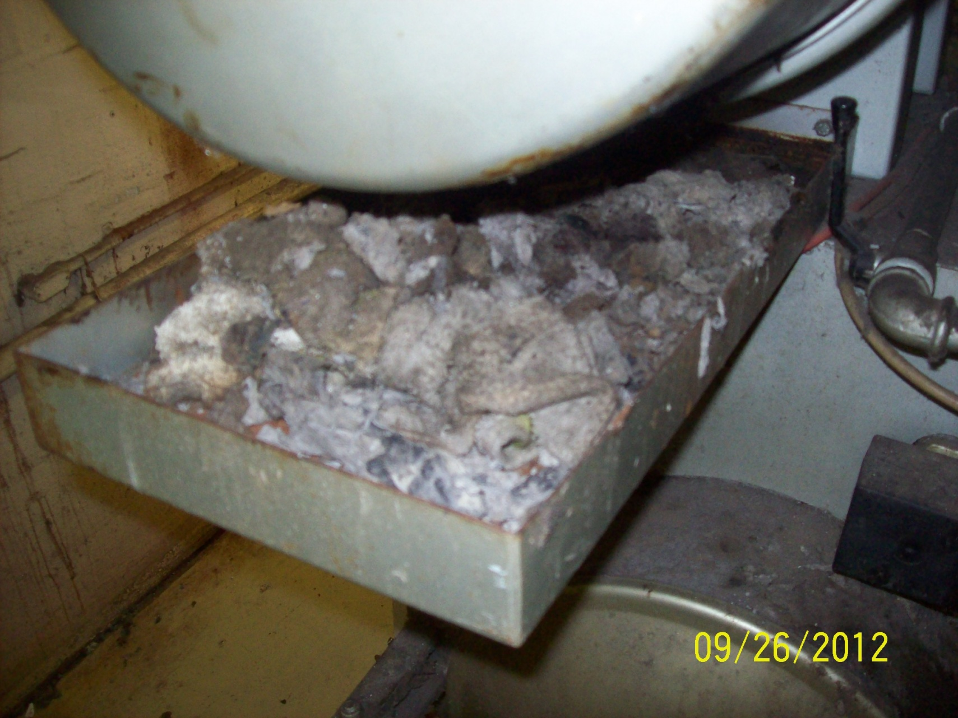
Bad, allowing perc to evaporate
40 CFR 261.5(g)(3)

Slide 52
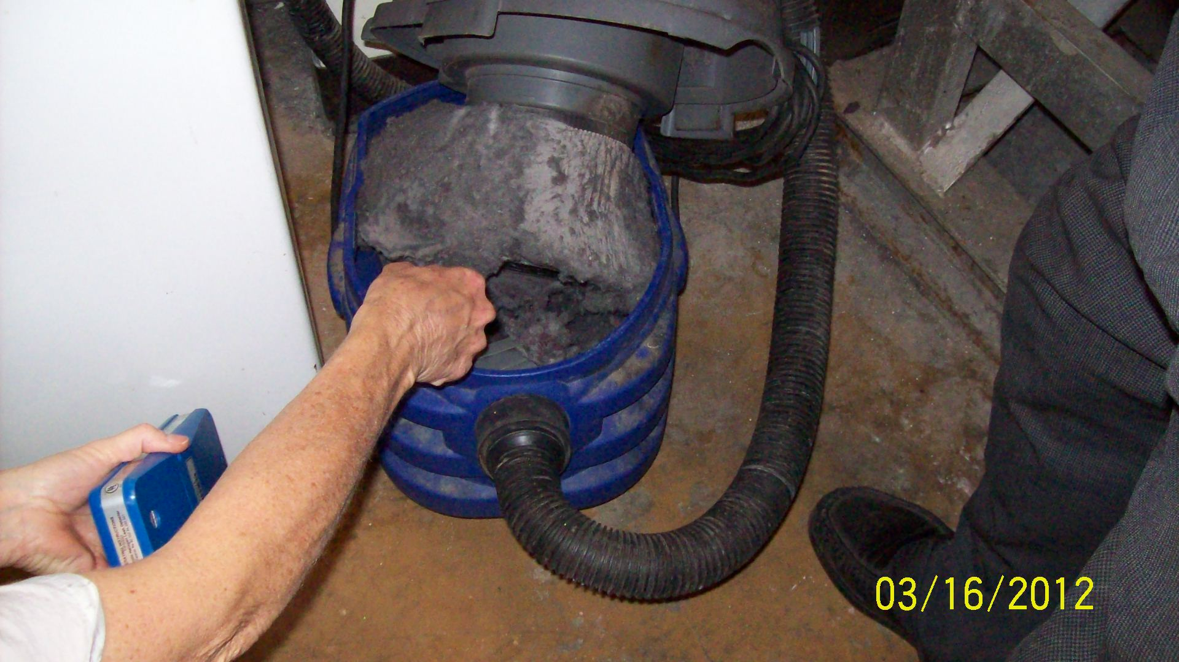
Testing with Halogen Leak Detector
Notes:
Halogen Leak Detector responding to the presence of halogenated compounds in a dry cleaner vacuum

Slide 53
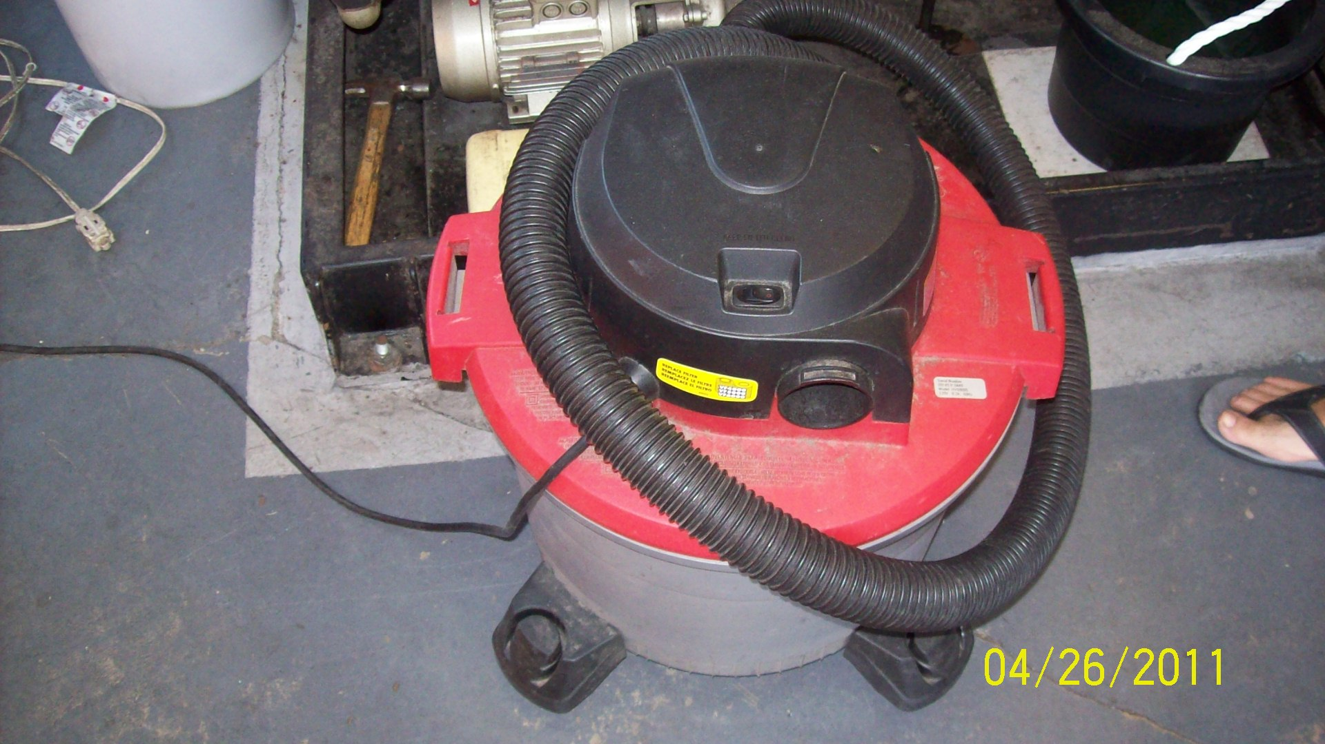
Vacuum storing hazardous waste lint, should be in secondary containment
376.3078(9)(a), FS
Notes:
376.3078(9)a), FS

Slide 54
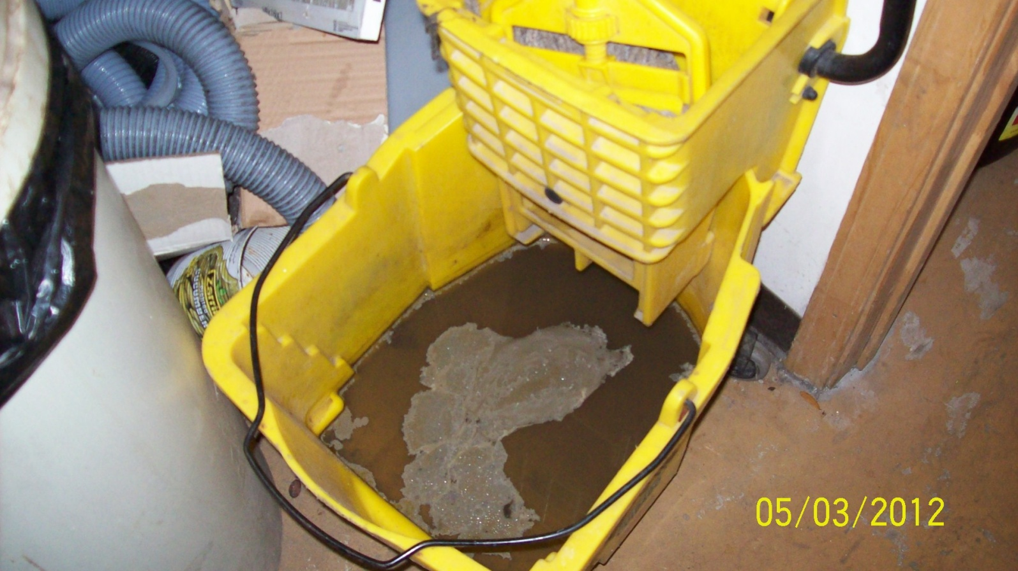
Mop Water
Recommend the facility not mop around machine. If around machine is dirty, use a rag to clean, then run rag through machine.
Mop water should be placed into hazardous waste drum
if the facility
mops around
the machine.

Slide 55
Machines Taken out of Service or Abandoned
Due to economic hardships, sometimes property owner is left to deal with the machine and solvents.
If Perc is not used in 90 days, it could be considered abandoned and would be regulated as hazardous waste.
Facility owner should keep on file notice describing the sale and disposition of the old equipment (who, when, how and where of transfer).
After all wastes are removed, machine can be recycled as scrap metal or sold.
Wastes removed should either be reused or manifested for proper disposal as HW.
Notes:
Land owner can be responsible for the management of abandoned or out or service wastes. Co-generation. Good idea to include something in your lease concerning disposal of Haz waste.

Slide 56
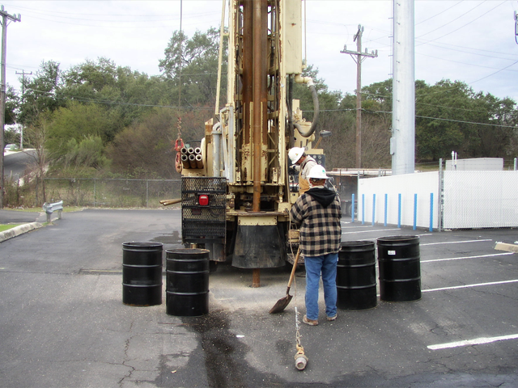
Cleanup
The average clean up costs for a dry cleaning contaminated property is $300,000-$400,000.
Depending on the extent of contamination, the costs can be much higher.
Notes:
The average clean up costs for a contaminated property is $300,000-$400,000. Depending on the extent of contamination, the costs can be much higher.

Slide 57
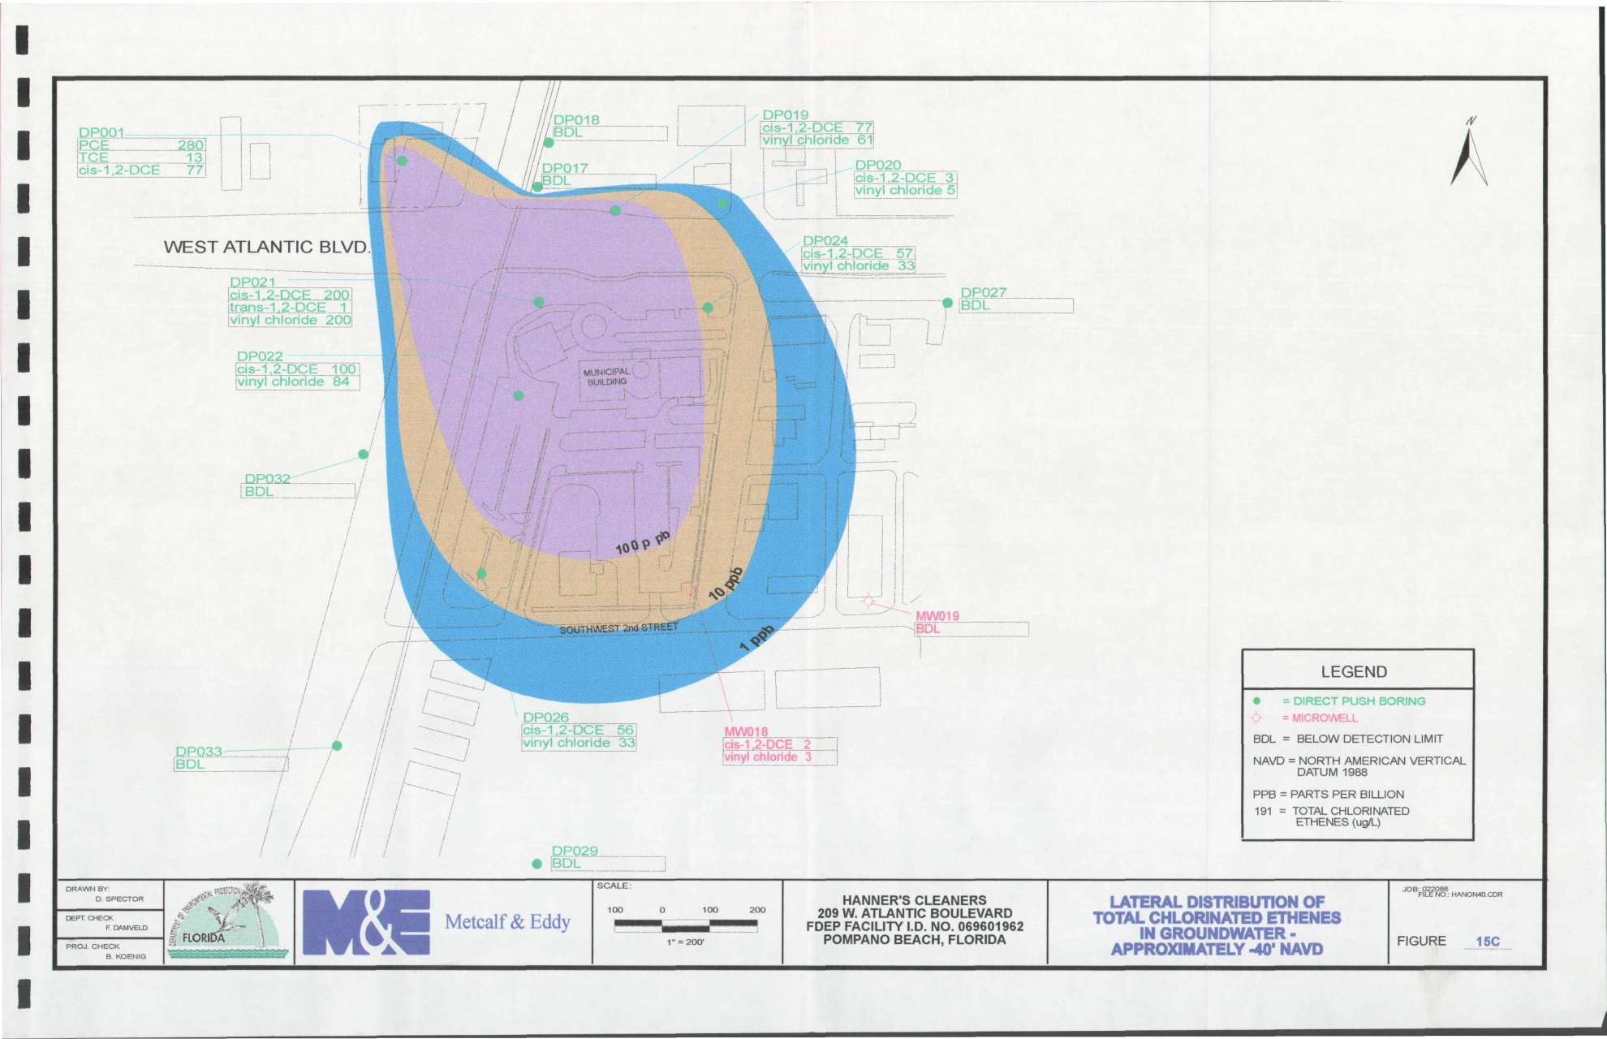
Groundwater Contamination From Dry Cleaner
Notes:
Hanner’s Quality Cleaners is a former laundry and dry cleaning business covering a ¼ acre parcel in an area of mixed commercial and residential development at the intersection of West Atlantic Boulevard (SR 814) and Dixie Highway (SR 811), Pompano Beach, Broward County from 1966 until 1989.
It contaminated the public drinking water wells.
Hanner’s and adjoining properties were unfenced with no restrictions to public access and vagrants were observed occupying the property.
Two underground tanks were removed in 1990 and reportedly held mineral spirits and chlorinated solvents, respectively, used in the dry cleaner operation. The tanks were visibly observed during the excavation and one tank was in poor condition with two holes in it.
The nearest private well is within ¼ mile from Hanner’s and the City of Pompano Beach Municipal Supply Well #8 is located between ½ mile and 1 mile NE of the site and had become contaminated with Perchloroethylene and 1,2-dichloroethene.
The site became eligible for Florida’s Drycleaning Solvent Cleanup Program and all further assessment and cleanup activities are being handled by the Bureau of Waste Cleanup.

Slide 58
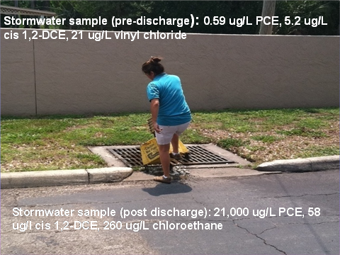
Mismanagement of Mop water
Notes:
Note the difference in the amounts of the constituent after the discharge.

Slide 59
Due Diligence
Prospective buyers should perform a due diligence study (environmental investigation of the property) before buying a dry cleaner location. Buyers could become liable for soil/groundwater contamination they did not cause.
A Phase I ESA (Environmental Site Assessment) would look at compliance records for the dry cleaner at the FDEP and determine if any soil or groundwater contamination has been found on the property. It also includes a thorough site inspection to determine potential environmental impacts. Should investigation reveal possible impacts, a Phase II ESA with sampling may be warranted.
For more information contact William Rueckert at (561)681-6679 or William.Rueckert@dep.state.fl.us and visit our contamination locater map website at: http://www.dep.state.fl.us/waste/default.htm

Slide 60
Voluntary Cleanup Tax Credit (VCTC)
In 1998, the Florida Legislature created the VCTC program to encourage voluntary cleanup of certain dry-cleaning solvent contaminated sites and Brownfield sites.
Participants may be private or public entities, but they must meet the eligibility criteria established under statute and must enter into a Voluntary Cleanup Agreement (VCA), for dry-cleaning solvent cleanup.
Tax credit certificates are awarded by the DEP from an annual $5 million authorization and are valid against Florida Corporate Income Tax.
For more information contact William Rueckert at (561)681-6679 or William.Rueckert@dep.state.fl.us and visit our website at: http://www.dep.state.fl.us/waste/categories/vctc/default.htm.

Slide 61
Alternatives to Perc
Dry Cleaning
There are alternatives to using perc and petroleum dry cleaning which would result in:
Less stringent regulation
Reduction in disposal costs
Reduction in energy use
Less hazardous to environment
Society moving towards “Green” and “Earth Friendly”, would appeal to customers
Less potential for expensive clean up costs and risk of ground water/soil contamination
Notes:
Do your own research and determine the pros and cons of an alternative and see what works for your business. What incentives would encourage you to transition to an alternative??

Slide 62
Good Resources
Small Business Environmental Assistance Program:
http://www.dep.state.fl.us/air/emission/drycleaners.htm
Best management practices for dry cleaners publication
http://www.dep.state.fl.us/waste/quick_topics/publications/default.htm
Hazardous Waste Dry Cleaner Compliance Assistance page:
http://www.dep.state.fl.us/waste/categories/hazardous/pages/DryCleanCompliance.htm
Dry Cleaner Solvent Clean Up Program main page:
http://www.dep.state.fl.us/waste/categories/drycleaning/
Separator Water Facts Sheet:
http://www.dep.state.fl.us/air/emission/sbeaplib/GUIDELINES_FOR_PROPER_MANAGEMENT_OF_DRYCLEANING_SEPARATOR_WATER.pdf

Slide 63

Contact Information
    Nicole Stallings
    Phone – (561)681-6604
    Email – Nicole.Stallings@dep.state.fl.us
    Kathy Winston
    Phone – (561)681-6756
    Email – Kathy.Winston@dep.state.fl.us

