Slide 1
Office of Permitting and Compliance
Summary of EPA’s Revised HPV Guidance
October 6, 2014

Slide 2
Effective 10/1/14
Supersedes previous HPV guidance
HPV is violation that:
          (1) May pose an unacceptable risk to human health and/or the environment from direct or indirect release of air pollutants; or
          (2) May harm the ability to implement CAA programs.
Goals of the Revision
  Quick Identification
  Reporting
  Engaging facilities
  Cooperative enforcement approach

Slide 3
The 6 Criteria are:
Failure to obtain NSR/PSD permit
Federally Enforceable emissions limitation, standard or operating parameter violation
NSPS emissions limitation, standard or operating parameter violation
NESHAP emissions limitation, standard or operating parameter violation
Work practice or recordkeeping that interferes with ability to determine compliance
Discretionary/mutual agreement with EPA
Reduces criteria from 10 general criteria and five matrix criteria to 6 criteria
  Adds the 7 day/168 hour duration for Criteria 1 - 5
  Removed
        Certification violations
        Permitting violations (other than failure to get one)
        Recalcitrant violators
        Violation of order or decree

Slide 4
Failure to obtain a new source review (NSR) permit (for either attainment or non-attainment areas) and/or install best available control technology (BACT) or lowest available emission reductions (LAER) (and/or obtain offsets) for any new major stationary source or major modification at a major stationary source. This criterion includes a violation by a synthetic minor stationary source of an emission limit or permit condition such that the source's actual annual emissions exceed (or are expected to exceed) the major stationary source threshold as defined in the applicable NSR regulations.
Criteria 1

Slide 5
A violation of any federally enforceable emission limitation, emission standard or operating parameter, which is a surrogate for emissions, that was issued pursuant to Title I, Part C or D, of the CAA and the implementing regulations, or the equivalent provision(s) in an EPA­ approved implementation plan (state, local, territorial or tribal) where such violation continued (or is expected to continue) for at least seven days. This criterion includes violations that, while not necessarily continuous for 168 hours, recur (or recurred) regularly or intermittently for at least seven days. EPA presumes that the violation is continuing unless the enforcement agency can document sufficient evidence to conclude that the violation is no longer ongoing and is unlikely to recur.
Criteria 2

Slide 6
A violation of any emission limitation, emission standard or operating parameter, which is a surrogate for emissions, in an applicable Standards of Performance for New Sources (NSPS) (Part 60) or in an analogous regulation adopted by state, local, tribal or territorial authorities and the EPA has granted delegation to enforce such regulations in lieu of the NSPS where such violation continued (or is expected to continue) for at least seven days. This criterion includes violations that, while not necessarily continuous for 168 hours, recur (or recurred) regularly or intermittently for at least seven days. The EPA presumes that the violation is continuing unless the enforcement agency can document sufficient evidence to conclude that the violation is no longer ongoing and is unlikely to recur.
Criteria 3

Slide 7
A violation of any emission limitation, standard or surrogate parameter (emission or operating) of an applicable National Emission Standards for Hazardous Air Pollutants (NESHAP) (Parts 61 and 63) or in an analogous regulation adopted by state, local, tribal or territorial authorities and EPA has granted delegation to enforce such regulations in lieu of the NESHAP where such violation continued (or is expected to continue) for at least seven days. This criterion includes violations that, while not necessarily continuous for 168 hours, recur (or recurred) regularly or intermittently for at least seven days. The EPA presumes that the violation is continuing unless the enforcement agency can document sufficient evidence to conclude that the violation is no longer ongoing and is unlikely to recur.
Criteria 4

Slide 8
A violation that involves federally enforceable work practices, testing requirements , monitoring requirements, recordkeeping or reporting that substantially interferes with enforcement of a requirement or a determination of the source's compliance. The determination of what is substantial shall be part of a case-by-case analysis/discussion between the EPA Region and the enforcement agency.
Criteria 5

Slide 9
Any other violations specifically identified and communicated to enforcement agencies from time to time by the Director, Air Enforcement Division (AED), U.S. EPA (general applicability) or as mutually agreed upon between the enforcement agency and corresponding EPA Region (case-by-case). For example, an enforcement agency believes an emission violation warrants designation as an HPV even though the violation lasted (or will last) for less than seven days.
Criteria 6

Slide 10
Must be “addressed” by day 180 (from day zero)
Existing HPV Cases Prior to 10/1/14 Should Be Resolved By Day 180
Addressing Actions:
Require immediate action through an enforceable order such as Court Injunction
Require penalties if now in compliance through an enforceable order such as Short Form Consent Order
Require long term actions through an enforceable order such as Long Form Consent Order
Referred to OGC for filing in Court
Day Zero
Day zero is whenever an agency has sufficient information to decide it’s an HPV, or 90 days from discovery

Slide 11
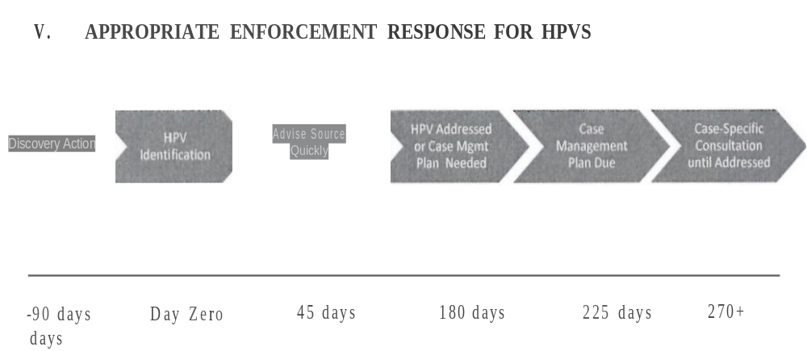

Slide 12
DARM/OPC through the monthly teleconferences
Involves use of AirCom data
Monthly AirC+E Teleconference
Sometimes additional emails/calls are needed for details
Requires, at a minimum, Quarterly consultations with EPA (Region 4)

Slide 13
  1) No longer believe it is an HPV?
  Document in file
  Consult EPA through DARM/OPC
  2)Don’t believe it justifies tracking as HPV?
  No evidentiary support
  Nature:
  Does not involve on-going violations
  Not in public interest to invest resources pursuing
  Consult EPA through DARM/OPC
Removing HPV Status

Slide 14
“All civil penalties for HPVs should be sufficient to achieve effective deterrence for the source subject to enforcement and for the regulated community as a whole. The EPA expects all enforcement agencies resolving an HPV to assess penalties that recover economic benefit and contain a component reflecting the gravity (seriousness) of the violation. All penalty calculations must be documented in the enforcement agency's file. In matters where no penalty is assessed or where a difference exists between the assessed and collected penalty, the enforcement agency should provide an explanation in its file.”
Penalties

Slide 15
QUESTIONS?

Slide 16
Jim Pennington, Professional Engineer II
Jim.Pennington@dep.state.fl.us
850-717-9102

