Slide 1
Aquatic Ecology and Quality Assurance
Rapid Periphyton Survey (RPS) Procedure
2018
Aquatic Ecology and Quality Assurance

Slide 2
Rapid Periphyton Survey (RPS)
The RPS quantifies the extent (coverage) and abundance (thickness) of attached algae in a 100m stream segment
Follow DEP SOP FS 7230
Conduct in conjunction with Habitat Assessment (SOP FT 3100) Linear Vegetation Survey (LVS; SOP FS 7320), and Stream Condition Index (SCI; SOP SCI 1000)

Slide 3
RPS Conceptual Layout
100m
100
90
80
70
60
50
40
30
20
10
0
Upstream
1
2
3
4
5
Downstream
6
7
8
9
100m reach; place flags every 10 m to create 11 cross-stream transects
Beginning at “0” transect, evaluate 9 roughly equidistant points across the stream
Point 1 is ~0.1 m from right bank and point 9 is ~ 0.1 m from left bank
Canopy measurement, face upstream, take between points 4 and 6, ideally at point 5
Notes:
9 observations every 10m (11 transects, including 0m and 100m) for a total of 99 points

Slide 4
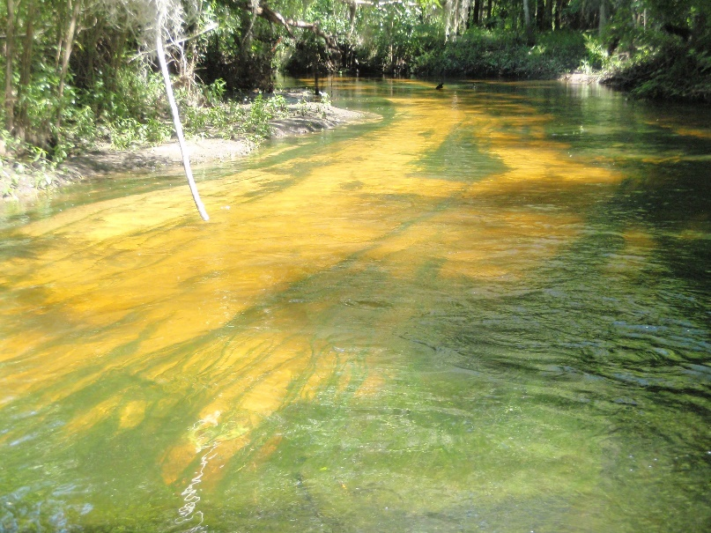
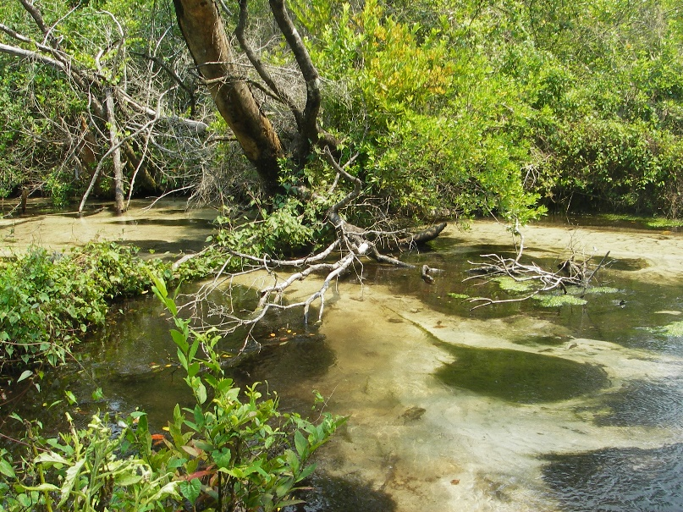
Assessing Algal Occurrence
After scanning the area for safety, choose points 1-9 haphazardly – that is, choose the actual point without looking (and potentially biasing your selection)
Measure average algae thickness, perpendicular to substrate, at each point

Slide 5

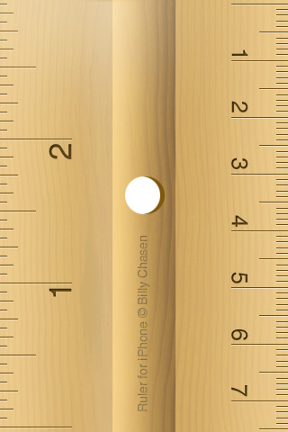
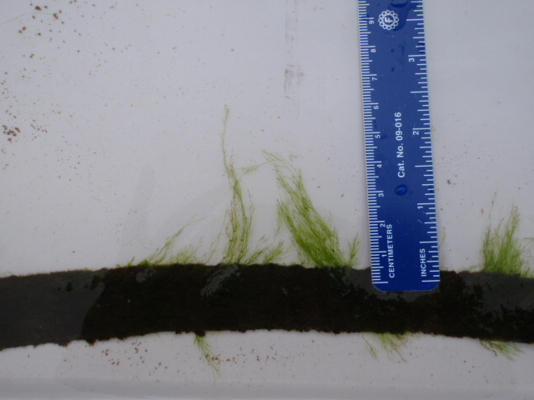
Thickness Ranks
Small snag
Rank | Algae Thickness
N | rough surface with no algae, slimy, or algae up to 1 mm
3 | >1 mm to 6 mm
4 | 6 mm to 20 mm
5 | 20 mm to 10 cm
6 | >10 cm
Average thickness is
>1mm to <6 = Rank 3

Slide 6
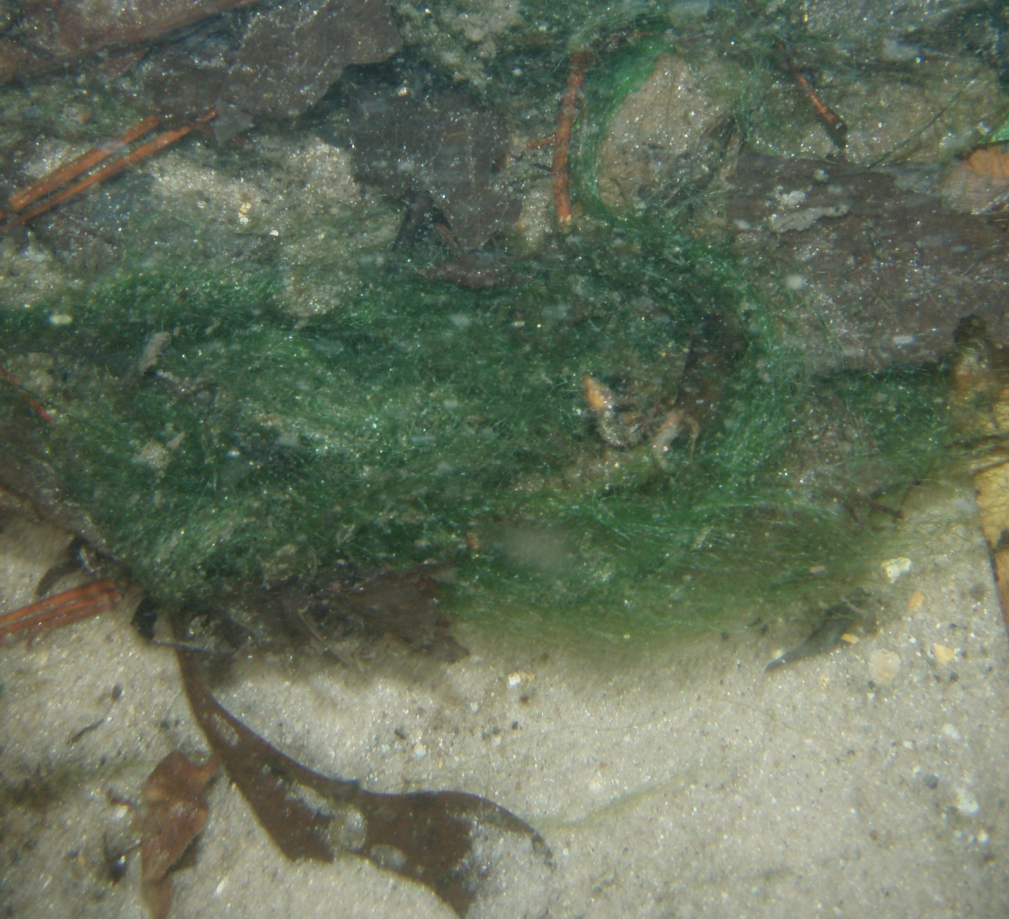
Thickness Ranks 4 or 5

Slide 7
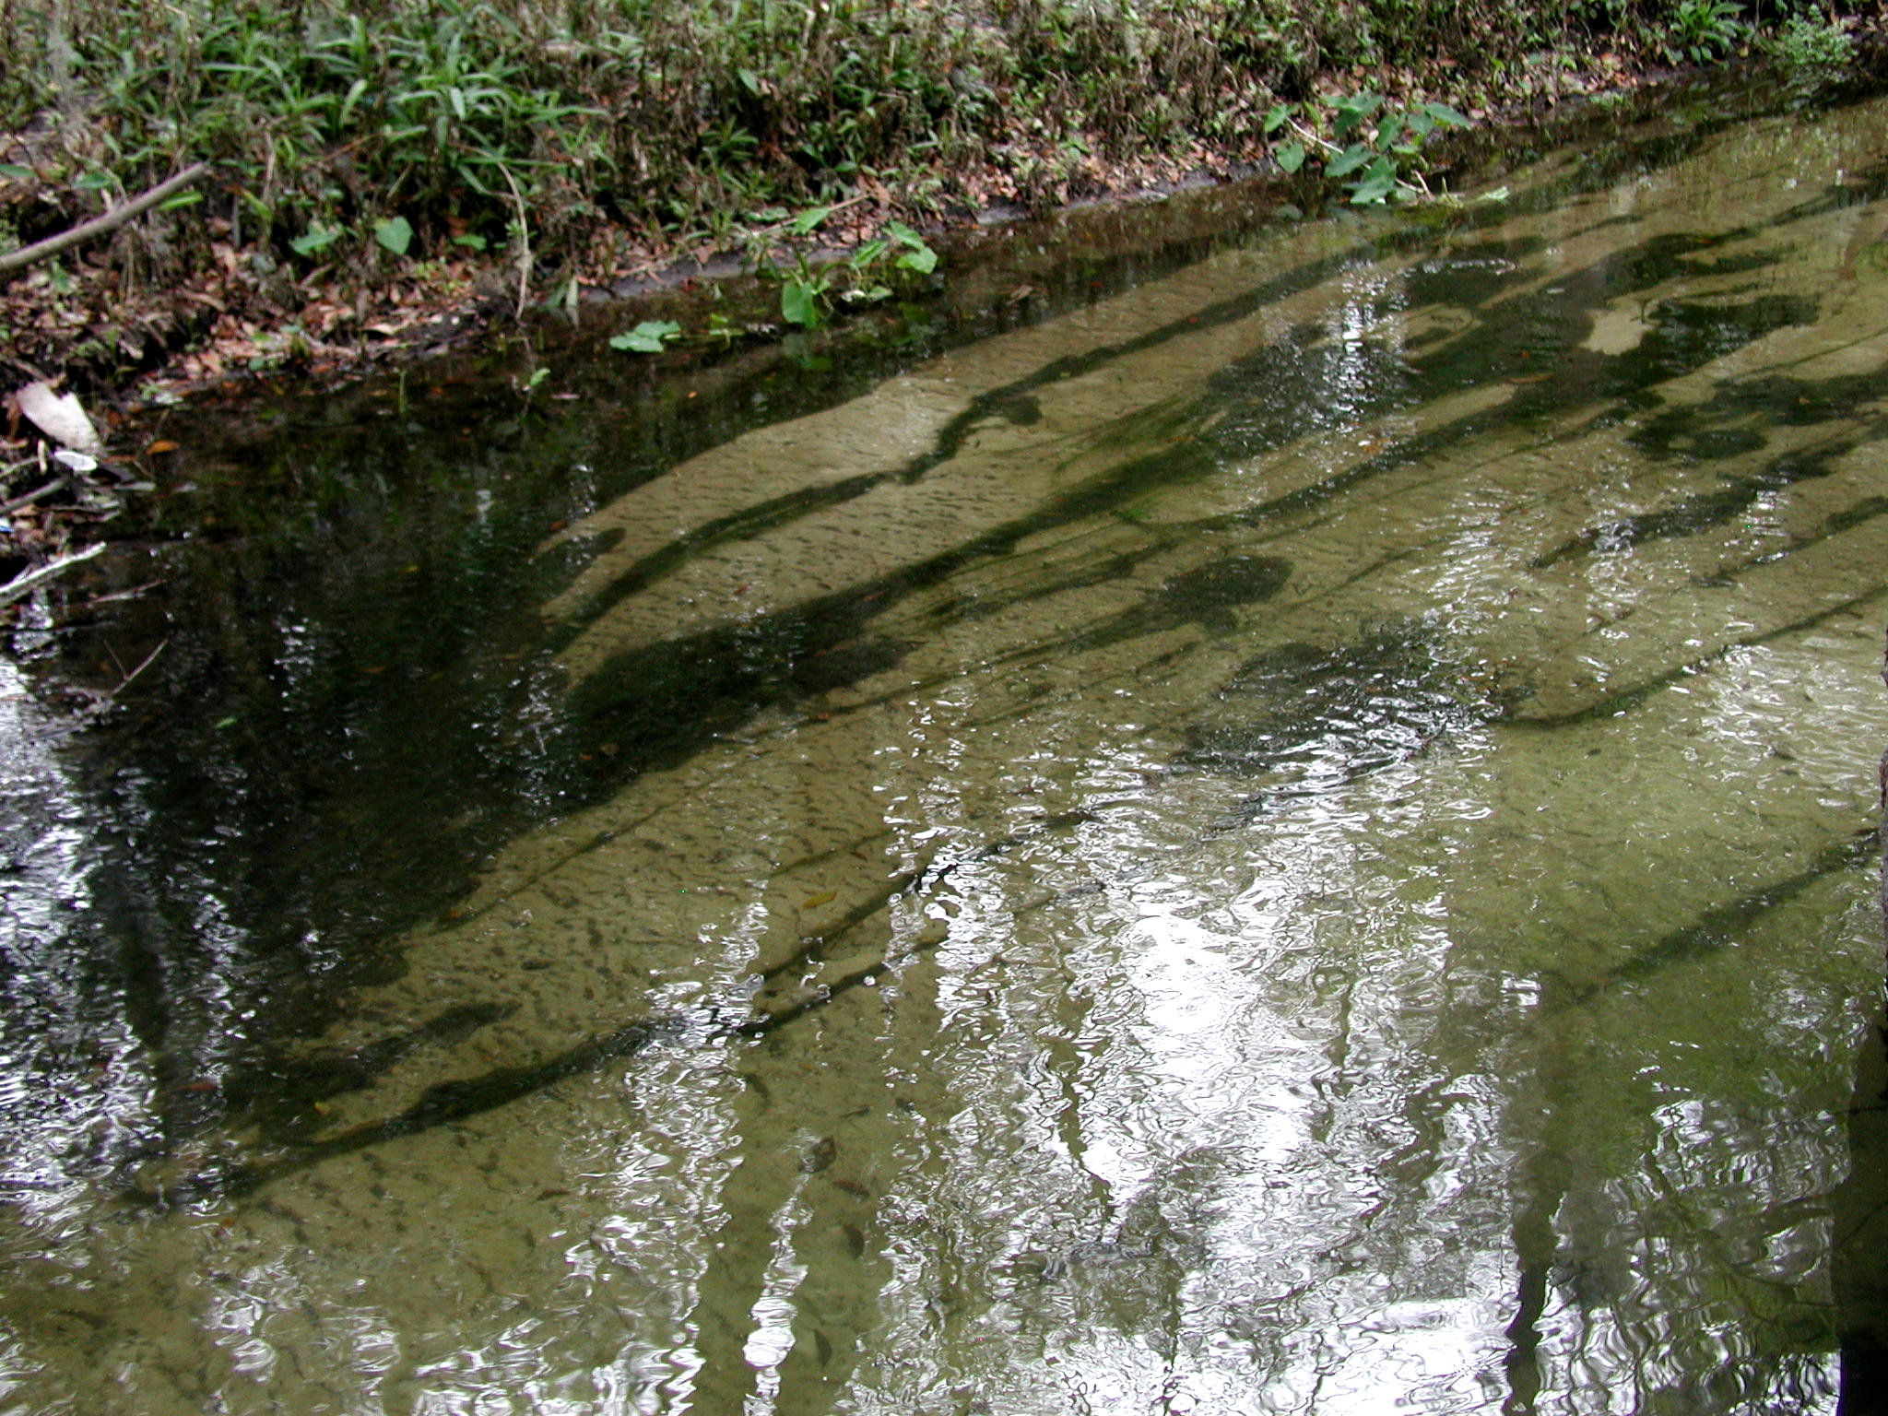
Thickness Rank 6

Slide 8
Assessing Algal Occurrence
If substrate cannot be reached and substrate depth is greater than Secchi depth (photic zone), record “N.” DEP study showed that no algae occurred below Secchi (photic) depth
If substrate cannot be reached or seen but depth is less than Secchi depth, record “X”
If you can see but not reach substrate, estimate rank based on similar reachable areas
Do NOT leave any box blank

Slide 9
Assessing Algal Occurrence
After completing the survey, count the points with ranks 4, 5, or 6. If >20% of the total points evaluated (include “N” points but not “X”), collect a sample of the dominant type of algae for taxonomic identification
Follow SOP FS 7240 for algal mat collection
Keep sample on ice until it is delivered to the lab (no chemical preservation)

Slide 10
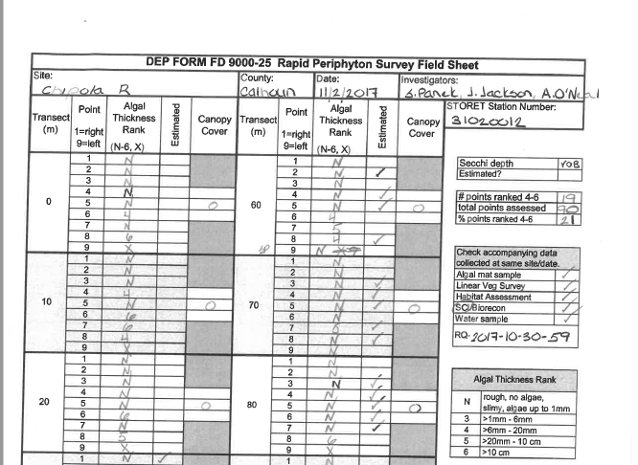
RPS Datasheet FD 9000-25

Slide 11
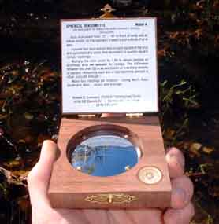
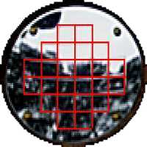
Estimating Canopy Cover
Use a spherical densiometer
Hold instrument level and away from body so that observer’s head is just outside the grid
Divide each of the 24 etched boxes into 4 imaginary boxes. Imagine a “point” in the center of each of the 96 smaller boxes
Count the small squares or points that ARE COVERED with vegetation. Record this number on the datasheet
level

Slide 12
71 squares with canopy cover
Estimating Canopy Cover
Record “71” for canopy cover on RPS field sheet

Slide 13
Estimating Canopy Cover
Densiometer measurement should indicate available light on the sampling date
Winter
Summer
Hypothetical view of one (of 24) box of the densiometer when branches are bare (winter) and full of leaves (summer)
Although there is something in each box in both cases, the “point” is covered for 2 in Winter and 4 in Summer.

Slide 14
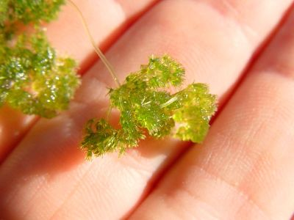
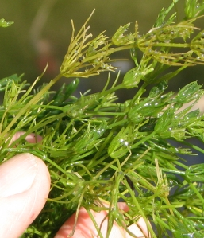
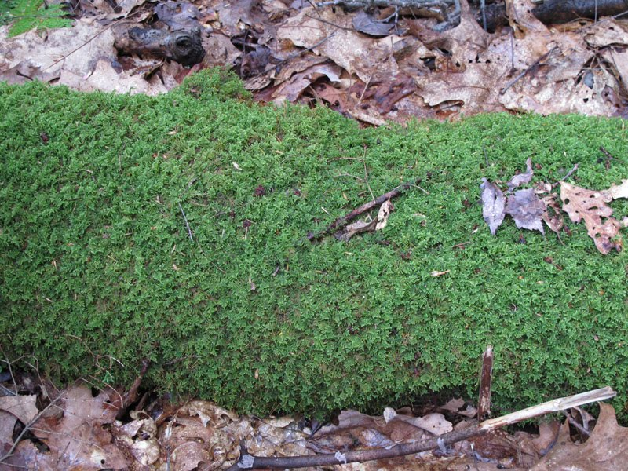
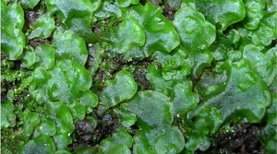
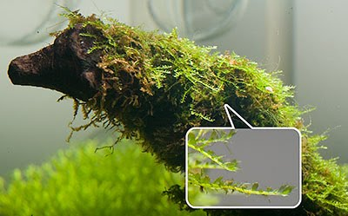
Things you might confuse with periphyton – DO NOT include in RPS
Macroalgae:
Nitella
Chara
Bryophytes: mosses and liverworts:
Liverworts
Sphagnum
Fontinalis

Slide 15
Resources
SOP FS 7230
  Posted here: https://floridadep.gov/dear/quality-assurance/content/dep-sops
Use in support of numeric nutrient criteria implementation described in “Implementation of Florida’s Numeric Nutrient Standard.” https://floridadep.gov/dear/water-quality-standards/documents/nnc-implementation
Field form (FD 9000-25) available on DEP website here: https://floridadep.gov/dear/quality-assurance/content/sop-forms

