Slide 1
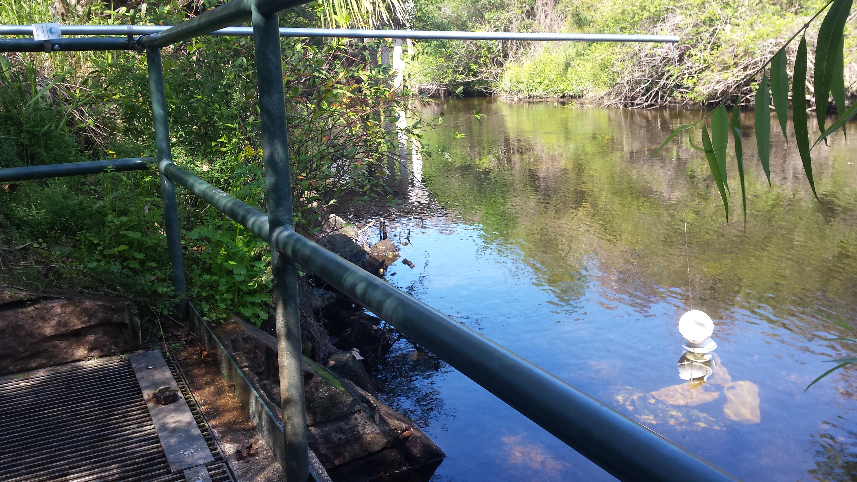

Emerging Substances of Concern
A Pilot Study

Slide 2
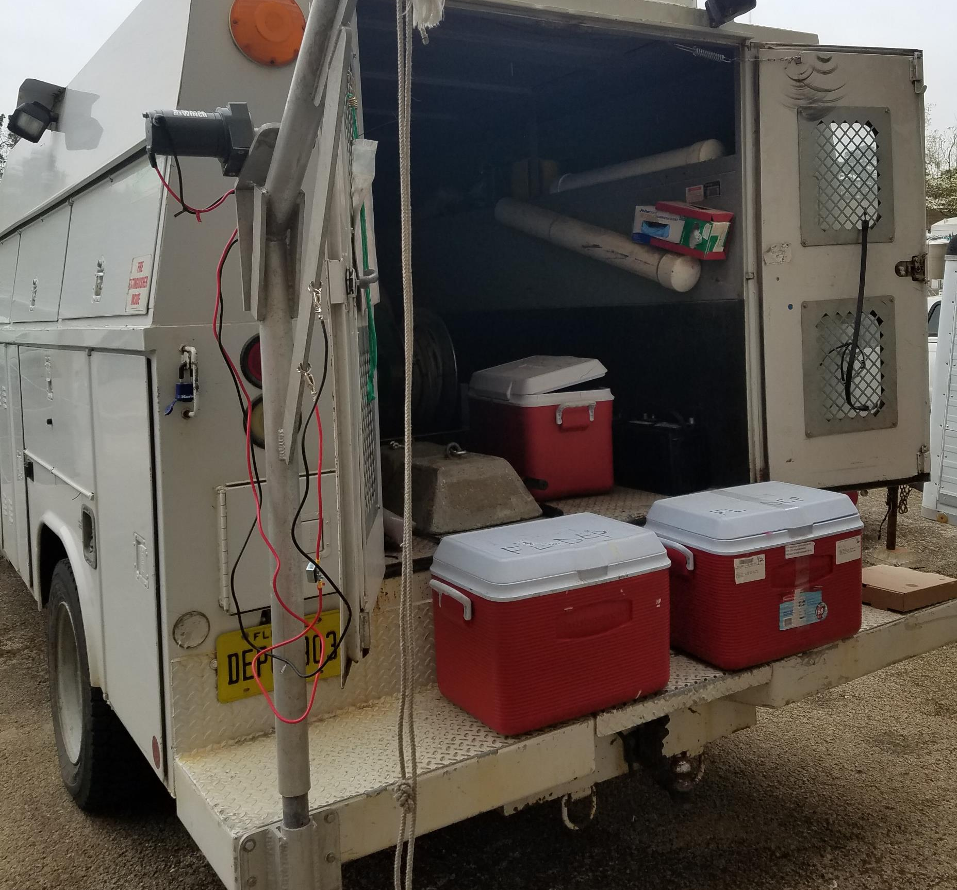
Day 1 – Deploy Withlacoochee & Ochlockonee

Slide 3
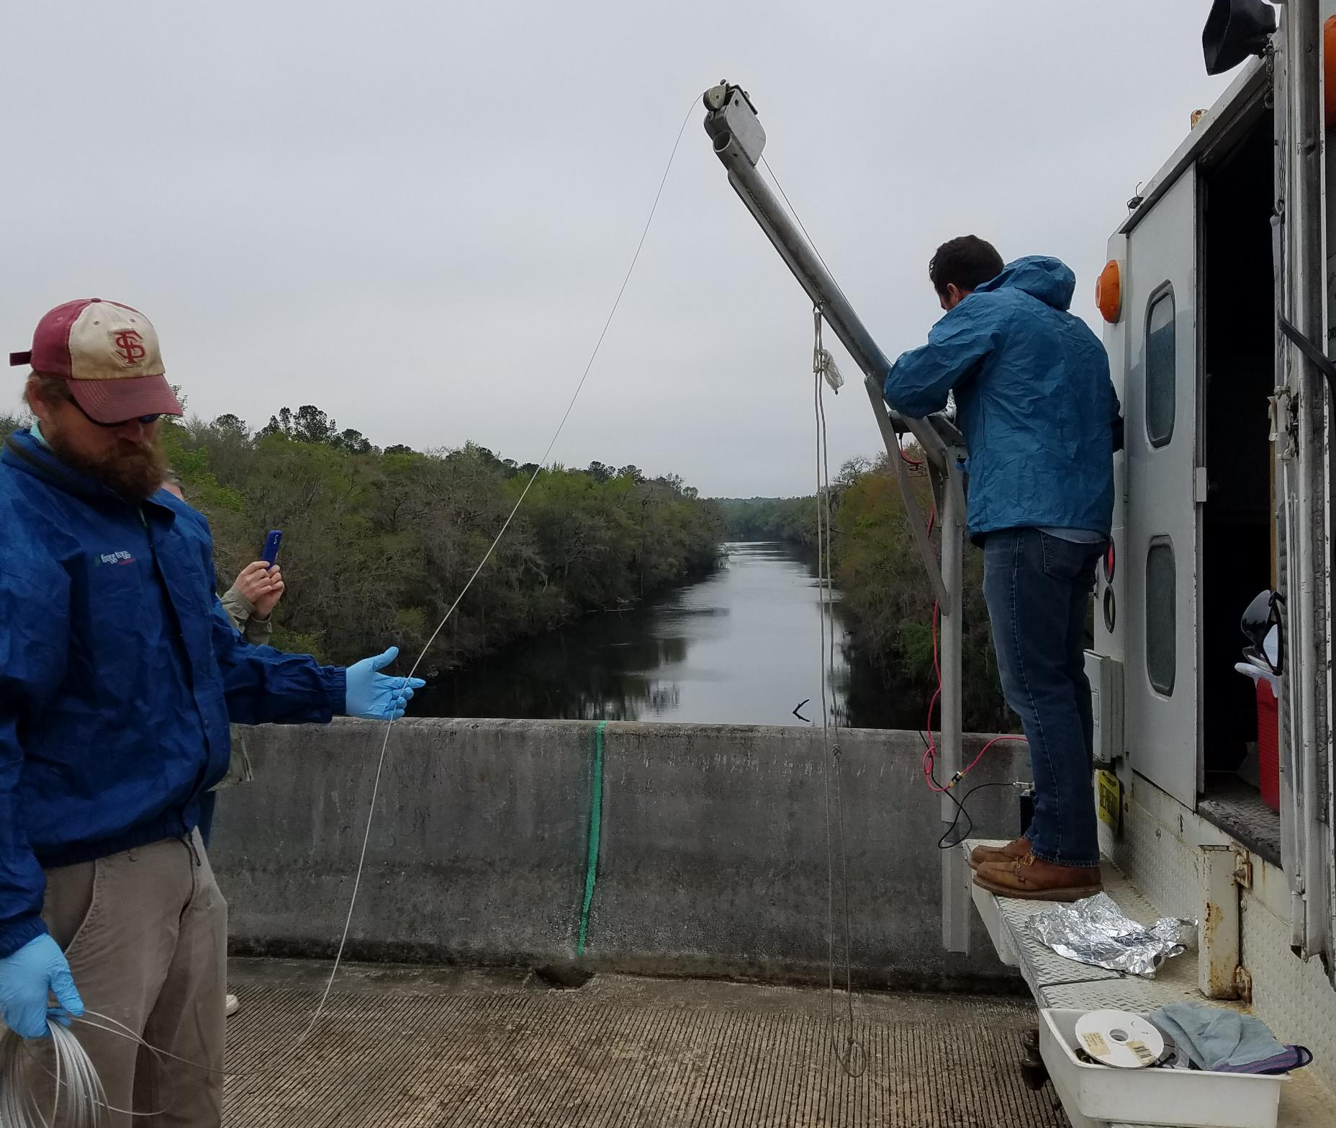
Withlacoochee – Crane Set Up

Slide 4
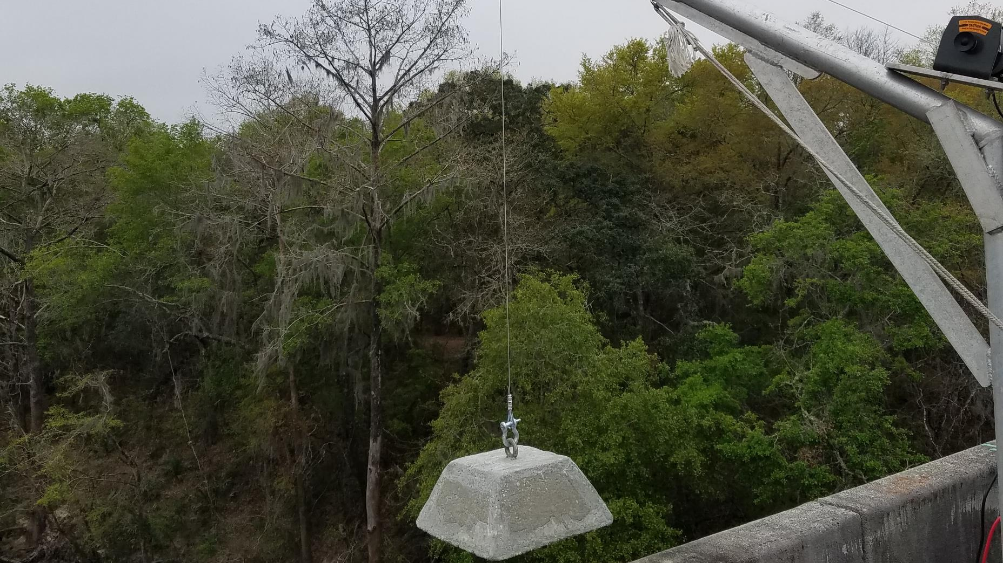

Slide 5
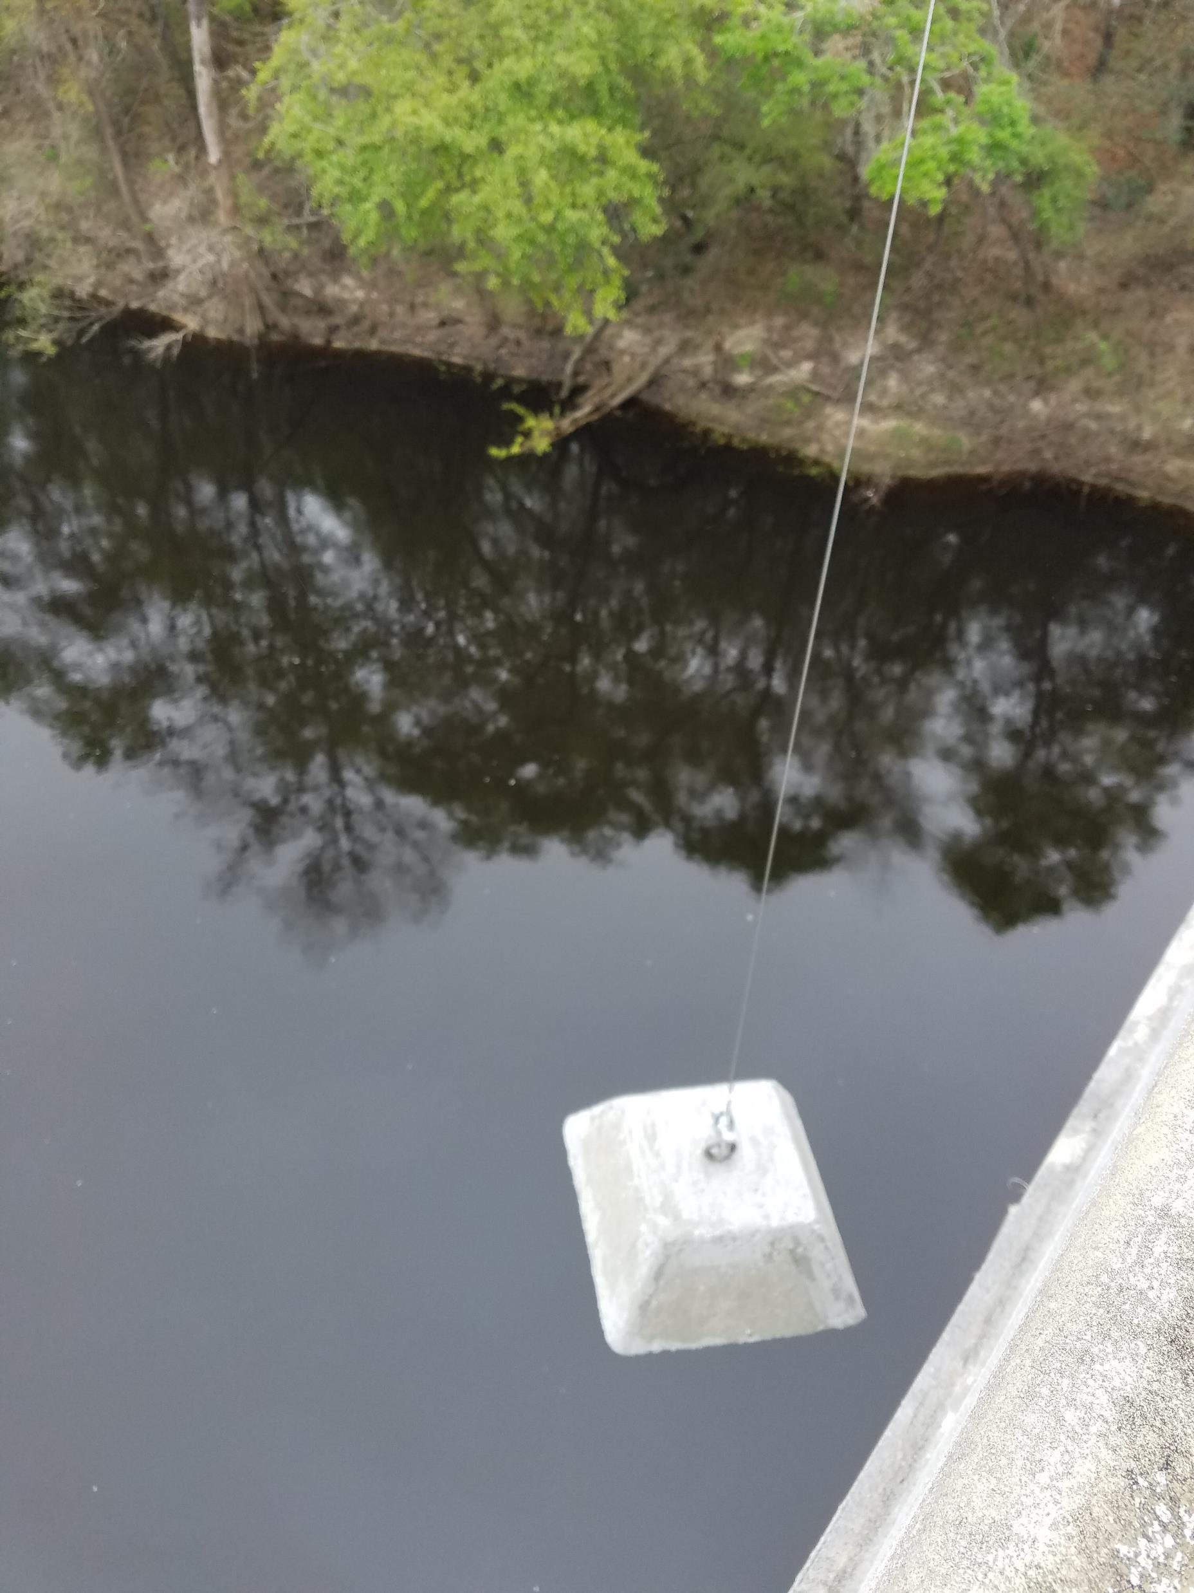

Slide 6
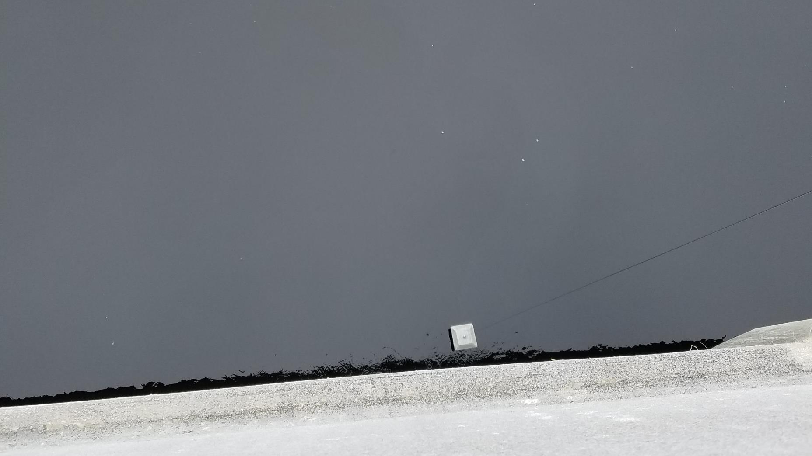

Slide 7
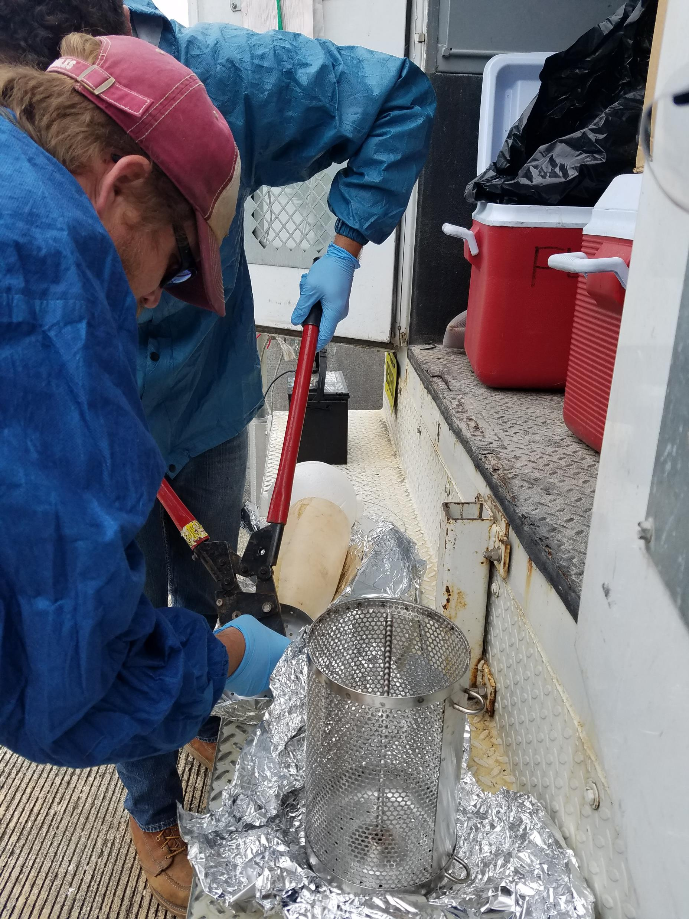
Withlacoochee – Sampling Device Set Up

Slide 8
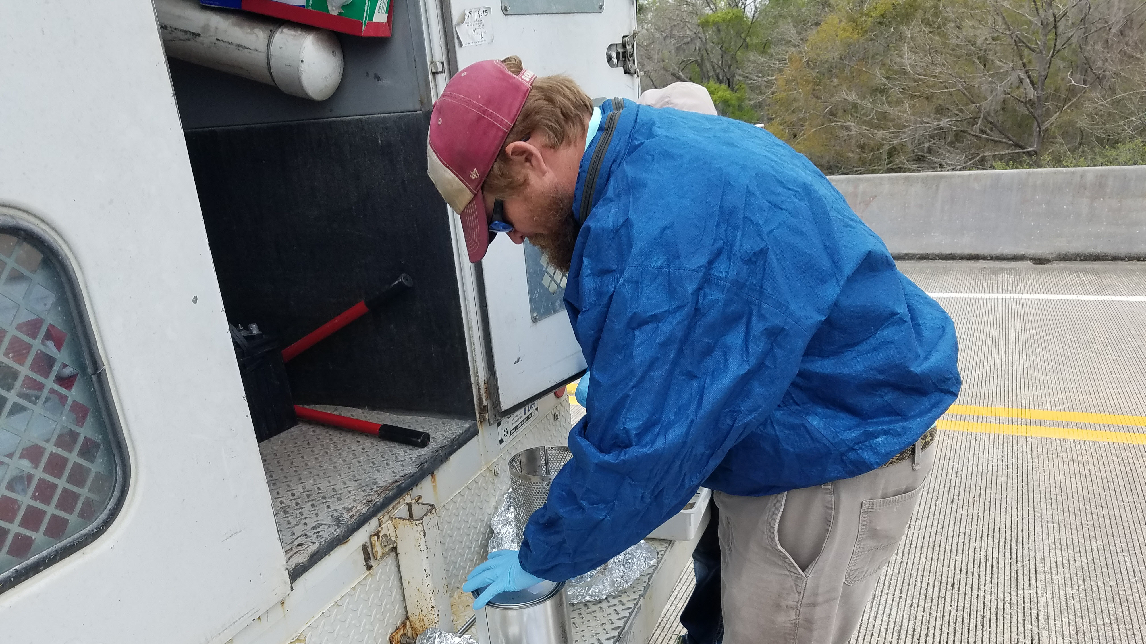
SPMD

Slide 9
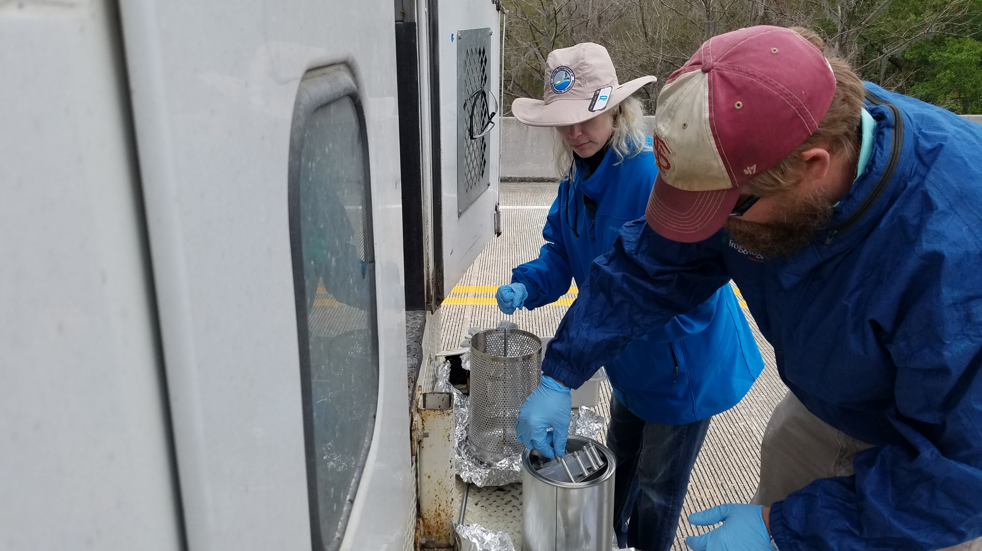

Slide 10
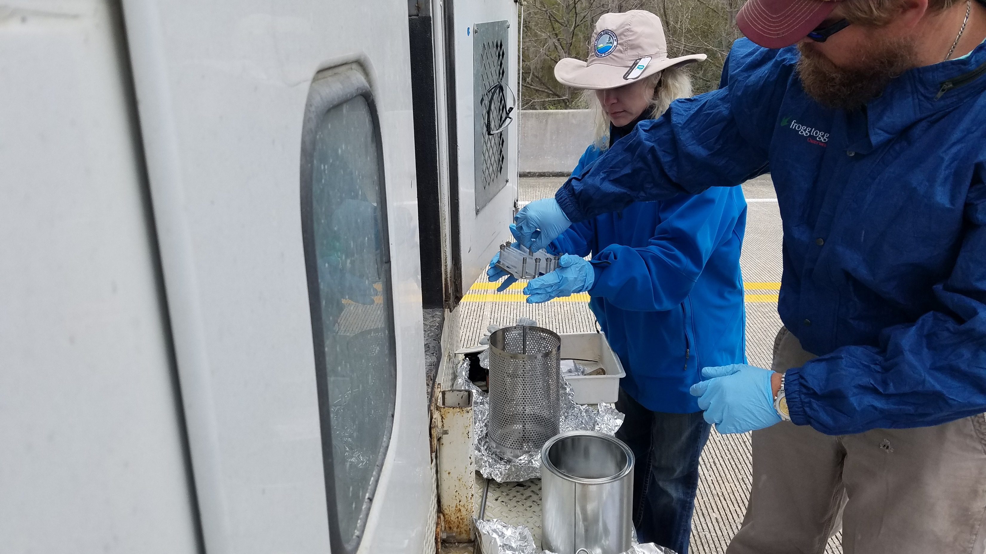

Slide 11
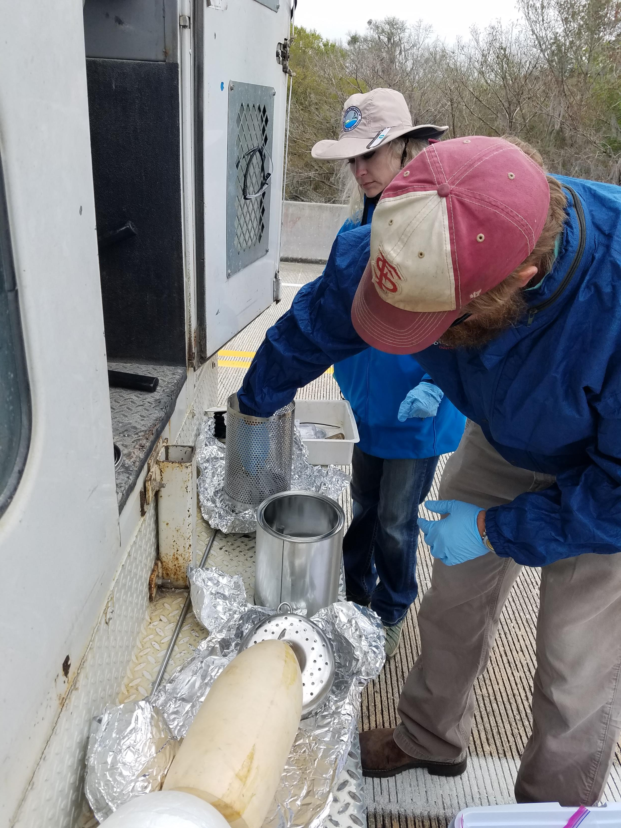

Slide 12
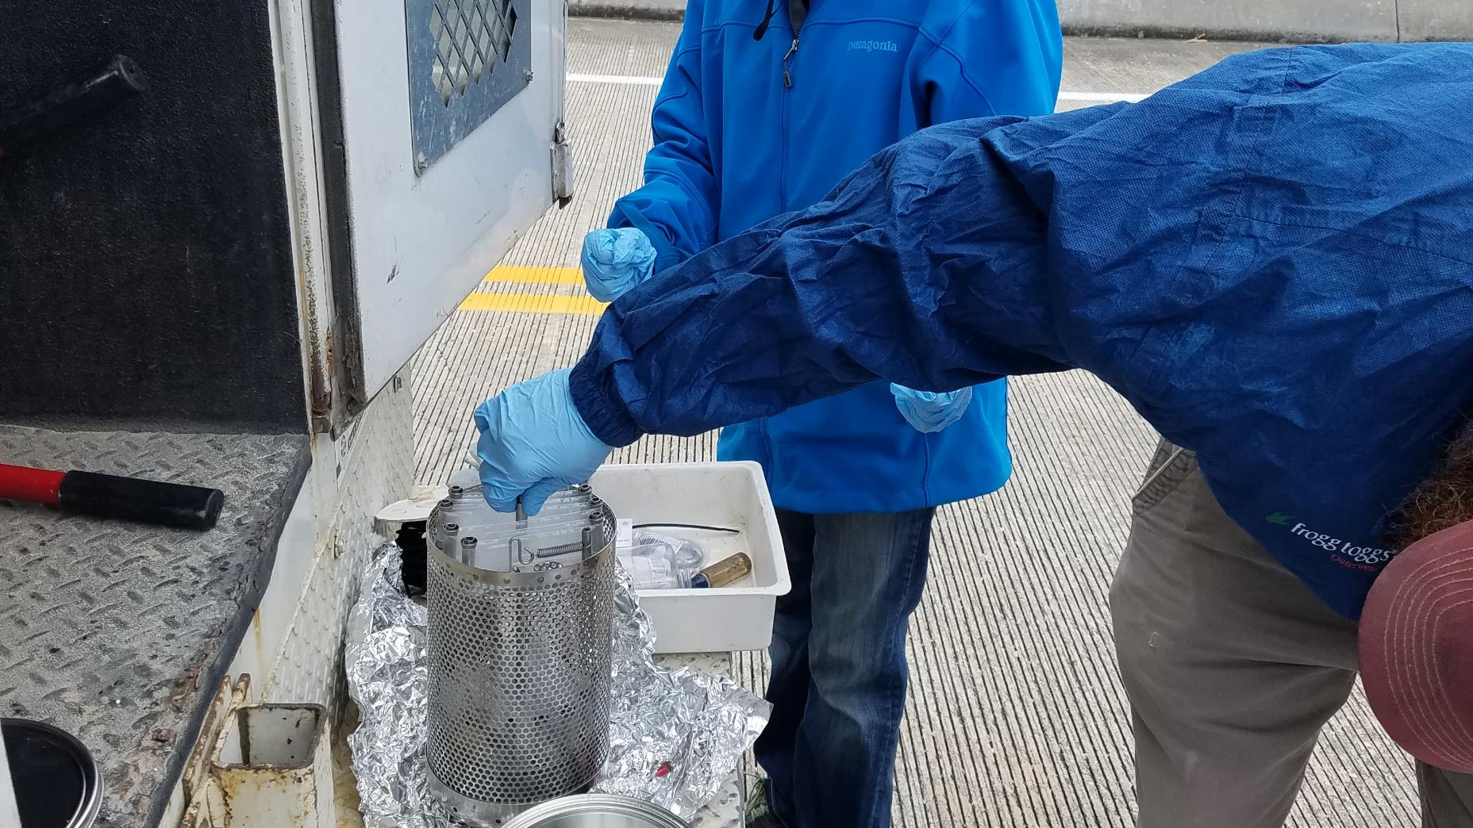

Slide 13
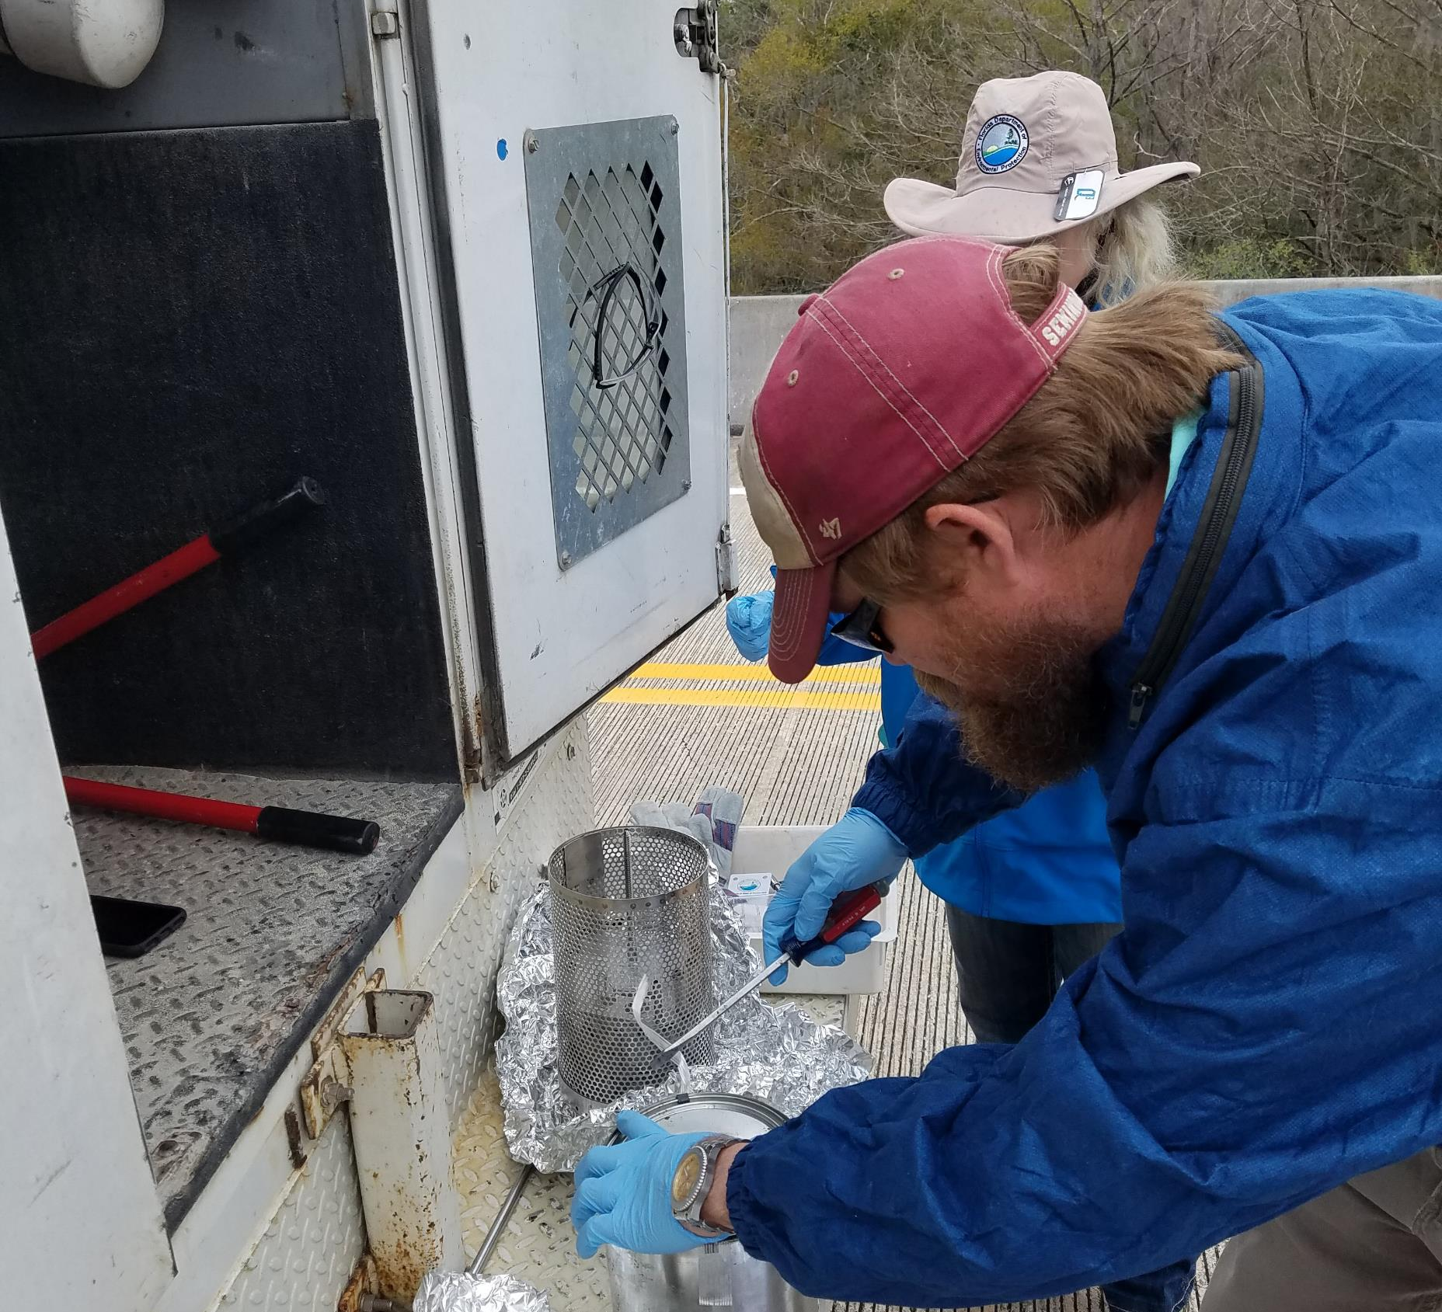
POCIS

Slide 14
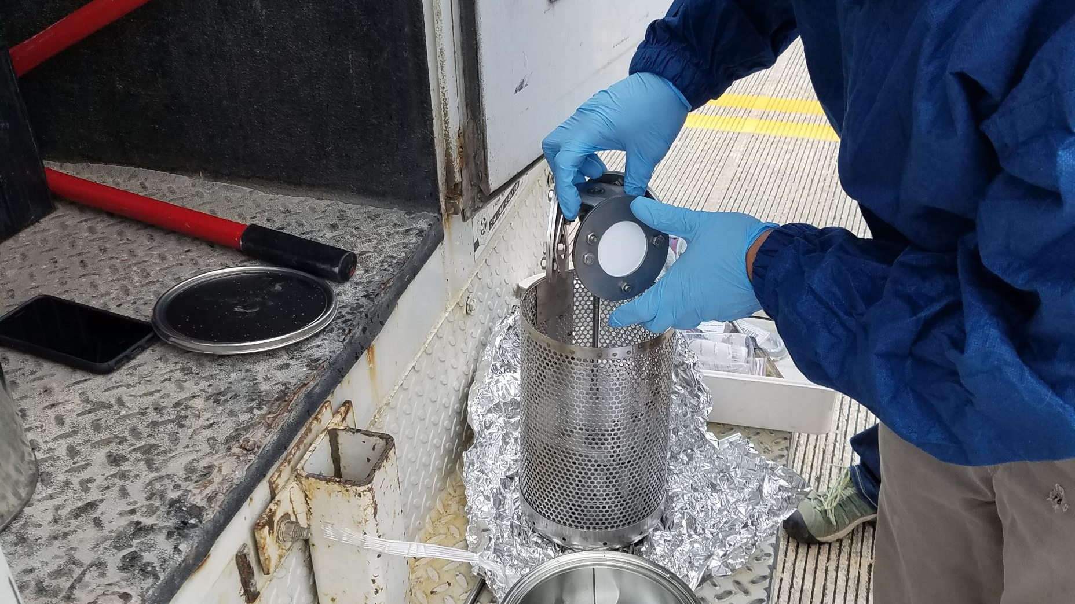

Slide 15
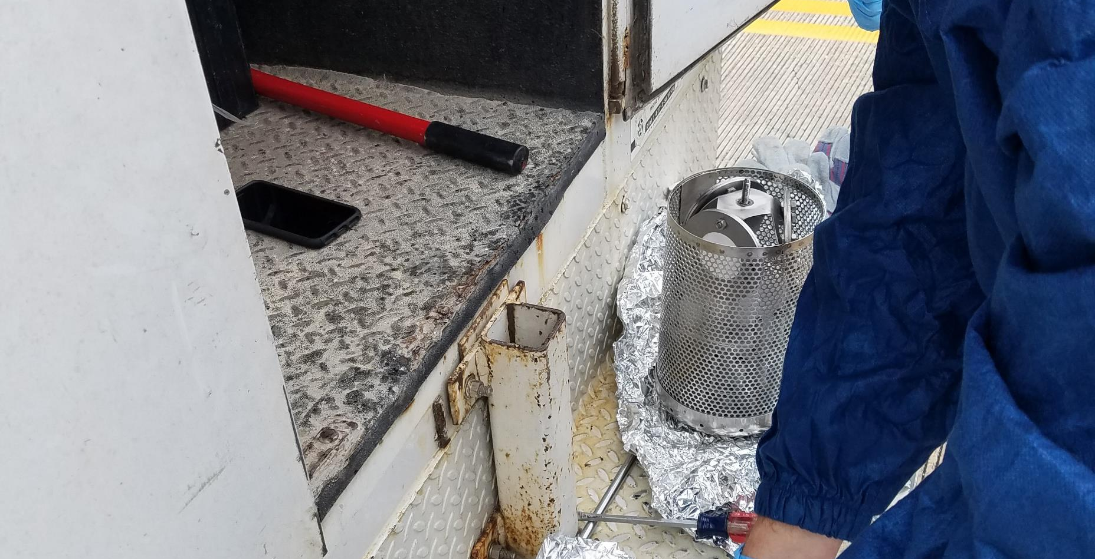

Slide 16
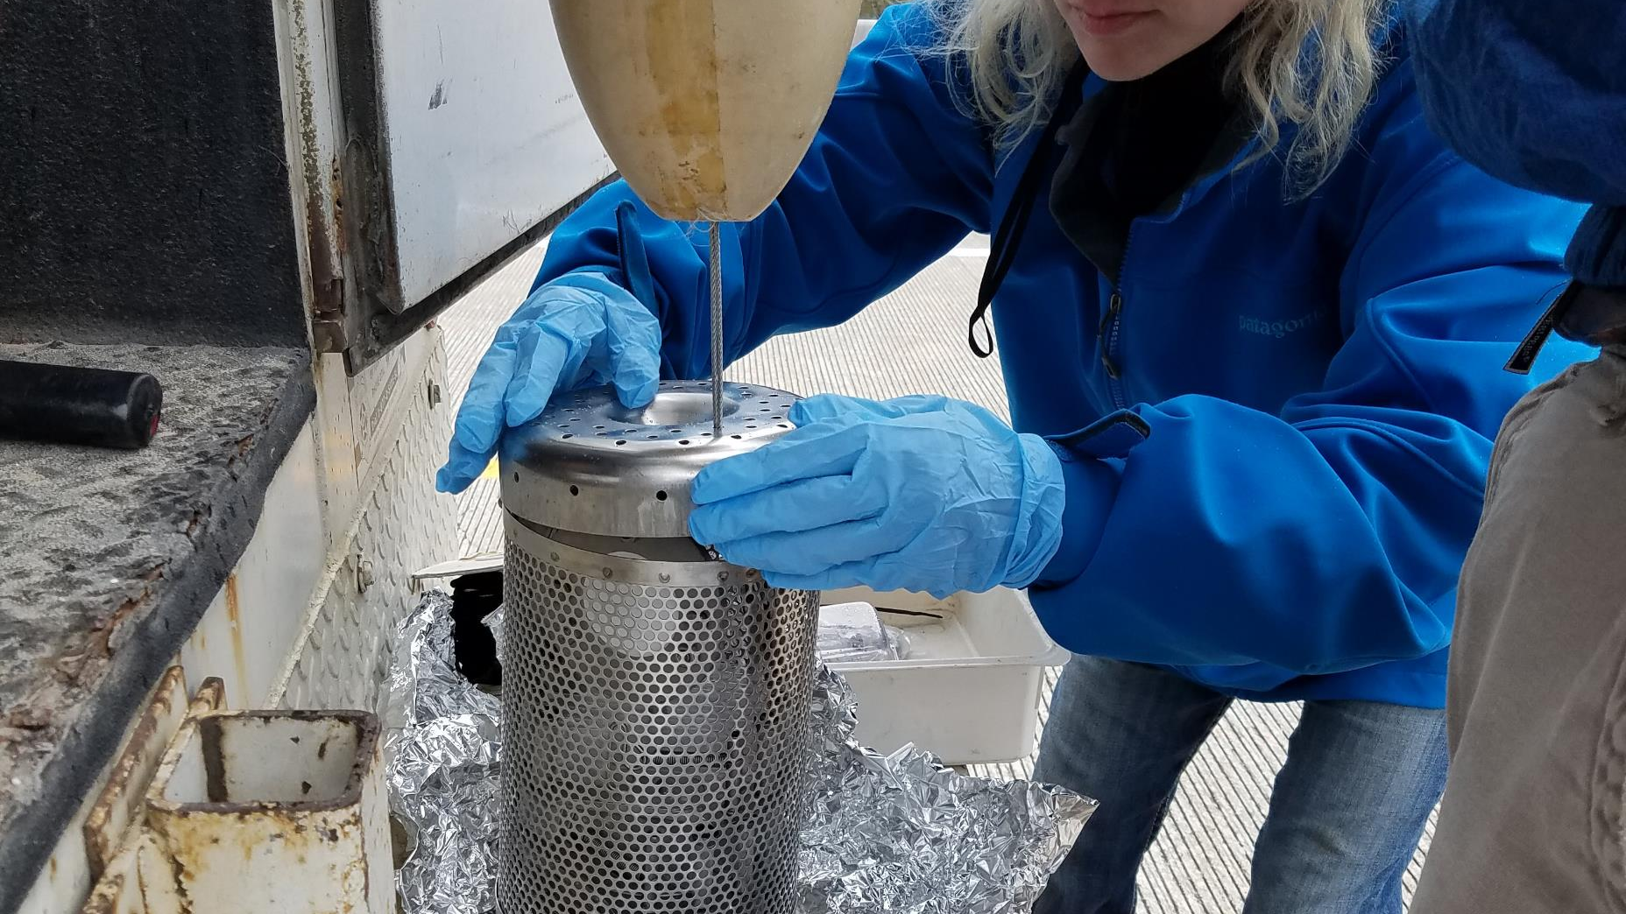

Slide 17
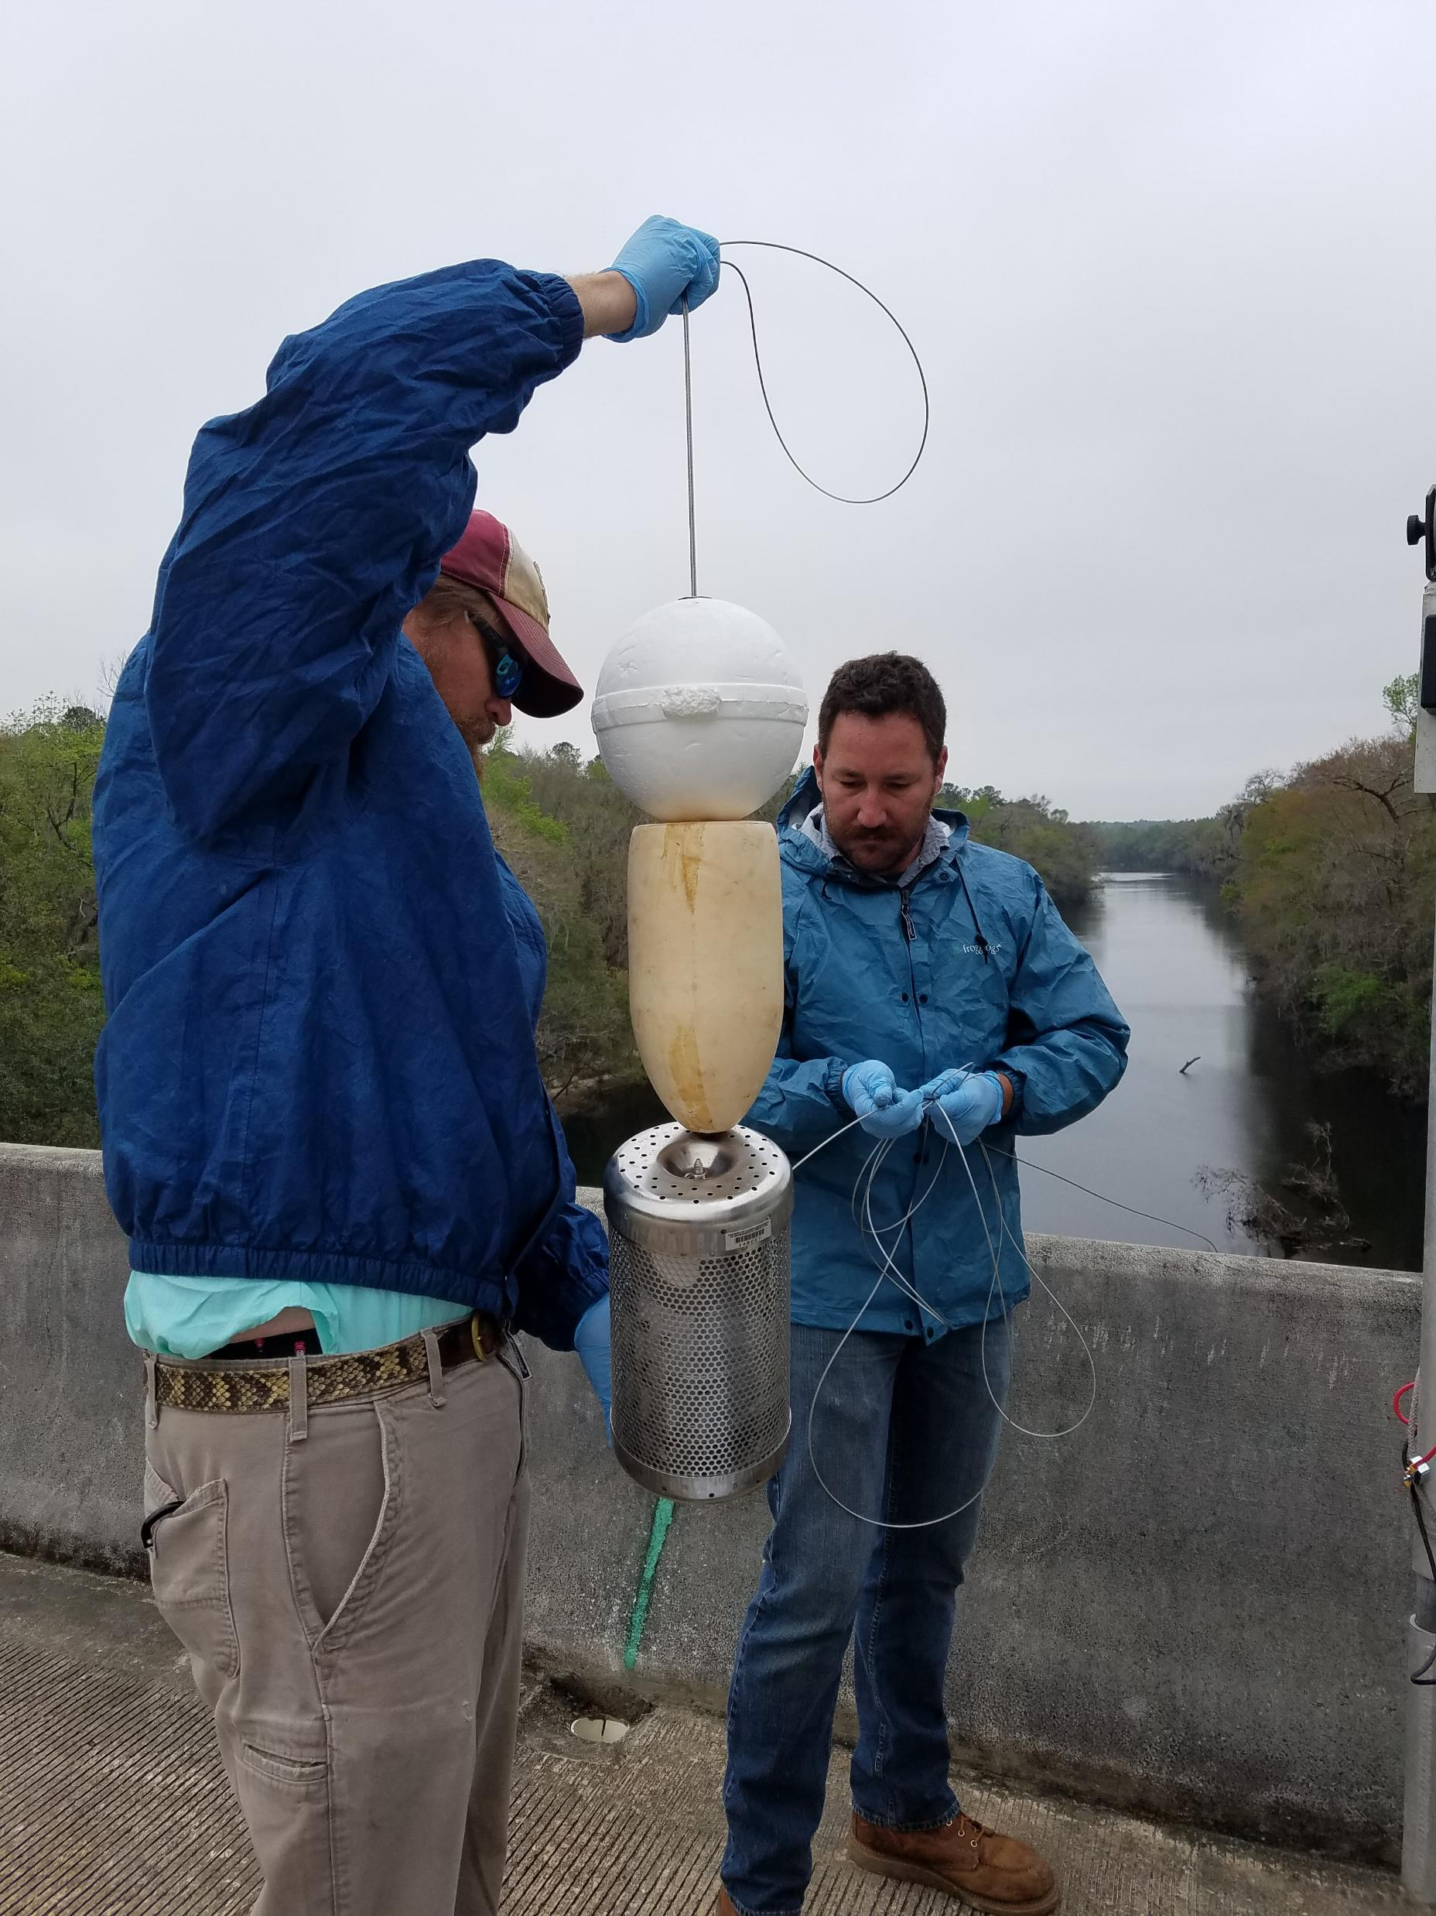

Slide 18
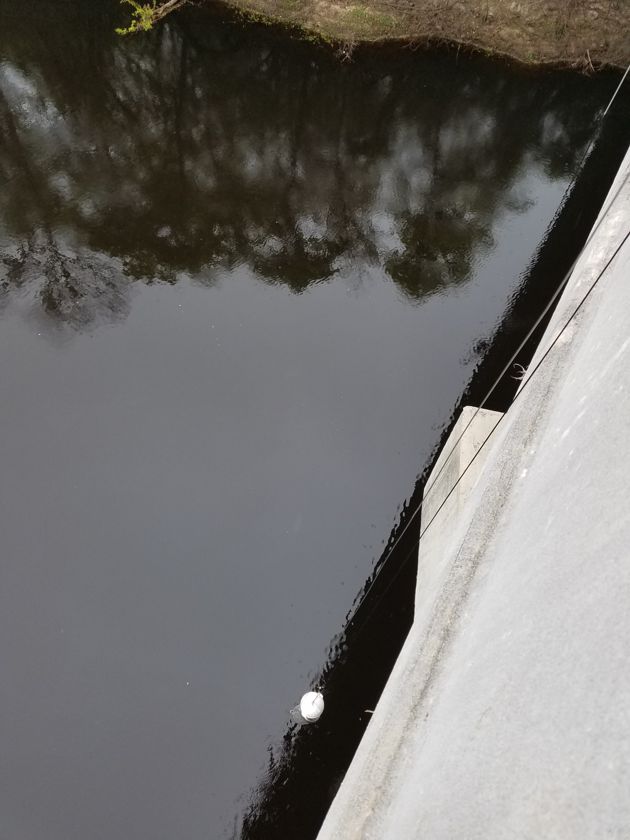

Slide 19
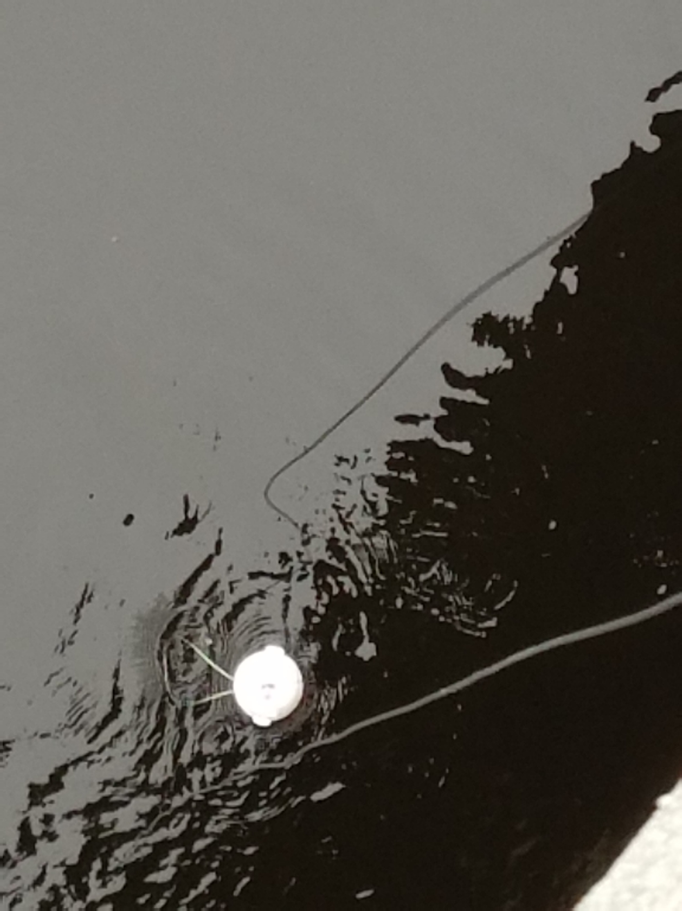

Slide 20
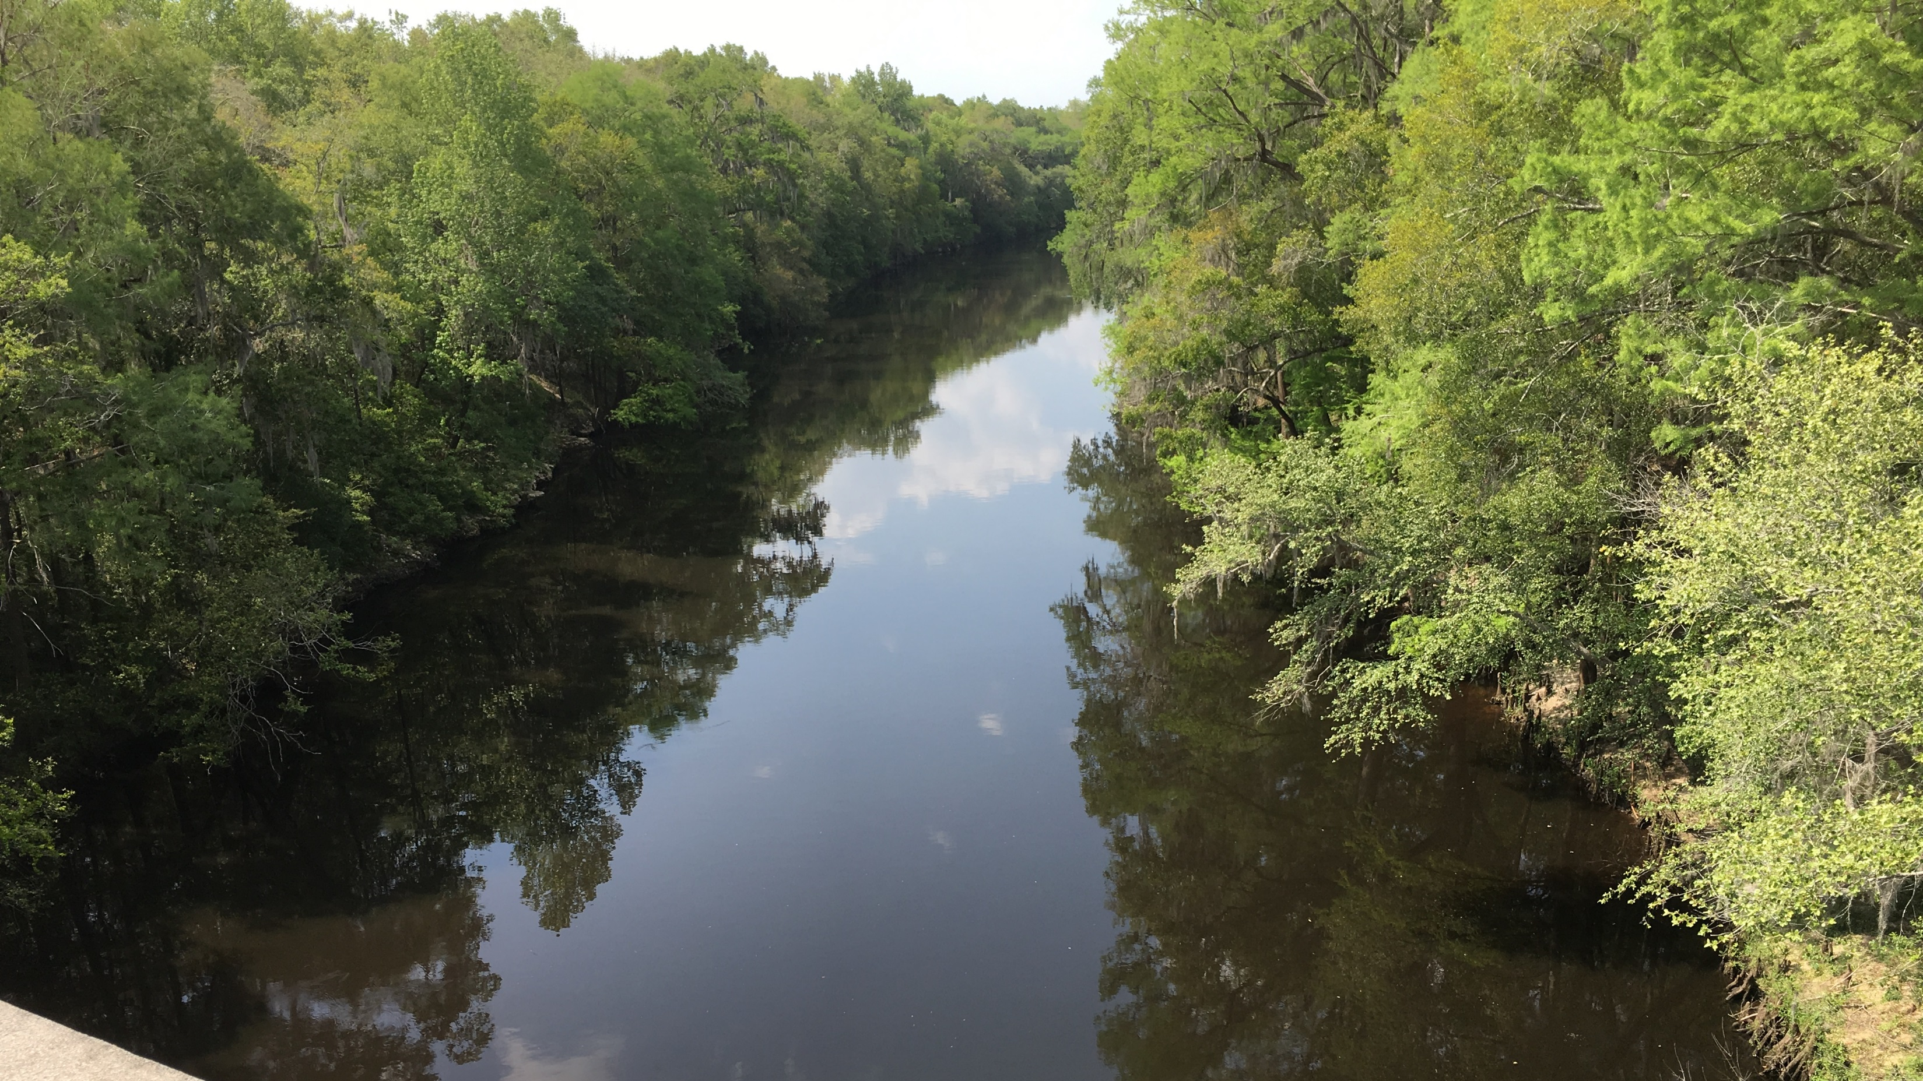
Withlacoochee – Device Retrieval Day

Slide 21
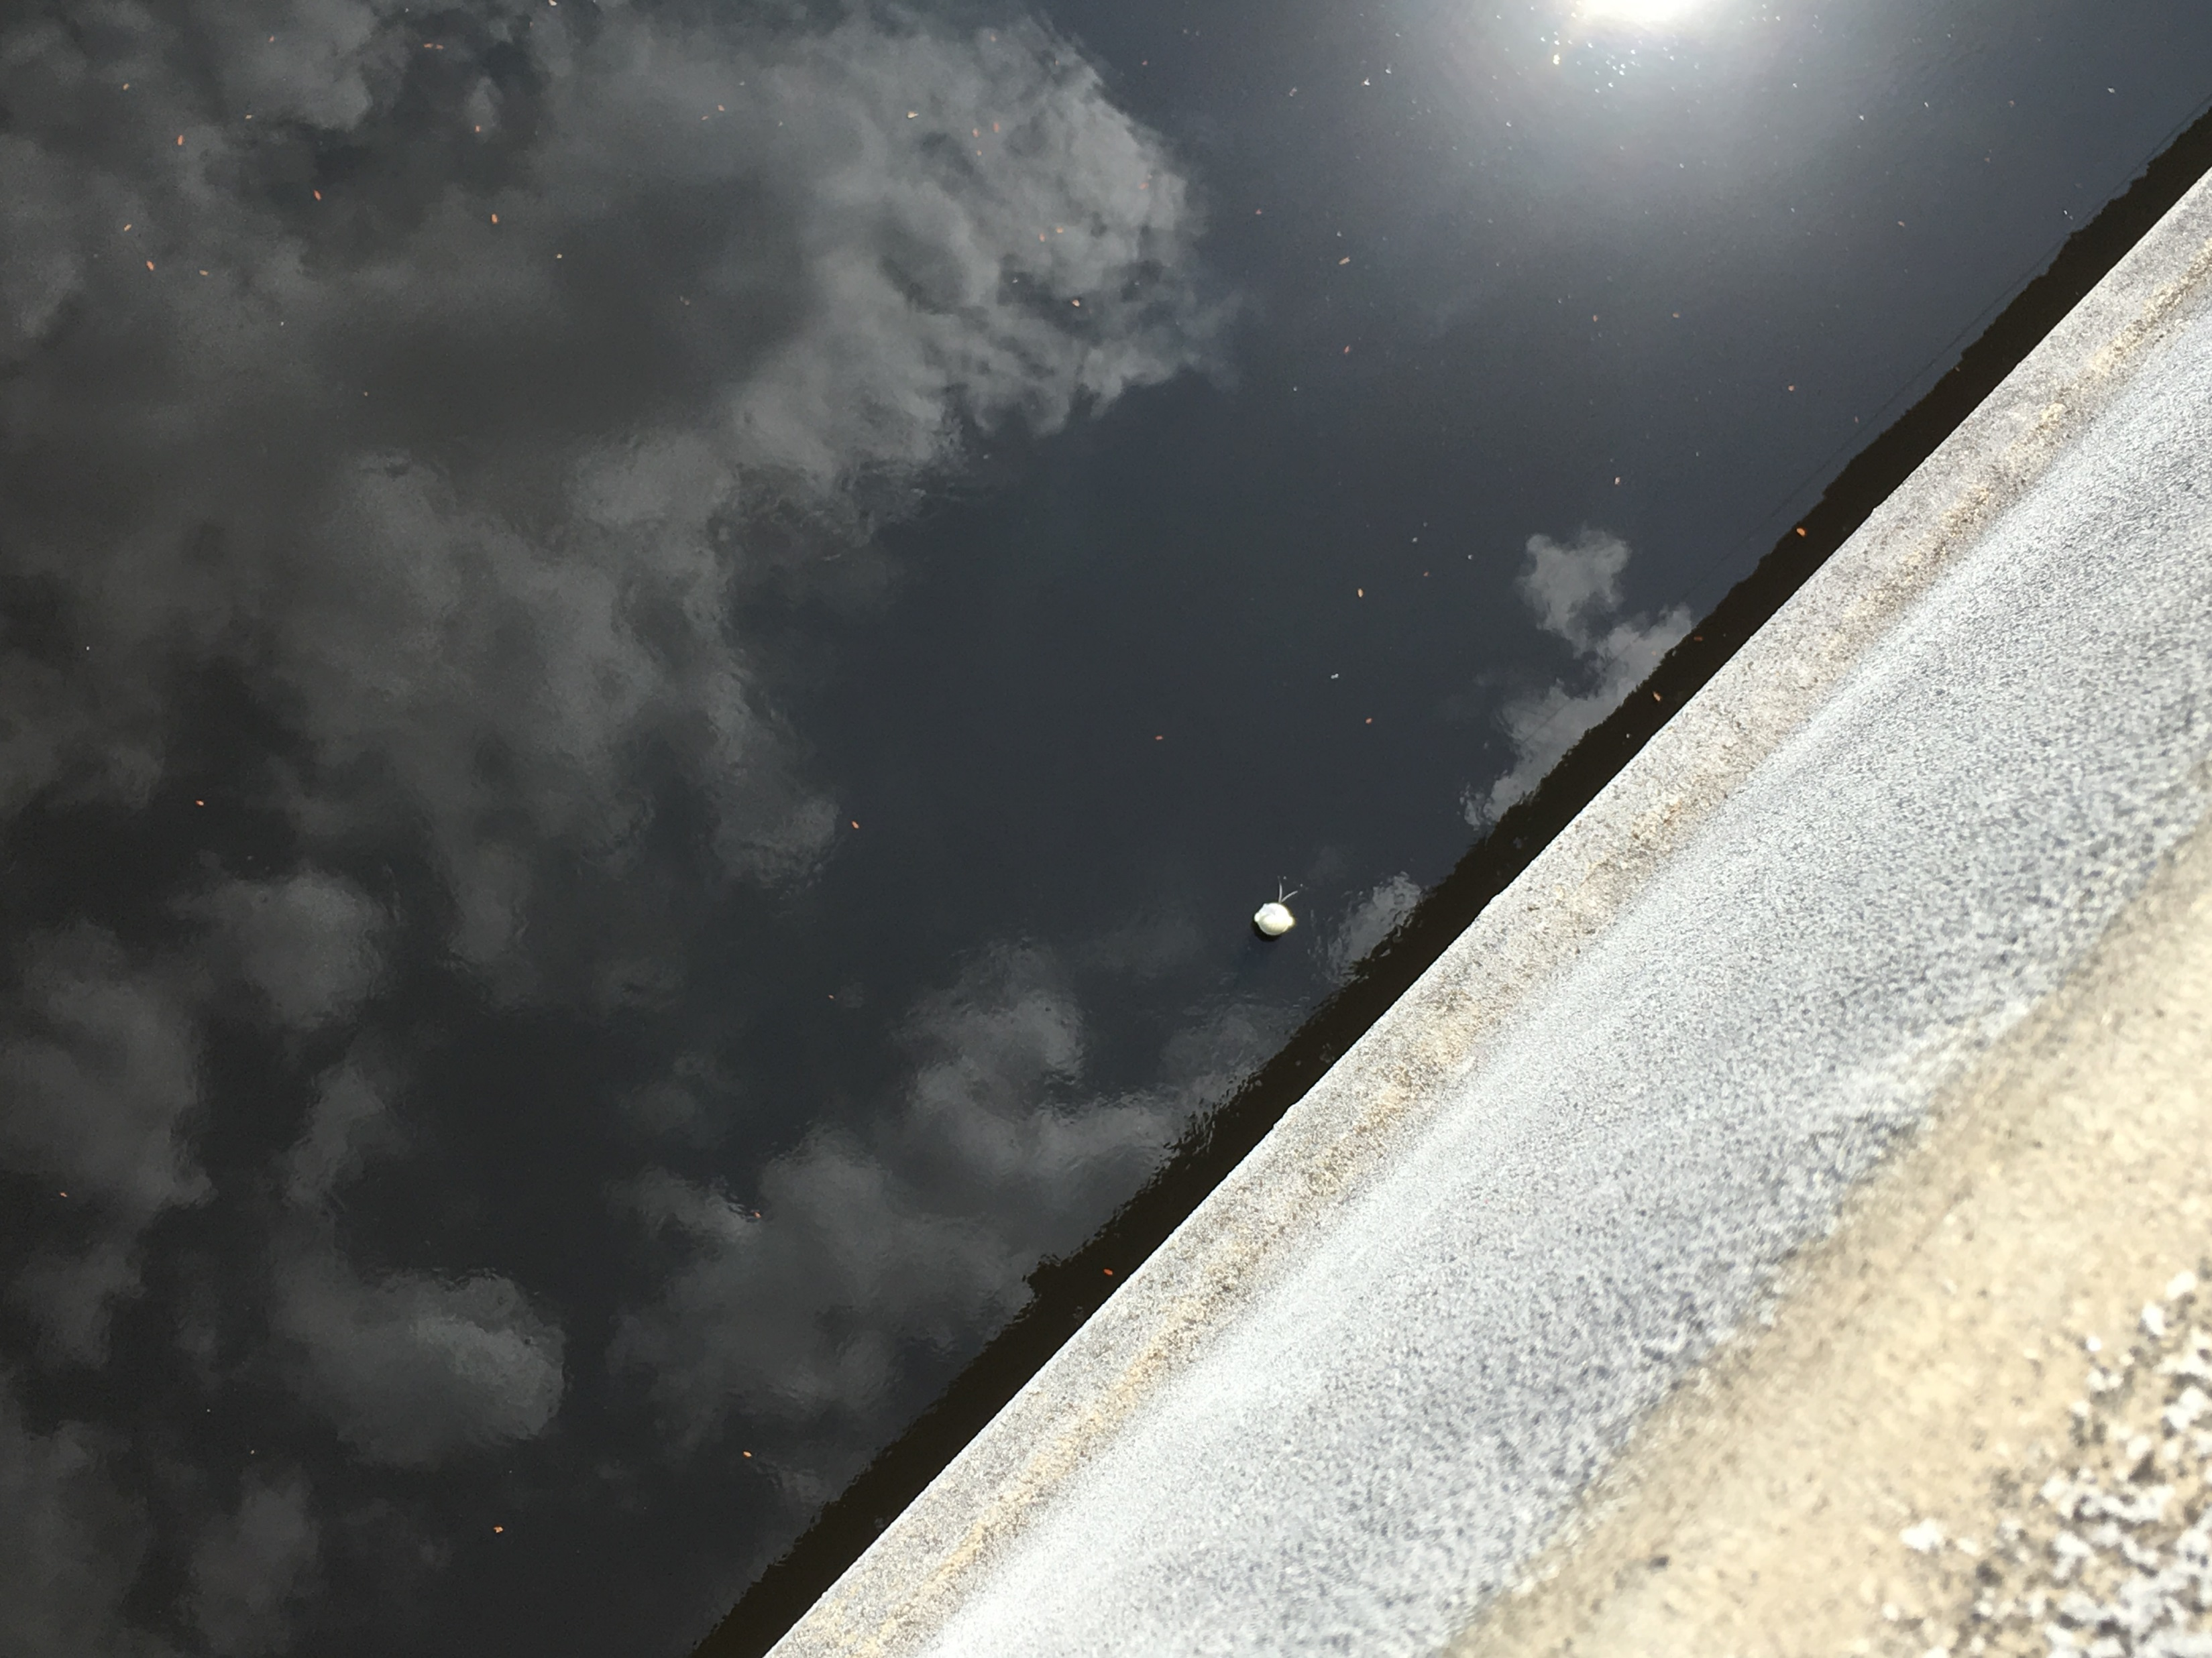

Slide 22
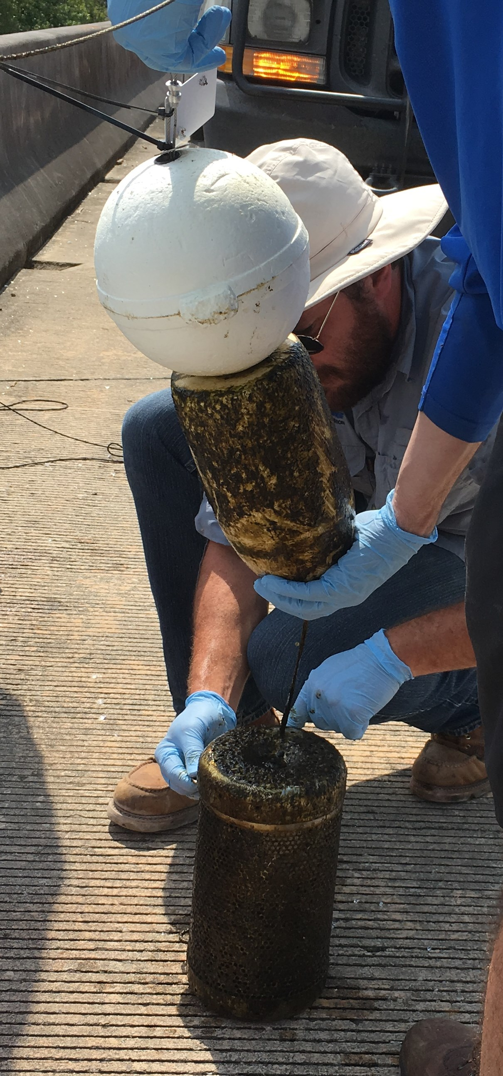

Slide 23
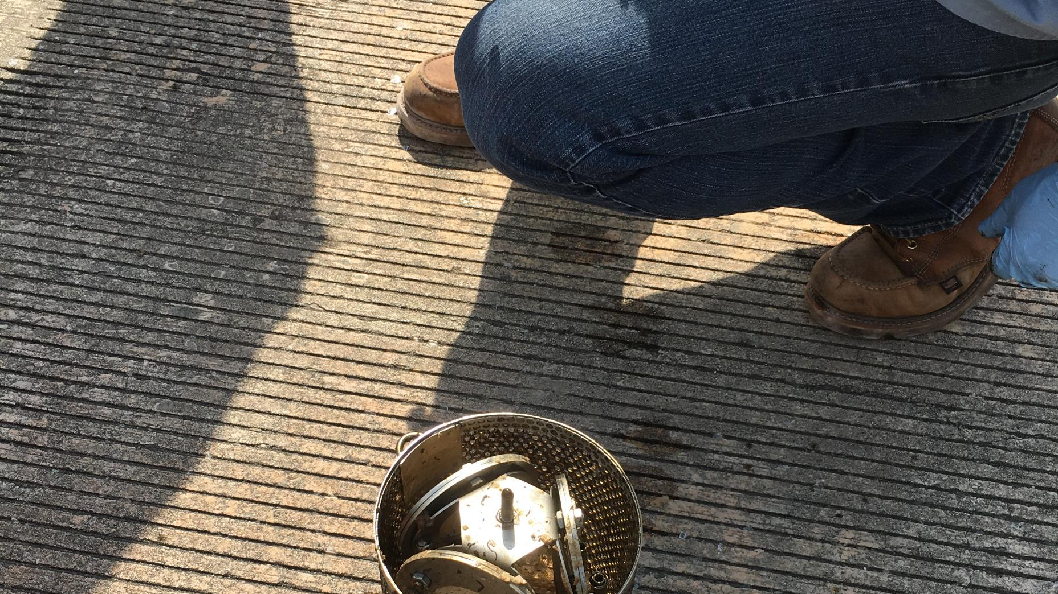
POCIS

Slide 24
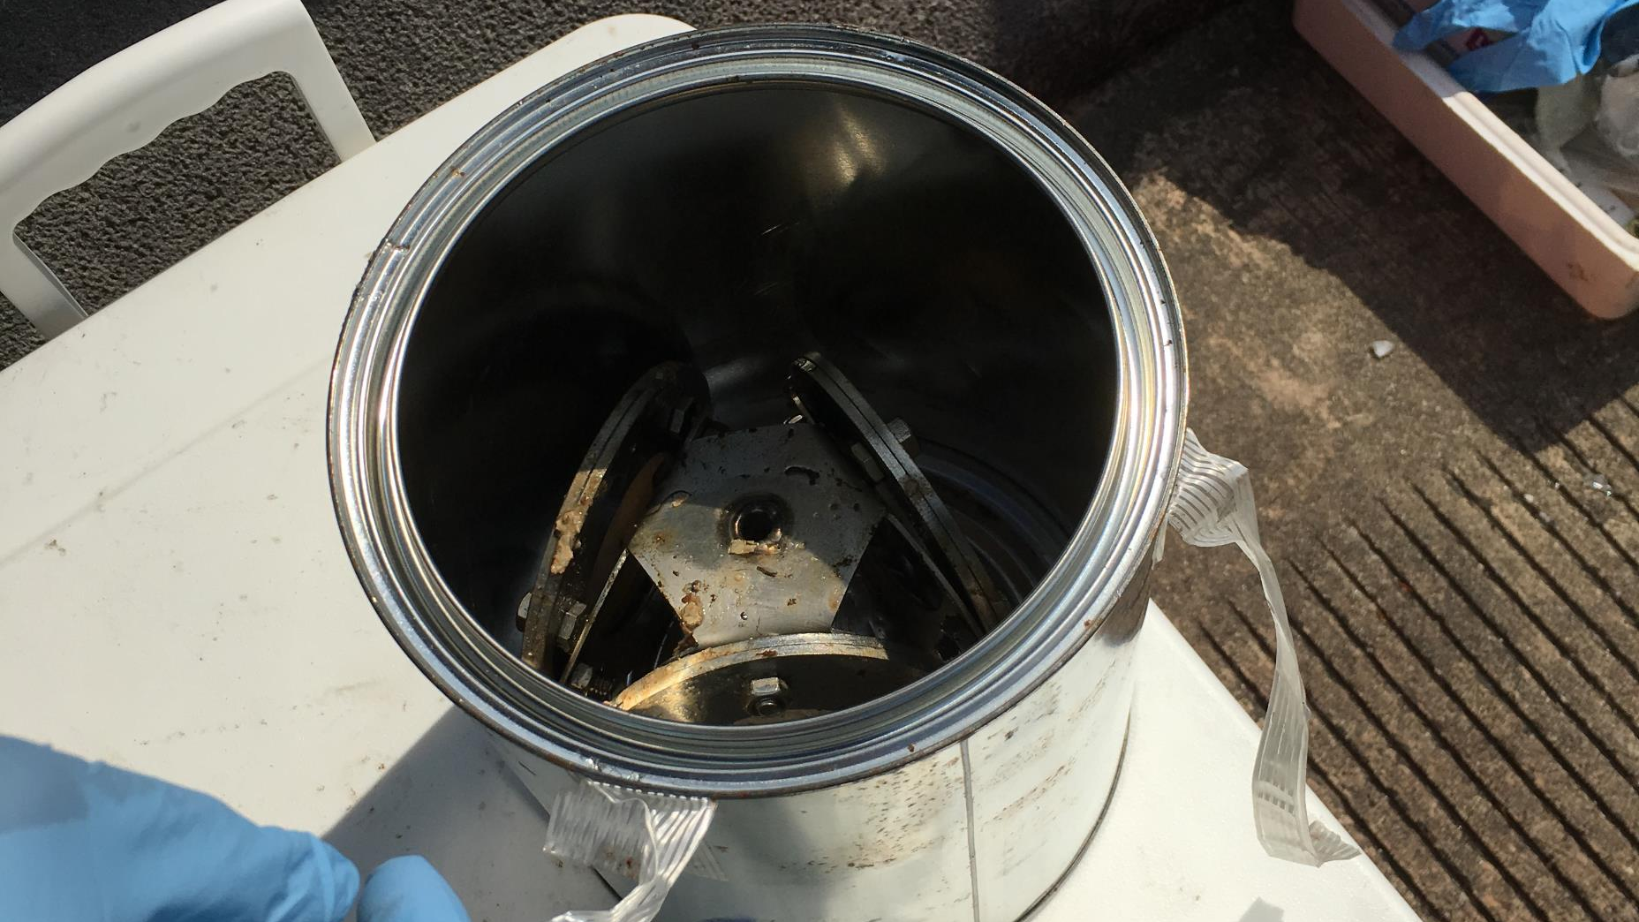

Slide 25
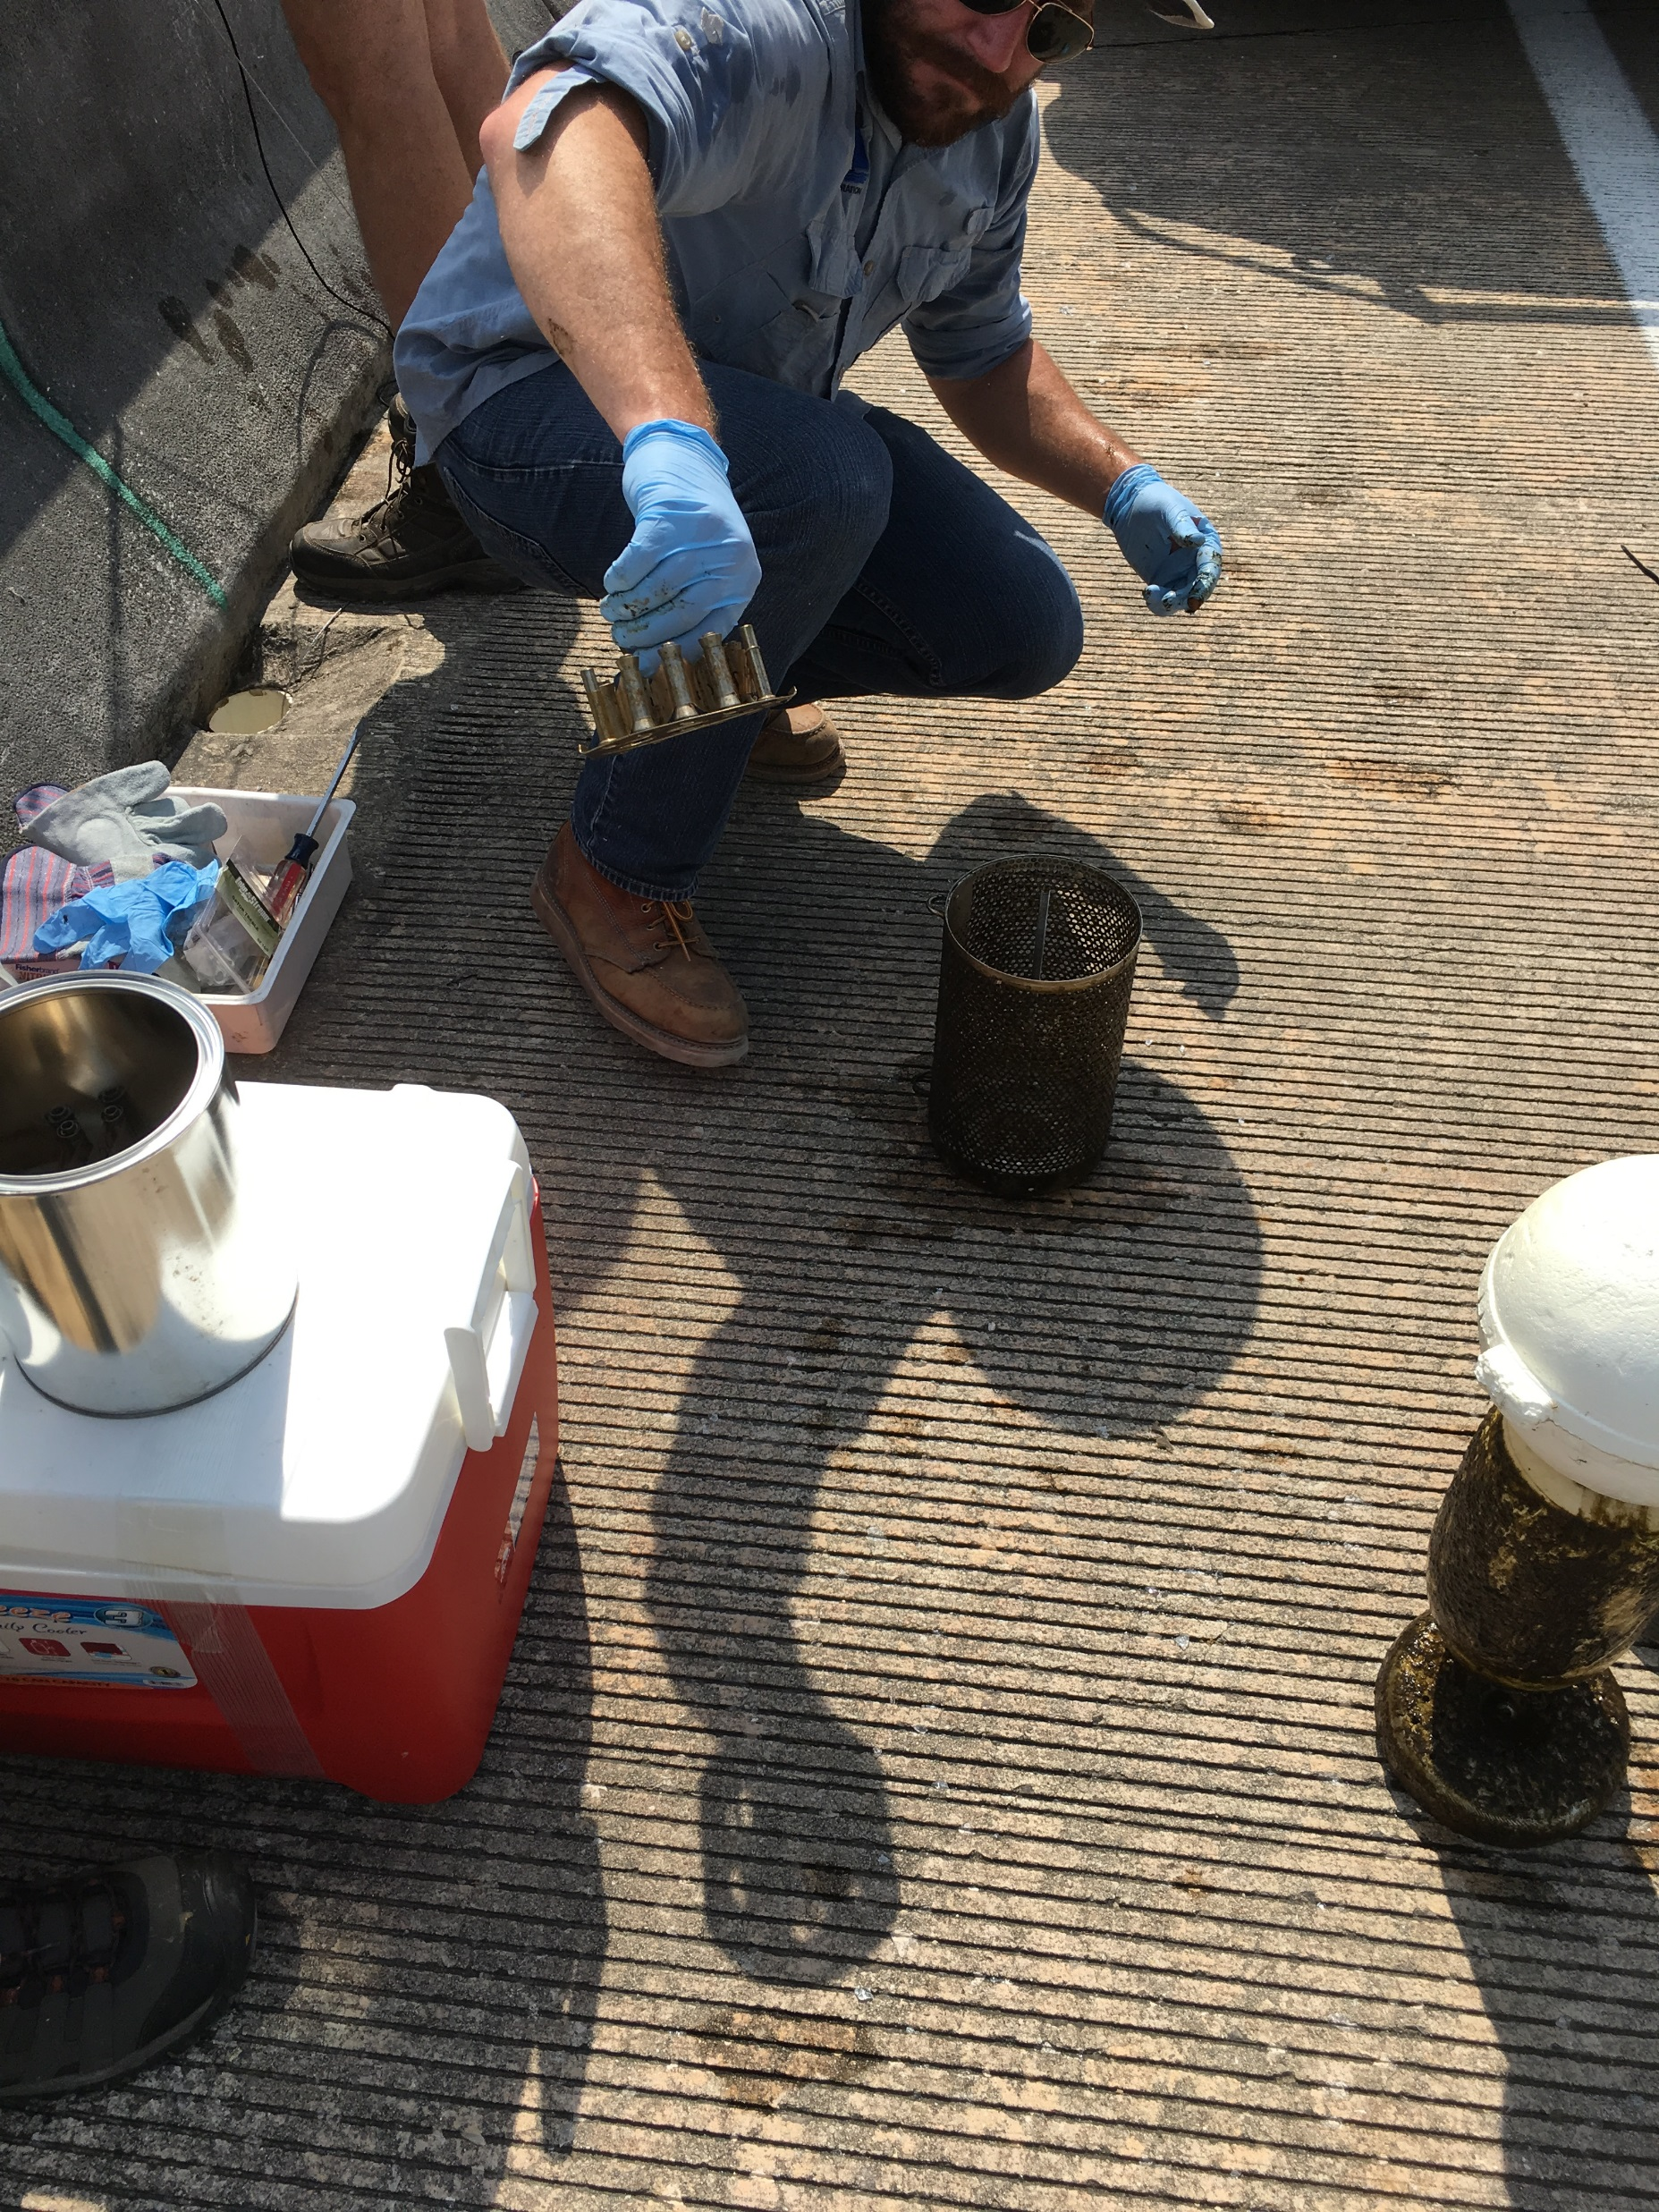

Slide 26
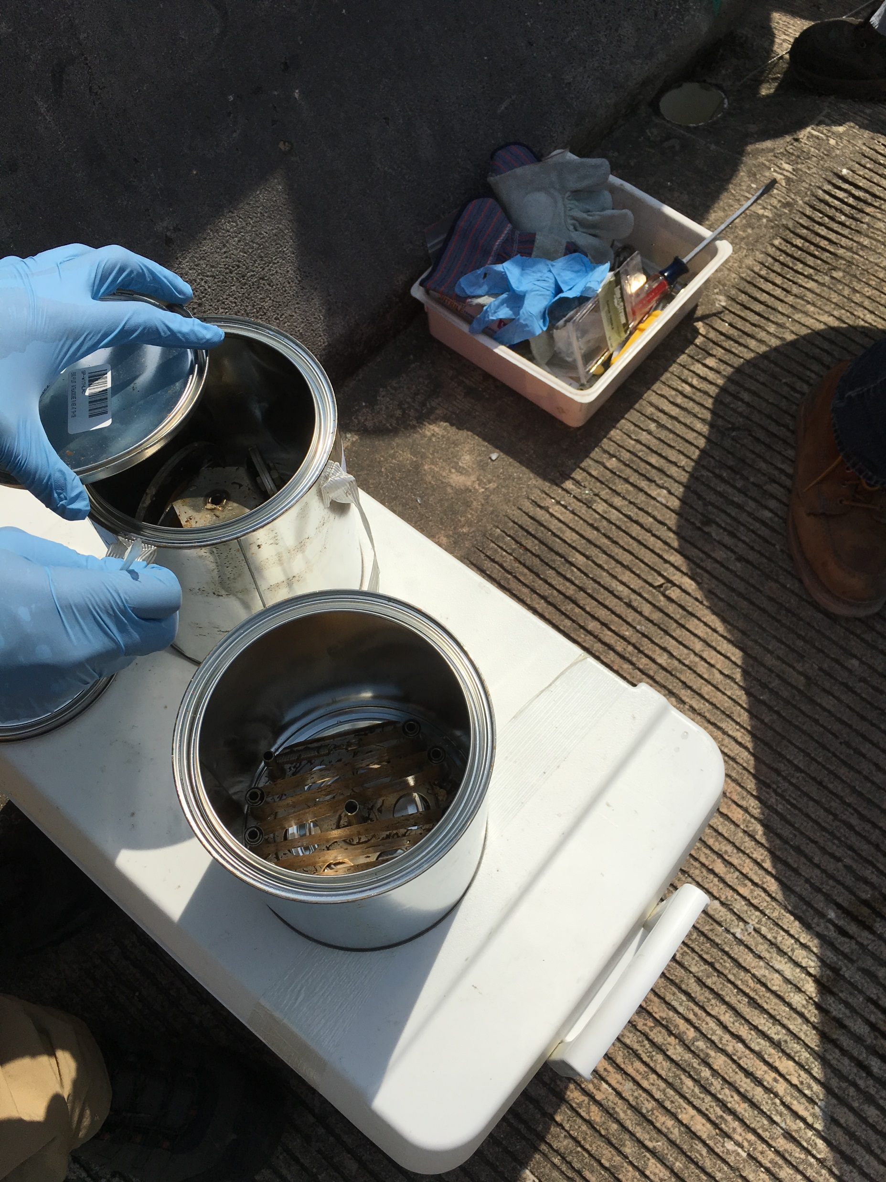

Slide 27
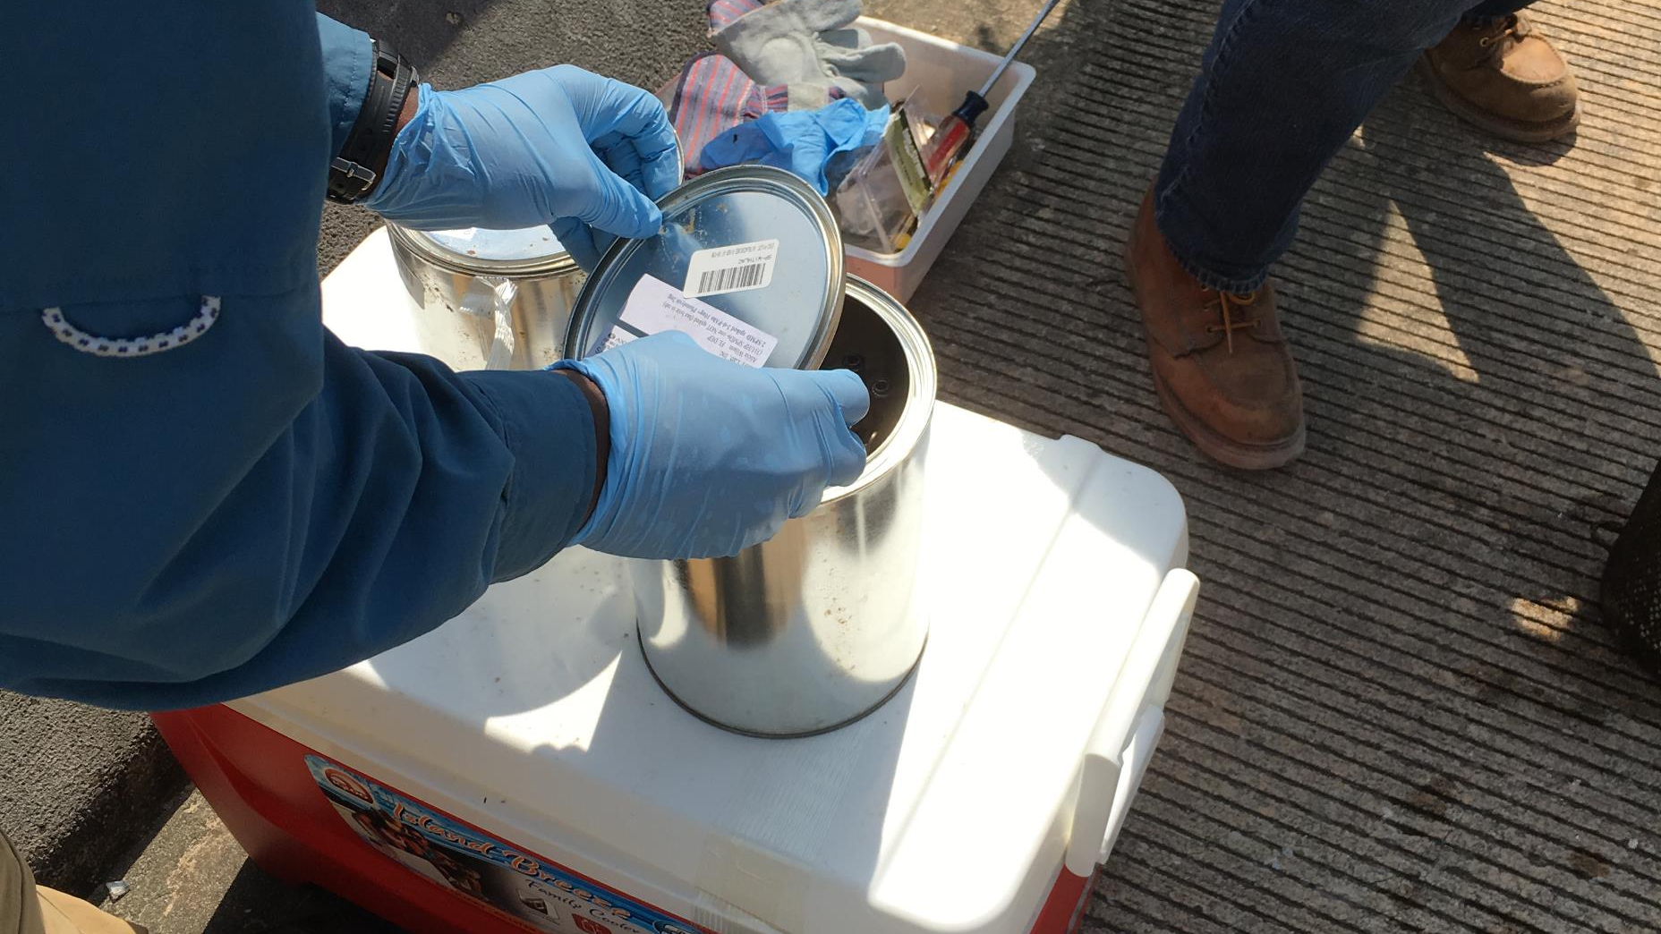
Closing the Can - SPMDs

Slide 28
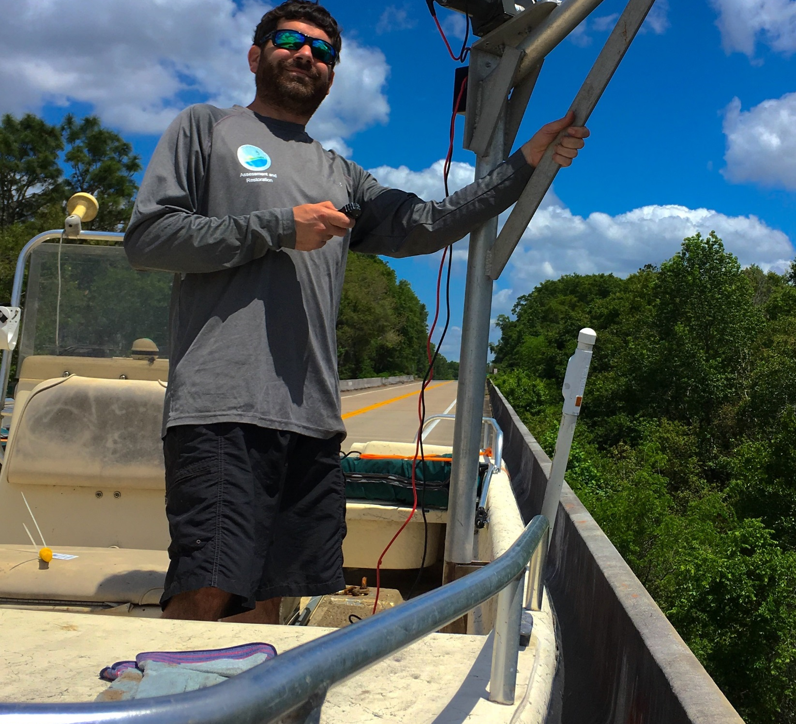
Block Retrieval Day

Slide 29
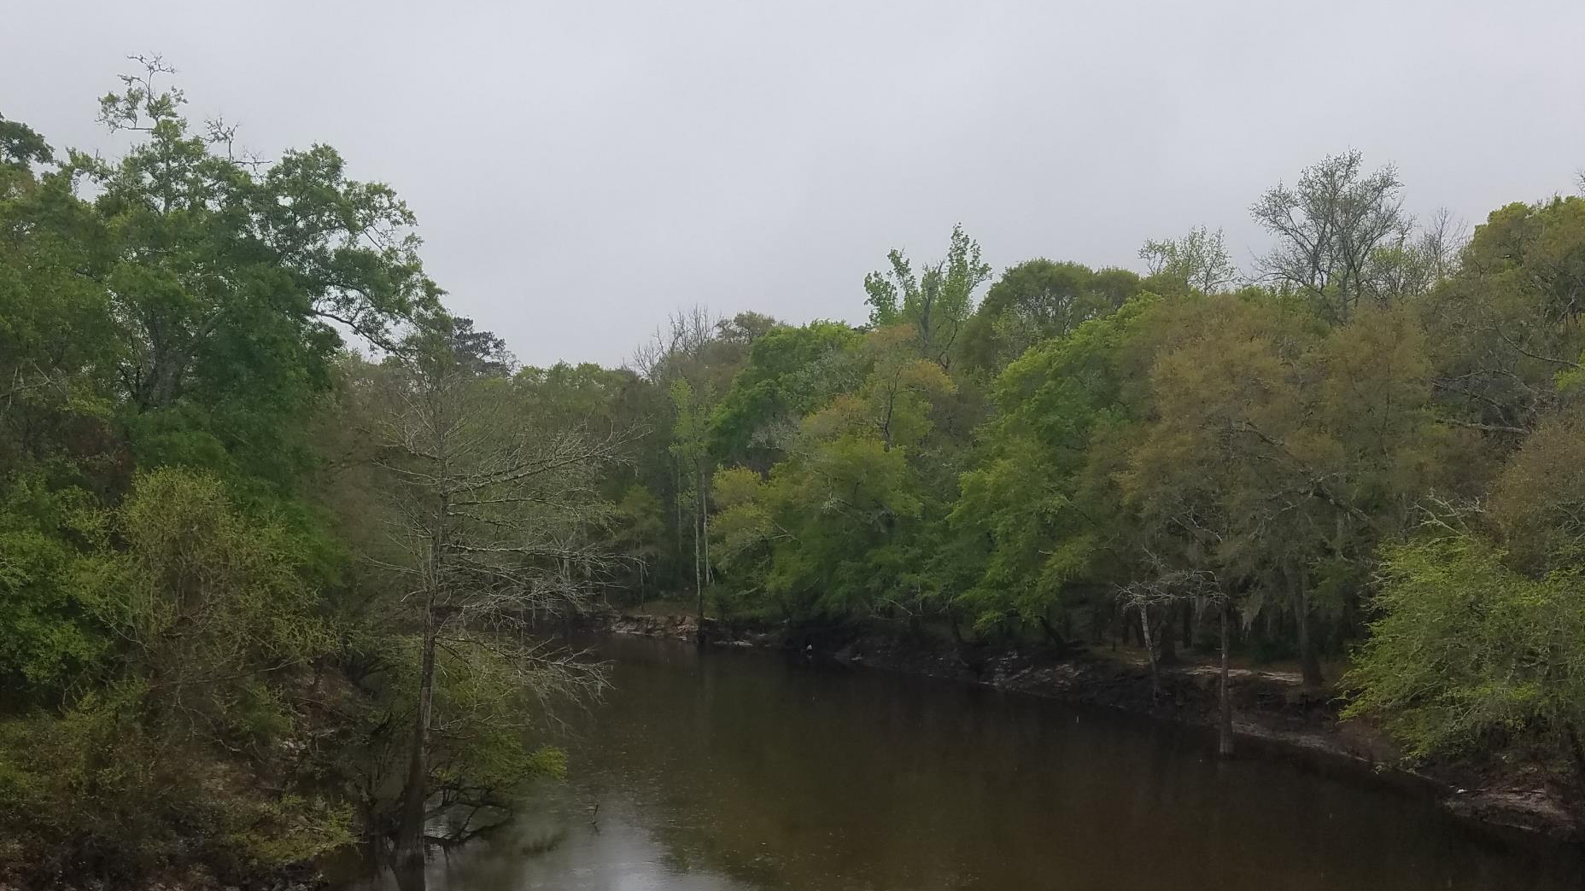
Ochlockonee – Day 1 Deploy

Slide 30
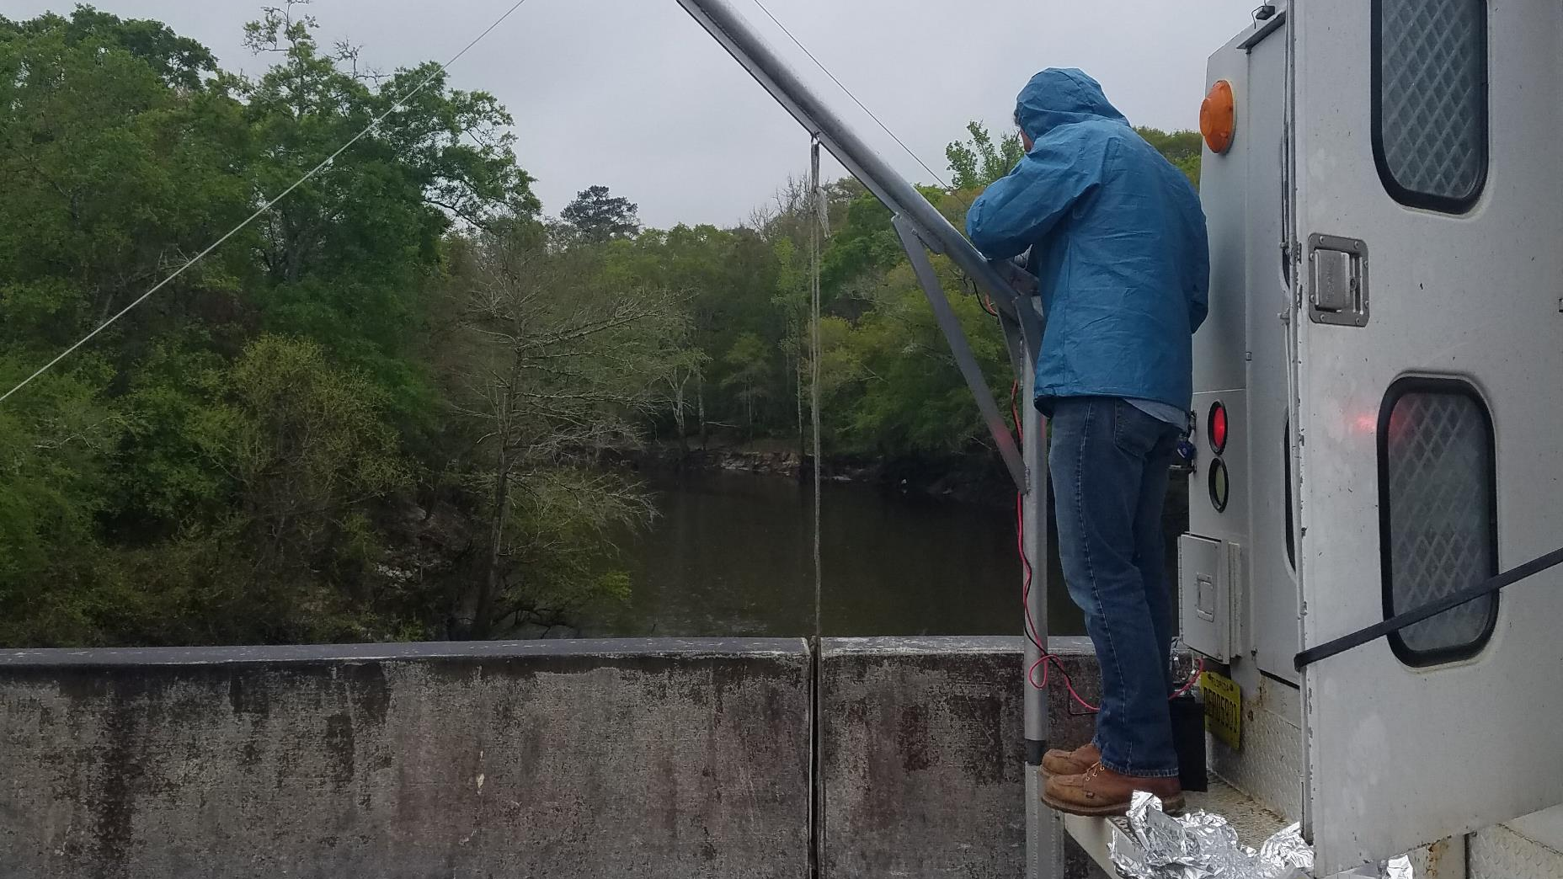

Slide 31
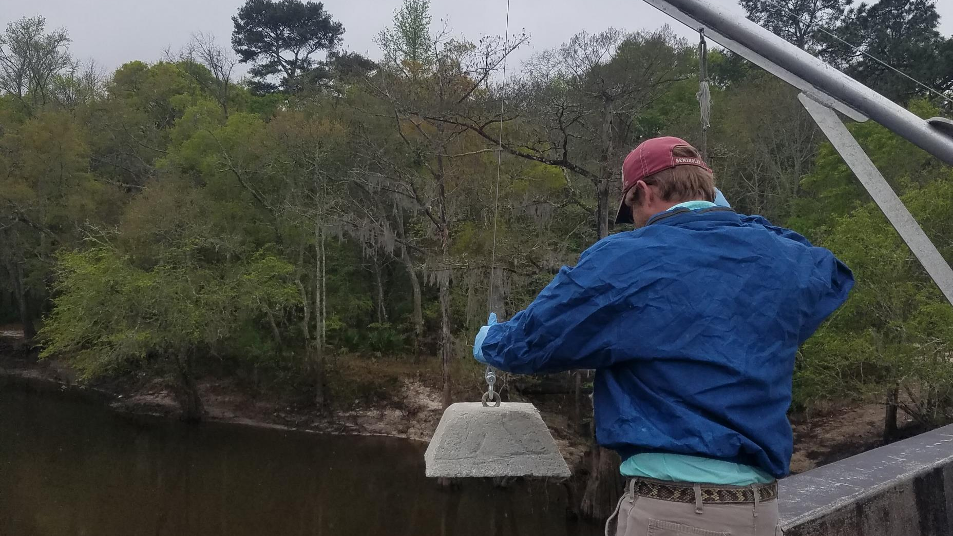

Slide 32
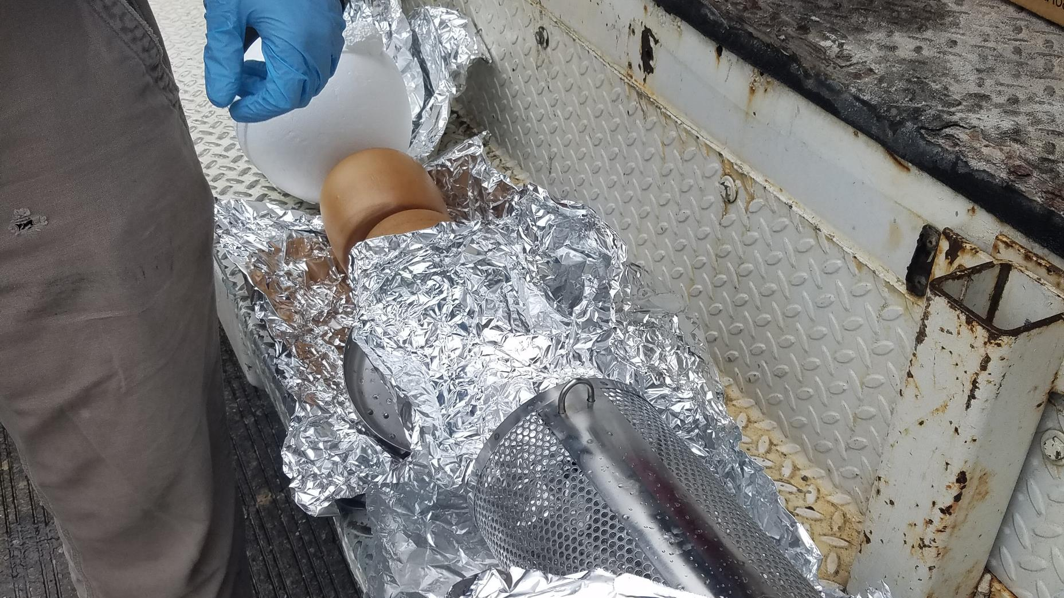

Slide 33
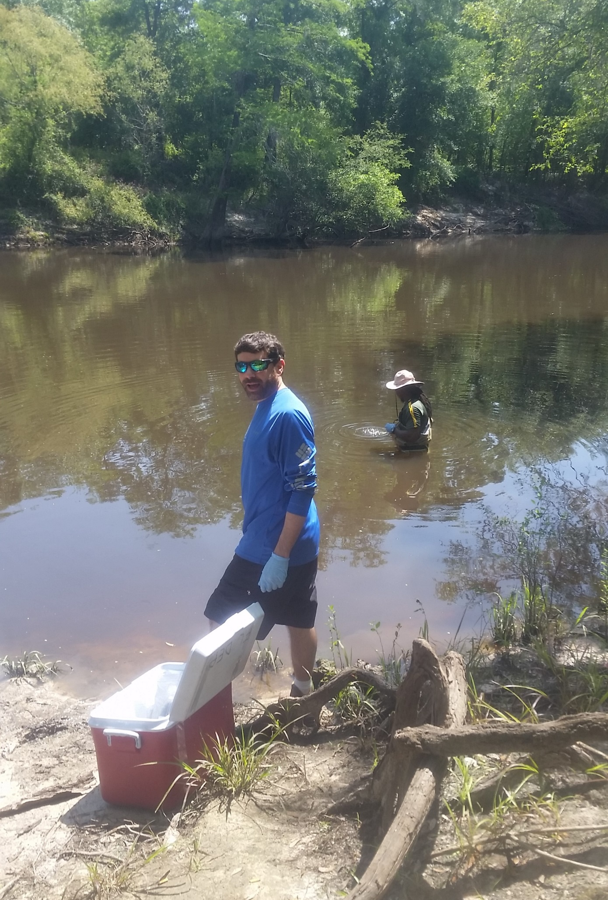
Ochlockonee – Retrieval Day
Whole water sampling

Slide 34
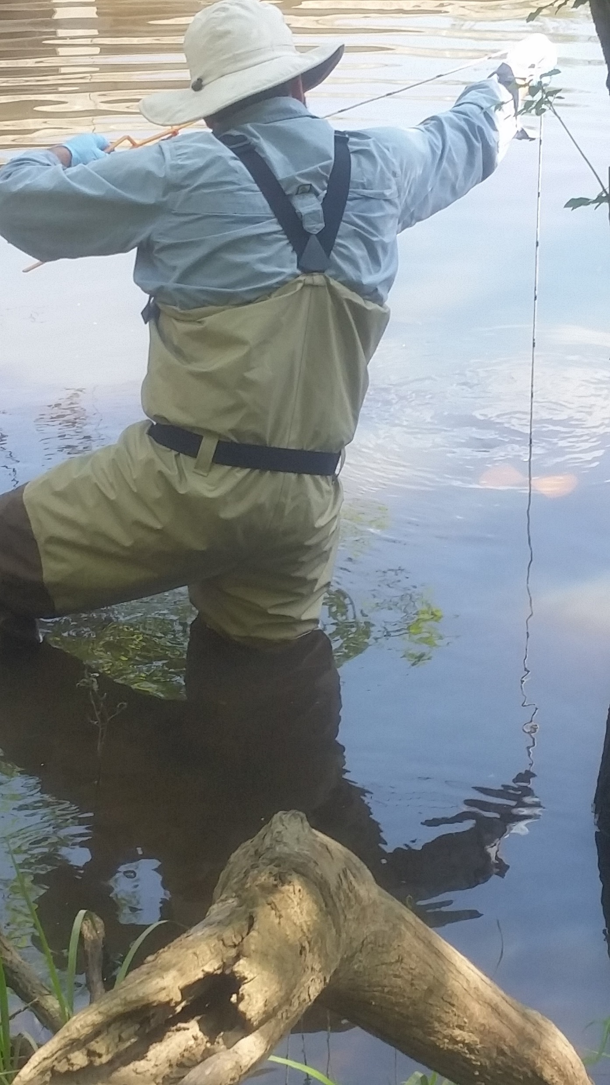

Slide 35
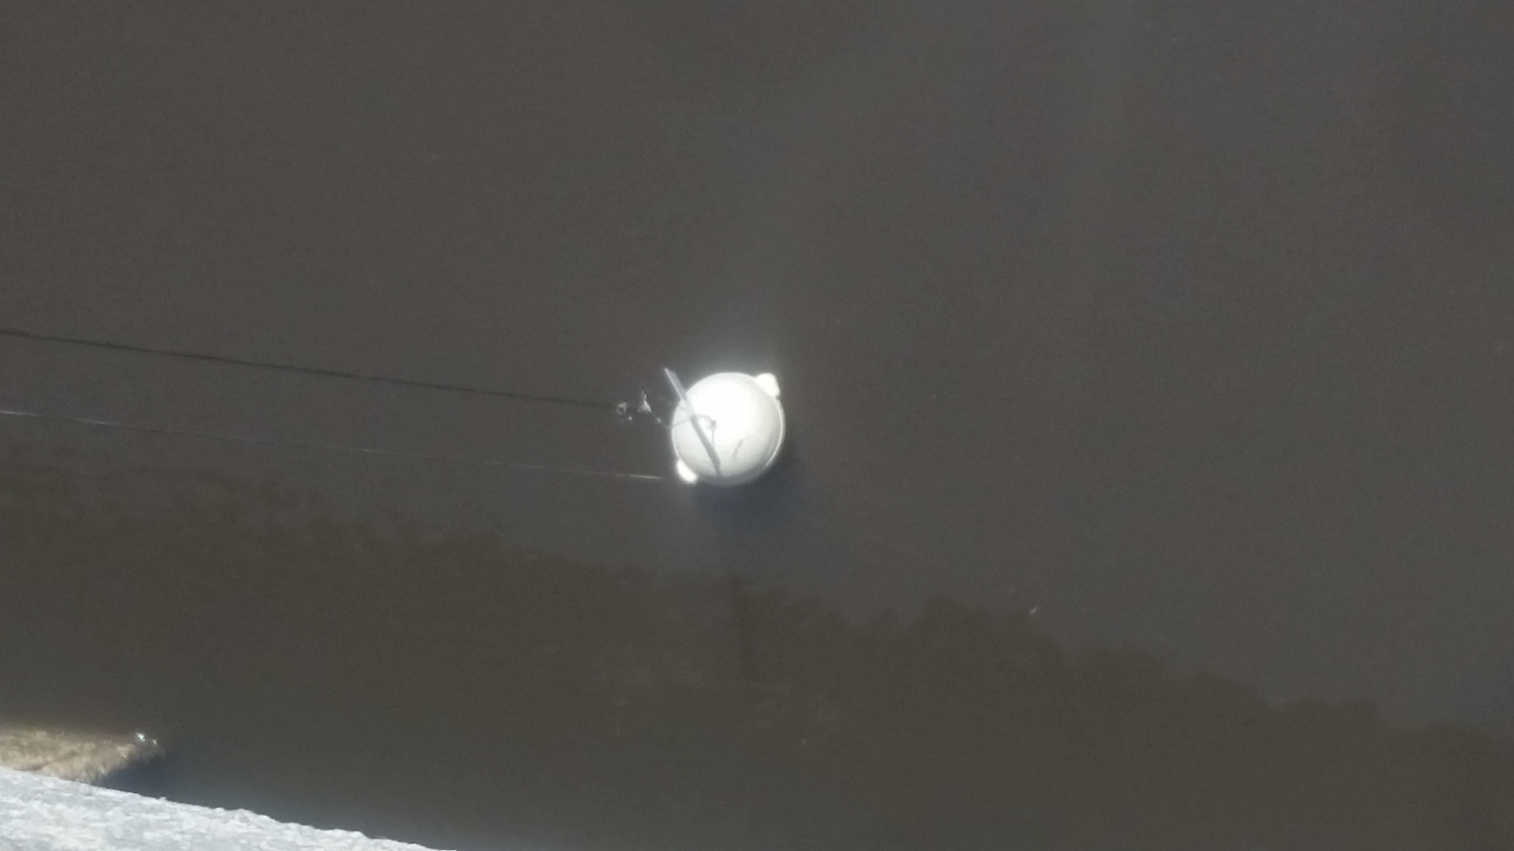

Slide 36
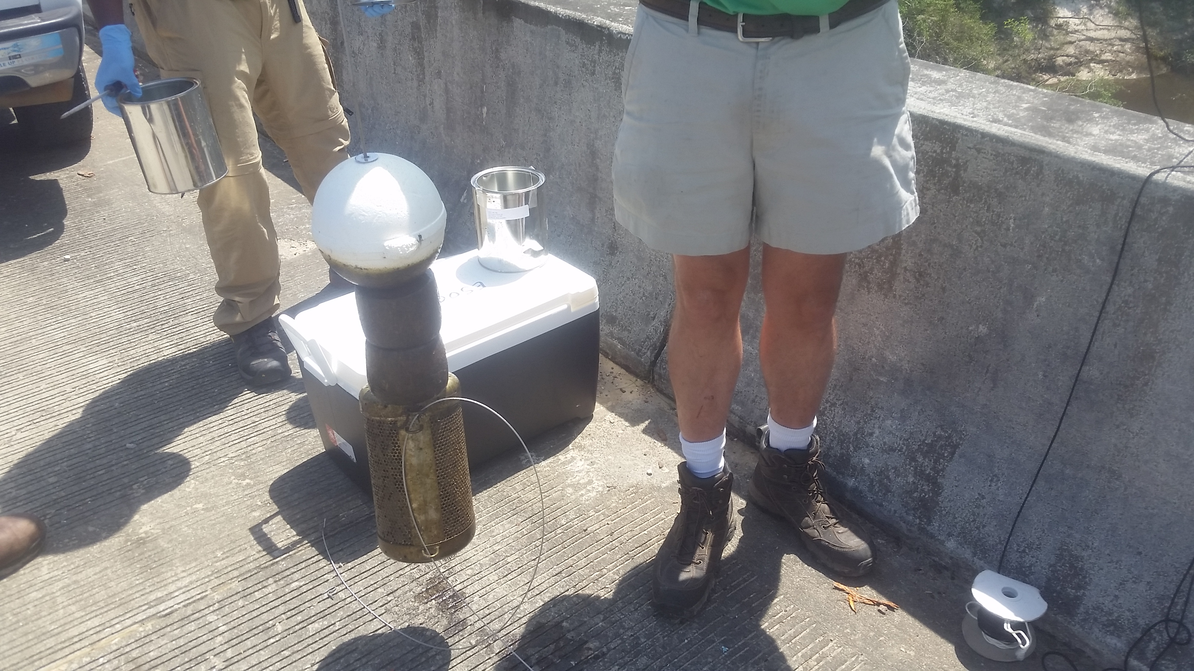

Slide 37
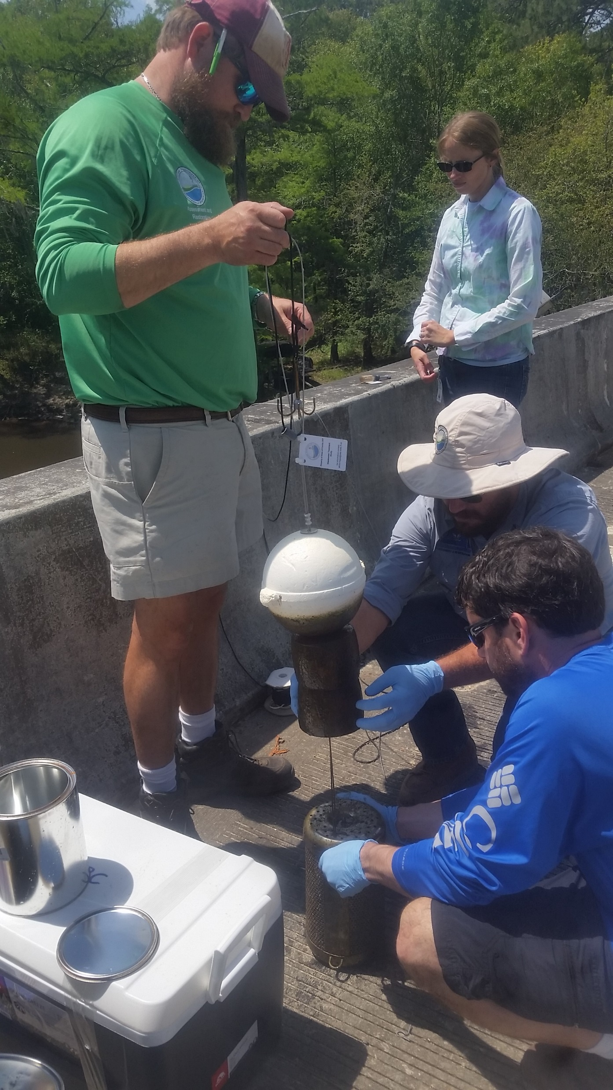

Slide 38
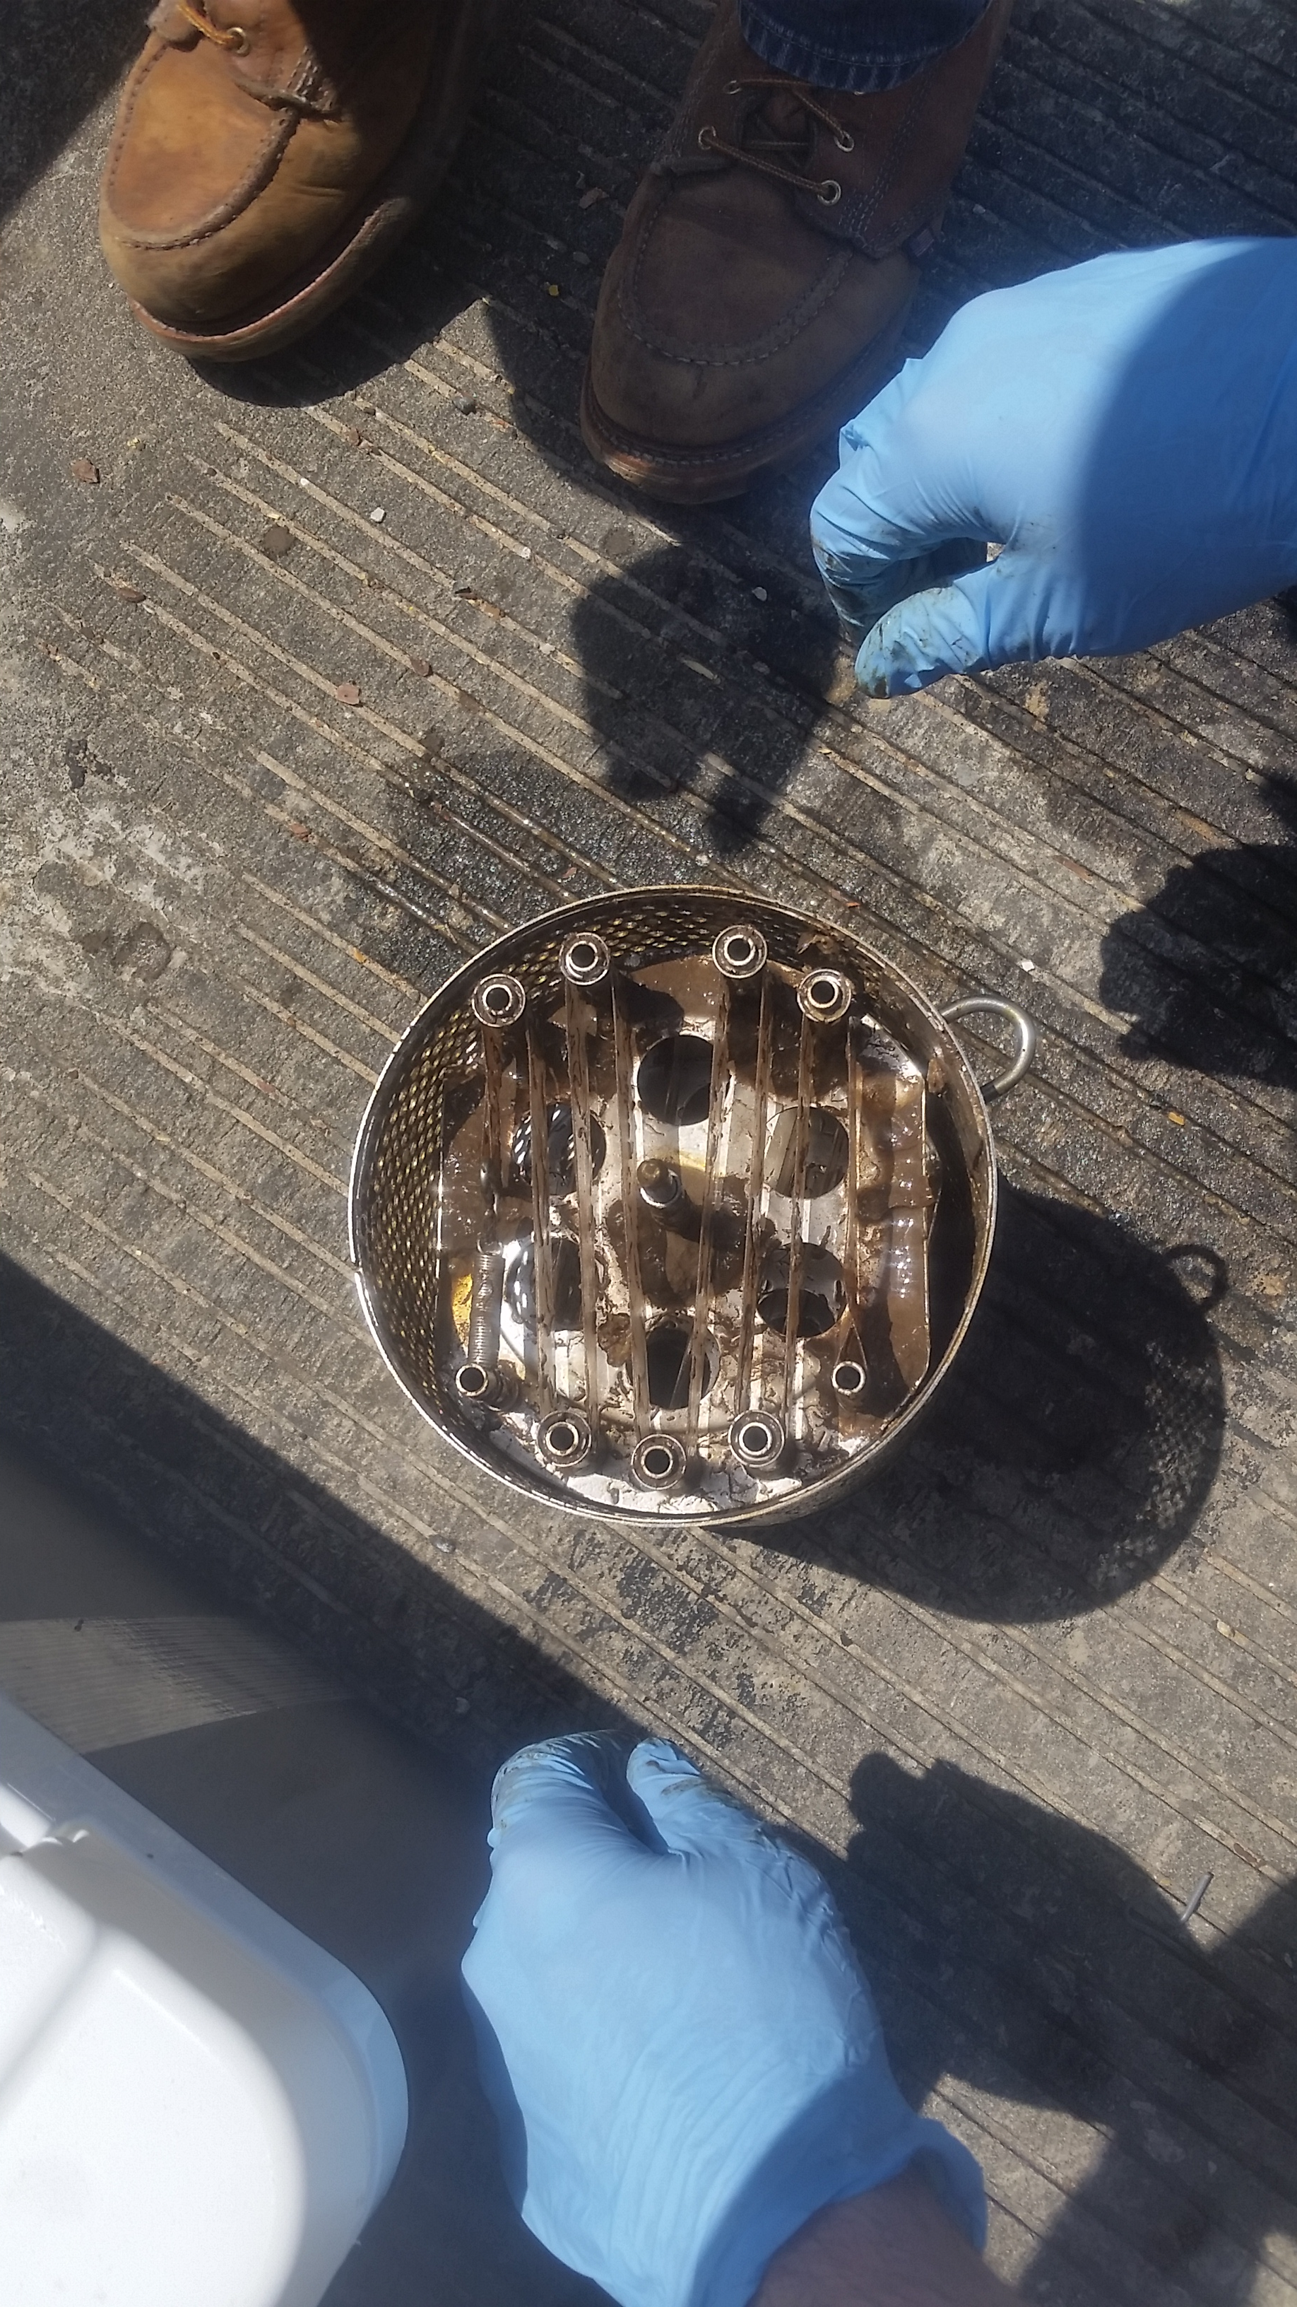
SPMDs

Slide 39
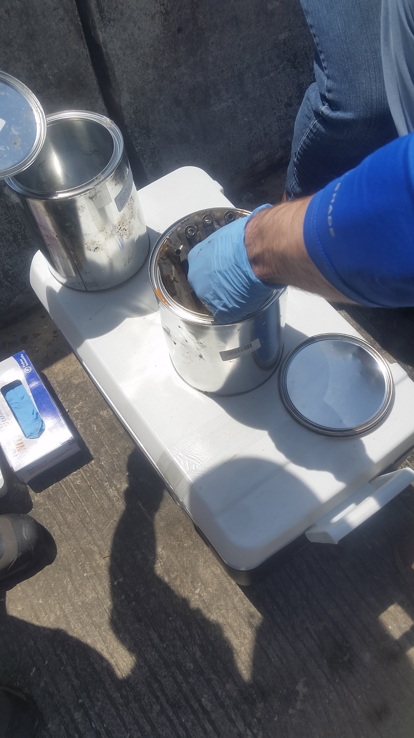

Slide 40
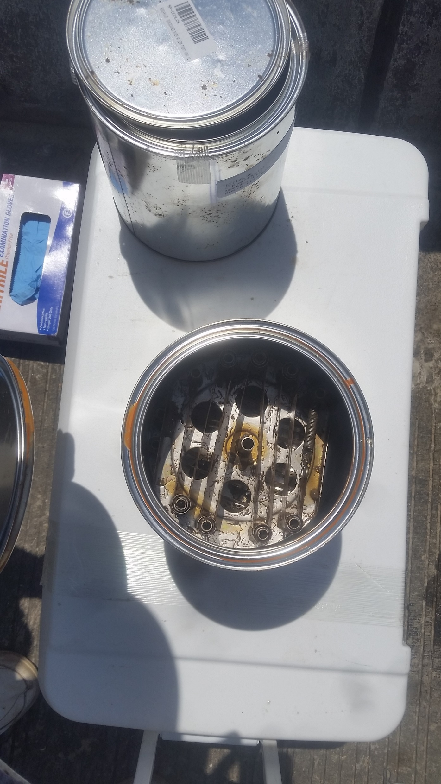

Slide 41
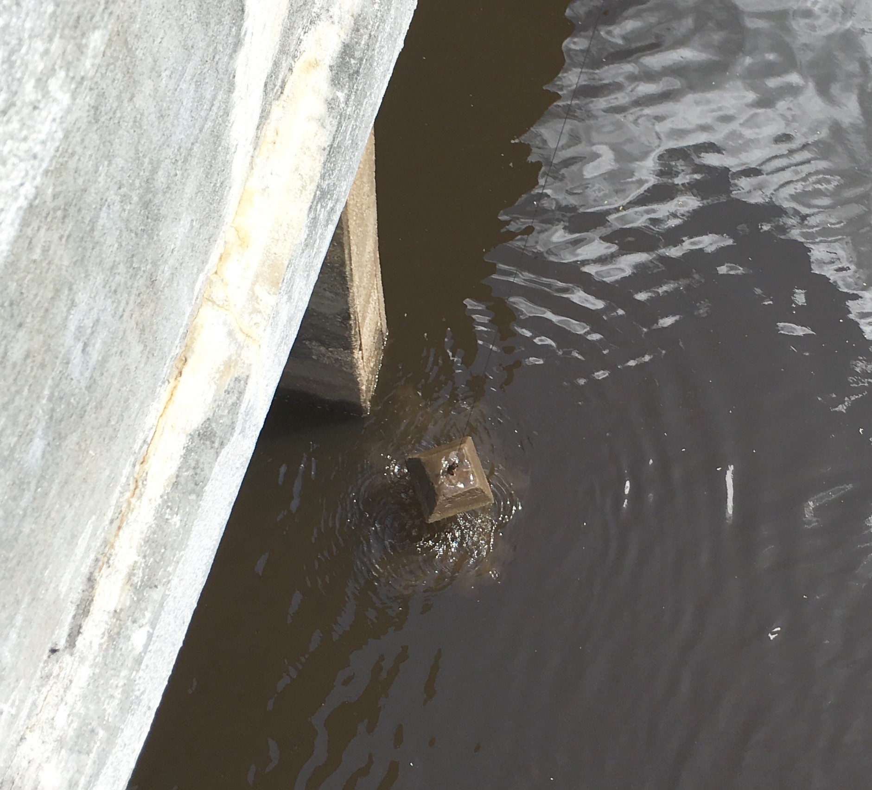
Block Retrieval Day

Slide 42
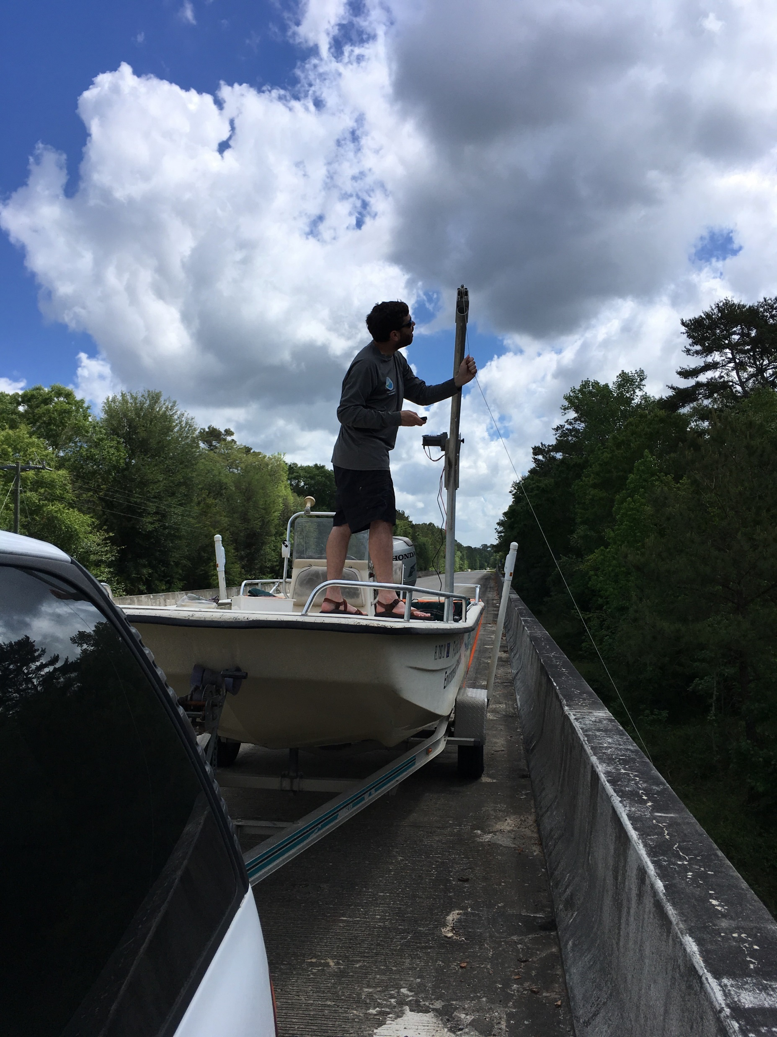

Slide 43
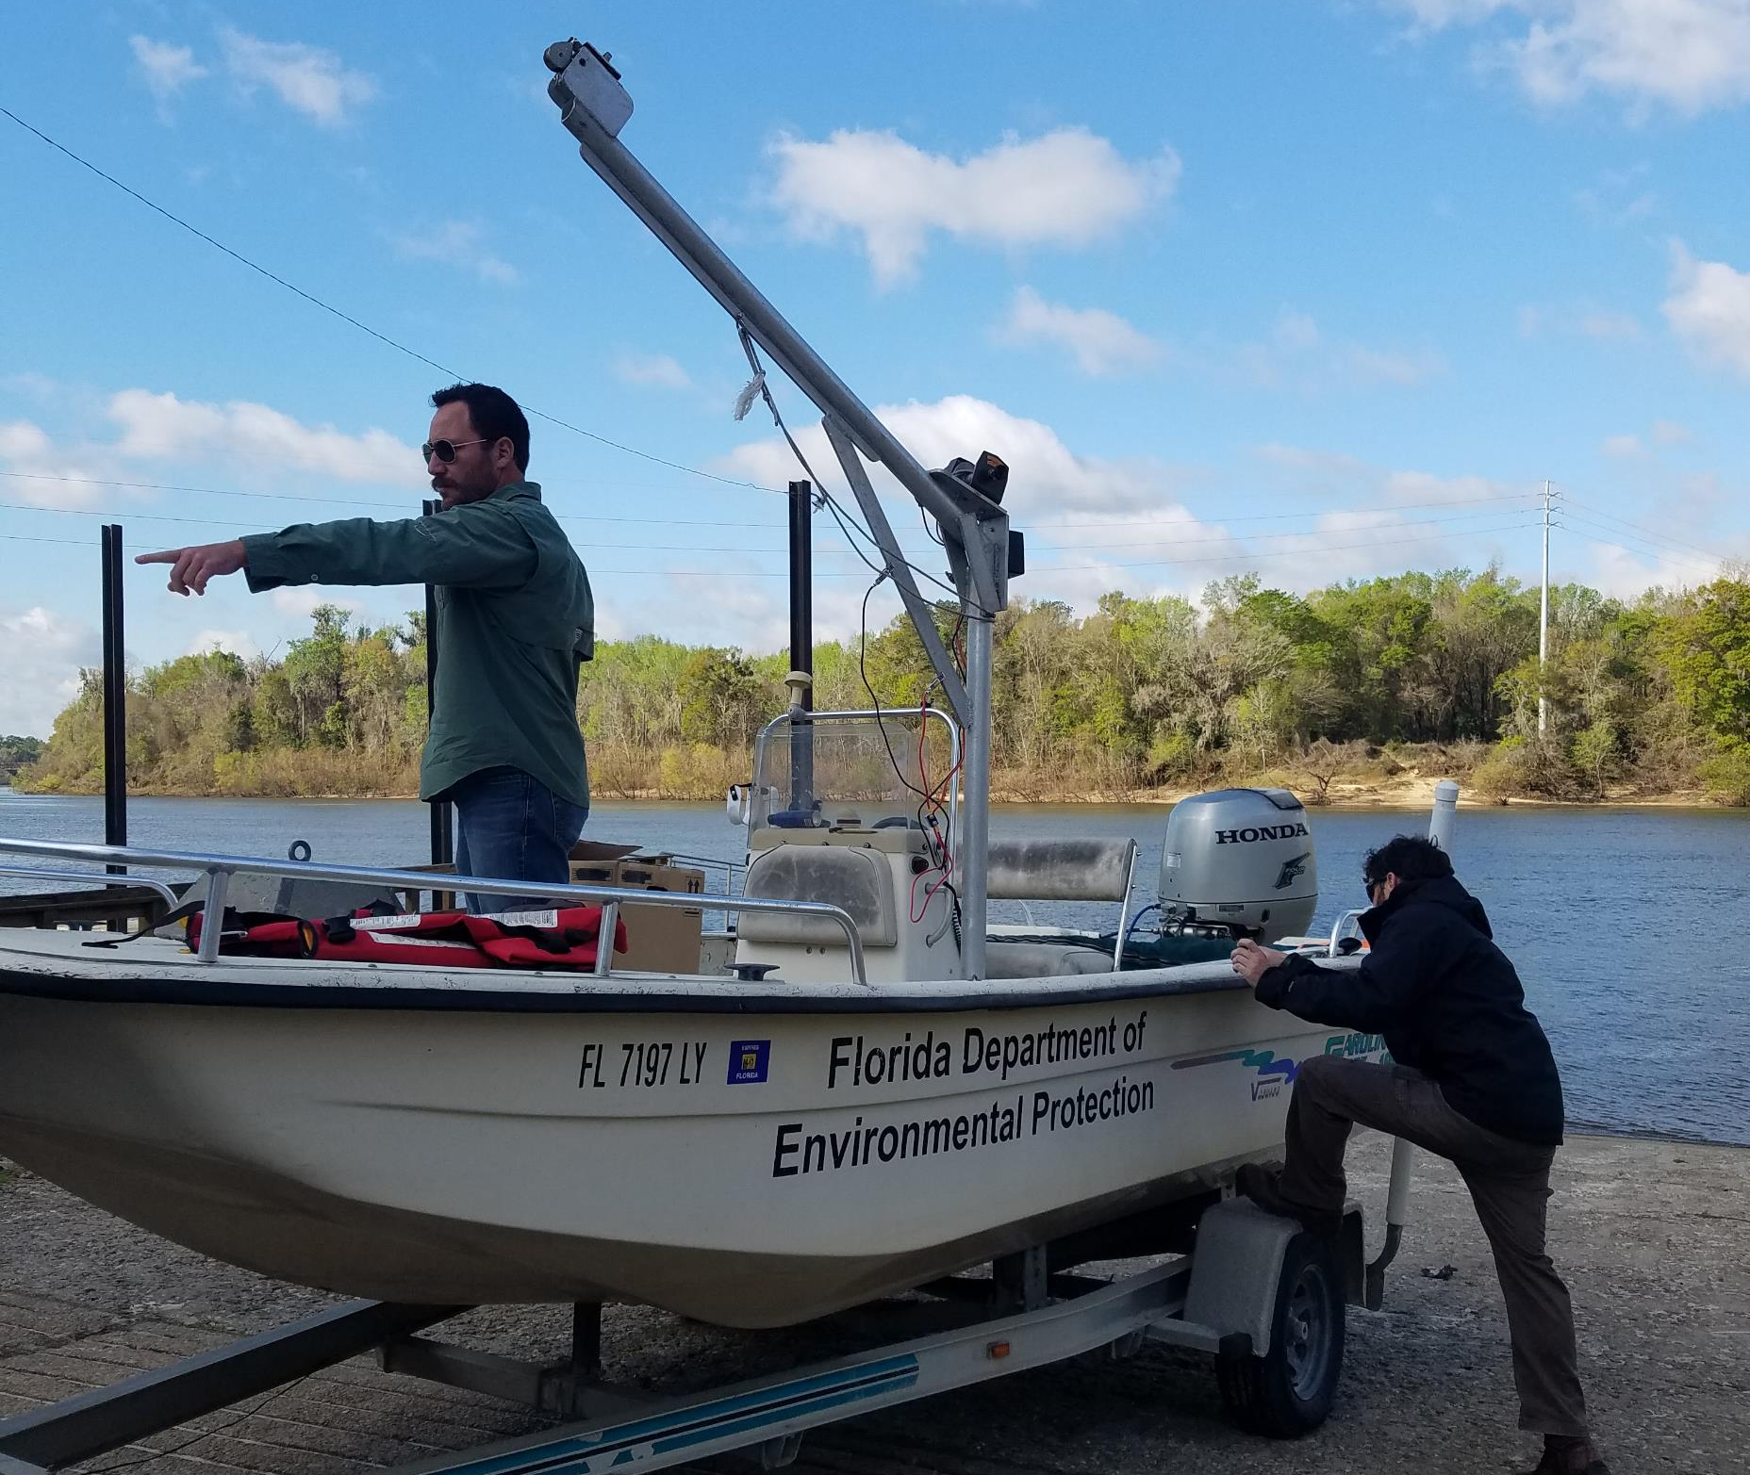
Apalachicola – Day 2 Deploy

Slide 44
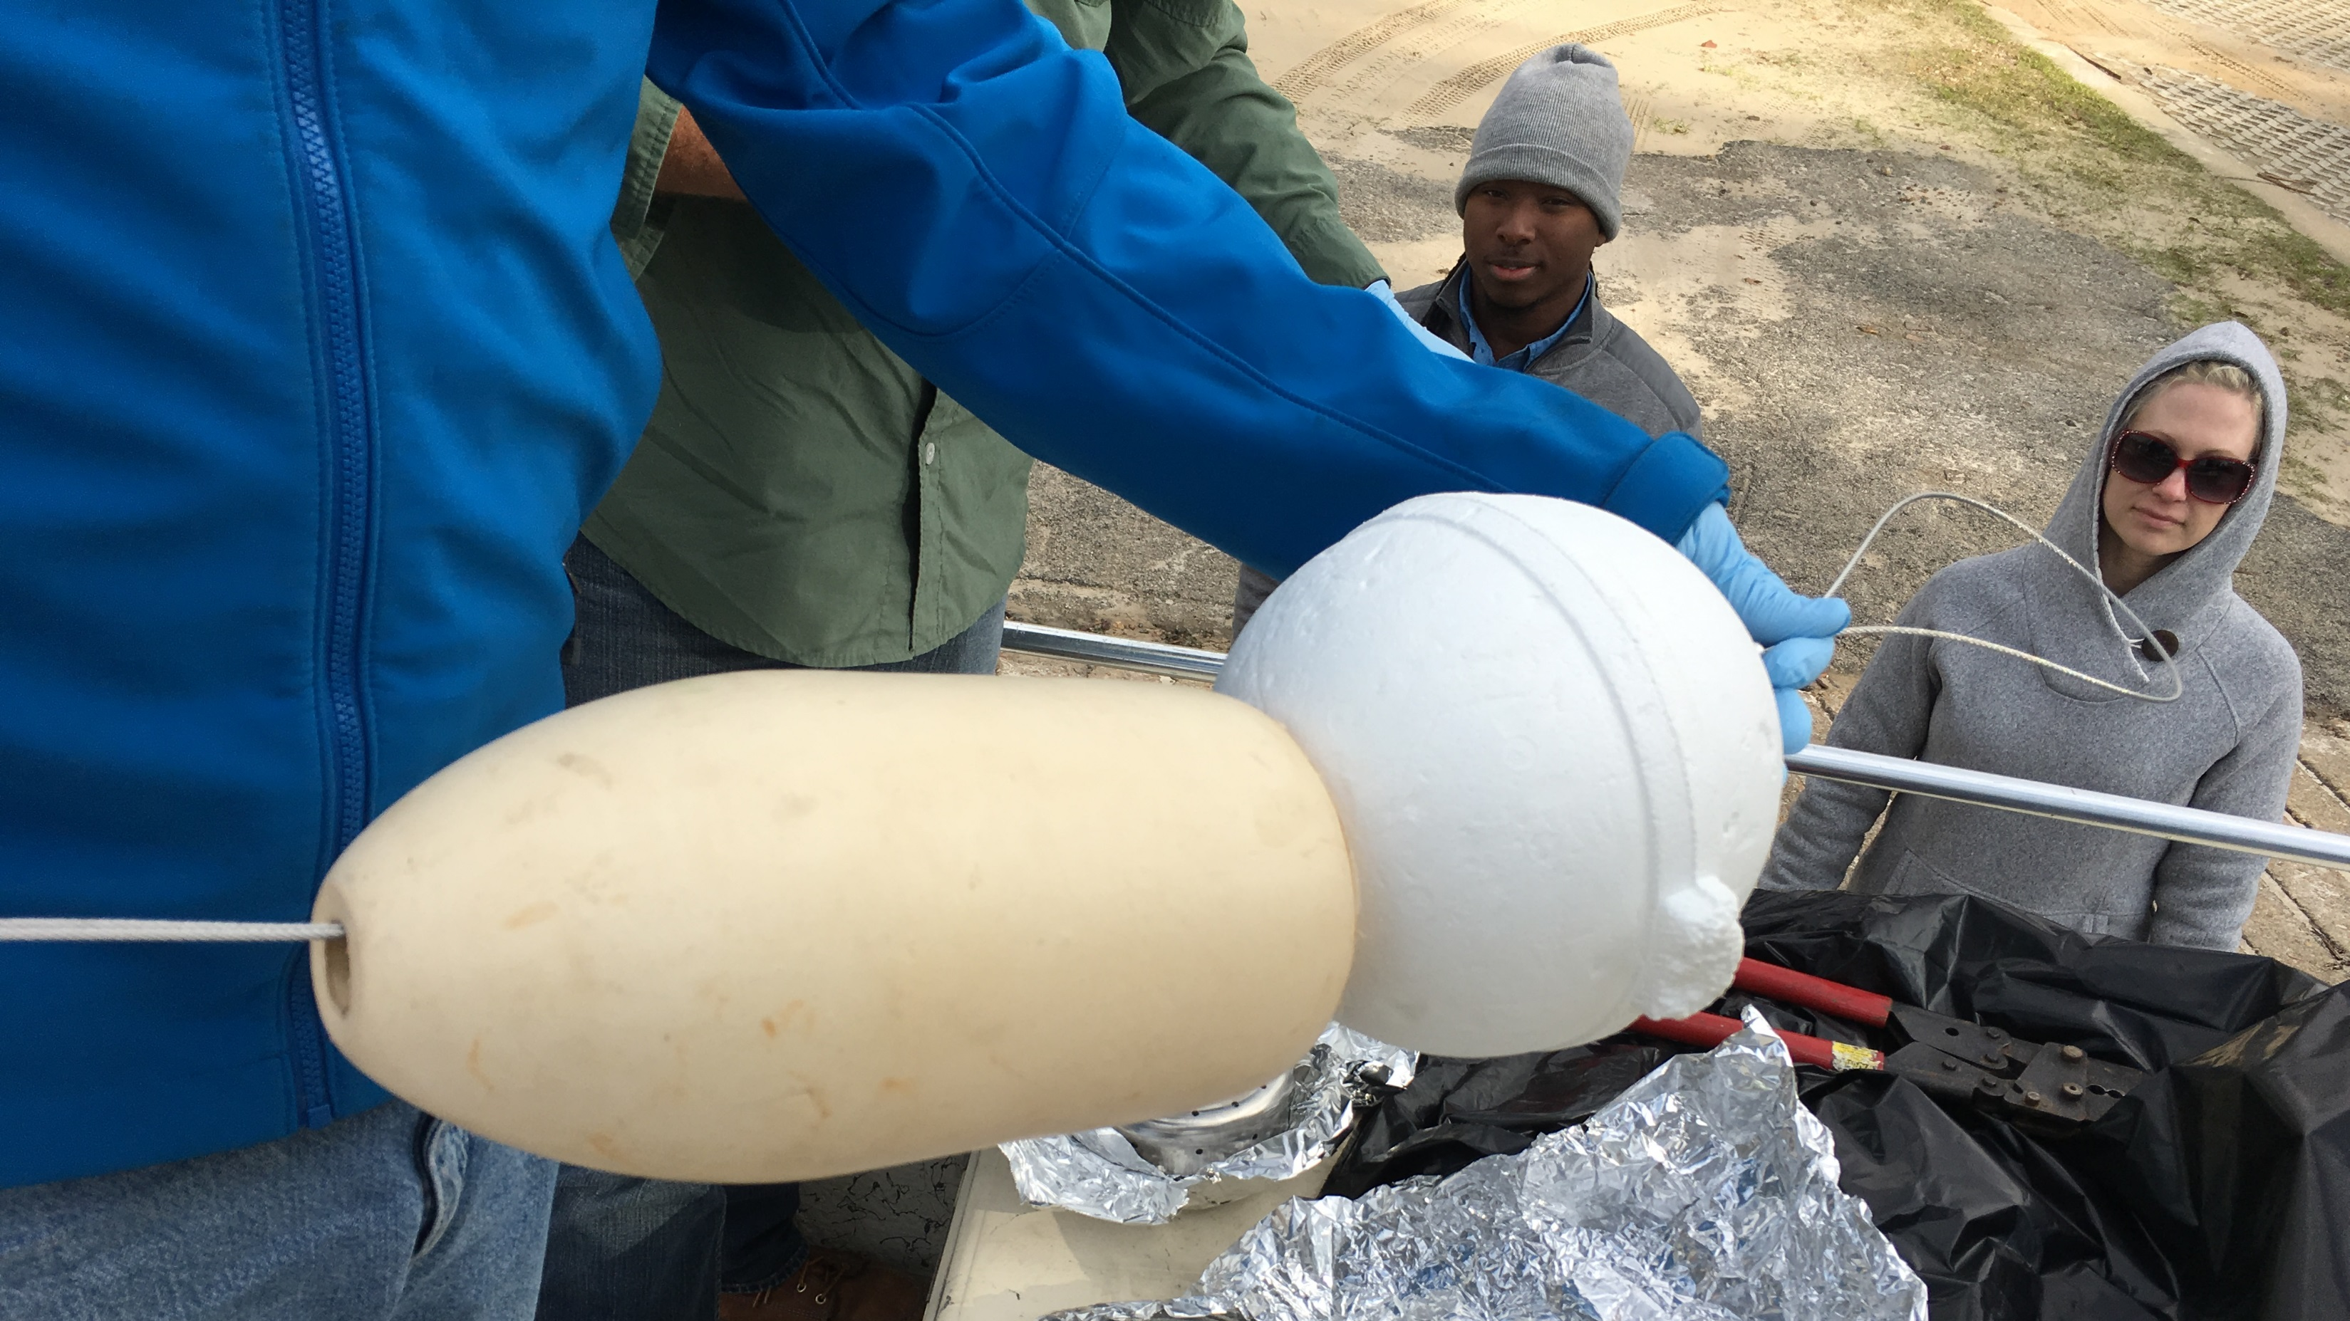
Float Attachment

Slide 45
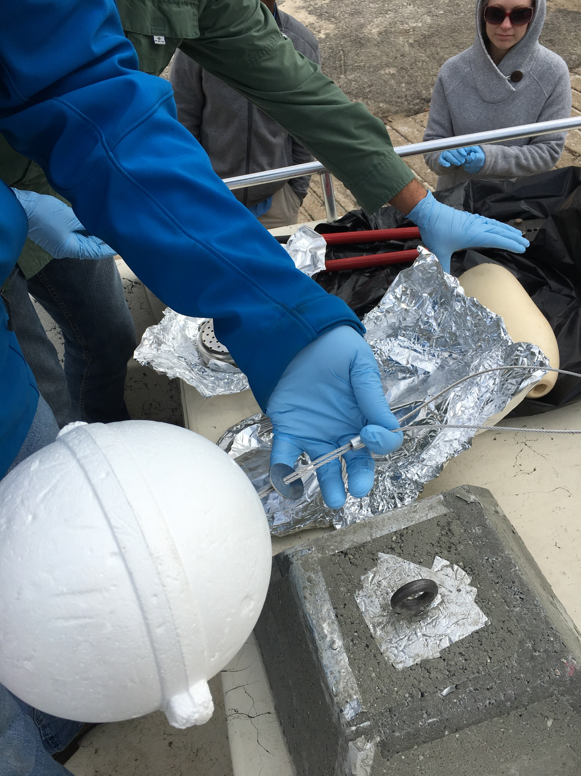

Slide 46
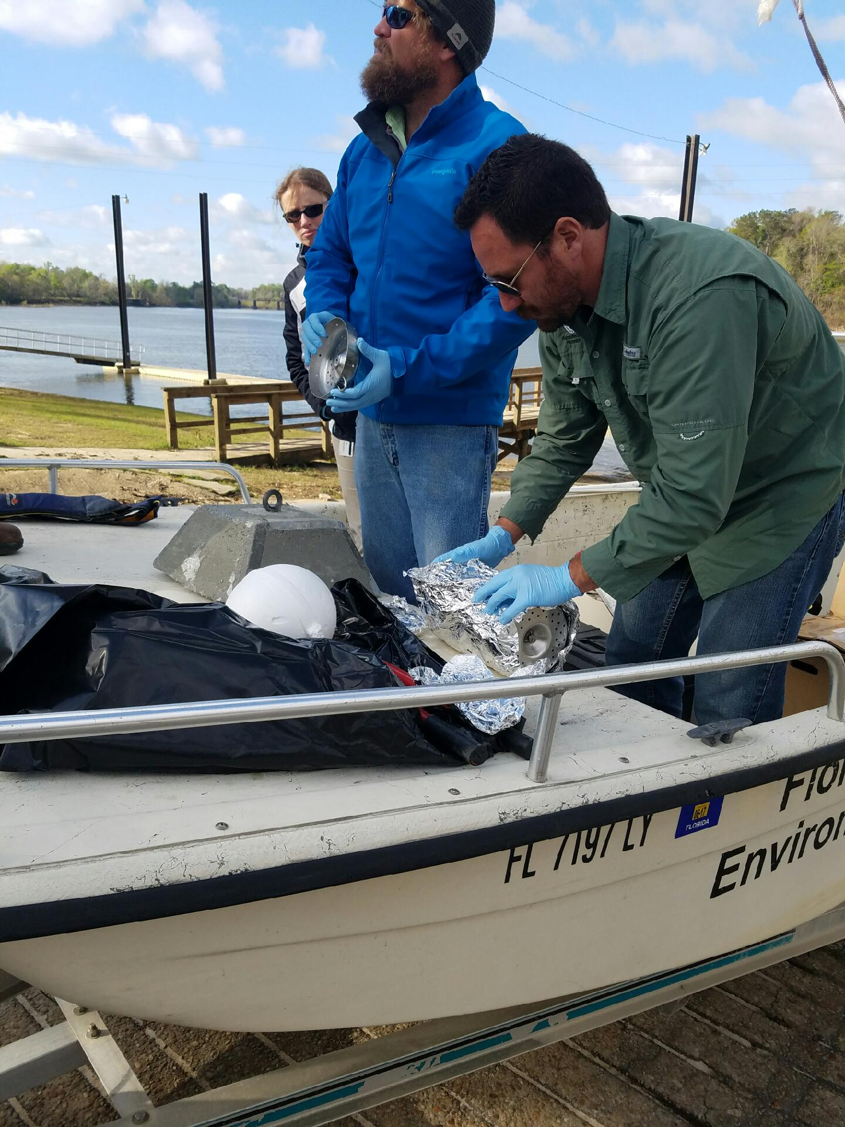

Slide 47
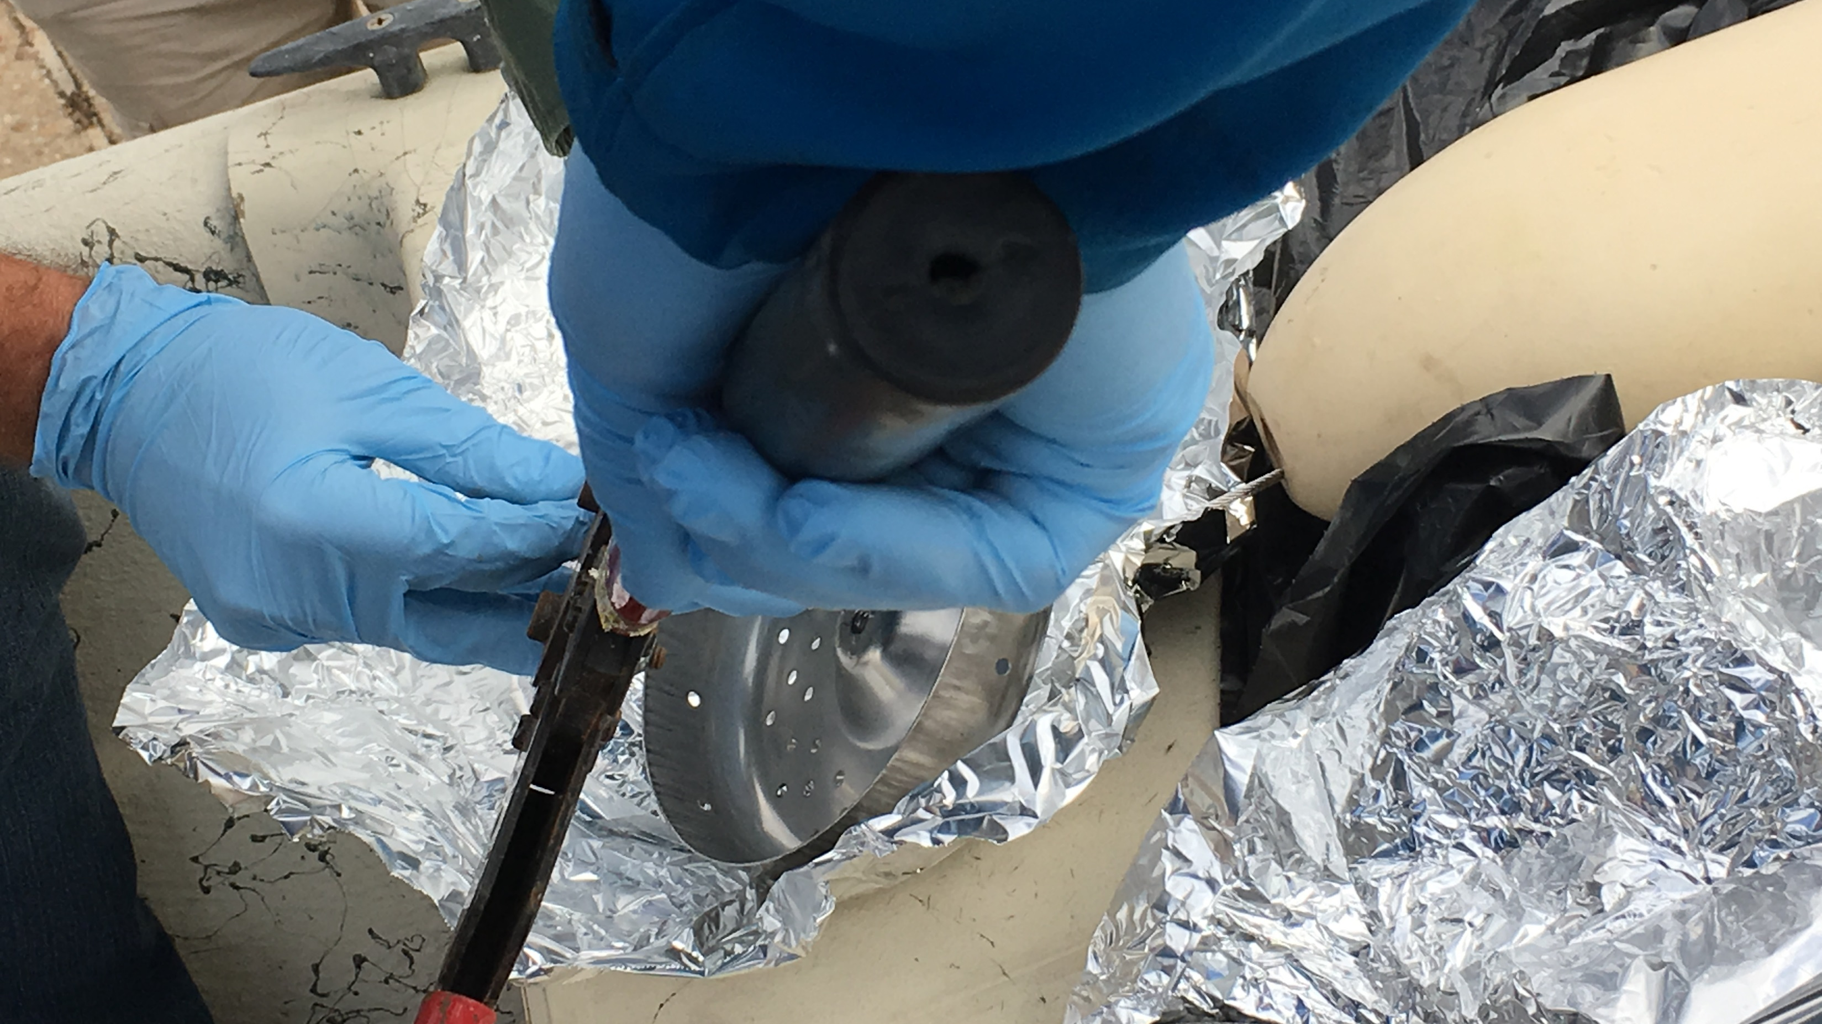

Slide 48
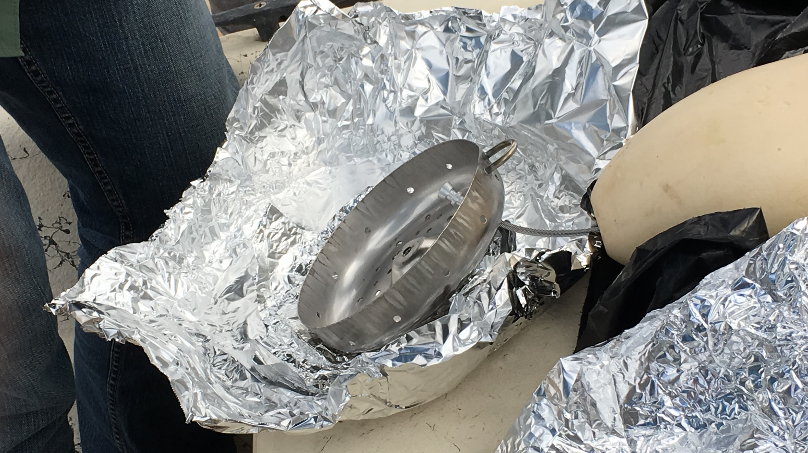

Slide 49
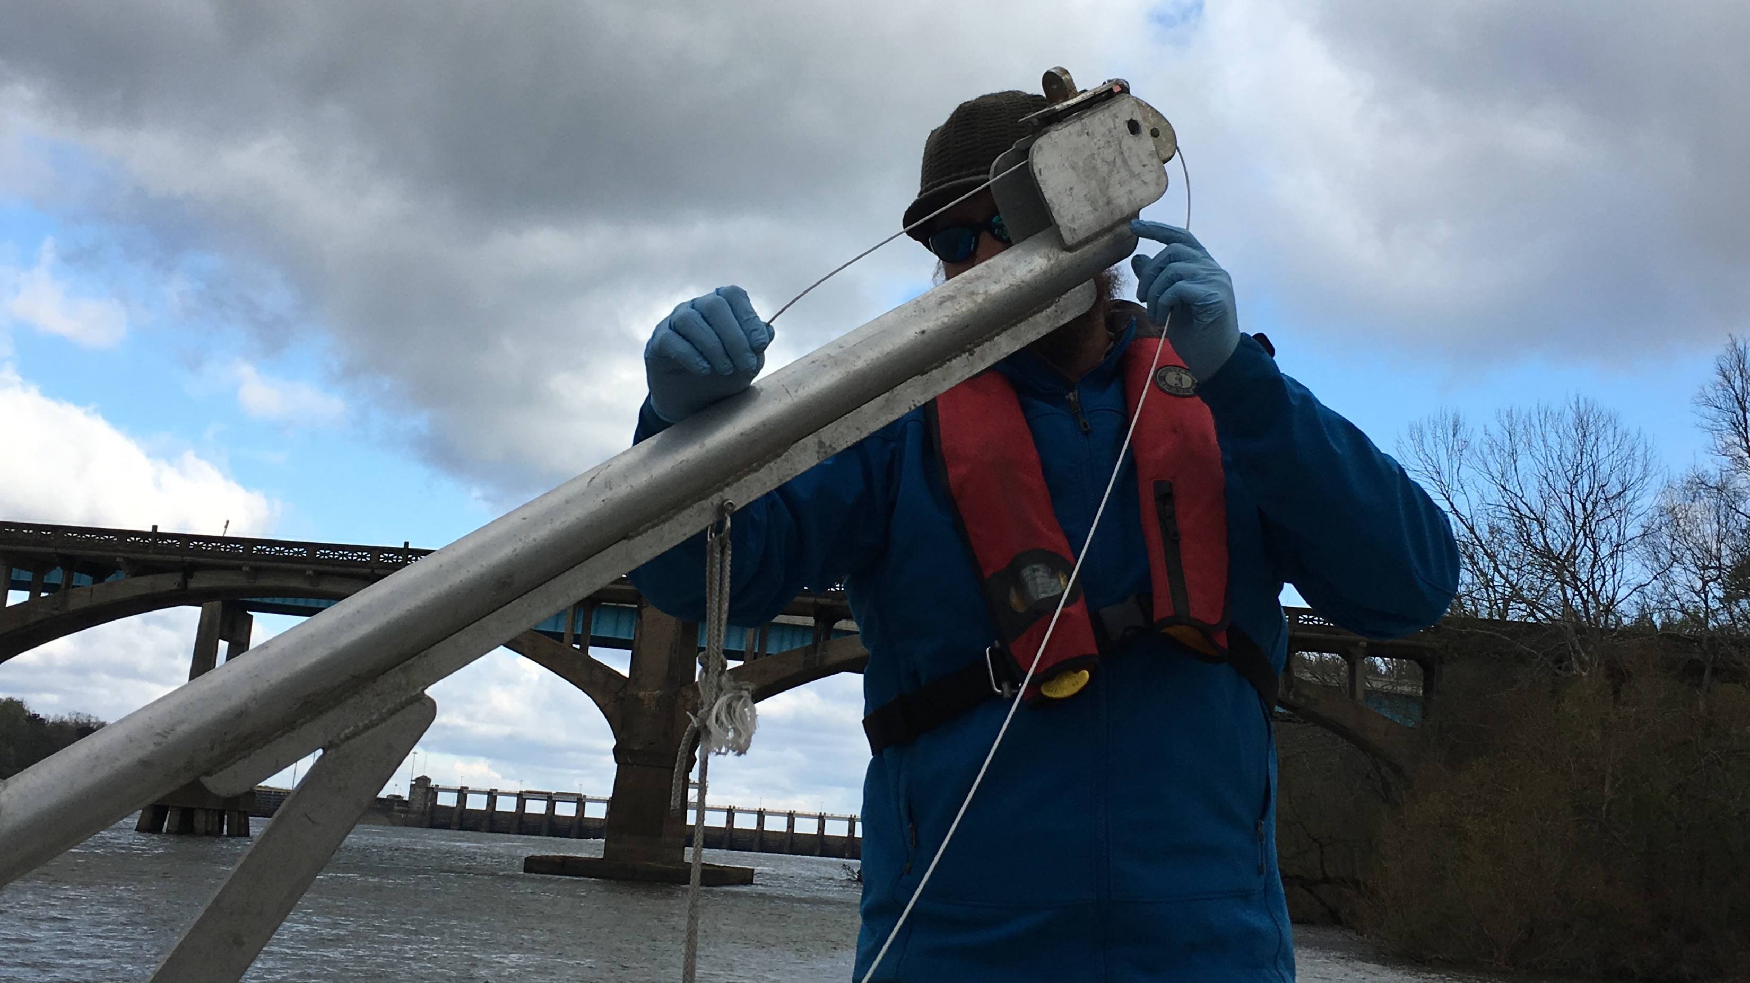
Crane Set Up

Slide 50
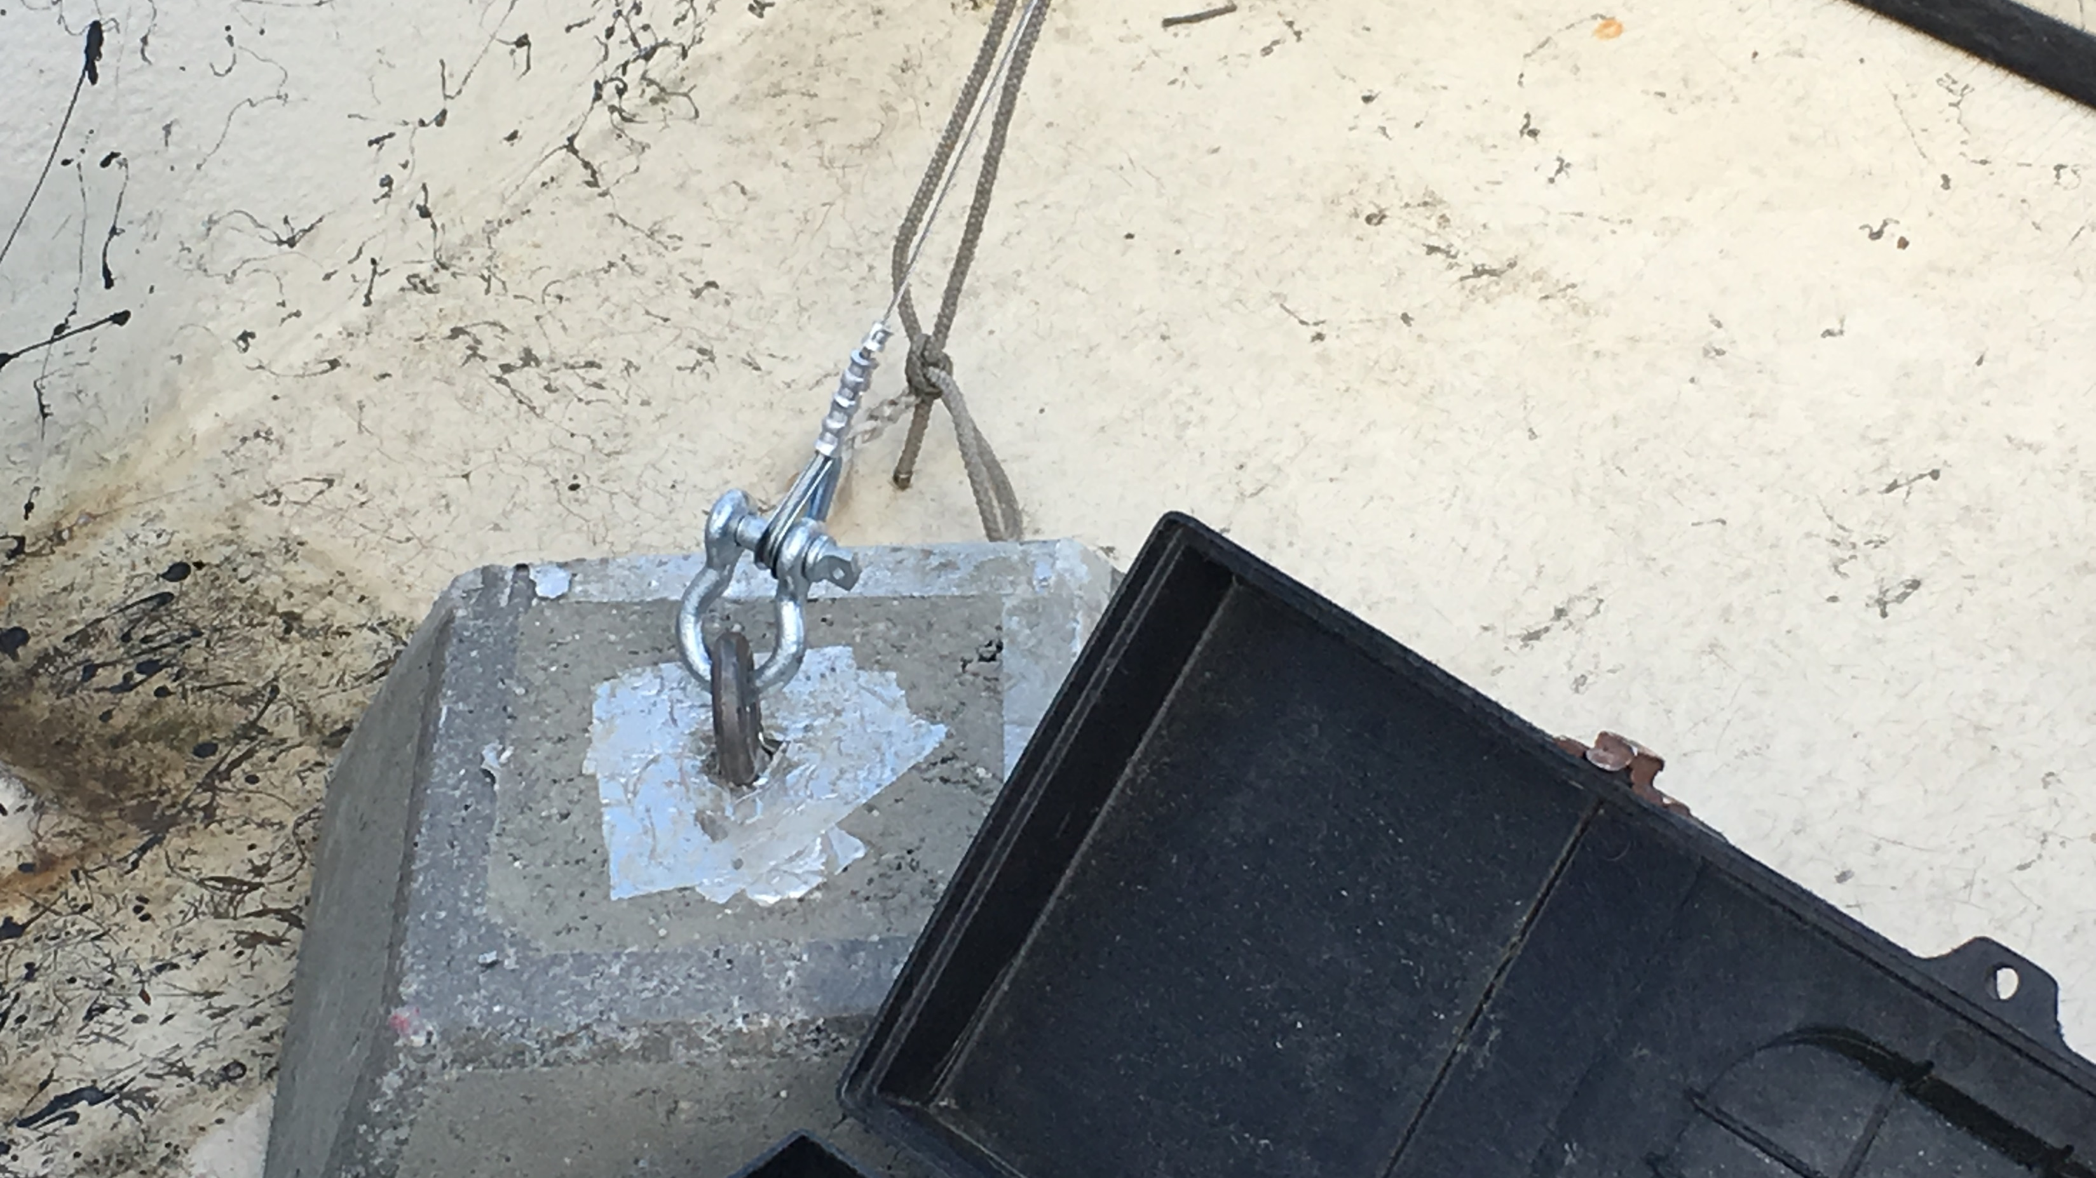

Slide 51


Slide 52


Slide 53


Slide 54


Slide 55

POCIS

Slide 56


Slide 57


Slide 58

SPMD

Slide 59


Slide 60


Slide 61


Slide 62


Slide 63


Slide 64


Slide 65


Slide 66


Slide 67

Apalachicola - Retrieval Day

Slide 68


Slide 69

Whole Water Sampling

Slide 70


Slide 71


Slide 72


Slide 73


Slide 74

Device Retrieval

Slide 75


Slide 76


Slide 77


Slide 78


Slide 79


Slide 80

SPMD

Slide 81


Slide 82


Slide 83

POCIS

Slide 84


Slide 85

Alafia River – Day 3 Deploy

Slide 86

Deployment Set Up

Slide 87


Slide 88


Slide 89


Slide 90
Devices Deployed

Slide 91


Slide 92


Slide 93


Slide 94

Device Retrieval Day

Slide 95


Slide 96


Slide 97


Slide 98


Slide 99


Slide 100


Slide 101


Slide 102


Slide 103


