Slide 1
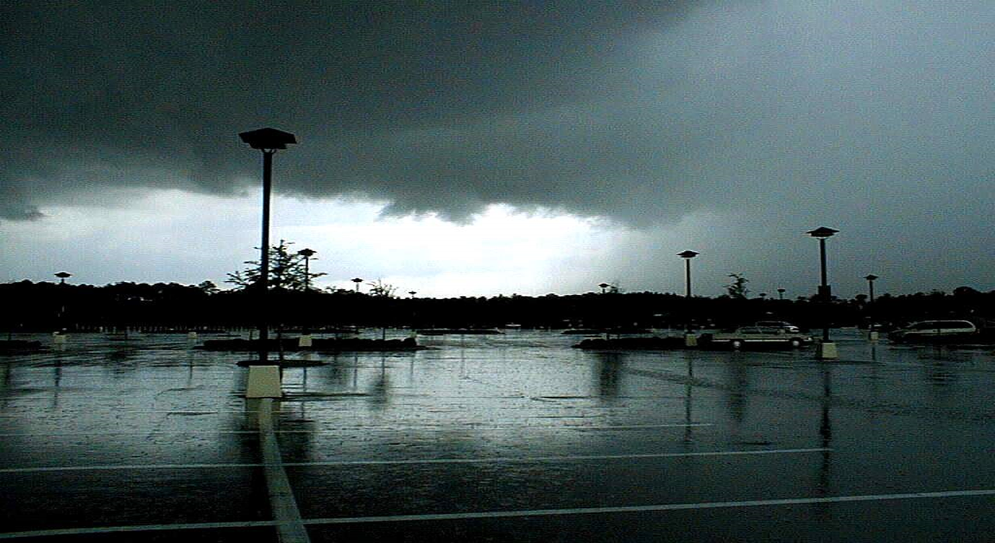
Chapter 8
Best Management Practices for
Stormwater Management

Slide 2
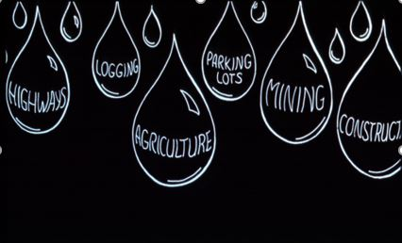

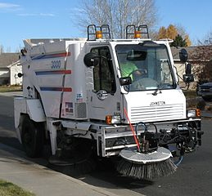
8.1.1 Nonstructural vs. Structural BMPs
Nonstructural BMPs are the first line of defense!
Prevention oriented, very cost effective, and aesthetically acceptable to the public and other inspecting agencies.
Improve water quality by reducing the generation and accumulation of pollutants near their sources
Includes:
Planning and management (Basin Management Action Planning or BMAP)
Wetland and floodplain protection (ERP)
Public education (319 Grants and MS4s)
Proper fertilizer and pesticide application control (GI-BMP Program and Fertilizer Ordinances)
Solid waste collection and disposal (Waste Management Program)
Street cleaning (MS4s)
“Good Housekeeping” techniques on construction sites (CGP)
http://gibmp.ifas.ufl.edu
This Photo by Unknown Author is licensed under CC BY-SA

Slide 3
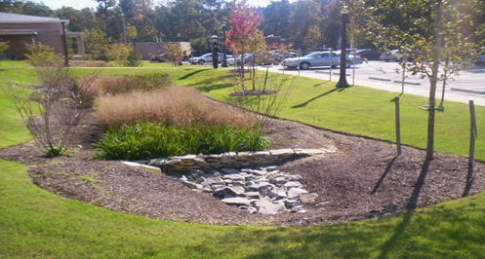
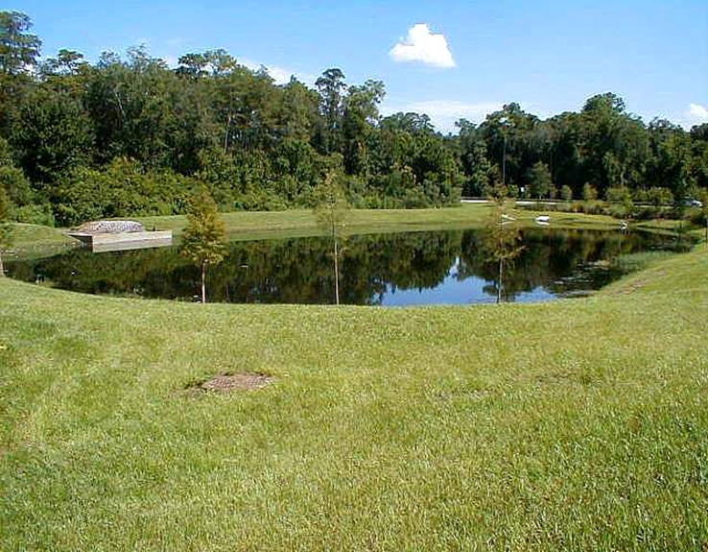
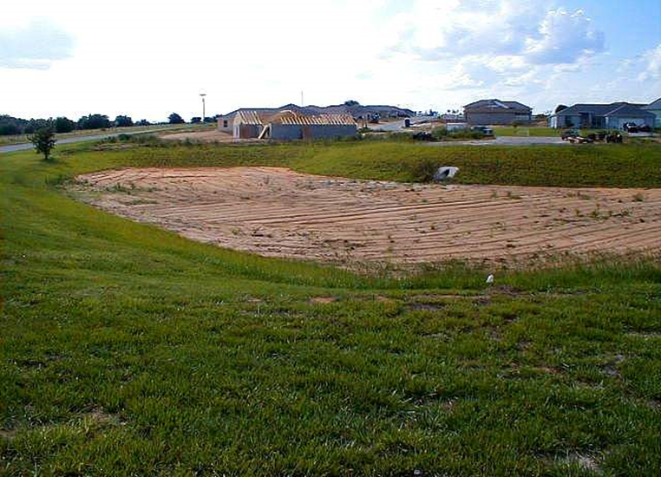
8.1.1 Nonstructural vs. Structural BMPs
Structural BMPs:
Control volume and discharge rate through physical containment and structural design and reduce pollutants through:
Settling
Filtration
Percolation
Chemical Treatments
Biological Uptakes of Nutrients; such as, N, P, K and many other pollutants impairing our waterbodies.
The practices are typically land intensive, require proper long-term maintenance, and can be costly in urbanized areas.
STORMWATER

Slide 4
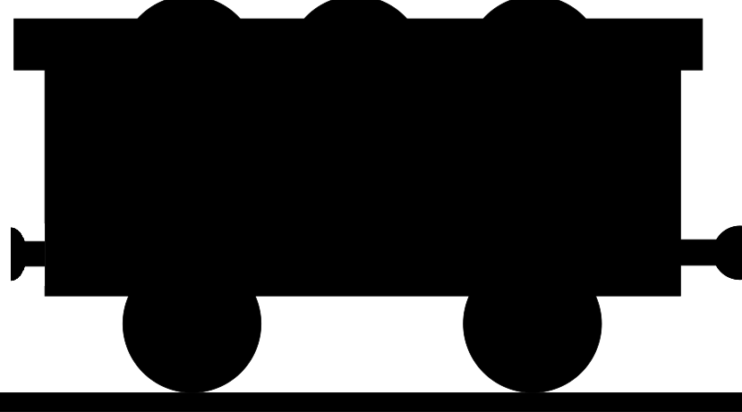
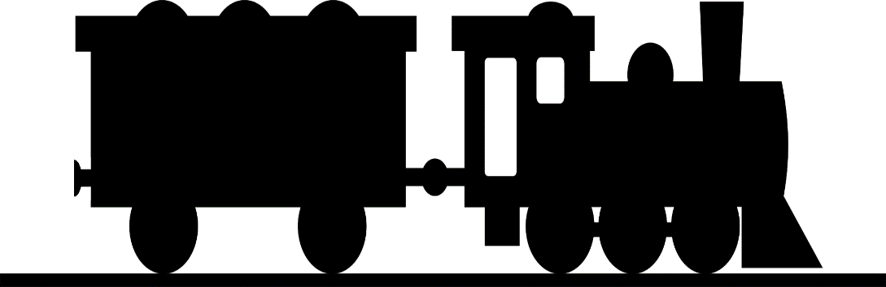
8.1.2 BMP Treatment Train
Use multiple BMPs in sequence to create a
Treatment Train!
Source
Control
Swales
Filters
Ponds

Slide 5
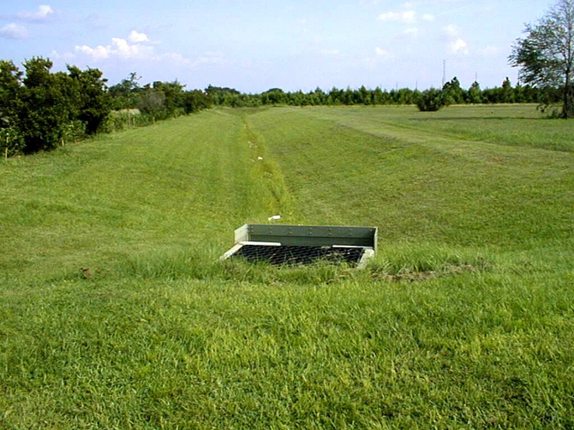
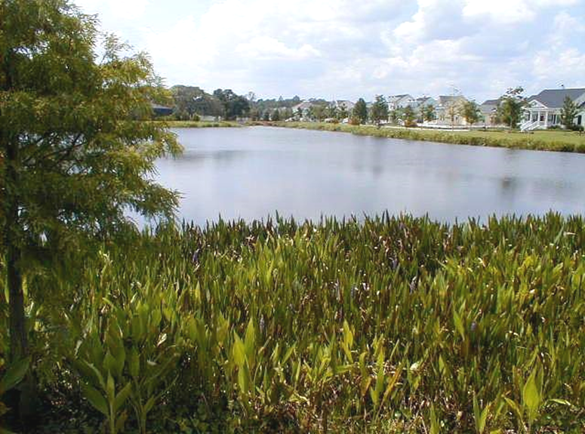

8.1.2 BMP Treatment Train
The more elements incorporated into the system, the better the performance of the “TREATMENT TRAIN”
Different BMPs explored in this chapter should be used together – finding the right sequence is key
Many BMPs in this chapter are susceptible to clogging, especially filtration techniques – long term maintenance essential
Treatment swales, sediment forebays, and stilling basins intercept sediments before reaching the filtration BMPs.
Grey Infrastructure: older control structures in existence for years already
Green Infrastructure: new technologies in the treatment train that remove nutrients like Nitrogen and Phosphorus + other pollutants
STORMWATER
Grassed Swale
Wet detention with littoral plants
Bio-Swale

Slide 6
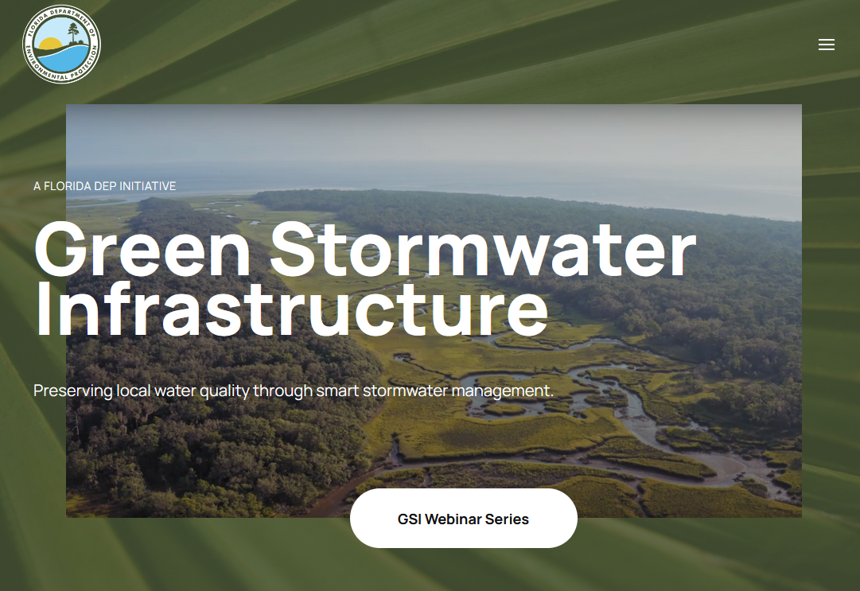
8.1.2 BMP Treatment Train
Find out more about Green Stormwater Infrastructure
(GSI) in Florida
@
gsi.floridadep.gov

Slide 7
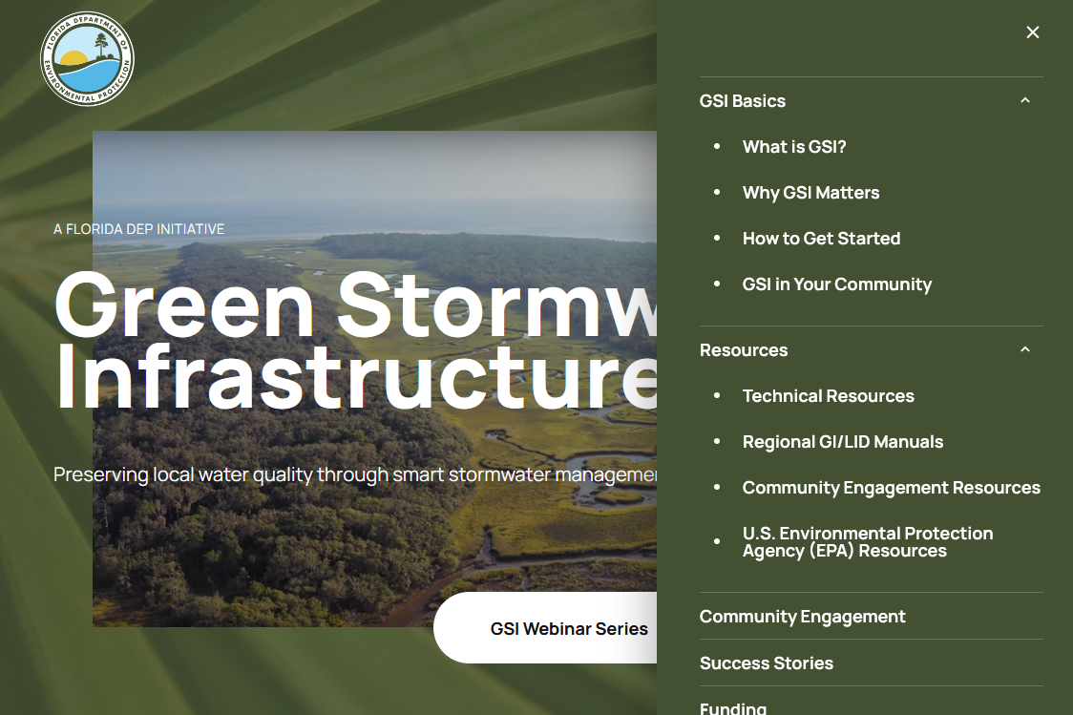
8.1.2 BMP Treatment Train
Educational materials, technical resources and more
@
gsi.floridadep.gov

Slide 8
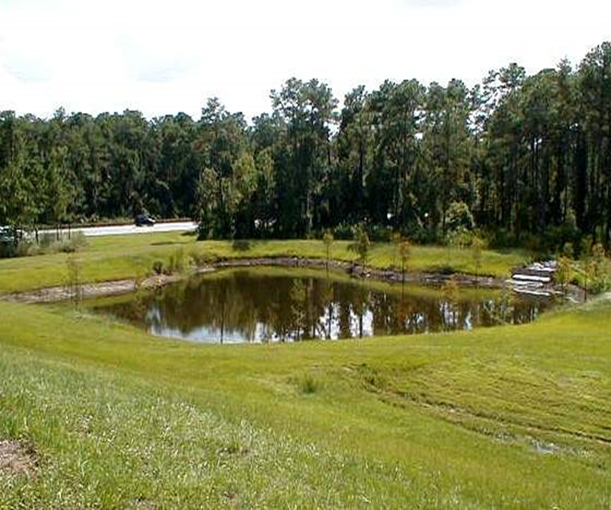
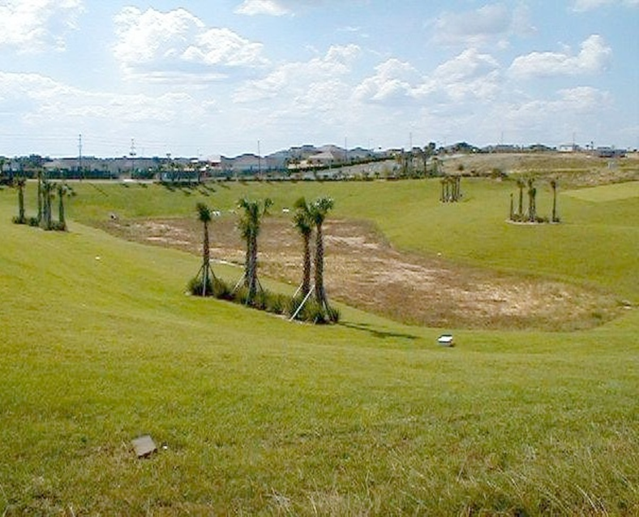
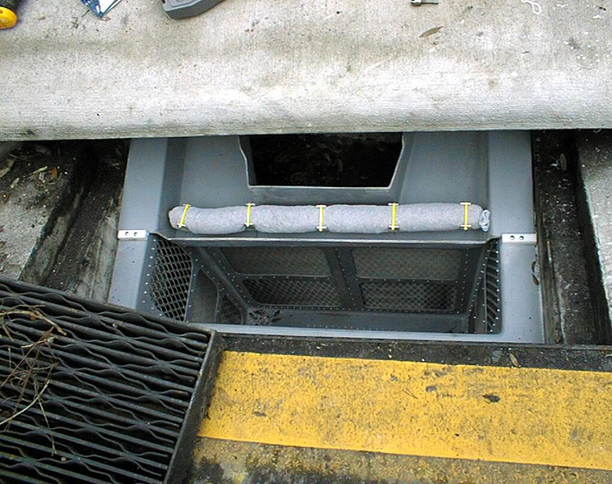
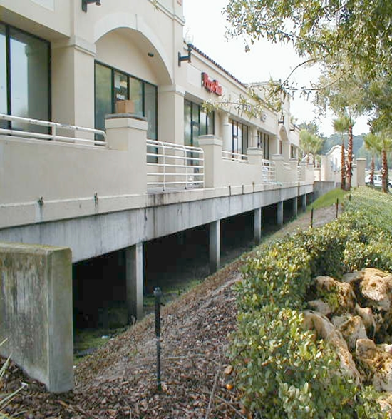
8.1.3 On-Line versus Offline BMPs
On-line BMPs capture all the runoff, temporarily storing it before discharge
Off-line BMPs divert a portion, or “treatment volume,” of the runoff and isolate from the remaining discharge.
Also called a “first flush” system
Detention Pond Retention Pond
Inlet Filters
“First Flush” Pond

Slide 9
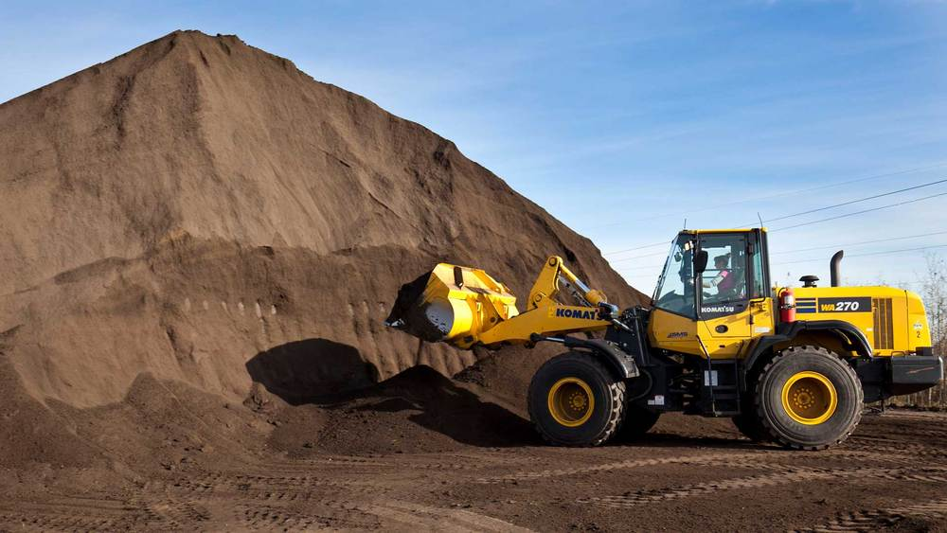
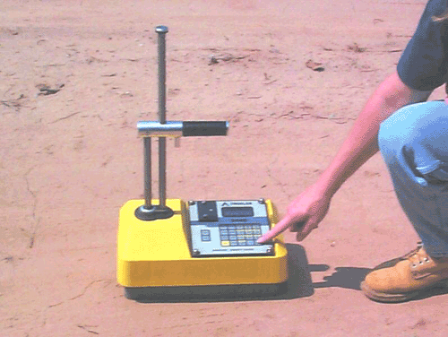
8.2 Earthwork Specifications
Definition: Earthwork specifications help maximize the desirable physical properties of soil and compensate for deficiencies
Purpose: to ensure that inadequate earthwork does not cause premature failure of constructed improvements
Condition where practice applies: this practice applies on all construction sites and where maintenance is necessary
Stockpile of Topsoil
Nuclear Densometer –
Used to Determine Compaction and a Quality Control for FDOT

Slide 10
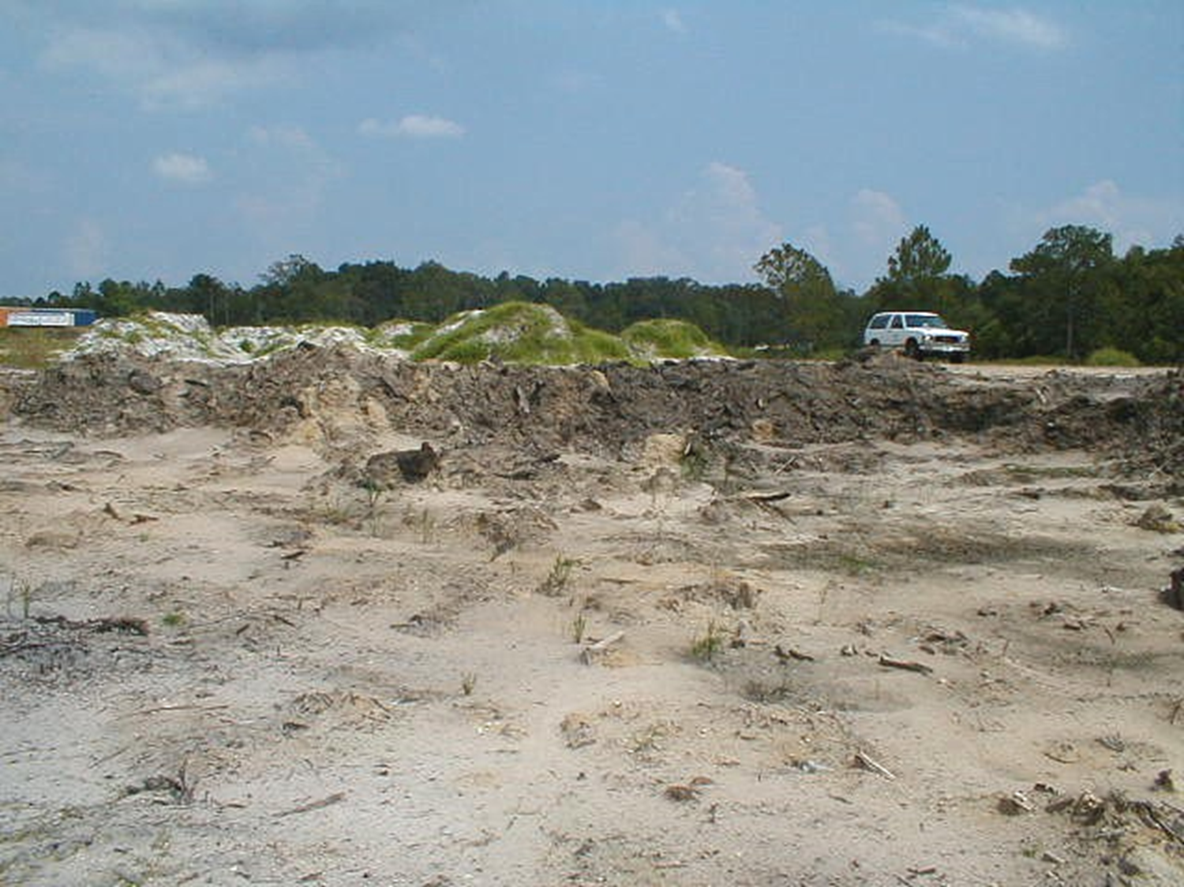
8.2 Earthwork Specifications
Specifications: Subgrade Preparation
Smooth & compact if no fill required – both subgrade and fill should be largely free of organic material
Muck must be removed – but check first! – muck means wetlands and impacts require ACOE/DEP/local permits
Scarify to make bond between native soil and imported fill – otherwise fill and sod can “slide” off
Check all permits for specific fill restrictions or conditions
Florida DOT may have additional specifications for Road and Bridge fill
Free of roots, rocks, demolition debris

Slide 11
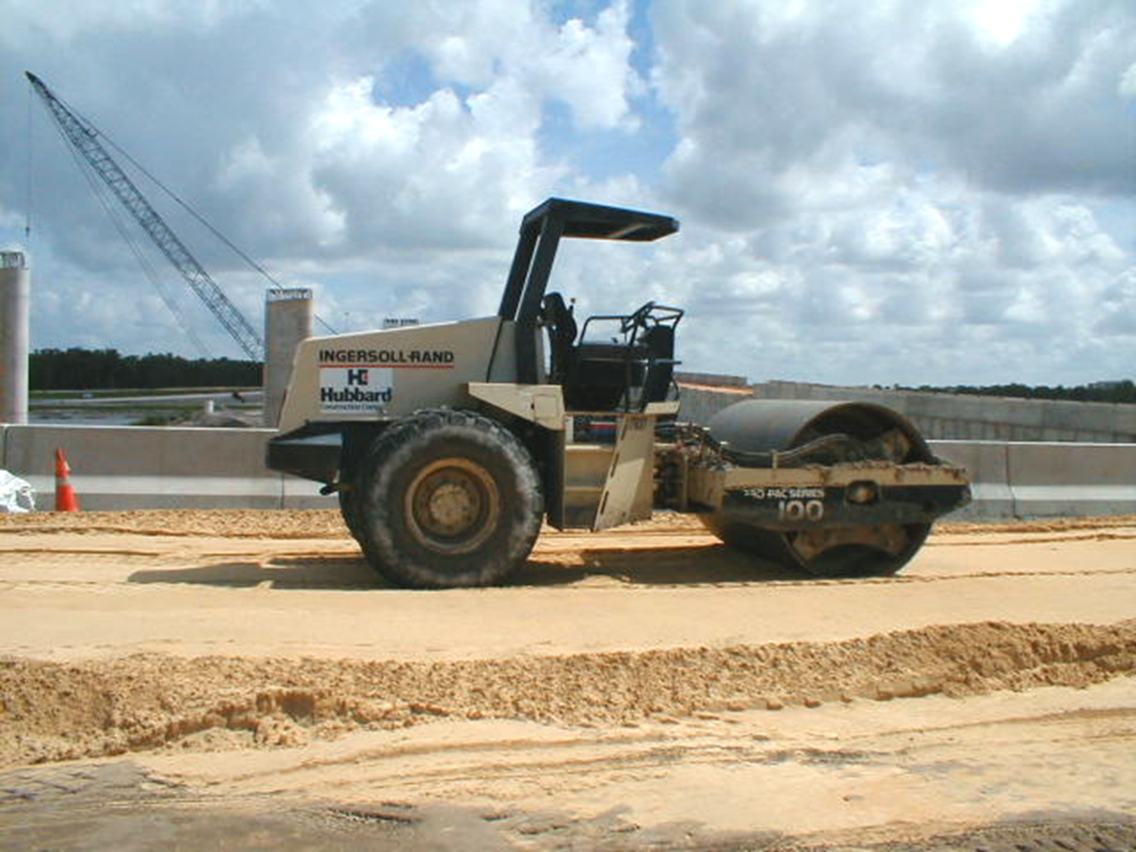
8.2 Earthwork Specifications
Specifications: Fill, Backfill, & Compaction
Fill should be clean and free of roots, rocks, demolition debris
Fill introduced and compacted in “lifts”
Large areas: 10 - 12” lifts of soil, heavy equipment packs
Around pipes: 4 - 6” lifts, small rollers, tampers – delicate!
Natural compaction: several wet months, sediment control required, not advised without other stabilization
Compaction w/ sprinkler; takes several days, only very sandy soils
STORMWATER
Large areas: 10 - 12” lifts, heavy equipment

Slide 12
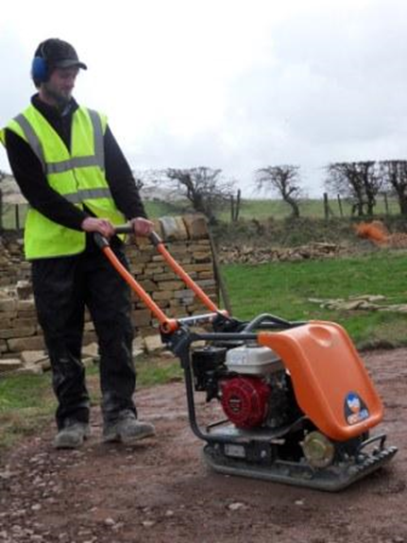
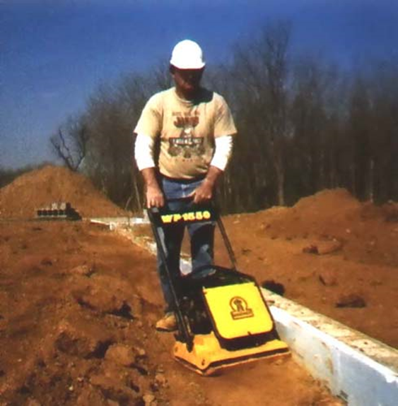
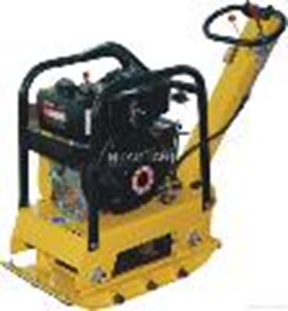
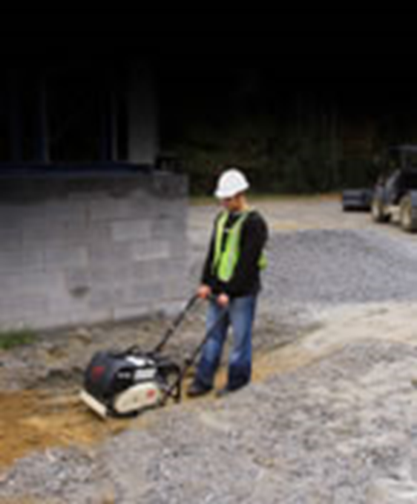
8.2 Earthwork Specifications
STORMWATER
Plate Compactor: used around pipes, inlets, etc: 4 - 6” lifts of soil at a time
Smaller machines = finer control around delicate structures

Slide 13
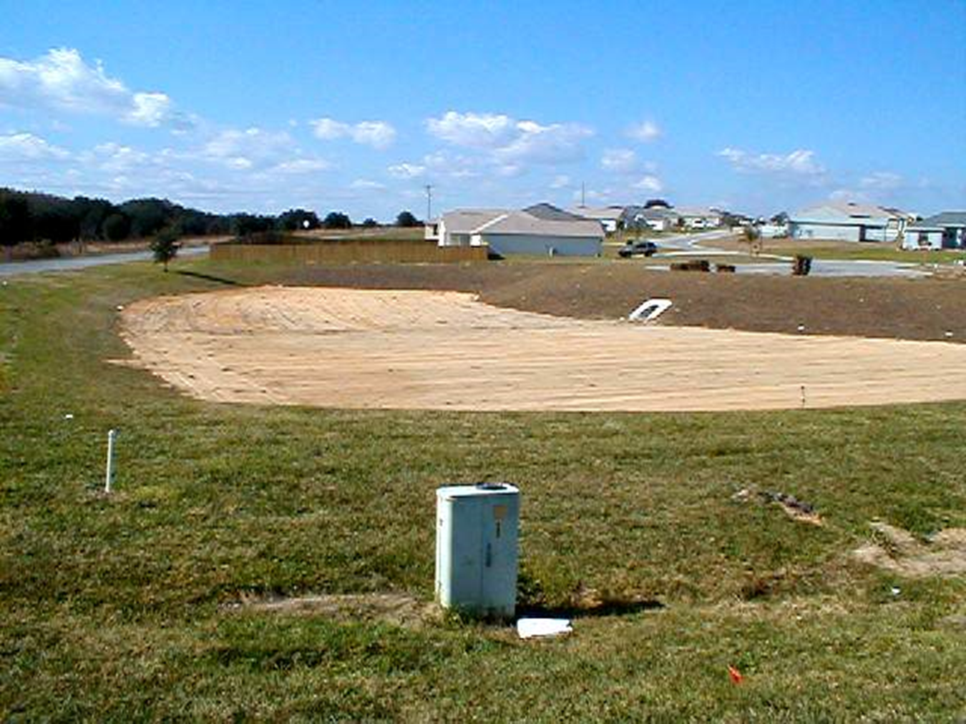
8.3 Stormwater Retention Basin
Definition: A surface area used to store runoff for a selected treatment volume that is retained onsite with storage volume recovered when runoff percolates into the soil or evapotransporates
Purpose: to combine flood control, pollution control, and ground water recharge in the design of a stormwater storage basin
Condition where practice applies: where space is available, and soil and ground water conditions allow recovery within 72 hours
Retention basins are designed to stay dry most of the time – standing water only from poor maintenance or design
STORMWATER

Slide 14
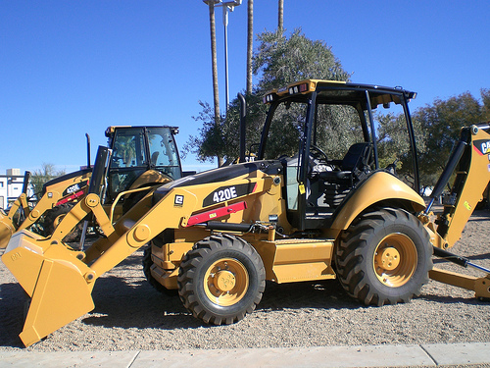
8.3 Stormwater Retention Basin
Construction:
Initial basin excavation within 1 foot of final elevation of
the basin floor
Interior side slopes vegetated as per specifications
Light equipment should be used to remove any accumulated sediments and to achieve final grade without compacting the basin floor
Scarify with rotary tillers or disc harrows to promote infiltration
All structural elements shall be designed by FL Registered P.E.
Prevent sediment-laden runoff from entering a finished basin
STORMWATER
Final inspection:
Correct location, dimensions, material
Control structures - location, type, functioning correctly
Bottom - free of sediments, scour, excess compaction

Slide 15
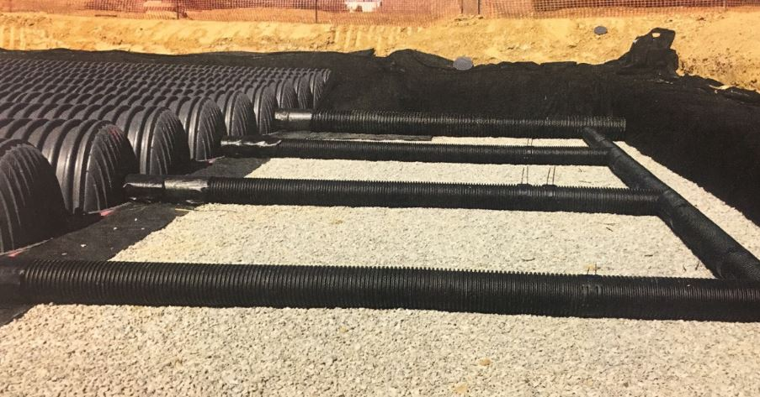
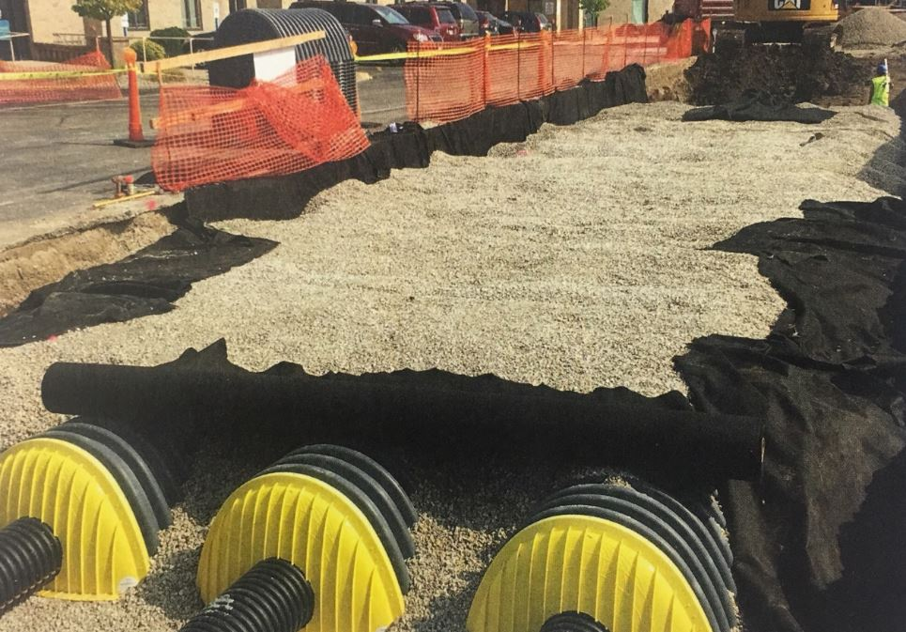
8.4 Exfiltration Trench
Definition: on-site retention accomplished below the ground
Purpose: to combine flood control, pollution control, and ground water recharge in the design of an underground stormwater storage facility
Condition where practice applies: where space is limited, yet soil type and ground water level will allow percolation of excess runoff – offline system usually for “first flush”
STORMWATER
Can take the form of tanks, perforated pipes or aggregate stone
Installed beneath a parking lot

Slide 16
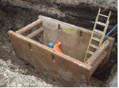
8.4 Exfiltration Trench
Construction:
Safety First!! *****Trenches are dangerous! *****
If there is water in trench or loose soils use a trench box
Place escape ladders every 25 feet
Excavate to proper dimensions
Stockpile spoils & materials at least 10’ from edge of trench – inspect all elements carefully after storms
All materials per specs., material quality important
Good fittings & connections, monitoring well
Backfill, compact, restore area

Slide 17
8.4 Exfiltration Trench
Final inspection:
Adequate access to inspect & maintain
Location, dimensions, materials per plan & specifications
No sediments inside
No settlement on surface
*If going into an access-way to inspect on the inside, practice confined space safety including gas detection (H₂S).
STORMWATER

Slide 18
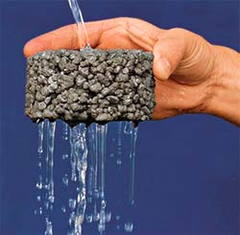
8.5 Permeable Surfaces -Porous Pavement
Definition: a concrete or asphalt pavement with a high percentage of void spaces which allows percolation of runoff
Purpose: to reduce the volume and peak flow of runoff, and to reduce the concentration and loading of pollutants
Condition where practice applies: low volume traffic, parking, pedestrian areas
STORMWATER

Slide 19
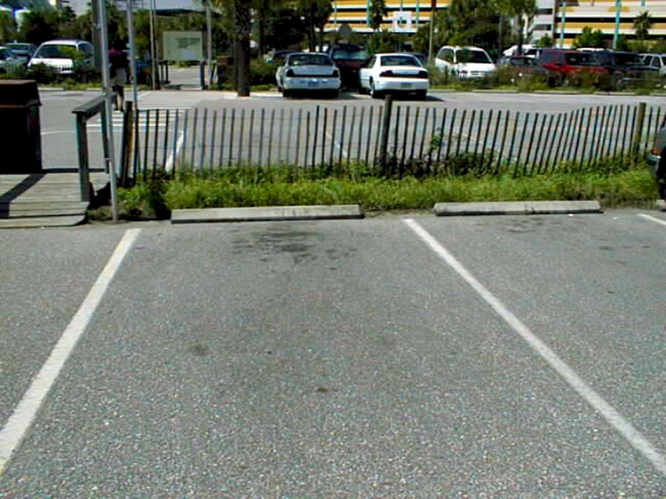
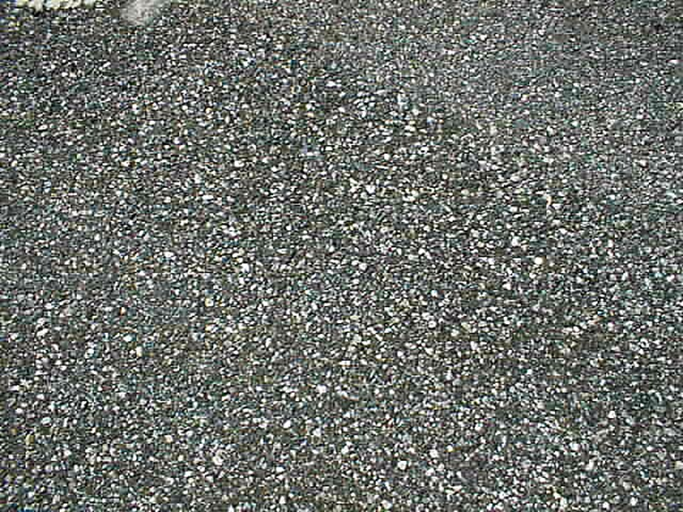
8.5 Permeable Surfaces -Porous Pavement
STORMWATER
Florida Aquarium Parking Lot
Close-up View

Slide 20

8.5 Permeable Surfaces -Porous Pavement
Construction:
Subgrade prep. (no excess compaction)
Used as part of the “treatment train” with other infrastructure
P.E. on site during mixing and placement
STORMWATER

Slide 21

8.5 Permeable Surfaces -Porous Pavement
Final inspection:
Correct location, dimensions, grading
Perimeter: stable contributing area, stable outlet, no sediment sources nearby
Materials, mix must be sampled at placement time
Performance test w/ water

Slide 22
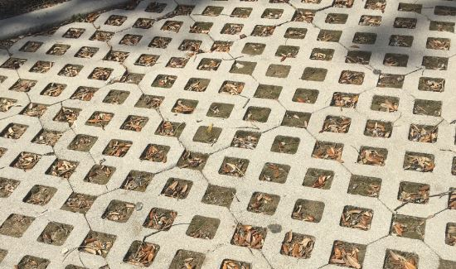
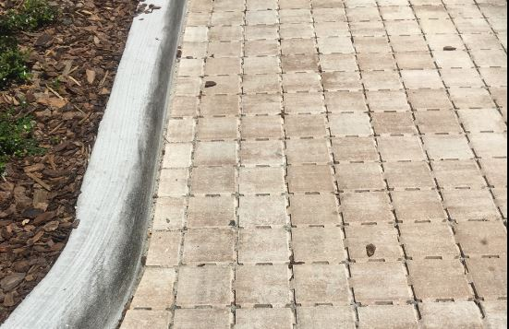
8.6 Concrete Grid & Modular Pavement
Paver Stones (Concrete Grid)
Definition: a pavement consisting of strong structural units having regularly interspersed voids filled with pervious material
Purpose: to reduce the volume and peak flow of runoff; and to reduce loading and concentration of pollutants
Conditions where practice applies: low volume traffic areas, parking, pedestrian areas
Not where pollutants will infiltrate into the ground water
STORMWATER

Slide 23
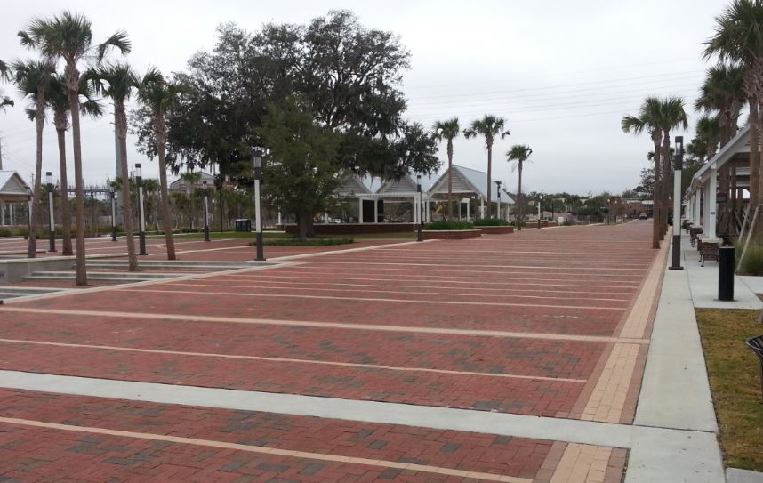
8.6 Concrete Grid & Modular Pavement
STORMWATER
Red Brick Pavers used for park at Kissimmee, FL
Great choice for pedestrian focused areas

Slide 24
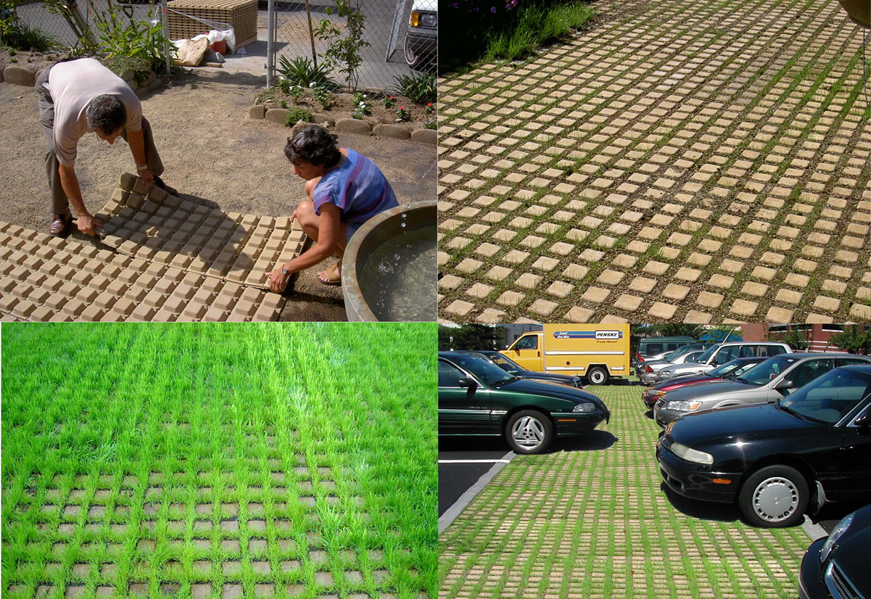
8.6 Concrete Grid & Modular Pavement
STORMWATER
Modular Pavement

Slide 25
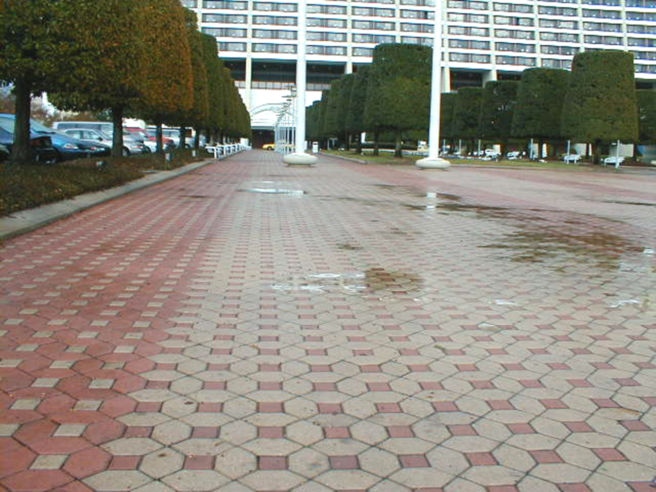
8.6 Concrete Grid & Modular Pavement
Construction:
Subgrade prep.(no excess compaction)
Geotextile underlay for strength
Install per manufacturer’s instructions

Slide 26
8.6 Concrete Grid & Modular Pavement
Final inspection:
Location, dimensions, grading per plan
All materials per spec., no defects
Check perimeter, outlets; test with water

Slide 27
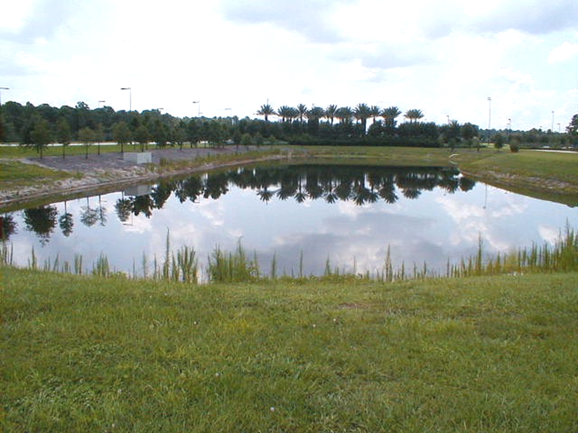
8.7 Detention Basins
Definition: a basin designed to temporarily store excess runoff prior to gradual release
Purpose: to reduce the impact of peak flows by redistributing the volume at a slower rate over a longer time
Condition where practice applies: where soil and/or ground water conditions do not allow percolation of excess runoff, yet pollution reduction and flood attenuation are desired or required
STORMWATER
Note: detention and retention structure definitions can be found in 62-331 F.A.C. and Applicants Handbook

Slide 28
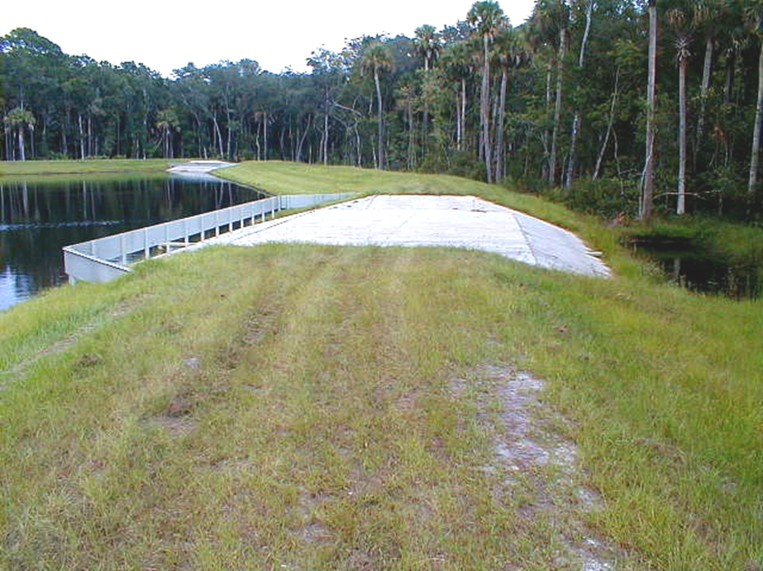
8.7 Detention Basins
STORMWATER
Detention Basins have a designed overflow control structure – such as this Engineered Weir

Slide 29
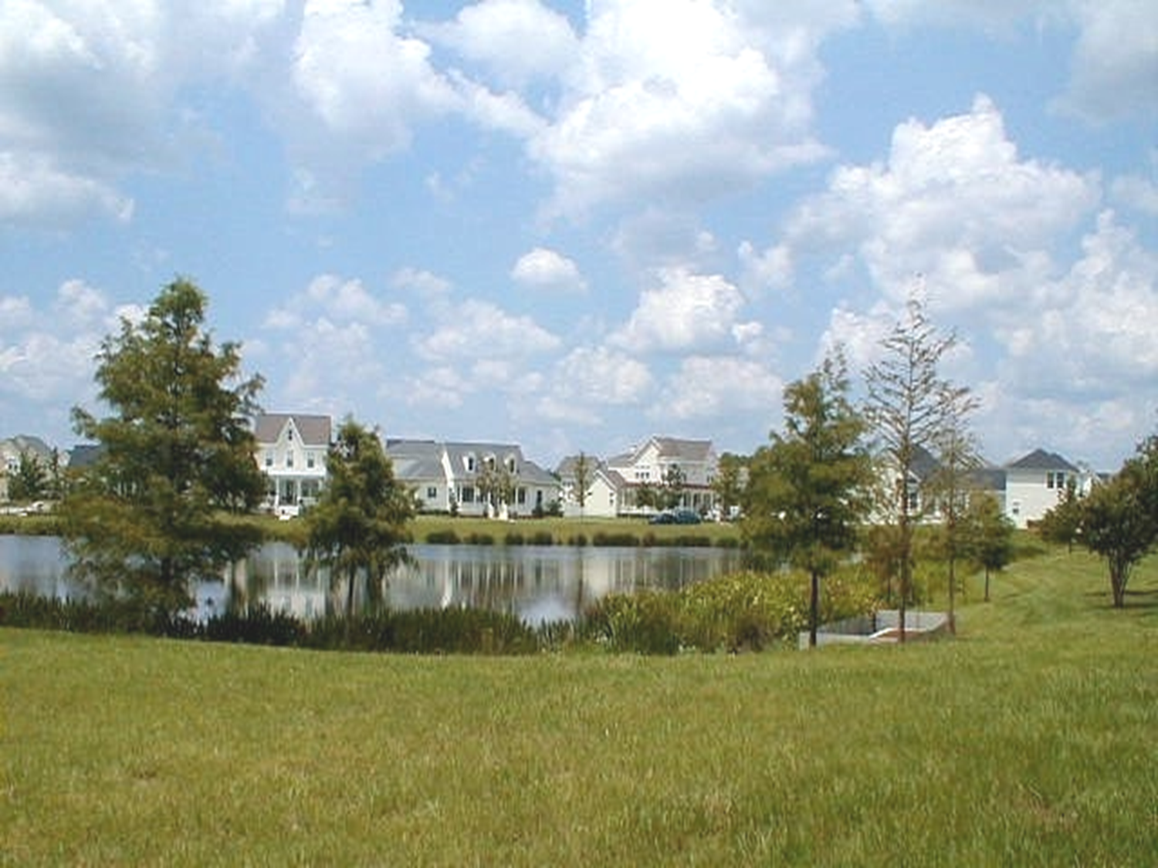
8.7 Detention Basins
Aquascaping with plants for aesthetic enhancement and water quality improvement
STORMWATER
Littoral plants bio-absorb nutrients (nitrogen, phosphorus), and other pollutants either from the water in basin or before the water reaches it

Slide 30
8.7 Detention Basins
Construction:
Subgrade preparation
Excavation, embankment, anti-seep collars
Inlets, outlets, control structures, filters
May require a littoral planting schedule

Slide 31
8.7 Detention Basins
Final inspection:
Basin location, dimensions, slopes, volume
Structures: location & type; backfill, compaction, stabilization
Vegetation per spec., good install, viable
Elevations: basin floor, structures, freeboard correct w/ respect to each other
Basin & structures free of sediments, debris
STORMWATER

Slide 32
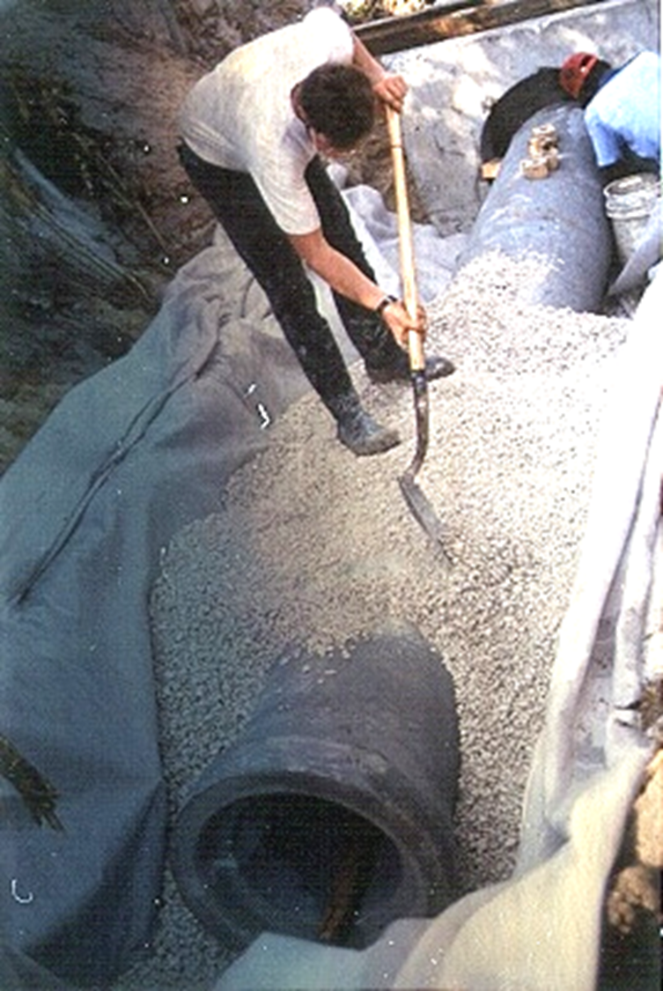
8.8 Underdrains & Stormwater Filter Systems
Definition: a system of conduits which collect and convey stormwater after it has infiltrated and been percolated through soil, suitable aggregate and/or filter fabric
Purpose: to allow infiltration and percolation in stormwater basins where permeability is restricted due to high water table or soil texture
STORMWATER
UNDERDRAIN

Slide 33
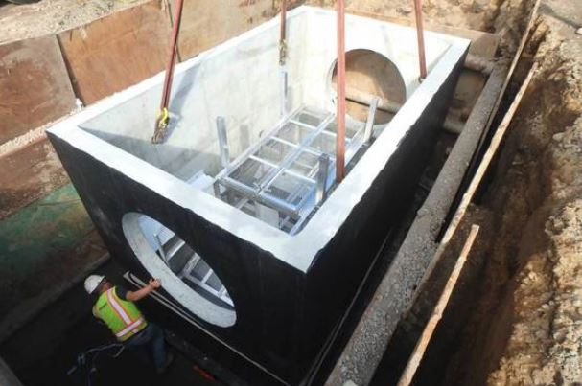
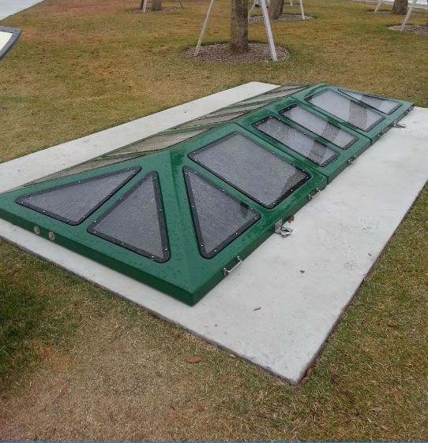
8.8 Underdrains & Stormwater Filter Systems
STORMWATER
Nutrient Removal Baffle Box
Baffle Box Vault Cover
At Kissimmee Lakefront Park

Slide 34
8.8 Underdrains & Stormwater Filter Systems
STORMWATER
Construction:
Subgrade preparation, excavation
Location, dimensions per plan; materials per specs.; fittings, connections per details
Backfill, compact, vegetate

Slide 35
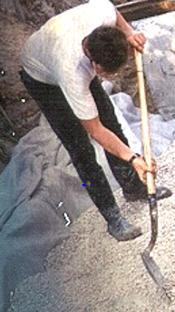
8.8 Underdrains & Stormwater Filter Systems
Final inspection:
Inspect during installation because there is little to see after completion, use shovel to verify materials & installation
Vegetation per specs., viable

Slide 36
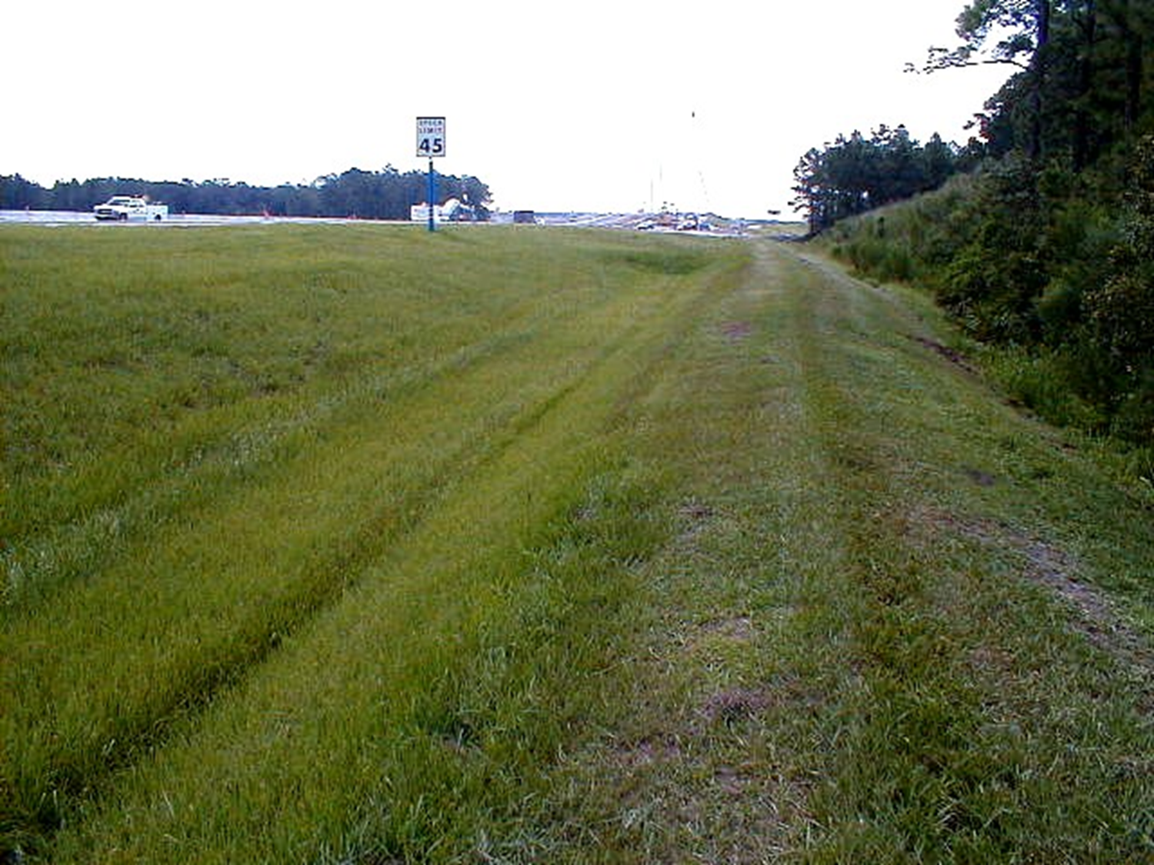
8.9 Swales
Definition: natural or constructed vegetated waterways designed for the treatment and disposal of runoff
Purpose: to allow removal of sediments and pollutants in flowing conditions and infiltration in standing conditions
Condition where practice applies: where space is available for natural, low cost, low maintenance stormwater conveyance & treatment
STORMWATER
Swale Block
GRASSED WATERWAYS AND SWALES

Slide 37
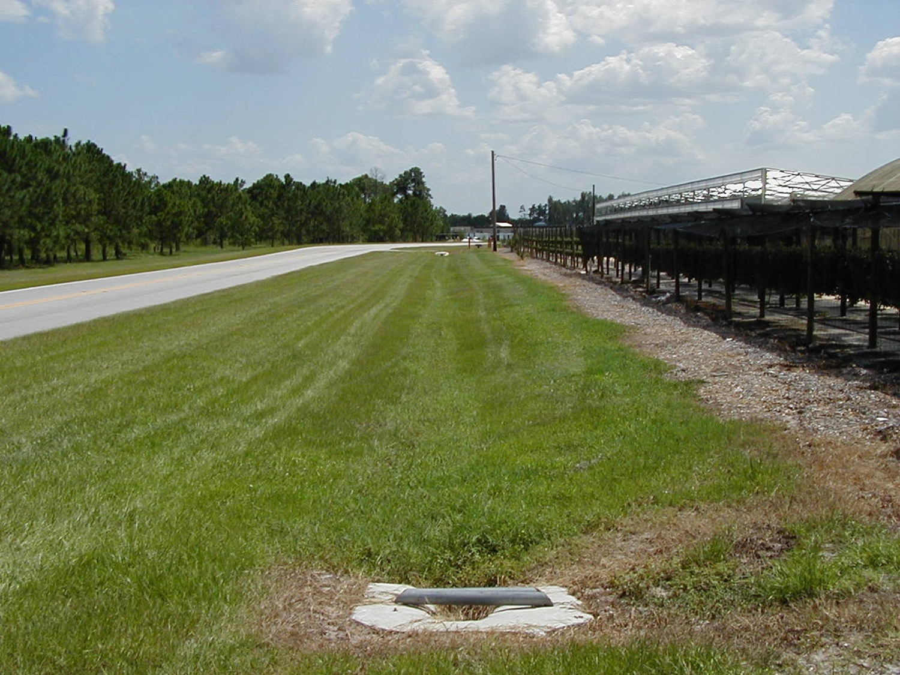
8.9 Swales
STORMWATER
Mitered End

Slide 38
8.9 Swales
Construction:
Excavate to proper grade & cross-section
Slope is 3:1 or less
Subgrade preparation
Vegetation
  Hydroseeding
  Bermuda grass sprigging
  Seed w/ straw & mulch
  Sod (establishes fastest)
Swale blocks used to slow energy
  Especially over long distance or steep grade
STORMWATER

Slide 39
8.9 Swales
Final inspection:
Correct location,
dimensions, cross-section
Swale blocks per plan & specifications
Vegetation viable & per specifications
STORMWATER

Slide 40
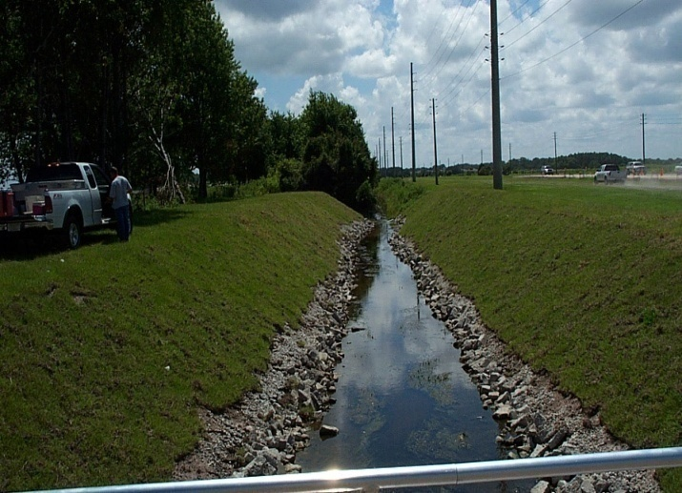
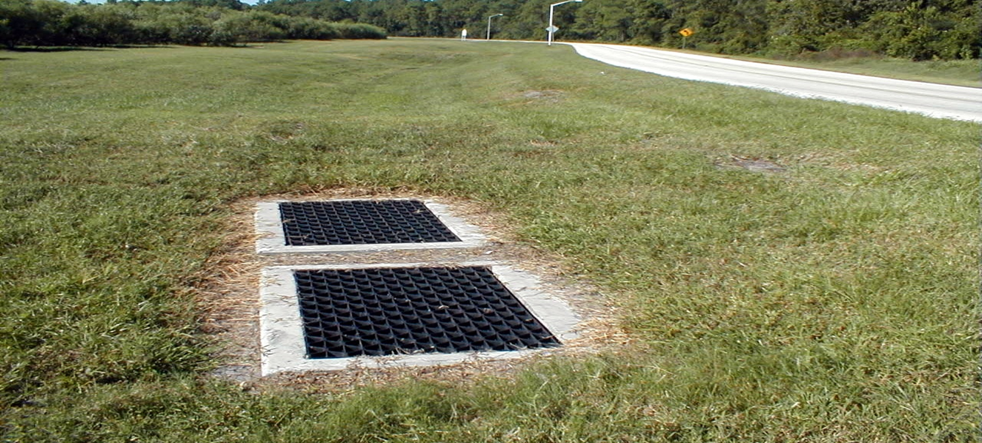
8.10 STORMWATER CONVEYANCE CHANNEL
Riprap armored channel
Definition: a permanent waterway designed to safely convey stormwater away from developed areas – steeper than swales
Purpose: to provide for the conveyance of stormwater without damage from erosion or flooding
Condition where practice applies: constructed channels (ditches) & modified natural channels with intermittent flows
Not designed for constant flows!!
STORMWATER
Vegetated channel w/ inlets leading to below ground system
(example of BMPs used in sequence - treatment train)

Slide 41
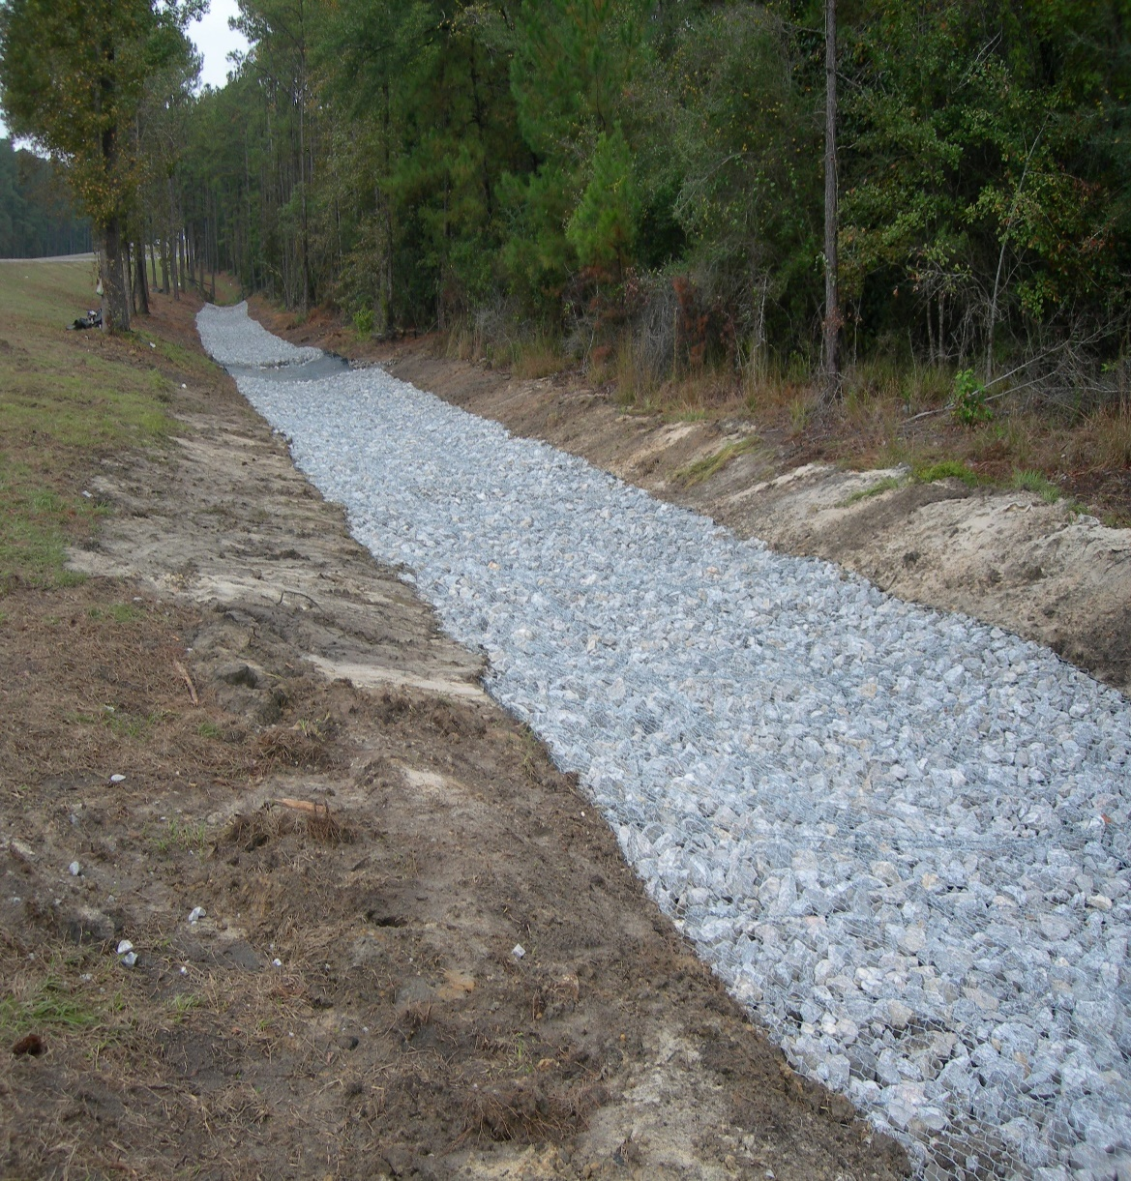
8.10 STORMWATER CONVEYANCE CHANNEL
Construction:
Excavate to proper grade & cross-section
Subgrade preparation
Vegetated: stapled sod or blanket & seed
Concrete: mix, rebar, joints, hydrostatic relief holes per specs.
Riprap: hand placed to avoid damage to geotextile underlay
Gabions: per manufacturer’s instructions
Gabion Mattress – I-10 Walton County, DeFuniak Springs, Florida
STORMWATER

Slide 42
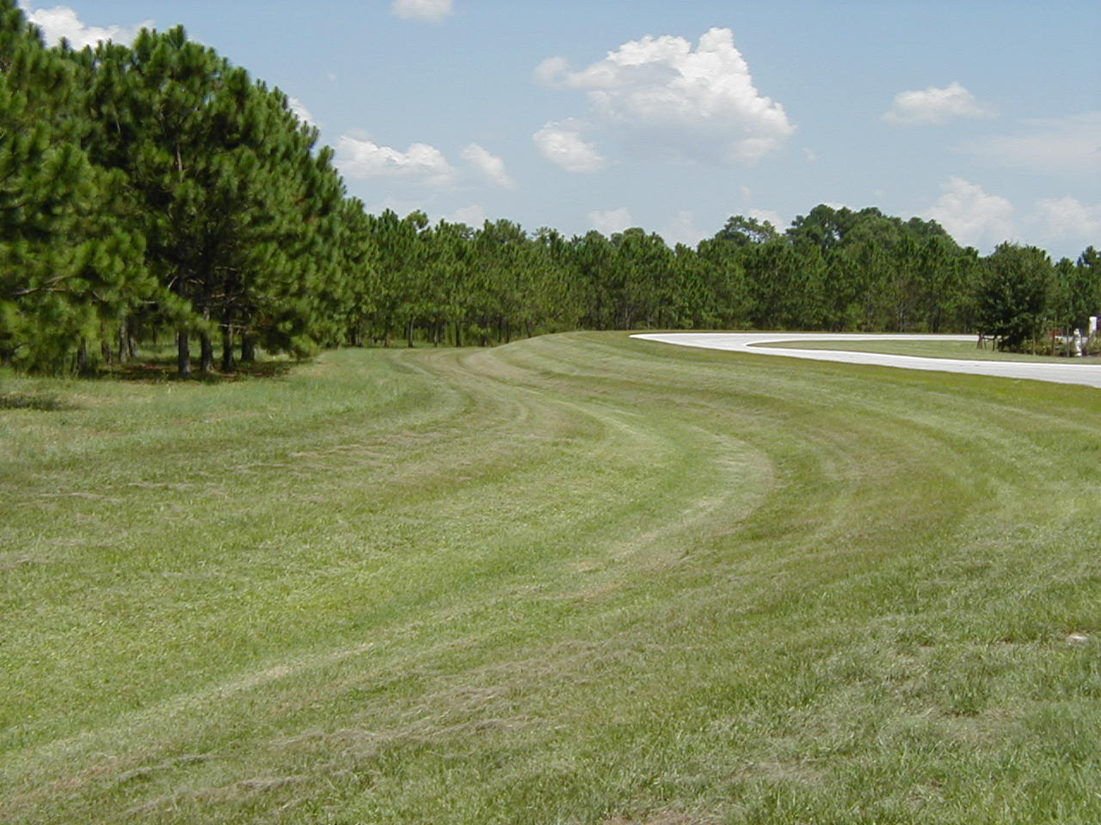

8.10 STORMWATER CONVEYANCE CHANNEL
GRASS CHANNEL
CONCRETE CHANNEL

Slide 43


8.10 STORMWATER CONVEYANCE CHANNEL
GABIONS
RENOMATS
STORMWATER

Slide 44


8.10 STORMWATER CONVEYANCE CHANNEL
CANAL

Slide 45


8.10 STORMWATER CONVEYANCE CHANNEL
Final inspection:
Correct location, dimensions, cross-section
No settling, piping, bypassing, overtopping, erosion or sedimentation
Adjacent vegetation viable & per specs.
STORMWATER

Slide 46

8.11 Paved Flume
Definition: a permanent concrete-lined channel constructed on a slope
Purpose: to conduct runoff safely down the face of a slope without causing erosion on or below the slope
Condition where practice applies: wherever concentrated runoff must be conveyed down a slope on a permanent basis
hydrostatic relief holes

Slide 47

8.11 Paved Flume
Construction:
Subgrade preparation
Excavate to proper grade and cross-section
Excavate for headwall, anchor lugs, curtain wall
Concrete, rebar, joints, hydrostatic relief holes per specs.
Compact and vegetate any backfill
Needs Rip-Rap Energy Dissipater installed at the end to stop erosion
STORMWATER
PAVED FLUME

Slide 48

8.11 Paved Flume
STORMWATER
Final inspection:
Correct location, dimensions, cross-section
No settling, piping, bypassing, overtopping, erosion or sedimentation
Adjacent vegetation viable & per specs.

Slide 49

8.12 Diversion
Definition: A channel constructed across a slope with a supporting ridge on the lower side
Purposes: To reduce slope length and to intercept and divert stormwater runoff to stabilized outlets at nonerosive velocities
Conditions Where Practice Applies:
Where runoff from higher areas may damage property
Where surface and/or shallow subsurface flow are damaging upland slopes
Where the slope length needs to be reduced to minimize soil loss
Diversions are applicable only below stabilized or protected areas
Diversions should not be placed on slopes > 15 %
STORMWATER

Slide 50

8.13 Check Dams
Definition: small dams constructed across a swale or drainage ditch
Purpose: to reduce the velocity and erosive force of concentrated flows in stormwater conveyance systems
Condition where practice applies: in constructed waterways to allow the use of vegetative lining by reducing velocity; and in natural channels which will receive increased flows due to development

Slide 51

8.13 Check Dams
Construction:
Subgrade preparation
Location & spacing per plan, materials per specs.
Key-in, backfill, compact, revegetate
Final inspection:
Correct location, spacing, materials
Center lower than ends, no end-around
No rolling stones, no rapid silting-in
CONCRETE CHECK DAM

Slide 52

8.14 Outlet Protection
Definition: structurally lined aprons or other acceptable energy dissipating devices placed at the ends of pipes or paved channels
Purpose: to prevent scour at stormwater outlets and to minimize the potential for erosion by reducing the velocity
Conditions where practice applies: applicable to the outlets of all pipes and paved channels where the velocity will exceed the permissible velocity of the receiving channel
STORMWATER
FABRIC FORM

Slide 53


8.15 Rip-Rap
Construction:
Subgrade preparation
Excavate to proper grade & cross-section
Geotextile per specs.; trenched & pinned per details
Granular filter material per specs.; placed uniform & compacted
Stone placement: hand-placed, uniform, compact; no damage to underlay
STORMWATER

Slide 54

8.15 Rip-Rap
Final inspection:
Correct location, dimensions, materials
Good placement - uniform density
No damage to underlay fabric
Toe of slope entrenched, not eroding
Design cross-sectional area not diminished by riprap liner

Slide 55

8.16 Grid Confinement Systems
Definition:
a high-density polyethylene (HDPE) grid of open cells which are filled with pervious material along slopes or stream banks allowing the establishment of vegetation
Purpose:
to prevent erosion by stabilization of the soil surface to reduce the volume and peak flow of runoff
to reduce the concentration and loading of pollutants
Condition where practice applies:
vegetated slopes, parking and low traffic areas, stream bank stabilization, gravity wall fills

Slide 56





8.16 Grid Confinement Systems
STORMWATER

Slide 57


8.16 Grid Confinement Systems
STORMWATER

Slide 58

8.16 Grid Confinement Systems
Green Infrastructure:
Decrease impervious area and need for stormwater ponds
STORMWATER

Slide 59



8.16 Grid Confinement Systems
Final inspection:
Location, dimensions, grading per plan
All materials per specs.
Grid well secured, edge conditions okay
Can be difficult to spot once vegetation becomes fully grown
Photo Credit: R.H. Moore & Associates

Slide 60


8.17 Cellular Concrete Block
Definition: Precast perforated concrete blocks that stabilize slopes or stream banks, but also allow vegetation.
Purpose: to prevent erosion by stabilization of the soil surface, to protect the banks of streams, lakes, estuaries, and excavated channels.
Condition where practice applies: areas in need of erosion protection, sloping areas, areas requiring stabilization due to traffic or maintenance activities, and low water interfaces

Slide 61




8.17 Cellular Concrete Block
STORMWATER
Ideal for low-water crossings

Slide 62


8.17 Cellular Concrete Block
Construction:
Subgrade preparation
Geotextile
Proper anchors, cables, connectors
Pervious backfill, vegetation
Final inspection:
Location, dimensions, grading per plan
All materials per specs.
Well secured, edge conditions OK

Slide 63

Chapter 8 Review
STORMWATER

Slide 64
Chapter 8 Review
When clearing a site and preparing for fill, tree and root debris should be (burned and buried under fill / removed from the fill area)
Pipes and structures can be damaged by heavy compactors and should be backfilled and compacted in small lifts with small compactors (T / F)
A ______________ is designed to retain stormwater on site and allow time for percolation into the ground.
retention basin

Slide 65
Chapter 8 Review
When constructing a retention basin with heavy equipment, special care must be taken to avoid excessive ____________ of surface soils, especially in the basin floor.
Retention basin storage volume must be recovered within ___ hrs.
The purpose of a _______________ is to temporarily store runoff and release it at a controlled rate.
All inlets, outlets, and other control structures should be inspected when?
Weekly and after each major storm event
By definition a swale should have side slopes no steeper than ___ horizontal to vertical.
compaction
72
detention basin
3:1

Slide 66
Chapter 8 Review
A swale is a good place to recycle yard debris since it's organic. (True / False).
A _____________________________ is a permanent, designed waterway; shaped and lined with appropriate material (erosion resistant): to safely conduct (convey) runoff away from a developing area.
The purpose of a paved flume is to safely conduct runoff down the face of a slope. (T / F)
The purpose of a diversion is to direct stormwater to a stabilized area. (T / F)
The maximum spacing between check dams should be such that the bottom(toe) of the upstream dam is at _____ elevation as the top of the downstream dam.
Sediments should be removed before they reach ________ of the original height of the dam.
stormwater conveyance channel
same
½ (50%)

Slide 67
Chapter 8 Review
outlet protection
A(n) ________________ device is designed to prevent scour at outlets and minimize erosion downstream by reducing the velocity of concentrated stormwater flows.
The three functions of riprap are:
protect soil surface from erosion
slow the velocity of flow
stabilize slopes
When placing ______ over geotextile great care must be taken to avoid damaging the geotextile while placing the stone.
riprap

