Slide 1
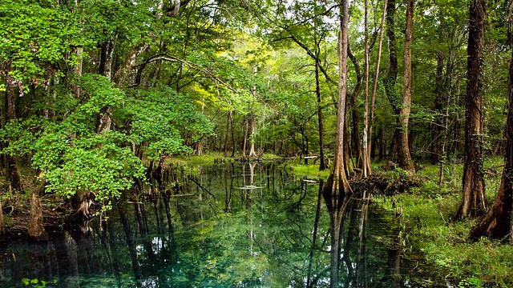

Watershed Information Network (WIN)
WIN Section
Watershed Services Program
Division of Environmental Assessment and Restoration
August 2022
This Photo by Unknown Author is licensed under CC BY-SA-NC

Slide 2
WHAT is WIN?
WIN, the Watershed Information Network, provides a modernized centralized environmental data management platform (excluding regulatory databases) as a successor to Florida STORET (STOrage and RETrieval).
WIN provides front-end quality assurance, data input, storage, and reporting of discrete surface water (and including sediment and fish tissue) and ground water data.
WIN provides a platform for data providers to submit their data and perform data quality checking interactively prior to allowing the data to be migrated into the published WIN environment.
WIN is used to store and manage data, and to report data to interested users and the U.S. Environmental Protection Agency (U.S. EPA).

Slide 3
WIN Data Uses
Through both the WIN and Florida STORET databases, the WIN section in the DEP Division of Environmental Assessment and Restoration (DEAR) Watershed Services Program implements Florida statutory requirements, DEP rule requirements and U.S. EPA funding requirements for management of environmental (non-regulatory) data for the state.
DEP DEAR uses of water quality data include but are not limited to:
Assessment of waters for purposes of the Impaired Waters Rule (IWR)
Development of:
  Water Quality Criteria
  Total Maximum Daily Loads (TMDL)
  Basin Management Action Plans (BMAP)
Providing data as required to U.S. EPA and to the public
    There are currently over 6.2 million results in WIN

Slide 4
Types of Data Providers
DEAR Programs and Regional Operations Centers
Other DEP entities such as:
    Office of Resilience and Coastal Protection Aquatic Preserves and National Estuarine Research Reserves
    Coral Reef Conservation Program
    Florida Keys National Marine Sanctuary
Water Management Districts
Cities
Counties
State entities such as:
    Florida Department of Health
    Florida Fish and Wildlife Conservation Commission
Universities
Private entities
Volunteer organizations
There are currently 89 Data Providers actively providing Activity and Result data to WIN

Slide 5
WIN Data Quality
All Monitoring Locations must be visually verified using an interactive map
After data are loaded into staging tables, data are checked using a robust rule engine containing over 200 quality checks, such as:
  Data element combinations are valid (e.g., Analyte/Analysis Method combination must be valid)
  Meets Holding Time Requirements
  Florida DEP Qualifiers per Chapter 62-160, F.A.C. are properly used
Corrections can be made interactively, or a corrected file can be reloaded
All data must pass WIN Minimum Data Quality Standards (MDQS) before they can be migrated from staging to published tables
Full list of WIN MDQS can be found at:
  http://publicfiles.dep.state.fl.us/DEAR/WIN/MDQS/

Slide 6
STORET
Florida STORET was closed to data loading in 2018
Data in Florida STORET will remain there:
  Not migrated to WIN because they don’t meet WIN MDQS
STORET Public Access (SPA) will be available for data retrievals for years to come

Slide 7
Reporting and Extraction
WIN Data Retrieval:
  http://prodenv.dep.state.fl.us/DearWin/public/winBasicPublicReports?calledBy=menu
STORET Data Retrieval:
  http://prodenv.dep.state.fl.us/DearSpa/public/welcome

Slide 8
Contacts
Denise Miller
Program Administrator
Watershed Services Program (WSP)
DEAR
850-245-8516
denise.miller@floridadep.gov
Julie Zimmerman
Environmental Administrator
WIN Section
WSP, DEAR
850-245-8508
julie.m.zimmerman@floridadep.gov
WIN Coordinators

Slide 9
This Photo by Unknown Author is licensed under CC BY-SA-NC

