Slide 1
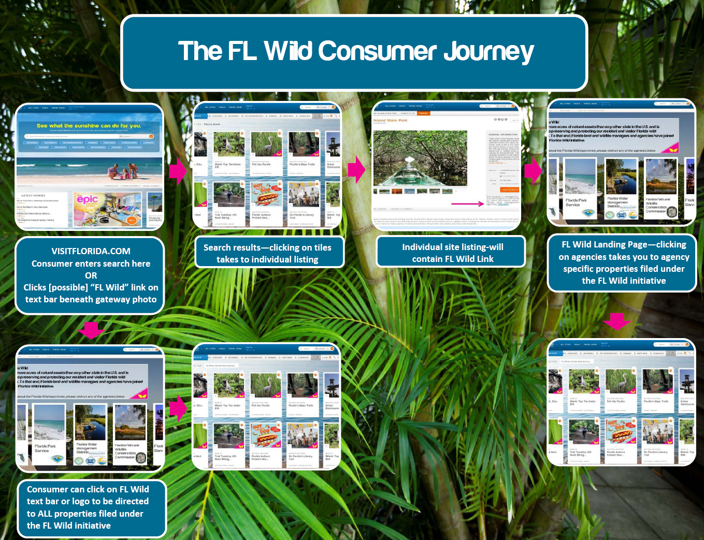

Slide 2

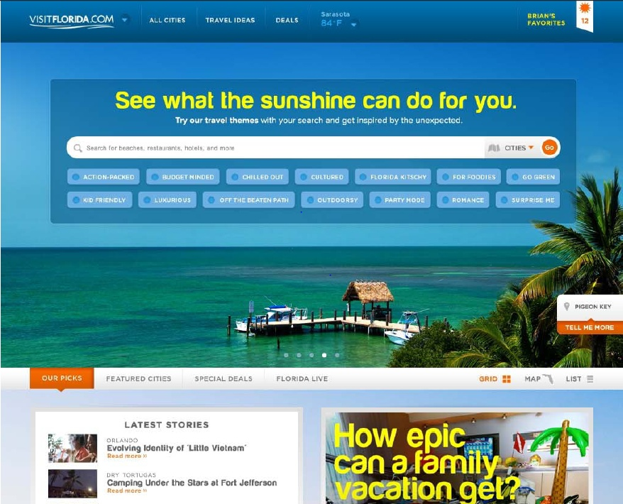
Visitor Journey Cycle
VisitFlorida.com
Consumer enters search for activity here
OR
Clicks “FloridaWild” link on text bar beneath gateway photo
FloridaWild
Notes:
Gateway page – look and feel of the new VISITFLORIDA.com

Slide 3
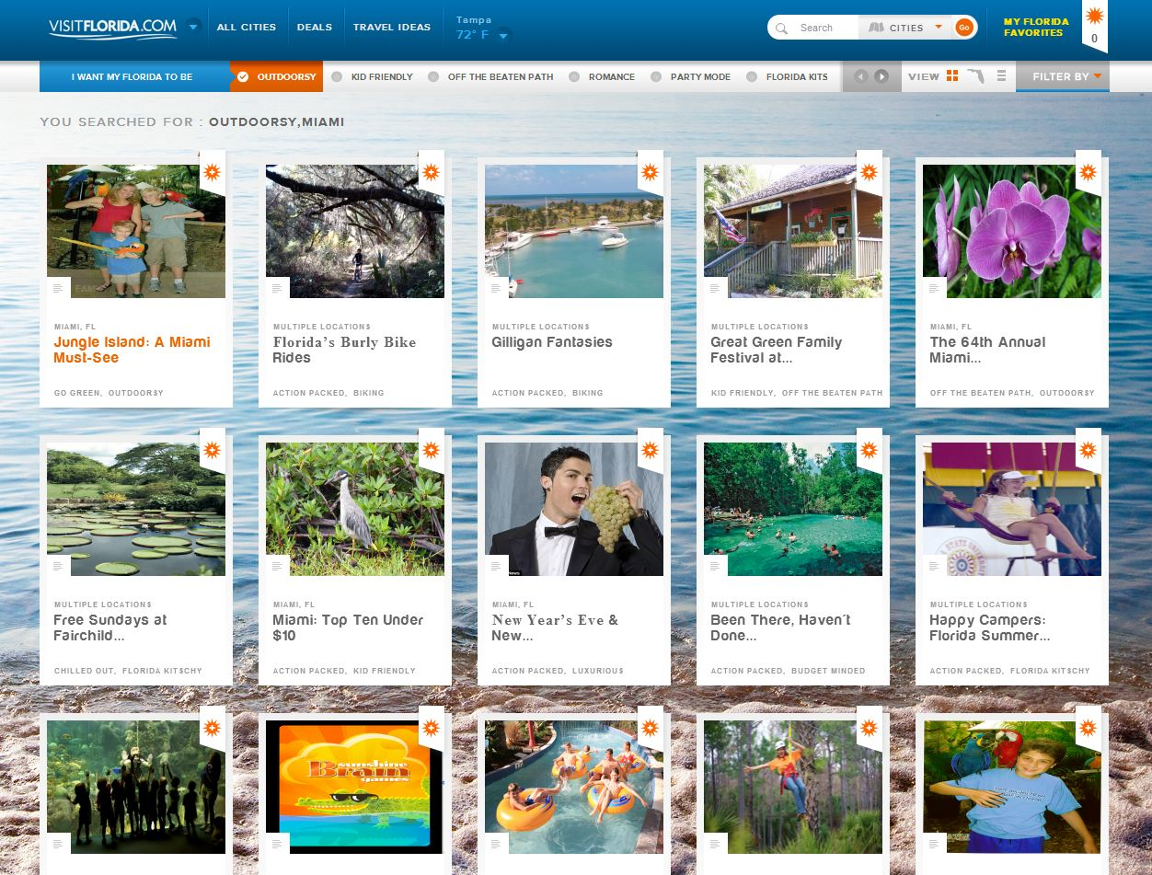

Search Results – clicking on tiles leads to an individual listing
OR
clicking on FloridaWild logo leads to FloridaWild landing page

Slide 4
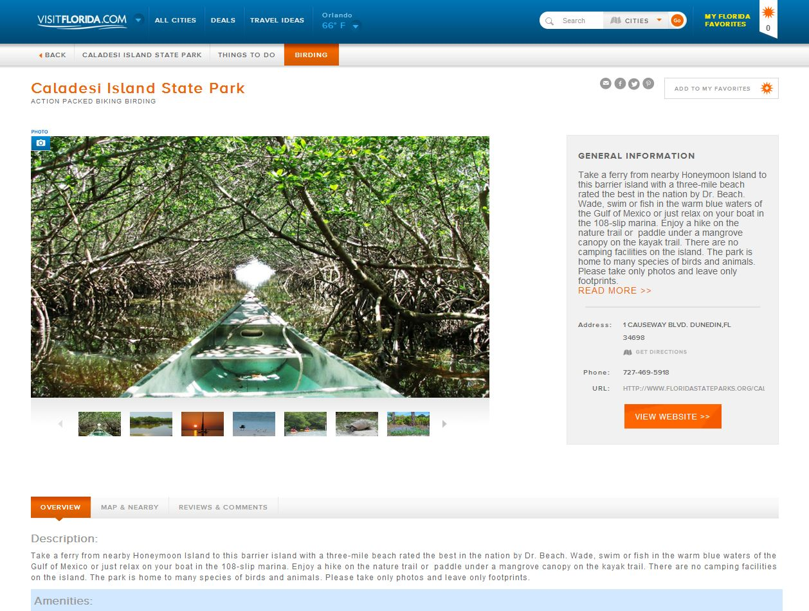
Individual site listing – will contain FloridaWild link
This location is managed by a state agency that participates in the Florida Wild initiative. For more information about this coalition of Florida land management and wildlife agencies, click here.

Slide 5
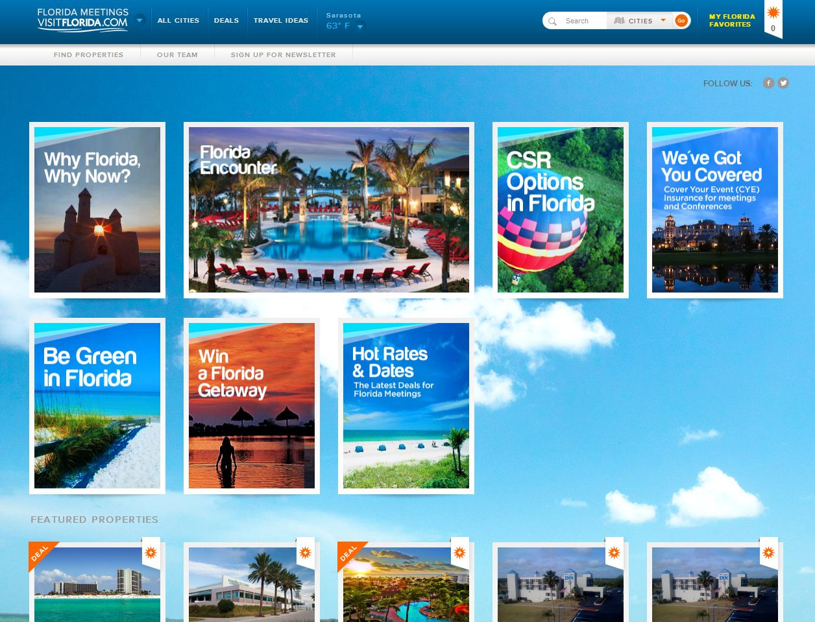

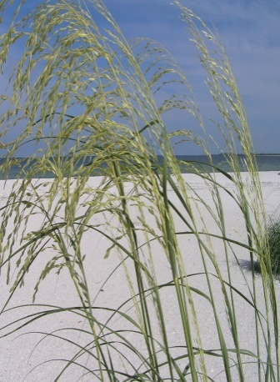
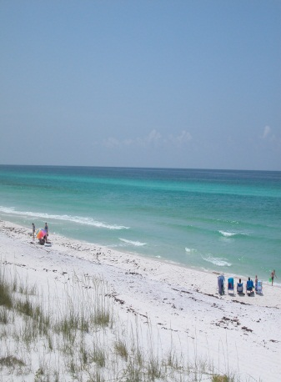
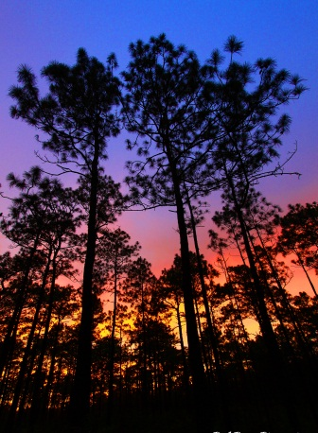
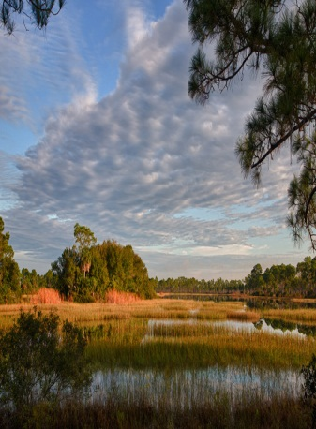
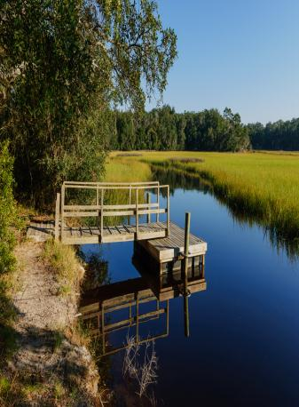









About Florida Wild
Florida is known for its sunshine, endless beaches and opportunities to play in the great outdoors. From fishing and boating to canoeing, hiking and hunting, Florida offers abundant natural areas to satisfy your need for family-friendly recreation. Florida’s land and wildlife managers have joined forces to help you discover FloridaWild.
To learn more about the Florida Wild experience, please click on any of the agencies below.
FloridaWild Landing Page – clicking on agencies takes you to agency specific properties which are part of the FloridaWild initiative
OR
Clicking the FloridaWild link leads to tiles for all properties affiliated with the FloridaWild initiative
Coastal and Aquatic Managed Areas
Florida Fish and Wildlife Conservation Commission
Florida Water Management Districts
Florida Park Service
Florida Forest Service
Notes:
This is a mock up for concept only. These tiles would be more likely to resemble the Epic horizontal tile. Inclusion of logos is a TBD for this level.

Slide 6
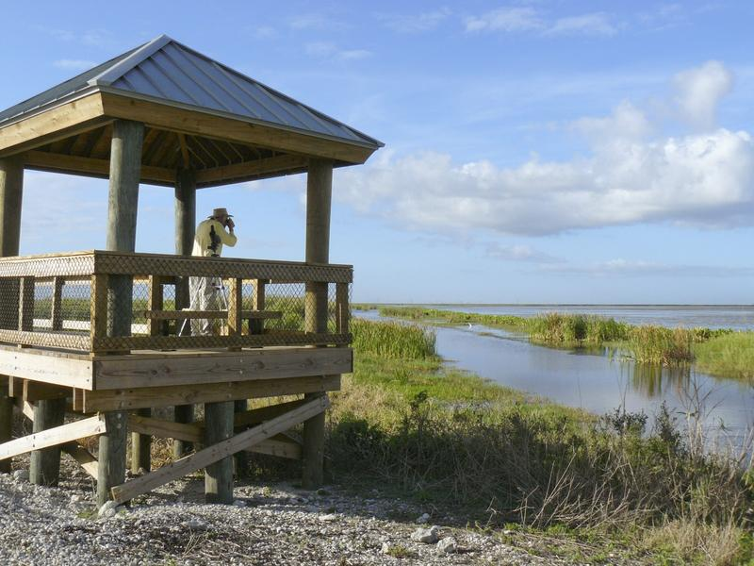
What’s next:
Naming rights
Logo development
VisitFlorida memberships
Individual site listing (tile) needs
Phase II

