Slide 1
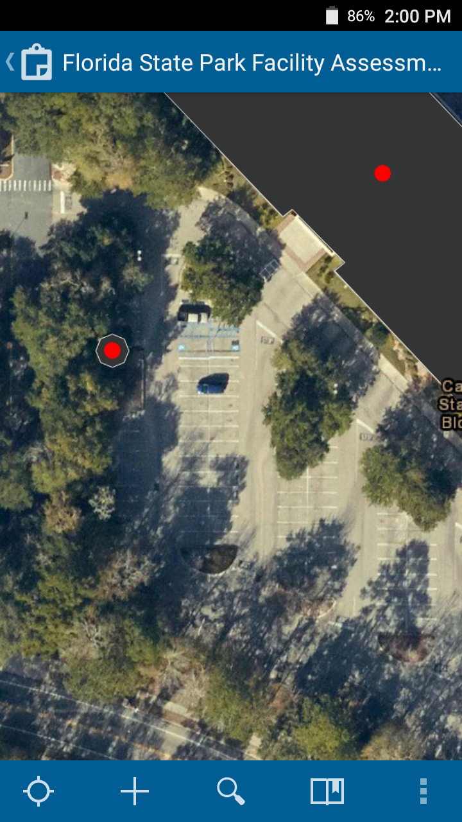
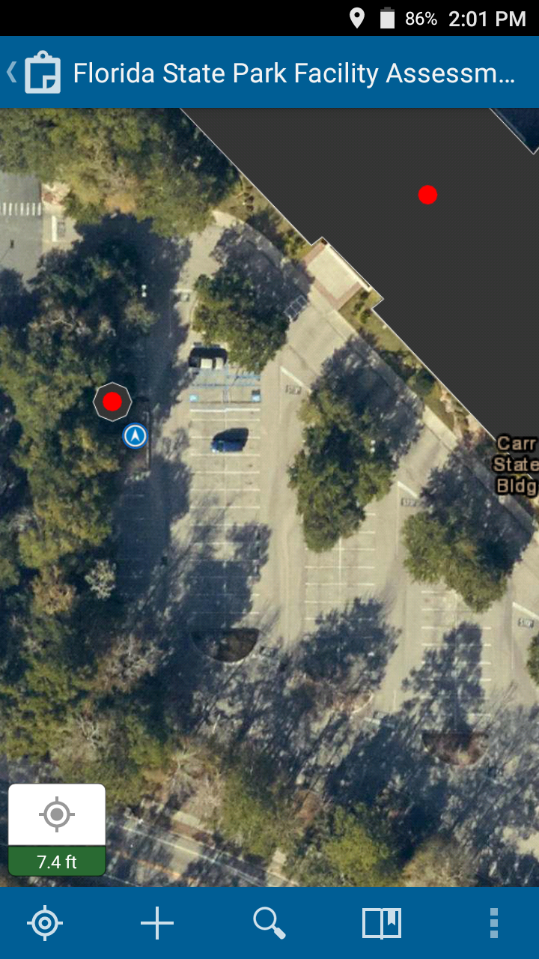
Finding your location
  If your location does not appear on the map, click the empty target button in the bottom-left
  This should focus on your location, shown in the map as a blue dot

Slide 2
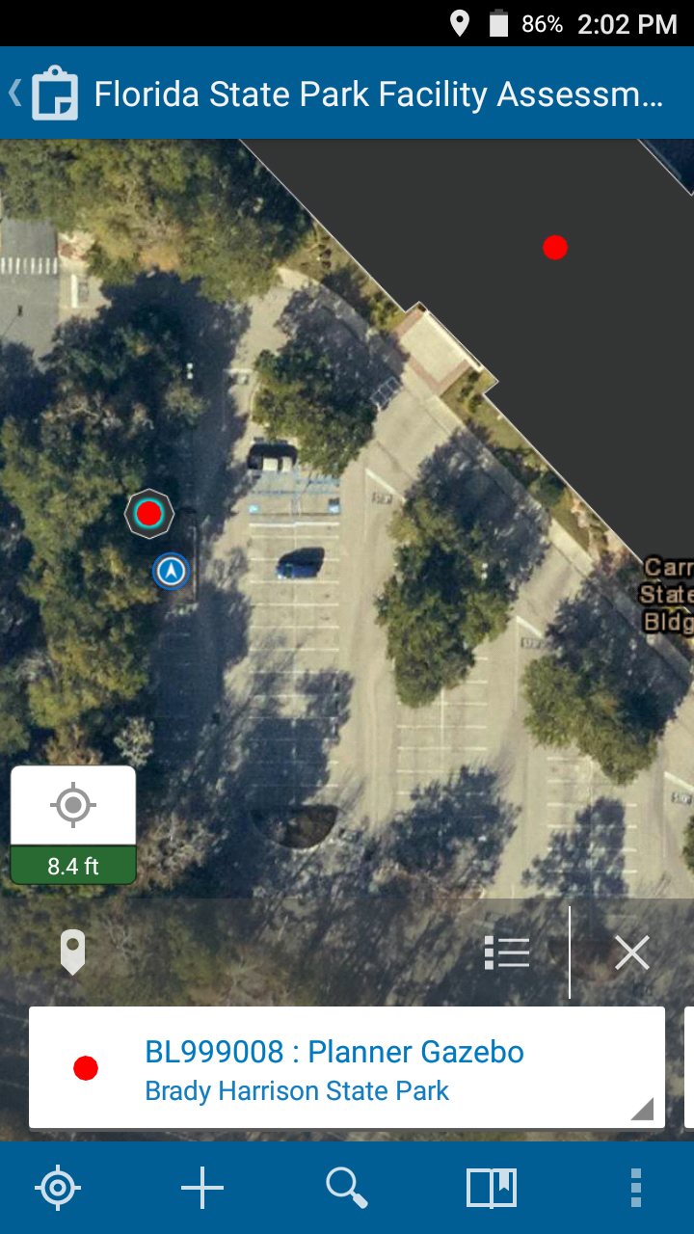
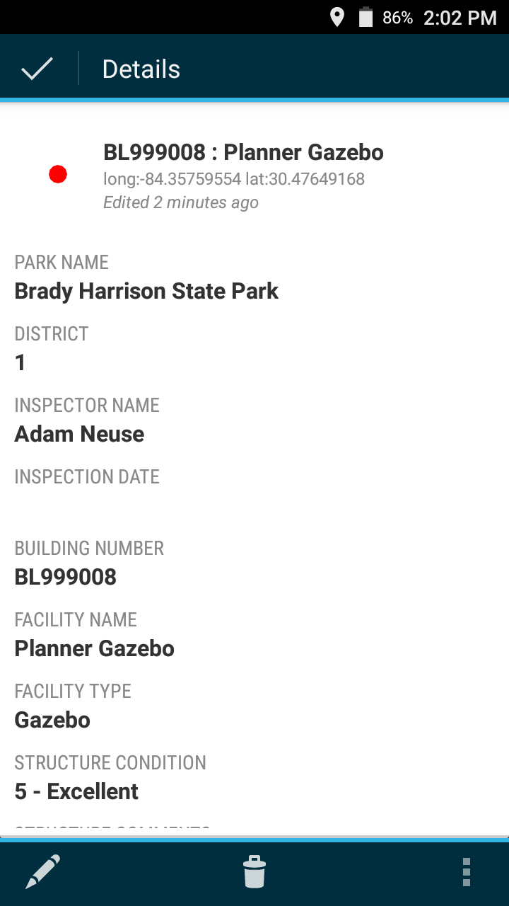
Viewing Data
  To view existing building data, select a point on the map then click the feature window at the bottom of the screen
  Scroll down to access more information about this building

Slide 3
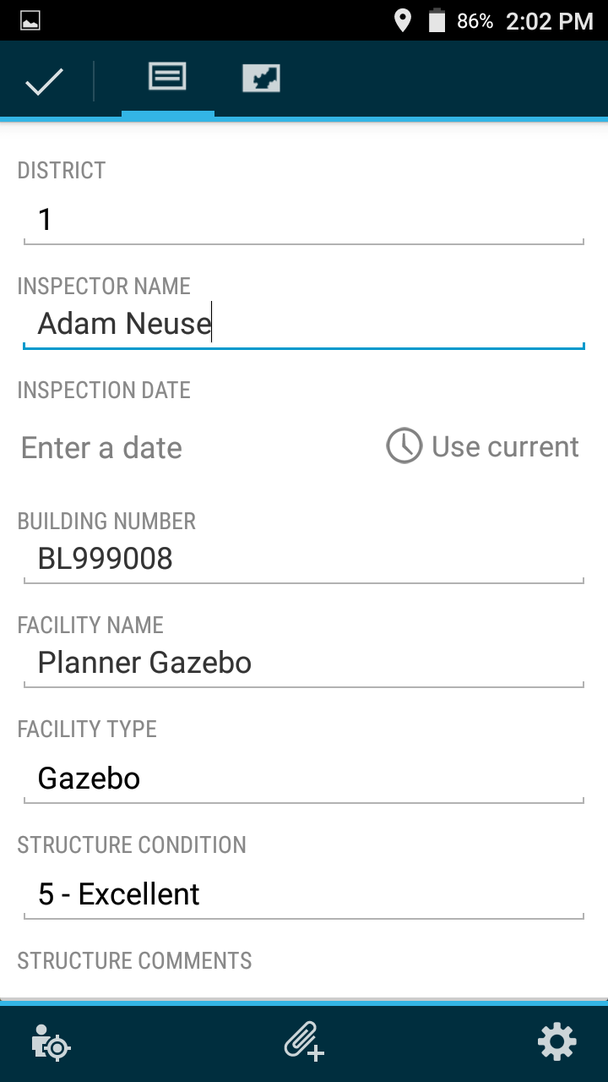
Editing Data
  To edit the building’s data click on the pencil icon in the bottom left
  Scroll down to access more questions about this building

Slide 4
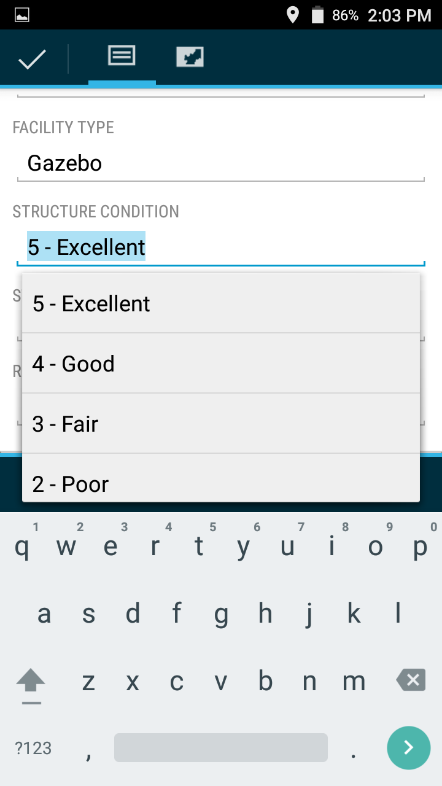
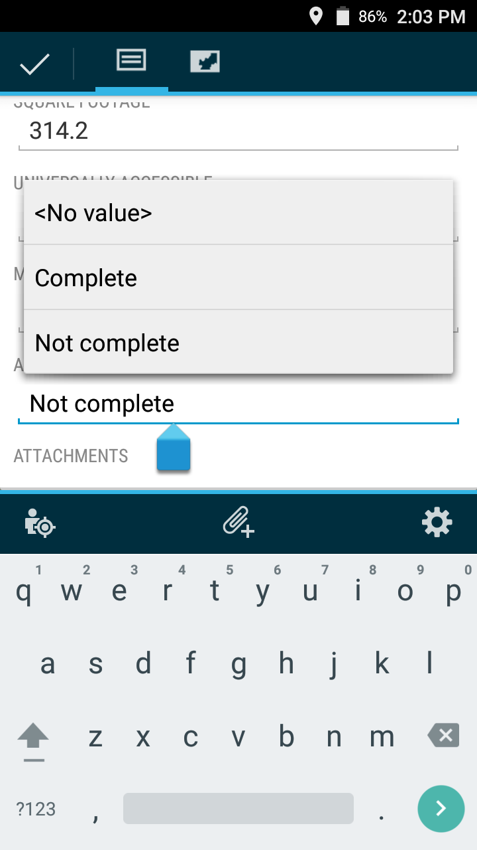
Editing Data
  Many questions have drop-downs that enable quick filling
  Many questions are required; you may receive an error if certain questions are not answered
  Please enter any additional information in the comments fields
  Comments are not required

Slide 5
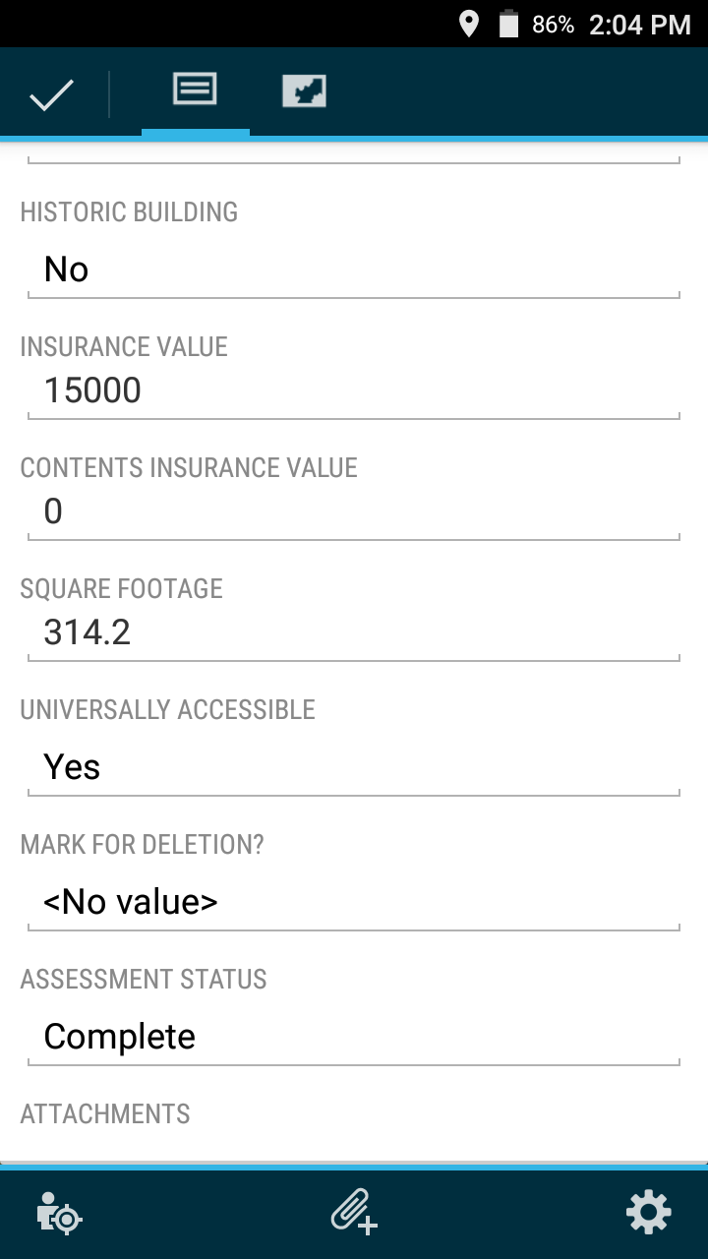
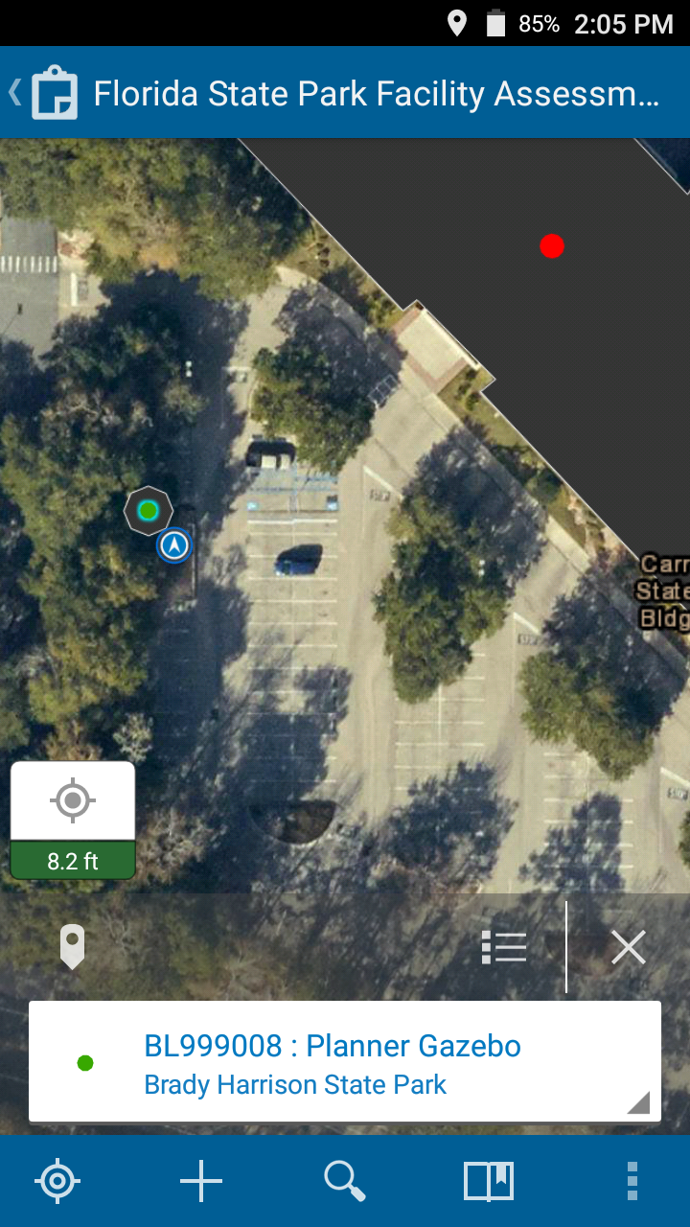
Finishing Edits
  When finished, select the check-mark in the top left
  If you changed “Assessment Status” to “Complete”, the building is now green
  This should help in tracking which buildings have already been completed!

Slide 6
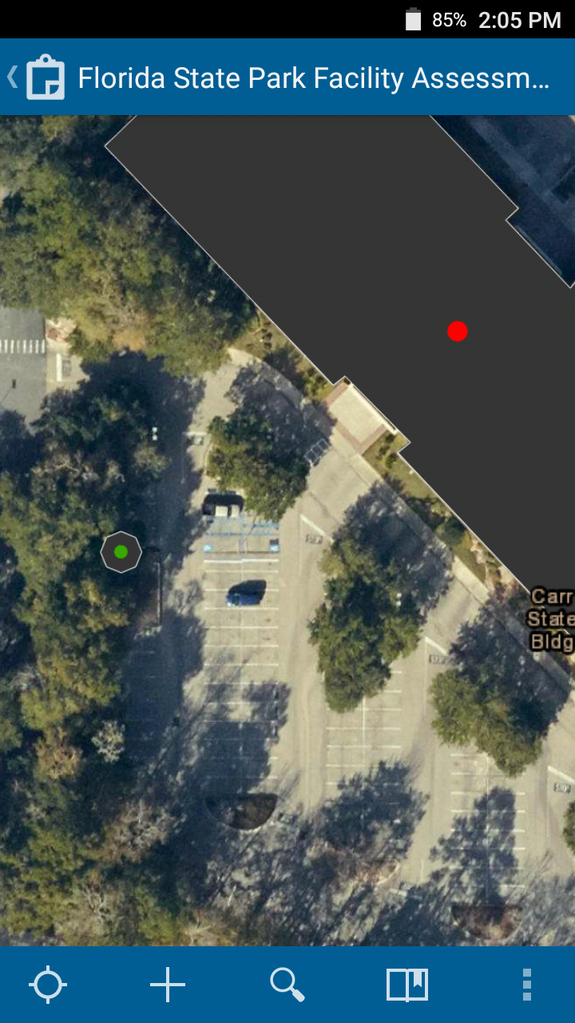
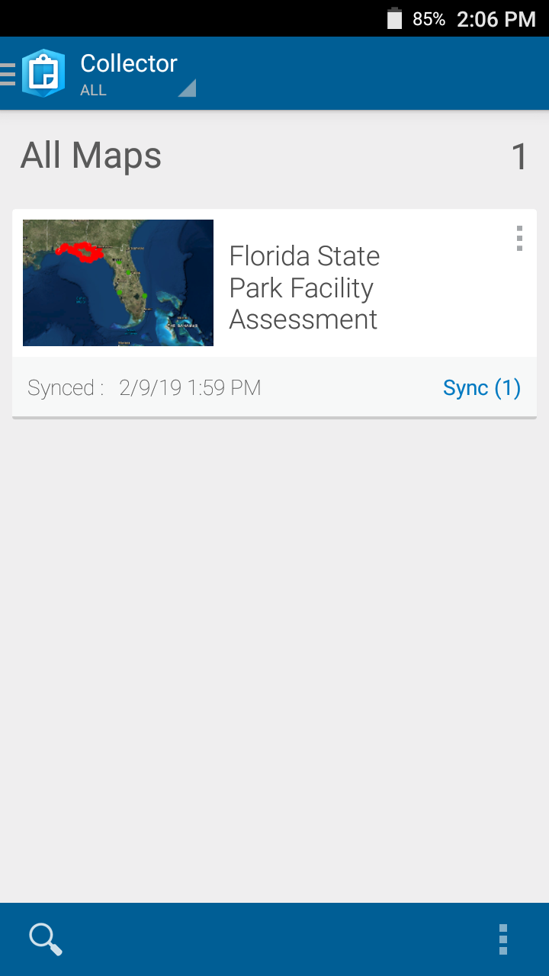
Uploading Data
Make sure your mobile device is connected to Wi-Fi
    A strong internet connection is sometimes necessary to upload successfully, especially with pictures
Click the back button at the top left of the map to return to the list of maps
The “Sync” button should now include a number representing the amount of changes you have made to the map
Click Sync (#) to upload your data

