Slide 1
Facility Assessment APP
Walkthrough using Collector for ArcGIS
Adam Neuse
02/09/2019

Slide 2
What is collector?
Map-based data collection app
  View, create, & edit shapes with attributes on a map using a mobile device
  Data can be exported to ArcMap, Google Earth, and/or Excel
Inherently Spatial
  All data must be associated with a shape (point, line, or polygon)
Cloud-hosted
  Collector maps are initially created in ArcGIS Online
  Data included in these maps are stored on an online database
  Synchronized data is updated on the web map automatically
  Wi-fi is required to work online or to download data for offline use

Slide 3
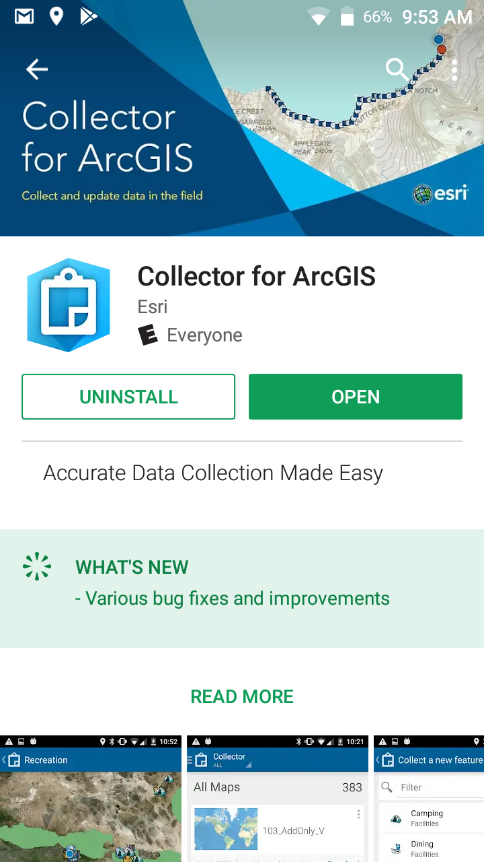
DOWNLOADING COLLECTOR
Search the app store for “Collector”
  If given a choice, choose “Collector Classic”
The app is free
If you do not already have the app, download and install to begin

Slide 4
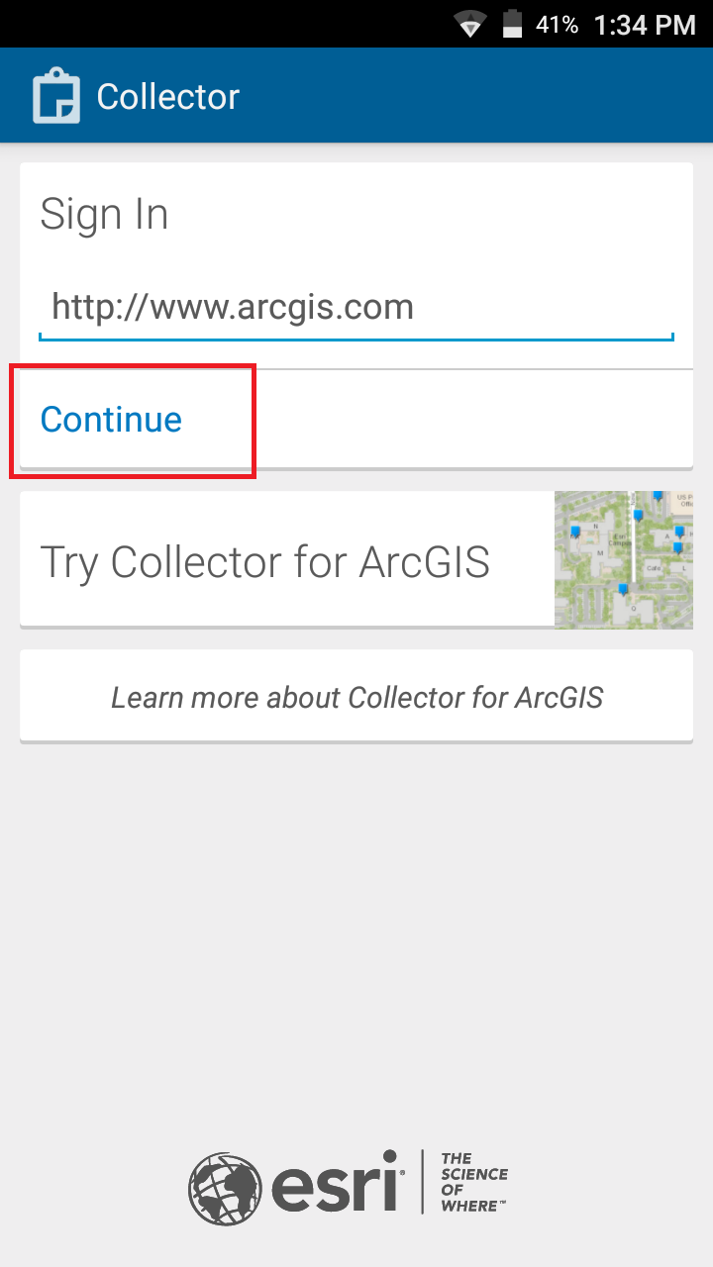
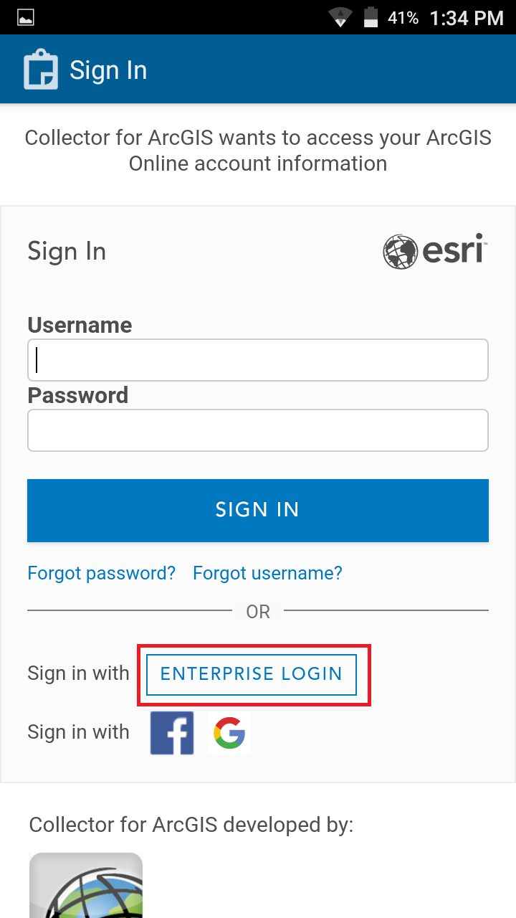
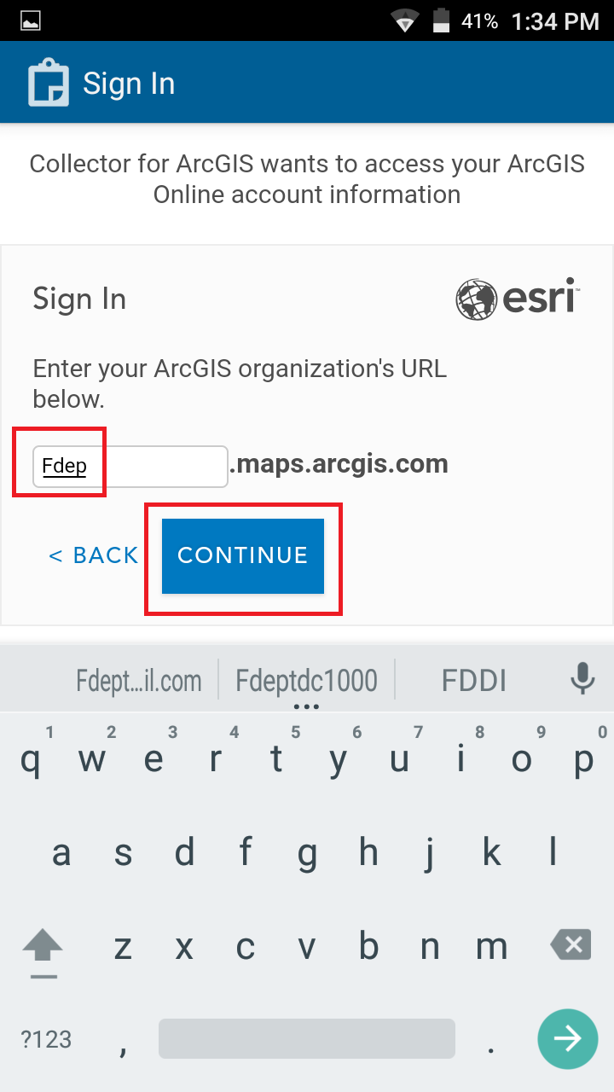
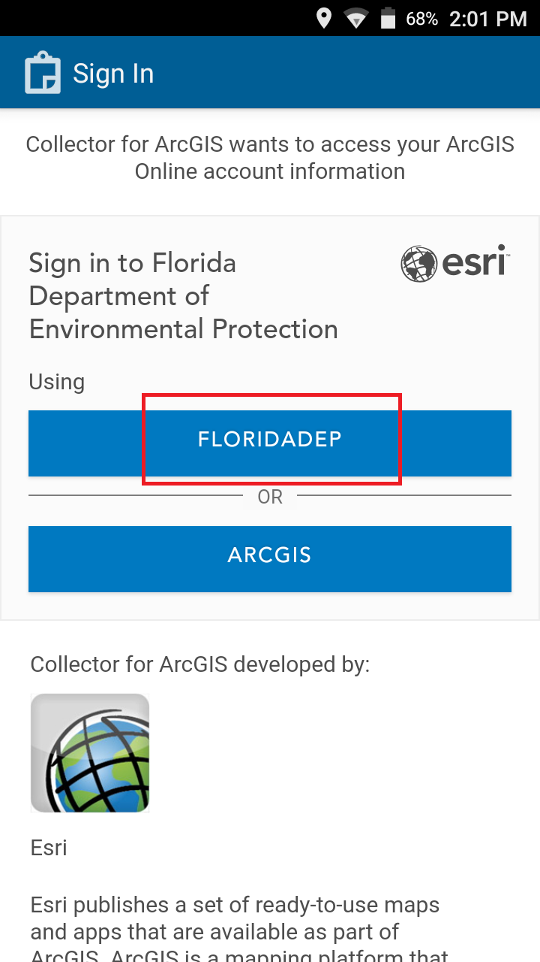
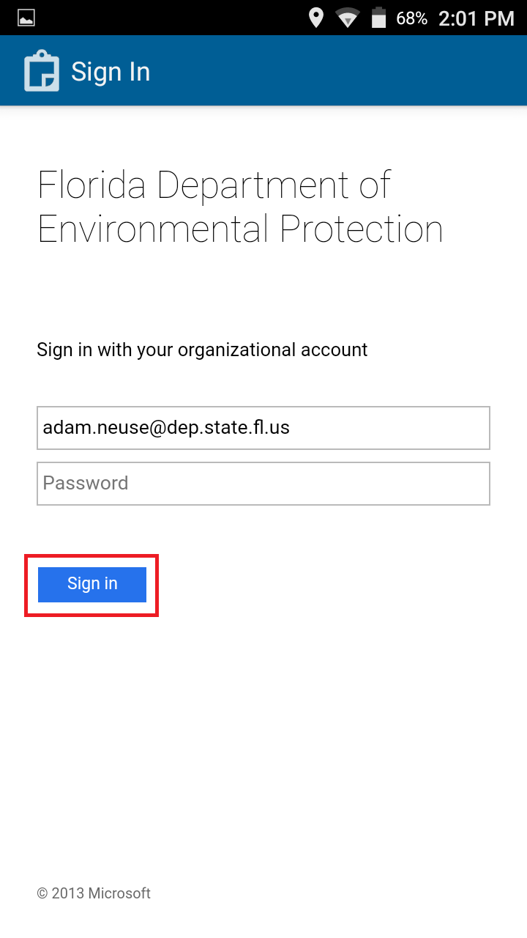
Sign in With Your ArcGIS Online Account
1
2
3
4
5
* This is currently the most common way to log into your FDEP account. Please * follow directions given to you by OTIS when you created your account.
If you need an account made, send an email letting us know

Slide 5
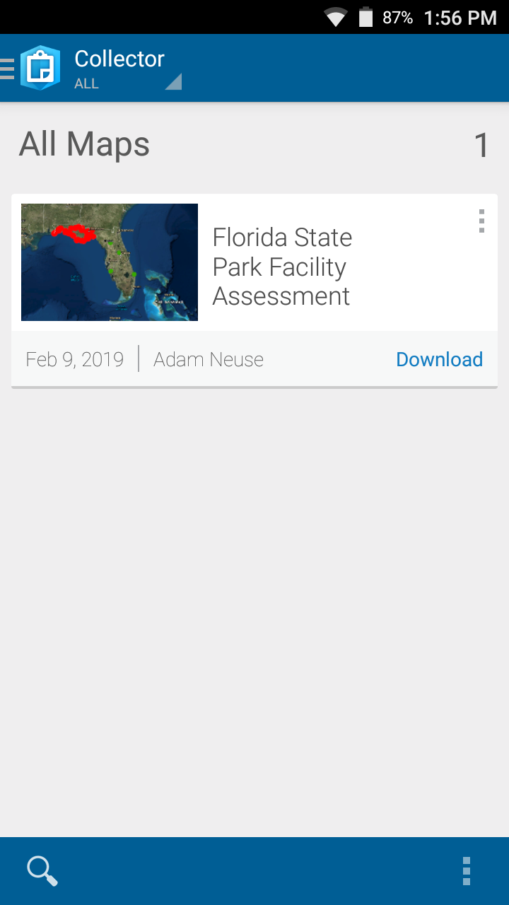
Downloading a Map for Offline Use
To start, scroll to the map you want to download
Click “Download”
If promoted to choose a basemap, click “Download a new basemap”

Slide 6
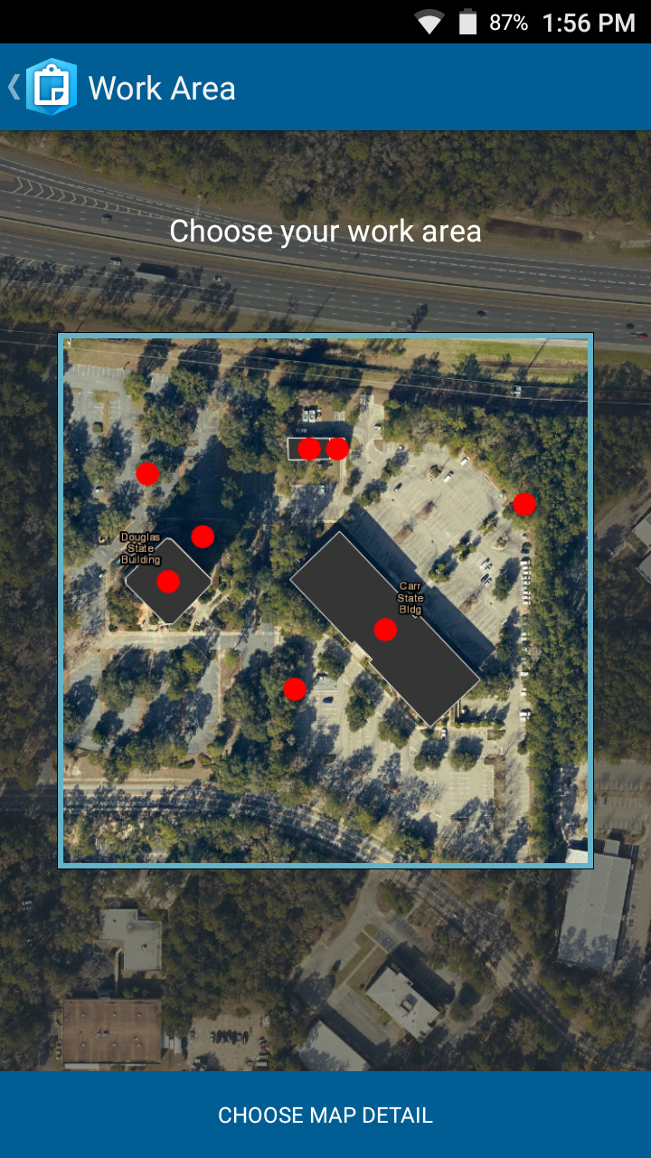
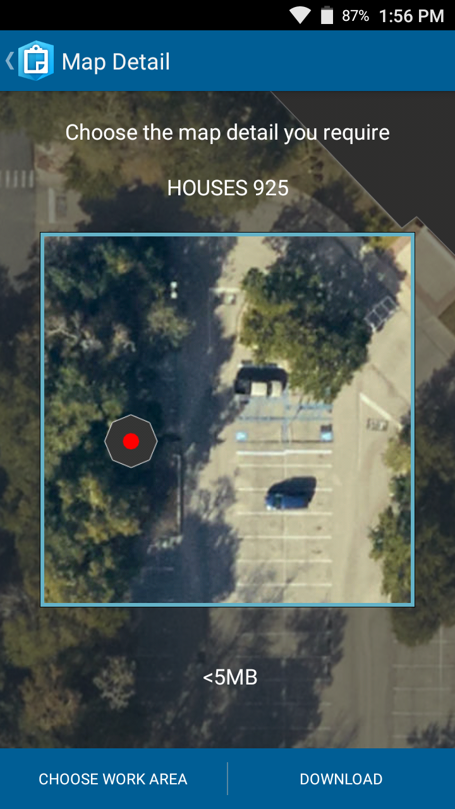
Downloading a Map for Offline Use
Select the download area
  Move the map to cover the area you want to download; think of this as the park boundaries
  When the boundary is set, click “Choose Map Detail” at the bottom of the screen
Select the basemap’s detail
  Higher detail lets you see more clearly when zoomed in
  Download file size increases significantly with more detail
  GPS accuracy stays the same regardless of size or quality
Click “Download” in the bottom-right

Slide 7
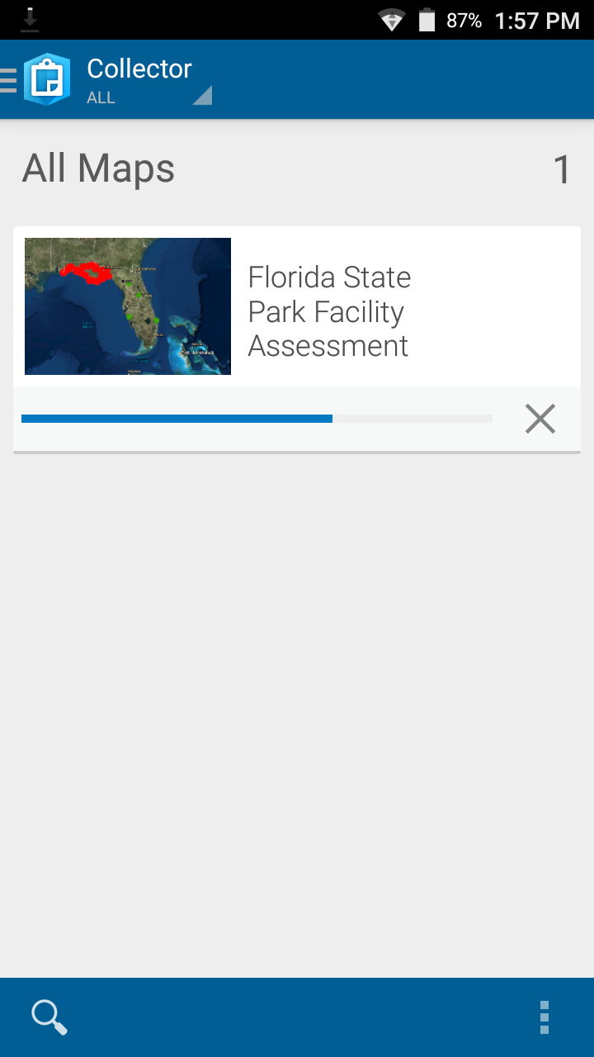

Downloading a Map for Offline Use
  The blue bar will show the progress of your download
  When the download is complete, you will be able to “Sync” your data
  At this point, you are able to work offline

Slide 8
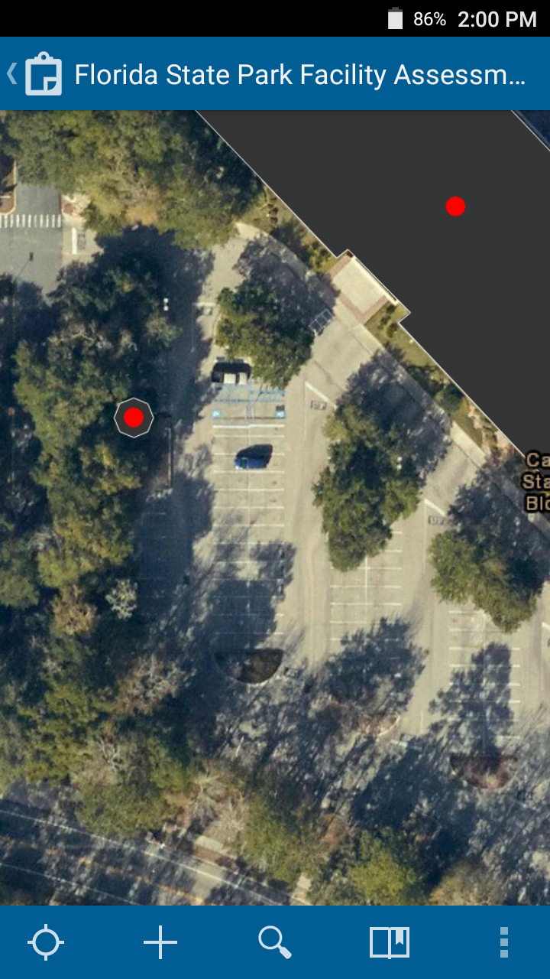
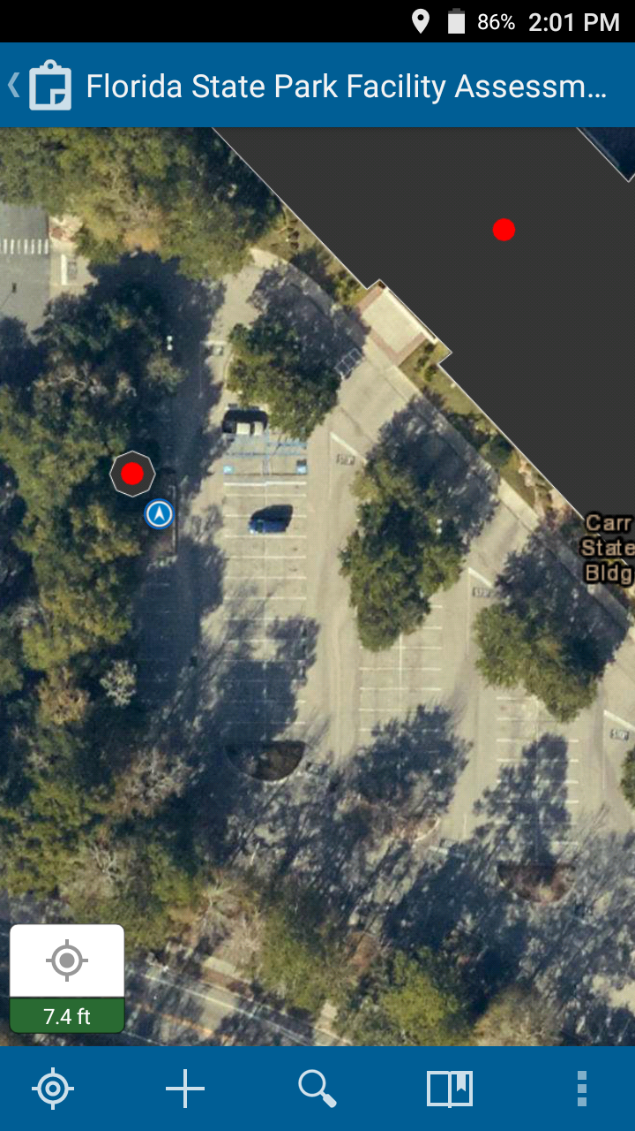
Finding your location
  If your location does not appear on the map, click the empty target button in the bottom-left
  This should focus on your location, shown in the map as a blue dot

Slide 9
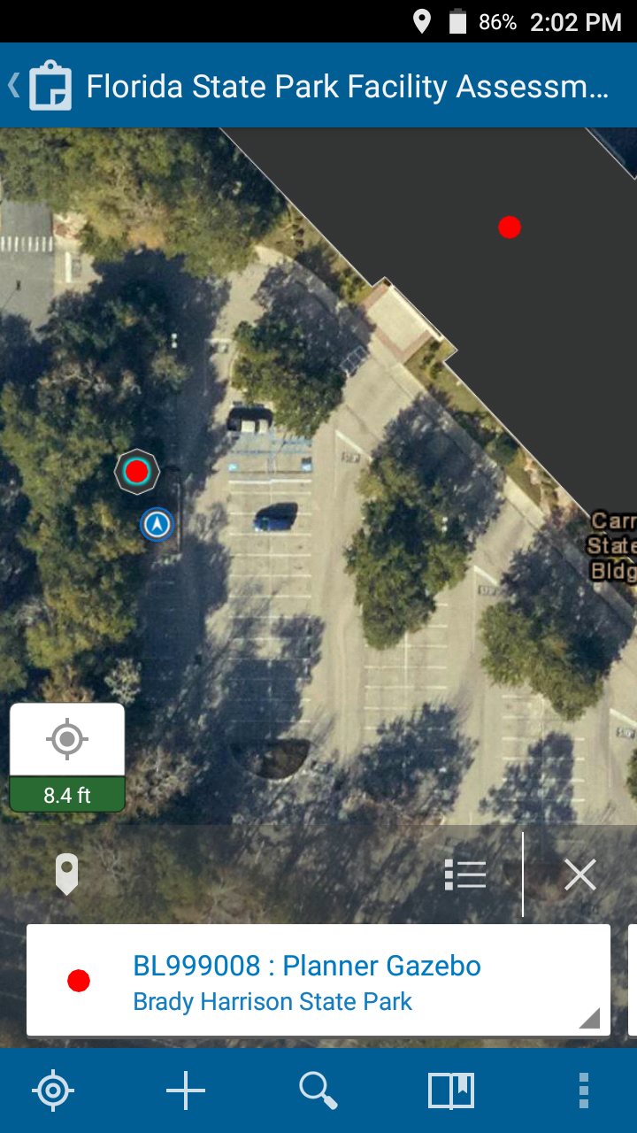
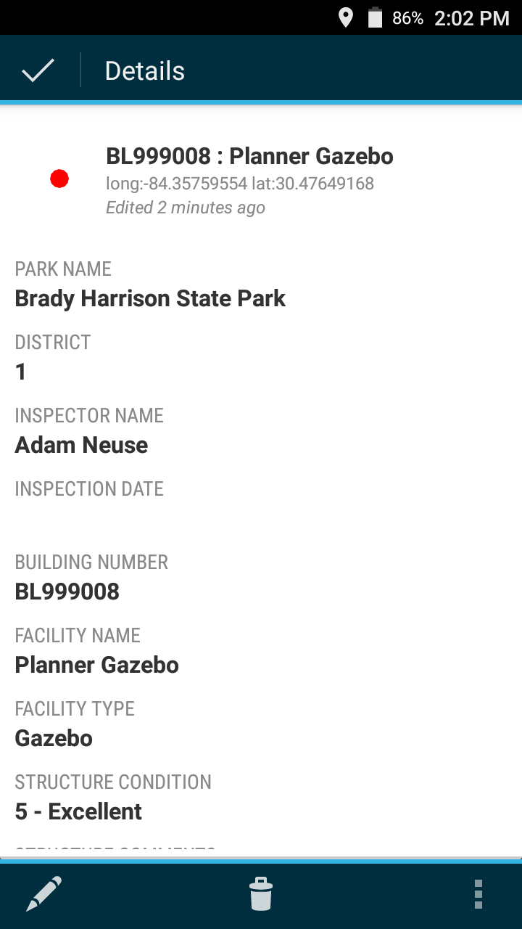
Viewing Data
  To view existing building data, select a point on the map then click the feature window at the bottom of the screen
  Scroll down to access more information about this building

Slide 10
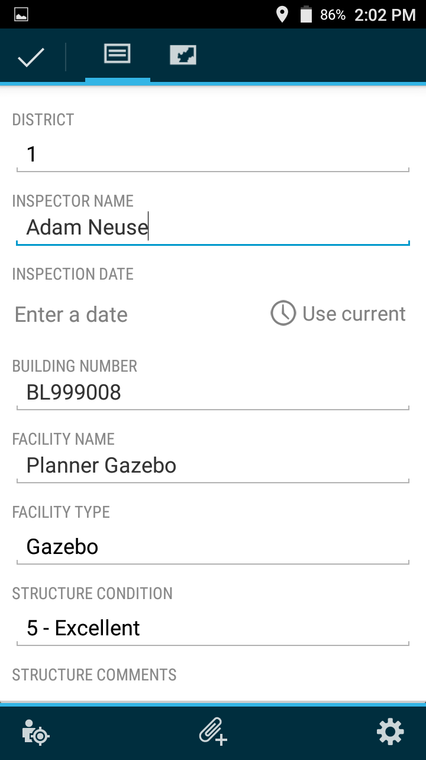
Editing Data
  To edit the building’s data click on the pencil icon in the bottom left
  Scroll down to access more questions about this building

Slide 11
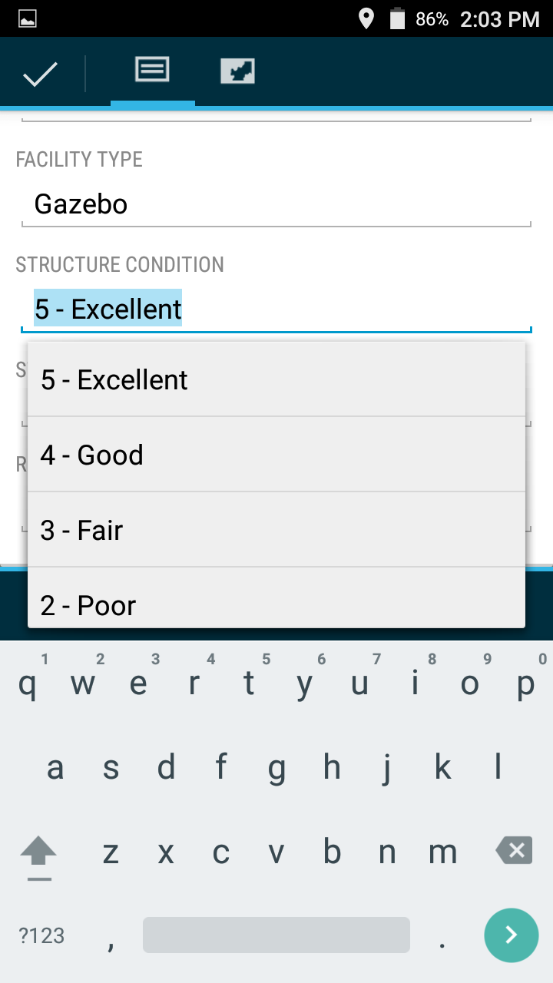
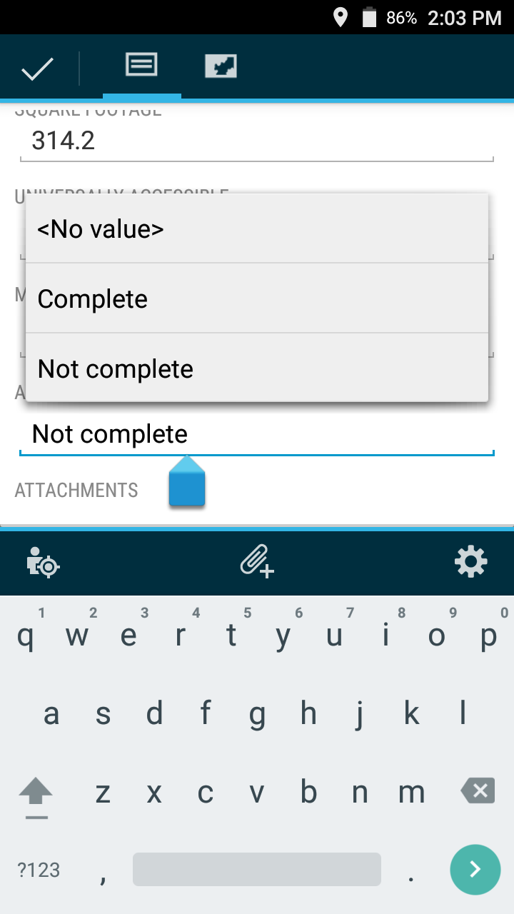
Editing Data
  Many questions have drop-downs that enable quick filling
  Many questions are required; you may receive an error if certain questions are not answered
  Please enter any additional information in the comments fields
  Comments are not required

Slide 12
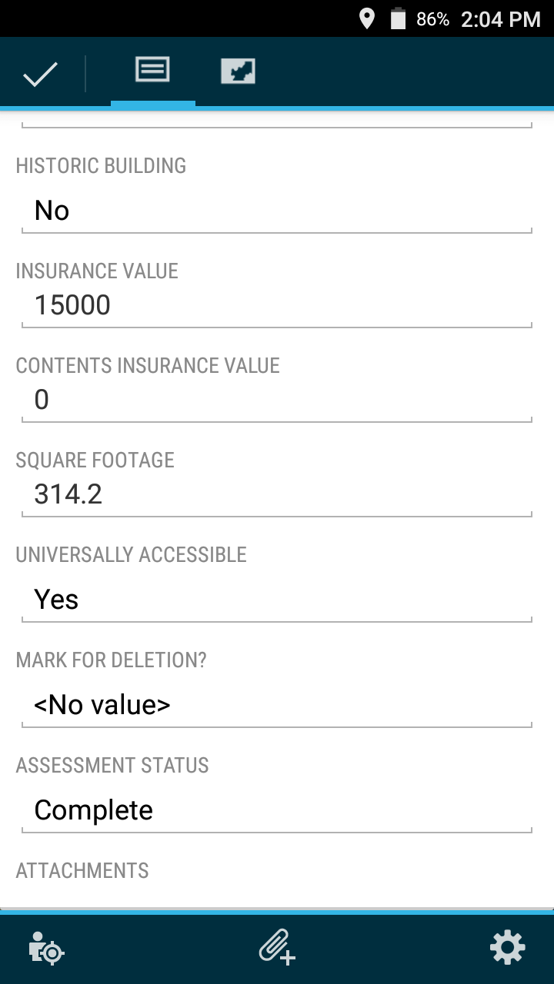
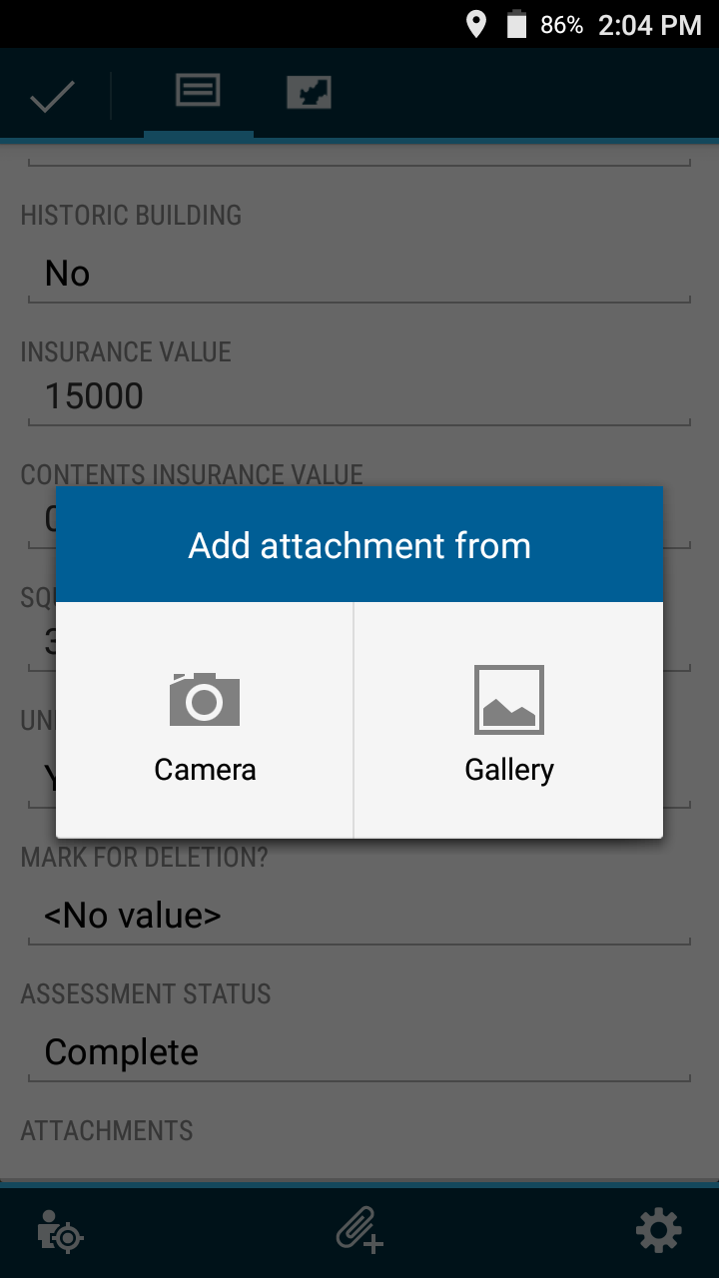
Editing Data
  To attach a photo of the structure, click the paper clip
  Select the camera to take a new picture or select a picture you have already taken

Slide 13
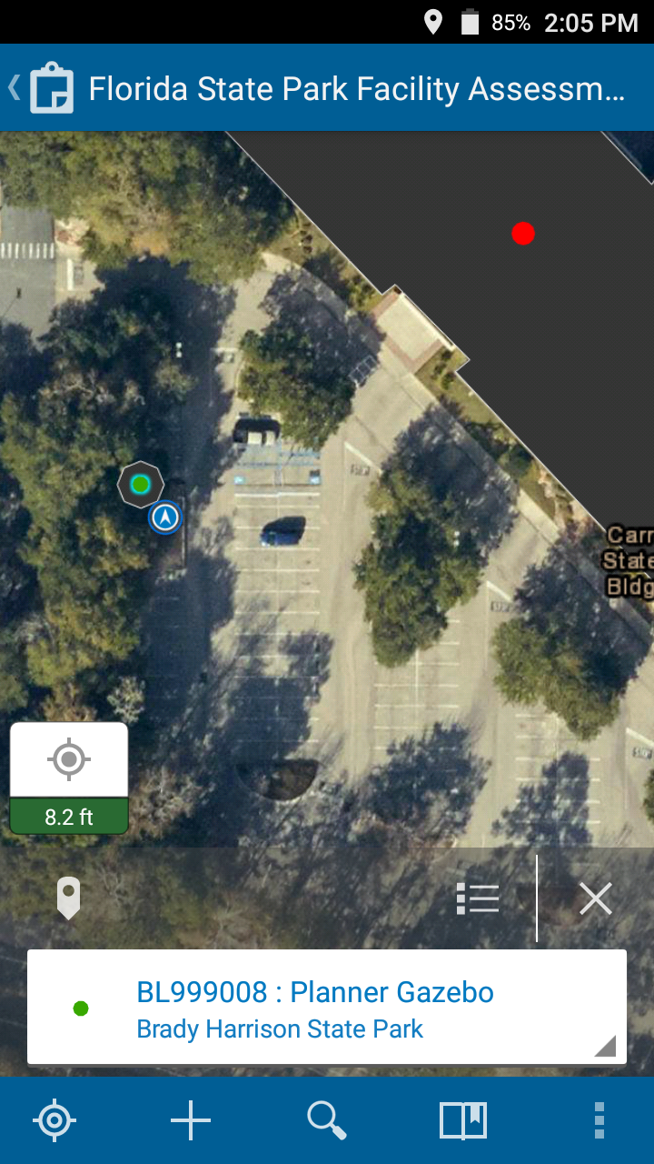
Finishing Edits
  When finished, select the check-mark in the top left
  If you changed “Assessment Status” to “Complete”, the building is now green
  This should help in tracking which buildings have already been completed!

Slide 14
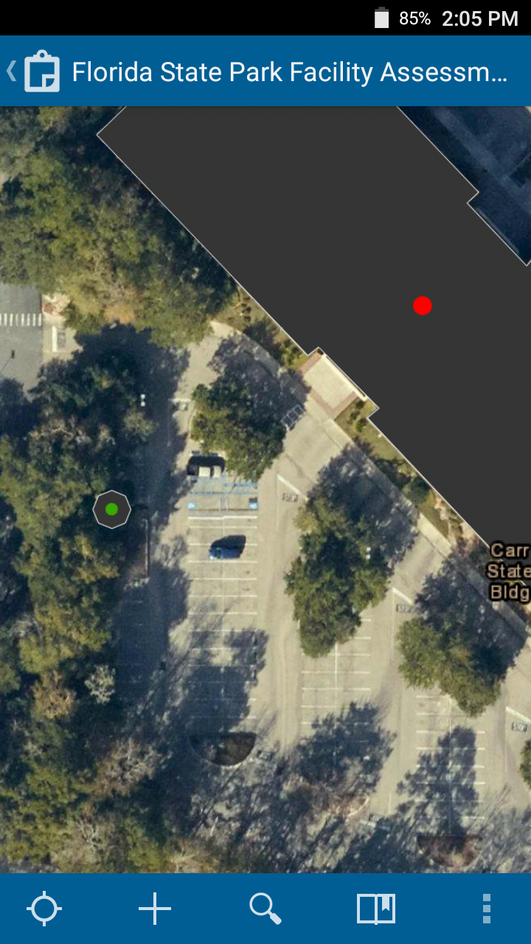
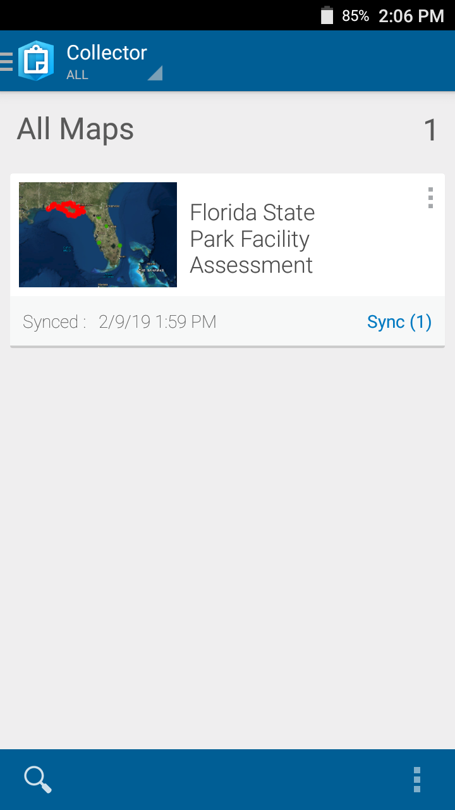
Uploading Data
Make sure your mobile device is connected to Wi-Fi
    A strong internet connection is sometimes necessary to upload successfully, especially with pictures
Click the back button at the top left of the map to return to the list of maps
The “Sync” button should now include a number representing the amount of changes you have made to the map
Click Sync (#) to upload your data

Slide 15
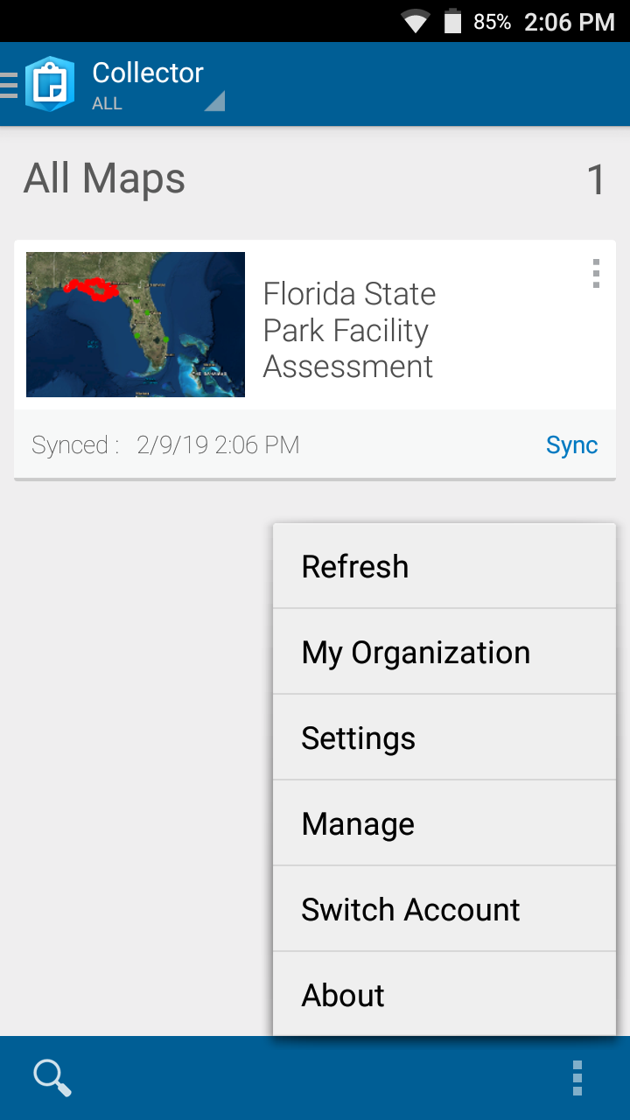
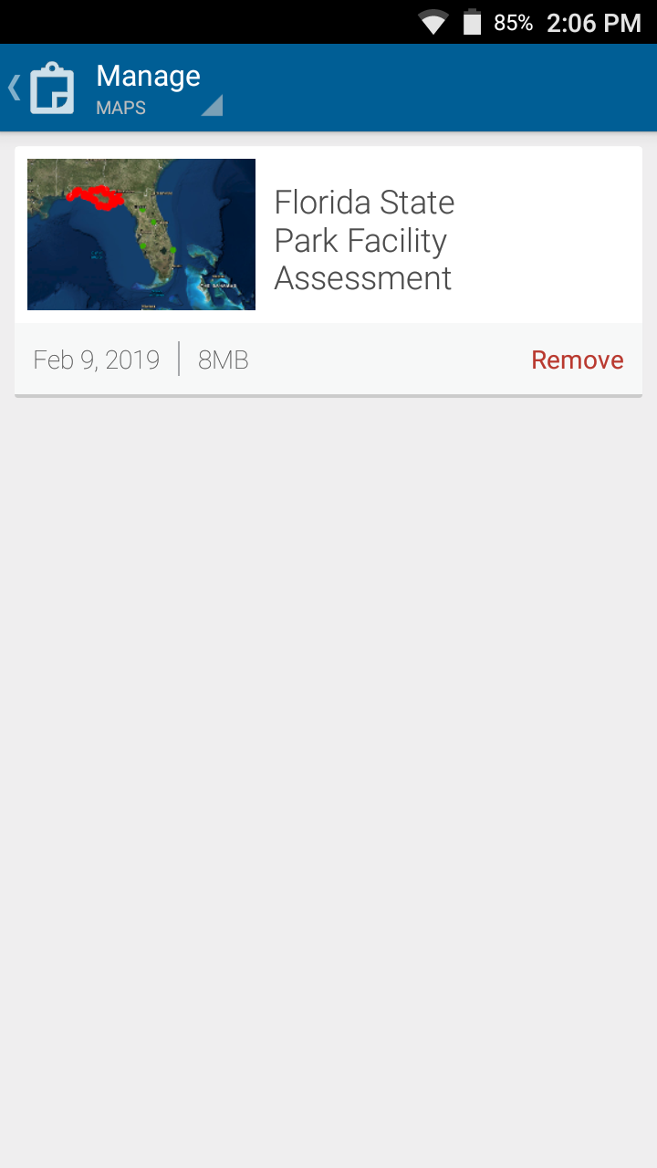
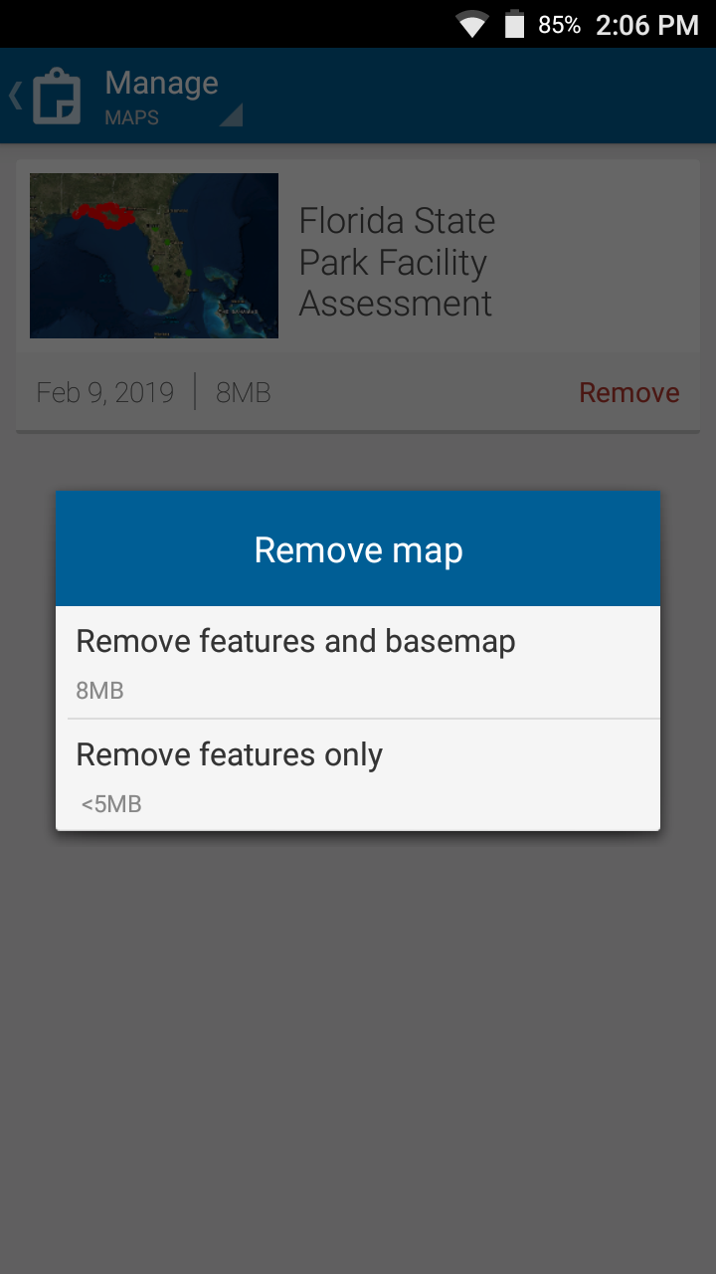
Removing maps
1
2
3
You need to remove a map to download the same map with a new area.
Ensure you have synced all changes before removing.

Slide 16
Troubleshooting
Please feel free to contact us with any questions that you may have:
Adam Neuse
Adam.Neuse@dep.state.fl.us
850-245-3058

