Slide 1
Facility Assessment App
D1 Park Manager Training
2/13/19

Slide 2
Agenda
9:00 – 10:00 – Classroom hour
10:00 – 10:30 – Map downloads
10:30 – 12:00 – Large group assessments
12:00 – 1:00 – Lunch
1:00 – 3:00 – Small group assessments
3:00 – 3:30 – Regroup for discussion
3:30 – 4:00 – Park map downloads
4:00 – Release/optional assistance

Slide 3
Concept and Pilot Testing
Follows a federal model used by NASA, USACE, and NPS
Rapid assessments replaced year-long inspections
Breaks a building into its systems
Scores each system 1-5
Scores feed cost estimates
Piloted in 5 parks, including Maclay Gardens
Most parks completed assessments within 1-2 work days

Slide 4
Systems defined
Structure
Roof
Exterior finishes
HVAC
Plumbing
Electrical
Interior finishes
Key notes:
  For roofs, really focus on the difference between 3 and 4
  For all other systems, focus on differences between 2 and 3
These are the scores which affect the cost estimates the most!

Slide 5
Scoring defined
5 : Excellent – Only normal scheduled maintenance required.
4 : Good – Some minor repairs needed. Normally functions as intended.
3 : Fair – Several minor repairs and some larger repairs required. System occasionally does not function as intended.
2 : Poor – Significant repairs required. Excessive wear and tear clearly visible. Not fully functional as intended.
1 : Non-functional – Major repair or replacement required to restore function.
N/A : Non-applicable – This system is not present in this facility.

Slide 6
Data collection – required vs voluntary
Required
Voluntary
Scoring of each system present in the building
Corrections
  Building number
  Square footage
  Etc.
Recommendations for deletion
Additions to the database

Slide 7
Data collection – excluded buildings
Any building which is not state-owned
Any building the park is not responsible for maintaining

Slide 8
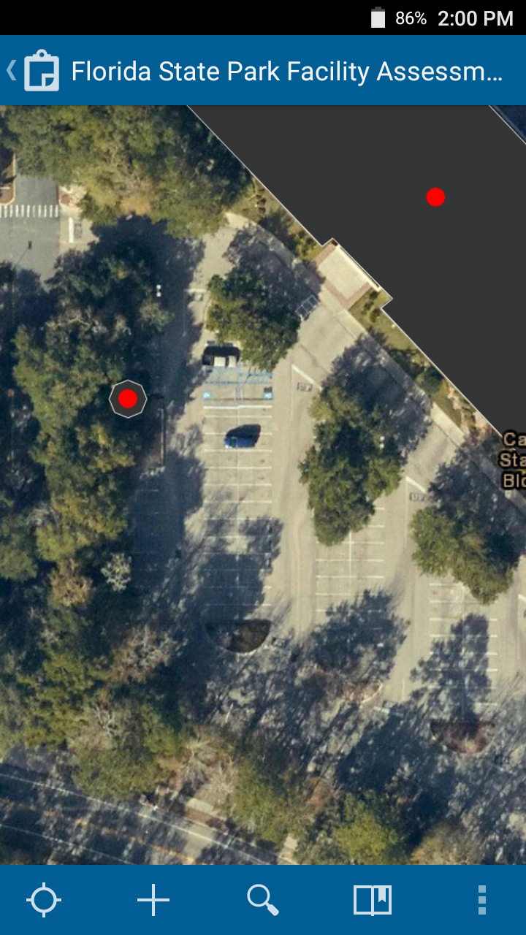
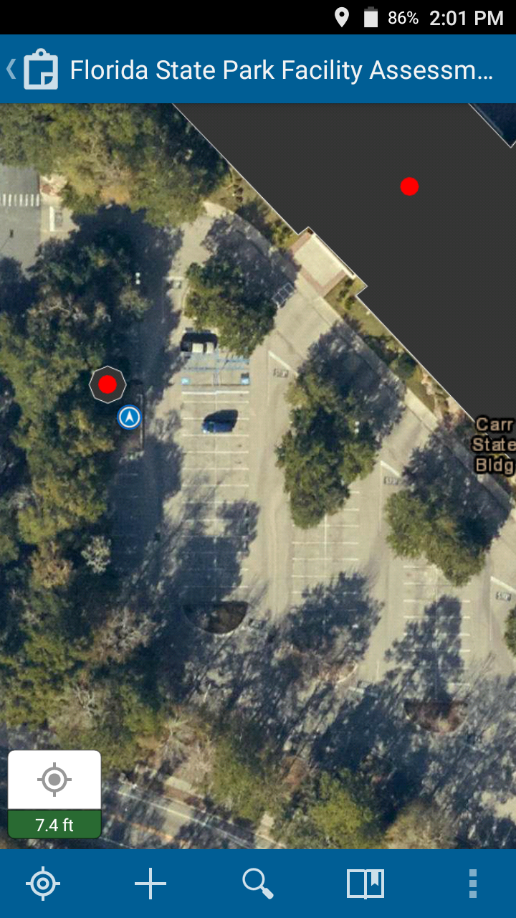
App Familiarity – Location
If your location does not appear on the map, click the empty target button in the bottom-left
Your location is shown as a blue dot

Slide 9
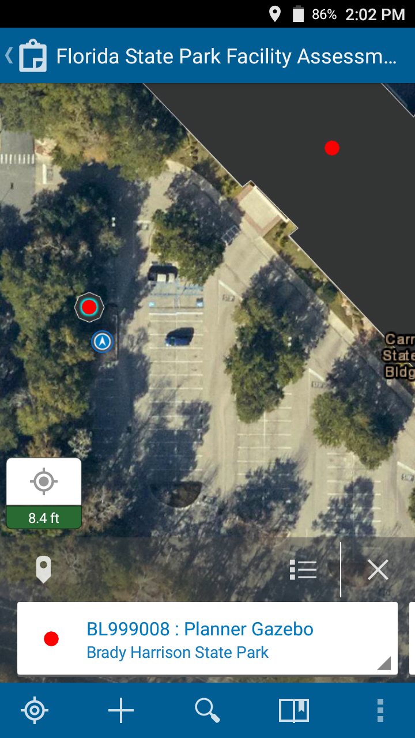
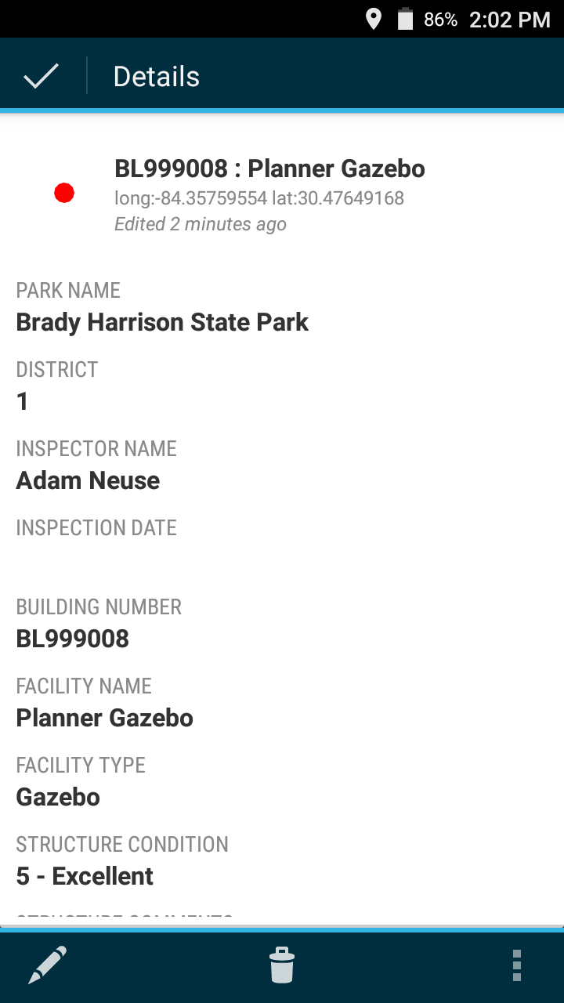
App Familiarity – Details
Select a point on the map
Click the feature window at the bottom of the screen
Scroll down to see more information

Slide 10
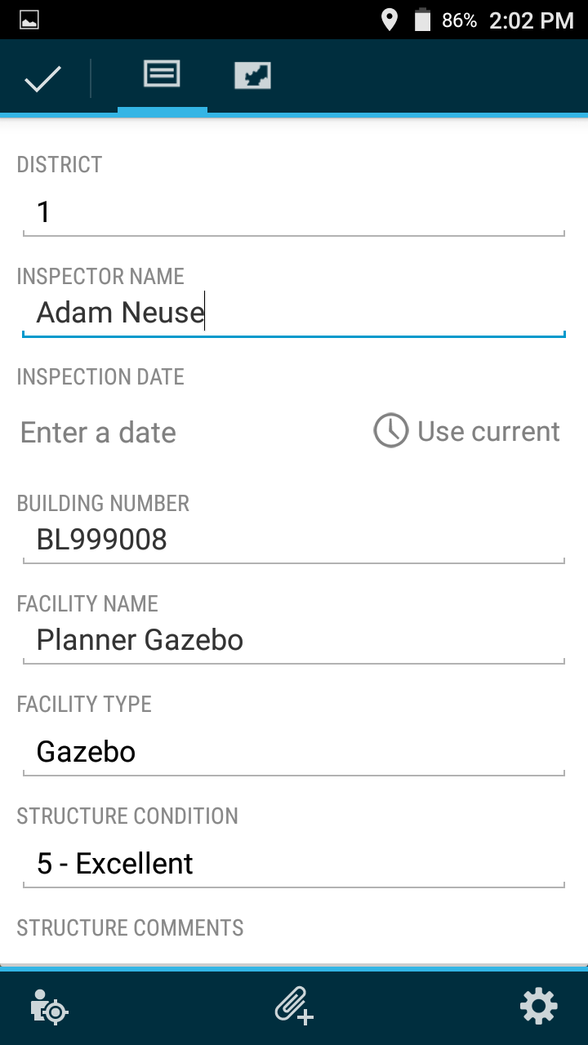
App Familiarity – Edits
Pencil icon to edit
Scroll down to see more questions

Slide 11
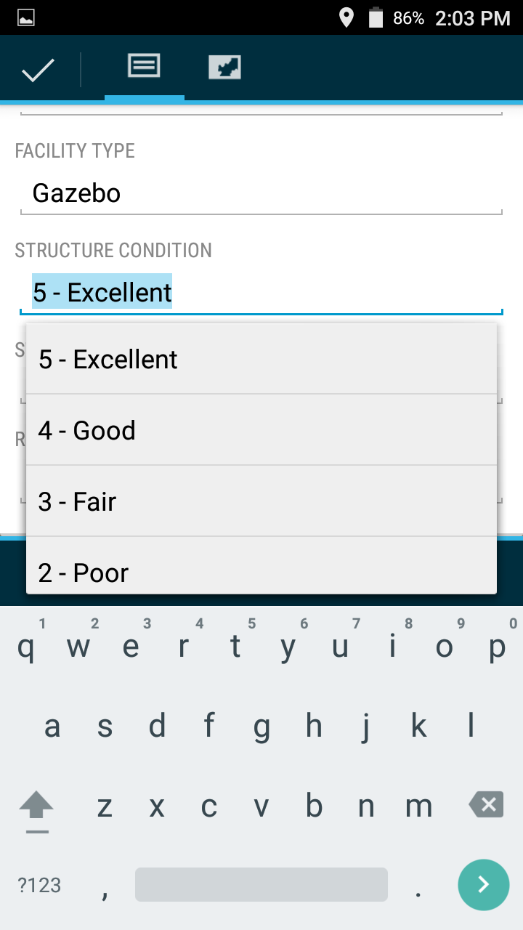
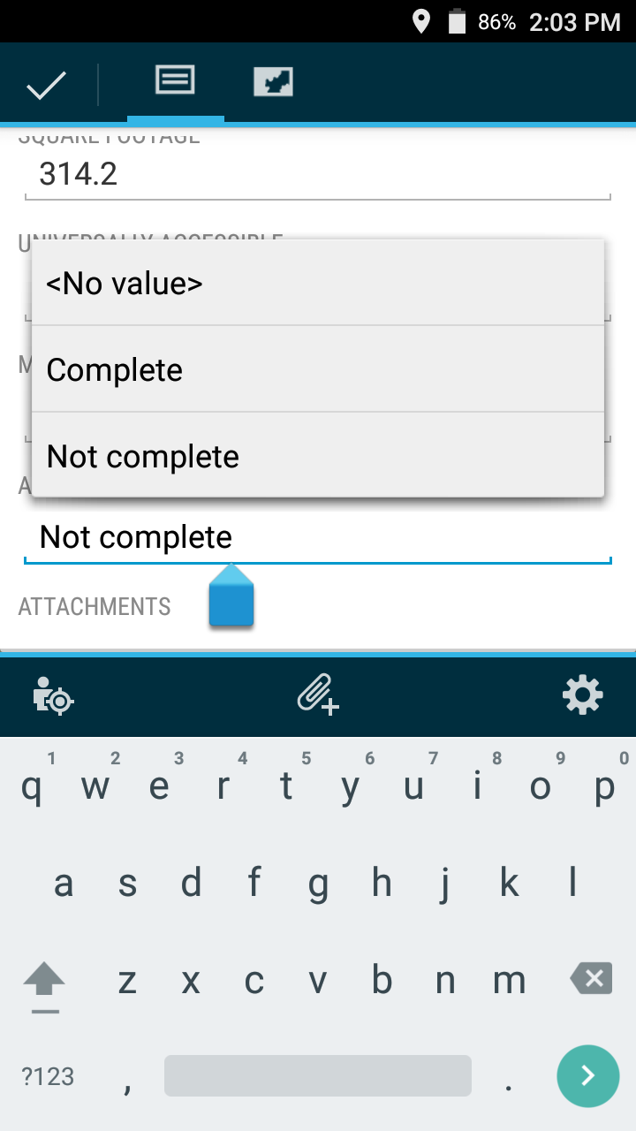
App Familiarity – Pick List
Many questions have drop-downs for quick response
Comments fields for additional notes

Slide 12
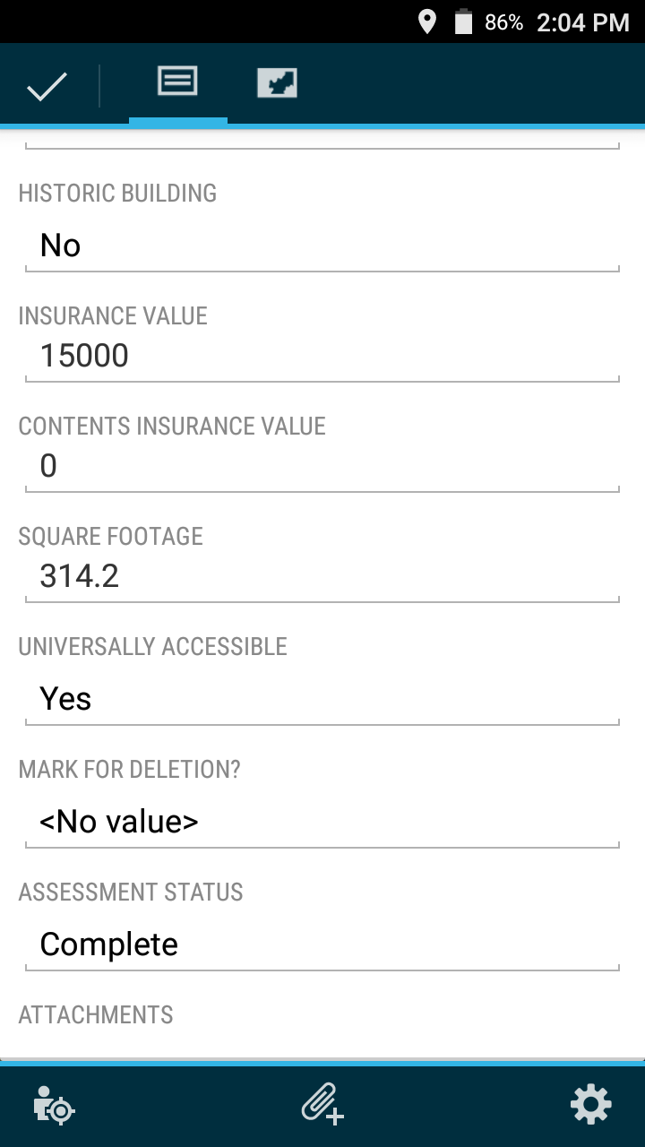
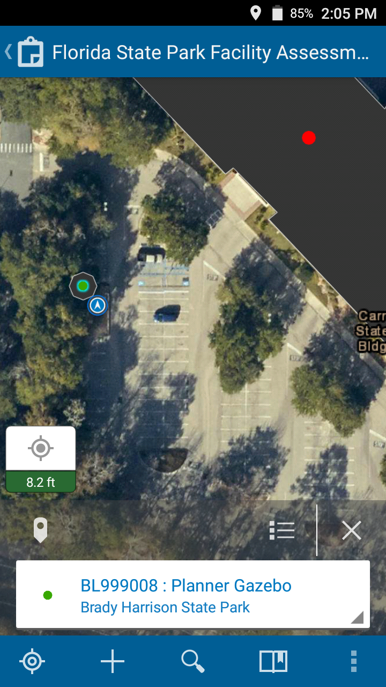
App Familiarity - Complete
When finished, select the check-mark in the top left
If you changed “Assessment Status” to “Complete”, the building is now green

Slide 13
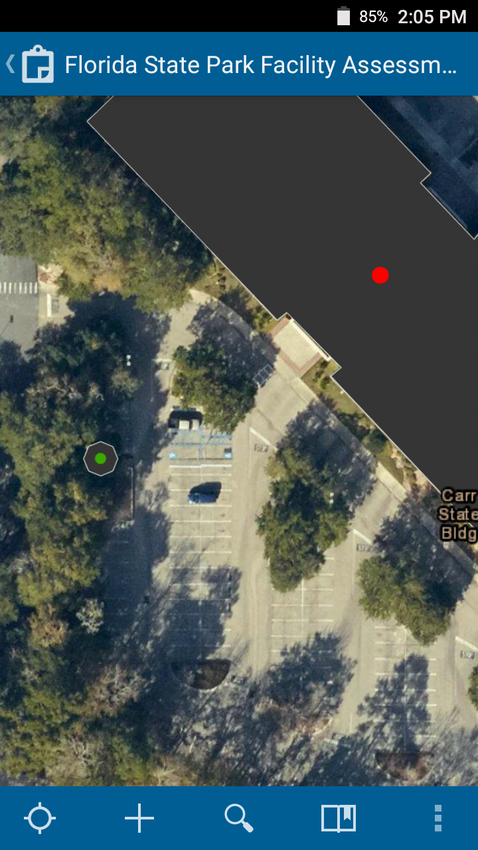
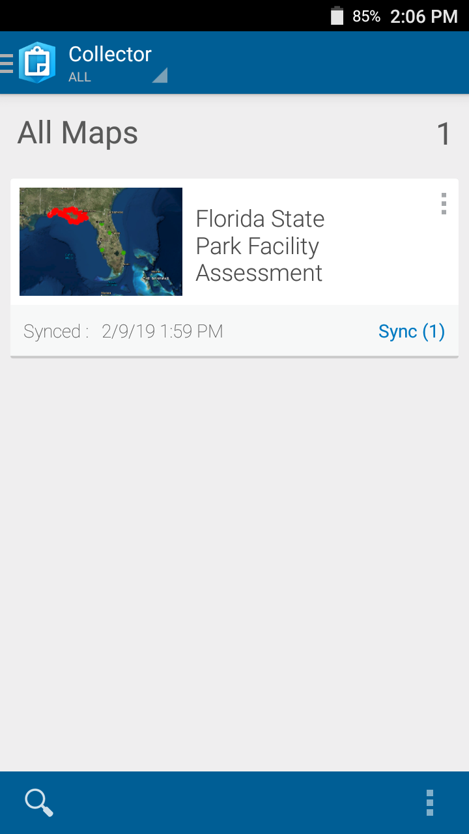
App Familiarity – Sync
When done, click the back button at the top left
Click Sync (#) to upload your data

Slide 14
Questions?
Technical (app) Support
Scoring and Systems Support
Contact info:
Adam Neuse
Brady Harrison
Contact info:
David Matson
Philip Madden
Michael Foster

