Slide 1
Facility Assessment App
D3 Park Manager Training
03/12/19

Slide 2
Agenda
10:00 – 11:00 – Classroom hour
11:00 – 12:00 – Large group assessments
12:00 – 1:00 – Lunch
1:00 – 2:30 – Small group assessments
2:30 – 3:00 – Regroup for discussion
3:00 – UTC - Park map downloads; Release

Slide 3
Concept and Pilot Testing
Follows a federal model used by NASA, USACE, and NPS
Rapid assessments replaced year-long inspections
Breaks a building into its systems
Scores each system 1-5
Scores feed cost estimates
Piloted in 5 parks, including Maclay Gardens
D1 recently completed
Most parks completed assessments within 1-2 work days

Slide 4
Systems defined
Structure
Roof
Exterior finishes
HVAC
Plumbing
Electrical
Interior finishes
Key notes:
  For roofs, really focus on the difference between 3 and 4
  For all other systems, focus on differences between 2 and 3
These are the scores which affect the cost estimates the most!

Slide 5
Scoring defined
5 : Excellent – Only normal scheduled maintenance required.
4 : Good – Some minor repairs needed. Normally functions as intended.
3 : Fair – Several minor repairs and some larger repairs required. System occasionally does not function as intended.
2 : Poor – Significant repairs required. Excessive wear and tear clearly visible. Not fully functional as intended.
1 : Non-functional – Major repair or replacement required to restore function.
N/A : Non-applicable – This system is not present in this facility.

Slide 6
Data collection – required vs voluntary
Required
Voluntary
Scoring of each system present in the building
Corrections
  Building number
  Square footage
  Etc.
Recommendations for deletion
Additions to the database

Slide 7
Data collection – excluded buildings
Any building which is not state-owned
Any building the park is not responsible for maintaining

Slide 8
Questions?
Scoring and Systems Support
Philip Madden
  Philip.J.Madden@FloridaDEP.gov
Philip Stone
  Philip.Stone@FloridaDEP.gov
David Matson
  David.Matson@FloridaDEP.gov

Slide 9
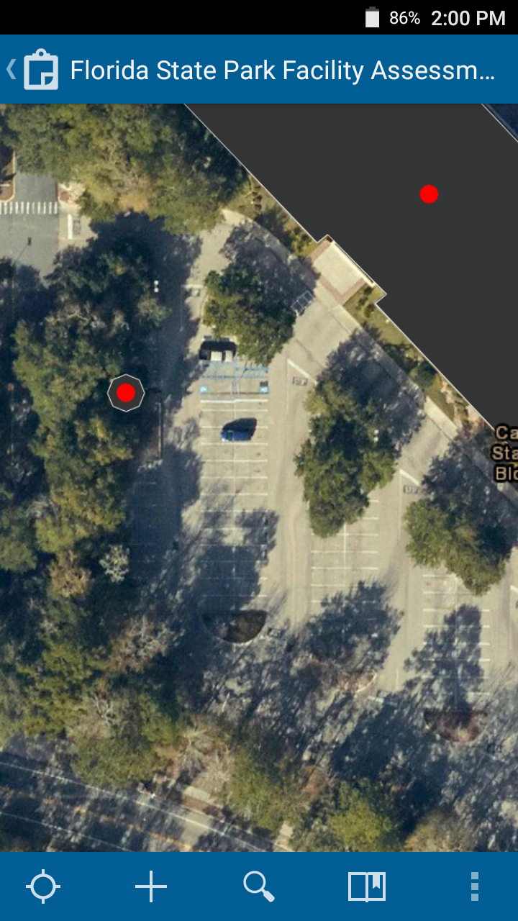
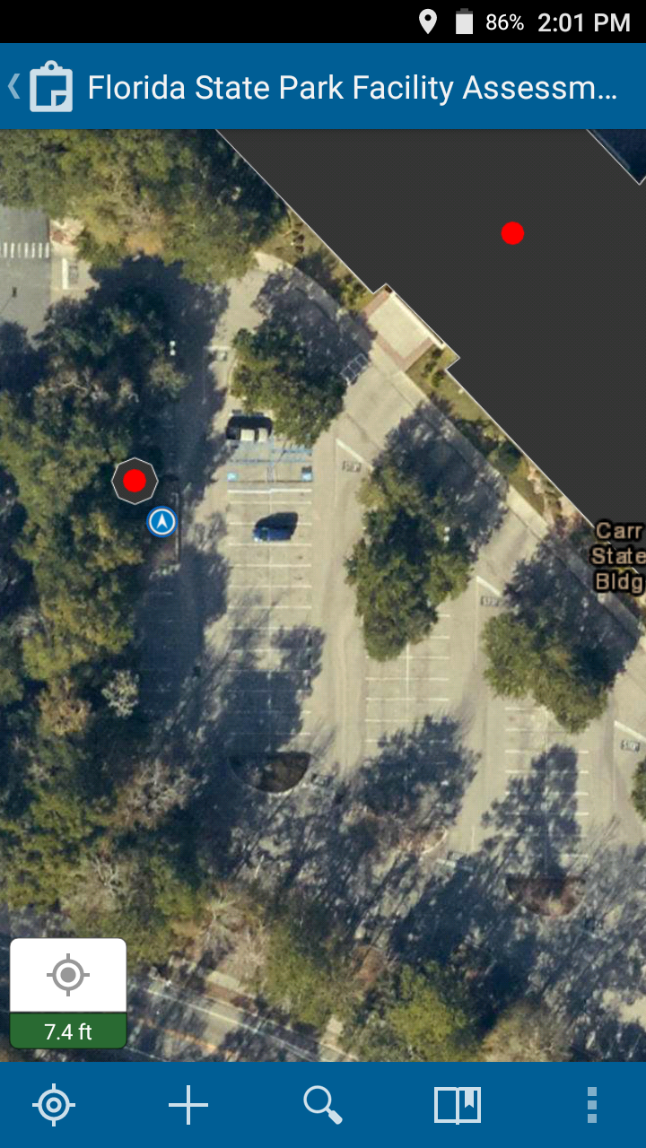
App Familiarity – Location
If your location does not appear on the map, click the empty target button in the bottom-left
Your location is shown as a blue dot

Slide 10
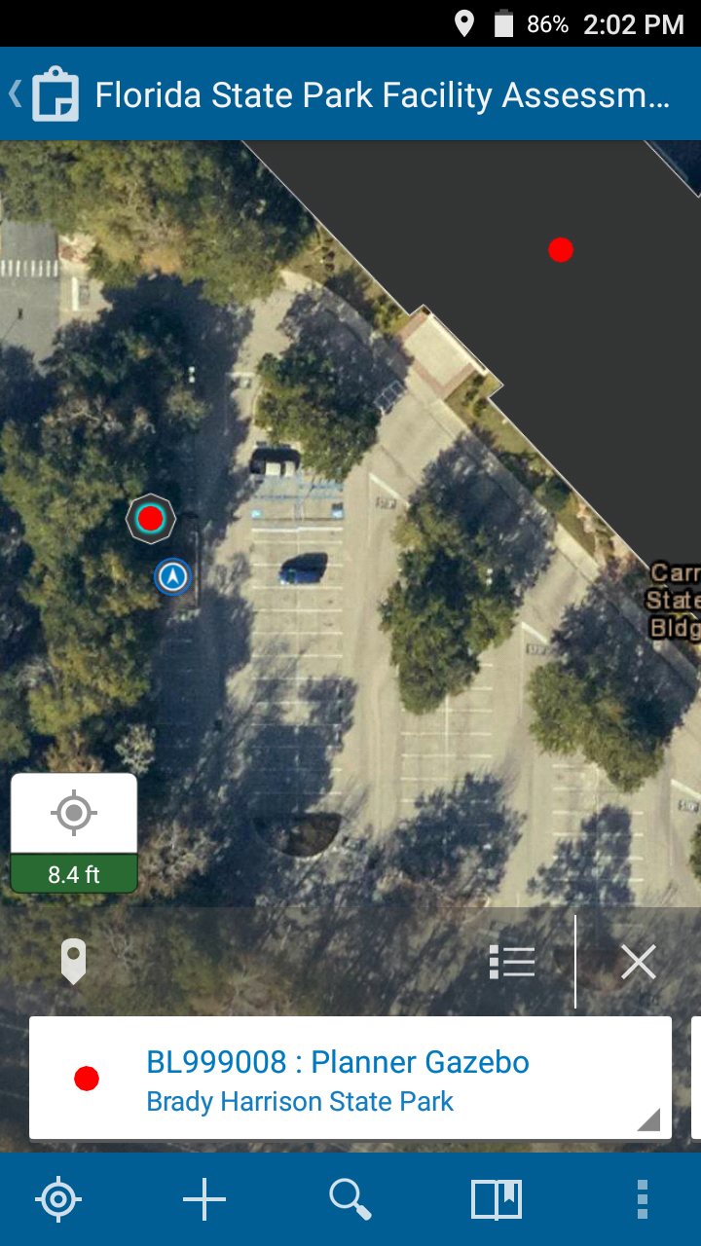
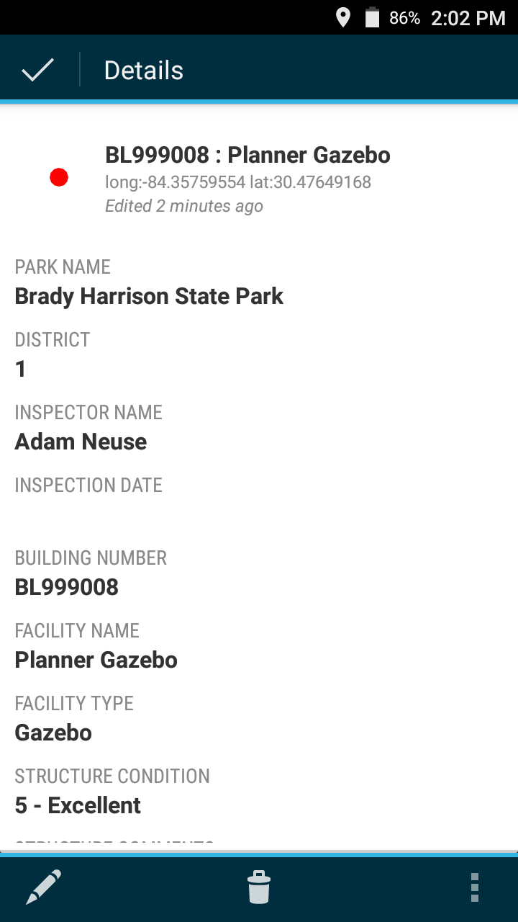
App Familiarity – Details
Select a point on the map
Click the feature window at the bottom of the screen
Scroll down to see more information

Slide 11
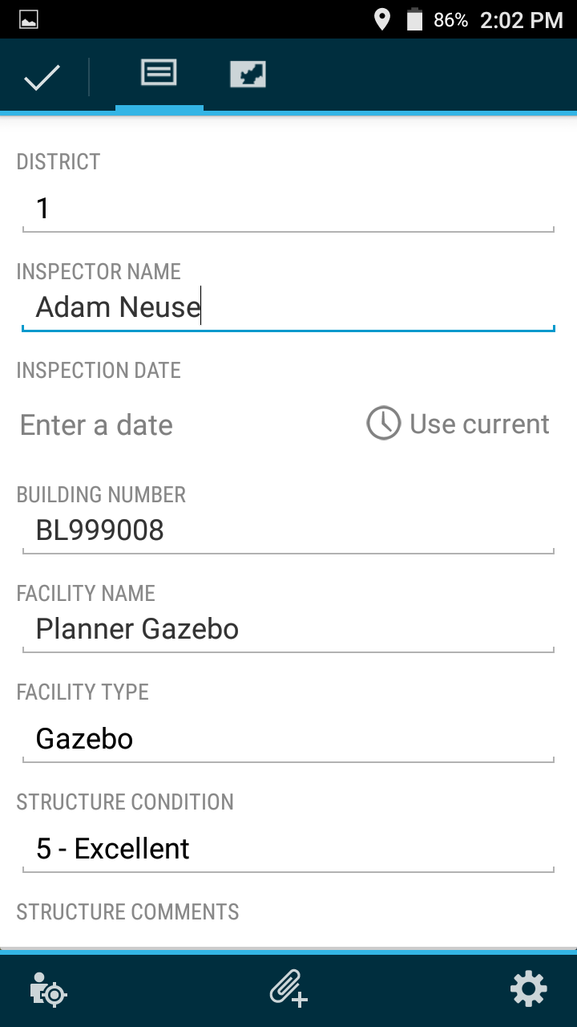
App Familiarity – Edits
Pencil icon to edit
Scroll down to see more questions

Slide 12
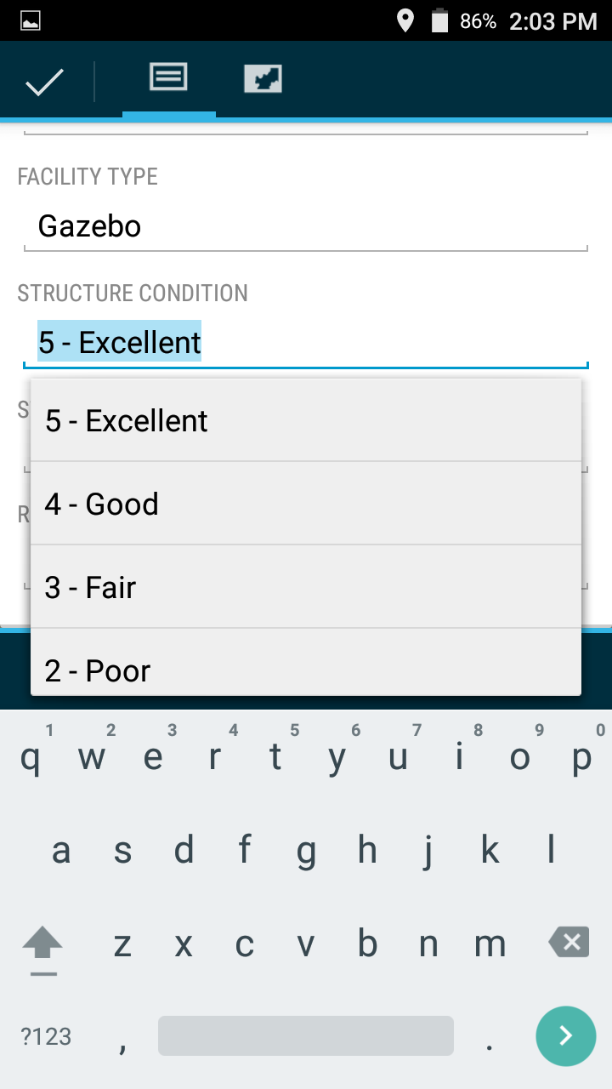
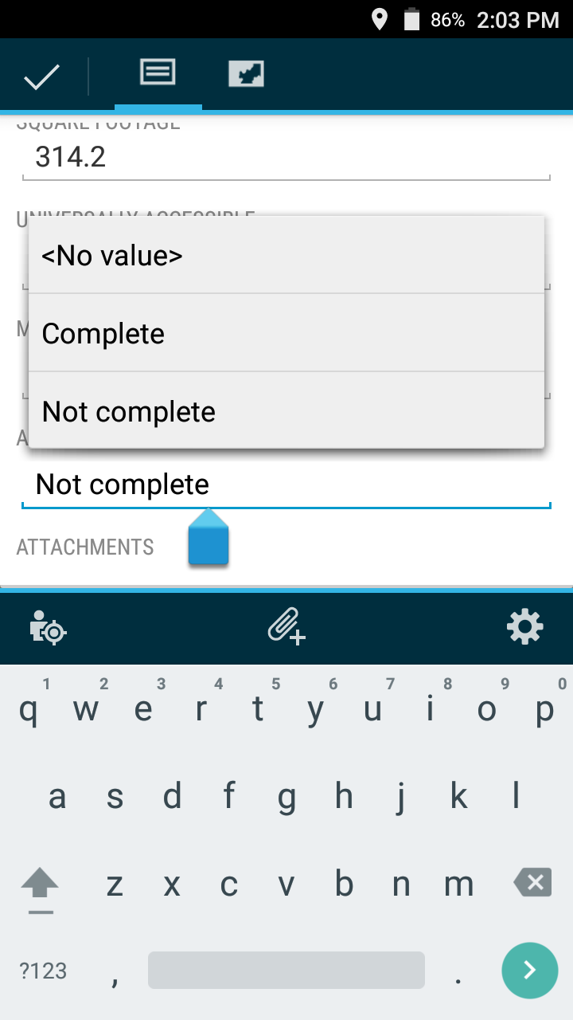
App Familiarity – Pick List
Many questions have drop-downs for quick response
Comments fields for additional notes

Slide 13
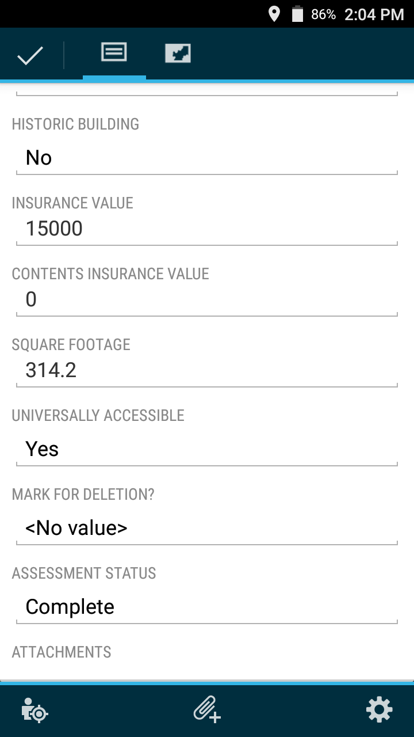
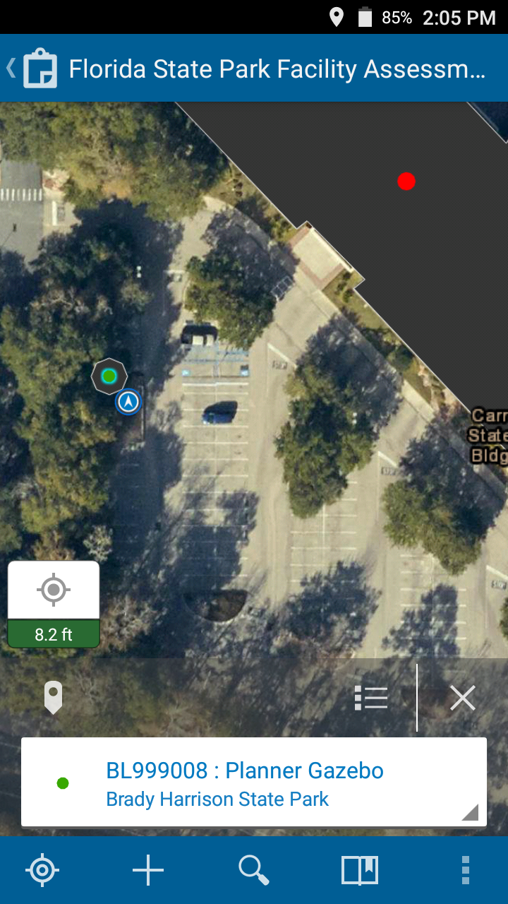
App Familiarity - Complete
When finished, select the check-mark in the top left
If you changed “Assessment Status” to “Complete”, the building is now green

Slide 14
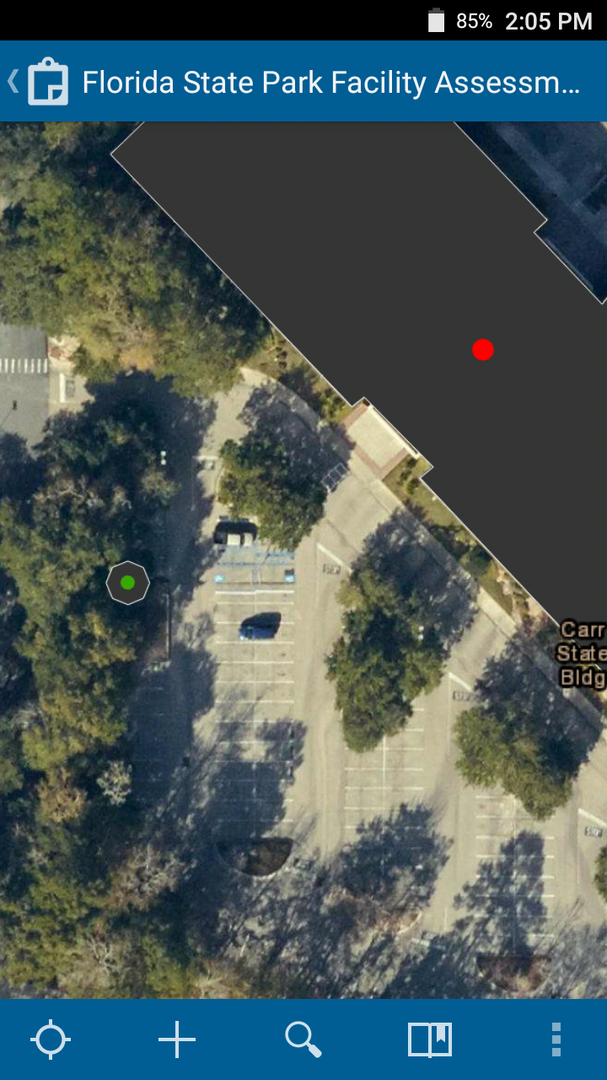
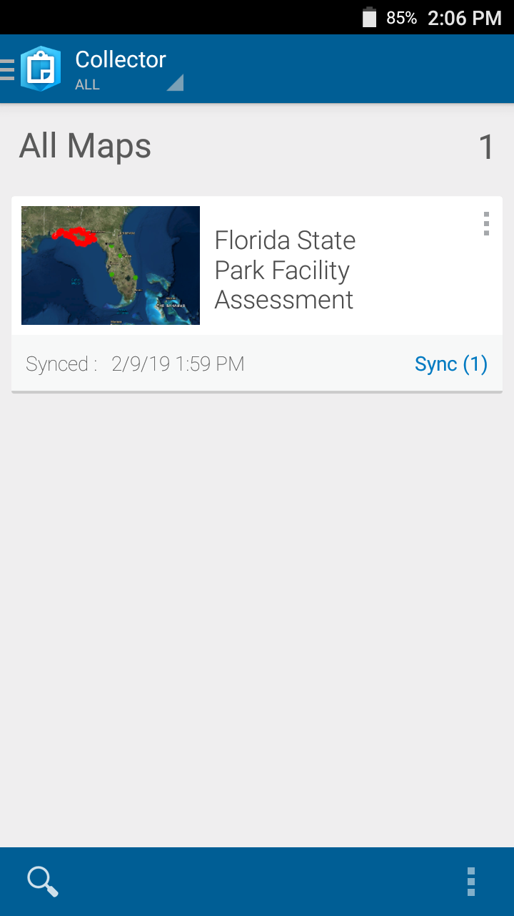
App Familiarity – Sync
When done, click the back button at the top left
Click Sync (#) to upload your data

Slide 15
Questions?
Technical (app) Support
Adam Neuse
  Adam.Neuse@FloridaDEP.gov
Brady Harrison
  Brady.Harrison@FloridaDEP.gov

Slide 16
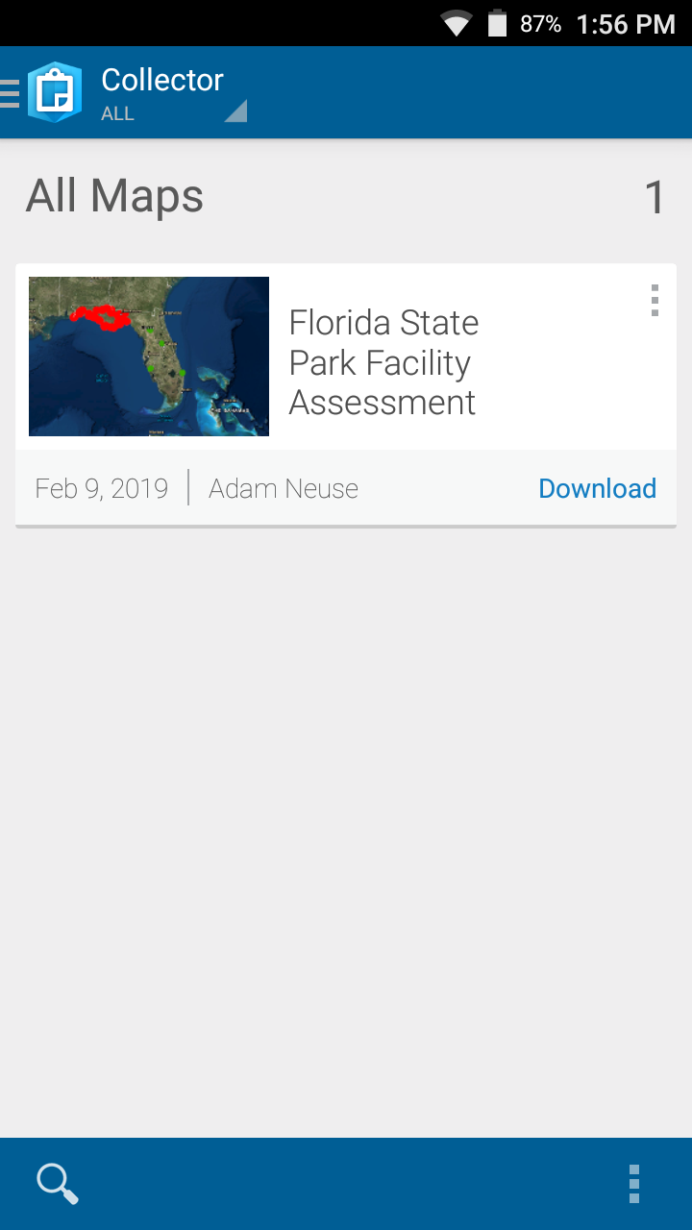
Downloading
Click “Download”
If promoted to choose a basemap, click “Download a new basemap”

Slide 17
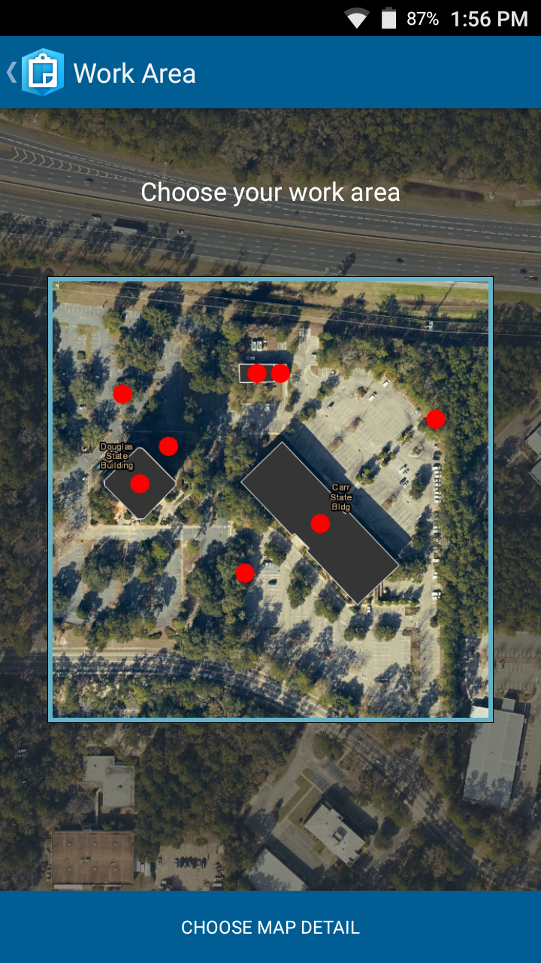
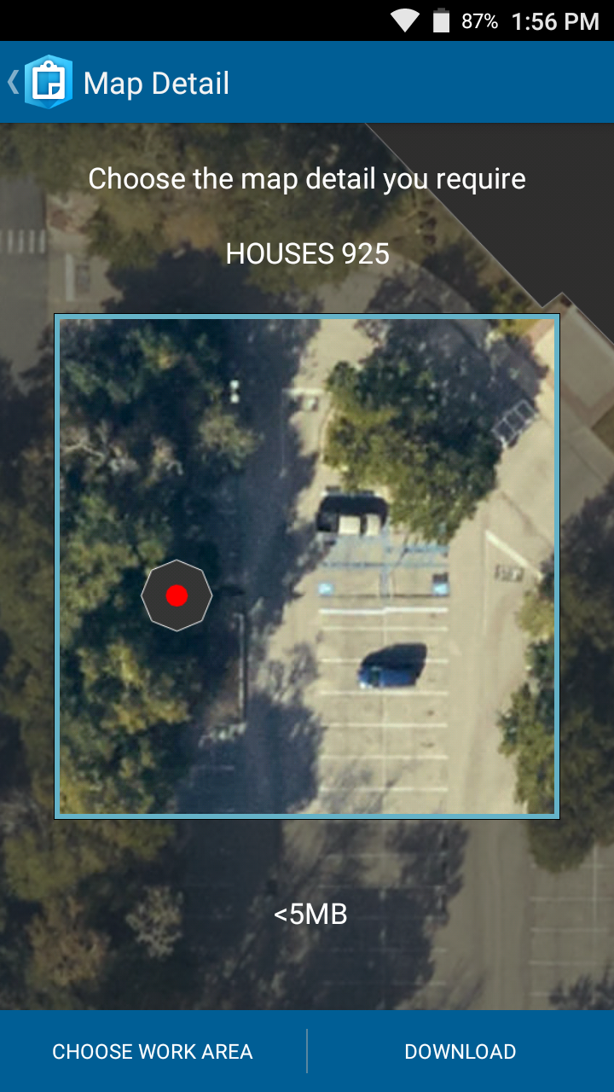
Downloading – Area and Detail
Select the download area
  Think of this as the park boundaries
Select the basemap’s detail
  Higher detail lets you see more clearly when zoomed in
Click “Download” in the bottom-right

Slide 18
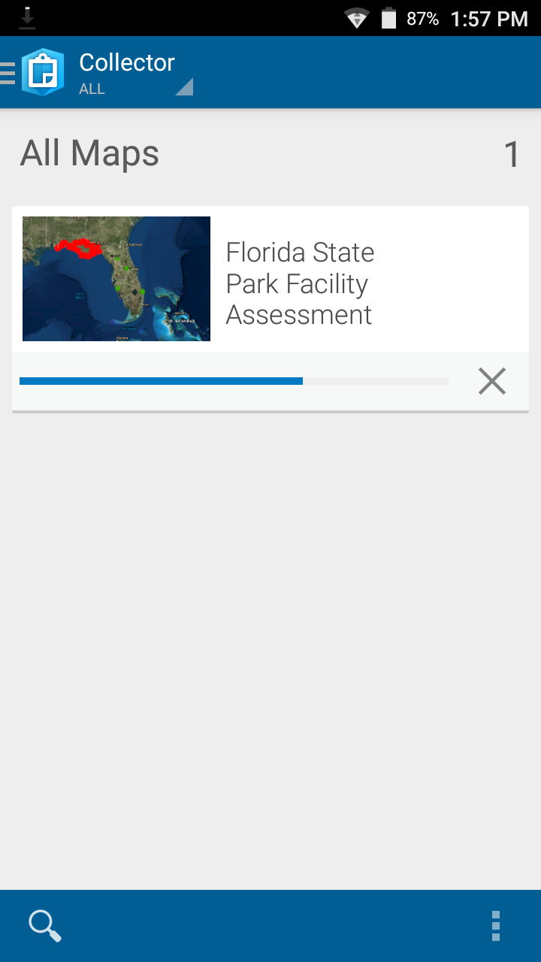

Downloading – Progress
The blue bar will show the progress of your download
When the download is complete, you will be able to “Sync” your data
At this point, you are able to work offline

Slide 19
Questions?
Technical (app) Support
Adam Neuse
  Adam.Neuse@FloridaDEP.gov
Brady Harrison
  Brady.Harrison@FloridaDEP.gov

Slide 20
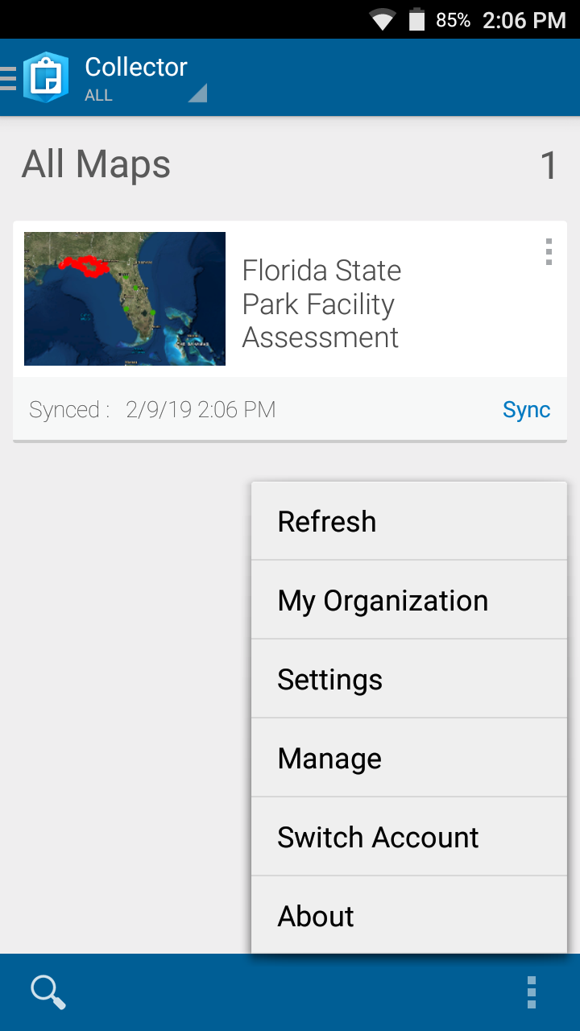
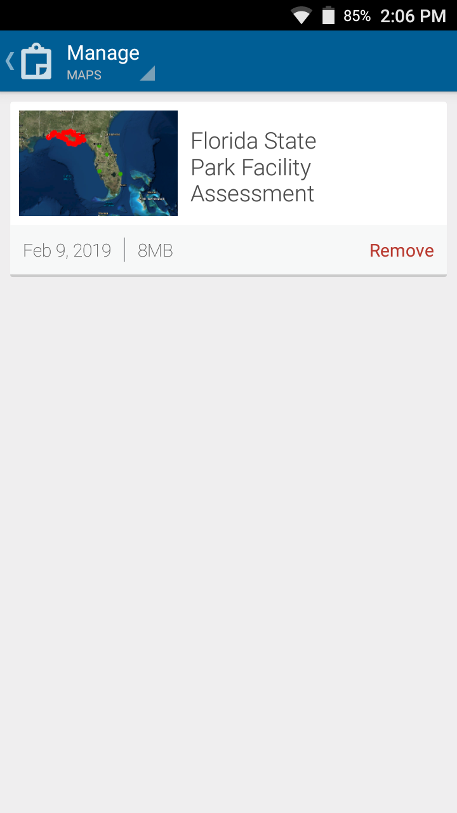
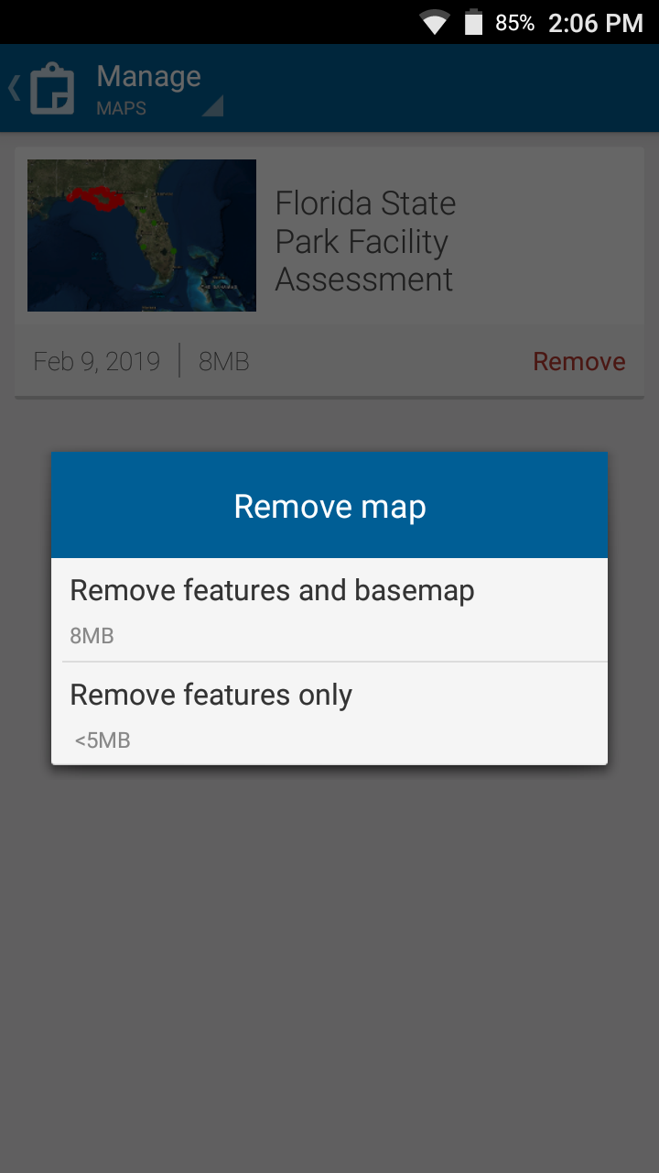
Removing a map
You need to remove a map to download the same map with a new area.
Ensure you have synced all changes before removing.

Slide 21
Questions?
Technical (app) Support
Adam Neuse
  Adam.Neuse@FloridaDEP.gov
Brady Harrison
  Brady.Harrison@FloridaDEP.gov

