Slide 1
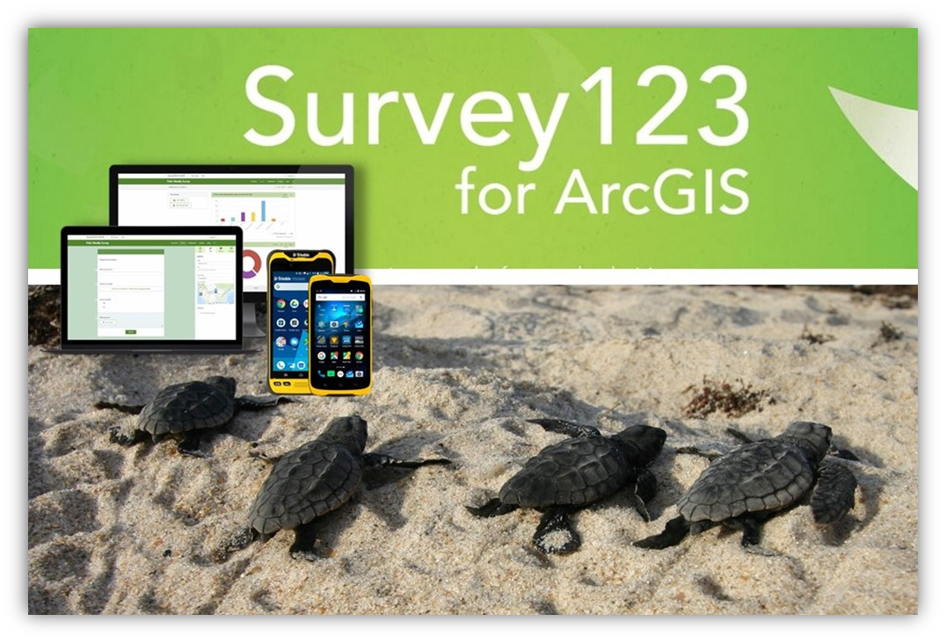

Sea Turtle Data Collection App Training
Leah Gerlock
Natural Resource Specialist
Leah.Gerlock@dep.state.fl.us
(850) 245-2079
GIS Team:
Brady Harrison
Jessica Richards
Allison Jones

Slide 2
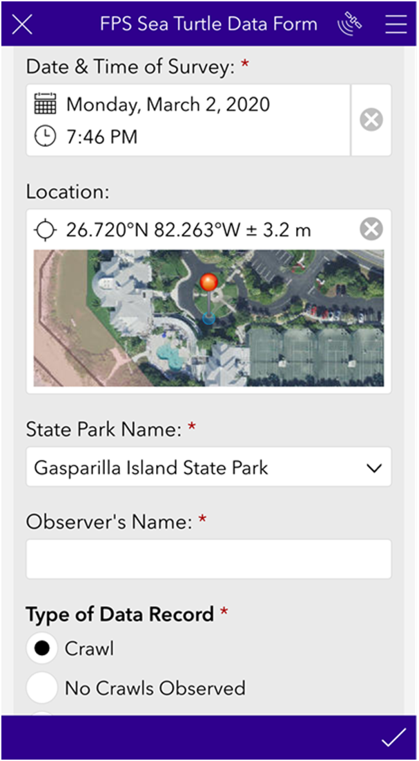

Introduction
Welcome to Survey123 for Sea Turtle Data Collection!
Here, we’ll discuss:
Project Background
Downloading Survey123 Software
User accounts
Collecting data
Auto-generated reports
QA / QC of data

Slide 3
Project Background
The Florida State Park Service (FPS) has been the largest single collector of data in the state, and collects data at 40 State Parks
Statewide Nesting Beach Survey (SNBS):
General nesting data collected by all beaches in Florida surveyed.
Index Nesting Beach Survey
(INBS):
Includes all SNBS data collected plus nest inventory
Summary Report and Daily Crawl report at the end of the season
40 state parks in this program
108 miles of beach
Index Report monthly
13 state parks in this program
45 miles of beach

Slide 4
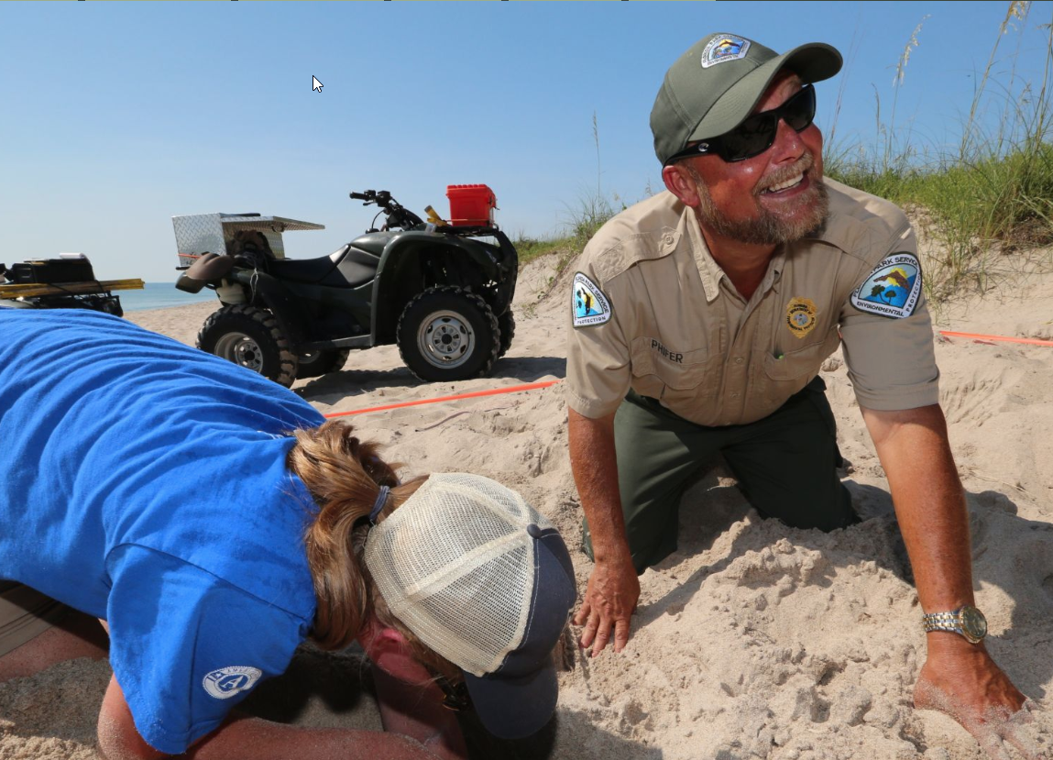
Survey Effort
Surveys are conducted daily
March 1st to Oct 31st
exact dates differ by region
Average 6,366 effort-days/season
The FPS surveys ~108 miles of beach
13% of Fl nesting beaches
Staff and volunteers usually work in pairs
Dozens of FPS staff and many volunteers
25,000 effort hours per year

Slide 5
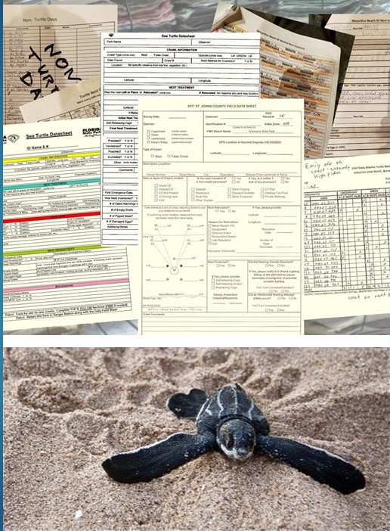
Why develop the app?
Standardization!
Every park using the same form.
Centralization!
Not stored in desktops or file cabinets at parks.
Available online to authorized users.
Less Transcription!
FWC reports, County reports, and Nourishment – all
from one database.
Quicker, Easier Reporting!
No more spreadsheets
No more datasheets.
Spatial Data, In Real-Time!

Slide 6

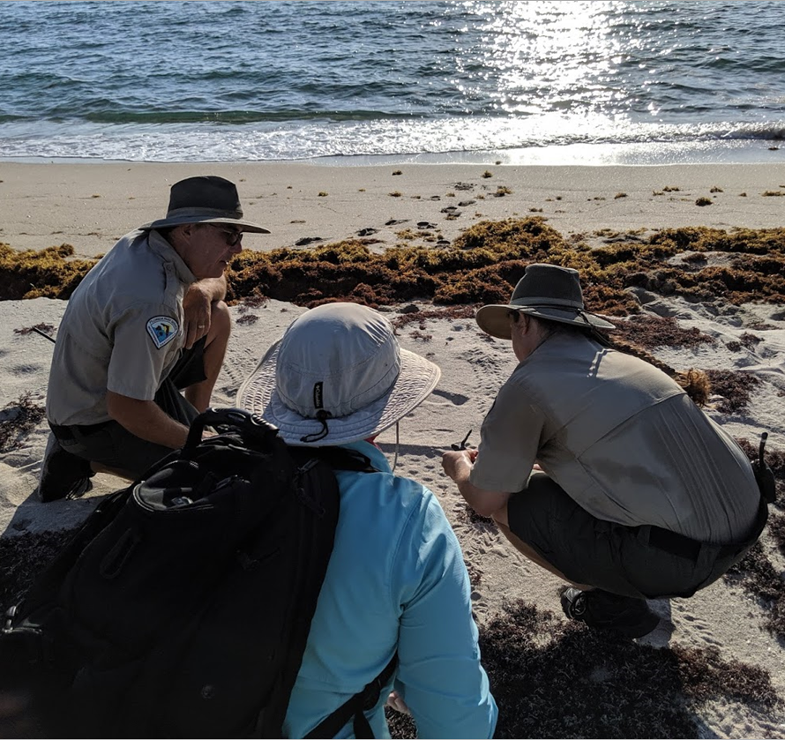

Downloading the Survey123 App
This is a data collection app –
  Used to fill out a form or “survey” built for your park
Compatible with Desktop Computers, and Tablets
The app looks and functions the same on the computer and the TDC devices!
Must be connected to the internet to download Survey123.

Slide 7
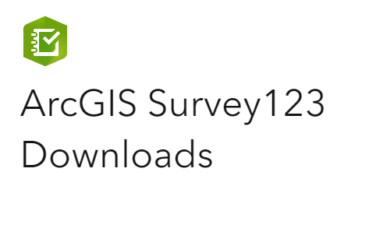
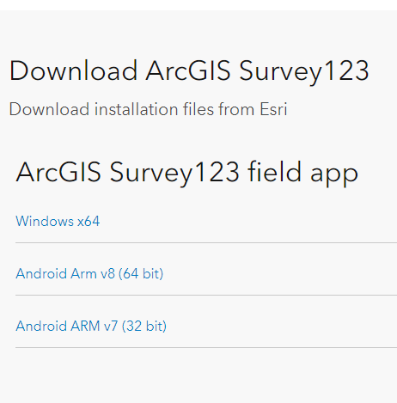
Downloading Survey123 on Desktop
Download the Desktop version HERE:
  https://www.esri.com/en-us/arcgis/products/arcgis-survey123/downloads
  This page will have several different types of software available for download.
You want “Survey123 Field App” (despite its name) for Windows x64.
If you are unable to install software onto your work computer, you may need to request installation from OTIS.
DO NOT download “Survey123 Connect” software

Slide 8
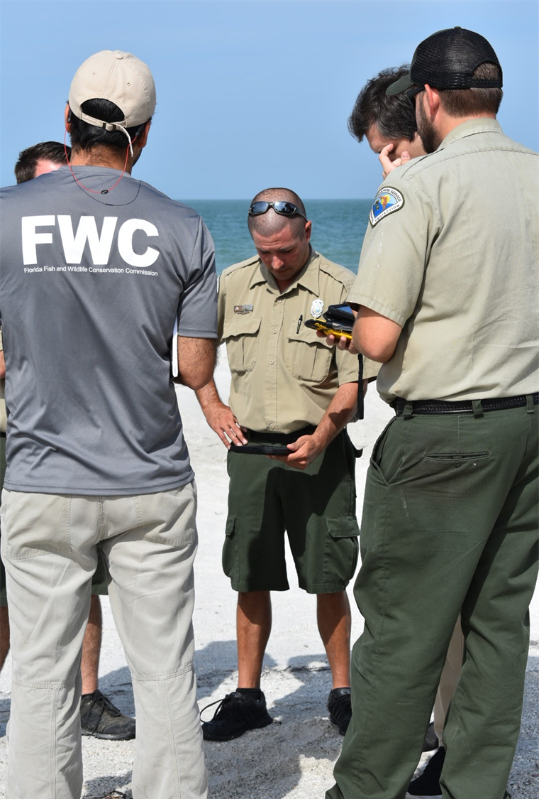


Downloading Survey123 on TDC/Tablet
To download Survey123 field app on TDC or tablet
Go to Play Store on device.
Search for “Survey123 for ArcGIS” for FREE app.

Slide 9
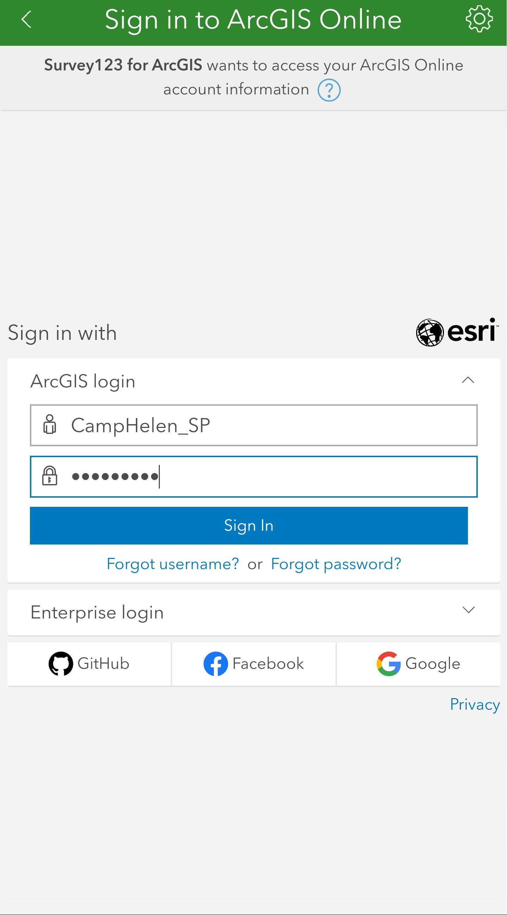
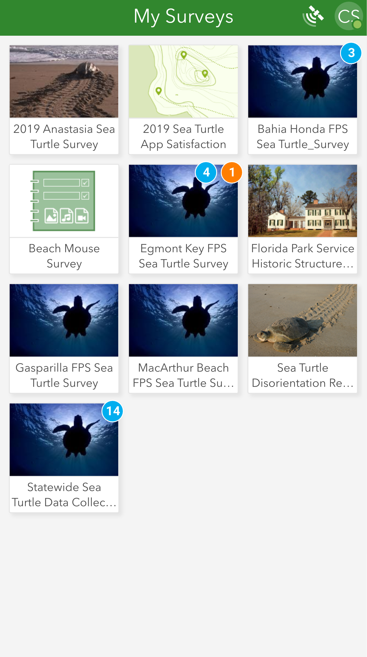
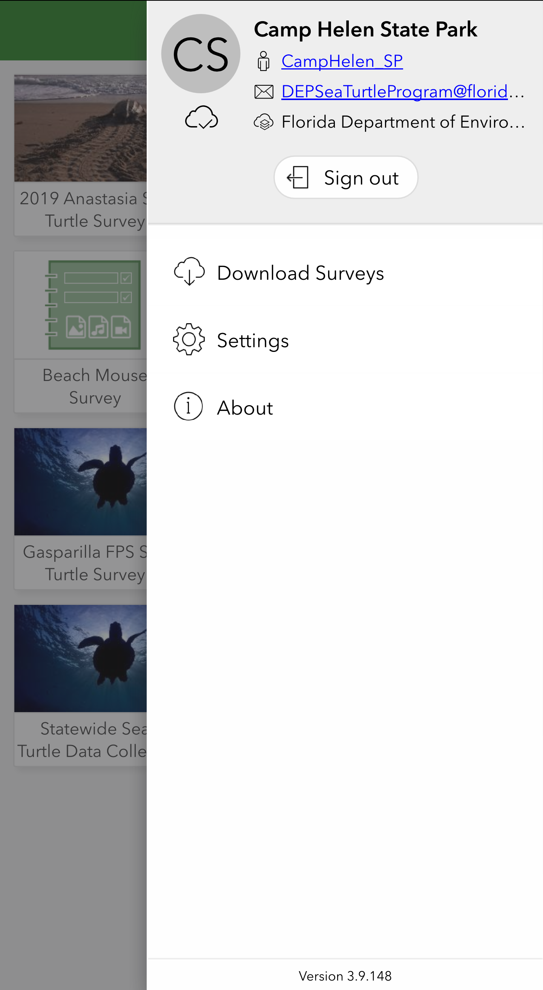
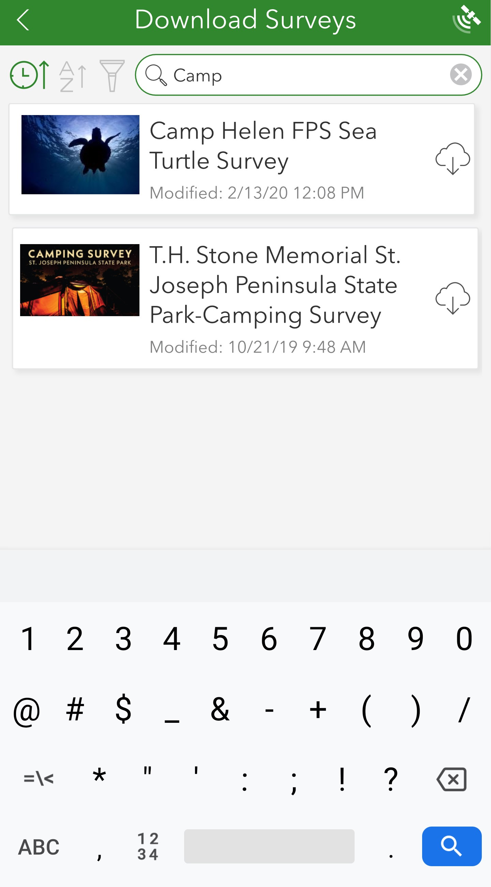
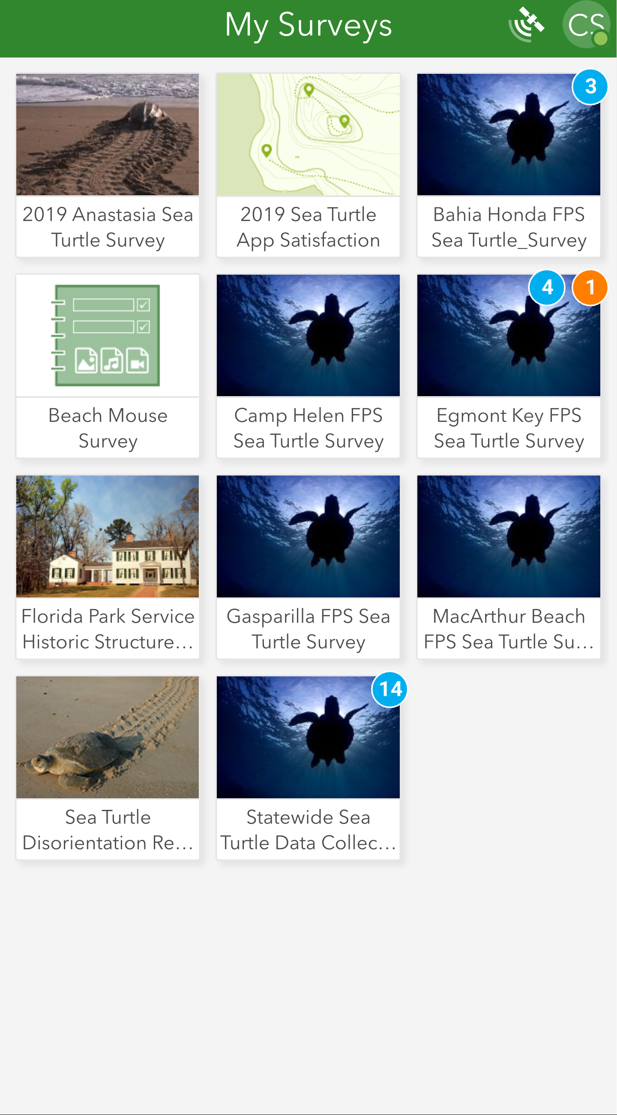
Download Your Beach’s Survey
1. Open Survey123 App and sign into your park’s AGO account.
2. In My Surveys, click the Menu button (top right).
3. Select Download Surveys.
4. Search for your survey and hit the download arrow.
5. Survey will appear in the “My Surveys” page.

Slide 10
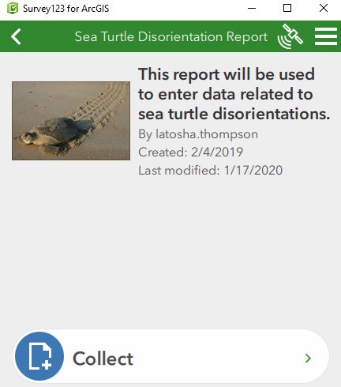
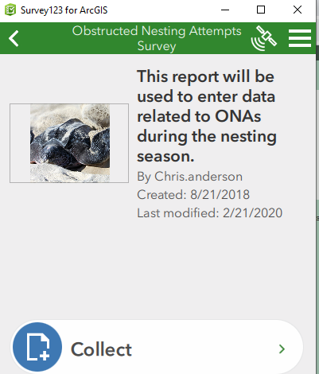
FWC’s Apps
Download to your device by entering the web address in internet browser on device. Open in Survey123 Field App.
Disorientation Report: https://arcg.is/mmfb8
Disorientation Report Tutorial: https://arcg.is/1e4Cue
ONA Report: https://arcg.is/0ya4nS
ONA Report Tutorial: https://arcg.is/1T54Hu

Slide 11
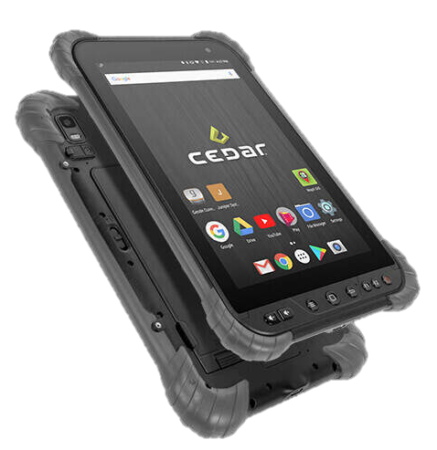
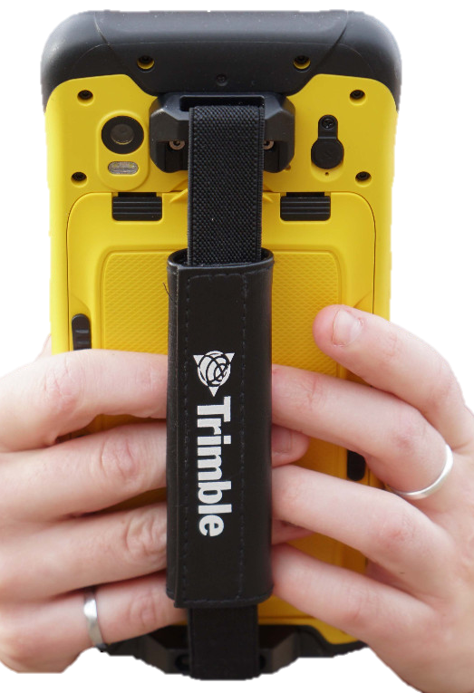
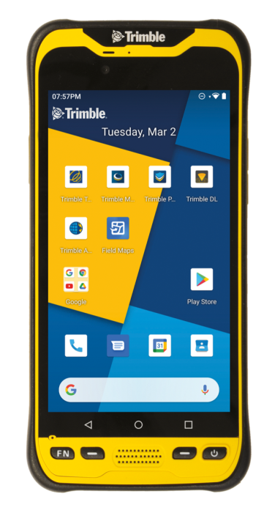
Devices and Hardware
Recommended Devices
Trimble TDC 600
Cedar CT8 Tablet
Durable
Great GPS chip, sub-meter accuracy.
Screen is easier to read in the sun
Water resistant – can be used in the rain
To use the mobile devices, must have:
AGO account – each park has its own
account
  Username and Password will be provided
Access to Wi-Fi – to download surveys and to sync data

Slide 12
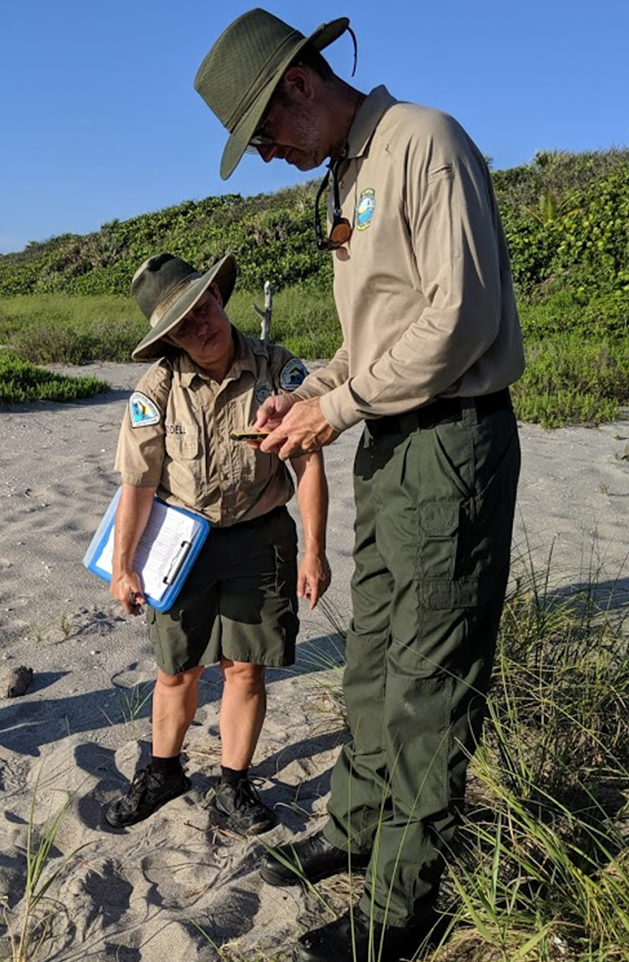
Device Settings You Should Know
Location Setting
How the survey gets your lat/long?
Device GPS Only – must use this for TDC/Tablet
  This will keep your device from connecting to wi-fi sources like condos or offices
  Connecting to other nearby systems will cause your GPS locations to end up off the beach.
Location accuracy
How good is your lat/long?
Location displayed in the map on the survey form
  Is the dot on the beach?
Horizontal Accuracy displayed – we want < +/- 5m
Satellite Map in Survery123

Slide 13
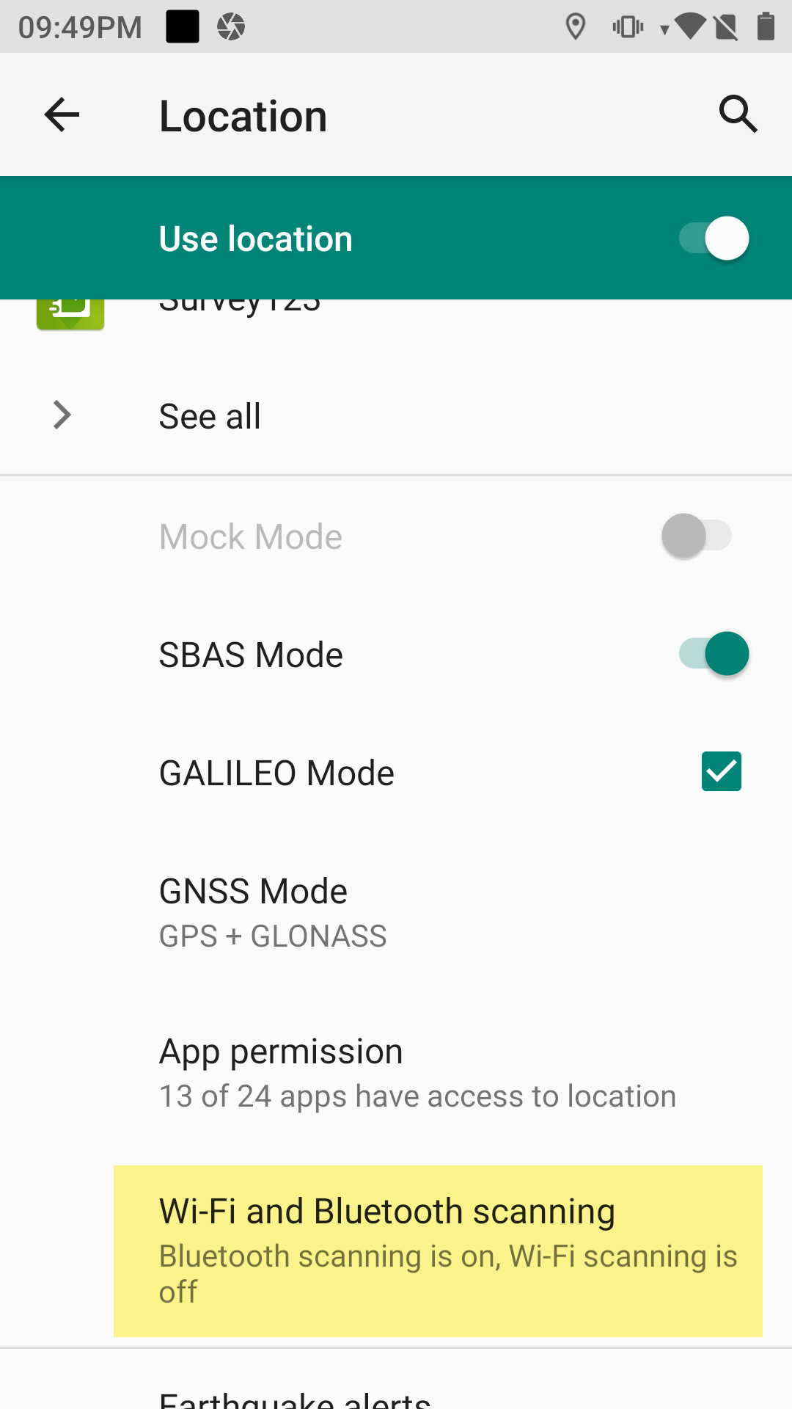
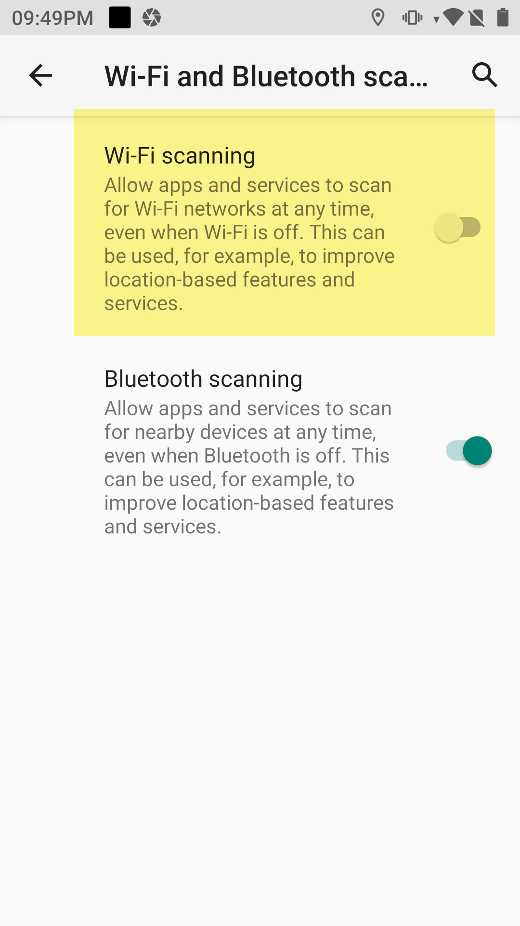
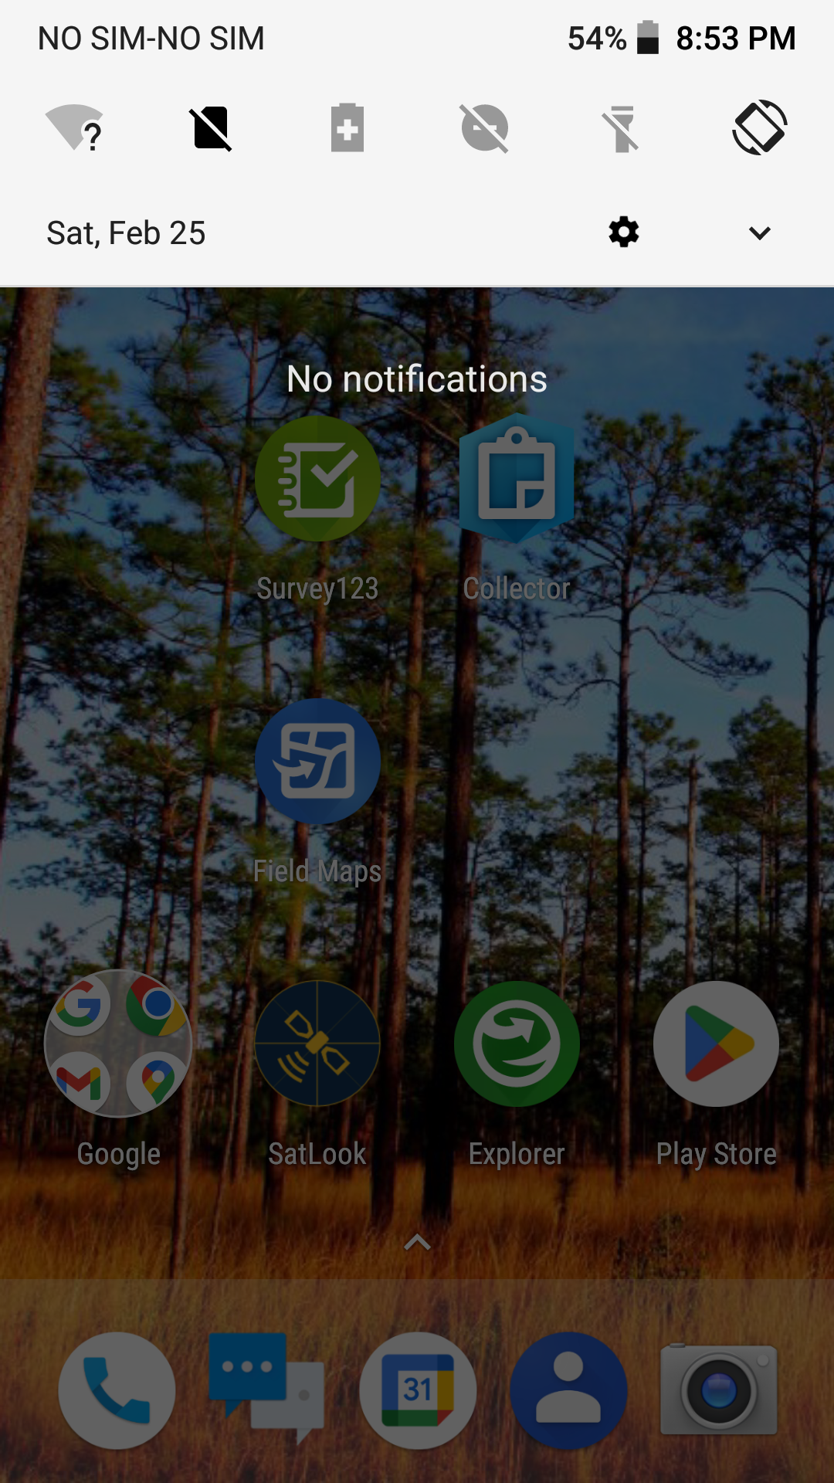
Device Settings
Location Setting – turn off Wi-Fi Scanning
1. Drag menu down from top of Home Screen, 2. Go to Settings.
3. Go to Location → Wi-Fi Scanning
4. Turn Wi-Fi scanning off

Slide 14
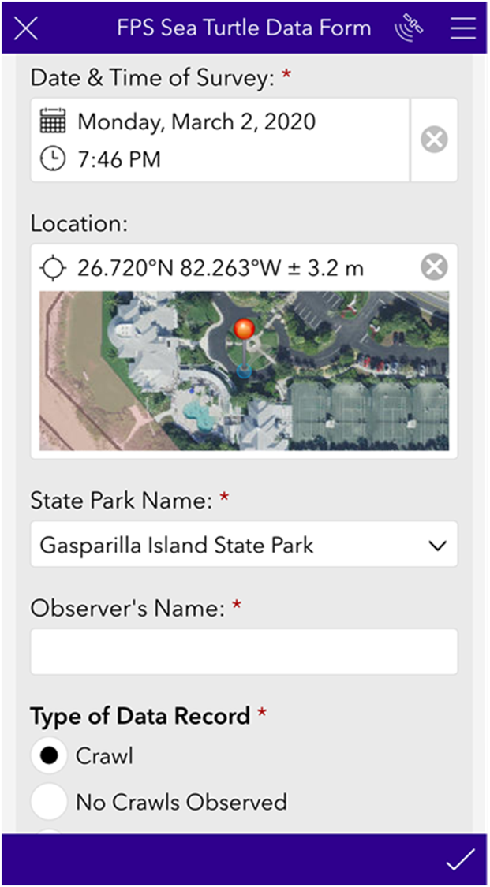
Device Settings
Location Accuracy
Horizontal Accuracy
Displayed next to the Lat/Long on survey form.
If device is using enough satellites, the accuracy should be ≤ +/- 5m.
Can be improved by hitting the bullseye. TDC will recalculate your location.
Location Map
Your location is shown on the map as a red pin.
Make sure that it shows you on the beach.
If no map is showing, you are not connected to satellites. Try hitting the bullseye. TDC will recalculate your location.

Slide 15
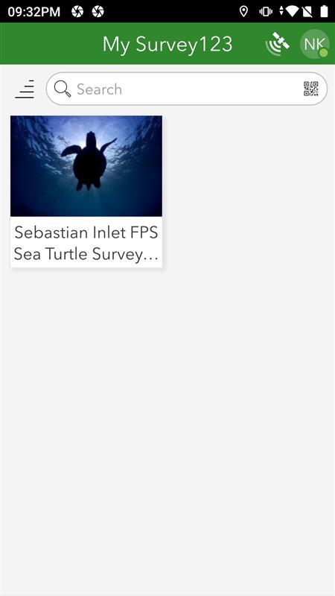
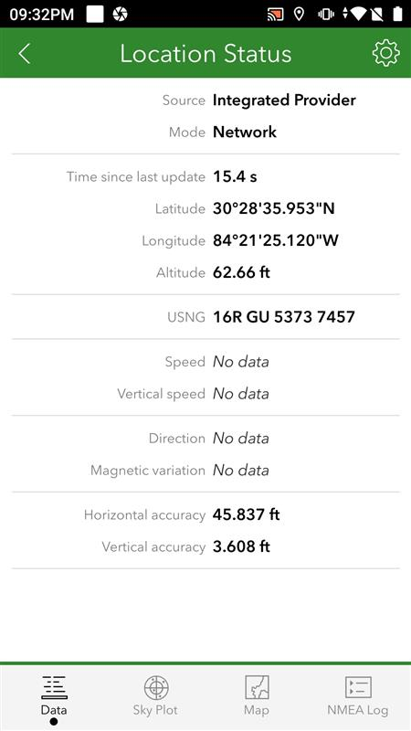
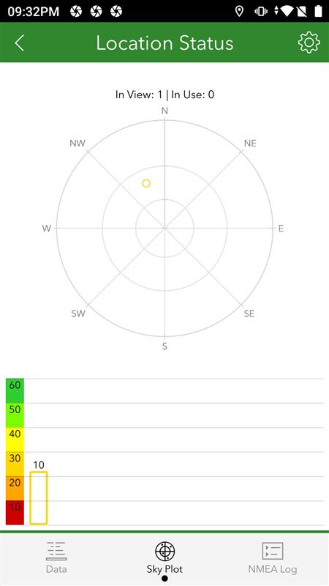
Device Settings
Location Accuracy
Satellite Map
8
5
Tip: We want the GPS using at least 8 satellites
Satellite tracking in Survey123 that shows a visual representation of the satellites your TDC is using.
The more satellites it’s using the more accurate your location.
Good
Signal Strength
Poor

Slide 16
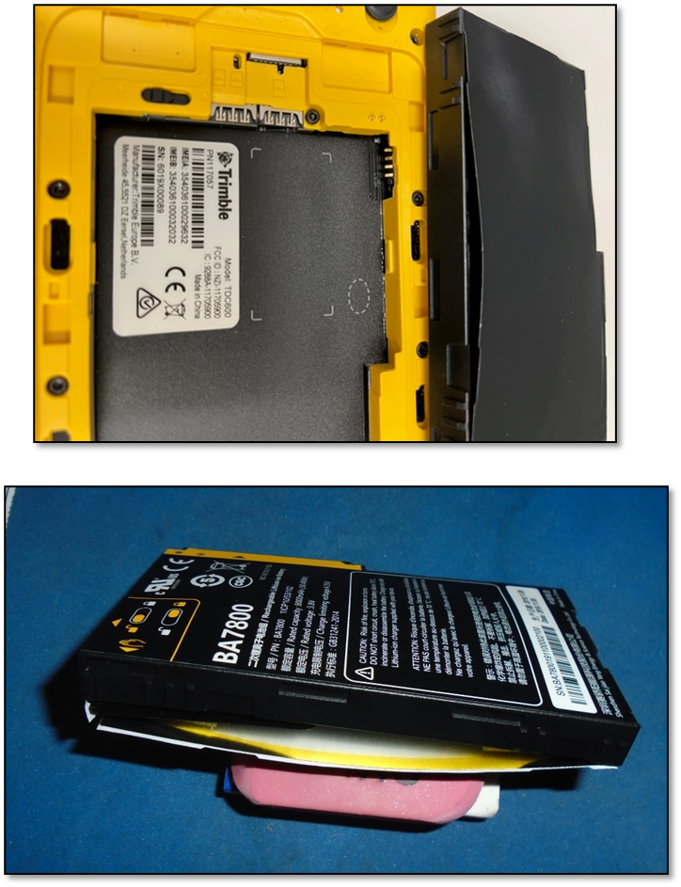
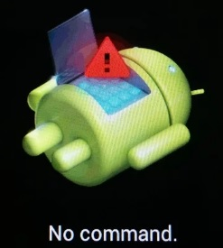
Device Care
With great power…
Do NOT Leave TDC battery plugged in constantly
Allow the battery to drain down before charging in a cool place.
Overcharged or overheated batteries will expand/explode
Do NOT Leave in extreme temperatures (heat or cold) like direct sunlight or outside shed
Run time of fully charged battery is up to 8 hours!
Full charging takes four hours.

Slide 17
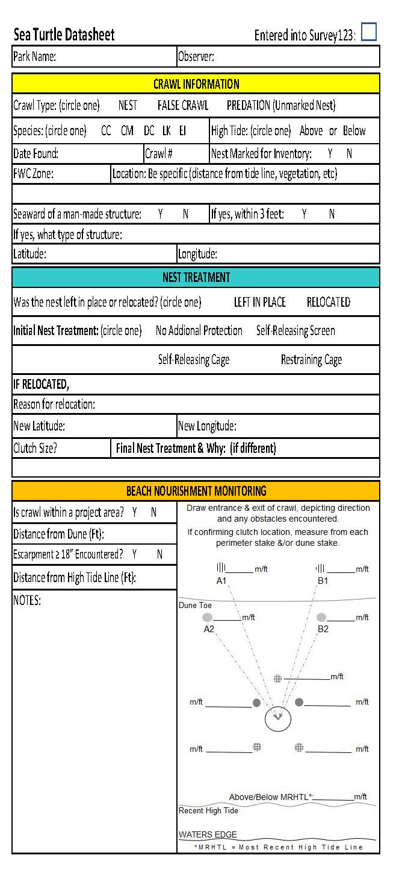
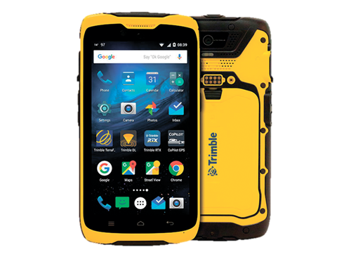
Data Collection
Two options for collecting data and syncing to database:
Collect data on paper datasheets and
desktop app to enter data.
Collect data on the beach with a mobile device and use wi-fi to sync data.
* Paper datasheet can be found on BNCR Sharepoint site Turtle App Training Materials.

Slide 18
Syncing Data
Syncing data from the mobile device to database
(same for desktop)
As often as you have access to wi-fi
High density beaches – at least once a week
Low density beaches – as often as you feel comfortable that you
will not miss any data
Caution: if your device has a catastrophic error and cannot be turned on, you may lose any data that has not been synced.
Catch data collection errors before they become troublesome to fix.

Slide 19
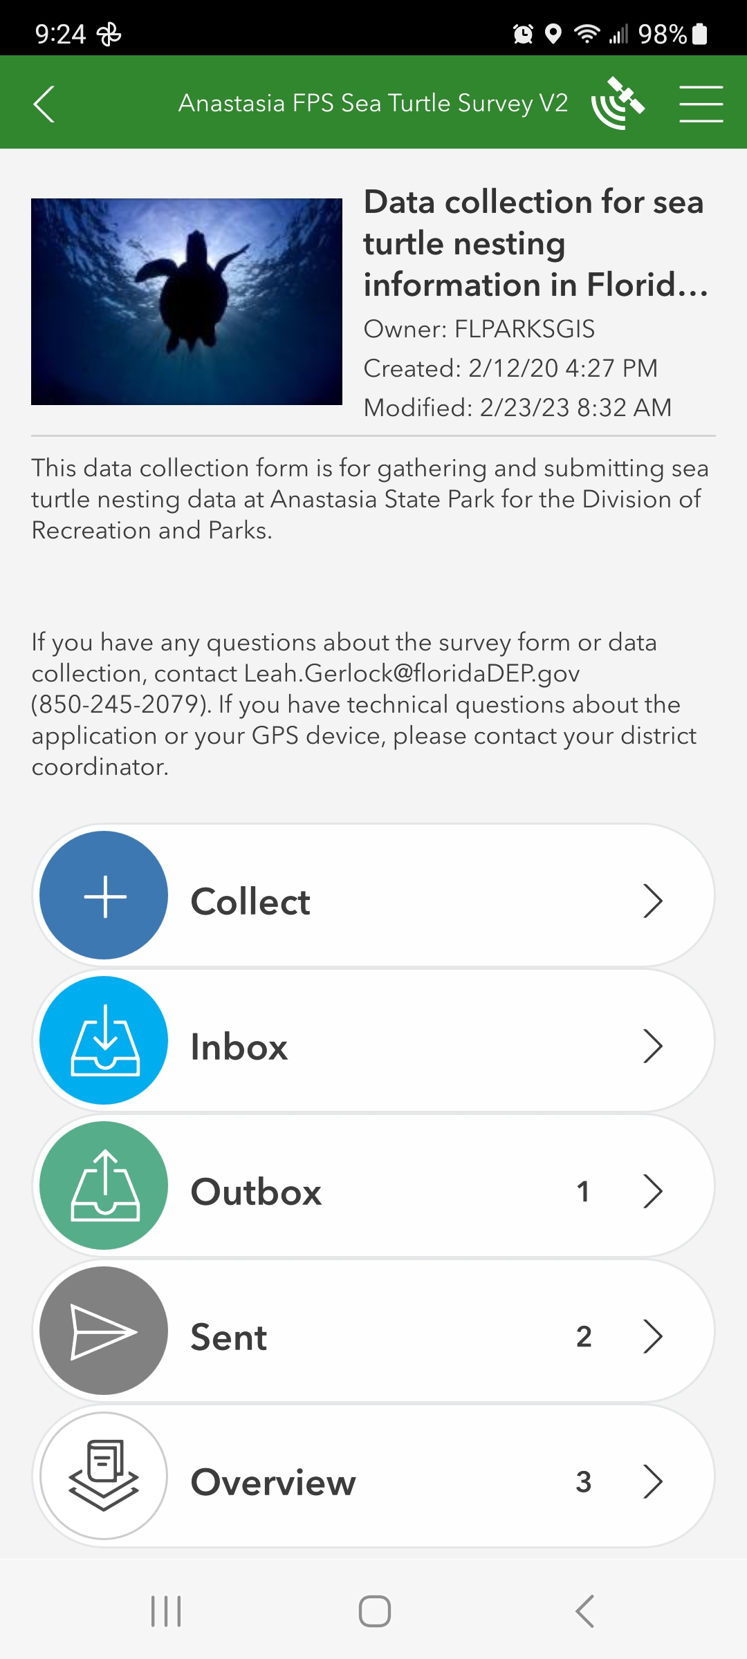
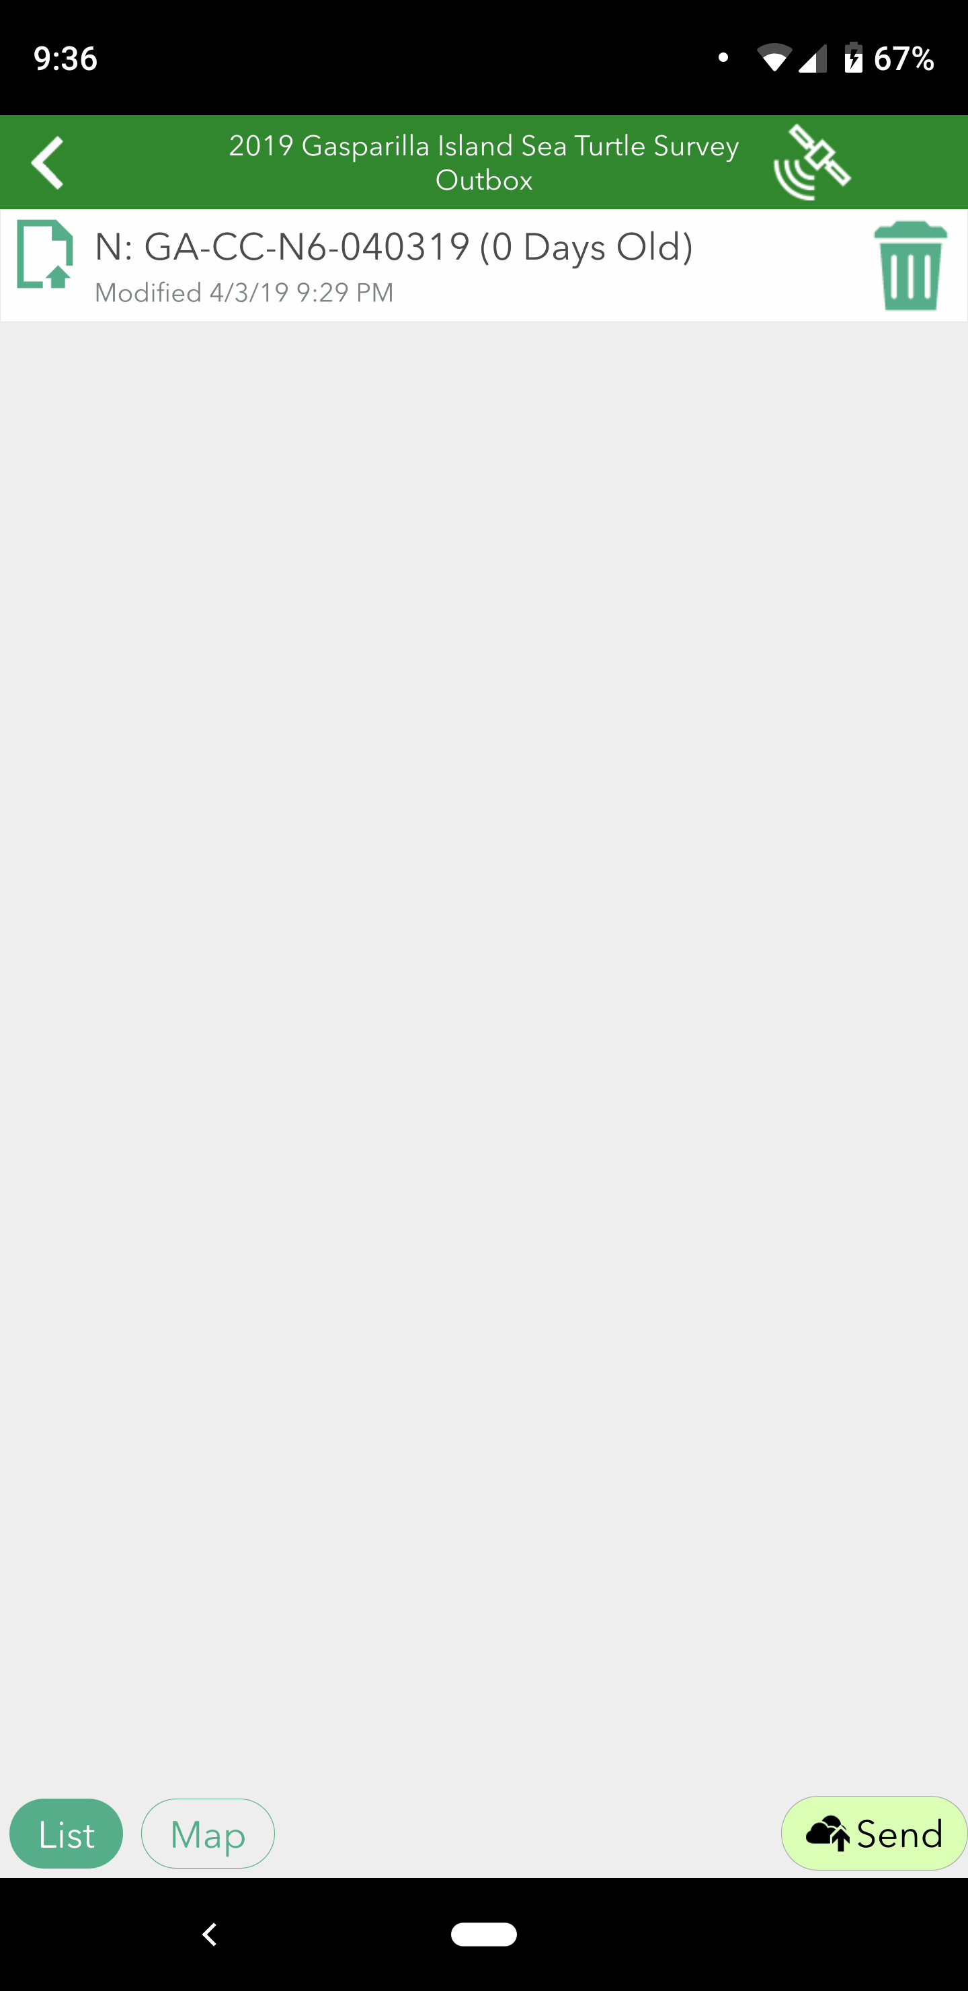
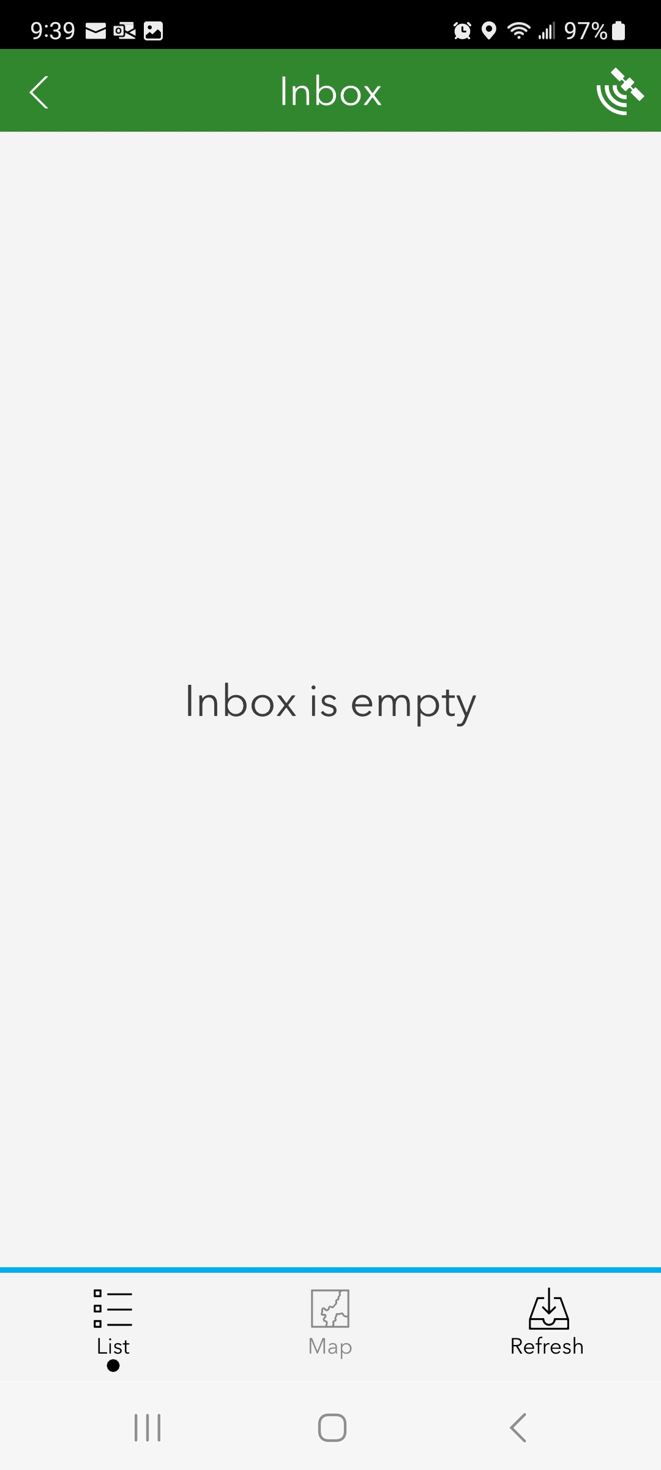
Syncing Data
Must be connected to Wi-Fi
1. Go to Outbox - data saved to device but not yet synced
2. Sync (Send) all the records – sends to database
3. Refresh Inbox
Inbox contains all the records collected with the park’s app (by any users or device)
Sent box contains all the records collected with your device
Overview contains all records, Sent and Outbox combined
1.
2.
Sync
3.

Slide 20
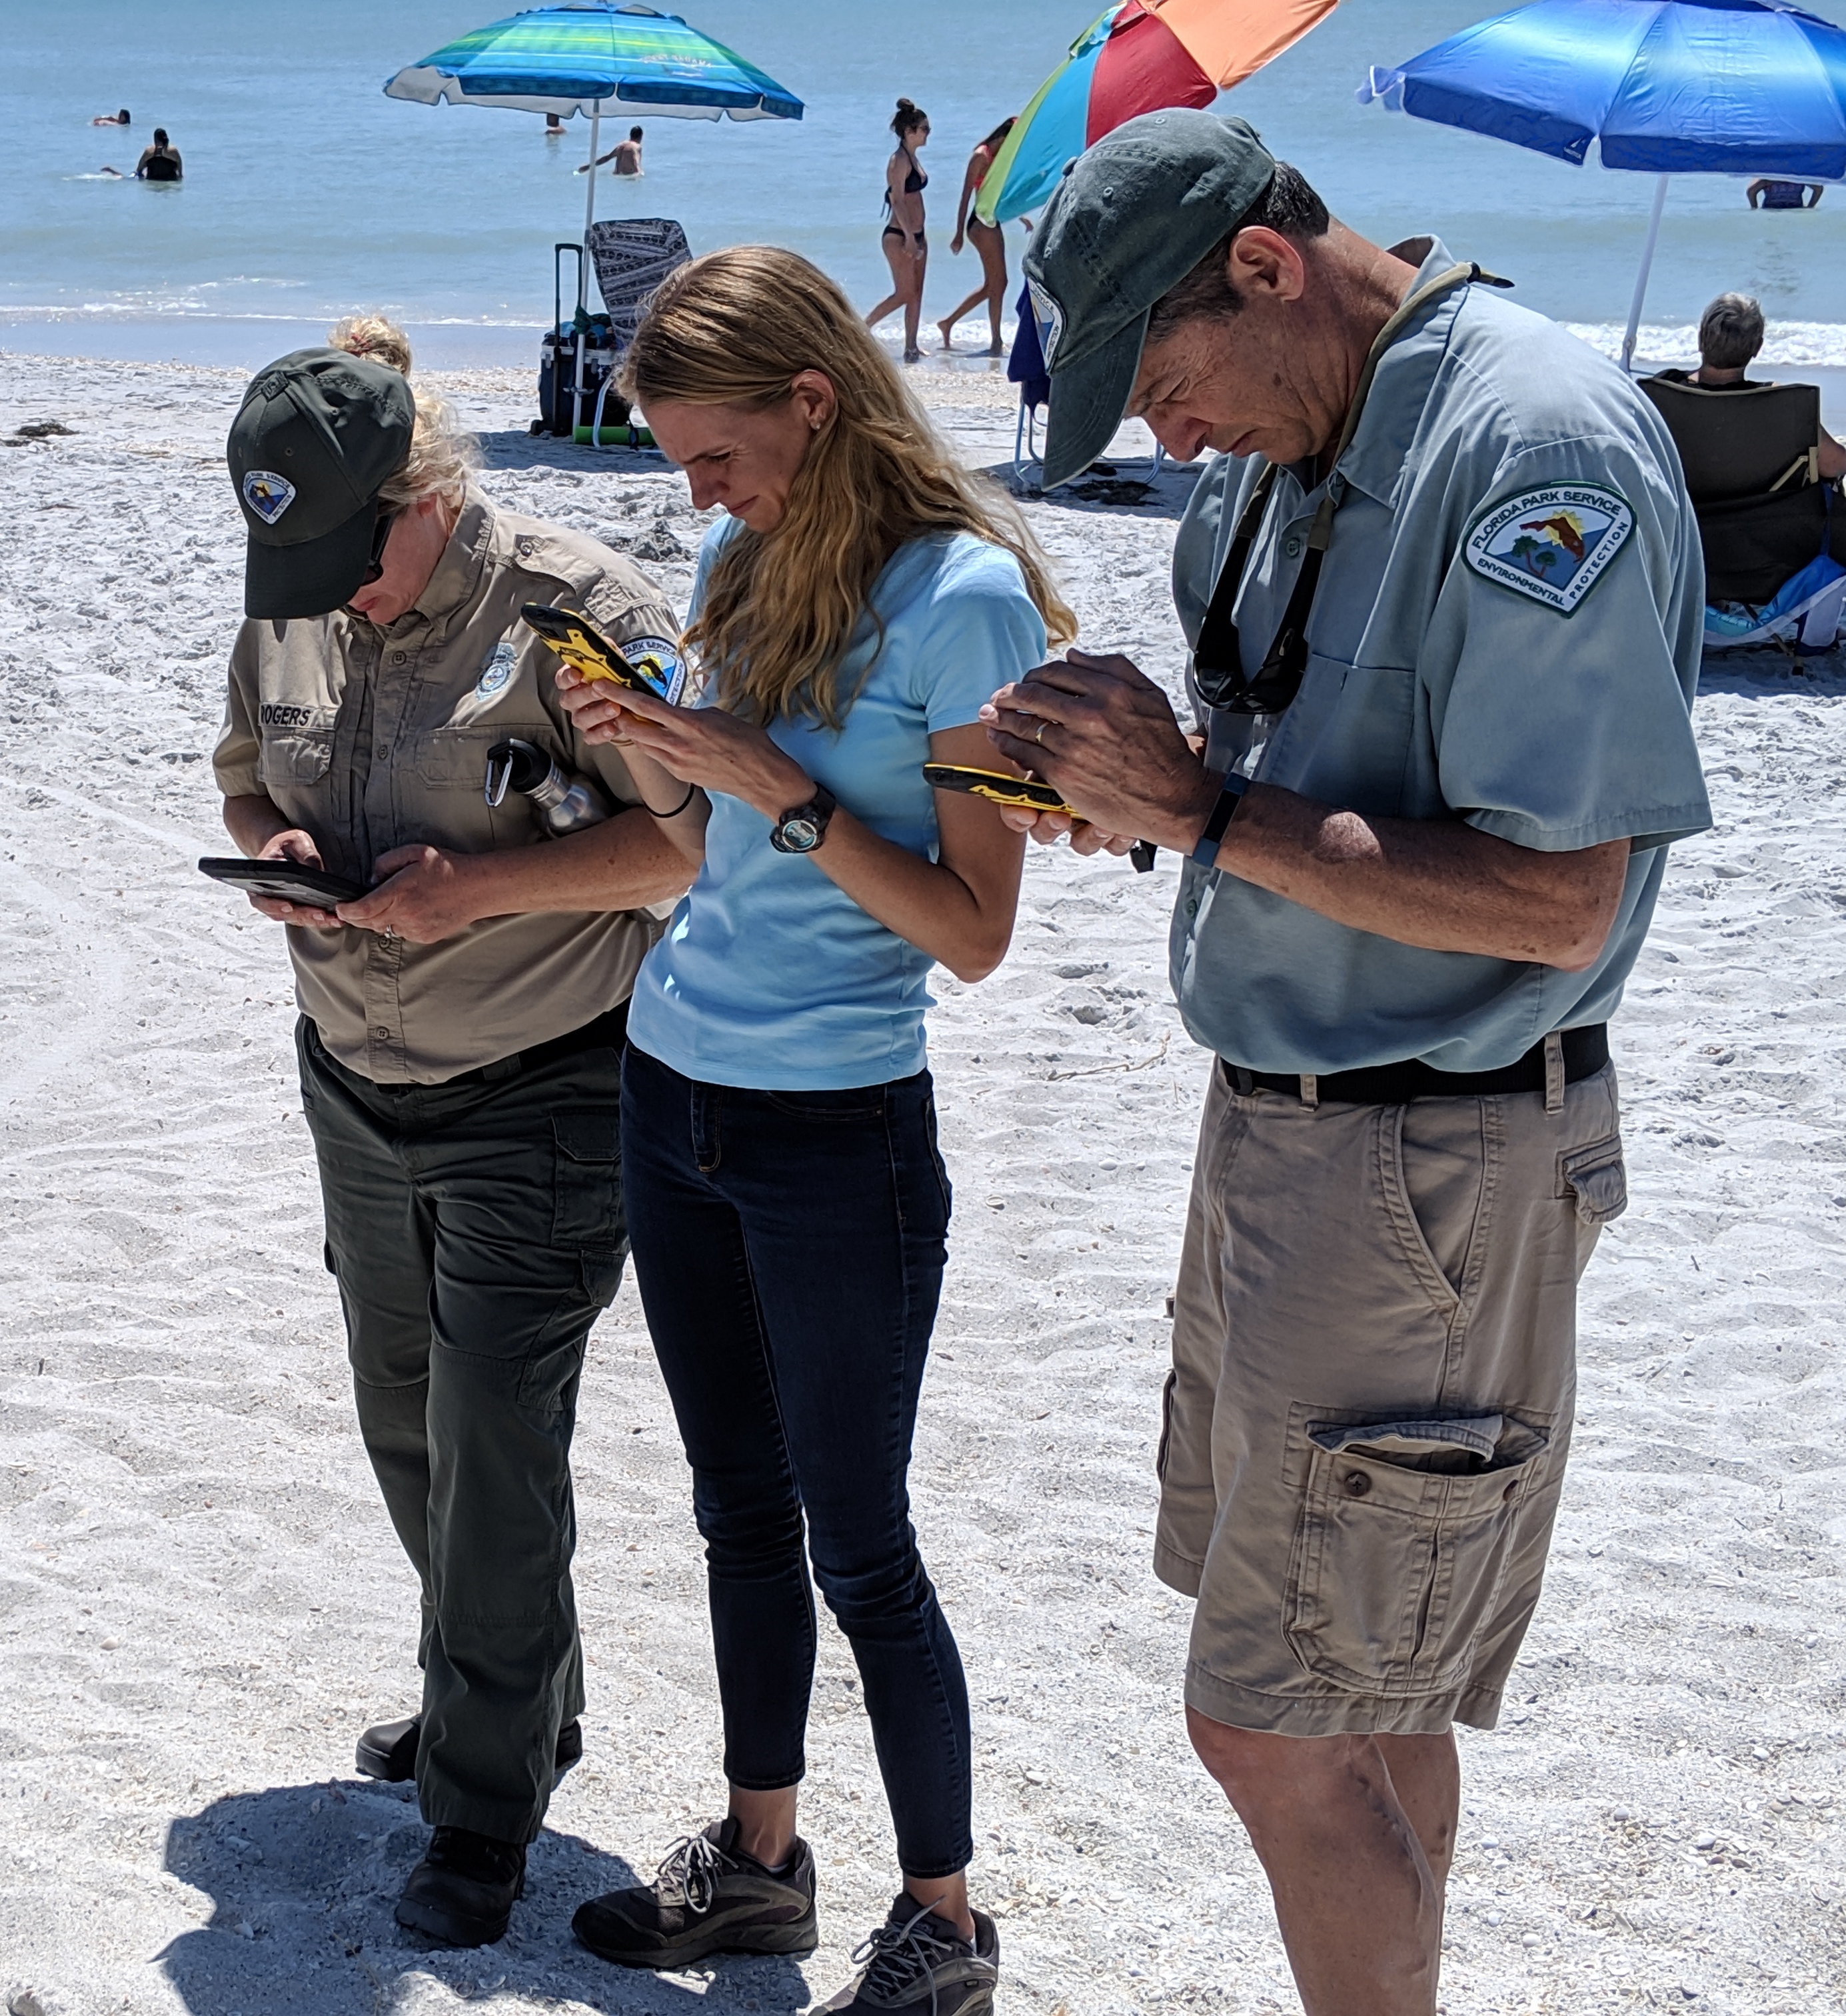

Revisiting Nest Forms
To update nest info/fate/or inventory data
Can be done as many times throughout the season as you need
Important to sync after every time form is edited
1. Refresh Inbox – now you have all the nests collected for your
beach
  Search for the nest ID and reopen the form
2. This will not change the lat/long or date/time
  Just adding more info and updating the form
3. Enter new information
4. Hit the green “check” at the bottom of the form
5. Return to office, connect to wi-fi and sync.
6. Refresh the Inbox

Slide 21
Data Management
Use the web map link
Do this on your desktop computer
Link for your park’s data map will be emailed by BNCR
Log-in using your park’s AGO account info
Check data often to catch errors, especially at the start of the season
Lat/long issues – happens when GPS is not given time to get a good fix.
Unanswered questions
Data not syncing from TDC
Duplicate entries
Can use filter tools to sort data

Slide 22
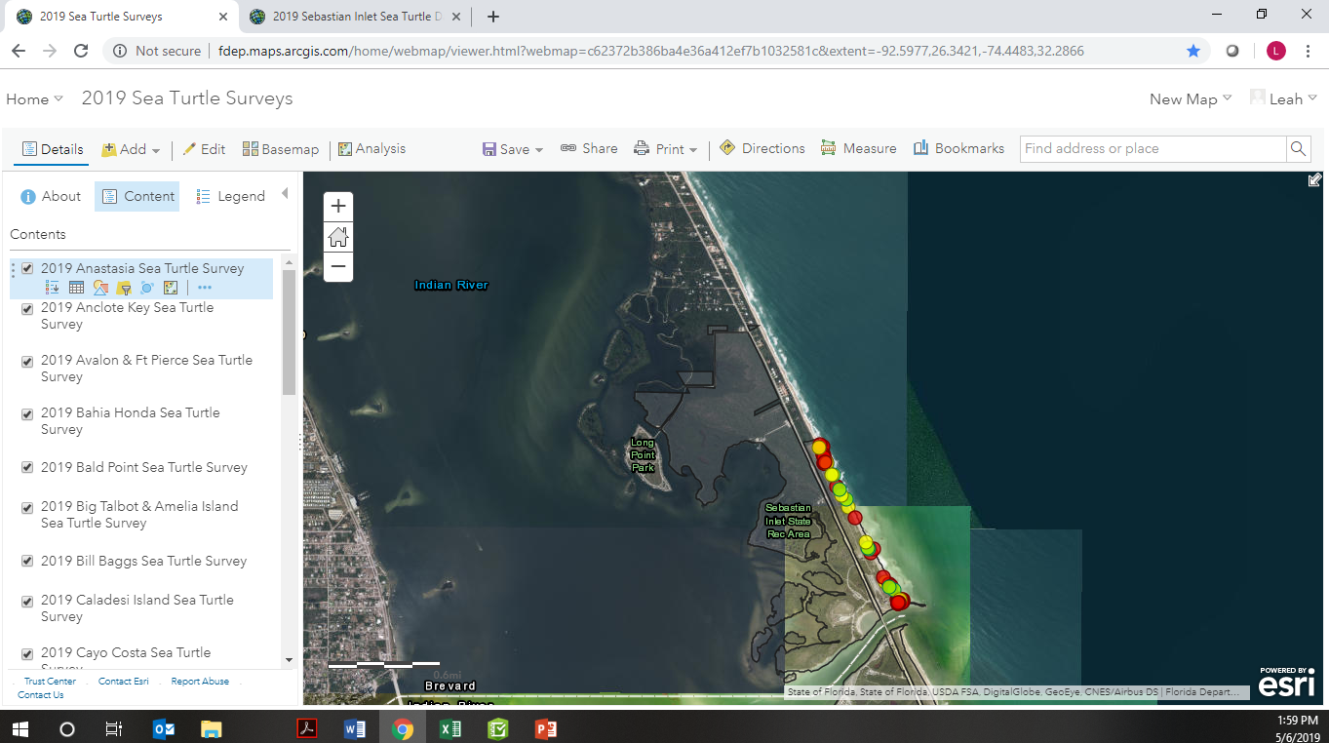

Reviewing Data
Using the Web Map to view and edit data
Open the link for your map on the desktop
May need to login to AGO with park account
Can “Zoom to” your park in the Contents tab
  Hit the icon under the park layer.
Two options for looking at data:
  Data Table
  Clicking on a point
Can use filter tools to sort data

Slide 23
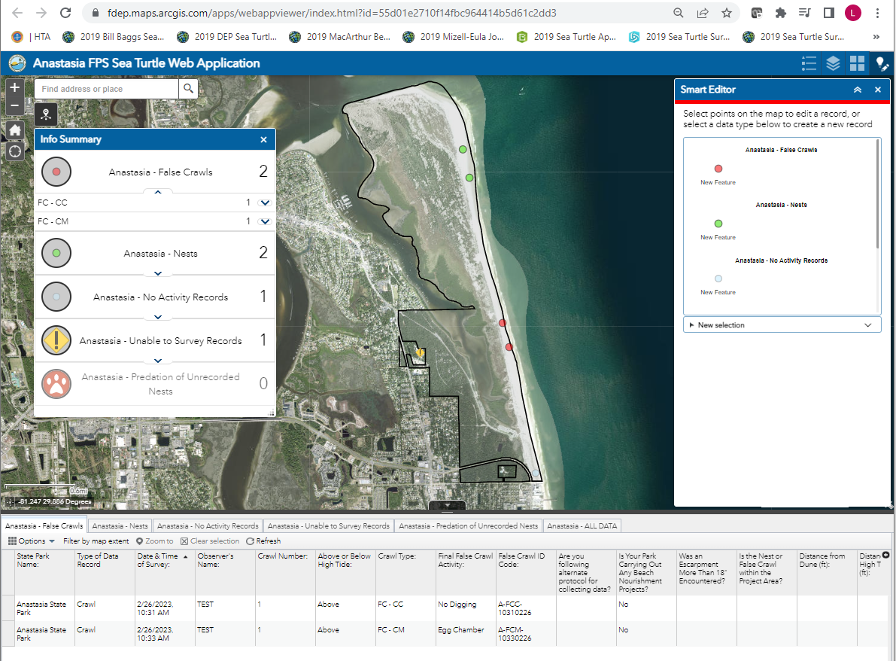


Web Map
Online database allows user to:
View records in database
Edit/Delete Records
Export data

Slide 24
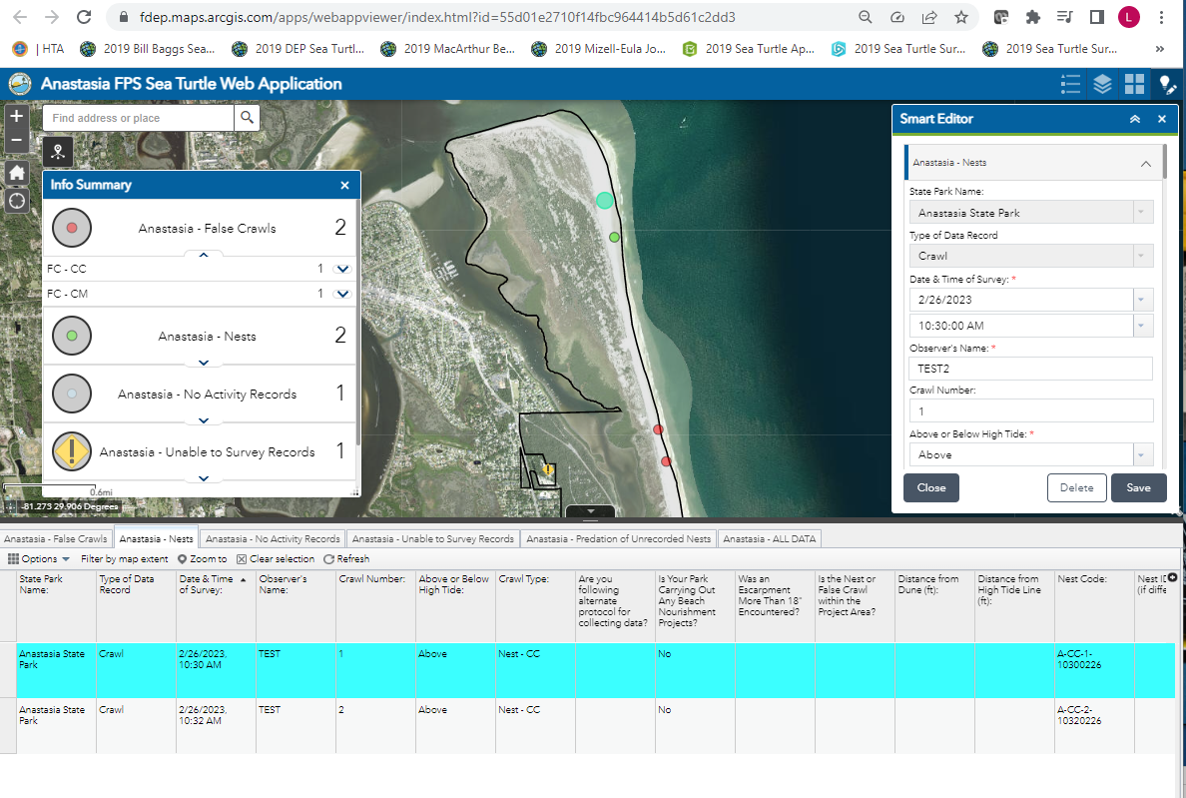
Editing Point Information
Open the data table at the bottom of the map.
Make sure you are in the right “crawl type” tab.
Find the record you want to edit and click on it.
  Find it in the table or click on the dot on the map
  You may have to zoom in to the beach on the map.

Slide 25
Editing Point Information
Once you have selected the point, the form will appear in the Smart Editor.
Make any edits or updates.
Then hit save.
To Delete a point, just hit “Delete”
It will ask if you are sure, hit “Yes”
Caution: Deleting a point in the database cannot be undone.

Slide 26
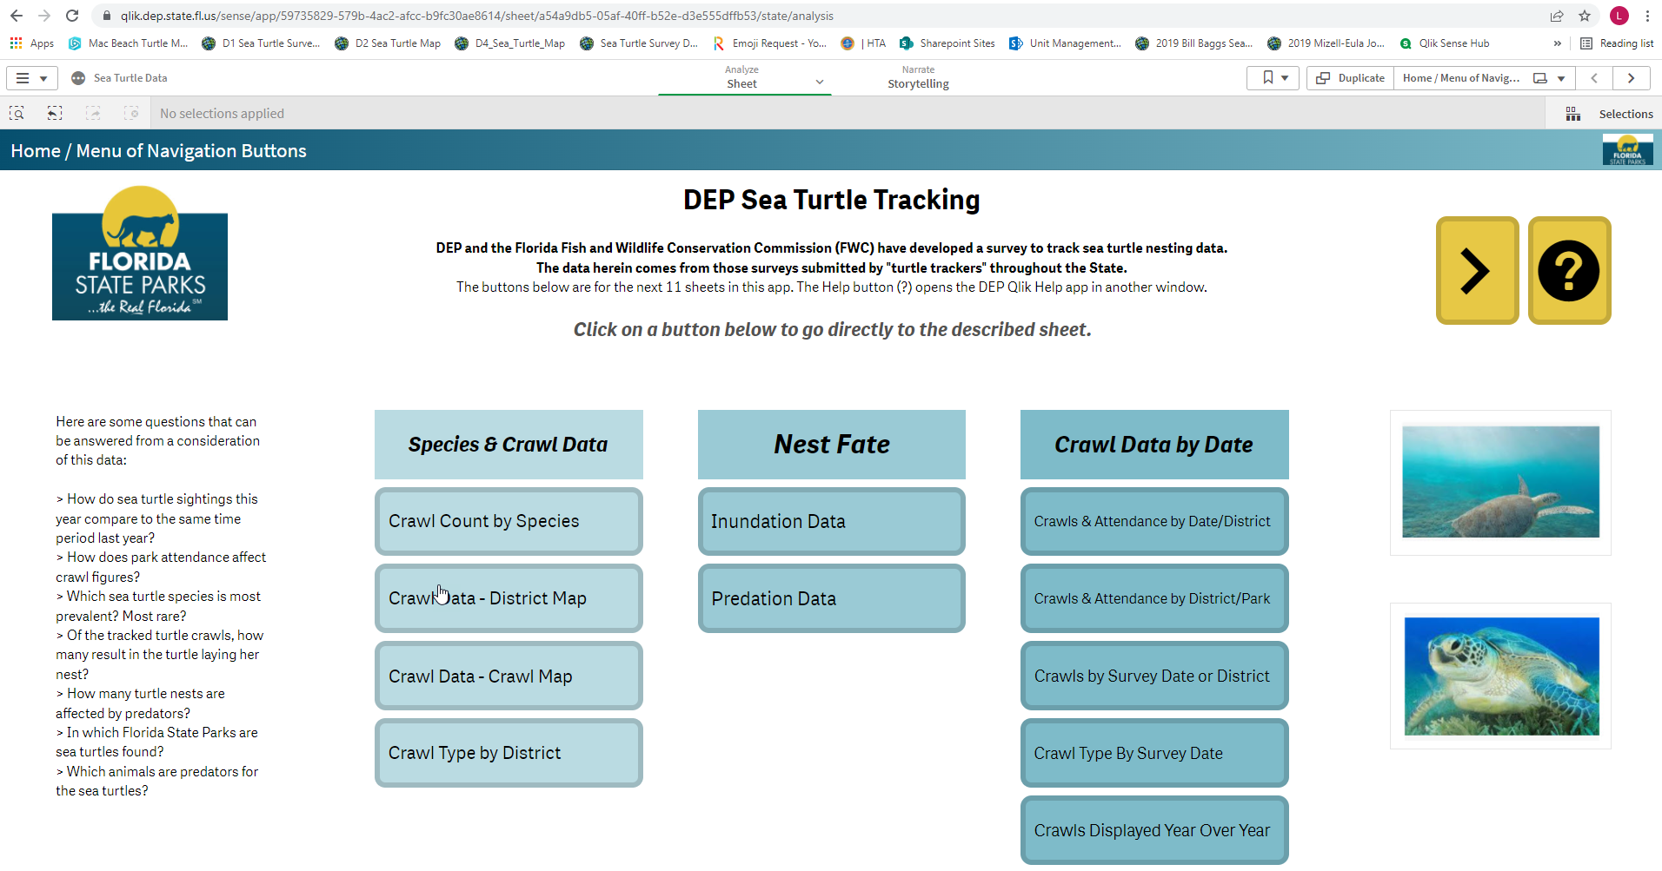
DEP Sea Turtle Tracking Dashboard
DEP Sea Turtle Qlik Site

Slide 27
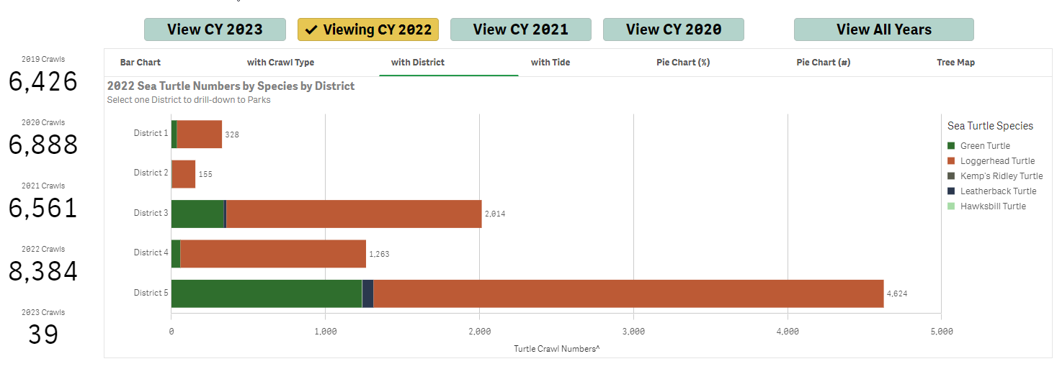
2022 – Nests by District

Slide 28
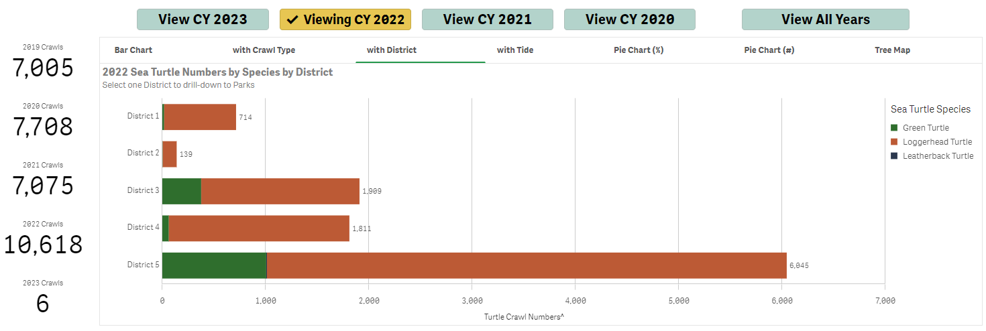
2022 – False Crawls by District

Slide 29
Reporting Data to FWC
PAPERLESS!
BNCR will automatically generate all of the reports required by FWC
Survey app is based on FWC’s NPA spreadsheet, SNBS summary report, Beach Nourishment and Daily Crawl reporting forms.
Reports will be auto-generated
  Parks must get ALL their data into Survey123.
  BNCR will send reports to parks for review
Park permit holder is still responsible for submitting reports to FWC.
If you have any questions about the reports or if data does not look correct, LET US KNOW
New NPA questions in 2023!

Slide 30
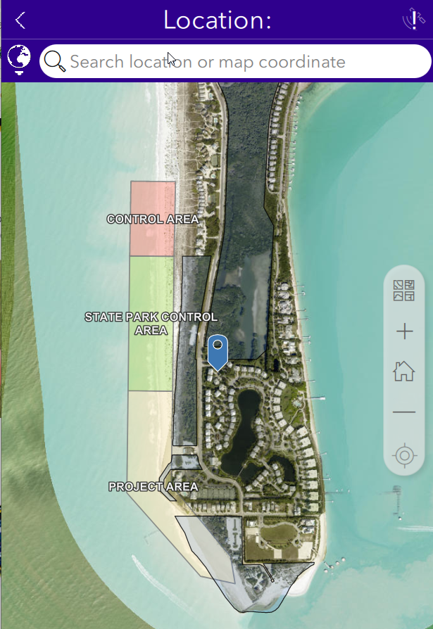
Beach Nourishment Monitoring Reporting
Additional nest monitoring required when a beach receives sand placement
Parks for 2023:
  Amelia Island
  Anastasia
  St. Joe
  St. Andrews
  Mizzell-Eulla
  Camp Helen
  Gasparilla Island
  Lovers Key
  South Sebastian Inlet
  Delnor Wiggins
  Fort Clinch
  Grayton/Deer Lake
  Honeymoon Island
  Stump Pass
Question, “Is your park carrying out a beach nourishment” will default “Yes”
  Requires additional info for each crawl

Slide 31
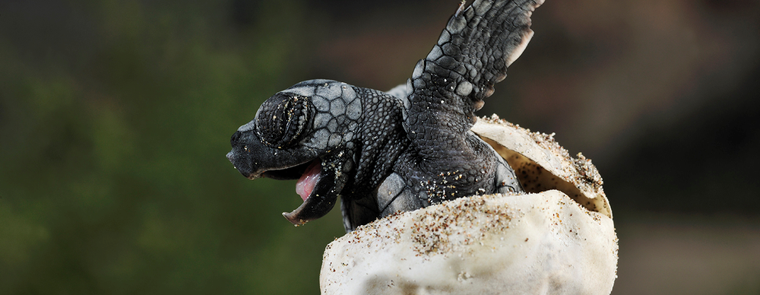
Sea Turtle Data Collection App Training
Questions?
Feel free to give us a call and we will do our best to help with any issues you have!
Leah Gerlock, Natural Resource Specialist
(850) 245-2079
Leah.Gerlock@dep.state.fl.us
Jess Richardson, GIS Technician
(850) 245-3058
Jessica.L.Richards@dep.state.fl.us

