Slide 1

Water Quality Restoration Program
Silver Springs Basin Management Action Plan
Mary Paulic
mary.paulic@dep.state.fl.us
August 7, 2013

Slide 2


Why There is a Silver Springs BMAP
Silver Springs listed as impaired in 2009:
  Due to presence of algal mats; and
  Mats linked to high nitrate level.
Total Maximum Daily Load required:
  TMDL adopted in 2012;
  Sets a nitrate target of 0.35 mg/L; and
  79% Reduction of Nitrogen Loading from Nonpoint Sources is required.
Notes:
BMAP has a 0.35 nitrate concentration target, but it is loadings of nitrogen that must be reduced to achieve lower concentrations of nitrate. BMAPs are a partnership between state and local communities to address impaired waterbodies.

Slide 3
Silver Springs BMAP
Basin Management Action Plan (BMAP):
  Initiated in March 2013; and
  Work on 5 year cycles.
Purpose of a BMAP:
  Identify actions or best management practices (projects) that will reduce nitrate level and loads;
  Identify partnerships for projects; and
  Focus is water quality.
Notes:
BMAP has a 0.35 nitrate concentration target, but it is loadings of nitrogen that must be reduced to achieve lower concentrations of nitrate. BMAPs are a partnership between state and local communities to address impaired waterbodies.

Slide 4
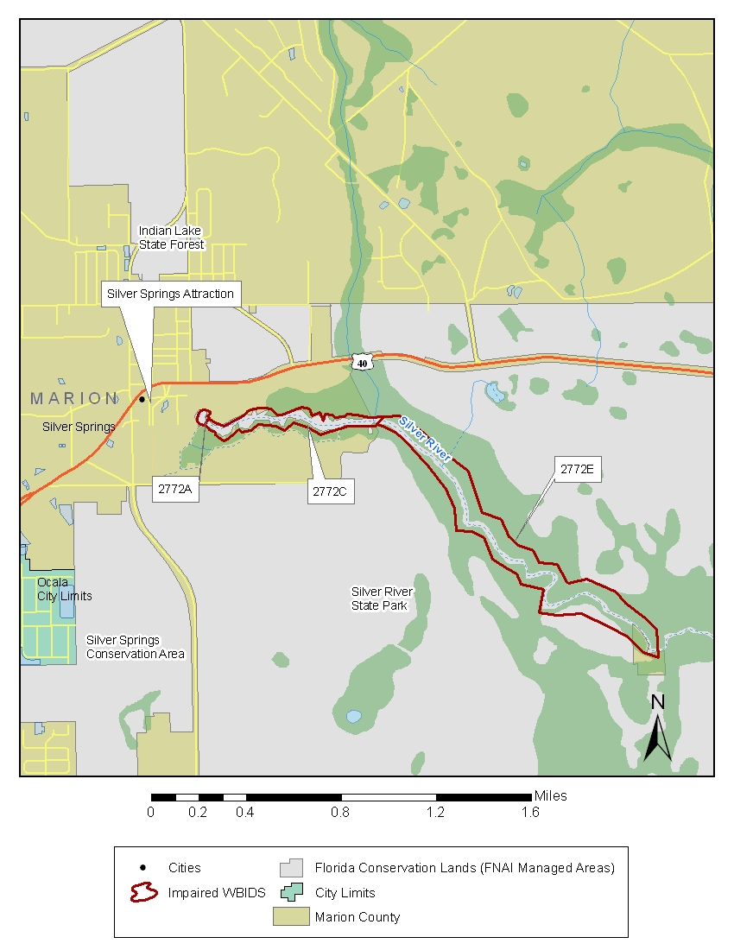
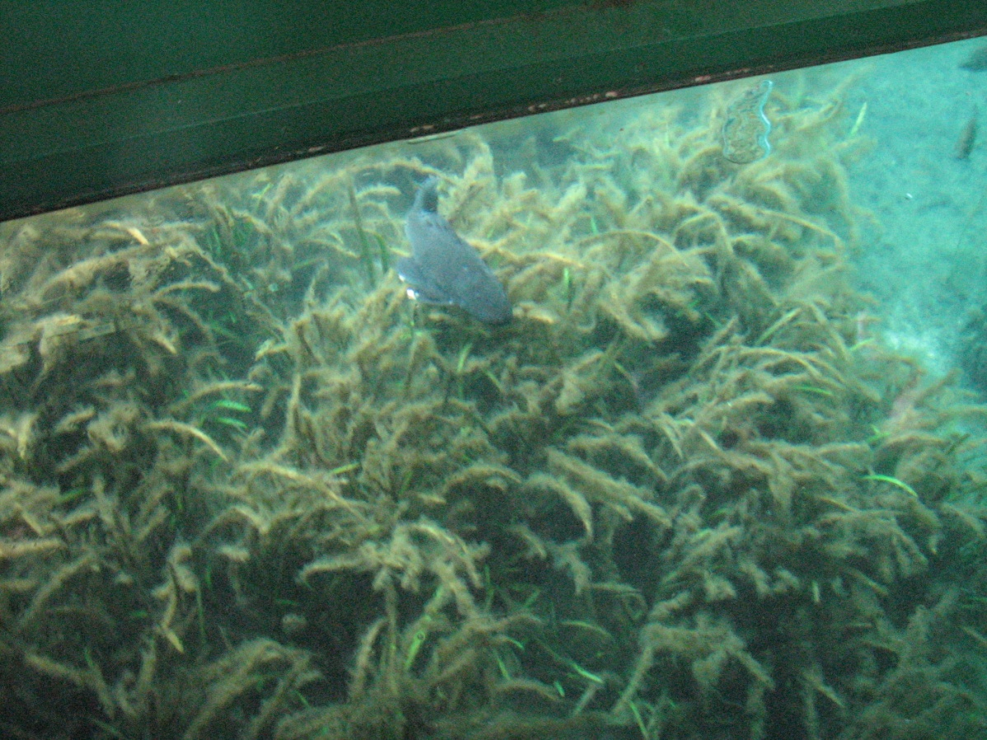
Impaired Waterbodies
Silver Springs Main 2772A
Silver Springs Group 2772C
Upper Silver River 2772E

Slide 5
BMAP Management Area
Provisional management area defined.
Role of management area:
  Helps identify stakeholders – at a minimum for communication purposes;
  Define area for nitrogen inventory; and
  Define area for project data collection.

Slide 6
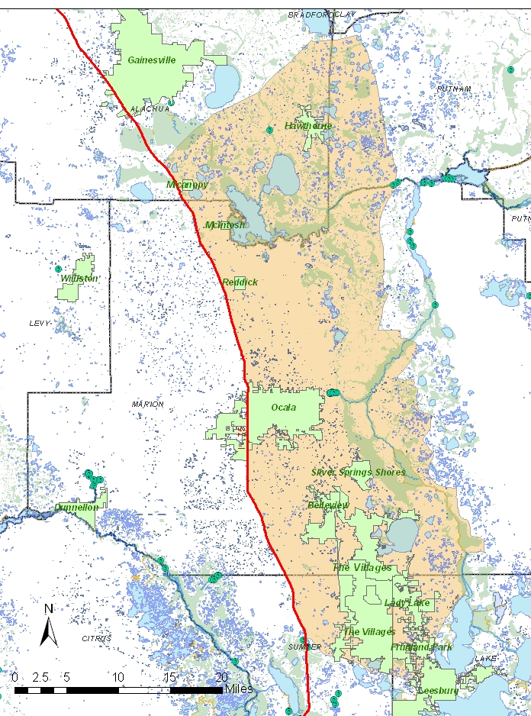
DEP Partners
County:
Marion, Alachua, Lake counties.
City:
Ocala, Belleview, The Villages,
Reddick, McIntosh, Micanopy,
Hawthorne, Fruitland Park, Lady
Lake Silver Springs Shores.
State and Regional:
SJRWMD, SWFWMD, DEP,
DOT, DACS, Silver Springs SP, FWC, DOH.
Community:
Silver Springs Alliance, Florida Springs Institute, Florida Farm Bureau, IFAS, business and community members.
Major roads define boundary of management area.

Slide 7




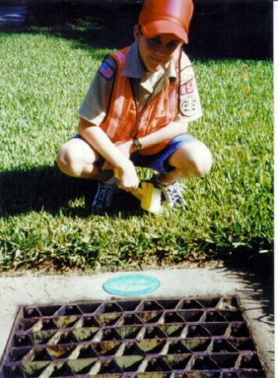


BMAP Activity –Nitrogen Inventory
Nitrogen loading inventory in progress:
  Purpose is to identify sources of nitrogen; and
  Identify locations with high loadings to aquifer.
Potential Nitrogen Sources:
  Wastewater;
  OSTDS (septic system);
  Agricultural fertilizer;
  Urban fertilizer;
  Animal waste;
  Lake seepage;
  Atmospheric deposition;
  Stormwater via drainage wells; and
  Direct stormwater.

Slide 8
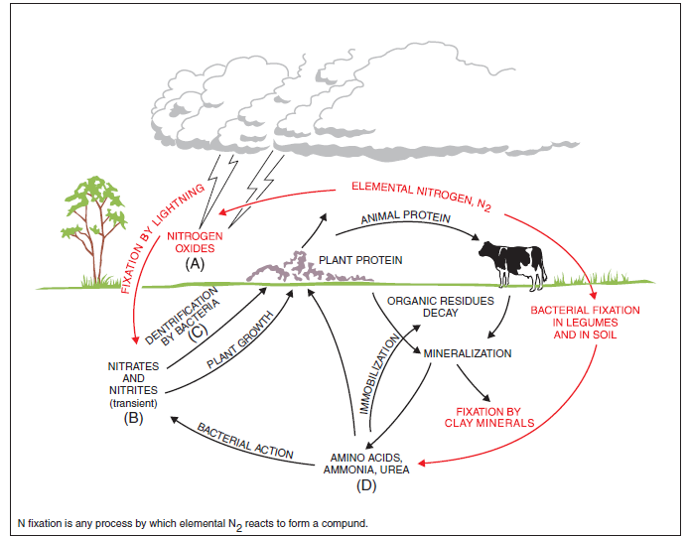
Nitrogen Cycle is fairly complicated

Slide 9
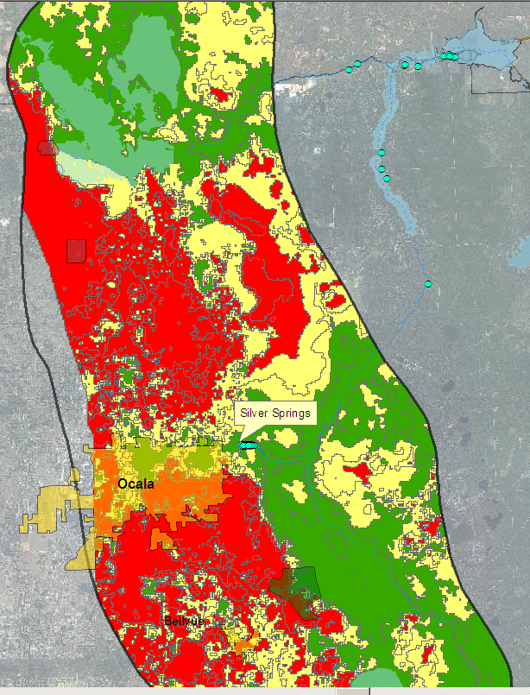
Geological Influences
Aquifer Recharge Rate
Low (green, discharge -4 in)
Medium (yellow, 4-12 in)
High (red, 12->25 in)

Slide 10
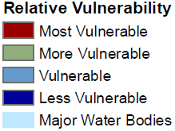
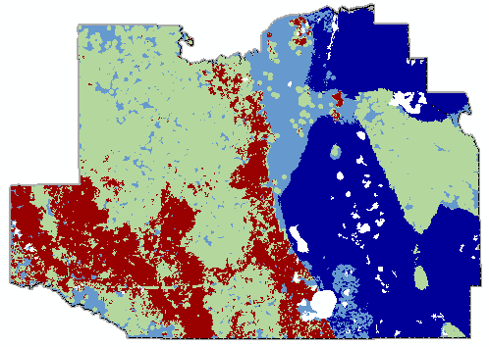
Marion County Aquifer Vulnerability Assessment
10

Slide 11
BMAP Activity – Project Data Collection
Collect information about local projects:
Urban structural BMPs – stormwater ponds, swales;
Street sweeping;
Public education and outreach;
Planning: Spring protection zone;
Maintenance and operation of BMPs;
Land purchases for conservation and preservation;
Florida Friendly Landscaping;
Agriculture BMPs – type and acreage covered under a notice of intent;
Upgrades to wastewater treatment plants; and
Sewering of areas served by septic tanks.

Slide 12

Focus Areas
Next step is to delineate where to “focus” restoration efforts.
  Purpose of focus areas is to concentrate remediation efforts where they will do the most good; and
  Most effective use of dollars.
Next BMAP meeting is August 21 at 1 p.m. at:
  Marion County Growth Management Office
  2710 East Silver Springs Blvd
  Ocala, Florida

Slide 13

QUESTIONS?

Slide 14
Website and FTP Addresses
http://www.dep.state.fl.us/water/watersheds/bmap.htm - website for meeting announcements.
http://www.dep.state.fl.us/water/tmdl/final_tmdl.htm - website for TMDL documents, under Ocklawaha Basin.
http://publicfiles.dep.state.fl.us/DEAR/BMAP/Silver_springs/ - FTP site for meeting notes and presentations.

