Slide 1
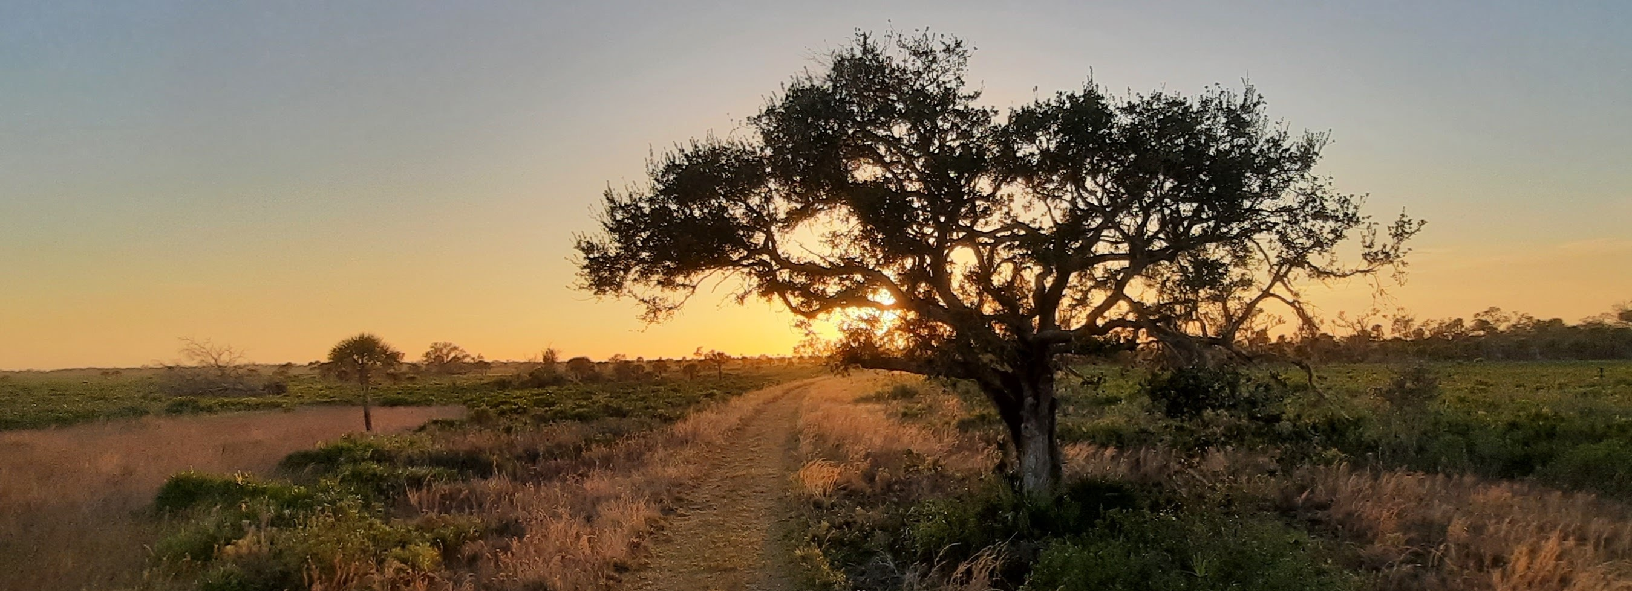
Introduction to the Use of Avenza Maps for Invasive Plant Data Collection
Padraic Elliott

Slide 2
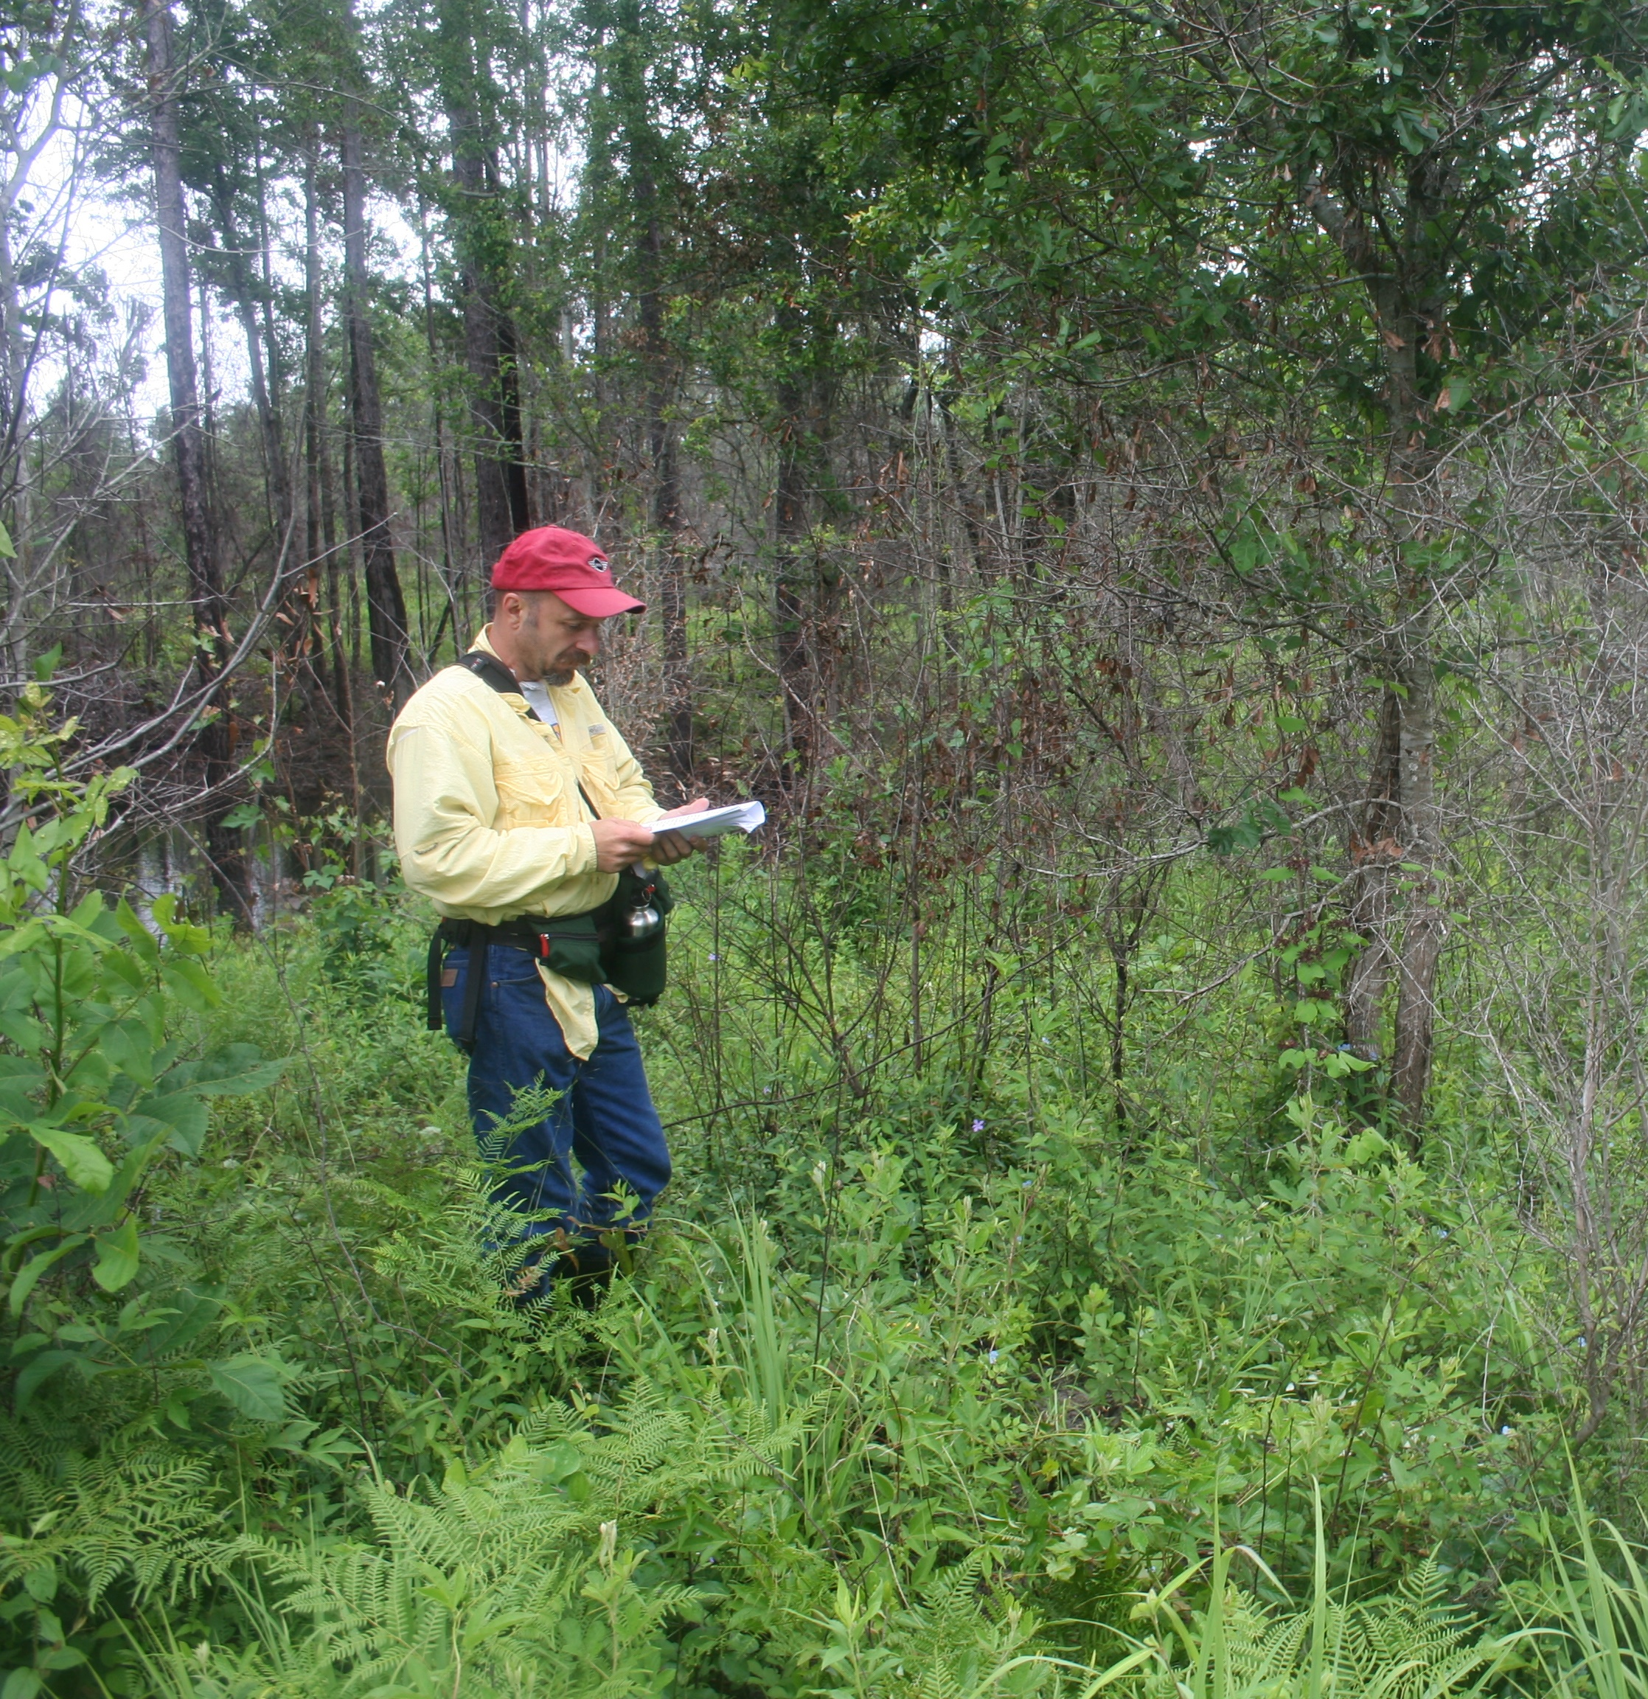
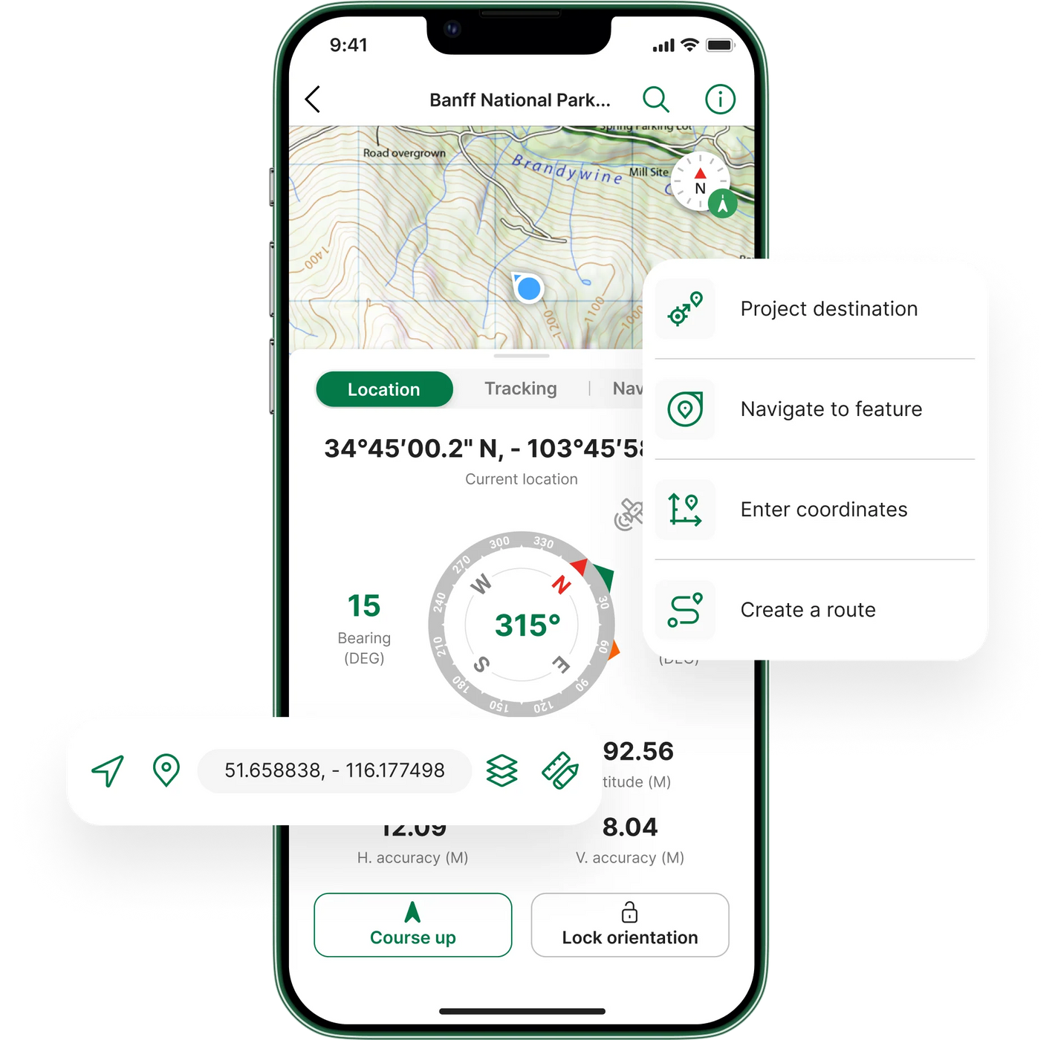
What is Avenza?
Geolocation and Navigation without internet
GPS and Compass only as good as your phone
Tools
  Measuring distance
  Record your tracks
  Record location and take data
Photo credit: https://store.avenza.com/pages/app-features, Pete diamond

Slide 3
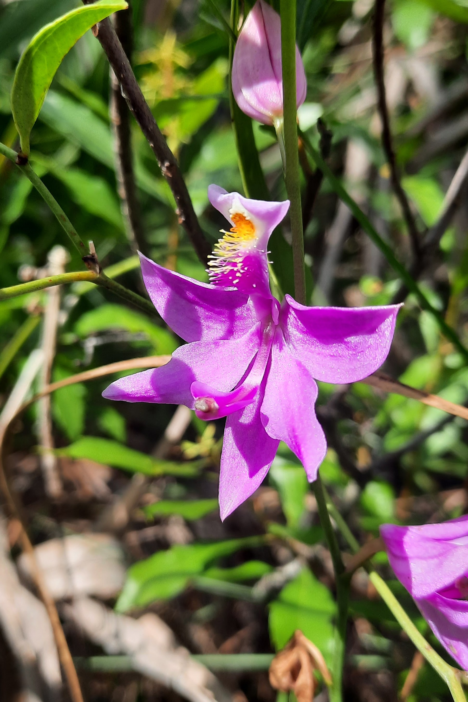
How I have used it
Navigation
Tracking bobwhite quail populations
Prescribed fire application
  “Are we really staying 2 chains apart?”
Recording microhabitat info for Texas horned lizards
Recording locations of cool plants seen

Slide 4


Uses for Invasive Species Management
Track the spread of invasive species on managed land
Conduct baseline surveys, compliance inspections, and maintenance treatment

Slide 5
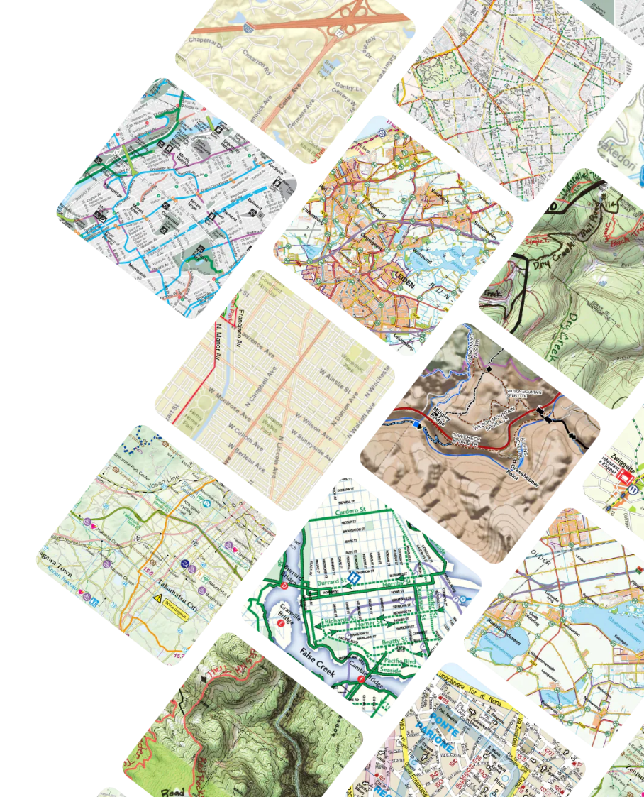




Maps
Uses Georeferenced PDFs
Make your own!
  ArcPro - $100 a year
  QGIS – free
  Sentinel Browser EO- free, most up to date satellite imagery
Can download from the app
  FWC WMAs are free!
  State parks and federal lands cost $$$
https://store.avenza.com/pages/cycling

Slide 6
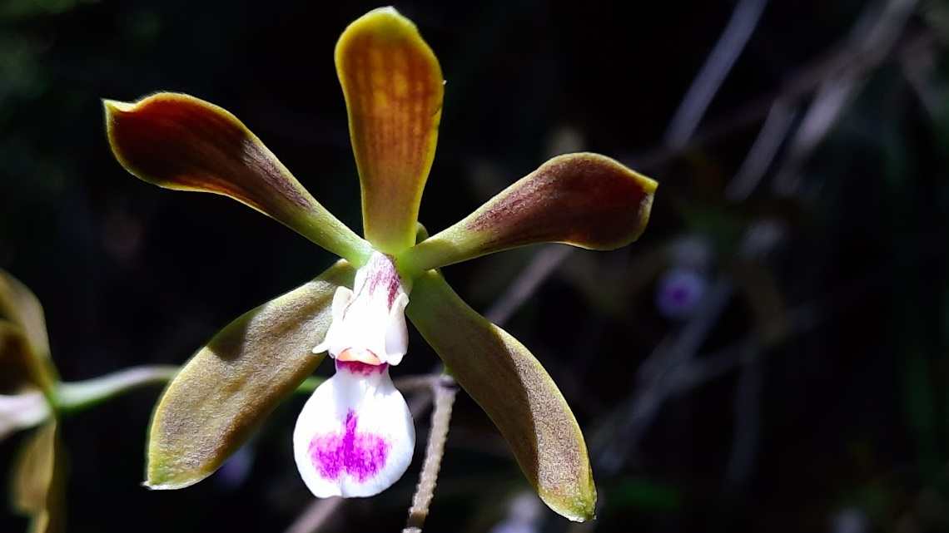
How to get Started

Slide 7

How to get started
Make sure that the app is downloaded onto your phone!!!
Download the map from the email
  SC-999_project_overview_map
Download the schema from the email
  Avenza_invasive_inspection_schema_2024.10.17.kml
PDF Avenza instructions not needed today
Open the app

Slide 8
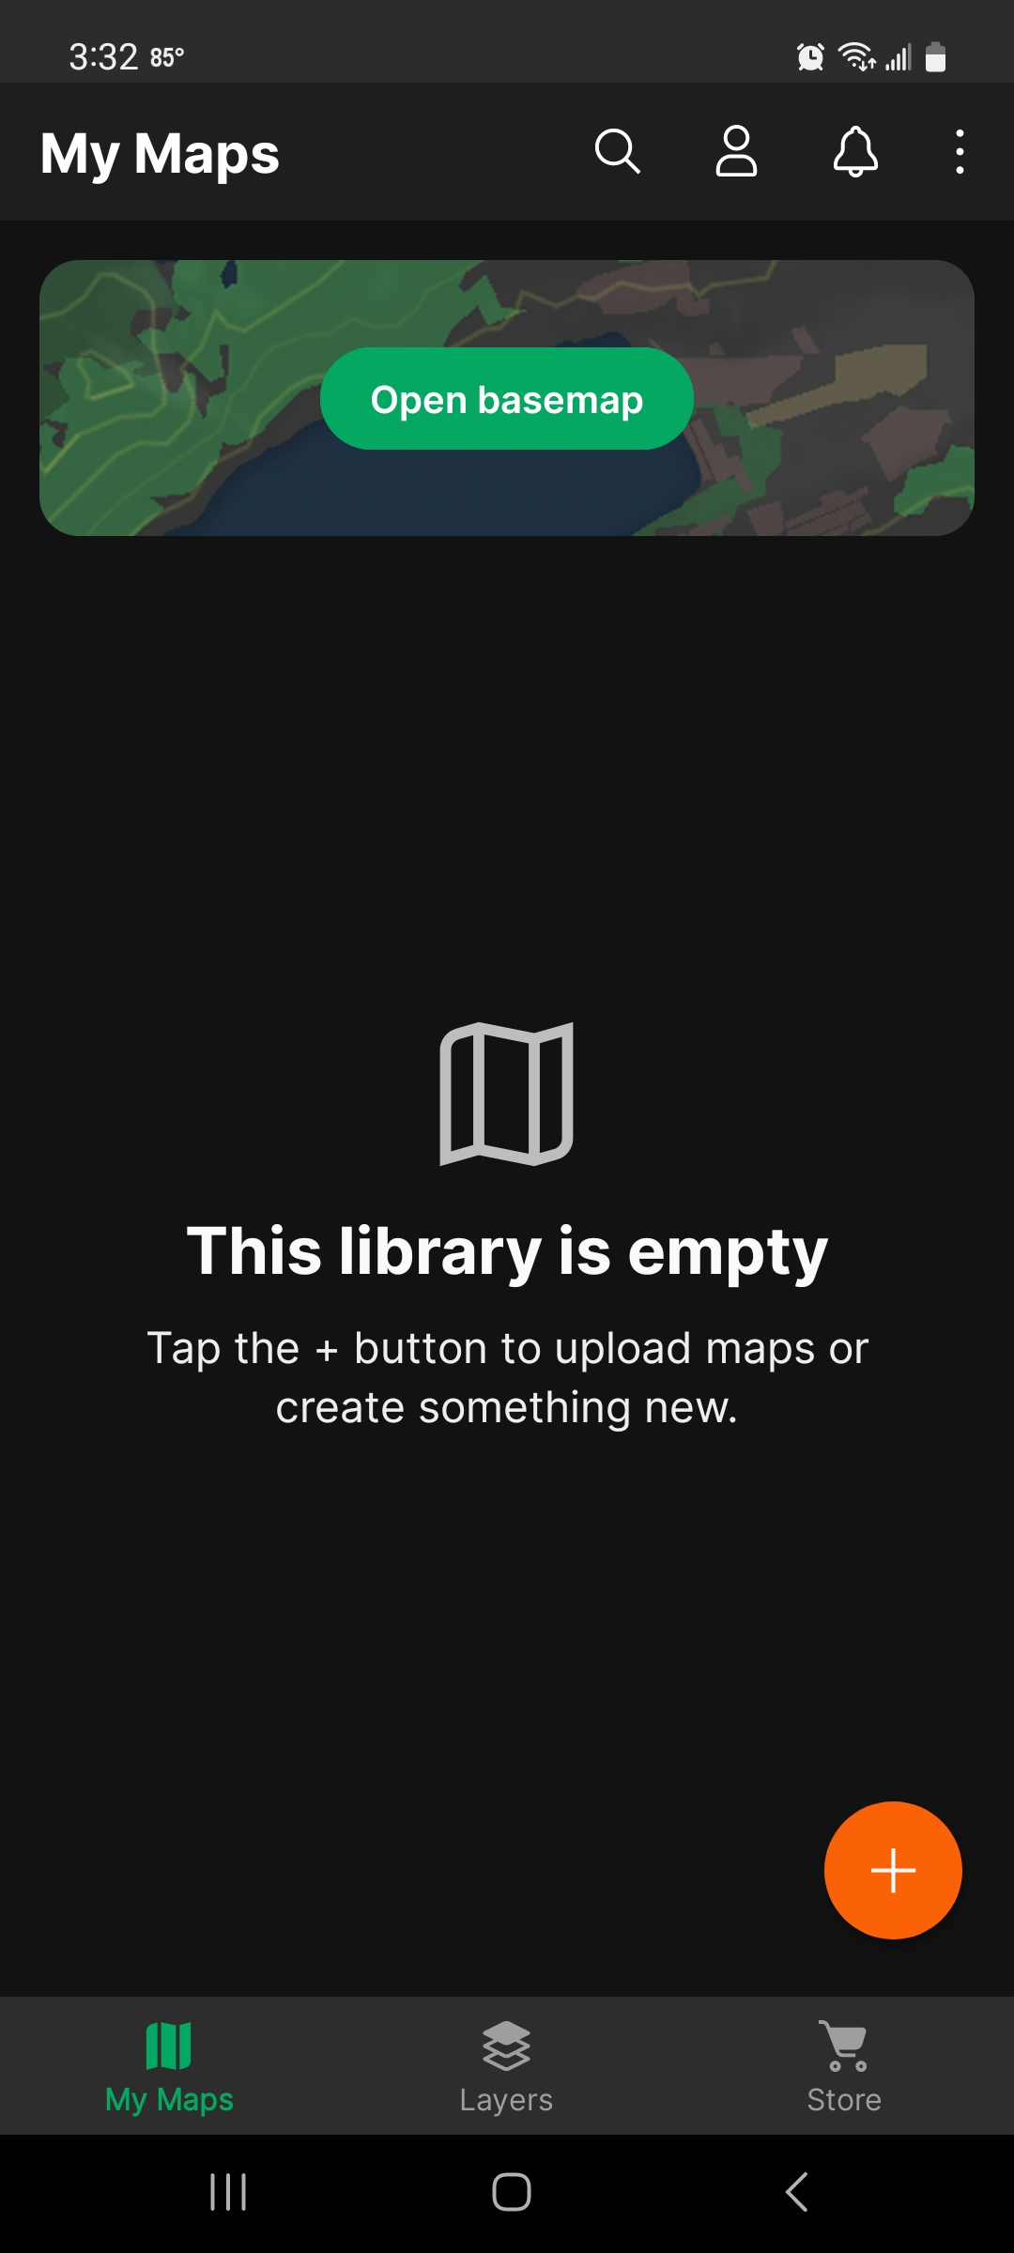
Opening the map
After opening the app, tap the ‘+’ icon at the bottom right corner of your screen.
Tap ‘Download or import a map”.
Choose a location on your phone to import the map.
  ‘Cloud storage or device’ will navigate through folders stored on your phone.
  “Dropbox” will redirect you to Dropbox login.
Once you choose a map you will be brought back to the ‘My Maps’ page of the app while the map is imported. This may take a few minutes.

Slide 9
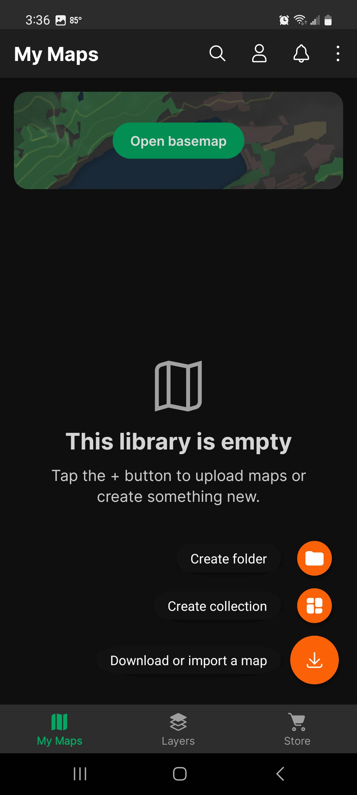

Opening the map
After opening the app, tap the ‘+’ icon at the bottom right corner of your screen.
Tap ‘Download or import a map”.
Choose a location on your phone to import the map.
  ‘Cloud storage or device’ will navigate through folders stored on your phone.
  “Dropbox” will redirect you to Dropbox login.
Once you choose a map you will be brought back to the ‘My Maps’ page of the app while the map is imported. This may take a few minutes.

Slide 10
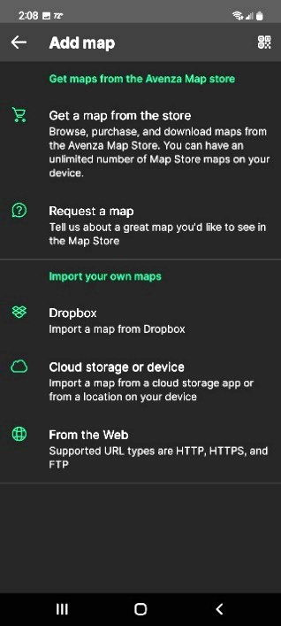


Opening the map
After opening the app, tap the ‘+’ icon at the bottom right corner of your screen.
Tap ‘Download or import a map”.
Choose a location on your phone to import the map.
  ‘Cloud storage or device’ will navigate through folders stored on your phone.
  “Dropbox” will redirect you to Dropbox login.
Once you choose a map you will be brought back to the ‘My Maps’ page of the app while the map is imported. This may take a few minutes.

Slide 11
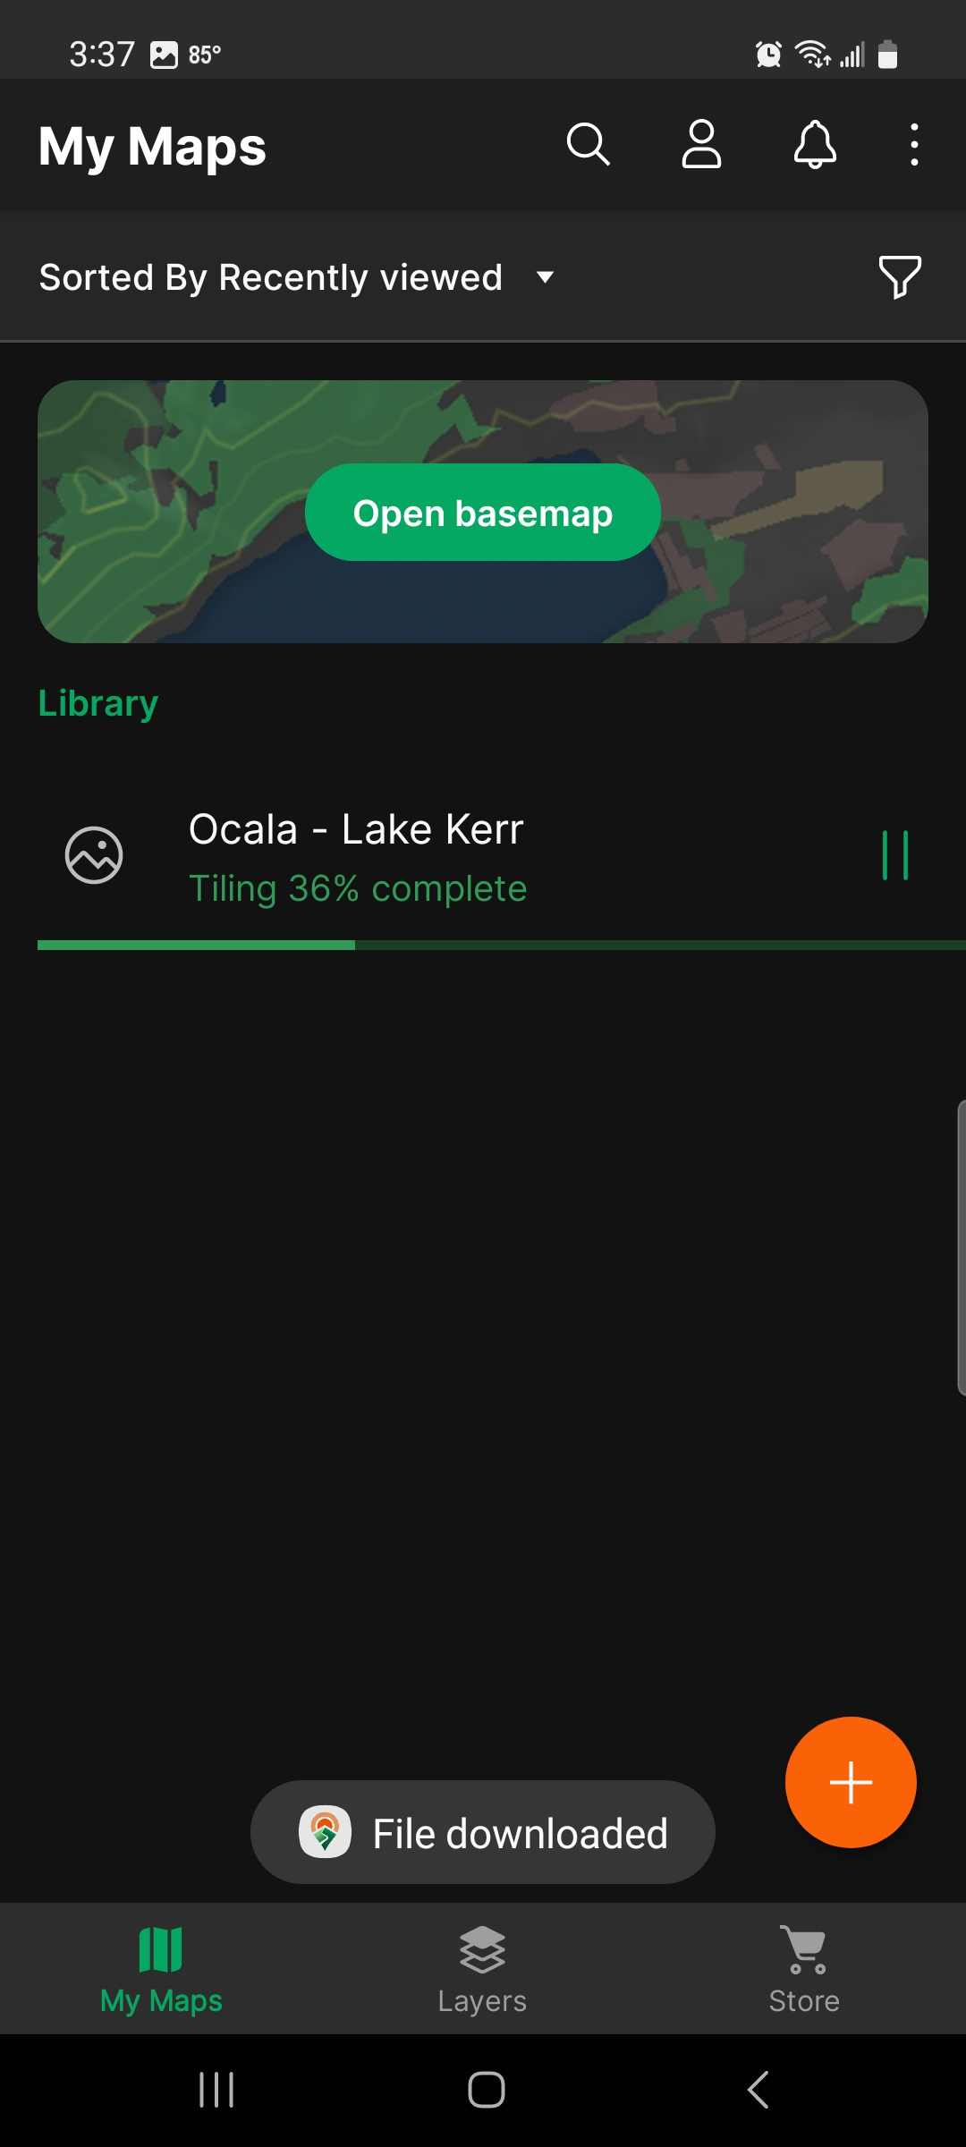

Opening the map
After opening the app, tap the ‘+’ icon at the bottom right corner of your screen.
Tap ‘Download or import a map”.
Choose a location on your phone to import the map.
  ‘Cloud storage or device’ will navigate through folders stored on your phone.
  “Dropbox” will redirect you to Dropbox login.
Once you choose a map you will be brought back to the ‘My Maps’ page of the app while the map is imported. This may take a few minutes.

Slide 12
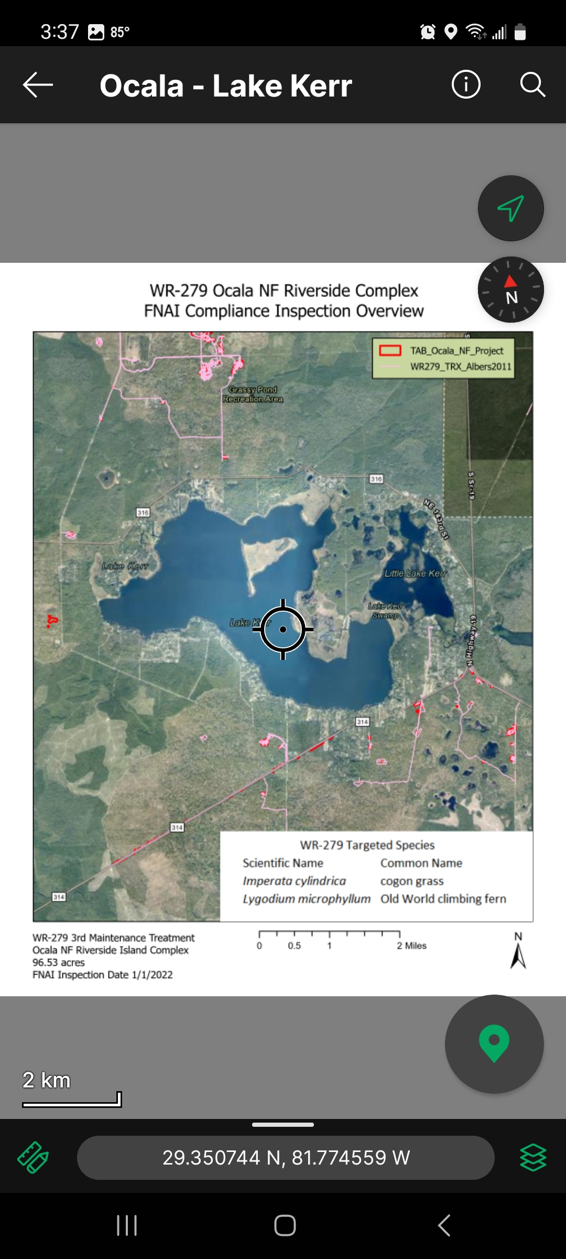
Opening the map
After opening the app, tap the ‘+’ icon at the bottom right corner of your screen.
Tap ‘Download or import a map”.
Choose a location on your phone to import the map.
  ‘Cloud storage or device’ will navigate through folders stored on your phone.
  “Dropbox” will redirect you to Dropbox login.
Once you choose a map you will be brought back to the ‘My Maps’ page of the app while the map is imported. This may take a few minutes.
Map uploaded!!!

Slide 13
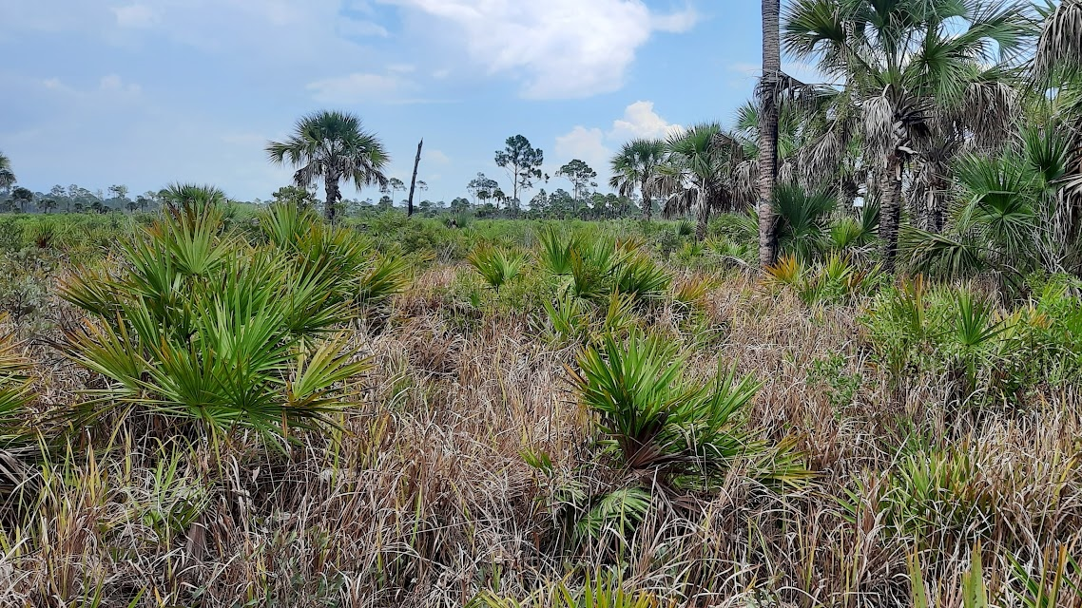
Opening Schemas

Slide 14
Opening Schemas
Tap the ‘Map Layers’ icon on the bottom right of the screen.
Tap the three lines at the bottom of the page, then tap the ‘Import Layers’ icon. The ‘Import Layers’ page will open.
Tap ‘Import Schema Only’
Scroll down and choose ‘Dropbox’ or ‘Cloud storage or device’,

Slide 15
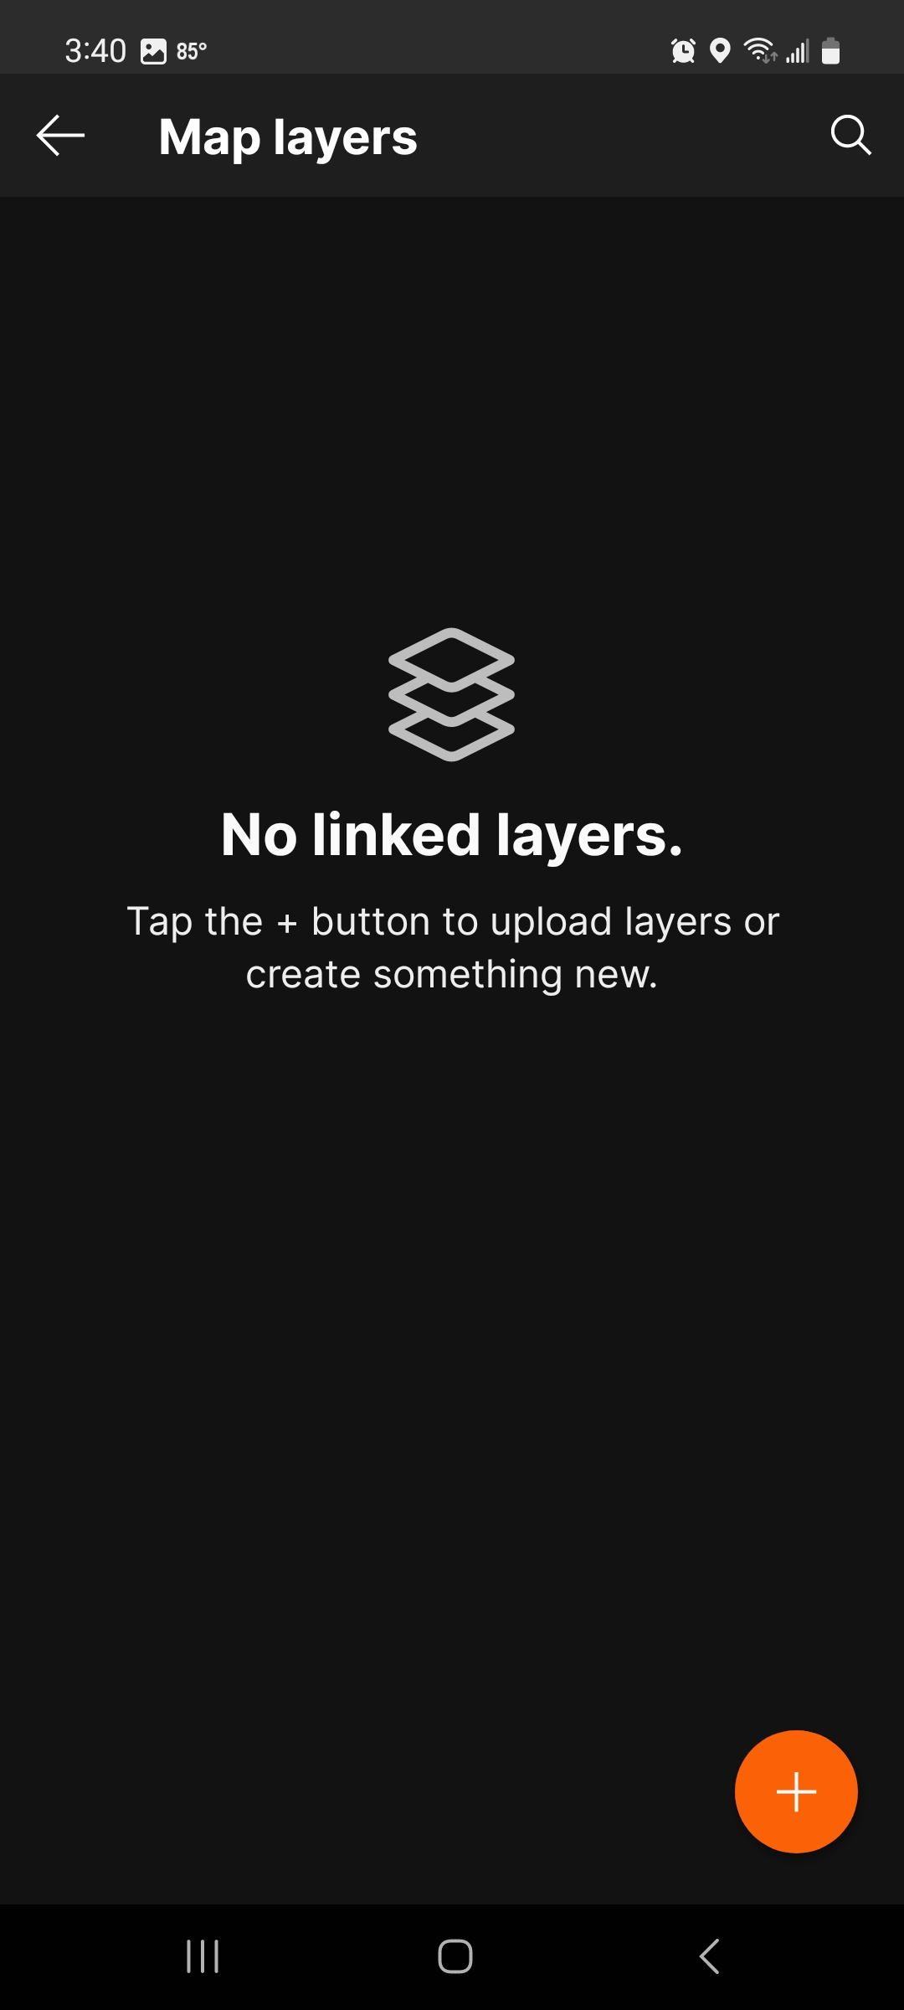
Opening Schemas
Tap the ‘Map Layers’ icon on the bottom right of the screen.
Tap the three lines at the bottom of the page, then tap the ‘Import Layers’ icon. The ‘Import Layers’ page will open.
Tap ‘Import Schema Only’
Scroll down and choose ‘Dropbox’ or ‘Cloud storage or device’,

Slide 16
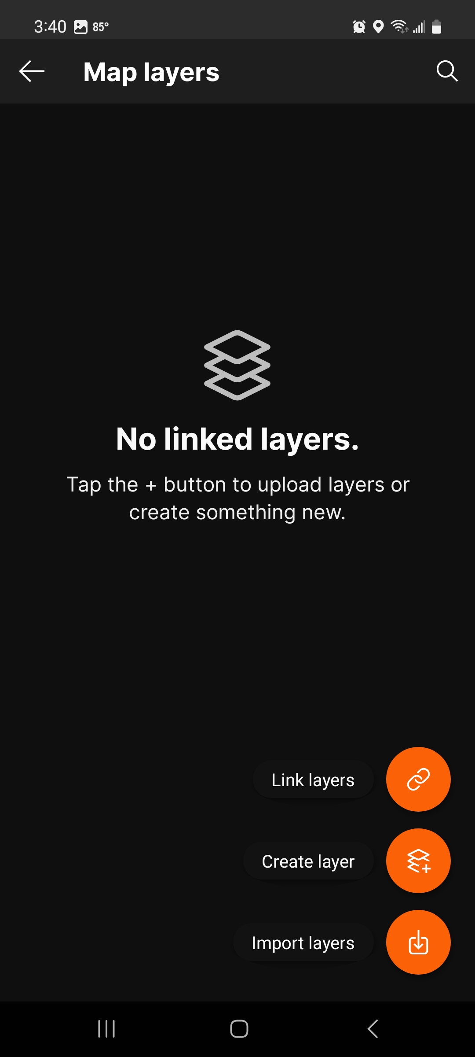
Opening Schemas
Tap the ‘Map Layers’ icon on the bottom right of the screen.
Tap the three lines at the bottom of the page, then tap the ‘Import Layers’ icon.
Tap ‘Import Schema Only’
Scroll down and choose ‘Dropbox’ or ‘Cloud storage or device’,

Slide 17
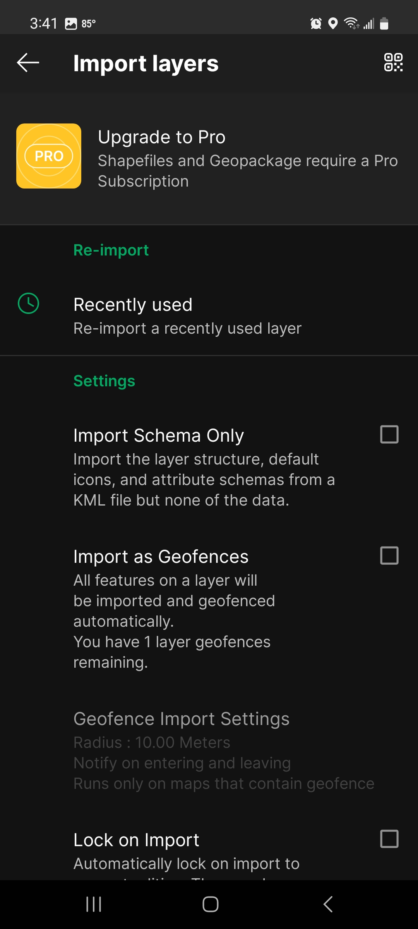
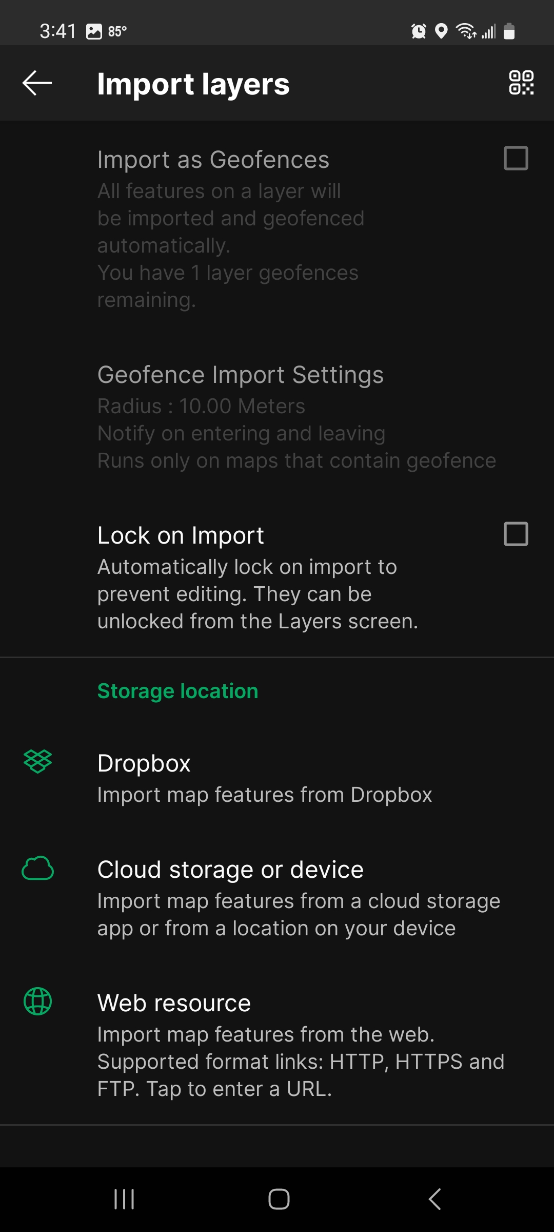
Opening Schemas
Tap the ‘Map Layers’ icon on the bottom right of the screen.
Tap the three lines at the bottom of the page, then tap the ‘Import Layers’ icon.
Tap ‘Import Schema Only’
Scroll down and choose ‘Dropbox’ or ‘Cloud storage or device’,

Slide 18
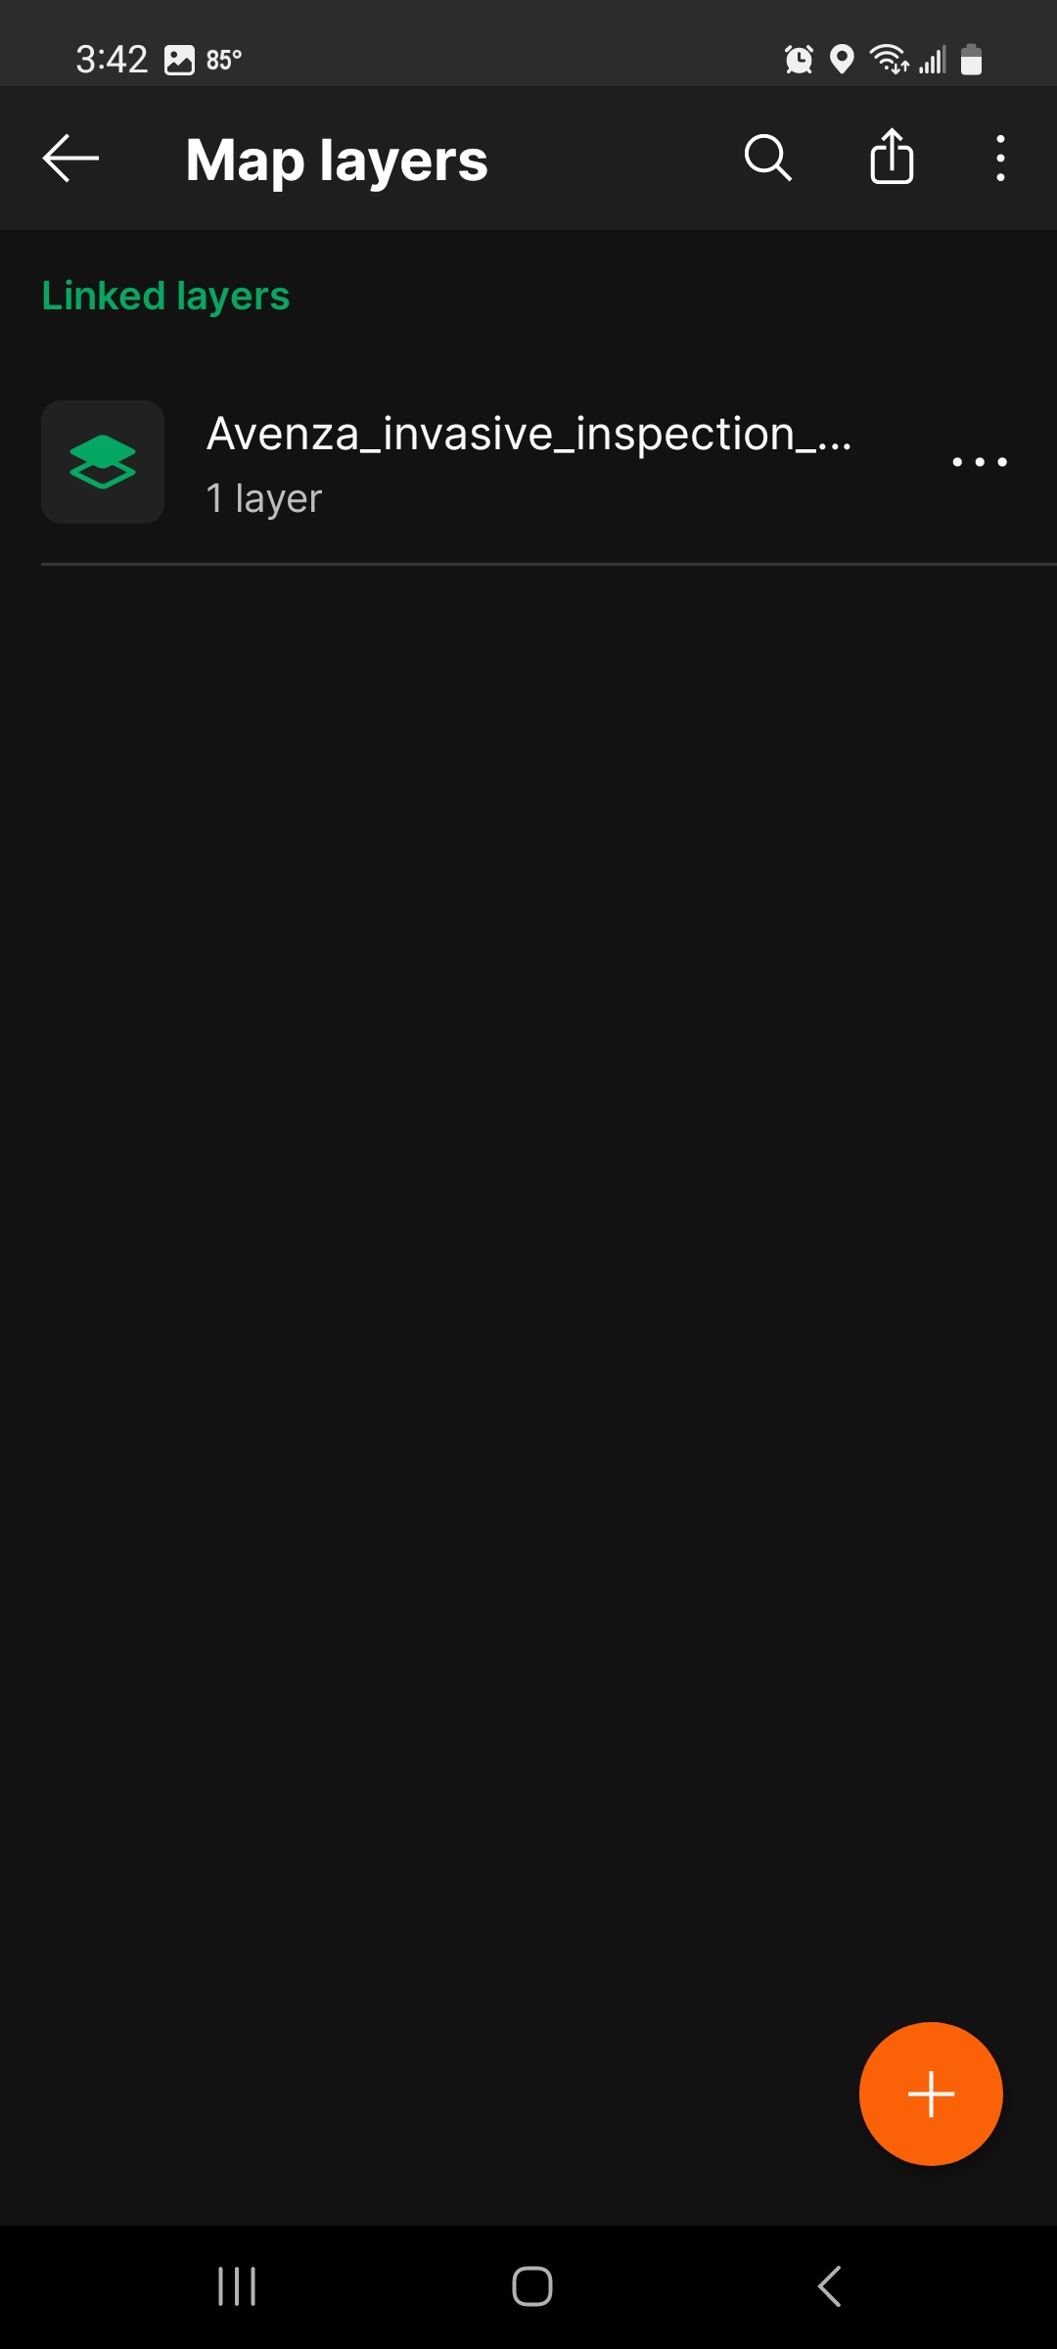
Opening Schemas
Tap the ‘Map Layers’ icon on the bottom right of the screen.
Tap the three lines at the bottom of the page, then tap the ‘Import Layers’ icon.
Tap ‘Import Schema Only’
Scroll down and choose ‘Dropbox’ or ‘Cloud storage or device’,
Schema’s Uploaded!!!

Slide 19

Locking Schemas

Slide 20
Locking Schemas
Tap ‘Avenza invasive inspection schema 2024.01.01’ once
  Not on the three dots
Tap the three dots to the right of ‘FWC Invasive Species Inspection’.
A drop-down menu will appear. Select ‘Set as active’

Slide 21
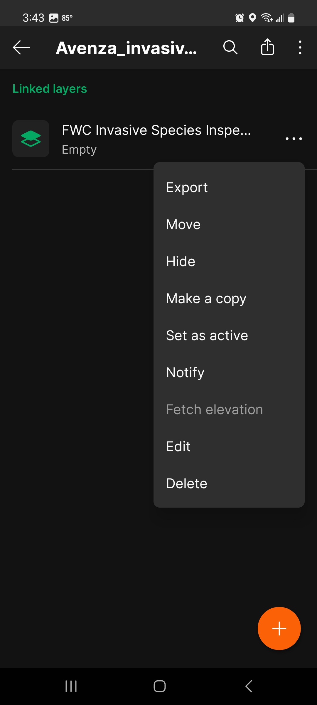
Locking Schemas
Tap ‘Avenza invasive inspection schema 2024.01.01’ once
  Not on the three dots
Tap the three dots to the right of ‘FWC Invasive Species Inspection’.
A drop-down menu will appear. Select ‘Set as active’

Slide 22
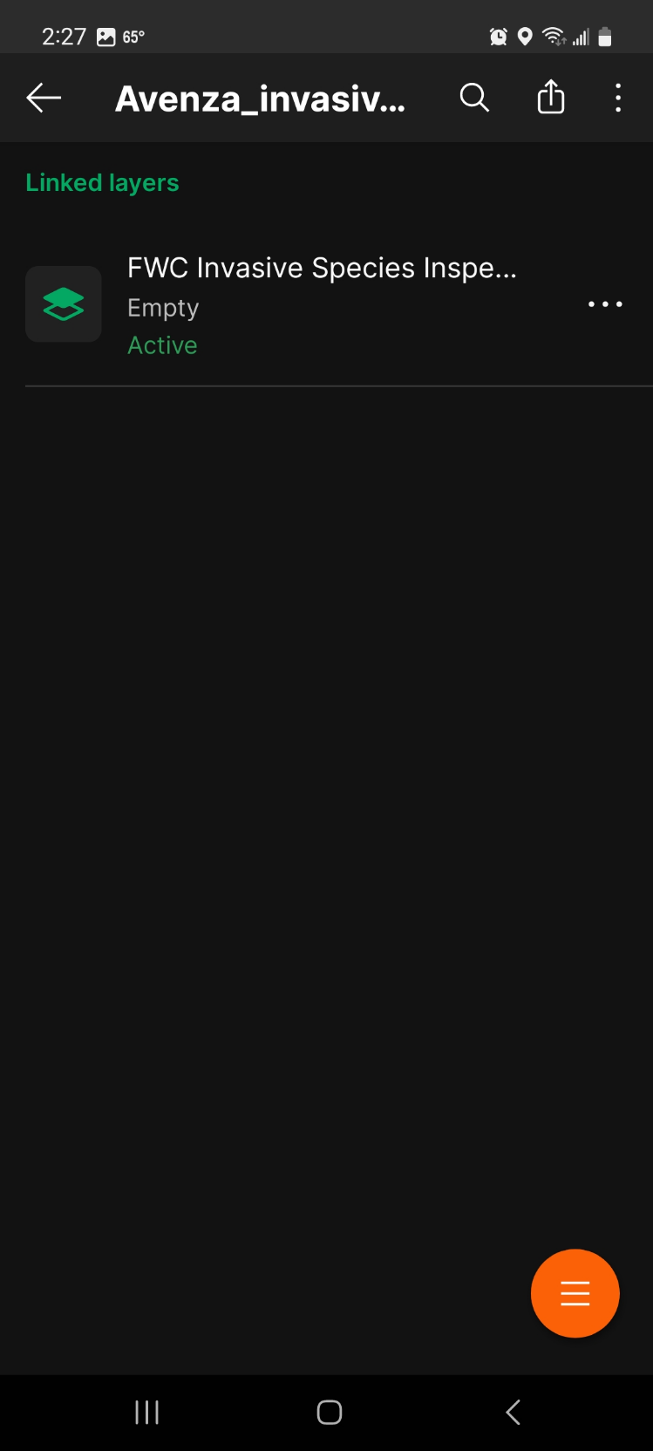
Locking Schemas
Tap ‘Avenza invasive inspection schema 2024.01.01’ once
  Not on the three dots
Tap the three dots to the right of ‘FWC Invasive Species Inspection’.
A drop-down menu will appear. Select ‘Set as active’
Schema’s ready to go!!!

Slide 23
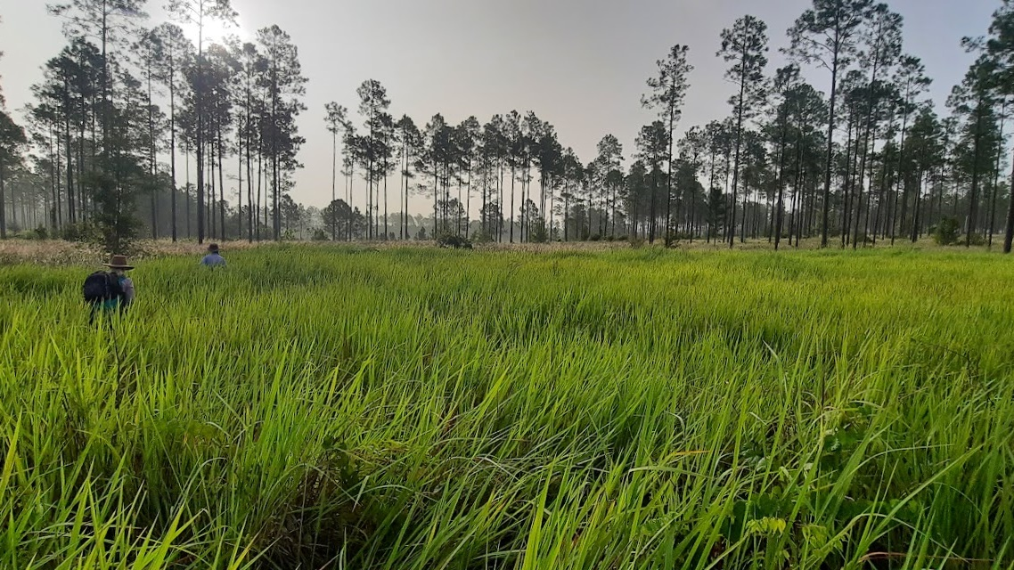
Exporting Schemas

Slide 24
Exporting Data
Tap the ‘Map Features’ icon on the bottom righthand side of the screen
Tap the ‘Export’ button
Change export format to CSV to export data
Press the export ‘Export’ button
Select email, WhatsApp, or another messaging system to export the data

Slide 25

Exporting Data
Tap the ‘Map Features’ icon on the bottom righthand side of the screen
Tap the ‘Export’ button
Change export format to CSV to export data
Press the export ‘Export’ button
Select email, WhatsApp, or another messaging system to export the data

Slide 26
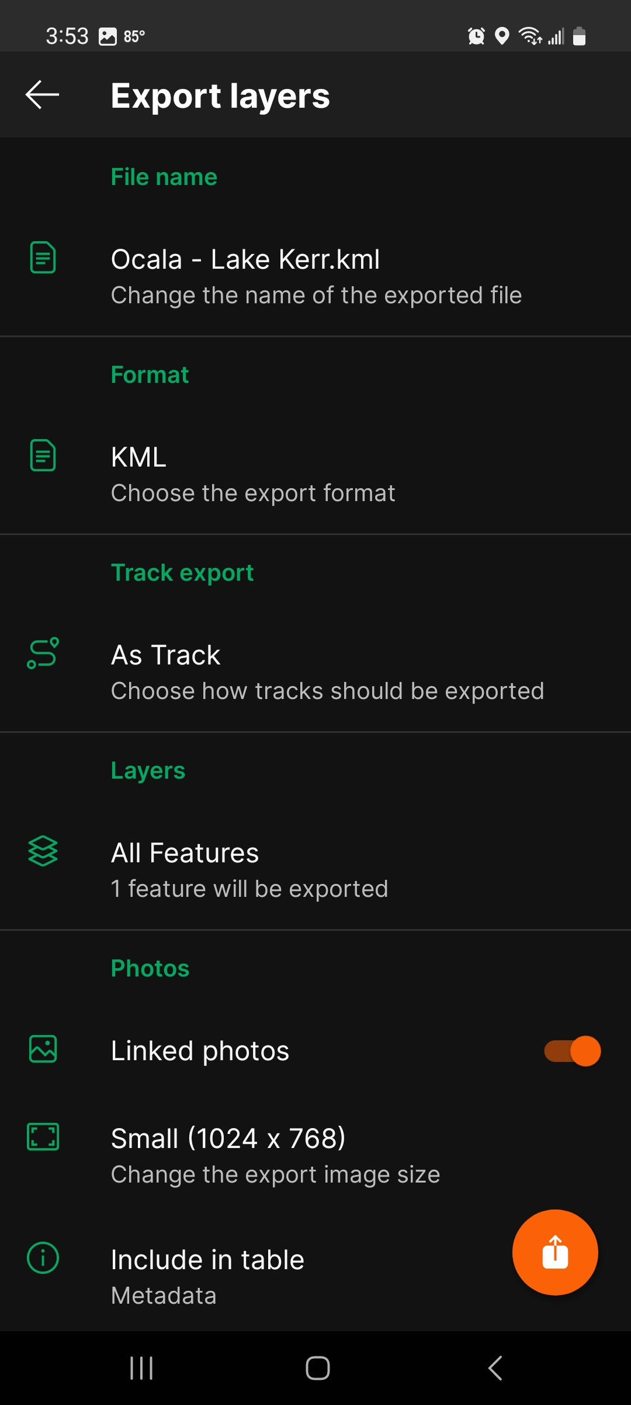
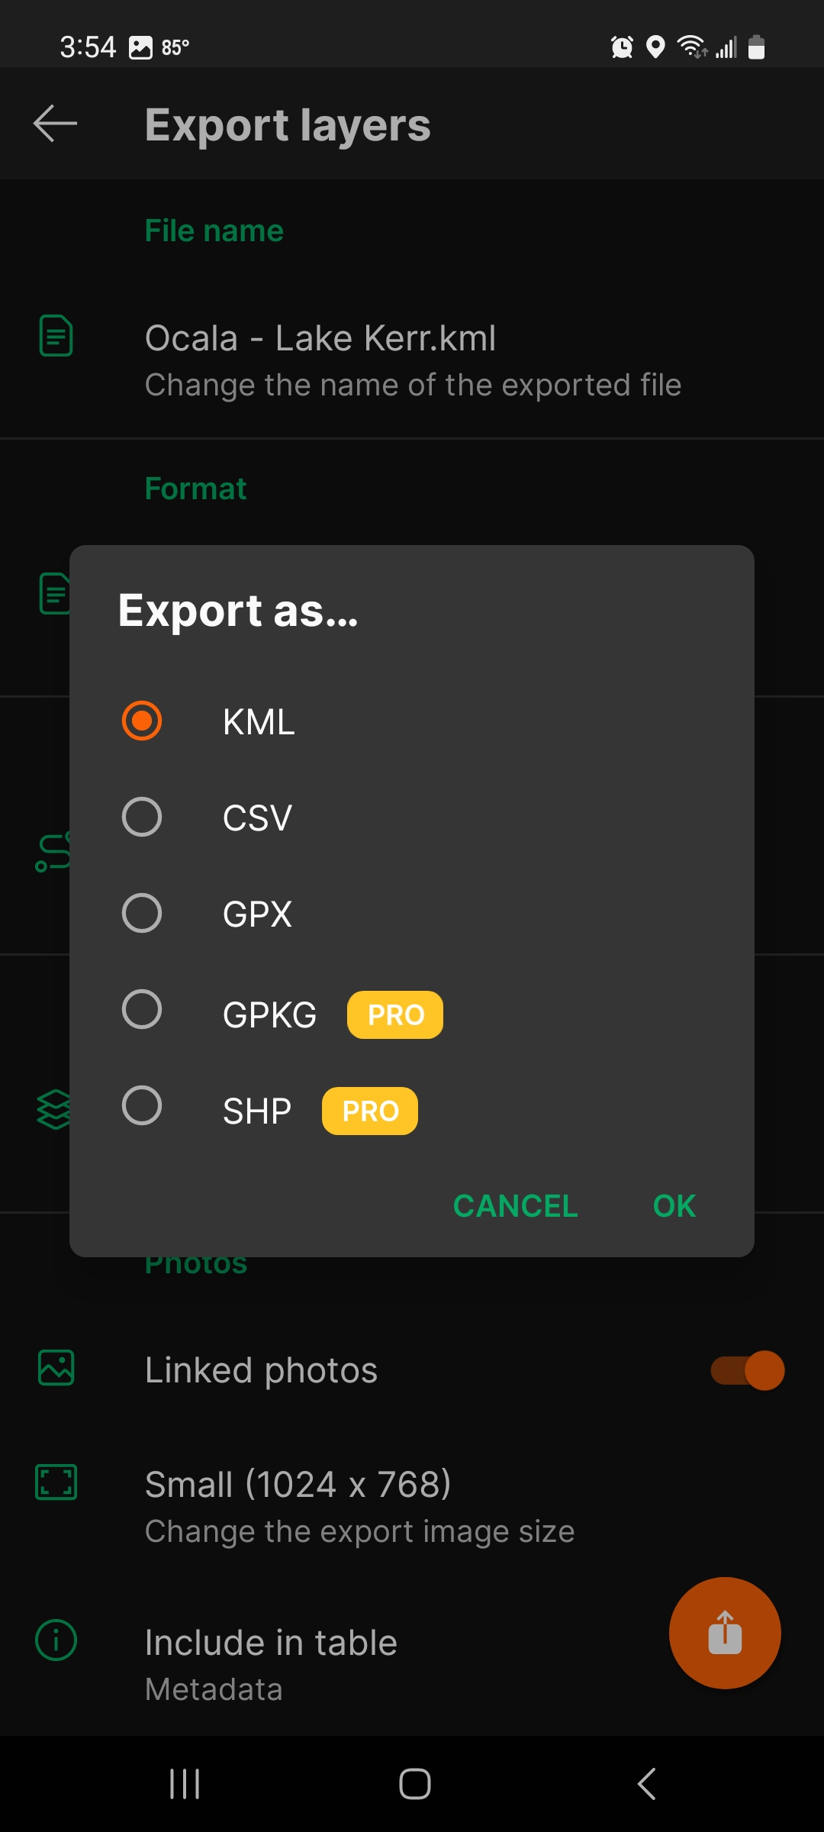
Exporting Data
Tap the ‘Map Features’ icon on the bottom righthand side of the screen
Tap the ‘Export’ button
Change export format to CSV to export data
Press the export ‘Export’ button
Select email, WhatsApp, or another messaging system to export the data

Slide 27
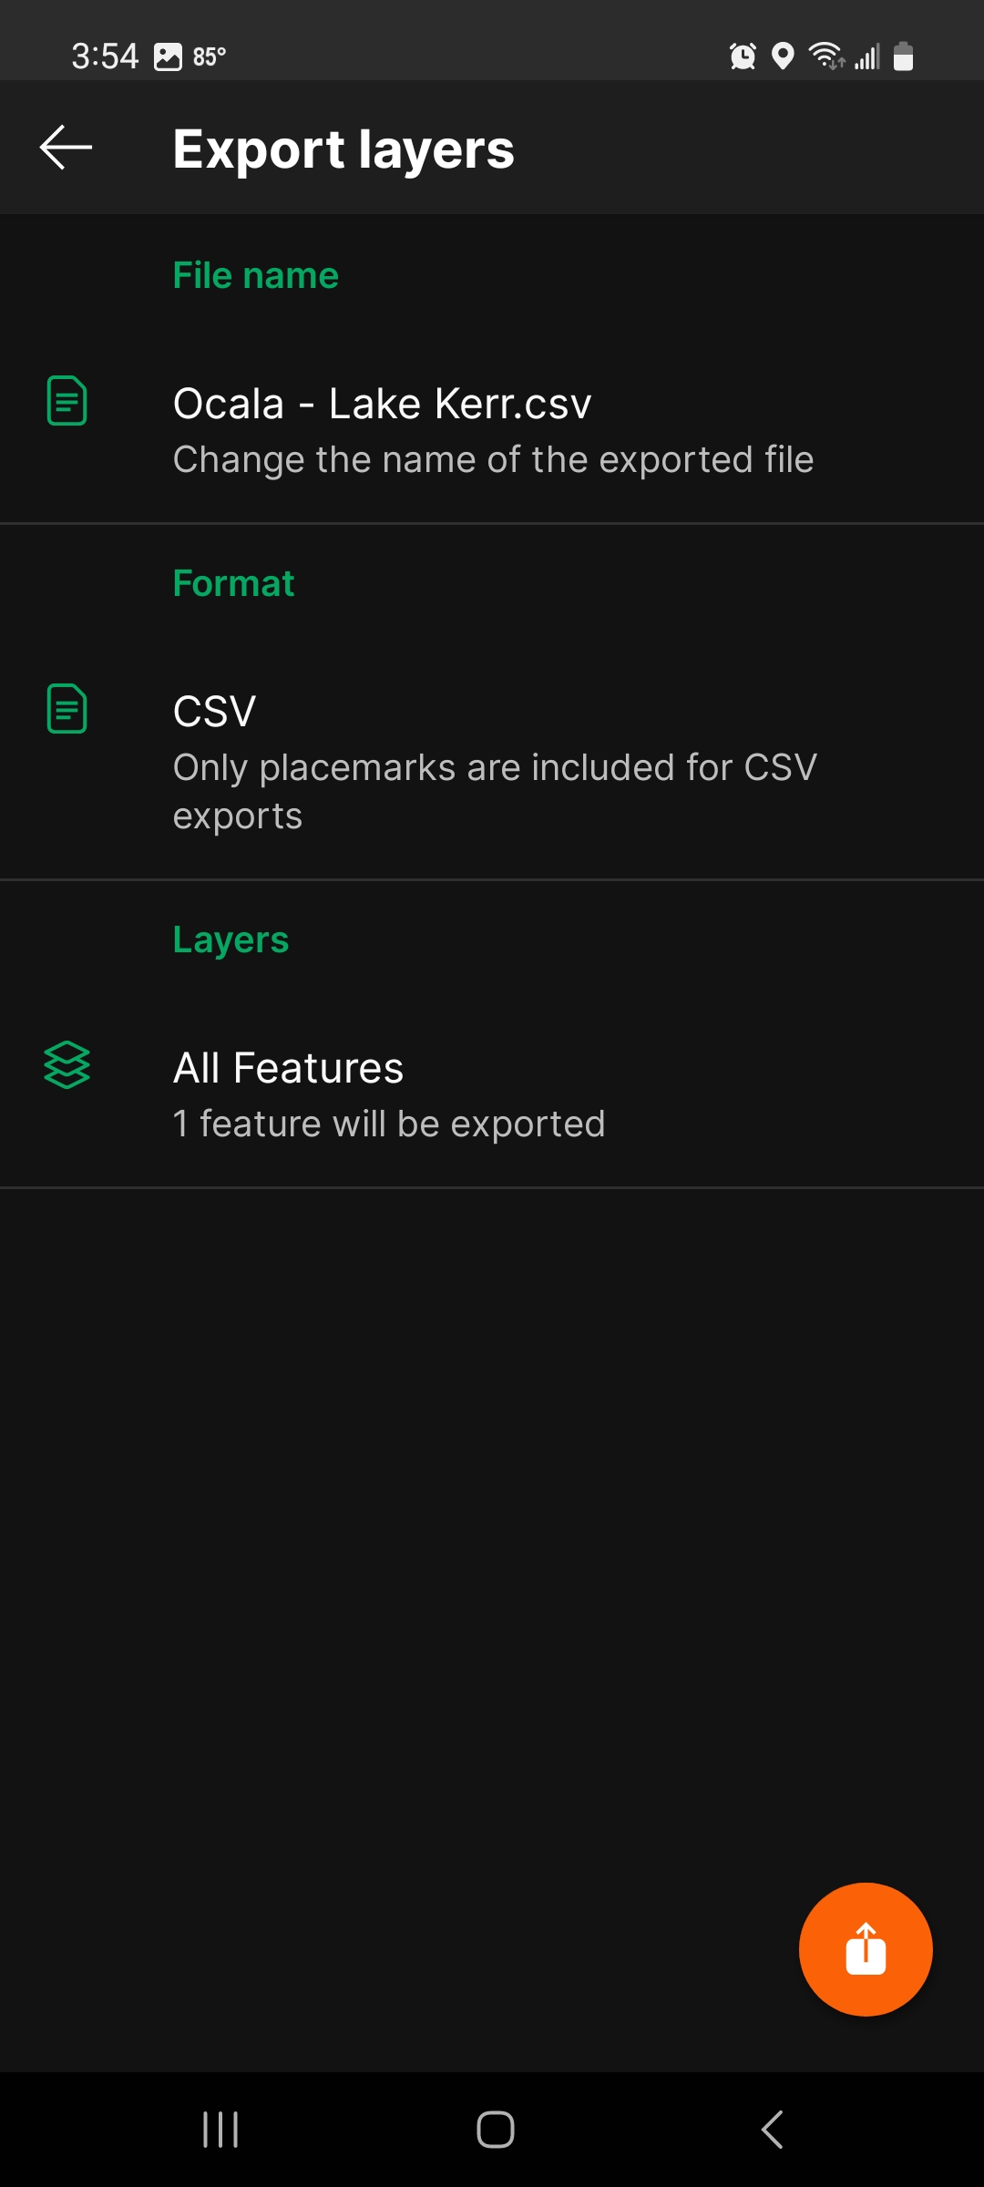
Exporting Data
Tap the ‘Map Features’ icon on the bottom righthand side of the screen
Tap the ‘Export’ button
Change export format to CSV to export data
Press the export ‘Export’ button
Select email, WhatsApp, or another messaging system to export the data

Slide 28
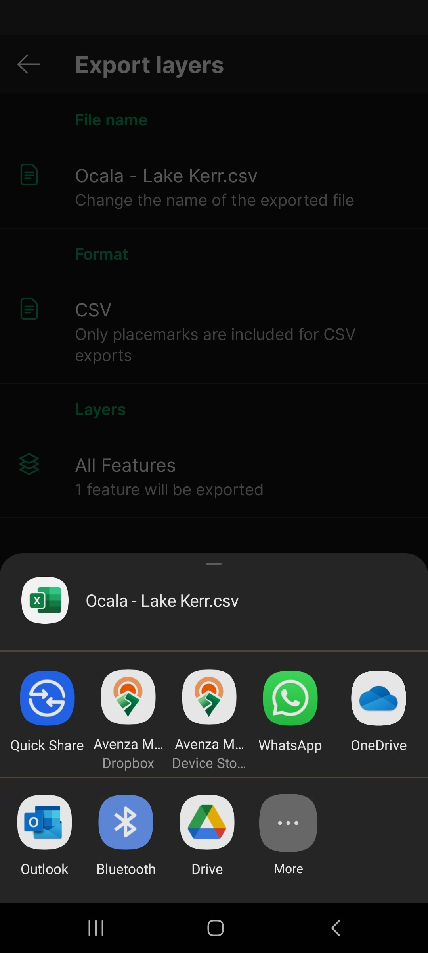
Exporting Data
Tap the ‘Map Features’ icon on the bottom righthand side of the screen
Tap the ‘Export’ button
Change export format to CSV to export data
Press the export ‘Export’ button
Select email, WhatsApp, or another messaging system to export the data

Slide 29

Analyzing the data:
We exported the Data
  Now what?
We emailed you the excel calculator
  Avenza_invasives_tool_beta_20241017.xlsx
Do not need to open it now

