Slide 1
Repository for Electronic Data Deliverables (REDD)
Lab analytical results for samples collected while monitoring the cleanup at the following sites are stored in various tables in REDD database schema
  Solid Waste (Mostly landfills)
  Hazardous Waste
  Petroleum Restoration (Mostly cleanup at gas stations)
  Waste Cleanup

Slide 2
Repository for Electronic Data Deliverables (REDD)
Who is responsible for submitting the lab results
Why are the lab results being submitted
How often are the lab results submitted
How are the lab samples submitted
Who is analyzing the lab samples
Who is validating the lab samples
Who is reviewing the lab samples
Who is responsible for enforcing the missing/high-value results
What reporting tools available
How can we improve the process

Slide 3

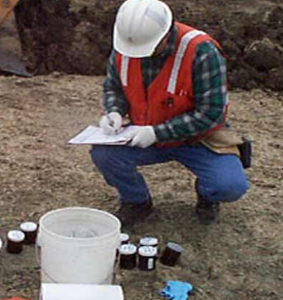






Data Collection Process into REDD
DepEssa
3
Oculus
v
2
DocLog
10
4
Validated file
1
5
9
Staging Server
Invalid file
AdaPT
Valid file
6
7
DEP FTP
REDD Batch Job
8
REDD Database

Slide 4
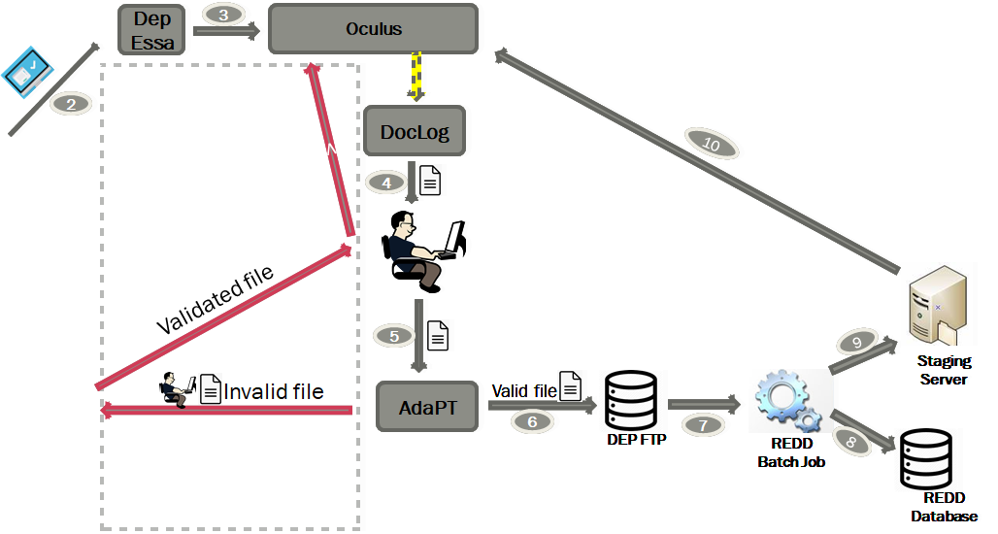
Sample Collection and Analysis
Samples are collected by contractors and sent to Labs for analysis
Collection frequency varies on program type, cleanup/monitoring type
Labs could be private/state/county or city owned
Orange county has the largest county operated lab in the state
A lab receiving the samples from field staff (primary lab) could sub-contract samples to other labs, but it is ultimately responsible for reporting the results
Primary lab send results back to the field staff who submitted the samples
1

Slide 5
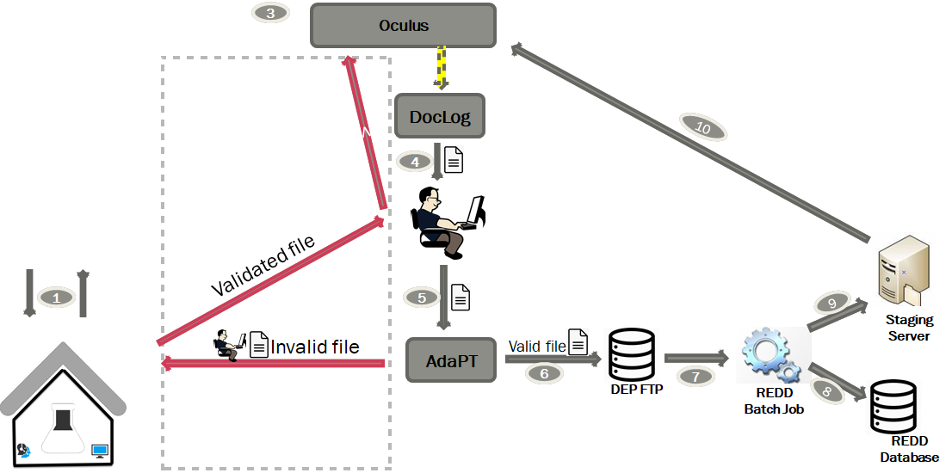
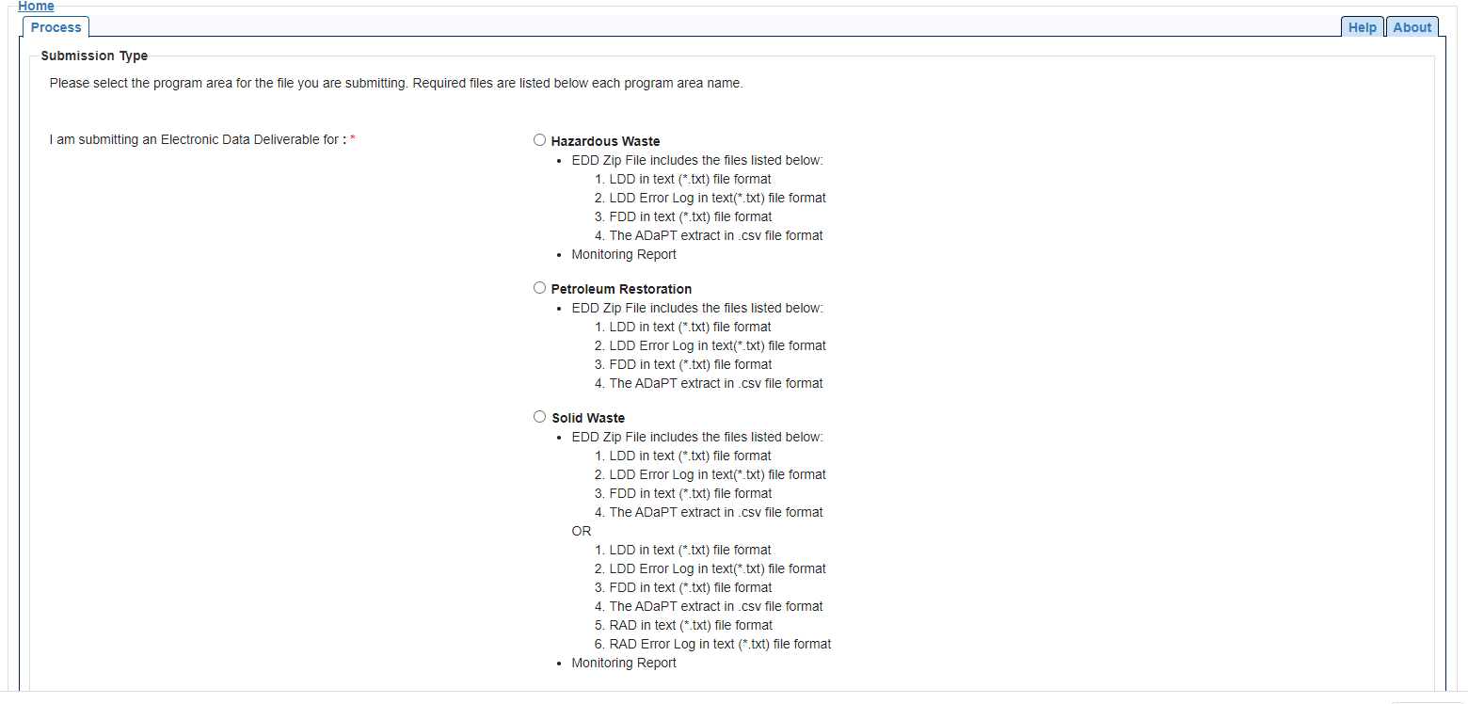
Reporting Results to DEP
DepEssa
Using DepEssa application, results are uploaded to DEP by contractors
Results are formatted in comma delimited format that is pre-defined by DEP
2

Slide 6
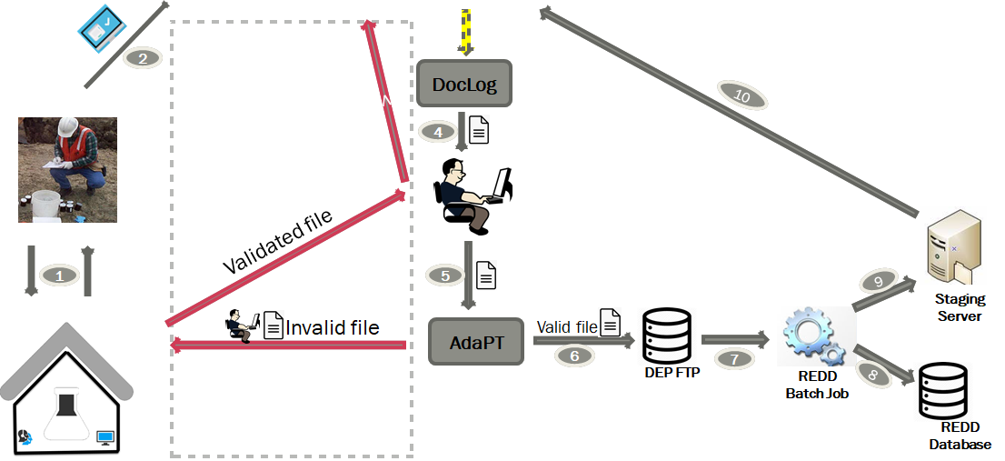
Saving Files in Oculus
DepEssa
3
Oculus
Upon submission, DepEssa sends a confirmation email to submitters.
Submitted files are uploaded Oculus.

Slide 7
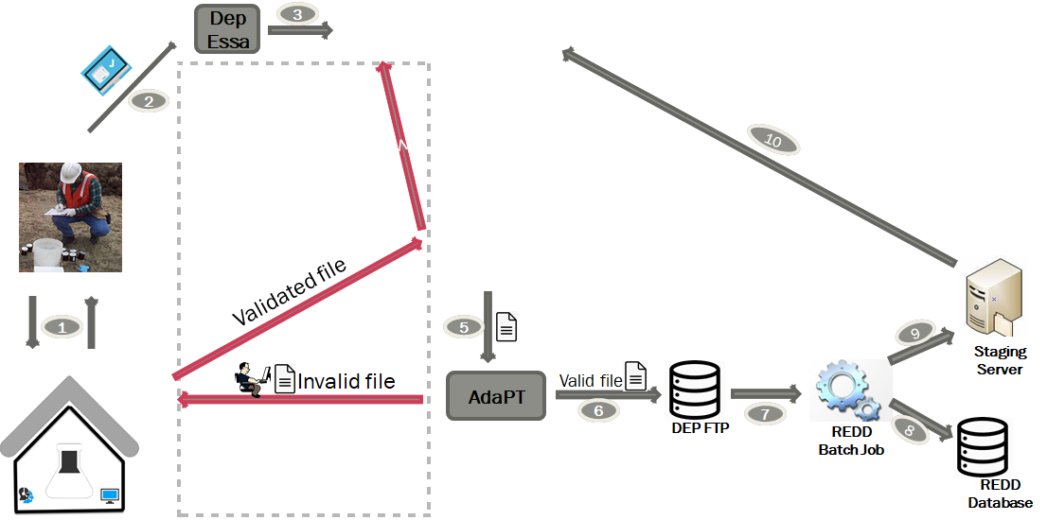
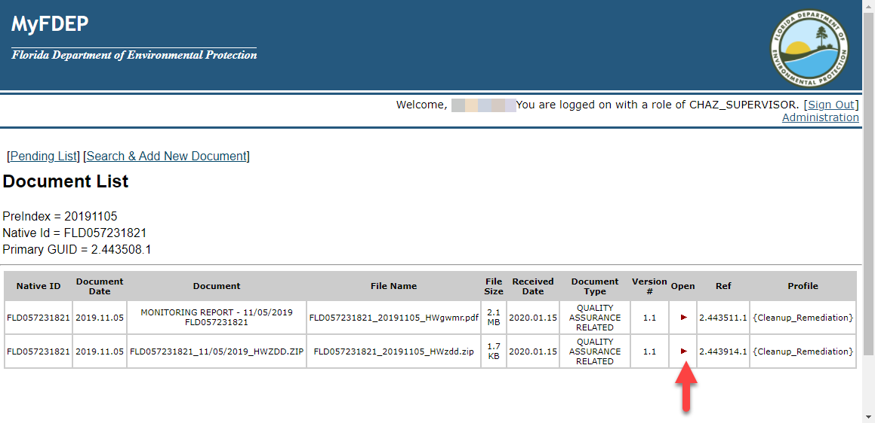
DEP Staff Accessing the Files for Review and Processing
DocLog application provides an interface to access the submitted files from Oculus.
Using DocLog application, DEP staff periodically downloads the submitted files to their local computer for review.
Oculus
DocLog
4

Slide 8
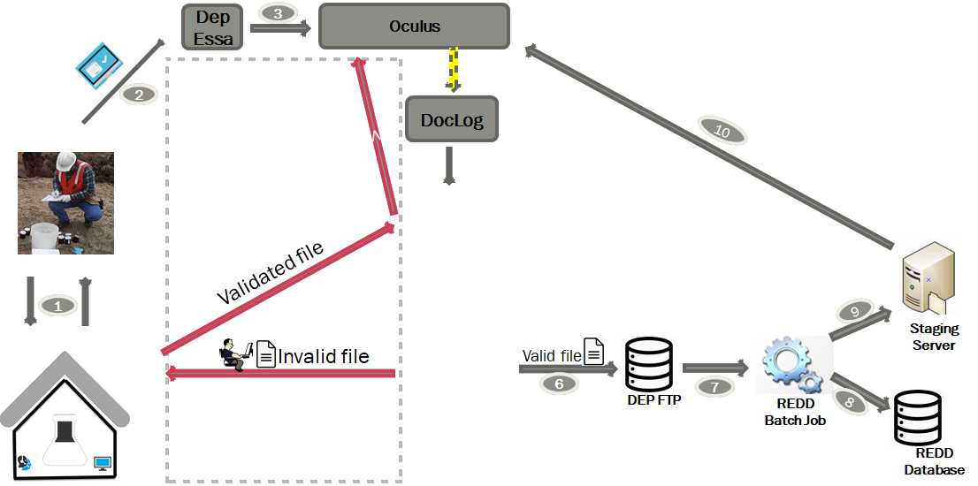
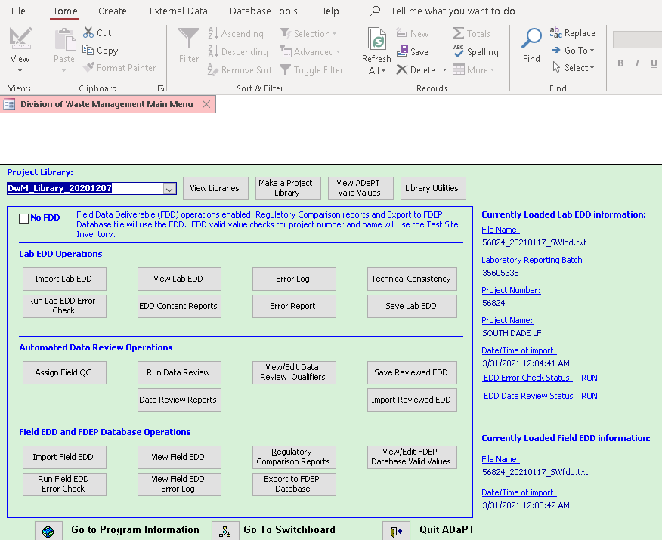
Validating the Sample Files
Reviewed files are processed using Automated Data Processing Tool (ADaPT) for compliance
Based on the pre-defined rules for analytes, ADaPT can output the results as success or failure
5
AdaPT

Slide 9
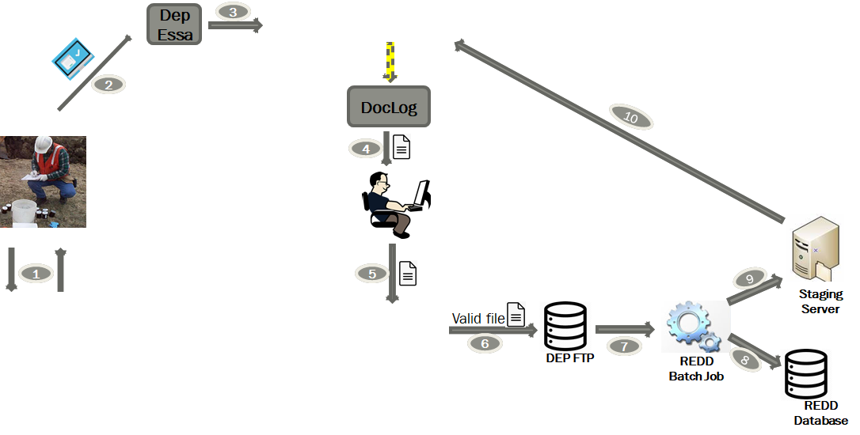
Processing the Invalid Sample Files
Invalid sample files are submitted back to the primary lab via e-mail with instructions
Lab responds back to DEP staff with corrections
Once a file is deemed valid, it is published into Oculus
Oculus
v
Corrected file
5
Invalid file
AdaPT

Slide 10
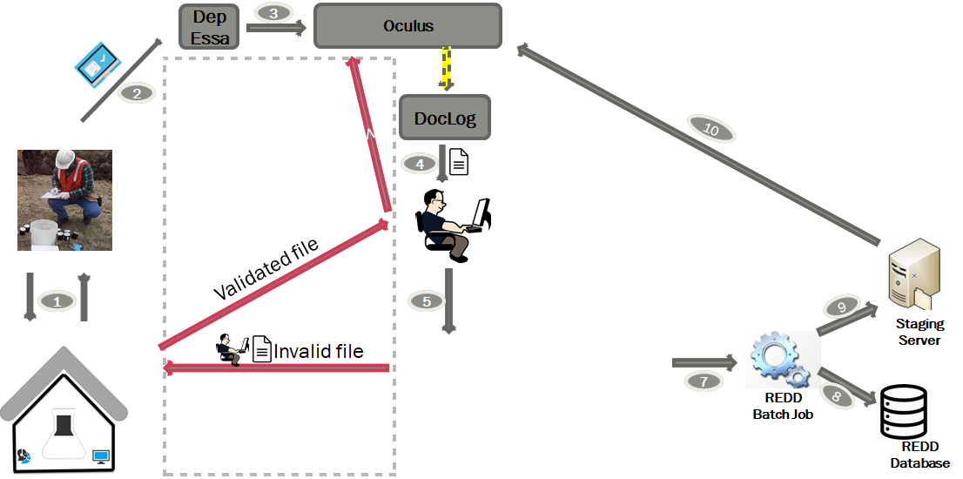
Processing the Valid Sample Files
Valid sample files are moved to DEP FTP server for further processing
AdaPT
Valid file
6

Slide 11
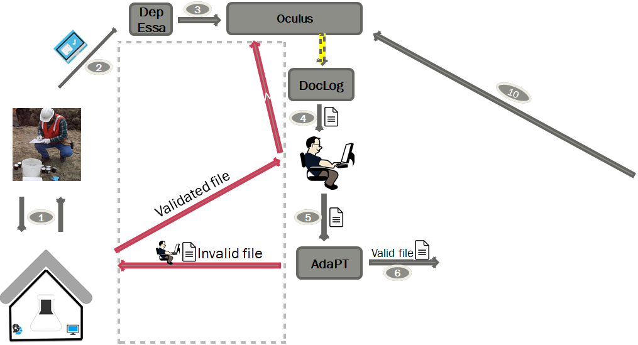
REDD Batch Job
REDD batch job executes twice daily and performs the following functions
  Read pending files from FTP server
  Parse the results and insert into REDD tables
  Generate and broadcast e-mails to program users with sample results
  Copy the e-mail content to DEP Staging server
9
Staging Server
DEP FTP
7
REDD Batch Job
8
REDD Database

Slide 12
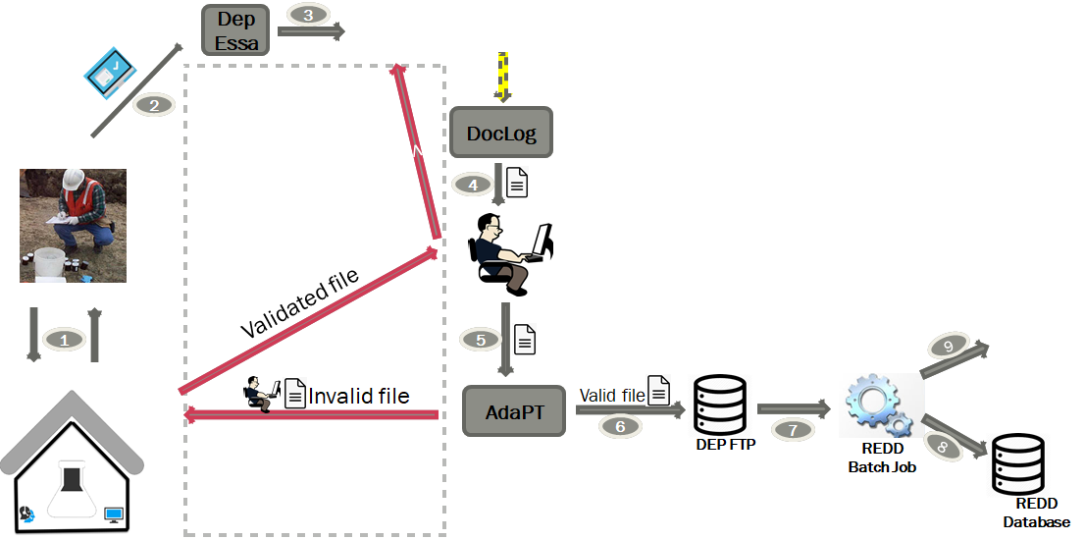
Saving the Files in Oculus
REDD invokes the Oculus API to copy the content from Staging Server to Oculus
Oculus
10
Staging Server

Slide 13
Data Collection Process into REDD
DepEssa
3
Oculus
v
2
DocLog
10
4
Validated file
1
5
9
Staging Server
Invalid file
AdaPT
Valid file
6
7
DEP FTP
REDD Batch Job
8
REDD Database

Slide 14
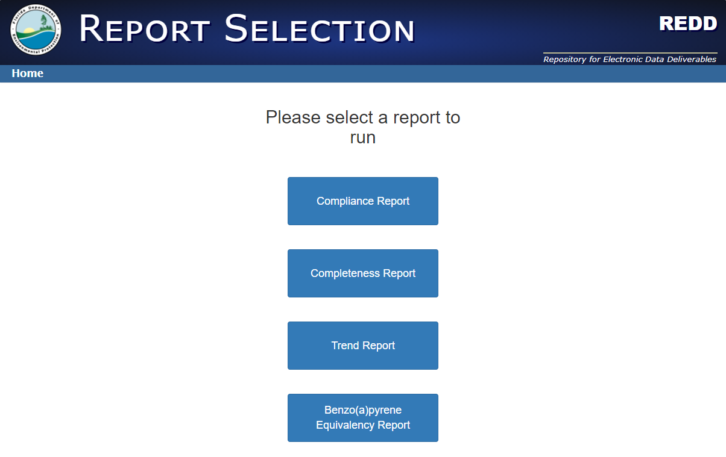
Reports

Slide 15
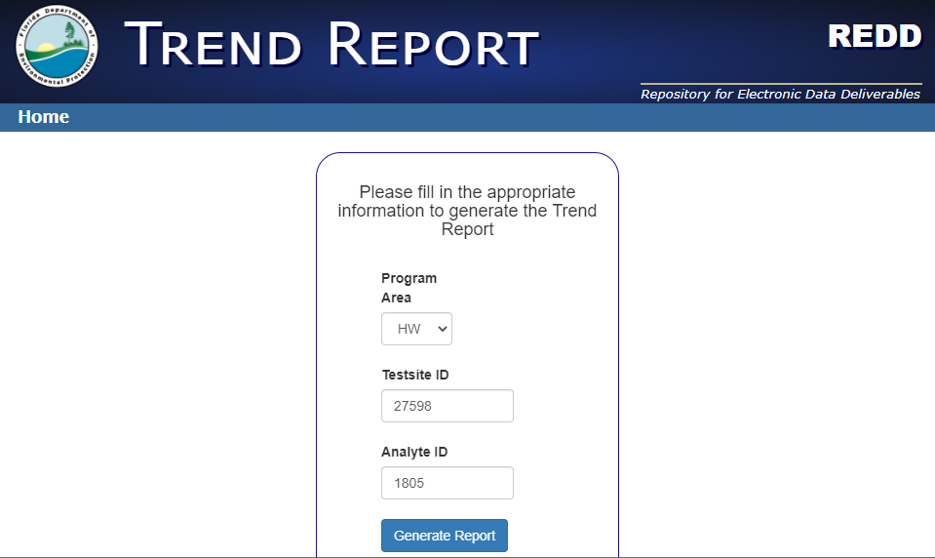
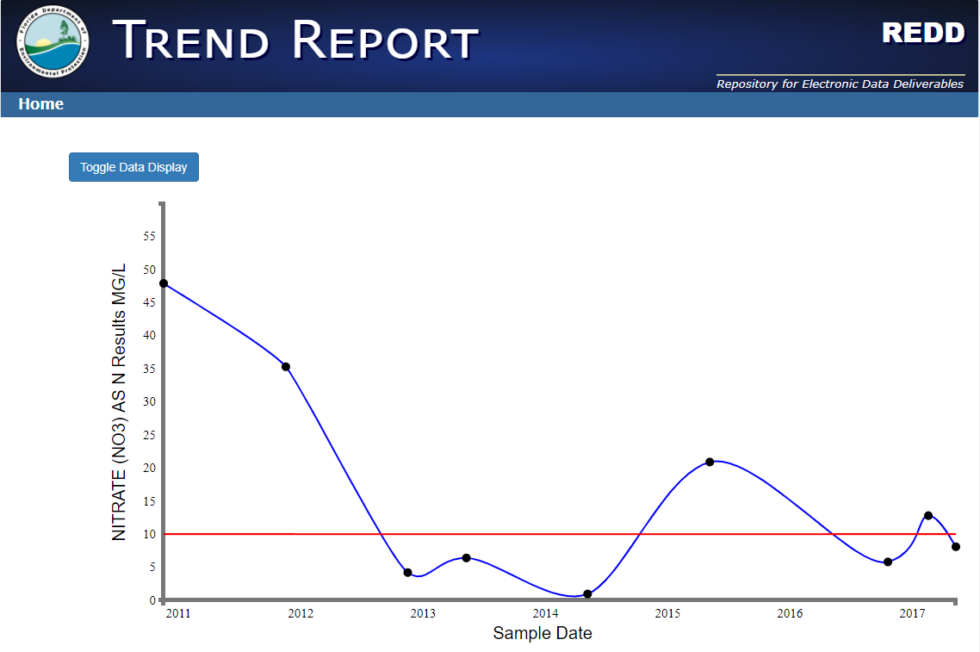
Trend Analysis Report

Slide 16
Possible Improvements
ADaPT could be updated to use current technologies and also perform the batch job tasks which would eliminate the need for FTP server and a separate batch job execution.
DocLog could be modified to list all the files for a sample event
No mechanism for detecting missing samples or analytes
Reporting interface could be made more intuitive

Slide 17
Questions?

