Slide 1
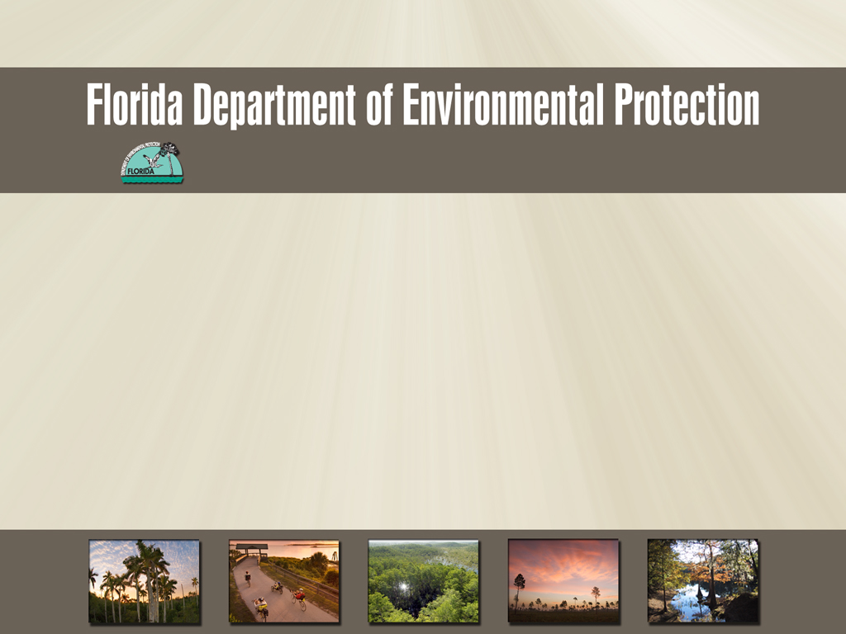
Office of Communications
Art Sengupta Mining Presentation

Slide 2
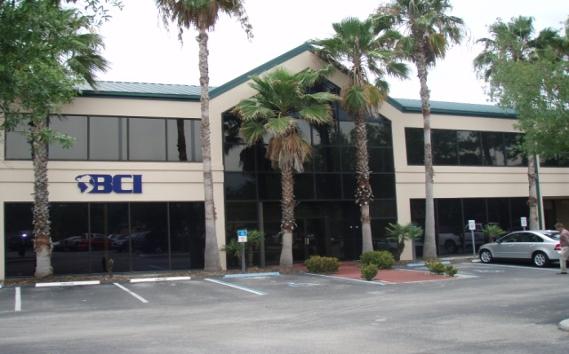
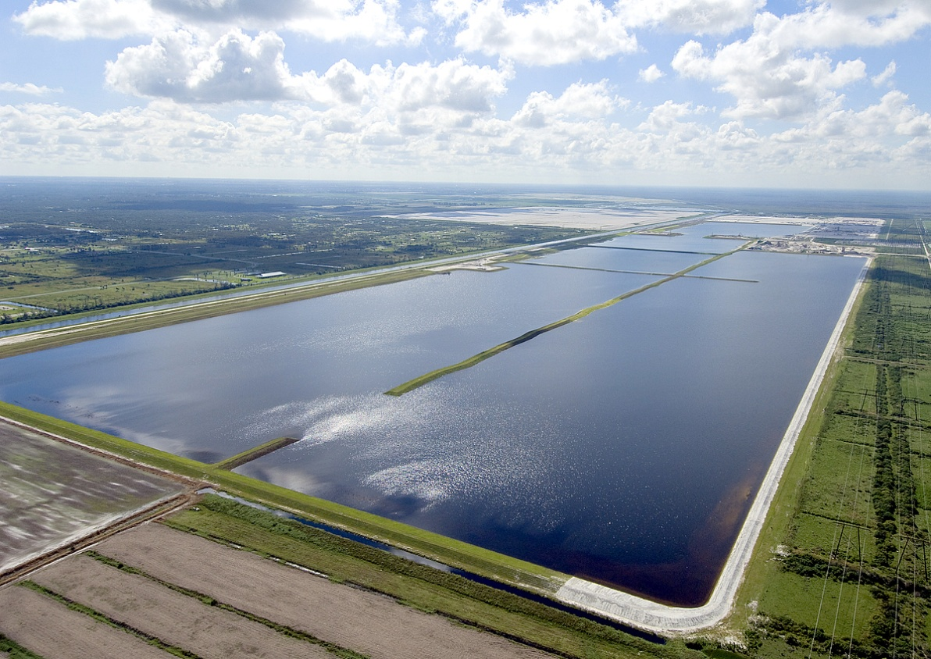
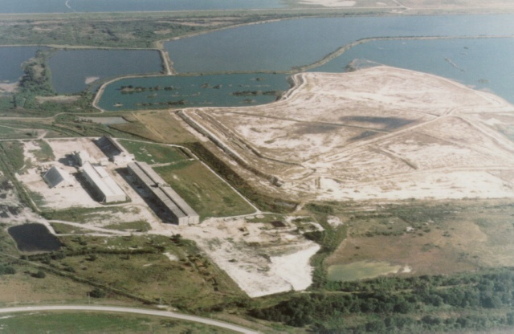

Slide 3
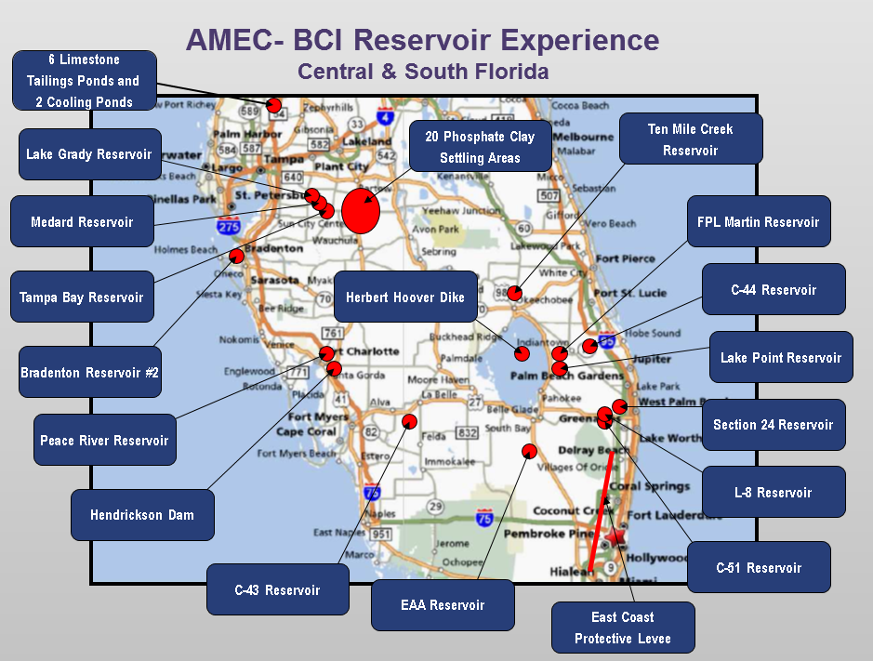
Reservoir Experience
Central & South Florida

Slide 4
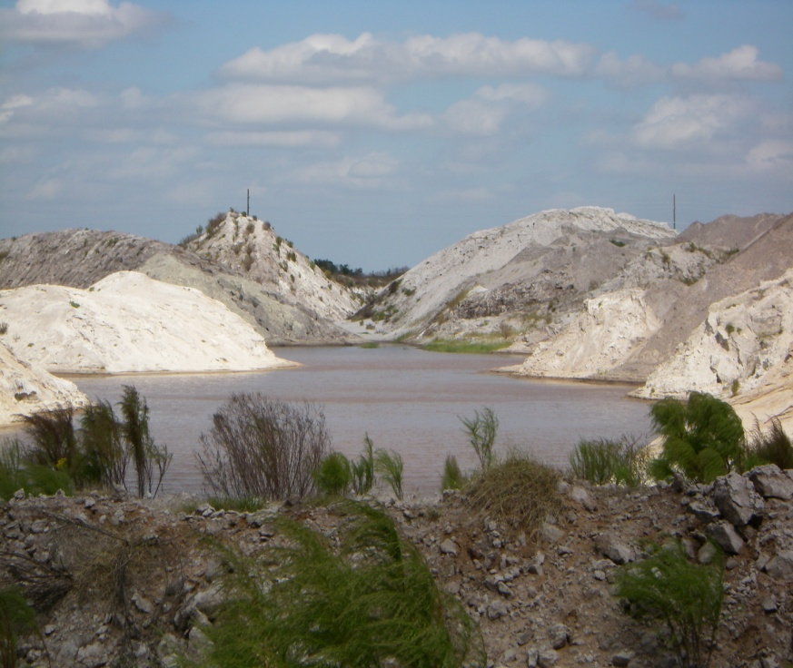
Mining Services
Mining and Waste Disposal Planning
  Phosphate
  Uranium
  Sand
  Aggregate
  Limerock
  Alumina
  Vermiculite
  Metals
Mine Development and Design
Land Reclamation
Gypsum Stack Design
Regulatory Permitting and Compliance Monitoring
Reserves Analysis

Slide 5
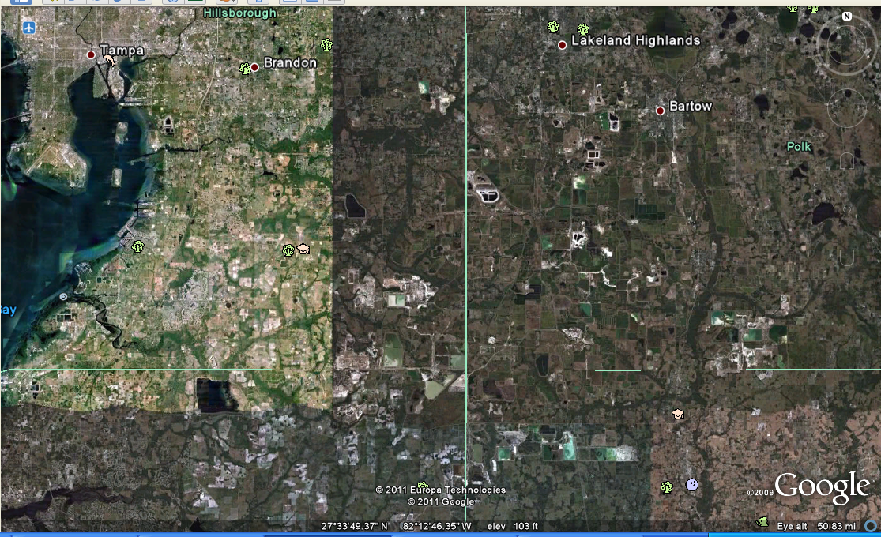
Phosphate Mining in Central Florida

Slide 6
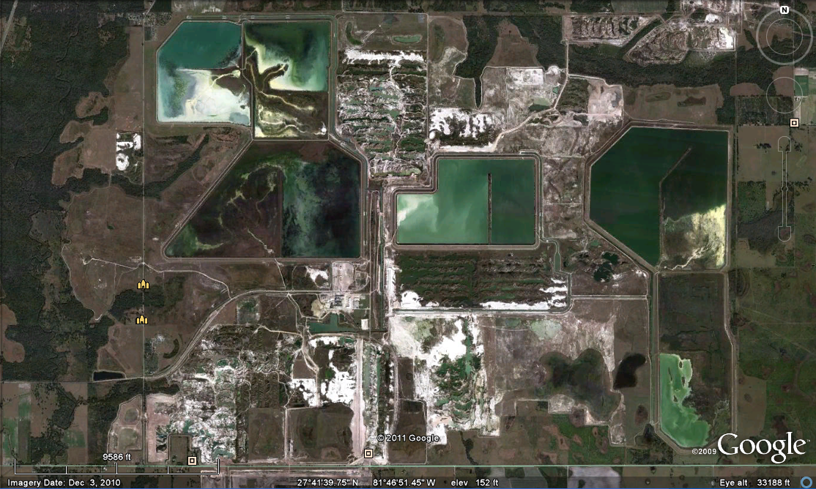
Typical Phosphate Mine

Slide 7
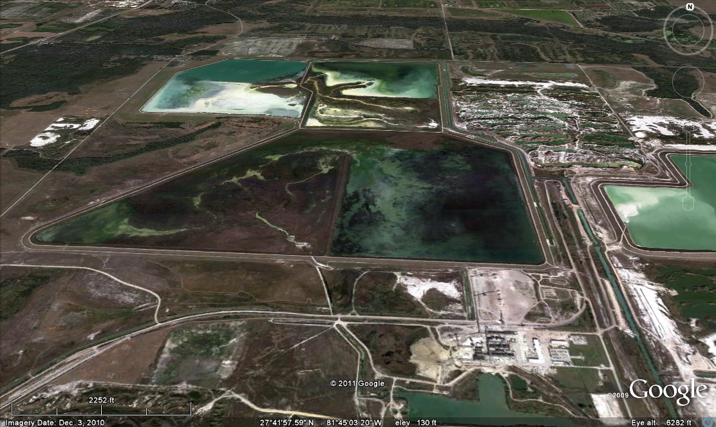
Typical Phosphate Mine

Slide 8
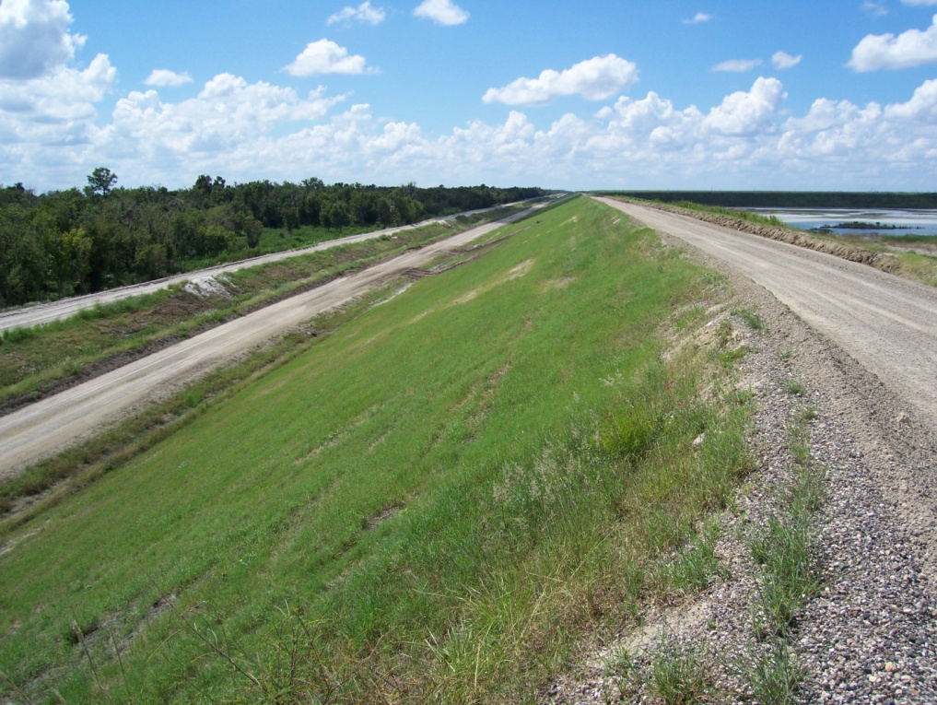
Typical Clay Settling Area Embankment
Typical Clay Settling Area Embankment

Slide 9
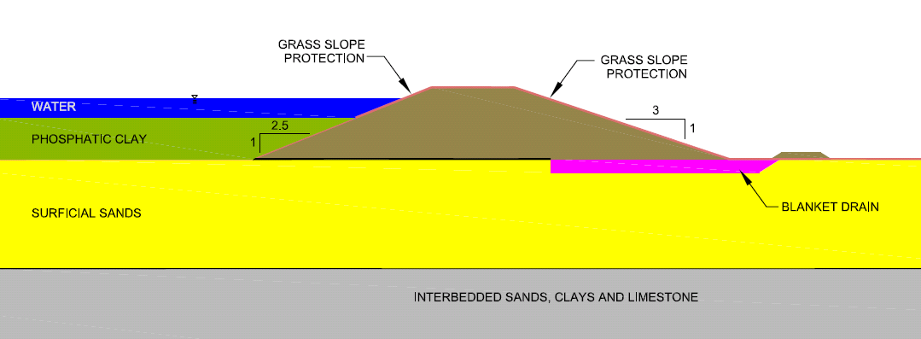
CSA Typical Embankment Section
2.5H:1V to 3H:1V Outside Slopes
2H:1V to 2.5H:1V Inside Slopes
Clay Seal of Foundation Soils
Blanket Drain using Sand Tailings

Slide 10
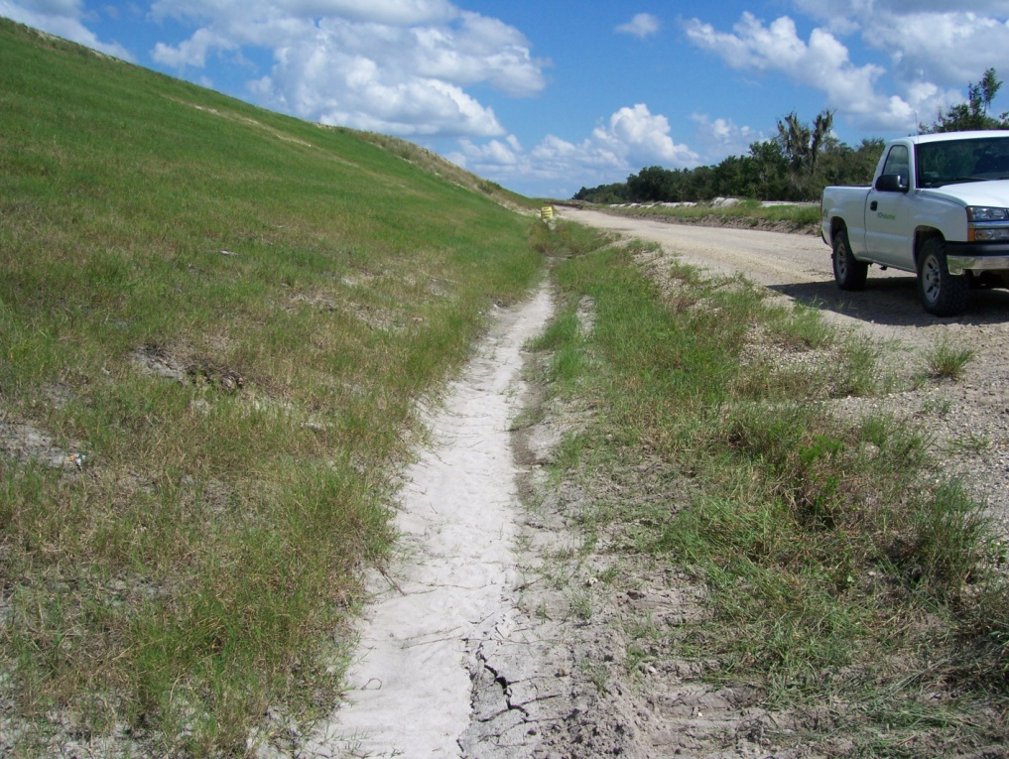
Surface Water/Seepage Collection Ditch

Slide 11
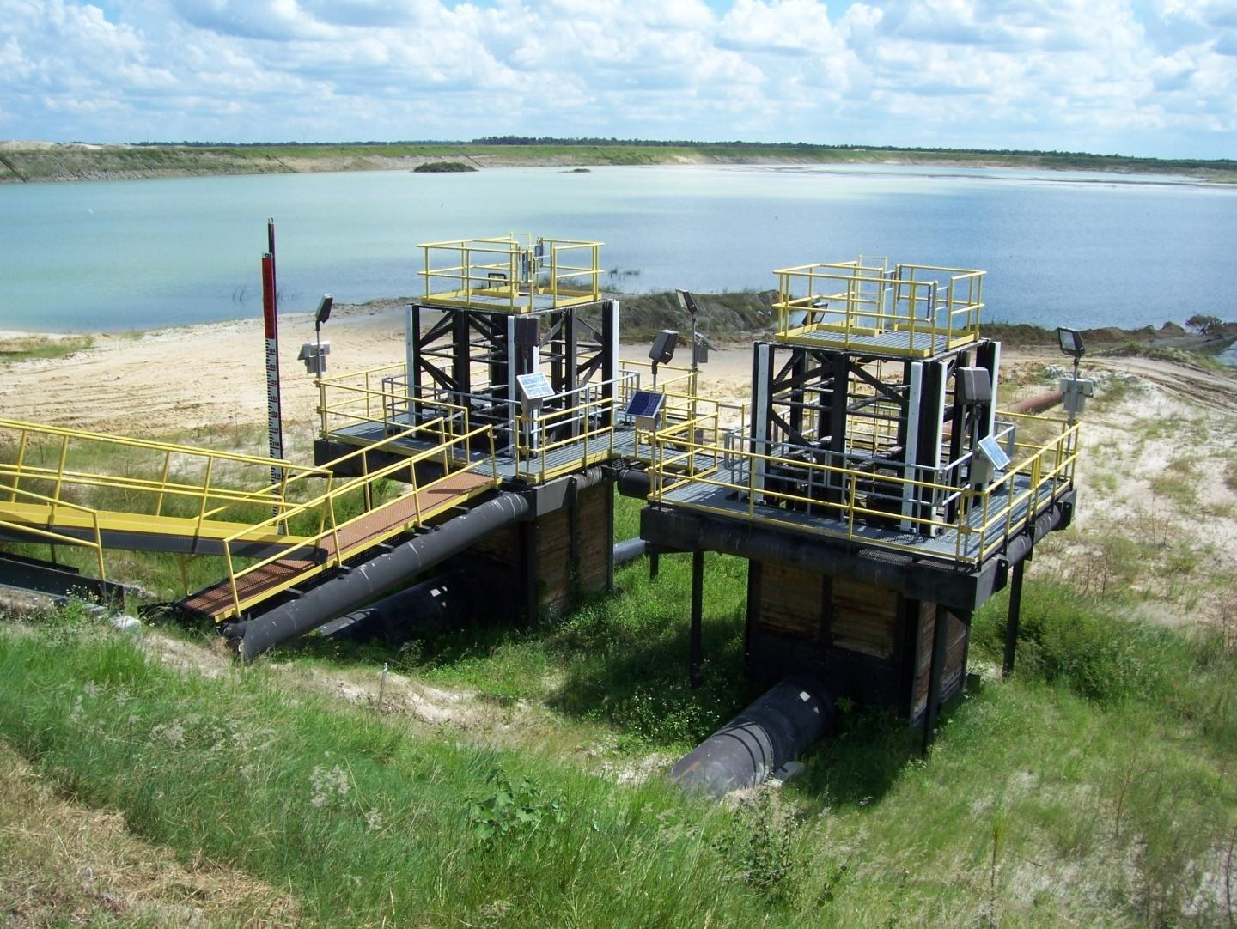
CSA Outlet Spillways

Slide 12
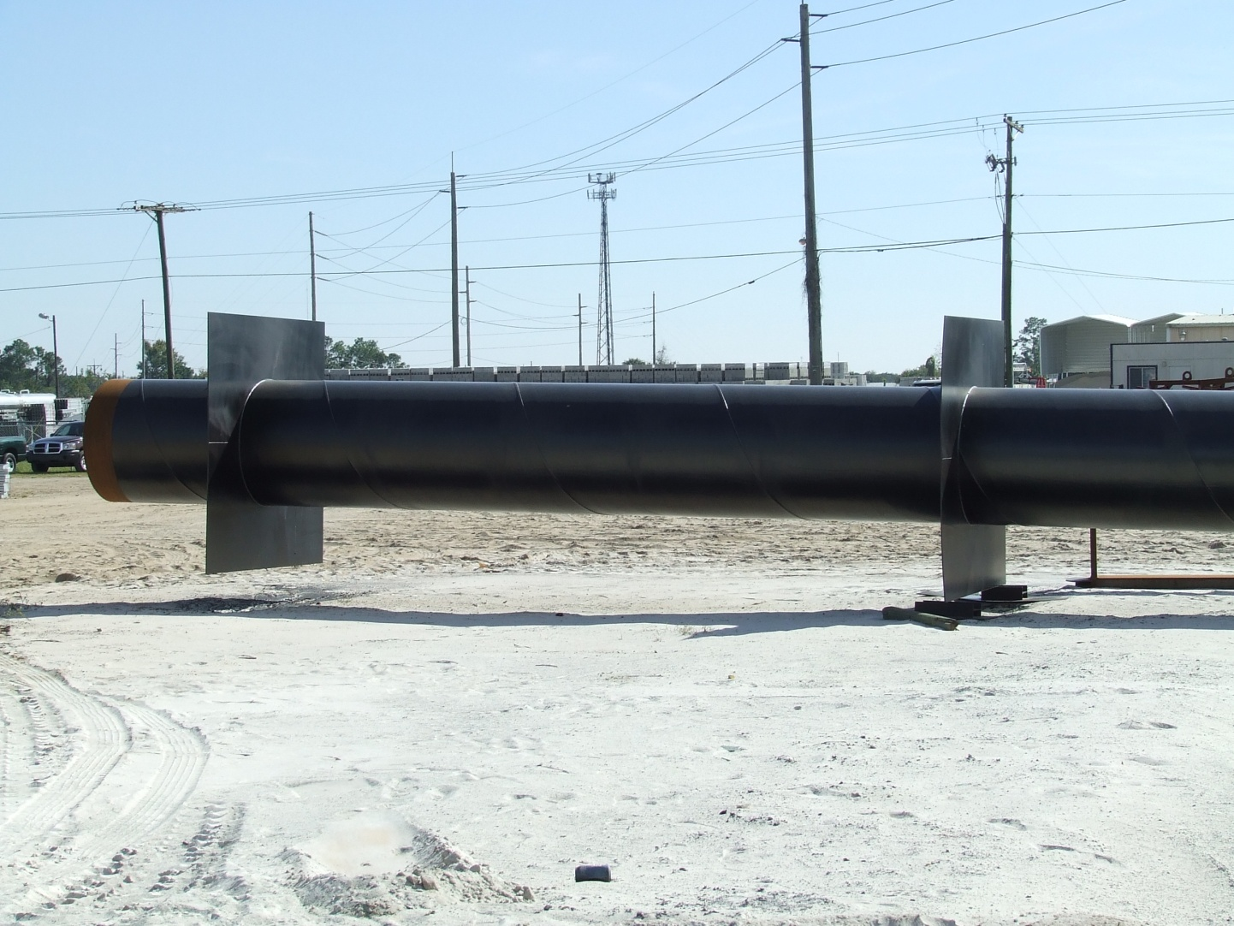
CSA Outlet Pipe w/Seepage Collar

Slide 13
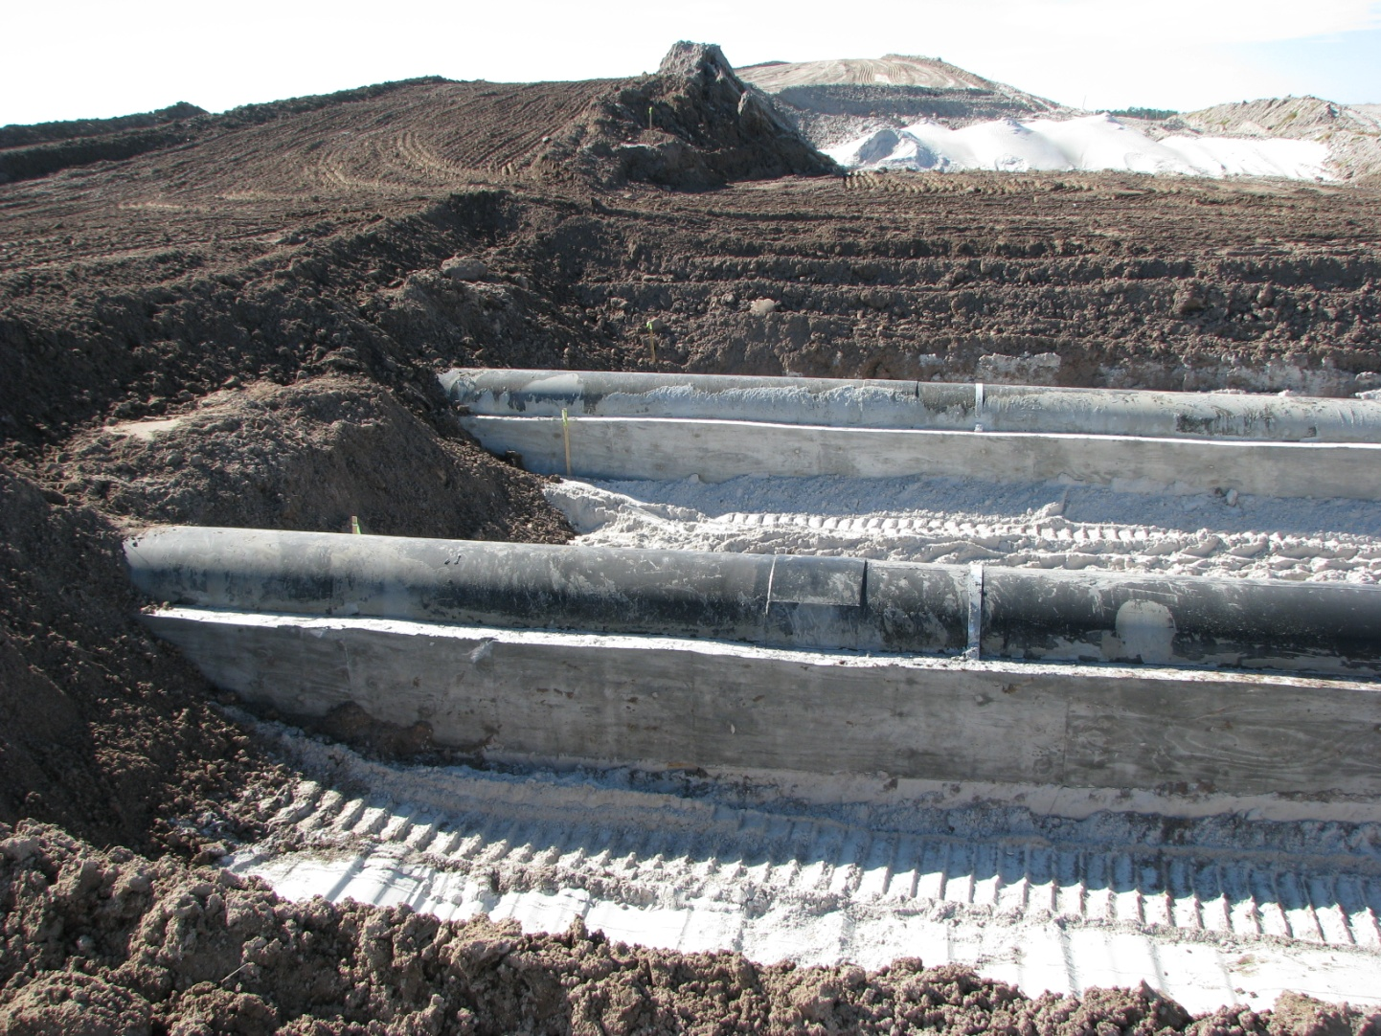
CSA Outlet Pipe Cradle and Drain

Slide 14
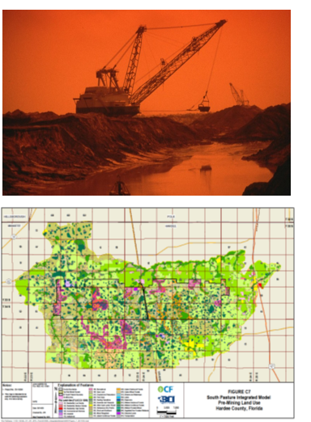
CFI--South Pasture Mine
Waste disposal planning, integrated hydrologic modeling, and dam break analysis
Applied MIKE SHE model to characterize groundwater and surface water interactions in a rebuilt surficial aquifer
Dam breach and flood hazard analysis using a combination of 2-D and 1-D models

Slide 15
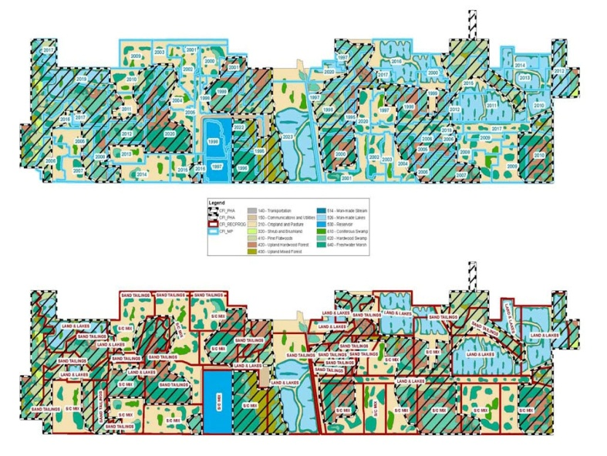
Reclamation Cost Model
Developed to aid in preparation of corporate budgets and regulatory financial assurance
Incorporates earthmoving, planting, maintenance, and monitoring
Multiple source unit cost estimates including RSMeans, NRCS, FDOT, and direct vendor quotes
Programmed custom GIS functions to automate updates
Incorporates mine plan, reclamation program boundaries, FLUCCS designations, and backfill type as GIS inputs
LOM budgets can be generated in minutes and grouped by reclamation program, mining year, etc.

Slide 16
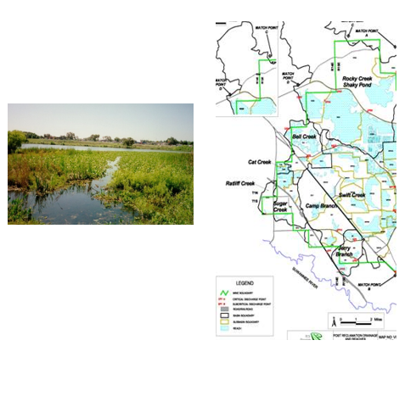
PCS Mine with Hydrologic Modeling
Developed reclamation plan
Obtained FDEP and USACE Life of Mine permit approval
Mine-wide hydrologic model developed (HSPF) – full integrated modeling of select basins
Developed detailed map set of all hydrologic related thematic maps, mining sequencing, reclamation plans, and wetland locations
Completed life-of-mine clay disposal plan

Slide 17
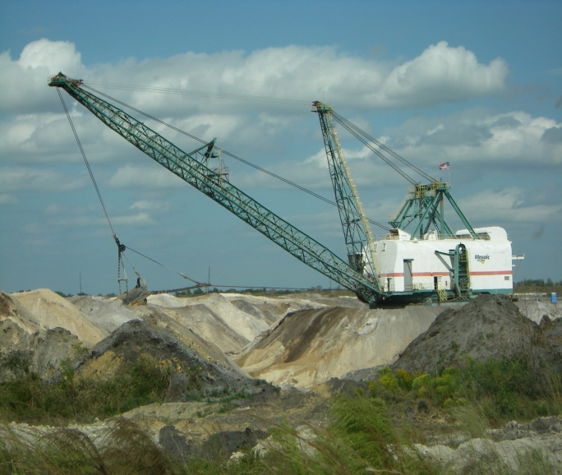
Reclamation Design—Multiple Clients
Worked for numerous clients for more than 30 years primarily in sand, aggregate, and phosphate industries
Reclamation design tasks include:
  State application submittal process
  Earthmoving and grading plans
  Hydrologic modeling and clay consolidation prediction
  Revegetation plans
  Drainage and stormwater management plans
  Bid document development and reclamation specifications
  Construction administration and as-built documentation

Slide 18
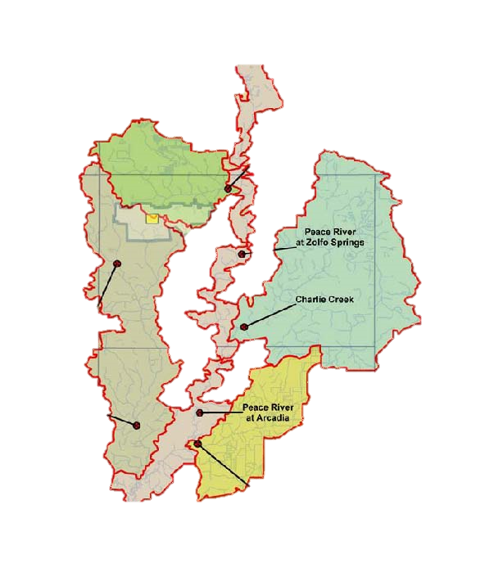
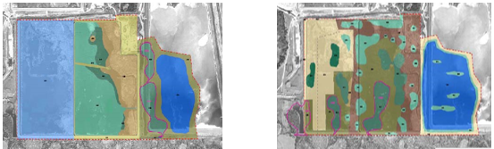
CF Industries Aquifer Recharge and Recovery Project
Redesigned reclamation plan in support of project permitting
Conducted integrated modeling in support of modifications and project
Assessed project impacts with regard to Peace River MFLs and PRMRWSA operations
Performed detailed 3-dimensional consolidation analyses of s/c mix areas to aid in project design and layout

Slide 19
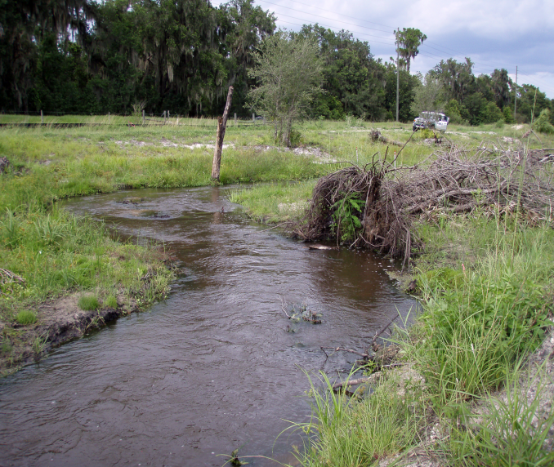
Mosaic—Litigation Support and Reclamation Design
Provided testimony on the sufficiency of 100 acres of bay swamps and wet prairies mitigation plans in an Administrative Law Hearing related to Mosaic’s demonstrated capabilities in bay swamp and wet prairie restoration
Administrative Law Judge issued findings of fact in complete agreement with this testimony and recommended approval of the permit
Dispute resolution concerning the conservation, mining, and restoration of more than 20 stream corridors in southwest Florida
Established a scientific basis that helped resolve the components of what stream corridors would be protected, the extent of protection, and the restoration goals and approaches of the company

Slide 20
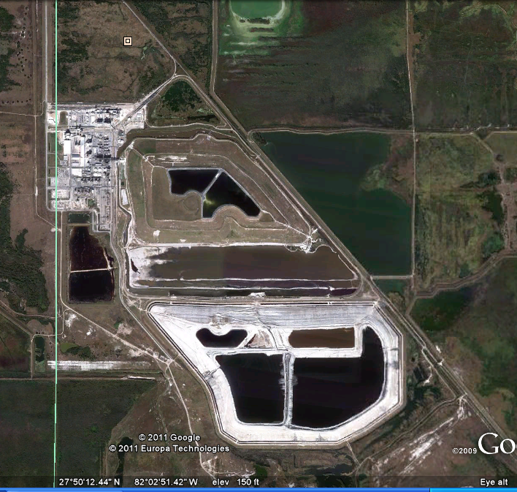
Typical Chemical Processing Facility

Slide 21
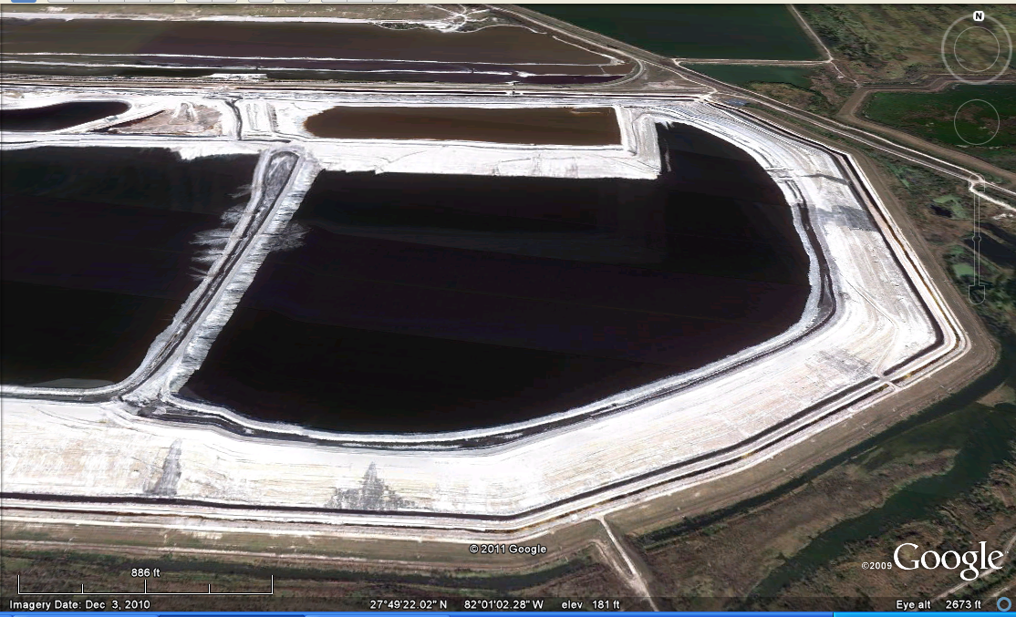
Typical Chemical Processing Facility Cont.

Slide 22
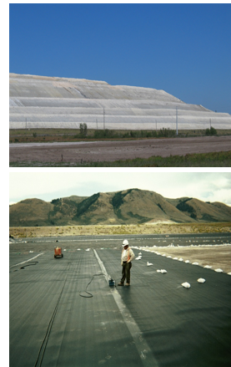
Nu-West Industries Phosphogypsum Stack Design
Design, permitting, and construction oversight of the first phase (125-acre-cell) of a new gypsum disposal stack to manage the 1,800-acre-feet of gypsum slurry produced yearly at the site
Currently working on the design of the second phase of the stack, which will ultimately encompass approximately 300 acres

Slide 23
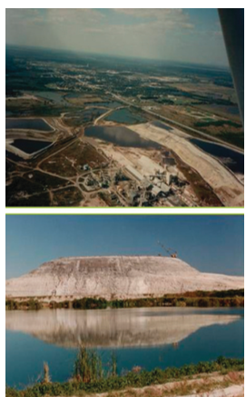
Royster Phosphogypsum Stack Expansion and Site Closure
Extensive subsurface exploration consisting of geotechnical borings and electromagnetic studies to characterize the site conditions for the expansion of an existing phosphogypsum stack
Provided recommendations to improve the processing efficiency
Expansion design included the need for foundation stabilization, construction of containment dikes, an under drain system, and associated cooling ponds
Installation of a 12,000-linear-foot slurry wall to reduce seepage from the existing stack
Groundwater monitoring to ensure permit compliance

Slide 24
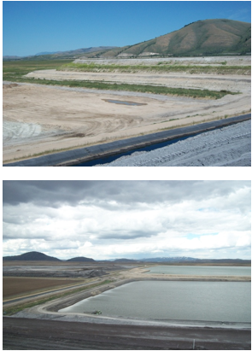
Conda Phosphate Tailing and Cooling Pond
AMEC has provided comprehensive professional services to Agrium US, Inc’s Conda Phosphate Operations for more than fifteen years.
A key project at the site has been the ongoing expansion of Talings Pond 4 which covers approximately 300 acres.
Services include:
  Ground investigation to asses foundation soils
  Characterization of potential borrow pit areas
  Slope stability and seepage analyses
  Design of seepage control measures
  Assessment of tailings storage capacity
  On-going monitoring of soil instrumentation

Slide 25
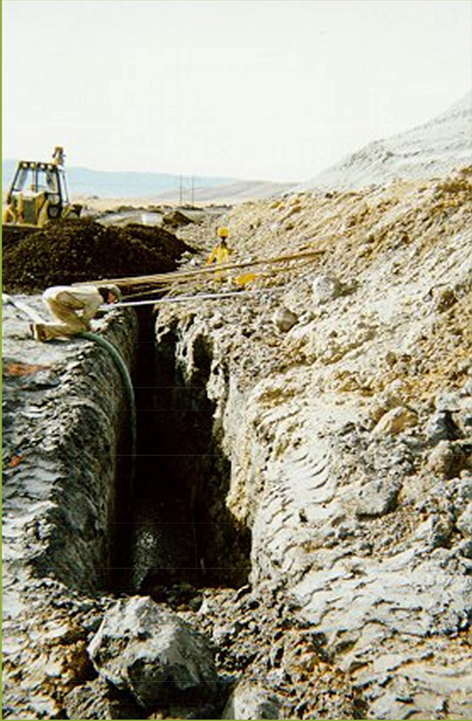
Agrium U.S. Inc. Gypsum Stack Evaluation
Provided emergency response to evaluate the cause of gypsum stack instability
Completed standard penetration test (SPT) borings and sampling of gypsum stack
Installed slope indicator instrumentation and provided recommendations to stability
Completed test borings in gypsum and foundation materials
Reviewed historical information and plans
Prepared design drawings and specifications for owner to install acid water seepage collection system

Slide 26
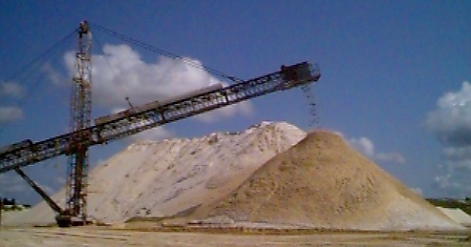
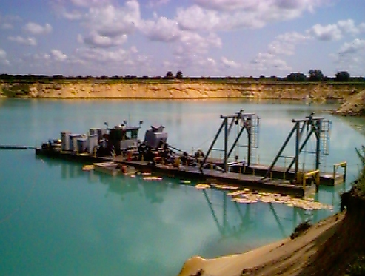
ER Jahna Sand Mine Development
Prepared 400-year (life of mine) Environmental Resource Permit
Development of a new 15,000-acre sand mine in the green swamp
Developed detailed thematic GIS coverage of site
Conducted detailed SWMM modeling of 140-square-mile contributing basin
Utilized MODFLOW to assess long-term regional groundwater impacts

Slide 27
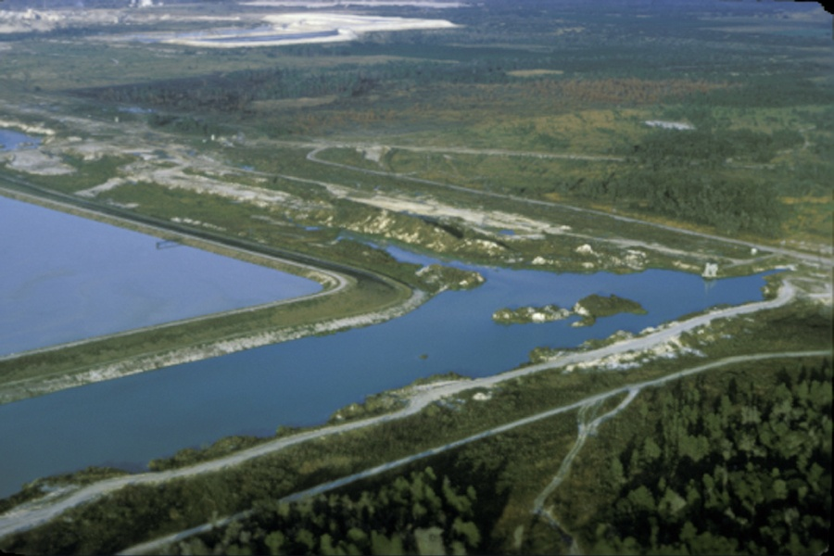
DAM & LEVEE PROJECT EXPANSION
Cemex Tailings Dams-Ongoing
Engineering Cost: $750,000
Client: Cemex Construction Materials, LLC
Since 1978, we have provided comprehensive services for the design and construction of more than 15 miles of tailings dams water reservoirs ranging in height from 30 feet to 110 feet and enclosing several thousand acres. Currently providing annual dam inspection services and design of repairs and maintenance to address potential sinkhole activity, seepage, and slope stability issues for the active reservoirs and tailings storage areas.

Slide 28
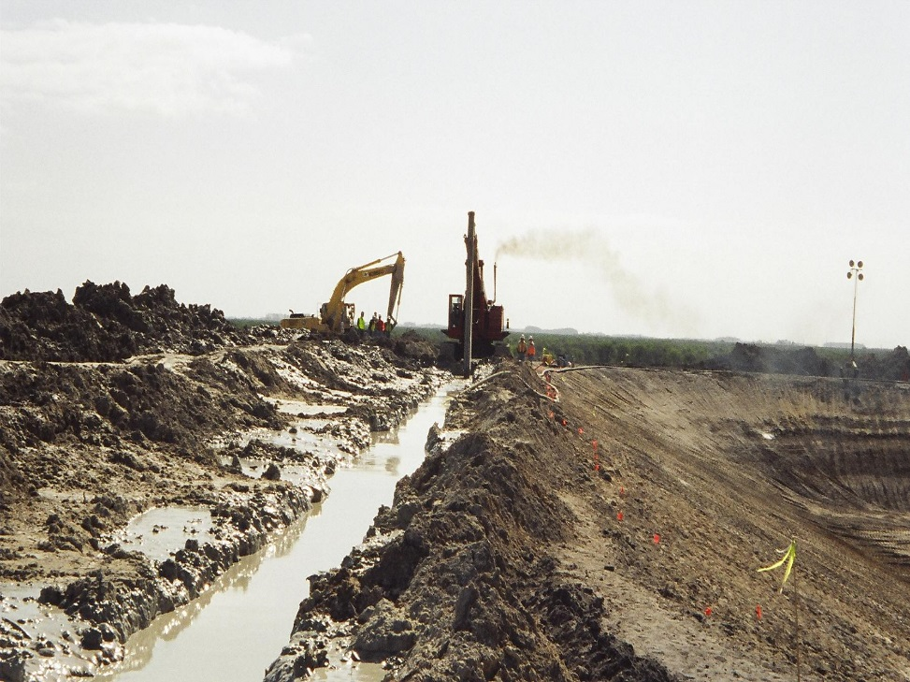
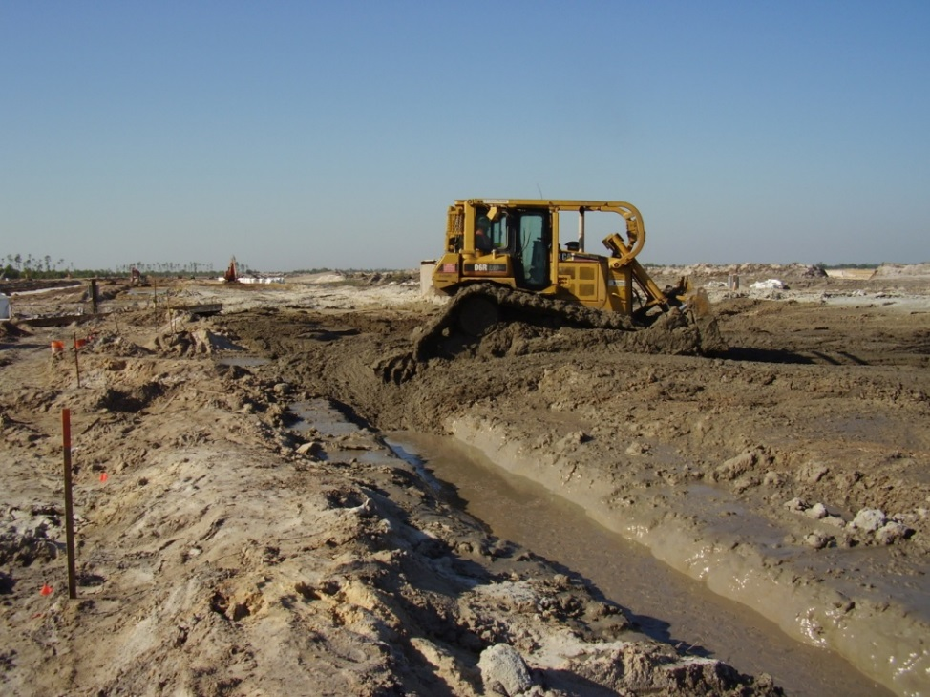
Soil-Bentonite Cut-Off Wall
Excavating Trench
Backfilling Trench

Slide 29
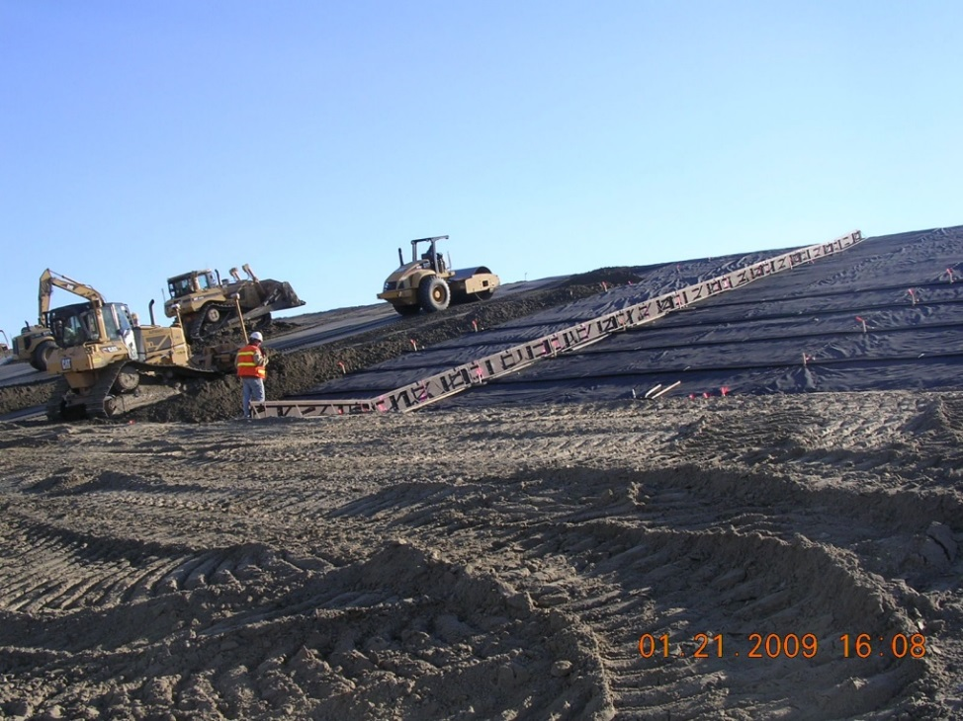
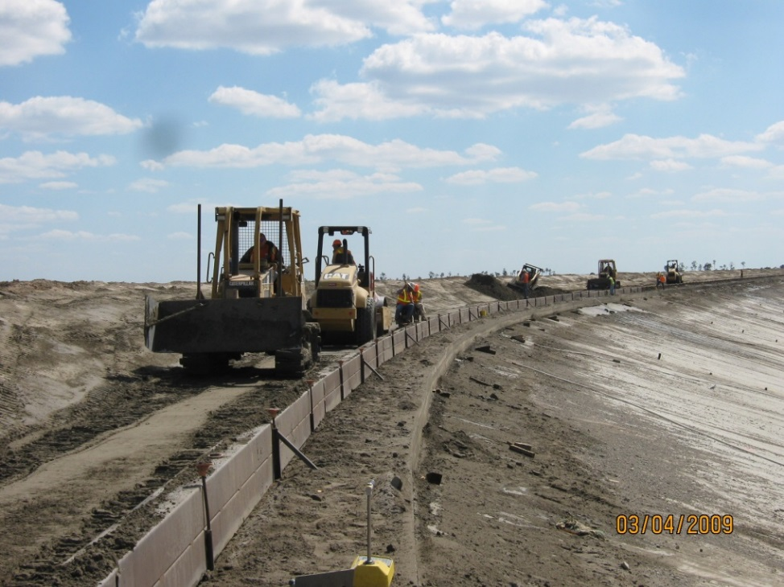
WSR Soil-Cement Placement
Flat Plate Soil-Cement
Stair-Step Soil-Cement

Slide 30
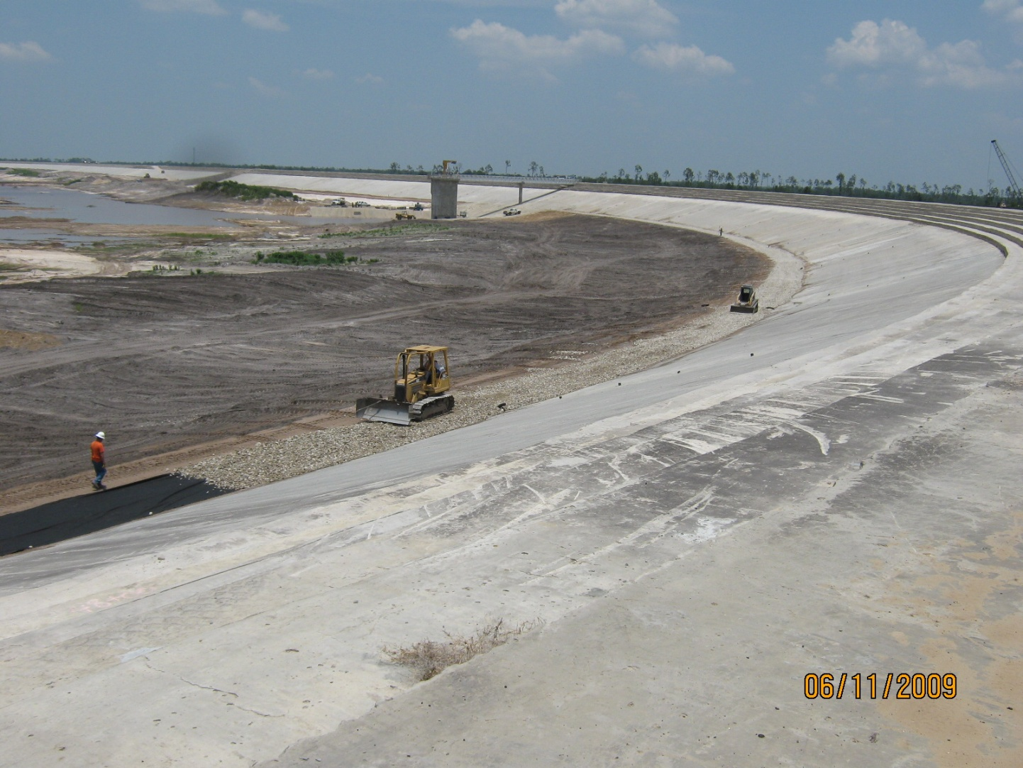
Completed Soil-Cement Slope

Slide 31
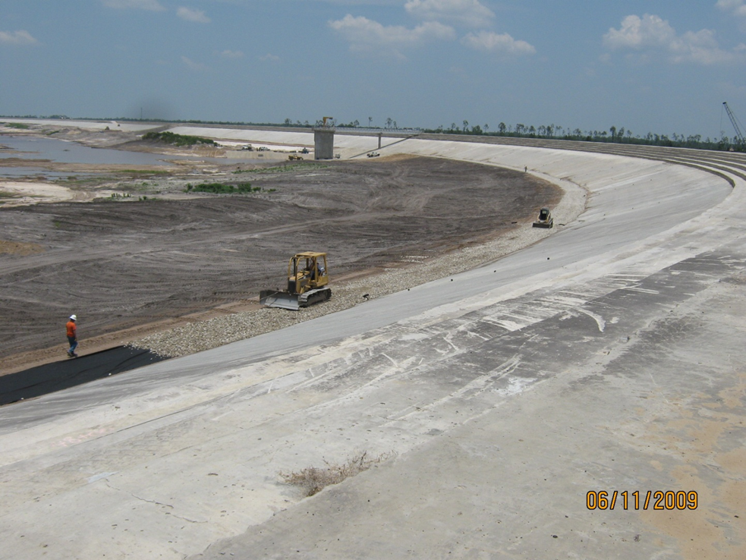

Slide 32
QUESTIONS????

