Slide 1
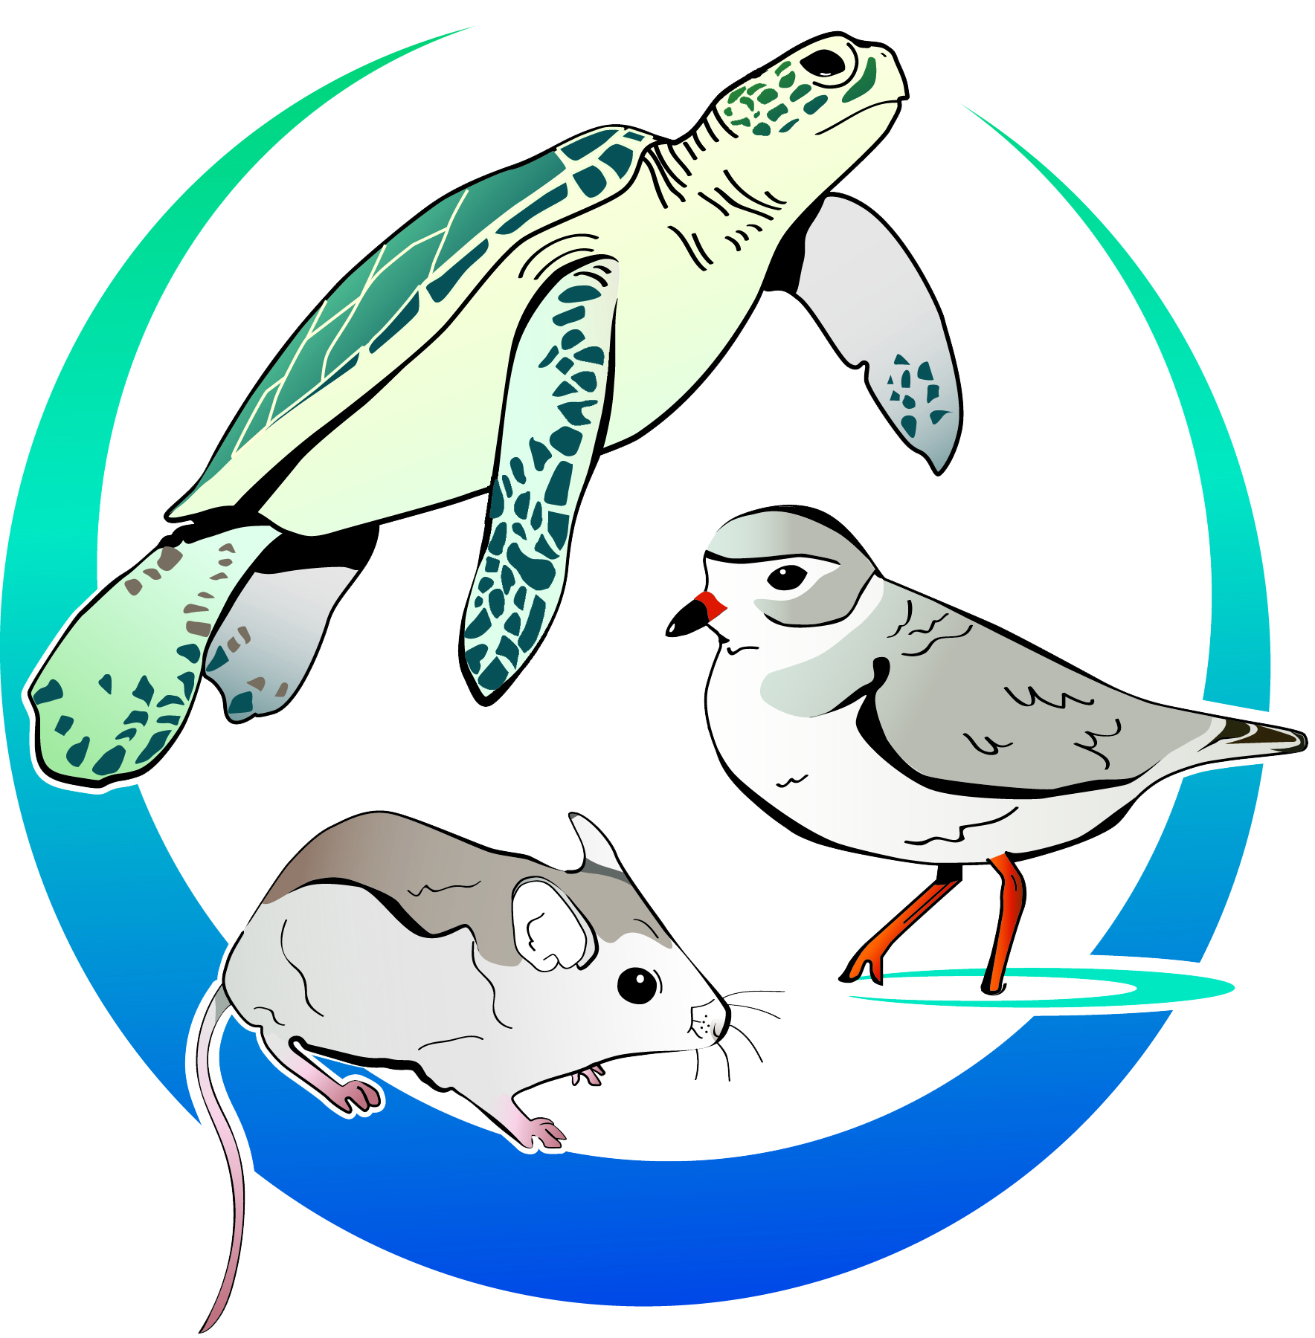
The Florida Beaches
Habitat Conservation Plan
CCCL TRAINING – JUNE 15, 2017 – TALLAHASSEE, FLA
Slides courtesy of Jennifer McGee, PhD, FWC

Slide 2
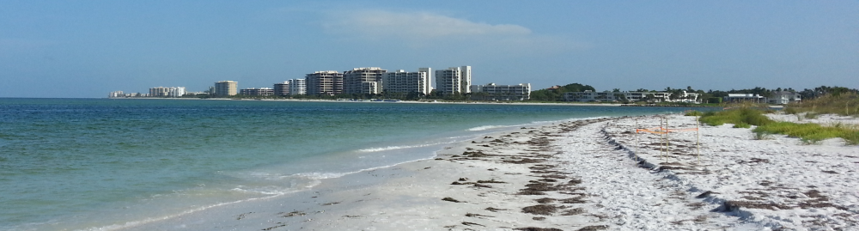
Florida Beaches Habitat Conservation Plan
Multiagency effort - FDEP, FWC, USFWS, & other stakeholders
ITP for FDEP’s CCCL Permitting Program
One of the nation’s largest & most comprehensive, statewide habitat conservation plans.
“To obtain an ITP that will allow FDEP to fulfill its CCCL regulatory responsibilities in a manner that fully complies with the ESA.”
Photo: J.L.McGee
Notes:
Listed species habitat conservation
Initiated in 2007
Annual USFWS grant under Section 6 of ESA
- awarded annually since 2008
Execute funding agreements with FWC
Working Group comprised of DEP, FWC, & FWS

Slide 3
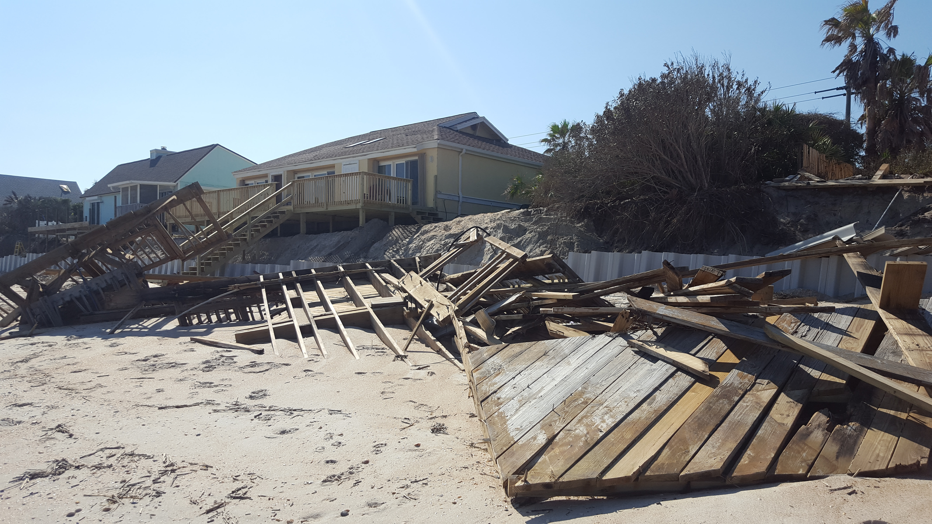
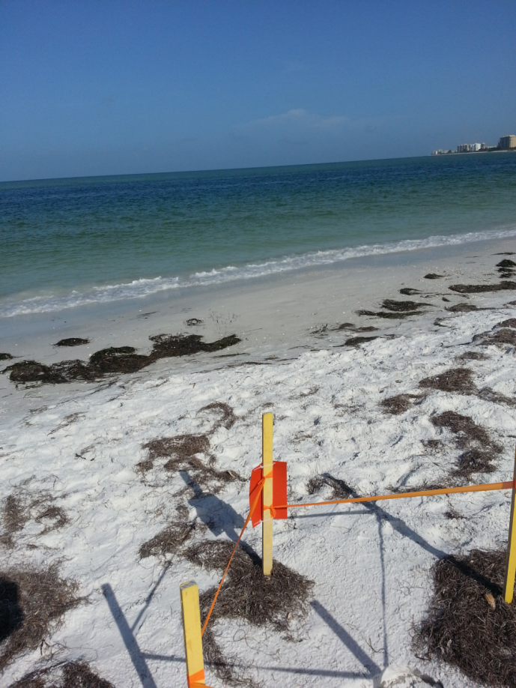
Benefits
    Ensure compliance with the ESA
    Minimize risk from potential 3rd party lawsuits
    Reduce risk of unauthorized take
    Develop standard environmental protection measures, providing a clear roadmap for CCCL activities
Photo: J.L.McGee
    Streamline the permitting process & reduce the application processing time
    Promote & improve healthy beaches for wildlife
    Address impacts to listed species & their habitats comprehensively, rather than parcel by parcel
Photo: J.L.McGee

Slide 4
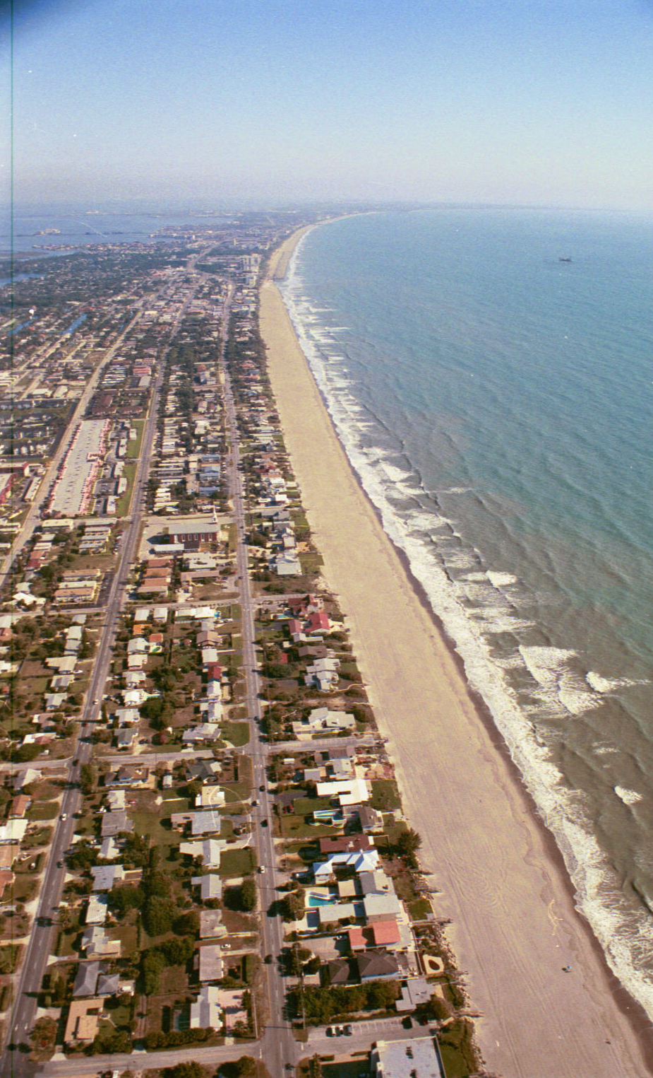
Background
CCCL Program Permitted Activities Only
Covered Activities
  Coastal Development – Major and Minor Structures
  Beach/Dune Restoration
  Armoring
  Dune Walkovers
  Mechanical Beach Cleaning
  Sand Fencing
  Emergency Response
  Special Events
  Other
Beach nourishment is not covered since permitted under JCP program

Slide 5
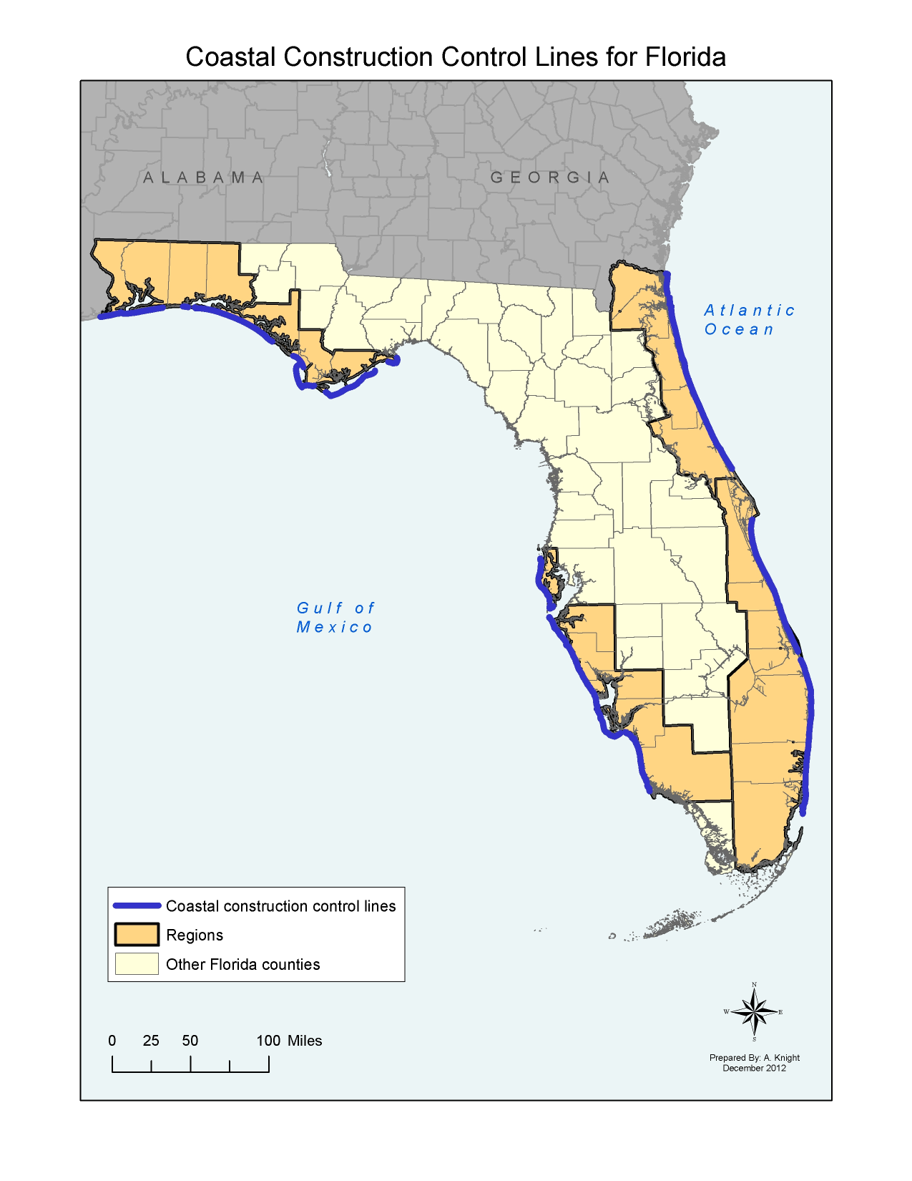
Plan Area
800+ Miles of Sandy Beaches
*25 Coastal Counties
Panhandle
Escambia, Santa Rosa, Okaloosa, Walton, Bay, Gulf, Franklin
Gulf
Pinellas, Manatee, Sarasota, Charlotte, Lee, Collier, *(Monroe)
Southeast
Brevard, Indian River, St. Lucie, Martin, Palm Beach, Broward, Miami-Dade
Northeast
Nassau, Duval, St. Johns, Flagler, Volusia
Northeast
Panhandle
Southeast
Gulf

Slide 6
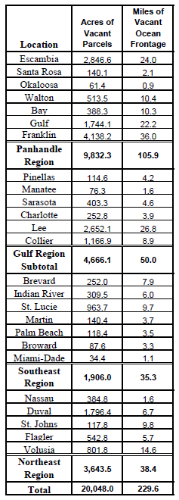
Plan Area
Vacant parcels seaward of CCCL
Covered Activities
  Coastal Development – Major and Minor Structures
  Beach/Dune Restoration
  Armoring
  Dune Walkovers
  Mechanical Beach Cleaning
  Sand Fencing
  Emergency Response
  Special Events
  Other
Summary of Potential Coastal Upland Development Area (2008 – 2010)

Slide 7
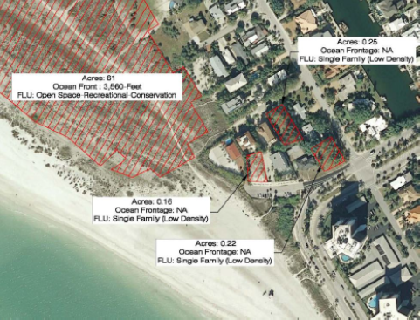
Vacant parcels seaward of CCCL – Sarasota County Example

Slide 8
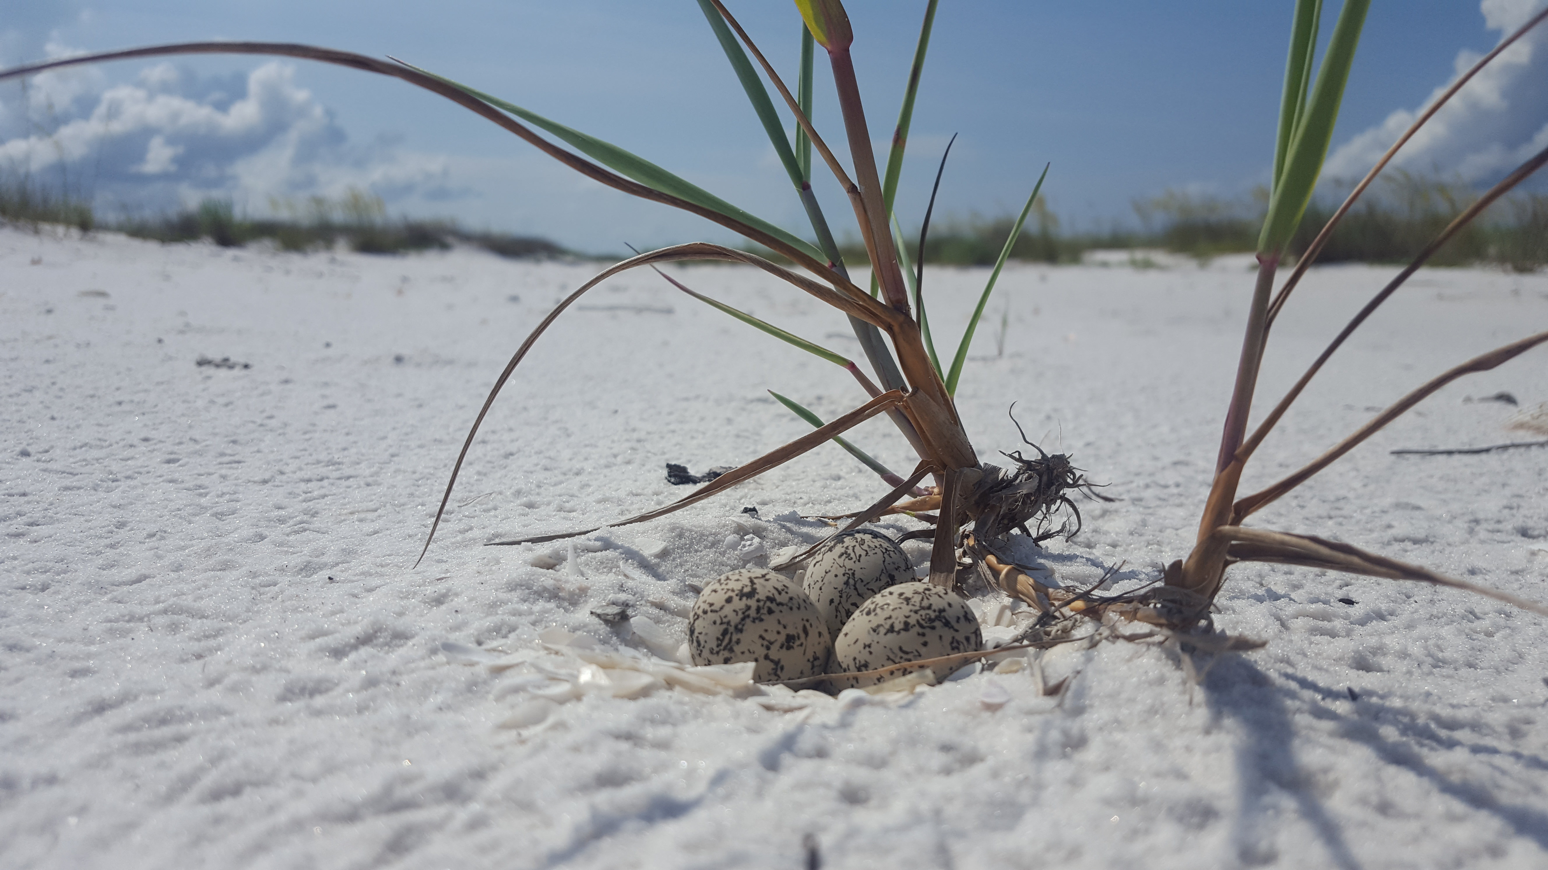
Background - continued
Only sea turtles currently addressed in Statute (161.053, F.S. – limited minimization & mitigation conditions)
The FBHCP will:
  Amend 161.053(4)(c) to allow for minimization of impacts to beach mice & shore birds
  Expansion of authority to include impact/mitigation
  Post construction activities
  Long term indirect effects (e.g. lighting, sea walls, landscaping, etc.)
  Exempt activities
Photo: J.L.McGee

Slide 9
Covered Species
NOTE: black font = currently CCCL protected; red font = new to CCCL
SHOREBIRDS AND SEABIRDS
Federal
• Piping plover (Charadrius melodus) –endangered or threatened populations
• Red knot (Calidris canutus rufa) - candidate
State
• American oystercatcher (Haematopus palliatus) – SSC
• Black skimmer (Rynchops niger) – SSC
• Least tern (Sternula antillarum) – threatened
• Snowy plover (Charadrius alexandrinus tenuirostris) - threatened
• Wilson’s plover (Charadrius wilsonia) – no data
REPTILES
Federal
• Green sea turtle (Chelonia mydas) – endangered.
• Hawksbill sea turtle (Eretmochelys imbricata) – endangered.
• Kemp’s ridley sea turtle (Lepidochelys kempsii) - endangered.
• Leatherback sea turtle (Dermochelys coriacea) – endangered.
• Loggerhead sea turtle (Caretta caretta) – endangered.
State
• Gopher tortoise (Gopherus polyphemus) –threatened.

Slide 10
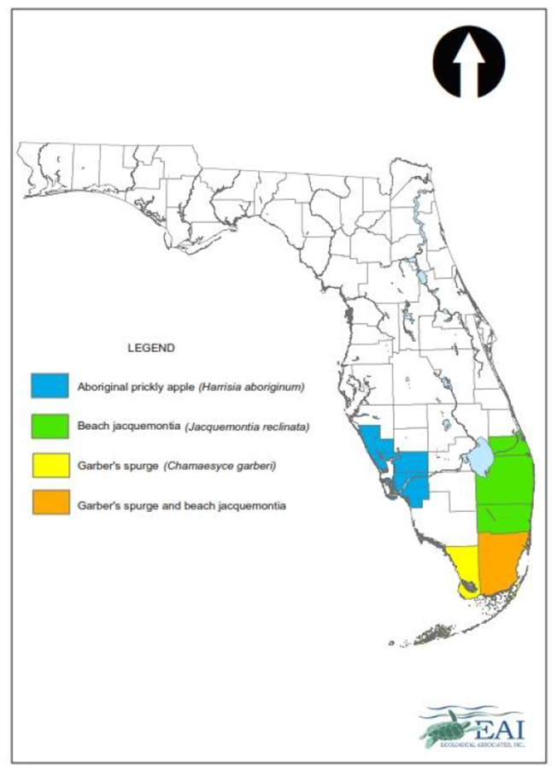
Covered Species
MAMMALS
Federal
• Anastasia Island beach mouse (Peromyscus polionotus phasma) –threatened.
• Choctawhatchee beach mouse (Peromyscus polionotus allophrys) – endangered.
• Perdido Key beach mouse (Peromyscus polionotus trissyllepsis) – endangered.
• St. Andrew beach mouse (Peromyscus polionotus peninsularis) – endangered.
• Southeastern beach mouse (Peromyscus polionotus niveiventris) – threatened.
State
• Santa Rosa beach mouse (Peromyscus polionotus leucocephalus) – no data.
LISTED PLANT SPECIES:
Federal
• Aboriginal prickly-apple (Harrisia aboriginum) endangered.
• Beach jacquemontia (Jacquemontia reclinata) endangered
• Garber’s spurge (Chamaesyce garberi) threatened

Slide 11
Organizational Process
HCP/ITP
Application (DEP)
FWS
Steering Committee
Working Group
Lee County TDC
Assoc. of Counties
League of Cities
Humiston & Moore
STC
FWRI
Audubon
FWC
FWS
DEP
CT/EAI/FNAI/Geodesign/Stratus
Issued
ITP
Scientific/Expert
Engagement
Ad hoc
Committees as
needed

Slide 12
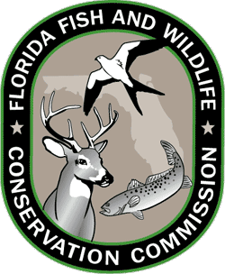
Committee Membership
Steering Committee
Chair-FWC
Co-Chair-DEP
Scientific Community – Fish &Wildlife Research Institute
Environmental/Conservation Groups - Sea Turtle Conservancy &Audubon Florida
Regulated Community - Humiston &Moore Engineering
Hotel/Tourism Industry- Lee County Tourism Development Council
Local Governments - FL Association of Counties &FL League of Cities

Slide 13
FBHCP Status
(Completed, In Progress, Up-Coming)
Executive Summary
Introduction (1)
Biological Goals, Objectives &Benefits (2)
Plan Preparation Process (3)
Covered Activities (4)
Covered Species with Accounts (5)
Plan Area (6)
Threats to Covered Species in Plan Area from CCCL Activities (7)
Assessment of Anticipated Take (8)
Alternatives Analysis (9)
Minimization Measures (10)
Mitigation Measures (11)
Implementation Strategy, Plan Management, Funding &Schedule (12)
Adaptive Management Plan (13)
Changed/Unforeseen Circumstances (14)
Compliance Monitoring &Reporting (15)

Slide 14
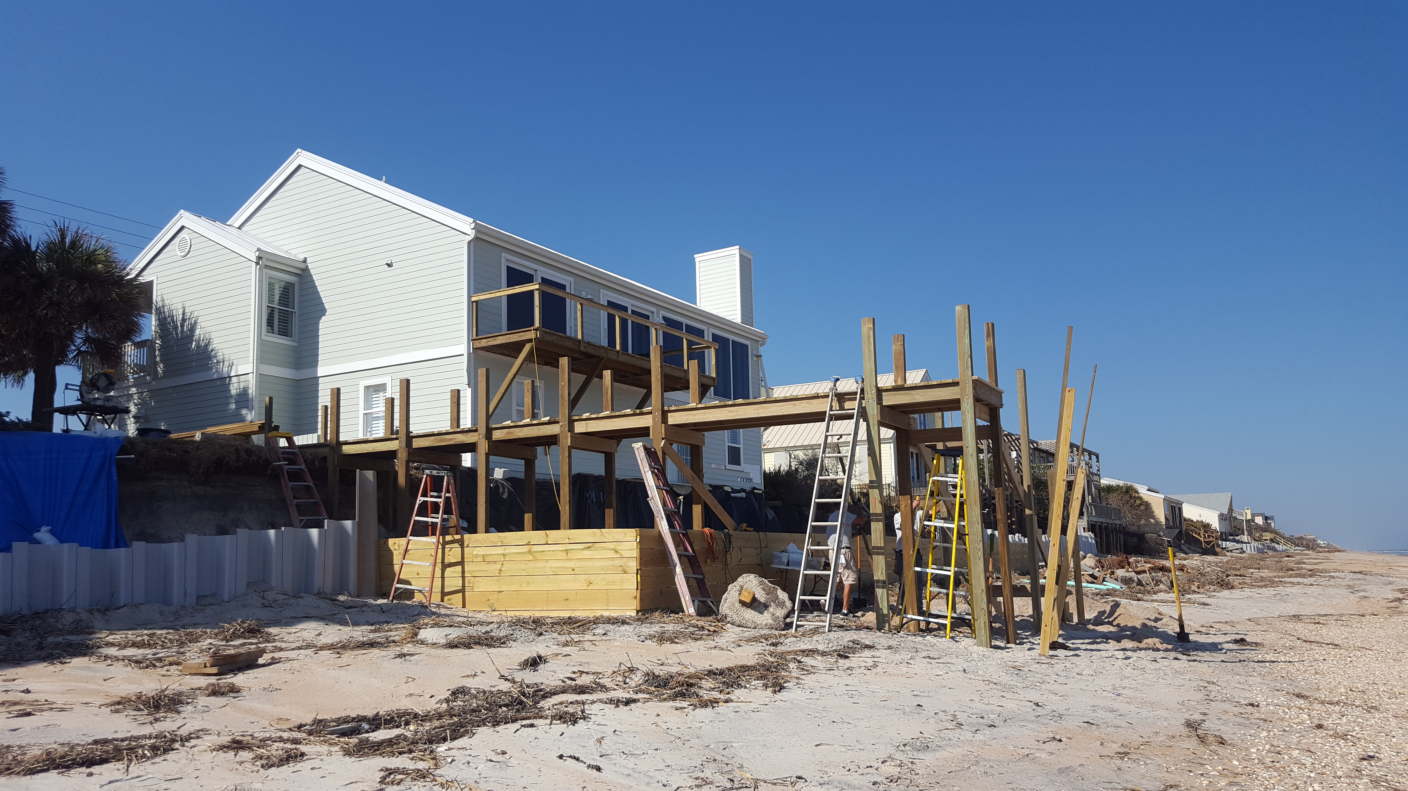
FBHCP Status - Phase 9
    Submission early 2018
    Finalize take models (direct and indirect impacts)
    SC vote on covered species edits (State vs. Federally Listed Species) How would this effect statutory changes?
    Additional review for minimization measures and conservation recommendations
    Compiling potential mitigation projects, calculating mitigation fees, ranking mitigation projects (habitat quality indices)
Photo: J.L.McGee

Slide 15
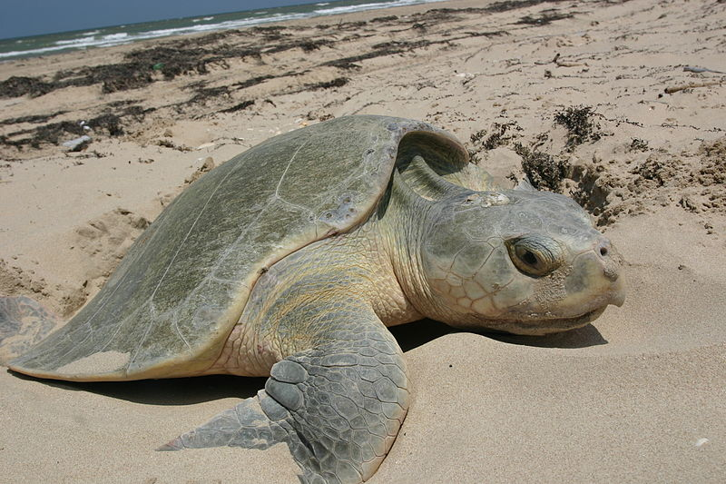
Phase 9 - 2017 and Beyond
Implementation Strategy/Plan Management (Chapter 12)
  Legislative changes needed for implementation
  Funding
  Schedule
  Implementation responsibilities (FDEP, FWC, local partners)
  NEPA
Adaptive Management (Chapter 13)
  Describes specific steps (alternative strategies) to be taken if monitoring data indicate that proposed minimization and mitigation measures are not achieving the biological objectives set forth in the FBHCP – seeking net conservation benefit to covered species

Slide 16
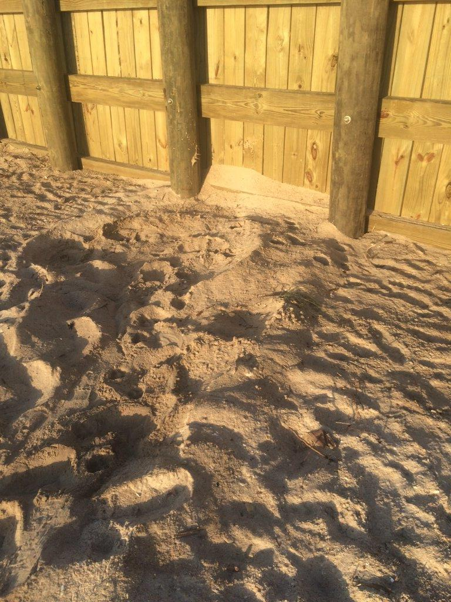
Phase 9 - 2017 and Beyond
Compliance Monitoring and Reporting (Chapter 15)
  - Compliance monitoring plan
  Reporting procedures
Outreach with local governments and stakeholders will increase and public meetings will be conducted
Legislative Changes 2017, 2018, …
Submission early 2018
Photo: Robbin Trindell, FWC

Slide 17
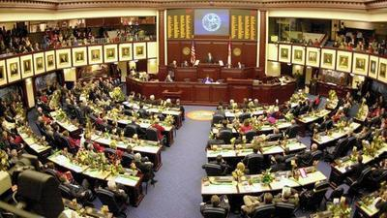
Legislative Changes
Add listed species not currently covered -161.053(4)(c)
Funding Mechanism -161 Part I
  Minimization Measures - 161.053(4)(c)
  Impact and mitigation measures – 161.053(4)(f)
Operational phase to CCCL permits – 161Part I
*Conditional denial/acceptance of CCCL permit pending proof of individual ITP

Slide 18
QUESTIONS?

