Slide 1


YEAR 5 NPDES MS4 AUDIT
6/18/2024

Slide 2


1A-01
1a | 01 | Distribute Educational Material Distribute stormwater educational material and articles to residents through mailings, events, local publications and newspapers | 1. Document and report the number of educational materials mailed to residents 2. Document and report the number of educational materials distributed at events 3. Document and report the number of articles published | Years 1-5 Years 1-5 Years 1-5 | 22,102 Materials Mailed to Utility Customers 2,274 Educational Materials 5 Articles
Events Where Materials Were Distributed | Date
Fox Lake Park Spring Festival | 3/25/23
Titusville Easter Egg Hunt Issac Campbell Park | 4/8/23
Enchanted Forest Earth Day | 4/22/23
Titusville Open Hours - Resiliency Stewardship | 4/24/23
Earth Day/Arbor Day Tree Giveaway | 4/24/23
Water Conservation Month Proclamation | 4/25/23
Brevard Zoo Pilot Seagrass Restoration Project | 5/23/23
Rain Barrell Workshop | 8/12/23
Water Conservation Display @ Enchanted Forest | 2/1/2024
Articles | Date
Talking Points - Restore our Shoes | 4/1/23
Talking Points -Resiliency Open House | 4/2/23
Brevard Business News - Water Conservation | 7/10/23
Brevard Business News - Public Works Update | 8/12/23
Talking Points -Restoring the Indian River Lagoon | 10/1/23

Slide 3
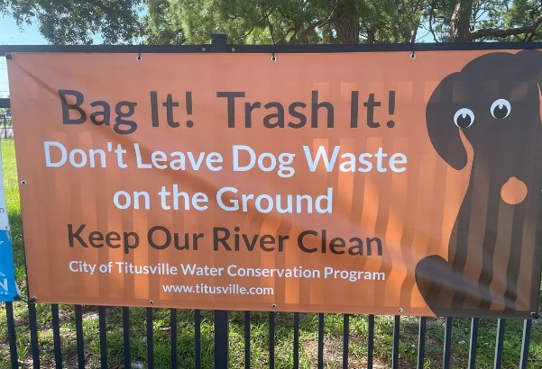
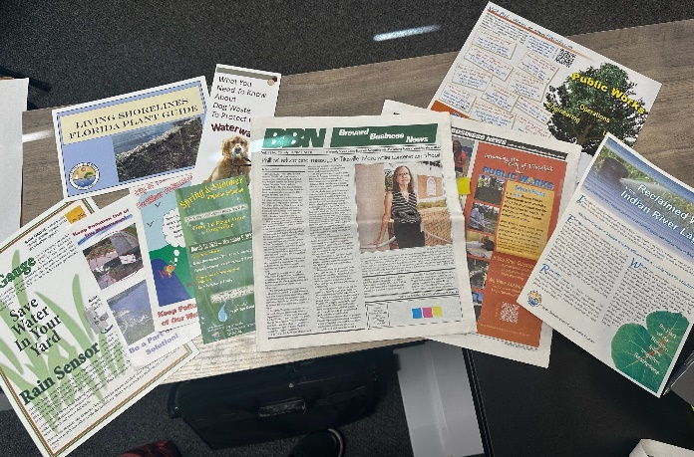
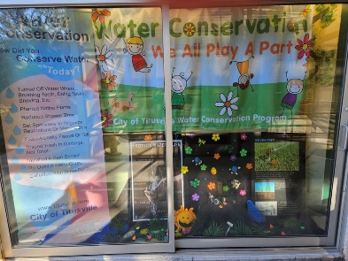
1A-01

Slide 4
1A-02
1a | 02 | Televised Educational Program Present public service announcements and educational video broadcasts on the City's government access television channel. | 1. Document and report the number of educational programs aired per permit year 2. Document and report the number of public service announcements aired per permit year 3. Estimate and report the approximate number of viewers | Years 1-5 Years 1-5 Years 1-5 | 4 Programs Aired 4 PSAs plus Audacy Facebook Ad Program 1403 viewers plus 234,375 impressions from Facebook Ads
Floating Wetlands
https://www.youtube.com/watch?v=rV-EU5lRCY4&list=PLU1aknF5k7J3MAlcW4doN8VuDoMK0RdhS&index=1&t=8s
Baffle Boxes
https://www.youtube.com/watch?v=t8qltpltxfY&list=PLU1aknF5k7J3MAlcW4doN8VuDoMK0RdhS&index=2&t=9s
Fertilizer Ordinance
https://www.youtube.com/watch?v=XzXBcFtREWE&t=9s
Scoop Your Poop
https://www.youtube.com/shorts/R0prnaVwNFw

Slide 5
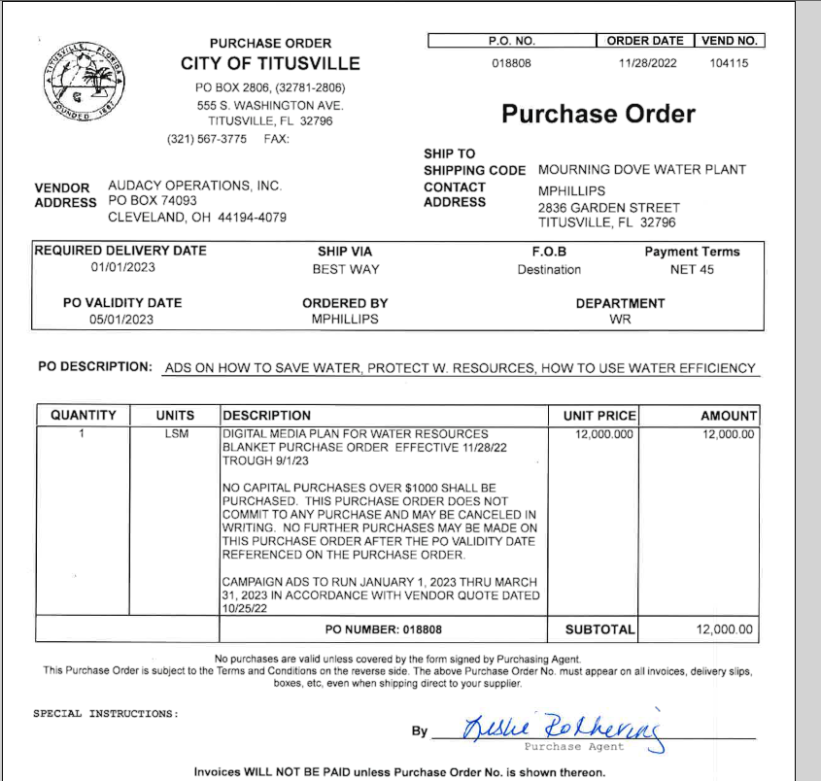
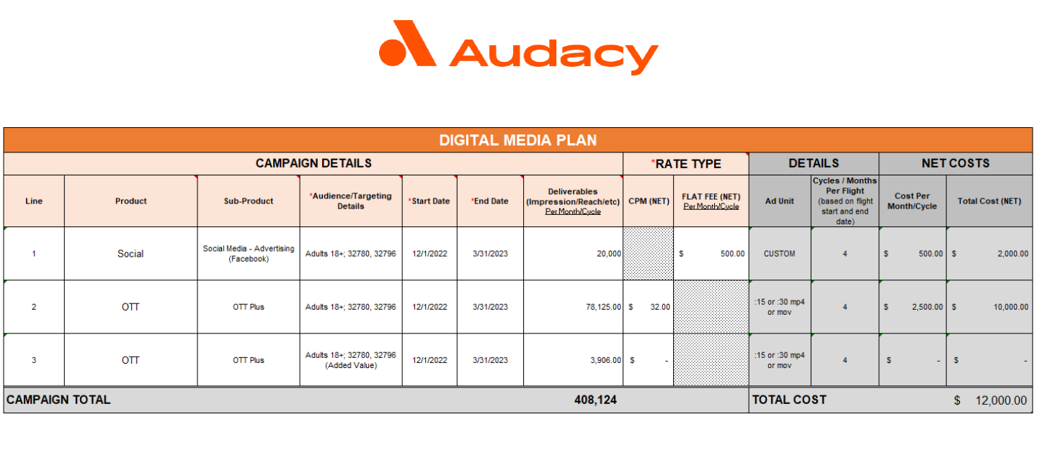
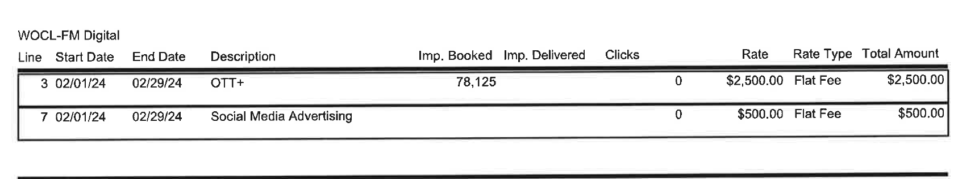
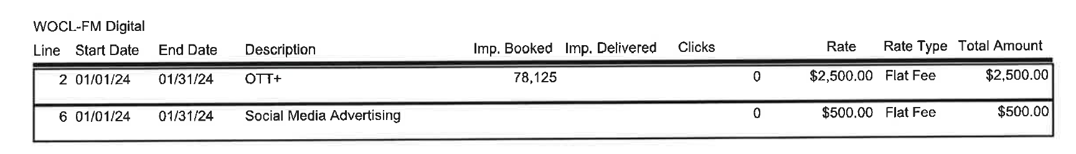
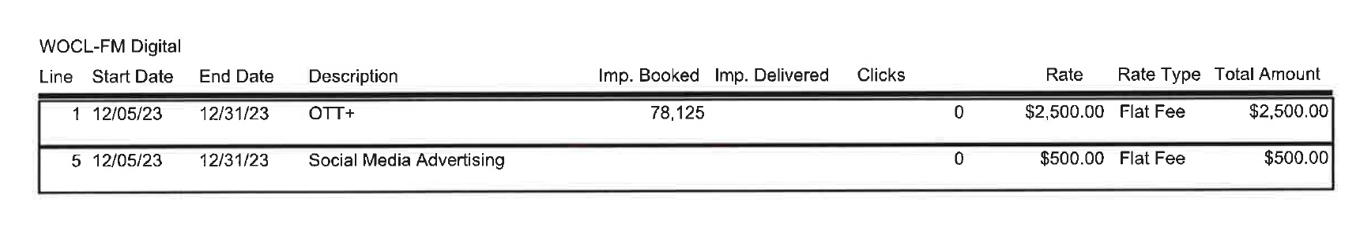
1A-02

Slide 6
1A-03
1a | 03 | Community Presentations Present educational material relating to stormwater management, Florida Friendly Landscaping, TMDLs, illicit discharges, water conservation, and pollution prevention to school children, residents, and HOAs. | 1. Document and report the number of presentations made 2. Document and report the approximate number of attendees 3. Document and report the number of materials distributed 4. Document and report the numbers of events | Years 1-5 Years 1-5 Years 1-5 Years 1-5 | 11 Presentations 327 Approximate Attendees 2,274 Materials 12 Outreach Events
Outreach Events | Date
Fox Lake Park Spring Festival | 3/25/23
Titusville Easter Egg Hunt Issac Campbell Park | 4/8/23
Enchanted Forest Earth Day | 4/22/23
Titusville Open Hours - Resiliency Stewardship | 4/24/23
Earth Day/Arbor Day Tree Giveaway | 4/24/23
Sustainability Update City Council | 4/24/23
Water Conservation Month Proclamation | 4/25/23
Brevard Zoo Pilot Seagrass Restoration Project | 5/23/23
SOIRL Presentation - Stormwater Ditch Spraying | 7/21/23
Rain Barrell Workshop | 8/12/23
St. Johns River Water Management District Video - Osprey Nutrient Removal Upgrades | 11/14/23
Sand Point Park Plantings | 12/23/23
Presentations | Date
Urban Canopy Council Presentation | 2/28/23
Rotary Club Sustainability | 3/7/23
Titusville Open Hours - Resiliency Stewardship | 4/24/23
Sustainability Update City Council | 4/25/23
Sustainability Action Plan Update | 4/25/23
Sustainability Update City Council | 4/25/23
Community Resiliency Lunch & Learn Webinar | 5/1/23
SOIRL Presentation - Stormwater Ditch Spraying | 7/21/23
Public Works Department Spotlight | 7/25/23
Rain Barrell Workshop | 8/12/23
Urban Tree Canopy Report | 8/22/23
St. Johns River Water Management District Video - Osprey Nutrient Removal Upgrades | 11/14/23

Slide 7





1A-03

Slide 8
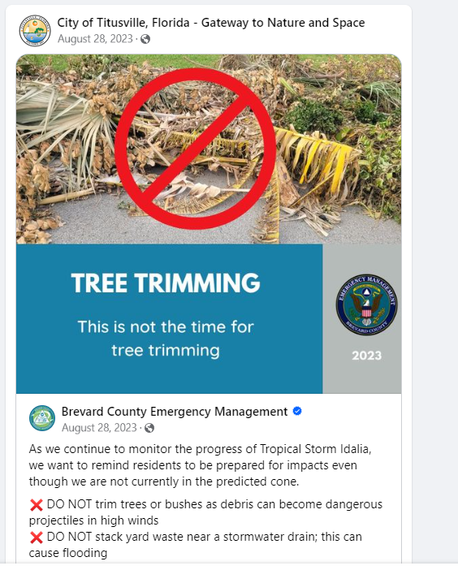
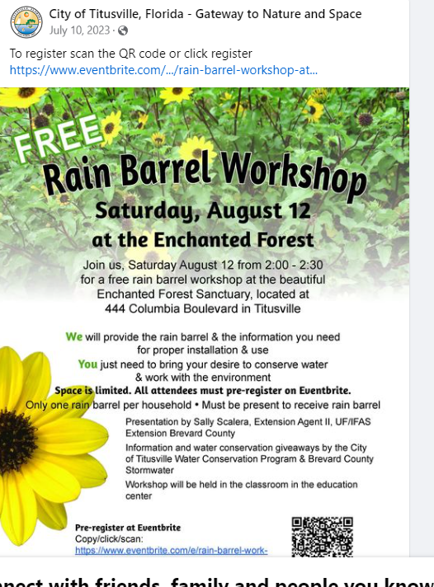
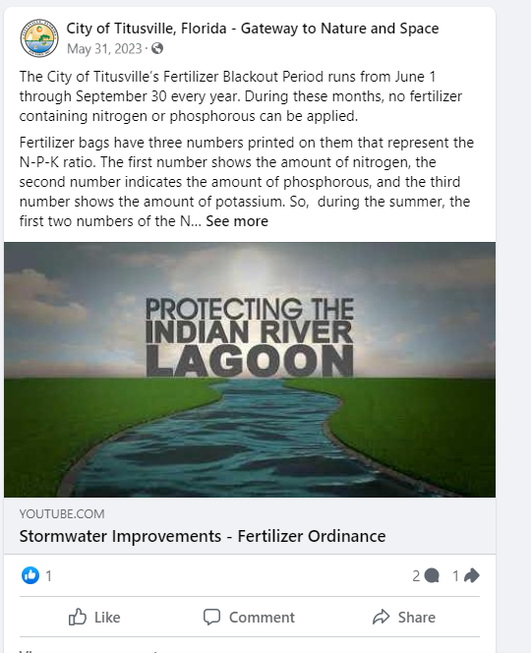
1A-04
1a | 04 | Webpage and Social Media Provide outreach & educational materials relating to stormwater management, Florida Friendly Landscaping, TMDLs, illicit discharges, water conservation, and pollution prevention on the City's website and social media pages. | 1. Document and report the number of updates made to the webpages 2. Document and report the number of social media posts related to stormwater education | Years 1-5 Years 1-5 | 65 Updates – 12,911 web views 44 Social Media Posts
Stormwater Utility: https://titusville.com/318/Stormwater-Utility
Illicit Discharge: https://titusville.com/319/Illicit-Discharge---Storm-Drains-the-Law
Resilient Titusville: https://titusville.com/486/Resilient-Titusville
Sustainability: https://titusville.com/1225/Sustainability
Public Engagement: https://www.inspire-engagement.com/titusville-nat-resources
Water Conservation: https://titusville.com/416/Water-Conservation

Slide 9
1A-05
1a | 05 | Public Education and Outreach Program Review and update the Public Education and Outreach Program SOP. | 1. Document and report the number of updates made to the SOPs | Years 1-5 | 5 revisions

Slide 10
2A-01
2a | 01 | Televised Public Meetings Present before City Council at public meetings that allow public comments about stormwater programs or projects and comply with state and local public notice requirements when conducting public meetings. | 1. Document and report the number of public meetings 2. Document and report the approximate number of attendees and comments 3. Document and report the number of public notices relating to stormwater quality | Years 1-5 Years 1-5 Years 1-5 | 18 Meetings 280 Approx. Attendees 18 Public Notices
Public Meetings & Public Notices | Date
Urban Canopy Council Presentation | 2/28/23
TEC – Wetlands/Stormwater | 3/15/23
TEC - Forested Wetlands/Stormwater | 4/12/23
Sustainability Update City Council | 4/25/23
Water Conservation Month Proclamation | 4/25/23
Cost-Share Funding Interlocal Agreement Stormwater | 5/23/23
Brevard Zoo Pilot Seagrass Restoration Project | 5/23/23
TEC-Stormwater Testing/Cost Share Funding | 7/11/23
SOIRL Presentation - Stormwater Ditch Spraying | 7/21/23
Public Meetings & Public Notices | Date
Public Works Department Spotlight | 7/25/23
Urban Tree Canopy Report | 8/22/23
Sand Point Park Baffle Box Construction Contract Award | 9/26/23
TEC- BMAP Update | 10/11/23
Space View Park MST Investigation and Response Plan | 10/24/23
SJRWMD Video - Osprey Nutrient Removal Upgrades | 11/14/23
Task Order -Review of ACC & Hazardous Waste Manual | 12/12/23
Comp Plan Natural Resources Public Engagement | 1/23/24
Amendment #1 FDEP Grant Agreement MN039 | 2/13/24

Slide 11
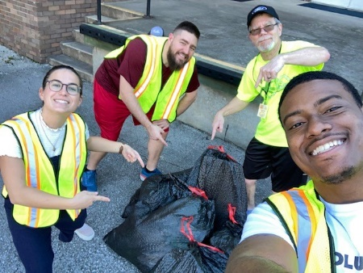
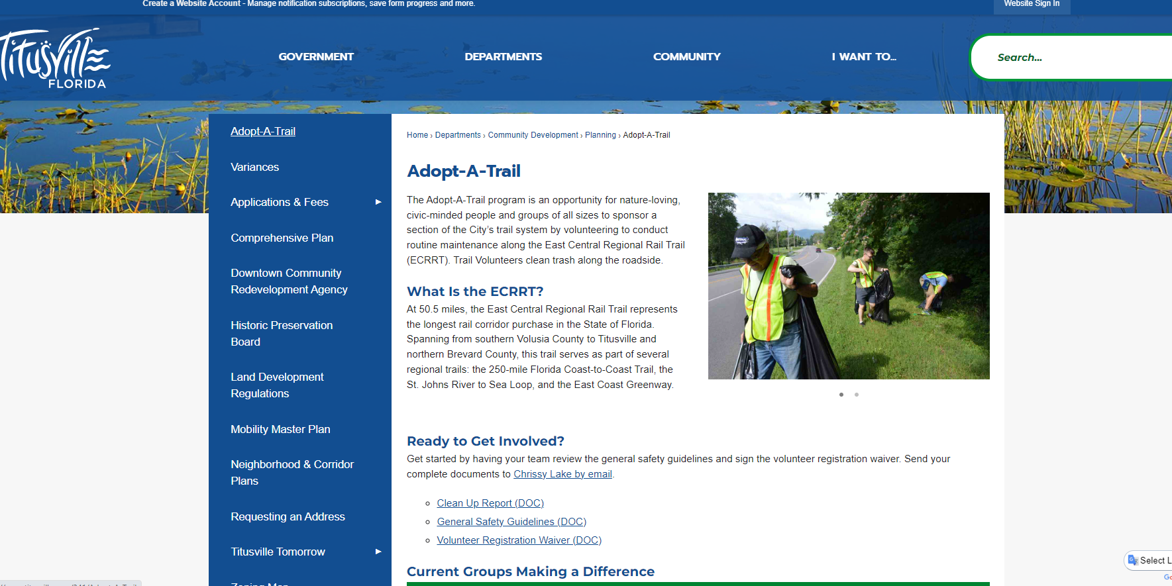
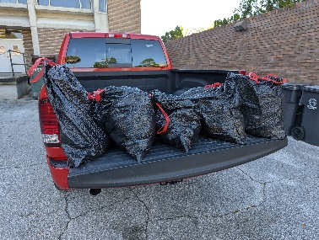
2A-02
2a | 02 | Adopt a Trail Program Participate in the "Adopt a Trail" litter control program along the City's public trails. | 1. Document and report the number of volunteers/groups participating 2. Document and report the number of bags of trash collected 3. Document and report the number of miles adopted | Years 1-5 Years 1-5 Years 1-5 | 2 Groups 5 Bags 1 Mile
https://www.titusville.com/341/Adopt-A-Trail

Slide 12
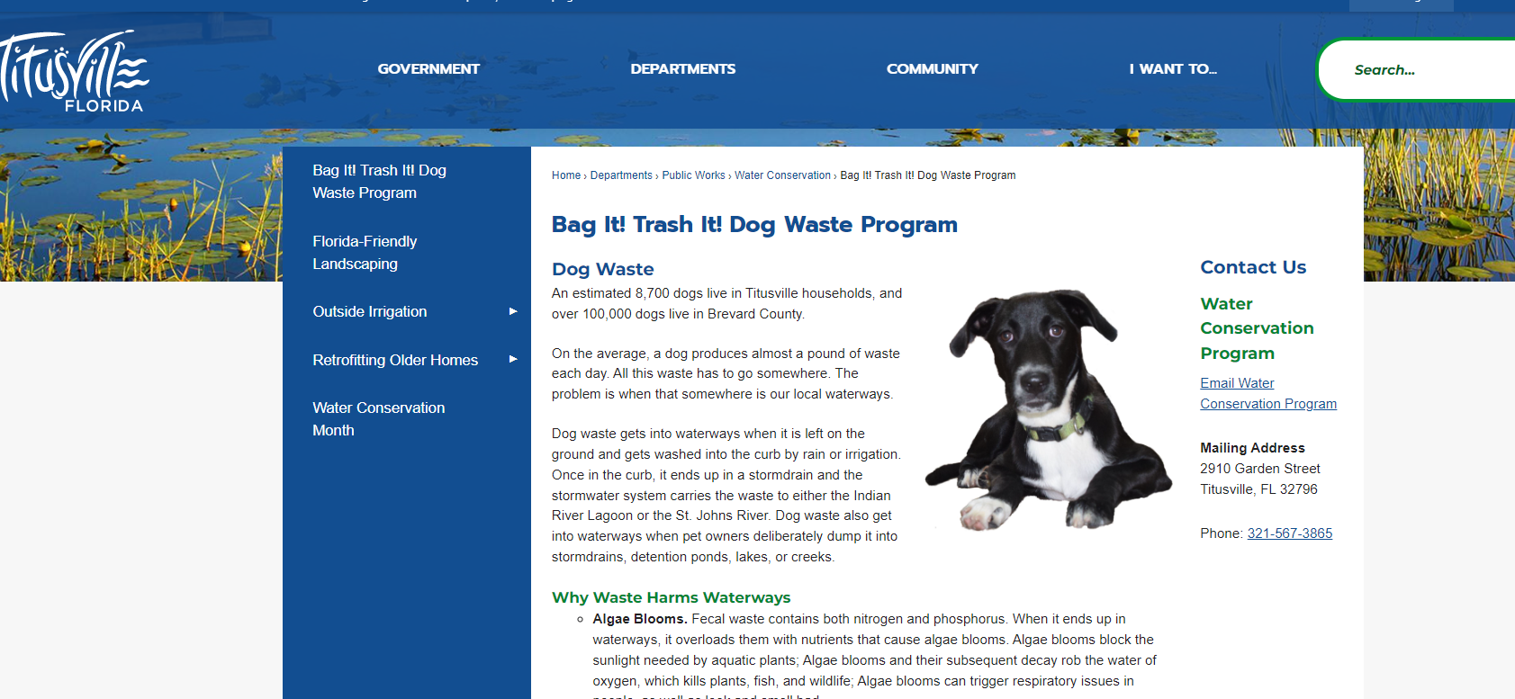
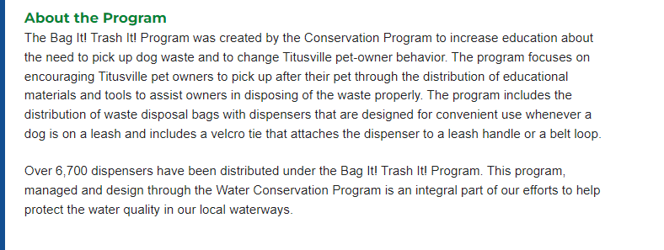
2A-03
2a | 03 | Bag It! Trash It! Program Continue the Bag It! Trash It! Program which educates the public on the proper disposal of dog waste and provides the public with permanent stations and the initial supplies needed for them to participate and properly dispose of dog waste. | 1. Document and report the number of containers provides to animal shelters and veterinarians 2. Document and report the number of Bag It! Trash It! containers provided at events 3. Document and report the number of permanent stations | Years 1-5 Years 1-5 Years 1-5 | 20 Containers 75 Containers 13 Stations
https://www.titusville.com/427/Bag-It-Trash-It-Dog-Waste-Program

Slide 13
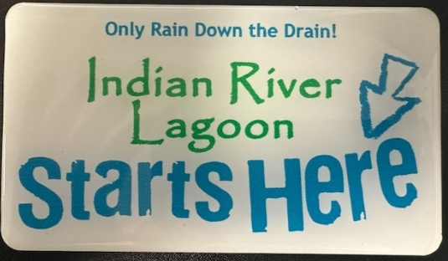
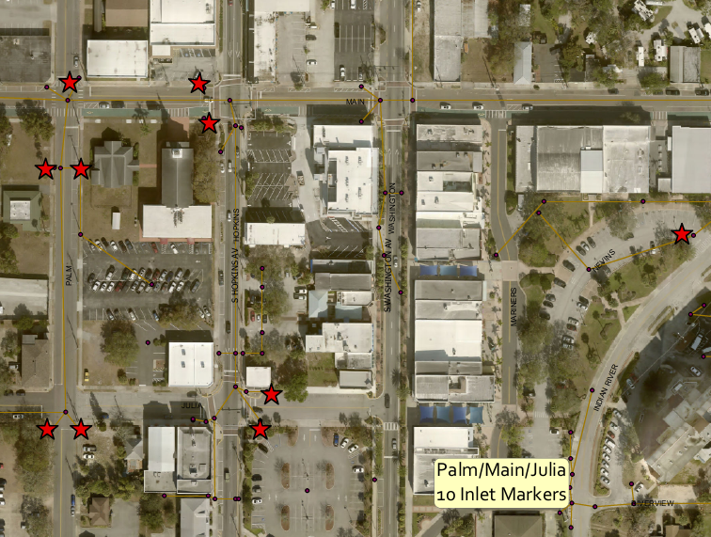
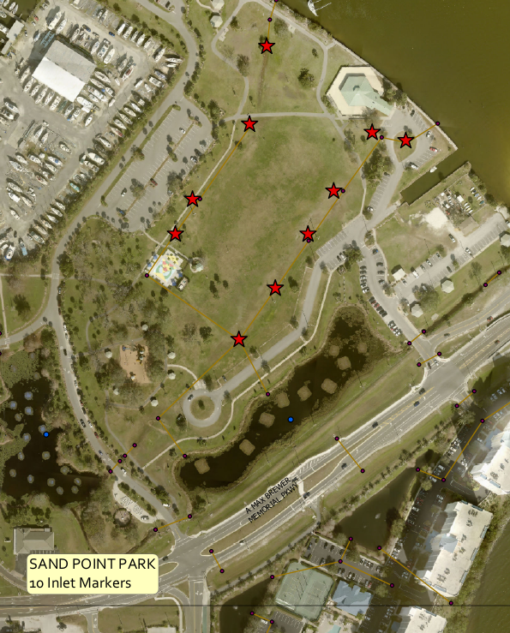
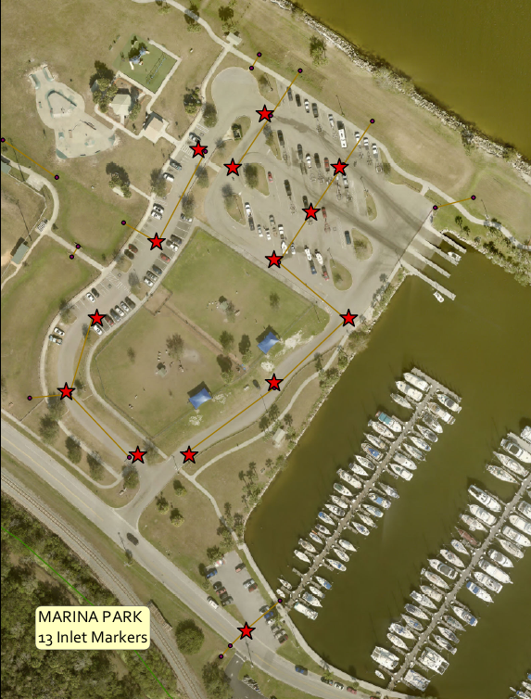
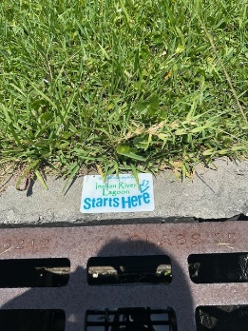
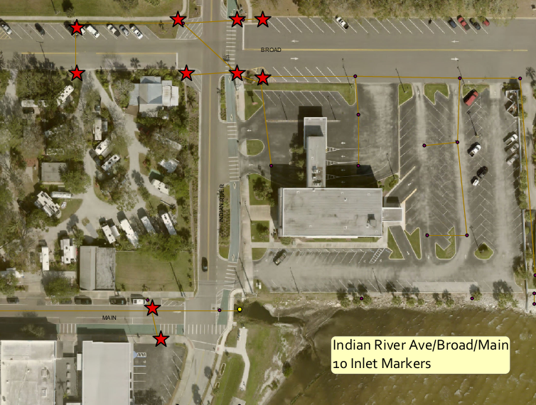
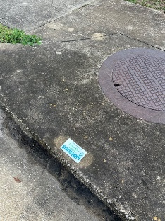
2A-04
2a | 04 | Stormdrain Marking Program Continue the stormdrain marking program which gives the public the opportunity to volunteer to install the markers. The program will be advertised on the City's website and social media and encourage the public to hold volunteer events. | 1. Document and report the number of stormdrain markers installed 2. Document and report the number of participants 3. Document and report the number of events held | Years 1-5 Years 1-5 Years 1-5 | 37 Markers 3 participants 1 Event

Slide 14
2A-05
2a | 05 | Public Involvement and Participation Program Review and update the Public Involvement and Participation Program SOP. | 1. Document and report the number of updates made to the SOP | Years 1-5 | 5 Revisions

Slide 15
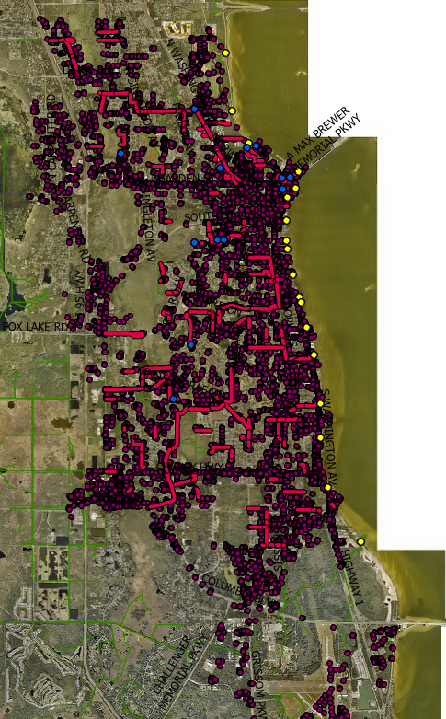
3A-01

Slide 16
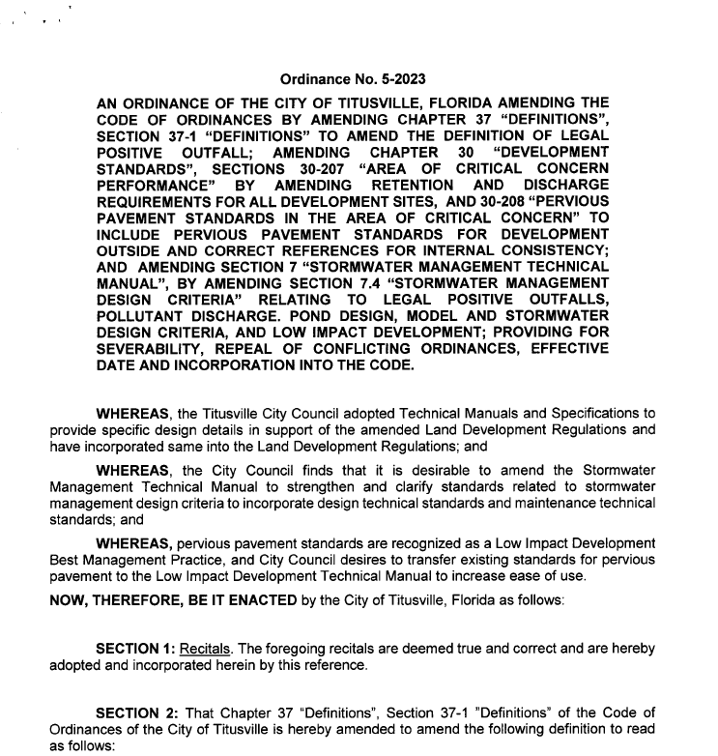
3B-01
3b | 01 | Illicit Discharge Ordinance Prohibit as allowed by law per Ordinances 21-2005 & 44-2004 discharges into the stormwater system and provide enforcement and penalties as specified in the ordinance. | 1. Document and report the number of changes or amendments to Ordinance 21-2005 2. Document and report the number of changes or amendments to Ordinance 44-2004 | Years 1-5 Years 1-5 | 10 changes 0 Changes

Slide 17
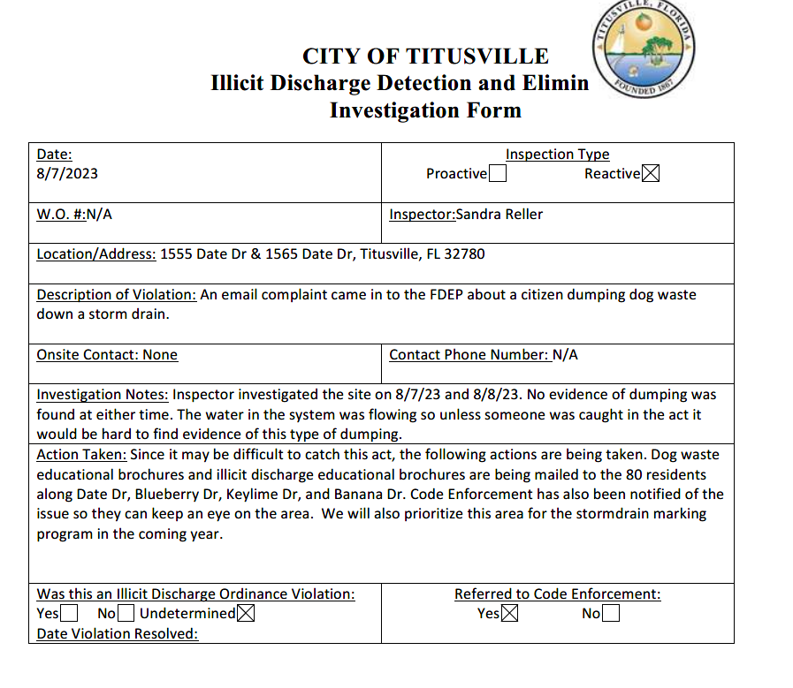
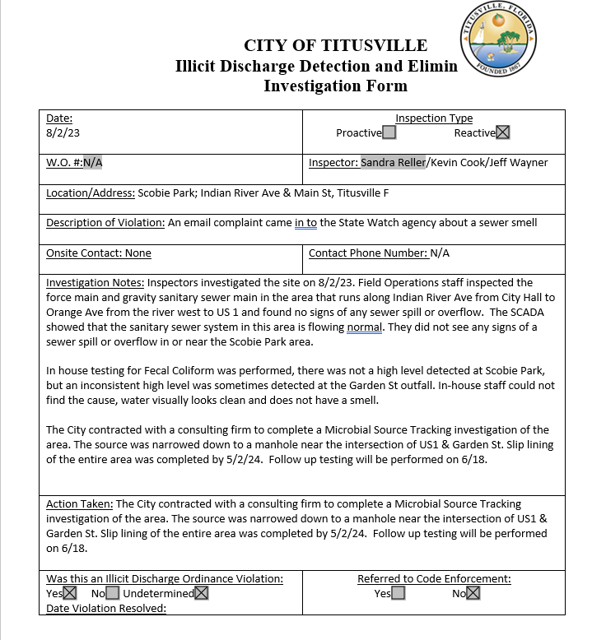
3C-01
3c | 01 | Illicit Discharge Inspections - Reactive Continue to conduct stormwater structure inspections to investigate complaints and suspicious connections or dumping. | 1. Document and report the number complaints received 2. Document and report the number of inspections performed 3. Document and report the number of illicit connections and discharges found and eliminated | Years 1-5 Years 1-5 Years 1-5 | 2 2 1 Suspected

Slide 18
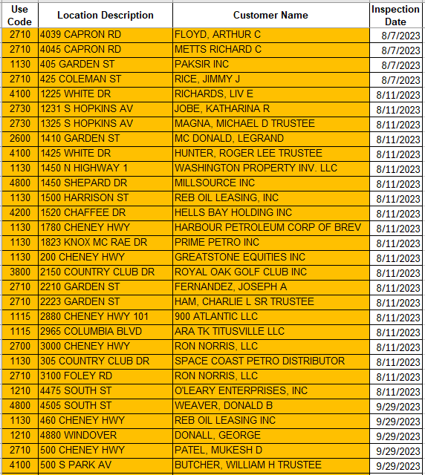
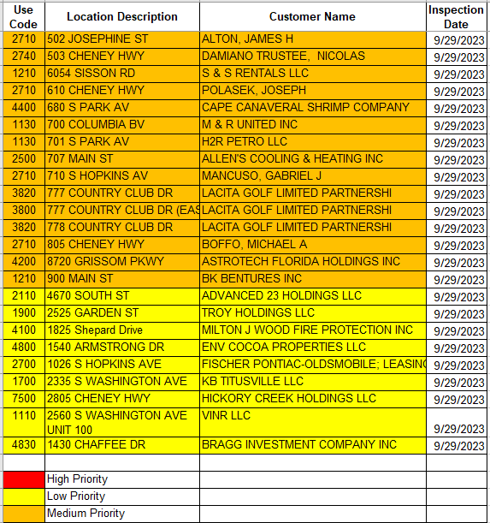
3C-02
3c | 02 | Illicit Discharge Inspections - Proactive Detect and eliminate non-stormwater discharges and illicit connections, including illegal dumping, to the stormwater system. Inspections will be performed proactively during regular maintenance and repairs. | 1. Track, document and report the number of linear feet of pipe inspected 2. Document and report the number of proactive inspections 3. Track, document and report the number of illicit connections and discharges found and eliminated | Years 1-5 Years 1-5 Years 1-5 | 3305 LF 83 Facilities 0 Found

Slide 19
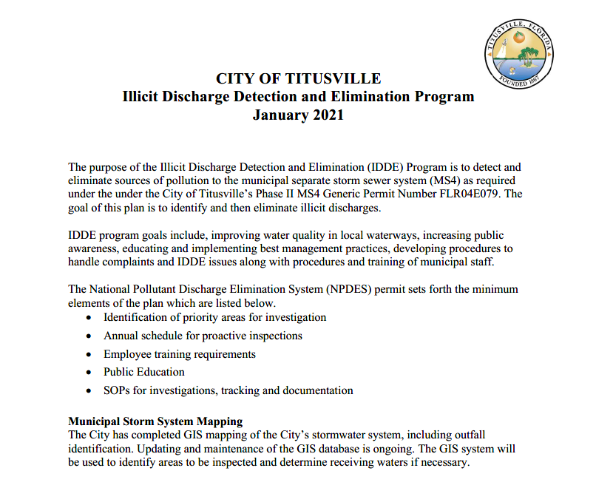
3C-03
3c | 03 | Illicit Discharge SOP Review and update the Illicit Discharge Detection and Elimination Program SOP and priority areas. | 1. Document and report the number of updates made to the SOP. 2. Document and report the number of changes made to priority areas. | Years 1-5 Years 1-5 | 0 Changes 10 Additions

Slide 20
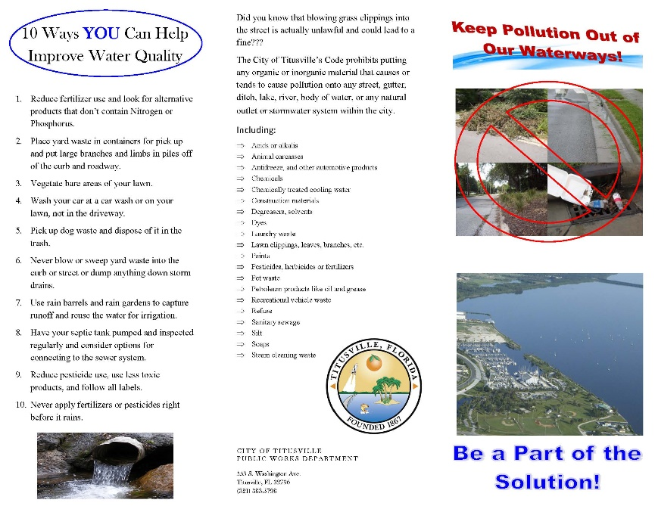
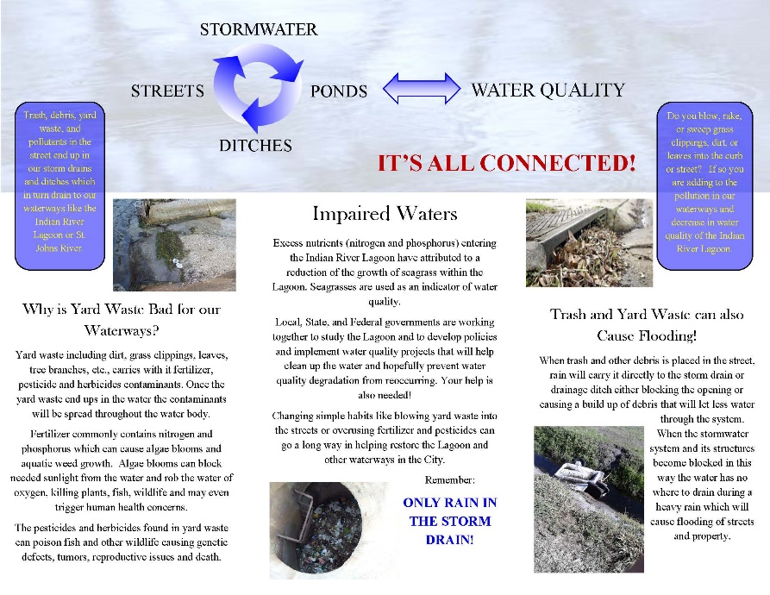
3D-01
3d | 01 | Illicit Discharge/Dumping - Public Education Distribute information through the use of flyers/handouts/brochures pertaining to illicit dumping and disposal of waste and the hazards associated with it. | 1. Document and report the number of educational materials mailed to the public 2. Document and report the number of handouts distributed at events, presentation, etc. | Years 1-5 Years 1-5 | 299 Materials Mailed 345 Handouts

Slide 21

3D-02
3d | 02 | Illicit Discharge/Dumping - Employee Education Provide information to employees pertaining to illicit dumping and disposal of waste and the hazards associated with it. | 1. Document and report the number of staffed trained in IDDE 2. Document and report the number of staff who have received a refresher course in IDDE | Years 1-5 Years 1-5 | 59 City Staff 71 City Staff

Slide 22
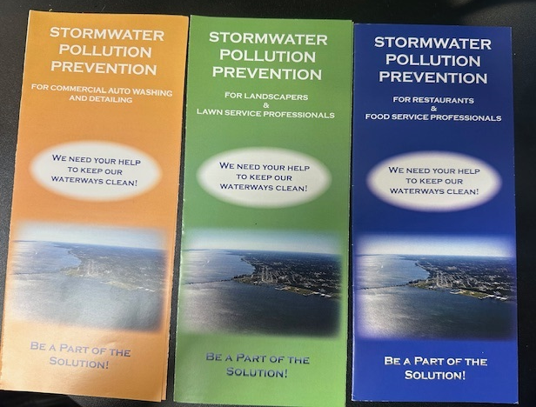
3D-03
3d | 03 | Illicit Discharge/Dumping - Business Education Distribute industry specific informational flyers by mail or in annual business license renewals pertaining to illicit dumping, illicit connections, and disposal of waste and the hazards associated with it. | 1. Document and report the number of industry specific flyers distributed to landscaping businesses 2. Document and report the number of flyers distributed to restaurants 3. Document and report the number of industry specific flyers distributed to automotive industry businesses | Years 1-5 Years 1-5 Years 1-5 | 70 lawn maintenance specific flyers 128 restaurant specific flyers 18 car wash specific flyers

Slide 23
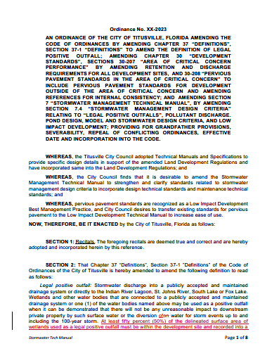
4A-01
4a | 01 | Erosion and Sediment Control Ordinance Maintain ordinances or other regulatory mechanisms as defined in Chapter 30 Division 6 of the City's LDRs that prevent erosion, sedimentation, flooding, and water pollution during development and allow penalties to ensure compliance. | 1. Document and report the number of changes or amendments to Chapter 30, Division 6 of the City's Land Development Regulations | Years 1-5 | 10 changes

Slide 24
4B-01
4b | 01 | Erosion and Sediment Control on Construction Sites Chapter 30 Division 6 of the City's LDRs requires that construction sites exceeding 1,000 square feet of impervious area submit a stormwater plan that addresses sedimentation and erosion control prior to commencing construction. | 1. Document and report the number of active construction sites 2. Document and report the number of violations found pertaining to erosion and sediment controls | Years 1-5 Years 1-5 | 13 Sites 12 Violations

Slide 25
4C-01
4c | 01 | Construction Site Cleanup Construction site cleanup inspections prior to issuance of certificate of occupancy as required by City Code. | 1. Document and report the number of cleanup inspections performed 2. Document and report the number of waste specific violations | Years 1-5 Years 1-5 | 10 Inspections 1 Violation

Slide 26
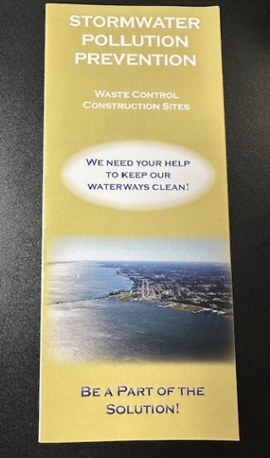
4C-02
4c | 02 | Construction Site Waste Control Enforce requirements for construction site operators to control waste such as discarded building materials, concrete truck washout, chemicals, litter, and sanitary waste at the construction site that may cause adverse impacts to water quality as defined in Article III of the City's Code of Ordinances and as a condition of their Site Plan Permit. | 1. Document and report the number of site plan or preconstruction meetings held where the requirement for construction waste control was discussed 2. Document and report the number of waste control pamphlets distributed | Years 1-5 Years 1-5 | 12 Pre-Construction Meetings 12 Pamphlets

Slide 27
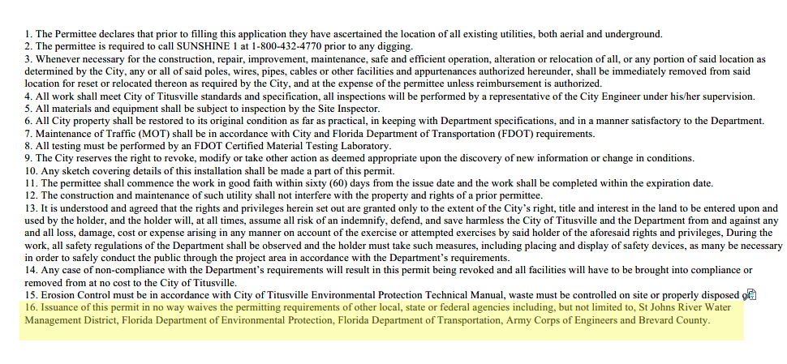
4D-01
4d | 01 | Site Plan Review - Water Quality Chapter 30 of the City's LDRs requires that all site plans be reviewed and that plans include water quality and ESC measures. The City will notify applicants of the potential need to obtain an ERP permit form SJRWMD and/or NPDES GCP from FDEP. | 1. Document and report the number of site plans reviewed 2. Document and report the number of applicants notified of the ERP and CGP permits | Years 1-5 Years 1-5 | 28 Site Plans 12 Applicants notified

Slide 28
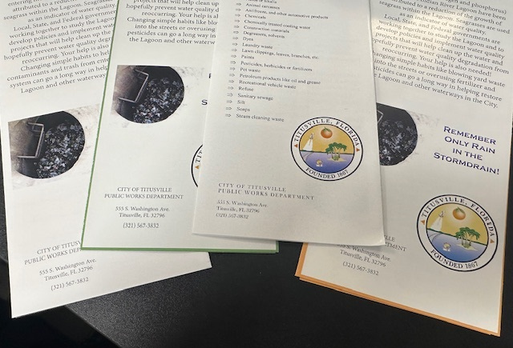

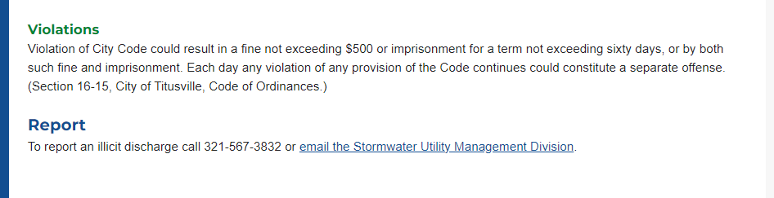
4E-01
4e | 01 | Submittal of Information by Public - Hotline Use and advertisement of stormwater telephone hotline number for public input on stormwater issues. Hotline number is included on all stormwater promotional and educational materials. | 1. Document and report the number of calls received by the hotline | Years 1-5 | 157 Calls Received

Slide 29
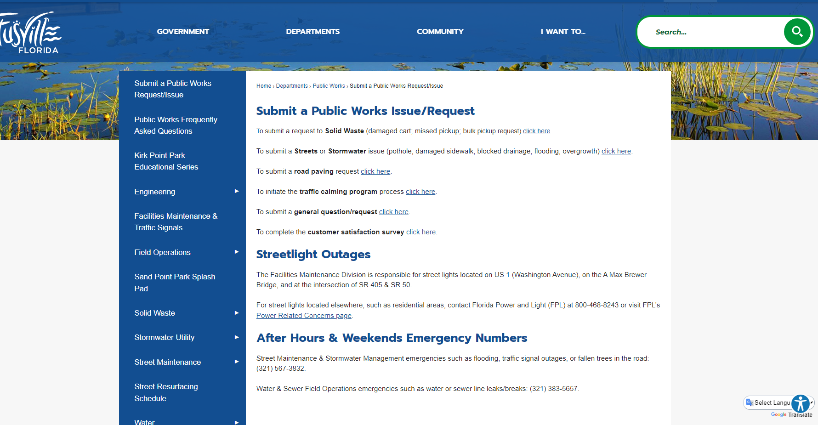
4E-02
4e | 02 | Submittal of Information by Public - Website Use email links on the City's website that allows the public to submit information on stormwater issues. The website details that this is where the public can ask questions, voice concerns/issues and the email will be forwarded to the appropriate division for response. | 1. Document and report the number of emails generated from the City's website | Years 1-5 | 31 Emails

Slide 30
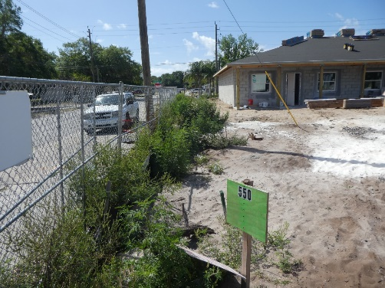
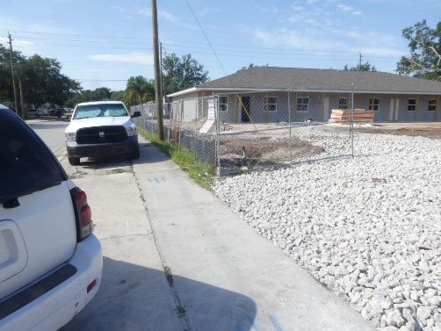
4F-01
4f | 01 | Construction Site Inspection Inspect construction site for violations of city code requirements, including erosion and sediment control. Inspections of the site will occur pre, during, and post construction. | 1. Document and report the number of construction site stormwater inspections 2. Document and report the number of stormwater violations taken and resolved 3. Document and report the number of construction sites verified for either a CGP or ERP permit | Years 1-5 Years 1-5 Years 1-5 | 34 Inspections 13 Violations Taken and 13 Violations Resolved 13 Sites Verified
Before
After

Slide 31
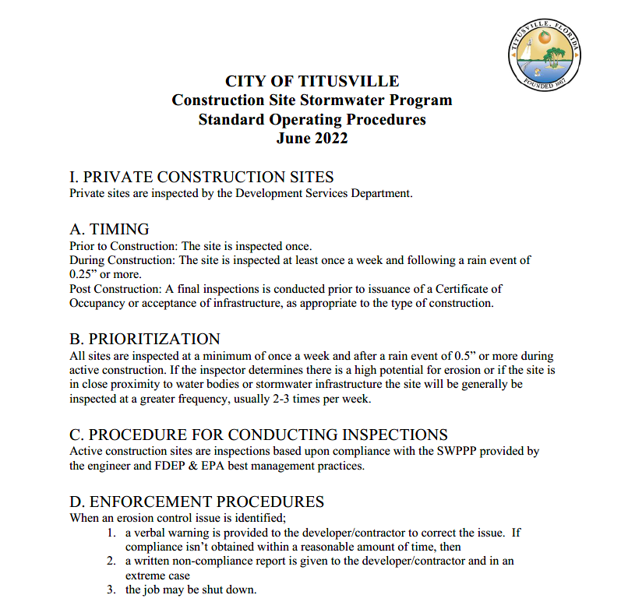
4F-02
4f | 02 | Construction Site Program SOP Review and update the Construction Site Stormwater Program SOP. | 1. Document and report the number of updates or amendments made to the SOP. | Years 1-5 | 3 Updates

Slide 32
5a-c - 01
5a-c | 01 | Qualifying Alternative Program Utilize qualifying alternative program; Titusville relies on the current SJRWMD and FDEP regulatory criteria by providing stormwater treatment for ERP Permitted projects. | 1. Continue to maintain compliance with DEP and WMD criteria | Effective upon permit issuance | N/A

Slide 33
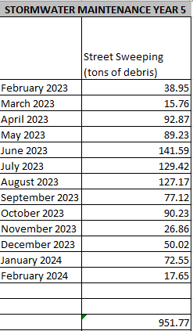
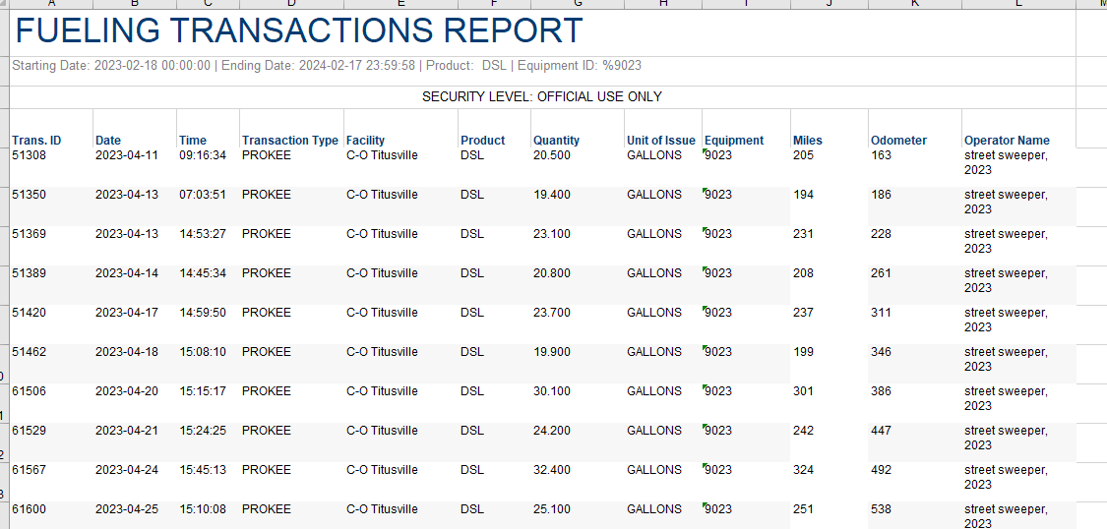
6A-01
6a | 01 | Street Sweeping Continue street sweeping program per City of Titusville standard operating procedures | 1. Document and report the tons of debris collected 2. Documents and report the number of miles swept | Years 1-5 Years 1-5 | 951.77 tons 34,806 curb miles
Sweeper Vehicle # | Miles
9022 | 21,441
9023 | 13,365
Total: | 34,806

Slide 34
6A-02
6a | 02 | Stormwater Structure Maintenance The city will remove accumulated sediment and debris from stormwater pipes, inlets, and baffle boxes using the vacuum truck. | 1. Document and report the number of linear feet of stormwater pipe cleaned 2. Document and report the number storm inlets cleaned 3. Document of report the number of baffle boxes maintained | Years 1-5 Years 1-5 Years 1-5 | 19,323 feet 3,058 inlets 12 baffle boxes cleaned 189 times

Slide 35
6A-03
6a | 03 | Stormwater Conveyance Maintenance Stormwater BMPs and conveyances shall be regularly inspected and maintained | 1. Document and report the number of miles of stormwater BMPs and conveyances mowed 2. Document and report the number of cubic yards of sediment excavated from ditches and swales | Years 1-5 Years 1-5 | 355.42 miles 822 cubic yards

Slide 36
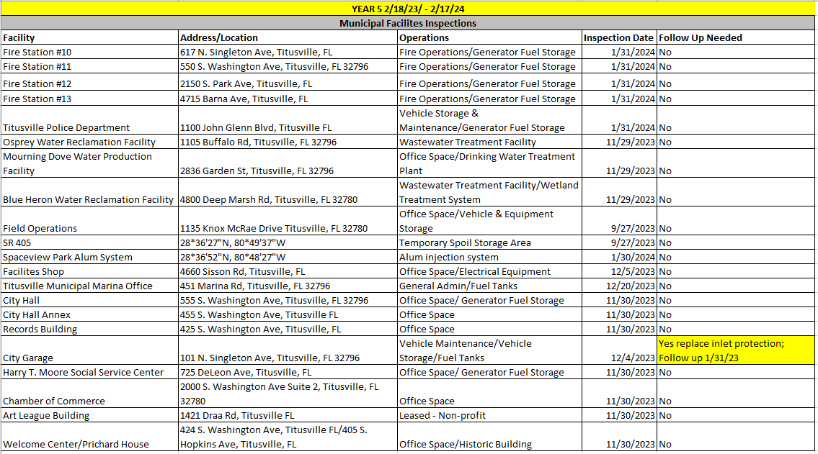
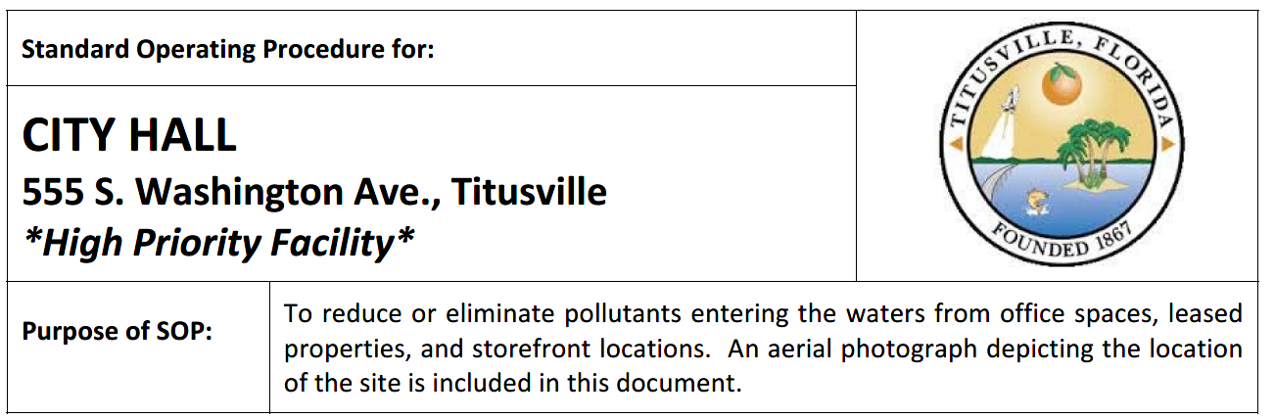
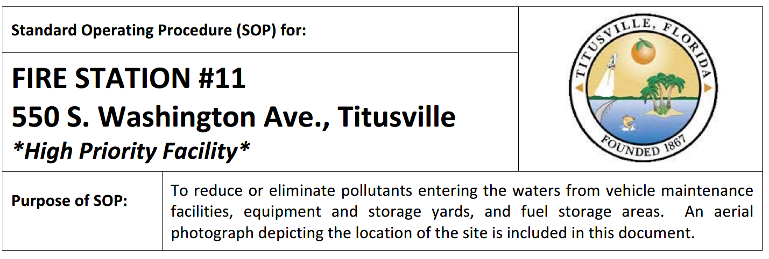
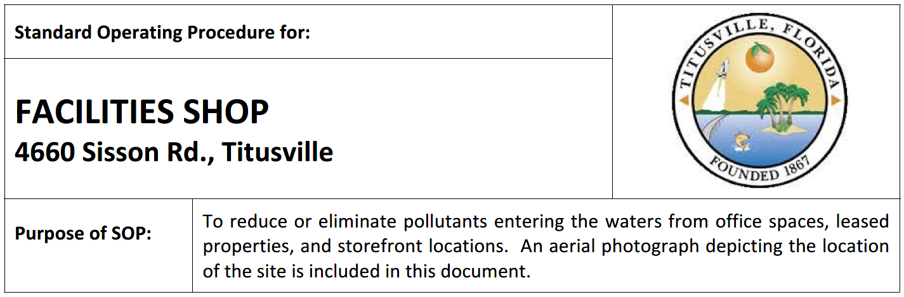
6A-04
6a | 04 | Municipal Facility Inspection Inspect all municipal facilities owned and operated by the City of Titusville for pollution prevention and good housekeeping and review SOPs for the facilities | 1. Document and report the number of inspections performed 2. Document and report the number of changes or amendments to the SOPs | Years 1-5 Years 1-5 | 21 inspections 6 changes

Slide 37
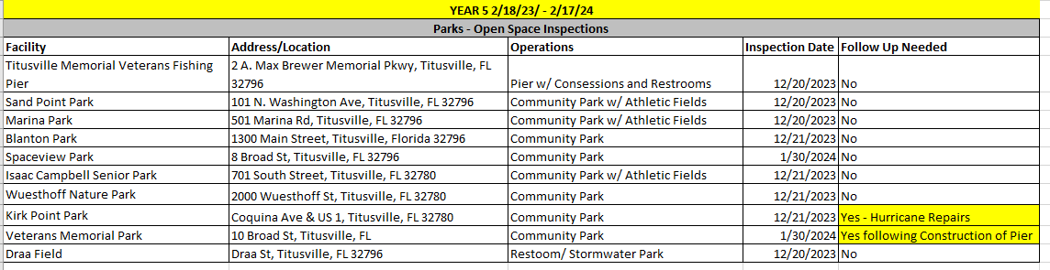
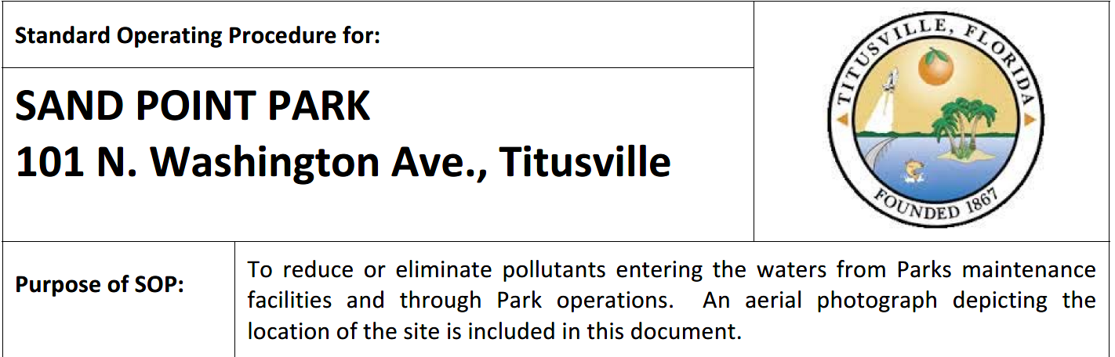



6A-05
6a | 05 | Municipal Facility Open Space Inspection Inspect all open space areas owned by the City of Titusville for pollution prevention and good housekeeping and review SOPs for the facilities. | 1. Document and report the number of inspections performed 2. Document and report the number of changes or amendments to the SOPs | Years 1-5 Years 1-5 | 10 inspections 10 changes

Slide 38

6A-06
6a | 06 | BMAP for an Adopted TMDL In accordance with Section 403.067, F.S., the City of Titusville must comply with adopted provisions of the BMAP and/or implementation plan that specify activities to be undertaken by Titusville during the permit cycle. | 1. Continue to participate and implement the scheduled activities defined in the adopted BMAP or implementation plan. | Years 1-5 | The City currently has been given credit for completed projects by the FDEP for 26,974 lbs of TN removed out of the final goal of 39,953 lbs of TN and 5,100 lbs of TP removed out of the final goal of 6,698 lbs of TN.

Slide 39



6B-01
6b | 01 | Employee Training Train employees on stormwater related issues, including erosion and sediment control, stormwater pollution preventions, etc., training will include an annual refresher course. | 1. Document and report the number of training sessions 2. Documents and report the number of employees trained 3. Document and report the number of employees who received a refresher course | Years 1-5 Years 1-5 Years 1-5 | 5 Sessions 59 New Hires 71 Employees

