Slide 1


Slide 2
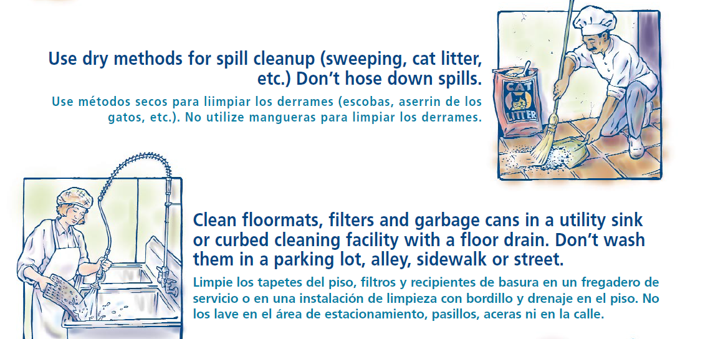

Slide 3
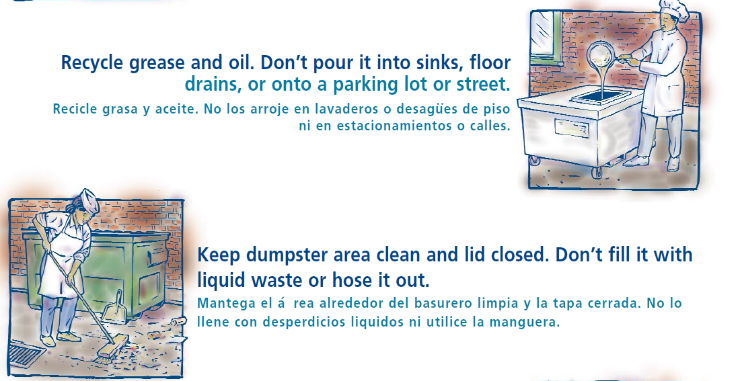

Slide 4
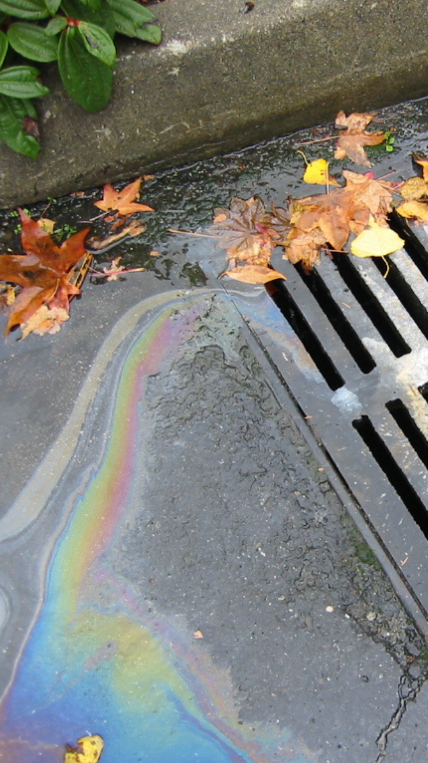
Report spills into the stormwater system
If you spilled grease into a storm drain
Witnessed grease spilled into a storm drain
Or notice a dumpster leaking into a storm drain
  Please call or email UCF Work Control
  (407) 823-5223
  wcc@ucf.edu

