Slide 1
Illicit Discharge Detection and Elimination Training
Division of Water Resource Management
NPDES Stormwater Program

Slide 2
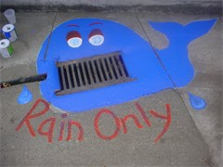
Purpose
Educate MS4 staff, contractors and residents to recognize, report, and prevent illicit discharges.
Establish accountability for pollution prevention which is a requirement for each permitted municipality.

Slide 3
Value of the Training
As MS4 staff:
You are in the field routinely.
You are the “eyes” of your local agency.
You are the first line of defense against illicit discharges.
You need to know how to identify and report illicit discharges.
Identifying and eliminating illicit discharges are required activities.

Slide 4
What Is The MS4?
Municipal Separate Storm Sewer System
Conveyance or system of conveyances;
Includes roads, inlets, catch basins, grates, detention and retention ponds, swales, ditches, pipes, canals, etc.;
Owned by local governments, public universities, correctional institutions, FDOT or special districts;
Designed or used to discharge stormwater to surface waters (lakes, rivers, bays, ocean, wetlands) of the State through outfalls.

Slide 5
NPDES MS4 Permit
National Pollutant Discharge Elimination System
MS4s permits require:
  Implementation of a Stormwater Management Program (SWMP) to minimize stormwater pollutant loadings to the stormwater system.
  Prohibit non-stormwater discharges to the MS4 through education, rules, policies, inspections and enforcement.
The goal of the MS4 permit:
  Reduce discharge of pollutants from the stormwater system to waters of the State to the maximum extent practicable.
Notes:
Discuss that the facility has a NPDES permit which requires illicit discharge training to be conducted to ensure the field employees know how to identify and report an illicit discharge.

Slide 6
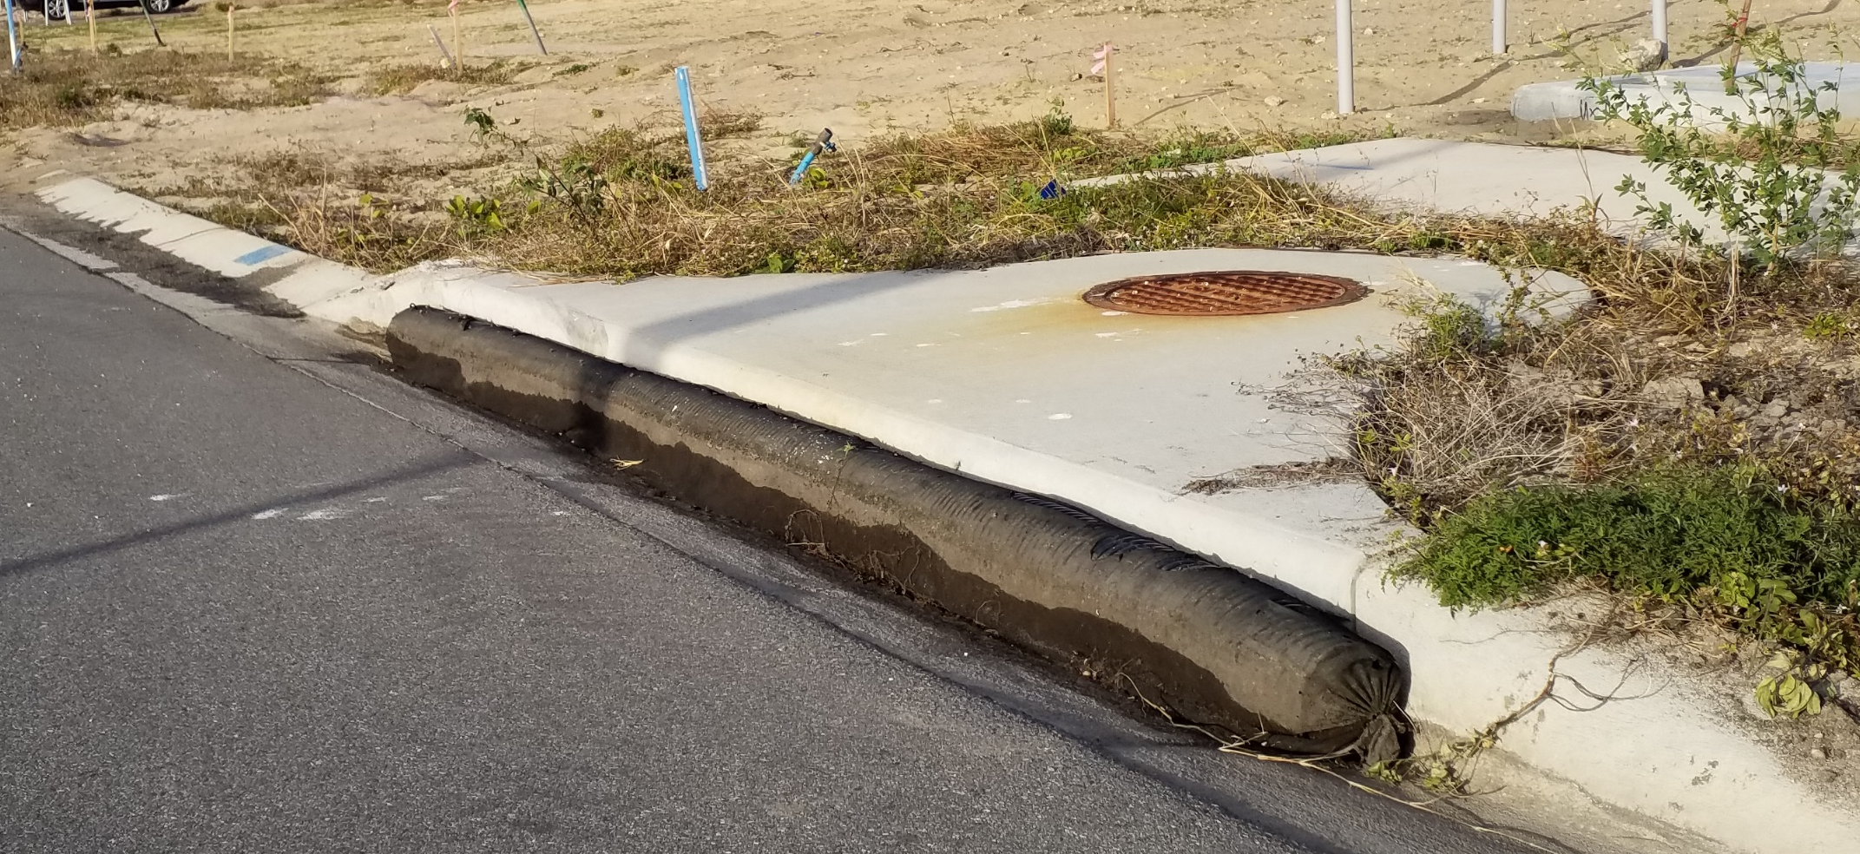
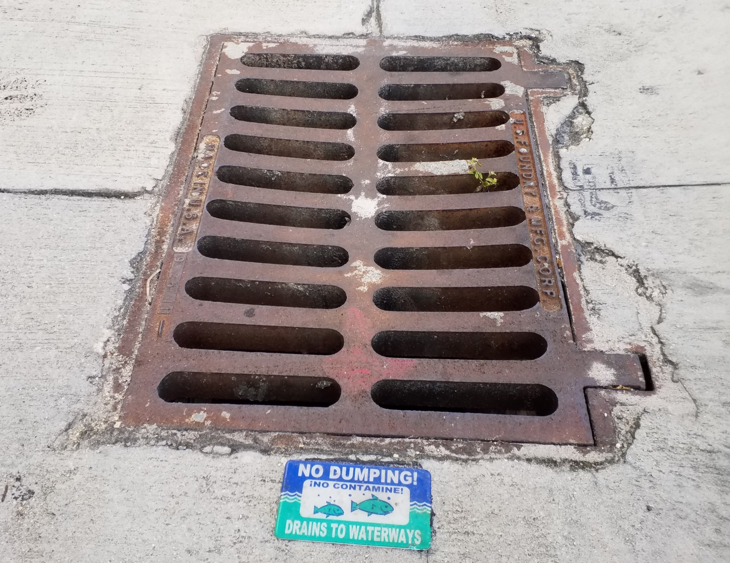
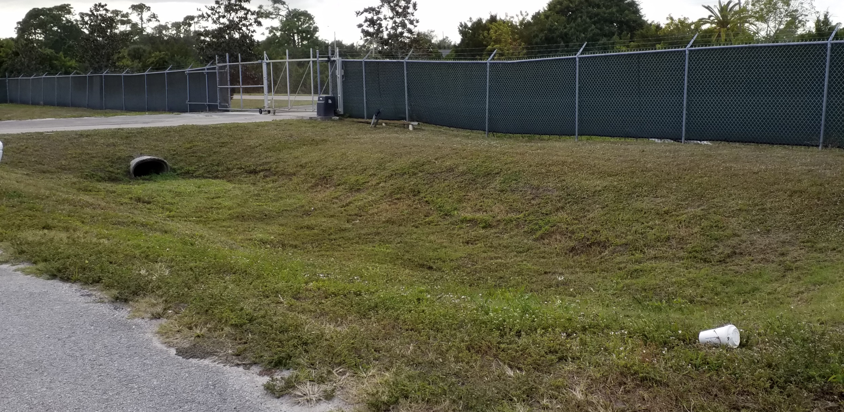
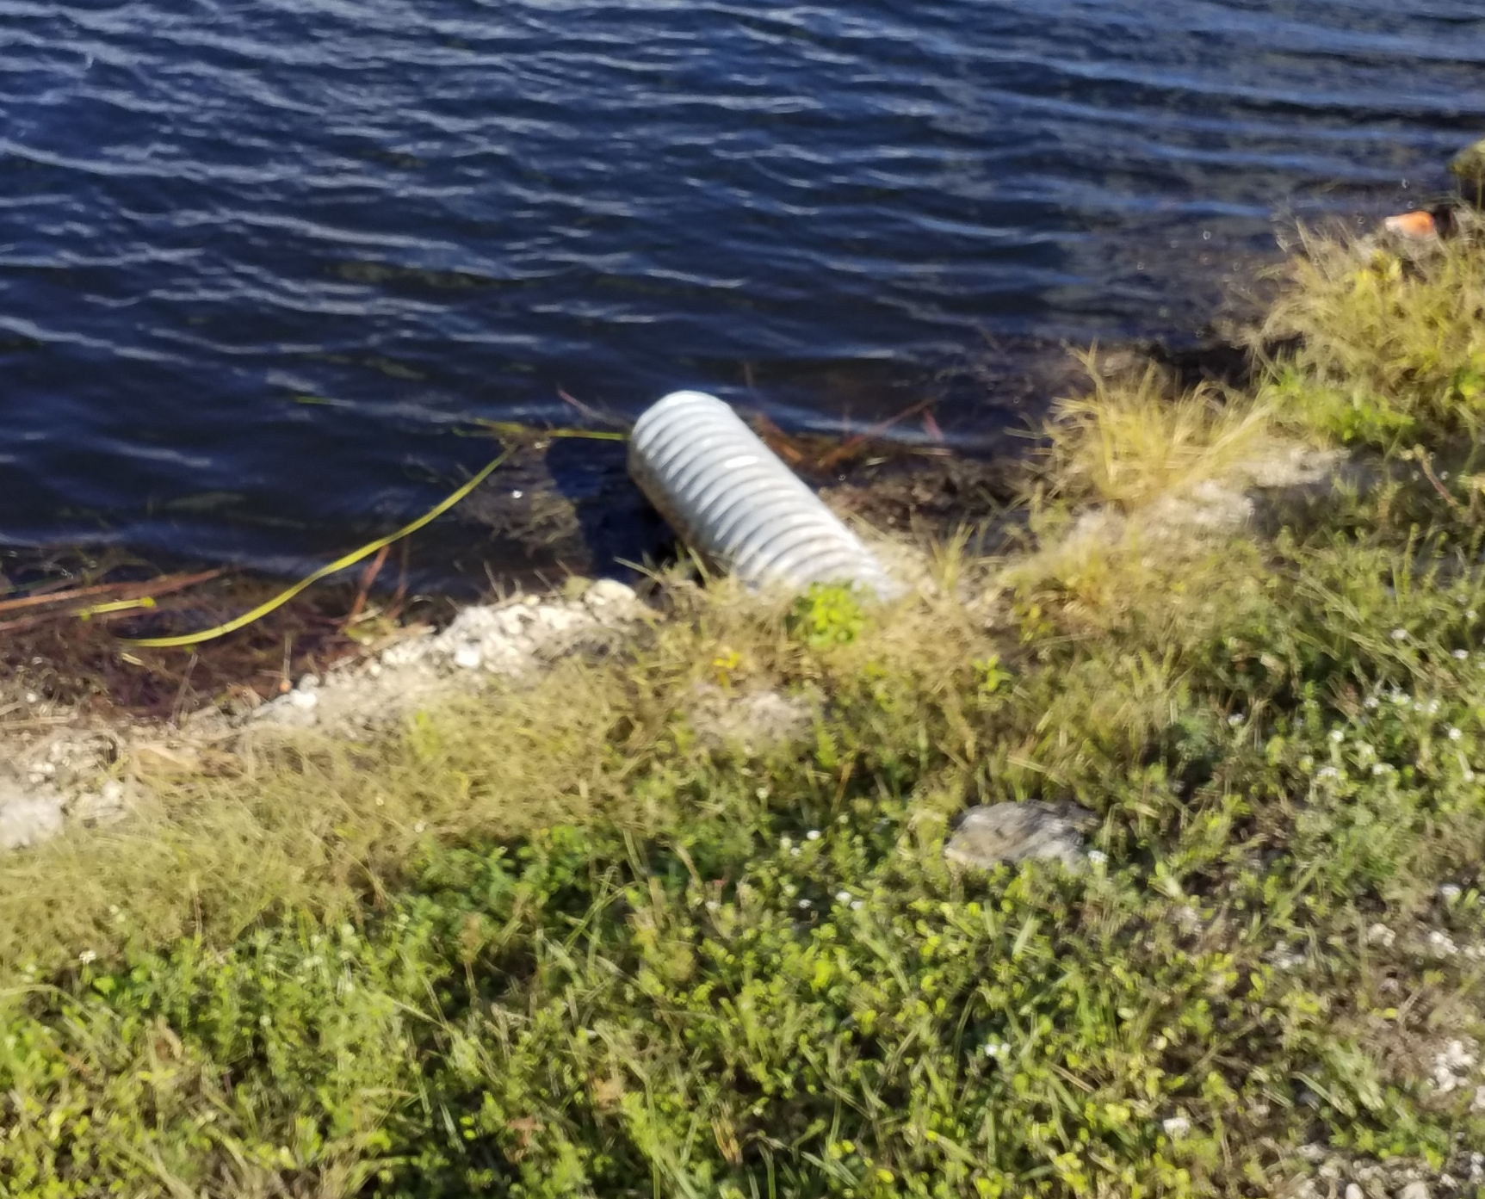
MS4 Components
Notes:
Discuss what each picture is identifying. Note these are all parts of the MS4.
Top Left to Bottom Right:
Storm Drain
Curbside Inlet
Dry Retention Pond
Outfall
Also mention catch basins, swales, culverts and any other site specific parts of the MS4.

Slide 7
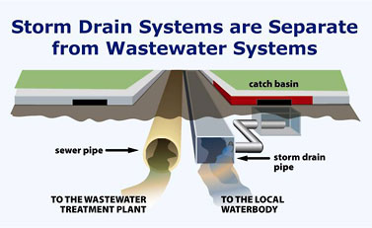
MS4 vs. Sanitary Sewer
https://www.cityofsantamaria.org/Home/ShowImage?id=508&t=635489686498670000
Notes:
There are two types of sewers. One is a sanitary sewer and the other is a stormwater sewer.
If you look at the diagram,
On the left you see a sewer pipe which leads to a wastewater treatment plant. All of the water in the pipe comes from homes and businesses – toilets, sinks, showers, dishwashers and washing machine, are all connected to the sanitary sewer pipes and flow to a wastewater treatment plant.
On the right of the diagram there are stormwater flow into the storm sewer system. The stormwater enters the storm pipes through a curb opening. It flows to ponds and lakes with little to no treatment.

Slide 8
Why Be Concerned?
Provide reasonable assurance that only stormwater enters into the MS4.
To protect water resources such as lakes, rivers, estuaries, and wetlands from pollution caused by discharges of stormwater.

Slide 9
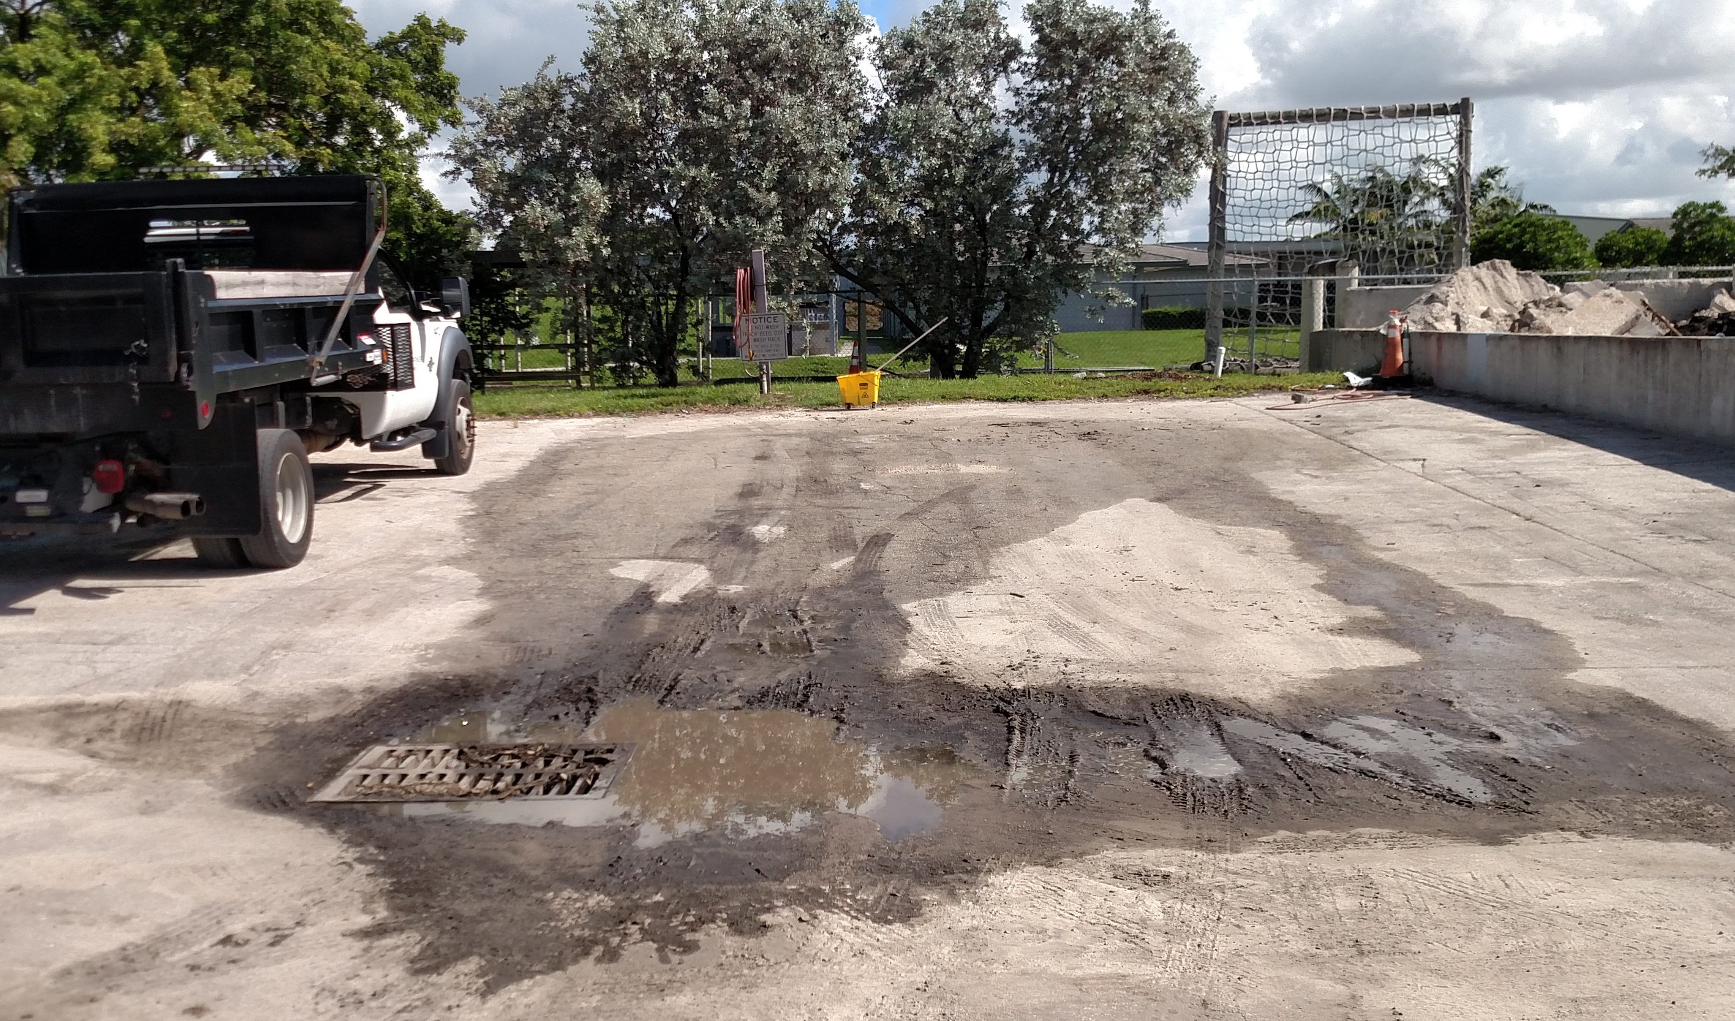
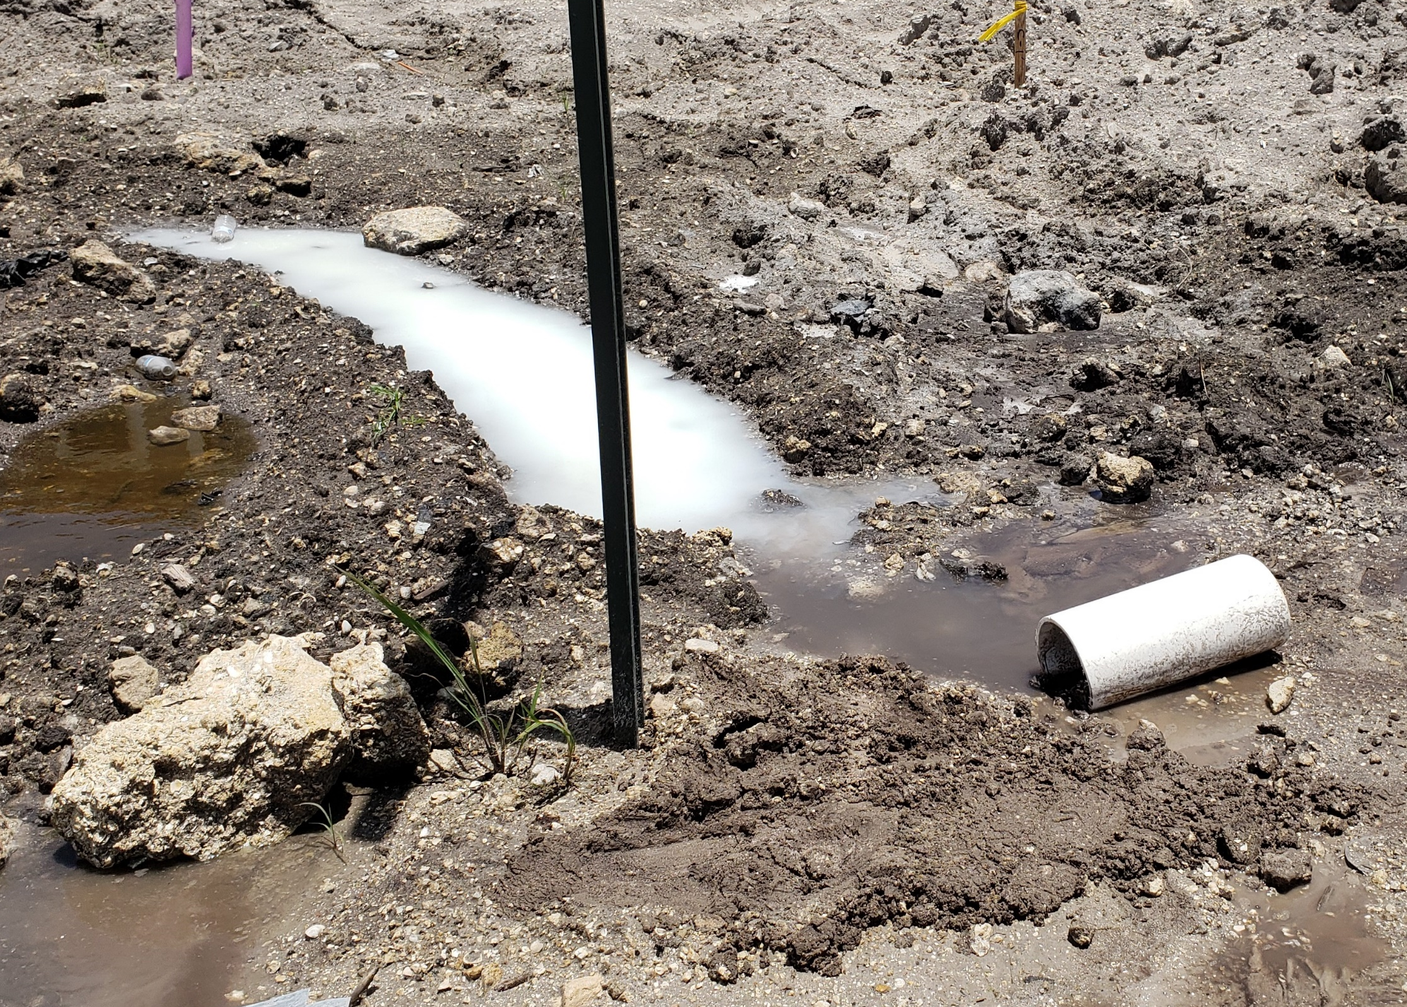
What is an Illicit Discharge?
Any discharge into an MS4 that is not entirely composed of stormwater.
Notes:
Illicit Discharges may include:
Deliberate discharges
Dumping
Illicit connections
Turbid water or debris from construction sites
Incidental runoff from sites with chemicals or raw materials

Slide 10
Allowable Non-Stormwater Discharges
Generally NOT considered Illicit Discharges as long as it does not violate water quality standards (Chapter 62-624, F.A.C.)
discharges from potable water sources
water line flushing
landscape irrigation
lawn watering runoff
uncontaminated ground water infiltration (as defined in 40 CFR 35.2005(20))
uncontaminated pumped groundwater
foundation/footing drains
water from crawl space pumps
air conditioning condensate
diverted stream flows
rising ground waters
springs
flows from riparian habitats and wetlands
water from individual residential car washing
dechlorinated swimming pool discharges
residual street wash water
discharges or flows from fire fighting activities

Slide 11
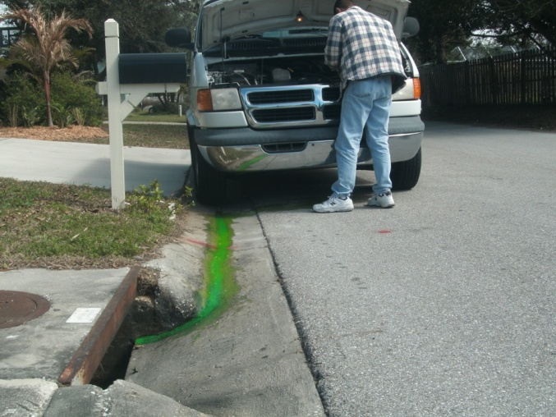
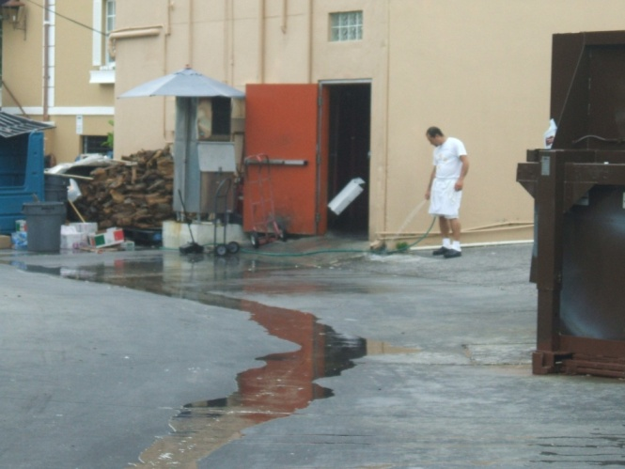
Types of Illicit Discharges
Illegal Dumping
Illicit Connections
Construction-Related Discharges
Pipe Defects (such as sanitary sewer failure)
Accidental Discharge or Spills

Slide 12
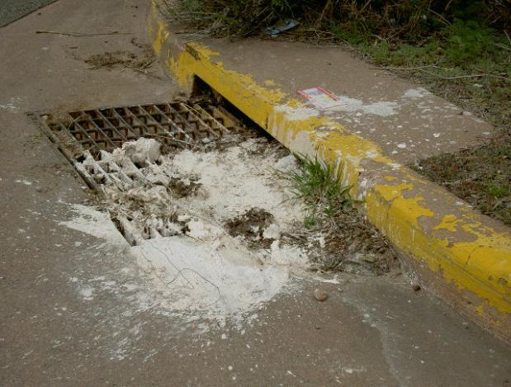
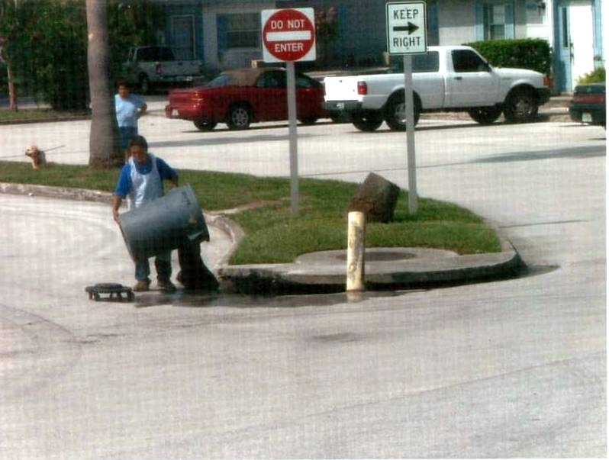
Illegal Dumping
Discharge of any materials not entirely composed of stormwater into the storm sewer system
Prohibited by local ordinance/policy
SHOULD BE REPORTED IMMEDIATELY
Notes:
Paint, used oil, or any other materials dumped into drainage systems

Slide 13
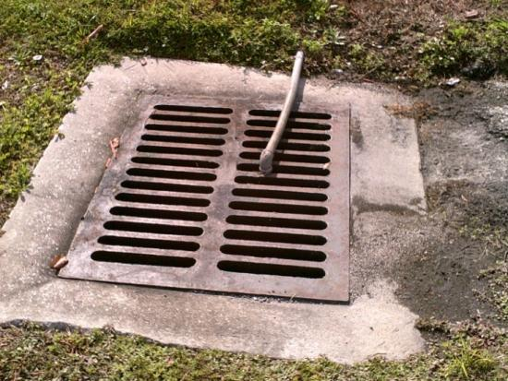
Illicit Connection
An improper physical connection to the stormwater system which can include unpermitted connections into the MS4.
Direct Connection
Wastewater cross connection
Sewage from residential property
Washing machine discharge
Unknown pipes to a storm drain
Indirect Connection
Introduction of pollutants from sanitary systems (like sanitary sewer overflow)
Discharges collected by storm drains

Slide 14
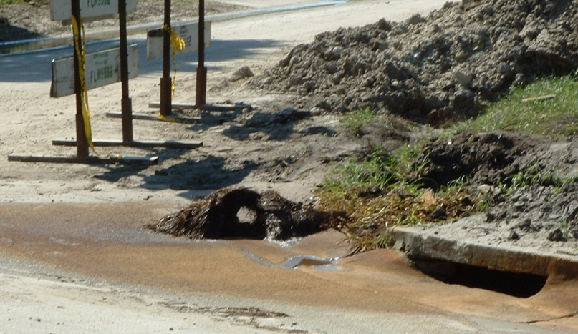
Construction-Related Discharges
Discharges from construction projects adjacent to the MS4 including the right-of-way:
  Turbid dewatering discharges
  Turbid runoff from construction activities
  Material or debris in right of way
  Tracking of sediment into roadway
  Concrete washout
  Chemical contaminants
Prevention is handled through
best management practices.
Notes:
Define turbidity during presentation. Exceedance of 29 nephlometric turbidity units (NTUs) above background. Chapter 302.530, F.A.C.

Slide 15
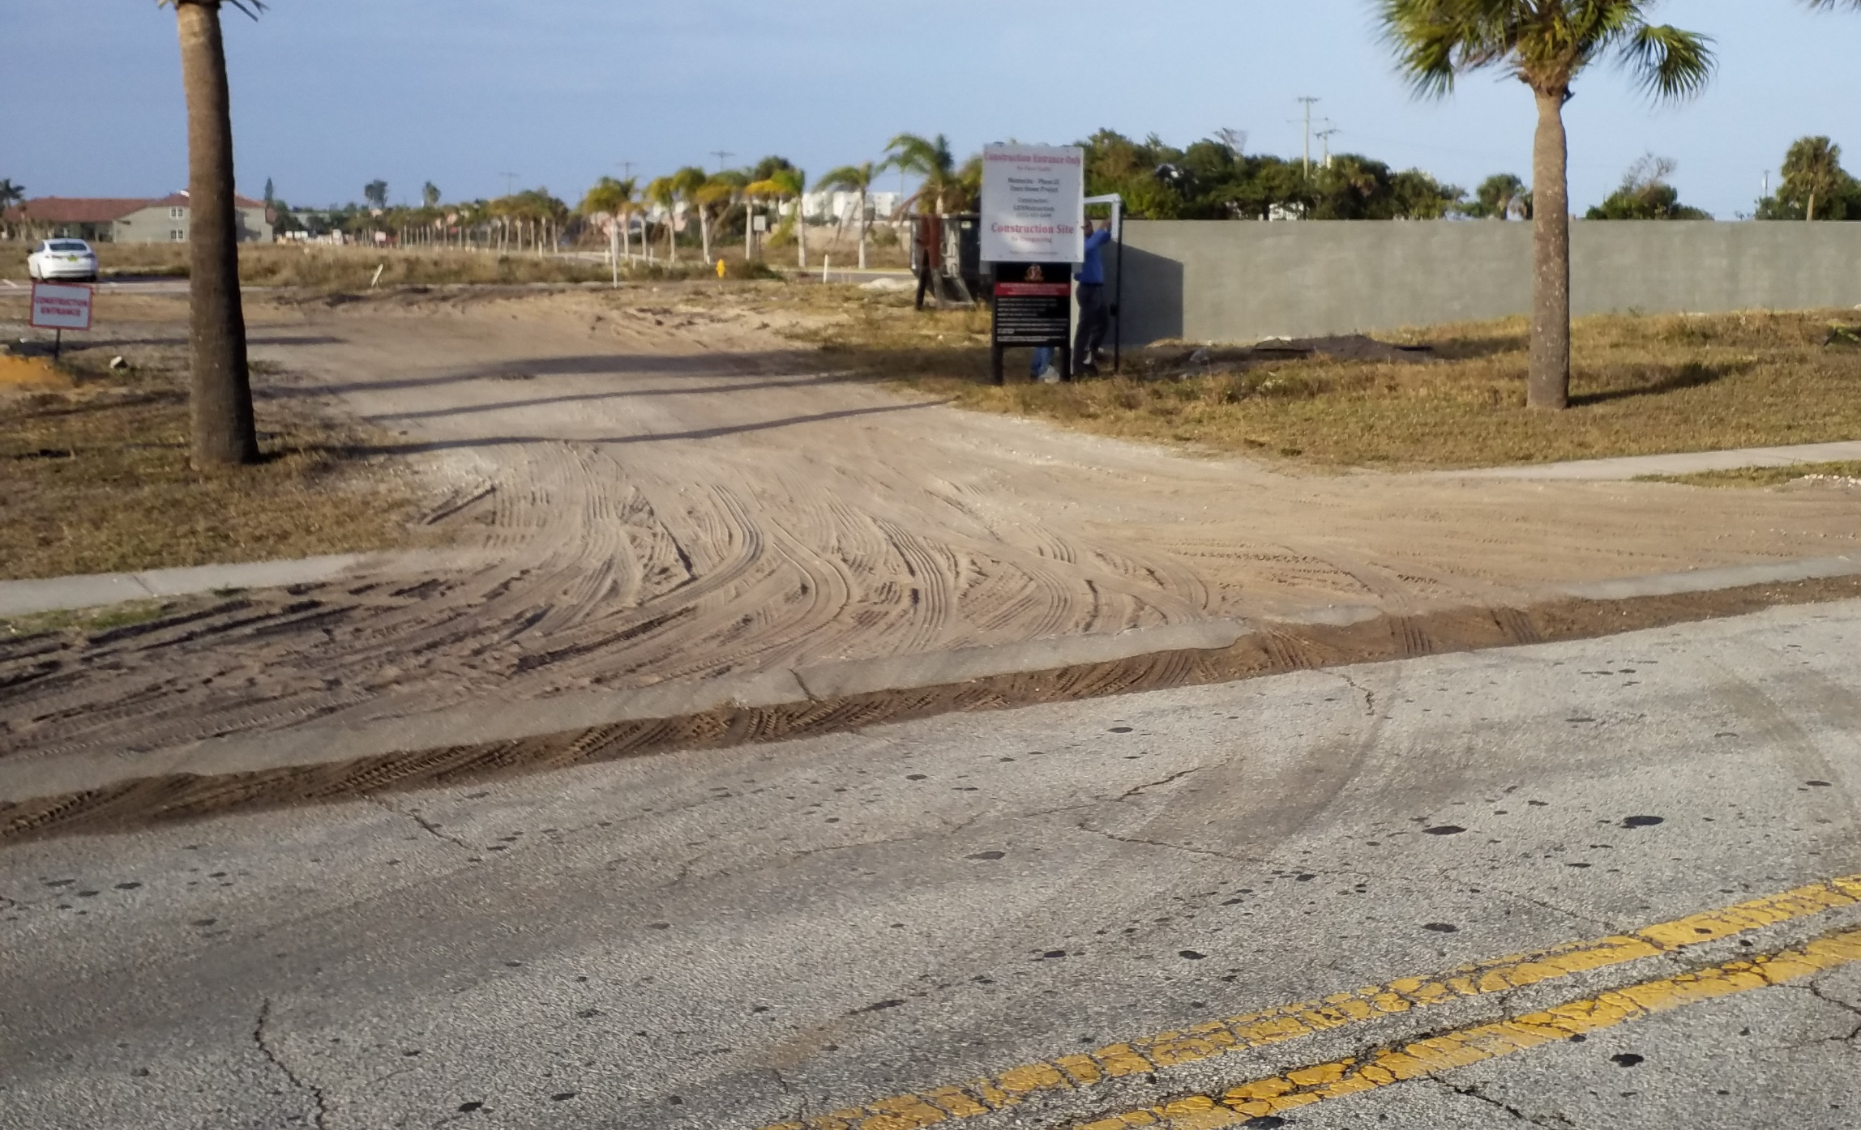
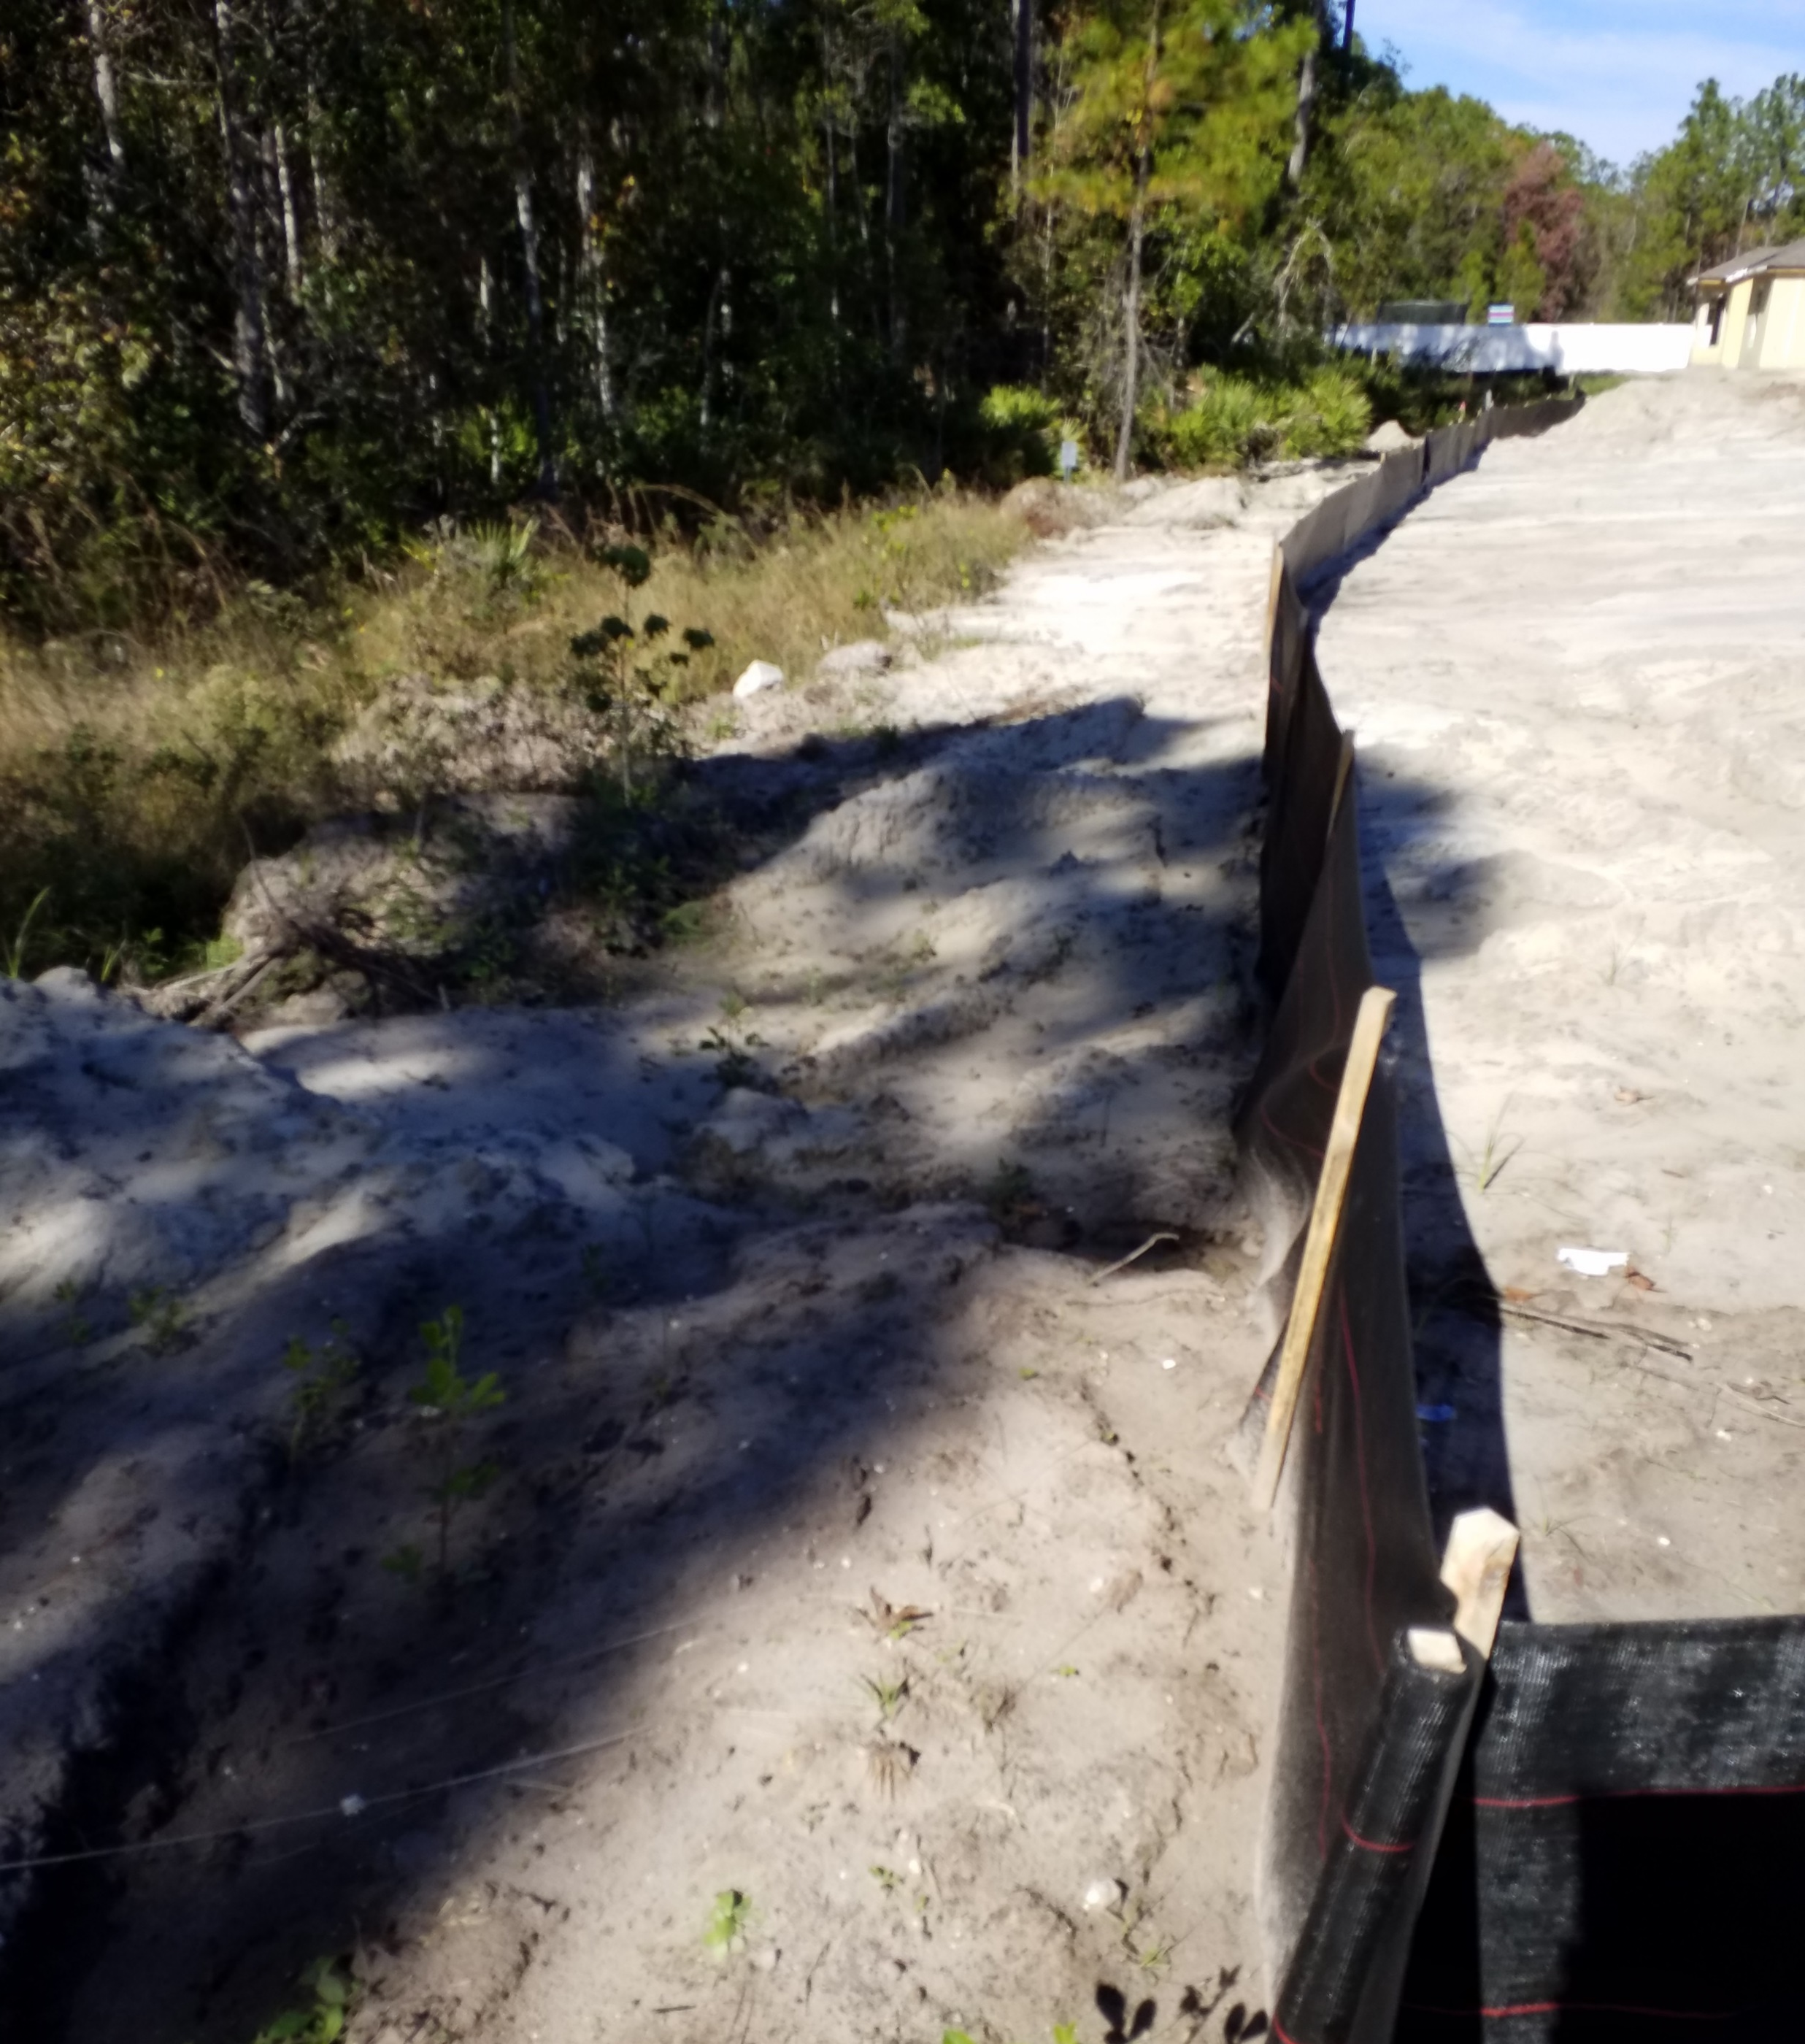
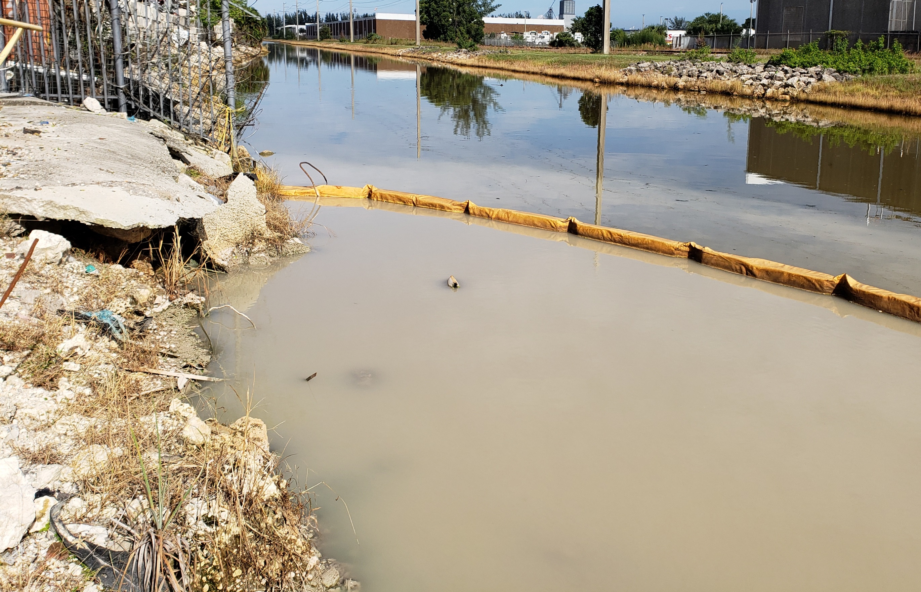
Construction-Related Discharges (continued)
Notes:
Top Left:
Track out
Bottom Left:
Turbidity barrier
Right:
Silt fence

Slide 16
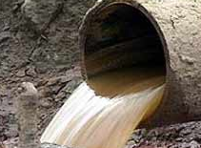
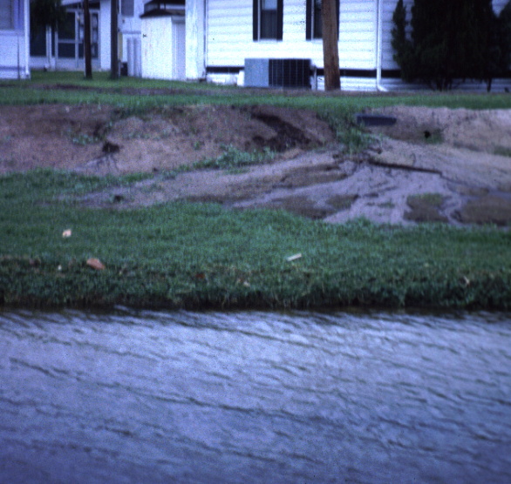
Sanitary Sewage
Sanitary sewage may be present if there is black staining inside the drainage pipe, visible evidence of sanitary waste, floating debris, foul odor or gray water.
Sewage may originate from failing septic tanks, improperly dumped travel trailer waste or cross-connections.

Slide 17
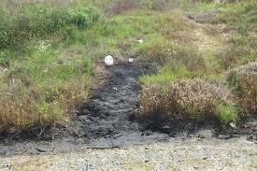
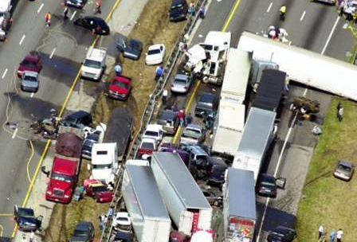
Accidental Discharges or Spills
When reporting a discharge or spill:
  Spills 25 gallons or more of petroleum or petroleum-based products are required to be reported to the:
  Florida State Watch Office
  1-800-320-0519
  Phase I MS4s are required to report all spills on the annual report.

Slide 18
Other Examples of Illicit Discharges
Improper disposal of:
  Oil
  Household Cleaners
  Paint
  Vehicle Maintenance Fluids
  Grass Clippings or Yard Waste
Improper application of:
  Pesticides, herbicides, and fertilizer

Slide 19
Illicit Discharge Examples (Continued)
Commercial Car Wash Wastewater
Washing Machine Wastewater
Pressure Washing with Soaps
Raw Sewage / Failing septic tanks (On-Site Treatment and Disposal Systems, OSTDS)
Chlorinated Pool Water

Slide 20
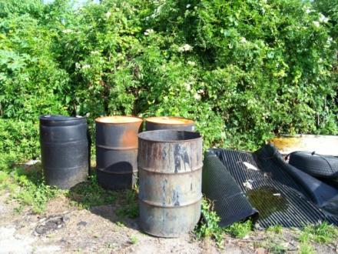
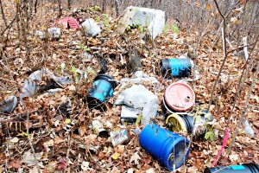
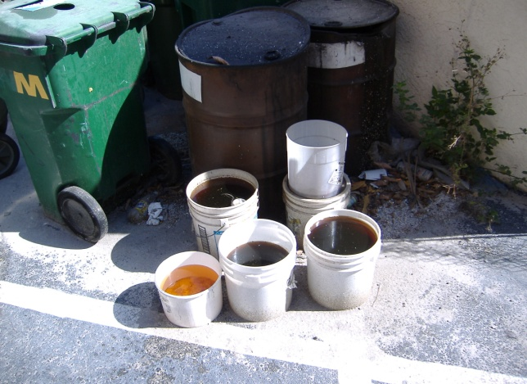
Common Signs of Discharges
Staining from paints or solvents on outfalls pipes, inlets and grates, and around pond banks
Turbidity, oil/gas sheen, foam and/or suds
Abandoned oil and gas containers, barrels, and paint cans
Discoloration of water or vegetation
Floatables and debris
Strong odors or other smells

Slide 21
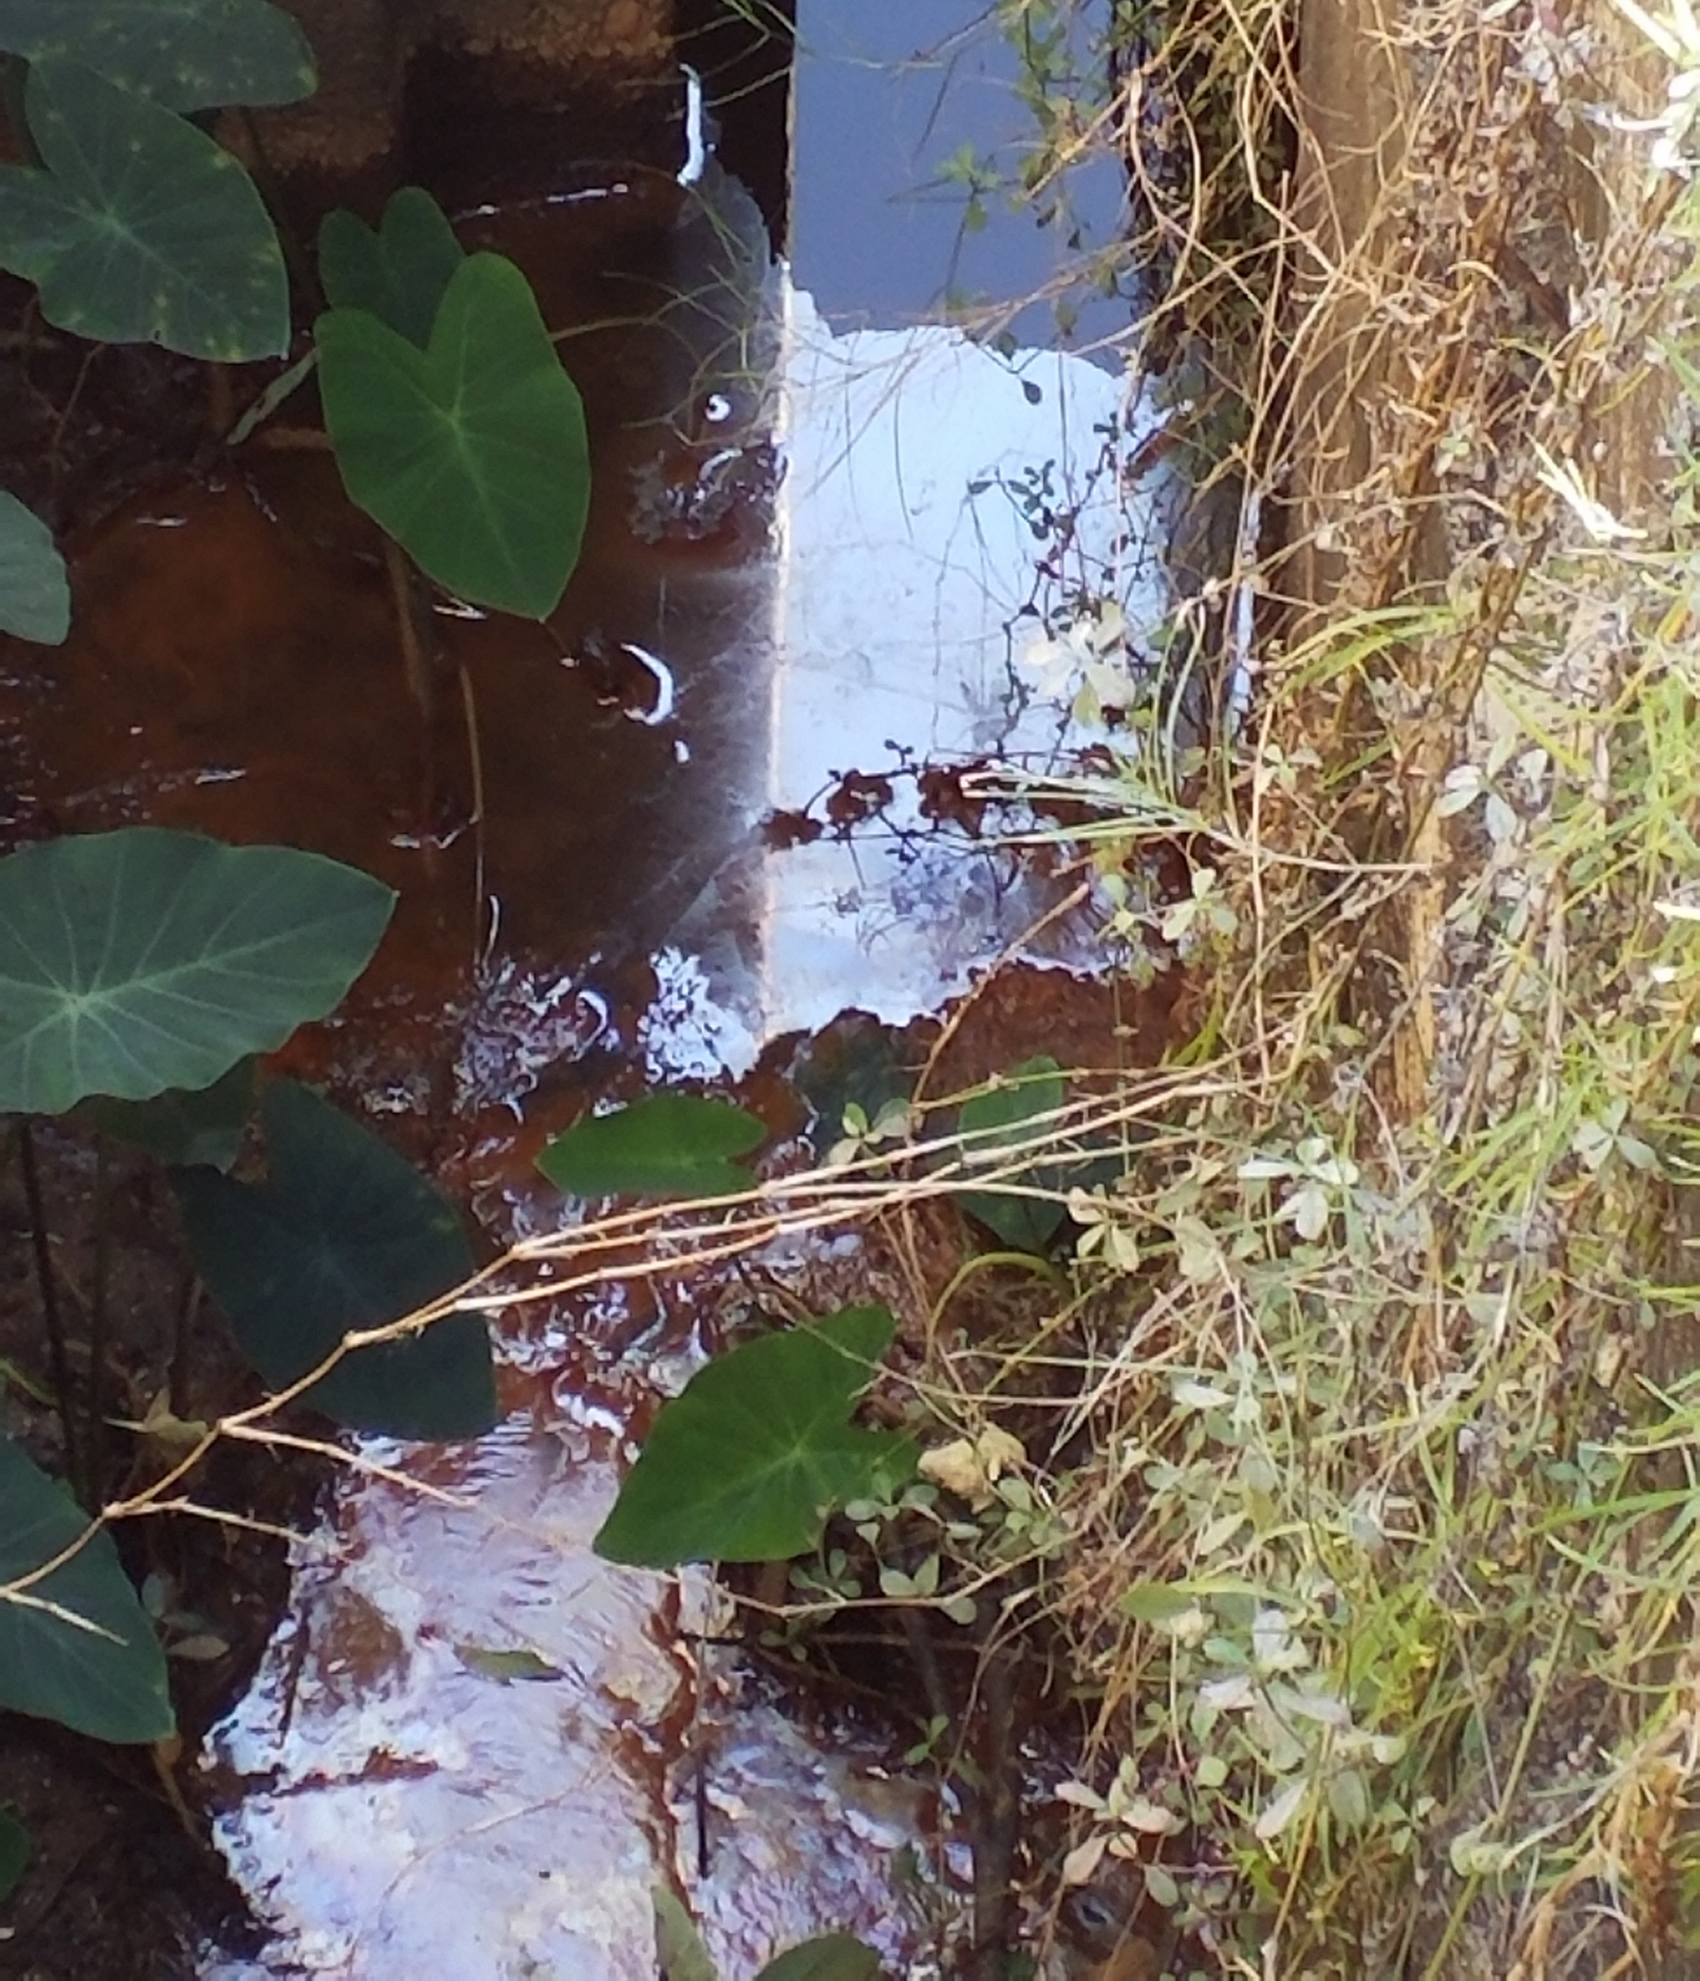
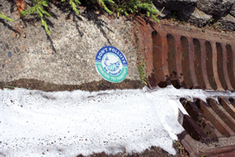
Examples Slide 1
Oil Sheen
Foams/Detergents
  Products used to wash boats/vehicles/buildings may include chlorine, phosphates, and ammonia
Notes:
Sheen caused by natural processes may be differentiated from sheen caused by petroleum product by swirling the sheen. If it breaks up easily, it is likely natural, if it quickly re-attaches, the sheen is likely petroleum based.
Detergent products often enter lakes and streams as a result of improperly connected car washing activities or washing machines.

Slide 22
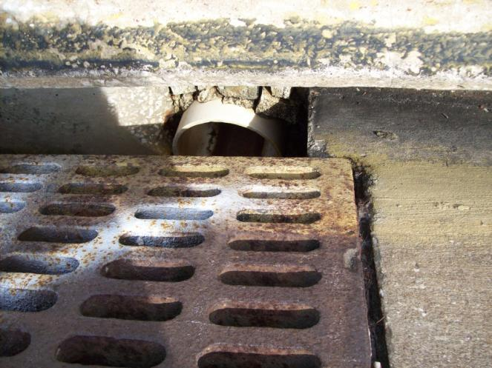
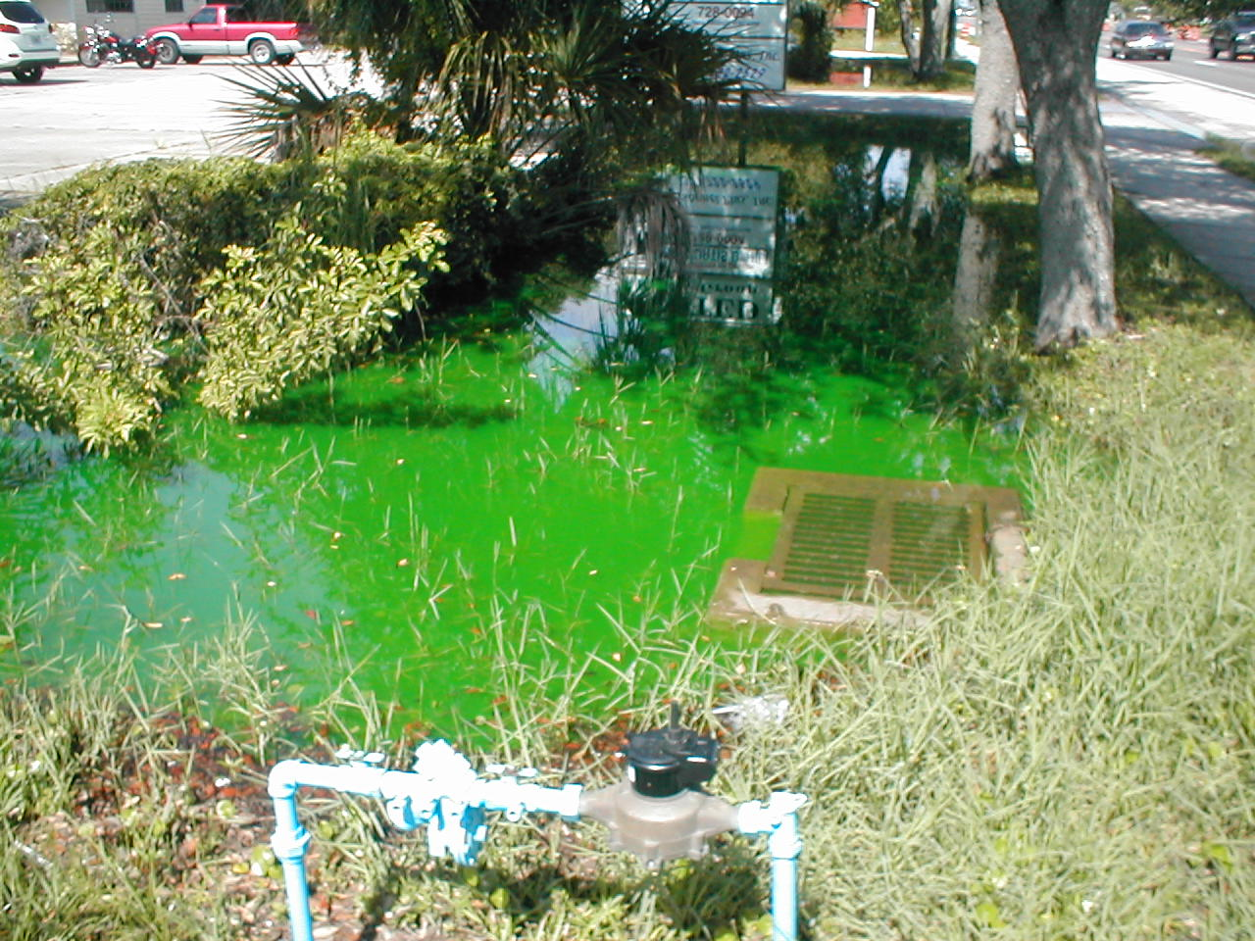
Examples Slide 2
Illicit connection of unknown pipe
Discolored water

Slide 23
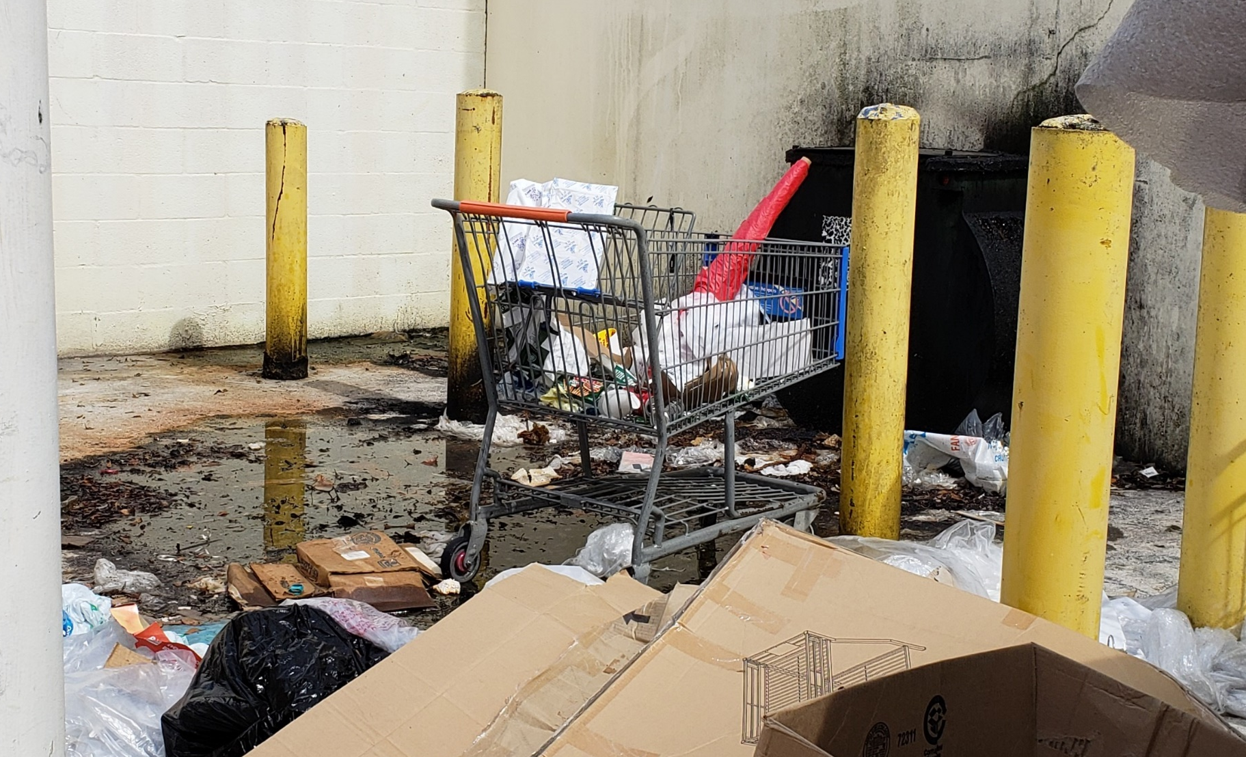
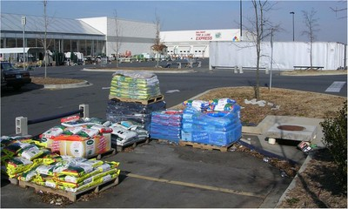
Examples Slide 3
Restaurant Grease Trap Overflow/Leaking
Exposed pesticide/fertilizer

Slide 24
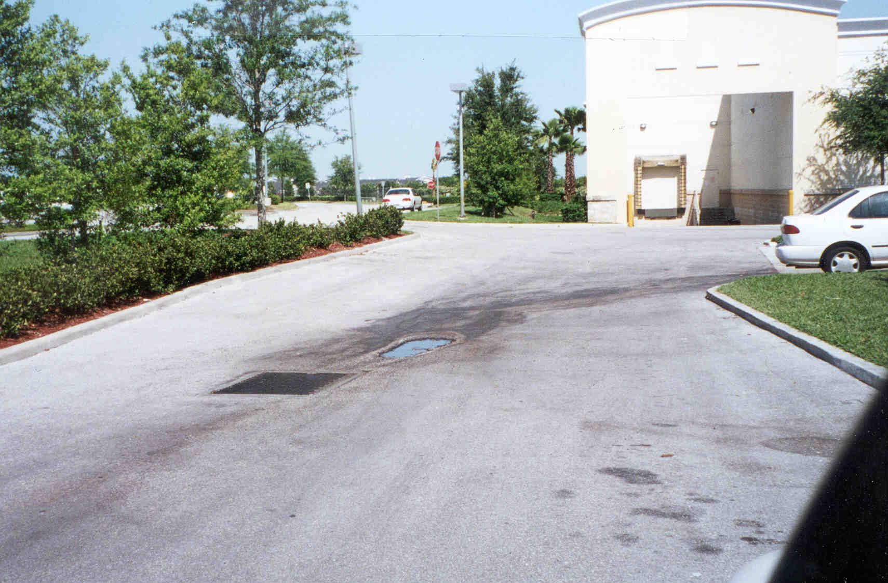
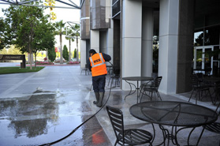
Examples Slide 4
Stains
Pressure Washing w/ Soaps
Notes:
Pressure washing sidewalk is okay.
Stripping paint using pressure washer is an illicit discharge.

Slide 25
When You Find an Illicit Discharge
On a property under your control:
  Stop or contain the discharge if safe to do so
  Protect the storm drain
  Notify supervisor and/or safety officer
  Clean up discharge or spill appropriately
  Implement strategy to prevent illicit discharges in the future

Slide 26
When You Observe an Illicit Discharge
On a property not under your control:
  Take pictures of the spill or discharge, potential sources and storm drain affected
  Note location, characteristics, date and time
  Document the type of vehicle/source
    commercial vehicle
    ID /name / phone on the door or vehicle
    License Number
  Report to MS4/Public Works immediately

Slide 27
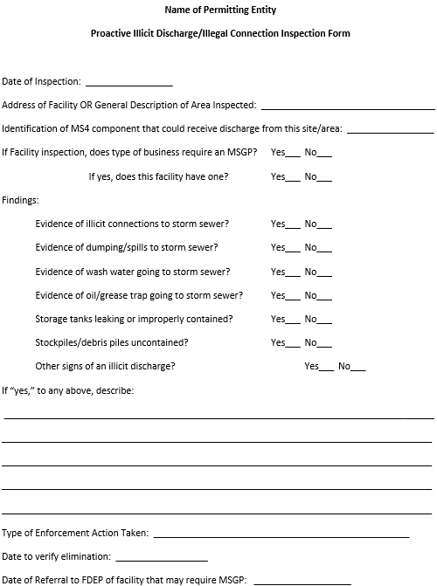
Reporting Illicit Discharges
Each MS4 must have it’s own SOP or inspection procedure
Use inspection checklist or log
Employees need to know how and whom to report possible illicit discharges

Slide 28
BREAK

Slide 29
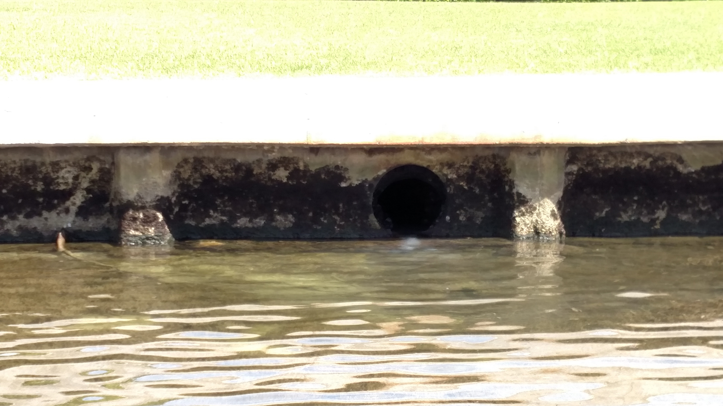
Investigation Slide 1
Discovery
Notes:
Discovery of an illicit discharge can either come from a routine inspection of the MS4 or a call from a concerned citizen.
Every individual in your area can possibly report an illicit discharge.
This is why it’s important to conduct this training and properly educate the public and employees on how to identify an illicit discharge.
Seen in the picture is a milky liquid being discharged from the pipe.

Slide 30
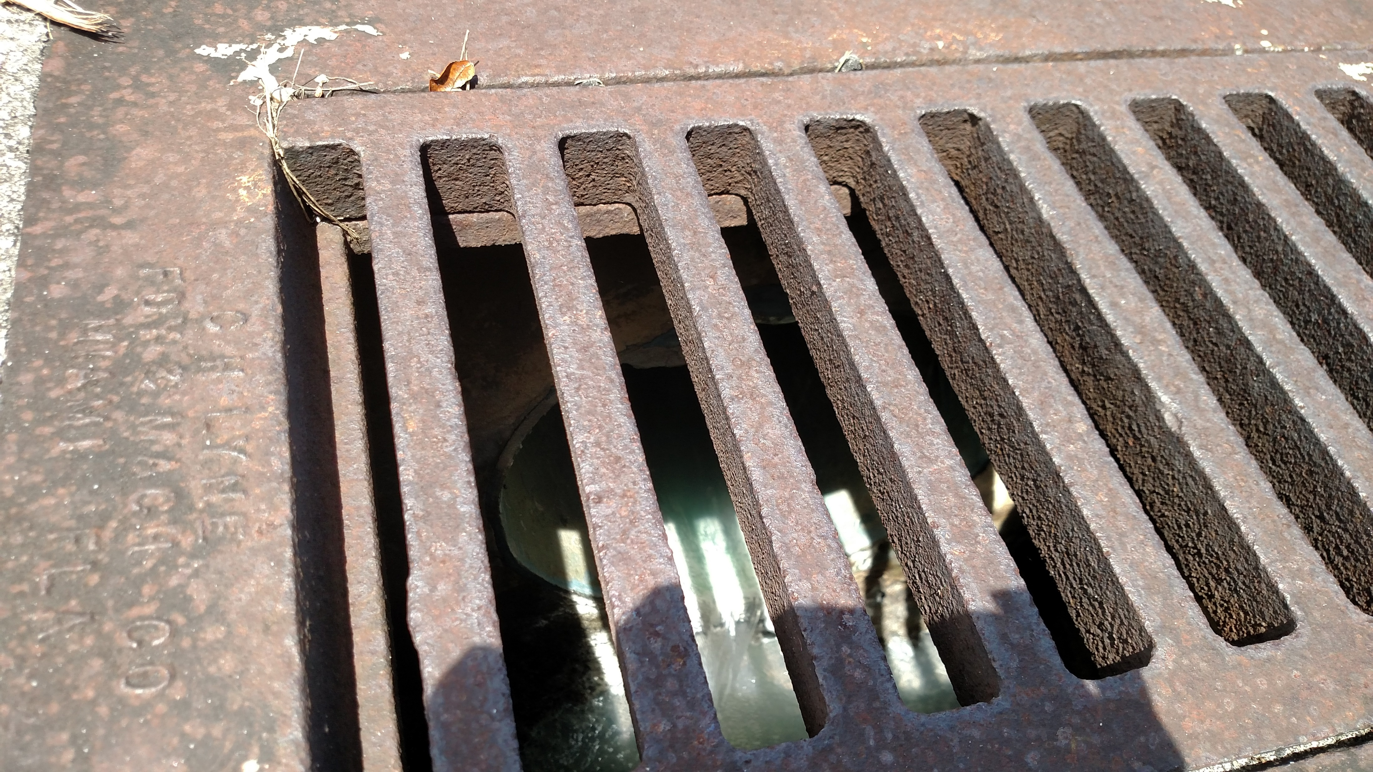
Investigation Slide 2
Following the source upstream
Notes:
All water being discharged from the pipe has a source and must be followed upstream.
Use your MS4 map to identify the nearest inlet/catch basin/manhole from the discharge and identify cross connections.
Identify which cross connection the discharge is from and continue following the discharge to the source.

Slide 31
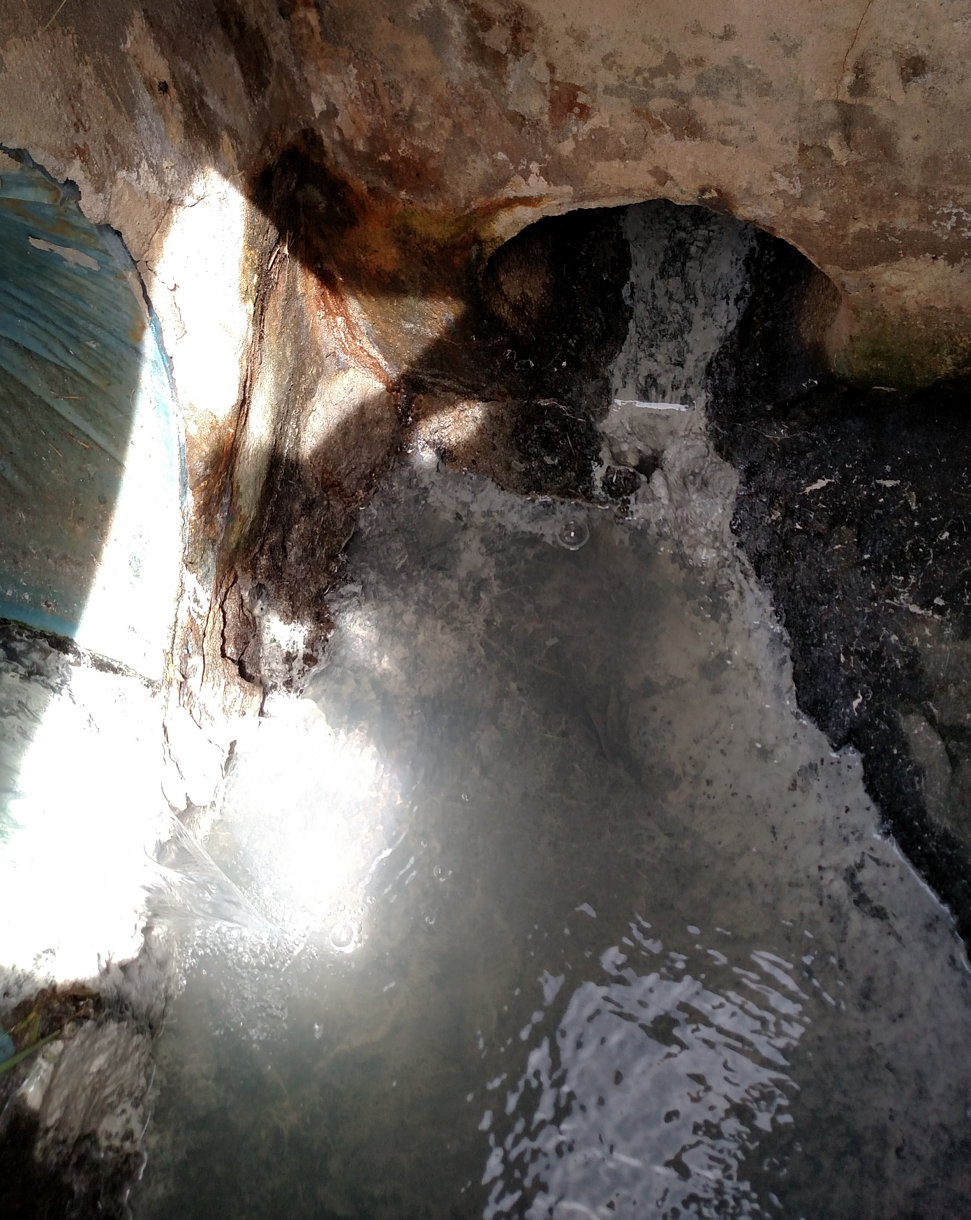
Investigation Slide 3
Split in storm drain network
Notes:
Follow pipe which discharge is coming from.

Slide 32
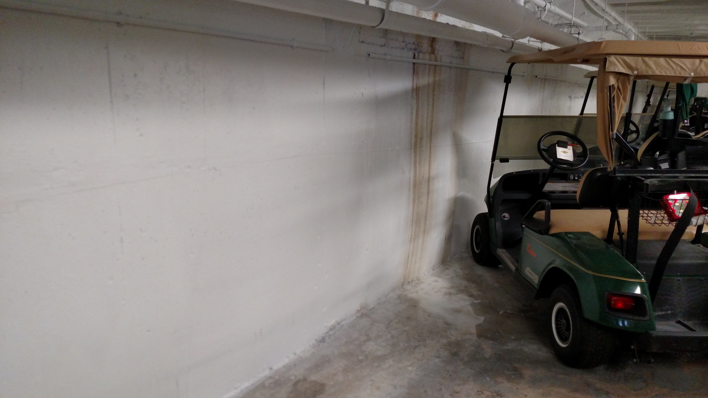
Investigation Slide 4
Identification of illicit discharge
Notes:
This discharge is from a pool soaking a wall and making fresh coats of paints run off with the water.
Once the source is identified ensure you document the issue with pictures and an inspection sheet.
Immediately contact the individual in charge of the discharge for the discharge to be corrected.
Utilize your standard enforcement procedures and follow up to ensure the discharge is eliminated permanently.

Slide 33
Good Housekeeping 1
Establishing accountability for pollution prevention (required)
Good housekeeping is everyone’s responsibility
  Ensure NO stormwater pollution is caused by daily activities at permittee-owned facilities and in the field
  Establish procedures and document pollution prevention activities
Notes:
We must set the example for active and effective pollution prevention

Slide 34
Good Housekeeping 2
Establish accountability for pollution prevention (required)
Use a Stormwater Pollution Prevention Plan (SWPPP)
Follow Spill Procedures
  Utilize Spill Cleanup Kits
  Maintain Spill Cleanup Kits
You must set the example for active and effective pollution prevention
Notes:
An example SWPPP can be found

Slide 35
Good Housekeeping 3
Vehicle/Equipment Washing
  Wash water should never discharge to storm sewer or surface waters
Vehicle/Equipment Maintenance
  Should be performed indoors
Vehicle/Equipment Storage
  Under cover or use drip pans/drop cloths

Slide 36
Good Housekeeping 4
Materials Management
  Secondary containment of waste materials
  Properly dispose of unused materials and document disposal methods
  Spill prevention kits
  Cover stockpiles, drums, and other containers
  Know manufacturers storage guidelines

Slide 37
Good Housekeeping 5
Disposal of Sediment from Street Sweeping and Stormwater System Cleaning
May be disposed of in a permitted Class I or II landfill or permitted WTE(Waste-to-Energy) facility
  If not contaminated, can be disposed of in Class III landfill
  May be used as construction/industrial fill or soil amendment if tested for contaminants and does not pose a threat to public health or the environment
For more information: https://floridadep.gov/sites/default/files/GuidanceSt-Sweep_05-03-04_0.pdf

Slide 38
Good Housekeeping 6
Landscaping and Lawn Care
  Keep clippings out of streets and inlets
  Use Florida-Friendly Landscaping techniques
  Use properly licensed/certified fertilizer and pesticide applicators
    Sweep up spills and reuse the fertilizer
    Keep pesticides and fertilizers away from waters, streets, and stormwater inlets
    Follow manufacturer’s application rates
Notes:
Florida-friendly fertilizers = low or no phosphorus and slow release nitrogen

Slide 39
Good Housekeeping 7
Administration and Communication
  Implement Standard Operating Procedures (SOPs) or a plan of action to manage illicit discharges.
  Use channels of communication for reporting potential or observed illicit discharges.

