Slide 1
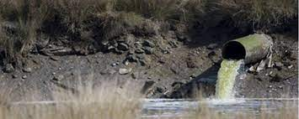
STORMWATER 101
Pollution Prevention and Illicit Discharge Detection and Elimination
Notes:
Hello and welcome to Stormwater 101 a refresher course from the City of Panama City Beach Public Works Department. Here in Panama City Beach we are proud of our natural resources and work hard to protect them for all of our residents both now and in the future. As a city employee, part of your job is helping to ensure that our water ways stay clean. Today we are going to talk about a few simple ways that you can do that.

Slide 2
Goals
Understand
The terms
“stormwater”,
Understand
Why these terms are so important and why you should care
Understand
What best practices you can use to help prevent stormwater pollution
Understand
How to recognize and report illicit discharge (pollution)
“illicit discharge”
“best practice”
Notes:
Throughout this presentation, please pay close attention the terms and key words such as “stormwater”, “illicit discharge” and “best practice.” By the end of the presentation, you should know what all of these terms mean why they are so important. You will also know how to identify and report stormwater pollution.

Slide 3
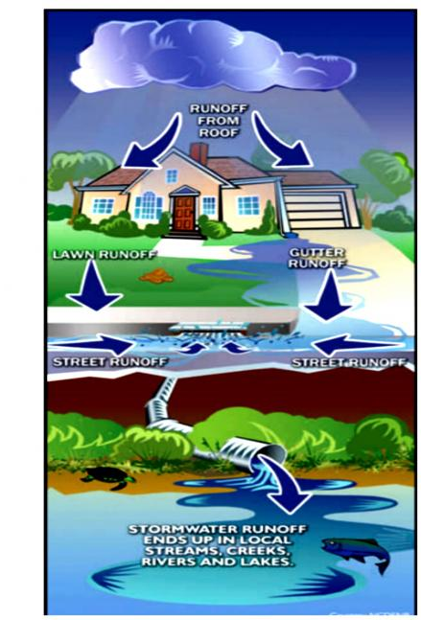
What is Stormwater?
Stormwater is rainwater that doesn’t soak into the ground but runs off into waterways.
Stormwater doesn’t usually flow into any type of wastewater treatment system, it flows into our storm drainage system which then ends up into local streams, creeks, rivers and lakes.
Notes:
Stormwater in a simple explanation is simply any rain, sleet or snow (not that we get much of the last two) that does not soak into the ground and runs off into a ditch, storm drain, or surface water. When it rains water will either soak into the ground or it will a hard or “impervious” surface and then will run off somewhere else. When this type of water falls onto a driveway or parking lot it may carry with it oil, fuel, heavy metals or even types of sediment. When this type of water runs off lawns it may have fertilizer, pesticides, dog waste or other containments in it. All of these pollutants that are carried in this water as it runs off will eventually make its way into our creeks and streams.

Slide 4
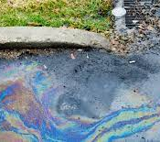

Why is Stormwater Runoff Important?
Stormwater runoff can pick up debris, chemicals, dirt and other pollutants
Stormwater runoff is NOT treated before it is discharged into the local streams, creeks, rivers and lakes.
Notes:
Stormwater runoff not only picks up pollutants and debris such as trash, dog waste, and chemicals but it is NOT treated and cleaned before it enters in our creeks, streams, and lakes. Here in PCB, we have a Municipal Separate Storm Sewer System or MS4. This means that the pipes that carry sewage water from toilets, sinks and showers are different than the pipes that carry stormwater runoff. Sewage water goes to a treatment plant to be cleaned before it is put back into surface water. Stormwater does not go through this process and dumps directly into surface water, carrying all the pollutants with it.

Slide 5

More impervious area
More stormwater runoff
Notes:
When rainwater falls on an undeveloped, natural area, most of the water will soak into the ground. As more impervious surfaces such as roads, buildings, parking lots, and driveways are built, the water has less area to soak the rain into and it instead runs off to the lowest point. In PCB we are growing both in population and more developed areas. The more we develop areas and impervious surfaces the more runoff we will have. The more runoff created the more pollution it carries into our beautiful natural waterways.

Slide 6
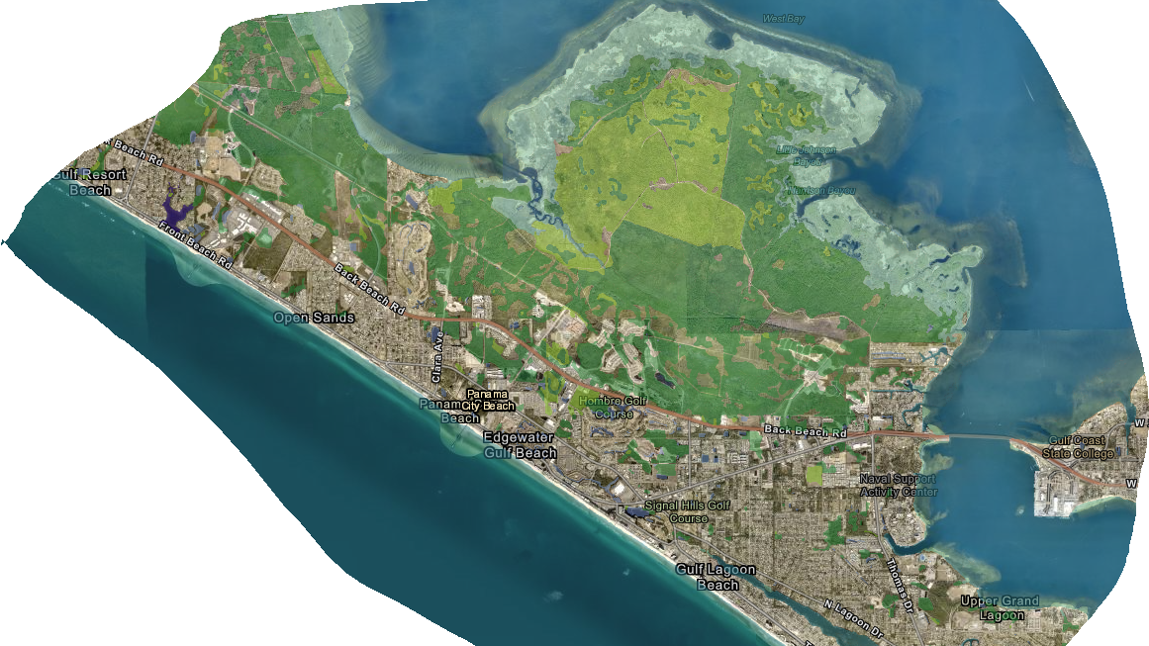
Notes:
Because of our population and size and where our stormwater flows, the city of Panama City Beach has a permit from the Environmental Protection Agency called a National Pollutant Discharge Elimination System (or NPDES) permit. Our NPDES permit basically states that we must monitor and reduce certain types of pollutants that go into our waterways.

Slide 7

What is an Illicit Discharge?
Any discharge to the storm sewer system that is not made entirely of stormwater
Exceptions Include:
Water line flushing
Runoff or return flow from landscape irrigation
Discharges from portable sources
Diverted stream flows
Air Conditioning condensation
Water from crawl space pumps
Flows from wetlands and riparian habitats
Dechlorinated swimming pool discharges
Discharges or flows from fire fighting activities
Rising ground waters and springs
Foundation and footing drains
Notes:
The word “illicit” simply means illegal. An illicit discharge is more than just dumping chemicals down a storm drain. In the City of PCB it is illegal for anything but stormwater to go down a storm drain or into a body of water. There are a few exceptions as noted, but it is best to remember the rule. “only rain goes down the drain”

Slide 8

Why are Illicit Discharges Important
Illicit discharges often include pathogens, toxic pollutants, bacteria and sediment.
Illicit discharge=pollution
Anything that enters a storm sewer system flows untreated to a local waterway
Notes:
Illicit discharges such as water containing excess fertilizer or water from cleaning a painting bucket can contain harmful substances. These substances go directly into our waterways and then into drinking water supplies.

Slide 9
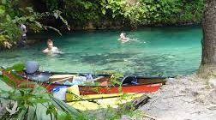
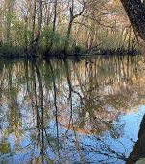
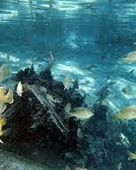
Why should you Care?
We use local waterways for swimming, fishing, boating and as a source of drinking water.
The City of Panama City Beach is required to prevent pollutants from entering the storm sewer system.
Notes:
We all want to have clean water to drink, to boat and kayak in. We want healthy fish and plants and our local wildlife to thrive in their environment. Not only are we required by our permit to keep the water clean it’s the right think to do for our health and safety and the health and safety of the environment.

Slide 10

What Can You Do?
Employees can help prevent stormwater pollution by:
Preventing pollutants from being dumped or spilled into the storm sewer system (this includes driveways, sidewalks, streets, storm drains)
Reporting pollution or questionable discharges to the storm sewer system or local waterways.
Notes:
As a city employee you play a major role in preventing stormwater pollution. The first step in pollution prevention is knowing what types of activities are most likely to cause a problem. Activities like vehicle or equipment refueling and maintenance, landscaping work, and materials storage are all examples of activities where you should be on the lookout for potential problems.

Slide 11
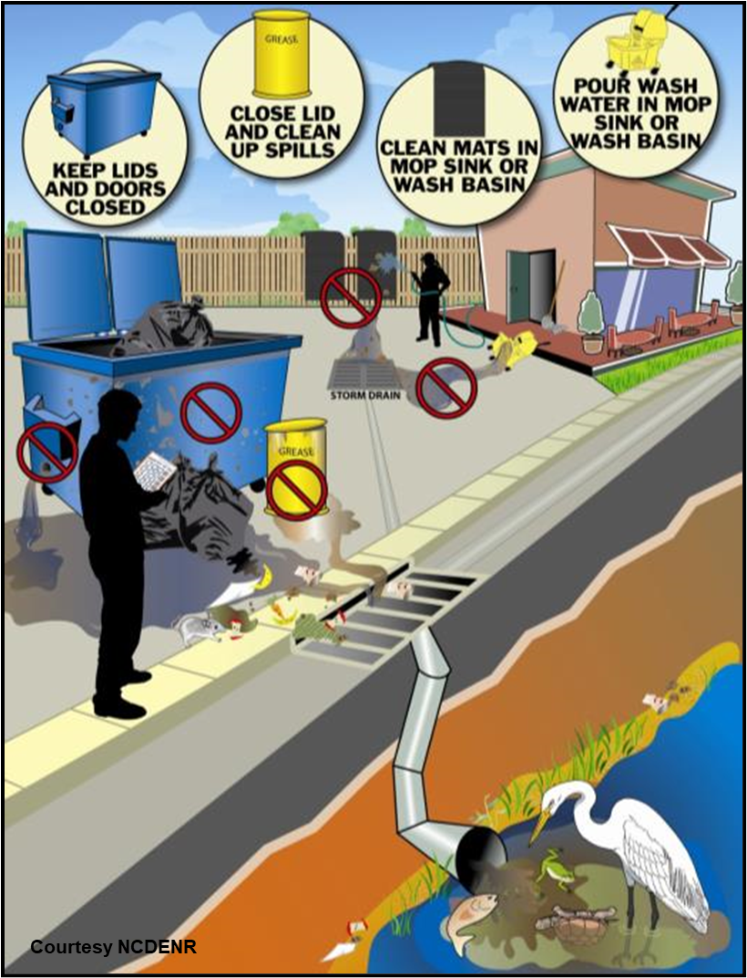
Best Practices for Preventing Pollution
Store and handle materials safely
Clean up spills properly using dry methods
Never dump or wash out items down or near a storm drain
Notes:
The first step in stormwater pollution prevention is to make sure you are handling and storing materials safely. Avoid doing work near the storm drainage system if you can. Do vehicle or equipment maintenance underneath a covered area. Keep material containers closed when you are transporting them from one place to another, and make sure to close lid's when you are done working with a material. Materials should be kept always covered under a roof or tarp. Materials containers should be stored with something underneath like a drip pan or a containment pallet to catch any drips or leaks. Make sure all dumpsters are leak-free and lids remain closed. Wash water should be contained collected and disposed of in the sanitary sewer or other appropriate place. Not in the storm drainage system. If there is a spill of a small amount of material clean it up immediately. Always use dry cleanup methods. Never hose down a spill.

Slide 12
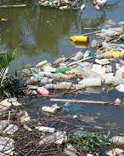
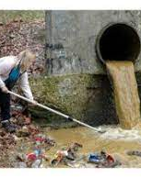
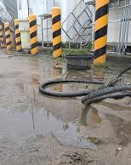
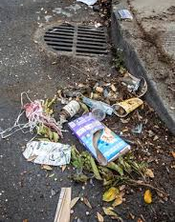
Recognizing Stormwater Pollution
Warning signs may include presence of the unusual
Color
Odor
Turbidity
Floatable liquids and solids
Notes:
Liquids coming out of a pipe or outfall, especially if it has not rained in several days, is a good indication that something is not right. Unusual colors, cloudiness, floatable solids or liquids, or any other unusual sign that there is more than just water in a storm drain, creek, or stream should be reported.

Slide 13

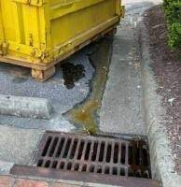
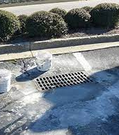
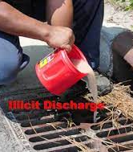
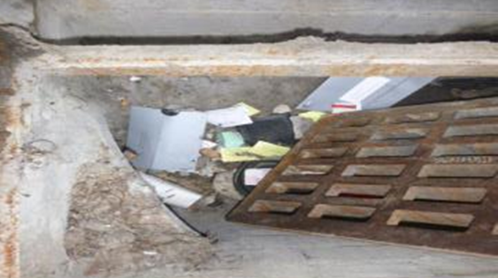
Reporting Pollution
If you see discharges entering the storm drainage system or someone dumping something down the storm drain, REPORT IT!
Notes:
If you see a spill of materials that do reach the storm drainage system or body or water or see someone dumping or evidence of dumping in the drainage system, be sure to report it immediately to your supervisor. You can also place a ticket in See Click Fix, or via the PCB website under stormwater illicit discharge form. https://www.pcbfl.gov/home/showpublisheddocument/866/635331710854700000

Slide 14
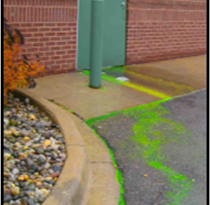
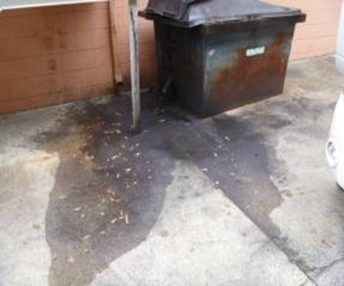
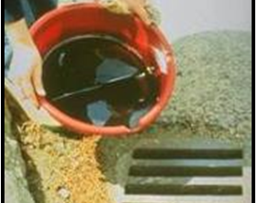
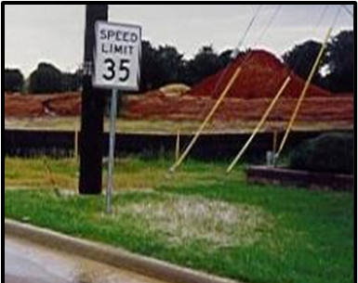
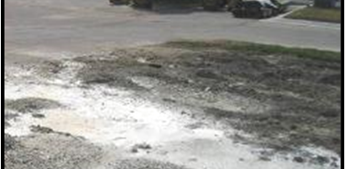
Examples of What to Report:
Pollution Entering the Storm Sewer System
Notes:
Stormwater pollution can often be seen. Keep your eyes open for cloudy dirty water running down streets. Washouts of solids/liquids, unusually colored discharges, Liquids dumped down storage drains, Leaks from dumpsters, Solids blown or swept in the street and down the drain.

Slide 15
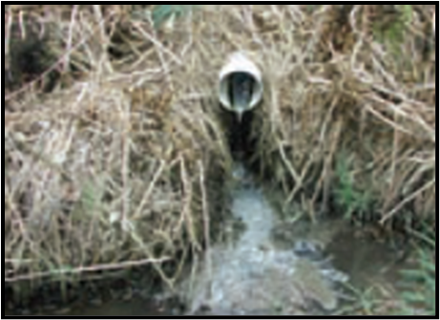
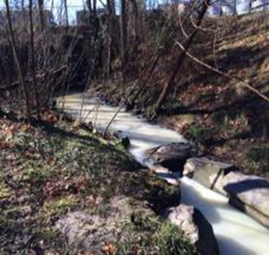
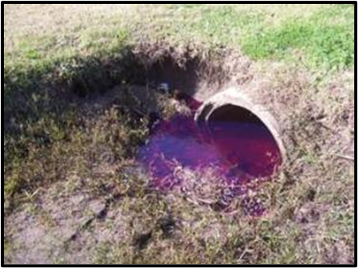
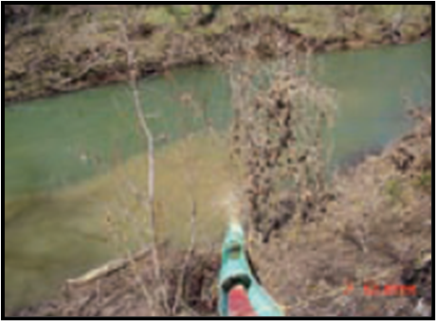
Examples of What to Report
Unusual Color or Cloudiness
Notes:
Unusual water color is always something to report. Bright green water could indicate a large algae bloom. Milky white water could be pain wash water Milky-gray black water could be an indication of a failing septic system sewage overflow. Tan or brown water could be discharge from a construction site. Purple or red water could indicate diesel fuel or heating oil spill.

Slide 16

Examples of What to Report
Unusual Odor
Some odors are an immediate indicator of pollution
Sewage, gasoline, and chemical odors should always be reported
Odor | Causes
Rotten eggs/hydrogen sulfide | Raw sewage, decomposing organic matter, lack of oxygen
Sharp, pungent odor | Chemicals or pesticides
Gasoline, petroleum | Industrial discharge, illegal dumping of waste, wastewater.
Notes:
If you smell a strong or unusual odor coming from the storm drainage system or water body, report it immediately. This could be an indication of a serious discharge.

Slide 17

How to Report
Report
Report to direct supervisor
Call
Call: (850) 233-5100 ext. 2415
Form
Online form at https://www.pcbfl.gov/departments/public-works-department/stormwater-division
Email
Email: Publicworks@pcbfl.gov
(public record)
Include the following information:
Specific location
Date and time
Description of the pollution
Description of the violator (license plate, personal description etc.) if applicable
Your contact information
Email a picture of video if you can

Slide 18


Marsha.Rivett@pcbfl.gov
Sign the training sign in sheet to receive credit for this training.
Have a great day!
Notes:
As an employee of the City of Panama City Beach, we are all counting on you to be on the lookout for stormwater pollution. Use best practices to prevent pollution on the job and report anything suspicious to the stormwater department.

