Slide 1
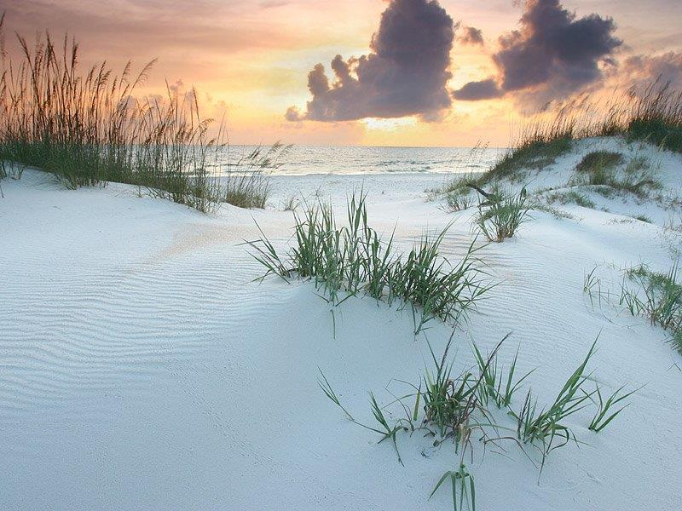
STORM WATER POLLUTION PREVENTION / GOOD HOUSEKEEPING
PANAMA CITY BEACH
Stormwater Pollution Control & Good Housekeeping

Slide 2
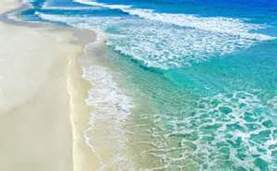
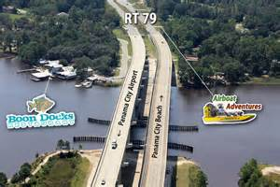
WHAT IS STORM WATER?
WHAT IS STORMWATER?
Storm water is rain water or melting snow that doesn’t soak into the ground but runs off into waterways.
Storm water doesn’t usually flow into a wastewater treatment system, it flows into our surface waters:
Gulf of Mexico
Local Ponds, Streams and Rivers
West Bay

Slide 3
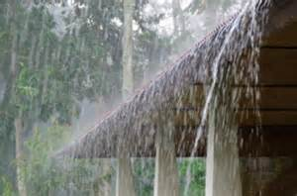
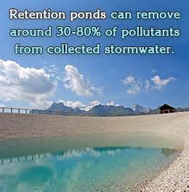
STORMWATER
As stormwater flows over driveways, lawns, and sidewalks, it picks up debris, chemicals, dirt and other pollutants. Stormwater can flow into a storm sewer system or directly to a lake, stream, river, wetlands, or coastal waterway.
Anything that enters a storm sewer system is discharged untreated into the water bodies we use for swimming, fishing, and providing drinking water. Polluted runoff is the nation’s greatest threat to clean water.

Slide 4
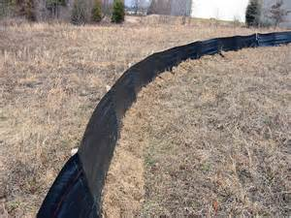
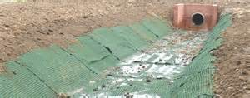
Purpose of the Stormwater Pollution Protection Plan
Protect on-site and off-site resources and waterways by:
Control Sediment
Minimize erosion
Controlling volume and peak rate of runoff
Reducing channel erosion
Improving soil stabilization
Improving water quality
Reducing flooding

Slide 5
GOOD HOUSEKEEPING PRACTICES
Keep your work area neat and orderly – do not let scrap or waste accumulate
Keep unused containers closed tightly
Clean up behind yourself (microwave, refrigerator, etc.)
Outdoor Materials Storage
Store materials out of rainfall – keep lids on all containers and label them correctly.
Avoid loading/unloading during poor weather or load/unload under a roof.

Slide 6
GOOD HOUSEKEEPING PRACTICES
VEHICLE & EQUIPMENT FUELING AND REPAIR
  Stay with vehicles while fueling – avoid overfilling or “topping off”
  Move leaking vehicles and equipment indoors
  Use a drip pan to catch temporary leaks until they can be fixed.
  *OUTDOOR MANUFACTURING AND MAINTENANCE
  Use a drop cloth or tarp to catch dust and scraps
  Clean-up scraps, drips and residues by sweeping after each shift

Slide 7
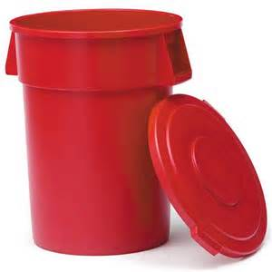
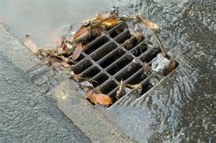
GOOD HOUSEKEEPING PRACTICES
WASTE MANAGEMENT
  NEVER use storm drains/ditches for waste disposal – avoid and report illegal dumping
  Close the lid or place a cover on all waste containers

Slide 8
HEALTHY HOUSEHOLD HABITS
VEHICLE AND GARAGE
  Use a commercial car wash or wash your car on a lawn or other unpaved surface to minimize the amount of dirty, soapy water flowing into the storm drain and eventually into your local water body.
  Check your car, boat, motorcycle, and other machinery and equipment for leaks and spills. Make repairs as soon as possible. Clean up spilled fluids with an absorbent material like kitty litter or sand, and don’t rinse the spills into a nearby storm drain. Remember to properly dispose of the absorbent material.
By practicing healthy household habits, homeowners can keep common pollutants like pesticides, pet waste, grass clippings, and automotive fluids off the ground and out of stormwater. Adopt these healthy household habits and help protect lakes, streams, bays, rivers, wetlands and coastal waters. Remember to share the habit with your neighbors.

Slide 9

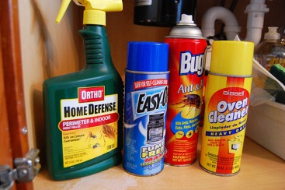
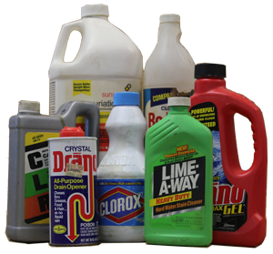

Pollution Control
Recycle used oil and other automotive fluids at participating service stations. Don’t dump these chemicals down the storm drain or dispose of them in your trash.

Slide 10
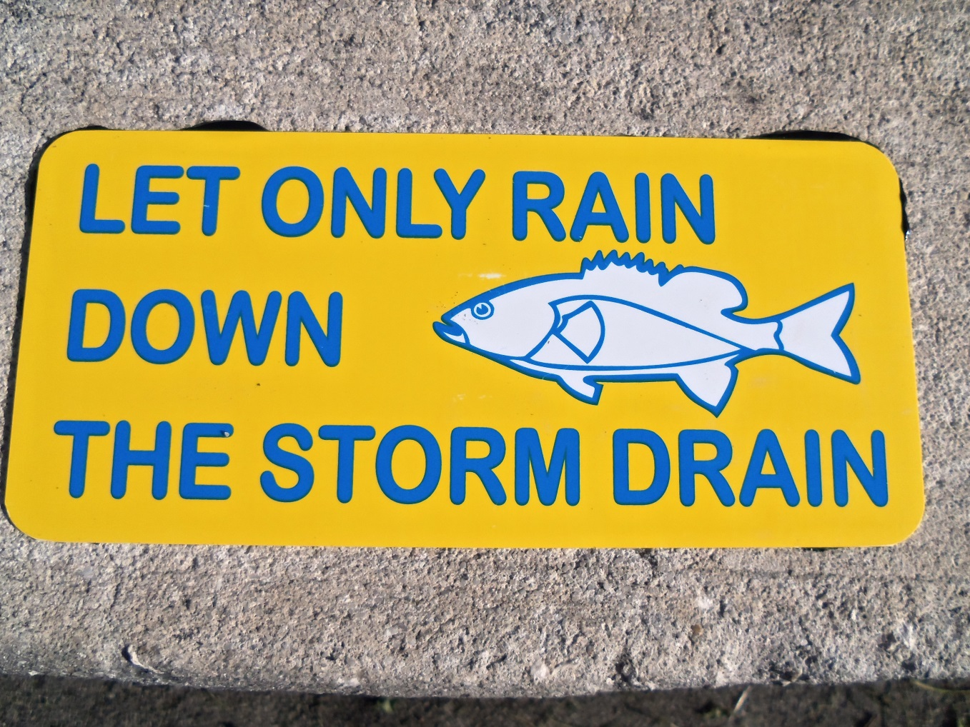
Stormwater pollution runoff
Pollution Control
Stormwater doesn’t usually flow into a wastewater treatment system, it flows into our surface waters
* West Bay
* Rivers
* Creeks
* Ponds
* Coastal waterways

Slide 11
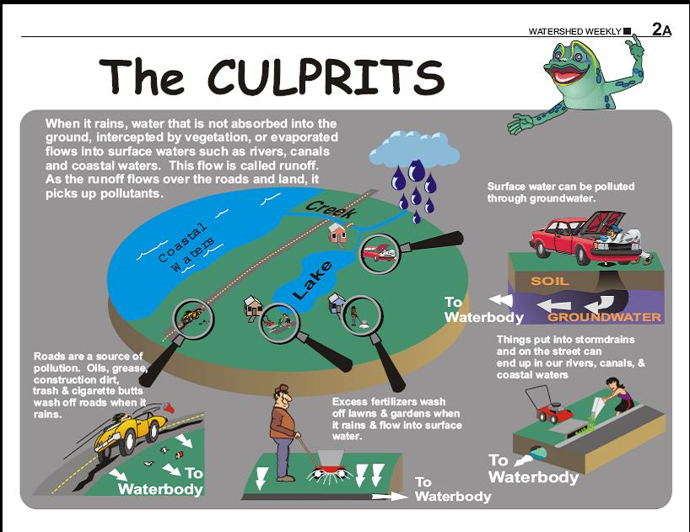
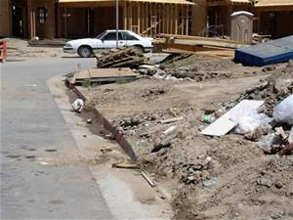
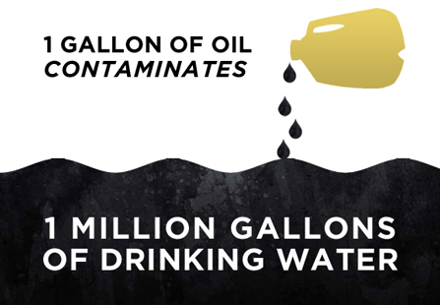
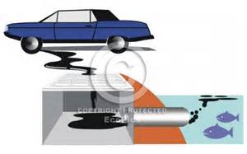
WHY SHOULD WE CARE?
POLLUTION CONTROL
Pollutants
* Sediment;
* Oil, grease, & toxic chemicals from vehicles;
* Pesticides & fertilizers from lawns & gardens;
* Trash & construction waste;
* Viruses, bacteria & nutrients from pet waste;
* Paints, solvents, degreasers & detergents;
* Heavy metals from roofs and vehicles;
* Thermal pollution from dark impervious surfaces such as streets & roofs.

Slide 12
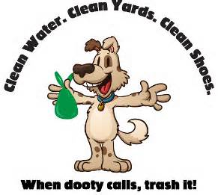
A GUIDE TO HEALTHY HABITS FOR CLEAN WATER
HOW TO CREATE A SOLUTION TO POLLUTION
  PET CARE –when walking your pet remember to pick up the waste and dispose of it properly. Flushing pet waste in the best disposal method. Leaving pet waste on the ground increases public health risks by allowing harmful bacteria and nutrients to wash into the storm drain and eventually into local waterbodies.

Slide 13
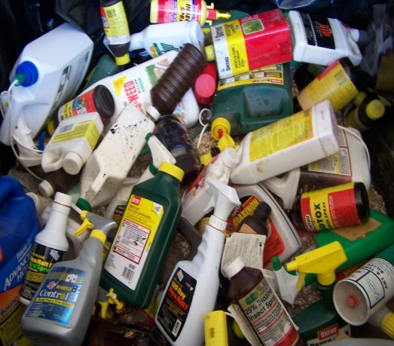
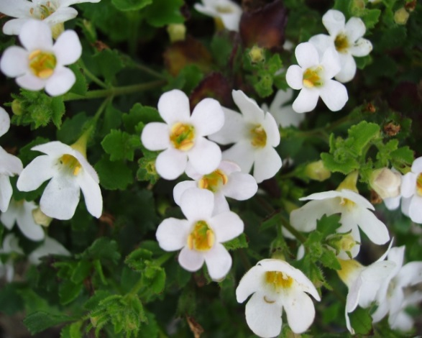
LAWN & GARDEN
Use pesticides and fertilizers sparingly. When use is necessary, use these chemicals in the recommended amounts. Avoid application if the forecast calls for rain.
Select native plants and grasses that are drought and pest resistant. Native plants require less water, fertilizers and pesticides.

Slide 14
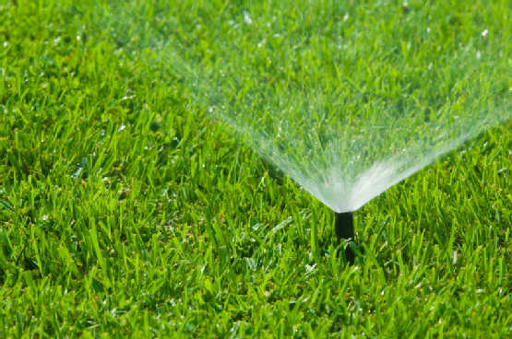
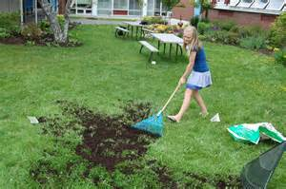
LAWN & GARDEN
Sweep up yard debris, rather than hosing down areas. Compost or recycle yard waste when possible.
Don’t overwater your lawn. Water during the cool times of the day, and don’t let water run off into the storm drain.
Cover piles of dirt and mulch being used in landscaping projects to prevent these pollutants from blowing or washing off your yard and into local waterbodies. Vegetate bare spots in your yard to prevent soil erosion.

Slide 15

HOME REPAIR AND IMPROVEMENT
Before beginning an outdoor project, locate the nearest storm drain and protect them from debris and other materials.
Sweep up and properly dispose of construction debris such as concrete and mortar.
Use hazardous substances like paints, solvents, and cleaners in the smallest amounts possible, and follow the directions on the label.

Slide 16
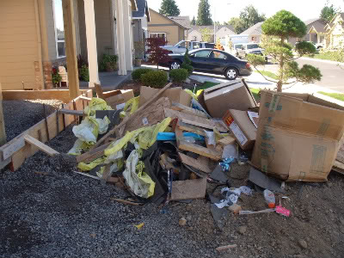
HOME REPAIR AND IMPROVEMENT
Clean up spills immediately, and dispose of the waste safely. Store substances properly to avoid leaks and spills.
Purchase and use nontoxic, biodegradable, recycled and recyclable products whenever possible.
Clean paint brushes in a sink, not outdoors. Fiber and reuse paint thinner when using oil-based paints. Properly dispose of excess paints through a household hazardous waste collection program, or donate unused paint to local organizations.

Slide 17
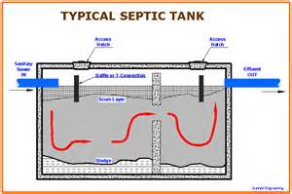
SEPTIC SYSTEM USE AND MAINTENANCE
Have your septic system inspected by a professional at least every three (3) years, and have the septic tank pumped as necessary (usually every 3 to 5 years).
Care for the septic system drain field by not driving or parking vehicles on it. Plant only grass over and near the drain field to avoid damage from roots.
Flush responsibly. Flushing household chemicals like paint, pesticides, oil, and antifreeze can destroy the biological treatment taking place in the system. Other items, such as diapers, paper towels, and cat litter, can clog the septic system and potentially damage components.

Slide 18
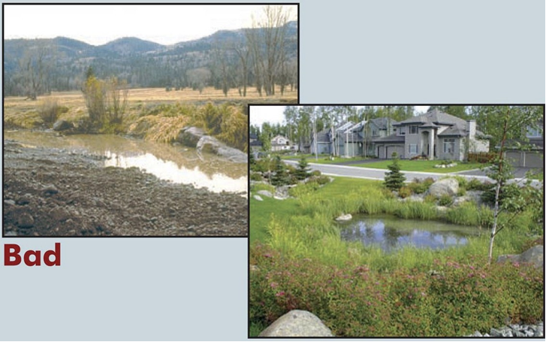
VEGETATIVE BUFFERS
Good

Slide 19
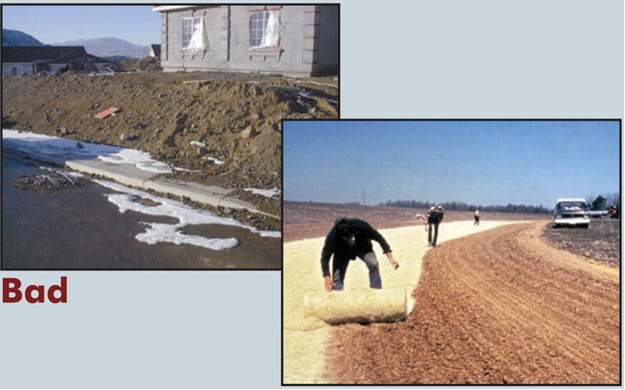
SITE STABILIZATION

Slide 20
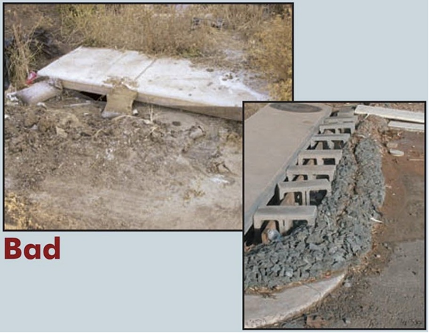
Storm Drain Inlet Protection
Good

Slide 21
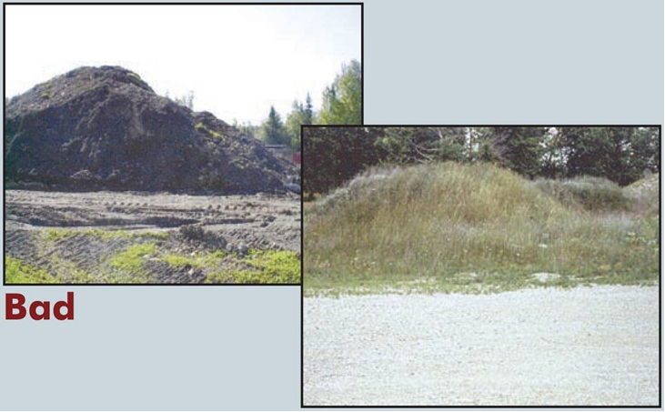
DIRT STOCKPILES
Good

Slide 22
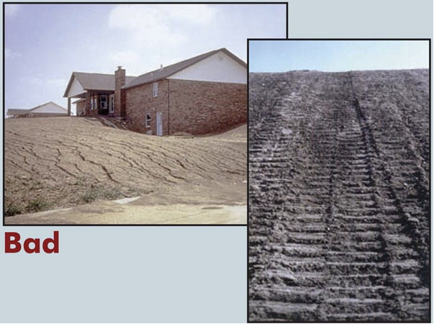
SLOPES
Good

Slide 23
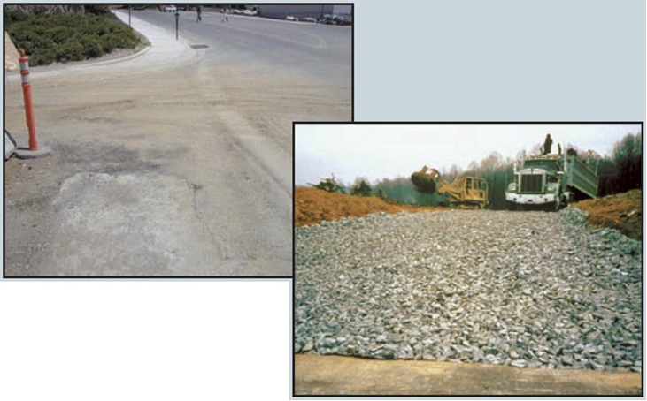
CONSTRUCTION ENTRANCES
Bad
Good

Slide 24
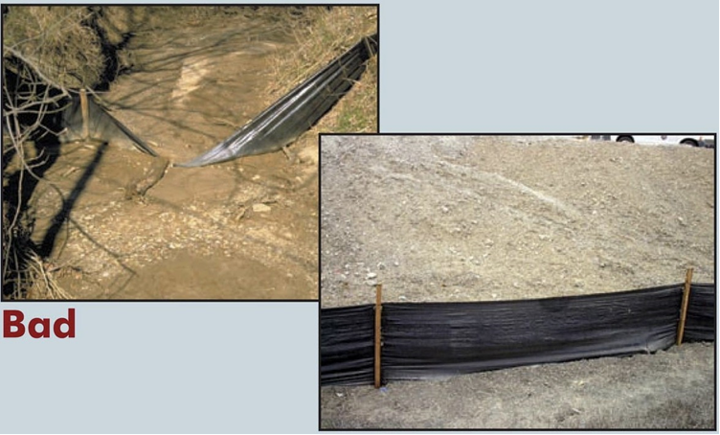
SILT FENCING
Good

Slide 25
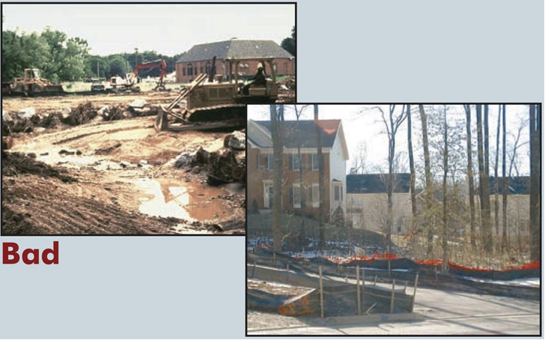
PROTECT NATURAL FEATURES
Good

Slide 26
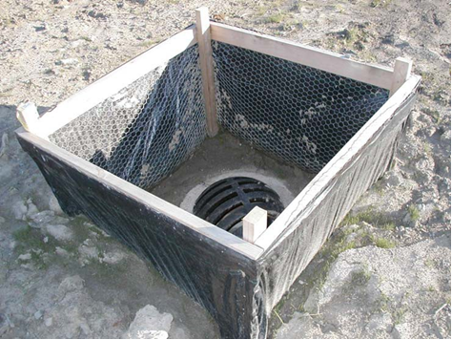
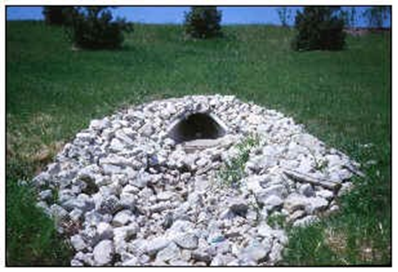
OTHER COMMON BEST MANAGEMENT PRACTICES

Slide 27
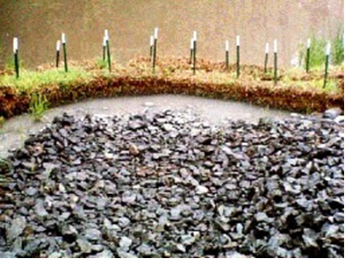
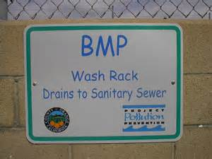
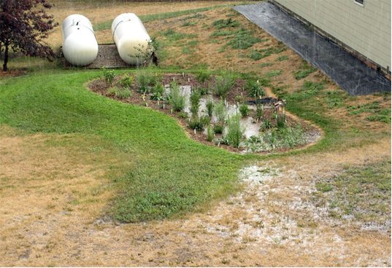
OTHER COMMON BMPs

Slide 28
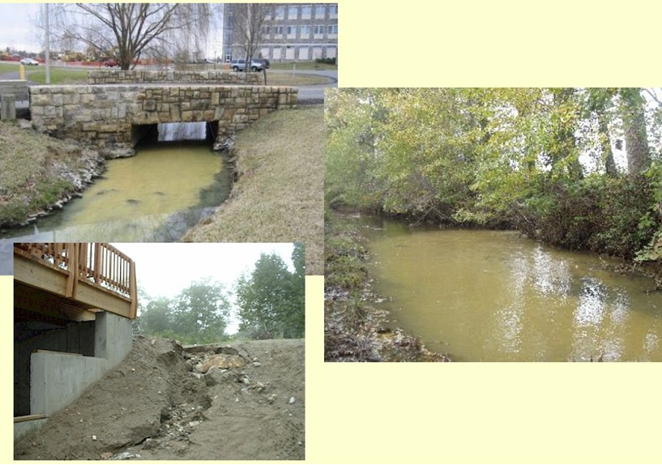
What’s wrong with these pictures?

Slide 29
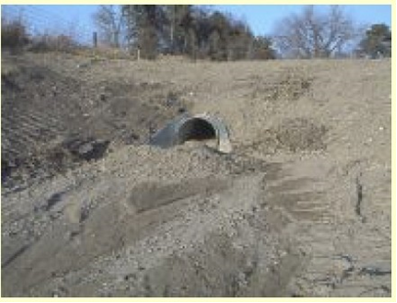
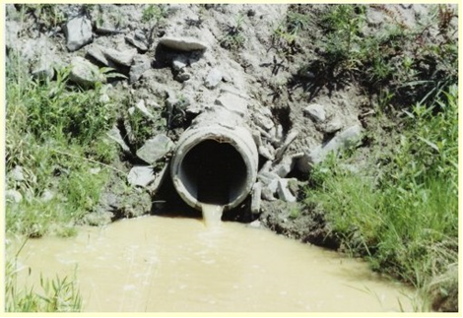
What’s wrong with this picture?

Slide 30
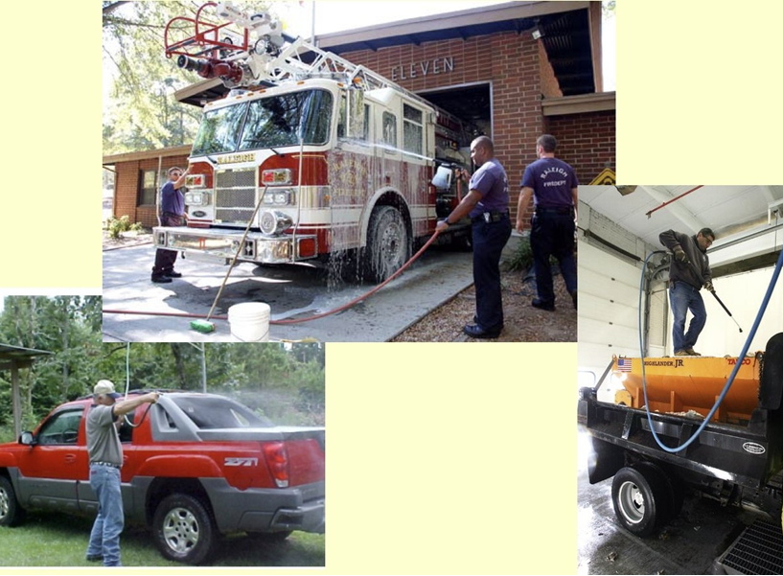

MUNICIPAL VEHICLE WASHING

Slide 31
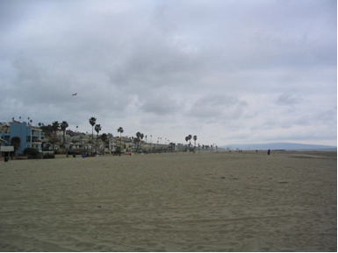
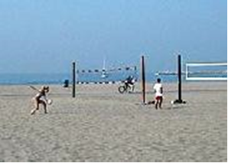
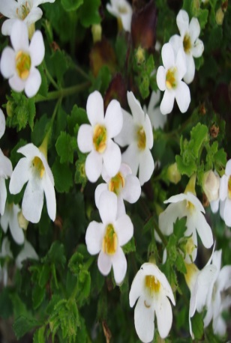
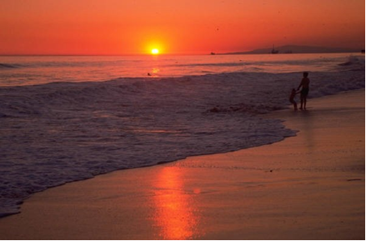
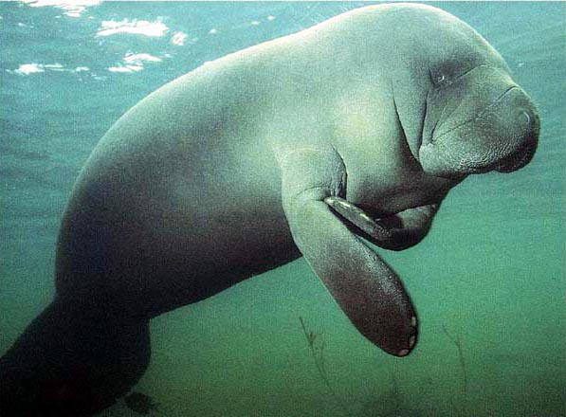

Slide 32
