Slide 1
NPDES Stormwater Program
Phase I MS4 Permit

Slide 2
Table of Contents
Program Overview
Phase I Municipal Separate Storm Sewer Systems (MS4)
Contact Information
Notes:
http://stormwaterandme.org/images/DucksInTheDrains.mp4

Slide 3
Phase I MS4s
Part III. Stormwater Management Program
  Structural Controls and Stormwater Collection System Operation
  Areas of New Development and Significant Redevelopment
  Roadways
  Flood Control Projects
  Municipal Waste Treatment, Storage or Disposal Facilities
  Pesticide, Herbicide, and Fertilizer Application
  Illicit Discharges and Improper Disposal
  Industrial and High Risk Runoff
  Construction Site Runoff
Part V. Monitoring
Part VIII. TMDLs
Notes:
Measureable goals and BMPs make up the SWMP. These elements are used to demonstrate the effectiveness of the MS4s program.
Inspection and maintenance of structural controls (inlets, swales, ponds, pipes), mow, repair; generally align with ERP requirements
Comprehensive planning and land development code review; encourage Green Industries
Litter control, street sweeping, maintenance yard operations
projects include water quality component, consistent with WMD
O&M and inspections
proper licensing; education; fertilizer application ordinance
legal authority; proactive/reactive inspections, spill response, public reporting, waste control education, limitation of sanitary seepage; employee training
MSGP coverage, inspection, sampling
Site plan review, inspection, training
Monitoring:
Annual pollutant load estimates, AND ambient or outfall monitoring
All elements are used to demonstrate the effectiveness of the MS4s program. SWMPs must be assessed and adjusted, to make progress toward the goal of reducing the discharge of pollutants to protect receiving waters.
Water Quality Standards:
TMDL-Prioritization, monitoring and implementation of BMPs to address TMDL wasteload allocations
MEP-Implementation of BMPs (narrative effluent limitations) by the permit constitutes compliance with the standard of reducing pollutants to the MEP.
Working with the TMDL and BMAP group in reference to MS4s.

Slide 4
Part III.A.1.
Structural Controls Operation
Maintain an up-to-date inventory of the structural controls and roadway stormwater collection structures operated by the permittee.
Provide an inventory and a map of all known major outfalls.
SUBMIT in the YEAR 1 ANNUAL REPORT.
Develop written Standard Operating Procedures (SOPs) for inspections and maintenance.
Conduct inspections and maintenance of all structural controls.
Report inspections and maintenance in each ANNUAL REPORT.
NOTE: Only report structures the permittee owns and maintains.
Notes:
Inspections may be visual observations, TVing, mirroring, or other appropriate methods, including during mowing, and should be included in the SOPs.
Examples of activities/documentation: work orders, contractor mowing, vac, TV

Slide 5
Part III.A.1.
Structural Controls Operation
Structural Control | Inspection Frequency
Dry/Wet Retention/Detention Systems | Once every three years
Exfiltration Trench / French Drains
Grass Swales (Dry)
Underdrain Filter Systems | 18 months
Pollution Control Boxes | Quarterly, < or >
Pump Stations | Semi-annually or >
Major Outfalls | Annually, < or >
Pipes/Culverts, Ditches, Other Conveyances | 10% annually FDOT: MRP
Inlets, Catch Basins, Grates
Descriptions of common stormwater structural controls: http://www.dep.state.fl.us/water/stormwater/npdes/docs/stormwater-structural-controls-ms4.pdf
Notes:
Inspection and maintenance of structural controls (inlets, swales, ponds, pipes), mow, repair; generally align with ERP requirements

Slide 6
Part III.A.1.
Structural Controls Operation
Inspect structures for the following conditions, as applicable:
  storage volume recovery (ponds/swales/exfiltration)
  vegetation (ponds/swales)
  mosquito breeding (ponds/swales)
  sediment accumulation
  debris/vegetation/litter/trash accumulation
  damage to structures
  petroleum hydrocarbon contamination
  Proper flow/operation
Inspections may be visual observations, TVing, mirroring, vac truck, or other appropriate methods, including during mowing, and should be included in the SOPs.

Slide 7
Part III.A.2.
New Development and Significant Redevelopment
Continue the comprehensive master planning process to reduce stormwater discharges from areas of new development and significant redevelopment.
New Development: To mitigate stormwater impacts from new developments, to use practices to treat, store, and infiltrate runoff onsite before it can affect water bodies downstream. Site designs that reduce imperviousness and include low impact development practices can be used to reduce flows and improve water quality.
Redevelopment is development that occurs on previously developed land. For stormwater management, redevelopment of impervious surfaces can help reduce net increases in impervious surfaces and associated degradation to receiving waters. Infrastructure upgrades during redevelopment can also be used to repair deteriorating pipes and upgrade undersized stormwater treatment systems.
Notes:
Comprehensive planning and land development code review; encourage Green Industries
Data from EPA.gov

Slide 8
Part III.A.2.
New Development and Significant Redevelopment
Adhere to the Comprehensive Plan (or similar) local codes and regulations, and development review and permitting procedures that incorporate stormwater quality considerations into land-use planning and development.
The comprehensive planning process shall limit the increases in the discharge of pollutants in stormwater as a result of new development, and shall reduce the discharge of pollutants in stormwater from redeveloped areas, consistent with the ERP rules of the local Water Management District.
REPORT the number of new development and significant redevelopment projects reviewed for post-development stormwater considerations in each ANNUAL REPORT.

Slide 9
Part III.A.2.
New Development and Significant Redevelopment
Conduct an inter-departmental review of local codes and LDRs to identify potential changes that will reduce the stormwater impacts of new development and redevelopment. Focus on promotion of low impact design (green infrastructure).
Develop a summary report: list of regulations reviewed; list of the current techniques aimed at reducing the stormwater impacts; list of techniques recommended/proposed for future incorporation into the regulations; and a plan for implementing changes.
SUBMIT in the YEAR 2 ANNUAL REPORT.
Develop a follow-up report that summarizes plan implementation to change the regulations and promote reducing stormwater impacts from new development and redevelopment.
SUBMIT in the YEAR 4 ANNUAL REPORT
NOTE: Follow up report is NOT due in YEAR 4 if NO changes were recommended in the YEAR 2 summary report. Include comment if Column F.
Notes:
See TEMPLATE
http://www.lowimpactdevelopment.org/index.htm

Slide 10
Part III.A.3.
Roadways
Public streets, roads, and highways, including rights-of-way, shall be operated and maintained by the permittees in a manner to reduce the discharge of pollutants in stormwater to the MEP.
Develop written SOPs for litter control, Adopt-A-Road (if applicable), street sweeping programs and road maintenance yard operation.
Implement a litter control program.
Report in each ANNUAL REPORT.
Optional: Coordinate an “Adopt-A-Road” program (or similar program) where volunteers collect litter and trash along roadways or similar.
Report in each ANNUAL REPORT.
NOTE: Report 0 if no program is coordinated.
Notes:
frequency of collection: daily/weekly/monthly
miles cleaned: miles, acres, linear ft, sq ft.
quantity collected: bags, lbs, tons, cubic ft/yds
Examples of litter control activities/documentation: trash collection before contractor mowing, park/rec area trash pick up, municipal employee trash pick up, correctional institute trash pick up.
Similar programs such as Adopt-A- Highway, Street, Beach, River, Bank, or Pond
Examples of public participation activities/documentation: number of bags collected, area cleaned

Slide 11
Part III.A.3.
Roadways
Implement a street sweeping program.
Report in each ANNUAL REPORT.
NOTE: Report 0 if the permittee does not own/operate roadways with curb and gutter. Include a note in Column F of the Annual report.
Use the FSA MS4 Load Reduction Tool to calculate Total Nitrogen and Total Phosphorous load reductions. http://www.dep.state.fl.us/water/stormwater/npdes/MS4_1.htm.
Notes:
frequency of collection: daily/weekly/monthly
miles cleaned: miles, acres, linear ft, sq ft.
quantity collected: bags, lbs, tons, cubic ft/yds
Examples of street sweeping activities/documentation: contract, miles cleaned, capacity of truck (cubic yards), weight tickets (lb/tons)
Tips for using the FSA Tool
Use street sweeping calculations only
Weight calculations
Dry vs. wet (percent moisture)
Multiply tons by 2000 (lb)
Volume calculations
Multiply yards by 27 (cubic ft)
Total Nitrogen should be greater than Total Phosphorus

Slide 12
Part III.A.3.
Roadways
Implement pollution prevention practices to reduce the pollutants in stormwater runoff from areas associated with road repair and maintenance:
  limit the amount of soil disturbance to the immediate area under repair; and
  use appropriate stormwater, erosion, and sedimentation control BMPs until disturbed areas are stabilized.
Implement pollution prevention practices to reduce the pollutants in stormwater runoff from permittee equipment yards and maintenance shops that support road maintenance activities.
  Identify the equipment yards and maintenance shops that support road maintenance activities,
  determine the necessary control measures for stormwater concerns
  perform annual site inspections
  Report in each ANNUAL REPORT.
  NOTE: Report 0 if the permittee contracts road repair, and does not own/operate roadway maintenance shops.
Notes:
BMPs: Florida Stormwater, Erosion, and Sedimentation Control Inspector’s Manual (Florida DEP, most current version) and State of Florida Erosion and Sediment Control Design and Review Manual, (FDOT, most current version)

Slide 13
Part III.A.4
Flood Control Projects
Assess the impacts of flood management projects on the water quality of receiving water bodies, and meet ERP rules for stormwater treatment.
Provide stormwater treatment for flood projects as required by ERP.
Maintain a list of stormwater CIPs proposed, with retrofits of existing flood control devices to provide additional pollutant removal.
REPORT in each ANNUAL REPORT.
Evaluate structural flood control devices to determine if retrofitting for additional pollutant removal from stormwater is needed / feasible.
REPORT in each ANNUAL REPORT.
Notes:
Common explanation for why projects did not include treatment: projects already include water quality component, consistent with WMD.

Slide 14
Part III.A.5
Municipal Waste Treatment, Storage, or Disposal (TSD) Facilities
Reduce pollutants in stormwater discharges from facilities that handle municipal waste not covered by an NPDES stormwater permit through procedures to evaluate, inspect, and monitor facilities to the MEP.
Develop written SOPs for inspections and control measures.
Implement pollution prevention practices to reduce the pollutants in stormwater runoff from permittee TSD facilities.
  Identify municipal waste treatment, storage, and disposal facilities: operating landfills; transfer stations; waste fleet maintenance facilities;
  determine necessary control measures for stormwater concerns
  perform annual site inspections
  Report in each ANNUAL REPORT.
  NOTE: Report 0 if the permittee contracts waste management, and does not own/operate TSD facilities.
  NOTE: May be same facilities reported in Part III.A.3.

Slide 15
Part III.A.6
Pesticides, Herbicides, and Fertilizer Application
Implement controls to reduce the stormwater discharge of pollutants related to the storage and application of pesticides, herbicides, and fertilizers applied by employees or contractors to public property to the MEP.
Require certification and licensing by FDACS for all permittee personnel and contracted applicators that apply pesticides or herbicides on permittee-owned property.
Report in each ANNUAL REPORT.
NOTE: If application is fully contracted, delete PERMITTEE lines. If services are not contracted, delete the CONTRACTOR lines.

Slide 16
Part III.A.6
Pesticides, Herbicides, and Fertilizer Application
All personnel applying fertilizer shall be trained through the Green Industry BMP Program. Use only commercial applicators of fertilizer who have been trained through the Green Industry BMP Program and have obtained a limited certification for urban landscape commercial fertilizer application under Section 482.1562, F.S.
Report in each ANNUAL REPORT.
NOTE: Report 0 if no fertilizer is applied on municipal property. Include a note in Column F of the Annual report.
Notes:
Example employee or contract applicators: pesticide at municipal buildings; aquatic herbicide on stormwater ponds or canals; fertilizer at municipal parks.

Slide 17
Part III.A.6
Pesticides, Herbicides, and Fertilizer Application
If the permittee operates one or more golf courses, the courses shall be operated in a manner that is consistent with the Best Management Practices for the Enhancement of Environmental Quality on Florida Golf Courses manual (Florida DEP, 2007).
All local governments within the watershed of a nutrient-impaired water body shall adopt the Department’s “Florida-friendly Guidance Models for Ordinances, Covenants and Restrictions” OR an ordinance that includes the requirements in the “Model Ordinance for Florida-Friendly Fertilizer Use on Urban Landscapes.” - Section 403.9337, F.S.
The ordinance shall be adopted within 24 months of permit issuance.
Provide the adopted ordinance with the Year 2 ANNUAL REPORT.
Note: Include a note in Column F of the Annual report if the permittee does not discharge into a nutrient-impaired waterbody.
Notes:
The County’s ordinance may be used if it if applicable to all incorporated and unincorporated areas.

Slide 18
Part III.A.6
Pesticides, Herbicides, and Fertilizer Application
Implement a public education and outreach program to encourage citizens to reduce their use of pesticides, herbicides, and fertilizers.
Report in each ANNUAL REPORT
Note: Activities performed under the FYN program may be reported.
Develop written SOPs to minimize its use of pesticides, herbicides, and fertilizers on public property and to properly apply, store, and mix these products.

Slide 19
Part III.A.7.
Illicit Discharges and Improper Disposal (IDID)
Detect and eliminate illicit discharges and improper disposal into the MS4 to reduce pollutants discharged to the MS4 to the MEP. Non-stormwater discharges to the MS4 shall be effectively prohibited by through inspections, ordinances, and enforcement.

Slide 20
Part III.A.7.a
IDID - Inspections, Ordinances, and Enforcement
Assess which non-stormwater discharges listed (and others) are allowed to be discharged to the MS4.
The following non-stormwater discharges may be allowed to the MS4 where they are not identified as a source of pollutants to waters of the State:
Water line flushing | Foundation drains | Residential car washing
Landscape irrigation | Air conditioning condensate | Flows from riparian wetlands
Diverted stream flows | Irrigation water | Dechlorinated swimming pool discharges
Rising ground waters | Springs | Street wash waters
Uncontaminated ground water infiltration | Water from crawl space pumps | Discharges from emergency fire fighting activities
Uncontaminated pumped ground water | Footing drains | Reclaimed water line flushing
Discharges from potable water sources | Lawn watering | Flows from uncontaminated roof drains

Slide 21
Part III.A.7.a
IDID - Inspections, Ordinances, and Enforcement
Enforce ordinances that prohibit illicit connections and illegal dumping into the MS4.
Strengthen the legal authority to:
  conduct inspections and monitoring;
  control illicit discharges, illicit connections, illegal dumping and spills
  require compliance with ordinances, permits, contracts, and orders, including taking legal action to eliminate illicit discharges or connections.
  Report amendments as needed.

Slide 22
Part III.A.7.c
IDID - Inspection and Investigation
Implement the program to identify and eliminate sources of illicit discharges, illicit connections and dumping to the MS4 through a proactive inspection schedule and through reactive investigations into reports of suspected illicit activity.
In Year 1, develop a proactive inspection program SOP:
  Identify and prioritize areas/facilities
    Inspect portions of the MS4 that have a reasonable potential of containing illicit discharges;
    Other program inspections (e.g., industrial pretreatment, SQG, health, fire, etc.), may be used;
    Include inspections from areas / facilities not normally visited by the permittee.
  schedule for annual inspections;
  procedures for inspections (MSGP determination)
  procedures for source tracing and eliminating the discharge;
  documentation (tracking and inspection report).
  procedures for enforcement actions;
  Responsible personnel
  Submit a proactive inspection SOP with the Year 1 ANNUAL REPORT.
  NOTE: All permittees must have a proactive inspection program, in addition to other program inspections conducted by the County.
Notes:
If the permittee determines or suspects that an industrial facility does not have coverage as required under the Department’s NPDES Multi-Sector Generic Permit for Stormwater Discharge Associated with Industrial Activity (62-621.300(5), F.A.C.), referred to as the MSGP, it shall notify the Department’s NPDES stormwater staff and provide the name and address of the facility.

Slide 23
Part III.A.7.c
IDID - Inspection and Investigation
Implement proactive inspection program.
Report in each ANNUAL REPORT.
NOTE: Report 0 if no illicit activities were found, or no enforcement was taken.
Conduct reactive investigations to identify and eliminate the sources of illicit discharges, connections or disposal to the MS4, based on reports received from personnel, contractors, citizens, or other entities.
Report in each ANNUAL REPORT.
NOTE: Report 0 if no reports were received, no illicit activities were found, or no enforcement was taken.

Slide 24
Part III.A.7.c
IDID - Inspection and Investigation
Implement an annual training plan for appropriate staff (field crews, fleet maintenance, inspectors) and contractors to identify and report conditions in stormwater facilities that may indicate the presence of illicit discharges / connections / dumping to the MS4. Instruct staff and contractors to be alert for illicit connections during routine maintenance activities.
Report in each ANNUAL REPORT.

Slide 25
Part III.A.7.d
IDID – Spill Prevention and Response
Implement procedures to prevent, contain, and respond to spills that may discharge into the MS4.
Implement a spill-prevention / spill-response plan to prevent, contain, and respond to spills that discharge into the MS4. Ensure that spills are properly addressed.
Report in each ANNUAL REPORT.
Implement an annual training plan for appropriate staff (field crews, fleet maintenance, inspectors) and contractors on proper spill prevention, containment, and response techniques and procedures. Include how to prevent a spill, recognize and quickly assess the nature of a spill, contain a spill, and promptly report hazardous material and chemical spills to the appropriate authority.
Report in each ANNUAL REPORT.

Slide 26
Part III.A.7.e
IDID – Public reporting
Implement a program to promote, publicize, and facilitate public reporting of illicit discharges.
Implement a public education and outreach program to promote, publicize, and facilitate public reporting of the presence of illicit discharges and improper disposal of materials into the MS4. Disseminate information on the problems associated with illicit discharges, illicit connections and improper disposal, how to identify them, and how to report incidents discovered.
Report in each ANNUAL REPORT.

Slide 27
Part III.A.7.f
IDID – Oils, Toxics, and HHW Control
Prohibit the discharge or disposal of used motor vehicle fluids, household hazardous wastes (HHZ), and lead acid batteries into the MS4.
Implement a public education and outreach program plan to encourage the proper use and disposal of used motor vehicle fluids, leftover hazardous household products, and lead acid batteries. Publicize the locations of Miami-Dade County Home Chemical Collection Sites.
Report in each ANNUAL REPORT.

Slide 28
Part III.A.7.g
IDID – Limitation of Sanitary Sewer Seepage
Prevent (or require the operator of the sanitary sewer to eliminate) unpermitted discharges of dry and wet weather overflows from sanitary sewers into the MS4. Eliminate the inflow / infiltration from collection / transmission systems and / or septic tanks into the MS4.
Implement SOPs to reduce or eliminate sanitary wastewater contamination into the MS4, including discharges from sanitary sewer overflows (SSOs) and from inflow / infiltration (I&I) from collection / transmission systems and / or septic tank systems. Advise the appropriate utility owner of a violation if constituents common to wastewater contamination are discovered in the permittee’s MS4.
Report in each ANNUAL REPORT.
Notes:
Reduction procedures may include:
TVing sanitary sewer pipes
Lining sanitary sewer pipes
Adding portable generators
Replacing line
Smoke-testing

Slide 29
Part III.A.8
Industrial and High Risk Runoff (HRF)
Implement a program to identify and control pollutants in stormwater discharges to the MS4 to the MEP from any operating municipal landfill(s); hazardous waste treatment, storage, disposal and recovery facilities; facilities that are subject to EPCRA Title III, Section 313; and any other industrial or commercial discharge that the permittees determine is contributing a substantial pollutant loading to the MS4.

Slide 30
Part III.A.8.a
HRF – Identification and Inspection
Implement a plan for conducting inspections of HRFs to determine compliance with the stormwater program:
  no illicit discharges / connections / dumping,
  compliance with local stormwater regulation requirements,
  coverage under the MSGP
  Report in each ANNUAL REPORT.

Slide 31
Part III.A.8.b
HRF – Monitoring
If inspections of HRFs disclose suspected illicit discharges to the MS4, sampling of the discharge may be required. New high-risk industrial facilities must be evaluated (may include site-specific sampling) to determine if the new discharge is contributing a substantial pollutant load to the MS4.
Report in each ANNUAL REPORT.

Slide 32
Part III.A.9
Construction Site Runoff
Implement a program to reduce the discharge of pollutants from construction sites to the MEP.

Slide 33
Part III.A.9.a
Construction - Site Planning and BMPs
Require the use and maintenance of appropriate structural and non-structural best management practices to reduce pollutants discharged to the MS4 during the time of construction.
Implement a pre-construction site plan review SOP.
  Review applications for compliance with the local codes or LDRs that require the use and maintenance of erosion, sedimentation and waste controls.
  Notify applicants of the need to obtain Environmental Resource Permit (ERP) Construction Generic Permit (CGP), as applicable.
  Confirm that ERP and CGP coverage has been obtained, as applicable, prior to the commencement of any land grading, excavation, or clearing.
  Report in each ANNUAL REPORT.

Slide 34
Part III.A.9.b
Construction - Inspection and Enforcement
Implement a program for inspecting construction sites and enforcing the requirements for stormwater runoff control measures.
In Year 1, develop a construction site inspection SOP.
  Timing of inspections:
    prior to land disturbance to ensure that BMPs have been properly installed,
    during active construction,
    at the conclusion of active construction.
  Prioritization and frequency of inspections:
    Site size. Larger sites shall be inspected more frequently.
    Water body status. Sites that discharge to sensitive waters shall be inspected more frequently.
    Significance of adverse water quality impacts. Sites that have been determined to be a significant threat to water quality shall be inspected more frequently.
    Seasonality and rainfall. Construction occurring during the wet season or sites where rains greater than one inch occur shall be inspected more frequently.
    Historical inspection considerations.
  Procedures for conducting an inspection:
    checklist with stormwater management and water quality inspection items
    summary log including site name and location, site operator, date of inspection, summary of inspection findings, enforcement actions or referrals, name of inspector.
  Enforcement procedures
  Submit a construction inspection SOP with the Year 1 ANNUAL REPORT.

Slide 35
Part III.A.9.c
Construction - Site Operator Training
Provide education and training to staff associated with the review, implementation, and inspection of proper stormwater, erosion, and sedimentation control measures at construction sites.
Implement a plan for stormwater training / outreach for staff or contractors involved in site plan review, inspection or construction of stormwater management, erosion, and sedimentation controls:
  construction site plan reviewers,
  site inspectors (Florida Stormwater, Erosion, and Sedimentation Control Inspector Training program)
  Permittee site operators
  Report in each ANNUAL REPORT.

Slide 36
SOPs
SOPs are be step-by-step instructions for a standardized process.
Common elements of a Standard Operating Procedure/Plan
Procedures for activities and checklist (for inspections)
Schedule for activities
Documentation/tracking including contact information
Responsible staff/contractor or department/section

Slide 37
SOPs
Part III.A.1 | Inspections and maintenance of structural controls.
Part III.A.3 | Litter control program.
Part III.A.3 | Street sweeping program.
Part III.A.3 | Inspections of equipment yards and road maintenance shops.
Part III.A.5 | Inspections of waste TSD facilities
Part III.A.6 | Public education and outreach on reducing the use of PHF
Part III.A.6 | Good housekeeping for the use of PHF.
Part III.A.7.c | Proactive illicit discharge inspections.
Part III.A.7.c | Reactive illicit discharge investigations.
Part III.A.7.c | Illicit discharge inspection training.
Part III.A.7.d | Spill prevention and response.
Part III.A.7.d | Spill prevention and response training.
Part III.A.7.e | Public education and outreach on identifying and reporting illicit discharges.
Part III.A.7.f | Public education and outreach on the use and disposal of oils, toxics and HHZ.
Part III.A.7.g | Procedures to reduce / eliminate sanitary wastewater contamination.
Part III.A.8 | Inspections of industrial high risk facilities.
Part III.A.9.a | Construction site plan review
Part III.A.9.b | Construction site inspections.
Part III.A.9.c | Construction staff training.

Slide 38
Contract Activities
If activities are conducted by another entity under a contractual agreement, then the permittees shall retain copies of the contractual agreement that specifies the schedule and frequency of the activities to be conducted.
Inter-local agreements may be used to share responsibility between permittees. Maintain a copy of ILAs and determine who tracks and reports joint activities.
Notes:
Examples of contract activities:
System inspection
Mowing and litter control
Street sweeping
PHF application
Construction site inspection
Examples of activities performed by another entity
Spill response
Monitoring
HRF inspections
E&O

Slide 39

Public Education and Outreach
A single plan may address all three of the required public education and outreach topics as per Parts III.A.6, III.A.7.e and III.A.7.f of the permit.
The plan should include the following:
goals and objectives;
topics to be addressed;
target audience(s);
activities and materials;
methods for distribution of materials;
annual schedule of activities;
documentation;
staff / department / entities to perform outreach;
method for assessing changes in public awareness and behavior.
Notes:
Goals: change citizen behavior
Topics: PHF, public reporting of ID; HHW disposal
Documentation: materials distributed; outreach events and attendees

Slide 40



Public Education and Outreach
Notes:
Providing opportunities for citizens to participate in program development and implementation, including effectively publicizing public hearings and/or encouraging citizen representatives on a storm water management panel.
Examples: Public meetings to involve citizen in the development of your program, public involvement events such as, clean up days, beach clean ups, street clean ups.

Slide 41

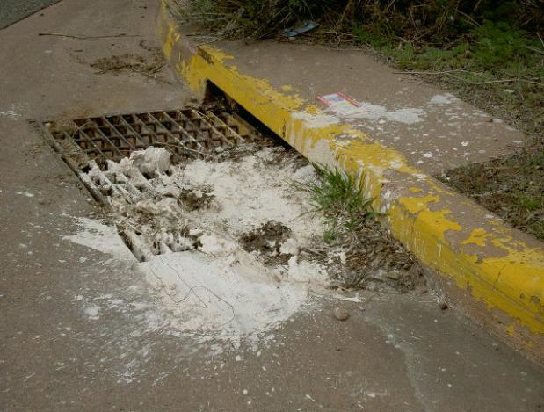
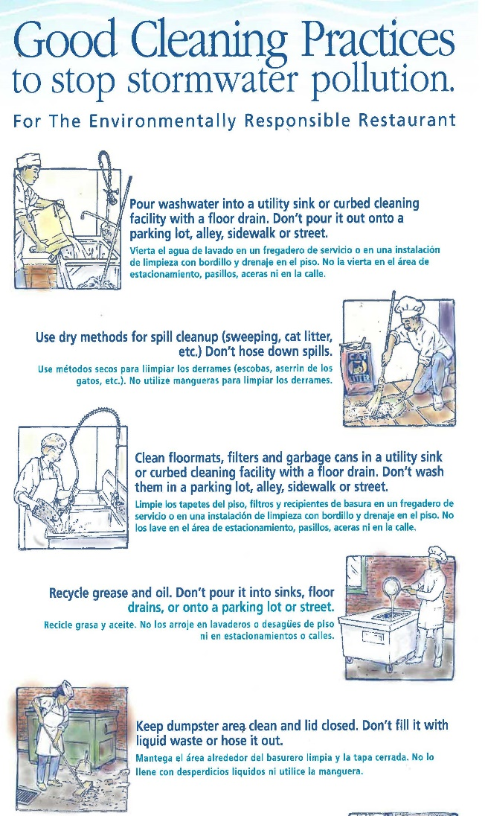
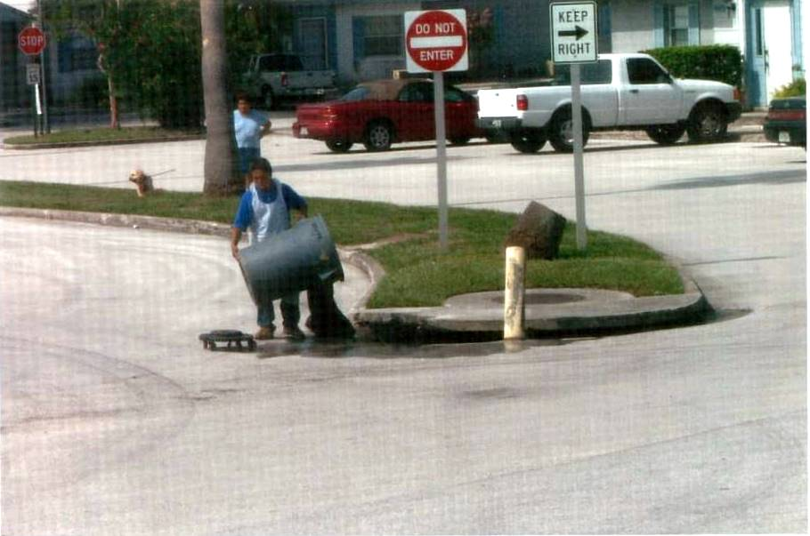
Public Education and Outreach
Notes:
Implementing a plan to detect and eliminate any non-stormwater discharges to the storm sewer system.
Permittees are required to adopt an ordinance or other regulatory mechanisms to prohibit illicit discharges into the storm sewer system and implement appropriate enforcement procedures.
Proactive inspection the system regularly
inform the community about hazards associated with illegal discharges and improper disposal of waste.

Slide 42
Multi-Sector Generic Permit
Who needs a MSGP? 40 CFR 122.26(b)(14)
Facilities that conduct regulated “industrial activities”; and
Discharge stormwater associated with those regulated “industrial activities” to surface waters of the State or to an MS4.
Regulated Industrial Activities
Sector A: Timber Products | Sector P: Land Transportation
Sector B: Paper Products Manufacturing | Sector Q: Water Transportation
Sector C: Chemical Manufacturing | Sector R: Ship & Boat Building
Sector D: Asphalt Paving | Sector S: Air Transportation
Sector E: Glass, Clay, Cement, Man. | Sector T: Treatment Works
Sector F: Primary Metals | Sector U: Food & Kindred Products
Sector G: Metal Mining | Sector V: Textile Mills
Sector H: Coal Mines | Sector W: Furniture & Fixtures
Sector I: Oil and Gas Extraction | Sector X: Printing & Publishing
Sector J: Mineral Mining & Dressing | Sector Y: Plastics Manufacturing
Sector K: Hazardous Waste Facilities | Sector Z: Leather Tanning & Finishing
Sector L: Landfills | Sector AA: Fabricated Metal Products
Sector M: Auto Salvage Yards | Sector AB: Transportation Equip.
Sector N: Recycling Facilities | Sector AC: Electronic Goods
Sector O: Power Plants (Steam) | Sector AD: Additional Activities
Notes:
SWPPP: Identifies controls to reduce stormwater pollution; maintenance and inspection schedule; Monitoring and reporting requirements
Conditional exclusion for “no exposure”: “No exposure” means that all materials and activities are protected by shelter that prevents exposure to precipitation.
Permit Conditions of an MSGP:
Develop a Stormwater Pollution Prevention Plan (SWPPP).
Implement proper Best Management Practices (BMPs).
Inspect site and conduct monitoring.
Submit Notice of Intent (NOI) and fee to DEP.
Meet water quality standards.

Slide 43
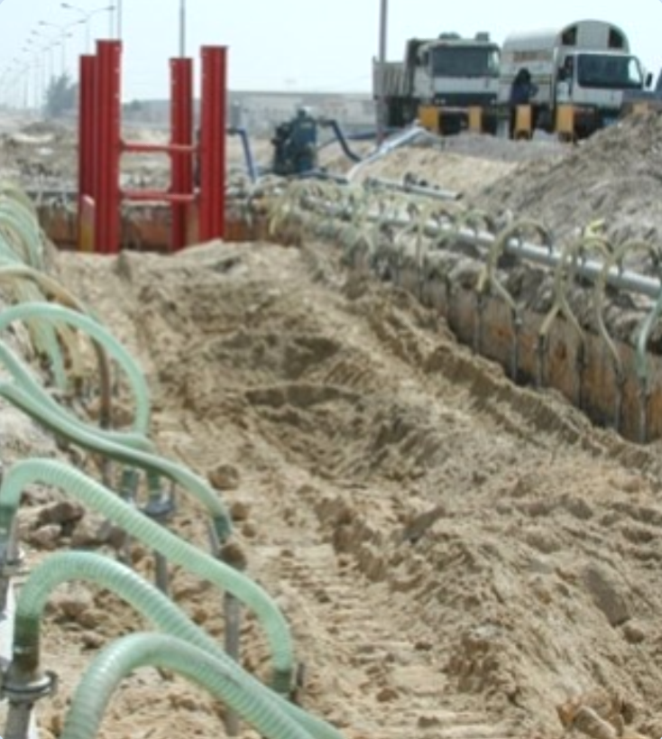
Construction Generic Permit
Who needs a CGP?
Chapter 62-621.300, F.A.C.
Anyone who disturbs one or more acres of land, or is part of a larger common plan of development or sale; and
Discharges stormwater to surface waters of the state or to an MS4.
CGP provides dewatering coverage from an uncontaminated site.
Notes:
The act or process of developing or improving land, including demolition and renovation activity, which involves the disturbance of soils not limited to, clearing, grading, and excavation.
Permit Conditions of a CGP:
Develop and update a SWPPP as necessary.
Implement proper Best Management Practices (BMPs).
Submit Notice of Intent (NOI) and fee timely.
Inspect site and conduct monitoring.
Meet water quality standards.

Slide 44
Contact Us
If you suspect a facility needs an MSGP or CGP, send facility name, address, contact information and information about site activities to:
NPDES Notices Center
(866) 336-6312 (toll-free)
NPDES-stormwater@dep.state.fl.us

Slide 45
Assessment
Objective: Provide information to determine the overall effectiveness of the SWMP in reducing stormwater pollutant loadings from the MS4.
Assessment program:
  Water Quality Monitoring Plan;
  Pollutant load/EMC calculations;
  Evaluate pollutant loading and water quality trends; and
  ID areas of MS4 be targeted for loading reduction.
  Each permittee, or permittees operating under a collaborative assessment program, shall develop and submit an assessment program.
Notes:
OVERALL MONITORING OBJECTIVE
each MS4 is required have program which is tailored to local objectives and challenges
Monitoring:
Annual pollutant load estimates, AND ambient or outfall monitoring
All elements are used to demonstrate the effectiveness of the MS4s program. SWMPs must be assessed and adjusted, to make progress toward the goal of reducing the discharge of pollutants to protect receiving waters.

Slide 46
Assessment
Annual Reporting:
Status of water quality monitoring plan: sampling frequency changes, monitoring location changes, or sampling waiver conditions.
Summary of the water quality monitoring data and / or stormwater pollutant loading changes from the reporting year.
NOTE: Results must be specific to each permittee’s SWMP.
An analysis of the data to evaluate the relationship between changes in water quality and/or stormwater pollutant loading.
Notes:
OVERALL MONITORING OBJECTIVE
each MS4 is required have program which is tailored to local objectives and challenges
Monitoring:
Annual pollutant load estimates, AND ambient or outfall monitoring
All elements are used to demonstrate the effectiveness of the MS4s program. SWMPs must be assessed and adjusted, to make progress toward the goal of reducing the discharge of pollutants to protect receiving waters.

Slide 47
Assessment
Reapplication Reporting
Requested changes and the rationale; Identify additional assessment elements that need to be completed to assist in the evaluation of the effectiveness of the SWMP;
Identify any evidence of water quality and / or pollutant loading improvements or degradation over the permit period
Identify any areas or drainage basins within the boundaries of the MS4 that should be targeted for corrective actions (retrofits, structural BMPs, and non-structural BMPs - public education, street sweeping).
Notes:
OVERALL MONITORING OBJECTIVE
each MS4 is required have program which is tailored to local objectives and challenges
Monitoring:
Annual pollutant load estimates, AND ambient or outfall monitoring
All elements are used to demonstrate the effectiveness of the MS4s program. SWMPs must be assessed and adjusted, to make progress toward the goal of reducing the discharge of pollutants to protect receiving waters.

Slide 48
TMDLs
Total Maximum Daily Loads
DEP-adopted TMDL
EPA-established TMDL within a water body that is verified impaired by DEP for the pollutant of concern using the processes defined in the Impaired Waters Rule (62-303, F.A.C.
“MS4 discharge” shall mean direct discharge, or indirect discharge through an interconnected MS4.
Notes:
Water Quality Standards:
TMDL-Prioritization, monitoring and implementation of BMPs to address TMDL wasteload allocations
MEP-Implementation of BMPs (narrative effluent limitations) by the permit constitutes compliance with the standard of reducing pollutants to the MEP.
Working with the TMDL and BMAP group in reference to MS4s.

Slide 49
TMDLs
Steps:
Identify TMDL waterbodies each MS4 discharges into.
If a BMAP: Comply with the adopted provisions of the BMAP that specify activities to be undertaken.
No BMAP (not bacteria):
  Prioritize TMDL waterbodies. (6 months)
  Must prioritize at least one per permit cycle.
  Prioritize outfall to TMDL (12 months)
  Monitoring (Years 2 and 3)
  Supplemental SWMP (Year 4 annual report)
  table of BMPs and activities in MS4 to be implemented
No BMAP (bacteria)
  Bacteria Pollution Control Plan (Year 3 annual report)
Notes:
Water Quality Standards:
TMDL-Prioritization, monitoring and implementation of BMPs to address TMDL wasteload allocations
MEP-Implementation of BMPs (narrative effluent limitations) by the permit constitutes compliance with the standard of reducing pollutants to the MEP.
Working with the TMDL and BMAP group in reference to MS4s.

Slide 50
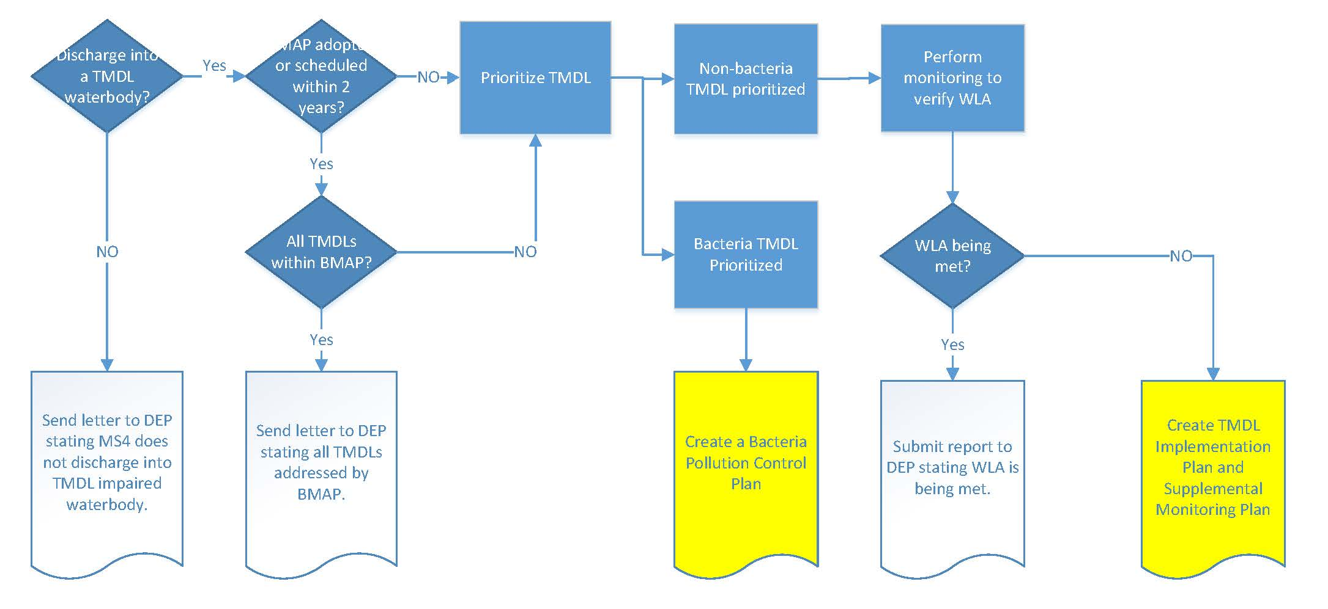
TMDLs
Notes:
Water Quality Standards:
TMDL-Prioritization, monitoring and implementation of BMPs to address TMDL wasteload allocations
MEP-Implementation of BMPs (narrative effluent limitations) by the permit constitutes compliance with the standard of reducing pollutants to the MEP.
Working with the TMDL and BMAP group in reference to MS4s.

Slide 51
Permit Reapplication
Items required to be attached to the Year 4 annual report:
62-624.420(2) F.A.C. – statement the Year 4 annual report is the re-application; include proposed revisions.
62-624.440(1)(d) F.A.C. – changes in co-applicants
62-624.440(1)(e,f) F.A.C. – previously unidentified waterbodies and known water quality impacts
62-624.440(1)(g) F.A.C. – reductions of pollutant loads from SWMP implementation
Permit Part V.A.3: If the total annual pollutant loadings have not decreased over the past two permit cycles, revisions to the SWMP, as appropriate.
Permit Part V.B.3: The monitoring plan with revisions, if applicable.
Permit Part VIII.B.3.d: TMDL Implementation Plan / Supplemental SWMP, if applicable
Miami-Dade County submits some of these documents on behalf of the co-permittees.
Notes:
Audit schedule based on 106 workplan/CMS plan
MS4 staff issue permits and perform audits.

