Slide 1
Overview of the NPDES
Phase I MS4 Permit
Notes:
Michelle Bull
2/12/2016

Slide 2
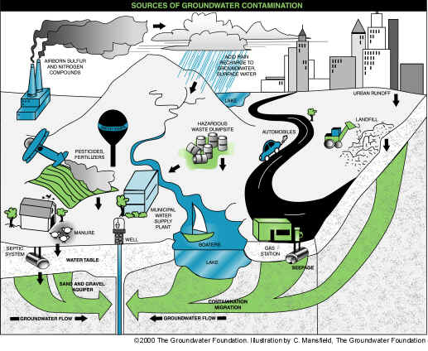
What is Stormwater?
Stormwater is runoff from rain that flows over impervious surfaces such as streets, parking lots, and rooftops. The runoff picks up pollutants like trash, chemicals, oils, and sediment that can harm rivers, streams, and coastal waters.
“Pollutants in stormwater discharges from many sources are largely uncontrolled.”
Notes:
Roughly 30% of water quality impairment are attributable to storm water discharges
Resources:
NPDES Storm Water Sampling Guidance Document (July 1992)
EPA website
https://www.youtube.com/watch?v=44Gll-AHLBs&list=PLBhfkkujnoRCxmp3QHd7sOErEHWpD21H6&index=42

Slide 3
Impacts to Water Quality
Water is Florida's lifeblood.
Water resources support drinking water, agriculture, industry, wildlife habitat, and recreation-based economy.
Many rivers and lakes are impaired because of pollutants from stormwater runoff. The beneficial uses of many water bodies are threatened by high levels of nutrients and sediments, habitat alteration, toxic pollutants and land-use changes.
Beach Closures
Fish Advisories

Slide 4
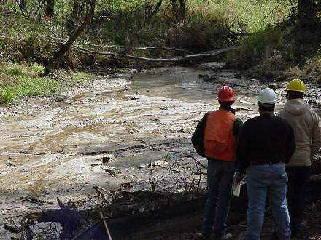
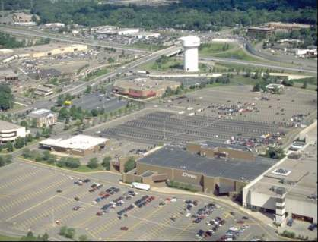
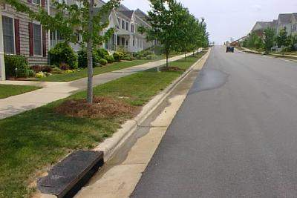
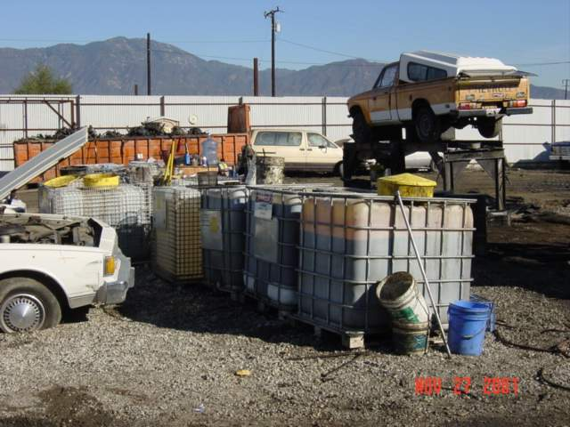
Sources of Pollutants
Construction
Urban Development
Industrial/
Commercial
Residential

Slide 5


Sources of Pollutants
Non-Point Sources: Pollution from a general area such as a community or watershed, that are usually unintentionally and unknowingly discharged.
Car washing
Lawn maintenance
Animal Waste
Notes:
EPA Monitoring Guidance for Determining the Effectiveness of Nonpoint Source Controls September 1997
The major pollutants in runoff from urban areas are sediment, nutrients, oxygen-demanding substances, road salts, heavy metals, petroleum hydrocarbons, pathogenic bacteria, viruses, and toxic chemicals. These are generated directly from the use of insecticides, road salts, and fertilizers, and indirectly from automobile exhaust, oil drippings from trucks and cars, brake lining wear, and various urban activities (USEPA, 1977).
http://www.epa.gov/sites/production/files/2015-10/documents/nps_urban-facts_final.pdf

Slide 6
Source Controls
To protect water resources, we use best management practices (BMPs) to minimize and prevent pollutants from entering waters of the state.
BMPs are techniques, activities, or structural improvements that help reduce the quantity and improve the quality of stormwater runoff.
Nonstructural (prevention): Improve stormwater quality by reducing generation and accumulation of potential stormwater pollutants at or near their sources.
Structural (mitigation): Control stormwater volume and reduce pollutants through physical containment, settling, filtration, percolation, or biological uptake.
Notes:
Source: STORMWATER MANAGEMENT: A Guide for Floridians (Florida Department of Environmental Regulation)

Slide 7
NPDES Stormwater Program
The National Pollutant Discharge Elimination System (NPDES) Program is required by 402 of the Clean Water Act (CWA).
1972 - CWA prohibits the discharge of pollutants to waters of the U.S. from a point source unless the discharge is authorized by a NPDES permit.
1987 - CWA amended to require EPA to develop requirements for stormwater discharges
1990 - Phase I: permits for large MS4s, large construction sites and industrial activities
2000 - EPA authorized the Florida Department of Environmental Protection (DEP) to implement the NPDES stormwater permitting program.
Notes:
DEP is working to help restore the health of rivers, lakes and streams.
40 CFR 122.26 (b)(8)

Slide 8
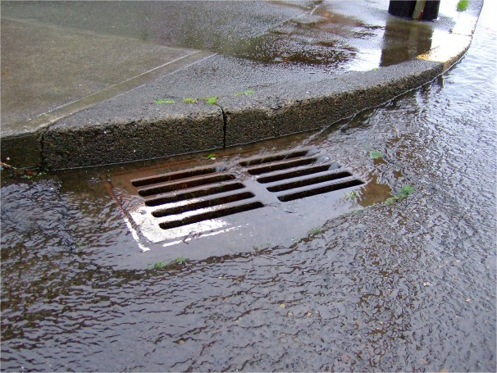
MS4s
Municipal Separate Storm Sewer System (MS4) is a system of conveyances:
roads, streets, catch basins, curbs, gutters, ditches, constructed channels, or storm drains
owned / operated by entity with jurisdiction over management and discharge of stormwater
  State, city, town, county, special district, etc.
discharges to waters of the state
Notes:
The entity that owns the MS4 is the permittee. Not all MS4s are regulated.
Environmental Resource Permitting (ERP) Program = Requirements for new stormwater systems or modifications of existing systems.
NPDES is operation and maintenance of existing systems.

Slide 9
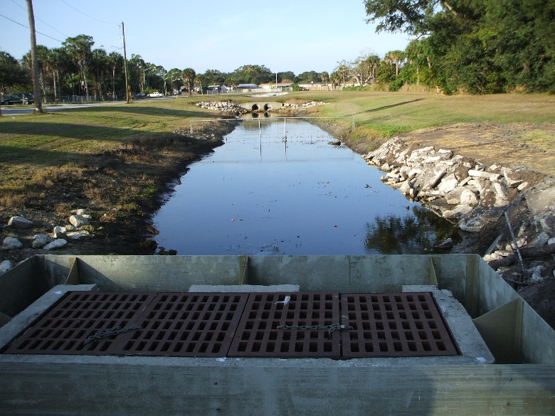
Phase I MS4s
MS4 operators are required implement a Stormwater Management Program (SWMP) to control the quality of stormwater discharged from the MS4.
The SWMP shall prohibit the discharge of non-stormwater into the MS4 and reduce the discharge of pollutants from the MS4 to waters of the State to the Maximum Extent Practicable (MEP).
Notes:
MEP standard is applied based on the best professional judgment of the permitting authority.

Slide 10
Phase I MS4s
Good Housekeeping: maintain stormwater systems, municipal property and facilities
Detect and eliminate non-stormwater discharges to the storm sewer system through legal authority and inspections
Reduce pollutants in runoff from industrial, commercial and residential areas through legal authority and inspections and public education and outreach
Control stormwater discharges from new development & redevelopment areas through land development regulations and site plan review procedures
Self-evaluation of the SWMP: annual reporting, pollutant load estimates and monitoring

Slide 11
Legal Authority
Prohibit non-stormwater discharges to the MS4
Prohibit and eliminate illicit connections / discharges / dumping to the MS4
Prohibit spills or other releases into the MS4
Require implementation of appropriate BMPs to control discharges from construction sites and industrial facilities into the MS4 (erosion and sediment control, post-construction stormwater discharges)

Slide 12
Phase I MS4s
Structural Controls and Stormwater Collection System Operation
Areas of New Development and Significant Redevelopment
Roadways
Flood Control Projects
Municipal Waste Treatment, Storage or Disposal Facilities
Pesticide, Herbicide, and Fertilizer Application
Illicit Discharges and Improper Disposal
Industrial and High Risk Runoff
Construction Site Runoff
Monitoring
Water Quality Standards - TMDLs
Notes:
Measureable goals and BMPs make up the SWMP. These elements are used to demonstrate the effectiveness of the MS4s program.
Inspection and maintenance of structural controls (inlets, swales, ponds, pipes), mow, repair; generally align with ERP requirements
Comprehensive planning and land development code review; encourage Green Industries
Litter control, street sweeping, maintenance yard operations
projects include water quality component, consistent with WMD
O&M and inspections
proper licensing; education; fertilizer application ordinance
legal authority; proactive/reactive inspections, spill response, public reporting, waste control education, limitation of sanitary seepage; employee training
MSGP coverage, inspection, sampling
Site plan review, inspection, training
Monitoring:
Annual pollutant load estimates, AND ambient or outfall monitoring
All elements are used to demonstrate the effectiveness of the MS4s program. SWMPs must be assessed and adjusted, to make progress toward the goal of reducing the discharge of pollutants to protect receiving waters.
Water Quality Standards:
TMDL-Prioritization, monitoring and implementation of BMPs to address TMDL wasteload allocations
MEP-Implementation of BMPs (narrative effluent limitations) by the permit constitutes compliance with the standard of reducing pollutants to the MEP.
Working with the TMDL and BMAP group in reference to MS4s.

Slide 13
Permit Conditions
Structural Controls and Stormwater Collection System Operation:
  Inventory and map of system
  Inspection & Maintenance
Structural Control | Inspection Frequency
Dry/Wet Retention/Detention Systems | Once every three years
Exfiltration Trench / French Drains
Grass Swales (Dry)
Underdrain Filter Systems | 18 months
Pollution Control Boxes | Quarterly, < or >
Pump Stations | Semi-annually or >
Major Outfalls | Annually, < or >
Pipes/Culverts, Ditches, Other Conveyances | 10% annually FDOT: MRP
Inlets, Catch Basins, Grates
Descriptions of common stormwater structural controls: http://www.dep.state.fl.us/water/stormwater/npdes/docs/stormwater-structural-controls-ms4.pdf
Notes:
Inspection and maintenance of structural controls (inlets, swales, ponds, pipes), mow, repair; generally align with ERP requirements.
Inspections may be visual observations, TVing, mirroring, or other appropriate methods, including during mowing, and should be included in the SOPs.

Slide 14
Permit Conditions
Areas of New Development and Significant Redevelopment:
    Comprehensive planning to apply same requirements to redevelopment as required by new development
    Land development code review to encourage Green Infrastructure
New Development: To mitigate stormwater impacts from new developments, use practices to treat, store, and infiltrate runoff onsite before it can affect water bodies downstream. Site designs that reduce imperviousness and include low impact development practices can be used to reduce flows and improve water quality.
  Redevelopment is development that occurs on previously developed land. For stormwater management, redevelopment of impervious surfaces can help reduce net increases in impervious surfaces and associated degradation to receiving waters. Infrastructure upgrades during redevelopment can also be used to repair deteriorating pipes and upgrade undersized stormwater treatment systems
Notes:
Comprehensive planning and land development code review; encourage Green Industries
The NPDES Stormwater Program does not regulate design and performance standards for stormwater management systems. Florida has a statewide ERP program regulated by FDEP and WMD; Local municipalities should also have codes for Performance Standard and BMP Design Criteria for local projects. State is least stringent.

Slide 15
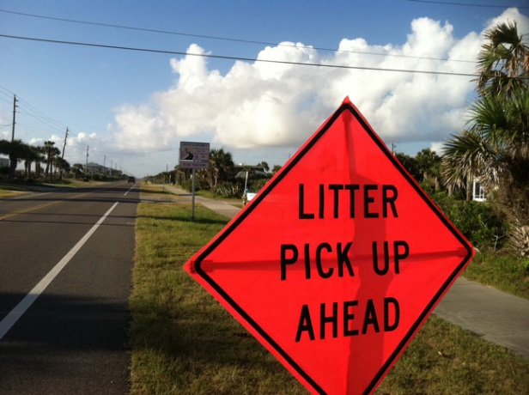

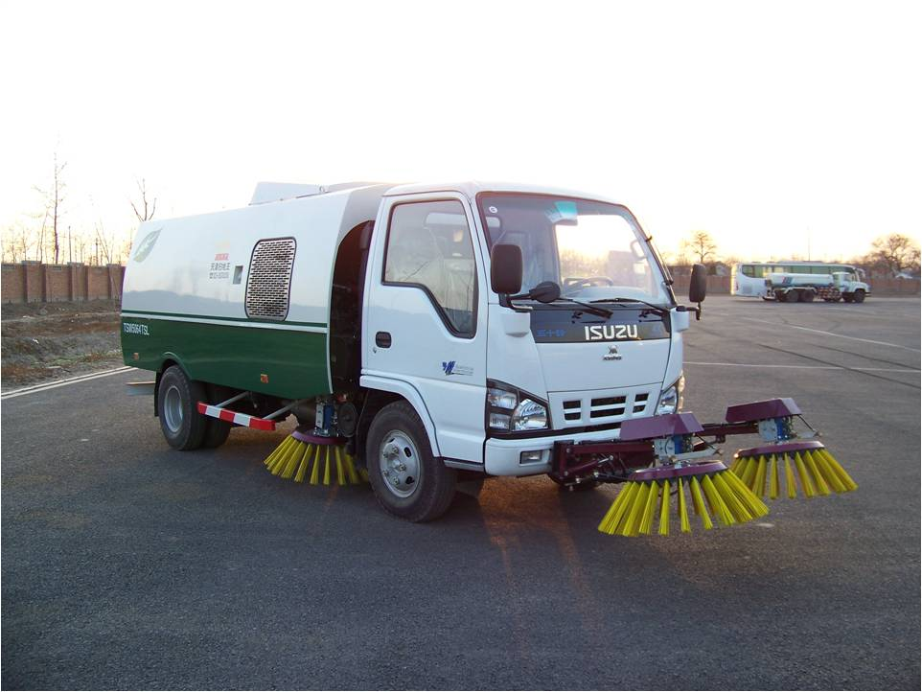
Permit Conditions
Roadways:
  Operate and maintain public streets, roads, highways, and rights-of-way
      Litter control
      Street sweeping
      Adopt-A-Road
      municipal road construction
      Good housekeeping at maintenance yards

Slide 16
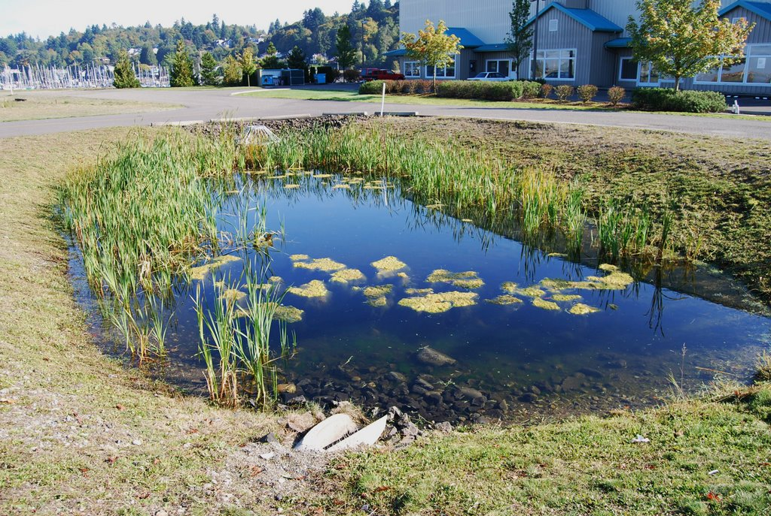
Permit Conditions
Flood Control Projects:
  Provide stormwater treatment for flood projects as required by ERP.
  Evaluate existing structural flood control devices to determine if retrofitting to provide additional pollutant removal from stormwater is needed / feasible.

Slide 17
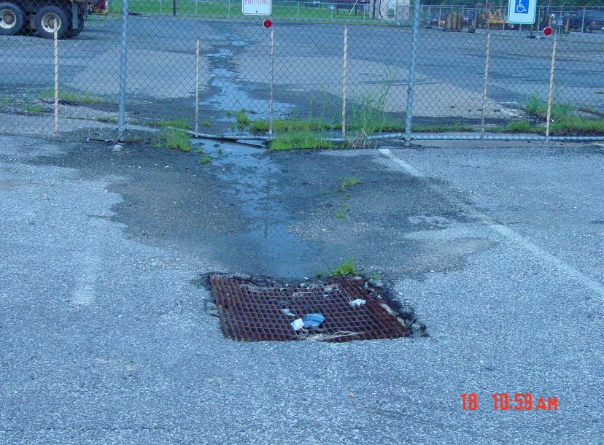
Permit Conditions
Municipal Waste Treatment, Storage or Disposal Facilities:
    Good Housekeeping and inspections for facilities without an MSGP:
      landfills;
      waste transfer stations;
      waste fleet maintenance facilities;
      other waste treatment, waste storage, and waste disposal facilities.

Slide 18

Permit Conditions
Pesticide, Herbicide, and Fertilizer Application:
    Required applicator certifications and licensing for pesticide and fertilizer application on municipal property; including Green Industries BMP training.
    Adopt a Florida-Friendly Fertilizer ordinance if MS4 discharges into a nutrient-impaired waterbody.

Slide 19
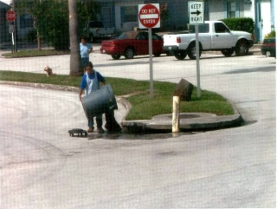
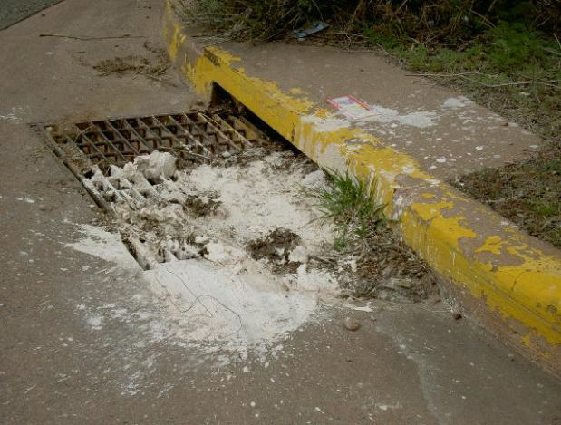
Permit Conditions
Illicit Discharges and Improper Disposal:
  Legal Authority
    Proactive & reactive inspection program, employee training
    Spill response plan, employee training
    Education to facilitate public reporting of the presence of illicit discharges into the MS4. Maintain a phone line.
    Education on the proper use and disposal of hazardous household products, publicize the locations of collection facilities and events.
    Reduce/eliminate sanitary wastewater contamination into the MS4, from SSOs, I&I and/or septic tank systems.

Slide 20
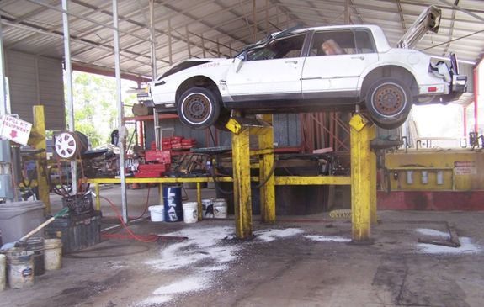
Permit Conditions
Industrial and High Risk Runoff:
  Inventory of high risk facilities discharging into the permittee’s MS4.
  Inspections & sampling.

Slide 21

Permit Conditions
Construction Site Runoff:
  Site Plan Review;
    ERP and CGP notification/confirmation
    Sediment and erosion control
    Waste control
  Inspections
    Preconstruction: proper BMP installation
    During construction: BMP maintenance
    Post-Construction: final stabilization
  Employee training for inspectors, site plan reviewers and operators (Permittee/contractor)

Slide 22

Public Education and Outreach Plan
A single plan may address public education and outreach topics for Parts III.A.6, III.A.7.e and III.A.7.f of the permit.
Pointless Personal Pollution
www.tappwater.org
www.floridaagwaterpolicy.com
http://www.dep.state.fl.us/water/watersheds
Stormwater Education Training
www.stormwater.ucf.edu
Notes:
Goals: change citizen behavior
Topics: PHF, public reporting of ID; HHW disposal
Documentation: materials distributed; outreach events and attendees

Slide 23
Contract Activities
If activities are conducted by another entity under a contractual agreement, then the permittees shall retain copies of the contractual agreement that specifies the schedule and frequency of the activities to be conducted.
Inter-local agreements may be used to share responsibility between permittees. Maintain a copy of ILAs and determine who tracks and reports joint activities.
Notes:
Examples of contract activities:
System inspection
Mowing and litter control
Street sweeping
PHF application
Construction site inspection
Examples of activities performed by another entity
Spill response
Monitoring
HRF inspections
E&O

Slide 24
Permit Changes
SOPs should already be developed
Training (track new/refresher training together)
Clarified monitoring/assessment requirements
New TMDLs - Bacteria
Annual Report changes

Slide 25
SOPs
Standard Operating Procedures (SOPs) should be developed for each permit requirement. SOPs are be step-by-step instructions for a standardized process.
Common elements of a SOP/Plan
Procedures for activities and checklist (for inspections)
Schedule for activities
Documentation/tracking including contact information
Responsible staff/contractor or department/section

Slide 26
SOPs
Part III.A.1 | Inspections and maintenance of structural controls.
Part III.A.3 | Litter control program.
Part III.A.3 | Street sweeping program.
Part III.A.3 | Inspections of equipment yards and road maintenance shops.
Part III.A.5 | Inspections of waste TSD facilities
Part III.A.6 | Public education and outreach on reducing the use of PHF
Part III.A.6 | Good housekeeping for the use of PHF.
Part III.A.7.c | Proactive illicit discharge inspections.
Part III.A.7.c | Reactive illicit discharge investigations.
Part III.A.7.c | Illicit discharge inspection training.
Part III.A.7.d | Spill prevention and response.
Part III.A.7.d | Spill prevention and response training.
Part III.A.7.e | Public education and outreach on identifying and reporting illicit discharges.
Part III.A.7.f | Public education and outreach on the use and disposal of oils, toxics and HHZ.
Part III.A.7.g | Procedures to reduce / eliminate sanitary wastewater contamination.
Part III.A.8 | Inspections of industrial high risk facilities.
Part III.A.9.a | Construction site plan review
Part III.A.9.b | Construction site inspections.
Part III.A.9.c | Construction staff training.
Notes:
Required to be reviewed and approved by DEP.

Slide 27
Training Plan
Training required annually for personnel or contractors.
Illicit Discharge inspectors
  Proactive inspections
  Reactive investigations
Spill Response
Construction Site staff
  Plan Reviewers
  Inspectors – DEP Sediment and Erosion Control
  http://www.dep.state.fl.us/water/nonpoint/erosion.htm
  Permittee Operators – pre-construction meetings, SWPPP review.
A single plan may address training for Parts III.A.7.c, III.A.7.d and III.A.9.c of the permit.
Notes:
Goals: change citizen behavior
Topics: PHF, public reporting of ID; HHW disposal
Documentation: materials distributed; outreach events and attendees

Slide 28
Assessment
Objective: Provide information to determine the overall effectiveness of the SWMP in reducing stormwater pollutant loadings from the MS4.
Assessment program:
  Water Quality Monitoring Plan;
  Pollutant load/EMC calculations;
  Evaluate pollutant loading and water quality trends; and
  ID areas of MS4 be targeted for loading reduction.
  Each permittee, or permittees operating under a collaborative assessment program, shall develop and submit an assessment program.
Notes:
OVERALL MONITORING OBJECTIVE
each MS4 is required have program which is tailored to local objectives and challenges
Monitoring:
Annual pollutant load estimates, AND ambient or outfall monitoring
All elements are used to demonstrate the effectiveness of the MS4s program. SWMPs must be assessed and adjusted, to make progress toward the goal of reducing the discharge of pollutants to protect receiving waters.

Slide 29
Assessment
Annual Reporting:
Status of water quality monitoring plan: sampling frequency changes, monitoring location changes, or sampling waiver conditions.
Summary of the water quality monitoring data and / or stormwater pollutant loading changes from the reporting year.
NOTE: Results must be specific to each permittee’s SWMP.
An analysis of the data to evaluate the relationship between changes in water quality and/or stormwater pollutant loading.
Notes:
OVERALL MONITORING OBJECTIVE
each MS4 is required have program which is tailored to local objectives and challenges
Monitoring:
Annual pollutant load estimates, AND ambient or outfall monitoring
All elements are used to demonstrate the effectiveness of the MS4s program. SWMPs must be assessed and adjusted, to make progress toward the goal of reducing the discharge of pollutants to protect receiving waters.

Slide 30
Assessment
Reapplication Reporting
Requested changes and the rationale; Identify additional assessment elements that need to be completed to assist in the evaluation of the effectiveness of the SWMP;
Identify any evidence of water quality and / or pollutant loading improvements or degradation over the permit period
Identify any areas or drainage basins within the boundaries of the MS4 that should be targeted for corrective actions (retrofits, structural BMPs, and non-structural BMPs - public education, street sweeping).
Notes:
OVERALL MONITORING OBJECTIVE
each MS4 is required have program which is tailored to local objectives and challenges
Monitoring:
Annual pollutant load estimates, AND ambient or outfall monitoring
All elements are used to demonstrate the effectiveness of the MS4s program. SWMPs must be assessed and adjusted, to make progress toward the goal of reducing the discharge of pollutants to protect receiving waters.

Slide 31
EPA Program Effectiveness
Level 6 - Improving Receiving Water Quality
Level 5 - Reducing Runoff Quality
Level 4 - Reducing Loads from sources
Level 3 - Changing Behavior
Level 2 - Raising Awareness
Level 1 - Documenting Activities

Slide 32
TMDLs
Total Maximum Daily Loads
DEP-adopted TMDL
EPA-established TMDL within a water body that is verified impaired by DEP for the pollutant of concern using the processes defined in the Impaired Waters Rule (62-303, F.A.C.
“MS4 discharge” shall mean direct discharge, or indirect discharge through an interconnected MS4.
Notes:
Water Quality Standards:
TMDL-Prioritization, monitoring and implementation of BMPs to address TMDL wasteload allocations
MEP-Implementation of BMPs (narrative effluent limitations) by the permit constitutes compliance with the standard of reducing pollutants to the MEP.
Working with the TMDL and BMAP group in reference to MS4s.

Slide 33
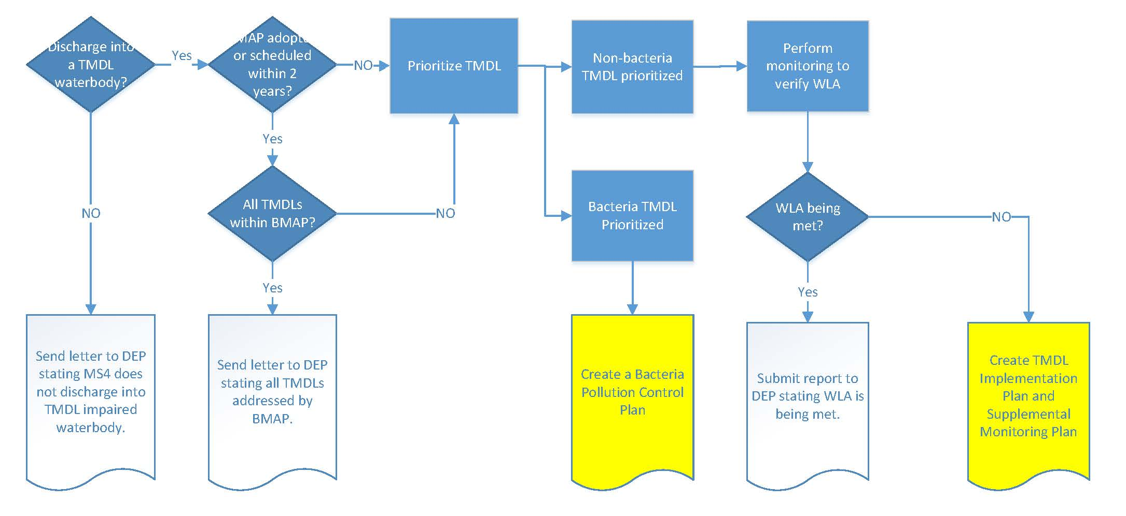
TMDLs
Notes:
Water Quality Standards:
TMDL-Prioritization, monitoring and implementation of BMPs to address TMDL wasteload allocations
MEP-Implementation of BMPs (narrative effluent limitations) by the permit constitutes compliance with the standard of reducing pollutants to the MEP.
Working with the TMDL and BMAP group in reference to MS4s.

Slide 34
Annual Report
Checklist
Strengths/Limitations
SECTION V. MATERIALS TO BE SUBMITTED WITH THIS ANNUAL REPORT FORM
Only the following materials are to be submitted to the Department along with this fully completed and signed Annual Report Form (check the appropriate box to indicate whether the item is attached or is not applicable):
Attached | N/A | Required Attachments
 |  | Any additional information required to be submitted in this current annual reporting year in accordance with Part III.A of your permit that is not otherwise included in Section VII below.
 |  | If program resources have decreased from the previous year, a discussion of the impacts on the implementation of the SWMP.
 |  | An explanation of why the minimum inspection frequency in Table II.A.1.a. was not met, if applicable.
 |  | A list of the flood control projects that did not include stormwater treatment and an explanation for each of why it did not (if applicable).
 |  | A monitoring data summary as directed in Section III.C above and in accordance with Rule 62-624.600(2)(c), F.A.C.
Provide an evaluation of the Stormwater Management Program according to Part VI.B.3 of the permit.
Strengths:
Limitations:
SWMP revisions implemented to address limitations:
Notes:
Water Quality Standards:
TMDL-Prioritization, monitoring and implementation of BMPs to address TMDL wasteload allocations
MEP-Implementation of BMPs (narrative effluent limitations) by the permit constitutes compliance with the standard of reducing pollutants to the MEP.
Working with the TMDL and BMAP group in reference to MS4s.

Slide 35
Annual Report
SECTION IX. TMDL Status Report
YEAR 1 Provide a table summarizing the status of the TMDL process. Include a list of prioritized TMDLs and their monitoring and implementation schedule; and include the Identification number of the outfall prioritized for TMDL monitoring.
WBID Number | Segment/ Waterbody/ Basin |  | Pollutant of Concern | TMDL DEP / EPA |  | Percent Reduction (WLA) | Priority Rank |  | Priority Outfall | Monitoring Summary / BPCP Due Date | Supplemental SWMP Due Date
 |  |  |  |  |  |  | 1 |  |  | (Year 3 AR) | (Year 4 AR; N/A) if BPCP)
YEAR 3 and annually thereafter, provide a summary of the estimated load reductions that have occurred for the pollutant(s) of concern being discharged from the MS4 to the TMDL water body during the reporting period and cumulatively since the date the Supplemental SWMP was implemented. Year 3: Submit a Monitoring data summary or BPCP (if applicable). Year 4: Submit a Supplemental SWMP (if applicable).
WBID Number |  | Pollutant of Concern | Monitoring Summary / BPCP Submitted |  | Supplemental SWMP Submitted |  |  | Projected load reductions OR Actual load reductions to date
 |  |  | (Year 3 AR) |  | (Year 4 AR; N/A if BPCP)
Provide a brief statement as to the status of TMDL implementation according to Part VIII.B. of the permit (e.g. status of monitoring to validate WLA):
Notes:
Water Quality Standards:
TMDL-Prioritization, monitoring and implementation of BMPs to address TMDL wasteload allocations
MEP-Implementation of BMPs (narrative effluent limitations) by the permit constitutes compliance with the standard of reducing pollutants to the MEP.
Working with the TMDL and BMAP group in reference to MS4s.

Slide 36
Permit Reapplication
Items required to be attached to the Year 4 annual report:
62-624.420(2) F.A.C. – statement the Year 4 annual report is the re-application; include proposed revisions.
62-624.440(1)(d) F.A.C. – changes in co-applicants
62-624.440(1)(e,f) F.A.C. – previously unidentified waterbodies and known water quality impacts
62-624.440(1)(g) F.A.C. – reductions of pollutant loads from SWMP implementation
Permit Part V.A.3: If the total annual pollutant loadings have not decreased over the past two permit cycles, revisions to the SWMP, as appropriate.
Permit Part V.B.3: The monitoring plan with revisions, if applicable.
Permit Part VIII.B.3.d: TMDL Implementation Plan / Supplemental SWMP, if applicable
Miami-Dade County submits some of these documents on behalf of the co-permittees.
Notes:
Audit schedule based on 106 workplan/CMS plan
MS4 staff issue permits and perform audits.

Slide 37
Contact Us
Borja Crane-Amores – Program Administrator
(850) 245-7520 Borja.CraneAmores@dep.state.fl.us
Michelle Bull – Phase I MS4 Coordinator
(850) 245-7561 Michelle.Bull@dep.state.fl.us
NPDES Notices Center
(866) 336-6312 (toll-free)
NPDES-stormwater@dep.state.fl.us

