Slide 1

DEP’s Website Tools www.floridadep.com

Slide 2

ERP Online Help
An interactive web resource to assist applicants in providing a complete Environmental Resource Permit application and Submerged Lands Authorization request

Slide 3
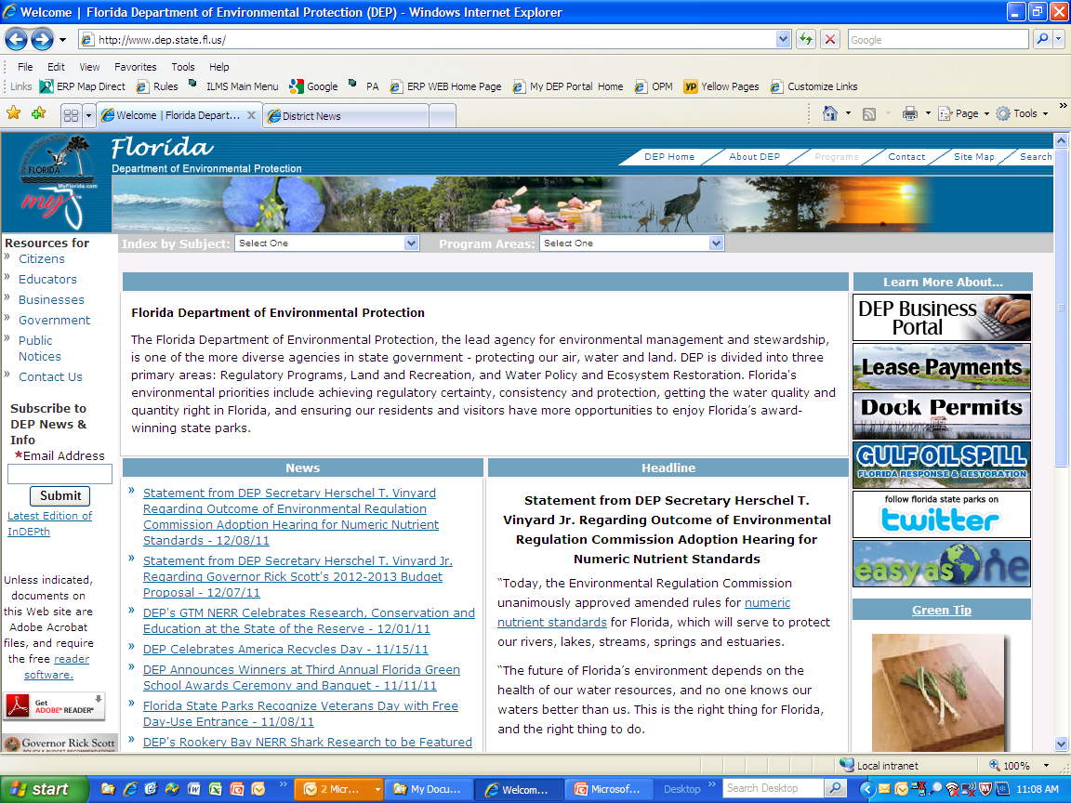
After going to our website, www.floridadep.com , click on the programs tab in the upper right corner

Slide 4
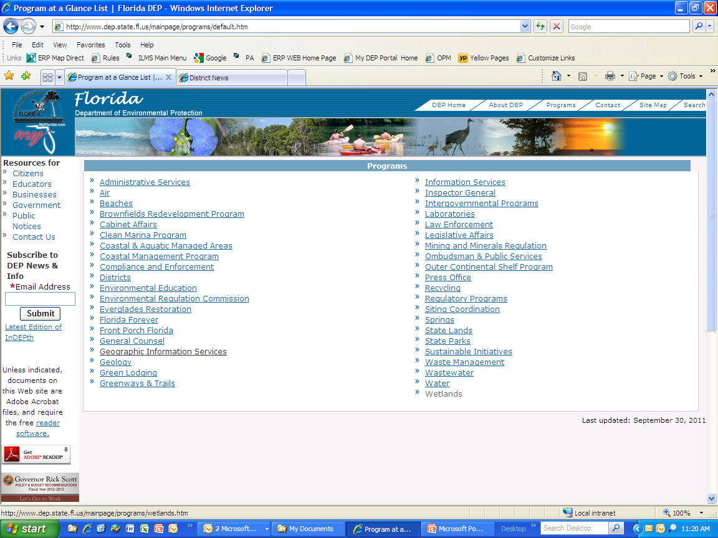
Choose the link to Wetlands

Slide 5
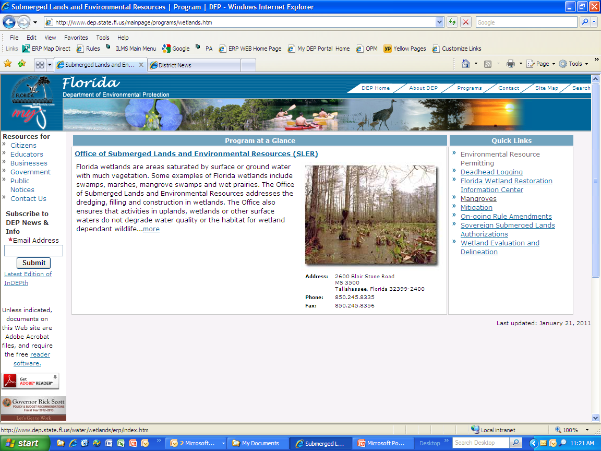
Choose the link to Environmental Resource Permitting

Slide 6
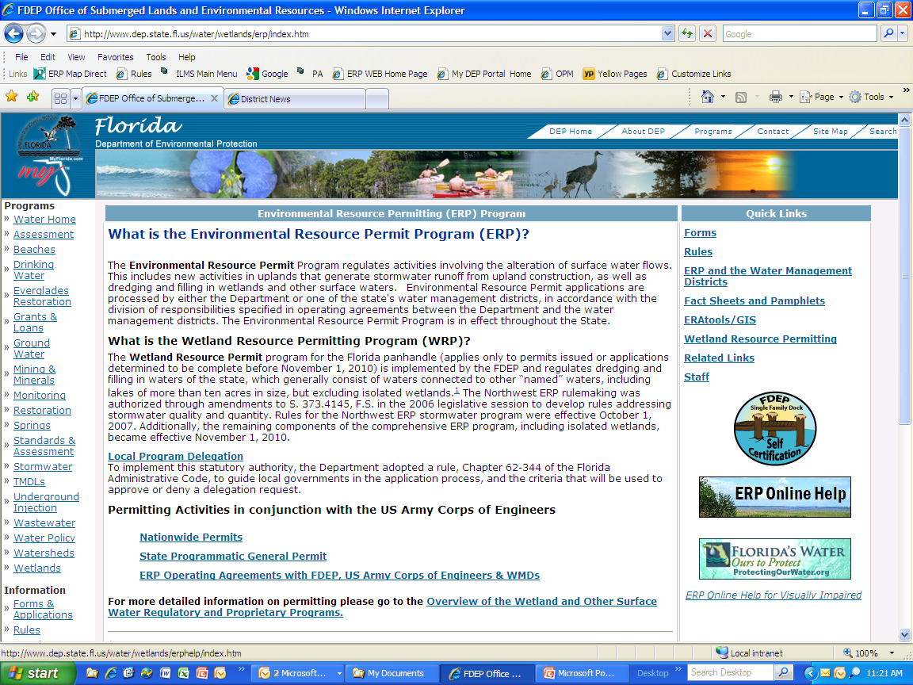
Click on the ERP Online Help Icon

Slide 7
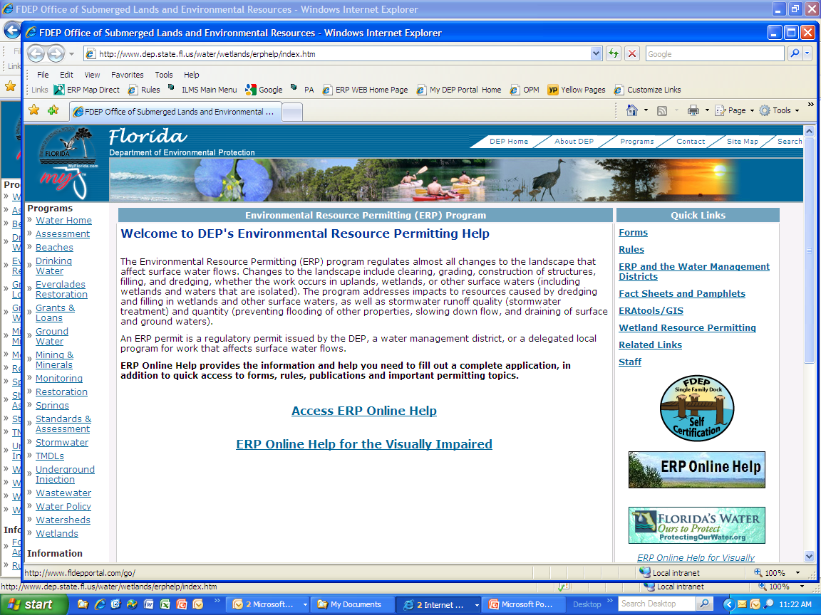
Choose the link to Access ERP Online Help

Slide 8
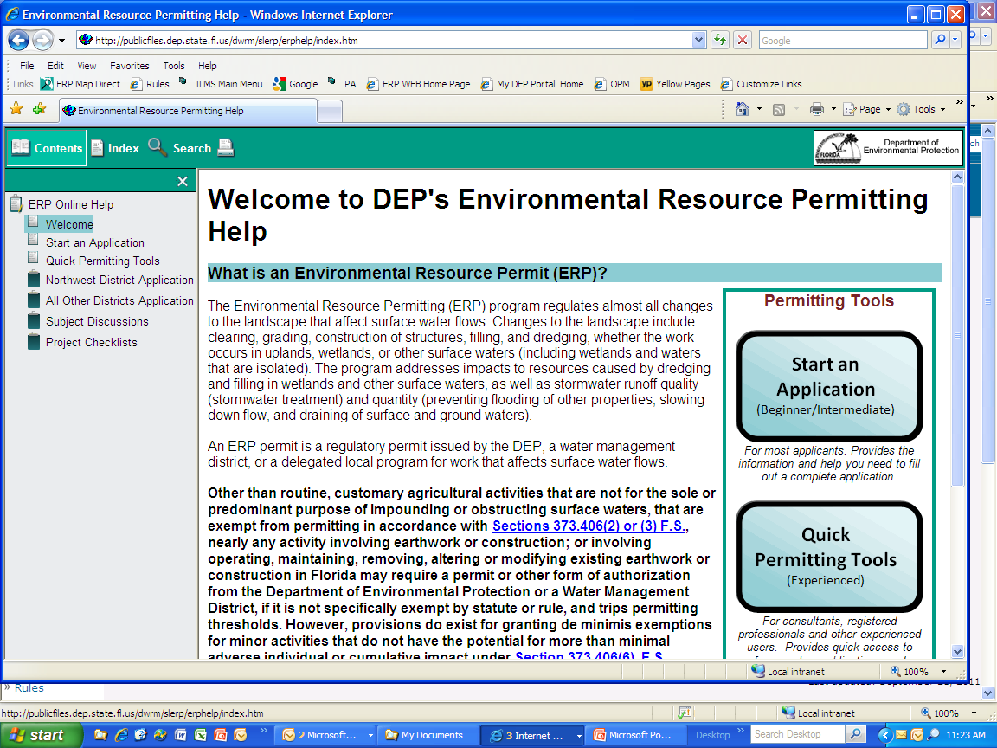
You can choose a helpful guide to complete an application (recommended for beginners)

Slide 9
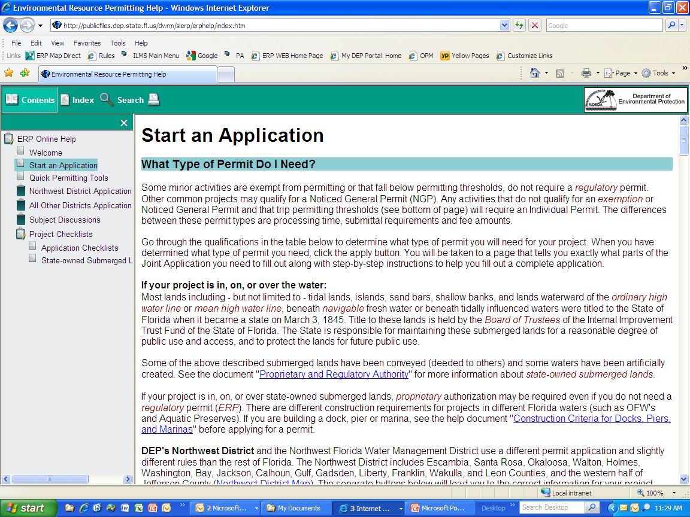
This will be a step by step guide to providing the information and assurances necessary to quickly receive permit authorizations.

Slide 10
If you are more experienced, you can choose the Quick Permitting Tools to focus on a specific question or aspect

Slide 11
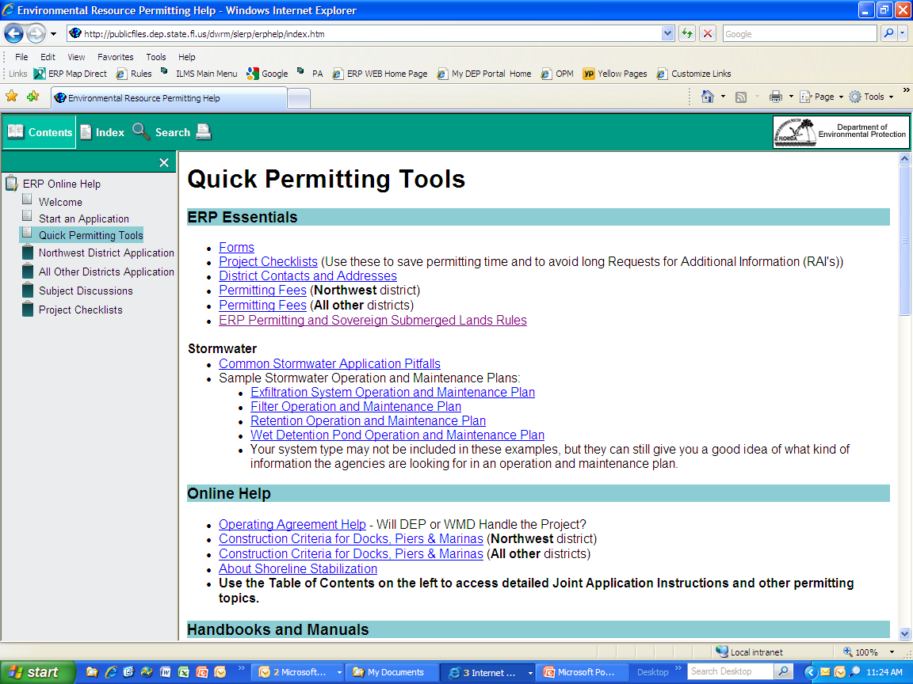
The Quick Permitting Tools allow you to choose a specific subject. The folder list on the left can be expanded to allow quick access.
Color indicates subfolders

Slide 12
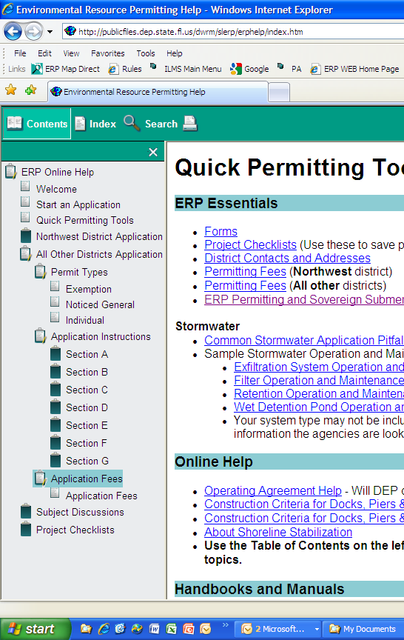
You can go right to the application forms by clicking on the folder

Slide 13
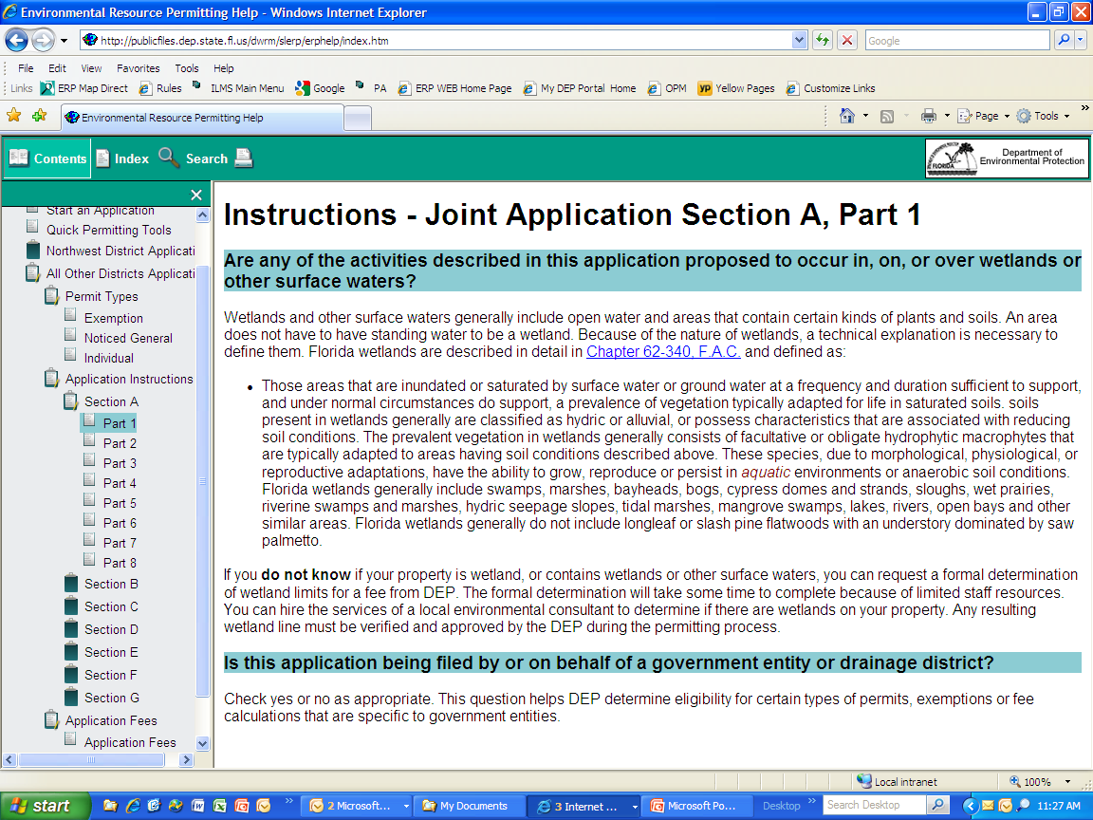
Each section of the application form will also provide guidance on how to fully complete the application

Slide 14
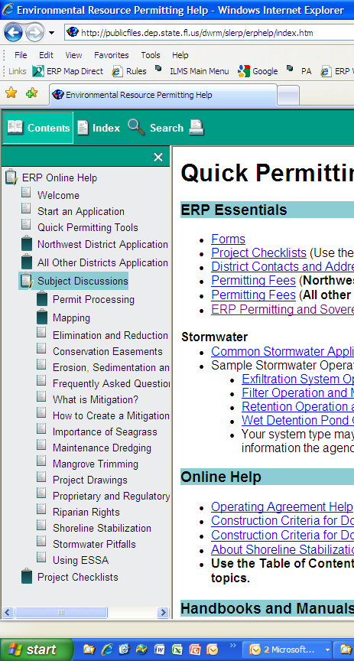
Under the Subject Discussion folder, you can choose a specific topic.

Slide 15
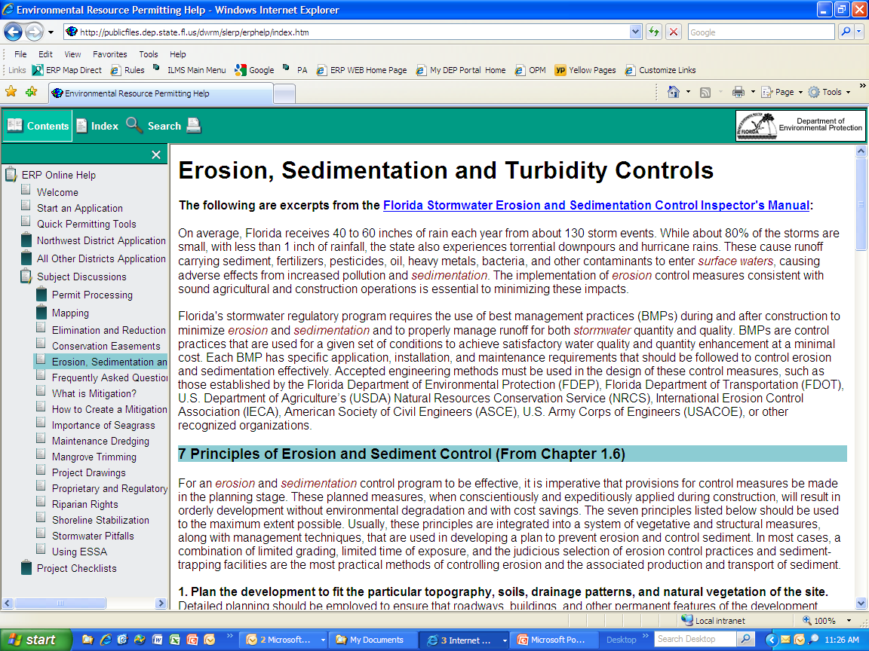
Selecting a specific topic will bring up a page with helpful information regarding that topic.

Slide 16
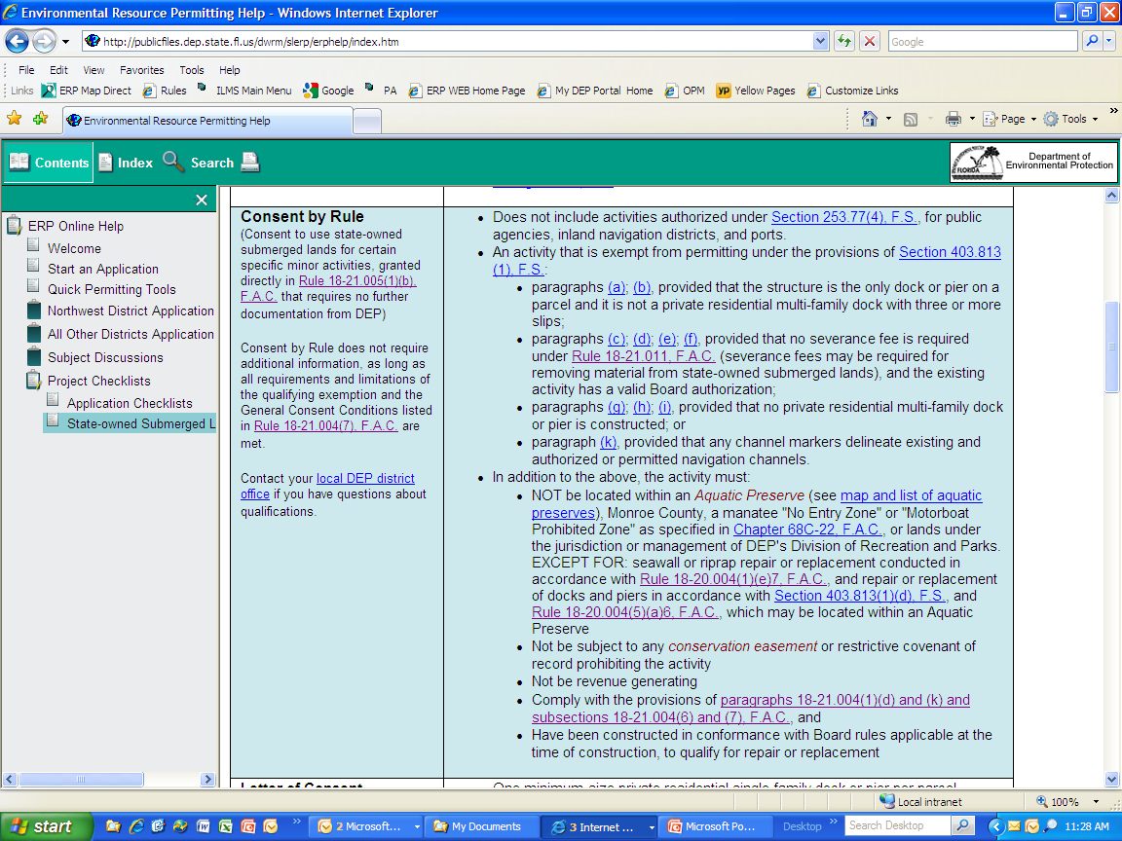
Click on the State Owned Submerged Lands folder to view the forms of authorizations and the types of projects that qualify.

Slide 17
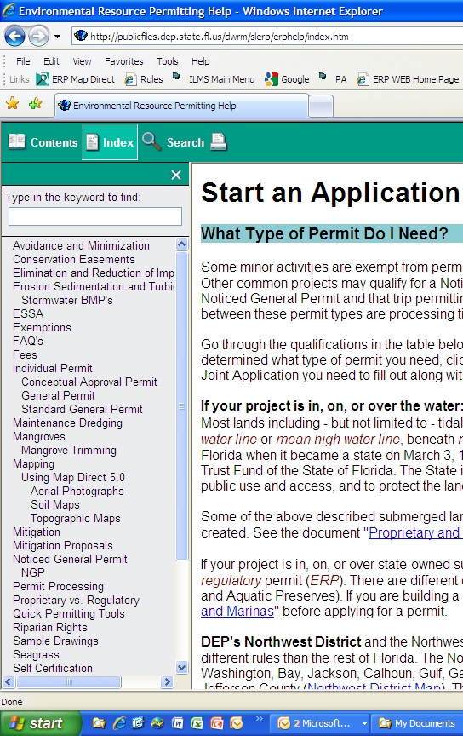
Under the Index tab, you’ll find many quick links listed by subject name. You can also use the Search tab to find information on additional keywords.

Slide 18
When you are thinking of submitting an application for a project, please contact Elizabeth Gillen at 239-344-5646 to discuss your proposal and set up a pre-application meeting.
Pre-application meetings allow us to give you additional guidance on how best to meet all rule criteria and complete the application form. It often allows us to more quickly review and approve your submittal.

Slide 19
Questions?
Lucy Blair
239-344-5618

