Slide 2

Permitting Template Guidance

Slide 3
Updated Templates
Exemption Verification
General Permit
Individual Permit
Notice of Intent to Issue
  Notice for newspaper publication
  Technical Staff Report
  Notice of Denial
Notes:
If a template was available from the OPM or OGC that template served as the “base” document for drafting the templates. When a specific template was not available examples from each district office were pulled from oculus and the end result is a compilation (general permit).
In addition to the templates above the SLER 1300 guidance within the OPM was updated to address Intents and Permits. (***The notice of denial is not included in the Permit and intent guidance…)
**** next slide

Slide 4

What is new?
New OPM guidance document
Templates updated with SWERP citations
Language modifications for clarity
Letter of Consent language updated
Notice of Rights (NOR) language updated
New Technical Staff Report (TSR)

Slide 5
OPM UPDATES
Why are the updates important?

Slide 6

New SLER 1300 replaces old HISTORIC document
OKAY… so it is not exactly that old… But it has been 19 years!!!
Notes:
A lot has changed…. The historic guidance references WRP’s, COU’s, and rules and procedures that are no longer valid. I am hoping that you all will find the new guidance more user friendly.
As new guidance documents are added to the OPM they will be provided in the more user friendly format .

Slide 7
SLER 1300 contains the following “active” links:
Table of Contents (TOC) links within the Document
Links within each section to return to the TOC
Decision making Flow Chart
Statute/Rule citations
Links to other SLER guidance documents and templates
Notes:
Most documents and rules that are referenced within the guidance document will have active links. They are shown in blue font and can be accessed by holding down the control key and left clicking the mouse on the link. The links for rules will take you to the DOS website for that rule not necessarily to the exact passage referenced or paraphrased but to the general ballpark.
The document now includes a Table of Contents that will allow you to move more easily within the document. Main Topics are outlined within the TOC. At the end of each section there is also a link to return to the Table of Contents.

Slide 8
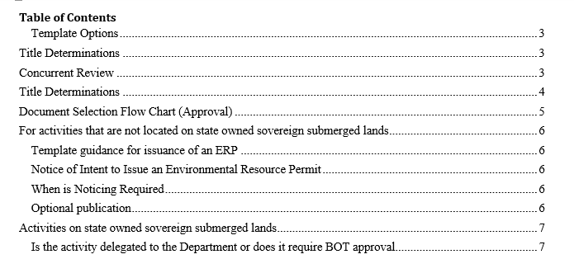
TABLE OF CONTENTS
NOW WITH ACTIVE LINKS
Notes:
Even though the TOC entries are not blue they are active links that will link you within the document.

Slide 9
SLER 1300 contains the following “active” links:
Statute/Rule citations
Table of Contents (TOC) links within the Document
Links within each section to return to the TOC
Decision making Flow Chart
Links to other SLER guidance documents and templates
Notes:
This document now has a flow chart that can be used to determine the appropriate permitting document to draft. (1. ERP, 2. Consolidated ERP and Sovereign Submerged Lands Authorization, 3. Consolidated ERP and Intent to Grant Sovereign Submerged Lands Authorization, 4. Notice of intent to Issue an ERP, 5. Consolidated Notice of Intent to Issue an ERP and Sovereign Submerged Lands authorization, 6. Consolidated Notice of Intent to Issue an ERP and Intent to Grant Sovereign Submerged Lands Authorization, 7. Recommended Consolidated Notice of Intent to Issue an ERP and Sovereign Submerged Lands Authorization, 8. Recommended Consolidated Notice of Intent to Issue an ERP and Intent to Grant Sovereign Submerged Lands Authorization. ( all of which will start out from the same base template)…
It replaces this table format

Slide 10
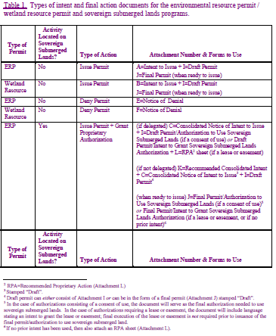
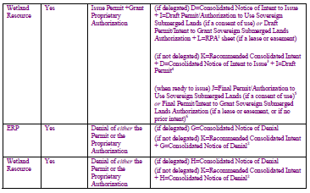

Slide 11
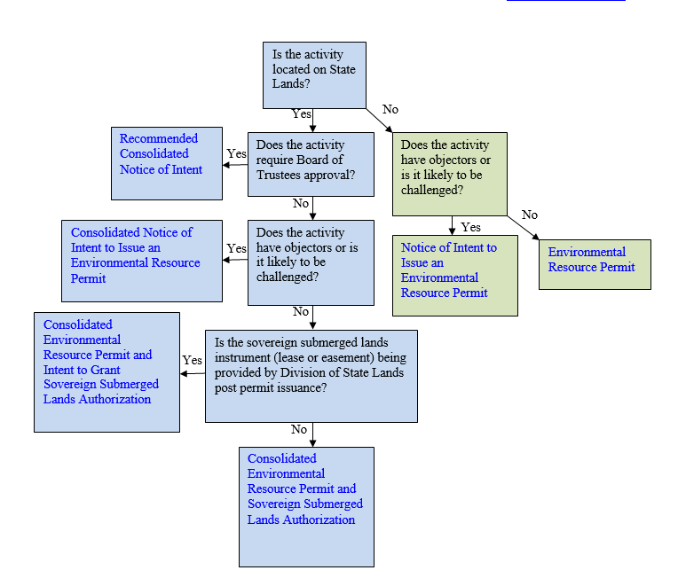

Flow Chart
Notes:
The links within the text boxes link to that section of the OPM…so… if you are not sure if the project will “require BOT approval?” if you click the question within the text box it will take you to the guidance section that relates to the BOT.

Slide 12
TEMPLATE REVISIONS
General Revisions to Templates Include
Notes:
these are the revisions that were made throughout the templates (not to be confused with revisions to general permit templates)…..

Slide 13
Templates contain Red font and XX’s to indicate locations where information is needed or instruction is provided.
Proprietary Review- Letter of Consent- references to Consent of Use have been removed.
New SPGP language provided
NOR’s updated to include FLAWAC

Slide 14

Proprietary Review-
The following language is included in all templates and needs to be included every time the appropriate form of proprietary authorization is a Letter of Consent (LOC).
During the term of this Letter of Consent you shall maintain satisfactory evidence of sufficient upland interest as required by paragraph 18-21.004(3)(b), Florida Administrative Code. If such interest is terminated or the Board of Trustees determines that such interest did not exist on the date of issuance of this Letter of Consent, this Letter of Consent may be terminated by the Board of Trustees at its sole option. If the Board of Trustees terminates this Letter of Consent, you agree not to assert a claim or defense against the Board of Trustees arising out of this Letter of Consent.
Notes:
LOC language was also added to all documents

Slide 15

Federal Review- SPGP Approved/ Not Approved/
Not Required
Now has three sets of paragraph options
SPGP approved language
SPGP not approved
SPGP not required (this is language is provided by the USACOE to use when the activity is not covered by the SPGP agreement and has been determined not to require any further authorization by the USACOE)
NEW
Notes:
Decision to use the USACOE instead of ACOE, USACE, or CORPS made in order to be consistent with the wording provided at the time the SPGP was signed. The SPGP language included is the same language discussed in the Oct. 31, 2013 ERPA.

Slide 16
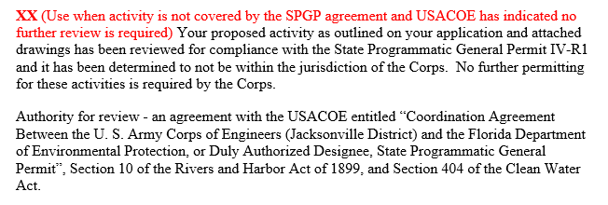
NEW SPGP NOT REQUIRED LANGUAGE
Added to ALL of the templates (exempt, GP, individual).
Notes:
For tracking purposes in PA, a new option is planned to be added to the ERP screen at issuance…. so in addition to the SPGP Y (yes- SPGP was granted) or N (no- SPGP was not granted) there will be a third option of NA (not applicable- activity not covered by SPGP, and the ****Corps determined no further authorization is required. Typically these would be projects sent to the ACOE as Yellow when the application is received.

Slide 17

NOTICE OF RIGHTS (Chapter 120 F.S.)
Required to be included for all Final Agency
Action’s
FLAWAC Review- (Florida Land and Water Adjudicatory Commission)
FLAWAC Review (Include for all projects)
The applicant, or any party within the meaning of Section 373.114(1)(a) or 373.4275, F.S., may also seek appellate review of this order before the Land and Water Adjudicatory Commission under Section 373.114(1) or 373.4275, F.S. Requests for review before the Land and Water Adjudicatory Commission must be filed with the Secretary of the Commission and served on the Department within 20 days from the date when the order is filed with the Clerk of the Department.
http://cabinet.myflorida.com/flwac/20120301_flwac_agency_org.pdf
Notes:
This is another hat that the Governor and Cabinet wear. For the activity to be heard by FLAWAC “three members of the commission must determine on the basis of the record below that the activity authorized by the order would substantially affect natural resources of statewide or regional significance. may also be accepted if three members of the commission determine that the order raises issues of policy, statutory interpretation, or rule interpretation that have regional or statewide significance from the standpoint of agency precedent.
The affected parties request to the commission must allege with particularity that the order is in conflict with statutory requirements or the order is in conflict with the requirements of a duly adopted rule.
****questions? Move on? Mangroves not subject to Flawac?

Slide 18
ENVIRONMENTAL RESOURCE
PERMIT TEMPLATE
Notes:
This template was updated in 2010 and was available from the Department and OGC website. A few additions were made to include the NEW language for processing of SF leases.

Slide 19
This base template is used to draft the following:
Environmental Resource Permit
Consolidated Environmental Resource Permit and Sovereignty Submerged Lands Authorization
Consolidated Environmental Resource Permit and Intent to Grant Sovereignty Submerged Lands Authorization
DRAFT permit for attachment to a Notice of Intent to Issue (NOI) an ERP or a Consolidated NOI, or a Recommended Consolidated Notice of intent.
Notes:
The new ERP permit model template is an updated version of the template available on the OGC permit manual website.
The template contains red font (like all the templates) that provide instruction for drafting the various versions of the ERP instructions on the document are also, within the SLER 1300 permit and intent guidance document. The guidance document is written to work with the templates (often times) providing specific instructions and including the exact language found with in the permit

Slide 20
Template includes the following “suggested DRAFT language” for use when preparing single family leases
Enclosed is a lease instrument, which requires acceptance by your notarized signature, (two witnesses required). Pursuant to Chapter 695, Florida Statutes, the names of the person executing the instrument, the two witnesses, and the notary public must be legibly printed or typewritten directly below that person's signature.
Execute and return the enclosed instrument within 30 days after receipt of this permit – please send the executed lease to: DEP, XX (for Single Family) District office address XX (for all others) Division of State Lands, Attn: Kathy Griffin, 3900 Commonwealth Blvd., CARR Bldg, MS 125, Tallahassee, FL 32399) Upon receipt and acceptance of the lease instrument, we will transmit the lease instrument(s) for final departmental execution. A billing invoice will be sent out to you once the lease instrument has been fully executed. You may not begin construction of the activities described above until you receive a copy of the executed lease from the Department.

Slide 21
Also, includes a new suggested specific condition for requiring a post construction As-Built Survey
SPECIFIC CONDITIONS- CONSTRUCTION COMPLETION
XX suggested language to require as-built survey and certification for SSL authorizations. Use as needed. XX Within 30 days after completion of construction of the permitted or authorized activity, and prior to transfer to operation, the permittee/lessee shall submit an As-Built Survey signed, sealed and dated by a Florida licensed Surveyor and Mapper in accordance with Chapter 61G17-7, Florida Administrative Code. The Survey shall depict the boundaries of the lease, including the entire preempted area and shall show the size and dimensions of all existing overwater structures and activities, including mooring pilings, located within the lease area. The Survey shall contain a statement that all of the depicted structures and activities occur within the lease boundary, if applicable. If the surveyor observes that structures or activities are occurring outside of the lease area, the surveyor shall document the condition in the statement and note the deviations on the Survey. Constructed deviations may require a permit or lease modification.

Slide 22
NOTICE OF INTENT TO ISSUE
Notes:
The Department may decide to issue a Notice of Intent to Issue an Environmental Resource Permit for individual permits when there are objectors to the proposed activities and a challenge to the permit is likely.
The Department will provide notice of agency action to any person who has filed a written request to be notified of DEP’s decision to issue or deny the permit, and to persons who have filed written objections or concerns about the activity. In addition, applicants will be required to publish, at their expense, a one-time notice of the agency decision in a newspaper of general circulation (meeting the requirements of Section 50.031, F.S.) in the county where the activity is located if DEP determines the proposed activities are reasonably expected to result in a heightened public concern or likelihood of request for administrative proceedings.
Also, projects not delegated to the Districts or have been determined by the BOT to be a Heightened Public Concern and therefore require BOT (gov. and cabinet) approval will use the NOI template, draft permit, and agenda item (recommended consolidated notice of intent to issue).

Slide 23
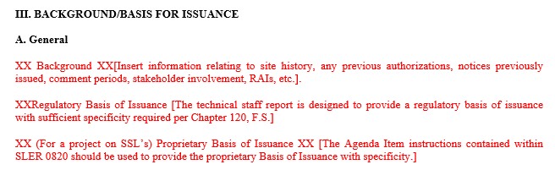
Notice of Intent to Issue
Four page document
Technical Staff Report designed to provide Regulatory Basis for Issuance
The agenda item (SLER 0820) should be used to provide information needed for the Proprietary Basis for Issuance
Notes:
Chapter 120.06 (licensing section) (3) states” Each applicant shall be given written notice, personally or by mail, that the agency intends to grant or deny, or has granted or denied, the application for license. The notice must state with particularity the grounds or basis for the issuance or denial of the license…” . “Each notice must inform the recipient of the basis for the agency decision, inform the recipient of any administrative hearing pursuant to ss. 120.569 and 120.57 or judicial review pursuant to s. 120.68 which may be available, indicate the procedure that must be followed, and state the applicable time limits. The issuing agency shall certify the date the notice was mailed or delivered, and the notice and the certification must be filed with the agency clerk.

Slide 24
TECHNICAL STAFF REPORT
NEW
Notes:
Several districts and water management Districts utilize a similar document in their evaluation of ERP’s (Technical staff report or Agency action memo). The document’s intent is to provide the “specificitiy” or “particularity” required to be provided by Chapter 120.

Slide 25
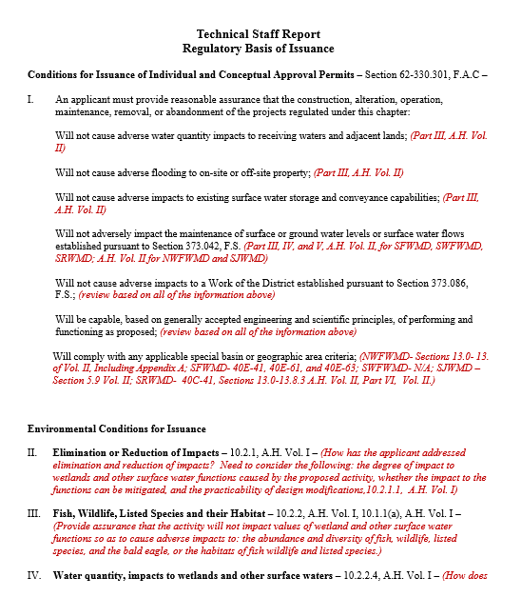
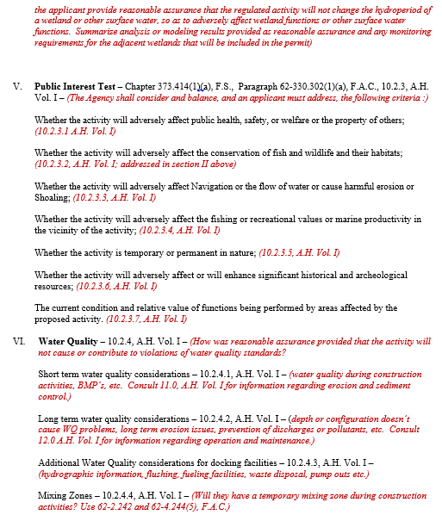
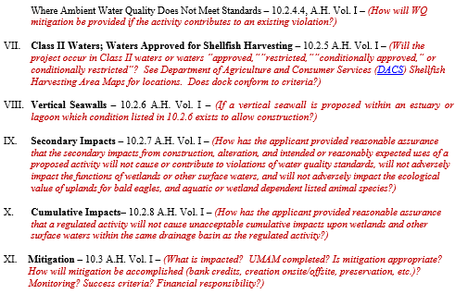
Notes:
The Red text is information that provides direction to the applicable rule/statute/ Section of the A.H. Red text will sometimes provide examples or a summary of the type of information that should be provided. The red text is intended as guidance only and the applicable sections of the rule/ A.H. should always be consulted. As you can see the TSR covers the Conditions for issuance or individual and conceptual permits, the environmental conditions of issuance, public interest, water quality, Class II waters, shellfish harvesting, Vertical seawalls, secondary impacts, cumulative impacts and mitigation….
It follows the Applicant Handbook’s order/format…

Slide 26
GENERAL
PERMIT
TEMPLATE

Slide 27

General Permit- A standardize form was not
available from the OPM. Unlike the exemption template the GP template “approves” three authorizations.
Regulatory Review- Approved
Please be advised that the construction phase of the GP must be completed within five years from the date the notice to use the GP was received by the Department. If you wish to continue this GP beyond the expiration date, you must notify the Department at least 30 days before its expiration.
Notes:
Since a standardized GP was not available Examples of recent GP’s were pulled from oculus for each district. Italicized language was added to the template (consistent with language in 62-330)

Slide 28

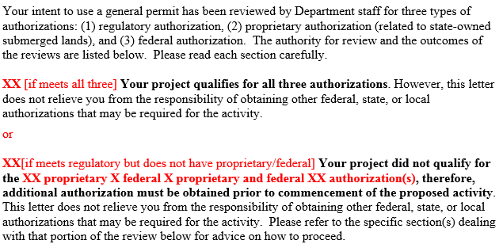
Modified GP template language makes it easy for applicants/agents to identify whether they have all three authorizations.
Notes:
This section is on the first page so that applicants/agents can easily tell if they have received all of the appropriate authorizations.

Slide 29
EXEMPTION VERIFICATION TEMPLATE

Slide 30

Regulatory Review- Verified
The template includes instruction and language for use in drafting both standard exemptions and de minimis exemptions.
General Conditions for Exemptions are included
within the body of the regulatory section. Red font Located under the heading identifies the specific 62-330.051 exemptions that require the inclusion of the General Conditions.
Notes:
Please note that the exemption template was revised so that we are “verifying” an exemption…. No longer “authorizing” the exempt activity. The regulatory approval section of the exemption template will also say verified instead of approved

Slide 31
Exemption Verification- New template based off
of the template located on the OPM. The
verification remains broken up into three sections.
Your request has been reviewed to determine whether it qualifies for (1) regulatory exemption, (2) proprietary authorization (related to state-owned submerged lands), and (3) federal approval that may be necessary for work in wetlands or waters of the United States.
XX[if meets all three]Your project qualifies for all three. However, this letter does not relieve you from the responsibility of obtaining other federal, state, or local authorizations that may be required for the activity.
or
XX[If meets regulatory but does not have proprietary/federal] Your project did not qualify for the XX proprietary review X federal review X proprietary and federal review XX portion(s) of this verification request. Additional authorization must be obtained prior to commencement of the proposed activity. This letter does not relieve you from the responsibility of obtaining other federal, state, or local authorizations that may be required for the activity. Please refer to the specific section(s) dealing with that portion of the review below for advice on how to proceed.
Notes:
This section is on the first page was revised so that applicants/agents can easily tell if they have received all of the appropriate authorizations.

Slide 32
QUESTIONS?
More information contact:
Allyson Minick, SLERC, Allyson.Minick@ dep.state.fl.us
(850)-245-8489, internal extension (58489)

