Slide 1

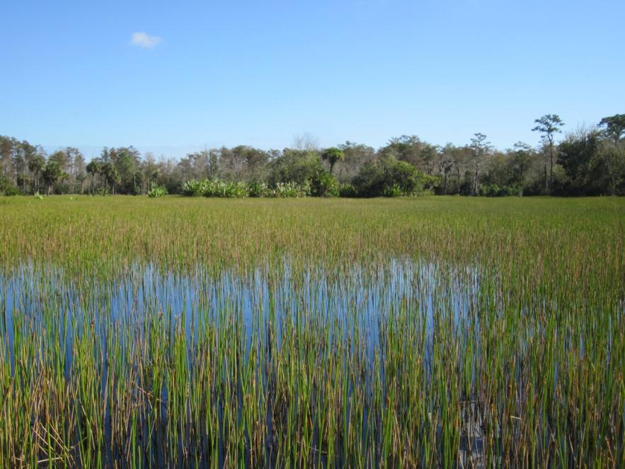


FDEP Webinar
Watershed Master Plan for Freshwater Wetlands
Tampa Bay, Florida
Maya Burke - Tampa Bay Estuary Program
Thomas Ries - Scheda Ecological Associates, Inc.
Special thanks to Rhonda Evans (US EPA) and Lindsay Cross (formerly TBEP)

Slide 2
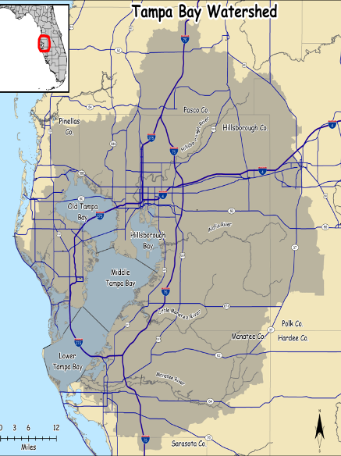
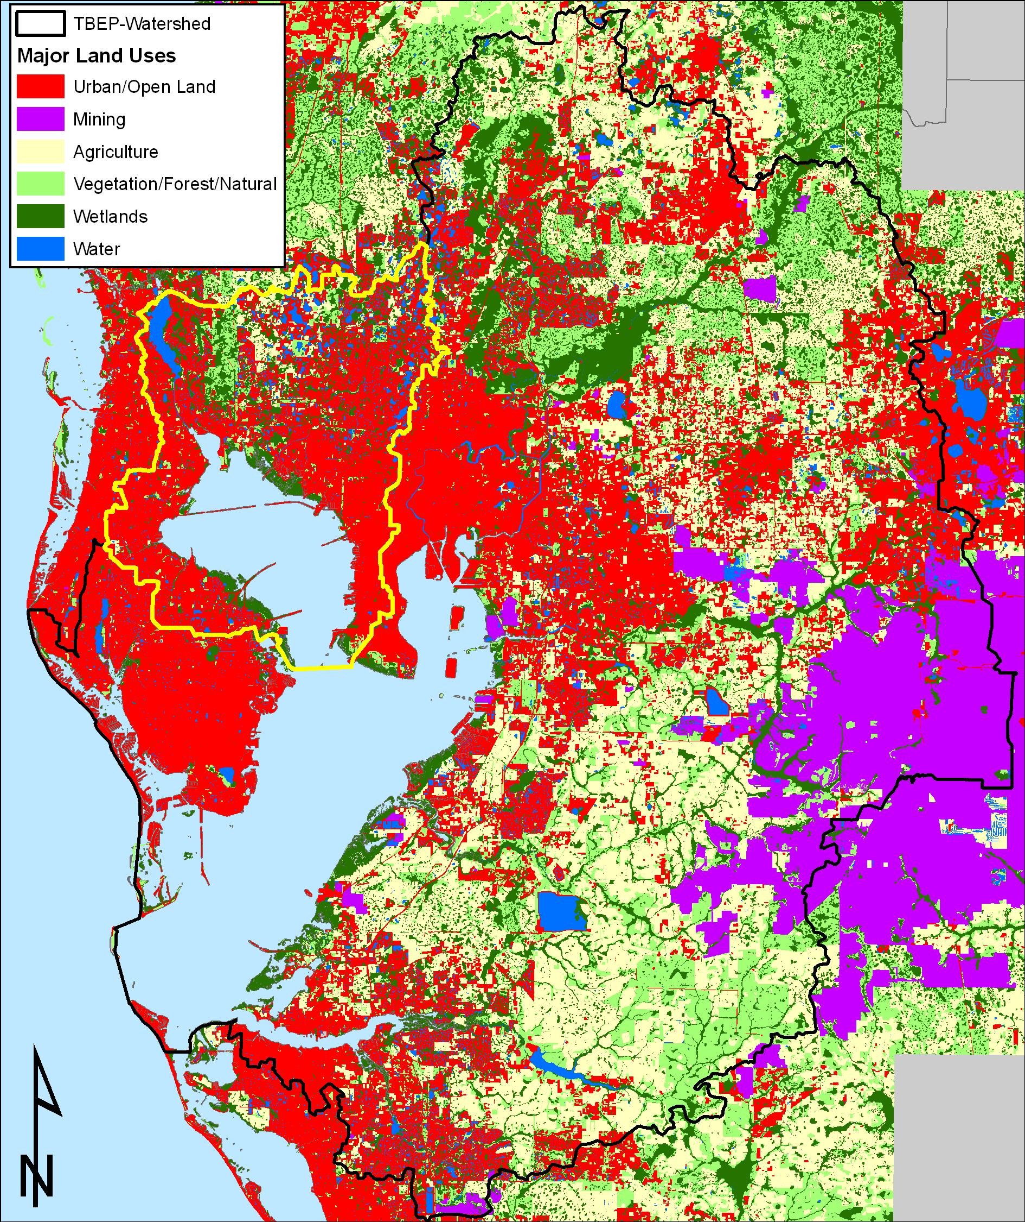

Project Study Area is Tampa Bay Watershed
Tampa Bay, Florida
Florida’s largest open water estuary
Watershed of mixed uses
Population of 2.3 Million
Source: Janicki Environmental, Inc.; E. Sherwood, TBEP

Slide 3
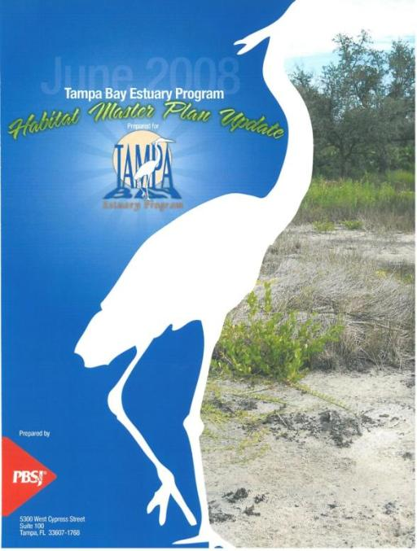
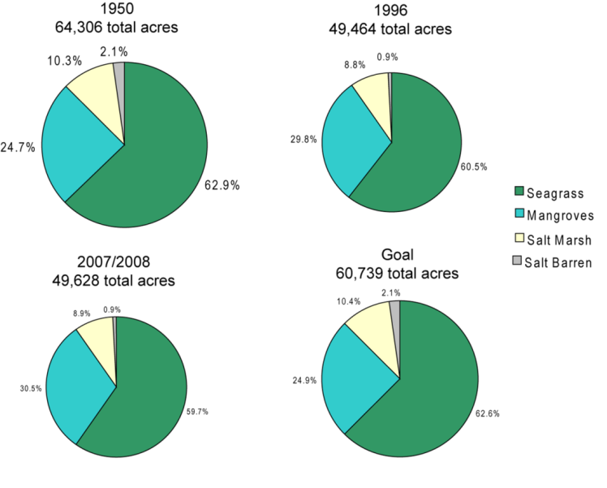
Tampa Bay Habitat Master Plan - Set goals for Estuarine Habitats
Establishes habitat restoration paradigms for estuarine habitats in and around Tampa Bay
“Restore the Balance” approach recognizes habitats that have been “disproportionately impacted”
Source: Robison, 2010

Slide 4
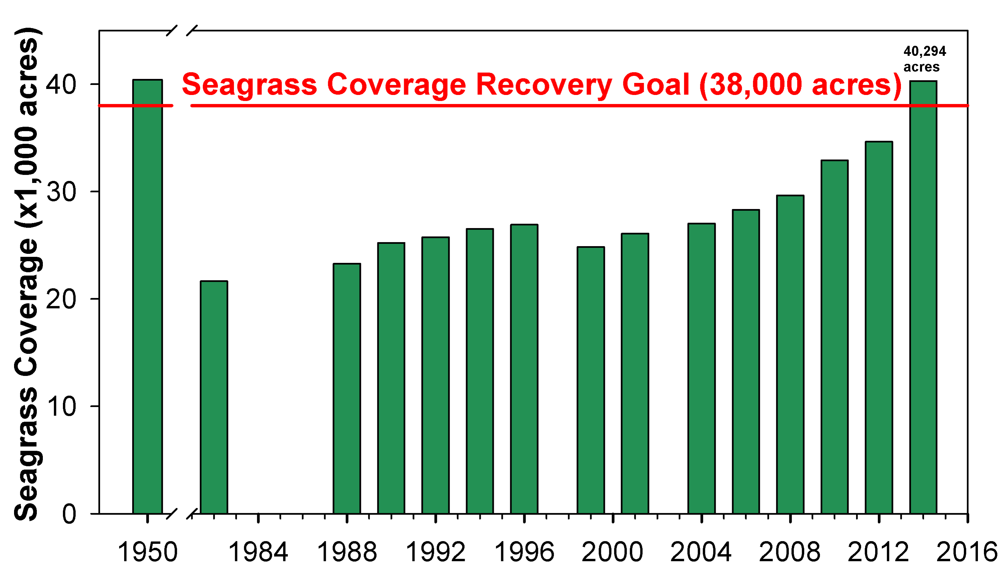
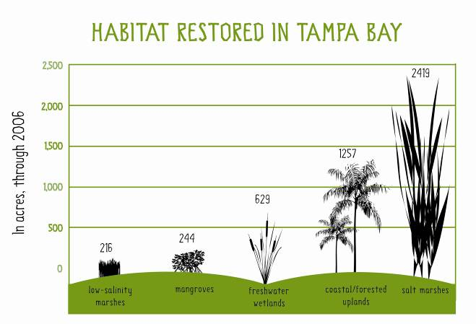
Tampa Bay - Gains in Estuarine Habitats
Seagrass Acreage is higher than in the 1950s
Restoration has led to gains in other habitats – mangroves, marshes, and coastal uplands
Source: SWFWMD, 2013; Robison, 2010

Slide 5
Target Setting Process
Project Tasks:
Mapped 1950s and 2007/2008 freshwater wetlands
Develop watershed and basin-specific freshwater wetland restoration and protection targets
Identify appropriate locations for restoration/mitigation
Improve federal-state-local regulatory coordination

Slide 6
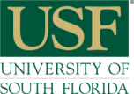

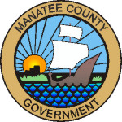
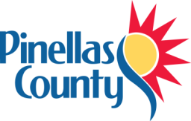
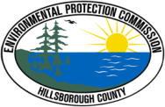
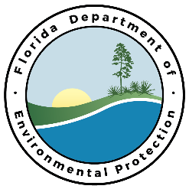
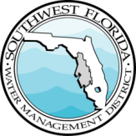

Overall Project Goal
Encourage publicly- and privately-funded mitigation to help meet restoration goals for freshwater wetlands
Project Partners
EPA Region IV Wetlands Development Grant
Technical Consultants
Local, state and federal partners and advisors

Slide 7
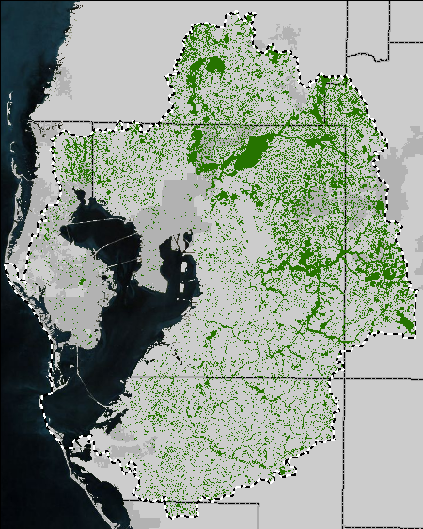
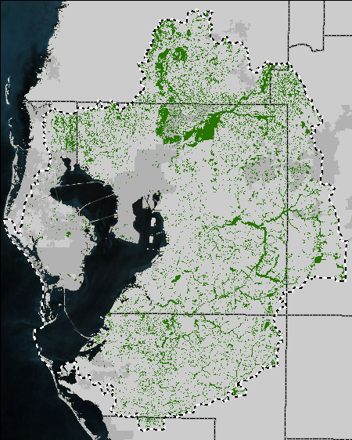

Wetland Mapping and Change Analyses
1950s
2007
Source: USF, 2012

Slide 8
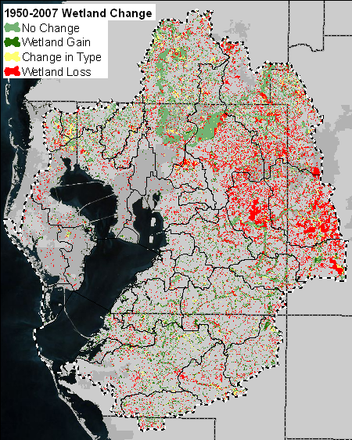
Aggregate changes throughout watershed
Wetland Loss | 153,900 acres
Wetland Gain | 51,080 acres
Change in Type | 36,200 acres
approximate acreages
Source: USF, 2012

Slide 9
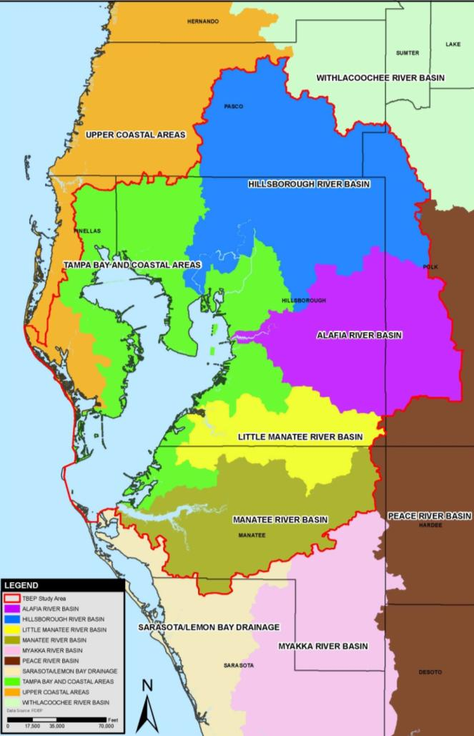
Talking the talk: formatting results for regulatory agencies
Environmental Resource Permitting (ERP) basin boundaries used
General rule: impacts to wetlands must be mitigated for in the same ERP basin
Source: Scheda, 2013

Slide 10
Freshwater Wetland Changes by Structure Type & Basin
Wetland Gains
Alafia Hillsborough Little Manatee Manatee TB Coastal Upper Coastal
Source: Scheda, 2013

Slide 11
Targets developed to address disproportional impacts: Alafia River Basin example
 | Acres |  | Proportion of Totals |  | Restore the Balance (ac) | What it Takes (ac)
Hydrologic/Structure Classification | 1950 | 2007 | 1950 | 2007 | Target | Delta
Forested/Lacustrine | 3,216 | 382 | 0.04 | 0.01 | 1,254 | 871
Forested/Other | 3,961 | 1,544 | 0.05 | 0.04 | 1,544 | 0
Forested/Riverine | 43,314 | 21,743 | 0.55 | 0.62 | 21,743 | 0
Forested Subtotal | 50,491 | 23,670 | 0.64 | 0.68 | 24,541 | 871
Non-Forested/Lacustrine | 4,759 | 1,252 | 0.06 | 0.04 | 1,856 | 603
Non-Forested/Other | 4,613 | 3,945 | 0.06 | 0.11 | 3,945 | 0
Non-Forested/Riverine | 19,424 | 5,977 | 0.24 | 0.17 | 7,573 | 1,595
Non-Forested Subtotal | 28,796 | 11,175 | 0.36 | 0.32 | 13,373 | 2,199
Total | 79288 | 34845 | 1.00 | 1.00 | 37,914 | 3,070
Least Impacted Current Acres = Target Acres (X)
Least Impacted Benchmark Proportion Target Benchmark Proportion
OR
(Forested/Other Acres) 1,544 = (Forested/Lacustrine Acres) X
(Forested/Other Proportion) 0.05 (Forested/Lacustrine Proportion) 0.04
Source: Scheda, 2013
Notes:
Figure 3-3.2.6

Slide 12
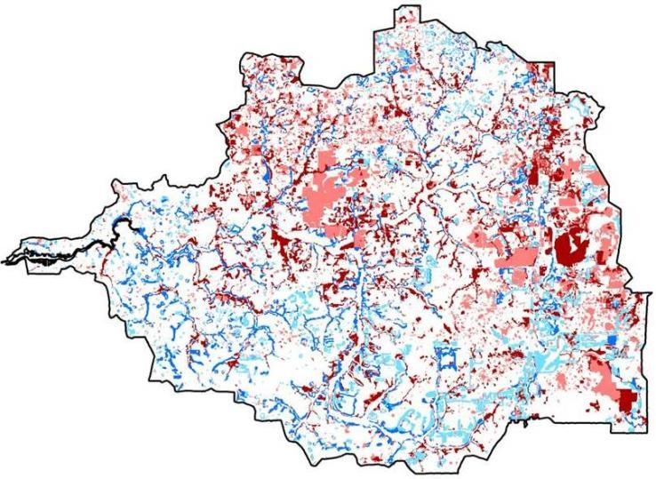
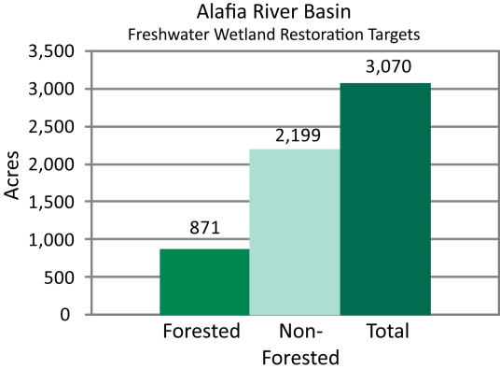
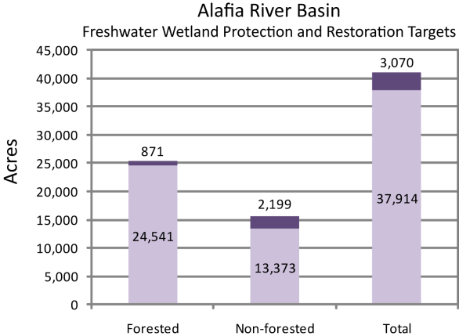
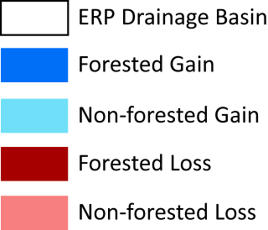
Alafia River Basin freshwater wetland targets
Source: Scheda, 2013
Notes:
Figure 2-2.2.1 (refer to Table 2-2.2.1)

Slide 13
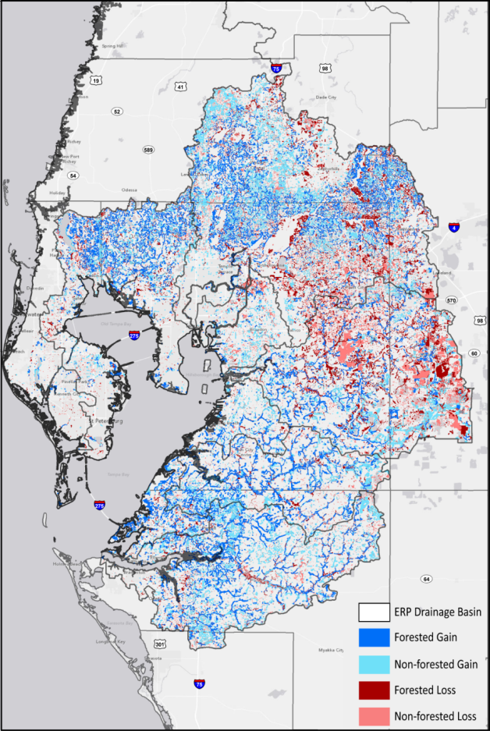
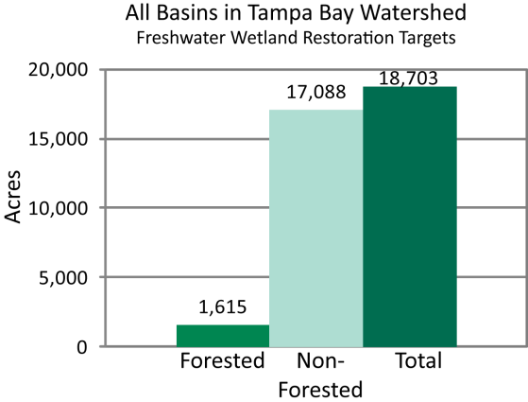
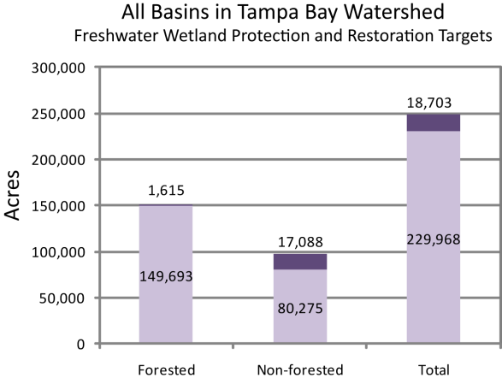
Overall Tampa Bay Watershed Freshwater Wetland Targets
Source: Scheda, 2013
Notes:
Figure 2-2.2.1 (refer to Table 2-2.2.1)

Slide 14
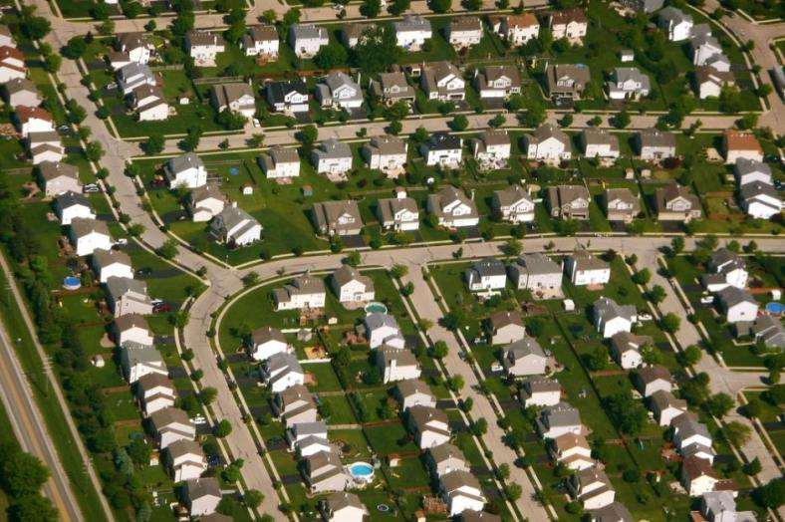
Reality Check: Are these goals attainable?
Is there sufficient acreage in each basin?
If so, where could future restoration occur?
Source: evansheline.com; G&K Development
Notes:
Figure 2-2.2.1 (refer to Table 2-2.2.1)

Slide 15
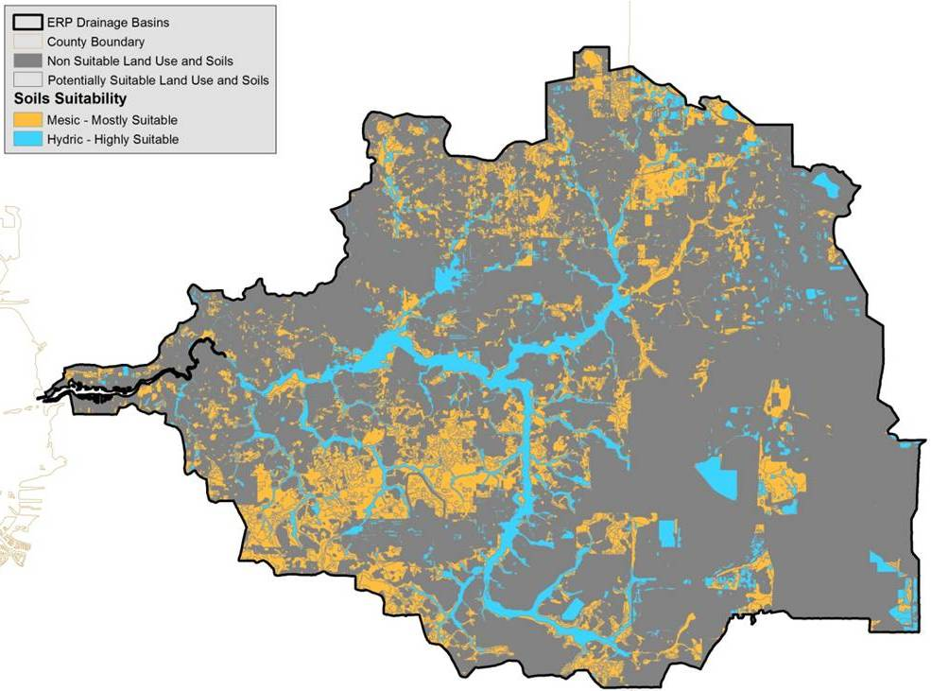
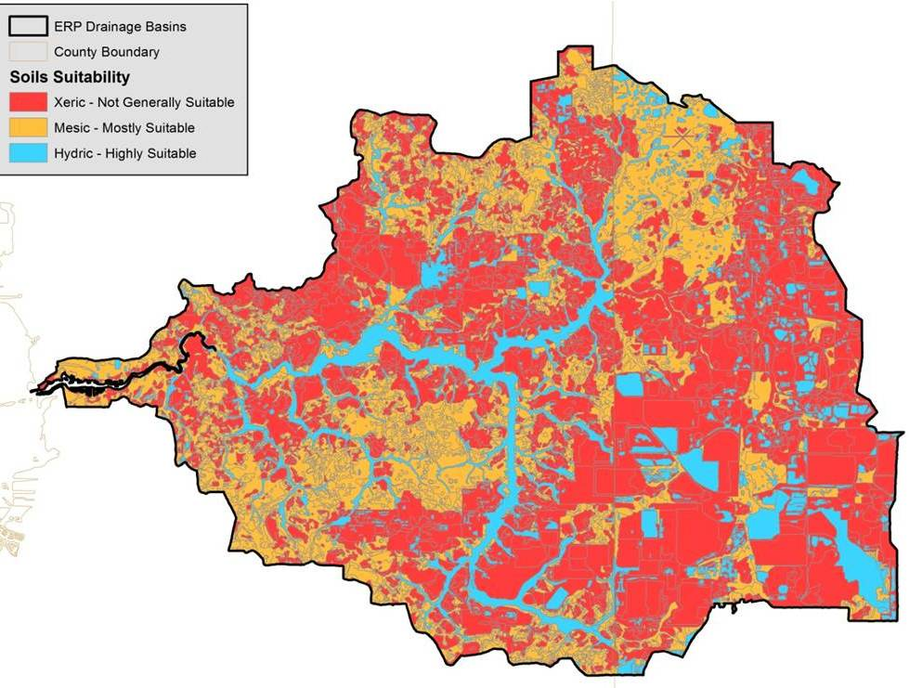
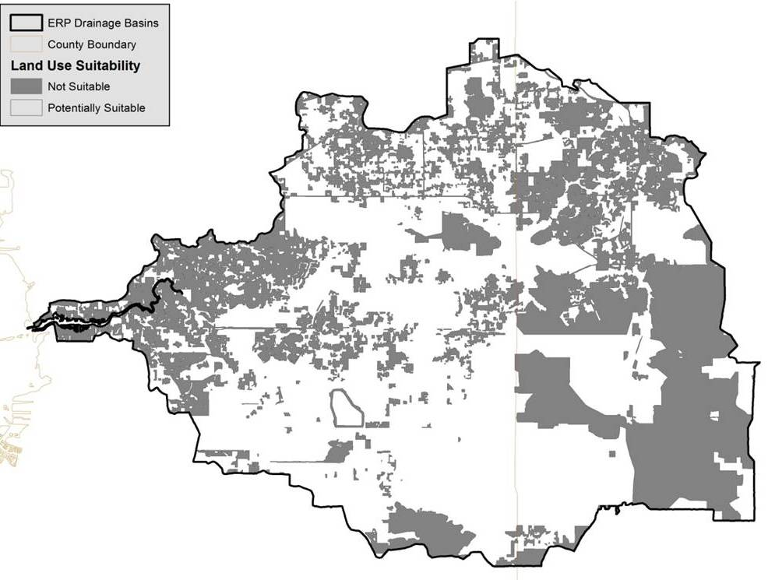
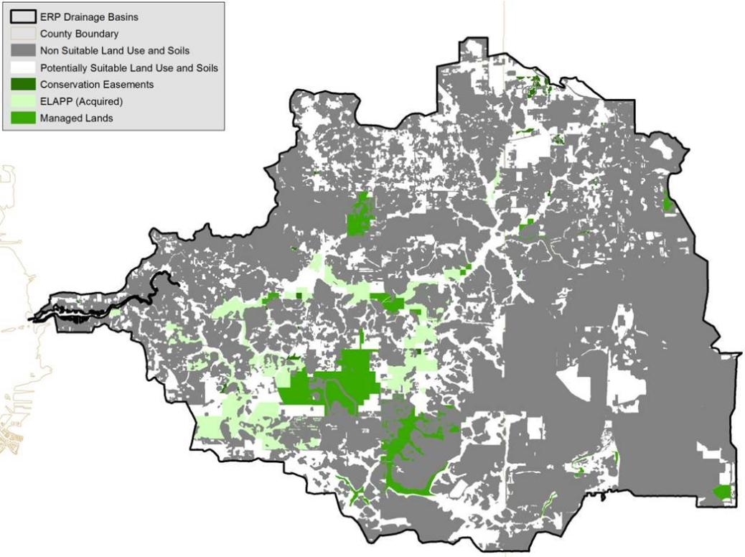

Potentially Restorable Areas in Alafia River Basin
Goal:
Forested: 871 acres
Non-forested: 2,199 acres
Source: Scheda, 2013
Notes:
Figure 2-2.2.1 (refer to Table 2-2.2.1)

Slide 16
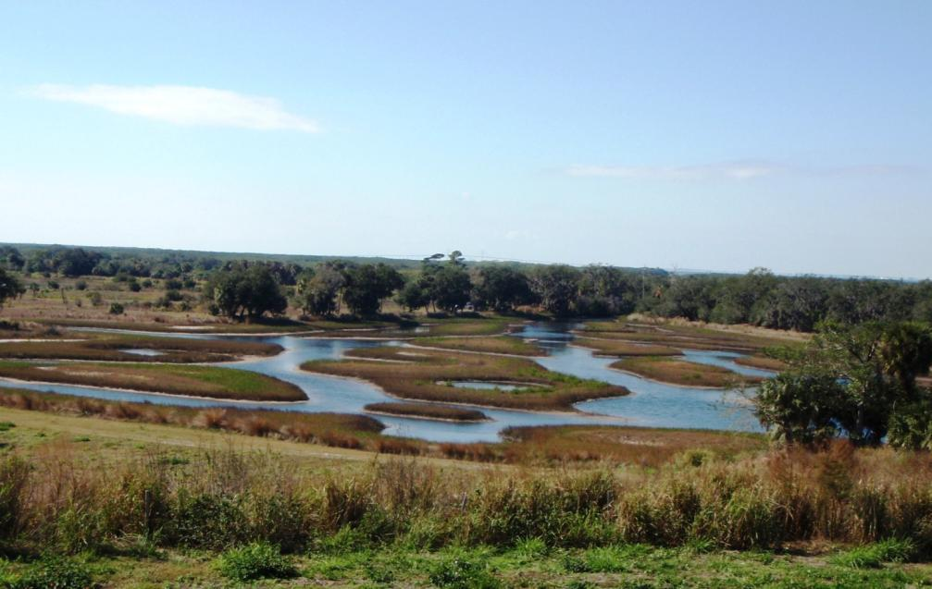
Now what? Who will use this information and how?
Resource Managers: results will help them to prioritize WHAT habitats to restore and WHERE restoration may be most beneficial
Estuarine restoration targets have been incorporated into other local and regional habitat plans
Source: L. Cross, TBEP

Slide 17

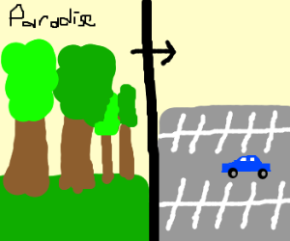
Proposed Concept: Coordination with Regulatory Agencies
Use privately-funded mitigation to advance habitat restoration goals that have been vetted by the science and management community
And return some of to this
Back to this!
Source: drawception; USF

Slide 18
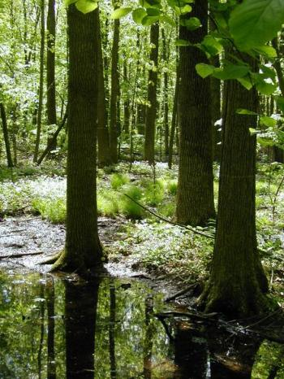
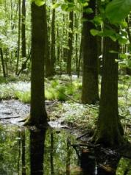
Proposed Concept: Assess Historic Conditions
Recommend that future freshwater wetland mitigation options consider whether forested mitigation is appropriate
Example:
3.0 units Functional Gain
3.0 units Functional Loss
Source: Gary F. Marx; Scheda, 2013

Slide 19
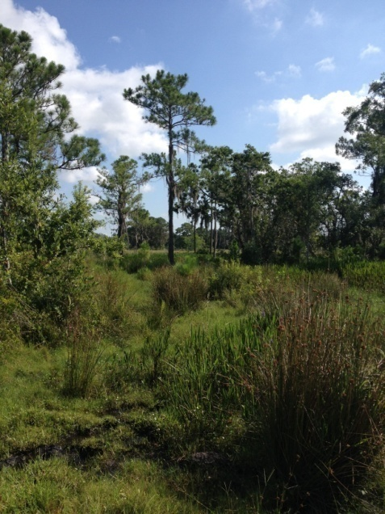

Restore the Balance: Approach
If historically non-forested = herbaceous mitigation solution

Slide 20
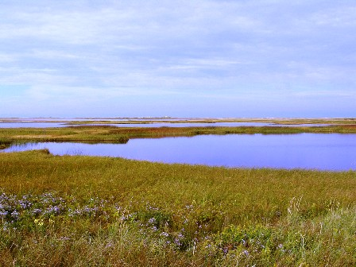
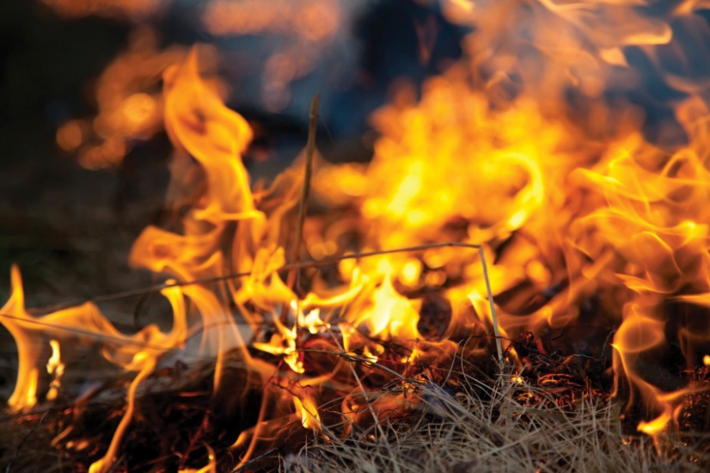
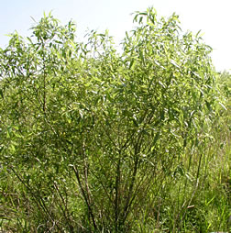
Many Herbaceous Systems have Transitioned to Scrub/shrub or Forested Wetlands
High quality herbaceous wetland
Change in fire or hydrologic regime(s)
Poorer quality scrub/shrub system:
Carolina willow encroaching into herbaceous marsh
Source: Floridian Nature; texasagriculture.gov, St. John’s River WMD

Slide 21
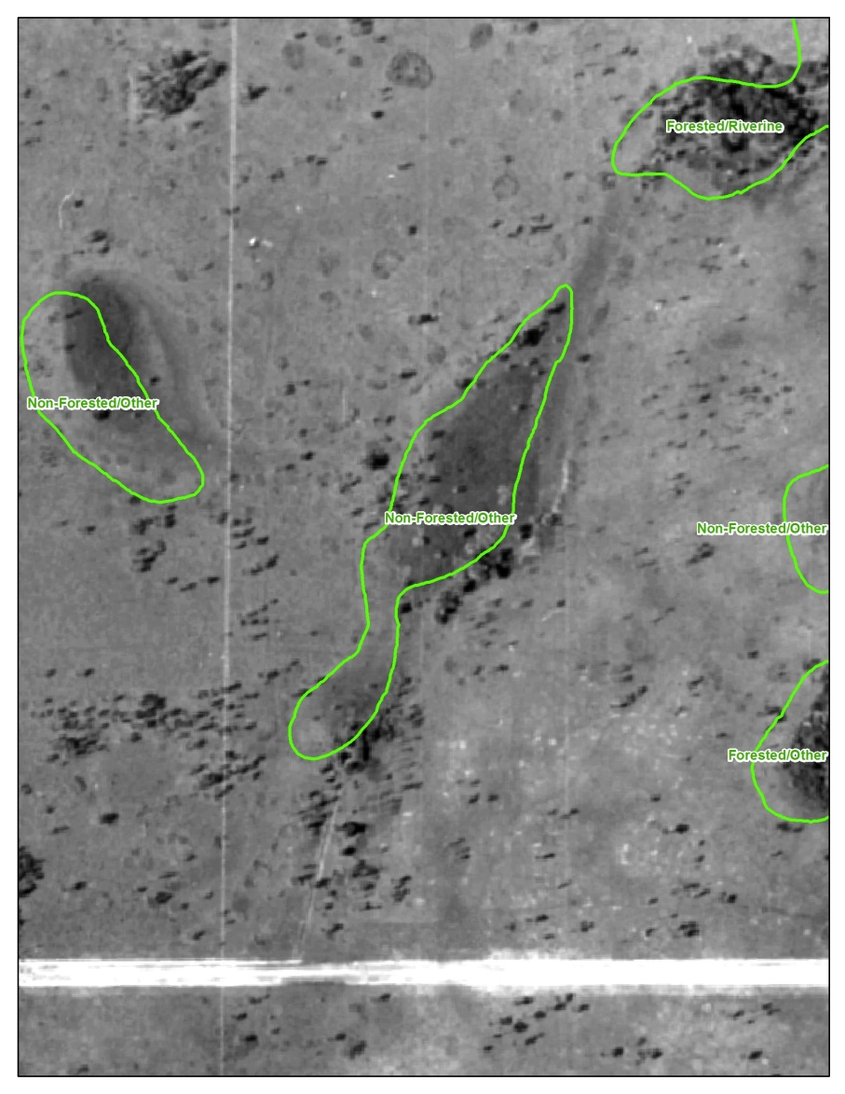
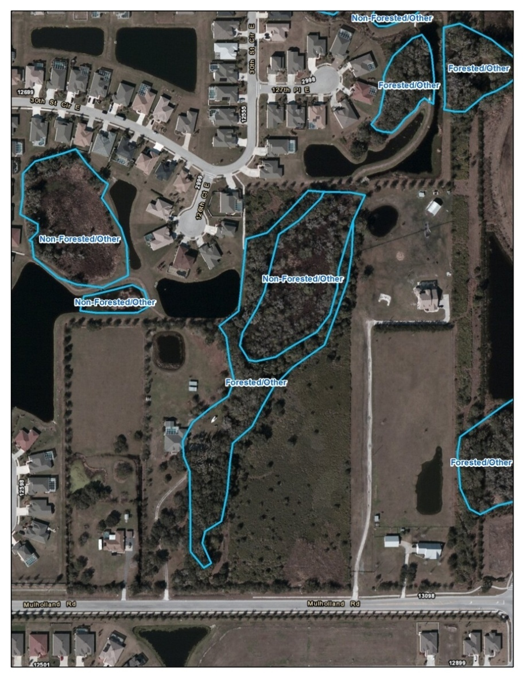
Utilize HISTORIC Wetland Type for Mitigation Solutions
1950
2007

Slide 22
Provision already included in FDEP’s ERP Applicant Handbook, Volume 1
Section 10.3.1.1: In general, mitigation is best accomplished through creation, restoration, enhancement, or preservation of ecological communities similar to those being impacted. However, when the area proposed to be impacted is degraded, compared to its historic condition, mitigation is best accomplished through creation, restoration, enhancement or preservation of the ecological community that was historically present.

Slide 23
Pre-Application Meetings with Regulatory Agencies & Applicants
Review historic aerials of any potential unavoidable wetland impacts
Determine whether they were historically herbaceous systems
Discuss the potential to mitigate these impacts with herbaceous wetlands even if the current wetland has some native trees

Slide 24
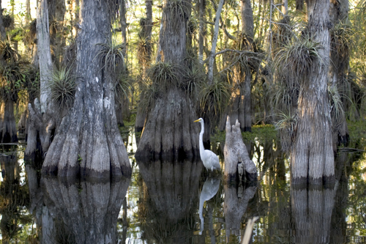
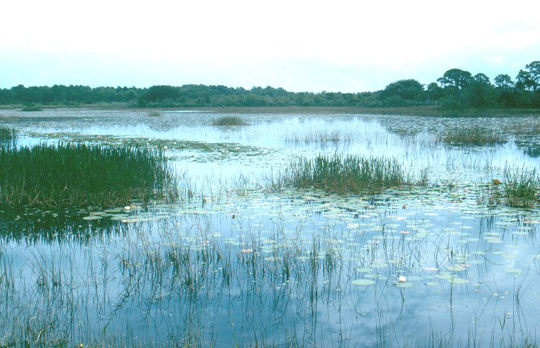
Benefits for Agencies, Applicants and Ecology
Permitting agencies: can work with existing regulations
Applicant: can purchase credits or perform mitigation to match historic conditions
Ecology: no loss of “good quality” forested systems plus a gain of “good quality” herbaceous systems
Protect Existing Forested Wetlands
Create New Non-Forested Wetlands
Source: US National Park Service; FDEP

Slide 25
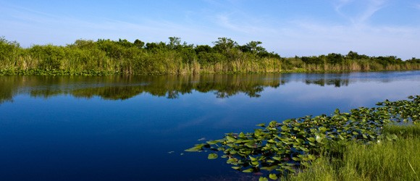
Steps
1. Approval of master plan for freshwater wetlands in Tampa Bay watershed - completed
Public partners:
Include freshwater wetland restoration and protection goals in habitat plans
Permitting partners:
Examine inclusions of disproportionate losses during the mitigation permitting process
Private partners:
Encourage restoration of non-forested wetlands through mitigation banks and/or off-site mitigation plans
MORE ECOLOGICALLY BENEFICIAL freshwater wetland mitigation
and restoration

Slide 26
Next Steps
Priority: NO NET LOSS of WETLAND FUNCTION
What regulatory mechanisms exist that can help to direct mitigation towards wetland categories that have had disproportionate losses?
Possible mechanisms were identified by regulatory partners:
Watershed profiles (ACOE)
Regionally significant habitats (SWFWMD, FDEP)
Guidance Memo (FDEP)
Source: strangetravel.com

Slide 27
Final Step
2. Regulatory Approval of Approach for Permitting
All Regulatory Agencies Onboard:
U.S. Army Corps of Engineers
Florida Department of Environmental Protection
Southwest Florida Water Management District
Environmental Protection Commission - Hillsborough County

Slide 28
Summary
TBEP has extensive ecosystem knowledge demonstrating a disproportional impact to herbaceous freshwater wetlands
Existing rule provision can be applied Statewide

Slide 29
Questions?
Tampa Bay Freshwater Wetland Master Plan – https://www.tbeptech.org/TBEP_TECH_PUBS/2014/TBEP_05_15_Freshwater_Wetland_Master_Plan.pdf
Maya Burke - Tampa Bay Estuary Program
  727.893.2765
  mburke@tbep.org
Thomas Ries - Scheda Ecological Associates
  813.989.9600
  tries@scheda.com

Slide 30
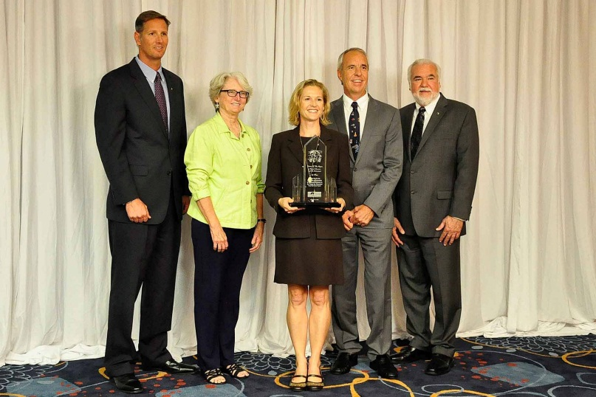
Award-Winning Project!
1st Place
Natural Resources/Environment Category
2015 Future of the Region Awards
Tampa Bay Regional Planning Council
March 27, 2015

