Slide 1
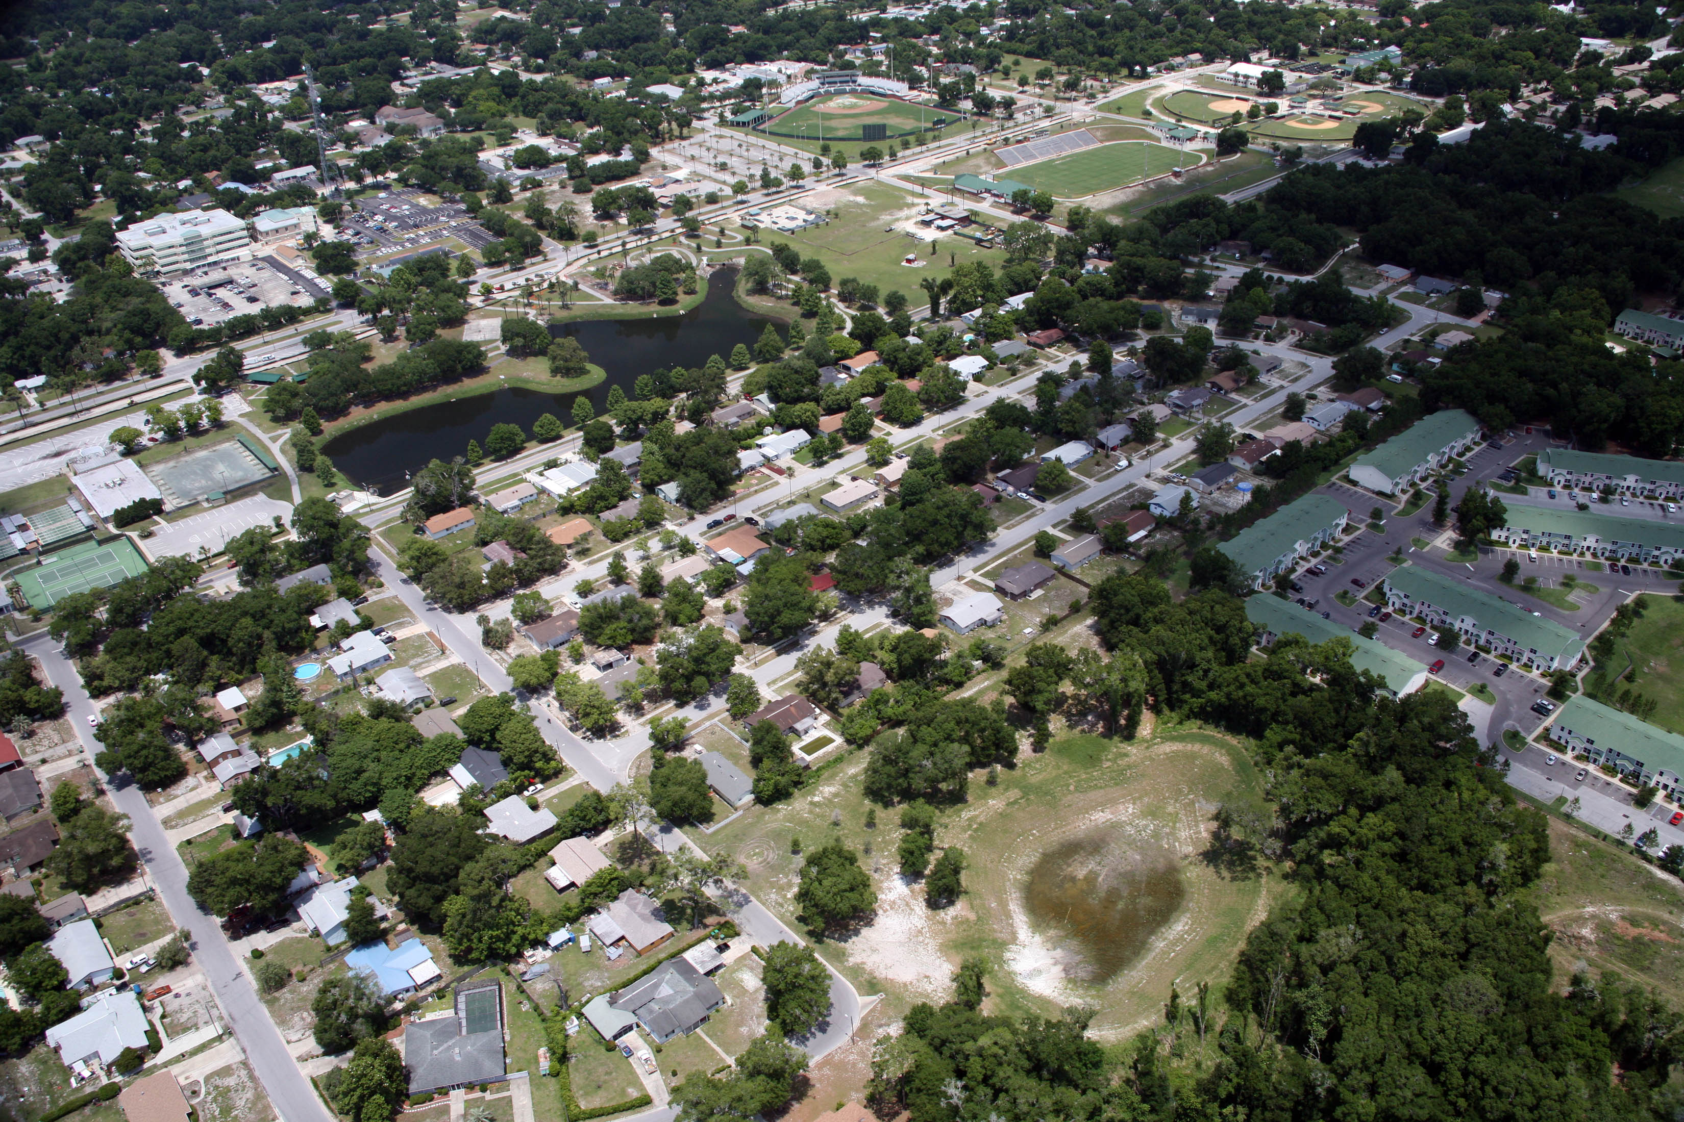
Groundwater/surface-water
Interaction, Aquifers and Springs
OLLI Karst Geology Course
Lecture 3, Harley Means

Slide 2
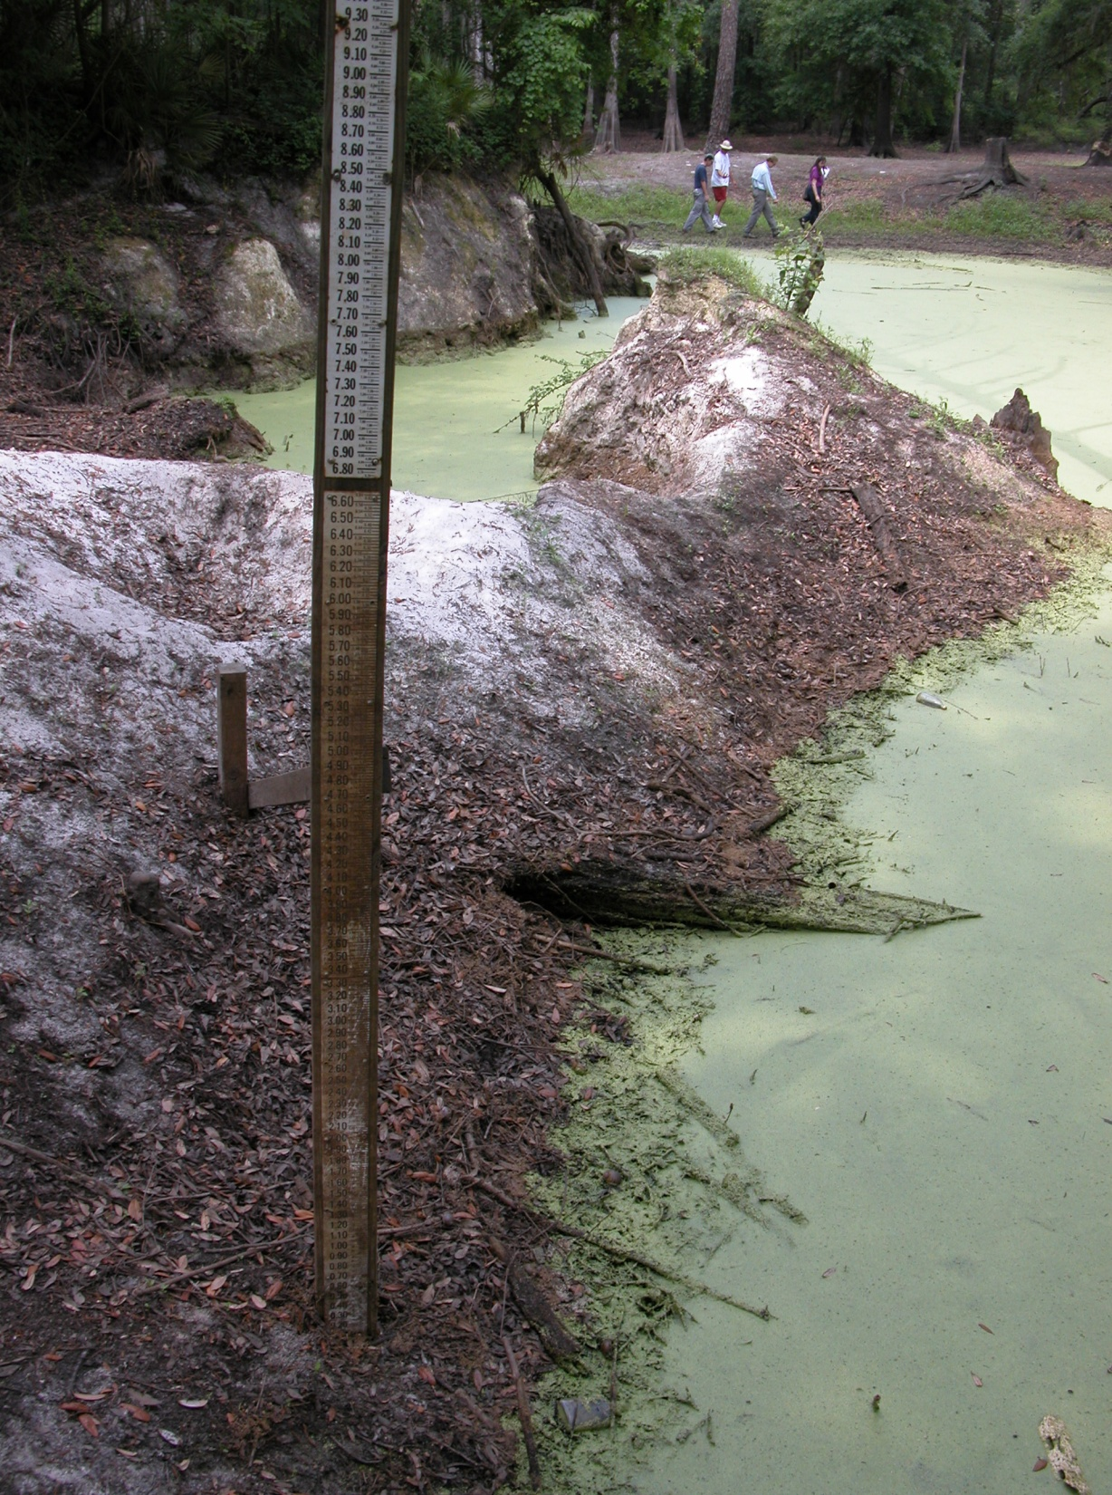
Because of Florida’s karst
terrain, surface water and
groundwater interact and
are essentially the same
Rapid recharge occurrs through swallets.
Stormwater enters here and reaches Wakulla in 18 – 19 days.
Surface water becomes groundwater rapidly.
Why is this important?
Ames Sink

Slide 3
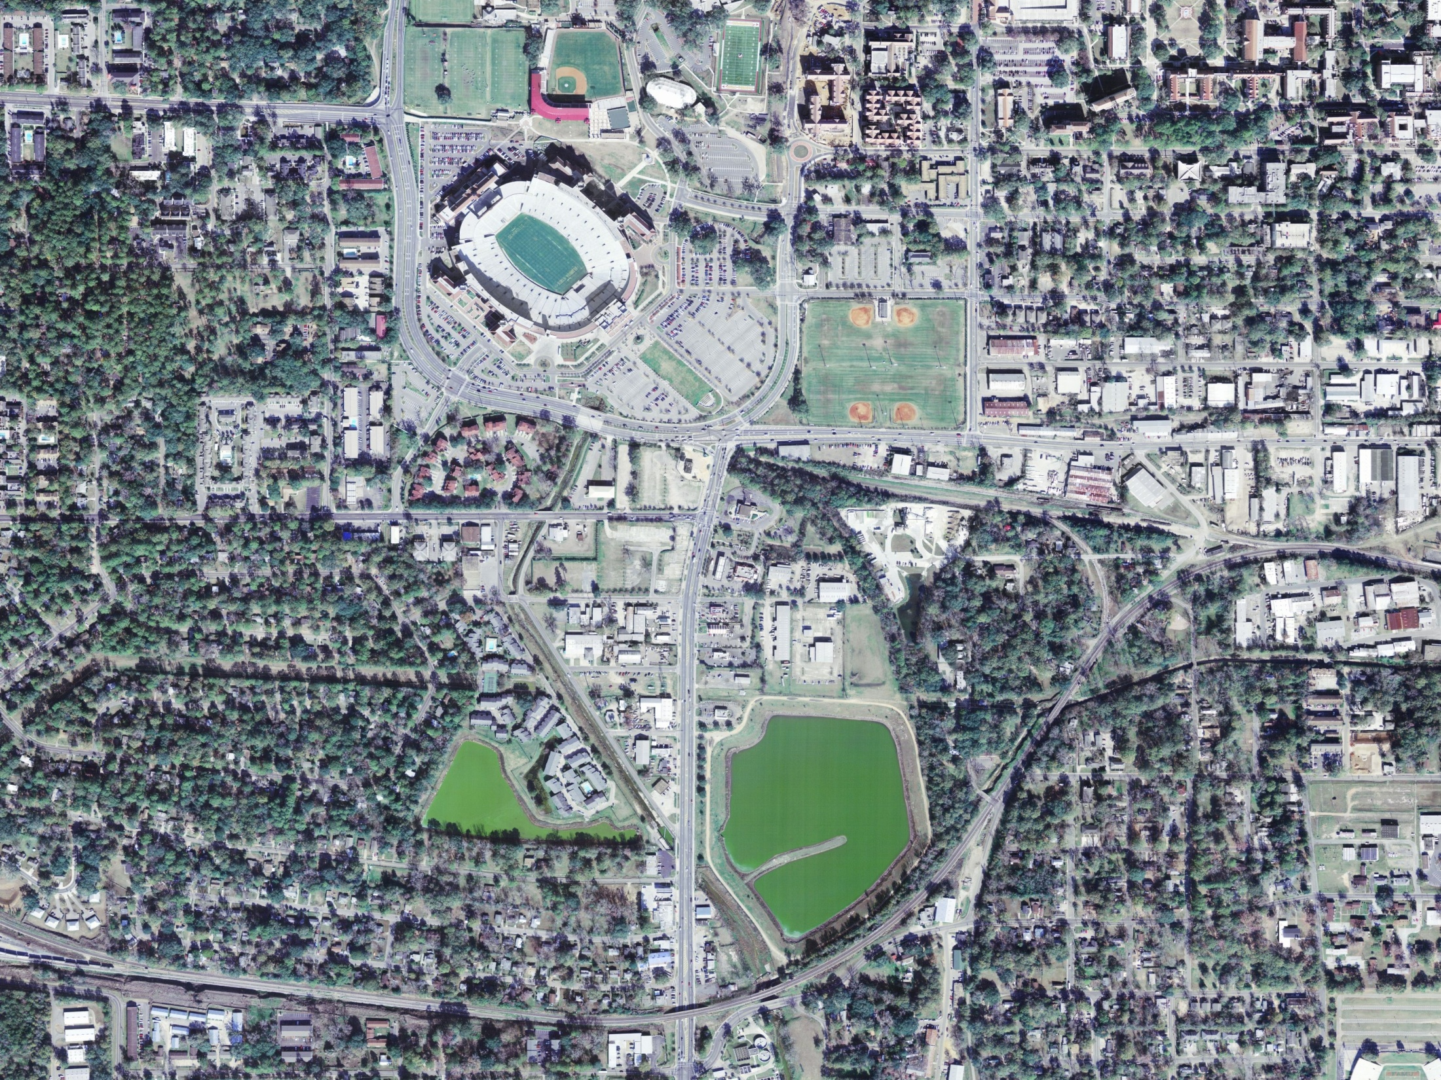

Slide 4
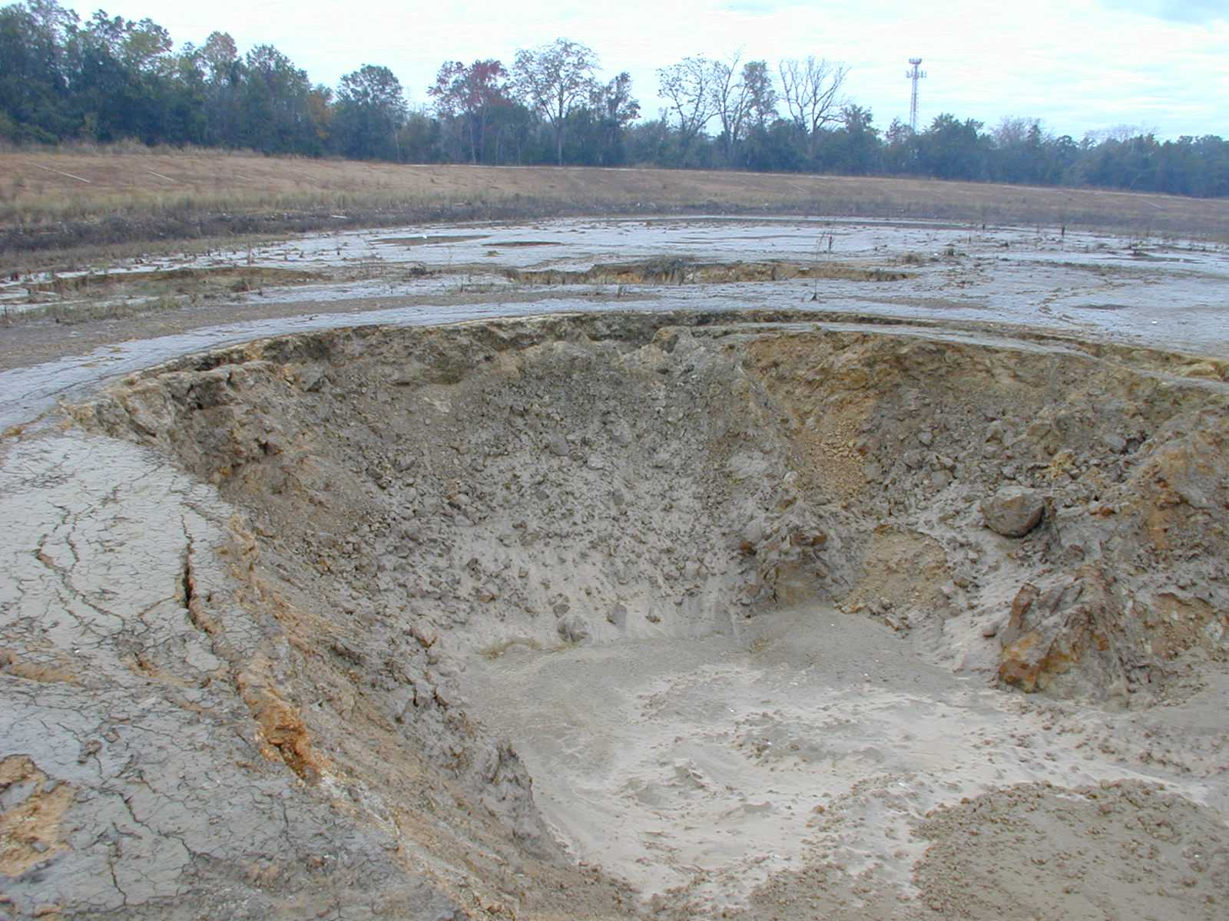

Slide 5
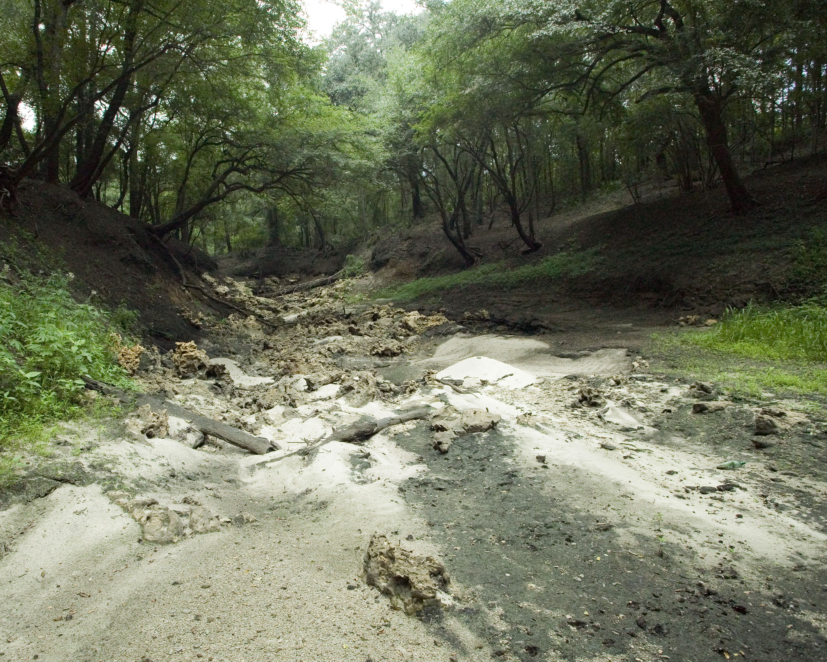

Slide 6
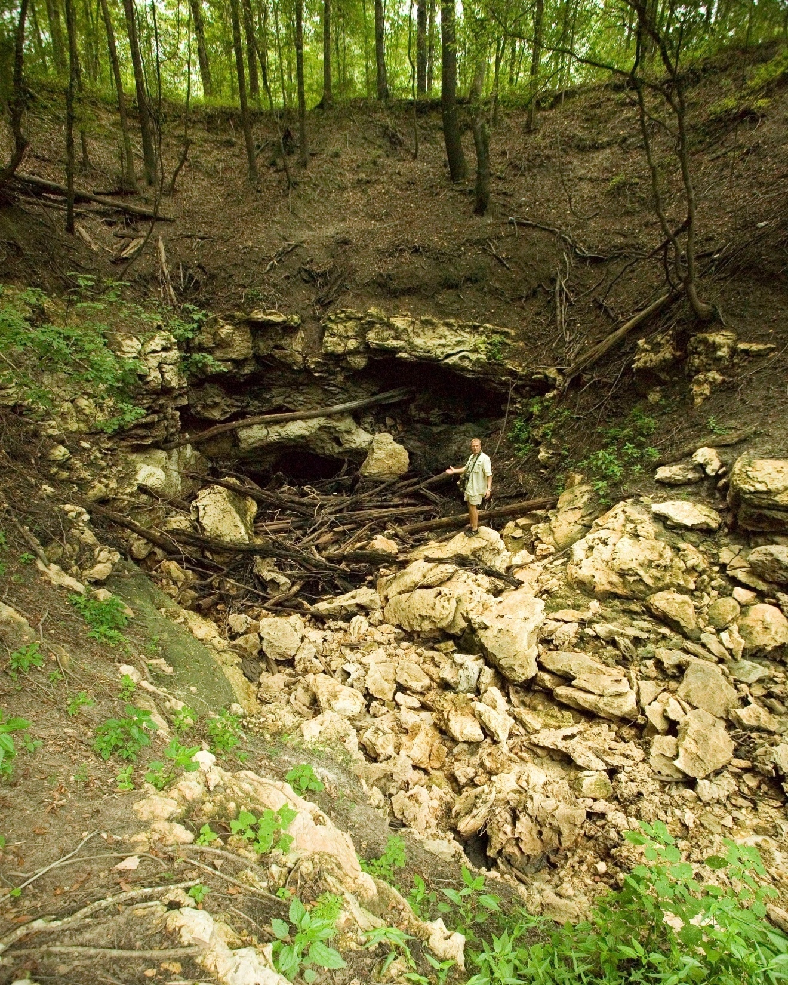

Slide 7
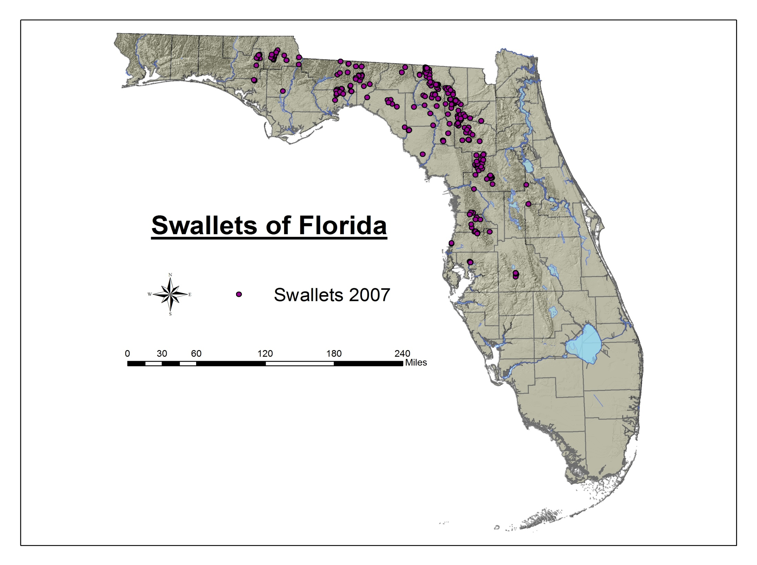

Slide 8
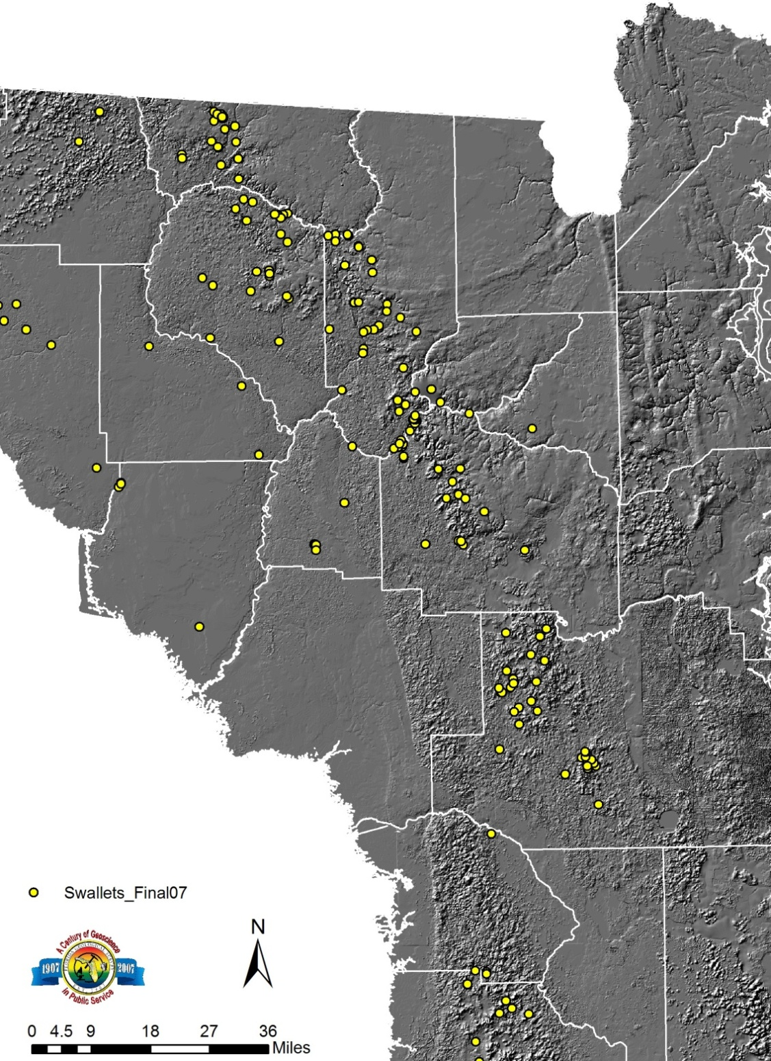
Where do swallets occur and why?
Swallets tend to occur along the transition between the highland areas and karst plains in Florida. This is because of differences in the underlying geology. The highland areas are underlain by clays and clayey sands that support surface runoff. Surface water in creeks and streams can flow toward the karst regions where limestone is near the surface and all drainage is internal. At the interface between the clayey uplands and the karst plains is where most swallets are concentrated.

Slide 9
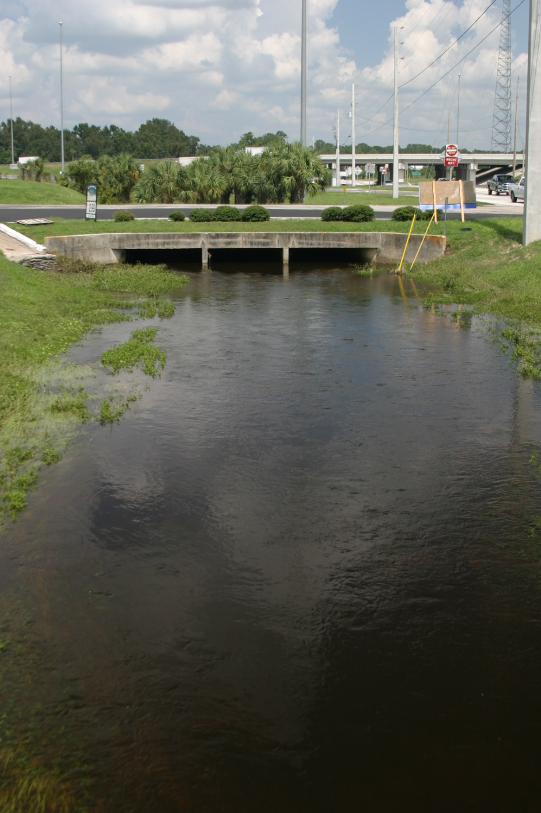
What is in stormwater?
Nurtients – phosphorus, nitrate
Turbidity – sand, clay
Organic chemicals – petroleum
Really anything that humans can produce can end up in stormwater!

Slide 10
Potential Groundwater Contaminants and Sources
Nitrates
  Fertilizers and animal excrement
  Atmospheric deposition
Synthetic Organic Compounds (including petroleum products)
  Underground storage tanks; tank farms
  Transfer stations
  Pesticides
  Pharmaceuticals
  Industry and manufacturing
  Dry cleaners
  Disposal sites

Slide 11
Continued
Trace Metals
  Battery storage facilities
  Disposal sites
  Fertilizers/pesticides
Bacteria and other microbiota
  Septic tanks
  Animal waste
Sodium, Chloride, Sulfate, TDS,
  Over pumping of GW in springsheds causing intrusion of salt-water
Miscellaneous
  Waste disposal sites

Slide 12
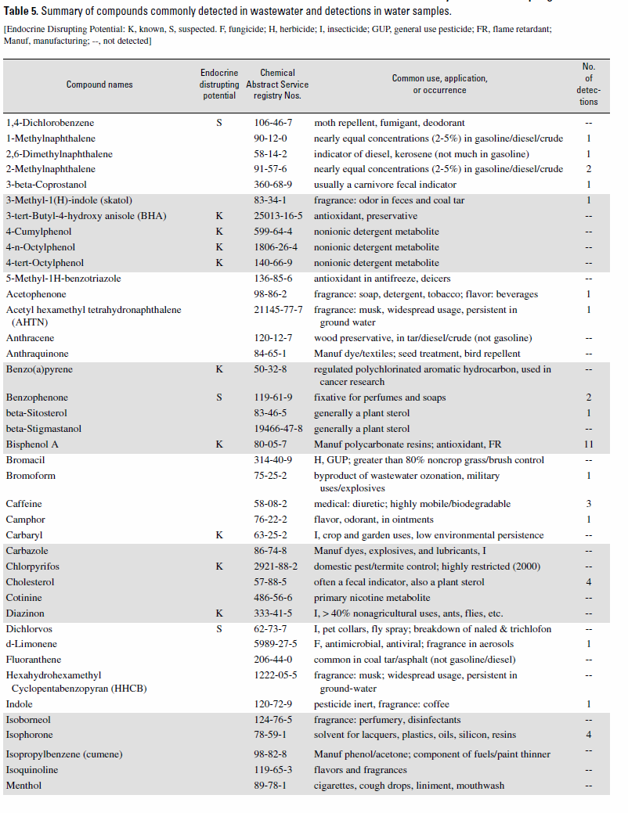
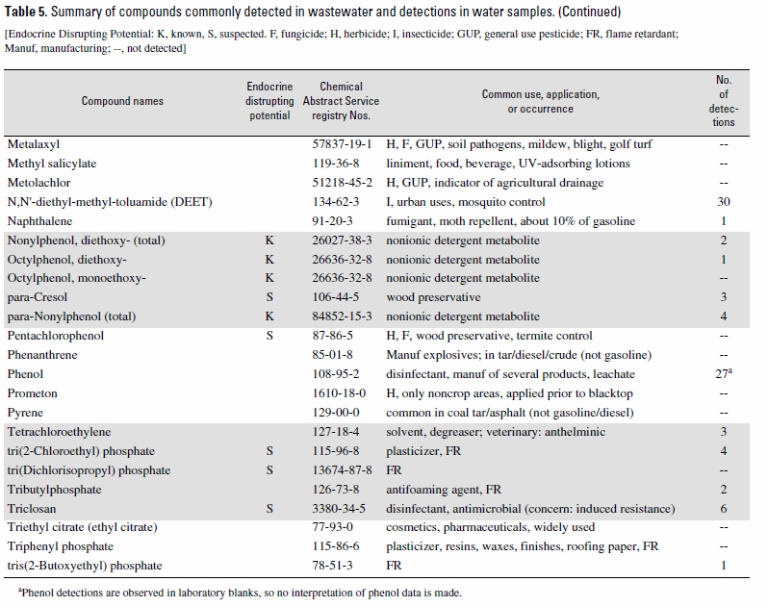
From Phelps, 2004

Slide 13
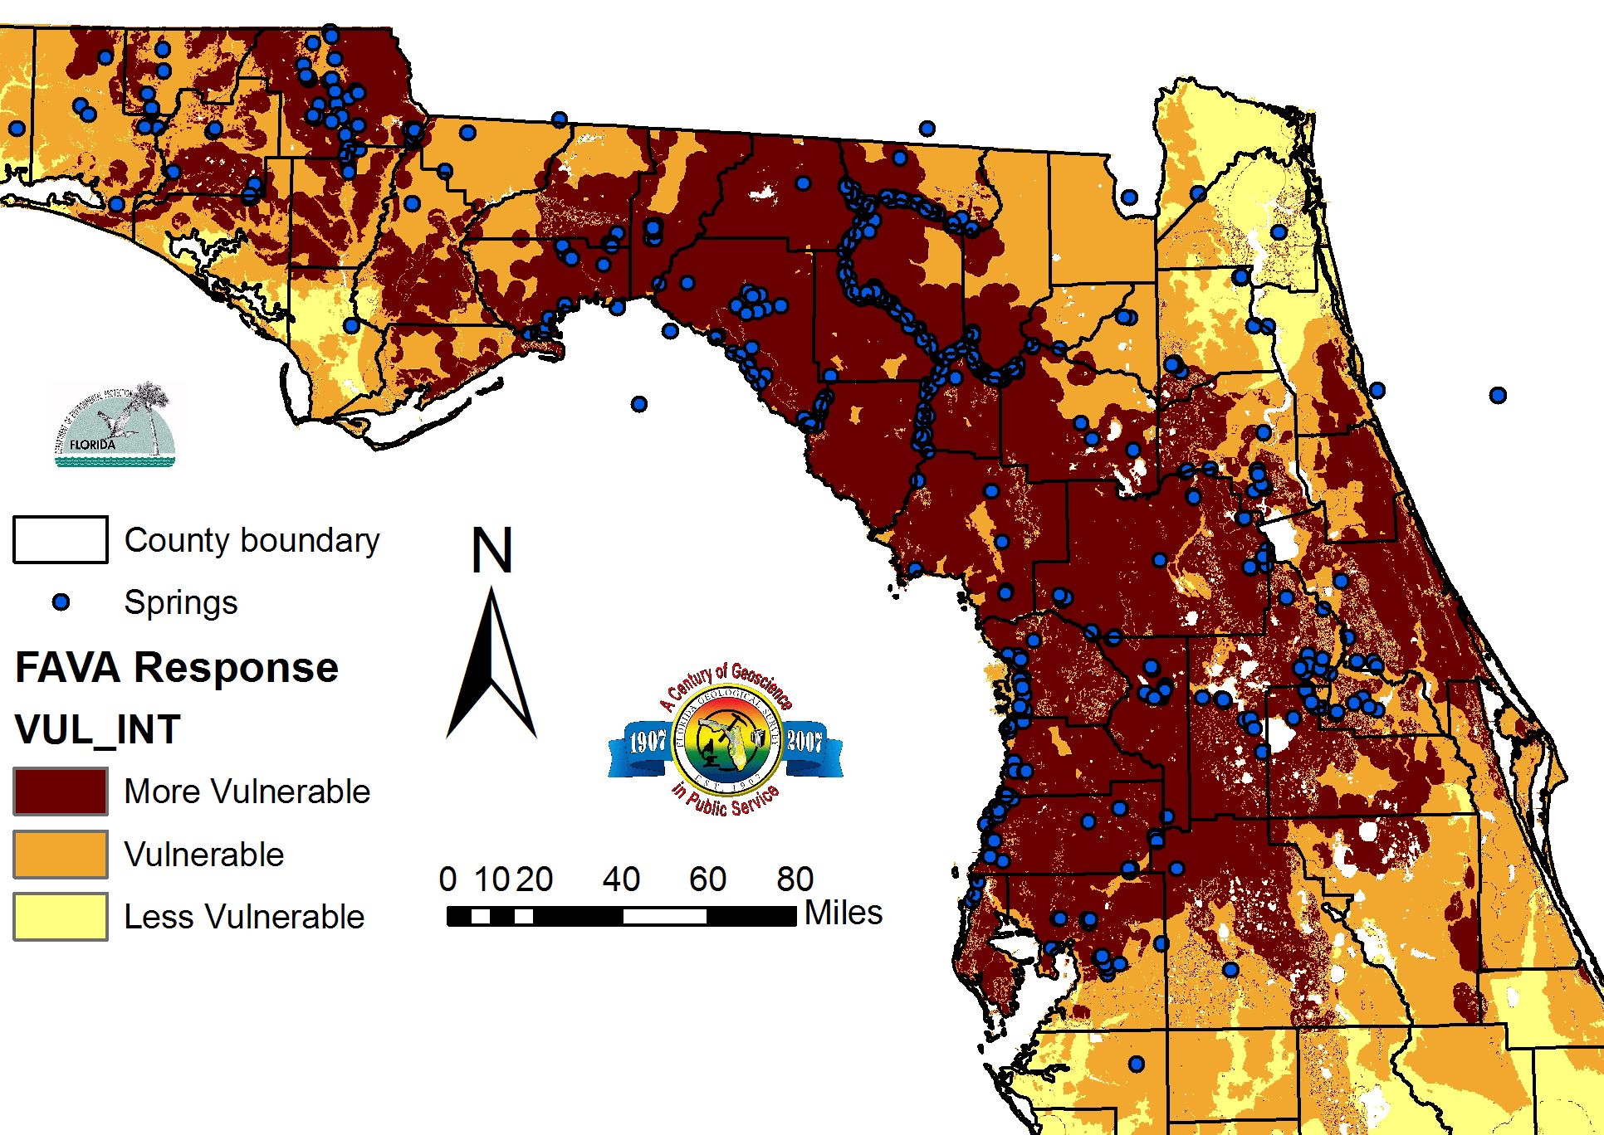
Karst makes our groundwater vulnerable!

Slide 14
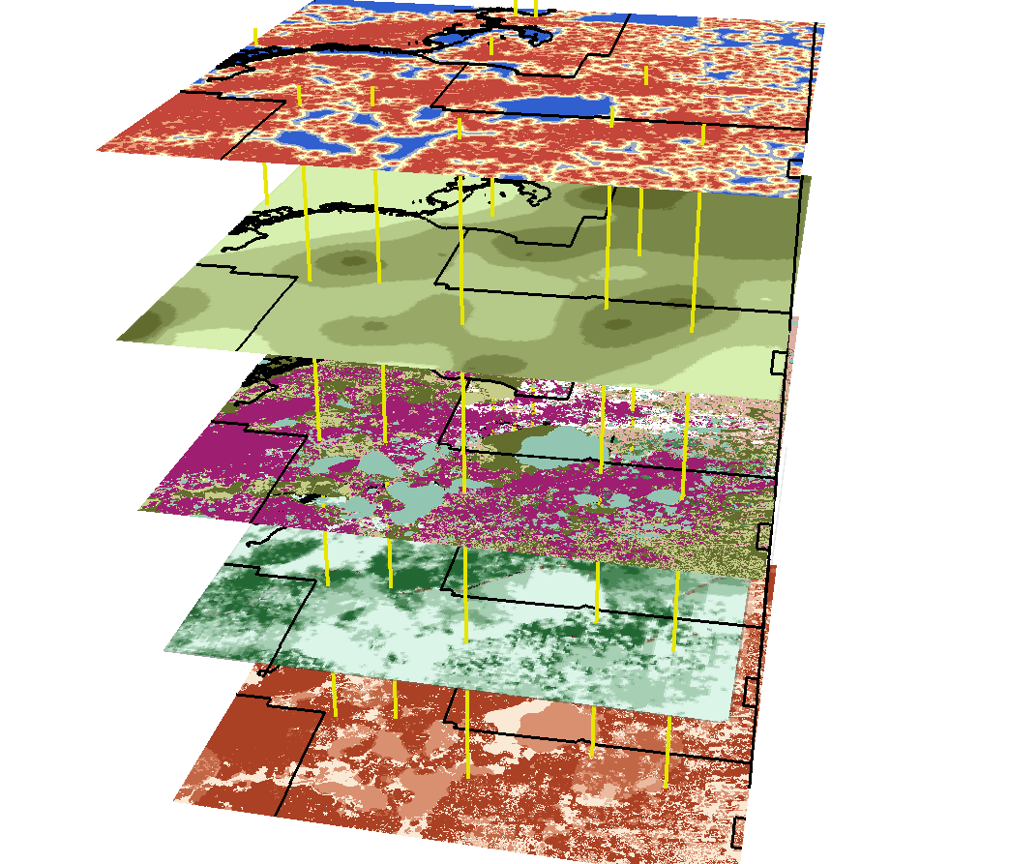
Distance to Karst Features
Thickness of Confining Unit
Soil Drainage
Head Difference; DTW
Vulnerability Model

Slide 15
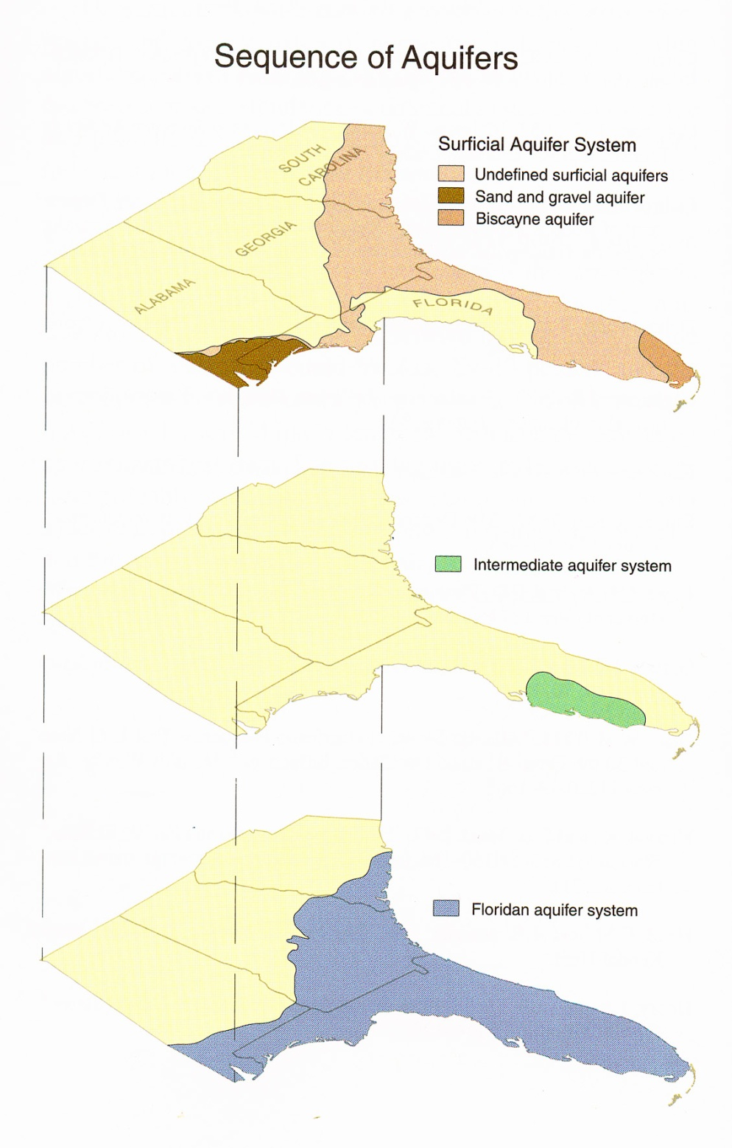
Three aquifer systems in Florida:
Surficial aquifer system: Sand and Gravel in west Florida and Biscayne aquifer in south Florida.
Intermediate aquifer and confining system – Essentially comprised of Hathorn Group sediments and occurs throughout central and northern Florida.
Floridan aquifer system – Occurrs under all of Florida.

Slide 16
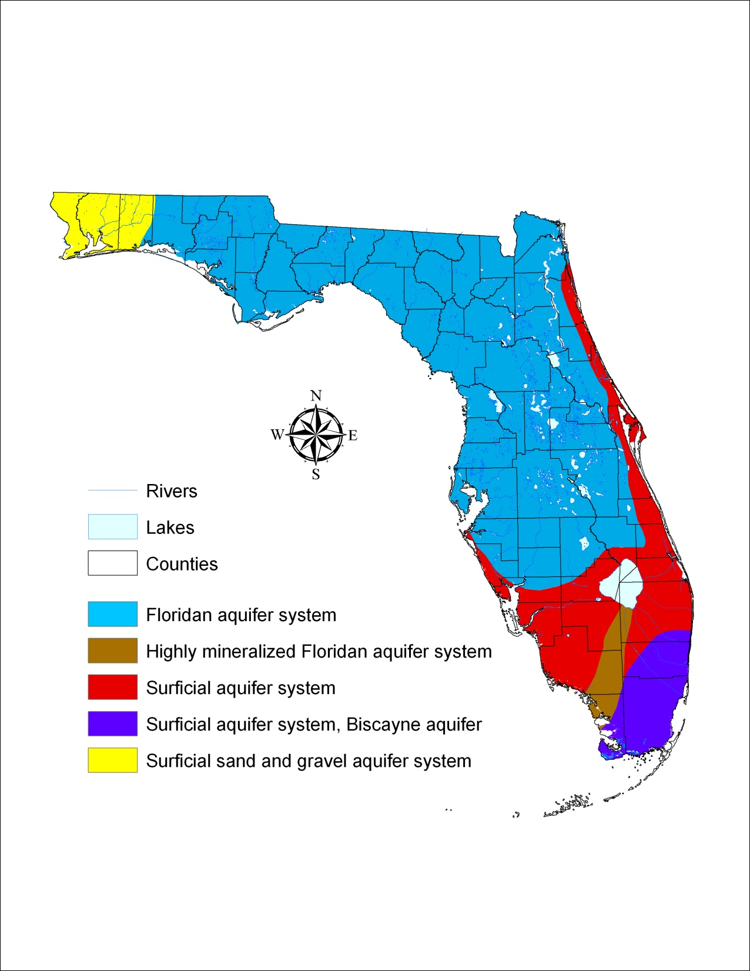
Florida’s aquifer systems

Slide 17
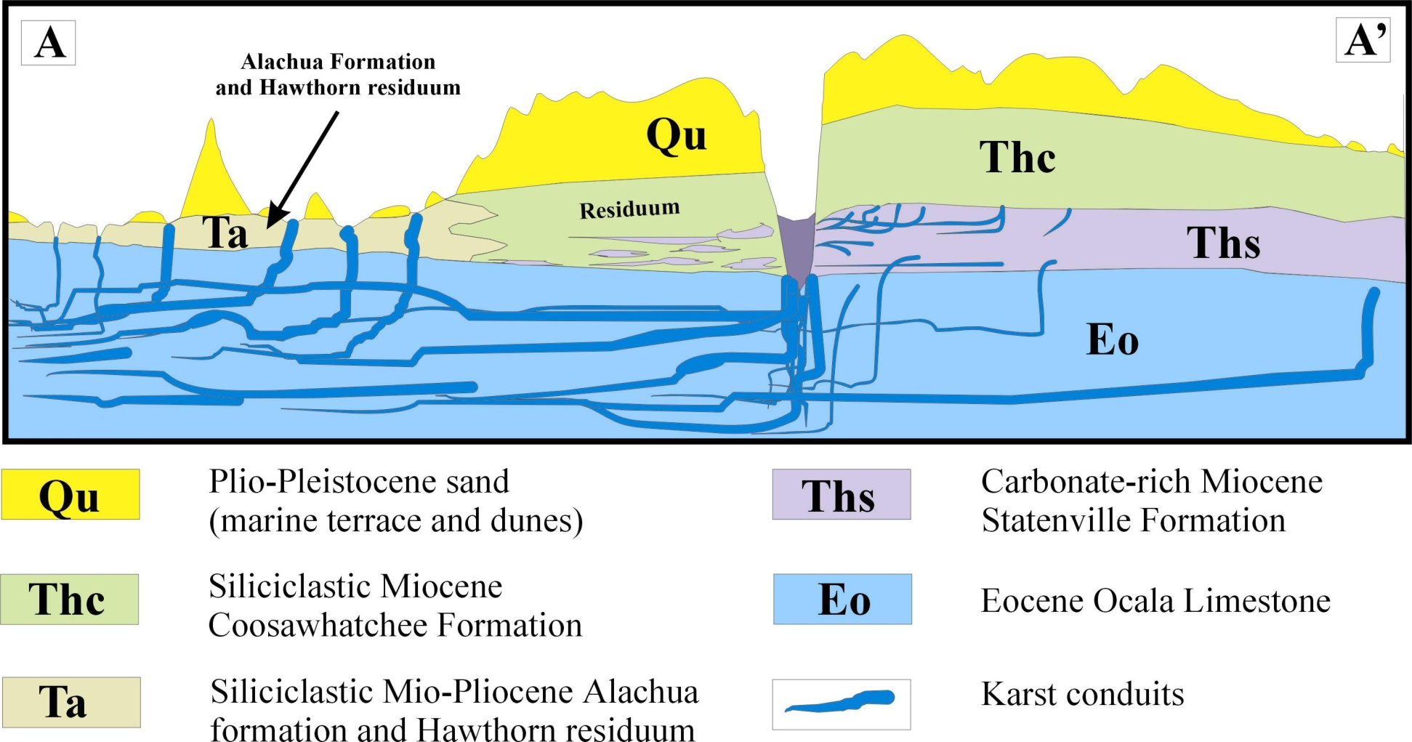
Geological Cross Section
Surficial aquifer system (SAS)
Intermediate aquifer system (IAS)
Floridan aquifer system (FAS)

Slide 18
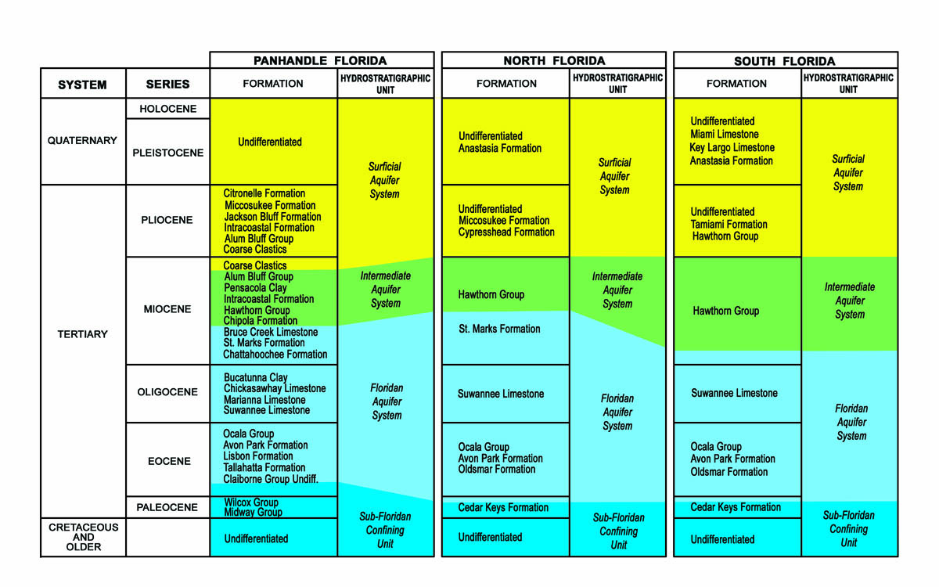
Lithostratigraphy versus hydrostratigraphy

Slide 19
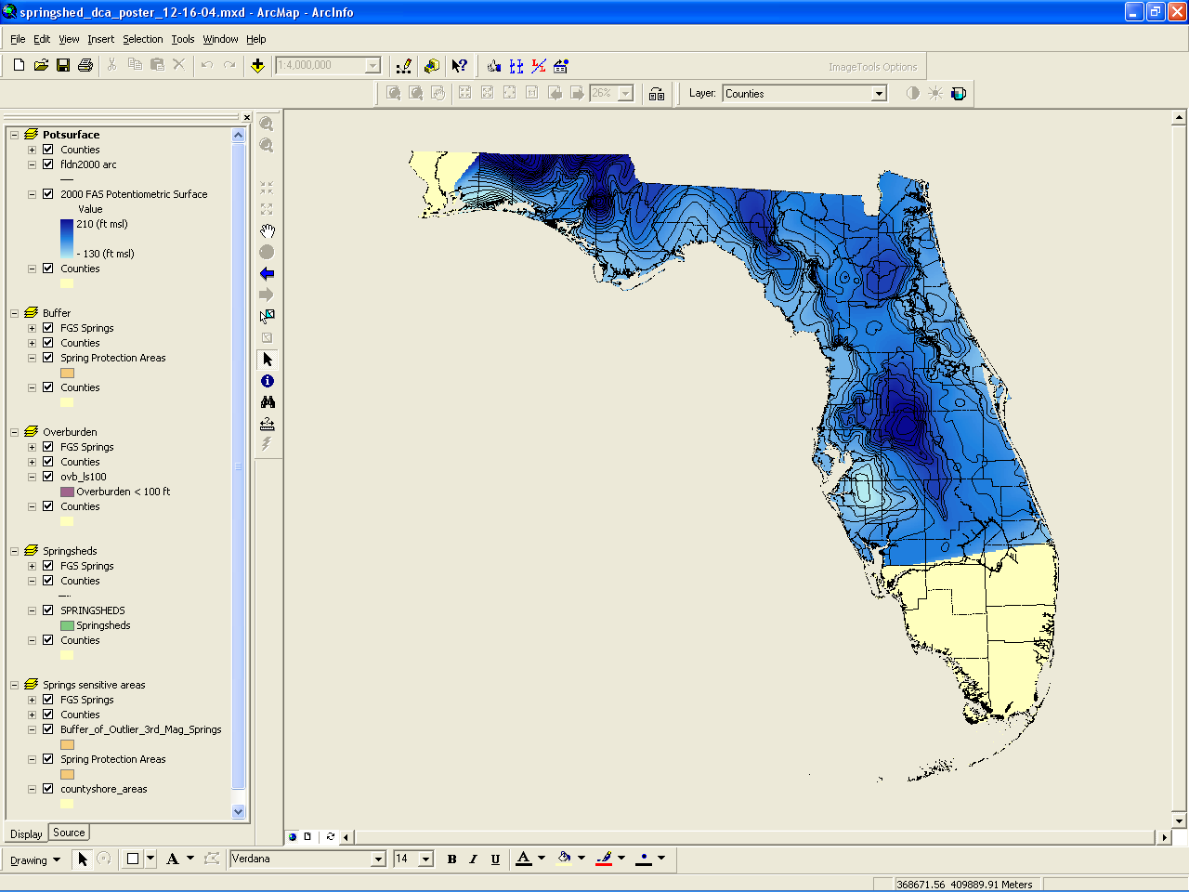
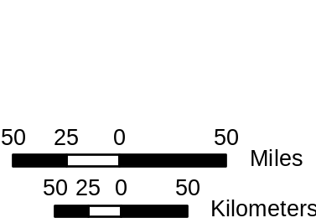
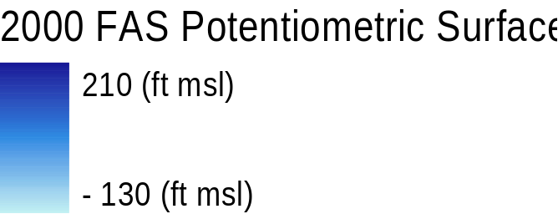
2000 Potentiometric Surface Map
Groundwater basins are delineated using potentiometric surface maps.

Slide 20
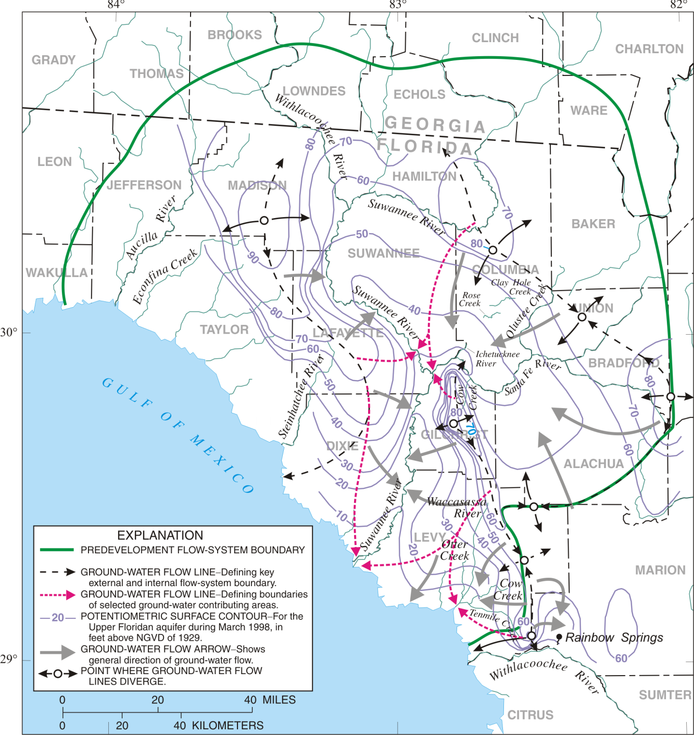
Potentiometric Surface:
“height of groundwater
surface”, or the height to
which water will rise in a
well, called hydraulic head.

Slide 21
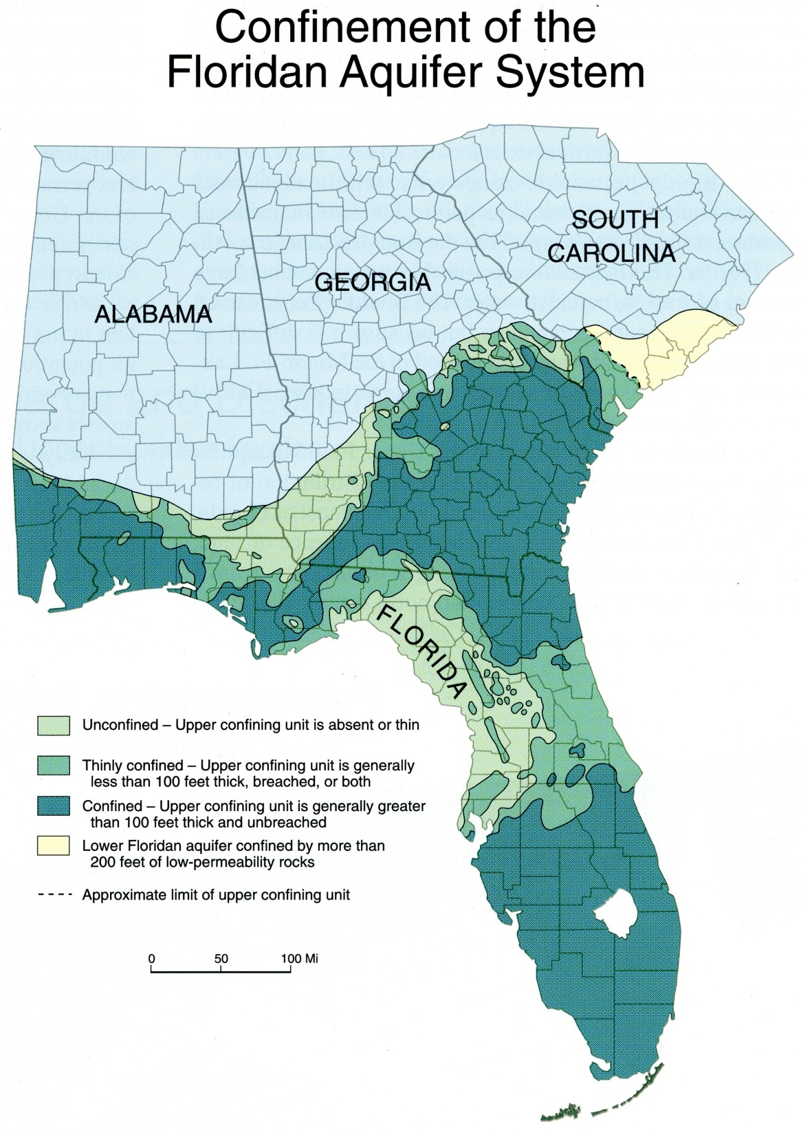

Slide 22
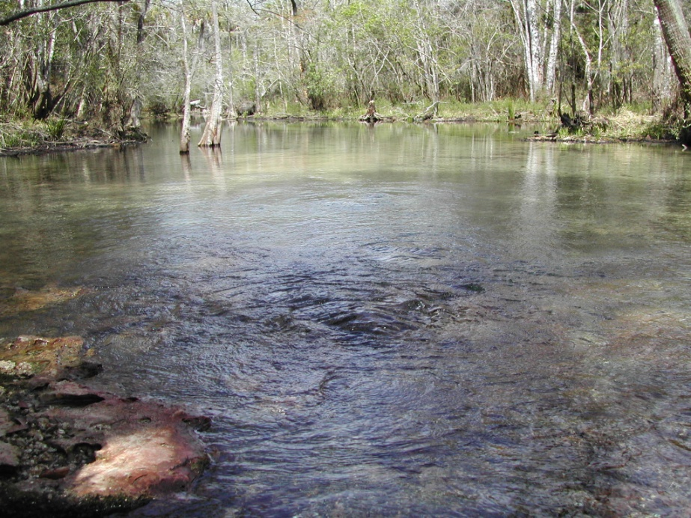
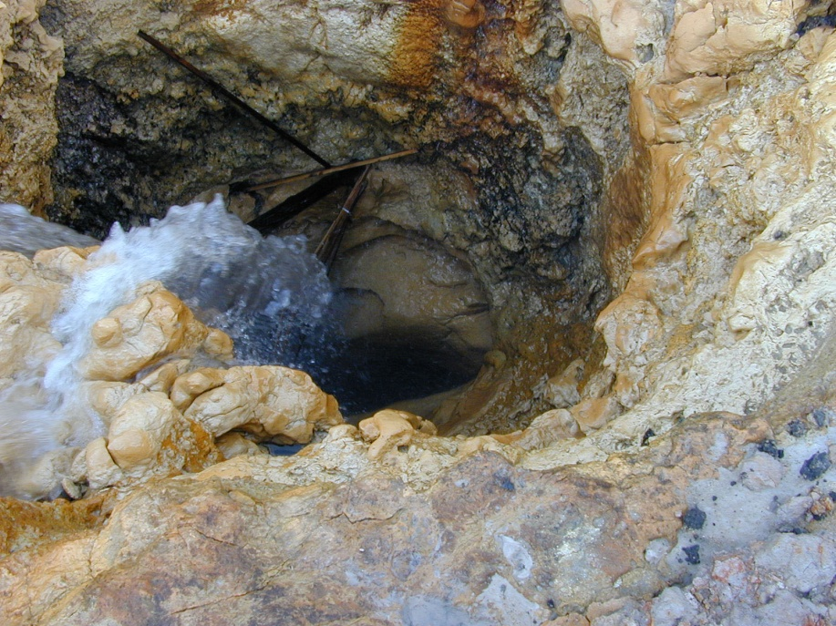

How much water is in the ground and how much is removed?
~ 2.2 – 2.5 x 10¹⁵ (quadrillion) gallons in our aquifers!
~ 4 trillion gallons recharge the aquifers.
~3 trillion gallons naturally discharge.
~1 trillion gallons are pumped from aquifers.
Numbers from: Water Resources Atlas of Florida, 1998!!
FGS

Slide 23
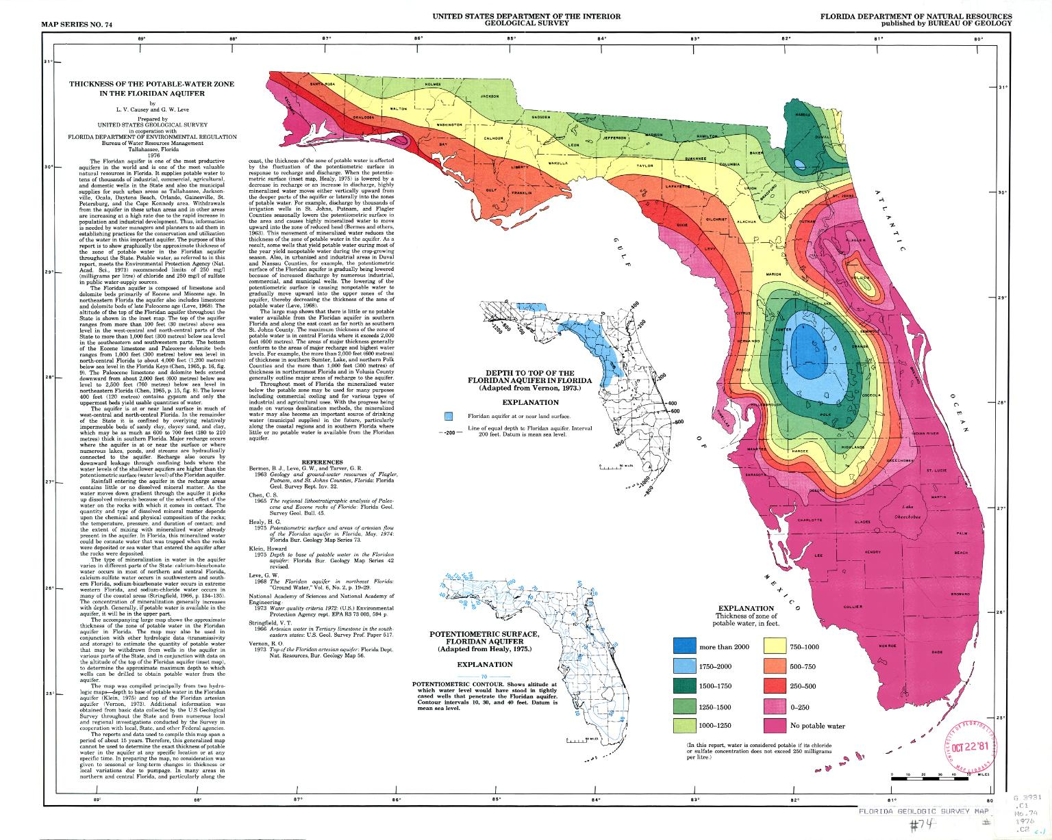

Slide 24
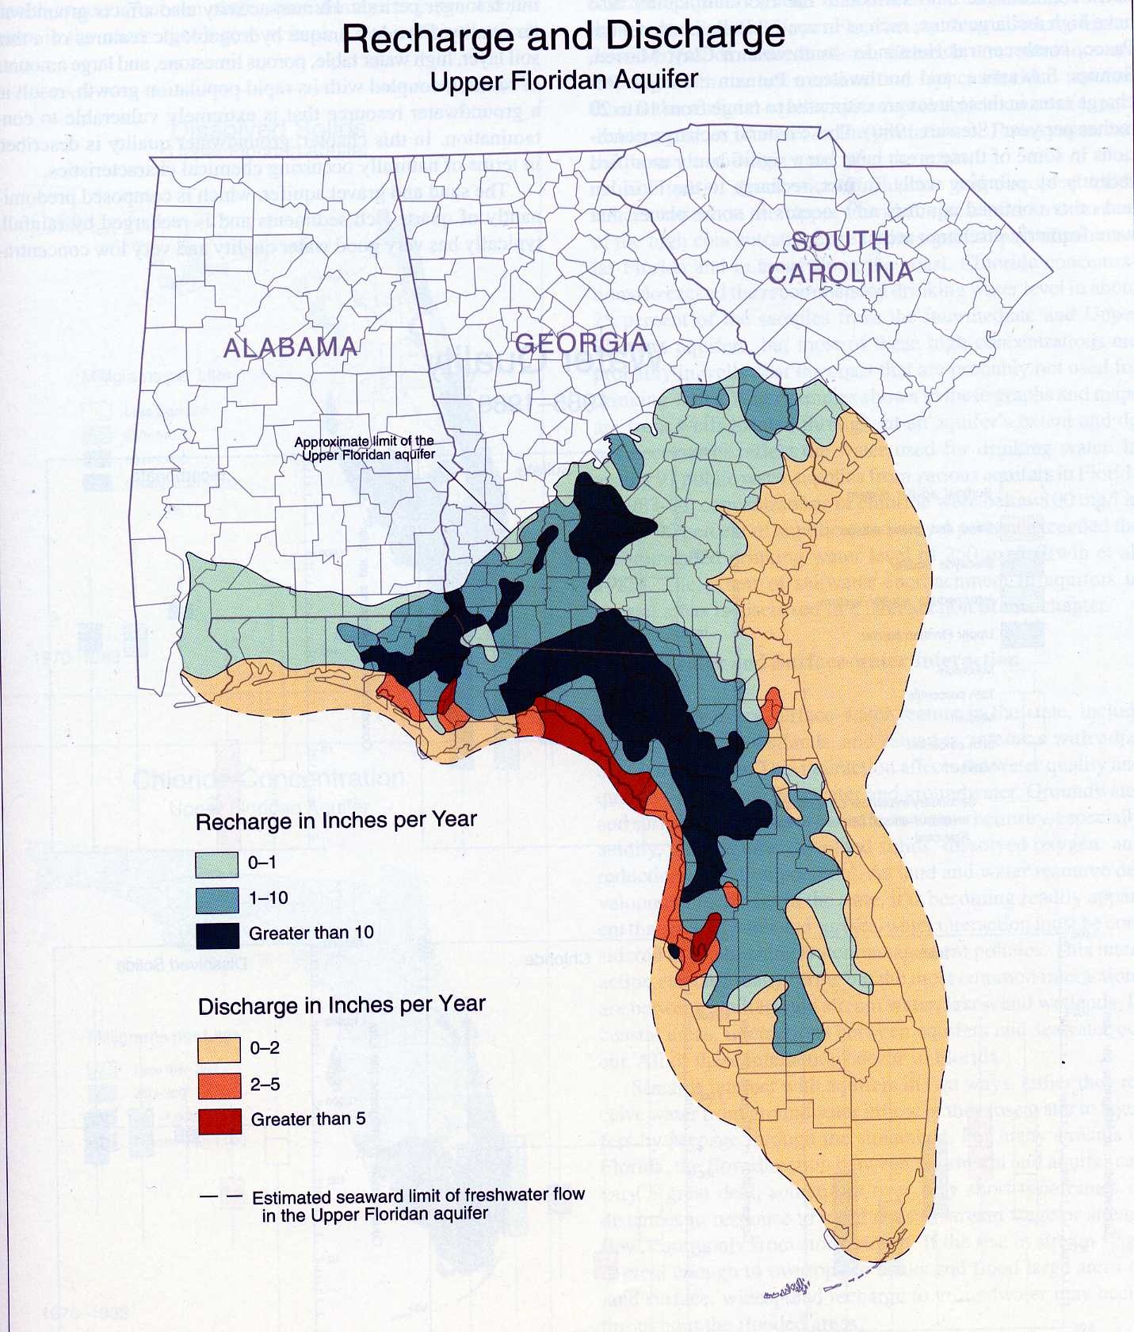
Recharge - Amount of rainwater that seeps into the ground and into the aquifer.

Slide 25
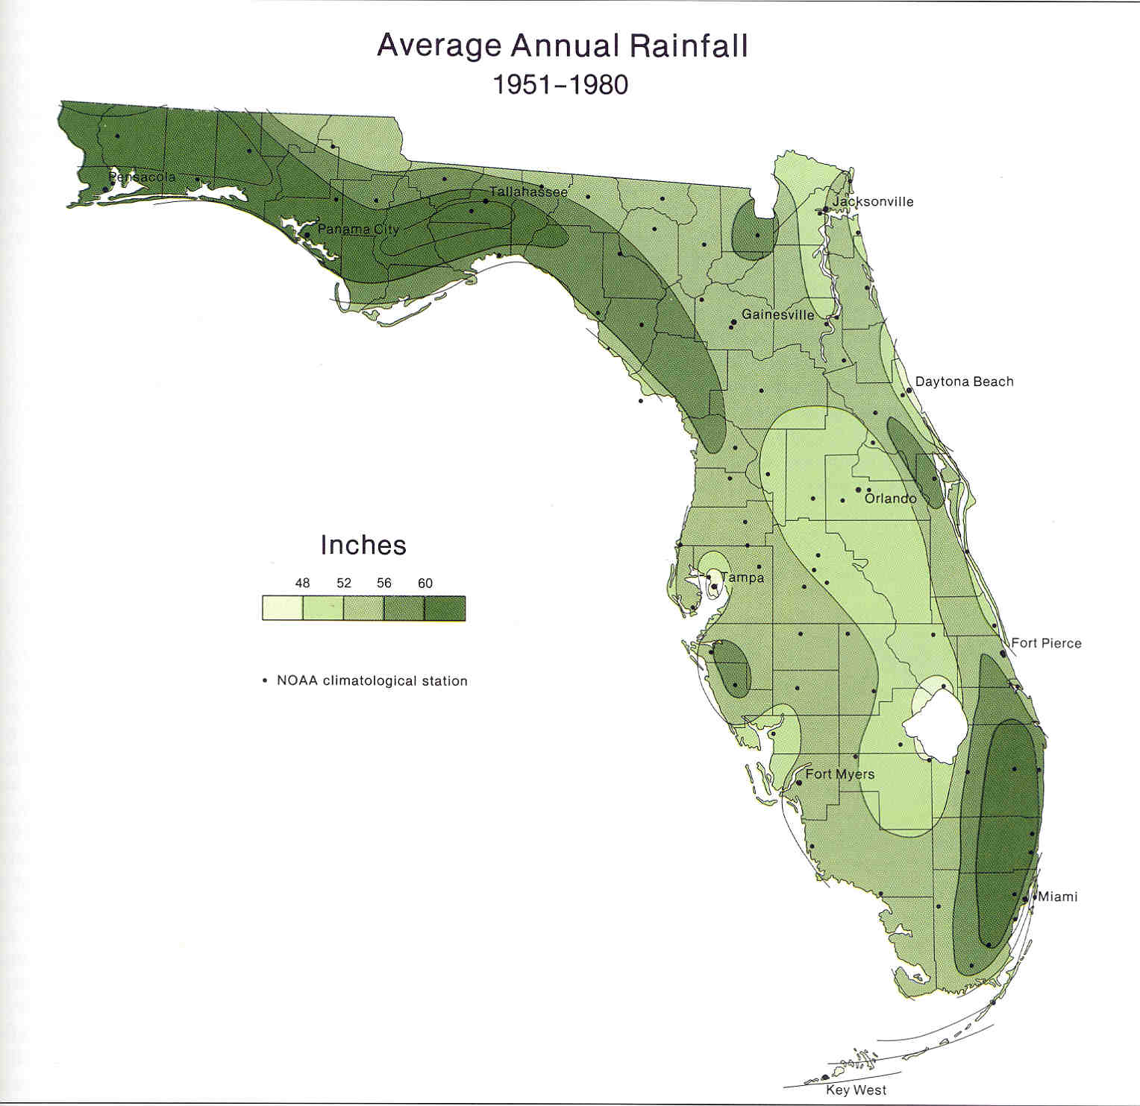

Slide 26
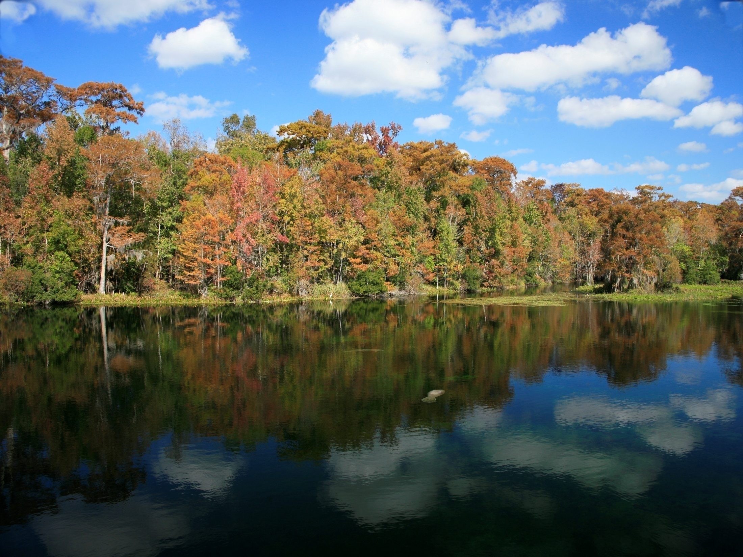
What is the Current Status
of
Springs in Florida?

Slide 27
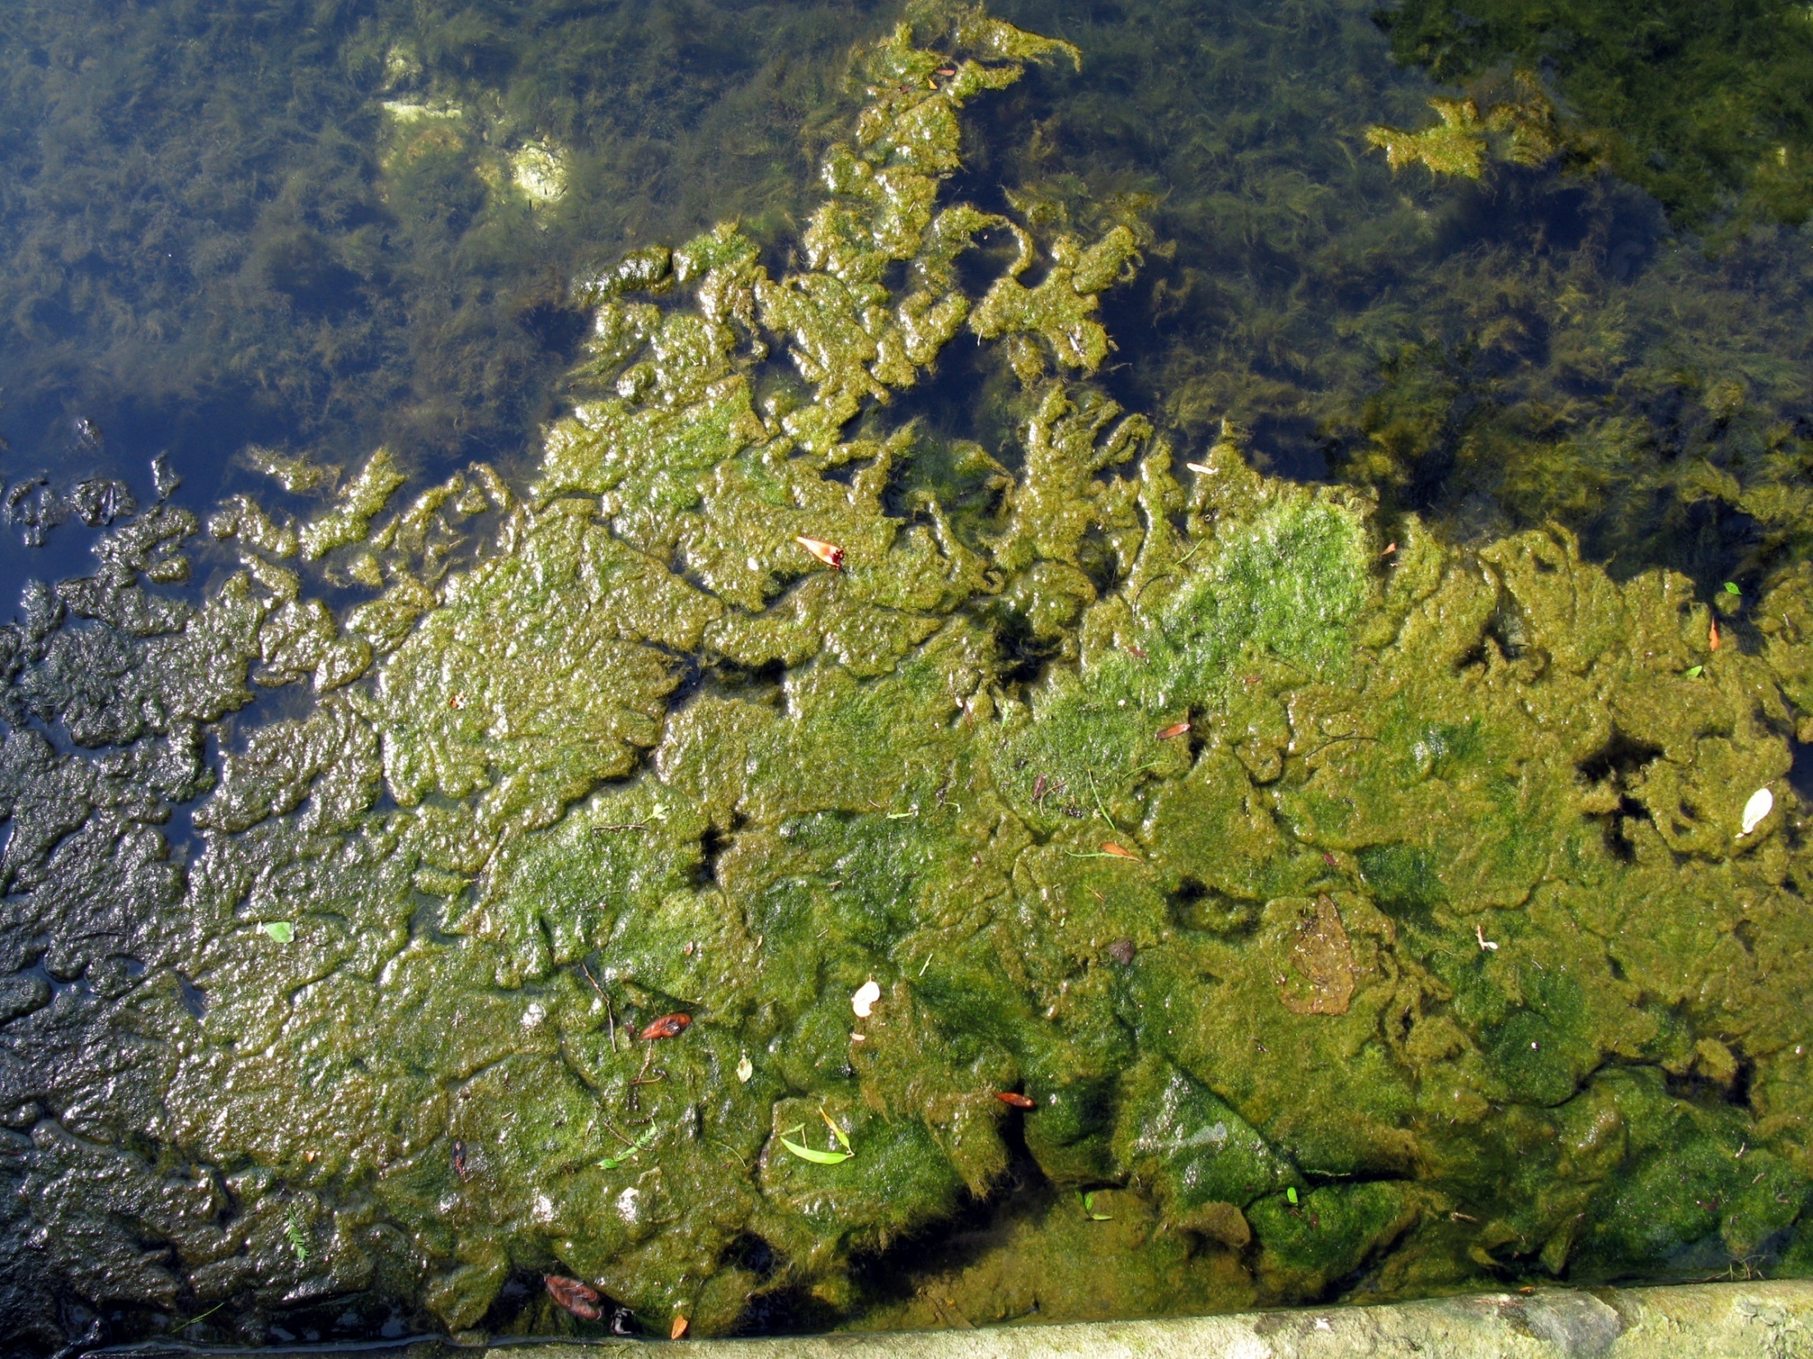

Slide 28
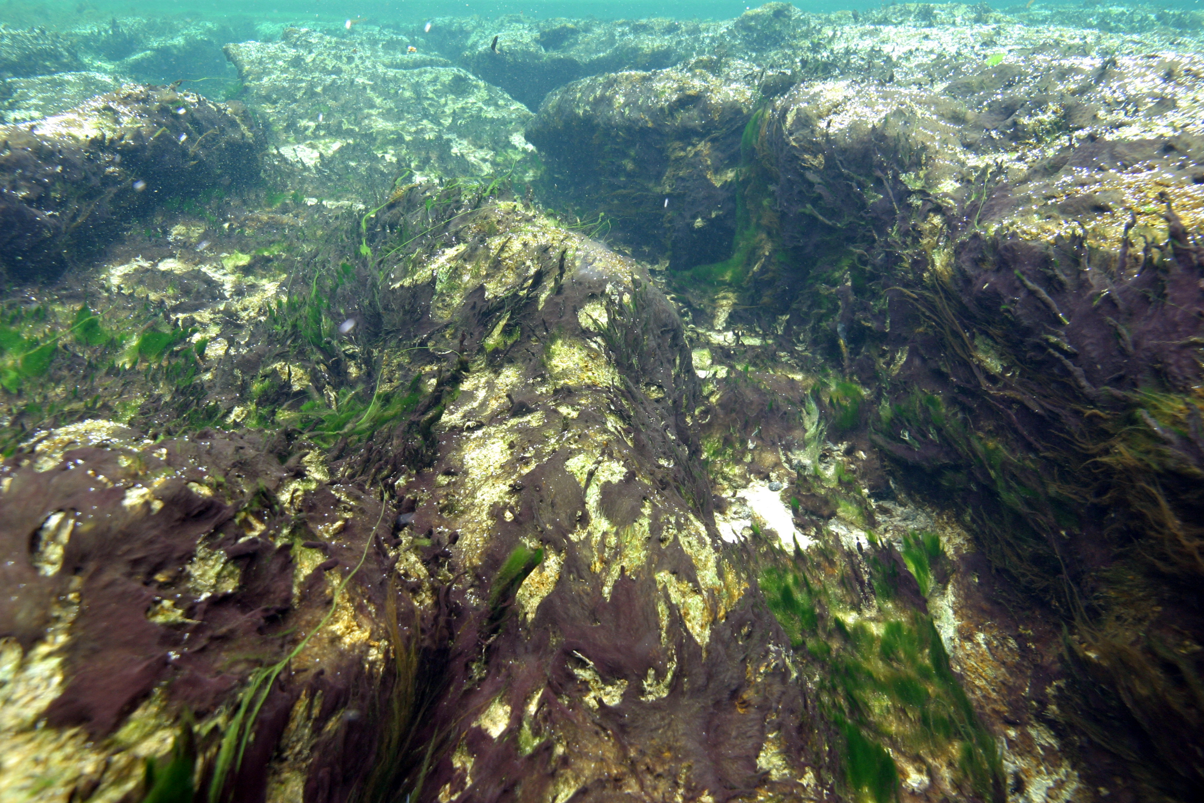

Slide 29
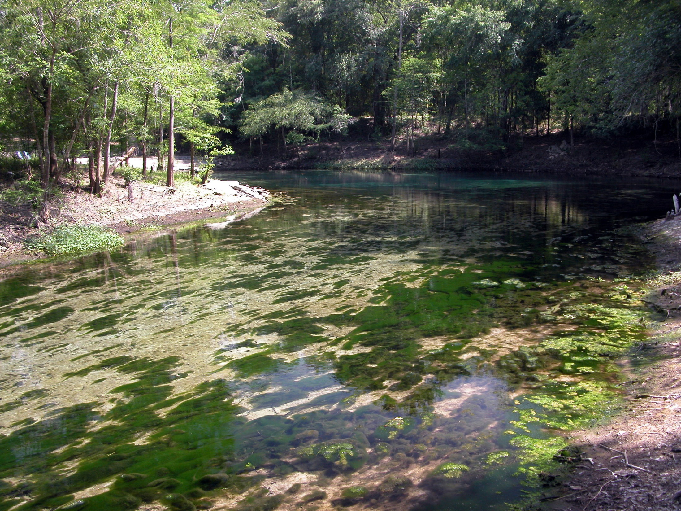

Slide 30
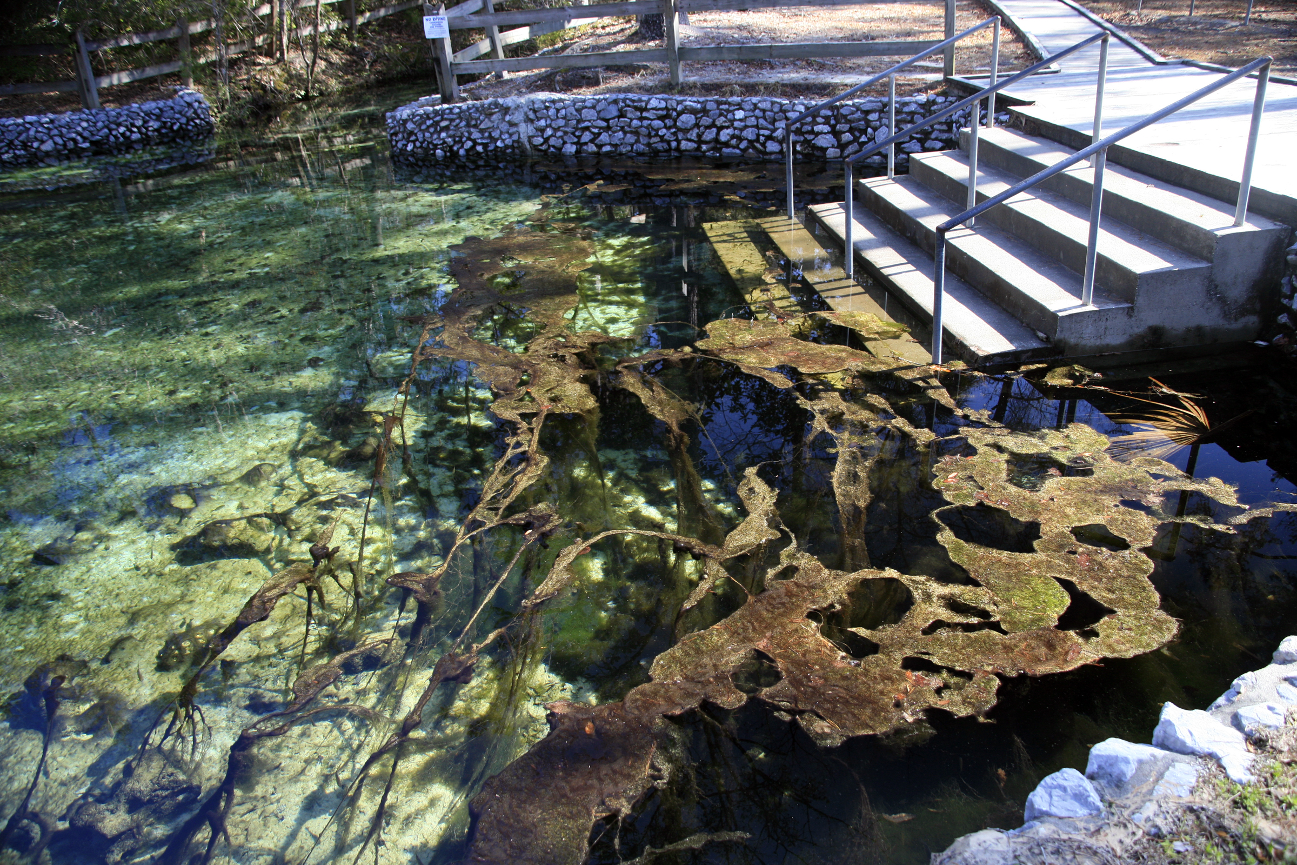

Slide 31
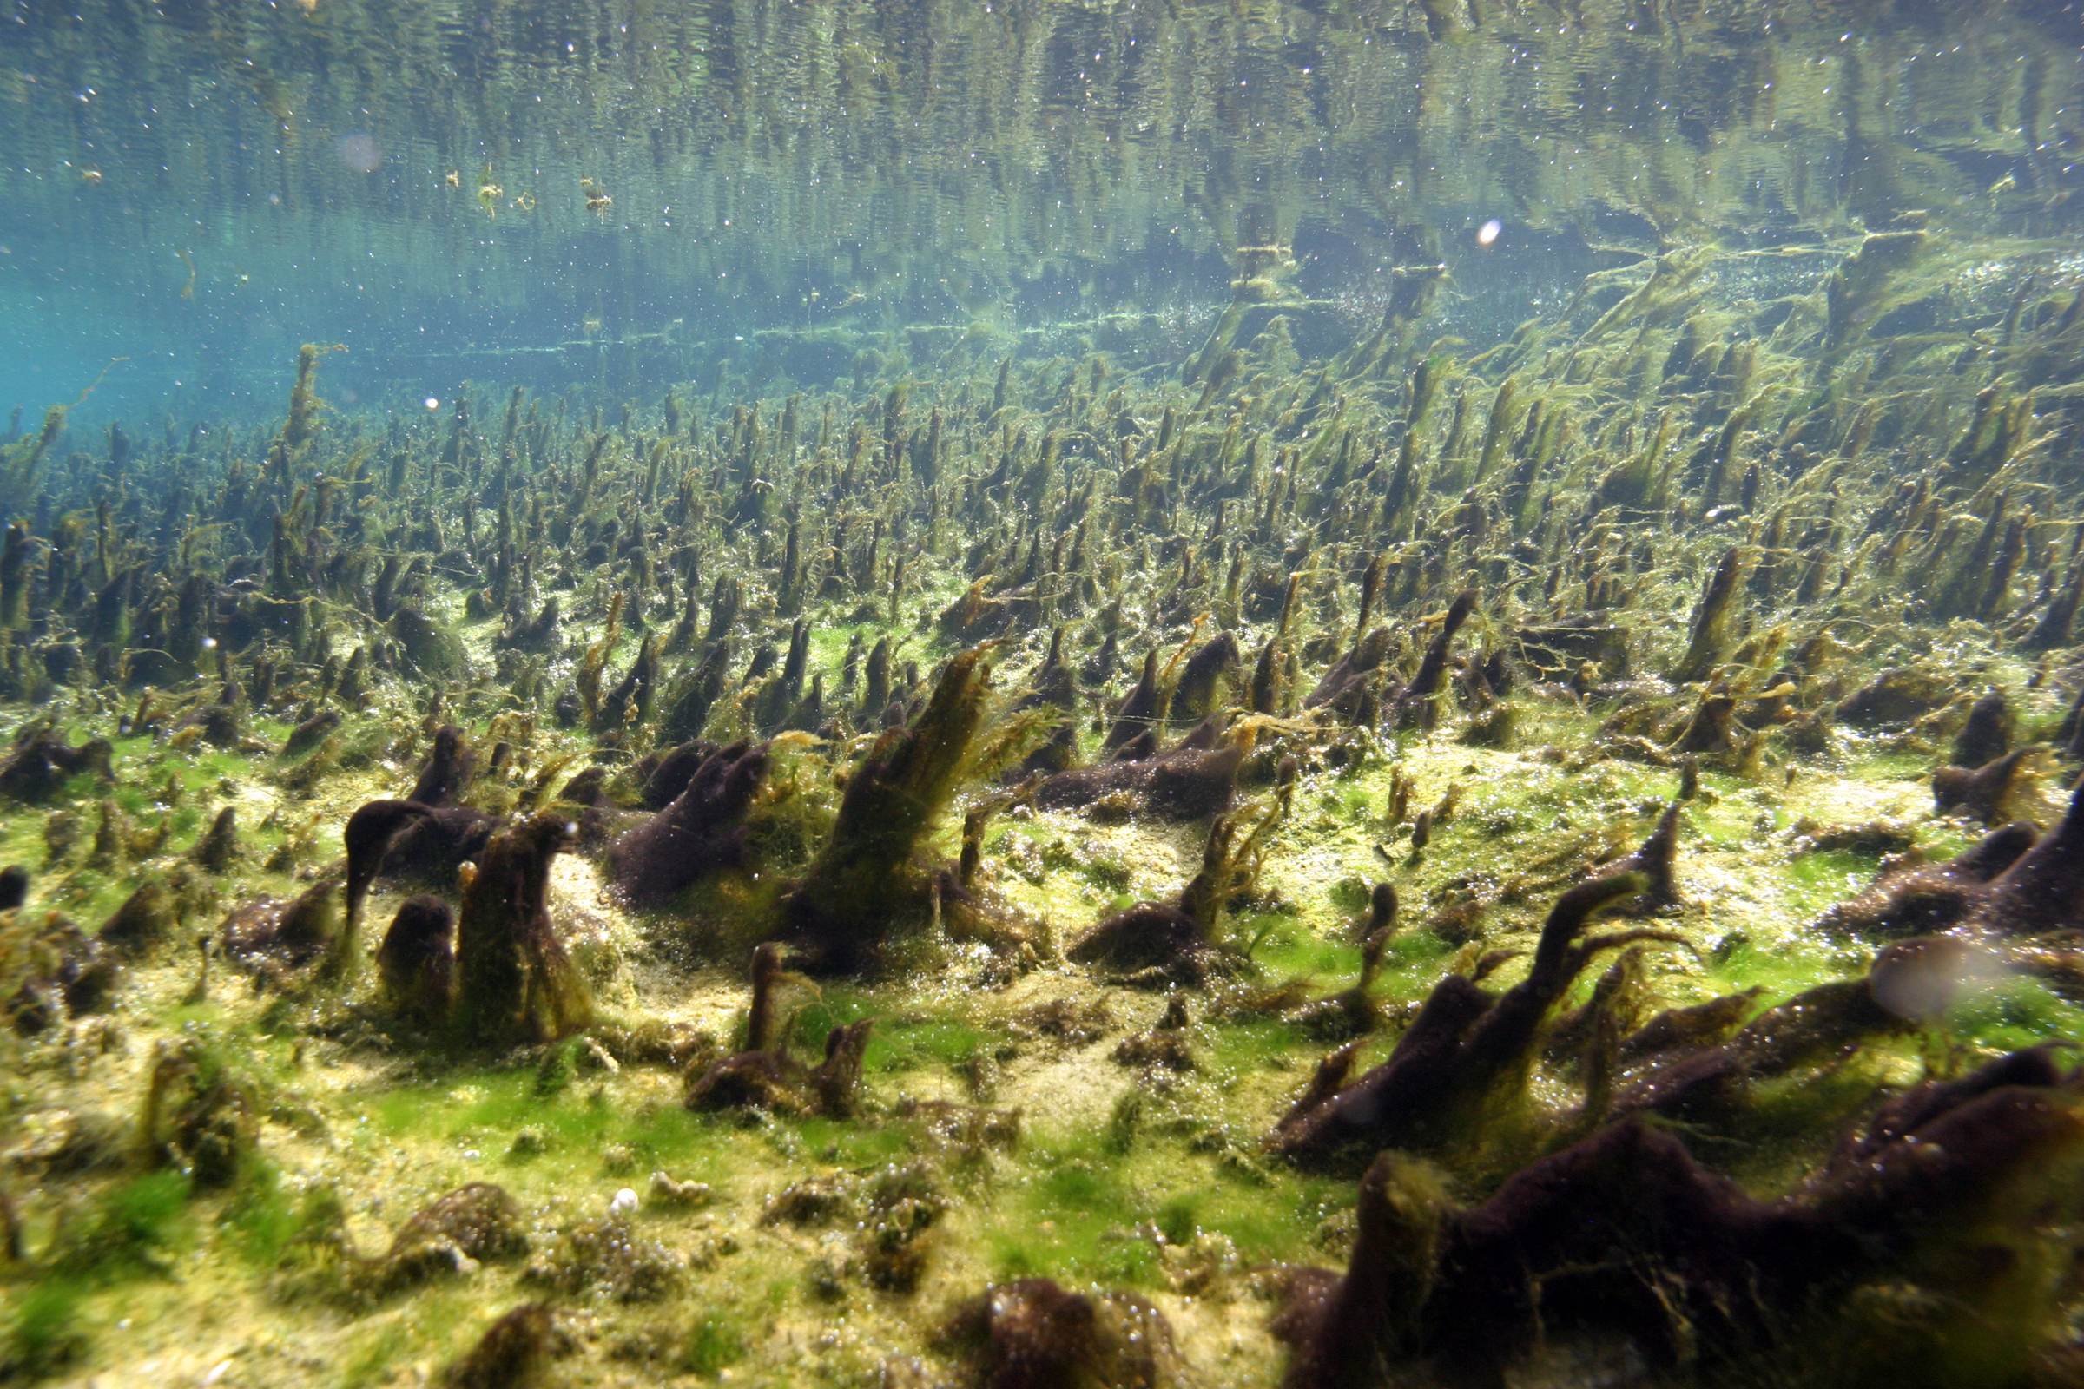

Slide 32
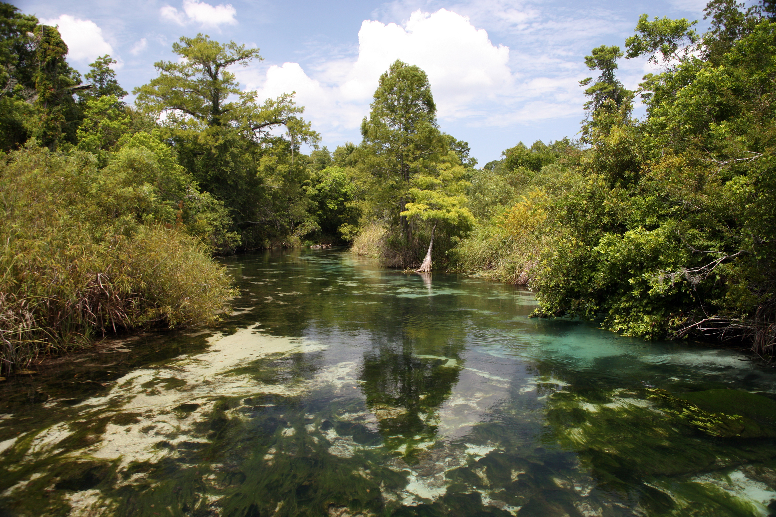

Slide 33
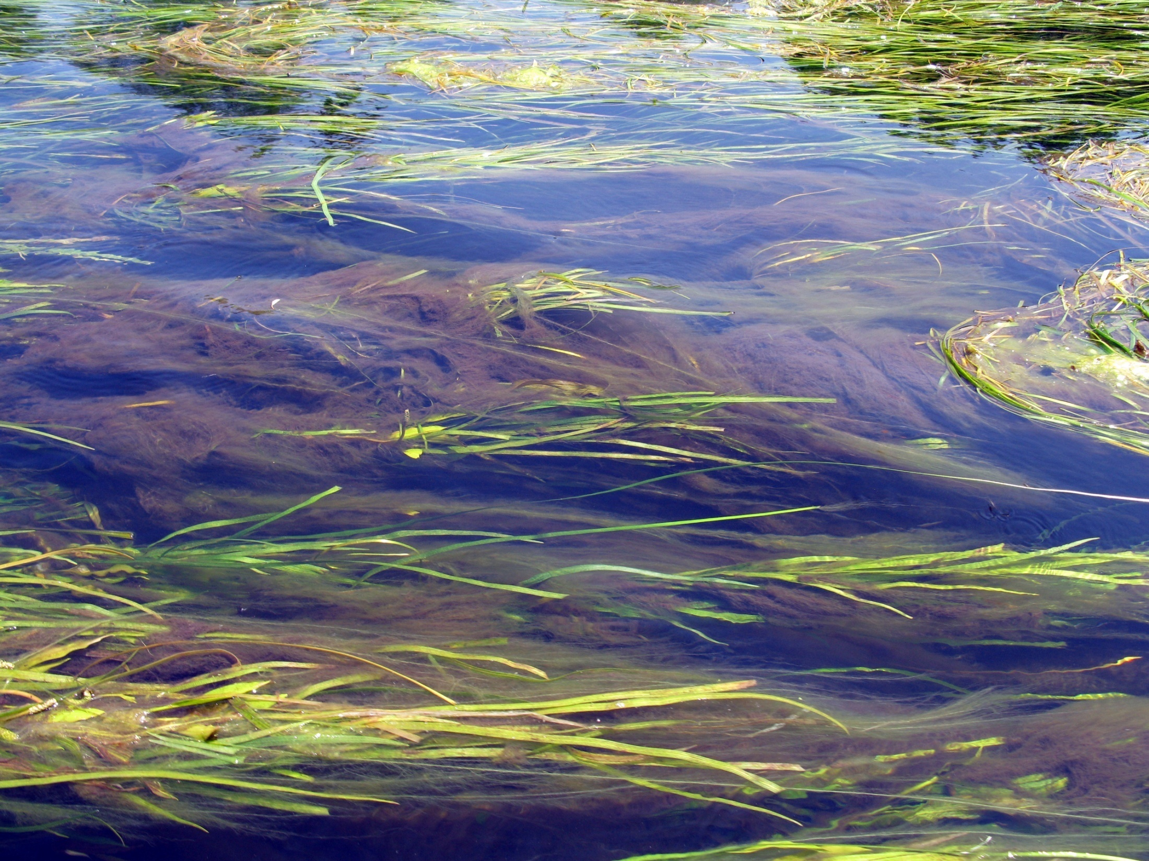

Slide 34
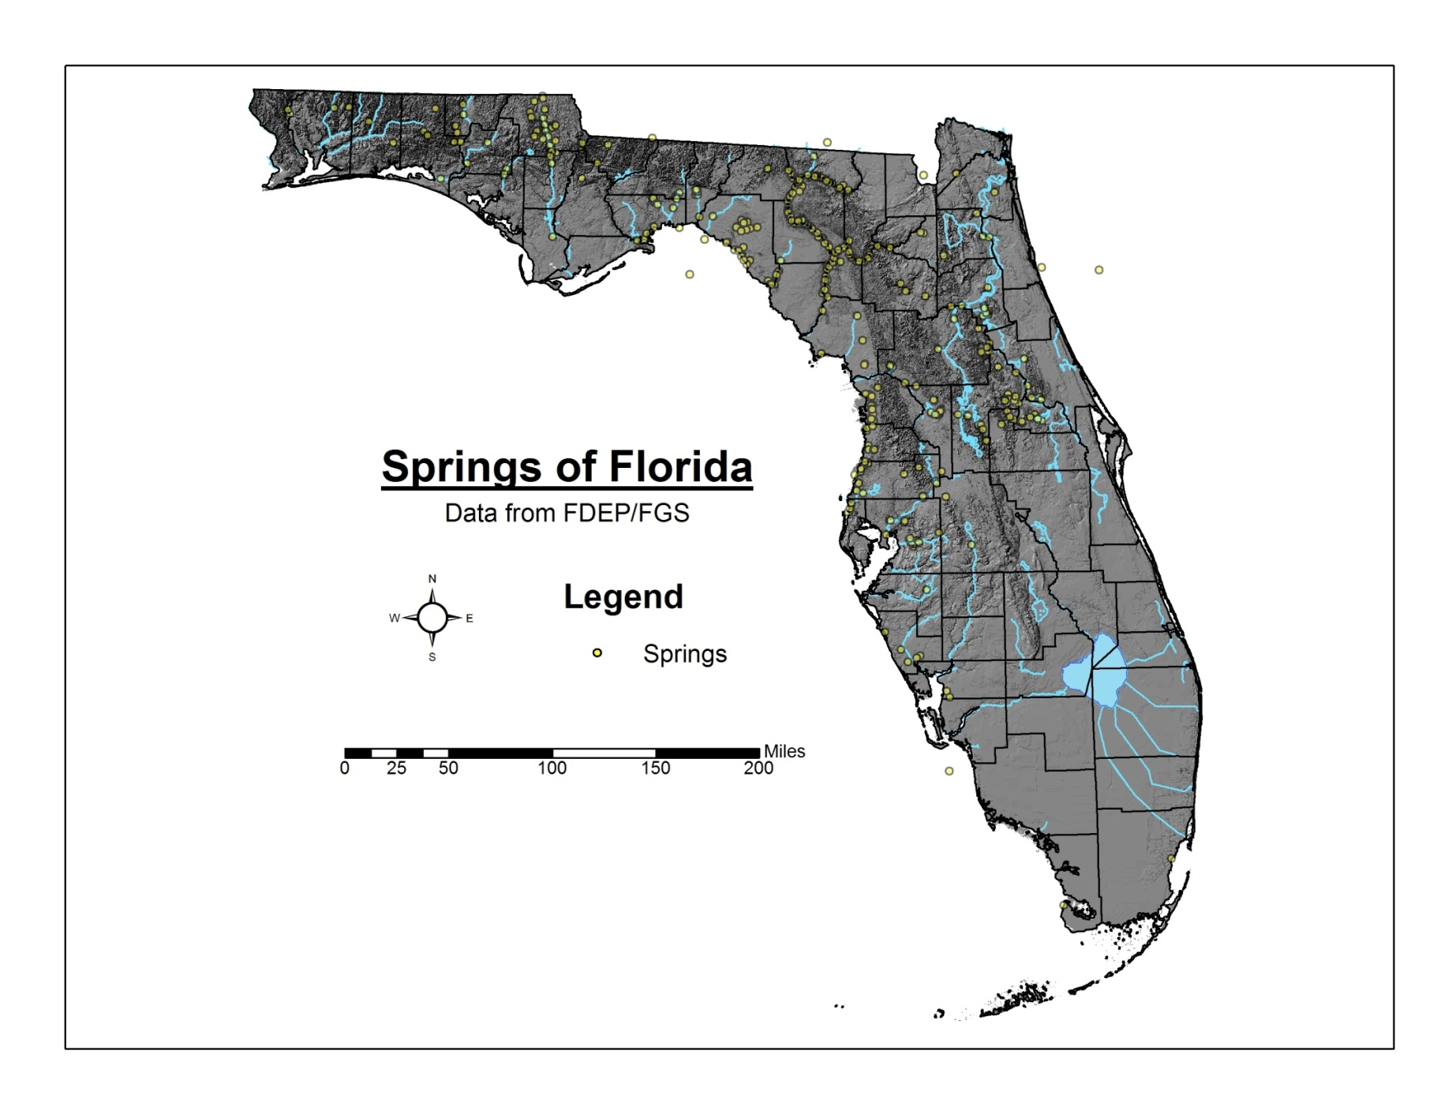

Slide 35
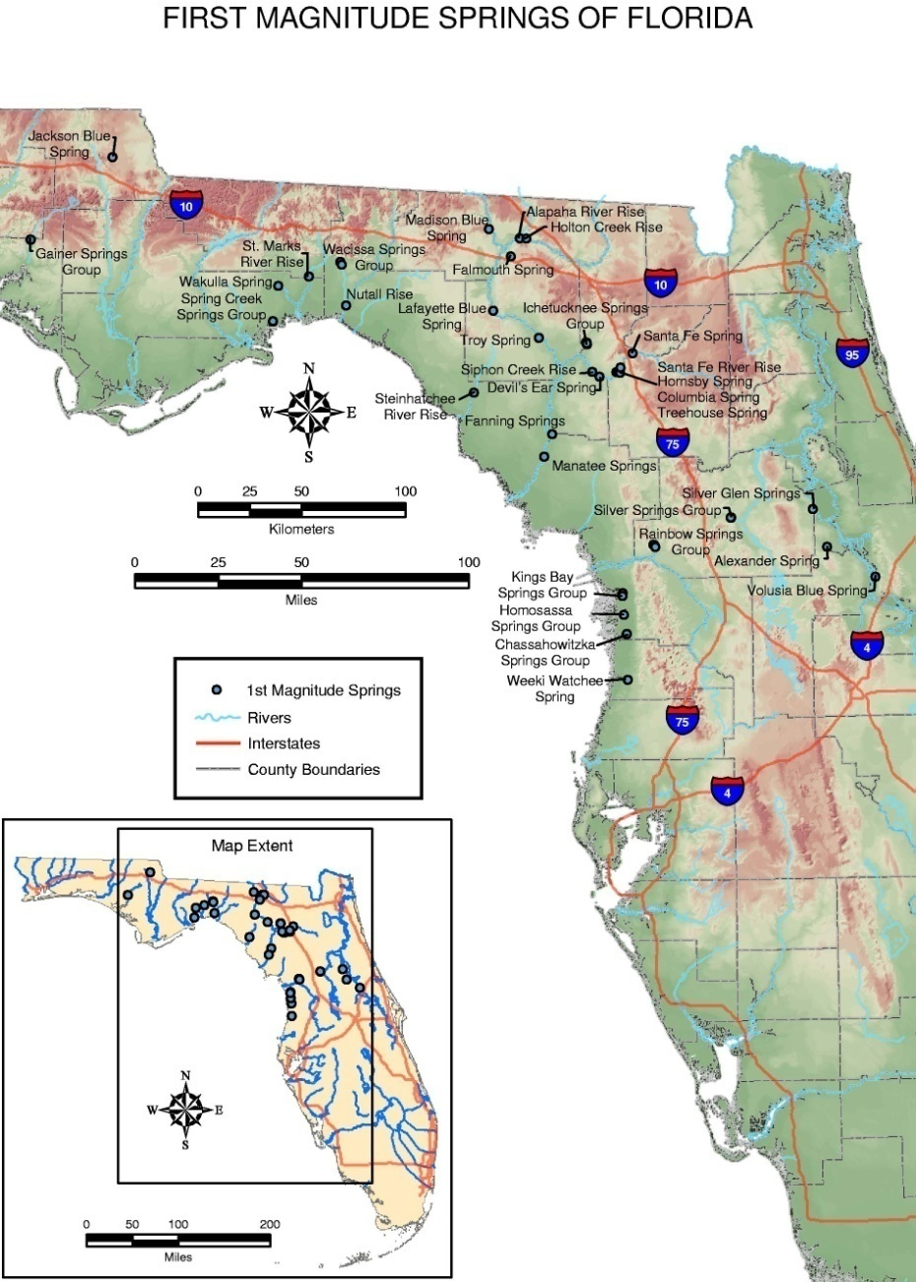
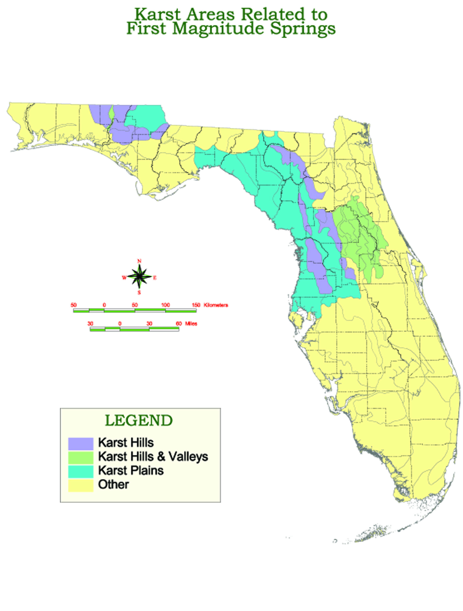
Springs related to karst areas

Slide 36
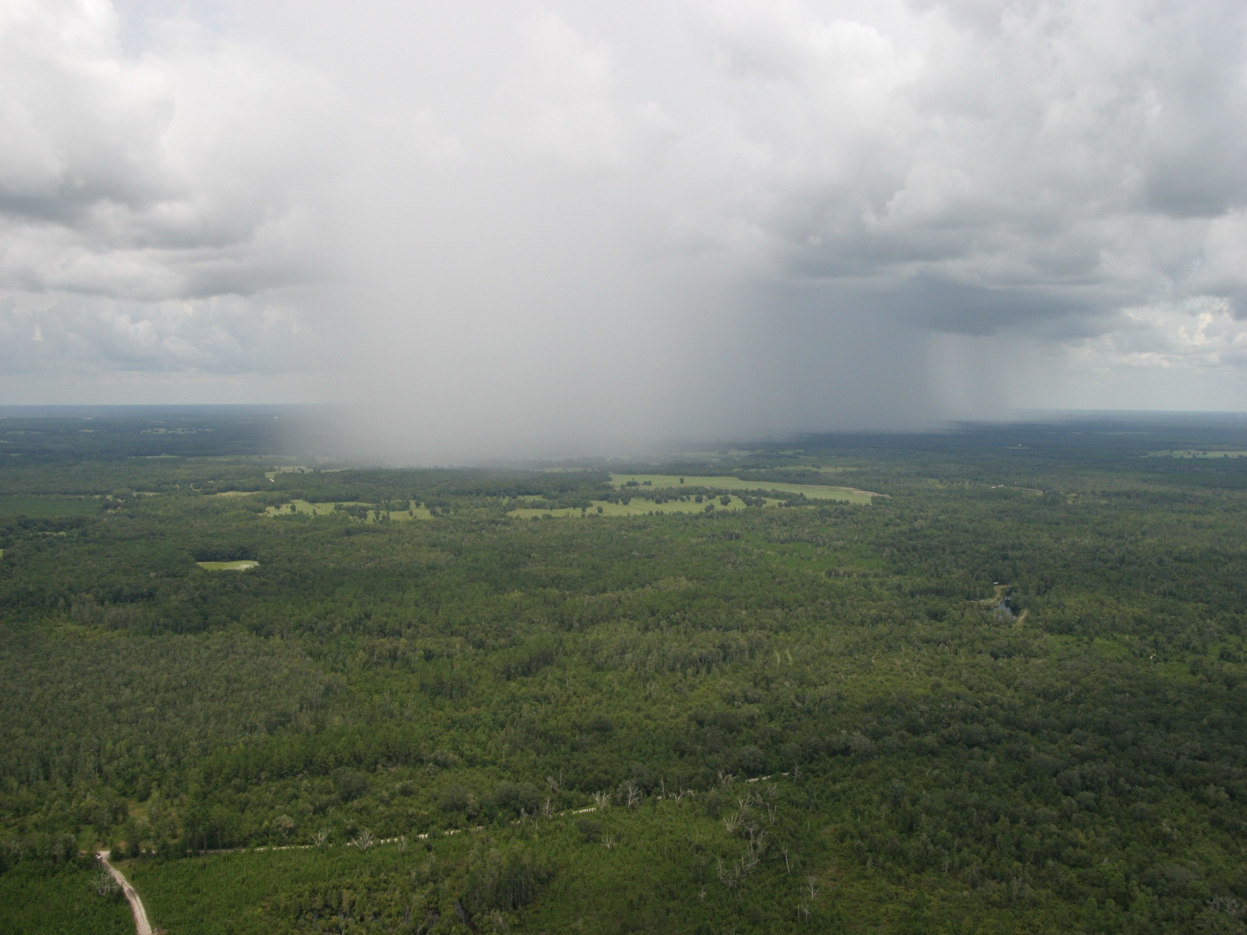
Where does spring water/groundwater come from and how does it get to springs? 50 to 60 inches of rainfall per year on average.

Slide 37
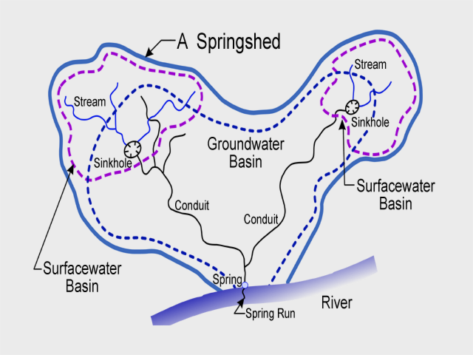
Springsheds
Springshed - those areas within ground- and surface-water basins that contribute to the discharge of the spring

Slide 38
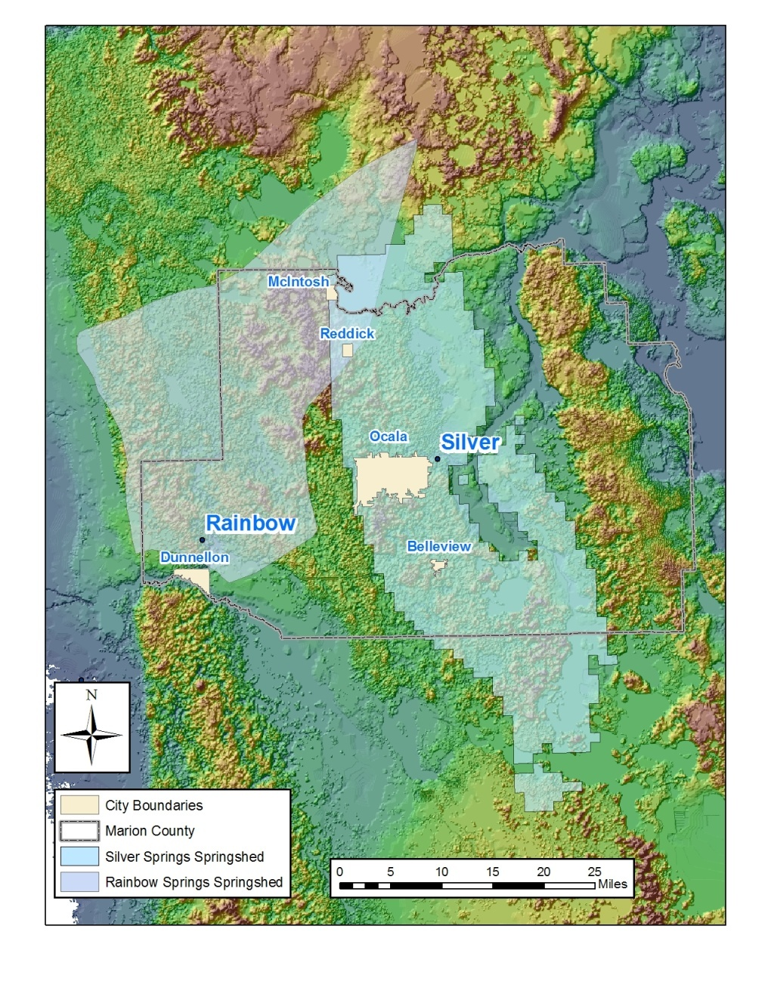
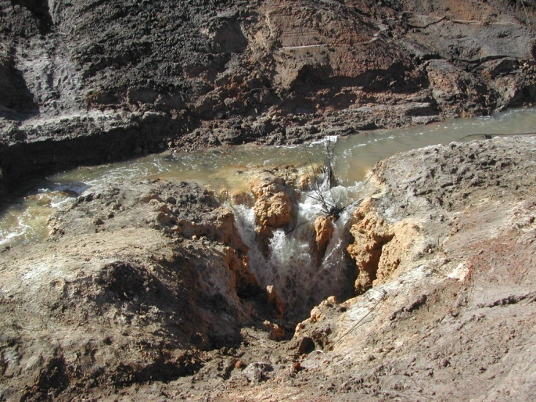
Springshed – Can overlap and change shape through time based upon rainfall and consumptive uses in the basin.

Slide 39
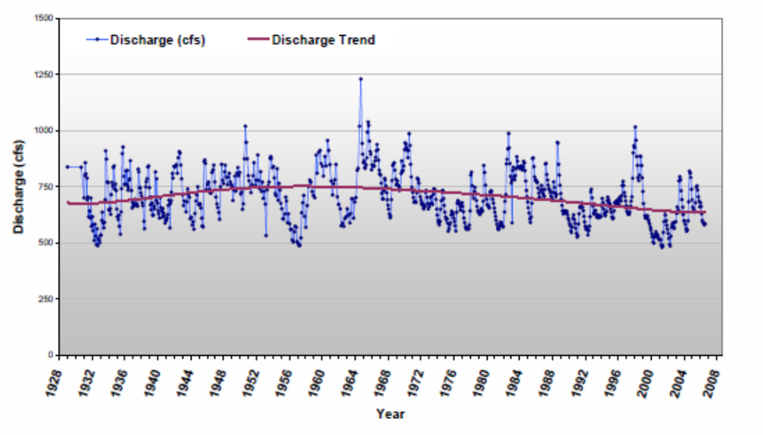
How much water comes out of springs?
Discharge from Rainbow Springs
1st magnitude = greater than 100 cfs. or 64.6 mgd. 33 in Florida
2nd magnitude = 10 to 100 cfs. 191 in Florida
3rd magnitude = 1 to 10 cfs. 151 in Florida
4th magnitude = 100 gallons/minute to 1 cfs.

Slide 40
USGS discharge record for Rainbow Springs
cubic ft/sec (cfs)
690 cfs median discharge
703 cfs average ~ 450 mgd
YEAR
cubic ft/sec (cfs)
765 cfs median discharge
744 cfs average ~ 500 mgd
YEAR

Slide 41
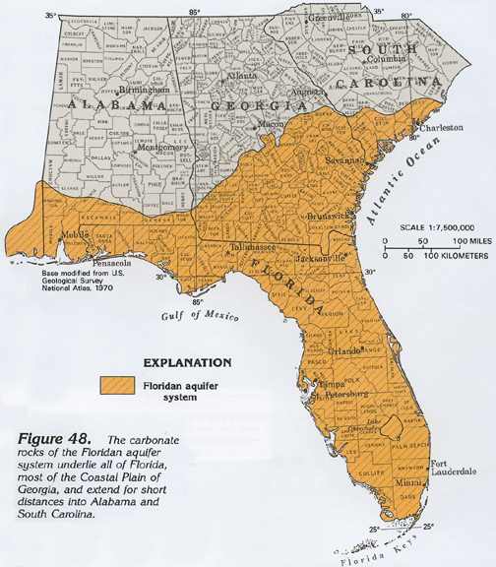
Source of water for most
Florida springs
Floridan aquifer system-
primary for
drinking water and
main source for most
of Florida’s major
springs.

Slide 42
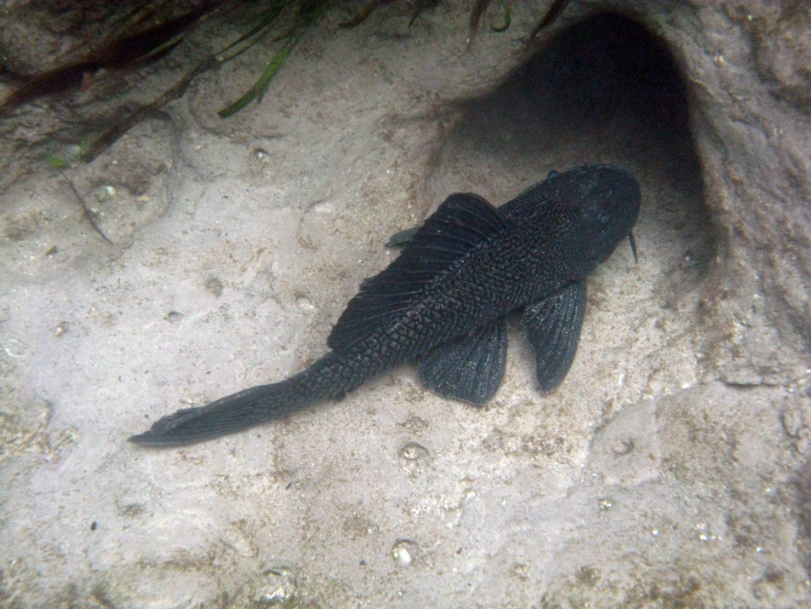
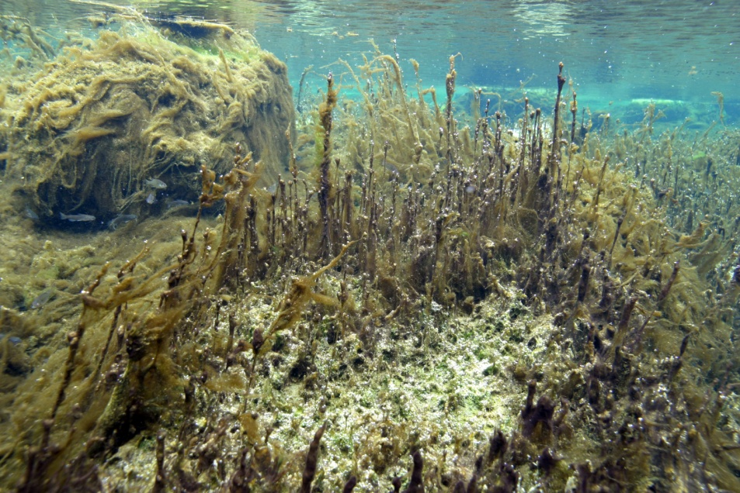
Springs in Trouble
Increasing nutrients (mainly nitrate) in spring water causing changes in spring and spring run ecology.
Increasing algae growth.
Increases in exotic animals and plants like Hydrilla.
Declining native populations of organisms – limpkins, apple snails and other aquatic species.
Declining flow and even ceased flow.
Waters becoming more saline.

Slide 43
Trends (FGS Bulletin 69)
Sufficient Data (1991 - 2003)
    58 springs and 46 wells
  Major Analyte Groups and Examples
    Field (Temp, discharge)
    Rock (Ca, Mg, HCO3)
    Saline (Na, Cl, SO4)
    Nutrients (NO3, P)
Severe Drought Occurred 1998-2002
  Cause of Numerous Trends

Slide 44
Statewide Trends in Springs
(1991-2003)
Analyte ↑ ↓ Direct P-Val
NO3 25 12 ↑ 0.047
Flow 3 14 ↓ 0.013
Ca 31 3 ↑ <0.001
Mg 32 3 ↑ <0.001
Sr 28 1 ↑ <0.001
Alk 29 1 ↑ <0.001
F 16 0 ↑ <0.001

Slide 45
Statewide Trends in Springs
(1991-2003)
Analyte ↑ ↓ Direct P-Val
Na 30 5 ↑ <0.001
K 20 4 ↑ 0.007
Cl 28 6 ↑ <0.001
SO4 27 8 ↑ 0.002
TDS 18 3 ↑ 0.001
Sp. Cond. 24 9 ↑ 0.007

Slide 46
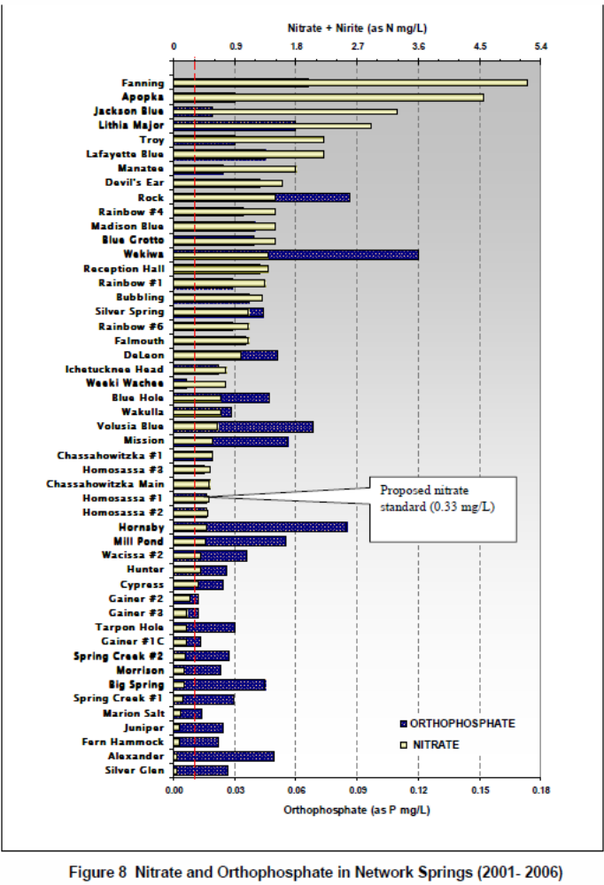
From the FSI Monitoring Network Report (2008).
All 49 springs monitored by the FSI exceeded “background” levels for nitrate (0.015 mg/l).
40% of the network springs exceed 1 mg/l nitrate.
WHY IS THIS HAPPENING?

Slide 47

Major Impacts on Springs:

Slide 48
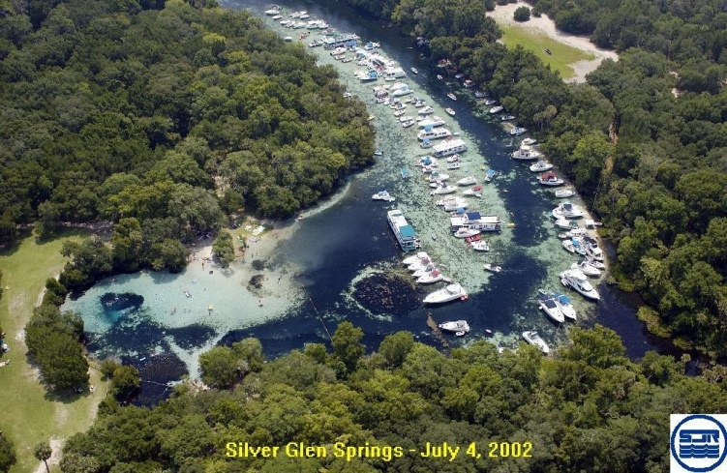
Recreational overuse

Slide 49
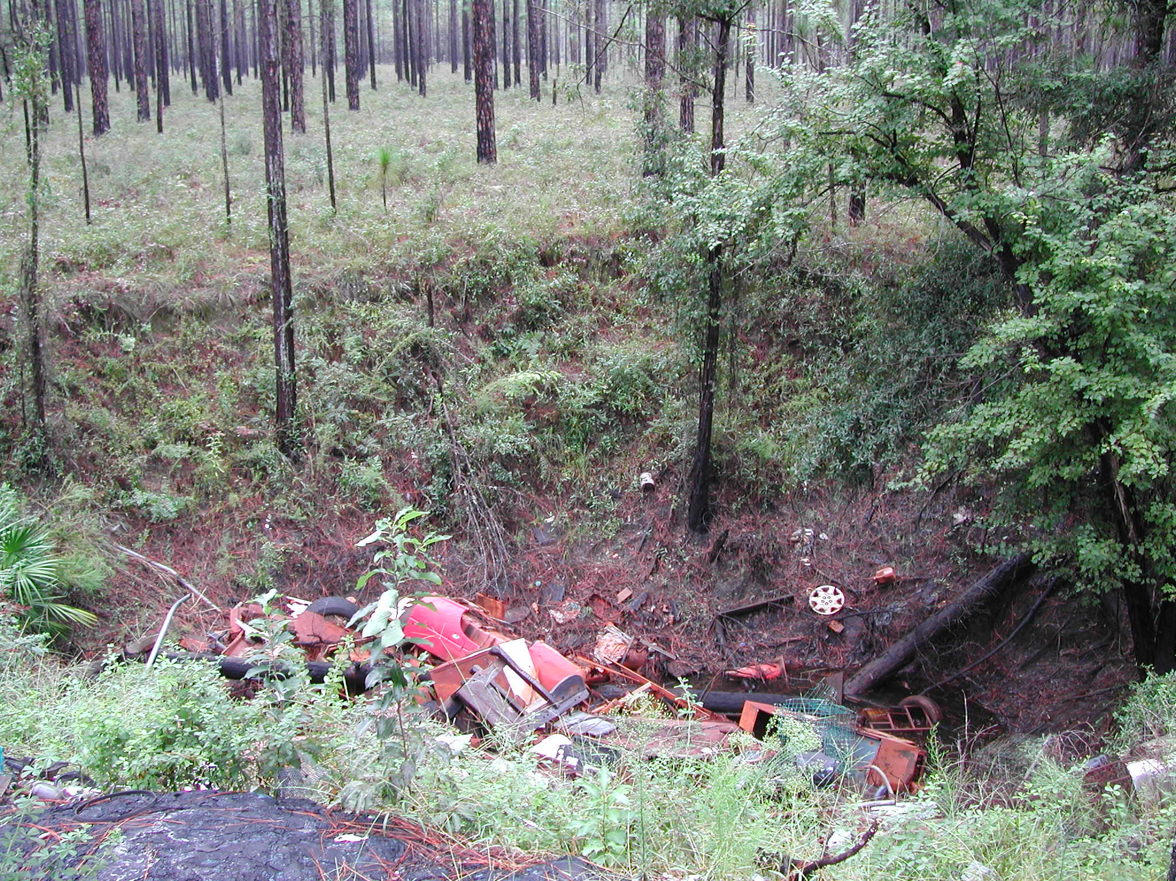
Illegal dumping

Slide 50
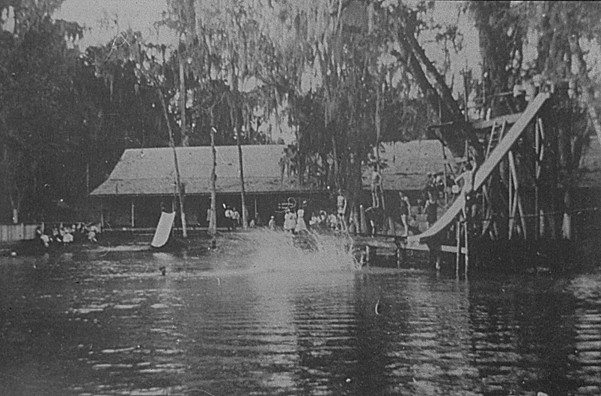
Kissengen Spring, Polk Co.
Over pumping the aquifer

Slide 51

Kissengen Spring, Polk Co.
Stopped flowing in 1950

Slide 52
Springs that either do not flow or flow intermittently
SPRING NAME | COUNTY
HORNSBY | Alachua
ECONFINA UNNAMED SPRING | Bay
HEILBRONN SPRING | Bradford
BEAR SPRING (CITRUS) | Citrus
HOMOSASSA UNNAMED SPRING #2 | Citrus
HOUSE SPRING | Citrus
BIG JACK HOLE SINK | Collier
RED SNAPPER SINK | Flagler
WHITE SULPHUR SPRINGS (HAMILTON) | Hamilton
ZOLFO SPRINGS | Hardee
EUREKA SPRING #1 | Hillsborough
EUREKA SPRING #2 | Hillsborough
EUREKA SPRING #3 | Hillsborough
EUREKA SPRING #4 | Hillsborough
PALMA CEIA SPRING | Hillsborough
PURITY SPRING | Hillsborough
SIX MILE CREEK SPRING | Hillsborough
NATURAL WELLS (LEON) | Leon
PETTIS SPRING | Madison
SEVEN SPRINGS (PASCO) | Pasco
PHILLIPPI SPRING | Pinellas
TARPON SPRINGS | Pinellas
KISSENGEN SPRING | Polk
PINEHURST SPRING | Sarasota
BIG HOLE SPRING | Sumter
COW SPRING | Suwannee
CARLTON SPRING | Taylor
EWING SPRING | Taylor
FENHOLLOWAY SPRING | Taylor
HAMPTON SPRING (TAYLOR) | Taylor
WORTHINGTON SPRING | Union
UNNAMED (WASHINGTON) 303950085400901 | Washington
UNNAMED (WASHINGTON) 303953085400201 | Washington
SPRING CREEK #1 | Wakulla

Slide 53


FGS
Consumptive uses

Slide 54


Slide 55
Overpopulation

Slide 56

Examples of land uses that
impact groundwater and springs:
Agriculture in karst regions
FGS

Slide 57


Slide 58
Industry and mining

Slide 59
Junk yards and
landfills

Slide 60
Urban sprawl – lawn fertilizer

Slide 61
Storm water runoff

Slide 62
Sprayfields and septic tanks

Slide 63

Golf courses

Slide 64
Land use

Slide 65


Slide 66


Slide 67


Slide 68


Slide 69


Slide 70


Slide 71

Spring water is the
same water 90% of
Floridians drink!

Slide 72


Slide 73

SUW725971

Slide 74

What is the end result of these impacts?

Slide 75

Ichetucknee Main

Slide 76

Hart Springs

Slide 77

Ichetucknee
Springs

Slide 78

Troy Spring

Slide 79

Manatee Spring

Slide 80

Sally Ward Spring

Slide 81

Wakulla

Slide 82

Wacissa

Slide 83

What Can We Do??

Slide 84

Education and outreach

Slide 85
More science

Slide 86

Tool for land use planning - FAVA

Slide 87


Florida Springs Initiative
The Initiative is Administered by DEP through Several Divisions
Funding allocated at 2.4 million dollars per year
Modeled after the Florida Springs Task Force Report, 2000
Research and Monitoring Portion
Landowner Assistance
Public Education and Outreach
Restoration
Funding for FY 10/11 slashed to ~$500,000.00
FGS

Slide 88

Enforce current regulations (WMD’s, DEP, local government).
Enact legislation (failure to do so over the past four legislative sessions).
Pass local ordinances.
Take personal responsibility and get involved!
FGS

Slide 89
Springs Web Based Resources:
http://www.floridasprings.org/
http://www.dep.state.fl.us/geology/geologictopics/springs/bulletin66.htm
http://www.dep.state.fl.us/geology/geologictopics/springs.htm
http://www.floridasprings.net/springlisting.html
http://www.thiswaytothe.net/springs/
Contact me at the Florida Geological Survey:
Guy.means@dep.state.fl.us, 850-488-9380.

Slide 90

Thank you OLLI participants!

