Slide 1




Martin County’s Septic to Sewer Program Update

Slide 2


10-Year Connect to Protect Program 2020-2029
Strong comprehensive approach provides cost effective residential connection to central sewer
~$160M infrastructure investment for sewer and some water connection
Sewer infrastructure will be available for connection to approximately 10,000 parcels within service area
Potential nutrient reduction up to ~100k lbs TN/yr and ~23K lbs TP/yr*
*TN: 9.7lbs/year/septic system (Ye et. al. 2017)
TP: Martin County Watershed to Reef Septic Study, Harbor Branch Oceanographic Institute, March 2016
*TN: 9.7lbs/year/septic system (Ye et. al. 2017)
TP: Martin County Watershed to Reef Septic Study, Harbor Branch Oceanographic Institute, March 2016

Slide 3
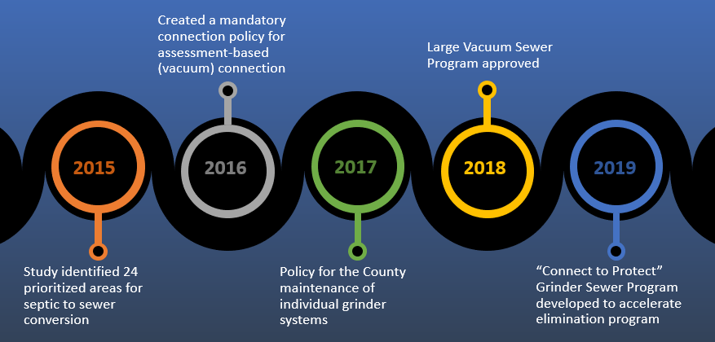
Martin County BOCC Commitment
*TN: 9.7lbs/year/septic system (Ye et. al. 2017)
TP: Martin County Watershed to Reef Septic Study, Harbor Branch Oceanographic Institute, March 2016

Slide 4
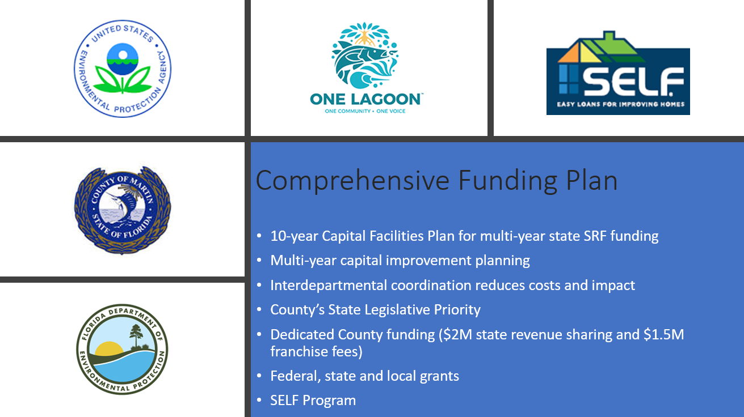

*TN: 9.7lbs/year/septic system (Ye et. al. 2017)
TP: Martin County Watershed to Reef Septic Study, Harbor Branch Oceanographic Institute, March 2016

Slide 5
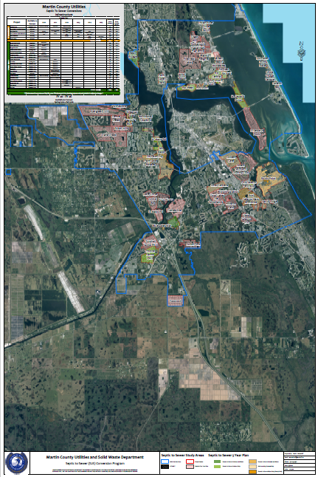
5-Year Septic to Sewer
Conversion Plan
2020-2025
Refined priority septic conversion areas based on 2015 study
Coordination with water and stormwater projects to reduce disruption
Infrastructure available to 7,394 units
Estimated annual reduction ~72k lbs. TN and 15k lbs. TP
*TN: 9.7lbs/year/septic system (Ye et. al. 2017)
TP: Martin County Watershed to Reef Septic Study, Harbor Branch Oceanographic Institute, March 2016

Slide 6
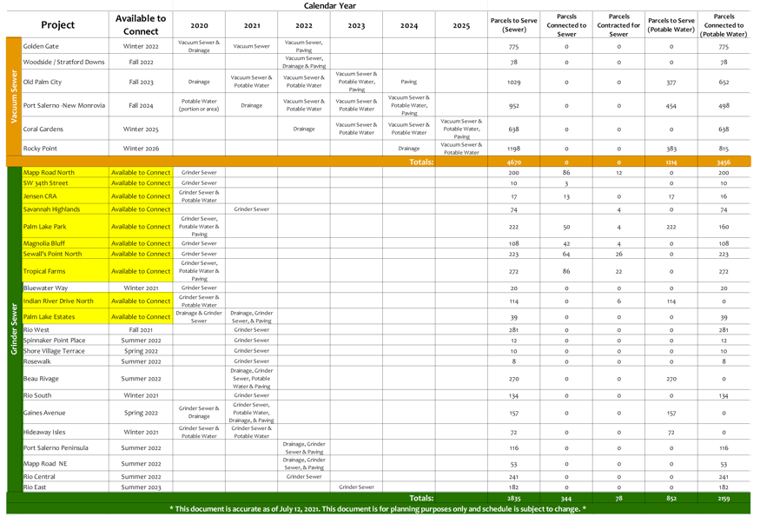
5-Year Project Plan
*TN: 9.7lbs/year/septic system (Ye et. al. 2017)
TP: Martin County Watershed to Reef Septic Study, Harbor Branch Oceanographic Institute, March 2016

Slide 7
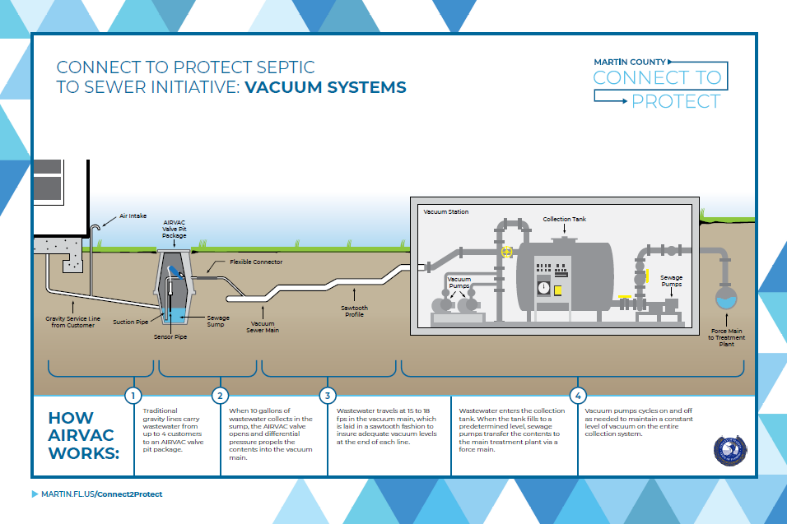
Notes:
>300 home communities
Assessment based

Slide 8
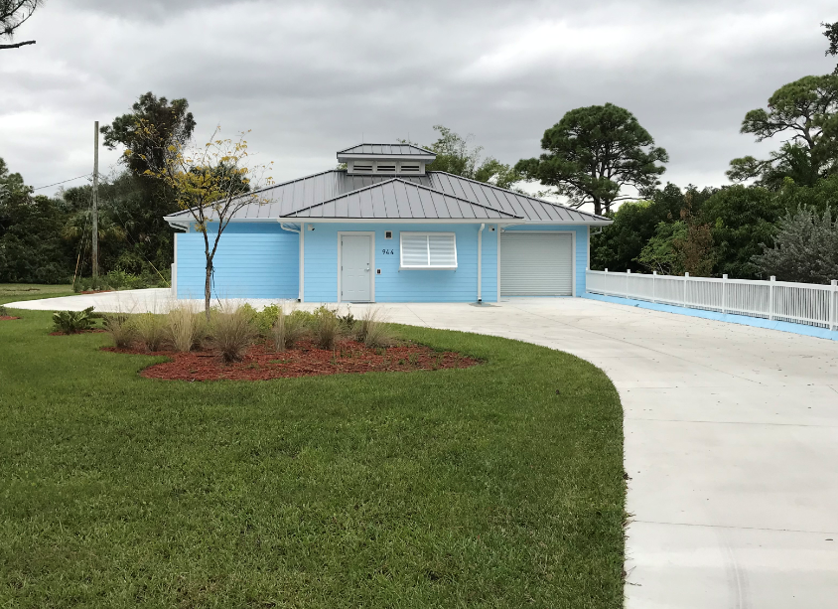
Vacuum Pump Building Example
North River Shores, Jensen Beach
*TN: 9.7lbs/year/septic system (Ye et. al. 2017)
TP: Martin County Watershed to Reef Septic Study, Harbor Branch Oceanographic Institute, March 2016

Slide 9
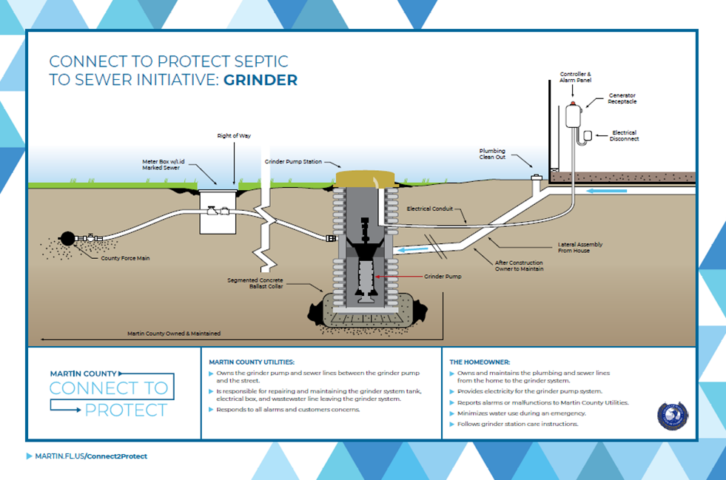
Notes:
<300 home communities
Voluntary connection

Slide 10
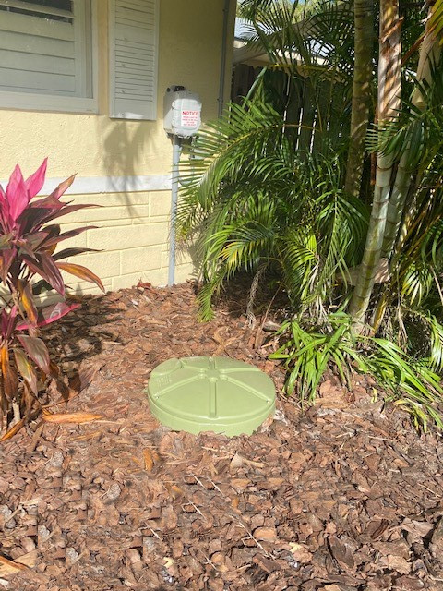
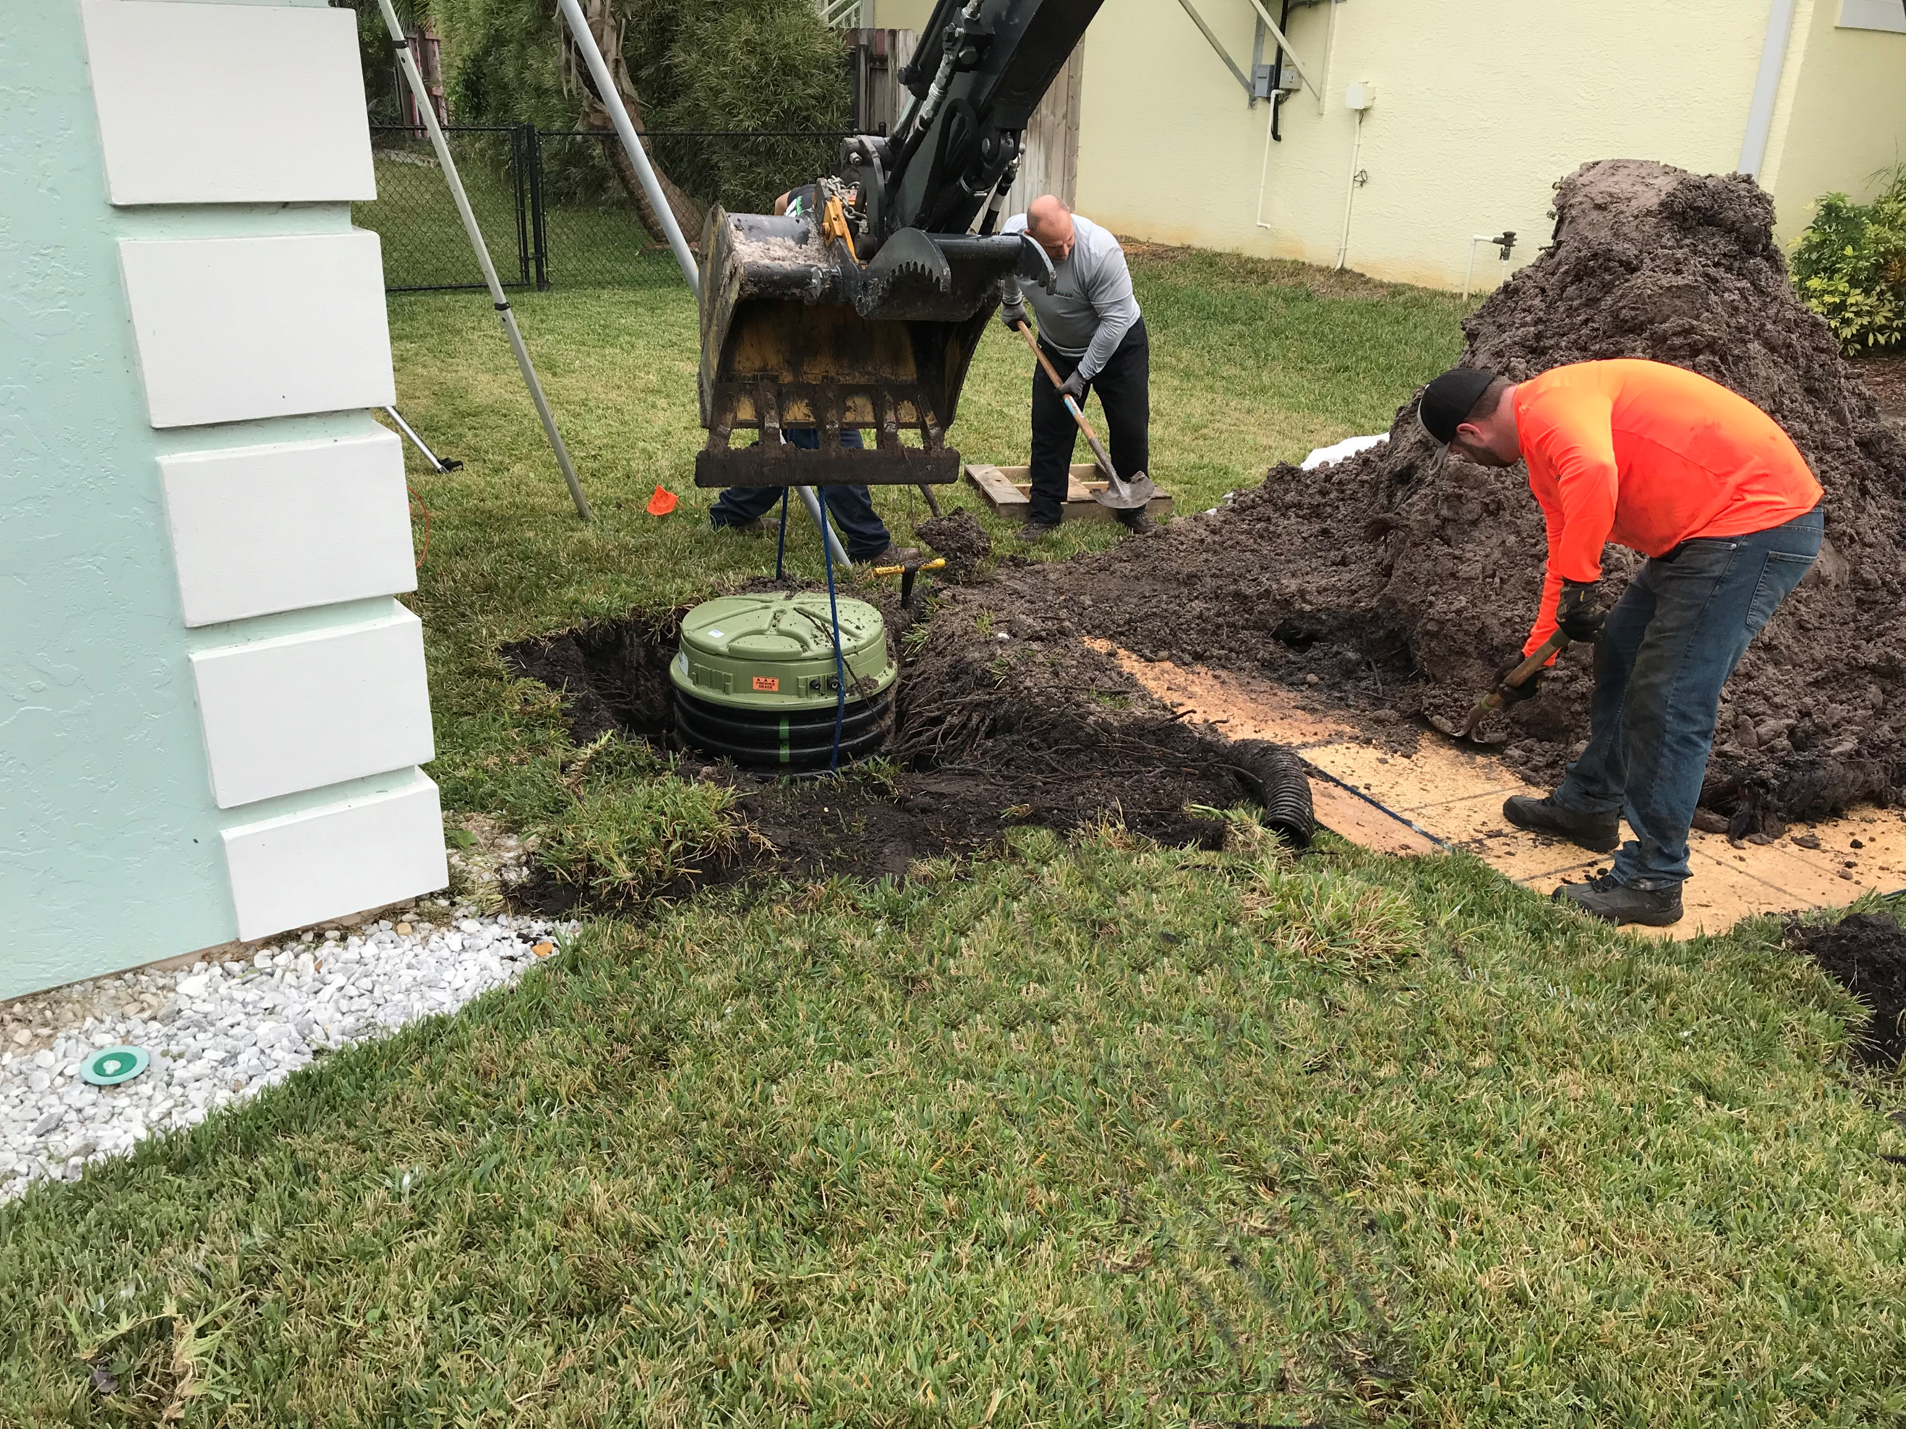
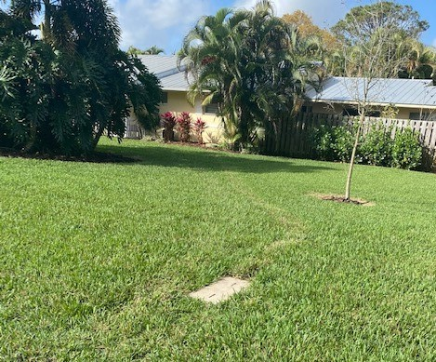
How Grinder Connection Works
Streamlined process for homeowners
Financial incentives to connect
Connect by MCU licensed contractors
MCU will maintain the grinder system in perpetuity
*TN: 9.7lbs/year/septic system (Ye et. al. 2017)
TP: Martin County Watershed to Reef Septic Study, Harbor Branch Oceanographic Institute, March 2016

Slide 11

Solar Energy Fund (SELF) Program
*TN: 9.7lbs/year/septic system (Ye et. al. 2017)
TP: Martin County Watershed to Reef Septic Study, Harbor Branch Oceanographic Institute, March 2016

Slide 12
IRL National Estuary Program Grants
Funding period October 1 – September 30
$150,000 grant for Connect to Protect grinders
$1,000 incentive for early connection per household
2020-21 Grant -100% connected
2021-22 Grant – agreement executed
*TN: 9.7lbs/year/septic system (Ye et. al. 2017)
TP: Martin County Watershed to Reef Septic Study, Harbor Branch Oceanographic Institute, March 2016

Slide 13
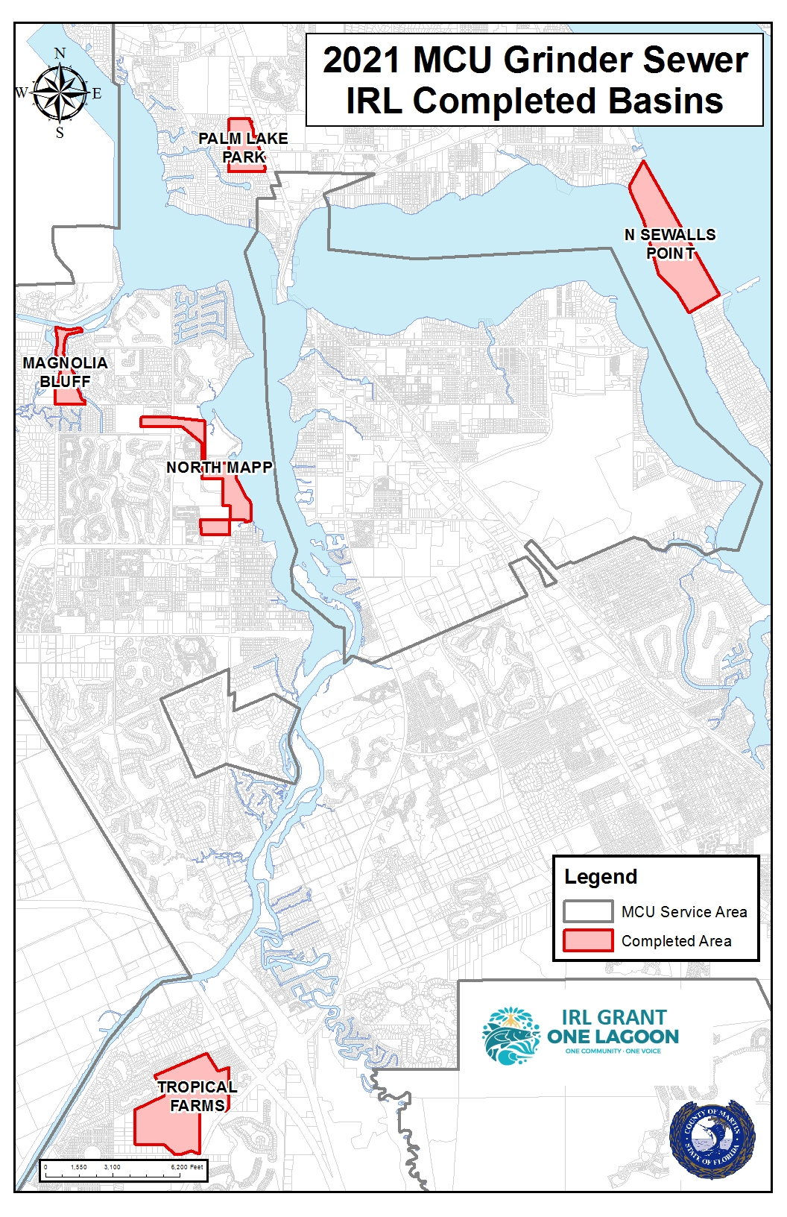
Completed Projects FY2021 IRL Grant
NORTH MAPP
MAGNOLIA BLUFF
PALM LAKE PARK
N SEWALLS POINT
TROPICAL FARMS
Total
26
21
18
41
44
150 connections
*TN: 9.7lbs/year/septic system (Ye et. al. 2017)
TP: Martin County Watershed to Reef Septic Study, Harbor Branch Oceanographic Institute, March 2016

Slide 14
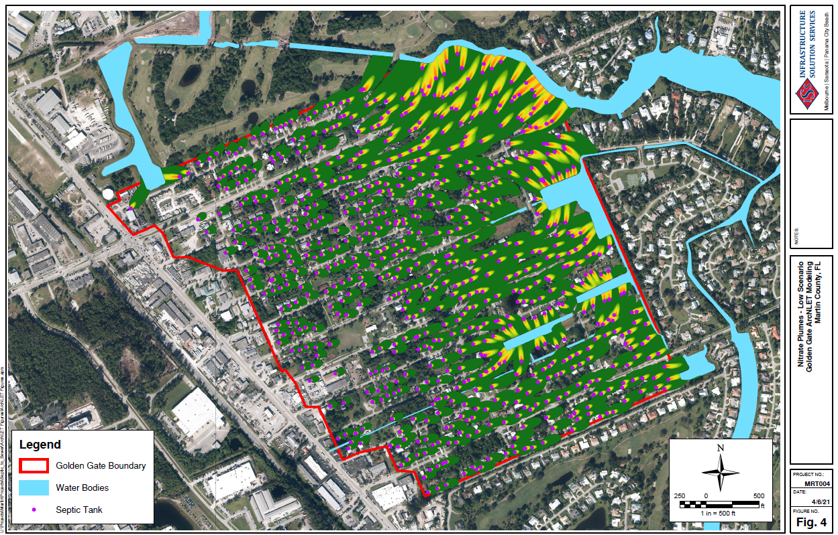
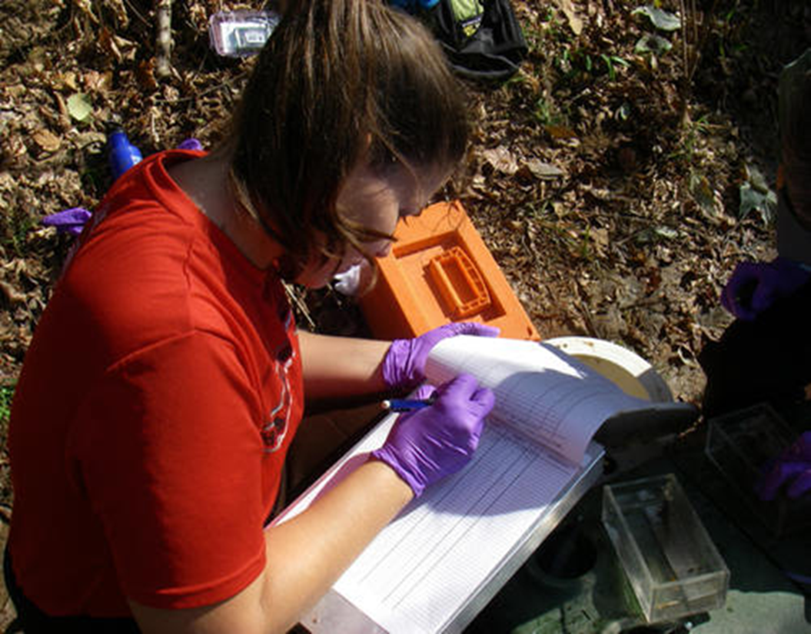
Measuring Nutrient Reduction
Development of FDEP ArcNLET models
Area specific septic TN loading impacts
Extrapolation of model for TP load estimates
Golden Gate nutrient monitoring study to measure loads before during and after connection
*TN: 9.7lbs/year/septic system (Ye et. al. 2017)
TP: Martin County Watershed to Reef Septic Study, Harbor Branch Oceanographic Institute, March 2016
(Source: USGS)

Slide 15
Program Success
Design, permitting and construction
Customer service
Financing and grants
Policies and partnerships
Measurable benefit
*TN: 9.7lbs/year/septic system (Ye et. al. 2017)
TP: Martin County Watershed to Reef Septic Study, Harbor Branch Oceanographic Institute, March 2016

Slide 16

“Long-term, the Martin County Connect to Protect Program will result in some of the most significant local nutrient load reductions to the IRL”
- excerpt from IRL Council grant agreement with Martin County
*TN: 9.7lbs/year/septic system (Ye et. al. 2017)
TP: Martin County Watershed to Reef Septic Study, Harbor Branch Oceanographic Institute, March 2016

