Slide 1
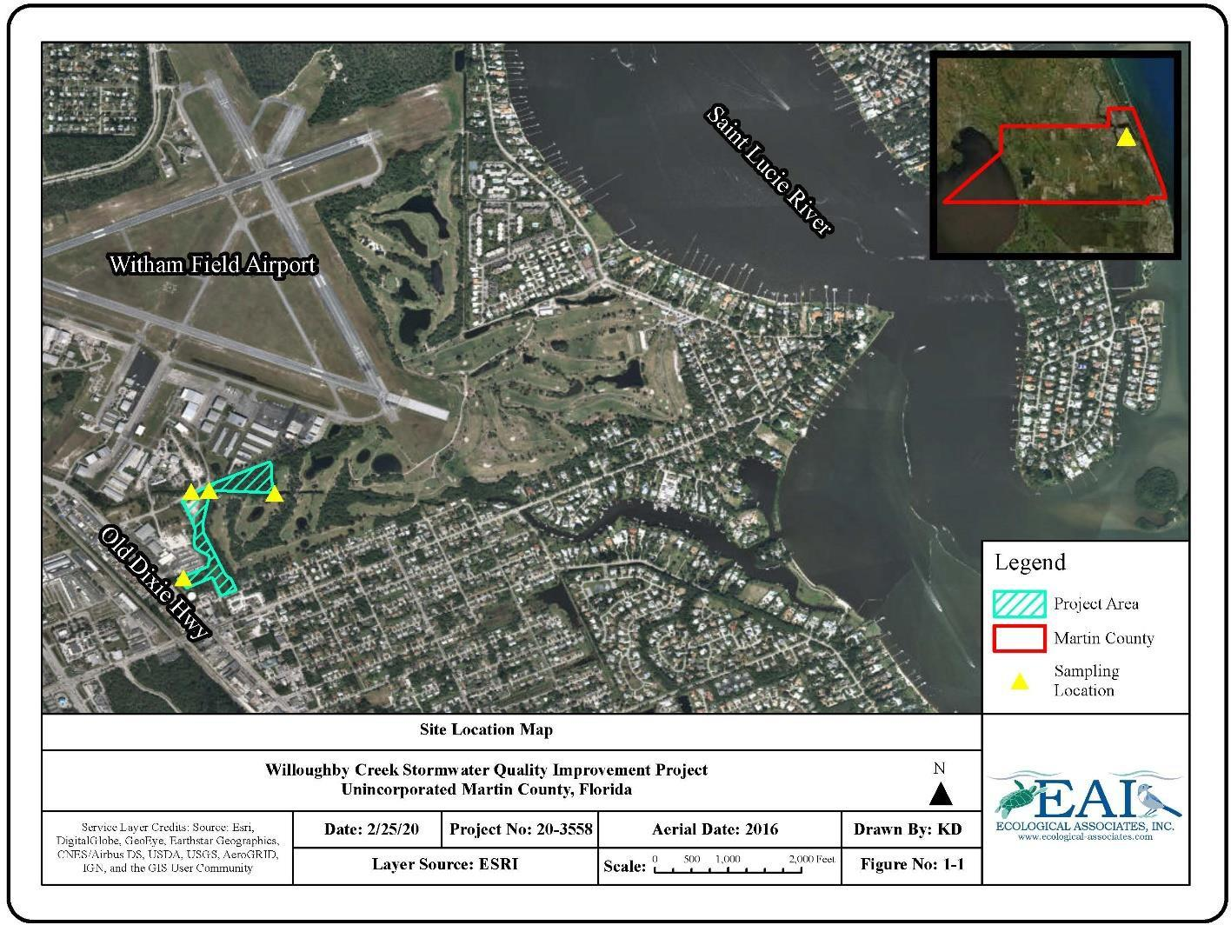
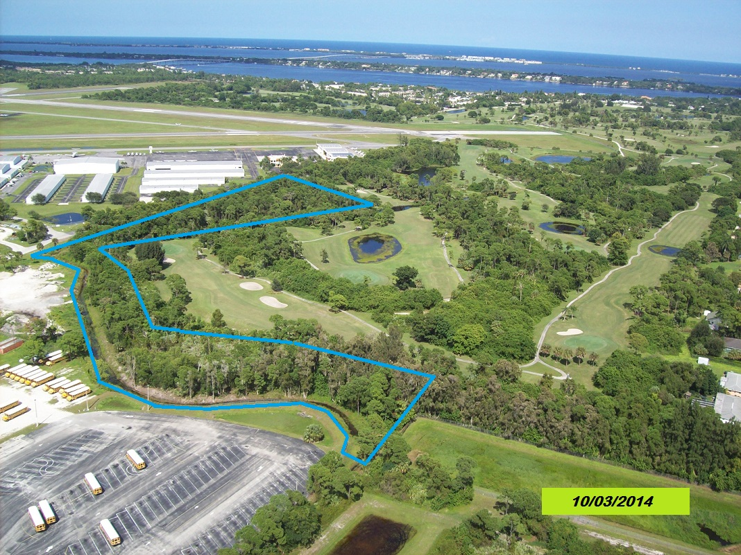
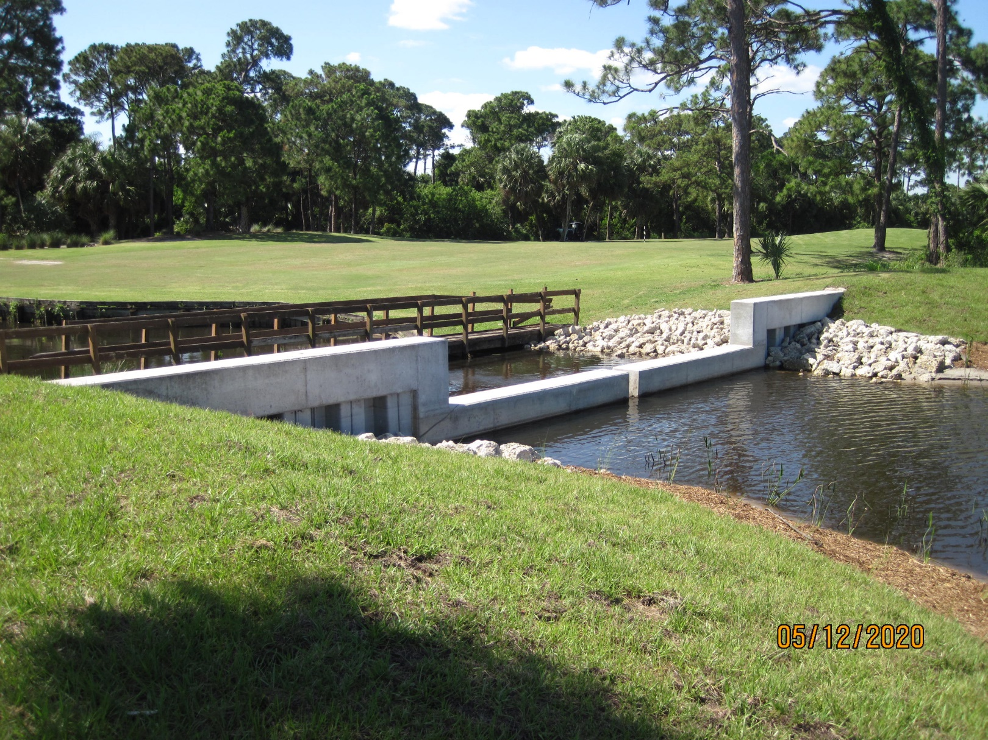
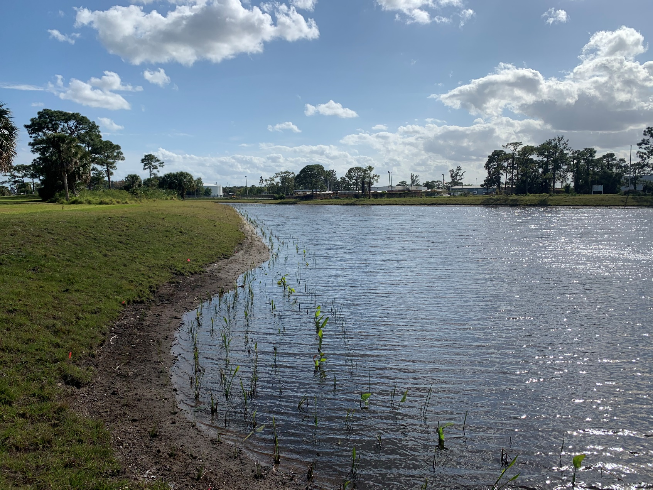
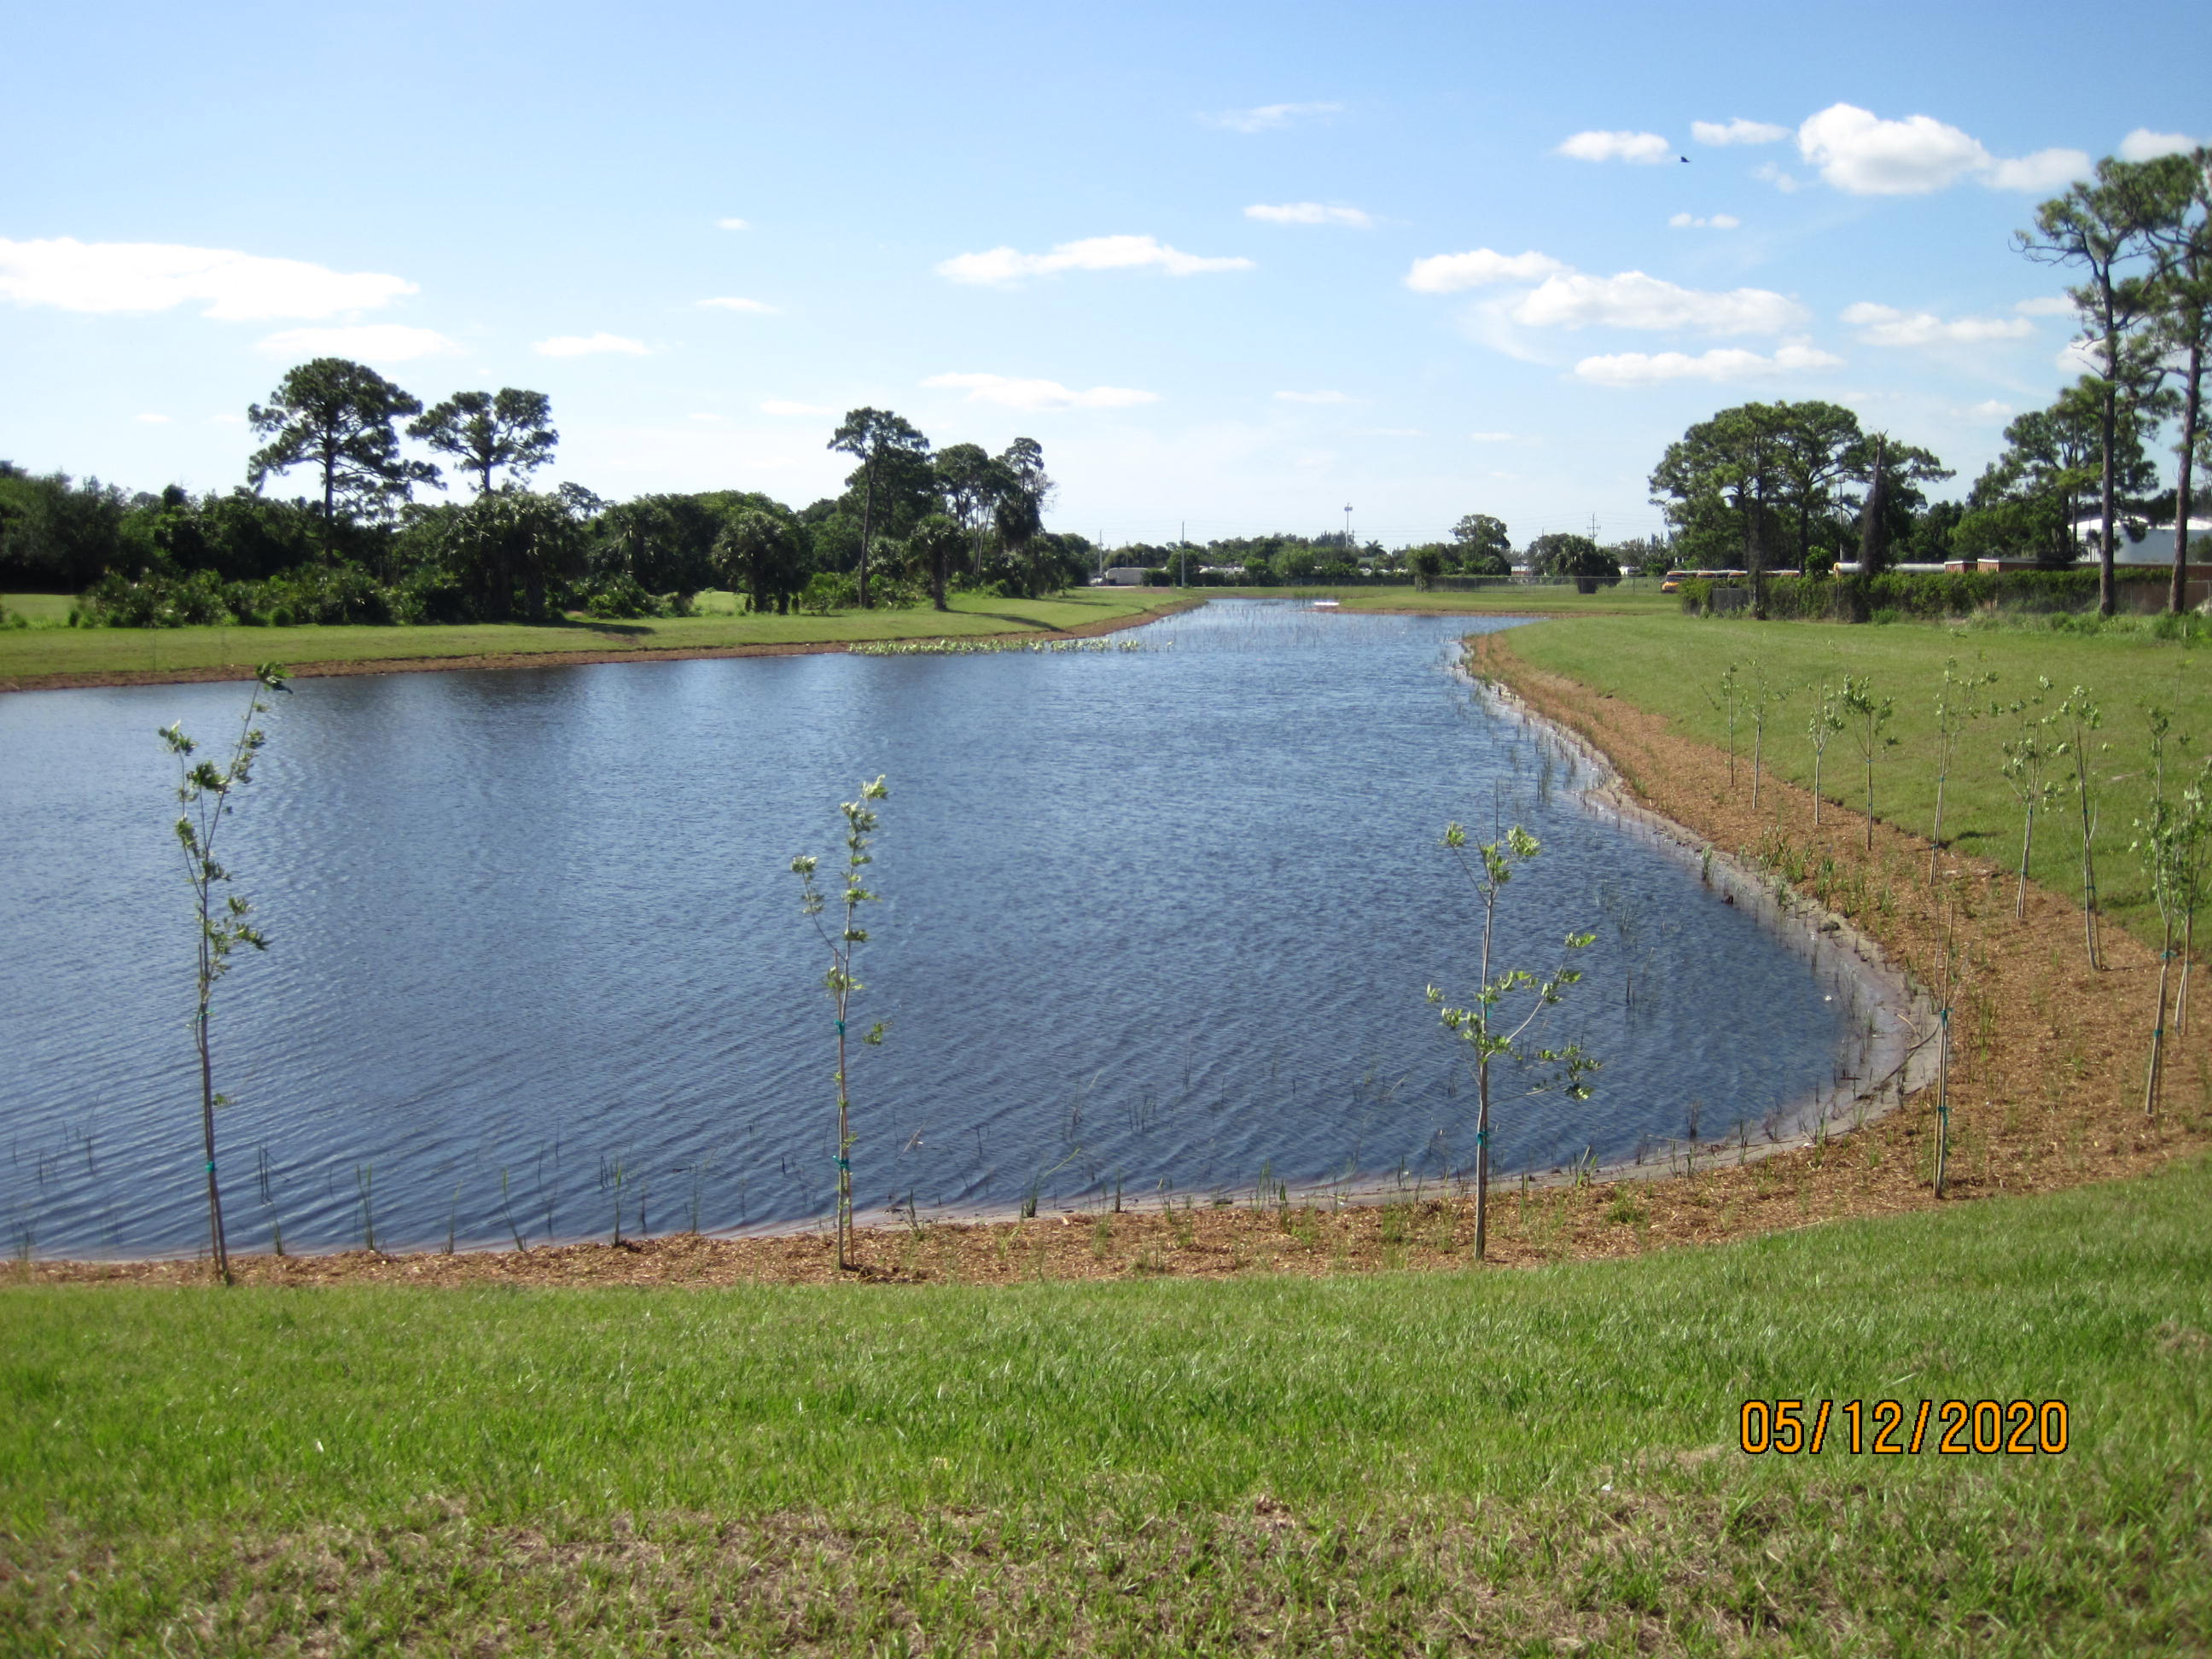
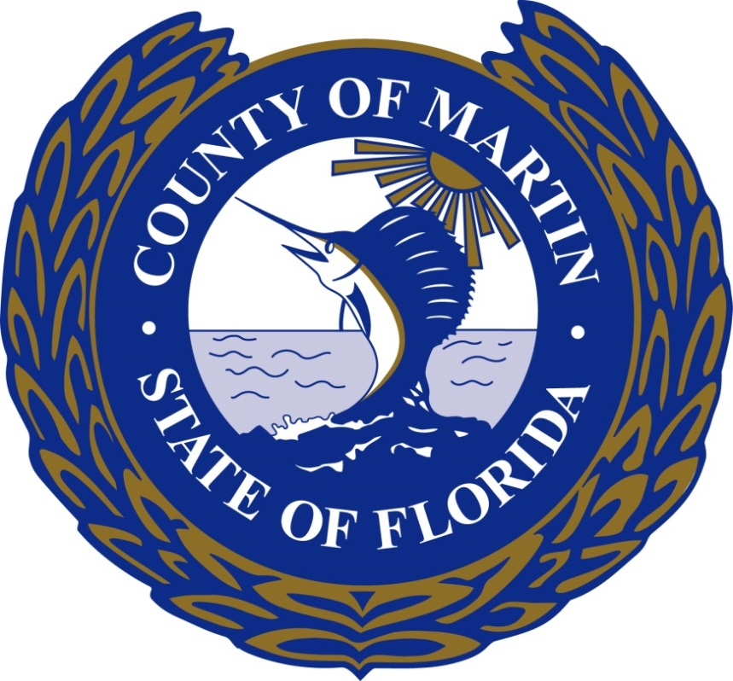
Willoughby Creek Stormwater Quality Improvement Project
The project completed in July 2020 consists of a Stormwater Treatment Area (STA) utilizing a combination of deep detention lakes and shallow treatment wetlands with native herbaceous submergent and emergent plants, along with storm pipes, associated ditch bottom inlets, control structures, and a sheet pile weir.
The 24.50-acre STA system is designed to provide water quality improvements to 222 acres that contributes to the Willoughby Creek watershed.
Currently the Ecosystem and Restoration Division is the monitoring the effectiveness of the treatment train system.
Site Location
Preconstruction
Control Weir at outflow
Deep Detention Lake and Plantings
Second Deep Detention Lake and Littoral Plantings
Project Team:
Administration: Taryn Kryzda, Don Donaldson
Ecosystem Restoration and Management Division: Zach Hughes, John Maehl, Mike Yustin, and Pati Higginbotham
Capital Projects: George Dzama, Logan Huber, Chris Goetzfried, Justin Deckard, Krysti Brotherton and Kim McLaughlin
Office of Managements & Budget/Purchasing: Stephanie Merle, Lisandra Bonet and Jennifer Manning and Nicole Carey
Design Team: CAPTEC, EAI
Construction: JW Cheatham LLC
.
“This document may be reproduced upon request in an alternative format by contacting the County ADA Coordinator (772) 320-3131, the County Administration Office (772) 288-5400, Florida Relay 711, or by completing our accessibility feedback form at www.martin.fl.us/accessibility-feedback ”.

