Slide 1

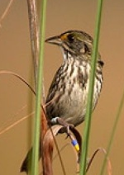
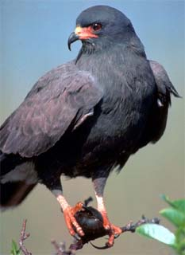
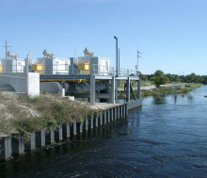
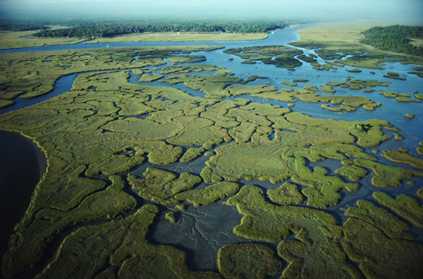
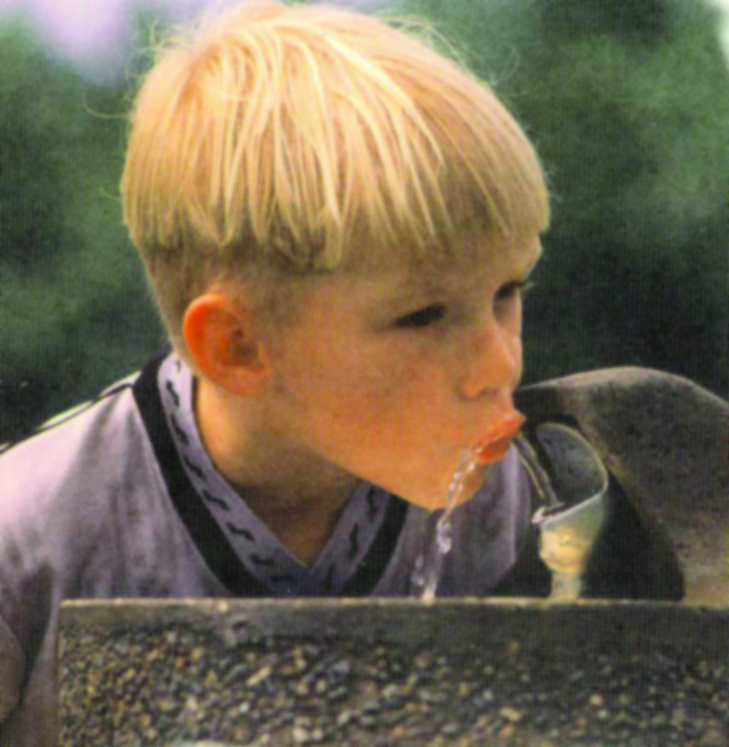
G-3273 Relaxation and
S-356 Field Test
Sean L. Smith, P.E.
Chief, Water Resources Engineering Branch
Jacksonville District
Appendix A – Technical Team Meeting
May 15, 2013

Slide 2
G-3273/S-356 Field Test
1989 Congress passed the Everglades National Park Protection and Expansion Act.… authorized the Secretary of the Army to make modifications to C&SF Project
“to improve water deliveries into the park and shall, to the extent practicable, take steps to restore the natural hydrological conditions within the Park.”
G-3273 relaxation will allow for more water in NESRS; S-356 will mitigate for increased seepage as a result of the relaxation.

Slide 3
G-3273/S-356 Field Test
Goals
Strategy & Objectives
Constraints
Monitoring
Project Status Update
Upcoming Effort
Comments & Questions

Slide 4
G-3273/S-356 Field Test
Goals
Increase and/or remove the G‑3273 stage constraint to increase water deliveries from WCA-3A to ENP through NESRS for the benefit of natural resources.
Gather data, analyze and report findings to support Florida Department of Environmental Protection (FDEP) operating permit application and to develop future water management operating criteria.
Implement field test for up to one-year (wet and dry season conditions). If weather conditions during the one-year test period do not provide sufficient data for a conclusive field test, the test may be extended.
To maximize flexibility of the existing infrastructure to improve conditions in WCA-3A and NESRS with or without the use of S-356.

Slide 5
G-3273/S-356 Field Test
Strategy & Objectives
Utilize WCA‑3A Regulation Schedule (including Rainfall Plan), ERTP, Operating Criteria for the 8.5 Square Mile Area
Maintain L‑29 Canal stage at 7.5 feet, NGVD
Maintain L‑31N and South Dade Conveyance System canal levels consistent with ERTP
Use existing gages to monitor field test conditions as part of a field test monitoring plan
Assessment of water quality will be included in the field test monitoring plan
Monitor incremental stage increase at G-3273

Slide 6
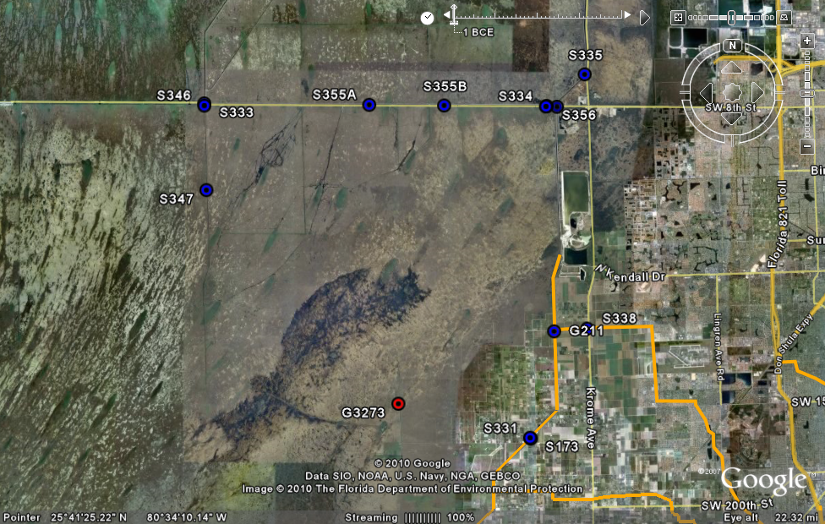
Operational Strategy

Slide 7
G-3273/S-356 Field Test
Constraints
USACE assessment of hydrometeorological conditions may suspend or discontinue the field test based on, but not limited to, the following:
  C&SF multiple purposes not met
  L-29 canal level exceeds 7.5 feet
  Forecasted Rainfall
  8.5 SMA detention cell water depth consistent with the operating Criteria for the 8.5 SMA Project
  Southern Detention Area (SDA) water depth consistent with ERTP
  Water Quality
  Effects on wildlife resources
Notes:
7
Now let me open the floor to your questions – please don’t ask any difficult ones…

Slide 8
G-3273/S-356 Field Test
Monitoring
Includes surface water levels, groundwater levels, rainfall, pumping rates, species conditions, water quality and cultural resources
  Canal stages and groundwater gages will be monitored during the test to characterize the localized effects of S-356 pumping and minimize risk of pumping more than the additional ENP seepage inflows to L-31N .
  WQ monitoring will be conducted to confirm that there are no unexpected or undesirable WQ effects within ENP as a result of this test.
  Cultural resource monitoring will show the effects of the volume of water discharged and how this volume spreads south throughout NESRS.

Slide 9
G-3273/S-356 Field Test
Monitoring - continued
Monitoring results will be used to adjust S-356 operations, if justified.
Information gained during monitoring will be included in a separate report.

Slide 10
G-3273/S-356 Field Test
Project Status Update
Documents developed
  Goals Objectives and Constraints – Final draft
  Operational Strategy – Draft
  Monitoring Plan – Draft
Documents provided to agencies and Tribe for review October 2012
Letter Requesting Testing Authorization along with documents sent to FDEP October 2012
  RAI received November 2012
Project is currently on hold pending resolution of comments regarding water quality

Slide 11
G-3273/S-356 Field Test
Upcoming Effort
Agencies and Tribe will be notified as soon as project kicks off again
Identify and work with Water Quality and Hydo- subteams to further define Operational Strategy and Monitoring Plan based on resolution
Draft appropriate environmental documentation
From Kick Off to Initiate Test – 7-8 months

Slide 12
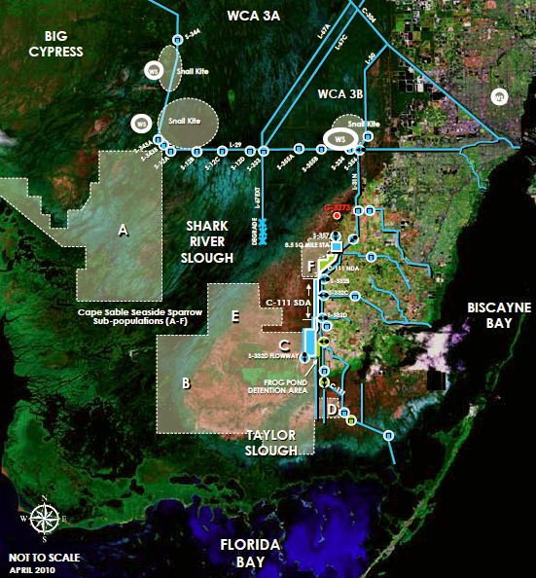
Questions?
Notes:
12
Now let me open the floor to your questions – please don’t ask any difficult ones…

Slide 13
Thank You
U.S. Army Corps of Engineers

