Slide 1
Existing Everglades Monitoring for Compliance with the Settlement Agreement
Peter Rawlik
Lead Environmental Scientist
WQM
May 2013

Slide 2
Scope of Presentation
Key language in the Settlement Agreement (SA) is summarized
Reviews stations in the Everglades Protection Area (EvPA) and associated areas used to meet the requirements
EvPA Structure and Marsh Stations are summarized
Relevant new and eliminated structures are listed
Other Projects discussed
Detailed parameter lists are available in an associated spreadsheet

Slide 3
SA Structure Monitoring Requirements
Verbatim
All water control structures for the Refuge, the Park, and the WCAs will be monitored, as is done by the present SFWMD CAMB, ENP, and LEC programs. Monitoring will be extended to any new water control structure added to the delivery system (Appendix D, Page 4)
In order to adequately assess Refuge and WCA nutrient inputs and outputs and Park nutrient inputs, the monitoring program shall include water quality monitoring of discharges at all relevant structures . . . (Appendix D, Page 5)

Slide 4
Projects Referenced in the SA Text
The Settlement Agreement final document is dated February 1992. Active stations were those in use for the period from February 1991 to January 1992
  LEC
    Lower East Coast
    Project suspended in 1986, no sampling in reference period
  ENP
    Everglades National Park
    7 stations around Park
  CAMB
    Conservation Area Materials Budget
    51 stations south of Lake Okeechobee

Slide 5
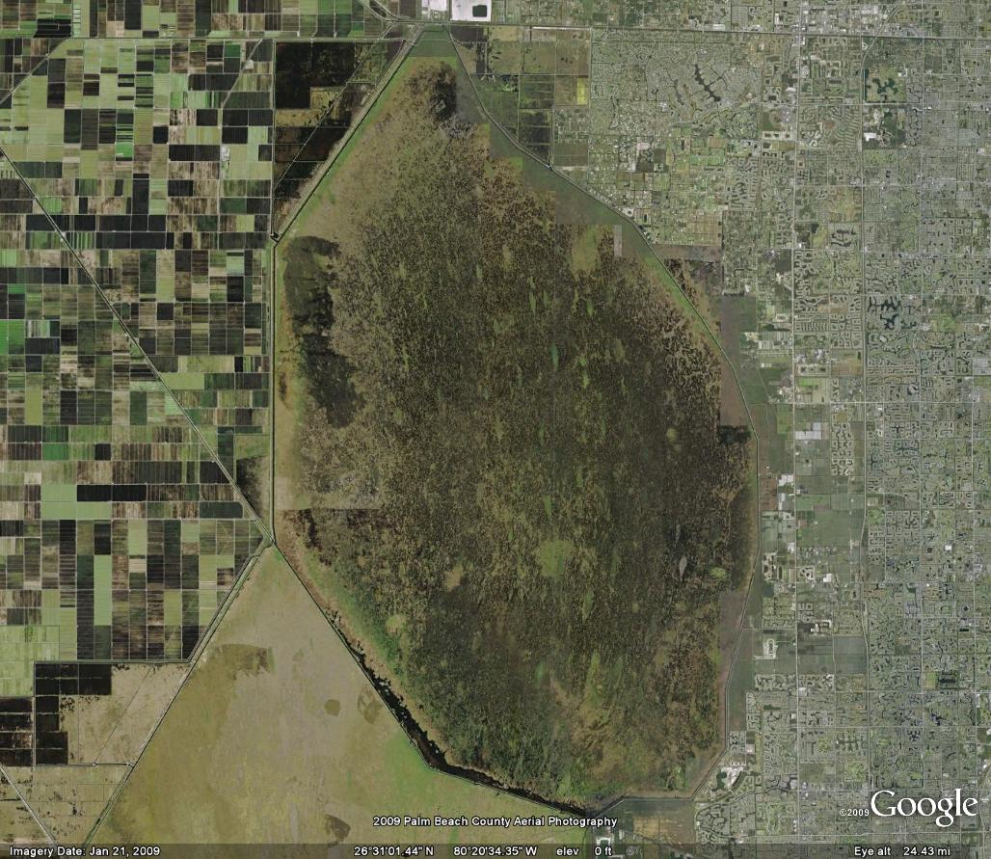
WCA-1
S5A
S5AE
S5AW
S5AS
S5A Distribution Basin
G300
G301
L7
Original
L40-1/Acme1DS
S362
2013
G251
G310
STA1E Construction
L40-2/G94D
STA1W Construction
G94C
Structures Not Covered by Settlement Agreement
STA-2 Construction
G338
G94B
S6
S10E filled in
S10E
G94A
S10D
S10C
S10A
S39

Slide 6
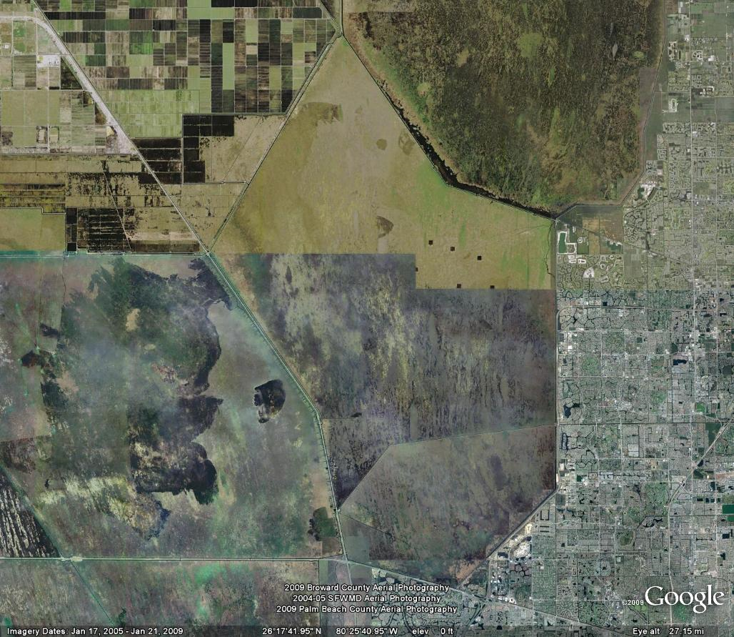
WCA-2
G339
Original
G336A-F
STA-2 Construction
G335
G436
2013
NSID1 rectification
S7
NSIDUS
S38B
S146
S145
S144
S11C
S38
S11B
S11A/S143
S34-G123 (S141)

Slide 7
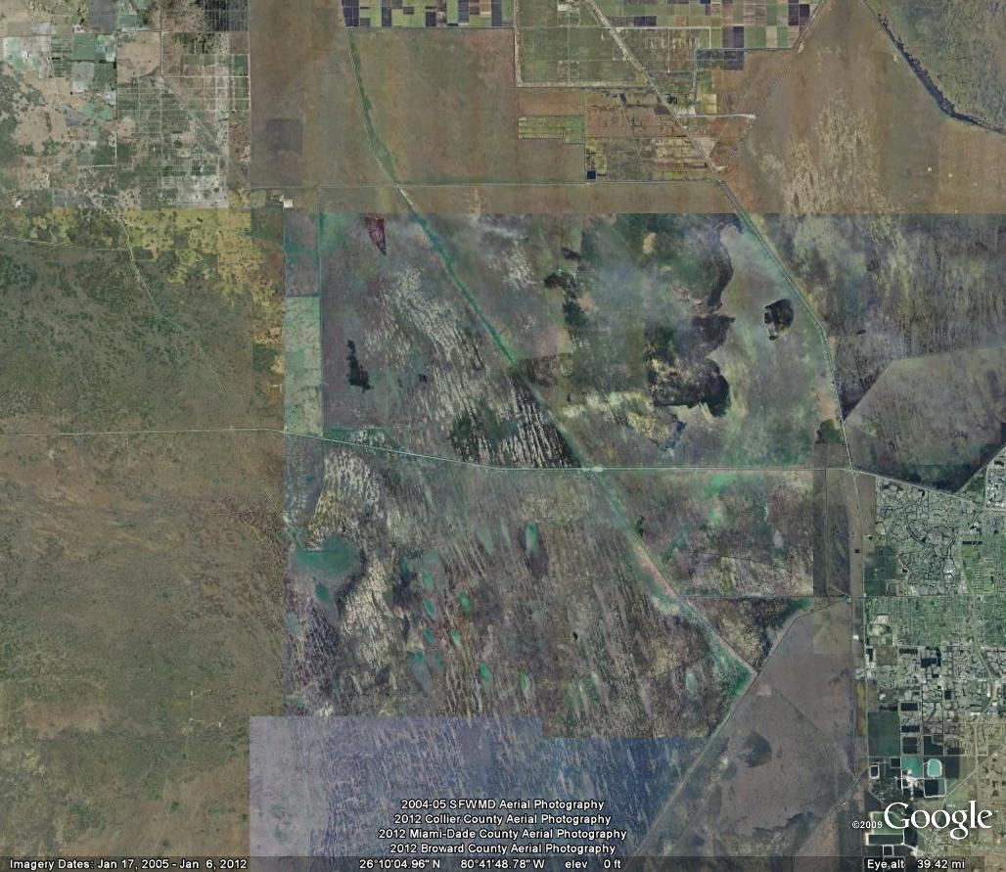
WCA-3
L3
L3BRN
STA5/6 Construction
Structures not included in Settlement Agreement
S8
S150
L3BRS
G64
S190
S339
S140
C123SR84
S142
L28I
S340
S9
Original
S9A
S151
Construction
2013
S31-S337
S344
Construction
S152

Slide 8
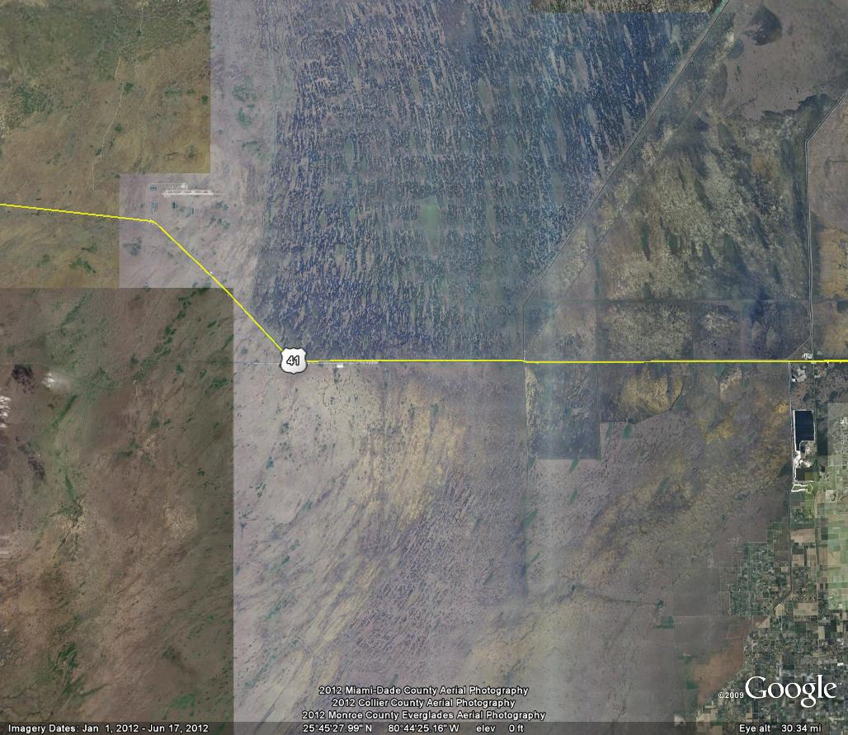
ENP North
Tambr105
Structure not included in Settlement Agreement
S343A&B
S333
G69
S355A&B
US41-25
S334
S12A
S12B
S12C
S12D
10 Tambr Culverts
S356
Construction
Original
2013

Slide 9
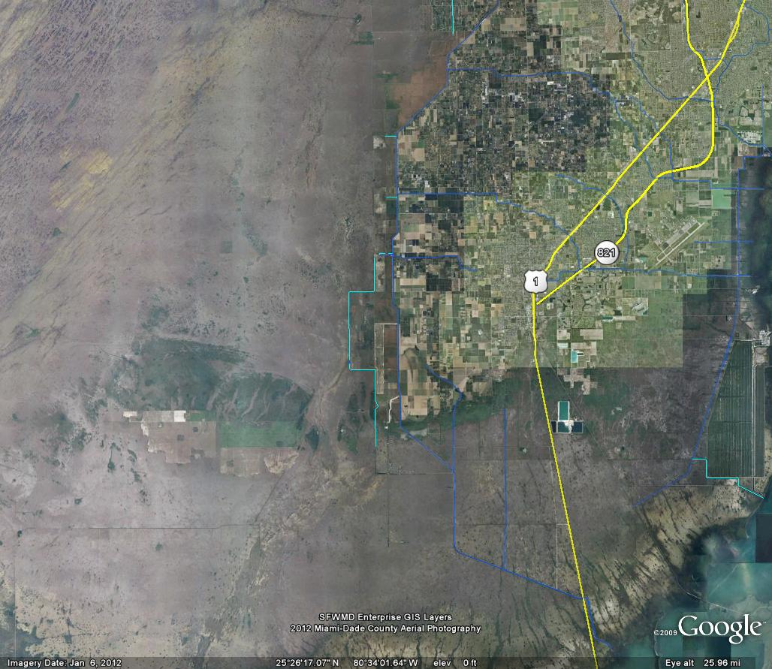
ENP East
S332B
DS2
Structure not included in Settlement Agreement
C111D Construction
S332C
S174
C111D Changes
S332D
S176
DS4/S328
Levee degrade
Berm B3
S332
S178
S175
S177
S199
Original
S18C
Aerojet Construction
2013

Slide 10
Changes to Structures
17 Additions
  STAs to WCAs
    G300, G301, G310, G251, S362, G338, G339, G335, G436
  WCAs (To and Withins)
    S9A, S334-S356, S355A, S355B, S152 (coming on line)
  ENP/C111
    S332D, DS4/S328, S199(?)
6 Subtractions
  S332, S175, S10E, L3, L3BRN, L7/G210
Original SA programs were 58 structures; now, they have increased to 69 structures

Slide 11
Marsh Monitoring Requirements Verbatim
The monitoring program shall include water quality and biological monitoring at interior marsh stations and downstream of all structures discharging into the Refuge, WCAs, and Park, including the Holeyland, Northeast Shark River Slough, Taylor Slough and C-111 basin. The objective . . . is to measure effectiveness of the total phosphorus limits and concentration levels and document further disturbances, or recovery processes, in the Refuge, Water Conservation Areas, and Park. (Appendix D, Pages 3 & 4)

Slide 12
Marsh Monitoring Requirements Verbatim (cont.)
The monitoring program shall include water quality sampling every other week at representative internal marsh stations including monthly sampling at the 14 permanent Refuge stations. (Appendix D, Page 4)
Monitoring shall be implemented . . .along transects in the WCAs, Park, and Refuge originating at major surface water inflow points and continuing along flow gradients. (Appendix D, Page 5)
Change to monthly monitoring of marsh stations approved by the TOC

Slide 13
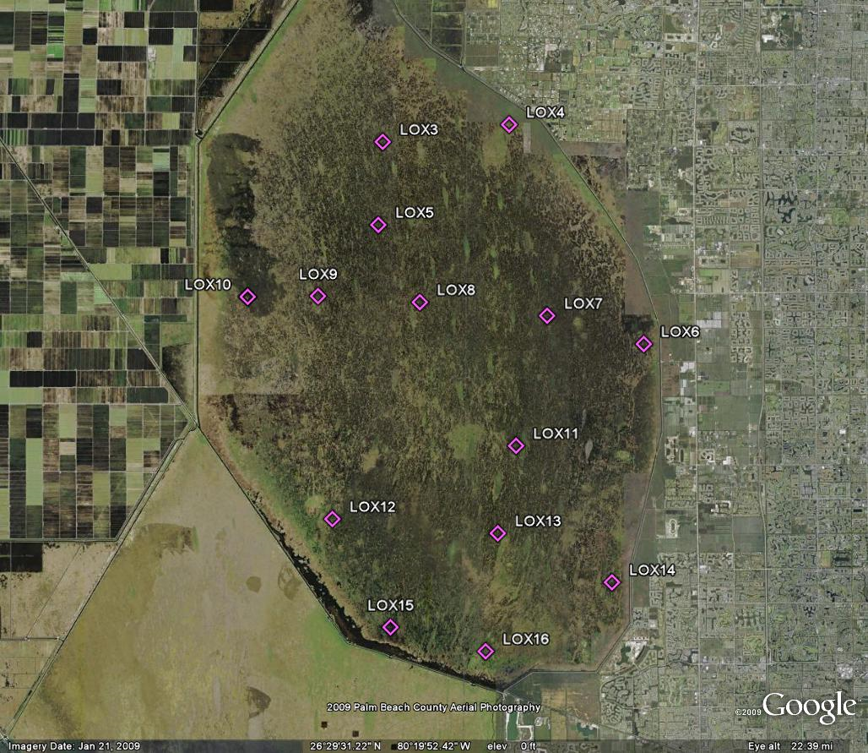
WCA-1 (14 Stations)

Slide 14
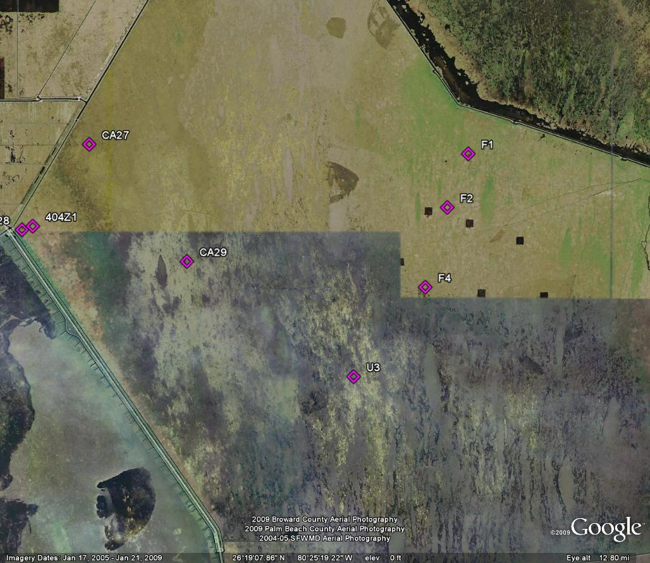

CA28

Slide 15
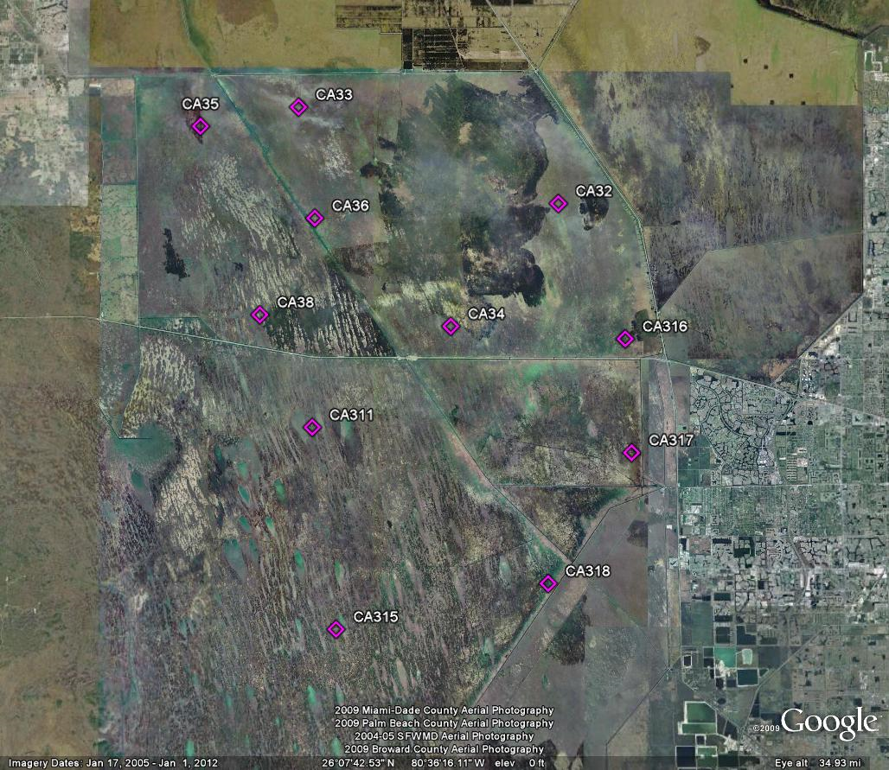
WCA-3A (11 Stations)

Slide 16
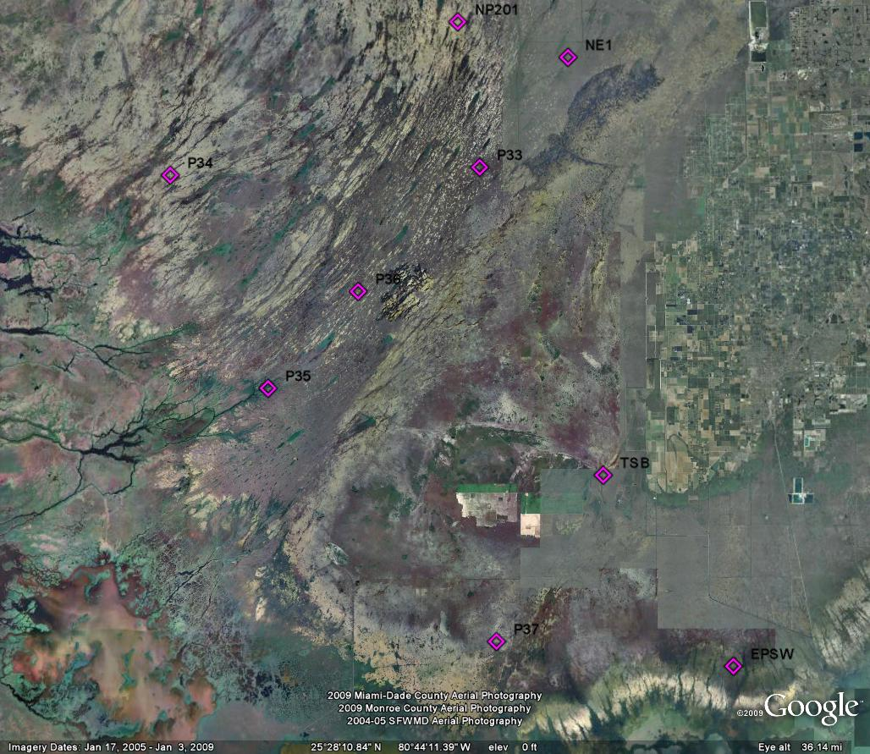
ENP (9 Stations)

Slide 17
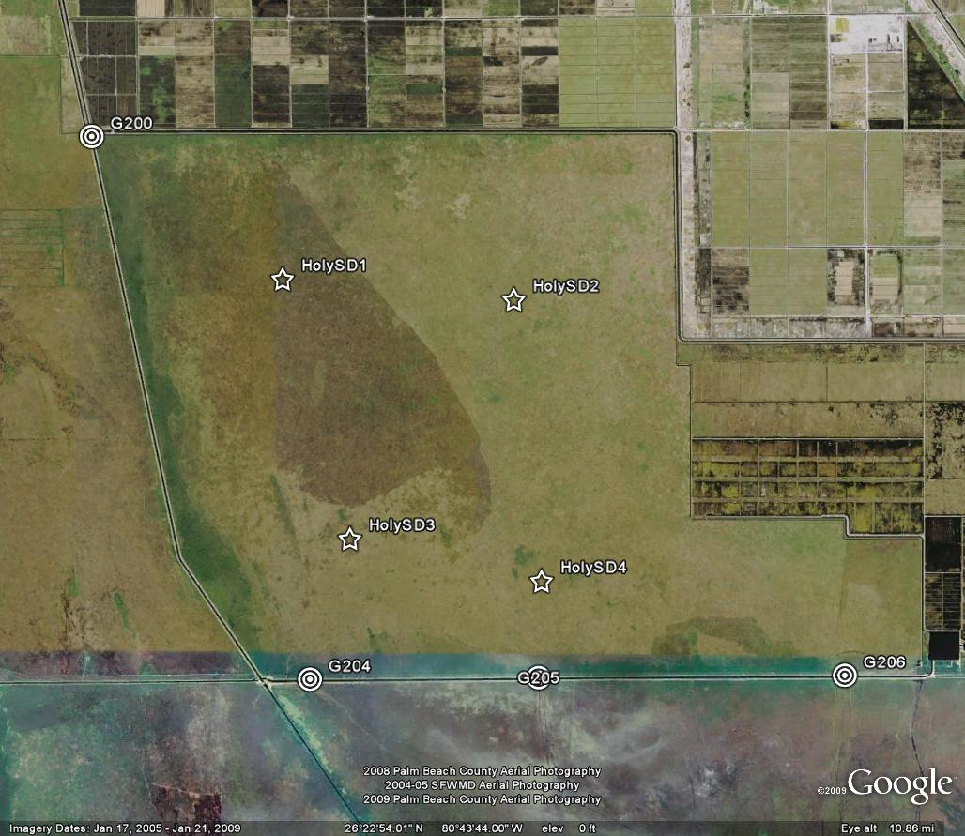
Holeyland
  4 Structures not part of CAMB or ENP
  Area too dry for routine water quality monitoring
  Interior sediments monitored for heavy metals

Slide 18
Atmospheric Deposition
Verbatim
Atmospheric deposition will be monitored at selected sites in the EAA, WCAs, the Refuge, and the Park. (Appendix D, Page 5)
Note: FDEP funded University of Michigan to conduct intensive monitoring of deposition at several sites in South Florida including ENP. TP deposition data are available for review.

Slide 19
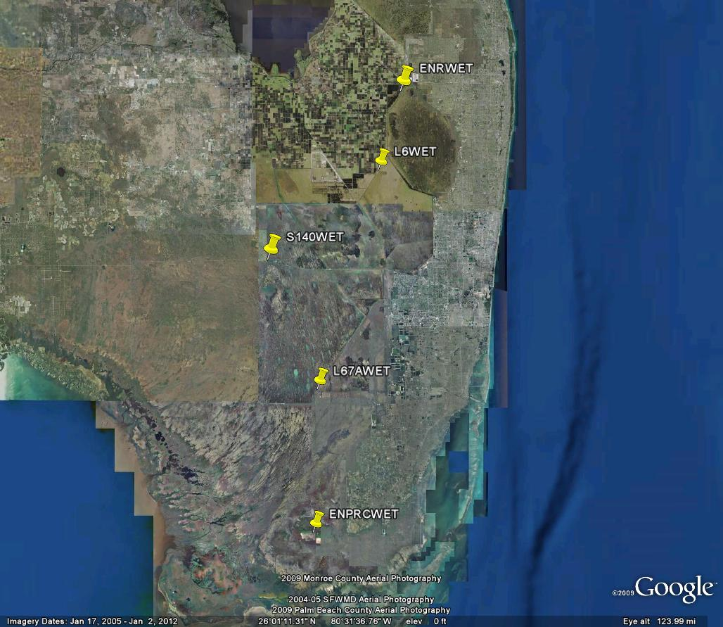
Atmospheric Deposition
(5 Stations)

Slide 20
Pesticides Monitoring
A plan for limiting pesticide/herbicide and heavy metal analysis to a range of representative compounds and sampling locations can be considered. (Appendix D, Pages 3 & 4)
Structures for Pesticides
  S5A, S6, S7, S8, S9, S12A, S333, S334-S356, S190, L3BRS, S31, S18C, S177, S178, S332DX
  DS4/S328 when used
Marsh for Pesticides
  Lox8, Lox10, WCA2F1, WCA2U3/CA215, CA315, CA33

Slide 21
Metals Monitoring
Surface Water
  Fe
    S5A, S5AE, S5AW, S5AS, S6, S7, S8, S10A, S10C, S10D, NSID1, S11A, S11B, S11C, L28I, L3BRS, S150
    All Marsh stations in WCA1, 2 and 3
  Cu
    S5A
  THg
    S332DX and DS4
  MeHg
    S332DX
Sediments
    Lox8, Lox10, WCA2F1, WCA2U3/CA215, CA315, CA33
      Ag, Al, As, Be, Cd, Cr, Cu, Fe, Ni, Pb, Sb, Se, Th, THg, TOC, Zn

Slide 22
Can We Make Changes?
Appendix D, Pages 5 & 6
  4) Any proposed changes in field sampling protocol or laboratory procedure must be justified and brought to the attention of the TOC for approval before implementation. The sampling designs, frequency, analytical methodology, and QA/QC protocols employed in the monitoring program shall be subject to mutual acceptance by all parties. The overall objective will be to maximize the accuracy and precision of the monitoring data, while insuring that any new sampling techniques or analytical procedures will not introduce biases relative to the historical monitoring data upon which the limits are based.

Slide 23
Overarching Issues
Settlement Agreement open to interpretation
TOC role modified in 1995 Status Report
Some of the existing monitoring stations have been made obsolete by construction
In places, monitoring is redundant
Some of the monitoring parameters are no longer a priority

Slide 24
ENP North
In transition
Tambr105
S355s don’t operate
S333
S355A&B
US41-25
S334
S12A
S12B
S12C
S12D
Tambr Culverts
S356
Bridge construction removes several culverts
Road improvements make sampling Tambr culverts dangerous
Full CEPP implementation will make calculation of compliance standard using Park structures almost impossible

Slide 25
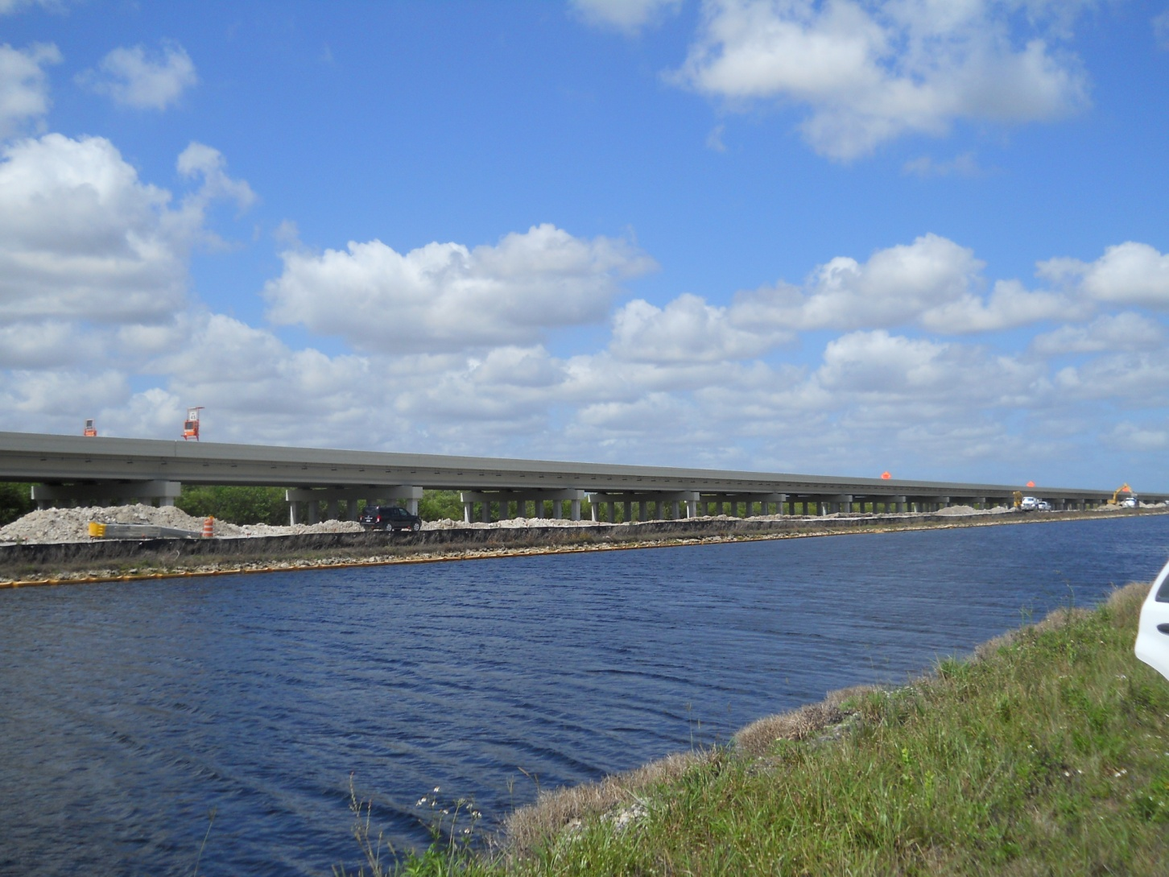
Discussion and Next Steps

