Slide 1
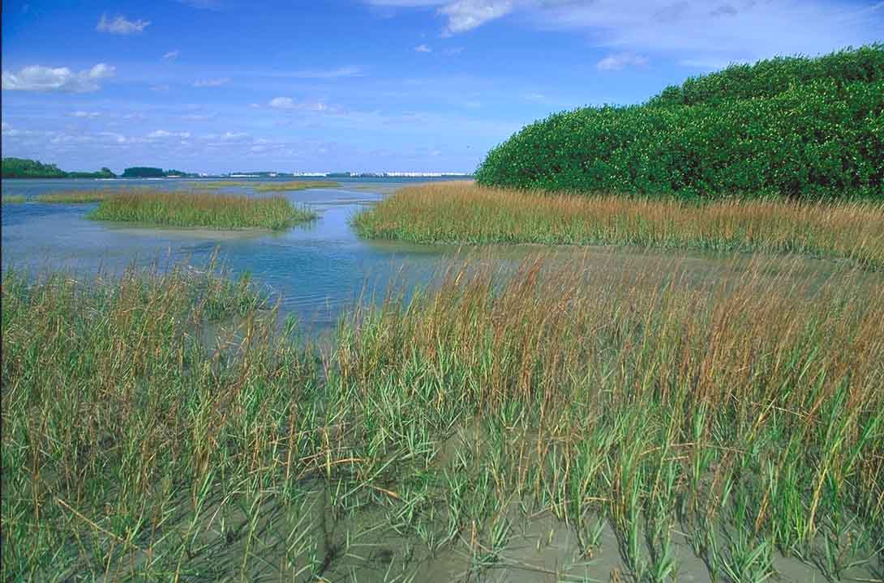
Improved Water Deliveries to
Northeast Shark River Slough
TOC Sub-committee Briefing
May 15, 2013

Slide 2
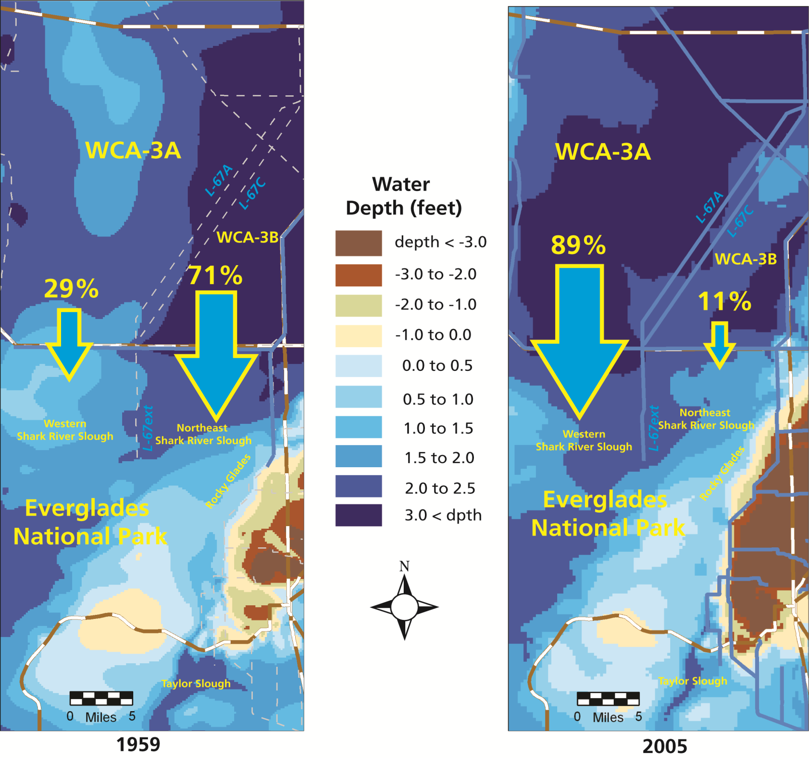
Changes in Surface Water Flows to
Everglades National Park (1959 vs 2005)

Slide 3
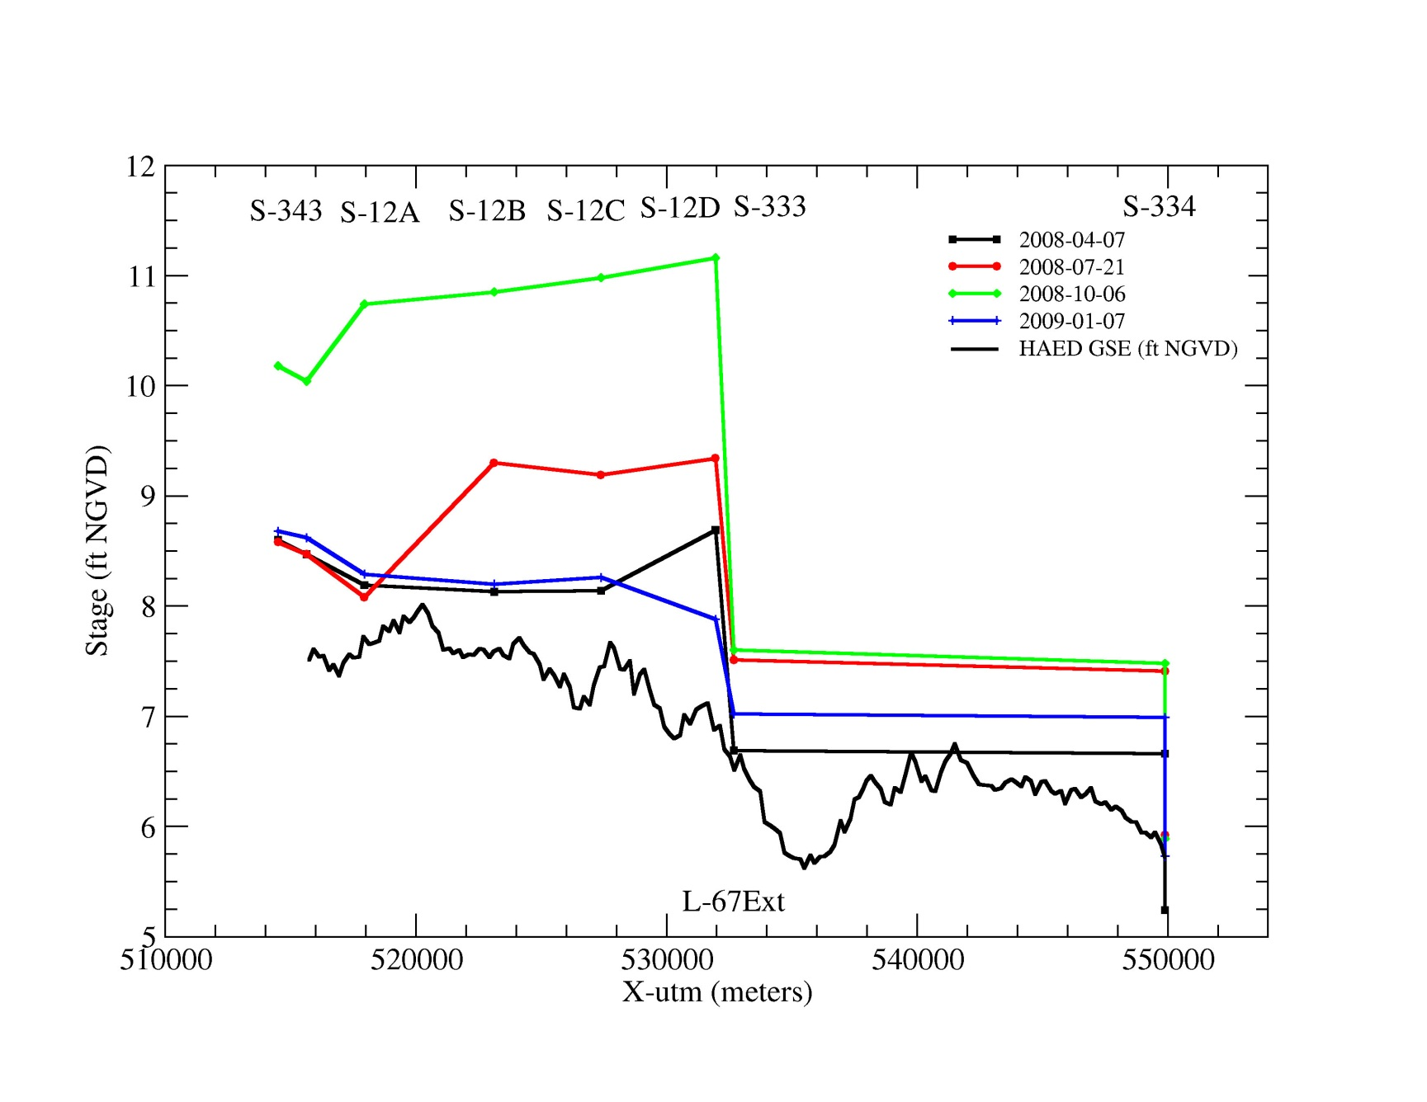
Comparison of Water Levels and Topography
in West vs Northeast Shark River Slough
West Shark River Slough
Northeast Shark River Slough
Ground Elevation
along Tamiami Trail

Slide 4
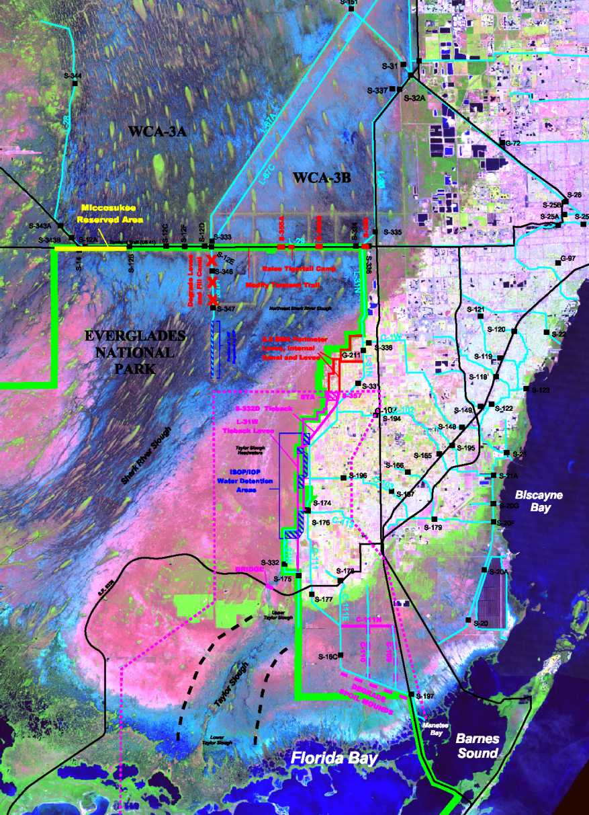
The Everglades National Park Protection
and Expansion Act of 1989
Authorized modifications to the Central & Southern Florida Project “to improve water deliveries into the park and shall, to the extent practicable, take steps to restore the natural hydrologic conditions in the Park.” (Army Corps)
Authorized the acquisition of 109,000 acres in Northeast Shark Slough and the East Everglades. (National Park Service)

Slide 5
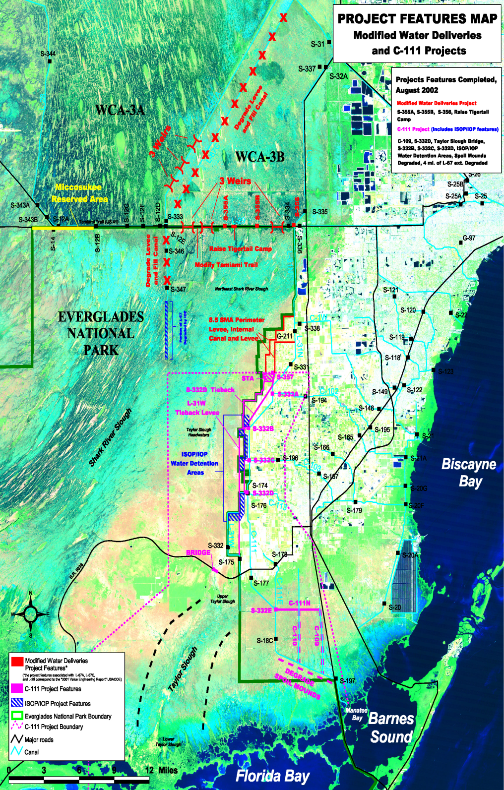
The ENP Protection and Expansion Act (1989)
Modified Water Deliveries Project
Authorized modifications to the Central & Southern Florida Project “to improve water deliveries into the park and shall, to the extent practicable, take steps to restore the natural hydrologic conditions in the Park.” (Army Corps)
East Everglades Acquisition
Authorized the acquisition of 109,000 acres in Northeast Shark Slough and the East Everglades. (National Park Service)
Conveyance
Mitigation
L-67A/C S-345s)
8.5 Square Mile Area
L-29 (S-355A/B)
Osceola Camp
Tamiami Trail
Tigertail Camp
L-67 extension
L-31N (S-356)

Slide 6
Components of the
MWD Project
Conveyance Features
L-67A and C
L-29 (S-355 A and B)
Tamiami Trail
L-67 extension
Mitigation Features
8.5 Square Mile Area
Osceola Camp
Tigertail Camp
Seepage Control Features
L-31N (S-356)

Slide 7
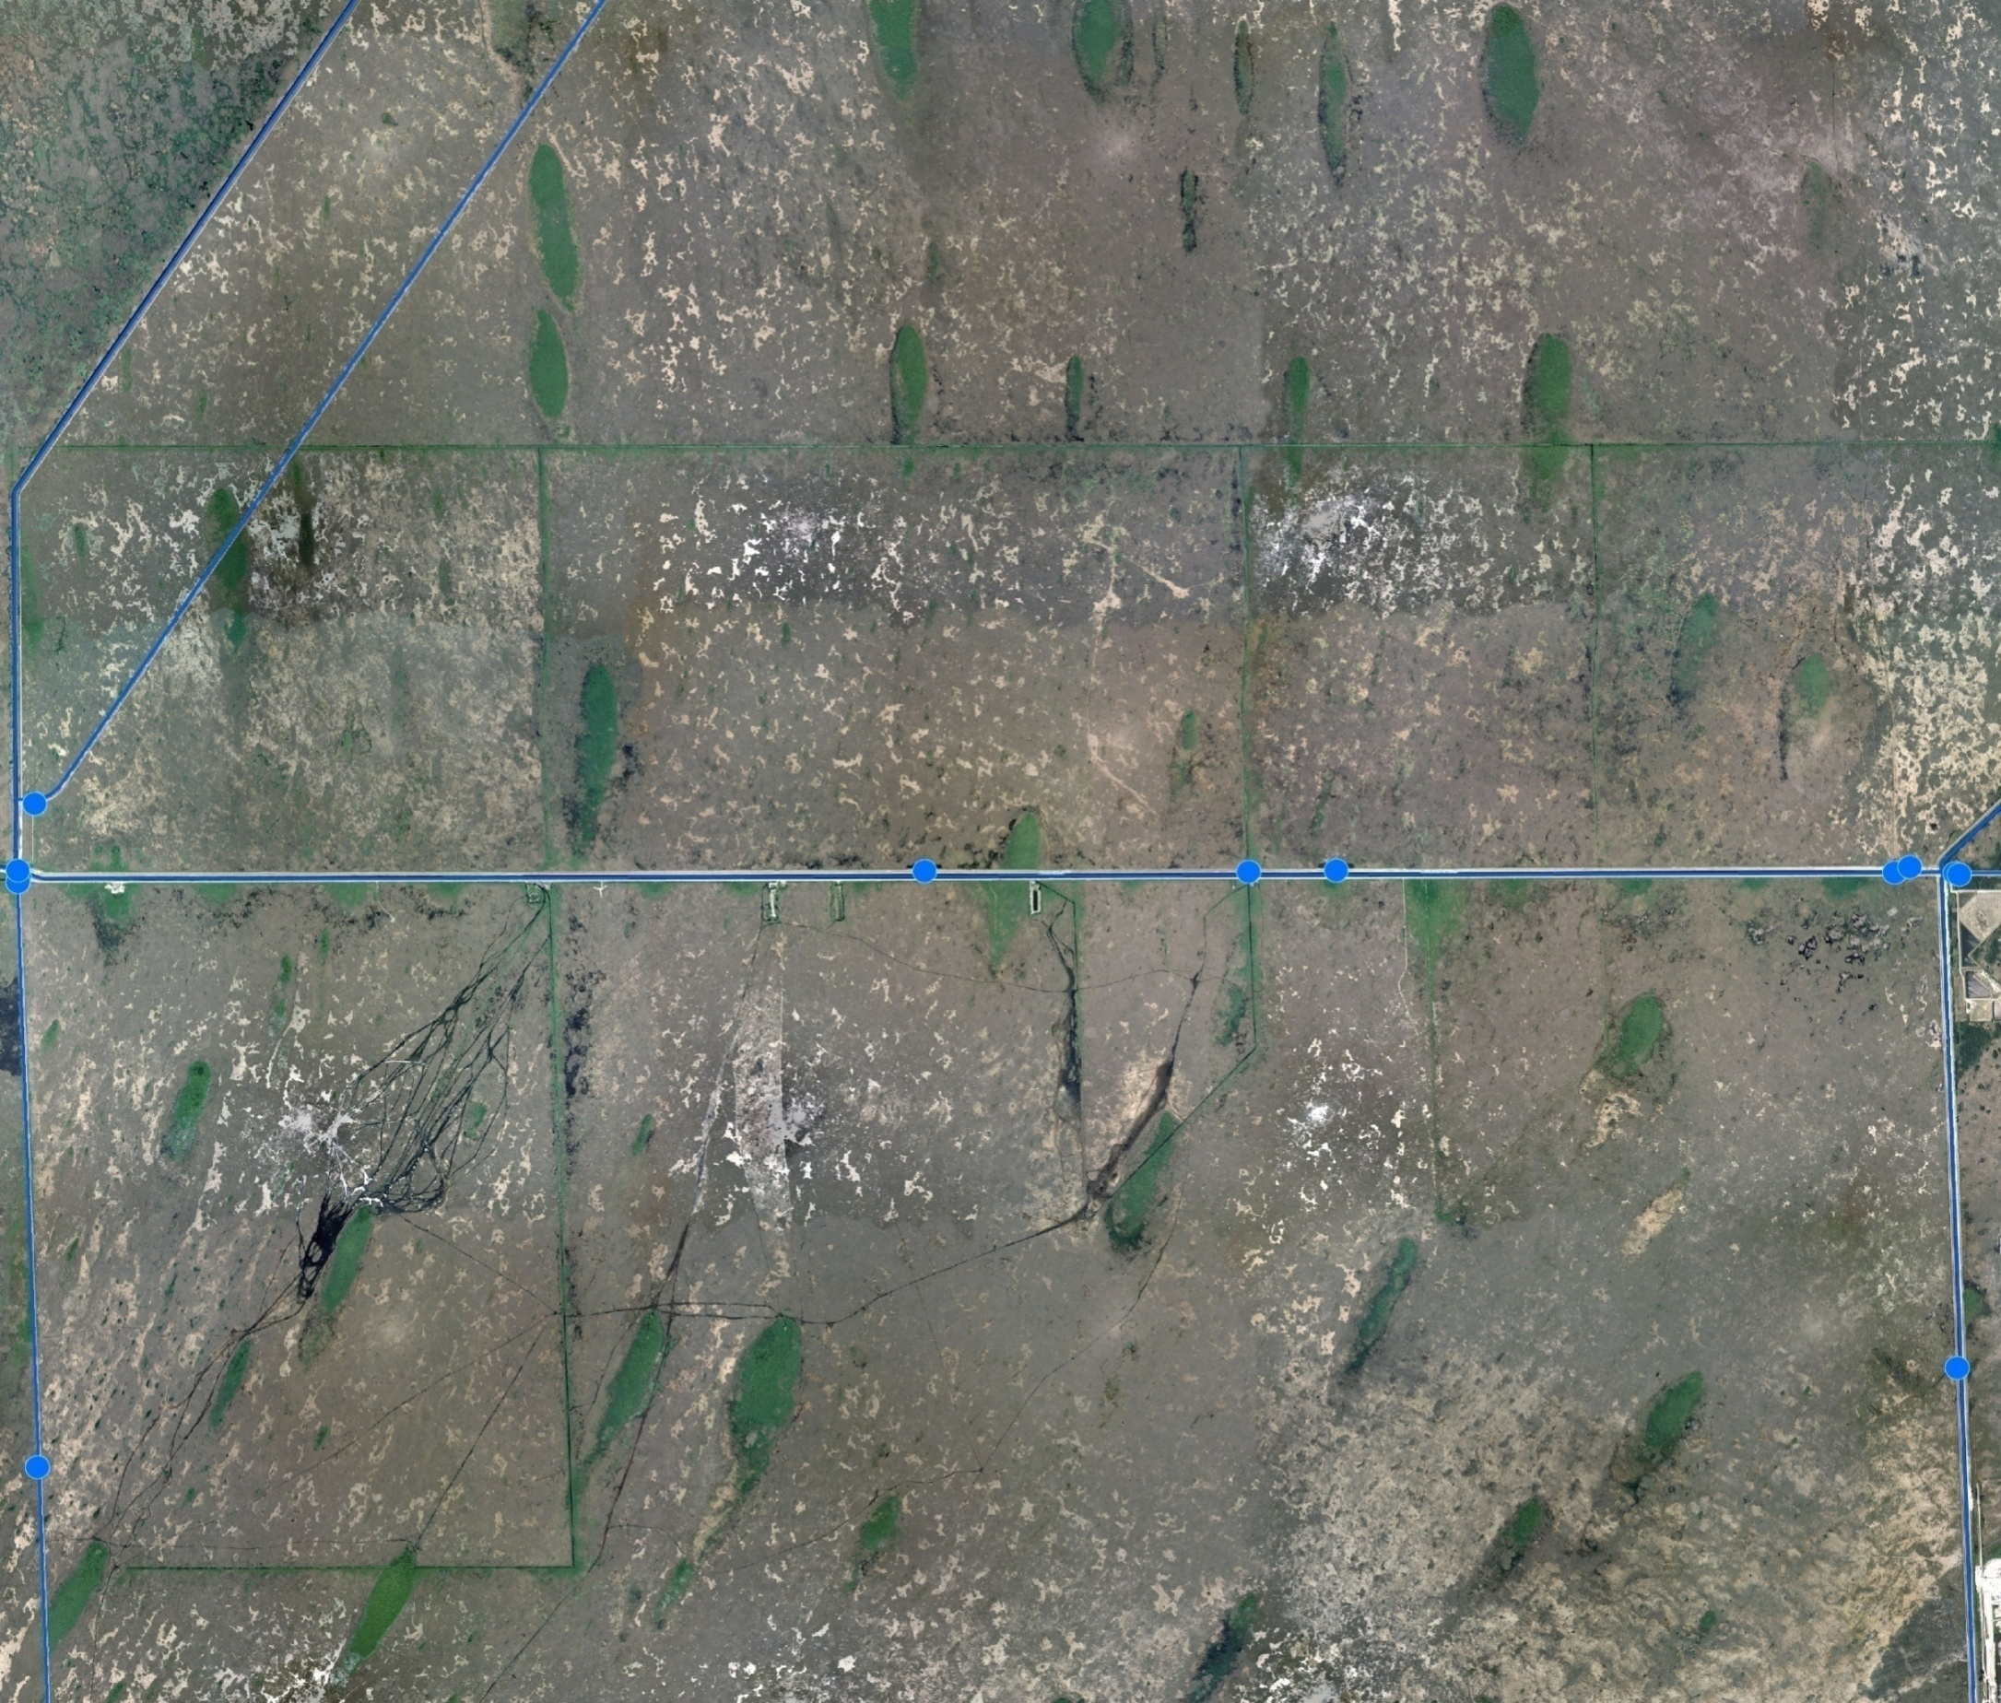
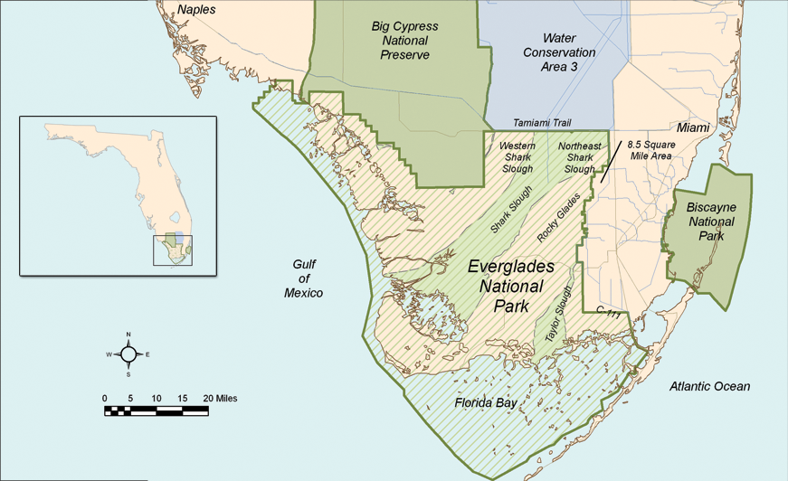
Modified Water Deliveries-Tamiami Trail Limited Re-evaluation Report
WCA
3A
WCA-3B
Project Location indicated by red box
1-mile Bridge
G70
S355A
S355B
S334
S333
L-29
G69
S24
Tamiami Trail
Existing Culverts
1-Mile Bridge Construction
Roadway Modifications
L-67ext
Blue Shanty Canal
Northeast Shark Slough
Everglades National Park
L-31N

Slide 8
LRR Project Hydrologic
Assessment Spreadsheet Model
A spreadsheet model was developed by the Army Corps to incrementally test the flow benefits associated with different combinations of L-29 canal stage constraints and bridge openings along eastern Tamiami Trail.
The combination of a one-mile bridge and an L-29 stage constraint of 8.5 (Alt 3.2.2a) was selected as the recommended alternative.
The model assumes that flow volumes from WCA-3A into Shark Slough are the same and a 45% West – 55% East distribution is the target.

Slide 9
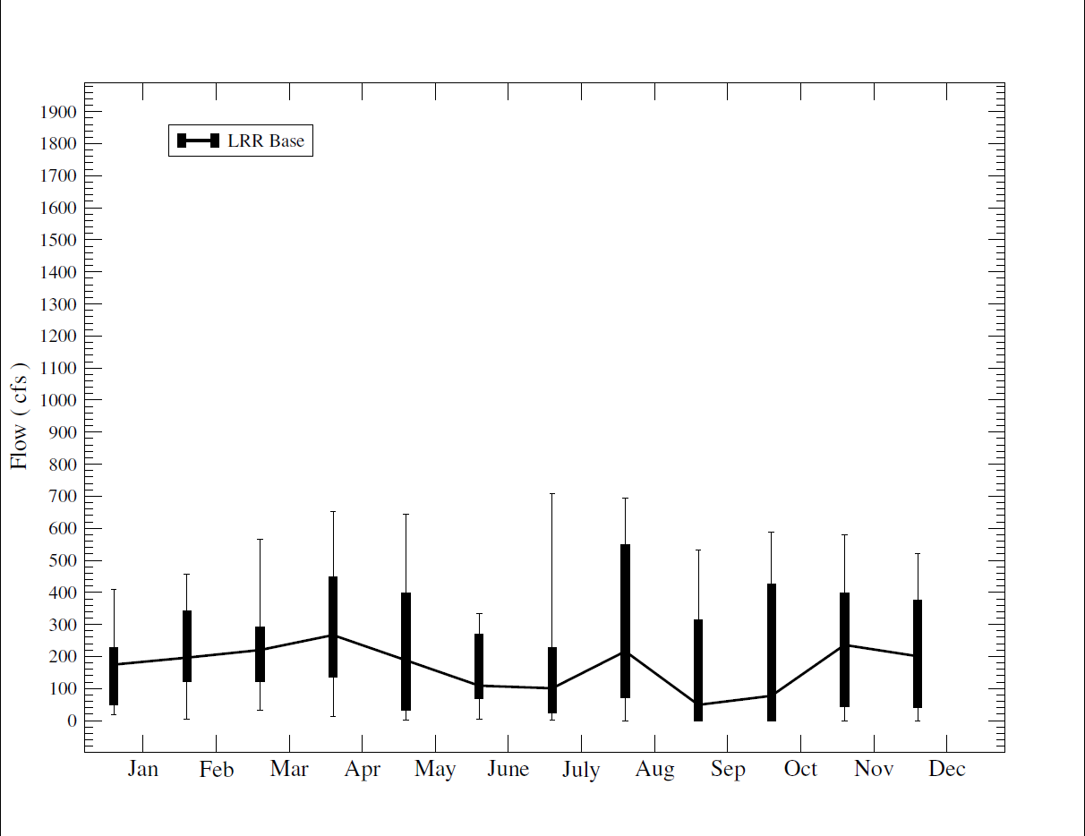
LRR Hydrologic Spreadsheet Model
No Action (no bridging or L-29 stage raising)
Avg. Annual Flows 177K ac-ft
Wet 30% Dry 70%

Slide 10
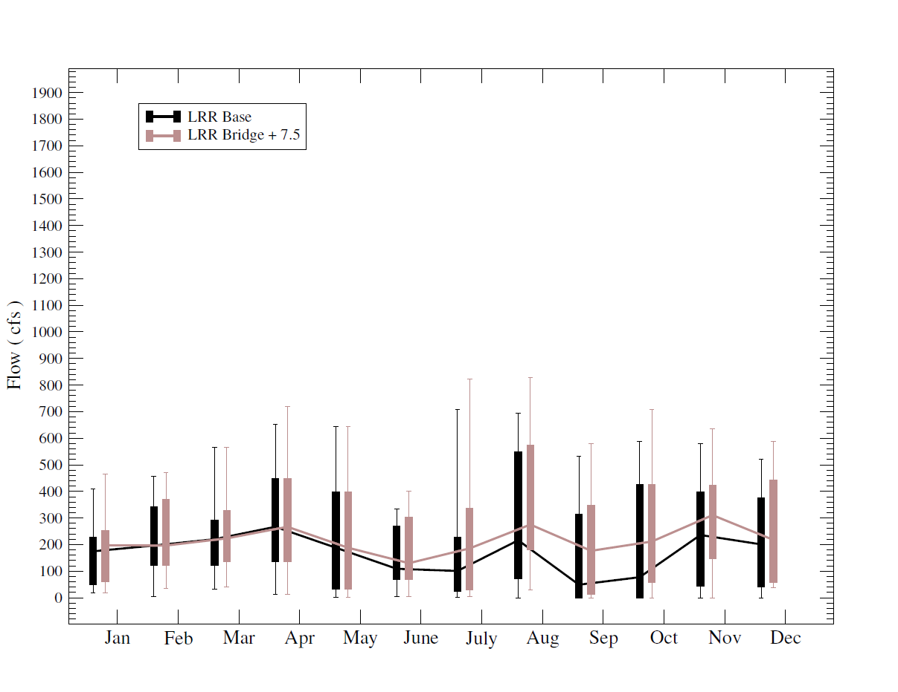
LRR Hydrologic Spreadsheet Model
Initial Field Test (1-mile bridge and L-29 7.5 ft. constraint)
Avg. Annual Flows 204K ac-ft
Wet 42% Dry 58%

Slide 11
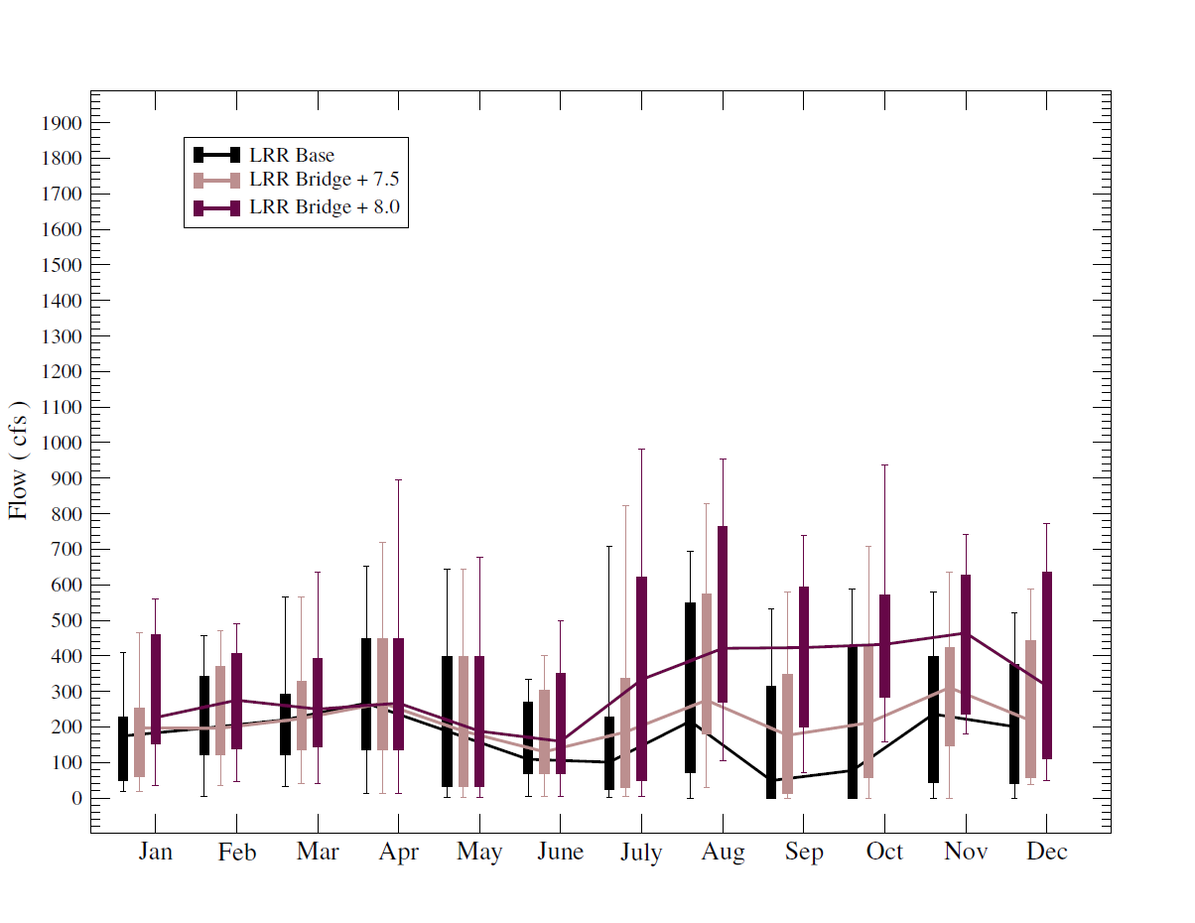
LRR Hydrologic Spreadsheet Model
Second Field Test (1-mile bridge and L-29 8.0 ft. constraint)
Avg. Annual Flows 274K ac-ft
Wet 46% Dry 54%

Slide 12
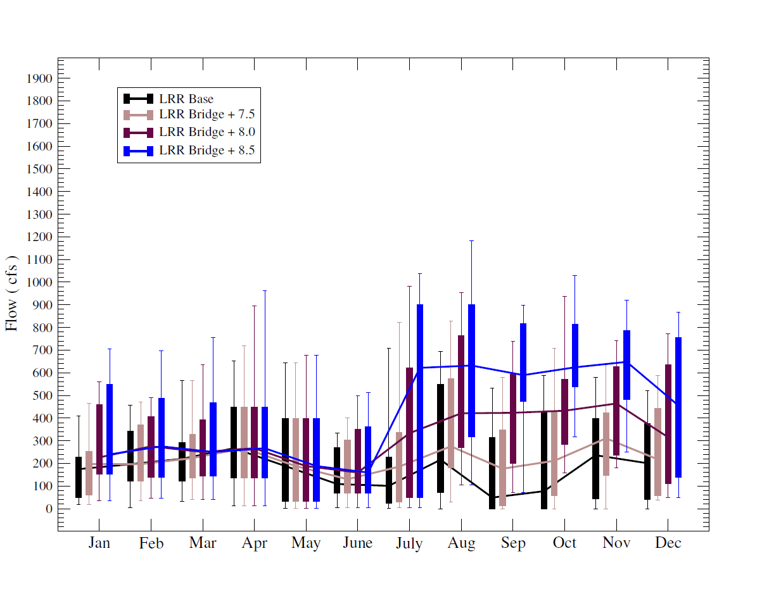
LRR Hydrologic Spreadsheet Model
Third Field Test (1-mile bridge and L-29 8.5 ft. constraint)
Avg. Annual Flows 340K ac-ft
Wet 49% Dry 51%

Slide 13
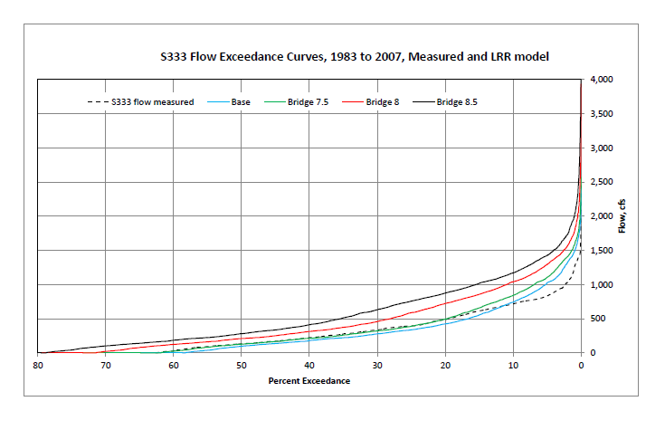
LRR Hydrologic Spreadsheet Model
Base LRR 177K ac-ft Wet 30% Dry 70%
Bridge 7.5 204K ac-ft Wet 42% Dry 58%
Bridge 8.0 274K ac-ft Wet 46% Dry 54%
Bridge 8.5 340K ac-ft Wet 49% Dry 51%

Slide 14
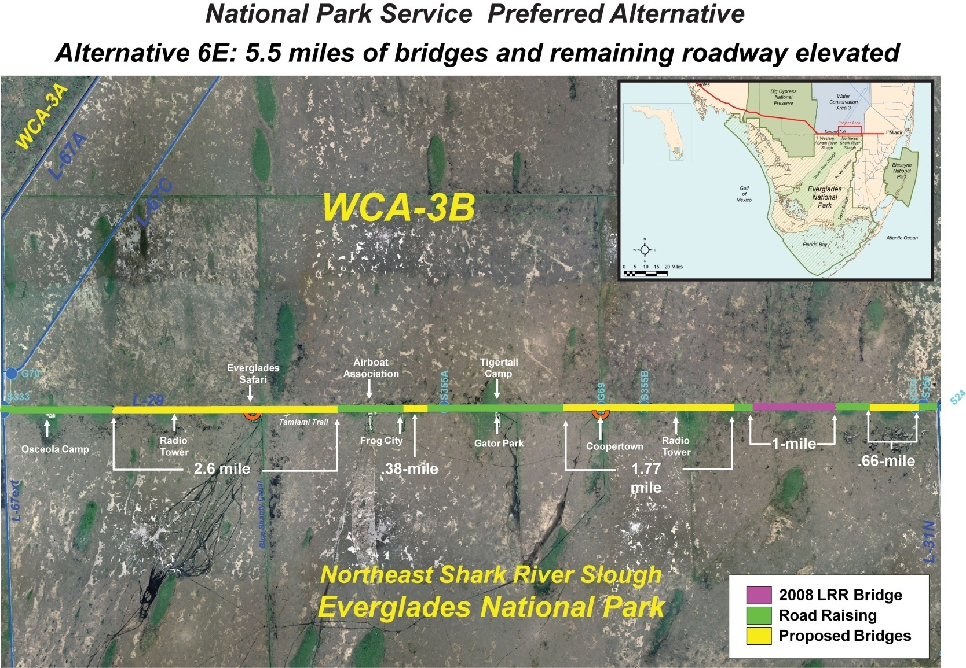
Tamiami Trail Next Steps Project
Alternative 6E (1st Increment)
NPS Design & Built
Contract in 2014

Slide 15
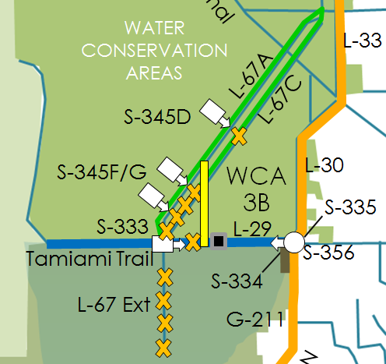
Central Everglades Alt4R Features
Redirect WCA-3A
flows (Enlarged
S-333)
WCA-3B Inflows (Blue Shanty Flow-way)
Levees Degraded
(L-67C & L-29)
L-29 Divide Structure
Seepage Mgmt.
(Enlarged S-356)
2.6-Mile Bridge

Slide 16
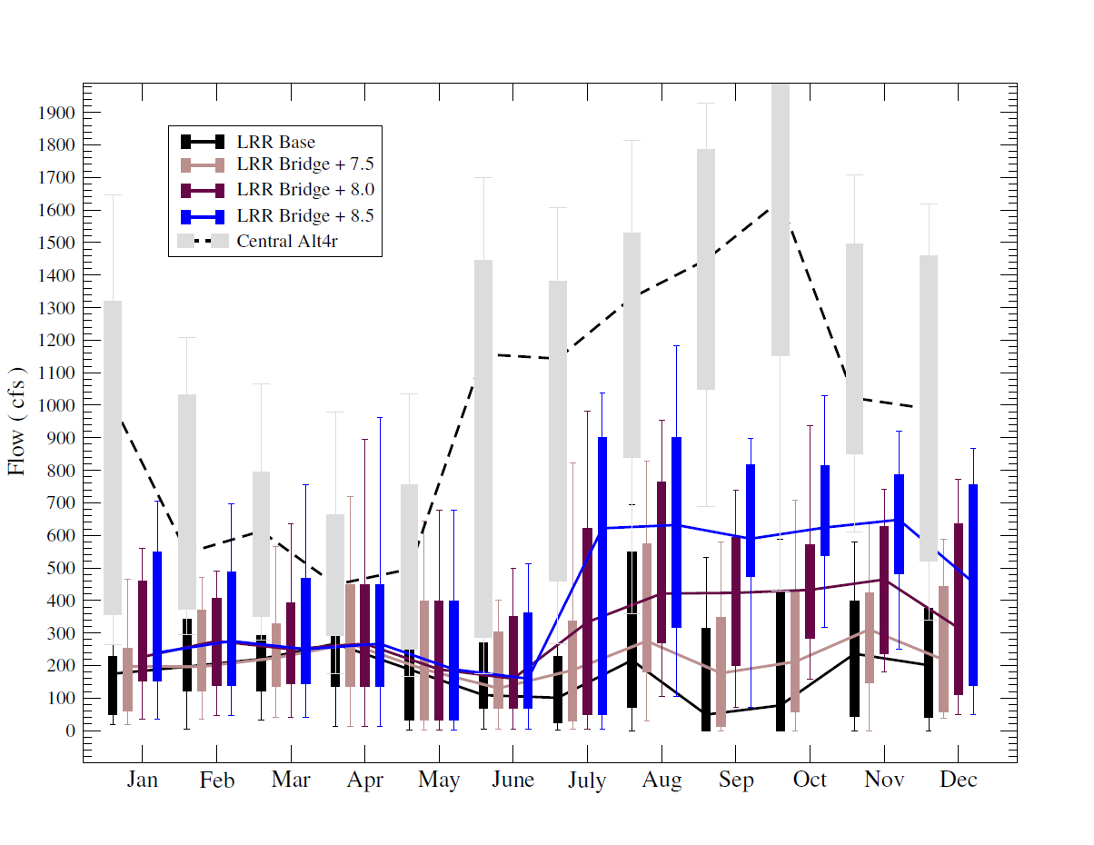
LRR Hydrologic Spreadsheet Model
Central Everglades Planning Project (for comparison only)
Avg. Annual Flows 700K ac-ft
Wet 54% Dry 42%

Slide 17
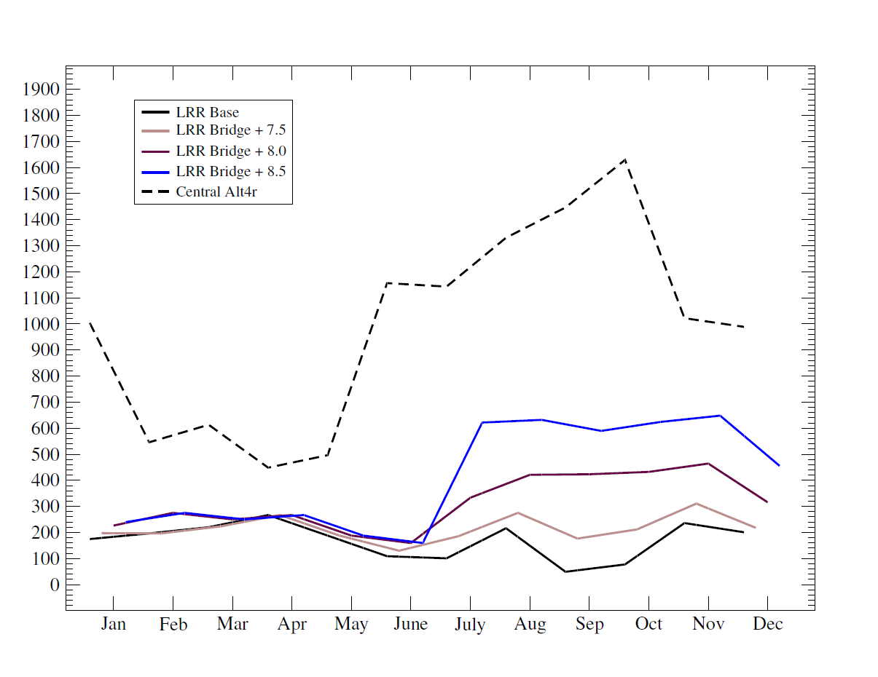
LRR Hydrologic Spreadsheet Model
Monthly Median Flow Comparison

