Slide 1
Basin Management Action Plan
Jackson Blue Spring Basin
April 12, 2016
Terry Hansen P.G., Basin Coordinator
850-245-8561
Terry.Hansen@dep.state.fl.us

Slide 2
Topics
BMAP Overview
Florida Springs and Aquifer Protection Act
BMAP Schedule
Ongoing Projects
Nutrient Source Inventory Loading Tool (NSILT)

Slide 3
BMAP Overview

Slide 4
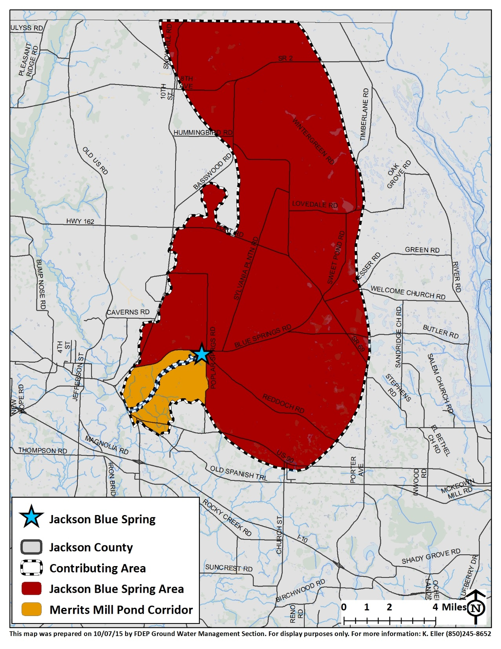
BMAP Area

Slide 5
Water Quality Framework
Collect data
Analyze and verify
List “impaired” waters
REPEAT
Set water quality standards
Monitor water quality
Determine pollution problems
Develop and implement restoration plans (BMAPs)
Establish restoration goals (TMDLs)
Measure success and adapt
Work with community leaders
Monitor and report progress annually
Adapt and change
Excessive nutrients
Bacteria
Mercury
Allocate responsibilities
Identify projects
  Infrastructure
  BMPs
Establish schedules
Identify success criteria
Gather additional data
Model water quality
Adopt pollutant reduction targets

Slide 6
Basin Management Action Plan
Florida Department of Environmental Protection’s method for restoring water quality to an impaired water body.
BMAPs are adopted by DEP through a Secretarial Order.
BMAPs are enforceable.
BMAPs are reviewed annually and updated every five years.

Slide 7
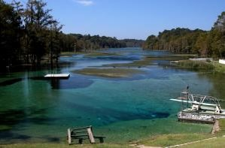
Regulatory Framework
The process for preparing BMAPs is found in:
  Section 403.067, Florida Statutes (F.S.), known as the Florida Watershed Restoration Act (FWRA).
  Spells out issues that are addressed within a BMAP.

Slide 8
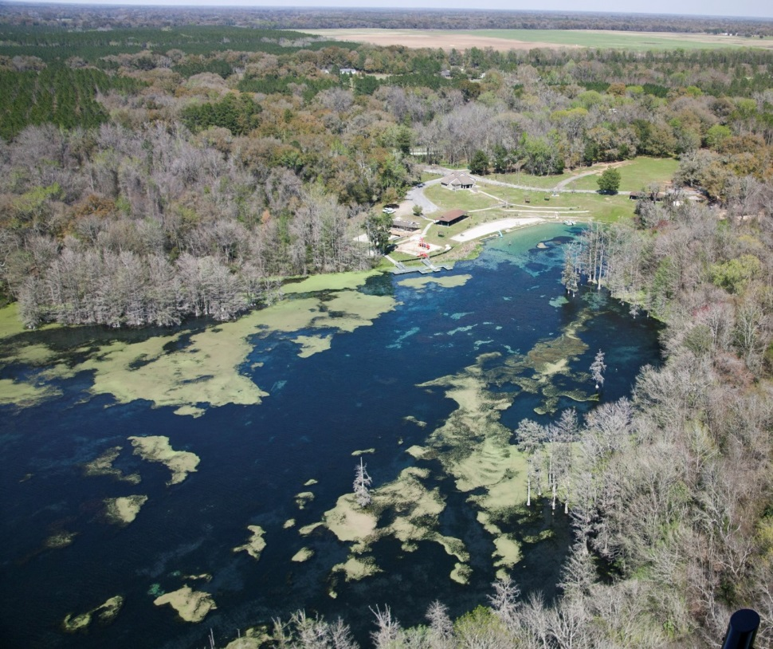
Jackson Blue Total Maximum
Daily Load
TMDL report dated January 2013.
Spring and Mill Pond impaired for excessive algae.
TMDL is 0.35 milligrams per liter (mg/L) nitrate as a monthly average.
BMAP goal is an
unimpaired waterbody.

Slide 9
Stakeholders
Reduce nutrient footprint
Agricultural producers:
  Enroll in Florida Department of Agriculture and Consumer Services (FDACS) Best Management Practices (BMPs) or Monitor
Homeowners:
  Observe fertilizer ordinance
  Healthy septic tank process

Slide 10
Florida Springs and Aquifer Protection Act

Slide 11
Florida Springs and Aquifer Protection Act
The 2016 Florida Springs and Aquifer Protection Act lists two main requirements for BMAPs for Outstanding Florida Springs (OFS):
  BMAPs must be adopted within two years after initiation and must include detailed project, financial and water quality benefits information; five-year incremental milestones; and TMDL achievement within 20 years (373.807(1)(b), F.S.).
  Any OFS BMAP adopted before July 1, 2016 must be revised to include the extensive new requirements by July 1, 2018 (373.807(1)(c), F.S.).

Slide 12
Florida Springs and Aquifer Protection Act
After the BMAP is adopted:
  Funding--Provides stakeholder the opportunity to access funding sources that require an adopted BMAP to be considered for receiving funds
  Focus--Allows the development of priority focus areas (PFAs) for the listed springs and determine the required actions within the PFA
  Inventory--Allows refinement of the NSILT to determine the required estimates of a project’s nutrient load reductions
  Pilot Projects--Allows development and implementation of innovative pilot BMP activities and effectiveness determination prior to required rulemaking

Slide 13
BMAP Schedule

Slide 14
BMAP Schedule
Adoption by June 1, 2016
Development of 5-year, 10-year, and 15-year goals
BMAP revision by July 1, 2018 with detailed plan to meet TMDL in 20 years

Slide 15
Ongoing Projects

Slide 16
Ongoing Projects
Indian Springs Sewering Project
Northwest Florida Water Management District (NWFWMD) Land Acquisition
Dye Trace in Jackson Blue Springshed
Installation and sampling of monitoring wells (NWFWMD)

Slide 17
Further Details of Ongoing Projects
Indian Springs
  Phase 1 – 125 homes and 25 vacant lots in lower section of neighborhood ($1.95M)
  Phase 2 – 175 homes
NWFWMD Land Acquisition
  Land Acquisition in Jackson Blue Springshed ($4.7M)
    394 ac. Blue Springs Plantation Inc.
    598 ac. Lakeshore Farms

Slide 18
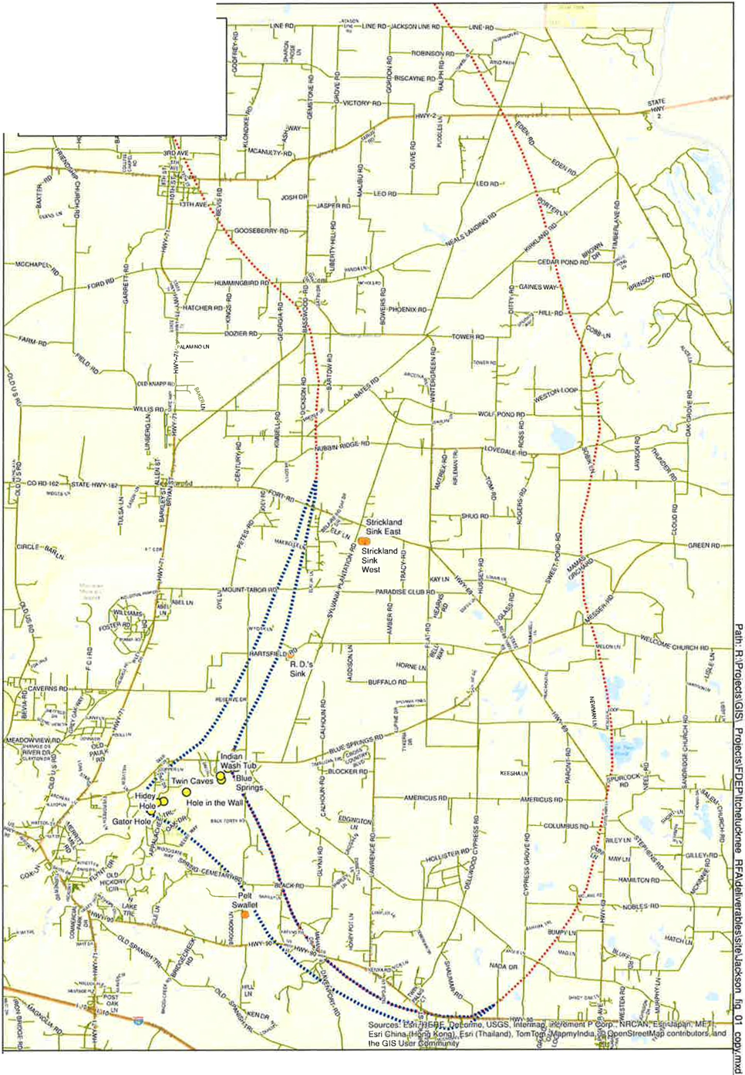
Ongoing Projects
Dye Trace & Well installation

Slide 19
NSILT

Slide 20
NSILT
BMAP Area

Slide 21
Basin Land Use Input
Category | Cropscape | FSA Aerial | PA | NWF | FSAID (irrigated only) | Composite
Total Crop | 33,001 | 29,128 | 33,236 | 24,455 | 13,386 | 30,170
Total Pasture | 3,705 | 5,899 | 7,258 | 13,051 | 104 | 12,271
Total Ag Lands | 40,744 | 35,027 | 44,034 | 37,513 | 13,490 | 42,720
Cropscape | 2014 data, annual product from the National Agricultural Statistic Service
FSAID | 2014 data, field verified land use for farming operations with consumptive use permits, created as part of a USGS/FDACS project, only irrigated acreage
FSA Aerial | 2013 data, land use created from aerial imagery from FSA taken while crops were in fields
PA | 2014 data, property appraiser data
NWFWMD | 2012 data, NWFWMD land use data based on aerial imagery
Composite | DEP-created layer based on the above land use datasets representing an estimated average land use within 750 ft x 750 ft grid cells

Slide 22
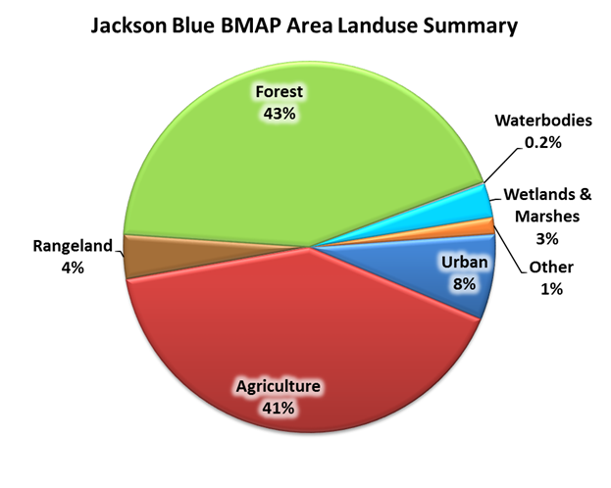
Land Use Summary

Slide 23
BMAP Area

Slide 24
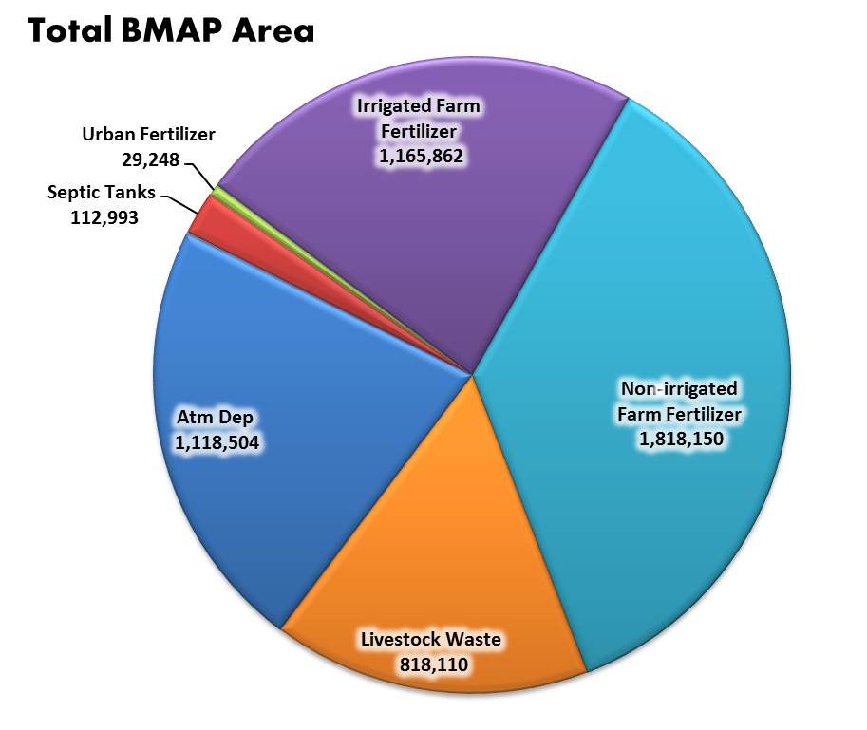
Nitrogen Input to Land Surface
Units: Pounds of nitrogen/year

Slide 25
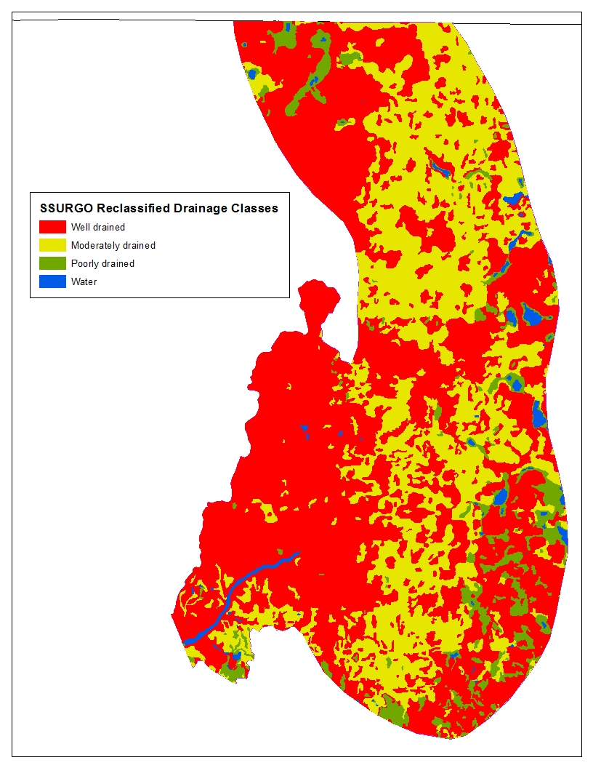
Recharge
Soil Drainage Types in the Jackson Blue Springshed

Slide 26
BMAP Area

Slide 27
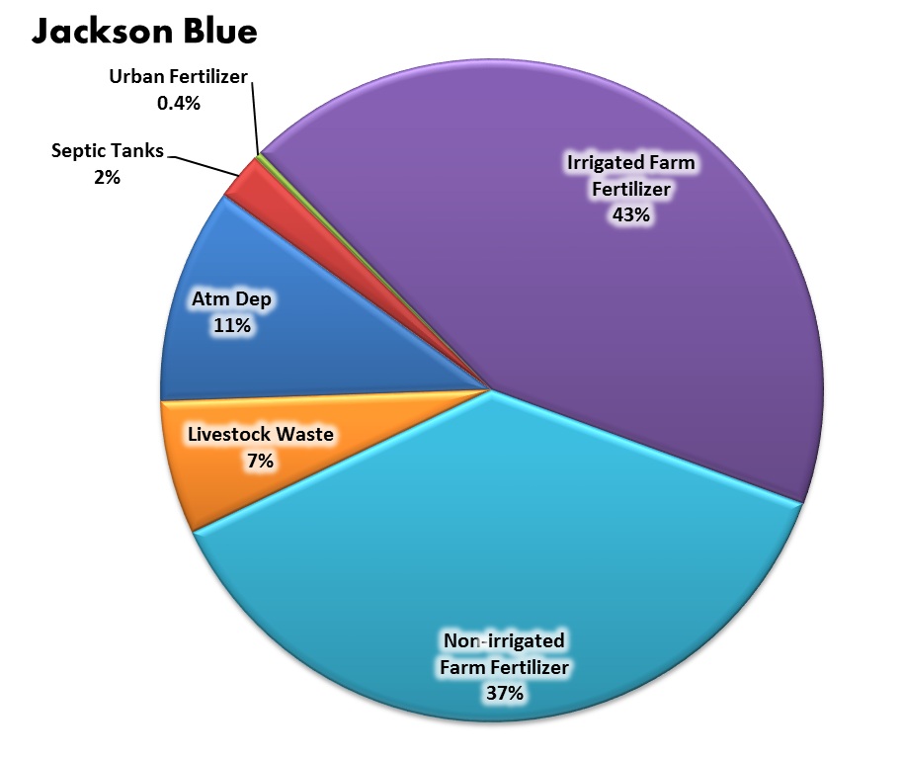
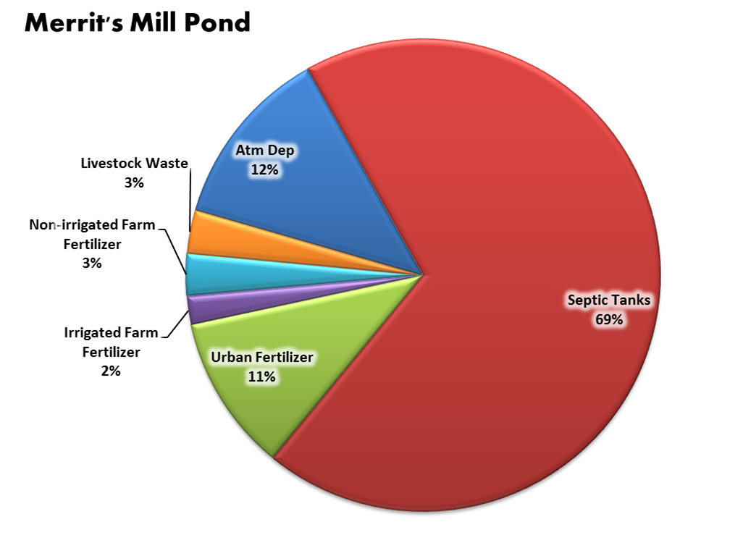
Nitrogen Load to Ground Water

Slide 28
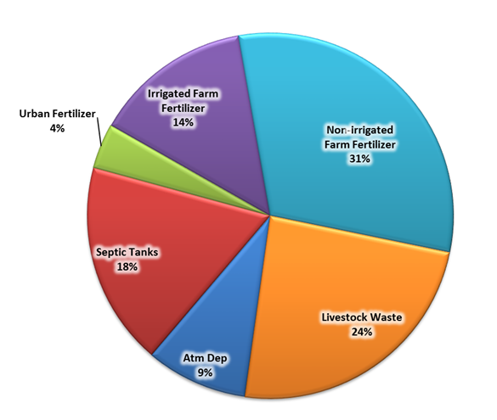
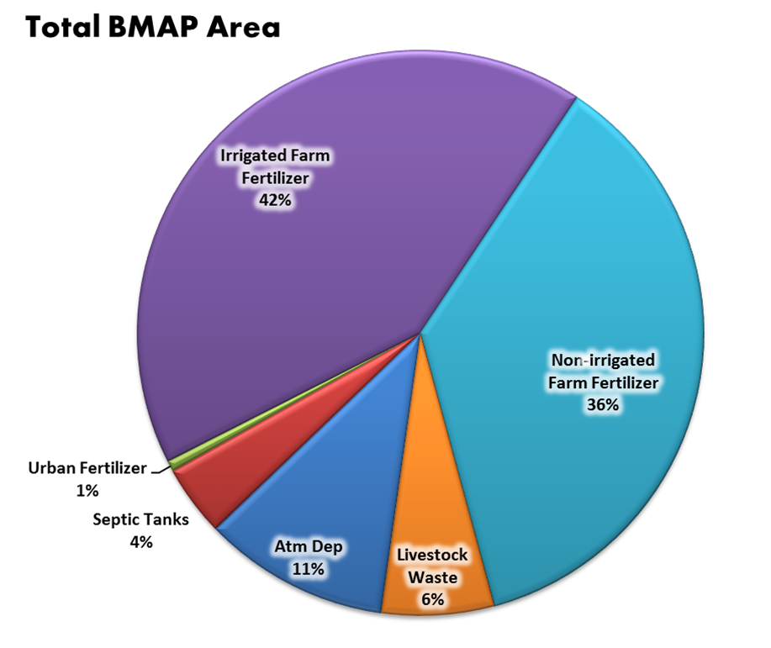
Nitrogen Load to Ground Water
Initial estimated load to ground water
Revised estimated load to ground water

Slide 29
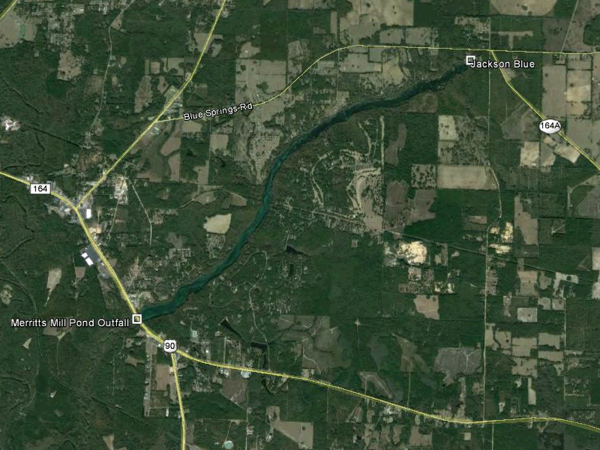
Questions?

