Slide 1
Jackson Blue
Basin Management Action Plan (BMAP)
March 7, 2018
Terry Hansen P.G., Basin Coordinator
850-245-8561
terry.hansen@dep.state.fl.us

Slide 2
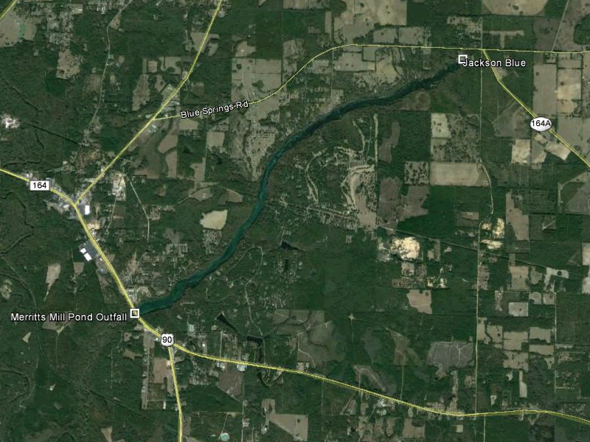
Jackson Blue and Merritts Mill Pond

Slide 3
Water Quality Framework
Collect data
Analyze and verify
List “impaired” waters
REPEAT
Monitor and report progress annually
Adapt and change – new statewide annual report
Set water quality standards
Monitor water quality
Determine pollution problems
Develop and implement restoration plans (BMAPs)
Establish restoration goals (TMDLs)
Measure success and adapt
Work with community leaders
Excessive nutrients
Bacteria, Metals, and Other Impairments
Allocate responsibilities
Identify projects
  Infrastructure
  Best Management Practices (BMPs)
Establish schedules
Identify success criteria
Gather additional data
Evaluate water quality
Adopt pollutant reduction targets

Slide 4
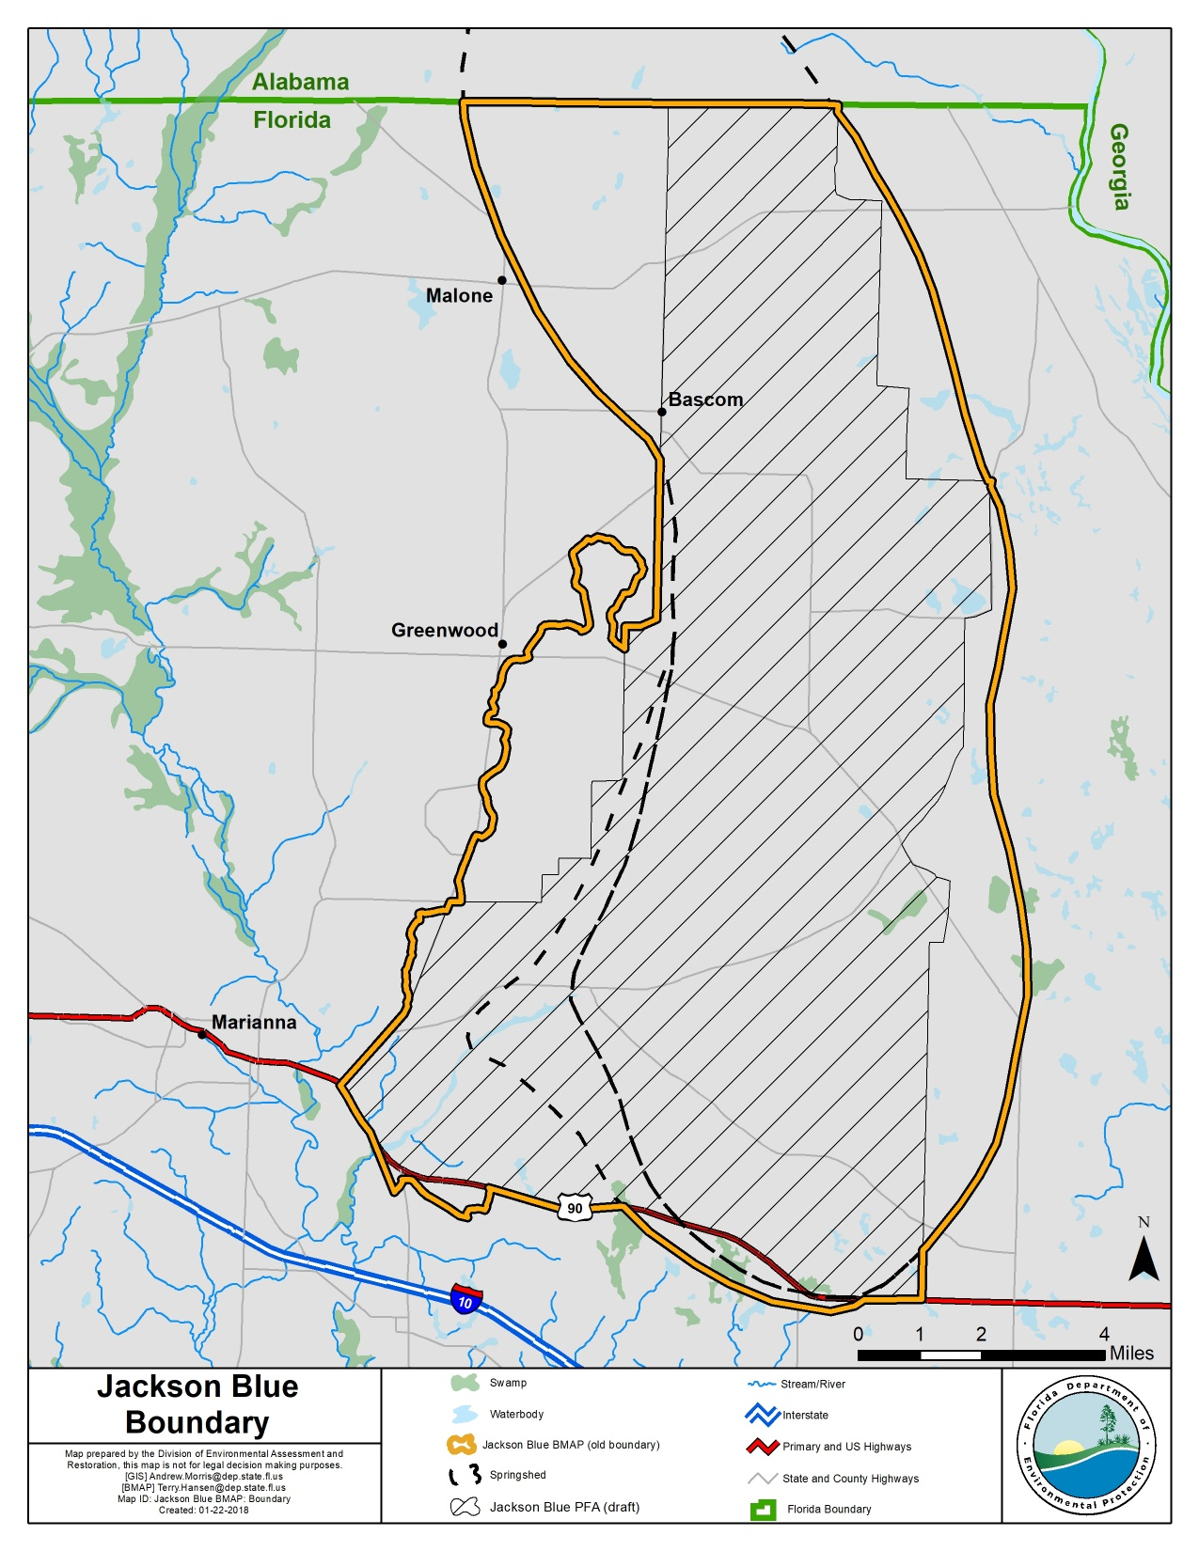
BMAP Area
Total contributing area:
154 square miles
8 % in Alabama
92 % in Florida
BMAP addresses Florida portion

Slide 5
Jackson Blue
Total Maximum Daily Load (TMDL)
TMDL report issued in January 2013
Spring and Mill Pond impaired for excessive algae
TMDL is 0.35 milligrams per liter (mg/L) nitrate as a monthly average
BMAP goal is an unimpaired waterbody
Waterbody Identification (WBID) | Parameter | TMDL (mg/L)
Jackson Blue Spring (WBID 180Z), Merritts Mill Pond (WBID 180A) | Nitrate, as monthly average | 0.35

Slide 6
Regulatory Framework
The process for preparing BMAPs is found in:
  Section 403.067, Florida Statutes (F.S.), known as the “Florida Watershed Restoration Act”
  The 2016 Florida Springs and Aquifer Protection Act lists requirements for BMAPs for Outstanding Florida Springs (OFS)
  PFA Report and NSILT developed by DEP for Jackson Blue Spring

Slide 7
OSTDS
BMAP will contain an OSTDS remediation plan
DEP and Florida Department of Health (FDOH) will work together to implement it
New OSTDS
  Meet the DOH Definition (64E-6F.A.C.) of new system
  Inside PFA on lot < 1 acre
  Unless sewer is available or described as becoming available in a BMAP project
Existing OSTDS
  Homeowners are encourage to upgrade to systems with higher levels of nitrogen reduction.
  Funding Assistance Program is being developed
  Upgrades are not mandatory

Slide 8
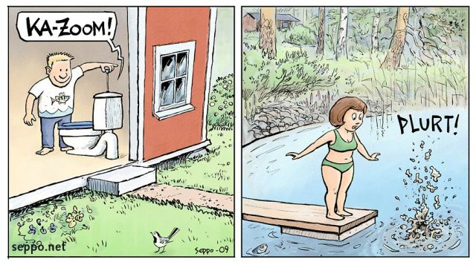
BMAP Policies – OSTDS
New OSTDS
No
Inside of PFA?
Yes
No
Lot <1 ac
Either:
Conventional System
Enhanced System
Yes
Sewer
Yes*
No
Either:
Conventional System
Enhanced System
Enhanced system
*Must connect to sewer when available

Slide 9

TMDLs / BMAP
To achieve the TMDLs, BMAP implementation will be a 20-year process
Plan will define nitrogen reduction milestones:
  30% reduction within 5 years
  50% reduction within 10 years
  20% reduction within 15 years
  Use last 5 years to finish up and see results
Notes:
The overall load reduction targets are 30 % of the total within five years; 80 % of the total within ten years; and 100 % of the total within 15 years
The goals are aggressive for the first ten years; these aggressive goals are to ensure that the overall load reduction occurs within 20 years.
The load reduction progress will be tracked yearly and adjustments made as needed. At the five-year milestone, progress will be assessed and load reductions adjusted as necessary.

Slide 10
Nitrogen Load to Groundwater
Determine Vent/TMDL Loads:
Average discharge
Average concentration
TMDL concentration
Calculate load to reduce

Slide 11
Nitrogen Load to Groundwater (NSILT) in Springshed
Nitrogen Source | Estimated Percent Contribution
OSTDS | 3%
Urban Turfgrass Fertilizer & Sports Turfgrass Fertilizer | <1%
Atmospheric Deposition | 5%
Farm Fertilizer | 85%
Livestock Waste | 7%
Wastewater Treatment Facilities | 0%
Total | 100%
Notes:
95% Avg GW conc. is 0.482 mg/L

Slide 12
Reduction to Meet the TMDLs
Required Reduction to Meet the TMDLs
Description | Nitrogen Loads (lb-N/yr) | Notes Regarding Data Used
Total Load at Spring Vents | 719,000 | Upper 95 % confidence interval – nitrate data and flow data from 2012 to 2017 (97.73 cubic feet per second [cfs] and 3.74 mg/L)
TMDL Load | 67,000 | TMDL target is 0.35 mg/L and using flow data from 2012 to 2017
Required Reduction | 652,000
cfs = cubic feet per second
mg/L = milligrams per liter
Notes:
95% Avg GW conc. is 0.482 mg/L

Slide 13
Gap Analysis
Nitrogen Source | Credits Based on Project Tables (lb-N/yr) | Description
OSTDS | 3,300 | Credits identified for stakeholder OSTDS projects (enhancement or sewer, approx. 200 tanks)
Urban Turf Fertilizer & Sports Turf Fertilizer | 120 | DEP approved credits (up to 6%) for public education activities as well as credits identified for stakeholder stormwater projects
Atmospheric Deposition |  | No reduction
Implemented Cost Share Projects | 5,400 | BMP measures implemented as part of the FY2013-2014 funding cycle
Farm Fertilizer (FF) | 94,000 | 15% BMP credit on FF load to groundwater, assuming 100% owner-implemented BMPs on all fertilized lands
Livestock | 5,400 | 10% BMP credit on load to groundwater, assuming 100% owner-implemented BMPs at all livestock facilities
Wastewater Treatment Facility | 0 | Achieved by BMAP WWTF policy (achieving 3 or 6 mg/L)
Total Credits | 108,200
Required Reduction | 652,000 | Approximate Load Remaining: 544,000

Slide 14
Options to Reduce Remaining Load
Estimated Reduction Credits for Additional OSTDS Enhancement OR Sewer
Recharge Area | OSTDS Parcels Less Than One Acre in PFA | Credit for Enhancement (lb-N/yr) | Credit for Sewer (lb-N/yr) | OSTDS Parcels One Acre and Greater in PFA | Credit for Enhancement (lb-N/yr)) | Credit for Sewer (lb-N/yr)
High | 460 | 2422 | 3502 | 1504 | 7919 | 11,573
Medium | 19 | 56 | 81 | 44 | 128 | 189
Total | 479 | 2,477 | 3,612 | 1,548 | 8,047 | 11,761

Slide 15
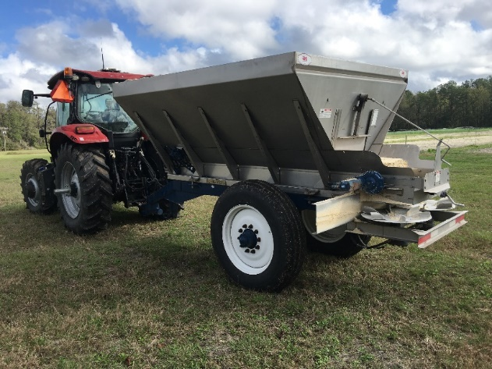
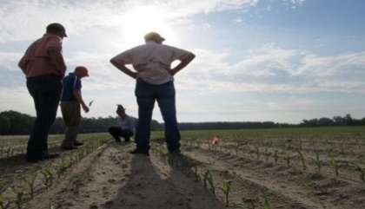
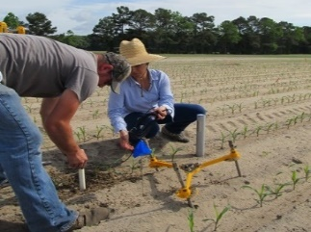
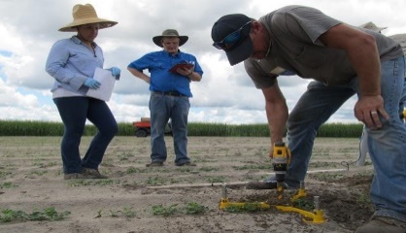
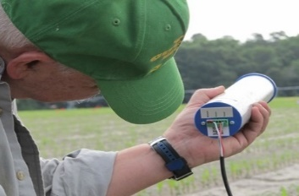
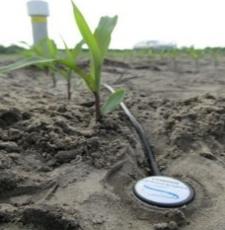
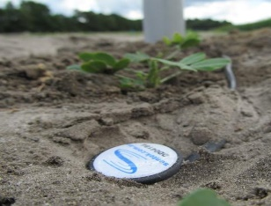
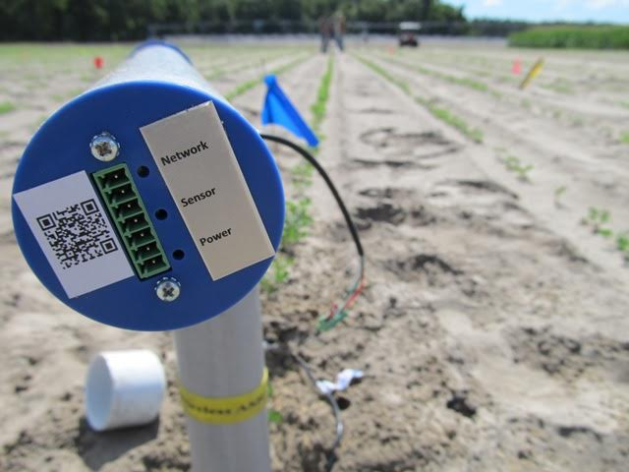
Ag Options to Reduce Remaining Load
Estimated Reduction Credits for Advanced Agricultural Practices
Potential Actions | Estimated Reduction Credit (lb-N/yr) High Recharge | Estimated Reduction Credit (lb-N/yr) Medium Recharge
Precision Irrigation | 3,882 | 2,157
Precision Fertilization | 43,705 | 24,280
Soil Moisture Probes | 45,477 | 25,265
Controlled Release Fert. | 3,608 | 2,044
Rotational Production | 88,807 | 49,337
Cover Crops | 101,560 | 56,422
TOTAL | 287,110 | 159,506

Slide 16
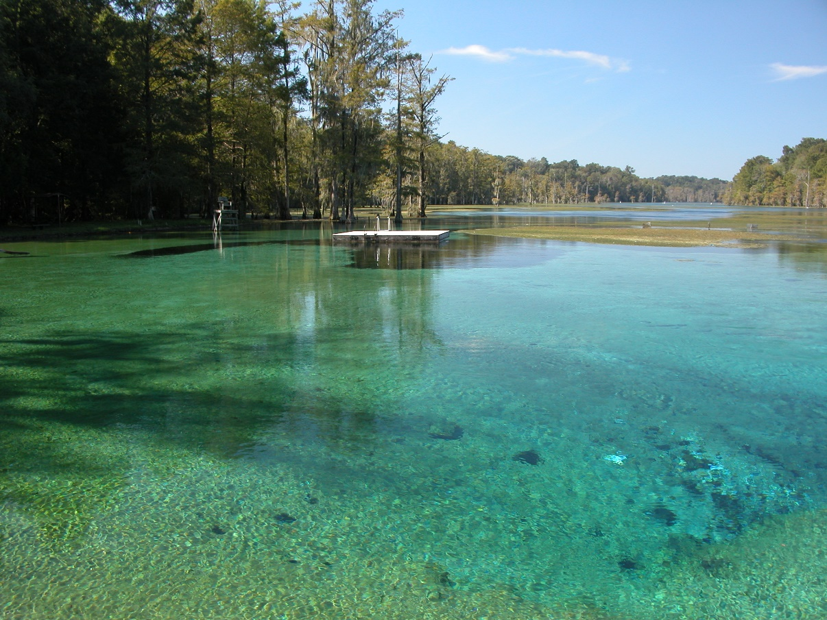
Next Steps
Next Meeting March 28, 2018
BMAP adoption before July 1, 2018
Water quality monitoring to determine improvements
Annual review of project accomplishments and adherence to schedule
Five-year revisions of BMAP and NSILT

Slide 17
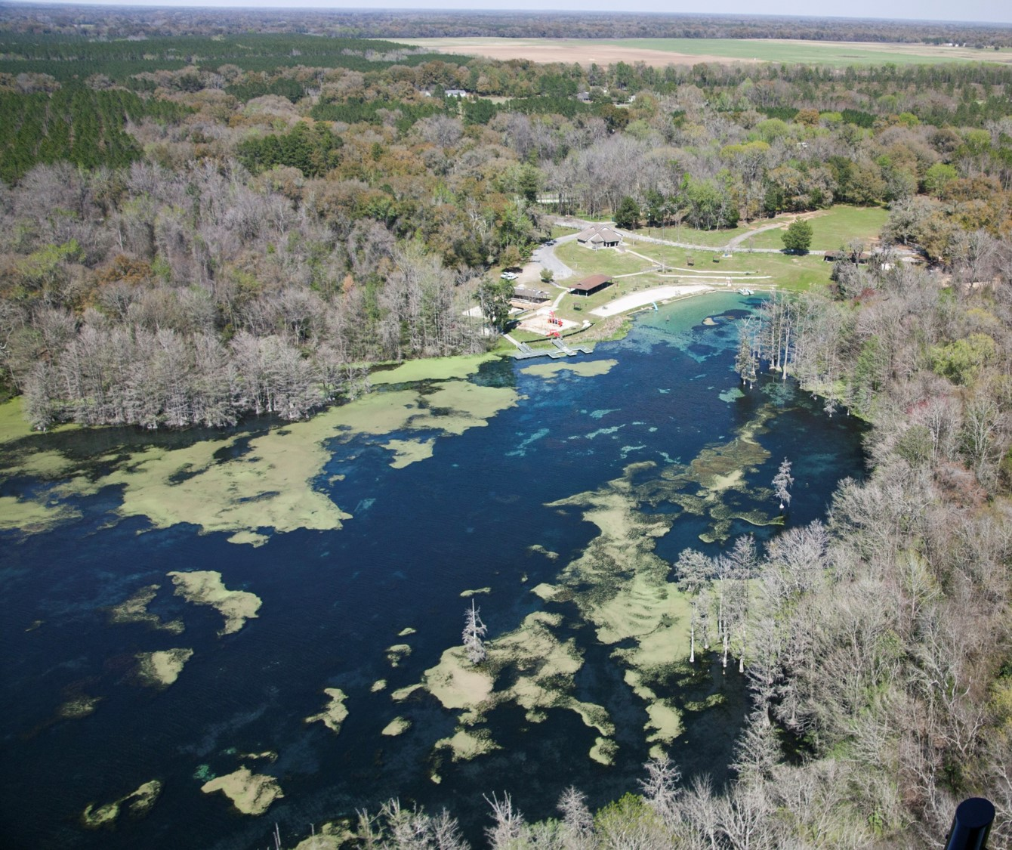
QUESTIONS??

Slide 18
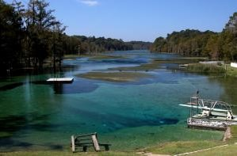
Basin Management Action Plan
Contact: Terry Hansen, P.G.
terry.hansen@dep.state.fl.us
http://www.dep.state.fl.us/water/
http://publicfiles.dep.state.fl.us/DEAR/BMAP/

