Slide 1
FDACS Agricultural Best Management Practices (BMP) Program
Clegg Hooks and Bonnie Wolff Pelaez
Florida Department of Agriculture and Consumer Services

Slide 2
Why
Federal Clean Water Act
Required Florida to identify impaired waters
Establish a Total Maximum Daily Load (TMDL)
Develop a plan to meet the TMDL

Slide 3
Total Maximum Daily Load (TMDL)
Determination of how much of a pollutant a water body can absorb and still meet standards that protect human and aquatic life
Biological standard
Numeric Nutrient Criteria

Slide 4
Basin Management Action Plan (BMAP)
Blueprint for restoring impaired waters by reducing pollutant loadings
Comprehensive set of strategies
  Wastewater limits
  Urban BMPs
  Agricultural BMPs
  Conservation Programs
  Estimates future changes

Slide 5
How
Agricultural Producers have two choices:
Participate in FDACS BMP Program and receive
Presumption of Compliance with water quality standards
Monitor loads and prove compliance

Slide 6
Implement Best Management Practices
      Practical, Cost effective, Technologically Feasible
Commodity specific BMP manual

Slide 7
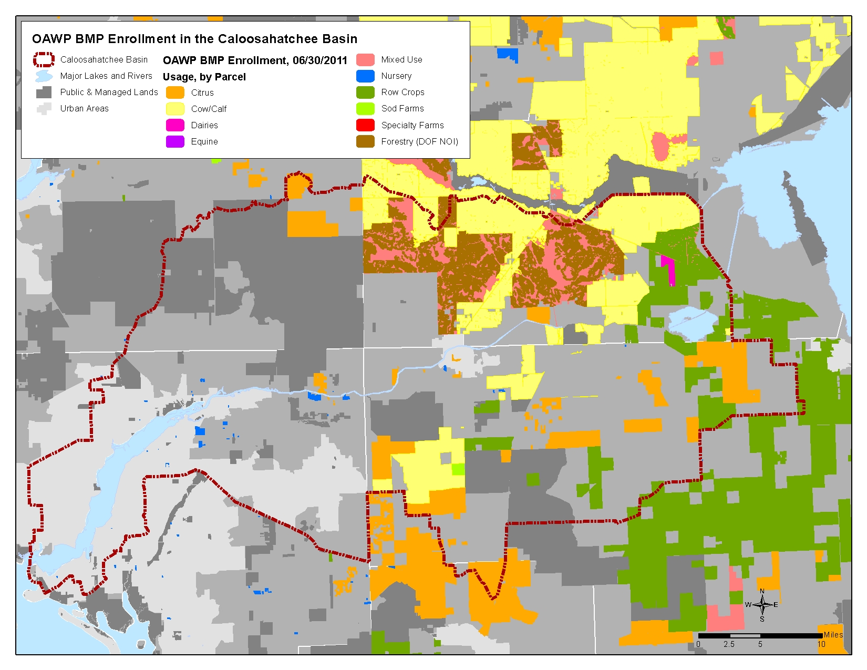

Slide 8
FDACS Contacts
Bonnie Wolff Pelaez
Linda Crane
Vanessa Bessey
David (Bo) Griffin
863-462-5881

