Slide 1
Dr. Xueqing Gao and Douglas Gilbert met with the modeling technical subgroup on October 22, 2014 and DACs staff on Okeechobee Oct 24th. At those meetings the Department committed to work with stakeholders to address remaining HSPF flow calibration issues at the S79 structure before drafting TMDLs for the estuary.
As a result of the meetings we are investigating use of the HSPF irrigation routines as one mechanism to address remaining water budget issues with the watershed model. We have been working with SFWMD modeling staff, DACs and other stakeholders to verify the HSPF model hydrologic representation and use of the HSPF irrigation subroutines.
Below are a series of slides that show the current HSPF daily flow calibration of the freshwater streams/canals tributary to the Caloosahatchee River and estuary.

Slide 2
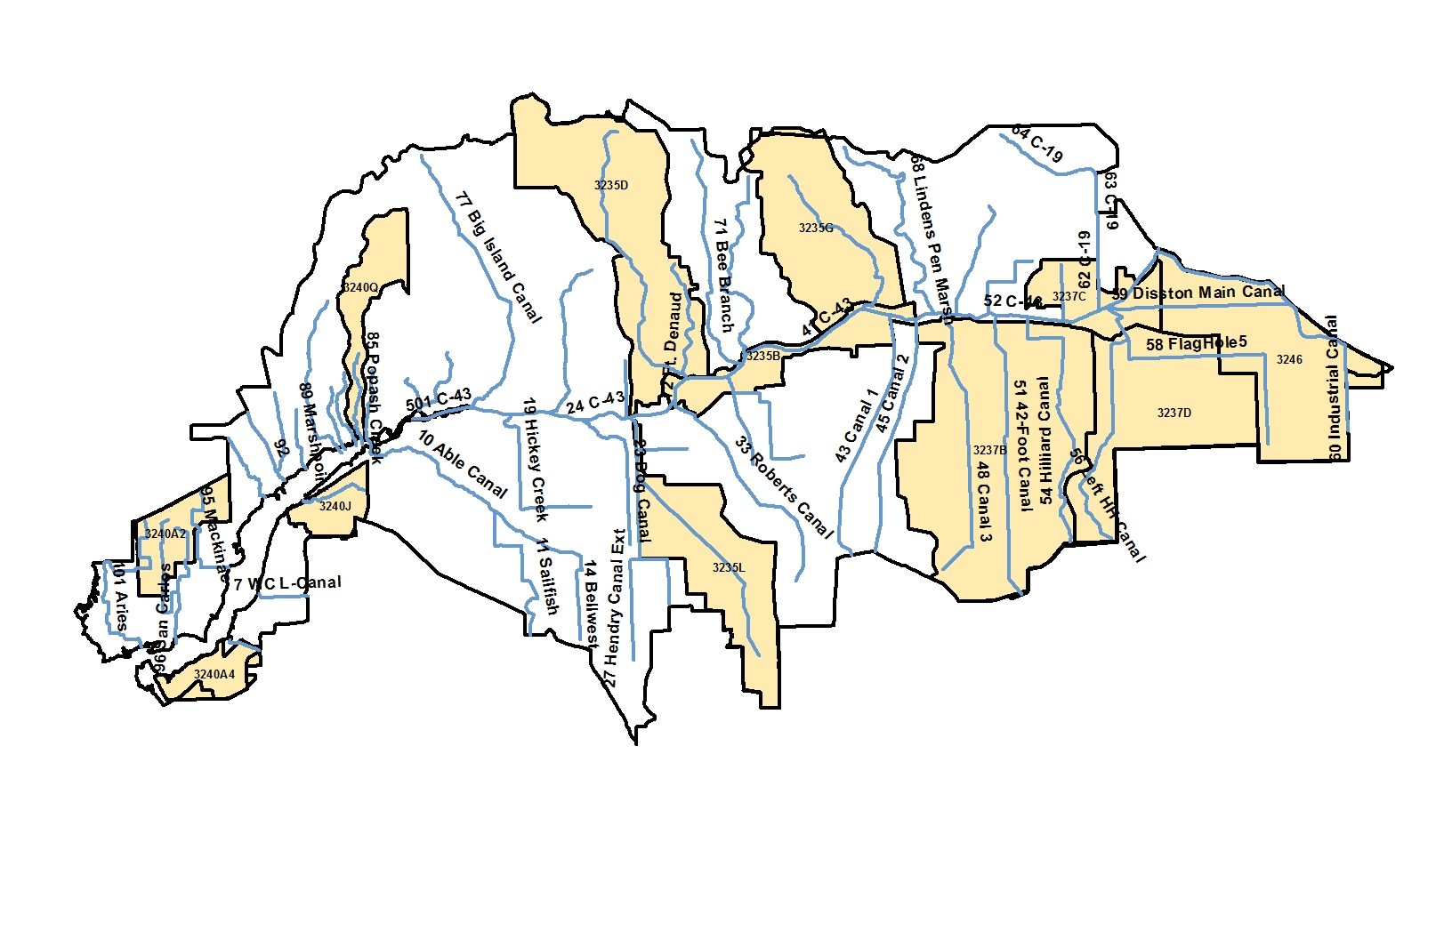
Cape Coral, 3240A2 - Historic Chla
Popash Crk, 3240Q, - Chla, DO
Jacks Branch, 3235D - Chla
Cypress Branch, 3235G - DO
Lake Hicpochee, 3237C - DO
Caloosahatchee Basin HSPF Reach Network and Impaired WBIDs
Deep Lagoon Canal, 3240A4 - Chla, DO
Billy Crk, 3240J – DO
Townsend Canal, 3235L – Chla, DO
Long Hammock Crk, 3237B – Chla
Ninemile Canal, 3237D – DO
S-4 Basin, 3246 – Chla, DO
Caloosahatchee River (b/w S79 and S78), 3235B - Chla

Slide 3
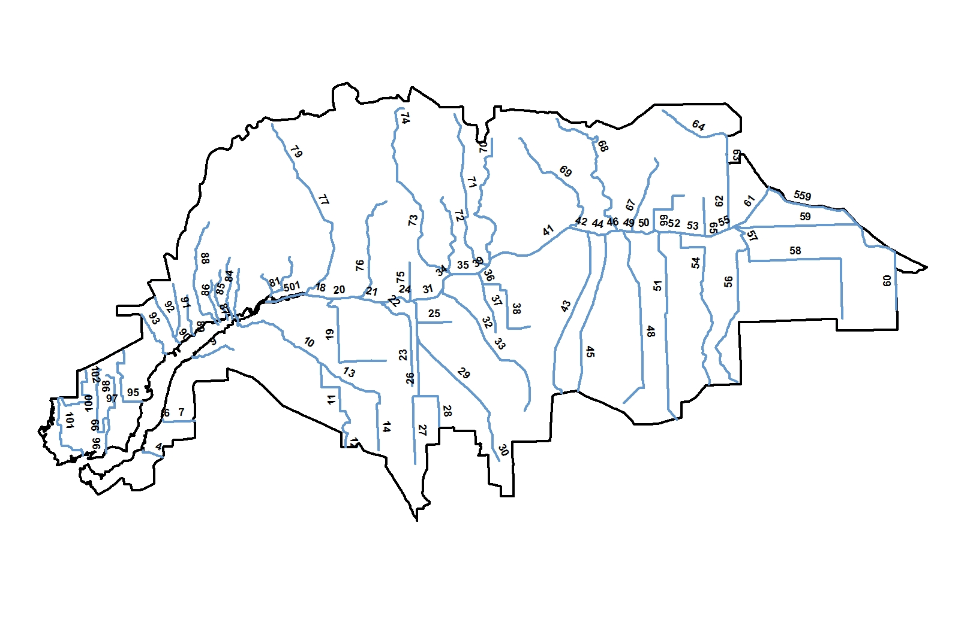
Caloosahatchee Basin HSPF Reach Network
Jacks Branch/ 73
Bee Branch/ 71
Powell/ 91
Owl/ 82
Telegraph/ 77
Stroud/ 84
Pollywog/ 70
Popash/ 85
Yellow Fever-Hancock/ 93
San Carlos/ 98
Courtney/ 99
Aries/102
Industrial/ 60
Orange/ 10
Fast-Crawford/ 36
Billy/ 9
Whisky/ 7
Location of Tributary Flow Calibration Sites
Reach Name/ Reach Number
Arrow shows ~ location of flow measurements

Slide 4
If the flow gage is located inside a model reach, the area tributary to the gage was estimated and an adjustment factor was applied then the graph will display the adjustment factor and show “adjusted,” if not adjusted then graph will show “unadjusted”
If gage is at the end of reach the graph will not have “adjusted” or “unadjusted”
If gage was USGS and tidally influenced, then the data was tidally adjusted by USGS
Graphs are arranged on the page in the pattern below, starting in Cape Coral going east along north side of Caloosahatchee to Pollywog. Then back to Whisky Creek on southwest side proceeding east to the Industrial Canal.
1
2
3
4

Slide 5
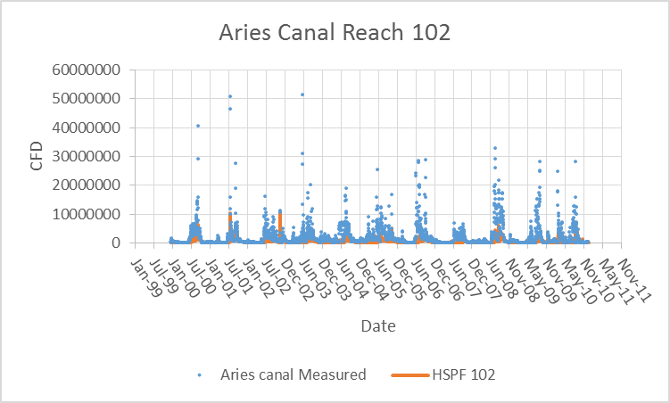
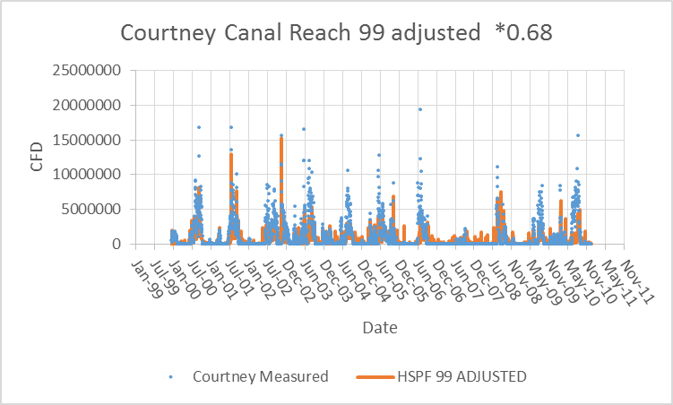
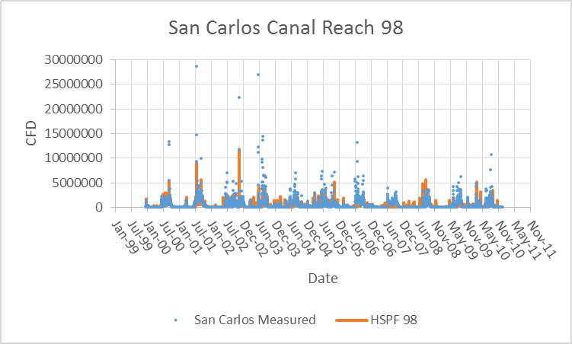
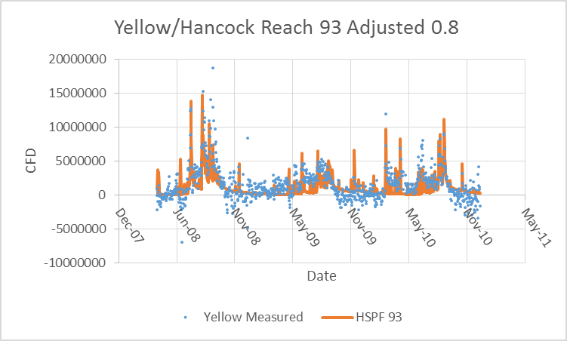
Model flow adjusted by area tributary to gage if gage is located inside a reach
USGS data tidally adjusted by USGS
Reversing flows

Slide 6
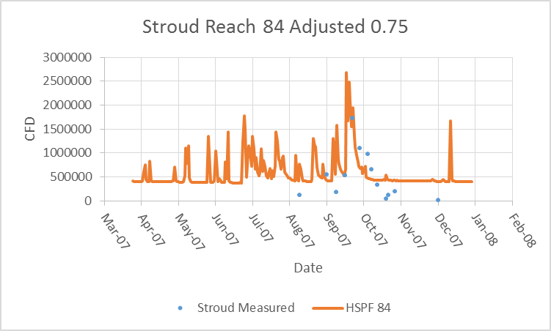
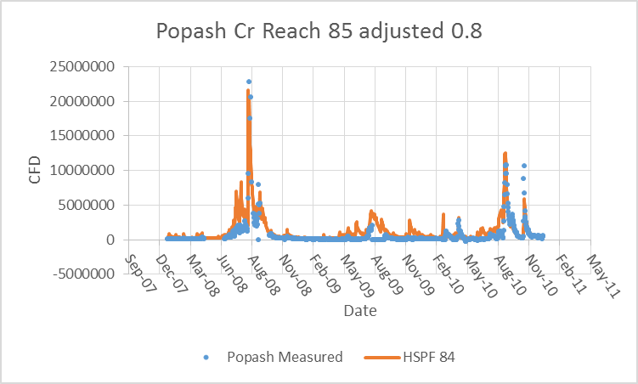
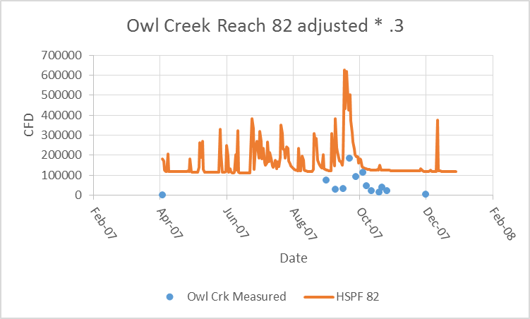
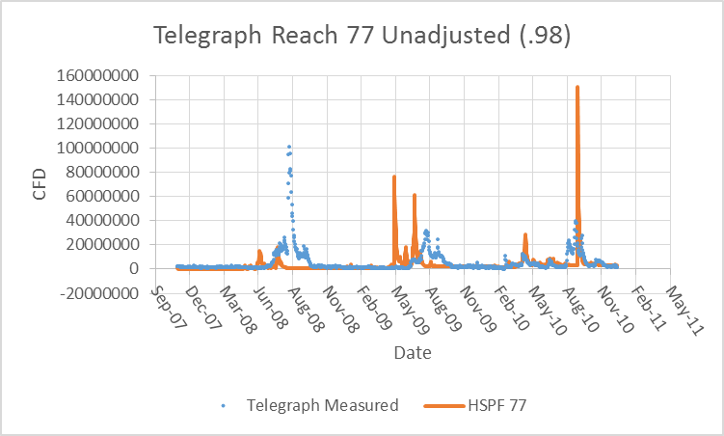
Reversing flows

Slide 7
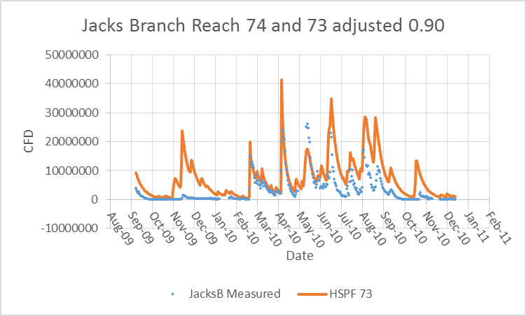
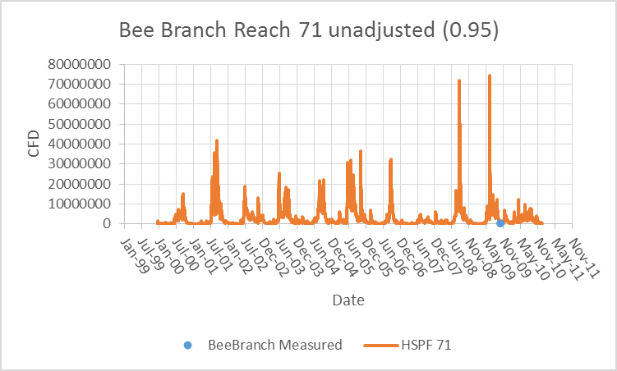
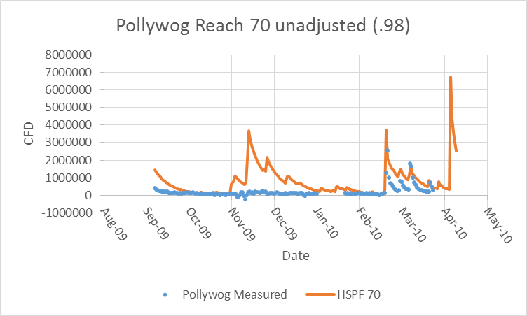
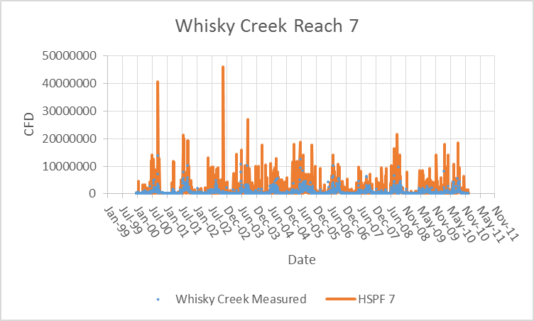
Reversing flows
South Side of Caloosahatchee
Reversing flows

Slide 8
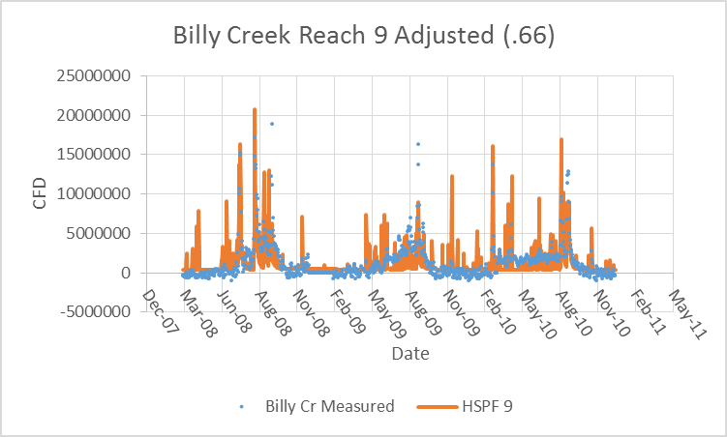
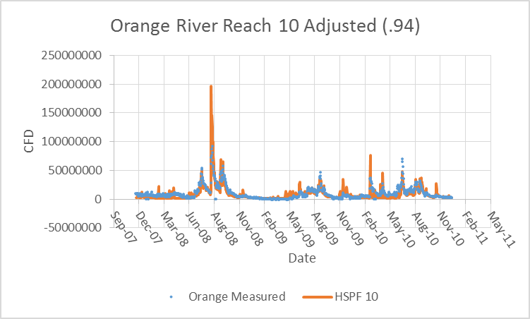
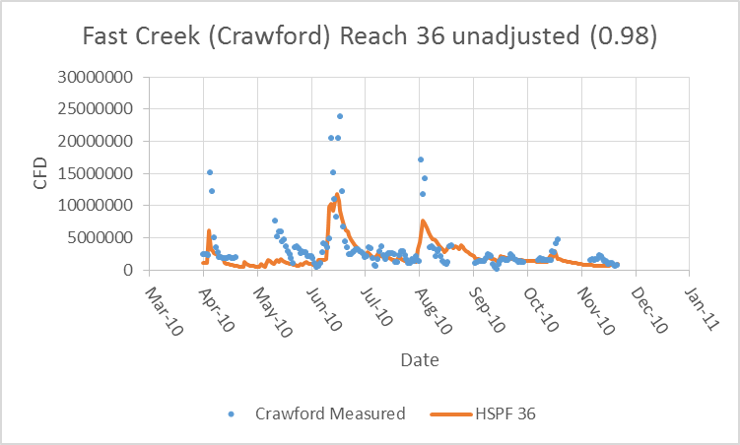
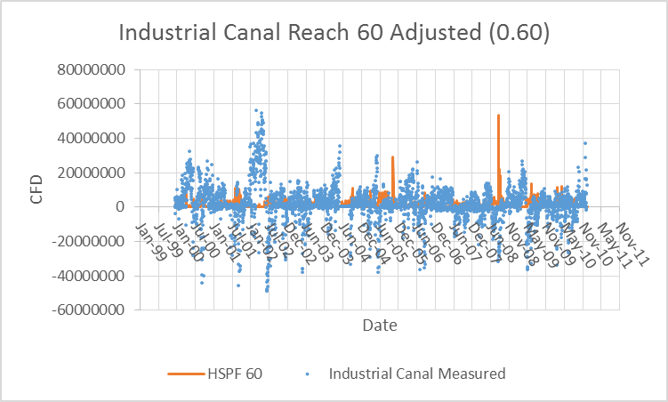
Reversing flows
Reversing flows
Reversing flows

