Slide 1
Agricultural BMP
“Crash Course”
Bill Bartnick, James Clements
Office of Agricultural Water Policy
www.floridaagwaterpolicy.com

Slide 2
Agricultural Economics
USDA Estimates Typical Family Spends Just 10.4% of Disposable Income on Food
Each American Farmer Feeds 129 Families
In Florida, Over 97 Billion Dollars in Farm-Related Economic Activity
Offsets “Net Loss” for Urban Services as a Function of Tax Revenues
Agricultural Water Resource Development Projects Fare Competitively with Other Sources (e.g. Desal)
Benefits of Open Spaces, Recharge, C-Sequestration, Cooling, etc.

Slide 3
Best Management Practices
“Best management practice” means a practice or combination of practices determined by the coordinating agencies, based on research, field-testing, and expert review, to be the most effective and practicable on-location means, including economic and technological considerations, for improving water quality in agricultural and urban discharges.

Slide 4
Agricultural BMP Authorities
Chapters 373, 403, 570, and 823 all Cite BMP References
BMPs are Quasi-Regulatory
Recognized in Some County Ordinances and WUP/CUP permits

Slide 5
Major Agricultural BMP
Programs and Total State Acreage
Silviculture (17 million)
Cow/Calf (11 million)
Row Crops ( 1 million, includes cane)
Citrus (¾ million)
Sod
Container Nurseries
Aquaculture

Slide 6
BMP Program Benchmarks
Collaborative BMP Manual Development
FDEP Effectiveness Verification
Rule Adoption
Manual on Website, Print and CD
Technical Assistance (IFAS, FDACS)
NOI Sign-up (Checklist, Record-Keeping)
Selective Use of Cost-Share
Confirmatory Effectiveness Studies
Manuals are Living Documents

Slide 7
Grower Benefits of Implementing BMPs
Incentive-Based Approach
Presumption of Compliance with State Water Quality Standards, Once Verified
Right to Farm Act Protection
Prequalification for State Cost-Share
Research and Demonstration Projects

Slide 8
BMP Nomenclature
Category, Groups, and Checkmarks
Level I and Level II BMPs
Notice of Intent (NOI)
BMP Checklist
Sample Record-Keeping Forms

Slide 9
BMP Picture Show
Note: Intended to Show Key BMPs and Spark Discussion Along the Way

Slide 10
Nutrient Management Series

Slide 11
Understanding Fertilizer
Label Analysis (10-10-10)
Fertilizer Type (e.g. Granular, Liquid, etc.)
Macronutrients (N-P-K)
Secondary (Ca, Mg, S)
Micronutrients (B, Cl, Cu, Fe, Mn, Mo, Zn)

Slide 12
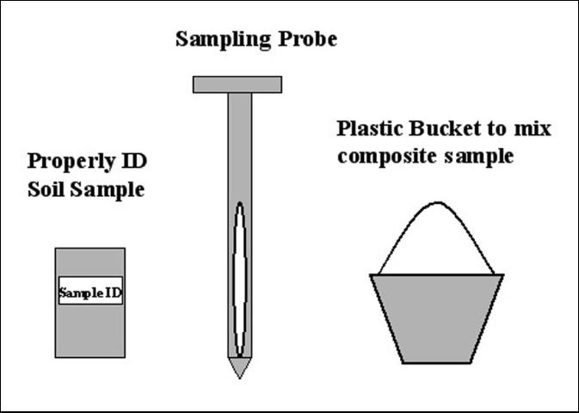
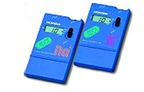
Soil and Tissue Testing
Soil and pH Analysis
In-Situ Tissue Test Meter

Slide 13
Tissue Test
Critical range
Crop Yield
Deficient
Low
Sufficient
High
Excess
Tissue Concentration

Slide 14
Effect of N Fertilizer on Soil pH
None
6.2
Ammonium nitrate
5.9
Ammonium sulfate
4.7
0 1 2 3 4 5 6 7
pH
Lufkin soil, Overton, TX

Slide 15
IFAS Recommendations
Science-Based Research using Field Trials on Grower Plots/Research Stations
Approved by PNOC
Recommendations Published on EDIS
Limited Water Quality Data to Date

Slide 16
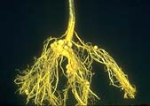
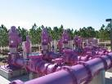
Nutrient Budgeting
Legume Root Nodules
Reclaimed Water

Slide 17
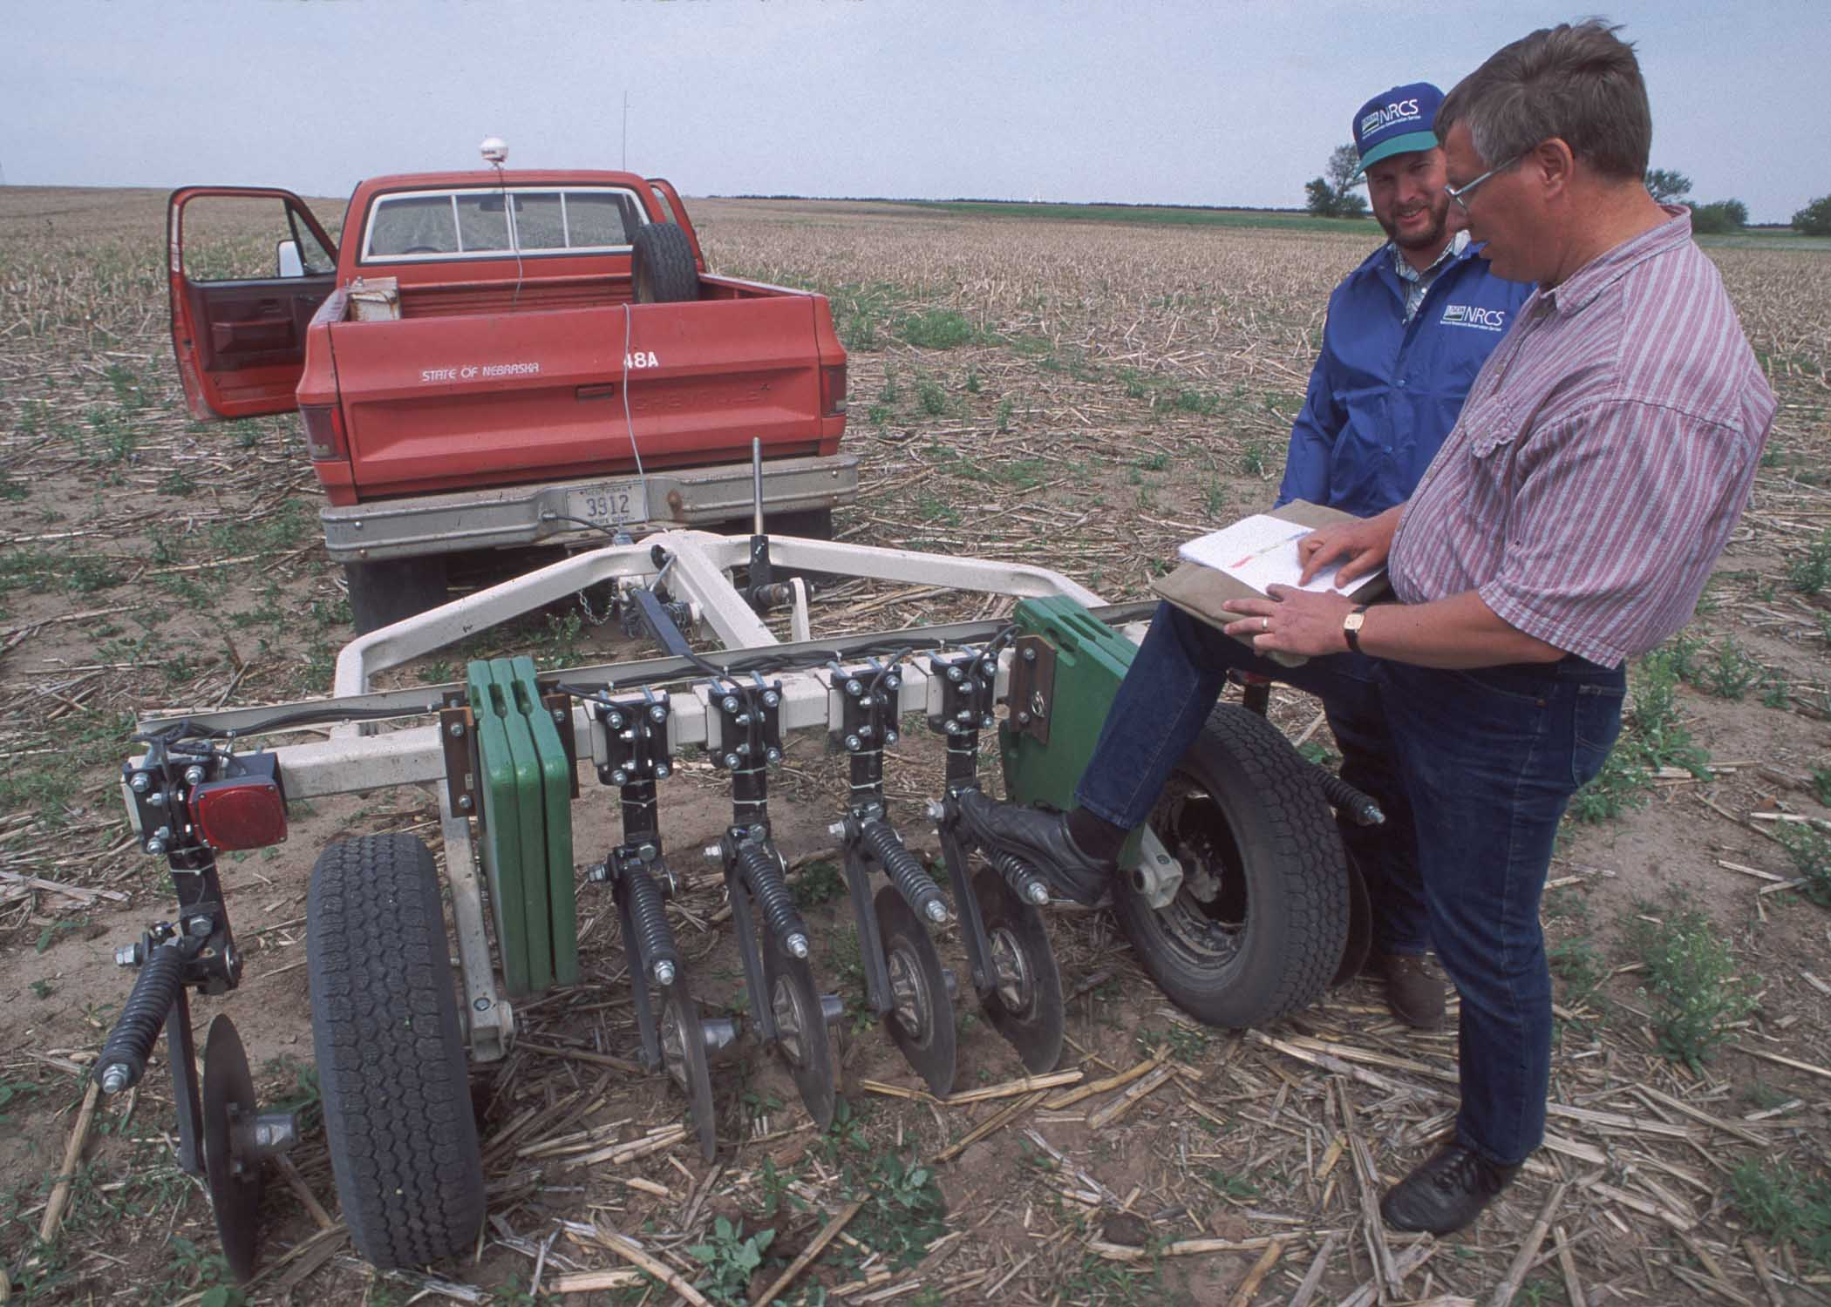
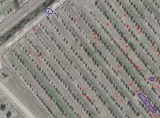
Precision Agriculture
Fertilizer Signature via Electrical Conductivity
Soil Sampling Grid

Slide 18
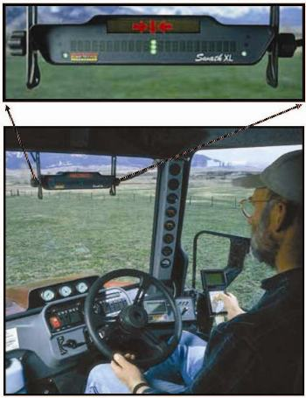
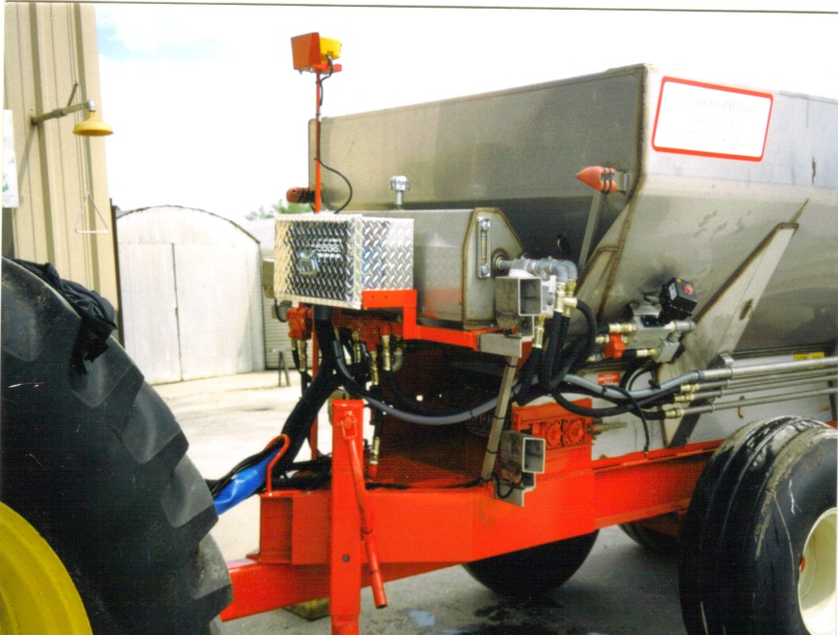
Precision Application
Variable Rate Spreader
Tractor Mounted Navigation Equipment

Slide 19
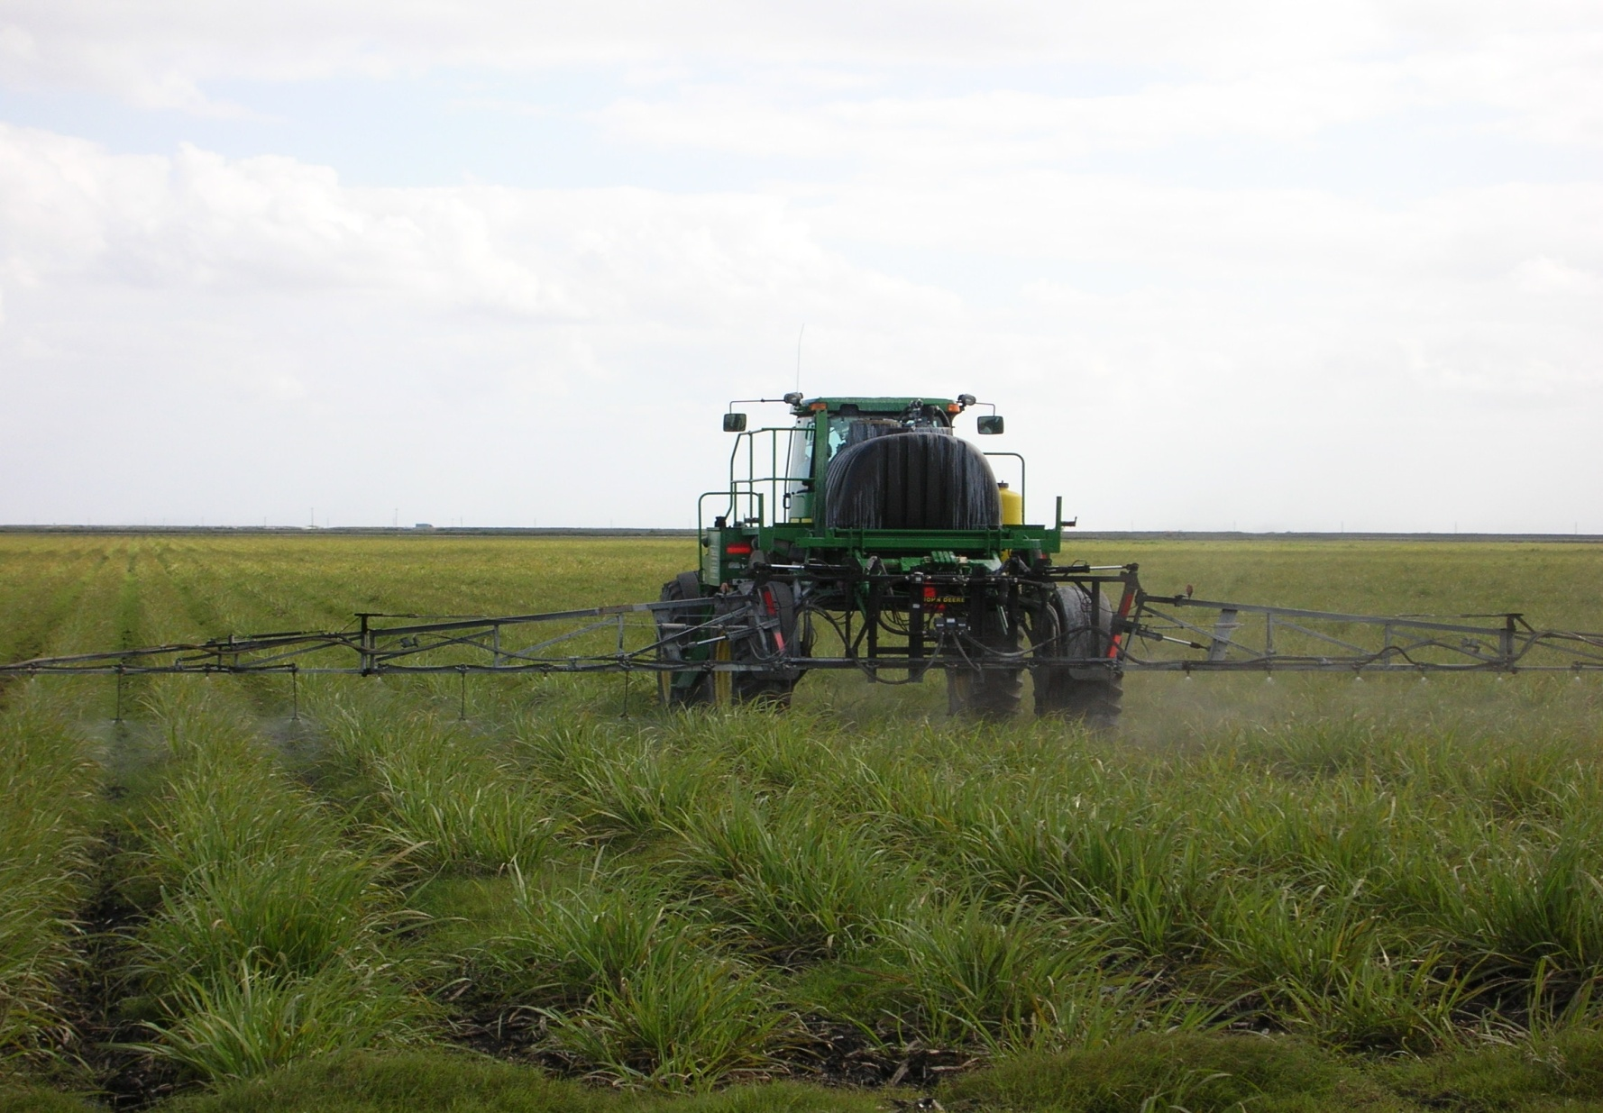
Equipment Calibration/Maintenance

Slide 20
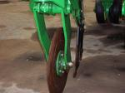
Split Fertilizer Applications

Slide 21
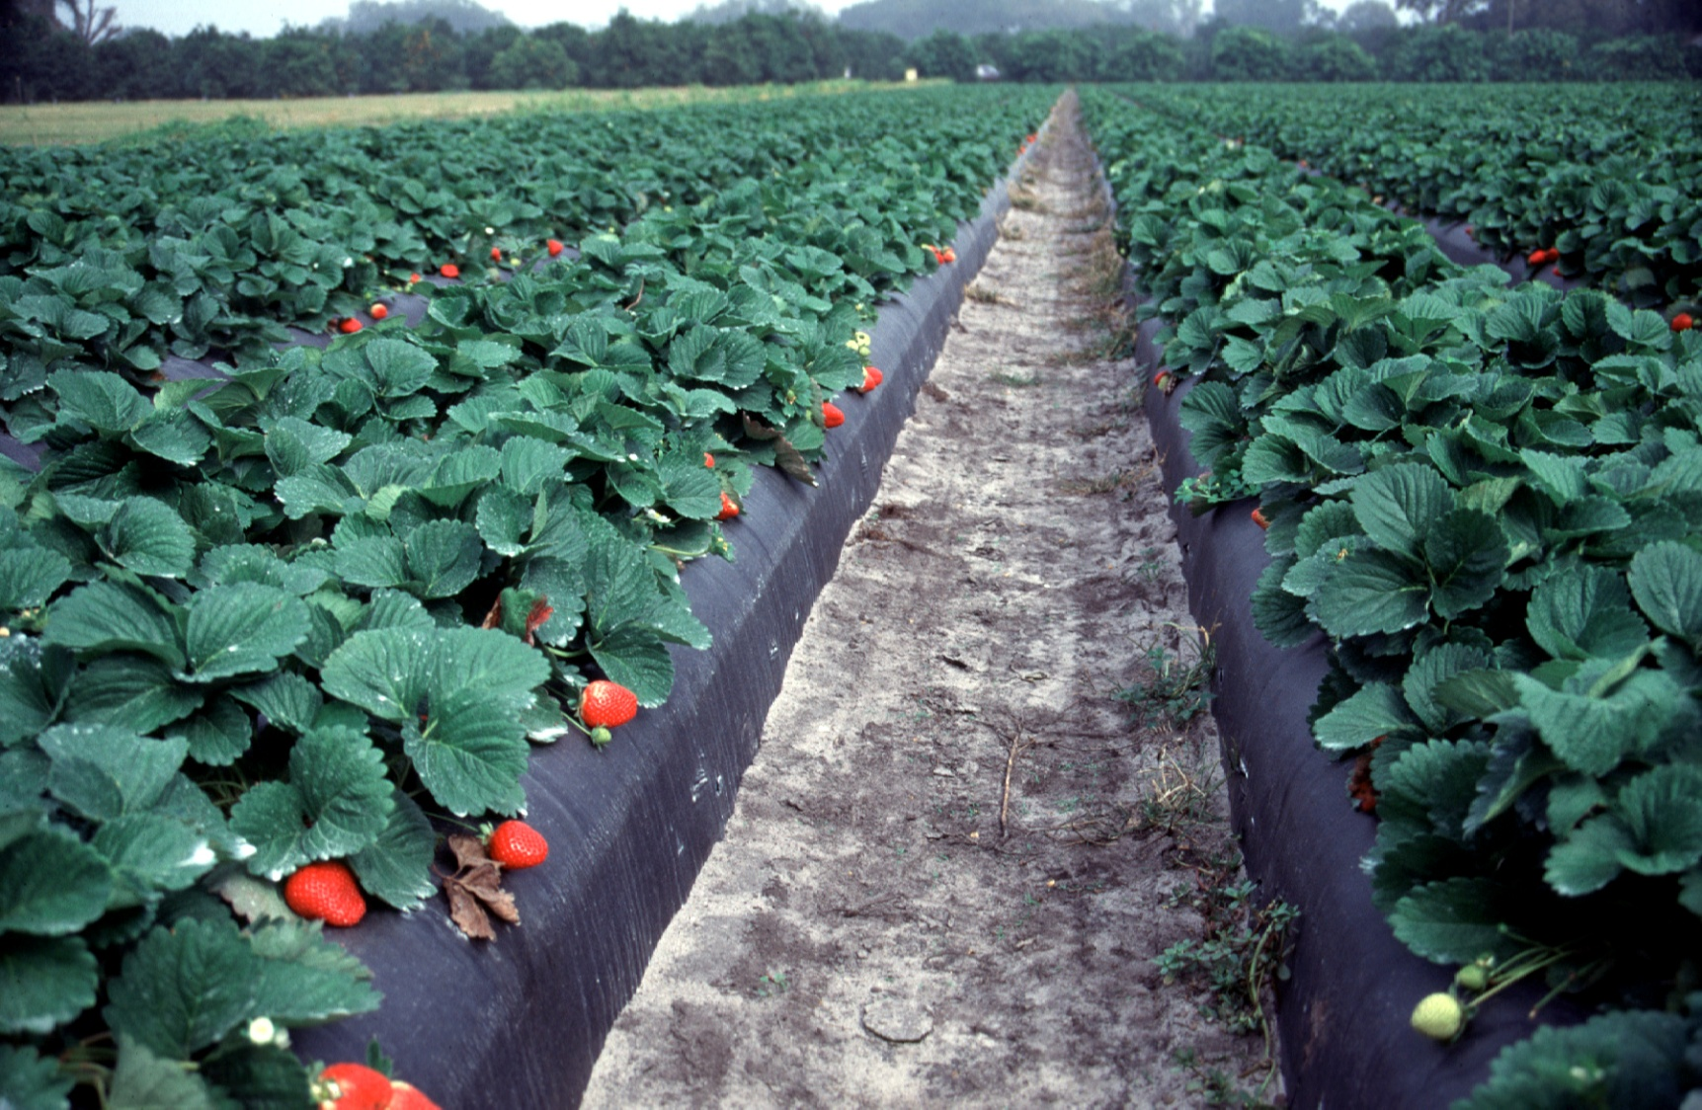
Fertigation

Slide 22
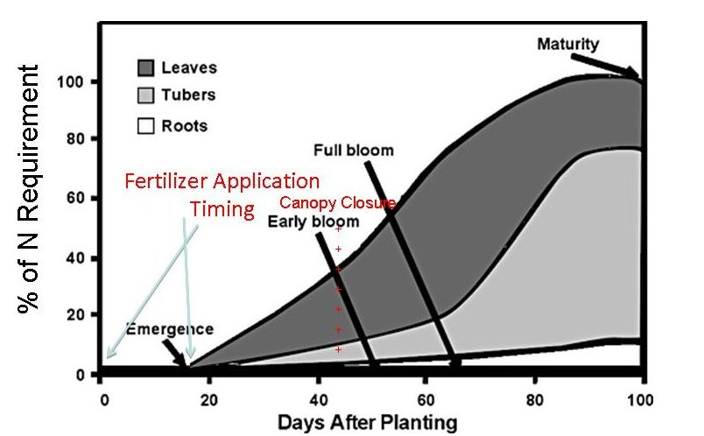
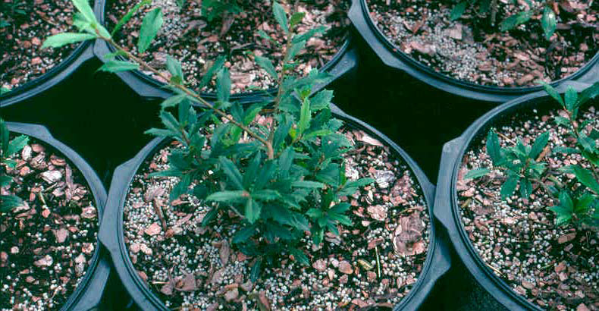
Controlled-Release Fertilizer
Nursery Potting Media
Potato Canopy Closure

Slide 23
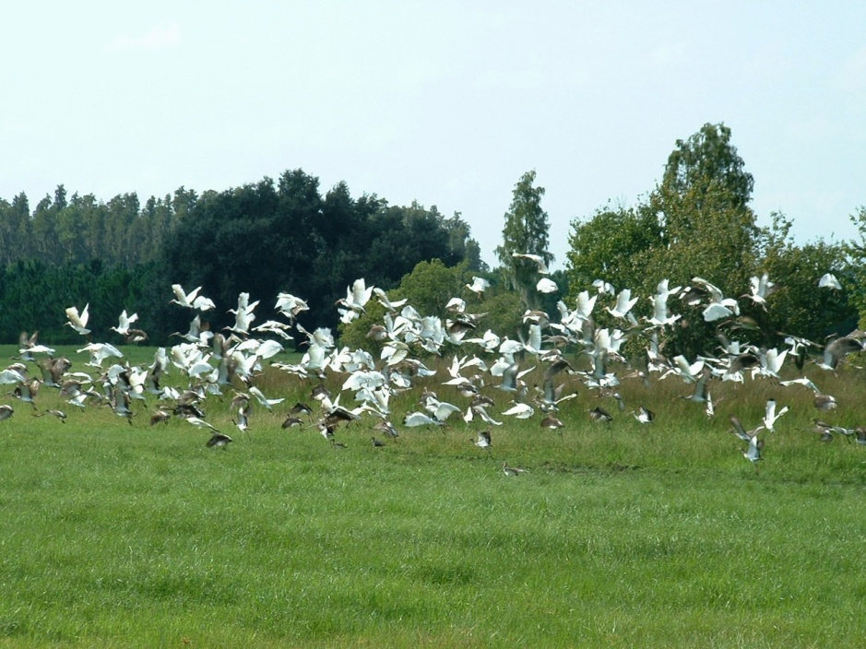

Fertilizer Application Setbacks
Wetlands
Springs and Spring Runs

Slide 24
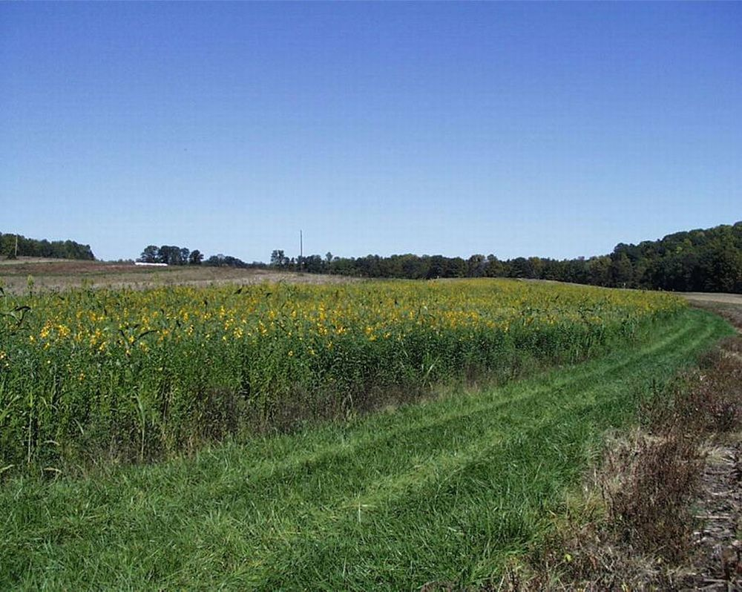
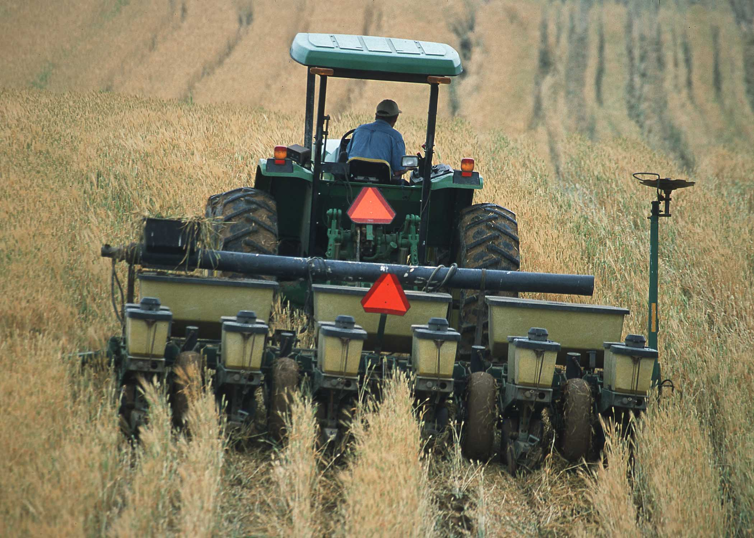
Cover Crops and Conservation Tillage

Slide 25
How About a Break to Give James a Rest?

Slide 26
Irrigation Management Series

Slide 27
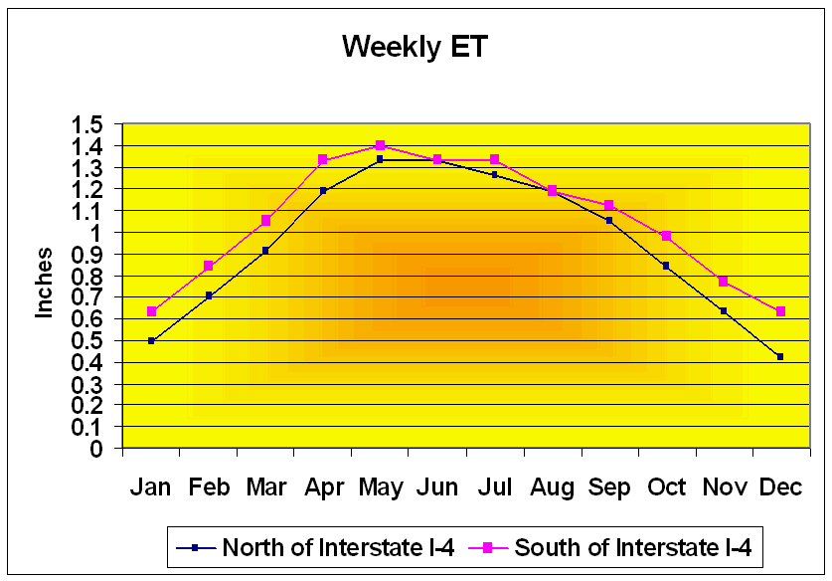
Irrigation Scheduling

Slide 28
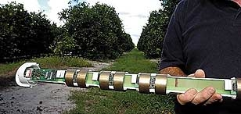
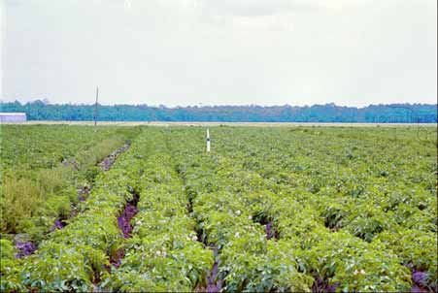
Monitoring Soil Moisture and Water Table Levels
Soil Moisture Devices
Observation Wells

Slide 29
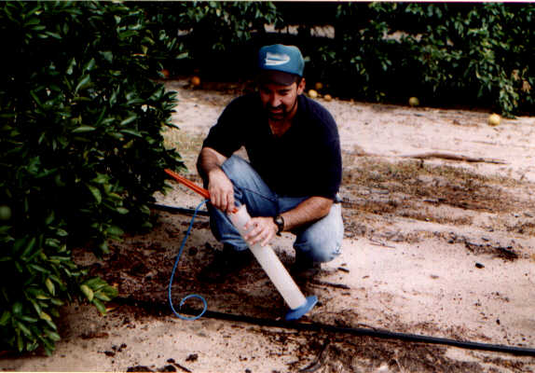
Mobile Irrigation Labs

Slide 30
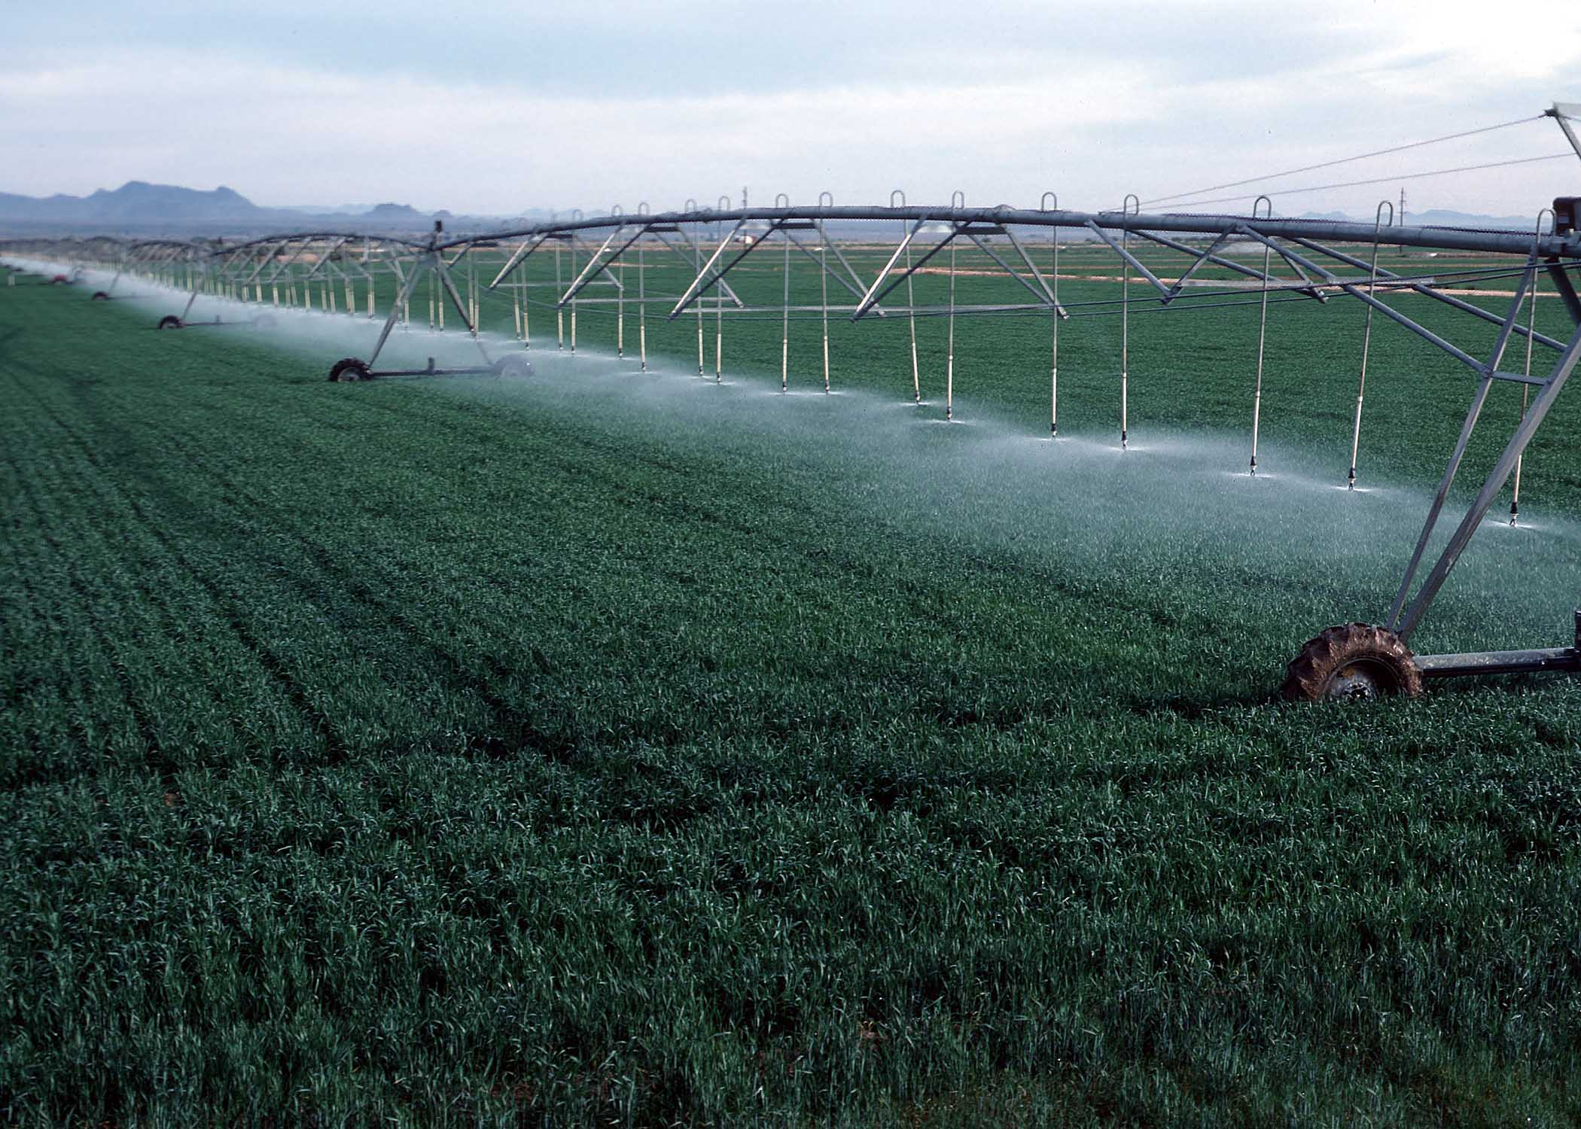
Irrigation System Retrofits

Slide 31
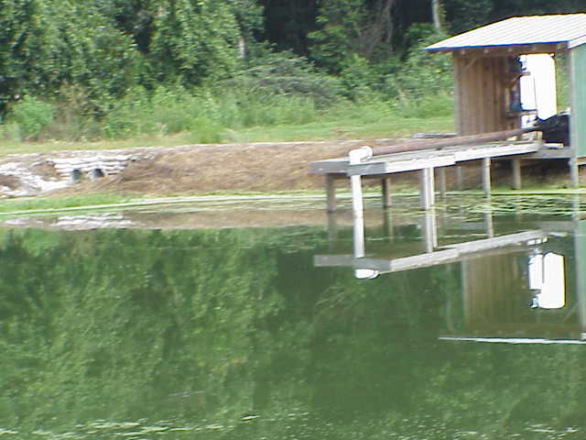
Tailwater Recovery

Slide 32
Treatment and Erosion Control Management Series

Slide 33
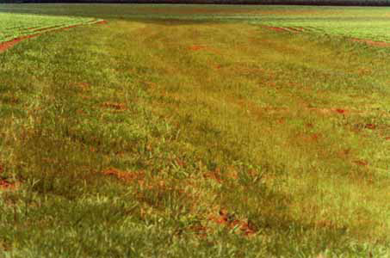
Grassed Waterways and
Filter Strips

Slide 34
Vegetative Buffers

Slide 35
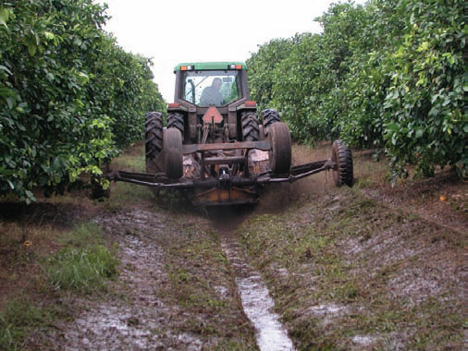
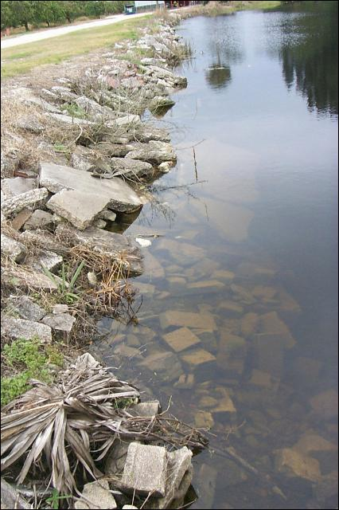
Ditch Maintenance and Retrofits

Slide 36
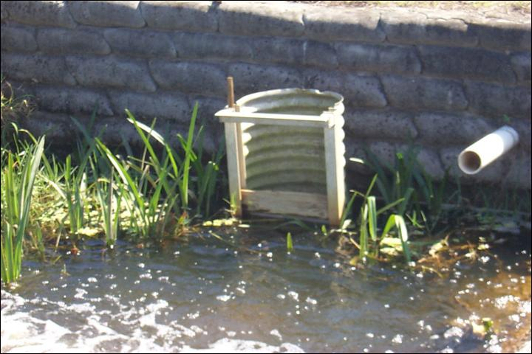
Water Control Structures

Slide 37
Operations Management Series

Slide 38
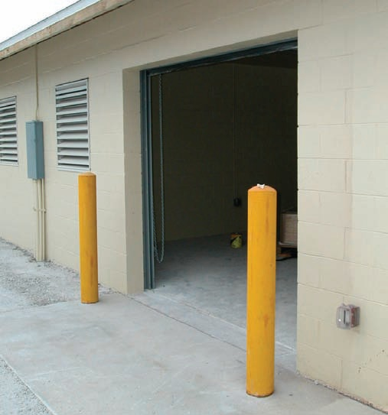
Fertilizer Storage

Slide 39
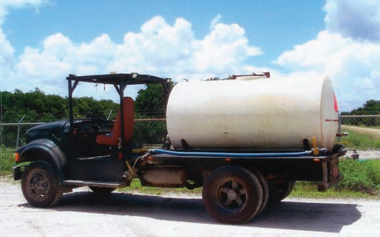
Fertilizer Mix/Load

Slide 40
Other Commodity Specific BMPs

Slide 41
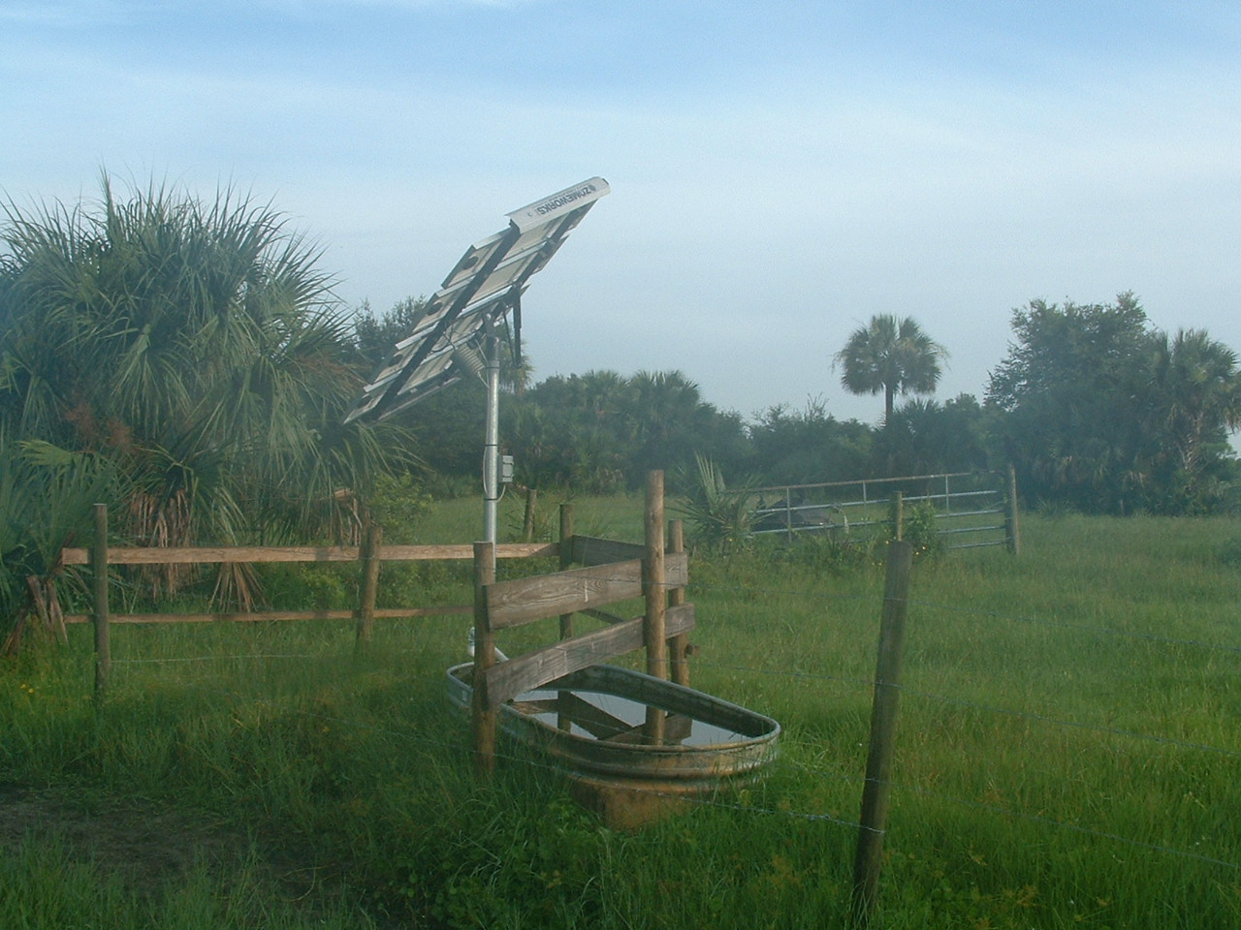
Livestock Watering Troughs

Slide 42
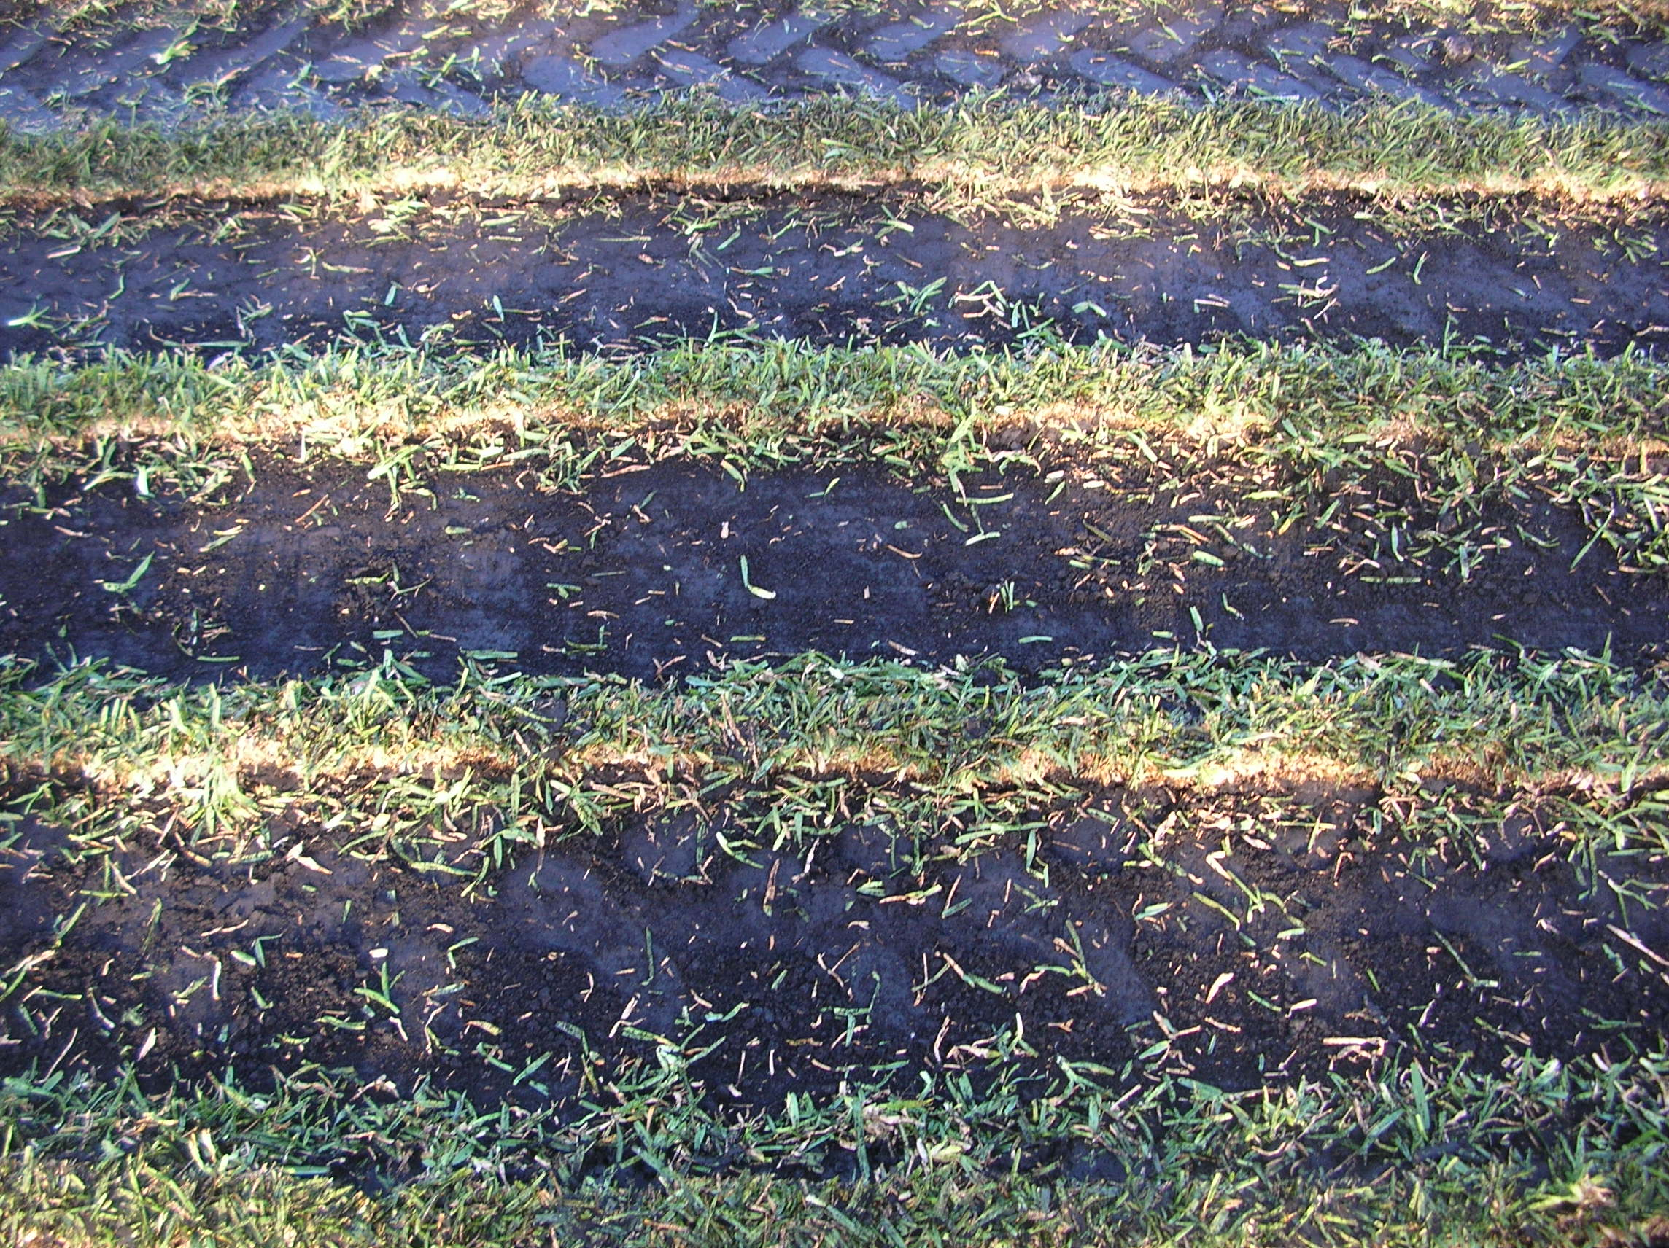
Ribbon Fertilization

Slide 43
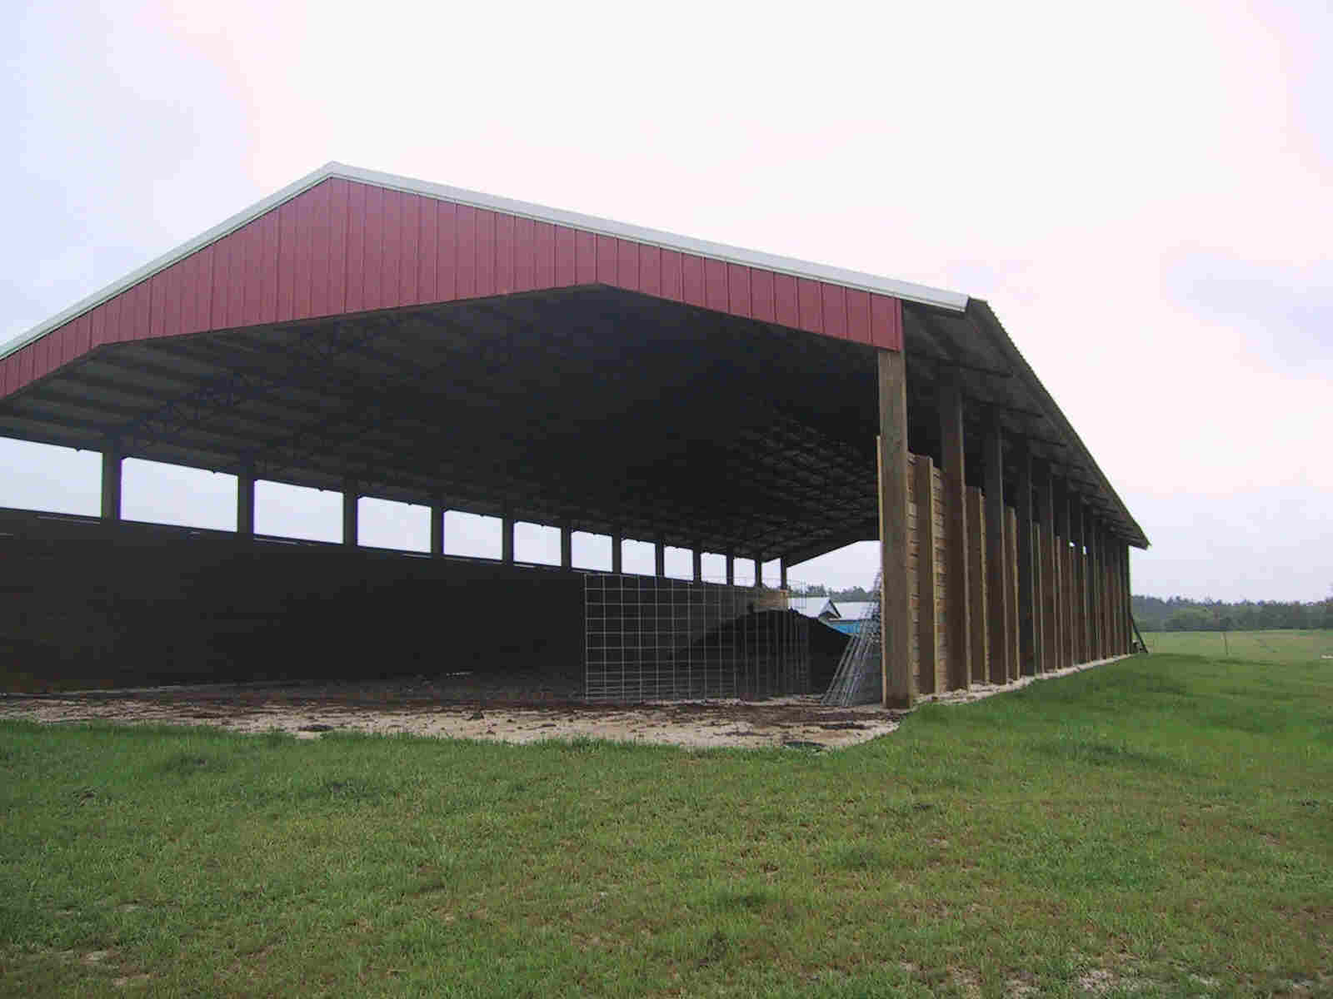
Litter Storage Shed

Slide 44
Specific BMP Manual Questions?

