Slide 1
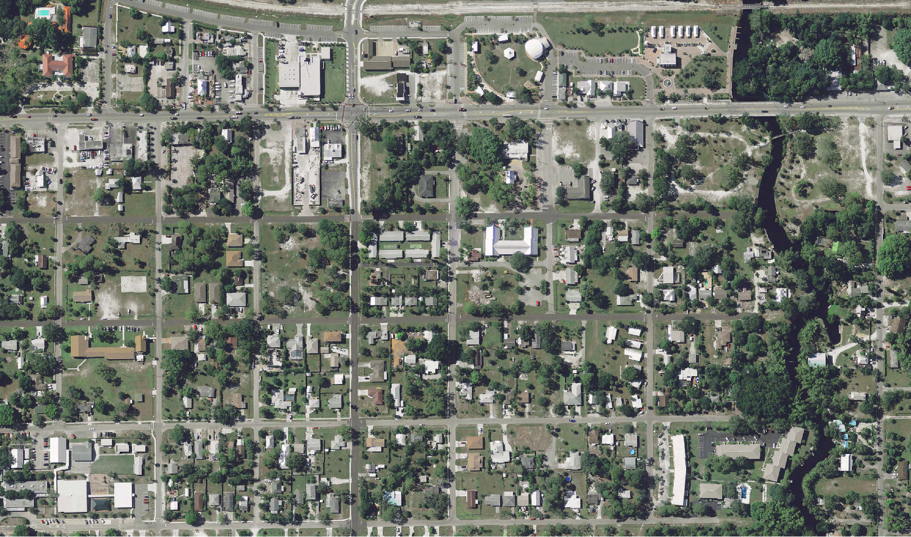
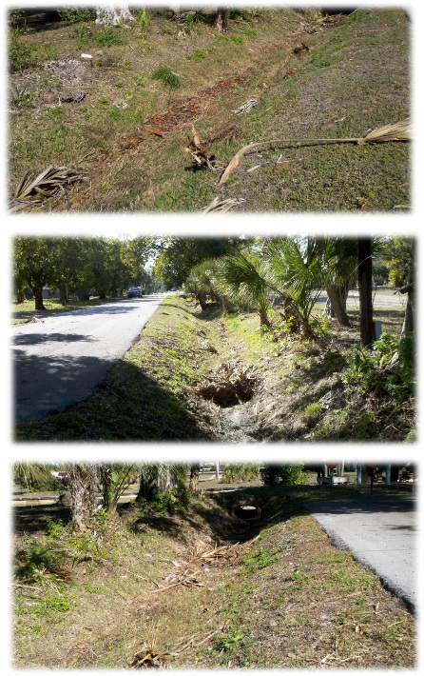
Pre Construction Conditions
36.6 Acre Drainage Basin
Project Location

Slide 2
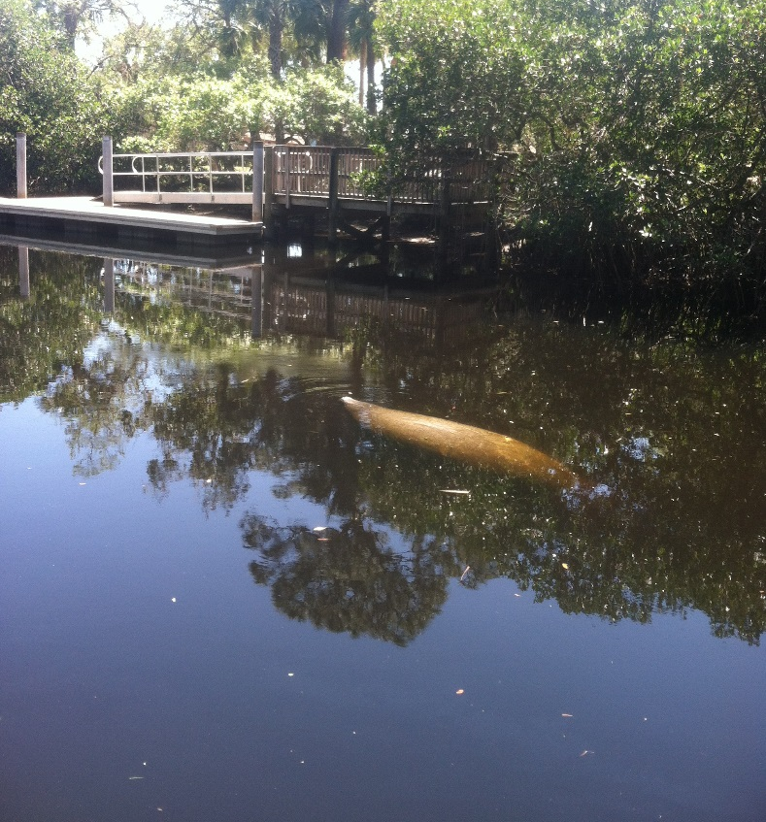
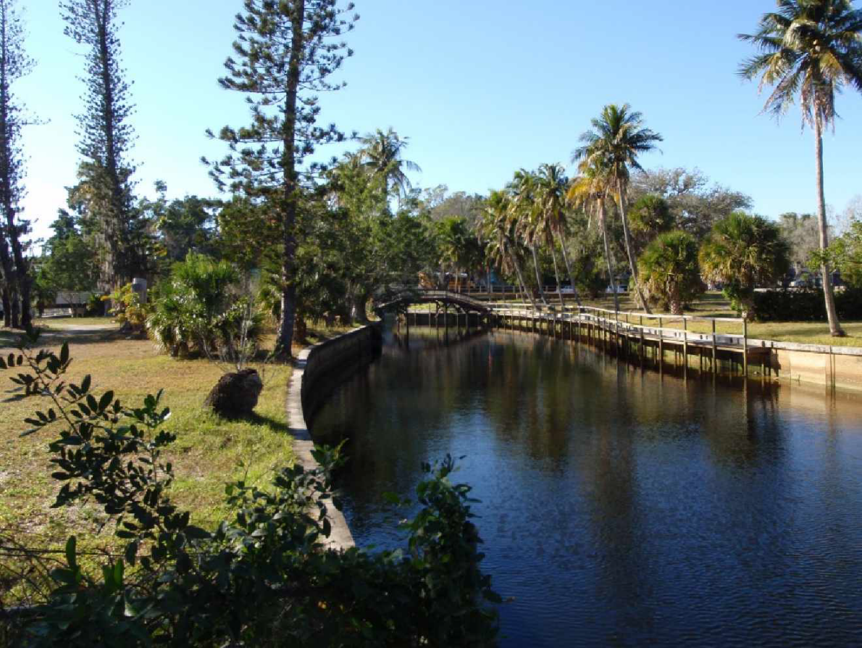

Project Focus
Treat Felts Basin Stormwater Runoff Prior to Discharge into the Imperial River

Slide 3
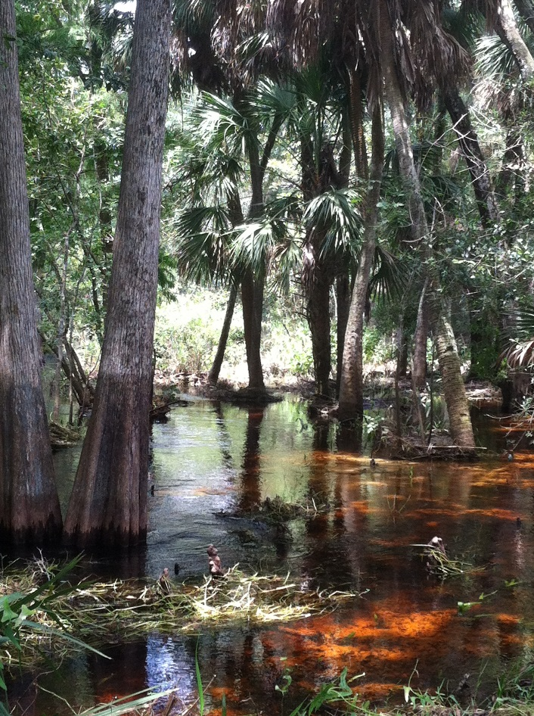
Overview
Imperial River is listed by FDEP as impaired for low Dissolved Oxygen levels
Causative Pollutant: Nitrogen
BMAP adopted 11/2012: City to remove 9,903 lbs/year of Nitrogen over next 15 years

Slide 4
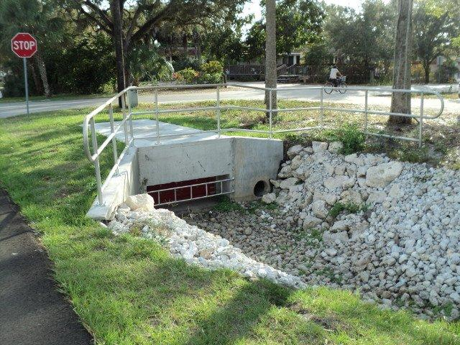
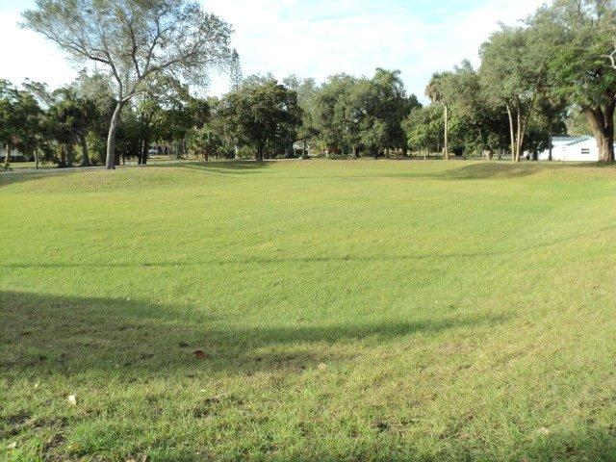
Project Details
City Purchased 4 Lots encompassing 1.2 Acres
Treatment Train Constructed:
Suntree Nutrient Separating Baffle Box
.75 Acres Dry Retention
70% Nitrogen & 69% Phosphorous Load Reductions

Slide 5
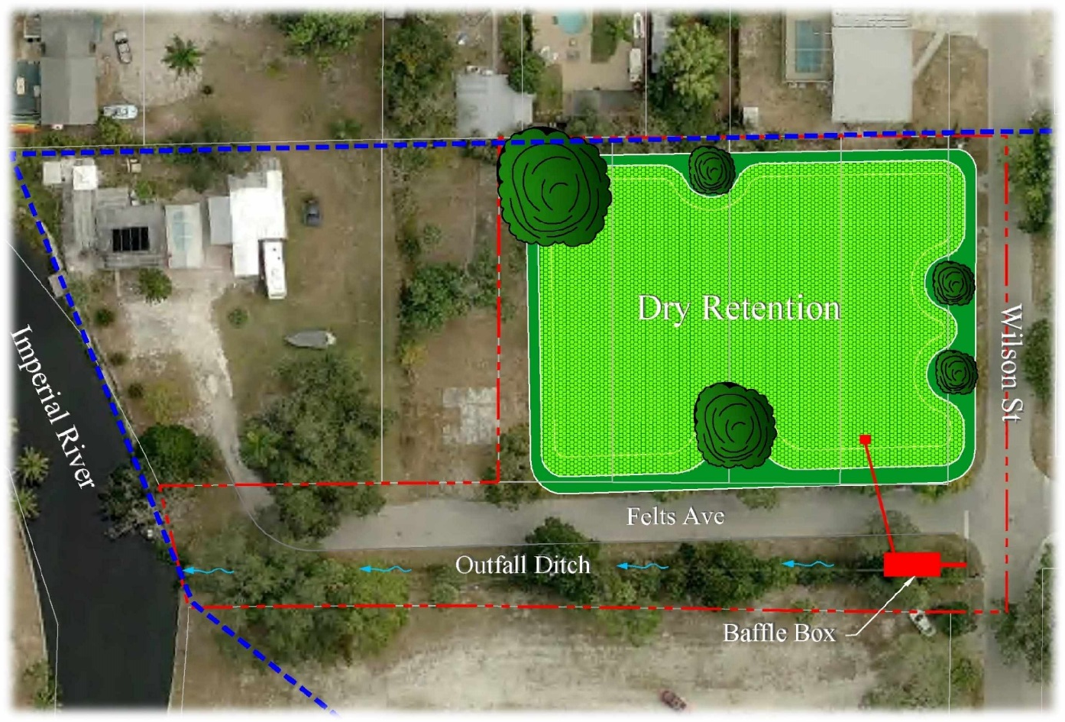
Project Schematic
.75 Acre Dry Retention w/Baffle Box

Slide 6
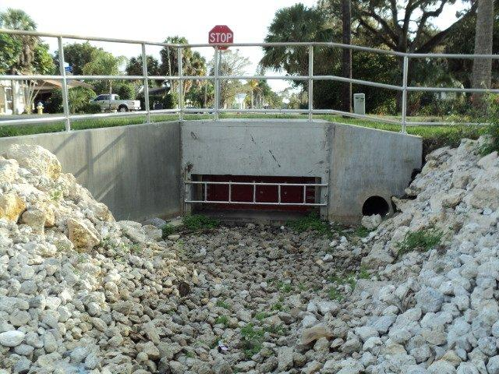
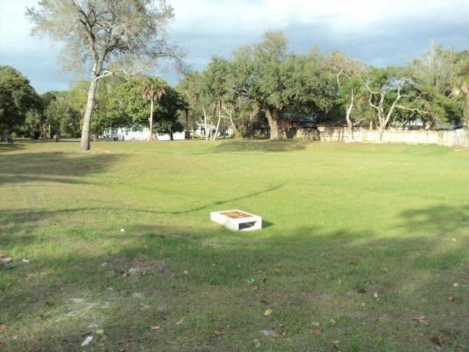
Treatment Train

Slide 7
Project Summary
Total Project Cost $138,679.00
Project TN Reduction = 258 lbs/yr

