Slide 1
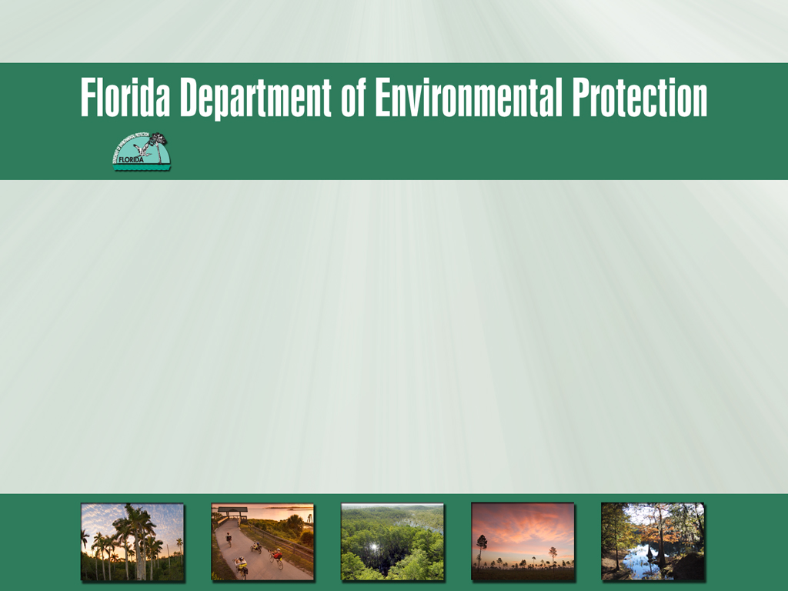
Everglades West Coast and Caloosahatchee
Basin Management Action Plan
2013 Progress Report
February 5, 2014

Slide 2
Agenda
Overview of the Caloosahatchee and Everglades West Coast BMAP Progress Reports.
Activities During the Reporting Period from Both BMAPs.
Upcoming Activities.

Slide 3
Annual Reports Overview
Everglades West Coast and Caloosahatchee BMAPs were adopted in November 2012.
This is the first annual progress report on BMAP activities.
Information was provided by the stakeholders on activities from December 1, 2012 through November 30, 2013.
The reports include:
  Background on the total maximum daily loads (TMDLs) and BMAP.
  Activities during the reporting period.
  Water quality and biological monitoring.

Slide 4
BMAP [403.067(7)]
Document a phased approach to achieve adopted the TMDLs.
Itemize initial set of total nitrogen (TN) load reduction activities and projects.
Identify needs for additional study and monitoring.
Allow for participation of stakeholder, partners and interested parties.

Slide 5
Everglades West Coast

Slide 6
TMDLs
Hendry Creek
Imperial River
Freshwater Segment
TN Target = 0.74 mg/l
Load Reduction = 32%
Marine Segment
TN Target = 0.6 mg/l
Load Reduction = 44%
Freshwater Segment
TN Target = 0.74 mg/l
Load Reduction = 24.87%
No definition of loading sources, differentiating wastewater treatment facilities, stormwater and agricultural sources.

Slide 7
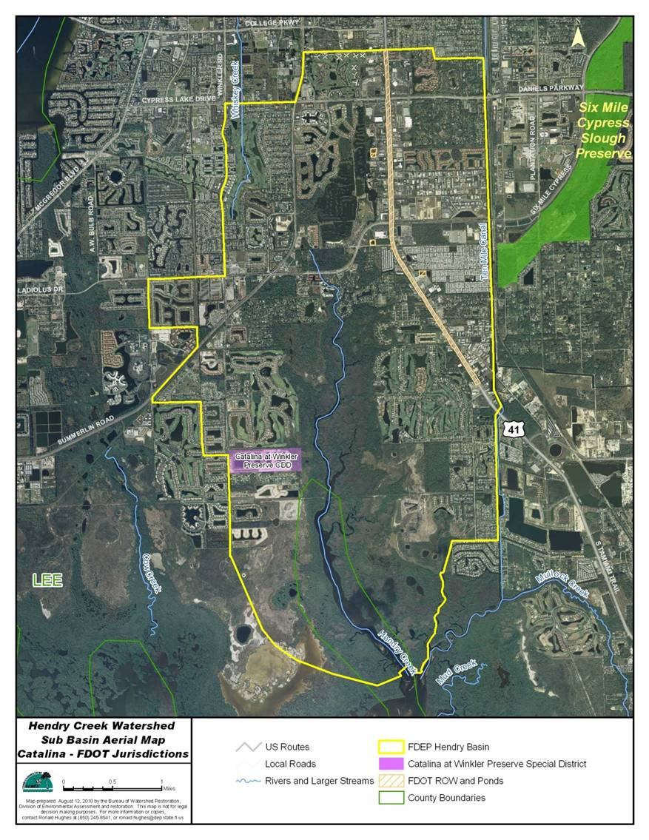

Slide 8
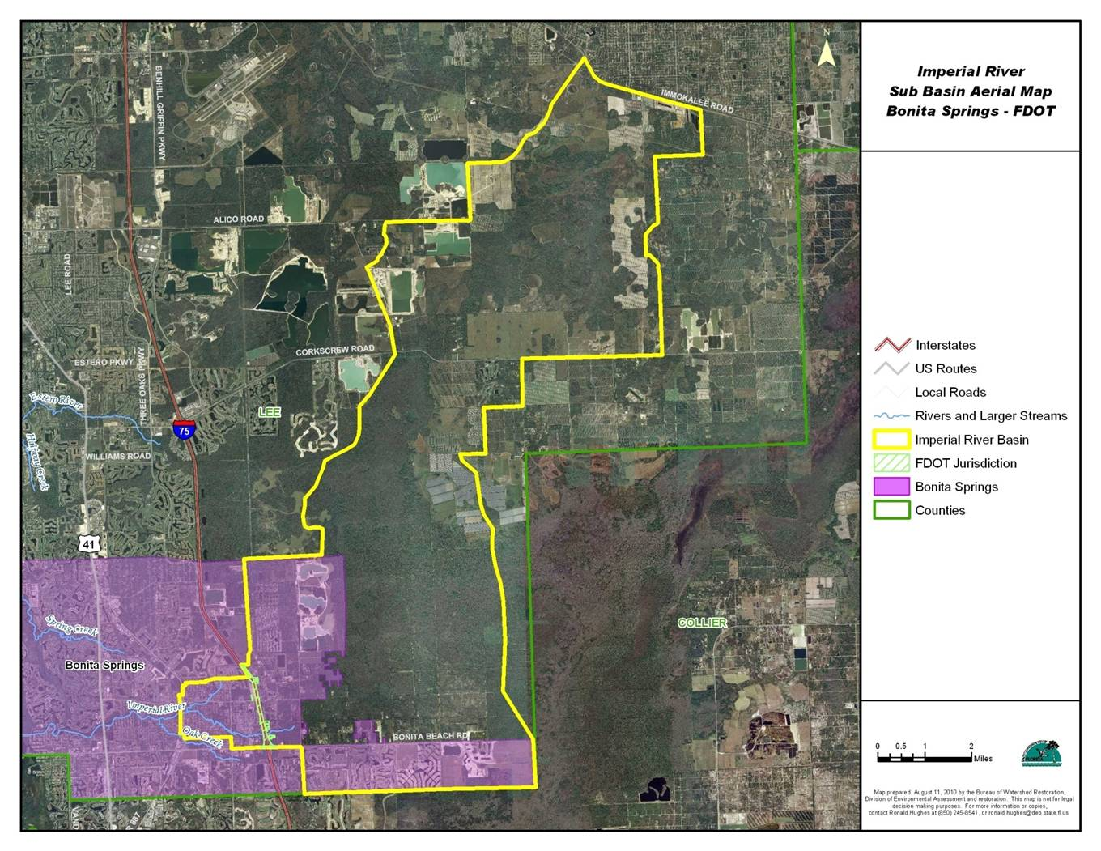

Slide 9
Adjustment of TMDL in the BMAP
For purposes of initial allocation, loading assigned to stakeholders based on land uses.
Allocation based on relative amount of developed (non-natural) loading:
Hendry Creek
  Lee County.
  Catalina.
  Florida Department of Transportation (FDOT).
  Agriculture.
Imperial River
  Lee County.
  Bonita Springs.
  FDOT.
  Agriculture.

Slide 10
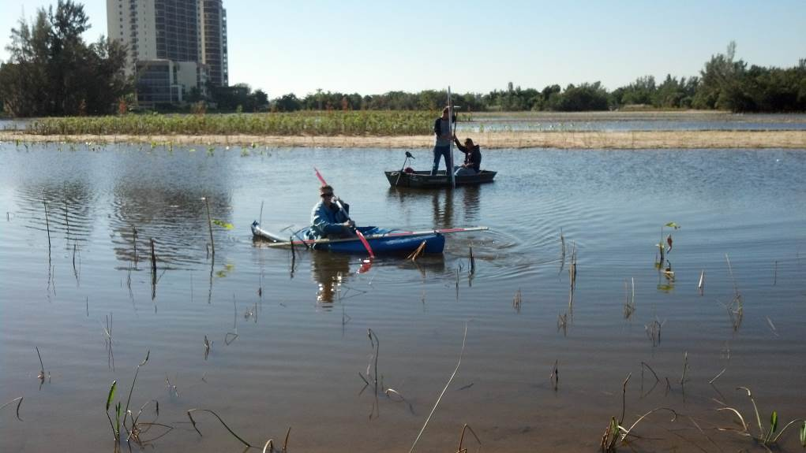
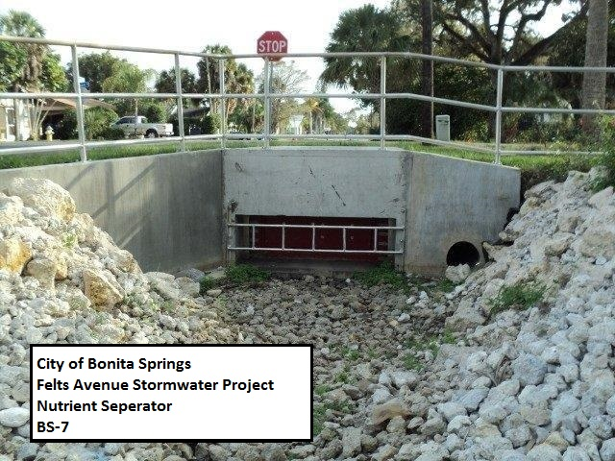
Accomplishments
Hendry Creek – Lee County completed the Lakes Park Water Quality Restoration Project.
Imperial River- City of Bonita Springs completed the Felts Avenue Stormwater Treatment.
Lee County Lakes Park Restoration Project
City of Bonita Springs Felts Avenue Project

Slide 11
Activities
Hendry Creek
FDOT continued street sweeping activities and illicit discharge training.
Stakeholders provided fertilizer ordinance workshops and compliance enforcement.
The Florida Department of Agriculture and Consumer Services (FDACS) has enrolled 30.7 acres or 33.7% of agricultural lands in the basin.

Slide 12
Activities, continued
Imperial River
City of Bonita Springs continued education and outreach activities.
FDOT distributes stormwater education information and implements Illicit Discharge Detection and Elimination Training.
Lee County continued street sweeping and education and outreach efforts.
FDACS has enrolled 6,274 acres (95%) of agricultural lands.

Slide 13
Activities, continued
Hendry Creek
Entity | Project Number | Project Name | TN Reduction (lbs/yr)
Lee County | LC-1 | Lakes Park Water Quality Restoration | 4,533
Total | N/A | Total Reductions in Reporting Period | 4,533
Imperial River
Entity | Project Number | Project Name | TN Reduction (lbs/yr)
Bonita Springs | BS-2 | FYN Program | 835
Bonita Springs | BS-7 | Felts Avenue Stormwater Treatment | 258
Total | N/A | Total Reductions in Reporting Period | 1,093
Notes:
Total= 5626

Slide 14
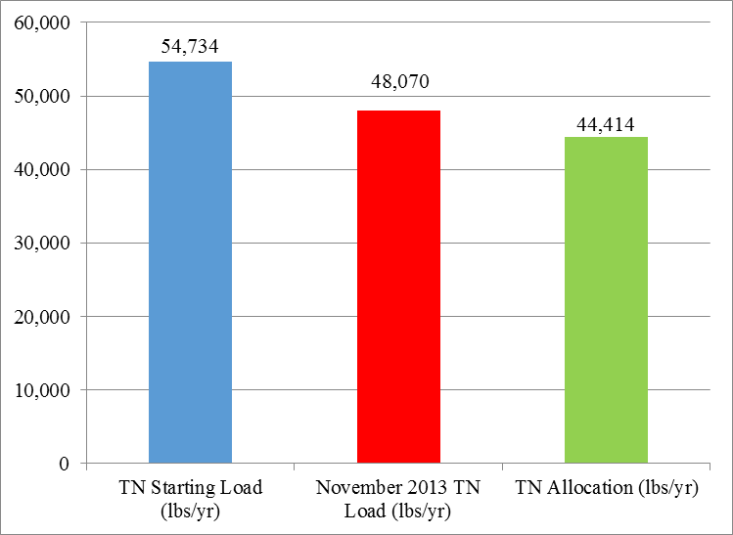
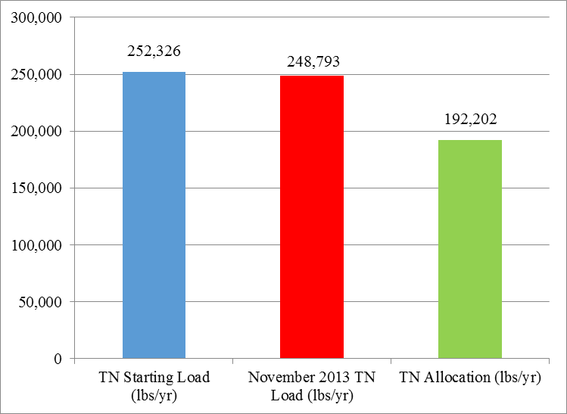
Progress to the TMDL
The total project reductions, including those shown as completed in the BMAP are 6,664 lbs/yr TN in the Hendry Creek Basin and 3,533 lbs/yr TN in the Imperial River Basin.
Hendry Creek Project Reductions
Imperial River Basin Project Reductions

Slide 15
Monitoring Activities
The BMAP monitoring plan was designed to enhance the understanding of basin loads, identify areas with high nutrient concentrations, and track long-term water quality trends.
A detailed water quality evaluation will be conducted no later than year four.
Water quality monitoring is being conducted by:
  Lee County (Hendry Creek and Imperial River).
  Department, South District (Hendry Creek).
  Bonita Springs (Imperial River).

Slide 16
Everglades West Coast Stakeholder Presentations

Slide 17
Caloosahatchee Estuary

Slide 18
Caloosahatchee Estuary TMDL
3 Segments: 3240A, 3240B, 3240C.
TMDL for Nutrients
  Causative Pollutant – TN.
  Target: Seagrass light requirements in San Carlos Bay.
TMDL= 23% reduction in TN loading (over the entire river basin).
Adopted by the Department Secretary in 2009.

Slide 19
Summary of TMDL

Slide 20
Stakeholders
Lee County.
Charlotte County.
City of Cape Coral.
City of Ft. Myers.
East County Water Control District.
Lucaya Community Development District (CDD).
FDOT.
FDACS.

Slide 21
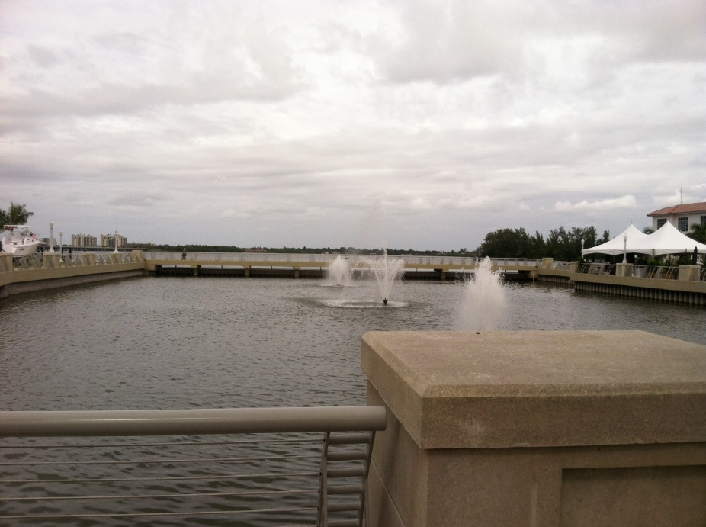
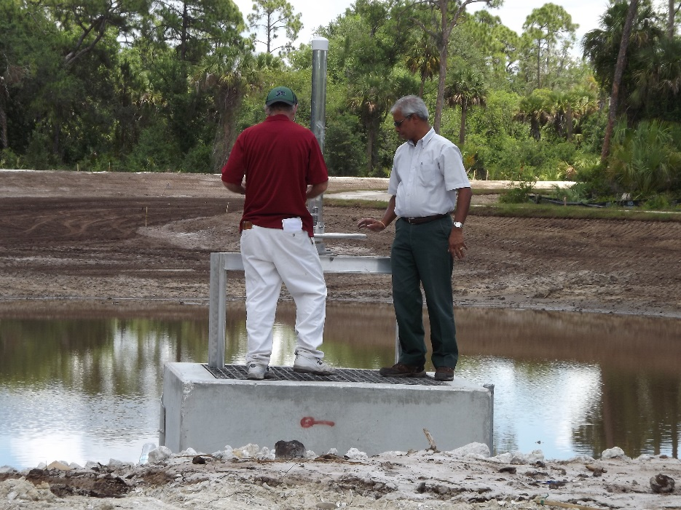
Accomplishments
  City of Ft. Myers completed Brookhill Drainage Improvements and Riverfront Improvement Phase 1.
  East County Water Control District Completed Mirror Lake Phase 1.
  Lee County Completed Powell Creek Filter Marsh and Extension Projects.
City of Ft. Myers Downtown Basin
Lee County Powell Creek Filter Marsh

Slide 22
Activities
Charlotte County continued its education and outreach efforts.
The City of Cape Coral has continued its outreach program which includes presentations, website and fertilizer information.
The City of Ft. Myers continues to work on the Ford St. Filter Marsh. Baffle Boxes were installed as part of the Brookhill Utility Drainage Improvements.

Slide 23
Activities, continued
East County Water Control District continued its education and outreach effort.
FDOT is constructing various road widening projects that will provide a TN reduction above net improvement and continues to distribute educational information.
FDACS continues to enroll agricultural lands in BMPs.

Slide 24
Activities, continued
Entity | Project Number | Project Name | TN Reduction (lbs/yr)
City of Fort Myers | FM-7 | Brookhill Utility Drainage Improvement | 11
City of Fort Myers | FM-10 | Riverfront Development Phase 1 | 90
ECWCD | EC-6 | Mirror Lake Phase I | 1,357
Lee County | LC-17 | NFM Powell Creek Extension/Lost Lane Levee | 2,976
Lee County | LC-20 | Powell Creek Filter Marsh | 1,693
Total | N/A | Total Reductions in Reporting Period | 6,127

Slide 25
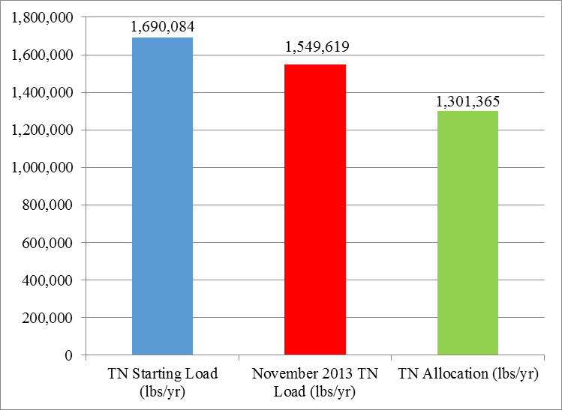
Progress to the TMDL
The total project reductions, including those shown as completed in the BMAP, are 140,465 lbs/yr TN.

Slide 26
Monitoring Activities
The BMAP monitoring plan was designed to enhance the understanding of basin loads, identify areas with high nutrient concentrations and track long-term water quality trends.
A detailed water quality evaluation will be conducted no later than year four.
Water quality monitoring is being conducted by:
  The City of Cape Coral.
  The City of Ft. Myers.
  Lee County.
  SFWMD.
  Department, South District.

Slide 27
Monitoring Activities, Continued
Seagrass sampling is being conducted by:
  SFWMD monthly.
  Department, South District bi-monthly
Oyster monitoring is being conducted monthly by SFWMD, with density evaluated semi-annually.

Slide 28
Caloosahatchee Estuary Stakeholder Presentations

Slide 29
Upcoming Activities

Slide 30
Upcoming Activities
The Department will continue to work with stakeholders to identify relevant projects and funding mechanisms.
We will continue to monitor watershed and project specific water quality to better identify areas with high TN concentrations and to site projects.
The Department expects TMDLs for the Caloosahatchee above S-79 by March 2014.
The Department anticipates initiating a BMAP process for the Caloosahatchee freshwater stretch following TMDL adoption.

Slide 31
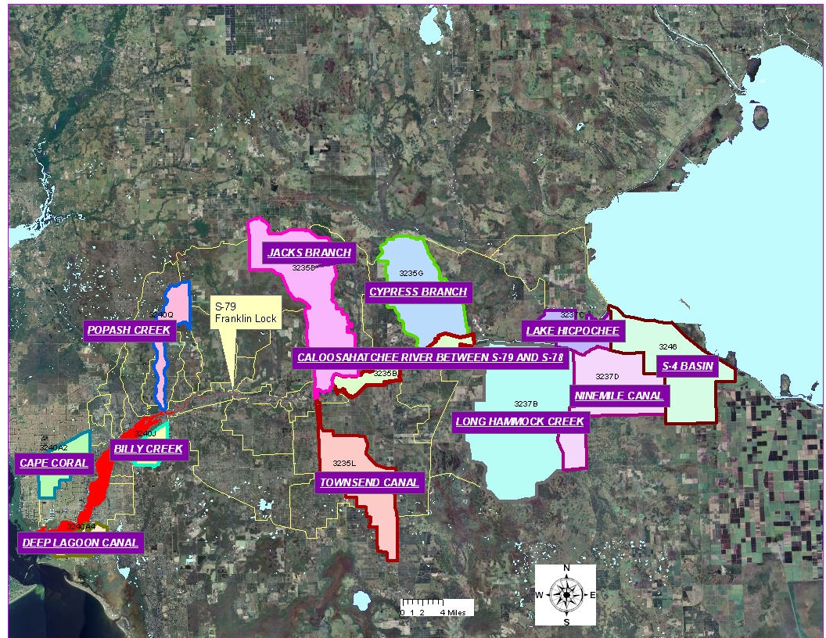
IMPAIRMENT OVERVIEW
Impaired Caloosahatchee WBIDs
to Receive TMDLs
Notes:
This slide show the WBIDs that have been assessed as individually impaired and for which TMDLs will be determined in this year’s TMDL.
Thus, besides contributing to the reduced load as dictated by the 2009 Estuary TMDL – The water bodies shown here may be also required to have additional load reductions because conditions within the WBIDs violate the standards as indicated in tables in the previous slides.

Slide 32
ArcNLET Modeling
ArcNLET is a simplified conceptual model of groundwater flow and solute transport, and it can be used to calculate nitrate plumes and loads.
ArcNLET has been used to calculate the associated nitrogen reductions with septic tank phase-out projects.
The model has been calibrated, but the calibration data are limited in some areas.
Need area-specific ground water monitoring data.

Slide 33
Questions and Discussion on the 2013 Progress Reports

Slide 34
Contact Information
For additional information please contact:
Kim Dinkins, Basin Coordinator
kim.dinkins@dep.state.fl.us
Charles Gauthier, FAICP, Environmental Administrator
charles.gauthier@dep.state.fl.us
Beth Alvi, Watershed Restoration Program Administrator
elizabeth.alvi@dep.state.fl.us

Slide 35
Ground Water Monitoring
8 ground water monitoring stations in Hendry Creek.
7 in Imperial River.
5 in Gordon River.
5 in Lake Trafford.

