Slide 1

Water Quality
Restoration Projects Completed
Anura Karuna-Muni, P.E.
Lee County Division of Natural Resources
BMAP annual meeting, February 5, 2014

Slide 2
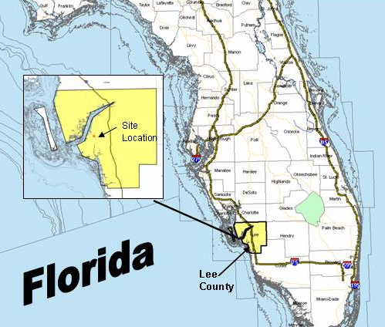
Lakes Park – Location & Issues
Located within Hendry Creek, an impaired water body
Impaired for dissolved oxygen, fecal coliform and mercury
Hendry Creek outfalls into Estero Bay, Florida’s first aquatic preserve (1966)

Slide 3
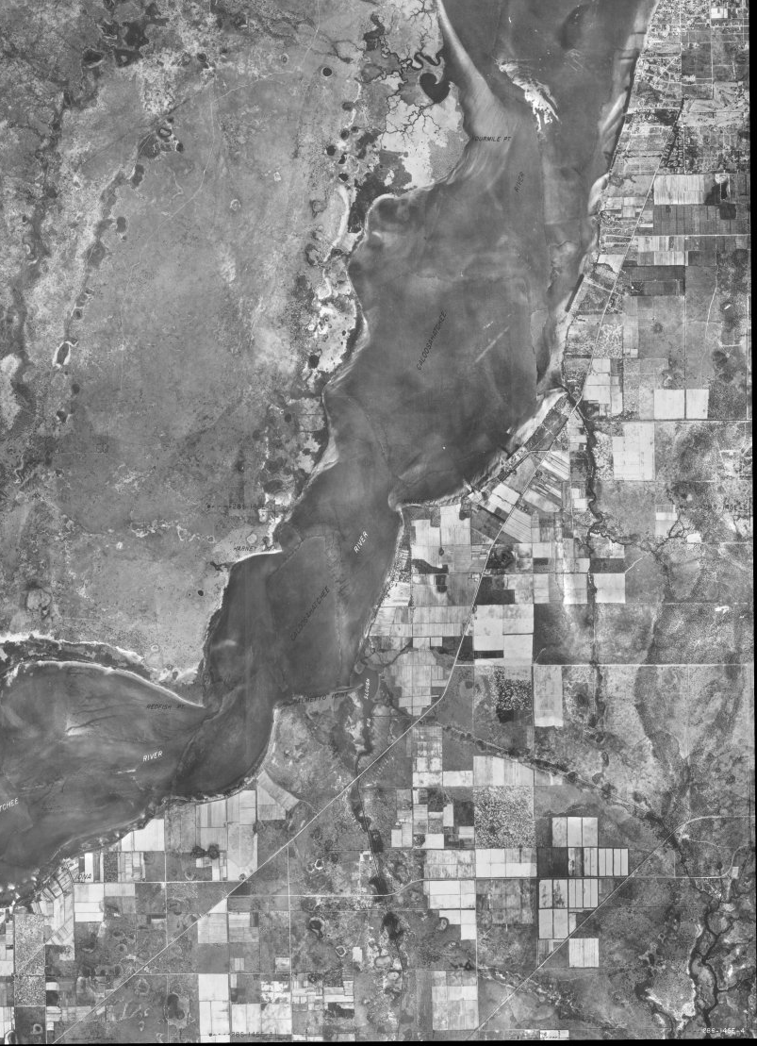

Lakes Park Pre-Development
Prior to the 1950s, the project area was undeveloped wetland and upland.
Headwaters of Hendry Creek Originated Further North of the Current Park.
In the 1950s and 1960s, the area was mined for limestone leaving the existing lakes.

Slide 4
Lakes Park
279-acre site with 158 acres of lakes. Purchased in 1978, park opened in 1984
Watershed is 2,000 acres
Park receives discharges from residential and commercial properties
Park runoff goes to Hendry Creek (Outstanding Florida Waters, an impaired water with a BMAP)
Estero Bay is the receiving estuary system (Florida’s 1st Aquatic Preserve – designated in 1966)

Slide 5
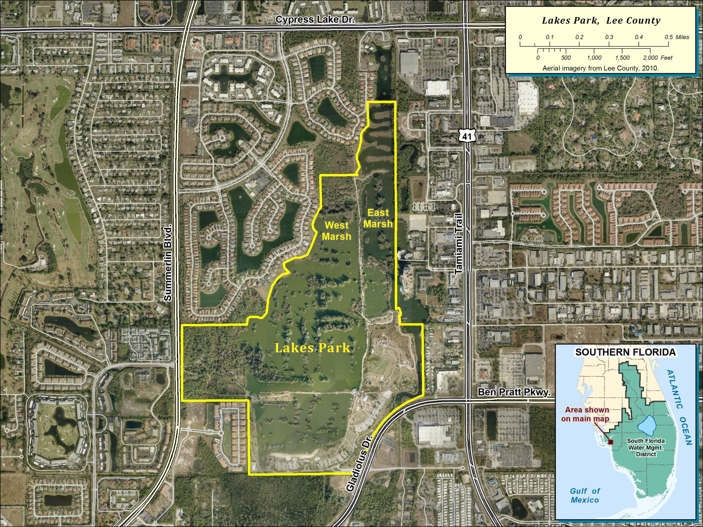
Lakes Park Project Area

Slide 6
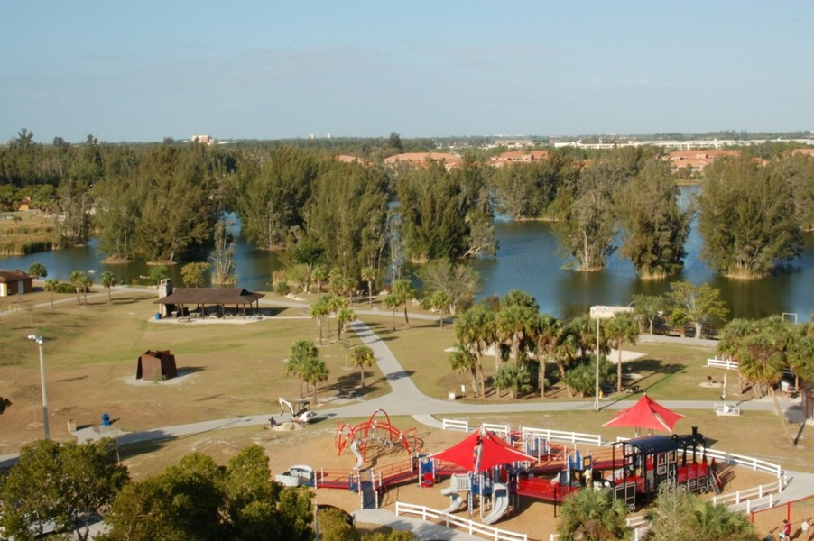
Lakes Park
500,000 visitors/year
Activities
  Many Events
    Farmers Market – Fairs – Summer Camps
  Lakes Park Botanic Garden
  Railroad Museum of South Florida
  Amphitheater

Slide 7
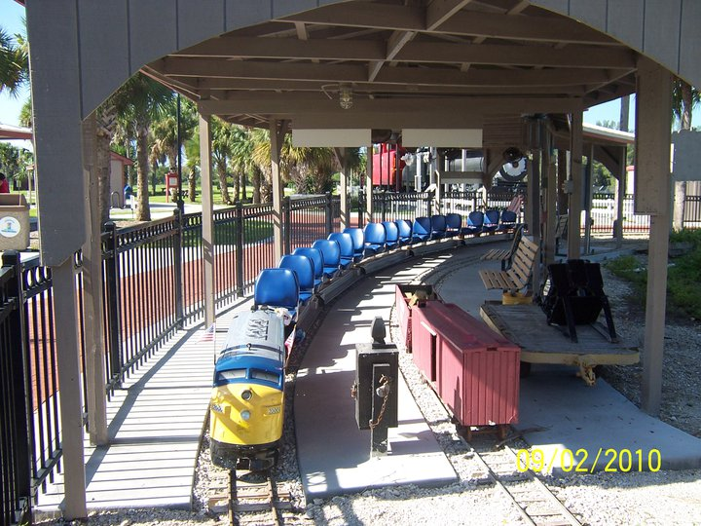
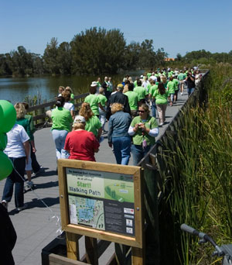
Lakes Park
Activities
  Playgrounds
  Picnicking
  Bird Watching
  Fishing
  Canoeing
  Biking/jogging/walking

Slide 8
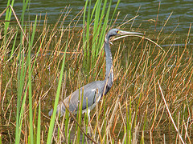
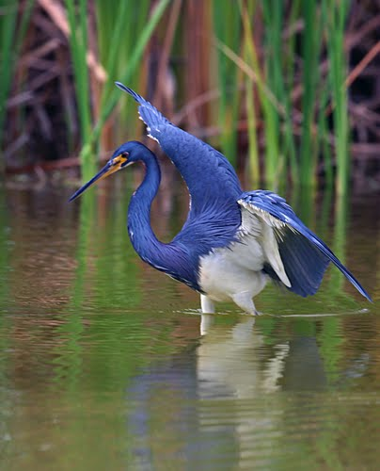
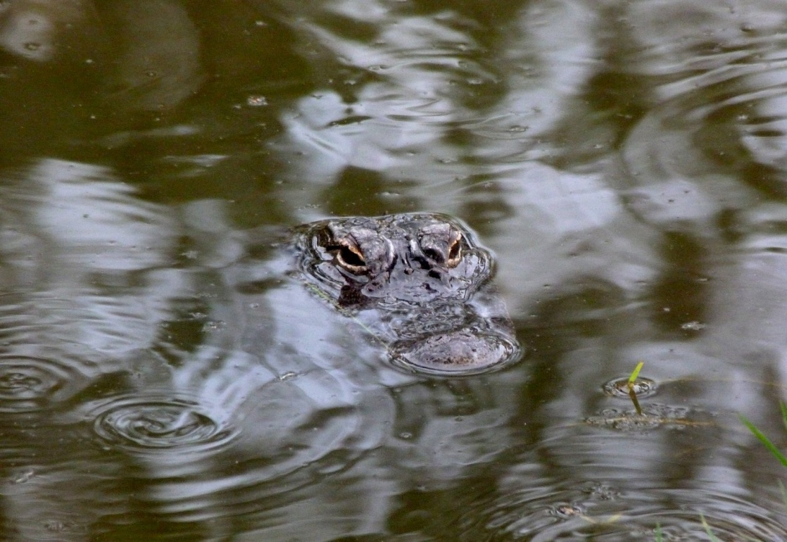
Lakes Park
A Beautiful Place !

Slide 9
Lakes Park Milestones/Facts & Figures
Water Quality – Phase I – Development Driven
CERP (“Yellow Book” project)
Corps planning and design - 2000 – 2007 ($680K)
Lee County Parks and Recs Master Plan
  Water Quality and Exotic Vegetation removal
Lee County Natural Resources
  Monitoring and Water Quality Improvements
SFWMD – 2007 agreement to assume Corps responsibly
Lakes Park Enrichment Foundation – return to native environment

Slide 10
Lakes Park – Adjacent Development Order – Phase I Water Quality
Late 90’s – significant water quality feature was required of adjacent community development
The 20 acre flow way constructed as part of the Reflection Lakes development's stormwater management system
Project was turned over to Lee County by the Reflection Lakes Home owner Association and became 1st phase of floway system

Slide 11

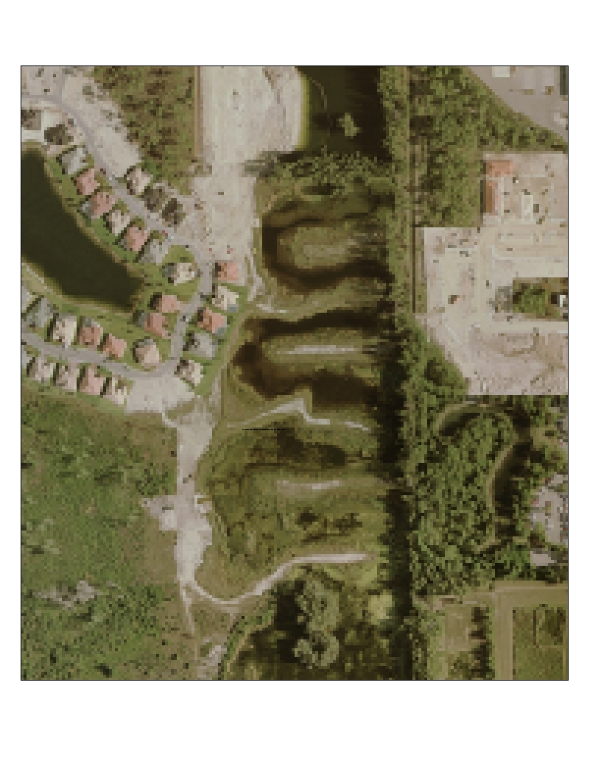
Lakes Park Floway – Phase One

Slide 12
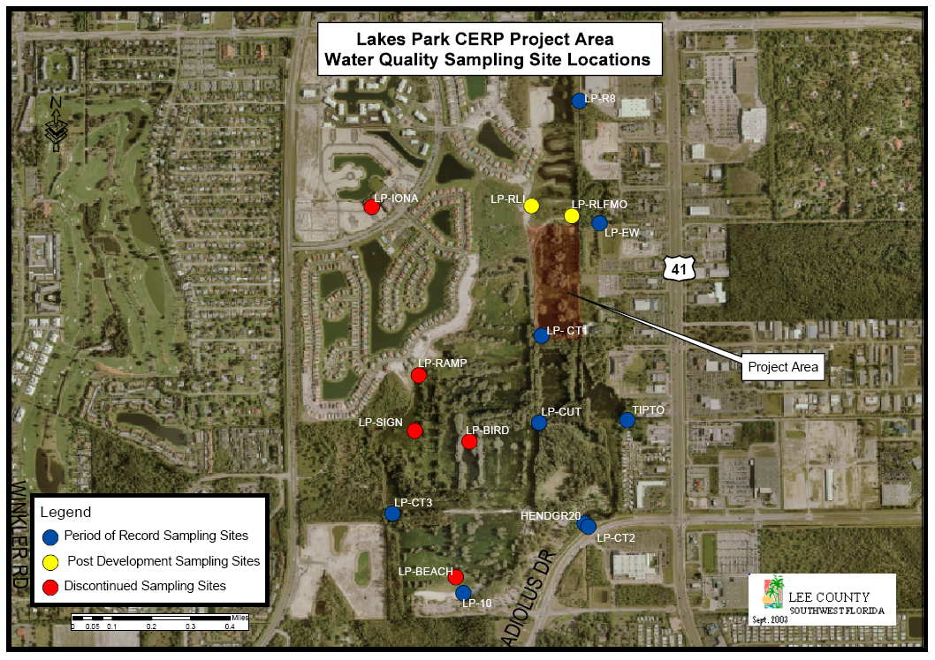
Lakes Park - Lee County Water Quality Monitoring

Slide 13
Lakes Park – Lee County Activities
Lee County major investment
Reconstruction of water control structures
Installation of aeration fountains
Exotic plant removal
Nutrient Removal
  Floating Islands, Alum infusion, and UV pilot project
Design and permitting of the filter marsh

Slide 14
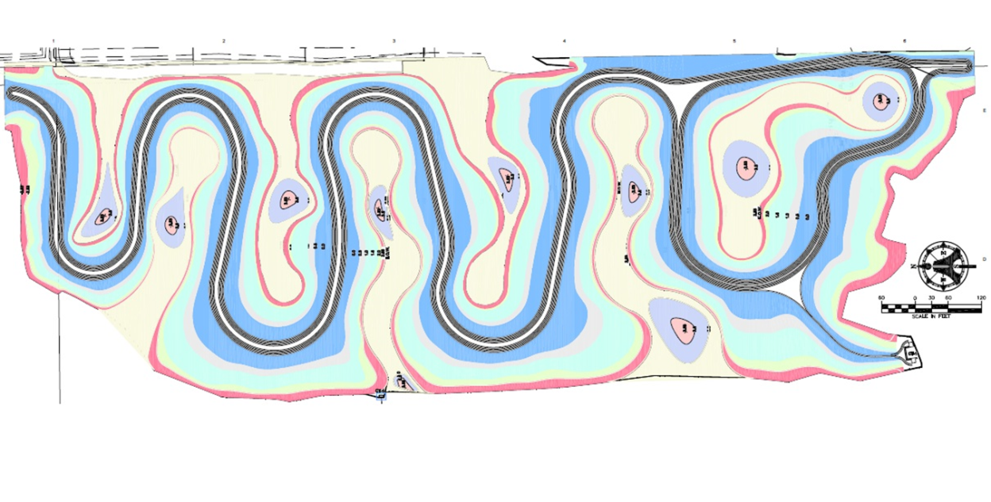
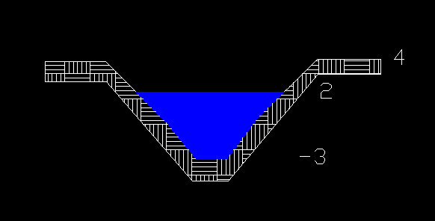
Lakes Park – Filter Marsh Design Elements
Construction of earthen fingers within the existing lakes and creation of littoral shelves
Removal of invasive exotics
Planting of native vegetation in wetland and adjacent upland areas

Slide 15
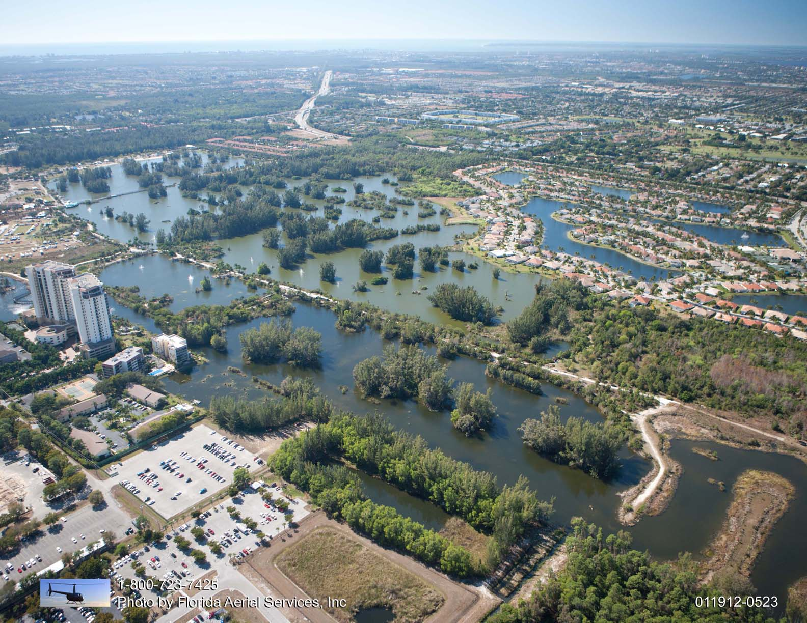
Lakes Park Restoration - Project Footprint

Slide 16
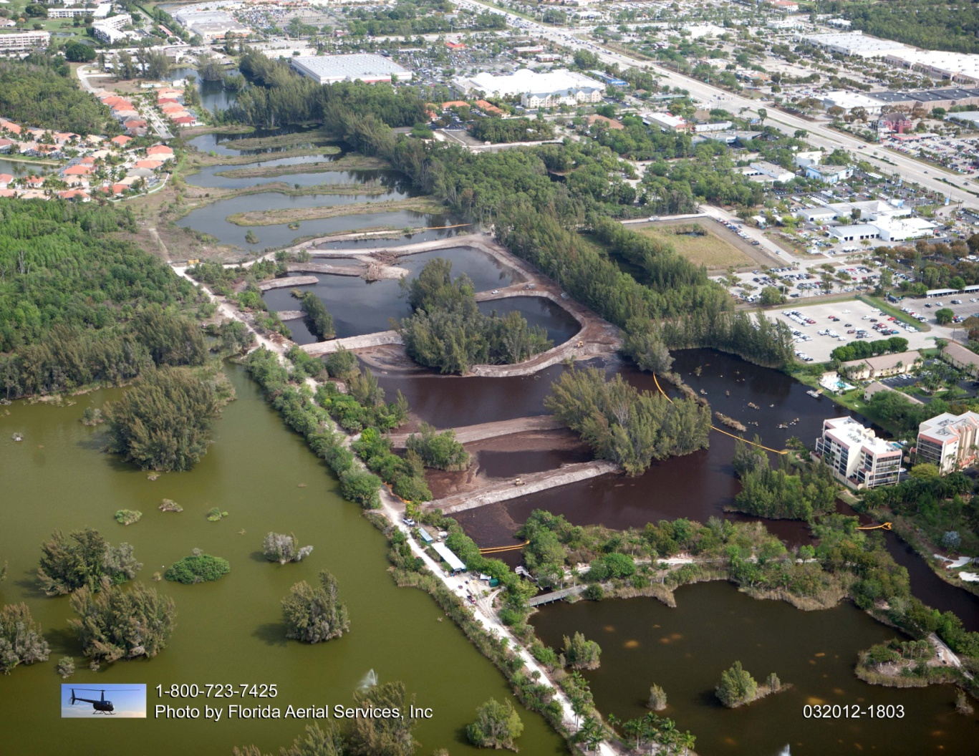
Lakes Park Restoration (March 2012)

Slide 17
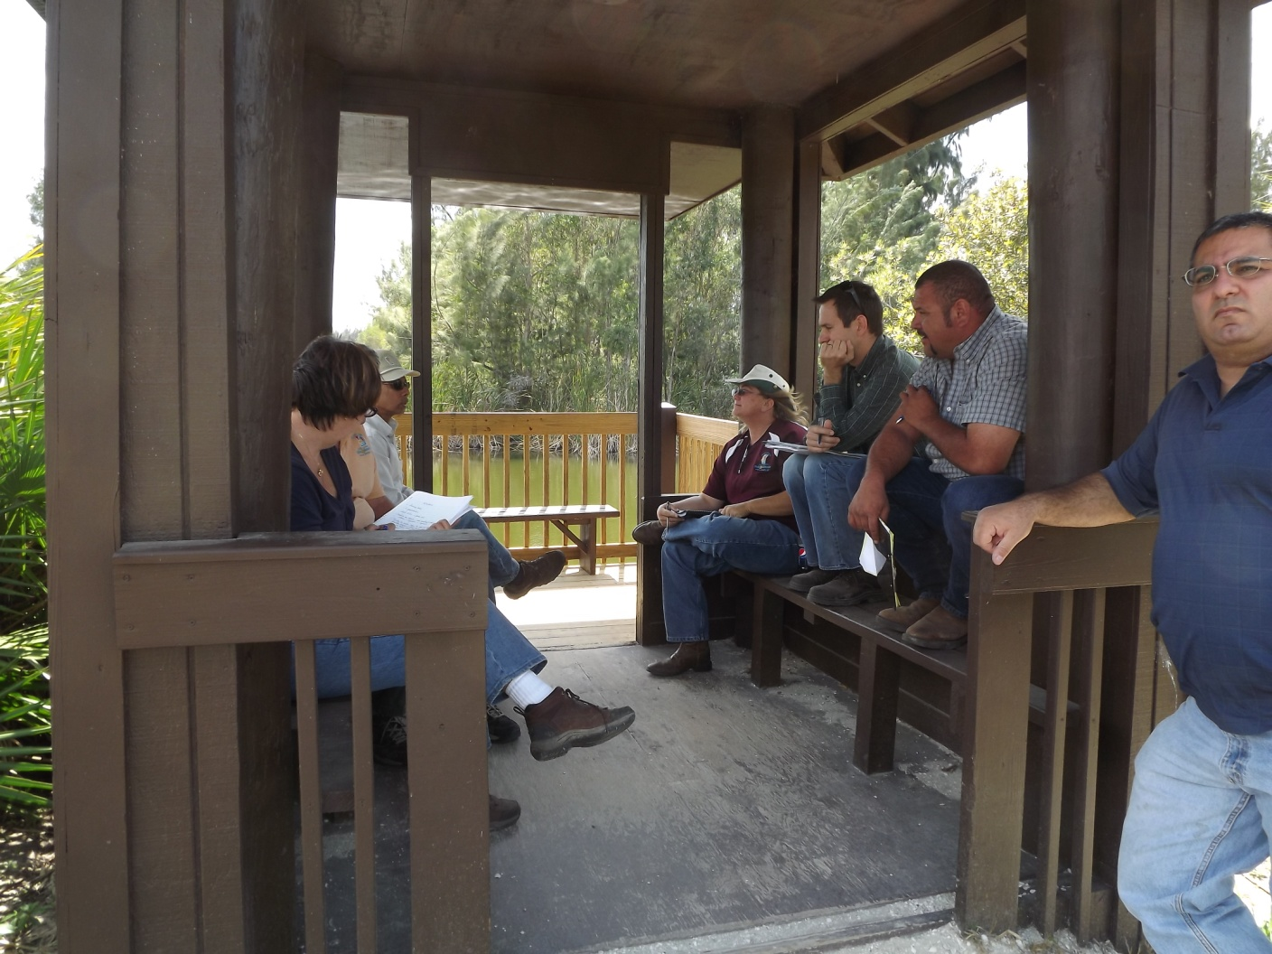
Lakes Park Restoration – Weekly Onsite Construction Progress meetings

Slide 18
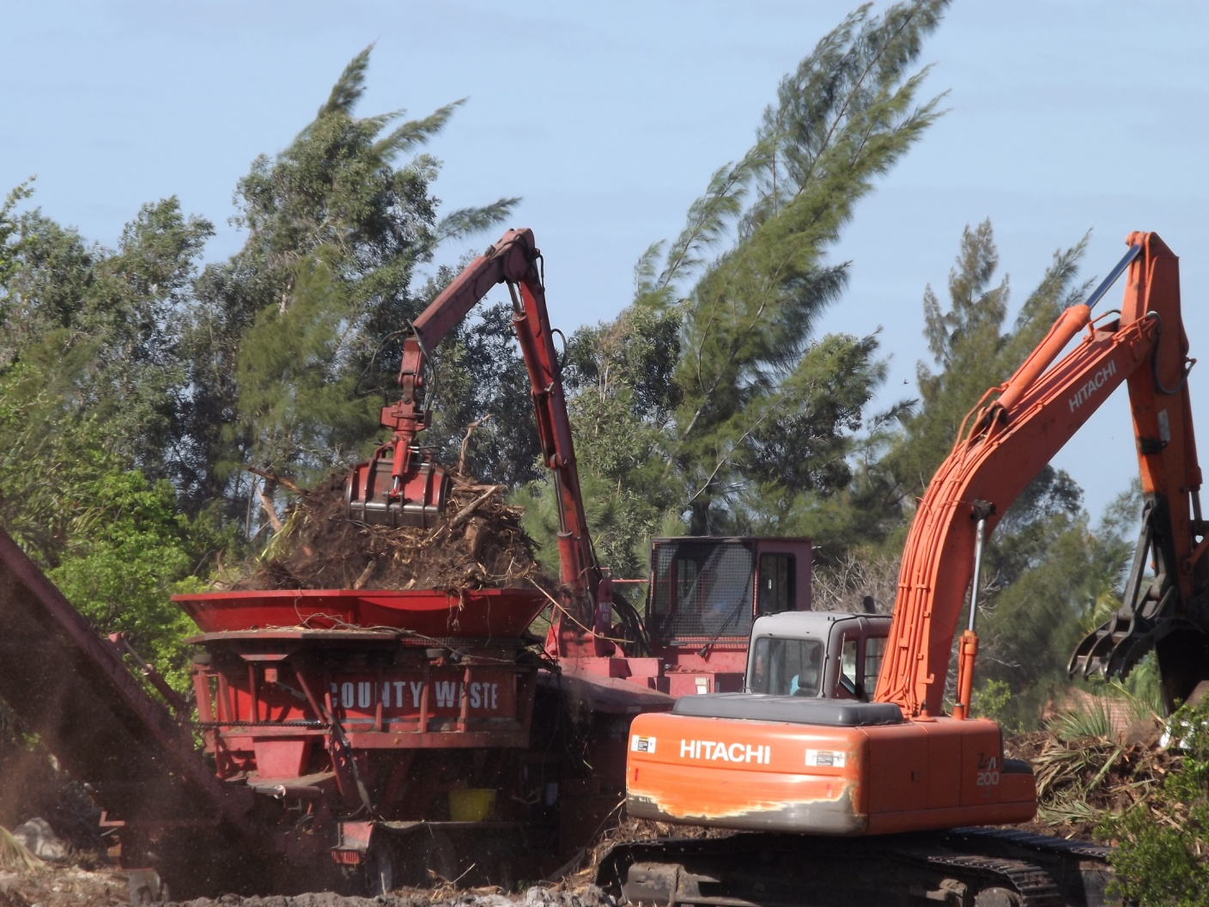
Lakes Park Restoration - Clearing

Slide 19
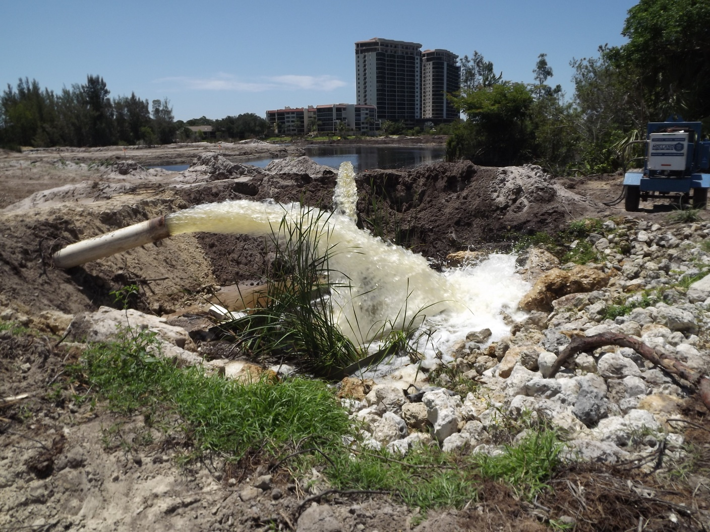
Lakes Park Restoration - Dewatering

Slide 20
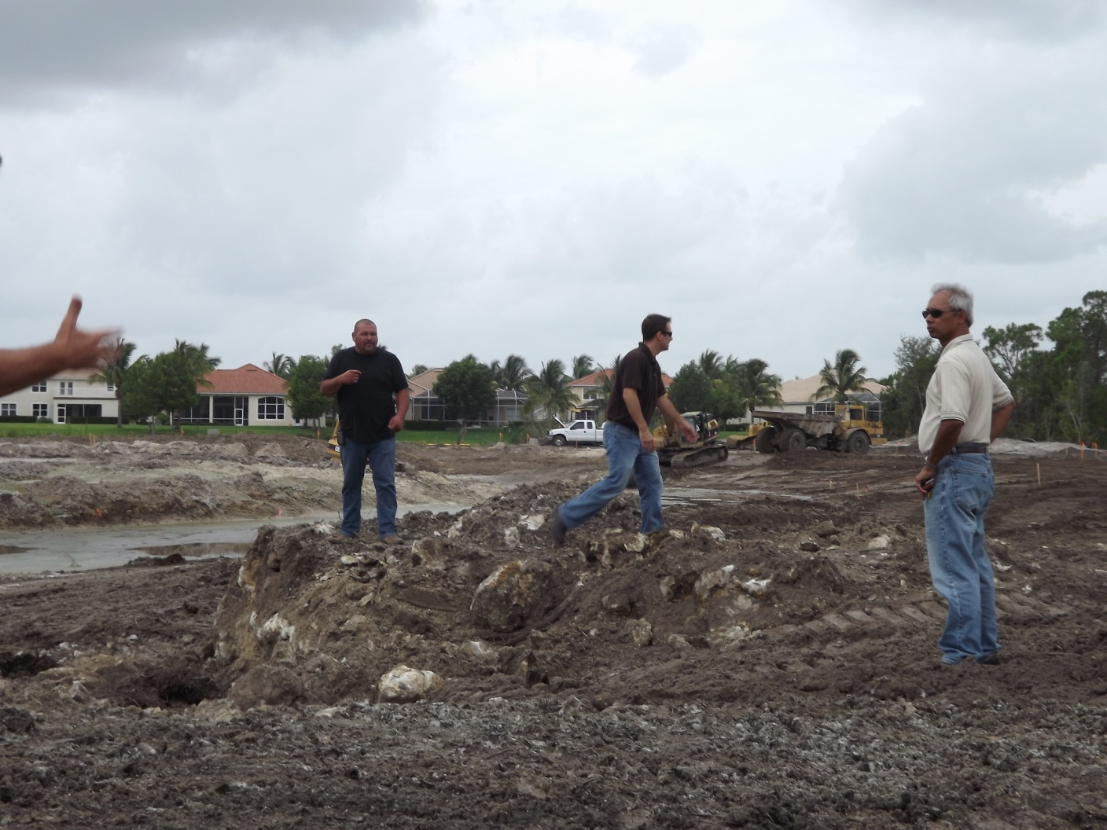
Lakes Park Restoration – Excavation and Grading

Slide 21
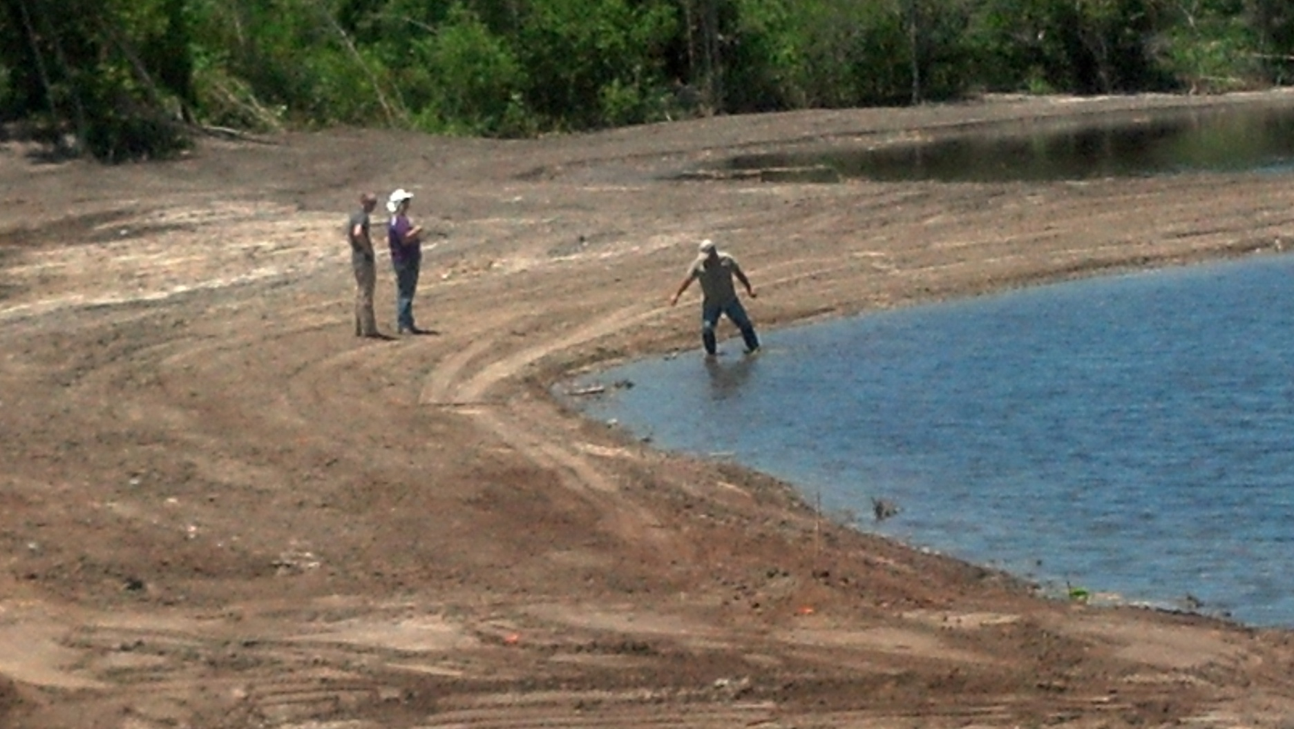
Lakes Park Restoration – Final Grading
Water depth in the deepest part of the flow way is about 5 feet

Slide 22
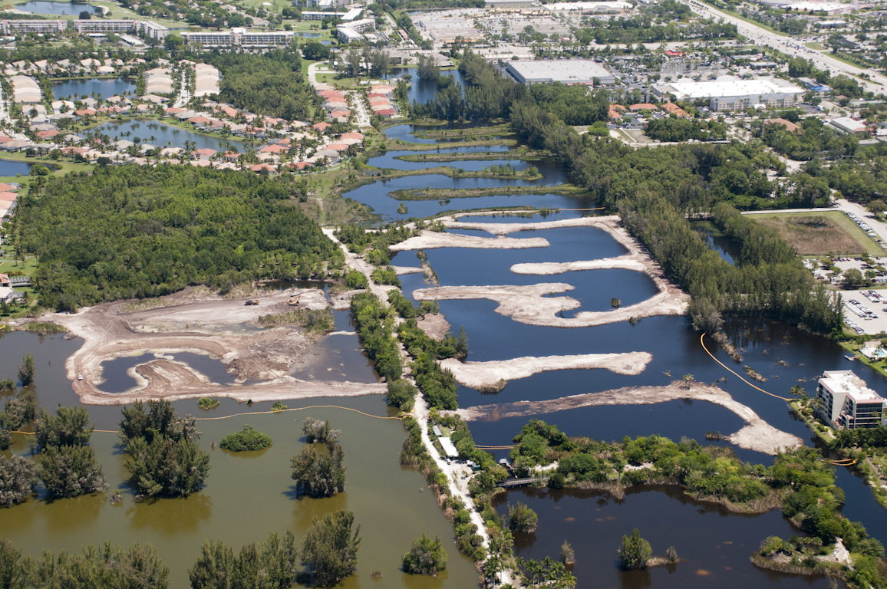
Lakes Park Restoration - May 2012

Slide 23
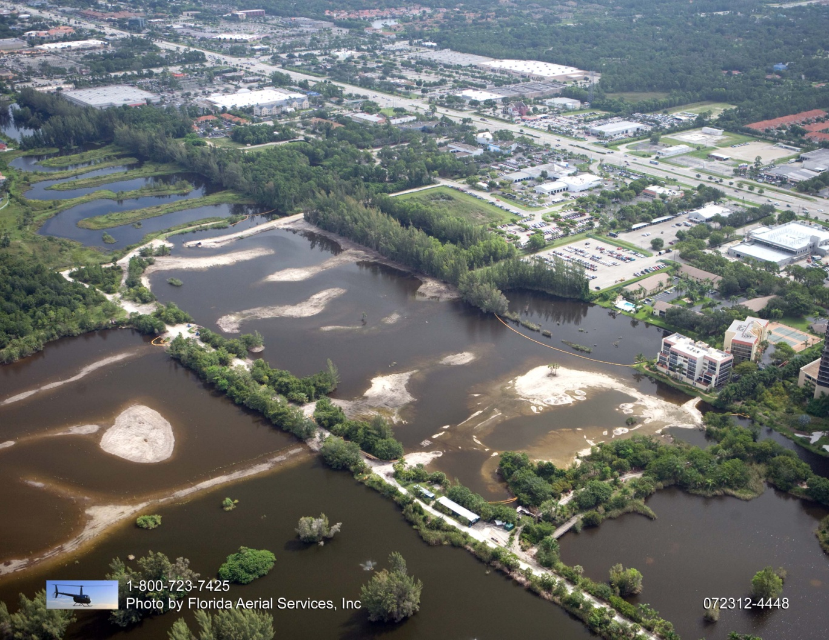
Lakes Park Restoration - July 2012

Slide 24
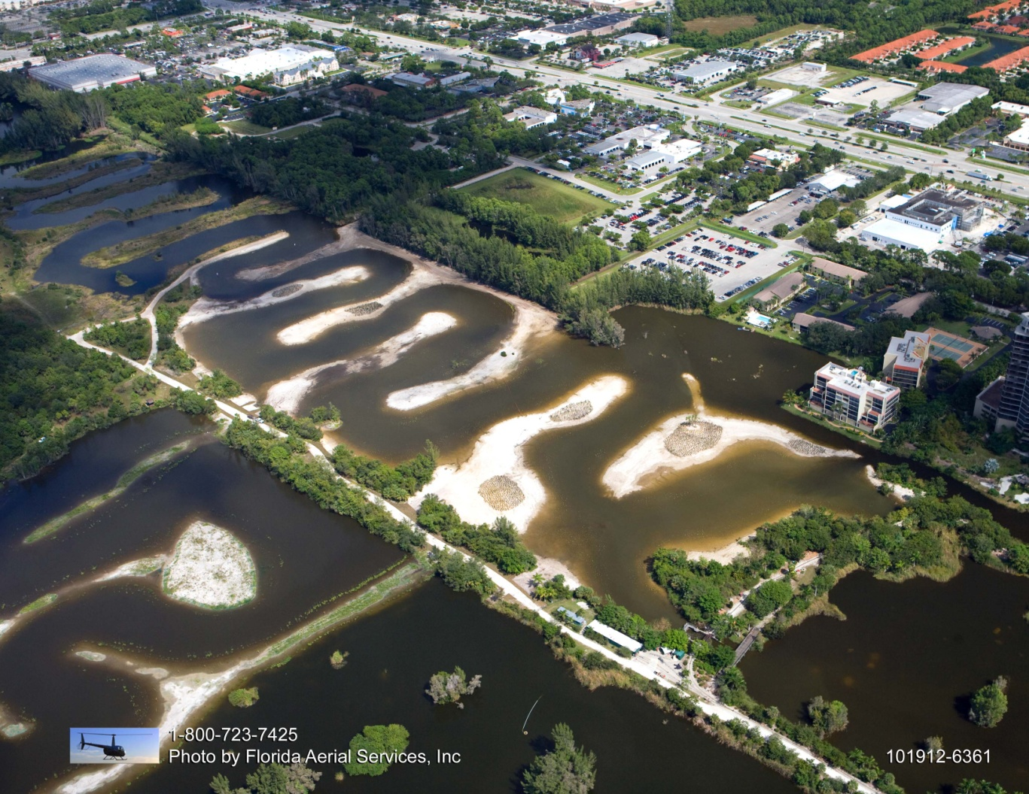
Lakes Park Restoration - October 2012

Slide 25
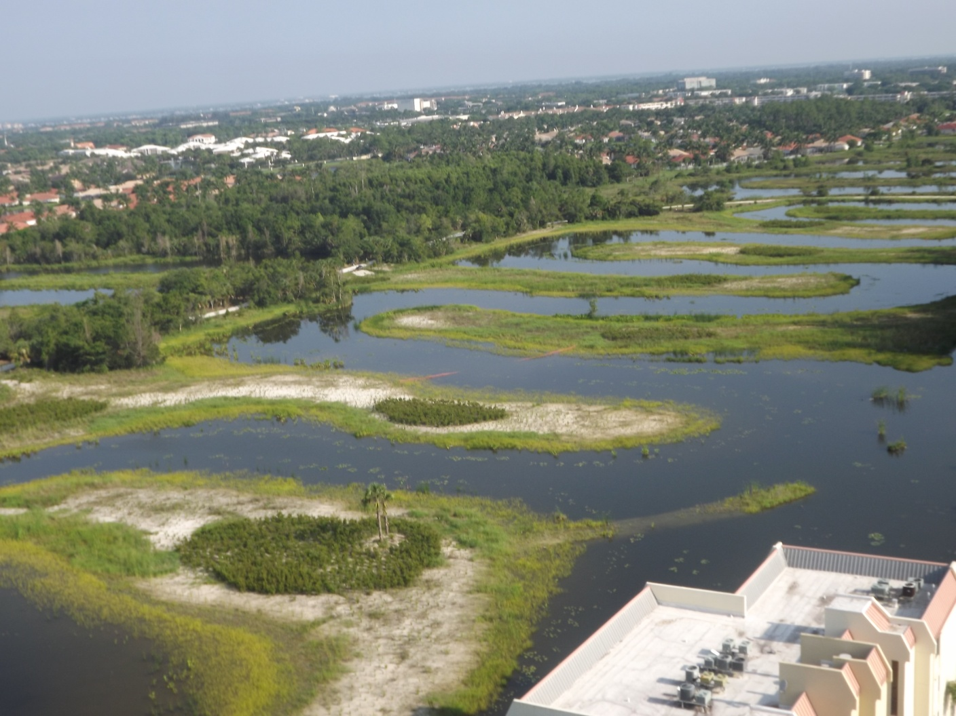
Lakes Park Restoration - August 2013

Slide 26
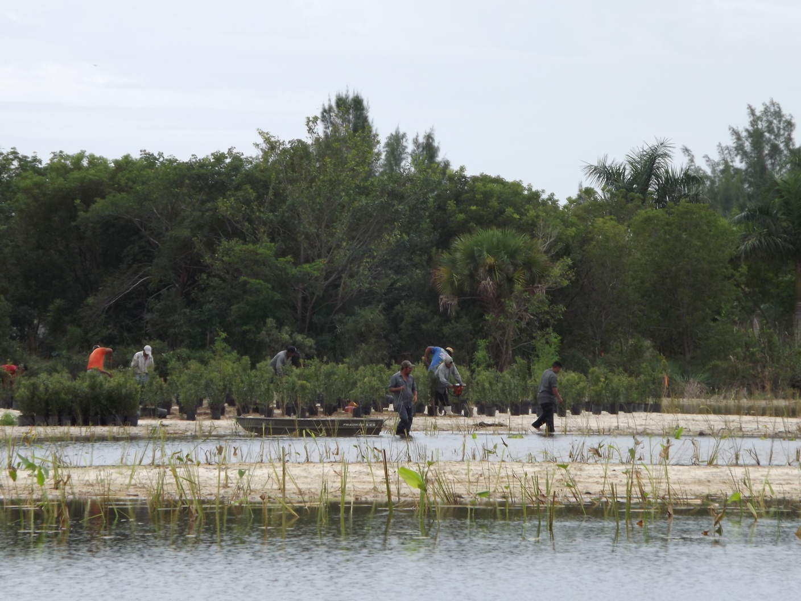
Lakes Park Restoration – Planting

Slide 27
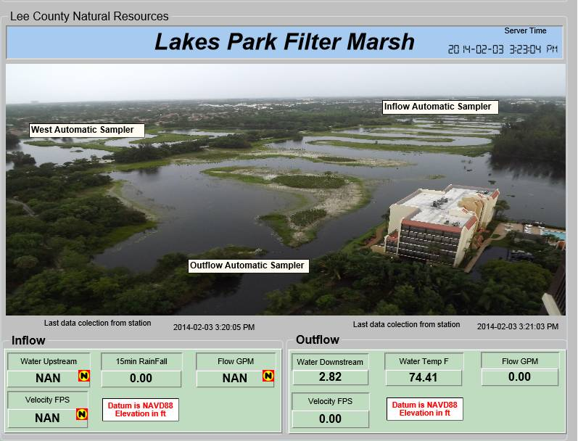
Lakes Park Restoration – Monitoring

Slide 28
Powell Creek – Filter Marsh Design Elements
Selection of the filter marsh foot print within an already disturbed area within the preserve and leaving out environmentally sensitive areas
Construction of a series of interconnected shallow water areas integrated with of littoral shelves
Divert water from the natural creek and the creek bypass canal through a piping system on to a wet well
Pump water from wet well on to the filter marsh
Planting of native vegetation in wetland and adjacent upland areas

Slide 29
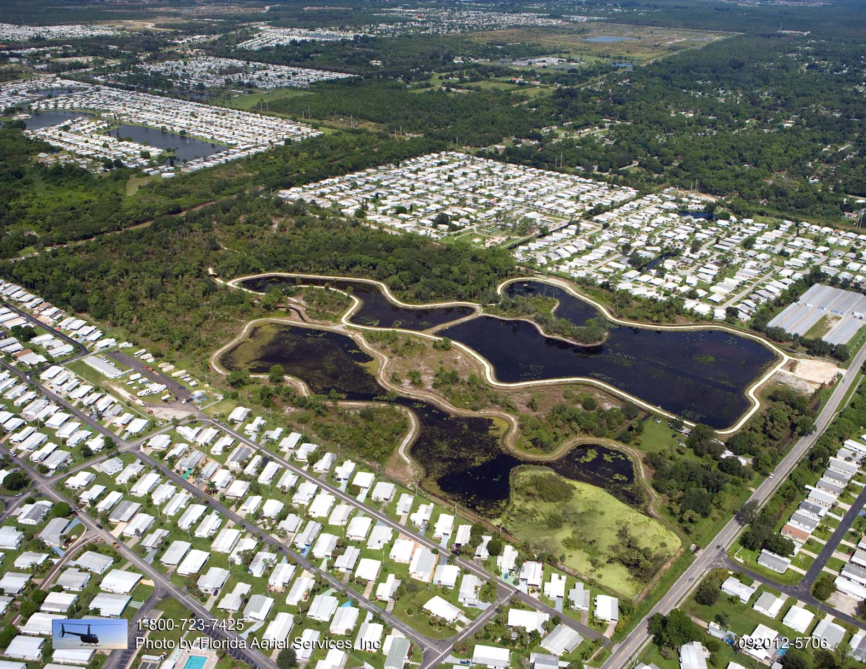
Powell Creek Restoration
Creek Bypass Canal
Natural Creek

Slide 30
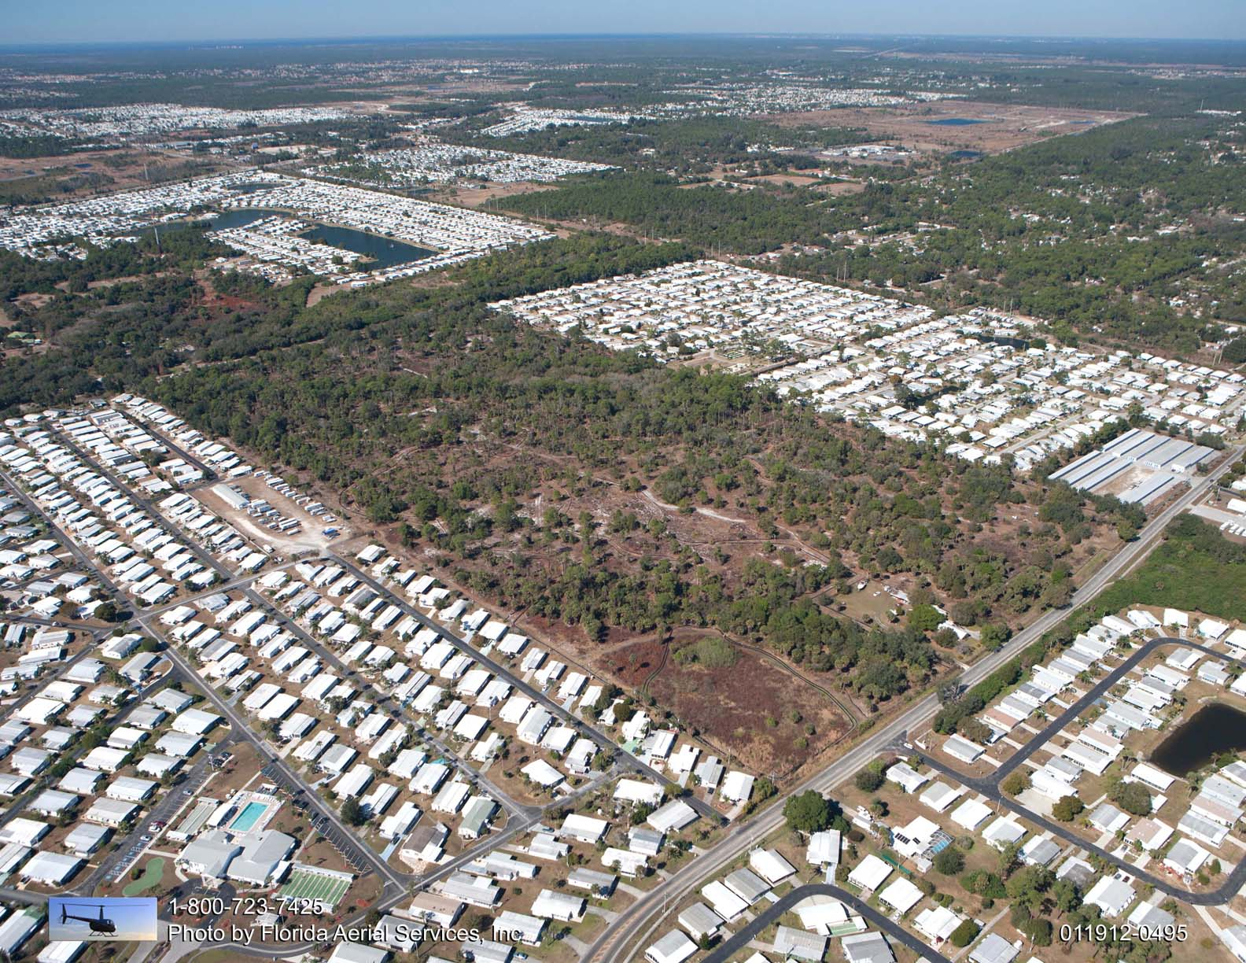
Powell Creek Restoration - Preconst.

Slide 31
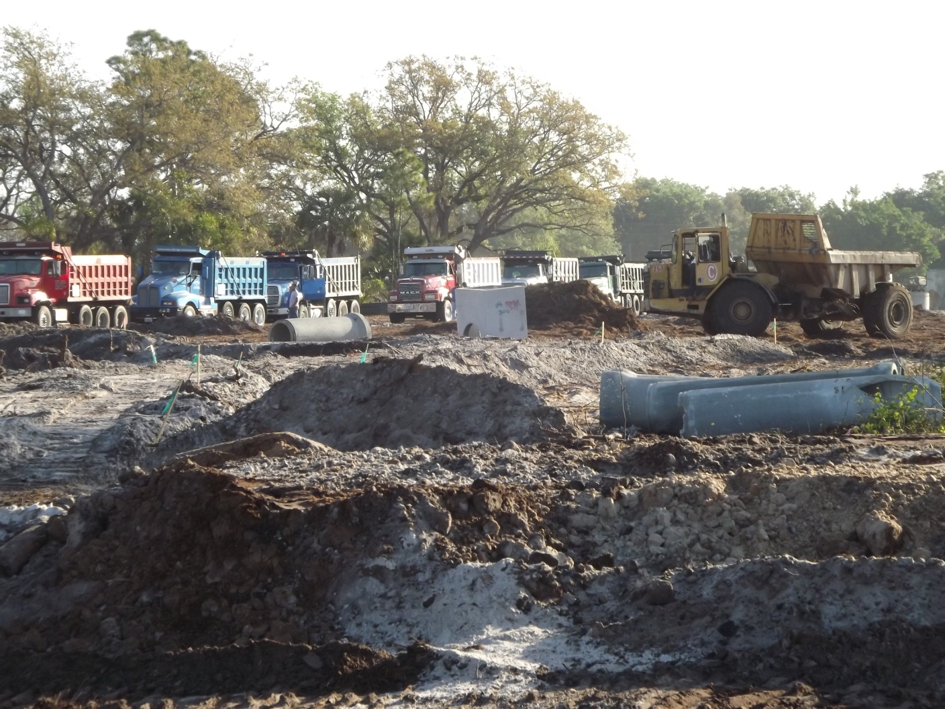
Powell Creek Restoration - March 2012

Slide 32
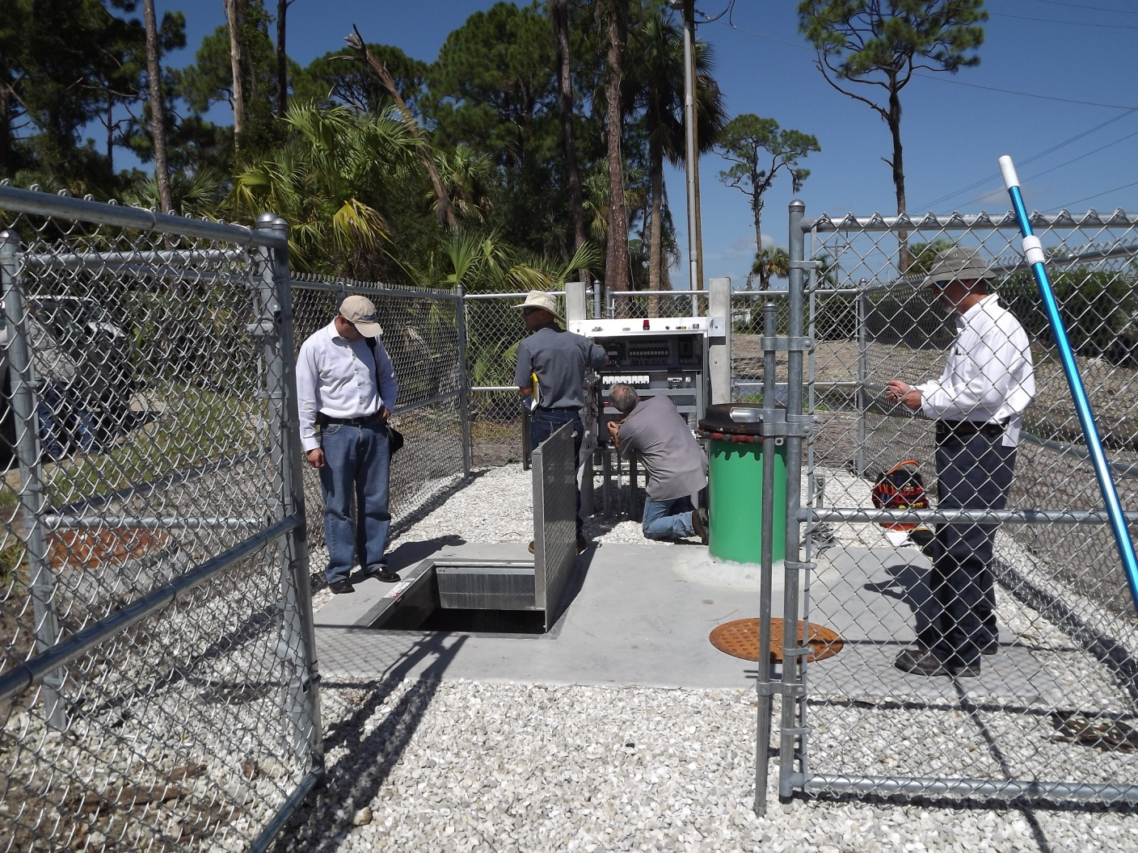
Powell Creek Restoration – control panel
7.5 HP 3 Phase motor pumping 1350 gpm at 8 feet head

Slide 33
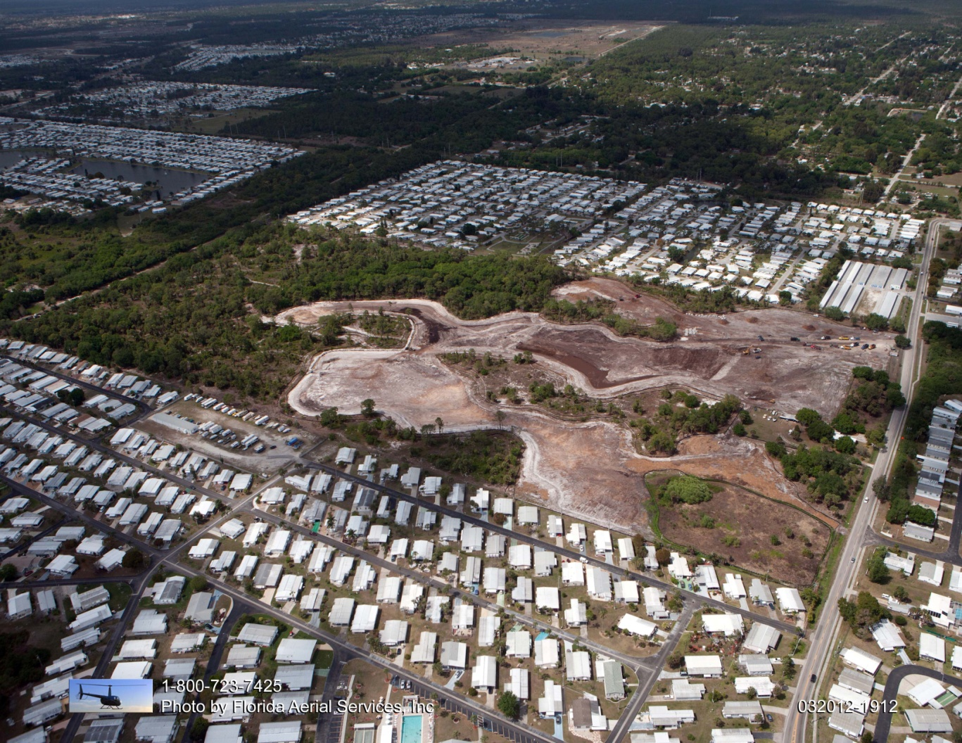
Powell Creek Restoration - March 2012

Slide 34
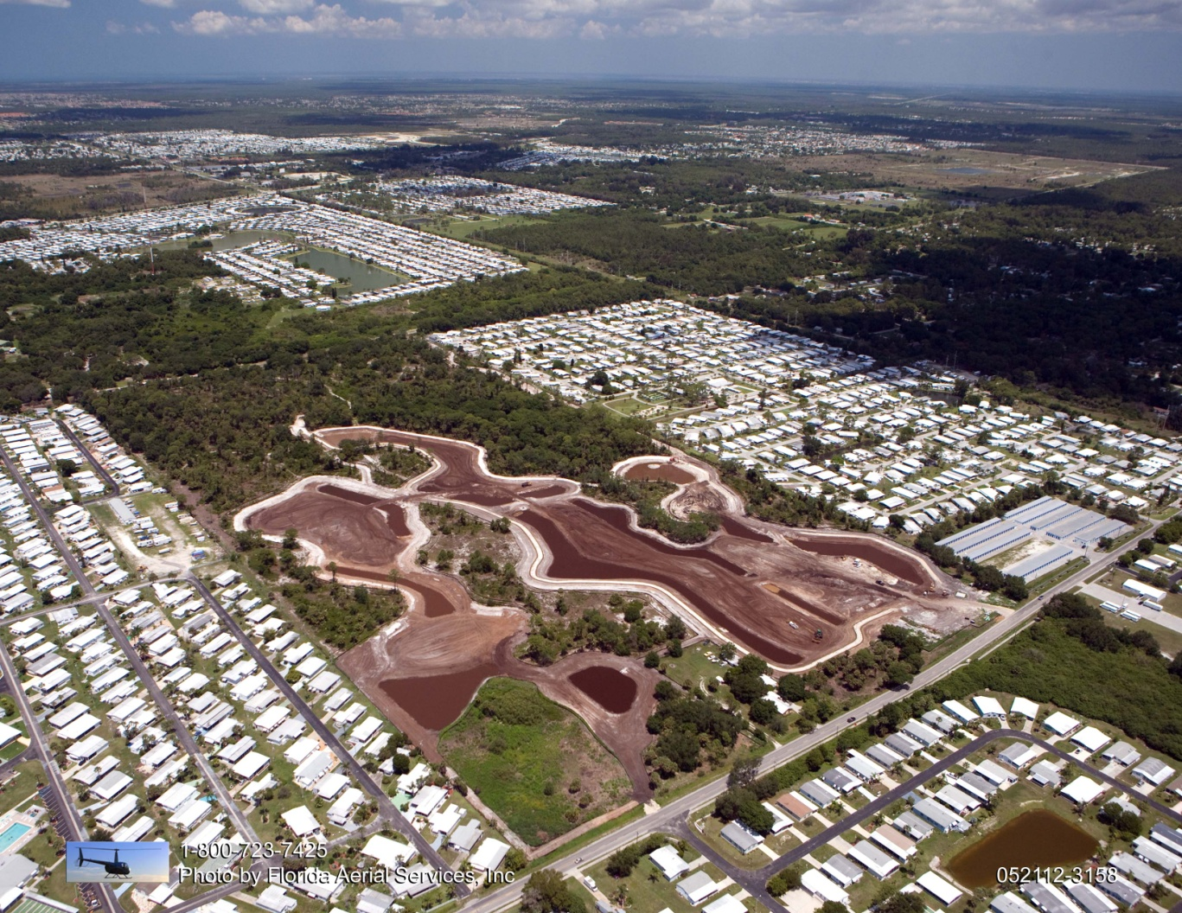
Powell Creek Restoration - May 2012

Slide 35
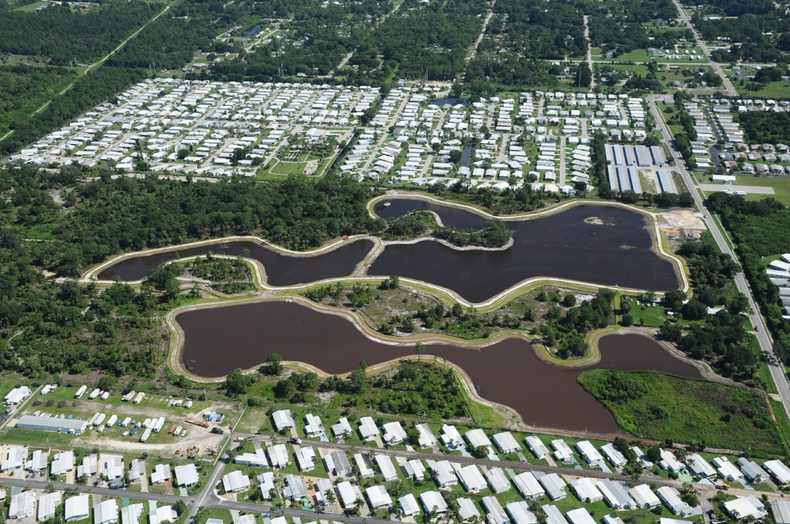
Powell Creek Restoration - June 2012

Slide 36
Powell Creek Restoration - Sept 2012

Slide 37
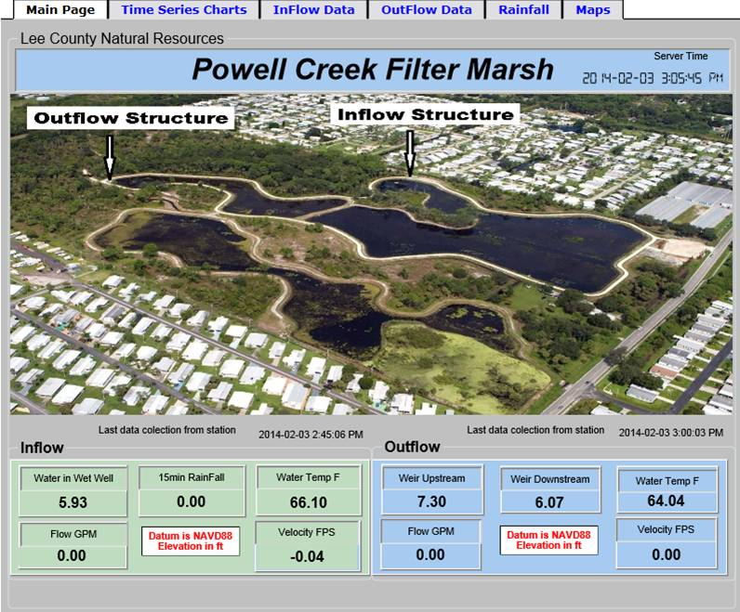
Powell Creek Restoration – Monitoring

Slide 38
Lakes Park & Powell Creek Restoration Funding Partners
Lakes Park - Total project cost of east and west marsh is $3 million
Powell Creek - Total project cost is $2.1 million
Cost Share Partners include
  Lee County Board of County Commissioners
  South Florida Water Management District
  Florida Department of Environmental Protection

Slide 39
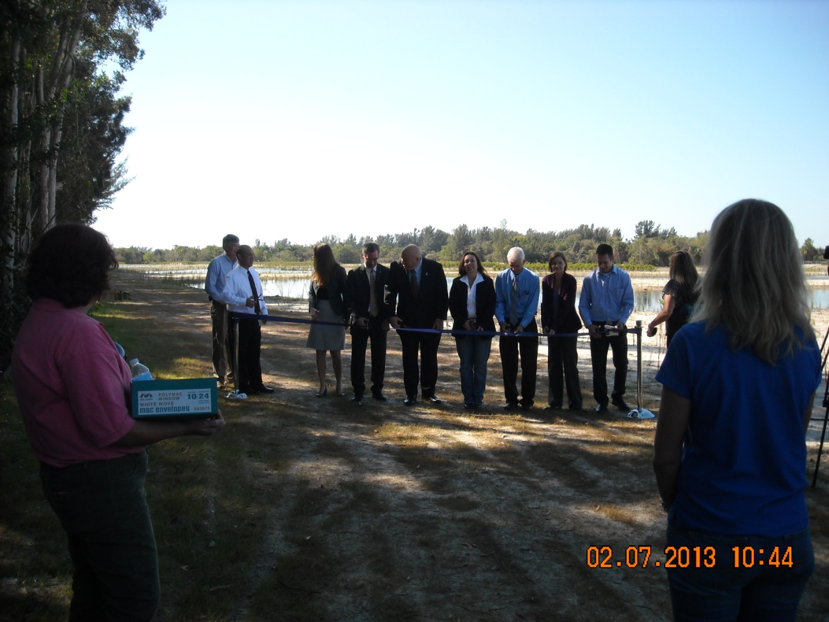
Lakes Park & Powell Creek Restoration Projects – Finish Line
Questions or Comments?

