Slide 1
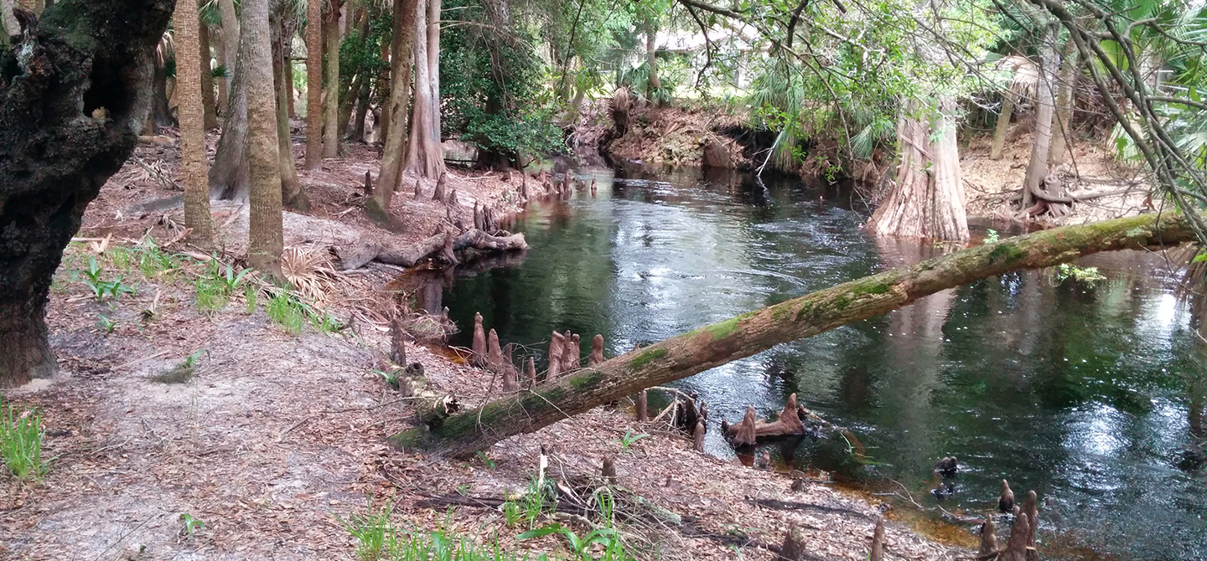



Bonita Springs Strategy for Total Nitrogen reduction using nitrate removal

Slide 2
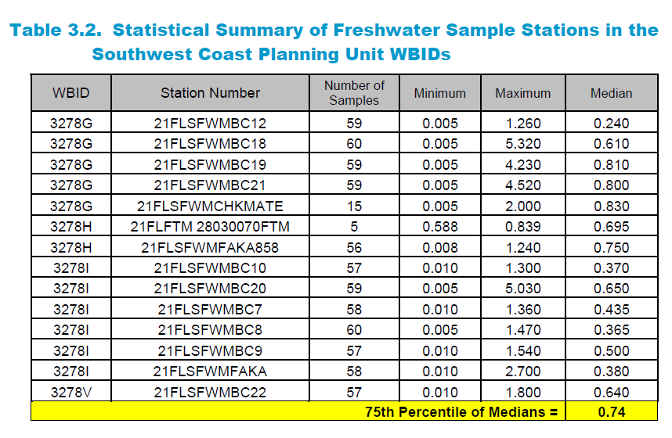

Slide 3
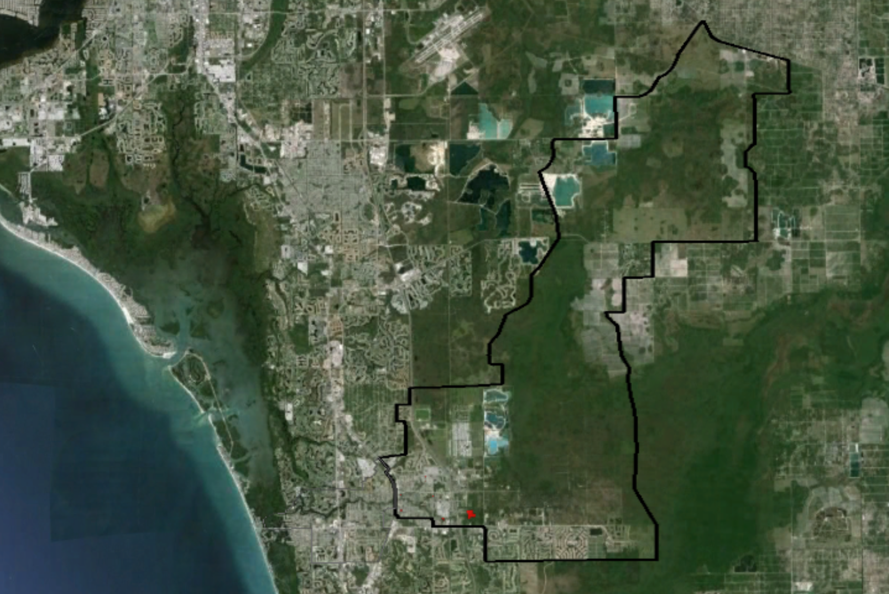

Slide 4
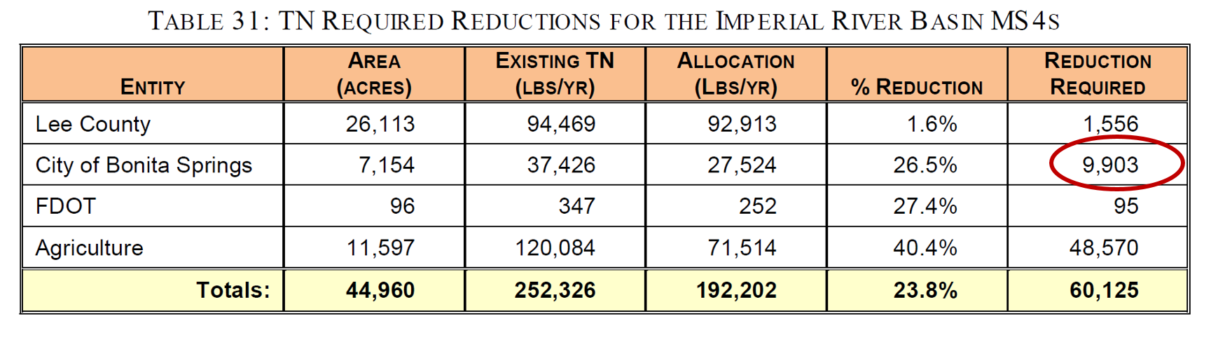

Slide 5
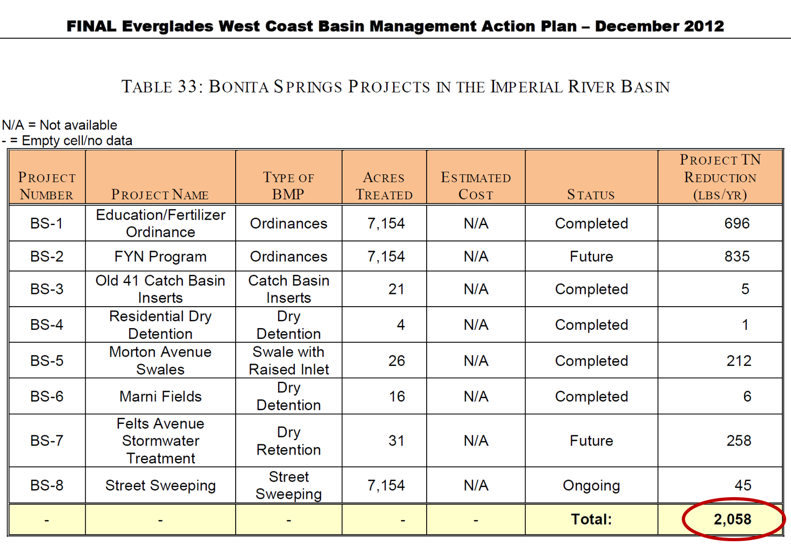

Slide 7
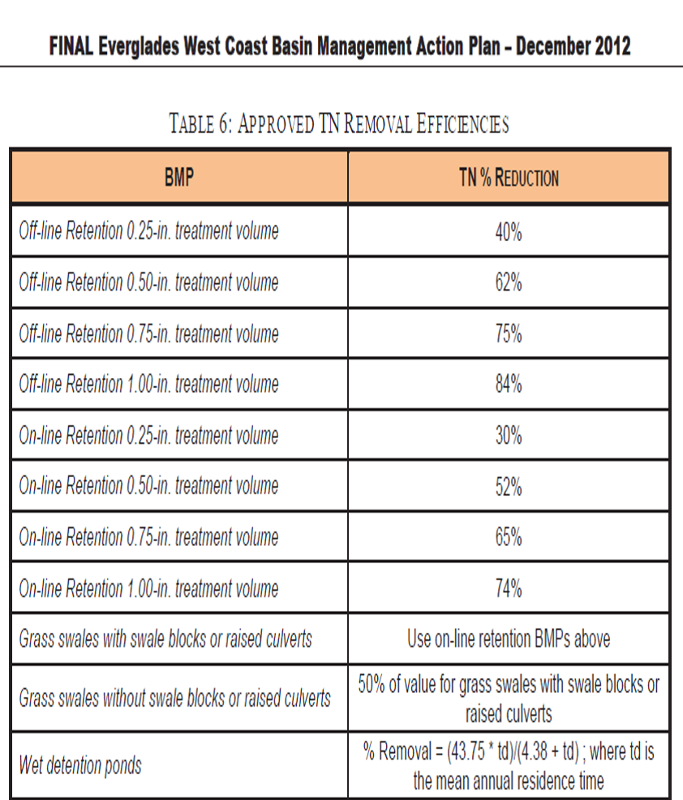

Slide 8
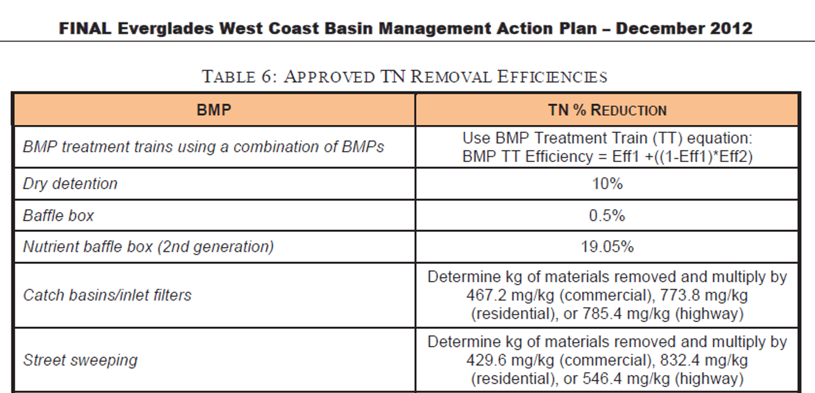

Slide 9
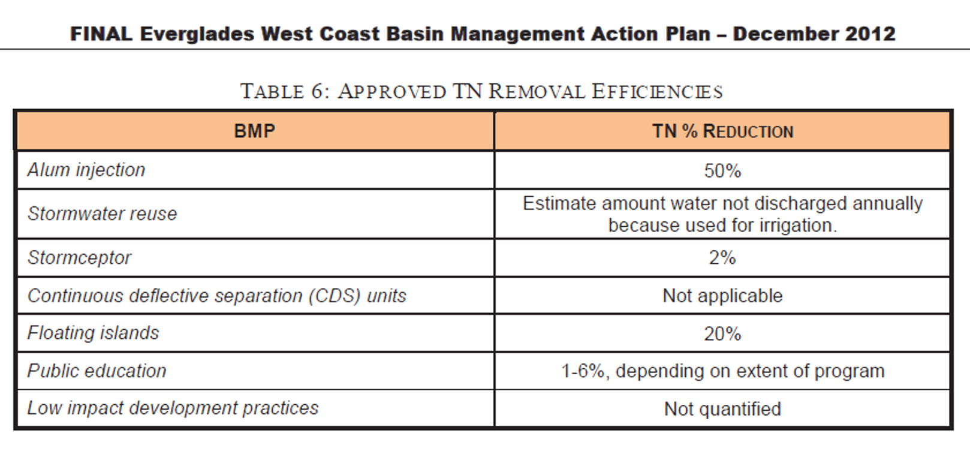

Slide 10
Using science and technology to improve treatment and environmental health.
Goals:
1) To work collaboratively with FDEP to implement a denitrification “woodchip bio-reactor” to decrease nitrogen loading to the Imperial River.
2) Develop a preliminary credit system so Bonita Springs can implement a pilot program which will provide data to support future learning regarding performance and credits.

Slide 11
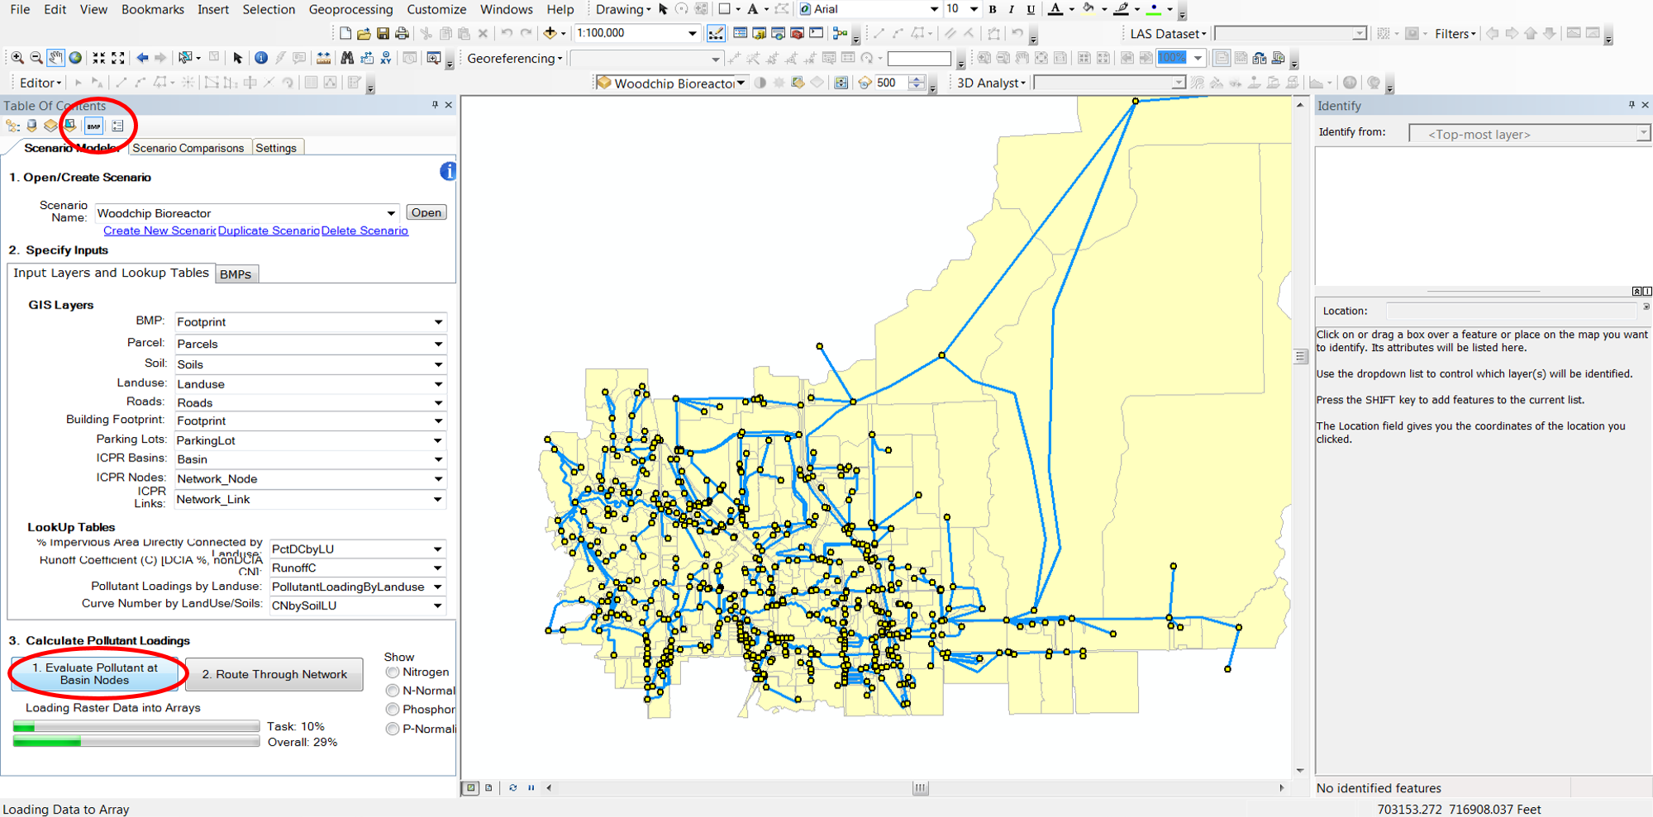

BMP Assessment Tool

Slide 12
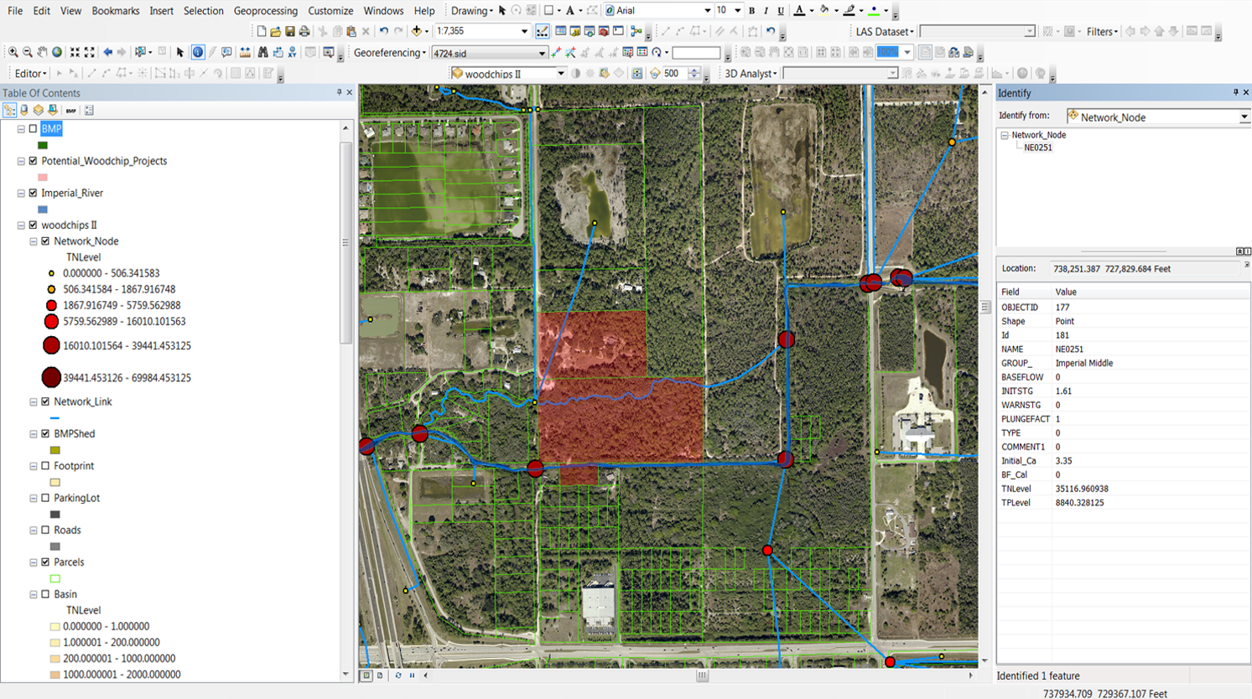
Hotspots Identified

Slide 13
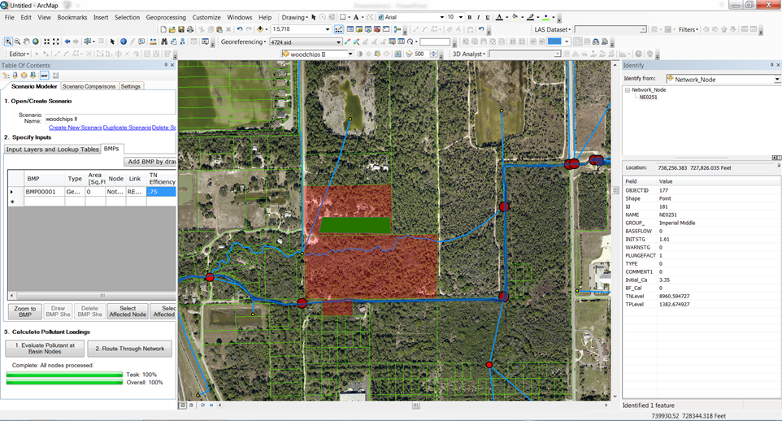
Solutions Modeled

Slide 14
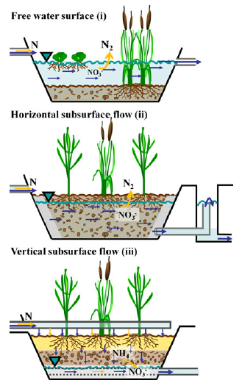
Kadlec and Wallace (2008) distinguish three types of constructed treatment wetlands based on their flow regime
Free water surface (FWS) wetlands;
Horizontal subsurface flow (HSSF) wetlands; and
Vertical subsurface flow (VSSF) wetlands.

Slide 15
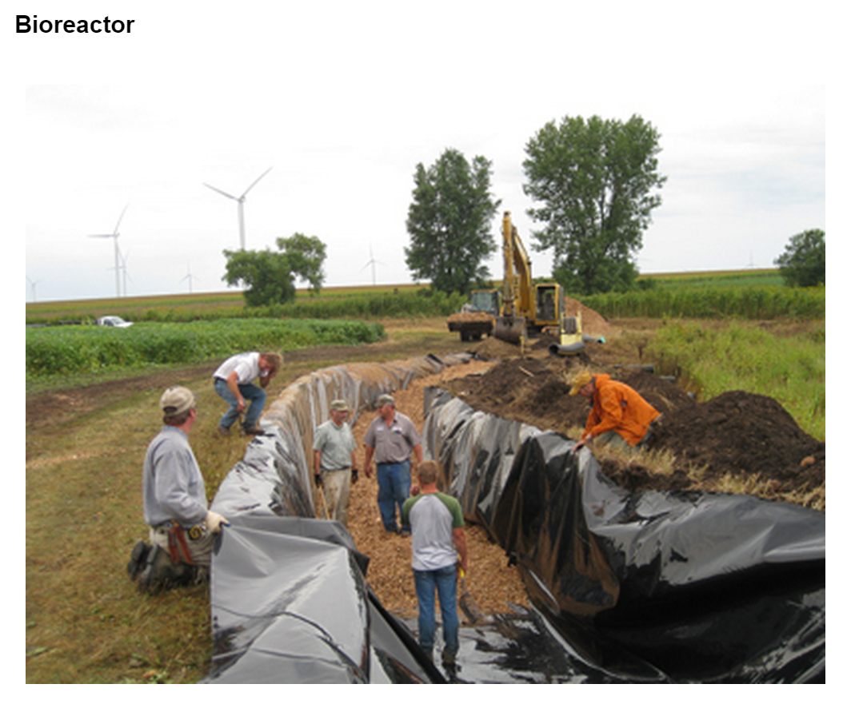

Controlled Drainage and Bioreactor- Research & Demonstration Site
Principal Investigator: Kathy Smith
Co-Investigators: Rich Perrine and Ashley Brenke
Organization: Martin Soil and Water Conservation District
Sponsor: Clean Water Fund
Award Amount: $119,396
Start Date: 5/15/2012 | End Date: 6/30/2016
Project Manager: Heidi Peterson (Heidi.Peterson@state.mn.us)
Photo used with permission

Slide 16
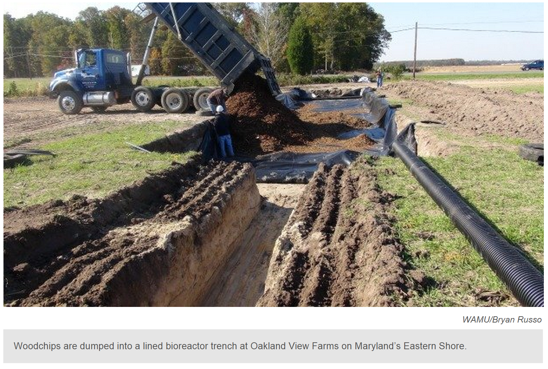

Slide 17
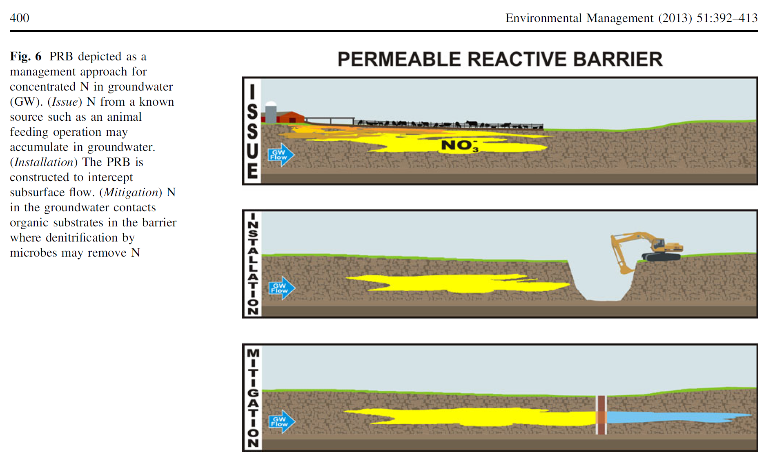

Slide 18
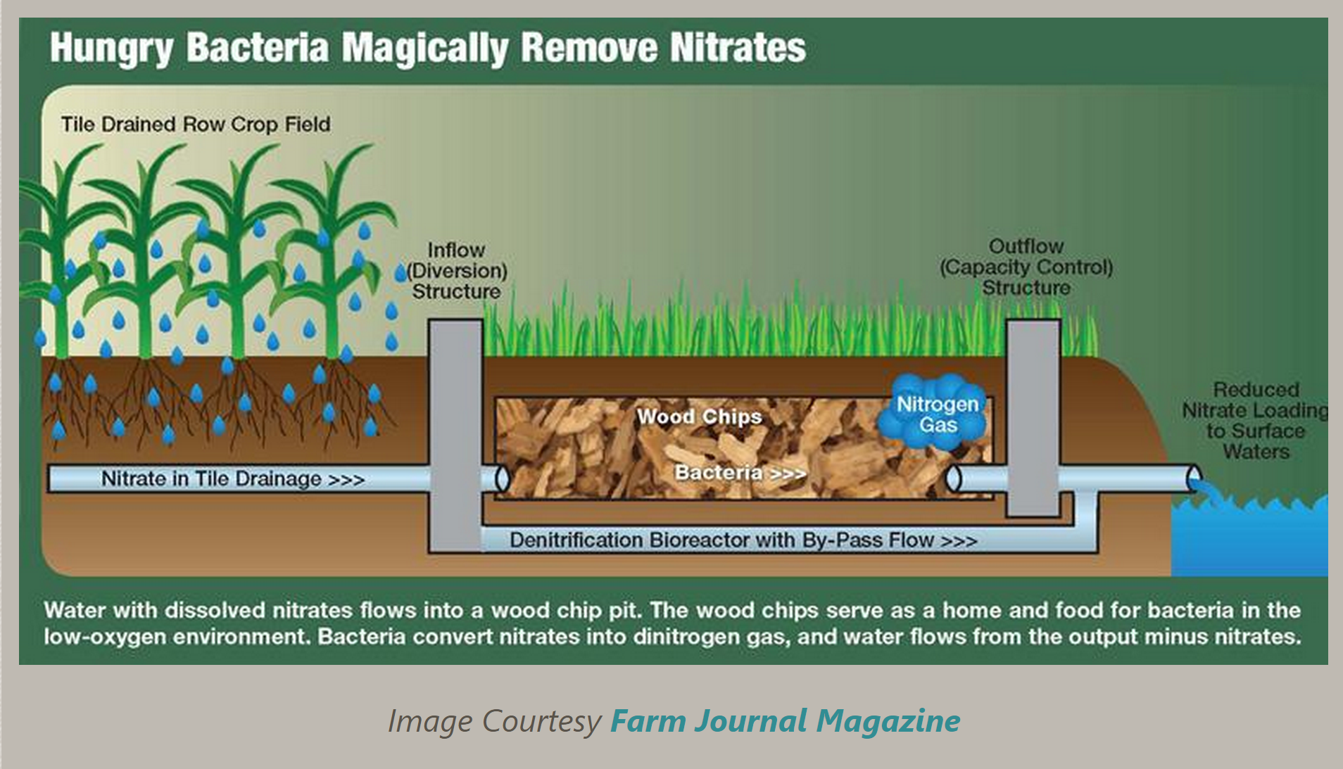

Slide 19
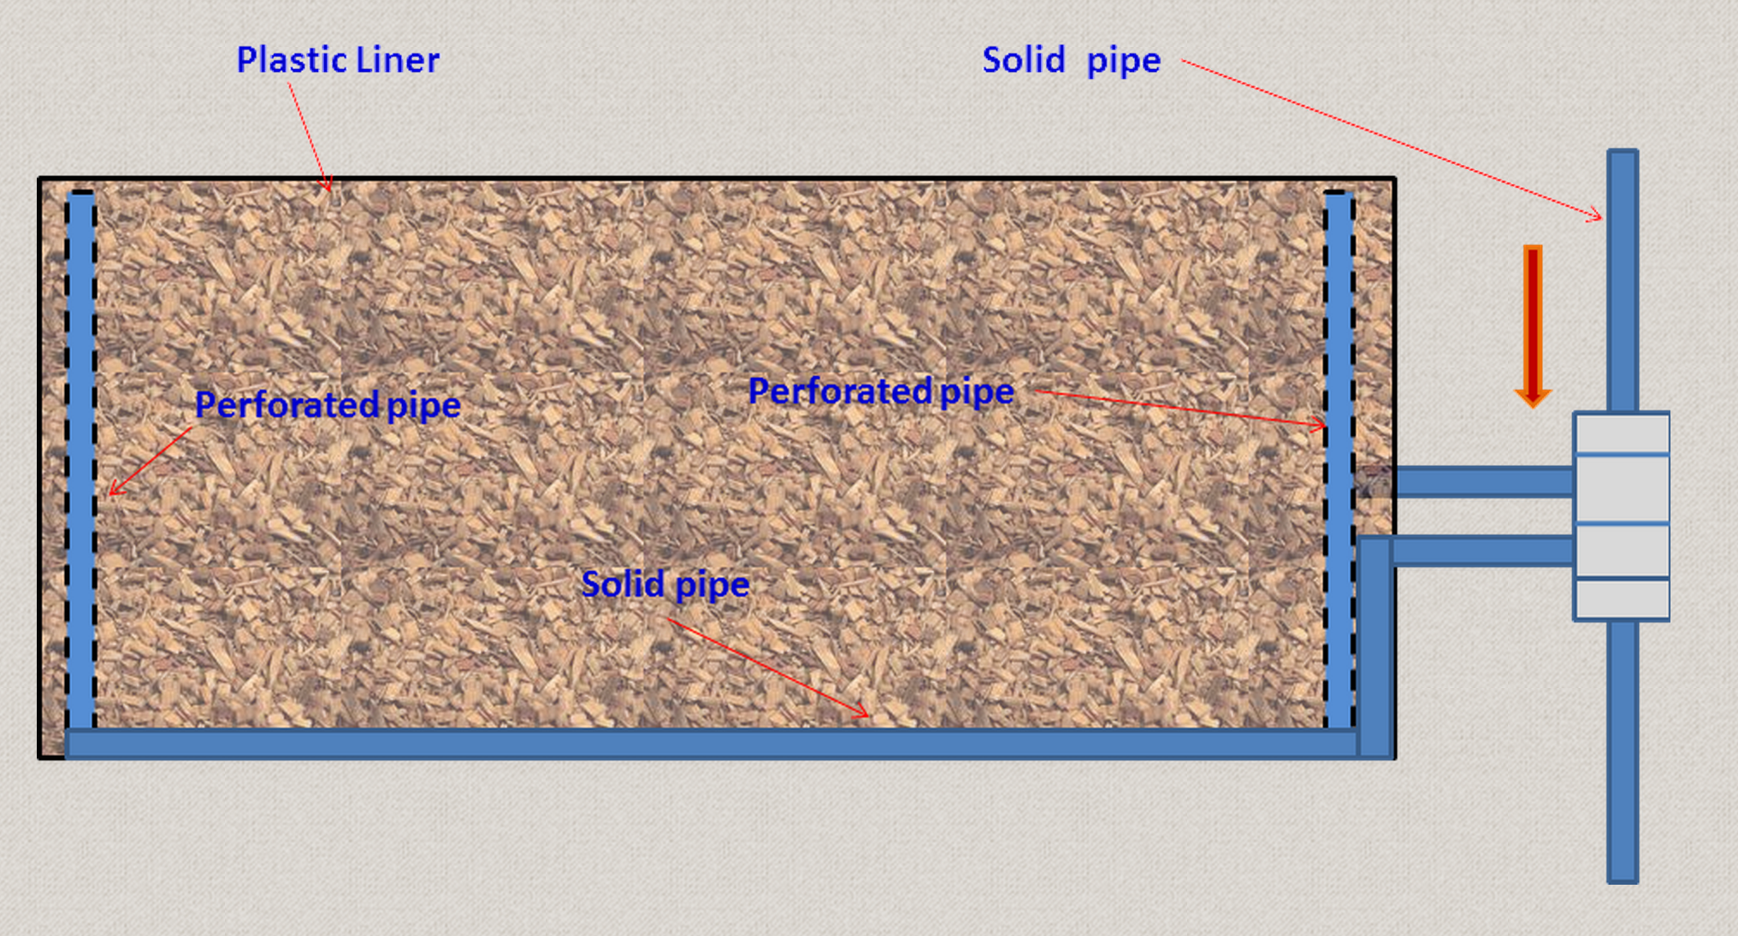


Slide 20
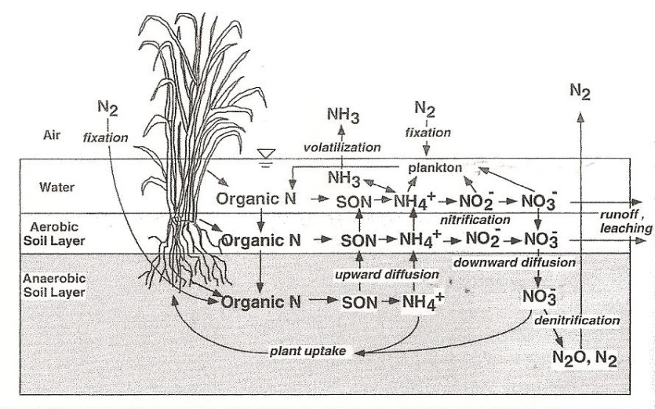
Nitrogen transformations in wetlands
Denitrification is illustrated by the equation:
4NO3− +6(CH2O) → 6CO2+2N2+6H2O (3)
Hauck, 1984
Mitsch and Gosselink 1993

Slide 21
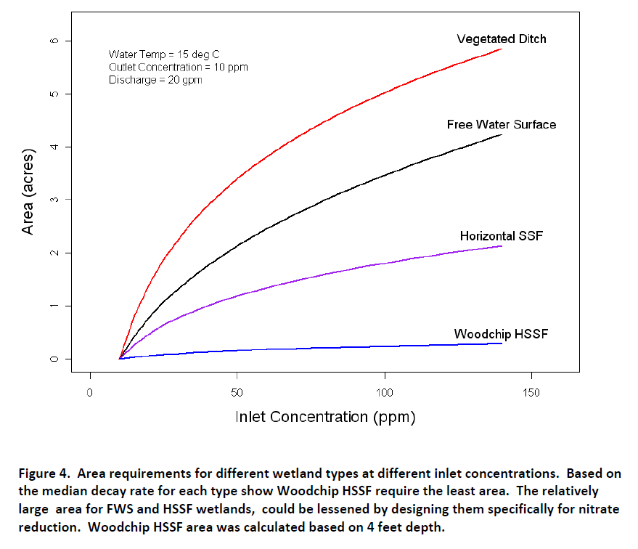
DESIGN TOOLS FOR VEGETATED TREATMENT SYSTEMS/ CONSTRUCTED WETLANDS/ WOODCHIP BIOREACTORS
Pam Krone‐Davis & Marc Los Huertos
Division of Science and Environmental Policy
California State University, Monterey Bay
PG&E Fund Grant #2005‐0735

Slide 22
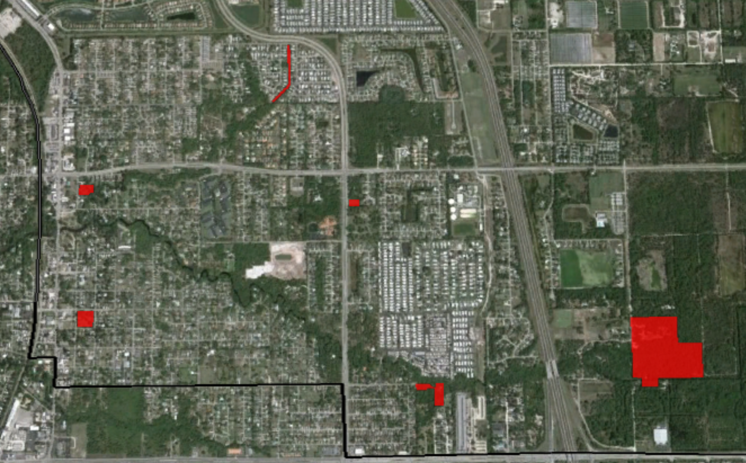

Slide 23
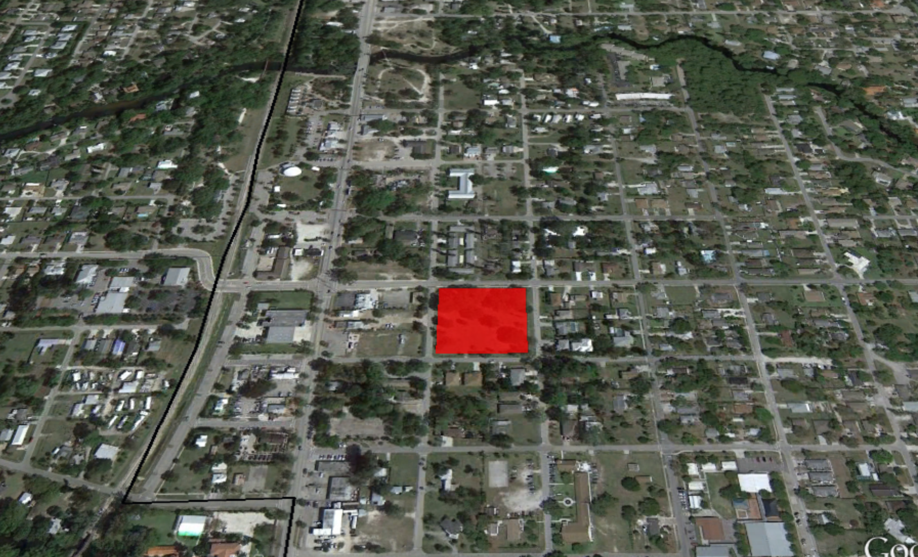

Slide 24
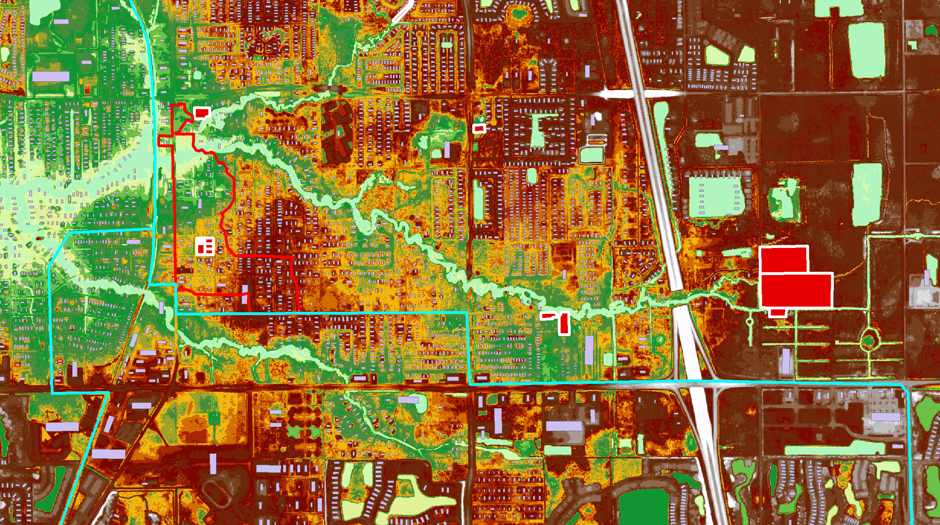

Slide 25
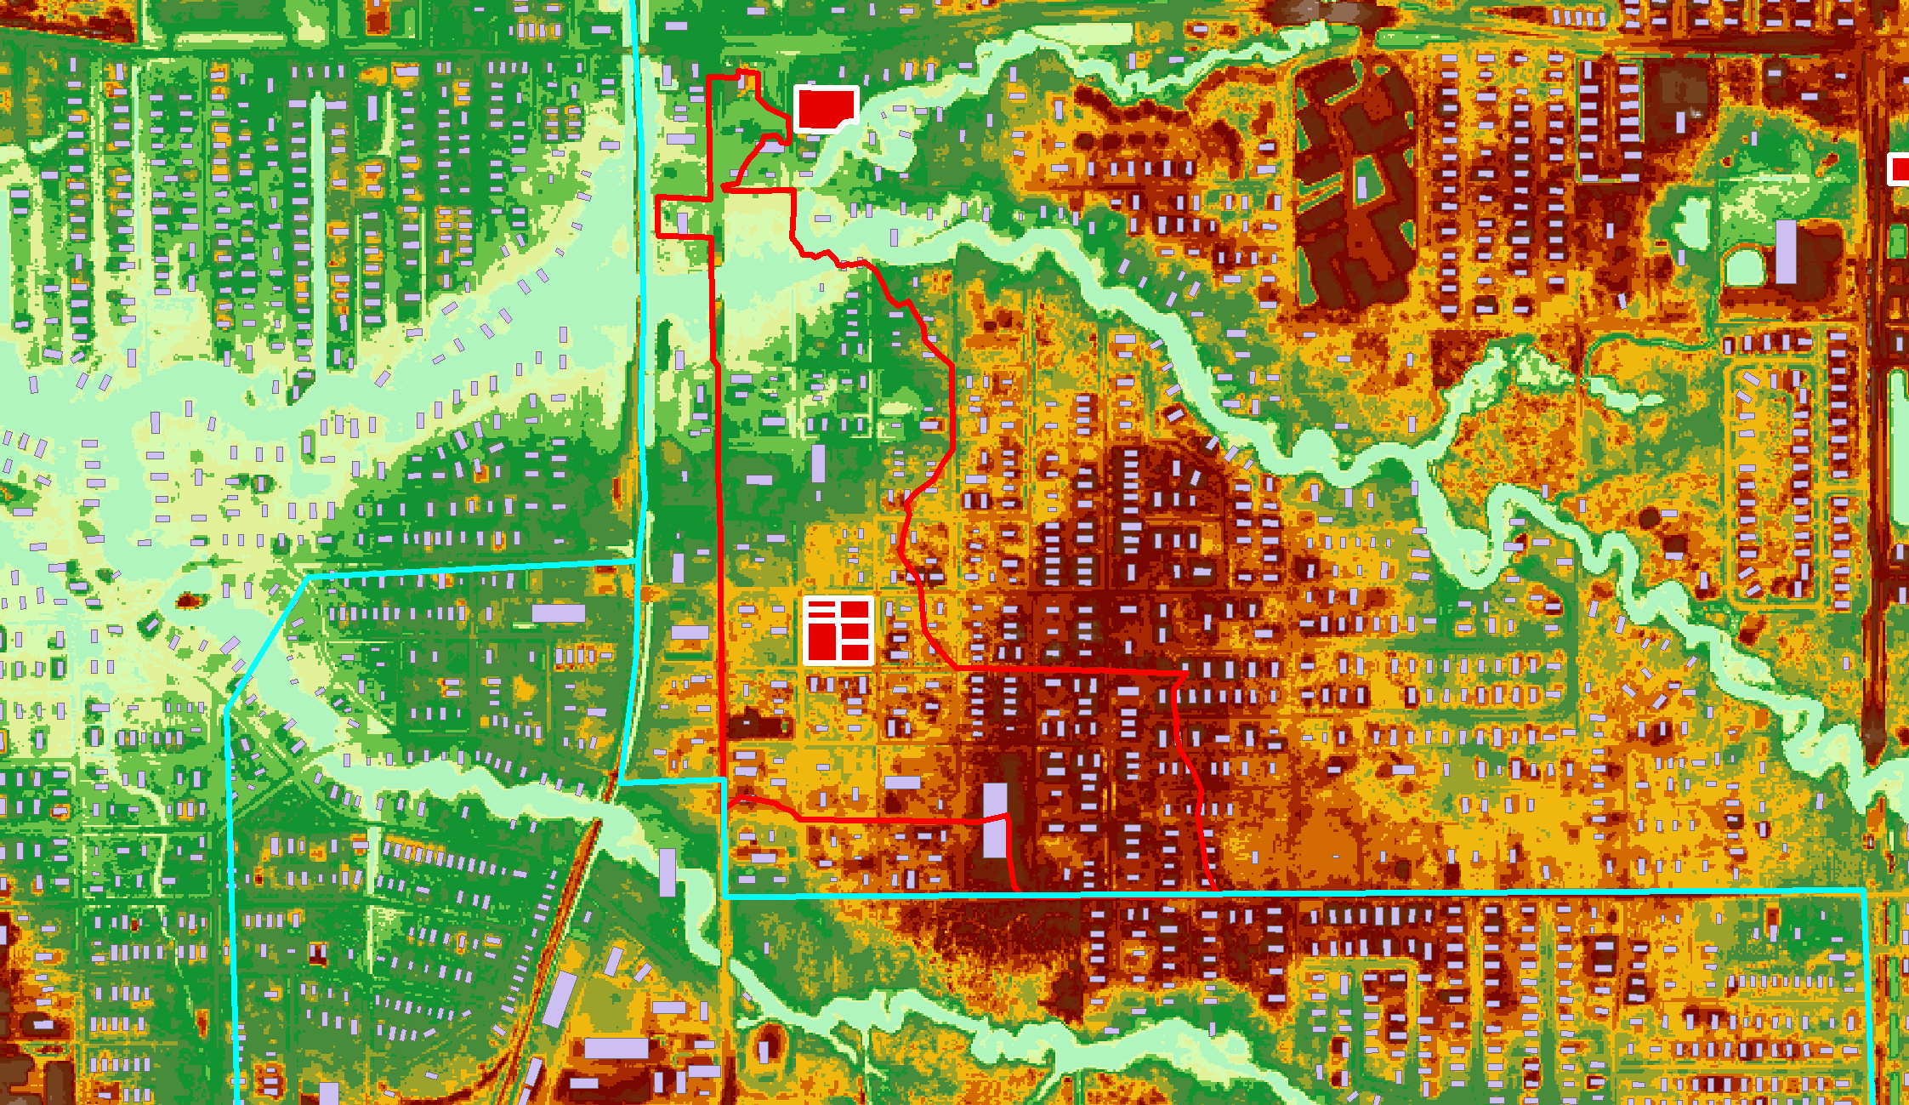

Slide 26
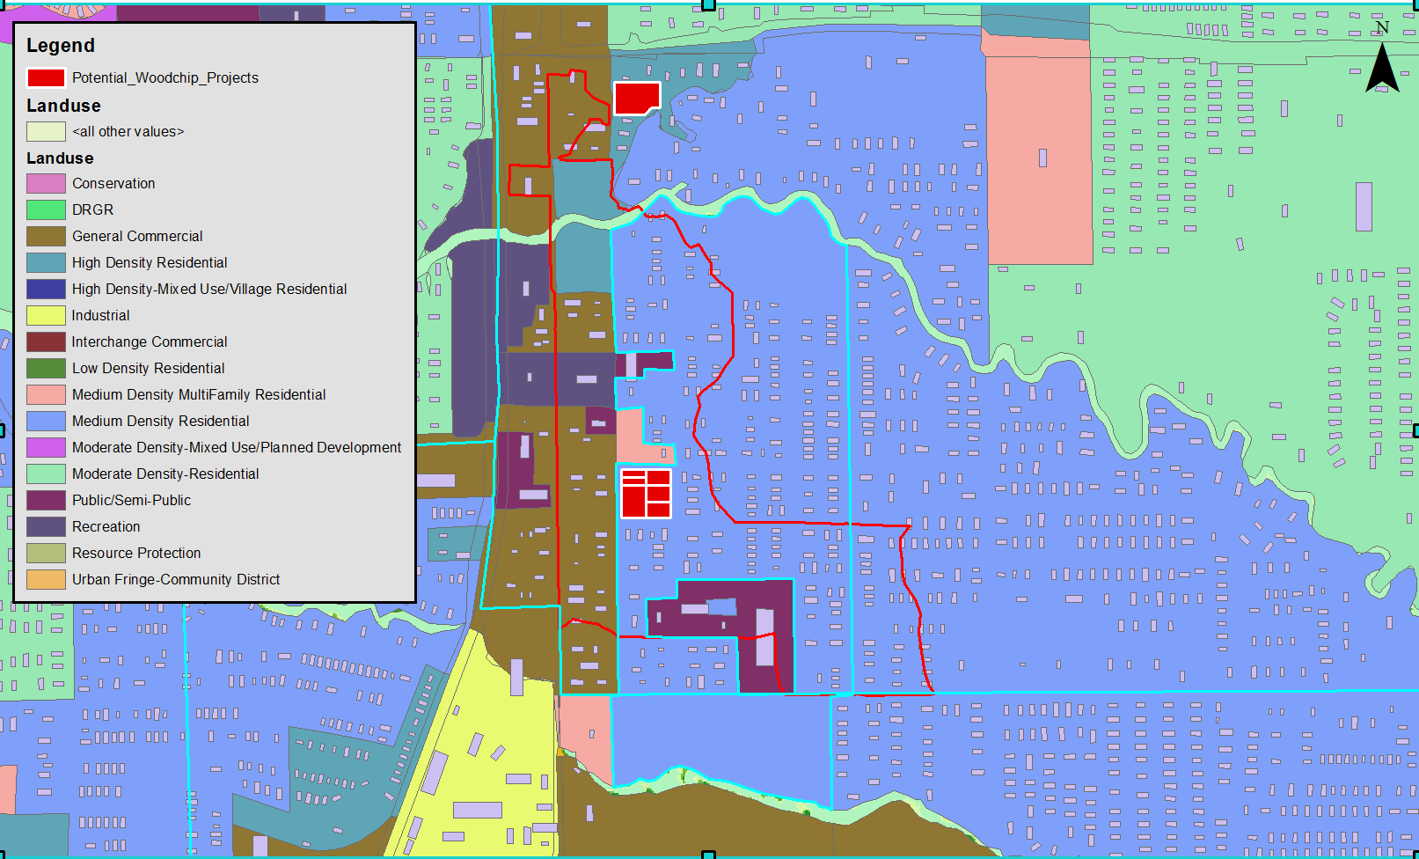

Slide 27
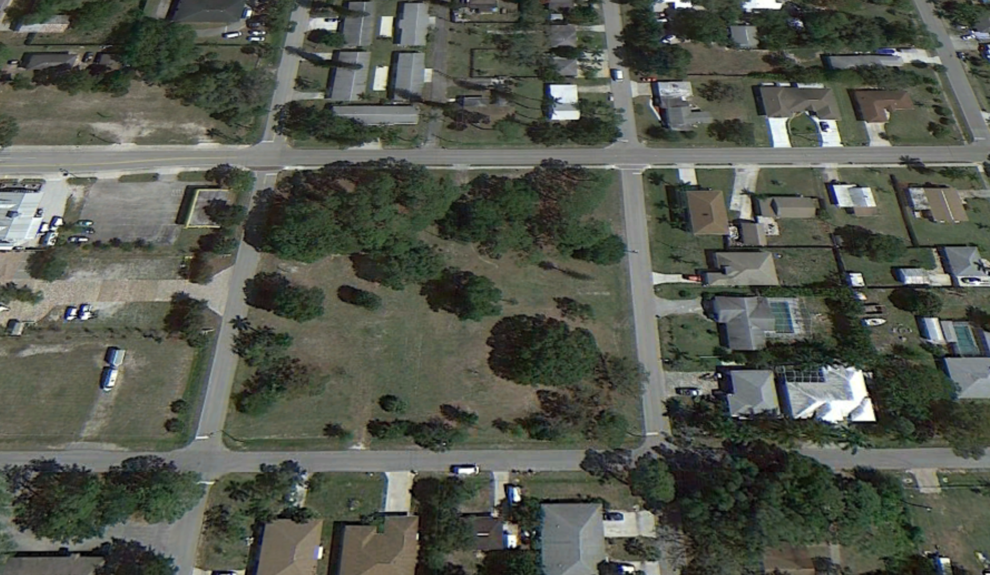
300 ft
300 ft

Slide 29
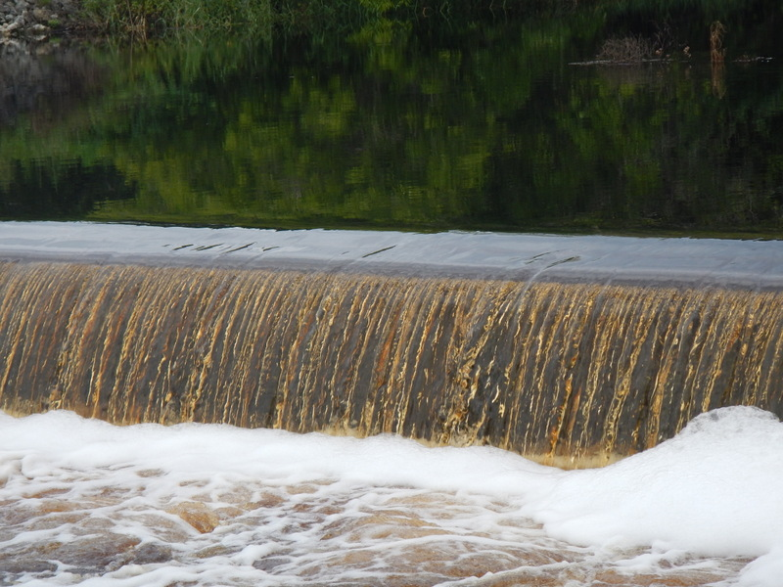
Strengths
Very high TN removal Rates
Low Cost
Smaller footprint

Slide 30
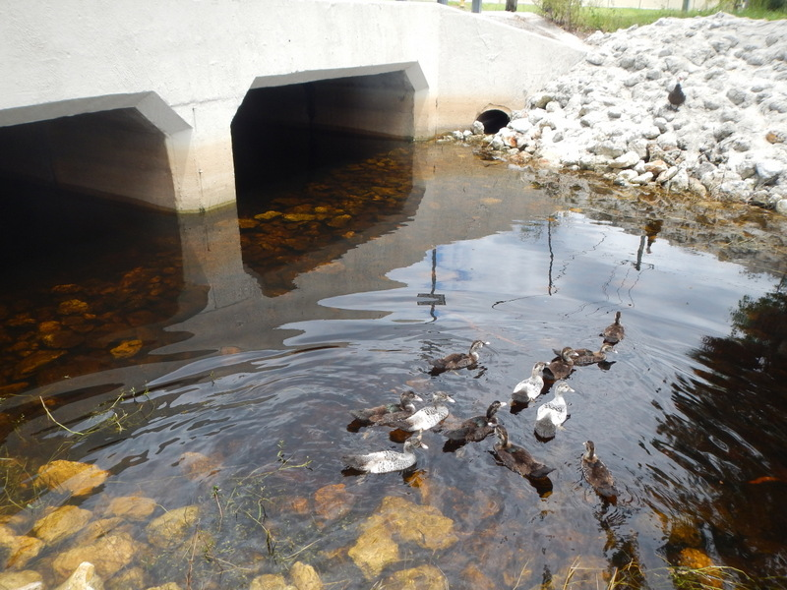
Design Challenges
Flow Rates are Low
Requires Head Differential
Seasonal rainfall
Potential Sulfur/Mercury Issues
Potential Carbon & Nutrient flux from Media
Potential Clogging

Slide 31
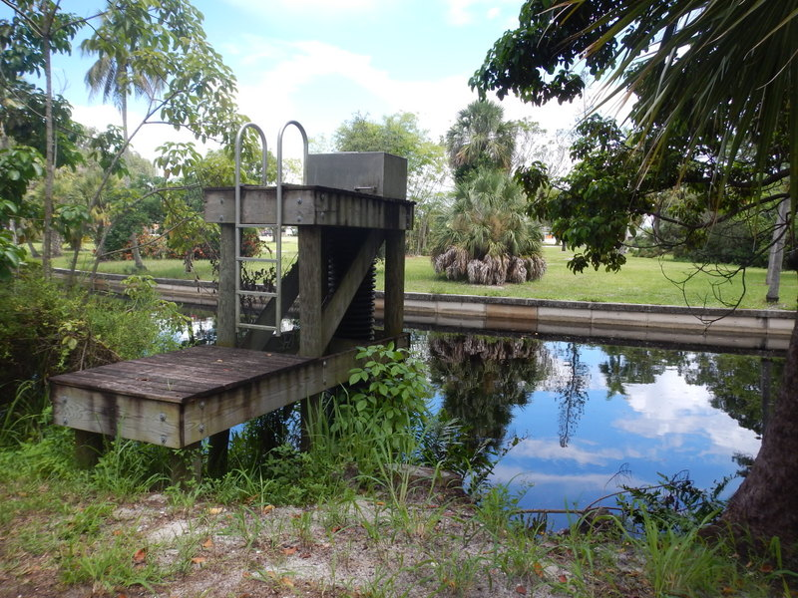
Monitoring of the Pilot Project
Inflow and Outflow
    Water Level Stage
    Volume
    TN
    TP
    DO

Slide 32
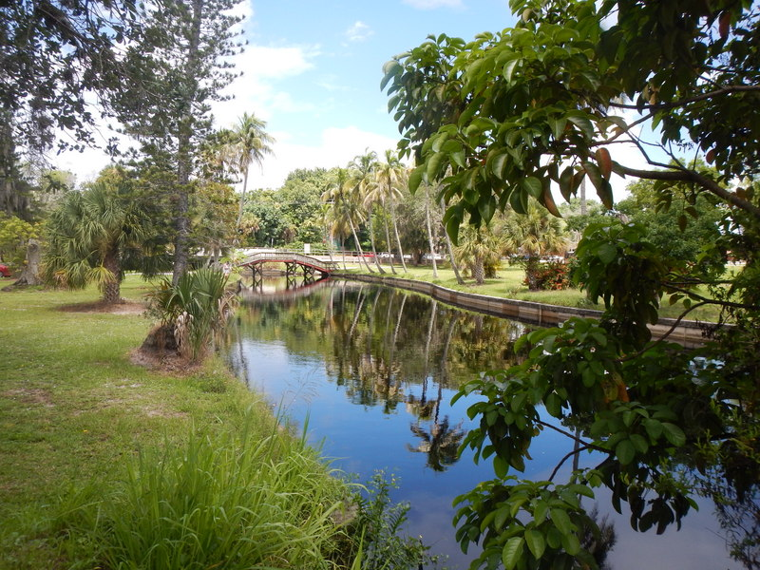
Pilot Project
Include in BMAP
Credit for Pilot Project
Monitoring
Increased credit for Increased Performance
Credit for Future Woodchip Bio-Reactors

Slide 33
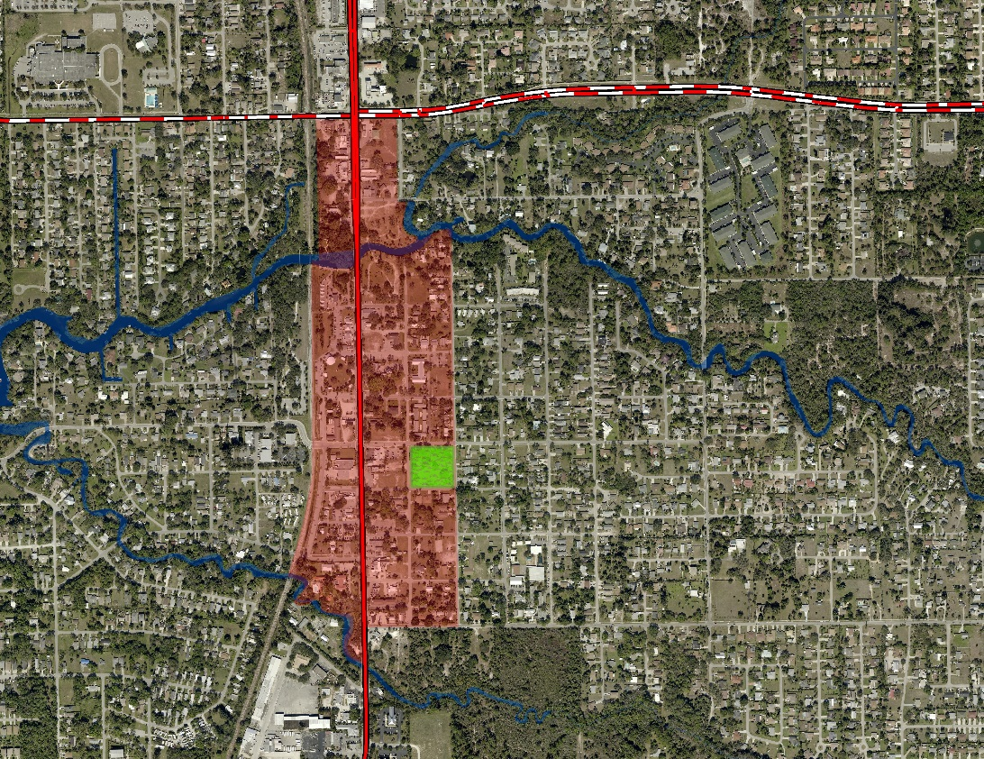
Timelines
$16 Million Dollar Downtown Design-Build Renovation Project: Construction to Start 1 April 2015.
Felts Project Area
July 2014: $250,000 received in State Grant Dollars for the Felts Water Quality Project
1st 5 Year BMAP Period ends 2017

